Slide 1
Cradle, Barrel HCAL & Moving Mechanism
Triple I Engineering Meeting Update – 4/07/25
Nathaniel Speece-Moyer (BNL)

Slide 2
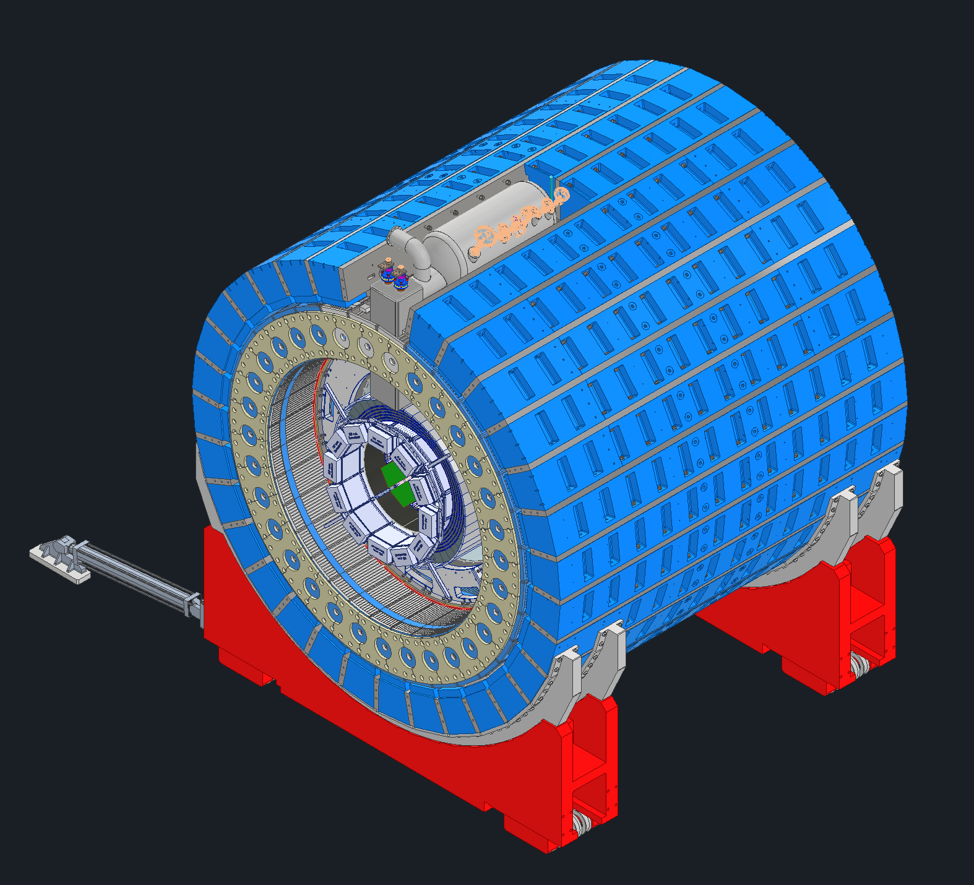
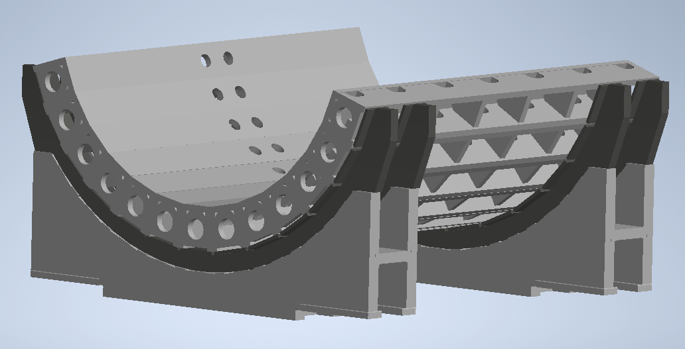
Intro and Background – Previous Work
Previously we had been looking at a design that re-used STAR flux return bars for support and magnetic shielding.
Magnetic shielding requirements were relaxed since the RCS beampipe was removed from the experimental hall.
A new concept was created and analyzed which would support the bottom half of the detector and use less support steel.
  8 mrad rotation required to align the ePIC detector with the electron beampipe.
    This rotation creates design complexity and assembly challenges, since this is 8 mrad of rotation from the existing cradle orientation and tracks used to move the detector.
Flux return bars (blue) and spacers (gray)
HCAL
Cradle
Cradle adapter
Previous design state (2025): Use STAR cradle and make new flux return bars/support structure.
Previous design state: Use STAR flux return bars and spacers in a full ring around the ePIC detector.

Slide 3
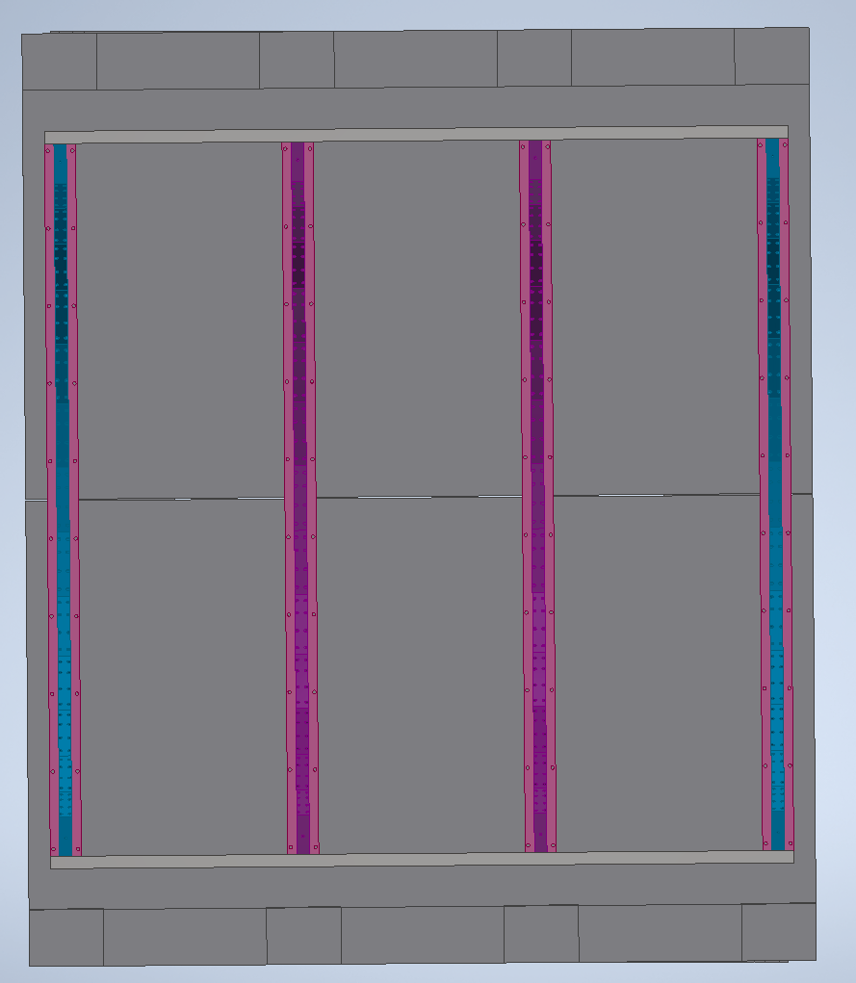
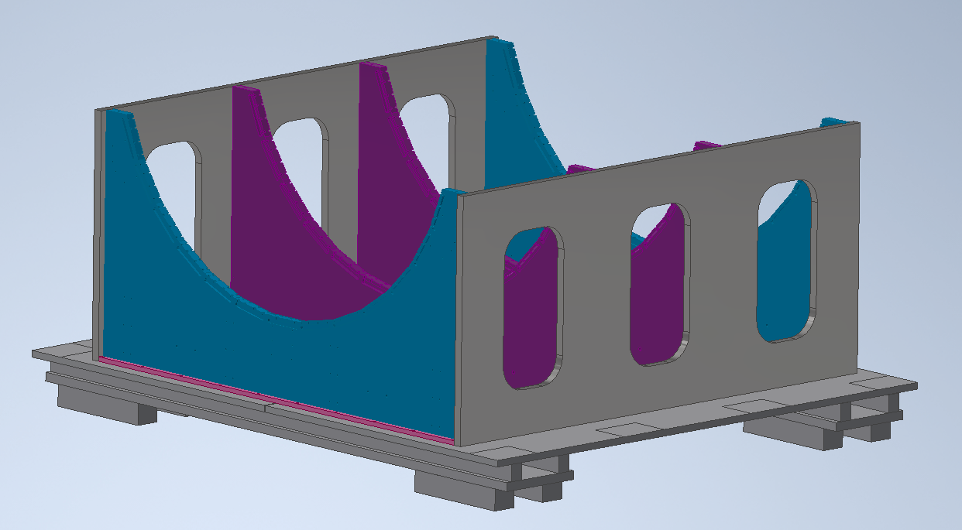
Update on work since last meeting – New cradle concept
  Re-use sPHENIX cradle
  sPHENIX support cradles are designed to work with the sPHENIX HCAL.
  Only reusing the top portion of the assembly due to different track spacing in the STAR hall compared to sPHENIX hall.
  The main benefit of this option is ease of alignment of the detector. Also allows better access to the HCAL.
  8 mrad rotation can be handled by rotating the entire upper assembly on the lower support beams. No complicated shimming or complex surfaces on parts.
Preliminary new cradle concept showing overall size and orientation of parts.

Slide 4
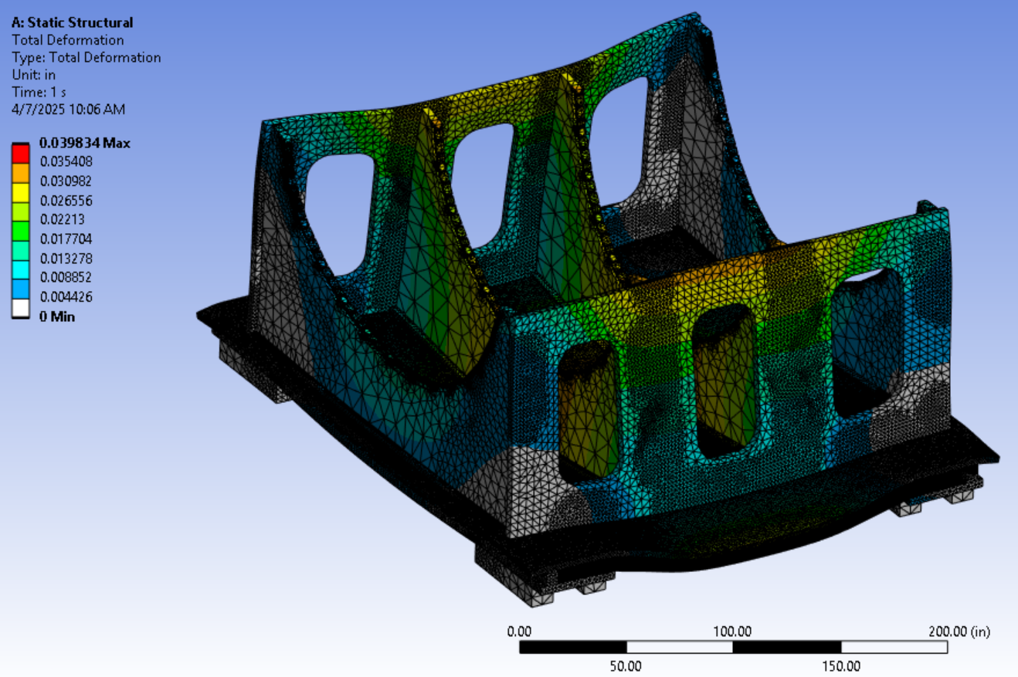
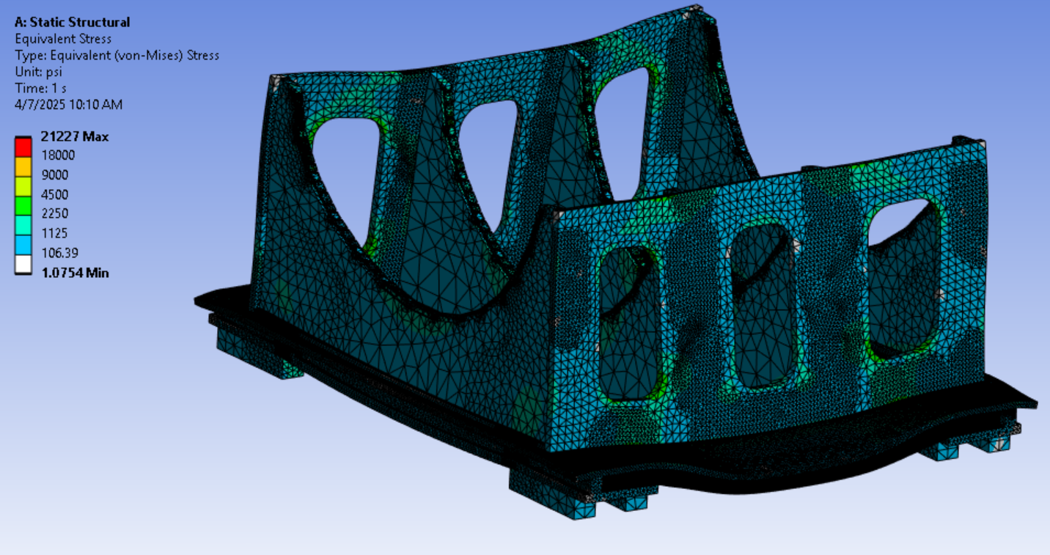
Analysis underway on concepts
  Preliminary results:
  A few concepts were analyzed but only a couple of screenshots are shown.
  This concept uses I-beams under the base plate and assumes fully bonded contacts for everything.
  Deflection on the order of 0.040-0.060 inches for various concepts.
  Stress in general look reasonable. Areas of stress concentration exist and need reinforcement added.

Slide 5
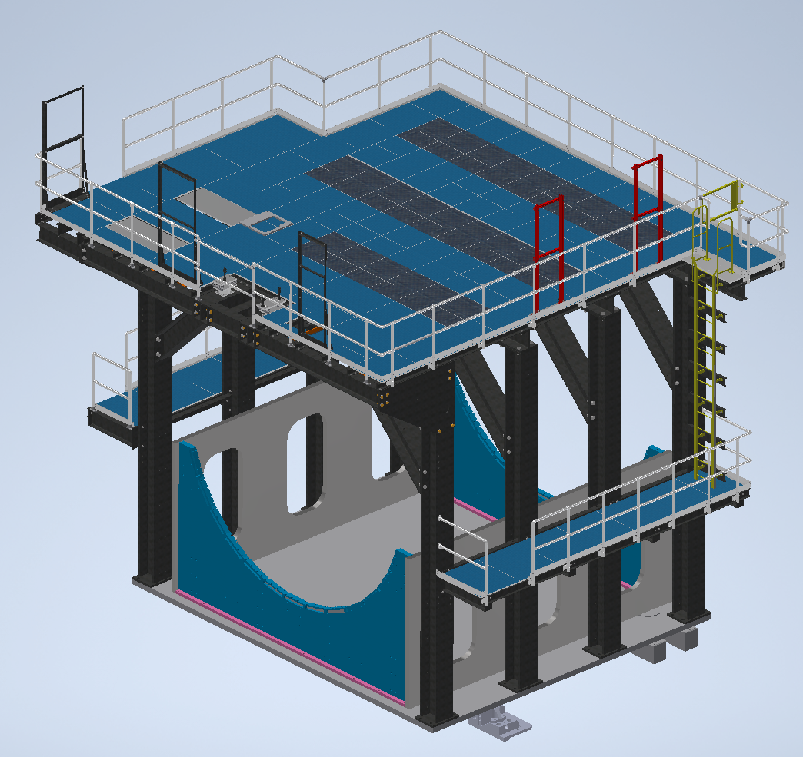
sPHENIX Platform re-use
  Re-use and modification of sPHENIX platform
  The platform can be re-used, but it interferes with endcaps, north and south platforms, and magnet phase separator. Modificaitions needed.
  Likely need to move outer columns in, or re-do the hall tracks so they are angled, so there is not interference with the endcaps.
    Tracks are grouted in place on top of steel rails which are leveled and grouted into the floor.
    Would likely require substantial work to update the track location. More investigation needed.
  Need to put a large “U” shape in the platform to account for phase separator.
    “U” would cut into two of the four main horizontal structural support beams of the platform.
    Need to understand if platform would meet loading requirements with the cutout.
    Requires design work and re-analysis of the platform structure.
  Additional scope needs to be included in resource-loaded schedule to account for the platform and required modifications.

Slide 6
Additional Updates
  Recent developments: Possible scope increase and requirements change (Discussed 4/4/24)
  Still Needs to be discussed with the larger group and agreed to.
  Need to add system to move cradle in Z direction (in line with beampipe)
    Re-use sPHENIX positioners? (sPHENIX design didn’t work – unclear why)
    Currently the direction is to leave enough room that the sPHENIX positioners will fit, then figure this out later.
    Complicates design substantially.
  Need to raise cradle to 24 in (?) from floor to allow access
    Requires structural modifications to main HCAL supports
    Complicates design and requires additional rework of HCAL support components which may have schedule impact.
  Need to agree to new changes, get requirements documented, and understand schedule impact.
  Other Updates
  Rahul and Dan met with a local hydraulic piston company. They are looking at options for re-building the horizontal moving pistons and options for lifting pistons.
  Josh and Rhaul have been in contact with Hilman to discuss roller options. May be improved design that can help with the issue of track edge deformation. Also plan to replace tracks with a harder steel from standard structural steel.
  No updates on the barrel HCAL cutout and support to accommodate the magnet chimney and phase separator.

Slide 7
Plans Towards PDR
Possible design changes and scope increase will affect the design and timeline. More discussion with a larger group is needed to confirm the path forward.
We need to settle on firm design requirements so the design can be completed.
New requests and scope need to be added to the resource-loaded schedule to verify that timelines can be met with remaining hours and current workforce.
Next steps
Current direction is to investigate what would be required to integrate the sPHENIX pistons and positioning assembly into the current design and raise the cradle for better access.
Need to look at what it would take to replace and angle the tracks in the STAR hall.

Slide 8
Question & Comments

