Slide 1
Detector Cooling - Update
Girish Gowda

Slide 2
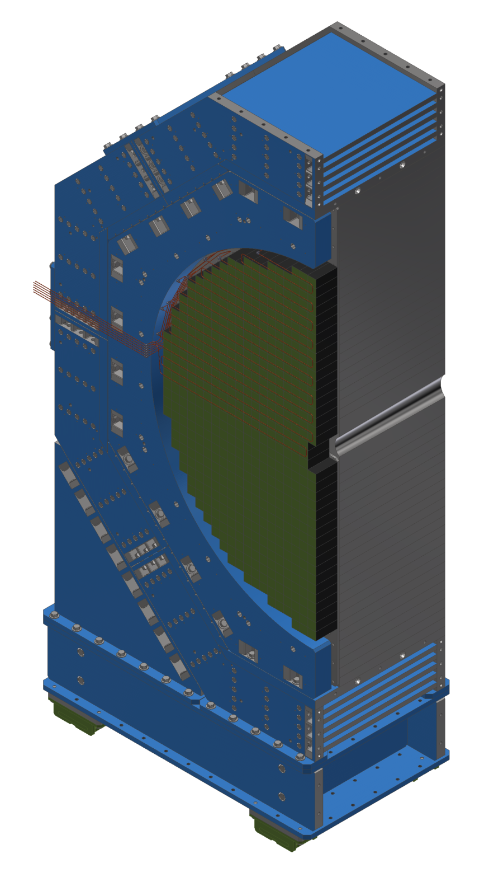
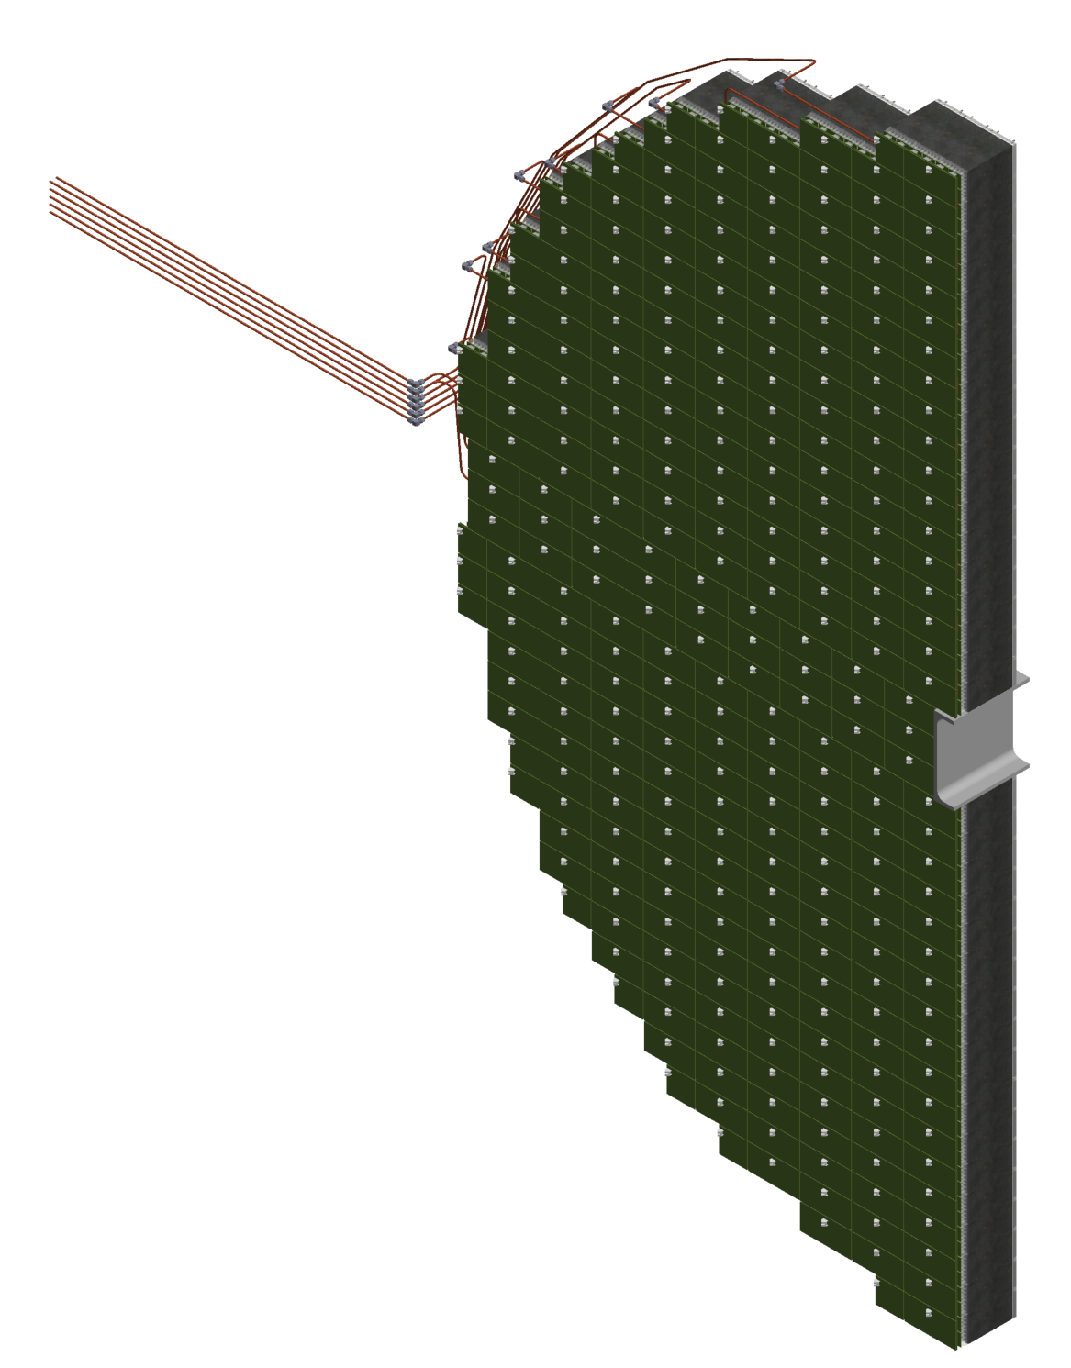
Forward EMCAL
Temperature Requirements
Maintain FEB temperature 3 C above dew point
Cooling the SiPMs to be determined
Sectional View

Slide 3
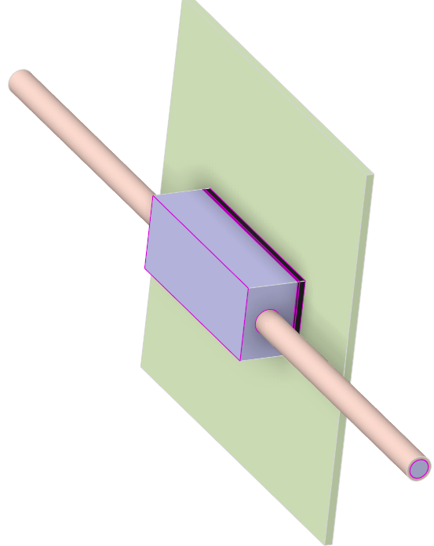
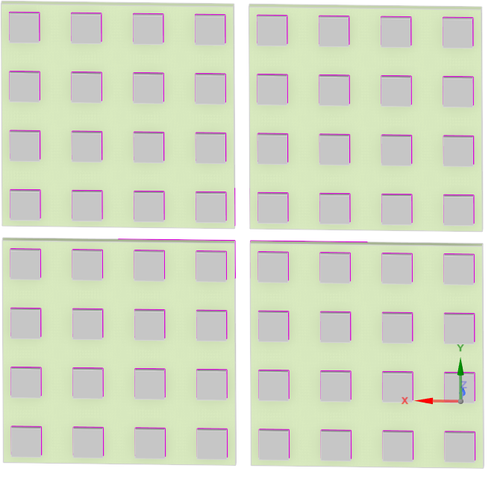
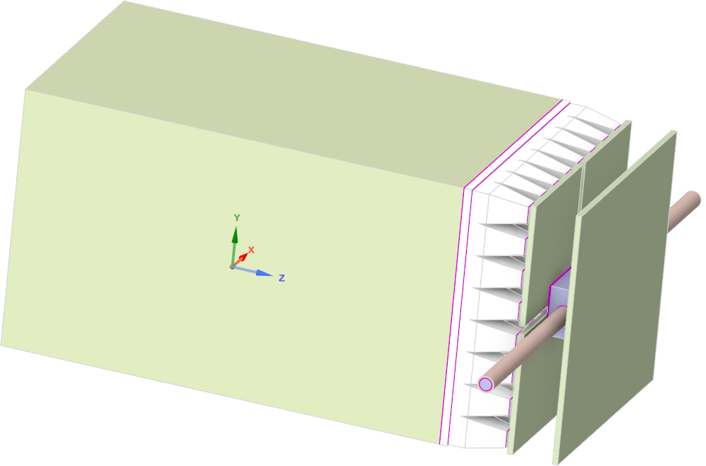
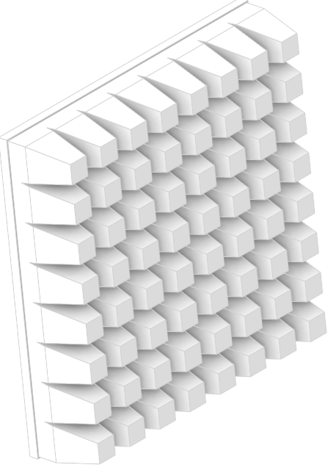
Forward EMCAL
FEB
Copper tube (inch)
0.25
SiPM
Thermal Pad
Heat Sink
Epoxy
Copper tube
SiPM Board
Tungsten Scifi
Exploded View
Acrylic
Sector Geometry

Slide 4
Forward EMCAL – CFD Simulation
Technical Data :
Water flow rate (litre/min) | Flow velocity (m/s) | Tube Length (m) | Pressure drop (psi) | Temperature rise (C) | FEB Heat load (W) | SiPM Heat load (W)
0.83 | 0.76 | 6 | 2.1 | 2 | 4.5 | 0.17
CFD Data :
Water flow rate (litre/min) | Flow velocity (m/s) | Tube Length (m) | Pressure drop (psi) | Temperature rise (C) | Half FEB Heat load (W) | SiPM Heat load (W)
0.83 | 0.76 | 0.21 | 0.07 | 0.04 | 2.25 | 0.17
Materials
Copper thickness (10 %) in FEB
Copper thickness (5%) in SiPM Board
FEB and SiPM Board thickness : 2 mm

Slide 5
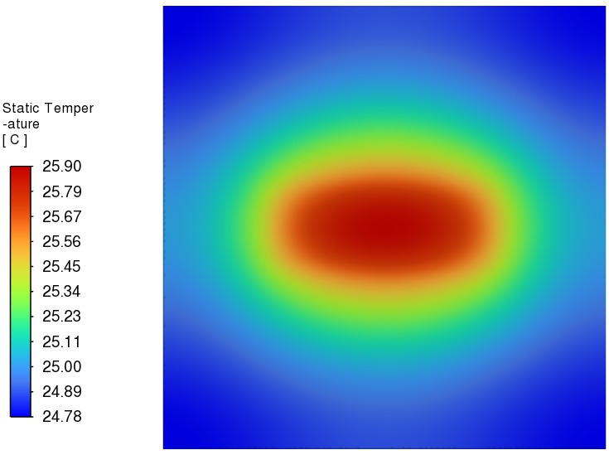
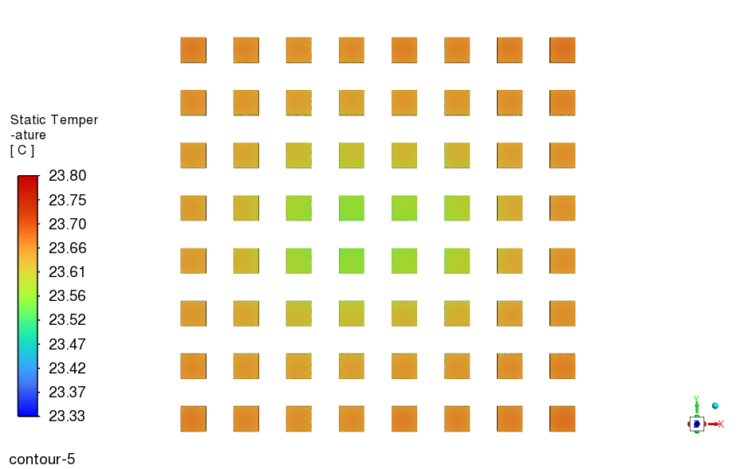
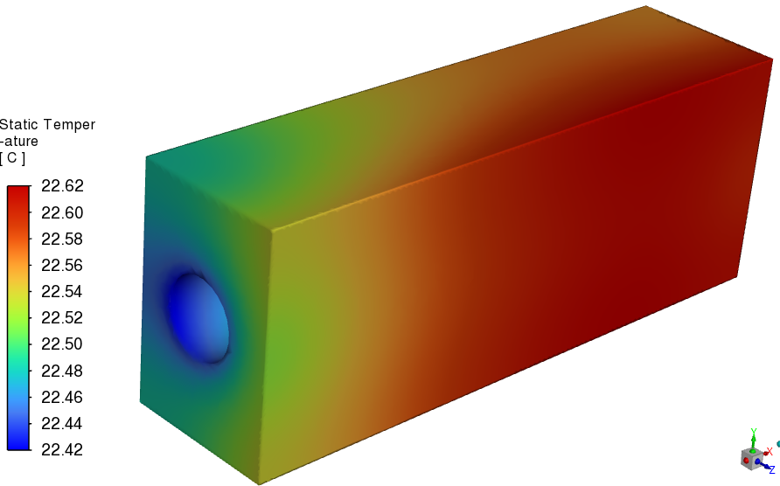
Forward EMCAL – CFD Simulation
FEB Temperature
Heat Sink Temperature
SiPM Temperature
Ambient Temperature (C) | Flow velocity (m/s) | Half FEB Heat load (W) | SiPM Heat load (W)
20 | 0.76 | 2.25 | 0.17
Relative Humidity (%) | Dew Point Temperature (C) | Water Inlet Temperature (C) | FEB Temperature (C) | SiPM Temperature (C)
100 | 20 | 22 | 25.9 | 23.8

Slide 6
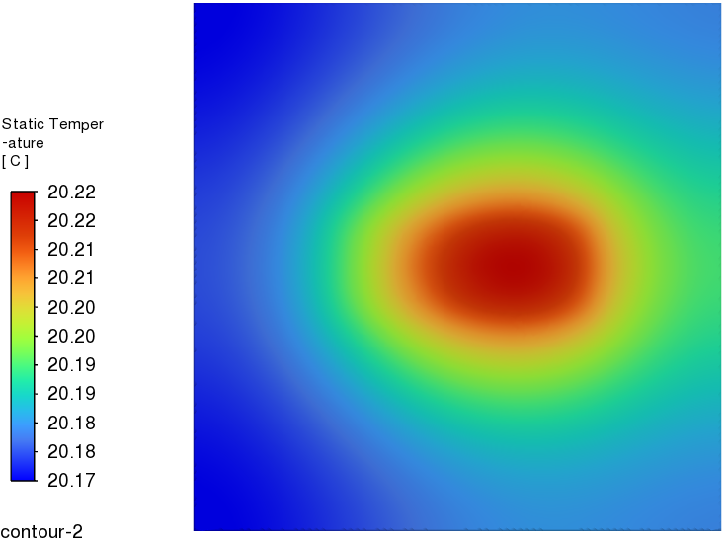
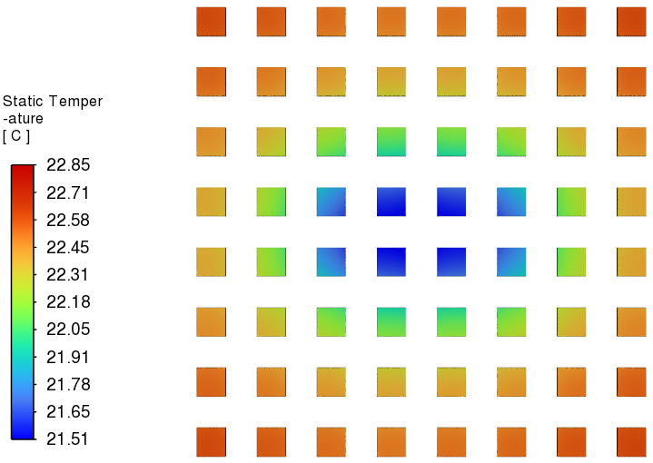
Forward EMCAL – CFD Simulation – Scenario 1
Relative Humidity :
FEB Temperature
SiPM Temperature
Ambient Temperature (C) | Flow velocity (m/s) | Half FEB Heat load (W) | SiPM Heat load (W)
20 | 0.76 | 2.25 | 0.17
Relative Humidity (%) | Dew Point Temperature (C) | Water Inlet Temperature (C) | FEB Temperature (C) | SiPM Temperature (C)
100 | 20 | 22 | 25.9 | 23.8
60 | 12 | 14 | 20.22 | 22.85

Slide 7
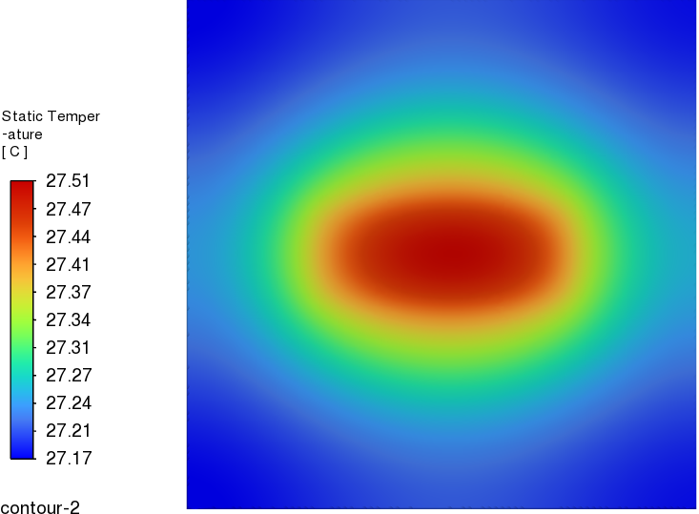
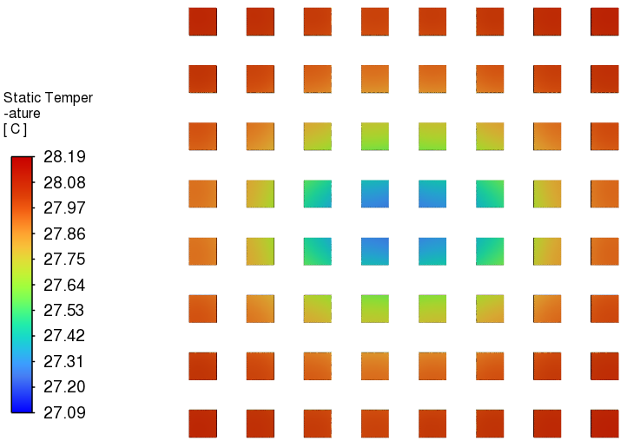
Forward EMCAL – CFD Simulation – Scenario 2
Heat Transfer Coefficient :
FEB Temperature
SiPM Temperature
Ambient Temperature (C) | Flow velocity (m/s) | Half FEB Heat load (W) | SiPM Heat load (W)
20 | 0.76 | 2.25 | 0.17
Heat Transfer Coefficient (W/m^2 C) | Dew Point Temperature (C) | Water Inlet Temperature (C) | FEB Temperature (C) | SiPM Temperature
5 | 20 | 22 | 25.9 | 23.8
1 | 20 | 22 | 27.51 | 28.19

Slide 8
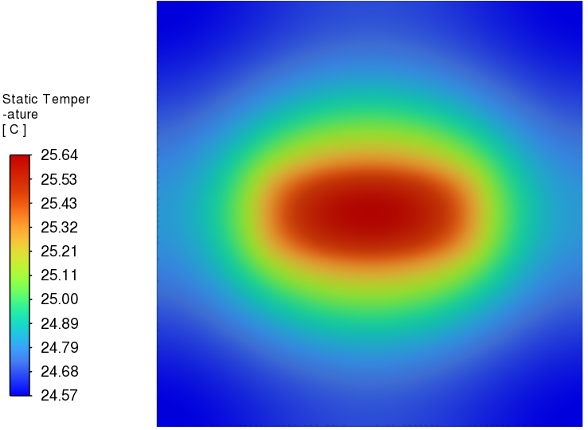
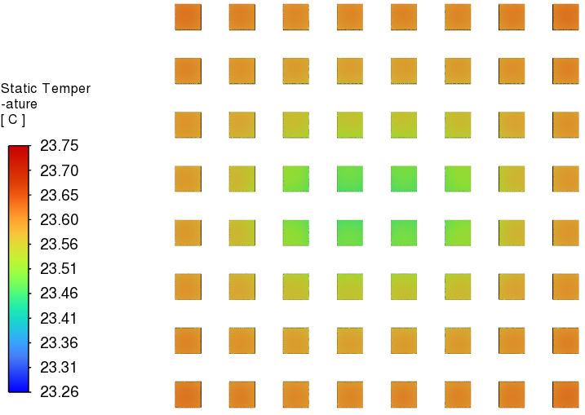
Forward EMCAL – CFD Simulation – Scenario 3
Velocity :
FEB Temperature
SiPM Temperature
Ambient Temperature (C) | Flow velocity (m/s) | FEB Heat load (W) | SiPM Heat load (W)
20 | 0.76 | 4.5 | 0.17
Velocity (m/s) | Dew Point Temperature (C) | Water Inlet Temperature (C) | FEB Temperature (C) | SiPM Temperature (C)
0.76 | 20 | 22 | 25.9 | 23.8
2 | 20 | 22 | 25.64 | 23.75

Slide 9
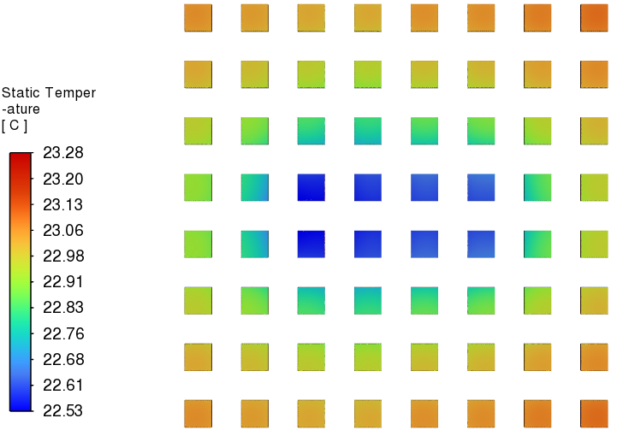
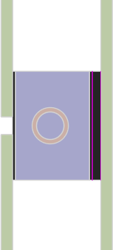
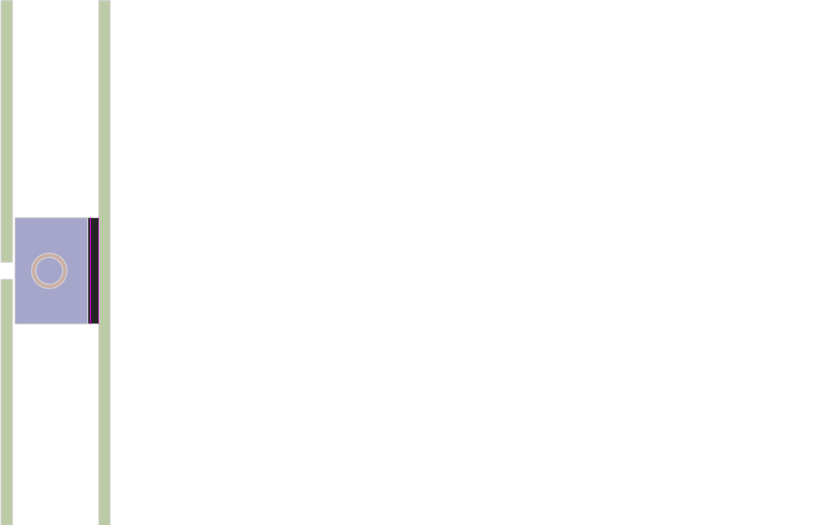
Forward EMCAL – CFD Simulation
Design :
SiPM Temperature
SiPM Temperature
SiPM Board
FEB
SiPM Board
FEB

Slide 10
Summary
Suggestions :
Modifying geometry from straight tube to serpentine tube will enhance heat transfer and reduce FEB temperature further.
Adding fins or turbulators in heat sink will enhance heat transfer and aid in cooling of FEB.
SiPM boards integrated with FEB heat sink downstream with thermal pad aids in improved cooling on SiPM’s,

