Slide 1
Abstract:
This is an attempt to allow NS-FFAG to be used together with the long linac with adiabatic matched curved arc. Applications are of multiple kinds: Energy Recovery Linacs (ERL’s), Recirculating Linacs Accelerators (RLA’s), and other fast acceleration applications. The transition from the NS-FFAG arc to the straight section NS-FFAG has already been solved where multiple orbits and betatron functions are adiabatically matched. This attempt is of a similar kind but the betatron functions in the NS-FFAG of small values will grow adiabatically along the matching arc to the values corresponding to the linac.
NS-FFAG matched to the long linac straight section
Dejan Trbojevic
Stephen Brooks, and J. Scott Berg

Slide 2
NS-FFAG with LINAC
Connection between time of flight and the linac
Cost saving by by using FFAG in ERL’s
Possible solutions of the problem
Non-relativistic and relativistic apps
NS-FFAG eRHIC Designs
Future work and summary

Slide 3
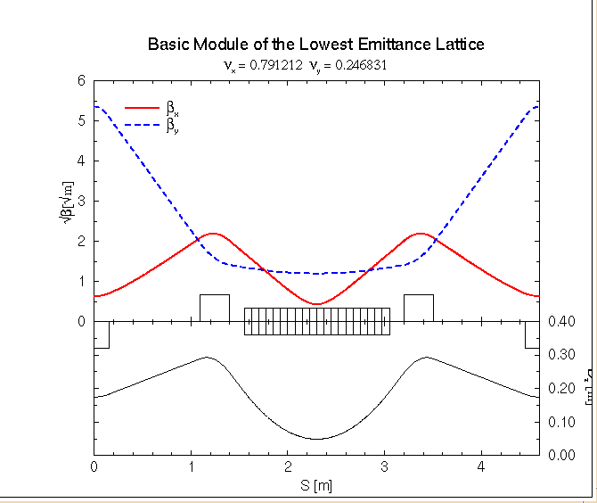
To minimize the dispersion function H the BENDING MAGNET (DEFOCUSING) should be in the centered in the cell with a minimum of β_{xmin}=L_{d}/2√15 and D_{xmin}=θ*L_{d}/24 @center
“FFAG Lattice Without Opposite Bends”
Dejan Trbojevic*, Ernest D. Courant* and Al Garren
Presented in September 1999
CP530, “Colliders and Collider Physics at the Highest Energies: HEMC'99 Workshop”, edited by B. J. King
β_{y}
β_{xmin}
0.3 m
Dispersion
D_{xmin}

Slide 4
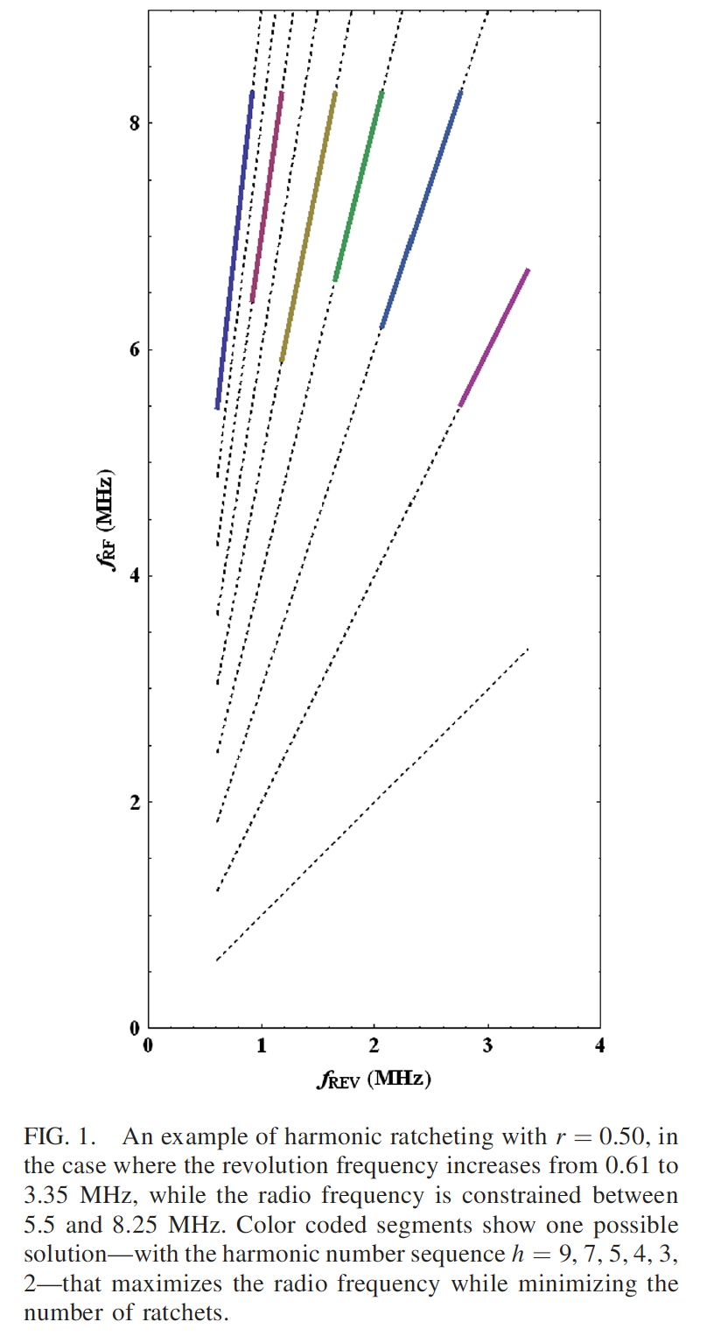
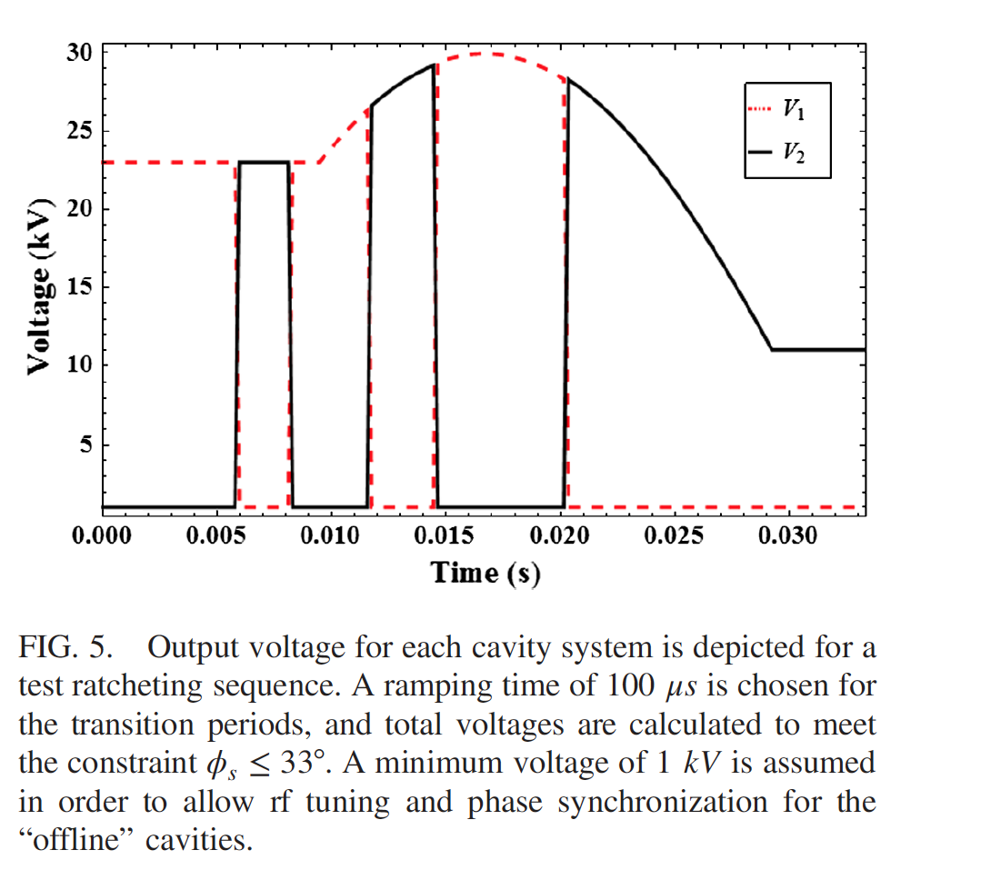
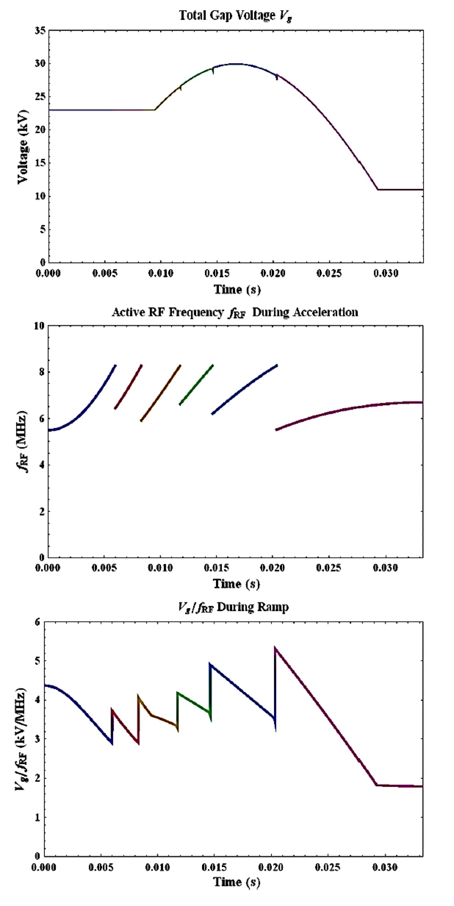
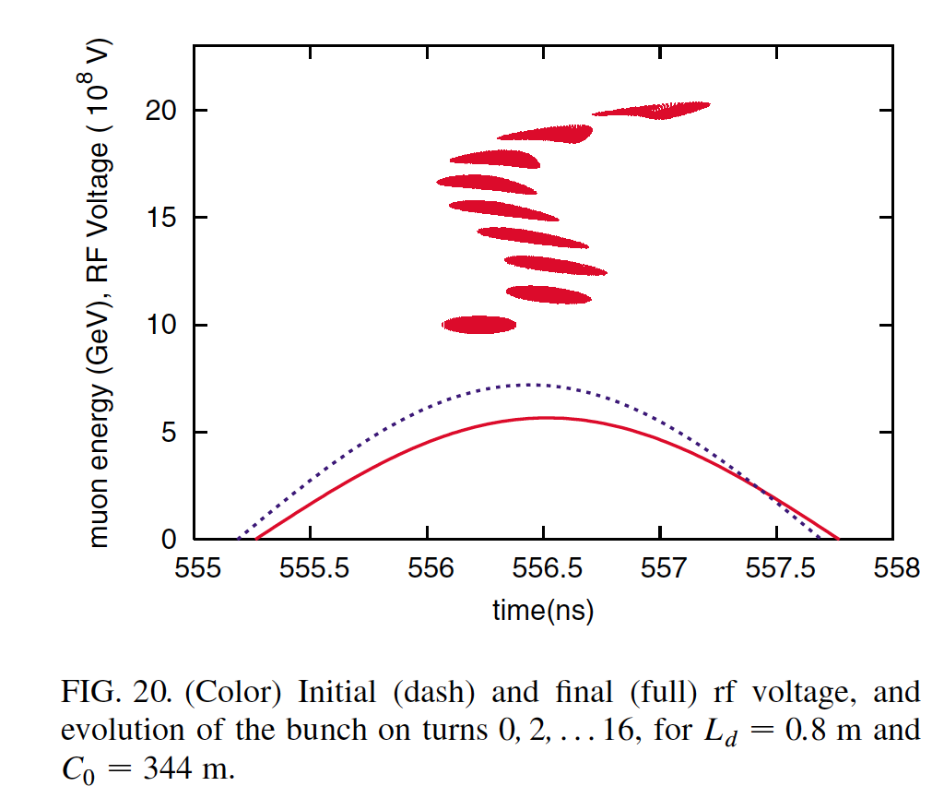
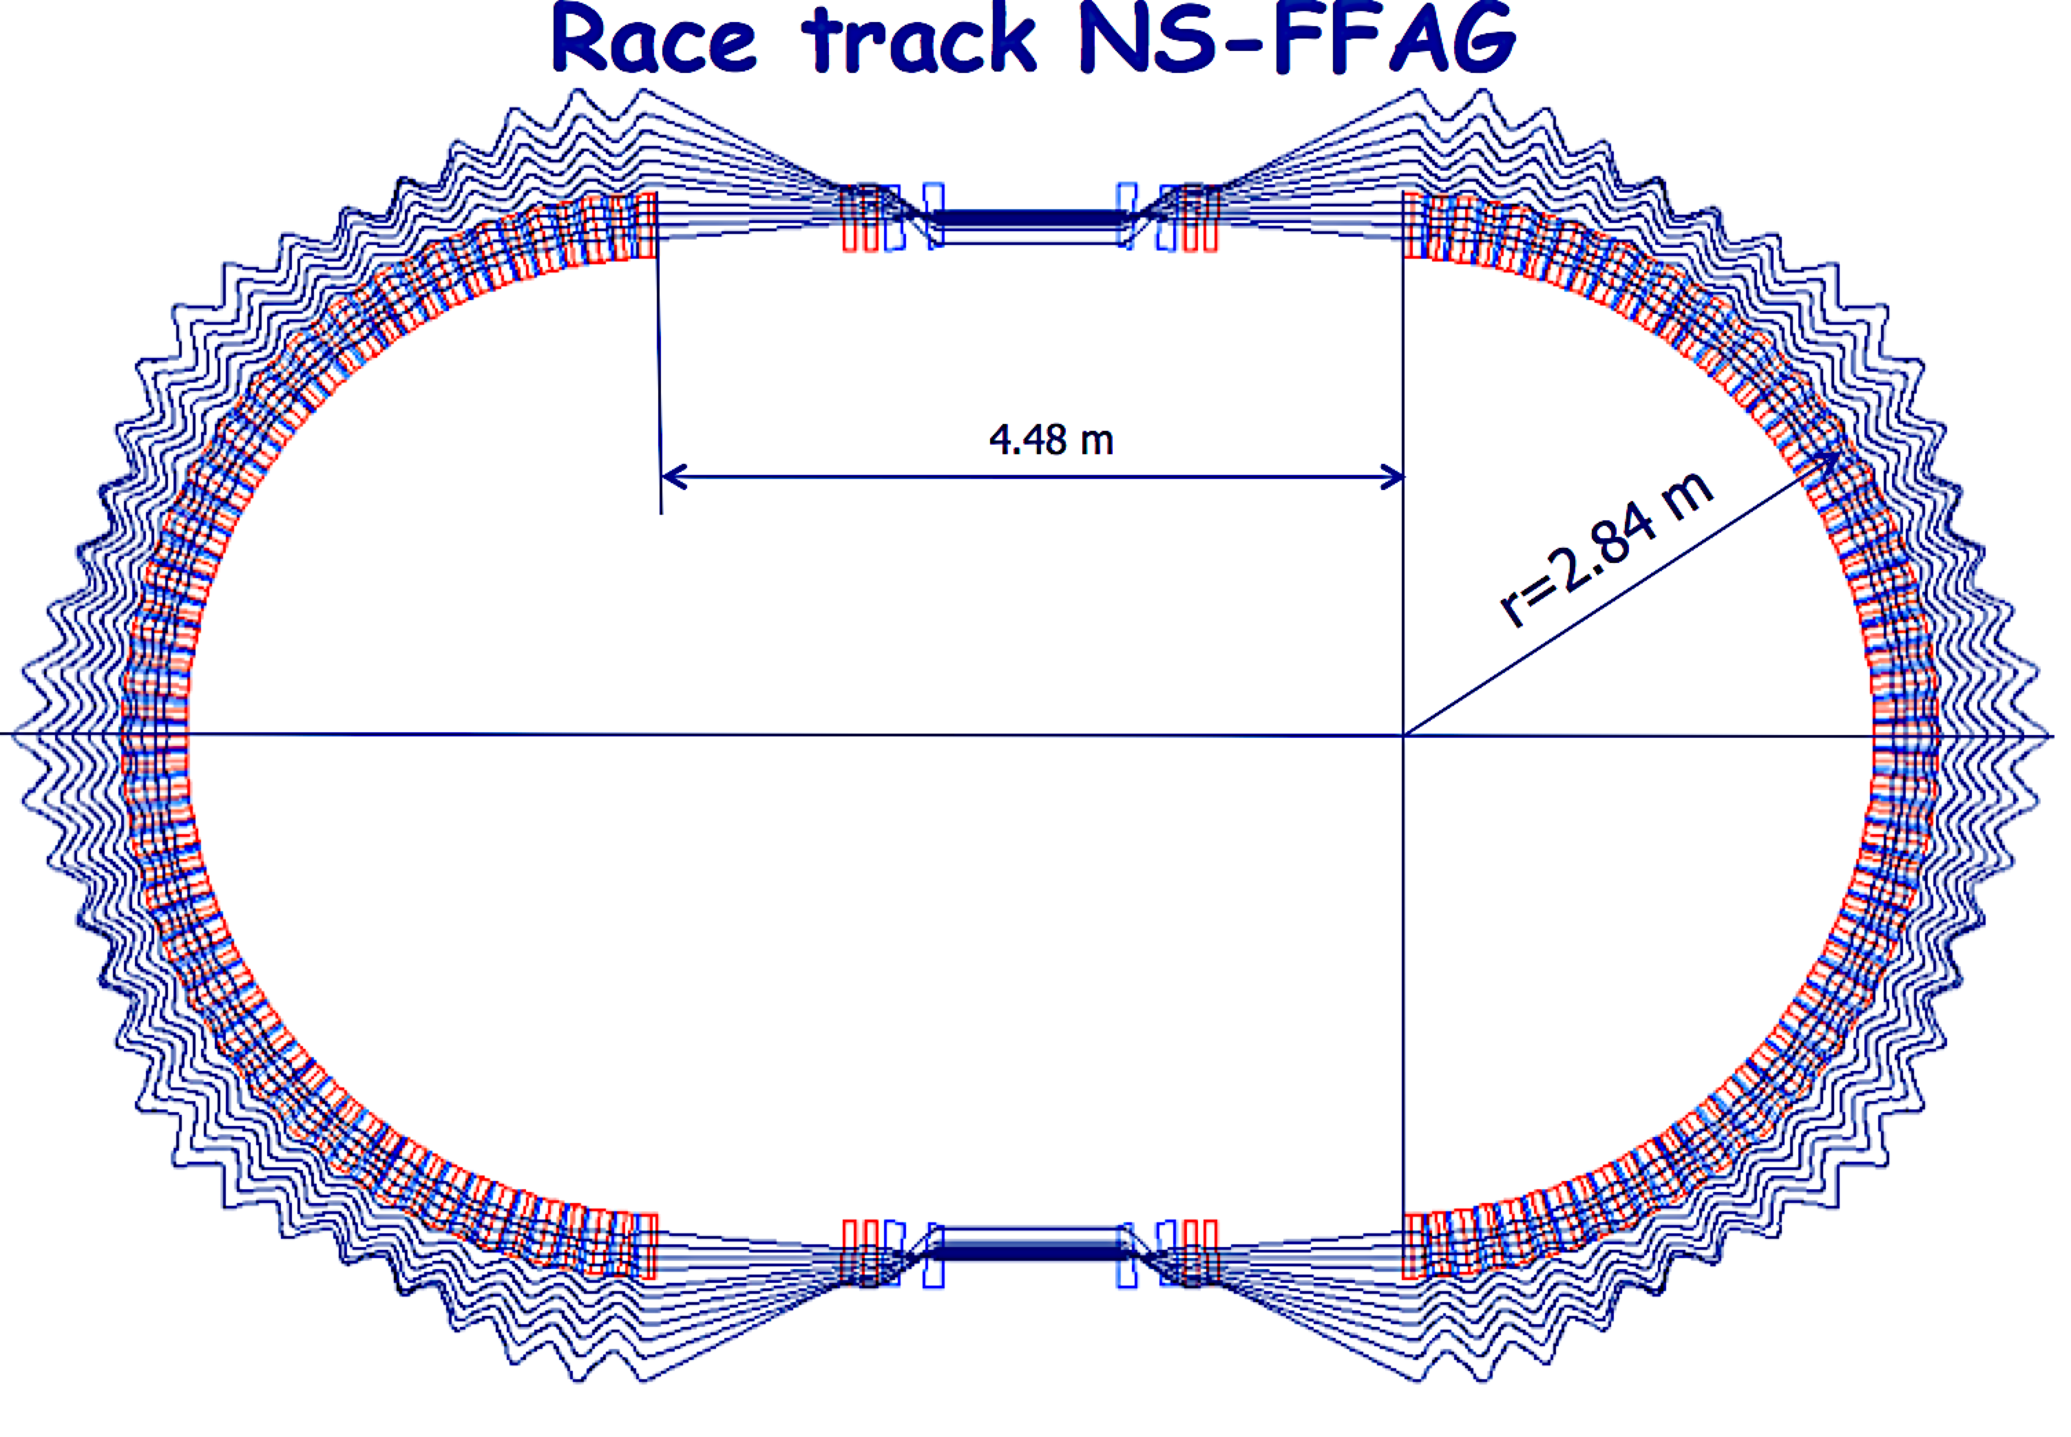
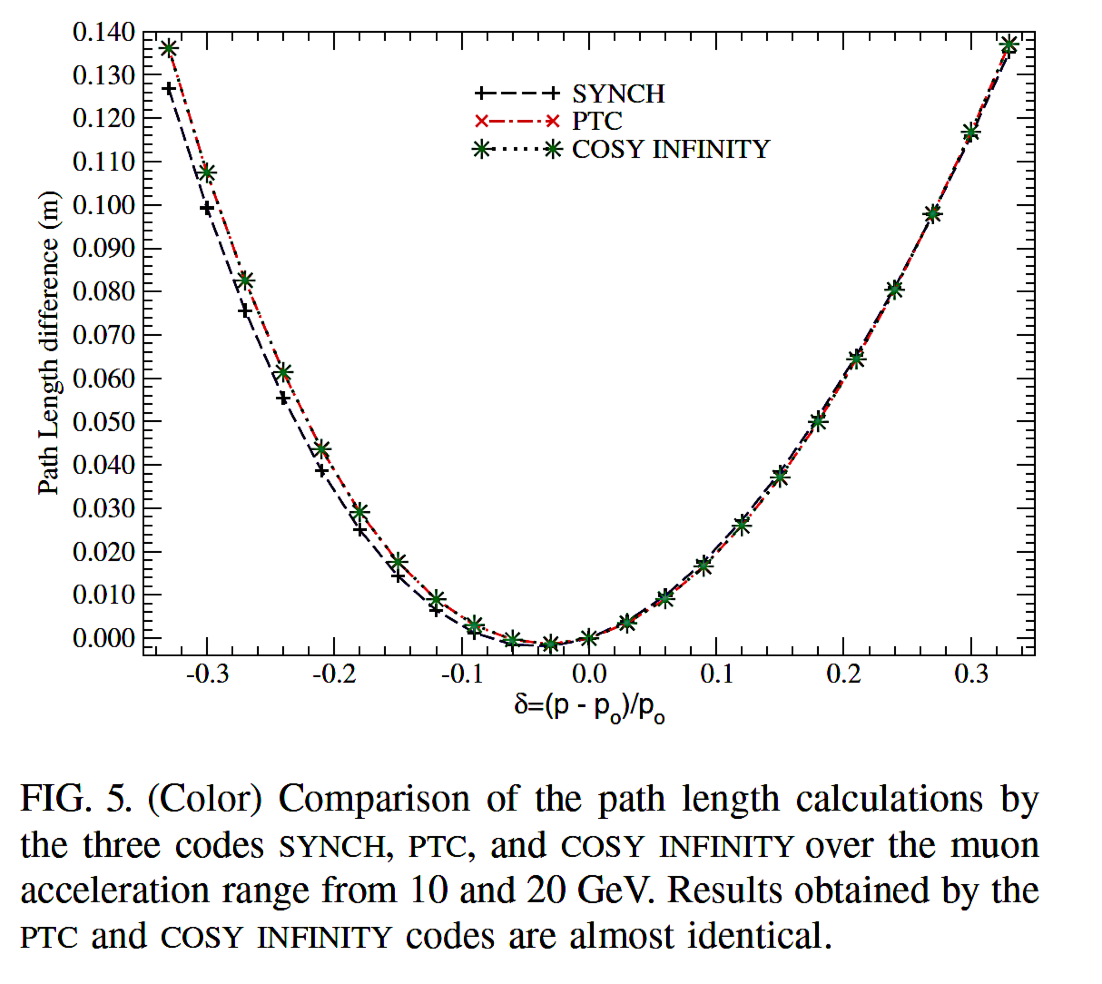
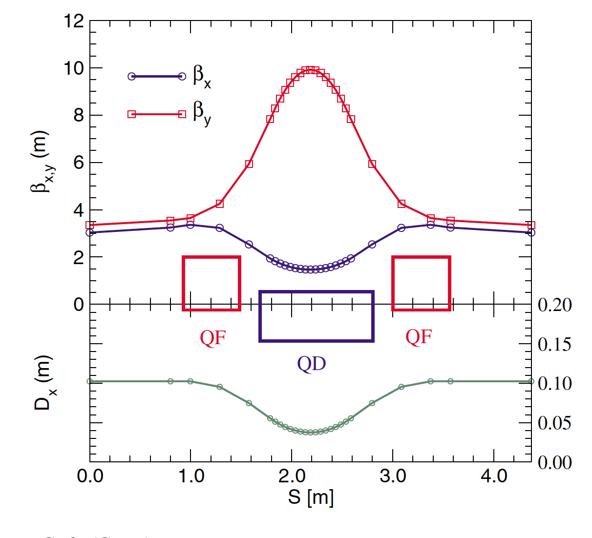
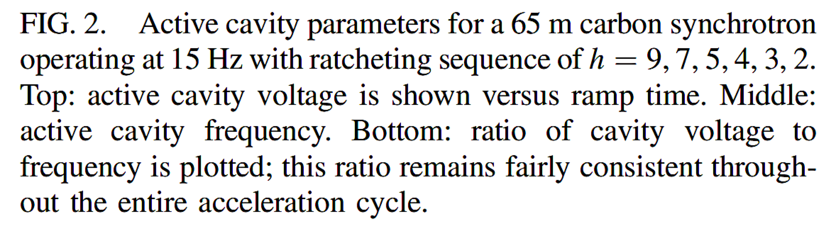
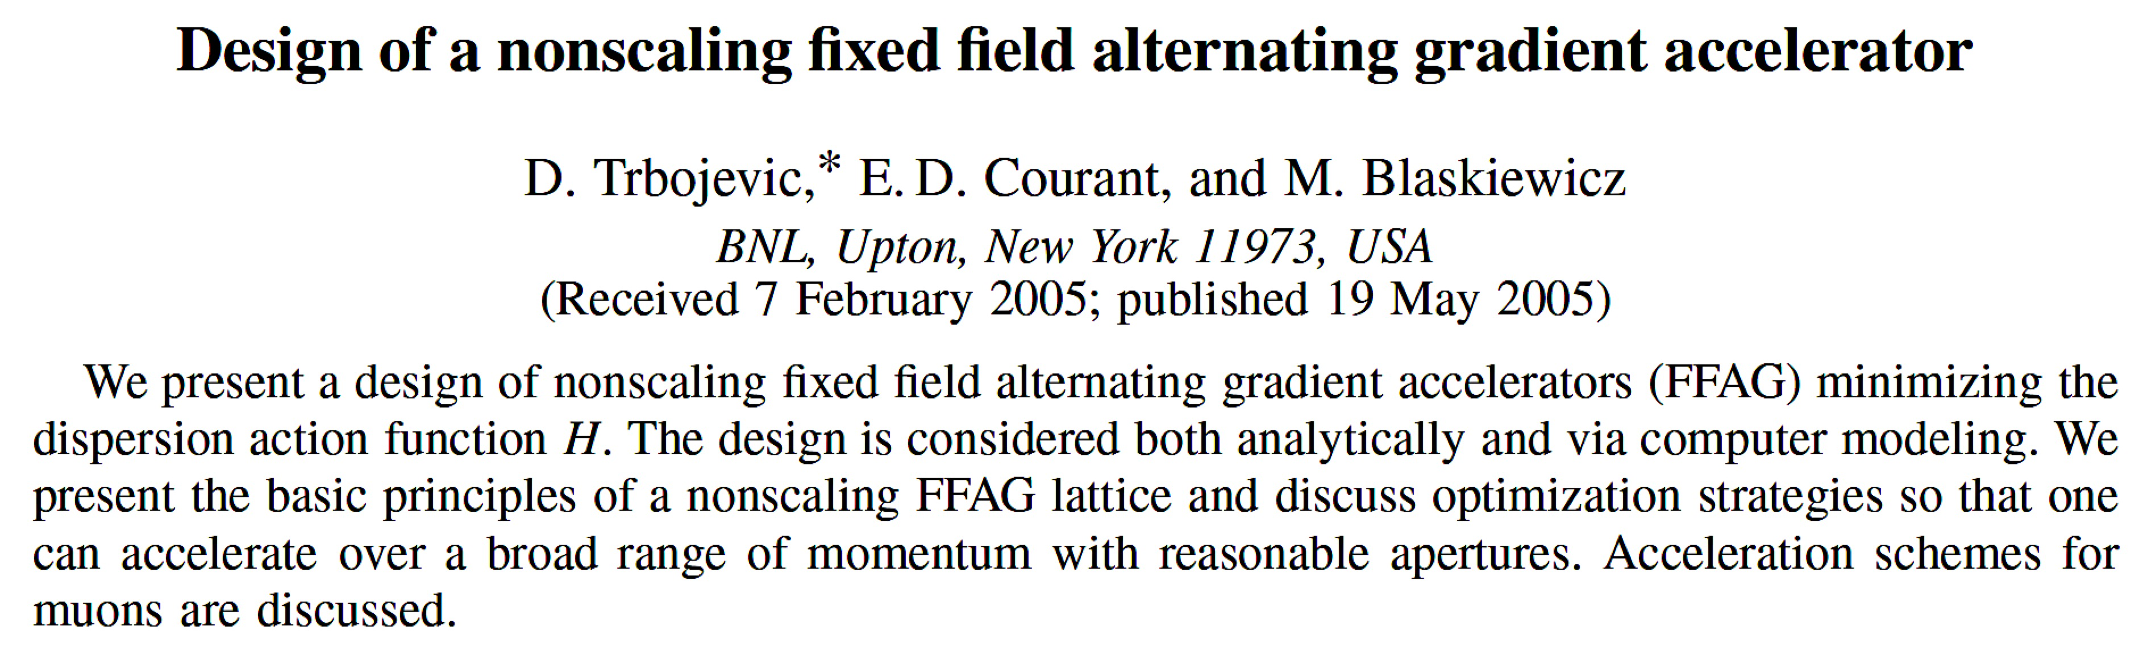
Acceleration with NS-FFAG
Non-Relativistic
Relativistic

Slide 5
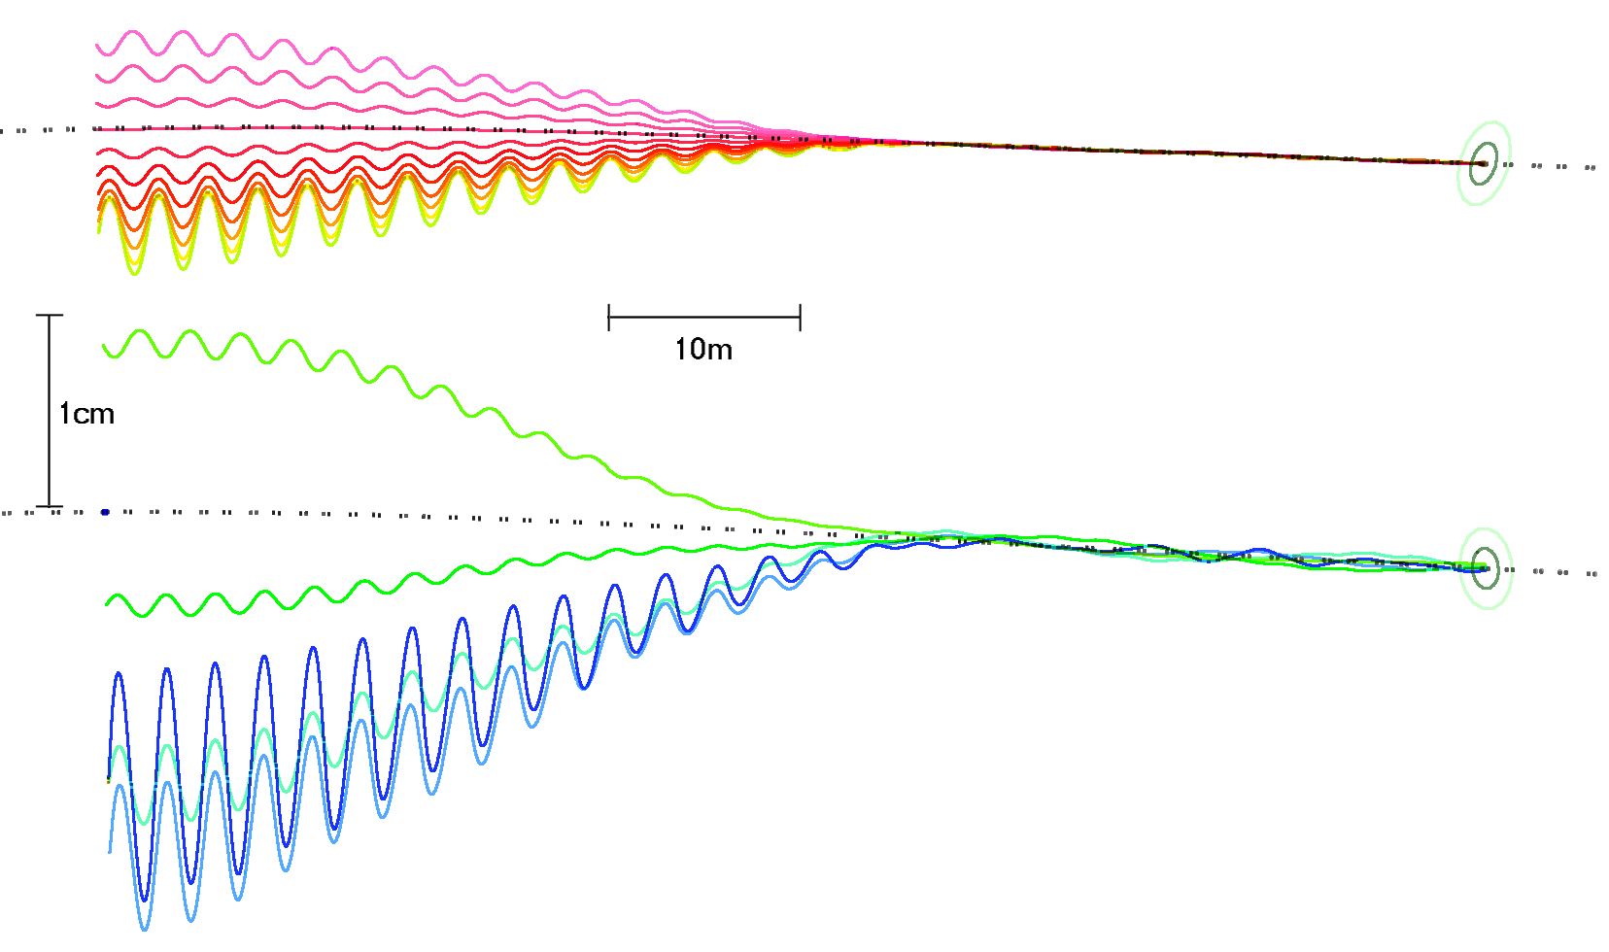
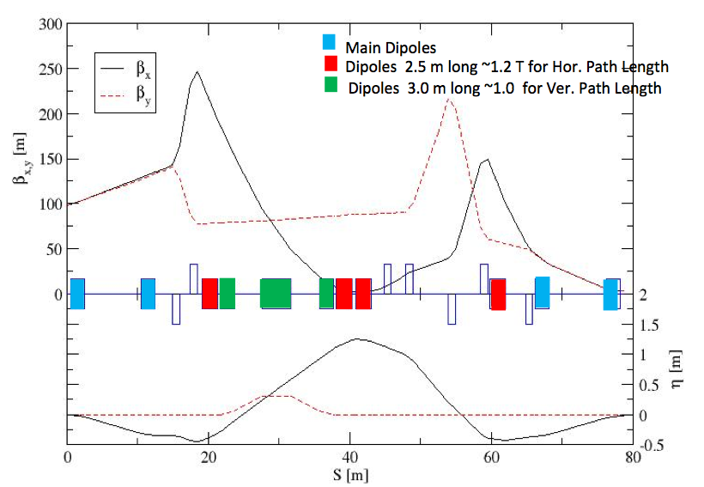
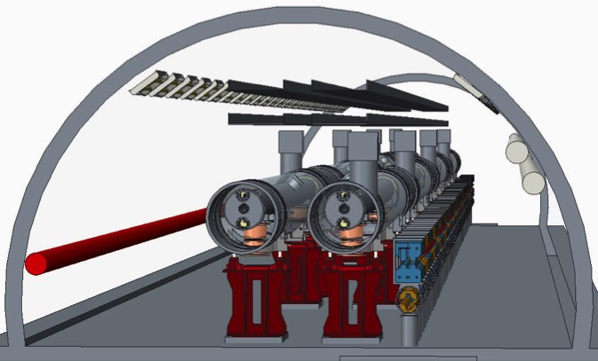
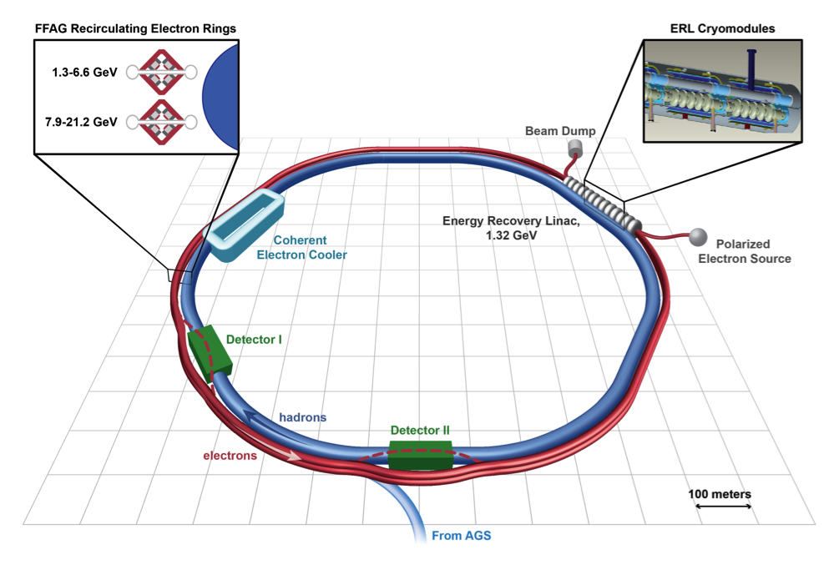
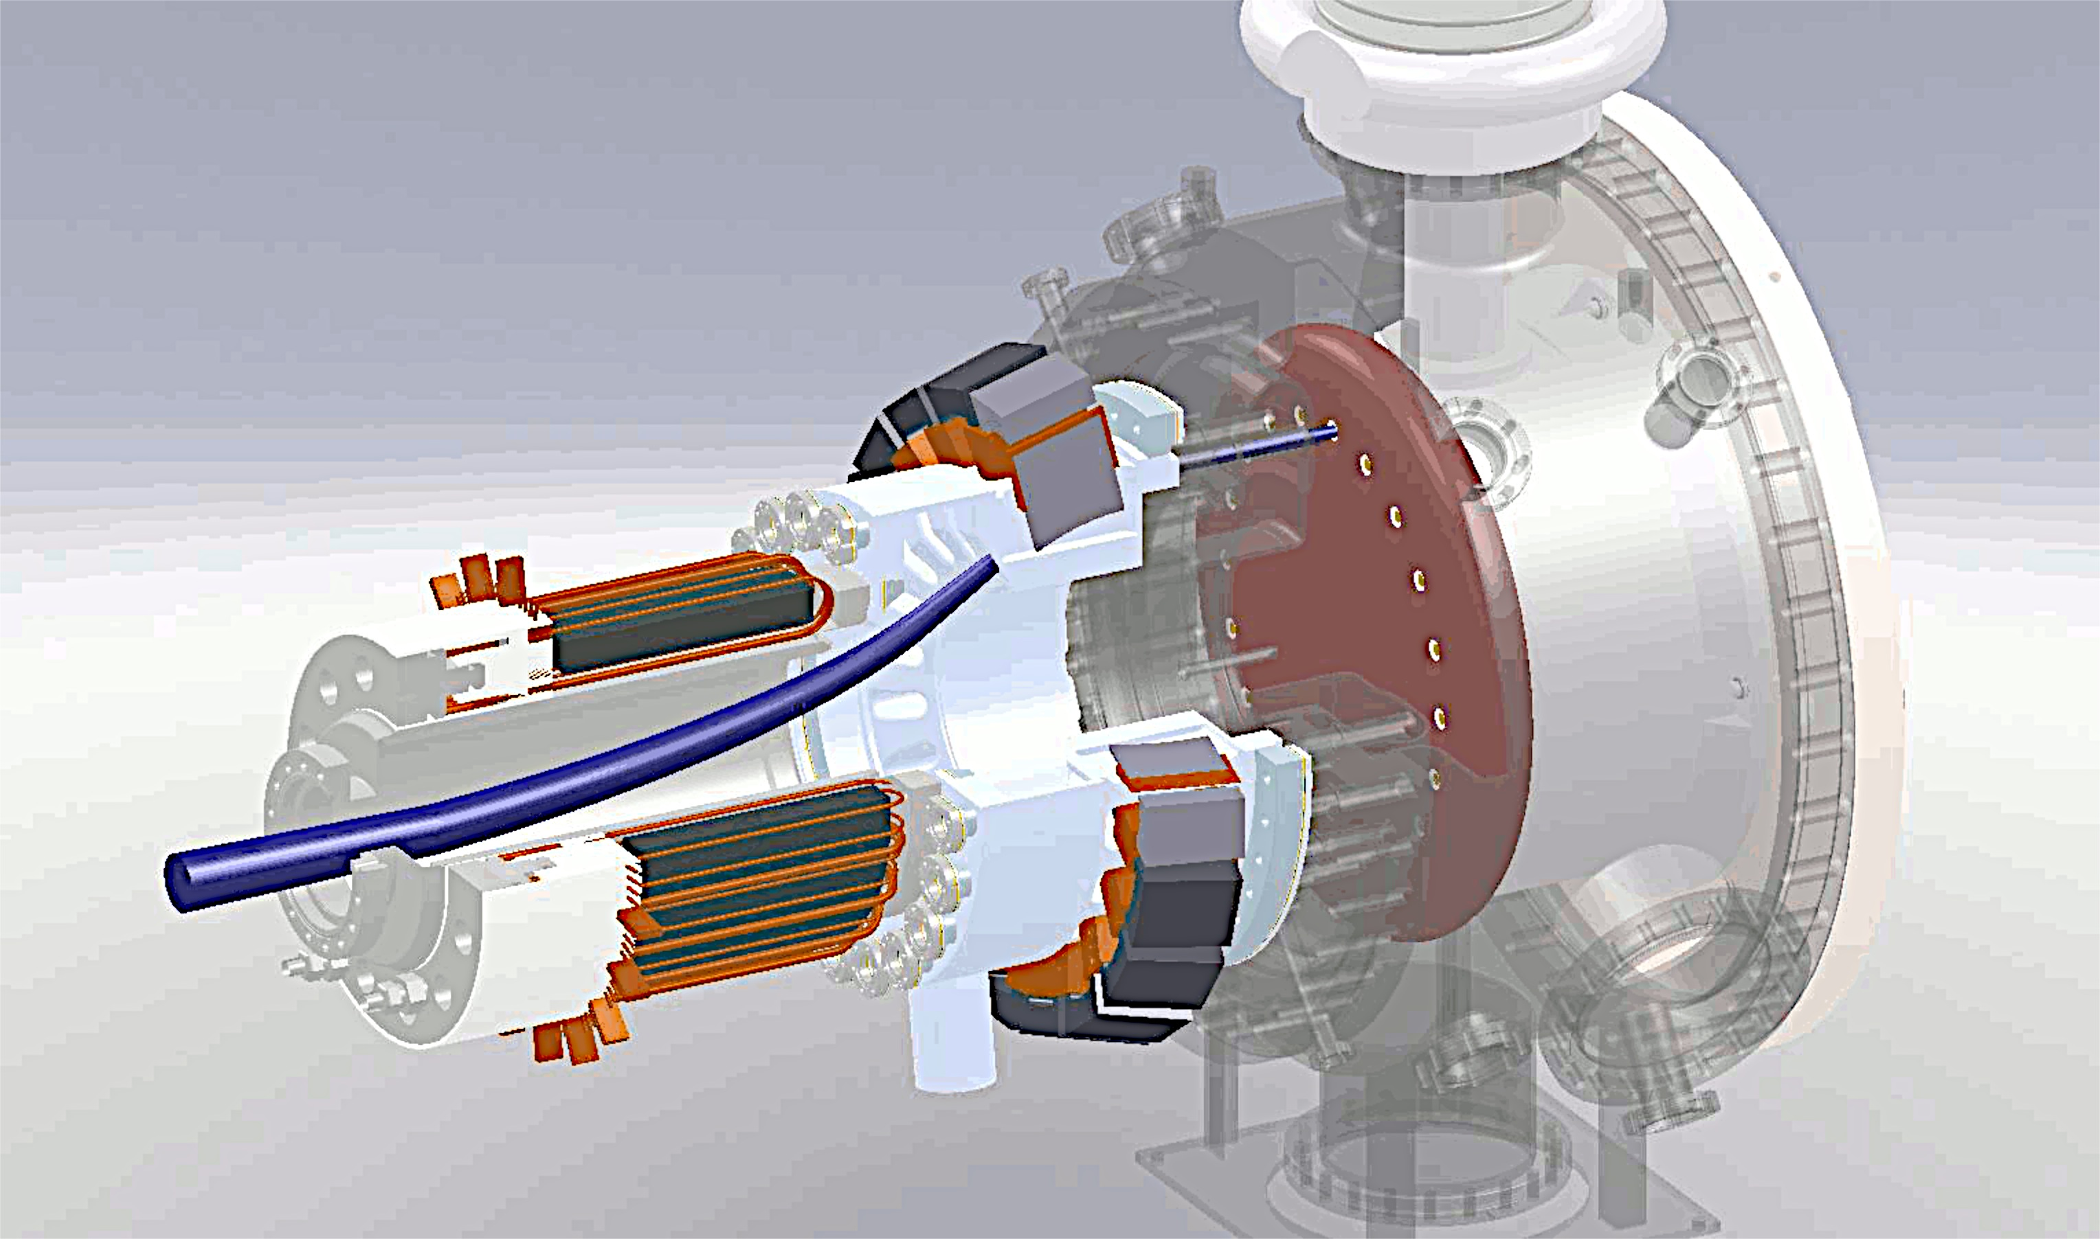
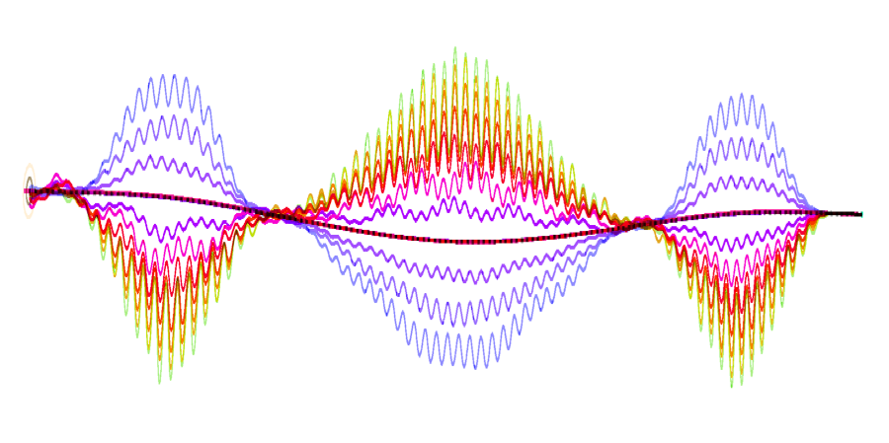
eRHIC Technical Overview
3
Major Technical Components:
3
3
2-6 GeV
5
Funneling Gun
8-20 GeV
5
ERL mergers
1
5
6
6
2
2
4
2
2
2
3
Superconducting Linac - ERL
6
6
7
4
4
2
3
2
1
2
6
3
2.0 GeV
4
4
Spreaders and Combiners
4
4
8
4
1
5
5
6
NS-FFAG arcs
9
7
7
Merging arcs to straight section
8
6
7
6
6
6
7
8
9
8
Straight section
5
5
5
5
Extracted high energy beam
© Stephen Brooks
8
9
Detector By Passes
The Non Scaling FFAG (NS-FFAG) lattice enables multiple passes of the electron beam with different energies in a single strong focusing recirculation beam line by using the superconducting RF (SRF) linac multiple times. The FFAG-ERL moves the cost optimized linac and recirculation lattice to a dramatically better optimum.
Proceedings of EPAC 2004, Lucerne, Switzerland
ELECTRON ACCELERATION FOR E-RHIC WITH NON-SCALING FFAG*
D. Trbojevic, M. Blaskiewicz, E. D. Courant, A. Ruggiero, J. Kewisch, T. Roser, and N. Tsoupas, BNL, Upton, N.Y. 11973, USA
© Stephen Brooks

Slide 6
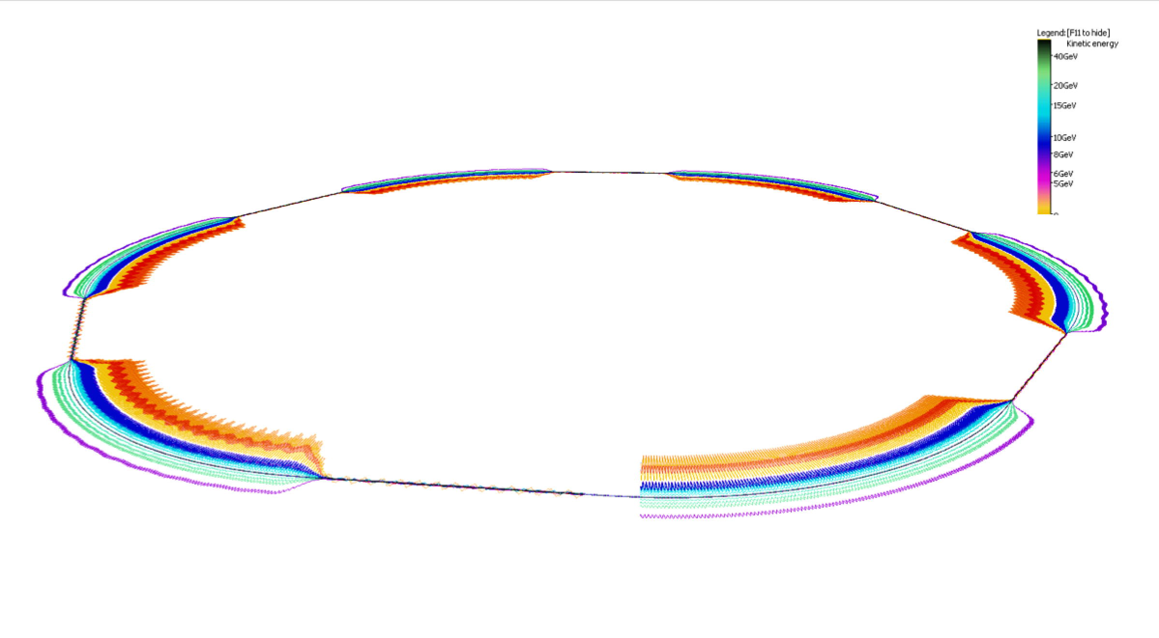
eRHIC FFAG Orbits Magnified x1000
Orbits exaggerated transversely 5000x, shape of hexagonal RHIC is evident
© Stephen Brooks

Slide 7
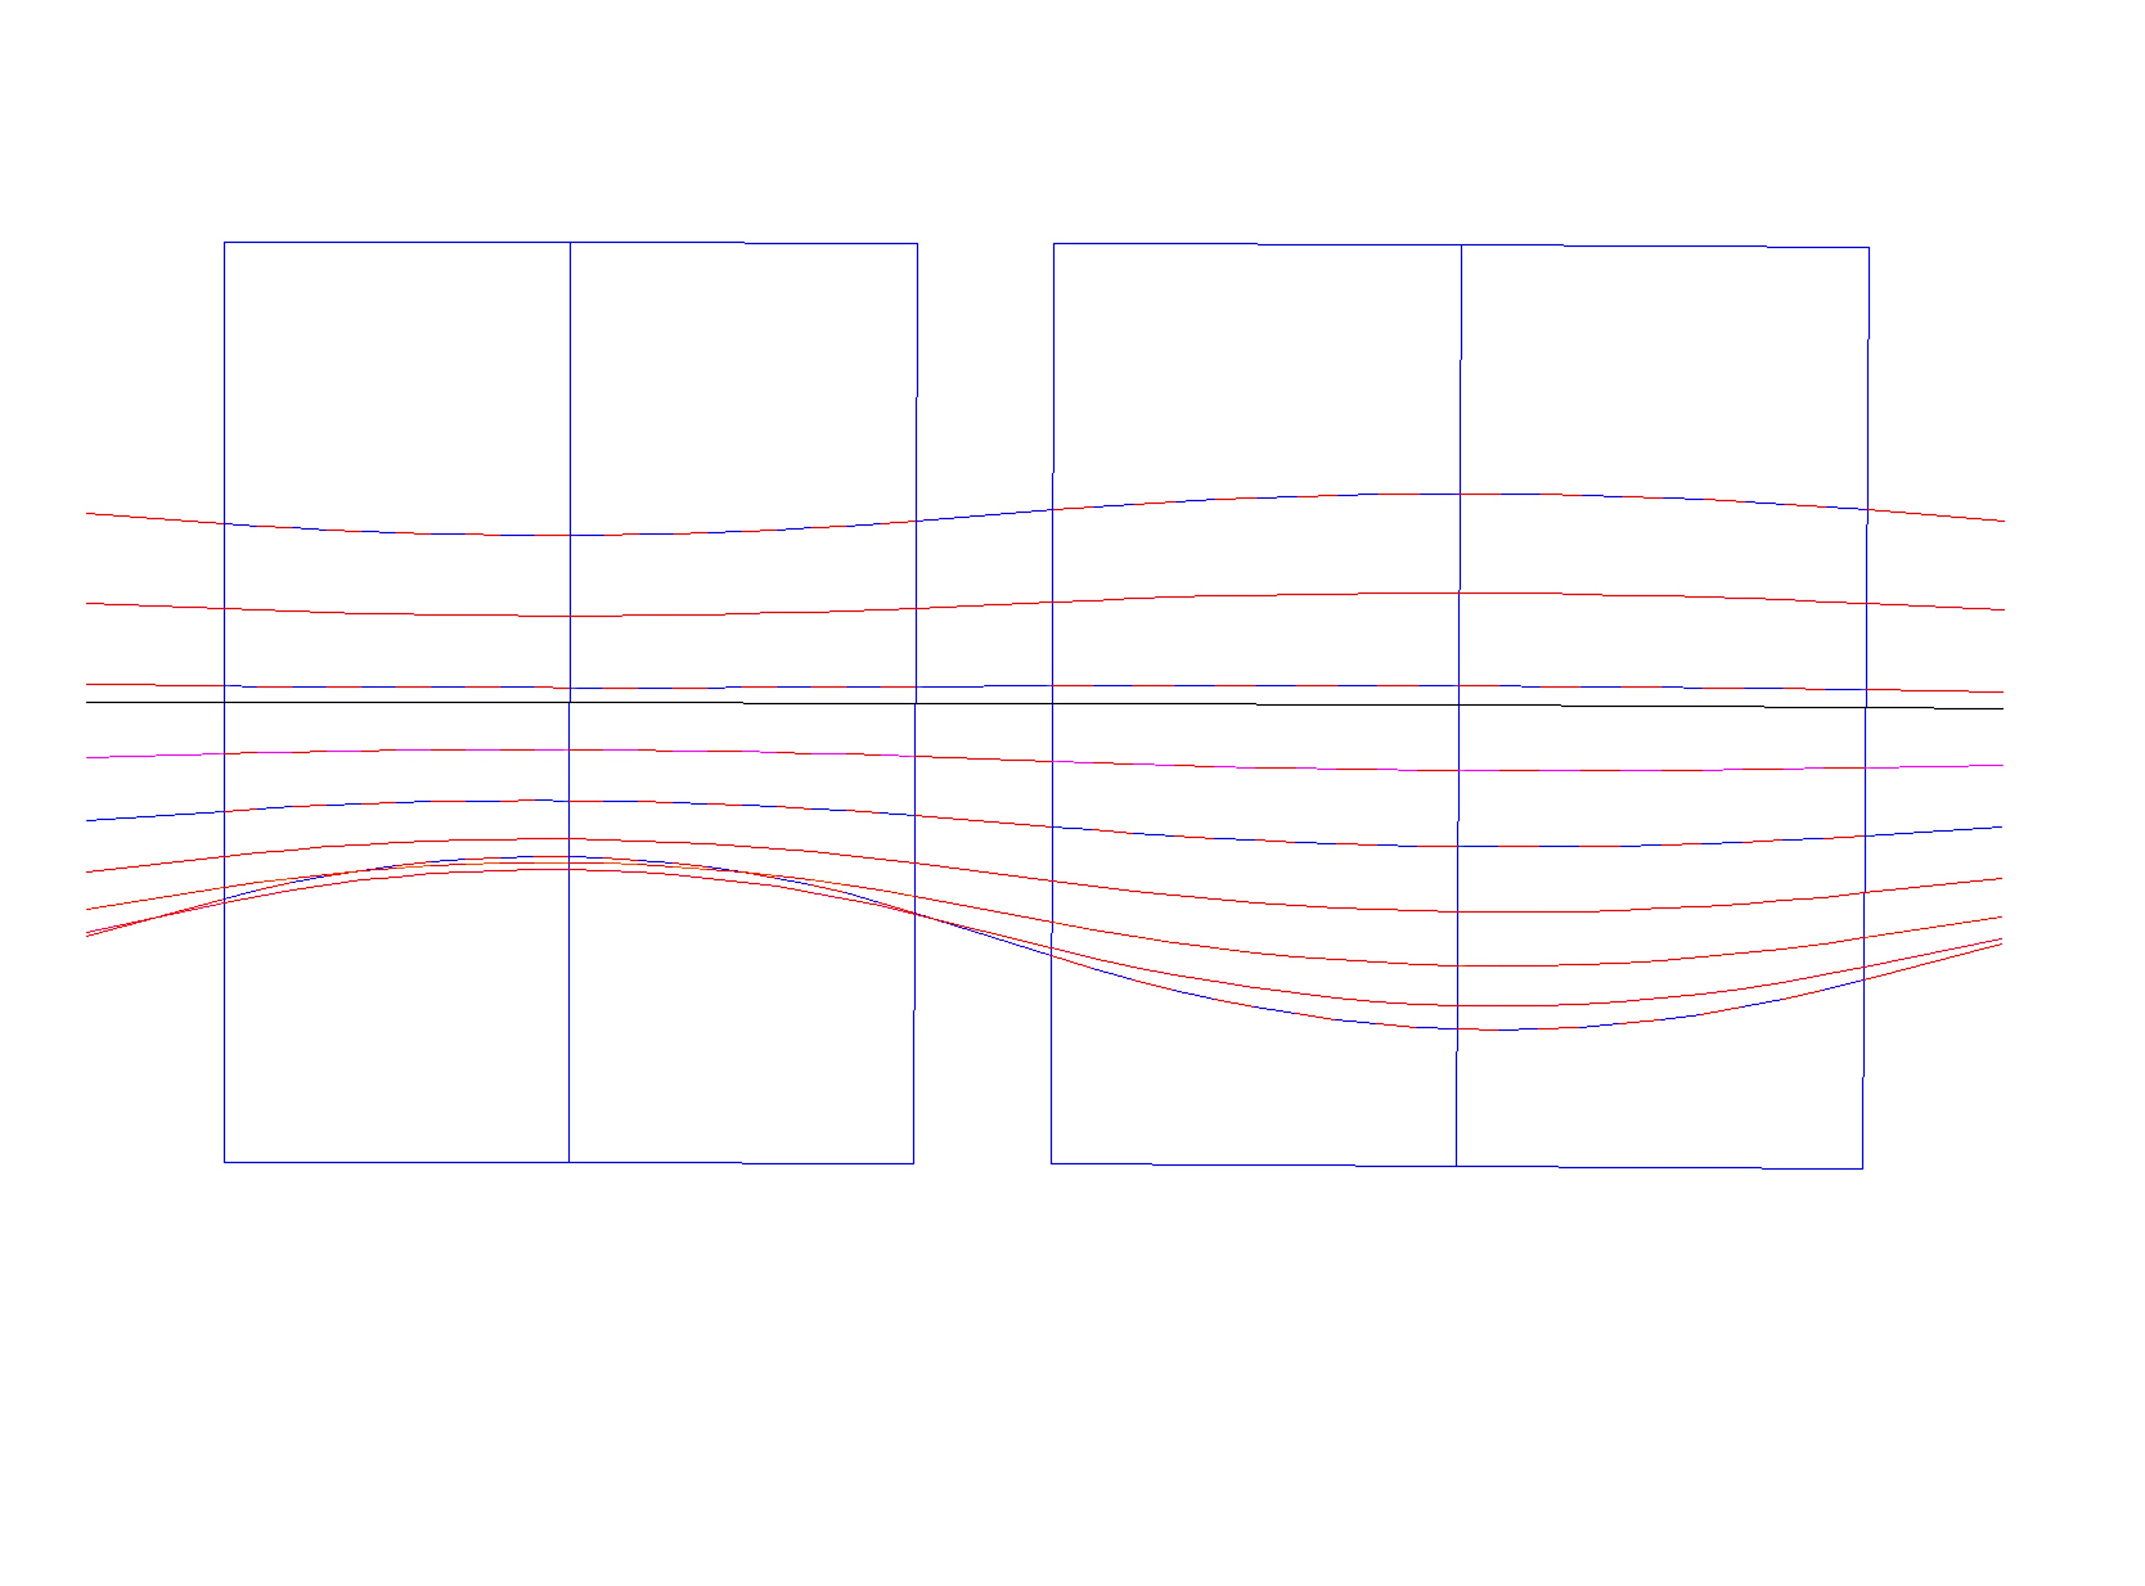
High Energy eRHIC NS-FFAG Cell
Synchrotron Radiation:
for 10 mA 20 GeV 3.32 MW
for 10 mA 15 GeV 1.62 MW
for 10 mA 16.67 GeV 1.95 MW
B_{Do} = 0.181 T,
G_{D} = -34.42 T/m
x_{Doffset}=+5.26 mm
B_{Fo}= 0.181 T,
G_{F}= 34.42T/m
x_{Foffset}= -5.26 mm
x(mm)
BD
B_{Fmax,min} =[0.446,-0.225] T
QF
x(mm)
10
B_{Dmax,min}=[0.443,0.046] T
20.00 GeV
1.3
D-Quad center
18.34 GeV
6.6
7.7
16.67 GeV
5.26
E_{CEN}=16.198 GeV
0
12.96
15.005 GeV
F-Quad center
-5.26
13.34 GeV
-7.6
11.68 GeV
10.01 GeV
-11.8
8.345 GeV
6.54
-10
6.68 GeV
B_{D}=B_{Do} + G_{D}•x
B_{F}=B_{Fo} + G_{F}•x
ρ_{D}=300.01 m
ρ_{F}= 302.3 m
20 cm
θ_{D}=3.366 mrad
20 cm
θ_{F}=3.927mrad
1.01 m
1.187m
20 cm
L = 2.797 m

Slide 8
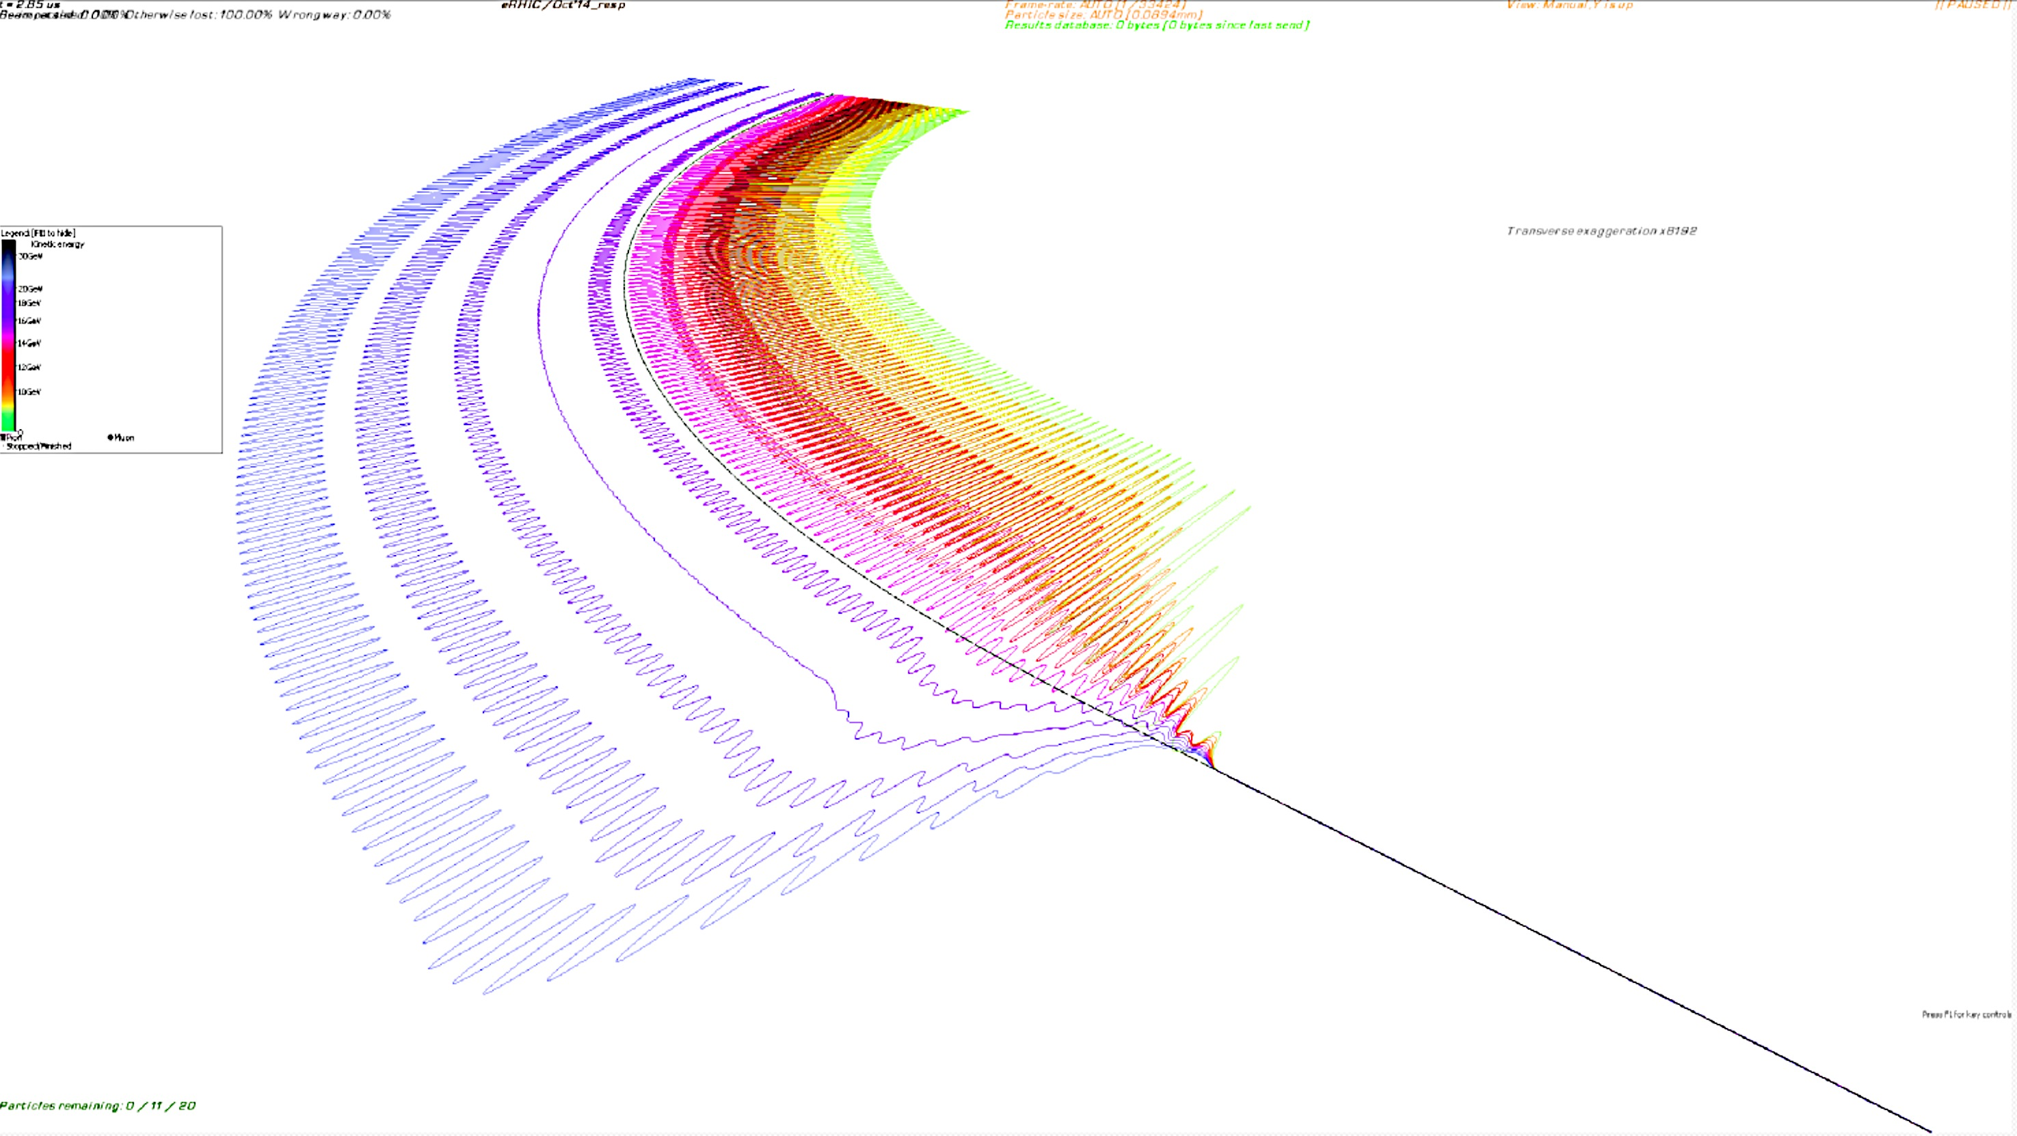
Merging FFAG arcs to the straight section in eRHIC
7.75 mm

Slide 9
eRHIC Layout
Linac 0.9 GeV
#1 4.5 GeV
#2 5.4 GeV
#3 6.3 GeV
#4 7.2 GeV
#5 8.1 GeV
#6 9.0 GeV
#7 9.9 GeV
#8 10.8 GeV
#9 12.6 GeV
#10 13.5 GeV
#11 14.4 GeV
#12 15.3 GeV
#13 16.2 GeV
#14 17.1 GeV
#15 18.0 G20
#1 0.9 GeV
#2 1.8 GeV
#3 2.7 GeV
#4 3.6 GeV
4.5 – 18 GeV
Linac 0.9 GeV
R=80m
0.9 GeV LINAC
20 passes through the Linac
x 4

Slide 10
eRHIC Layout
Linac 0.6 GeV
#1 3.6 GeV
#2 4.2 GeV
#3 4.8 GeV
#4 5.4 GeV
#5 6.0 GeV
#6 6.6 GeV
#7 7.2 GeV
#8 7.8 GeV
#9 8.4 GeV
#10 9.0 GeV
#11 9.6 GeV
#12 10.2 GeV
#13 10.8 GeV
#14 11.4 GeV
#15 12.0 GeV
#16 12.6 GeV
#17 13.0 GeV
#18 13.6 GeV
#19 14.0 GeV
#20 14.6 GeV
#21 15.0 GeV
#22 15.6 GeV
#23 16.2 GeV
#24 16.8 GeV
#25 17.4 GeV
#26 18.0 GeV
#1 0.6 GeV
#2 1.2 GeV
#3 1.8 GeV
#4 2.4 GeV
#5 3.0 GeV
3.6 – 18 GeV
Linac 0.9 GeV
R=80m
0.6 GeV LINAC
30 passes through the Linac
X 5 in energy

Slide 11
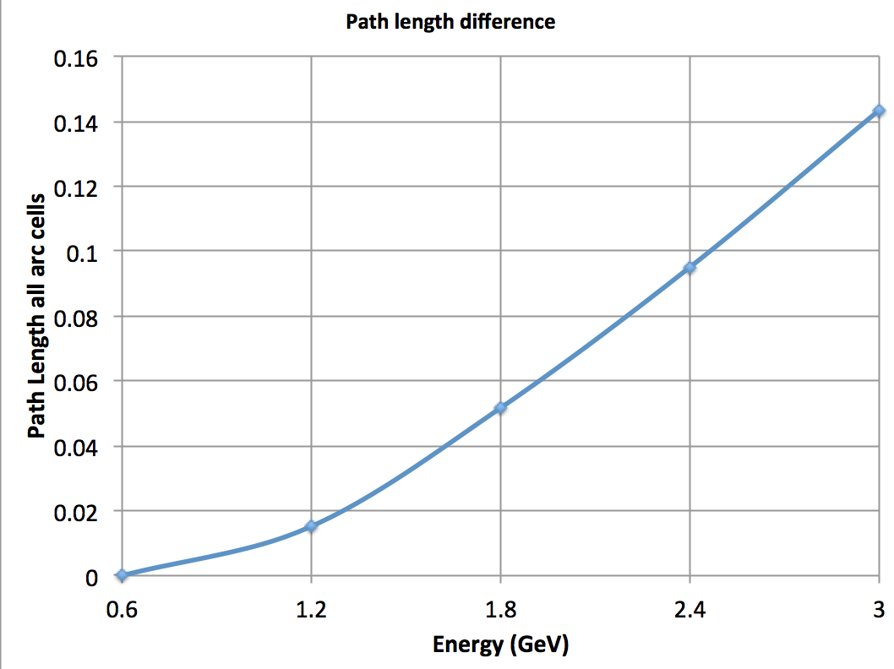
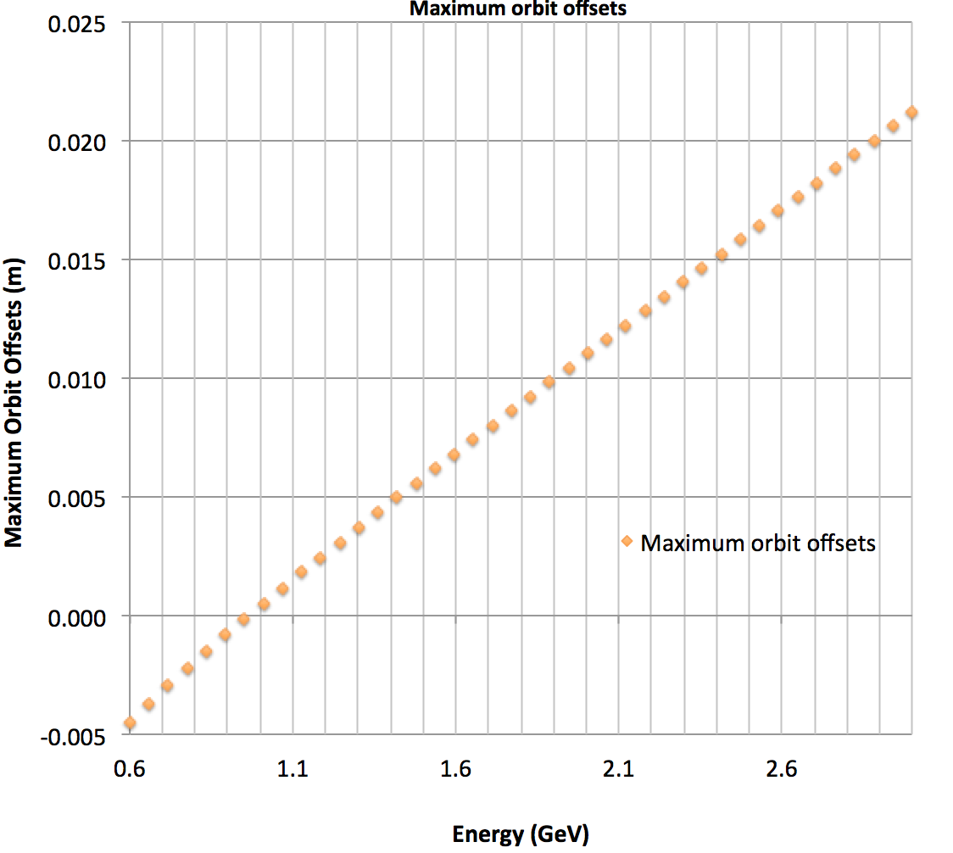
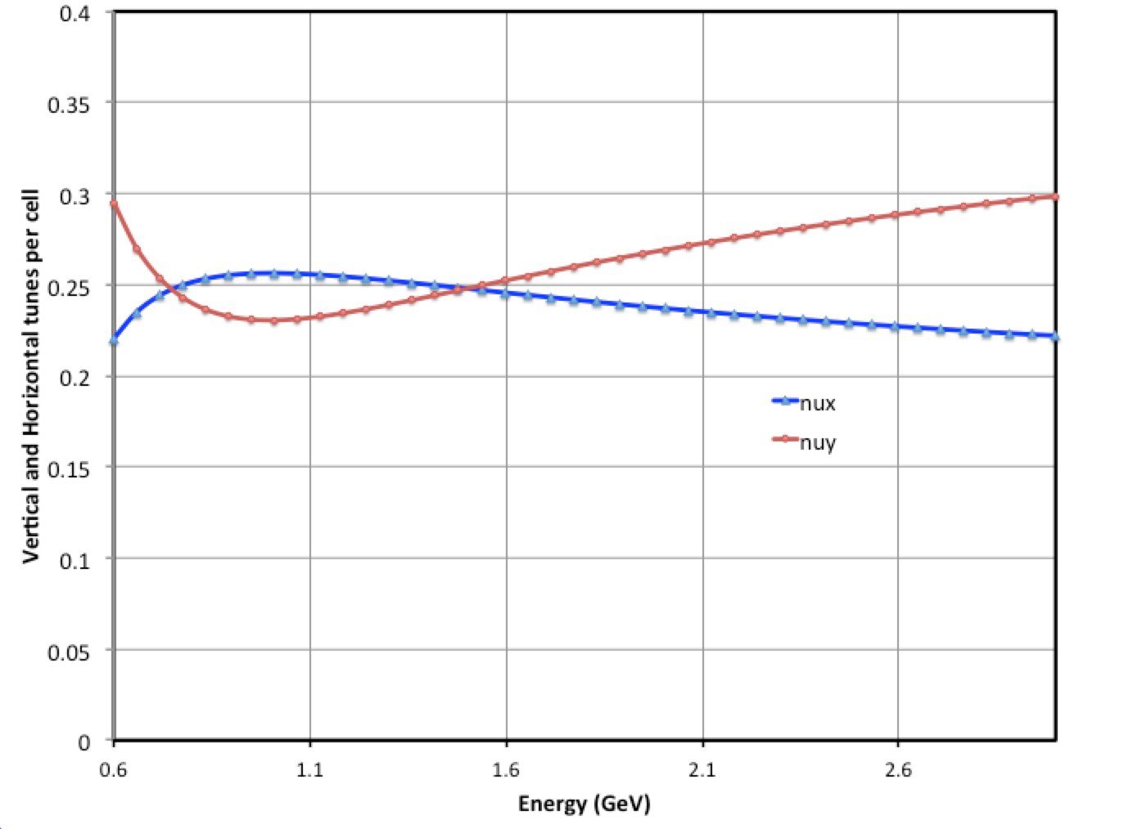
Tune dependence with sextupoles and the fields
d²B_{yh}/dx²=360 T/m^2 *3.3356401 Tm = 1200.83
so the magnetic field calculated at 21.183 mm
in the magnet would be:
B_SEXH= 0.269418 T
d²B_{yd}/d2x²=-520 T/m^2 *3.3356401 Tm = -1,734.533 T/m^2
B = Bo + dB/dx *x + 1/2 * d2B/dx^2 * x^2 + …. =
B_SEXD = -0.3891 T
The magnetic field from the focusing quadrupole
@ 21.18 mm is :
B_QF = 24 T/m * 0.02118 = 0.5 T
The value of the magnetic field at the 21.183 mm in
the defocusing combined function magnet is:
B = 0.108033 + (-19.9*0.02118) - 0.3891 = 0.7026 T

Slide 12
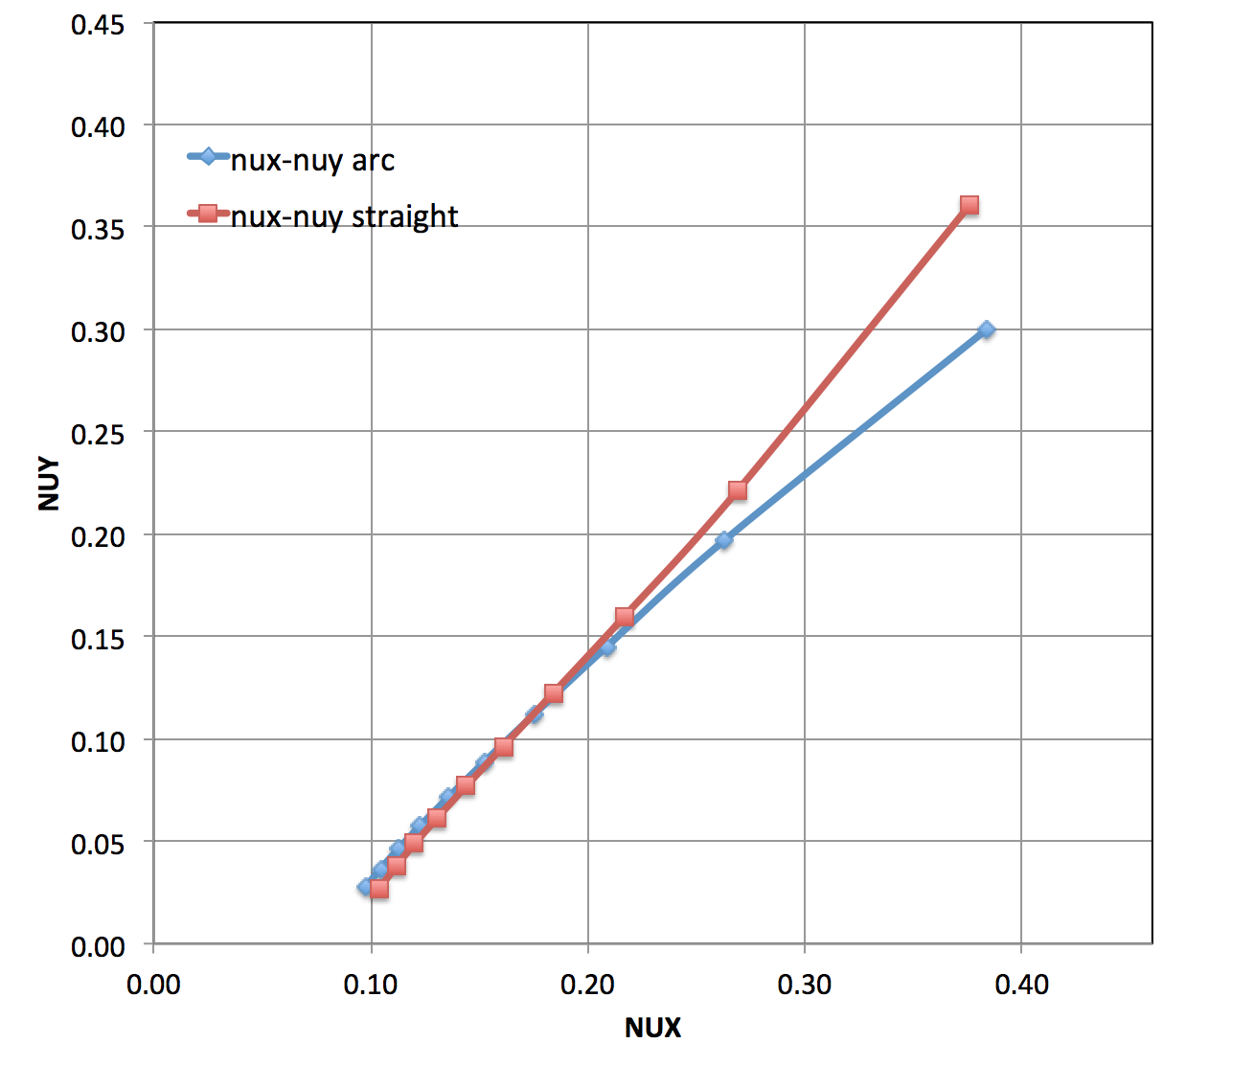
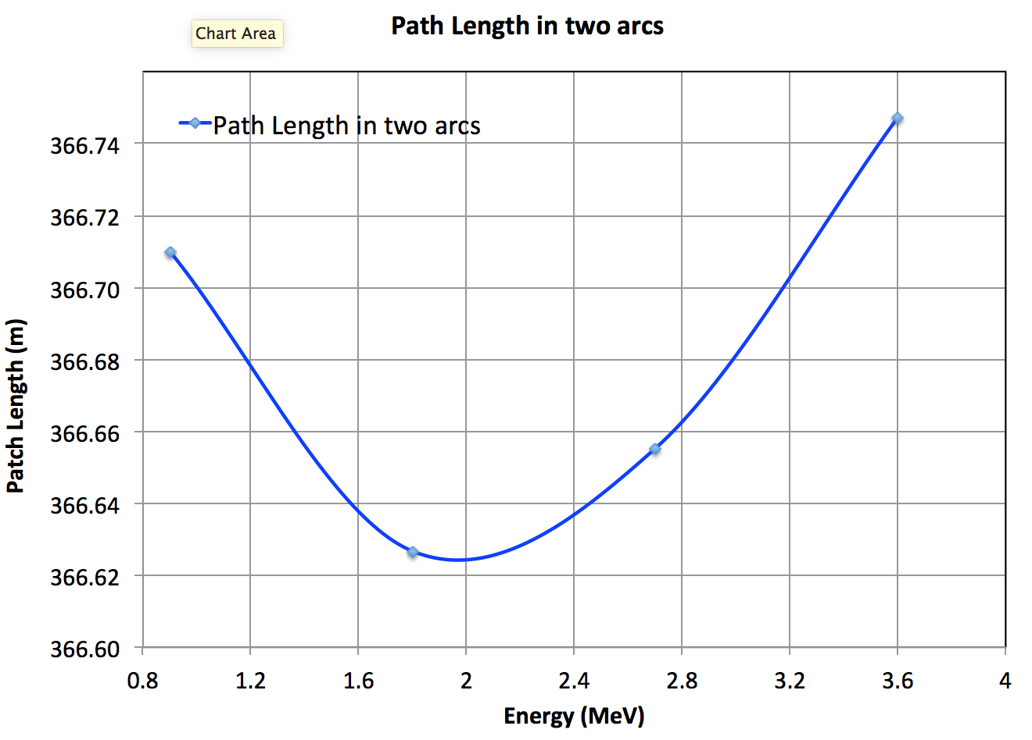
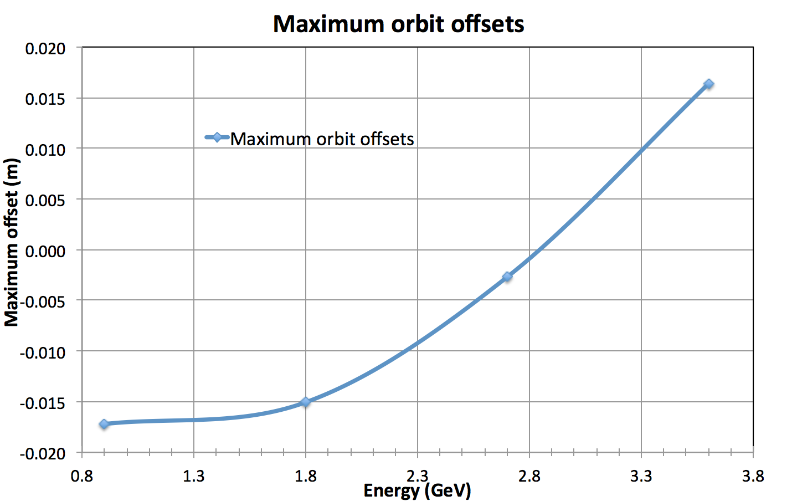
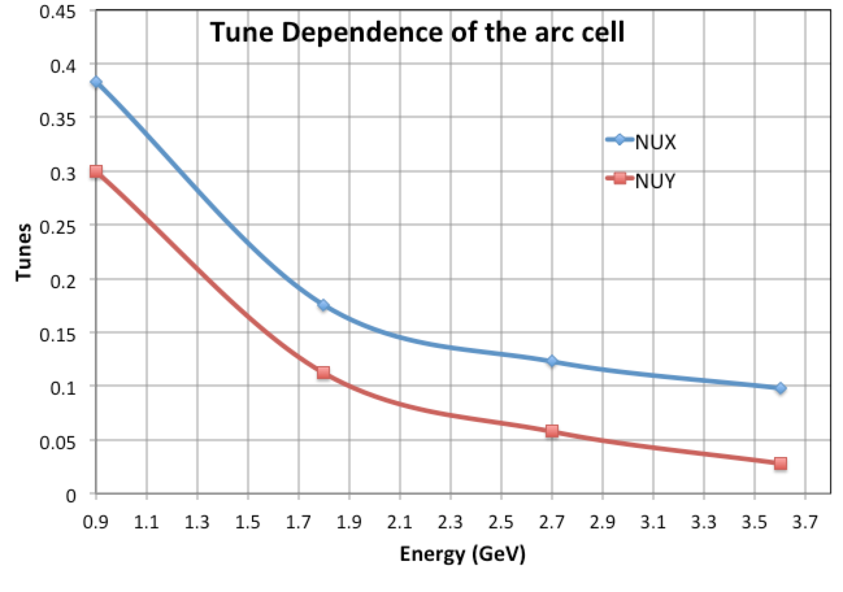
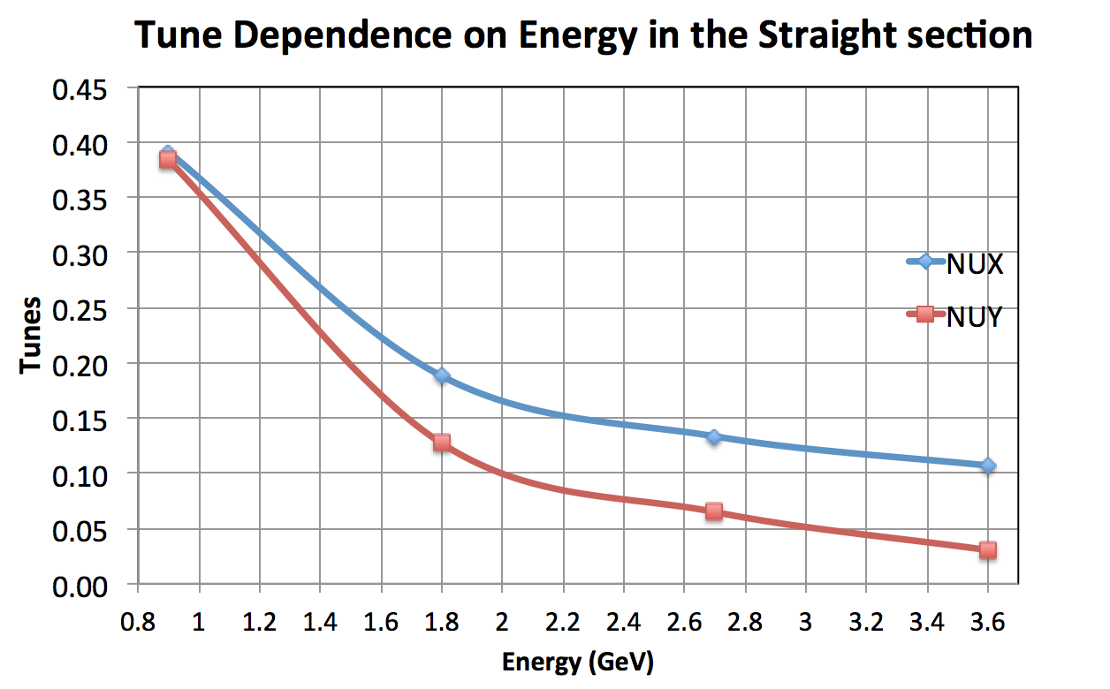
No Sextupoles 0.9-3.6 GeV

Slide 13
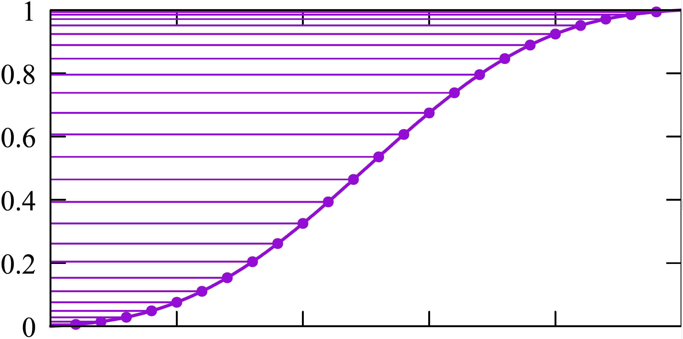
Adiabatic transition from the arc to the straight with expanding the transition cell lengths
(Scott Berg – talk)

Slide 14
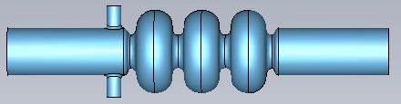
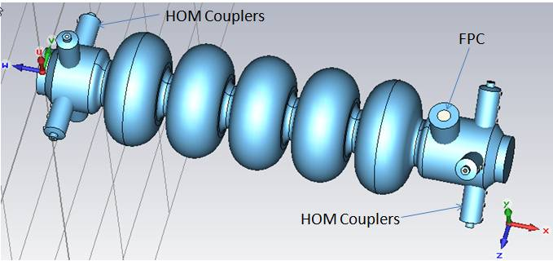
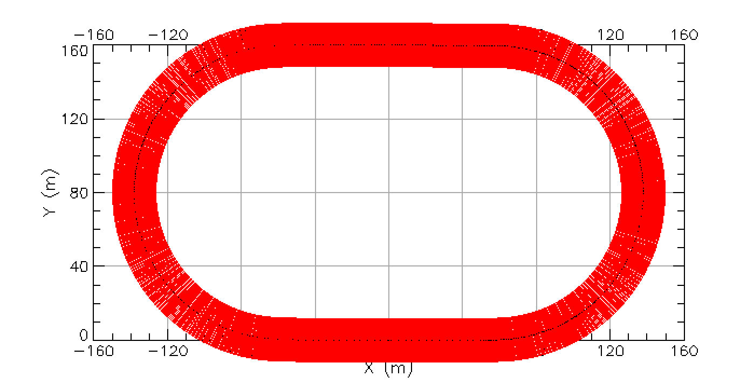
Few examples of the NS-FFAG racetrack with linac
1.7 m
Linac

Slide 15
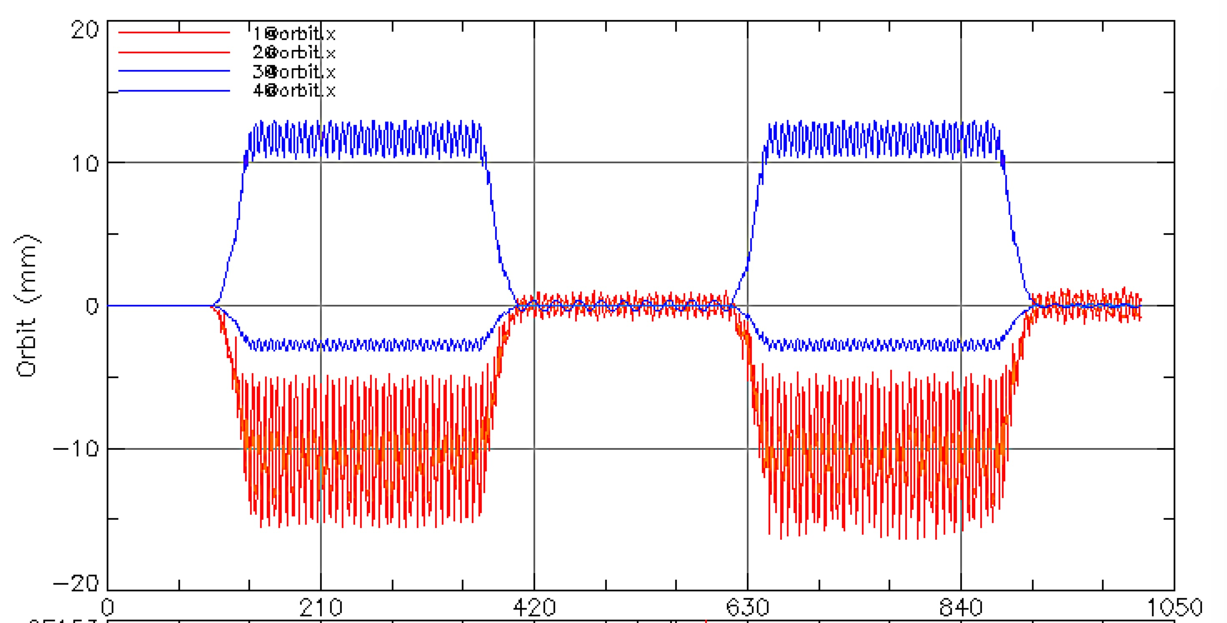
Few examples of the NS-FFAG racetrack with linac
Linac

Slide 16
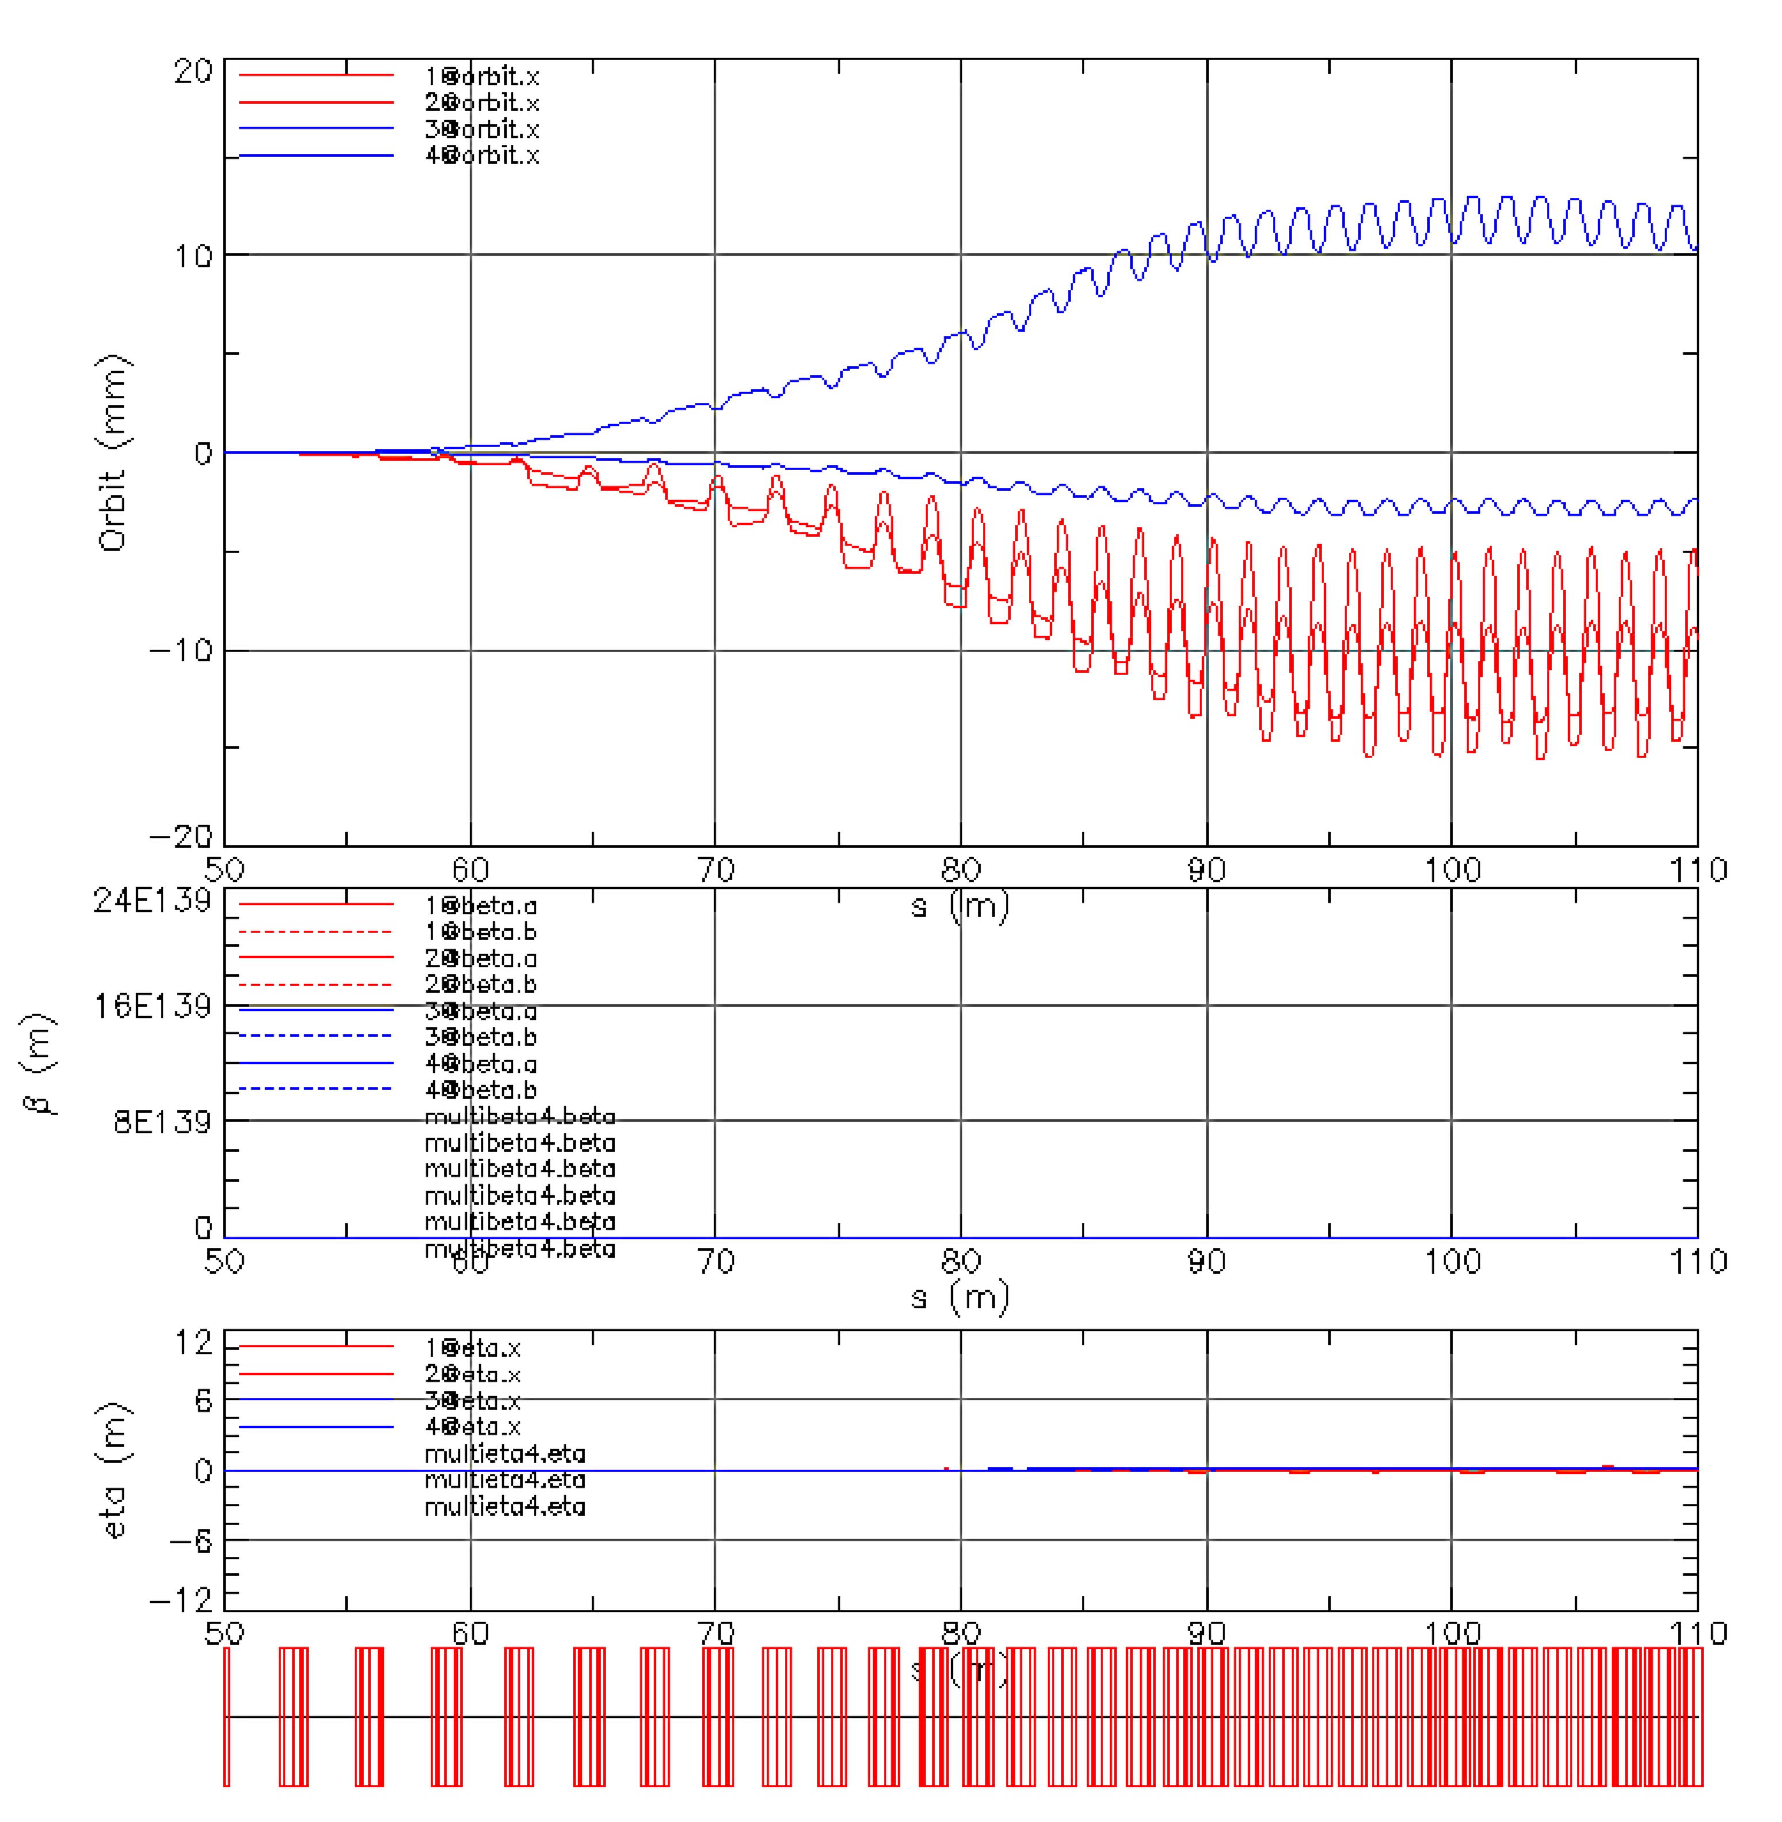
Few examples of the NS-FFAG racetrack with linac
Linac
Transition Cells

Slide 17
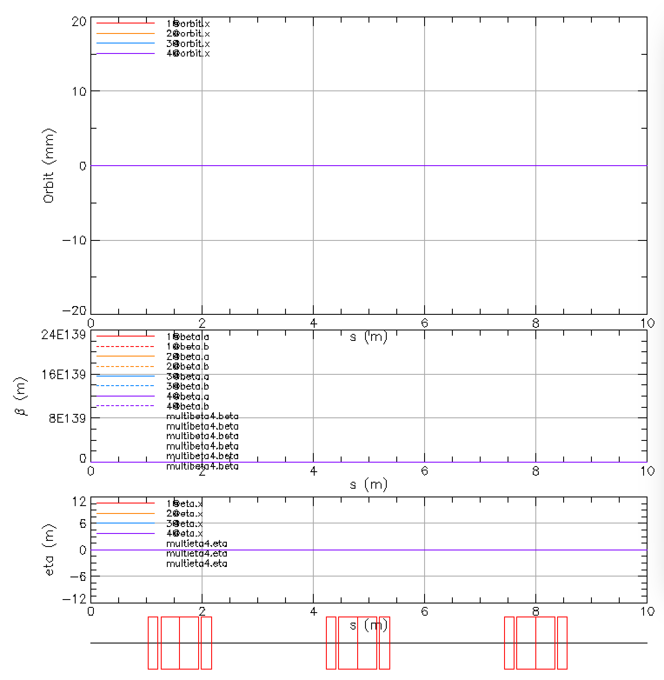
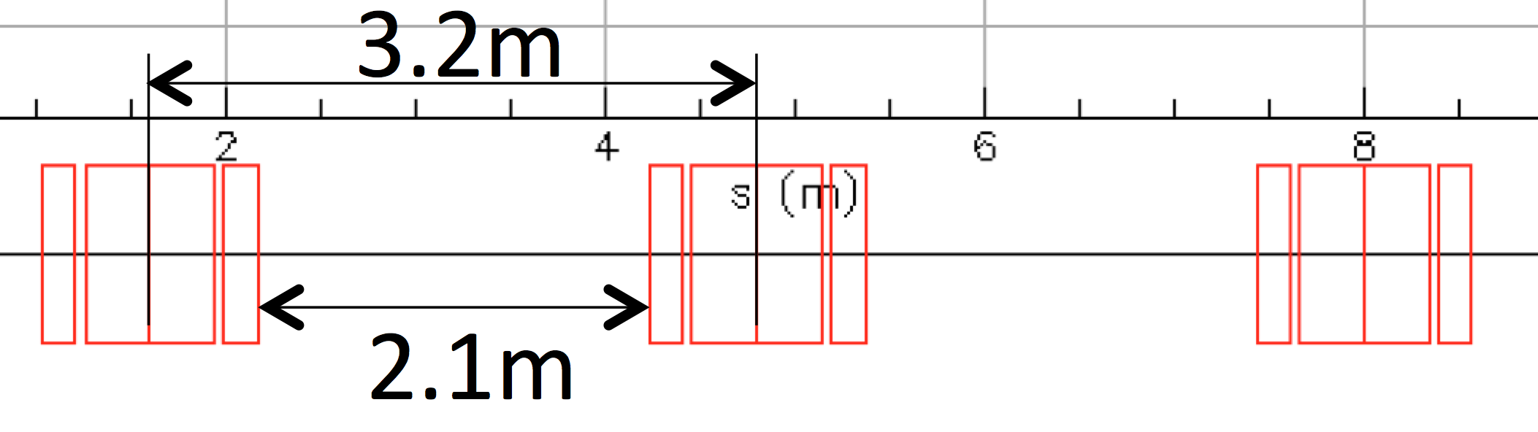
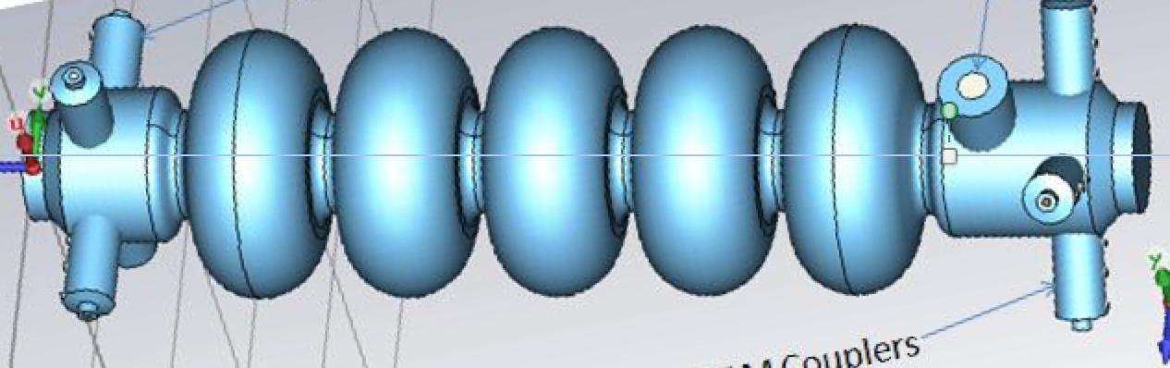
Few examples of the NS-FFAG racetrack with linac
Linac
Straight Section
Transition Cells
3.2m
2.1m

Slide 18
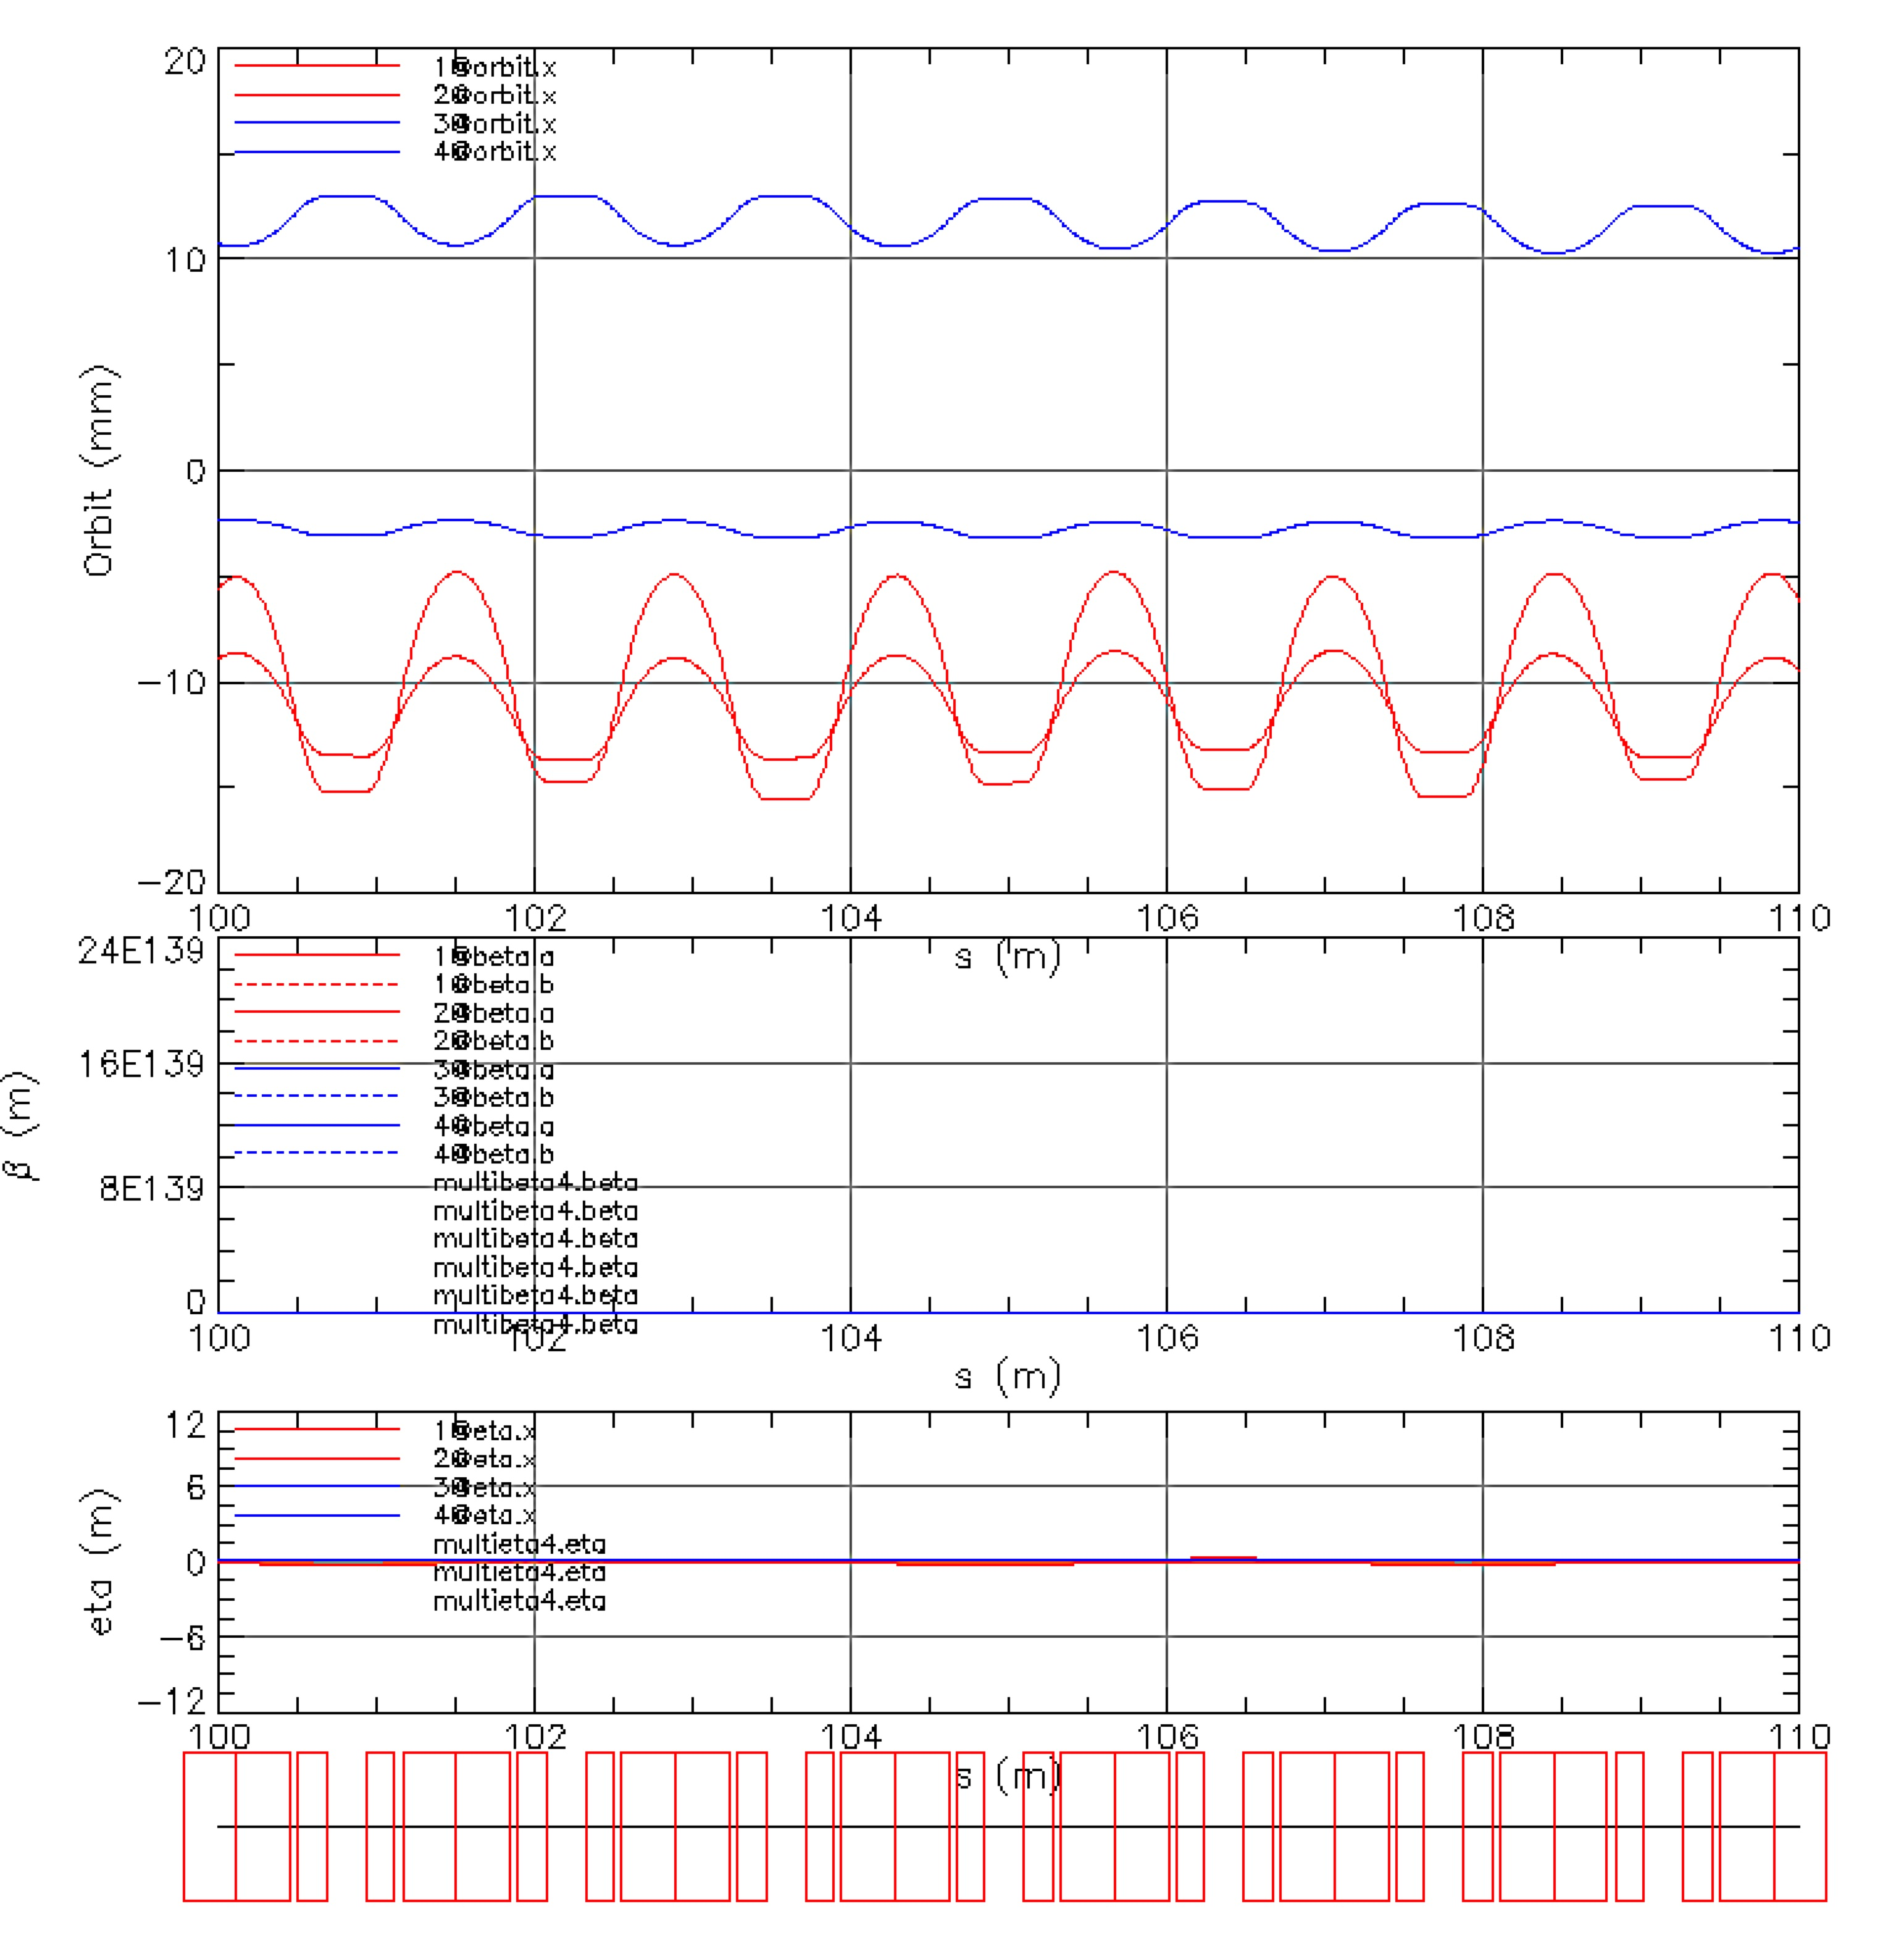
Examples: arc cell
3.6 GeV
2.7 GeV
1.8 GeV
0.9 GeV
Triplet cells

Slide 19
CONCLUSION
The adiabatic connection between the NS-FFAG arc and the straight section with gradual lengthening of the cell lengths allows placement of the linac cells between the triplets
This removes need of spreaders and combiners with serpentine acceleration at the top of the RF
The time of flight difference needs to be within the required limits E_{max}/E_{min} < 2%
E_{max}
E_{min}
Δτ

