Slide 1
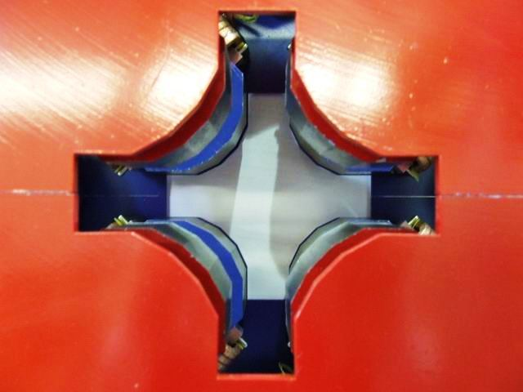
The EMMA experience: Orbit correction in EMMA
David Kelliher (ISIS/RAL/STFC)
FFAG’17 workshop, Cornell University
September 9th, 2017

Slide 2
EMMA
Linear non-scaling FFAGs allow rapid acceleration in the serpentine channel and have a large dynamic aperture. A large betatron tune range is traversed during acceleration.
EMMA consists of 42 offset quadrupole pairs, 19 cavities and ~84 BPMs. Nominally EMMA accelerates electrons in the range 10.5 – 20.5 MeV/c.

Slide 3
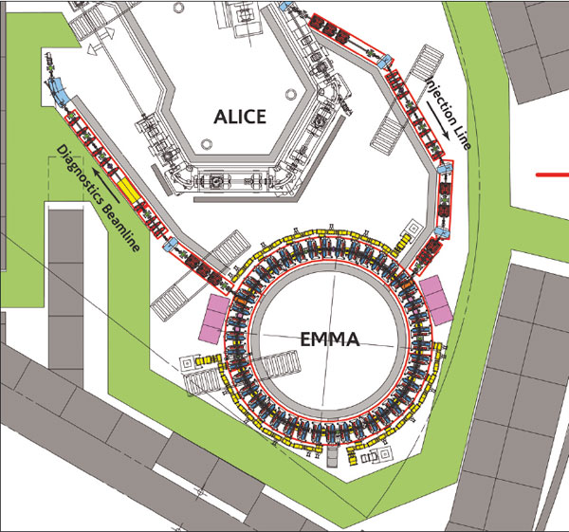
Linear non-scaling FFAG

Slide 5
Diagnostics

Slide 6
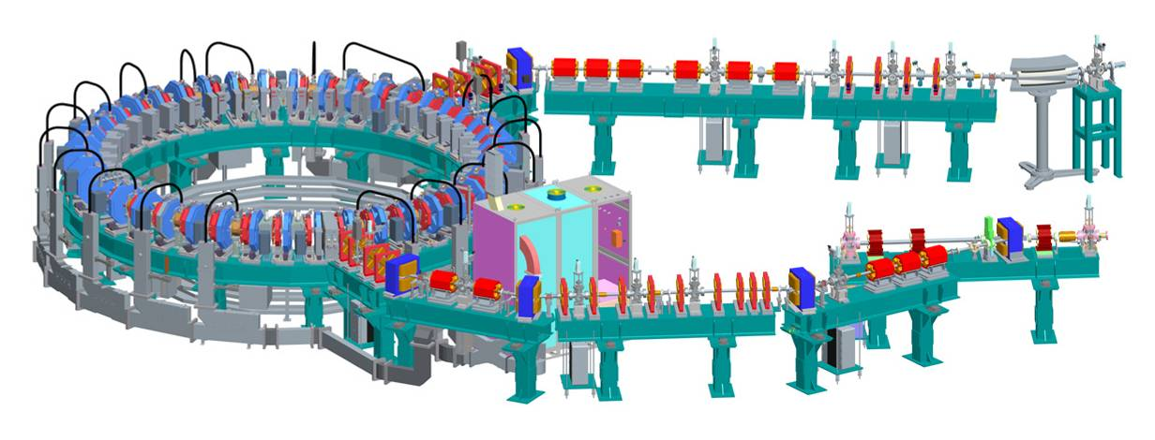
EMMA Parameters & Layout
Energy range | 10 – 20 MeV
Lattice | F/D Doublet
Circumference | 16.57 m
No of cells | 42
Normalised transverse acceptance | 3 mm-rad
Frequency (nominal) | 1.3 GHz
No of RF cavities | 19
Repetition rate | 1 - 20 Hz
Bunch charge | 16-32 pC single bunch
Diagnostics Beamline
Injection Line
Notes:
Large acceptance to be probed with the small emittance beam. This means moving this pencil-like beam to do a sort of painting of the available phase space. Bunch charge which is high enough to allow the diagnostics to work but not too high as to cause unwanted space charge or beam loading effects.

Slide 7
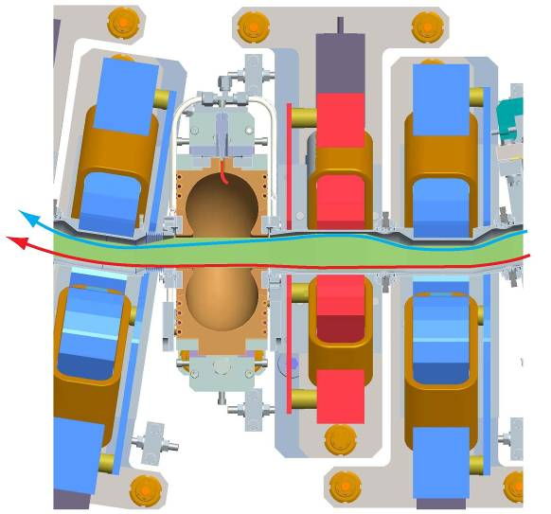
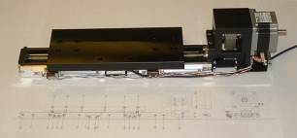
EMMA Ring Cell
65 mm
Long drift | 210 mm
F Quad | 58.8 mm
Short drift | 50 mm
D Quad | 75.7 mm
55 mm
D
D
F
Low Energy Beam
Cavity
42 identical doublets
Apart from injection and extraction
Beam stay clear aperture
High Energy Beam
110 mm
210 mm
Independent sliders
Notes:
The figure shows a horizontal cross-section of the EMMA cell with a D-quadrupole and F-quadrupole Doublet repeating 42 times around the 16.5 m circumference. There are no dipoles. The dipole field component is produced by off-setting the quad centres.

Slide 8
Slide: S. Machida, PASI 2013

Slide 9
EMMA BPM
Vertical corrector
Button pickup

Slide 10
2009 to 2011. EMMA BPM System design.
A button pickup was designed and mapped on bench.
‘Triangle’ strip-line irregular coupler for button pickup was designed.
Time domain multiplexing was proposed. It was built in the BPM Front-End.
VME-based architecture of the BPM system was designed.
Further development of beam-based trigger was done.
Unconventional way of use of a pipeline ADC in burst regime was proposed and tested.
Three PCB boards (Front-End, Analog Processor, ADC Clock) were designed and ordered for fabrication in UK (total >300 boards).
BPM VME cards was designed at WareWorks Ltd and fabricated in UK (50 boards).
[Alex Kalinin, 2011]

Slide 11
BPM data acquisition
During the first period of operation BPM data not available via EPICS.
BPMs connected to an oscilloscope, several at a time, and data downloaded from there to a memory stick. A lot of time was spent in the rack room switching cables!
Data became available via EPICS in August 2011, but still unreliable. Data acquisition reliability improved in July 2012 until end of EMMA operation in December 2012.

Slide 12
BPM data
Displays number of turns recorded by each BPM.
An issue with glitching or absent BPM RDY signal sidestepped by introducing a master interrupt from “empty” BPM card generating “NO BEAM” interrupt at appropriate time after ALICE “AWAK” signal.
BPM data stored on server in compressed archives (e.g. 15-08-2012\21-49-21-714.gz)
During experiments we noted the start and end times during which the machine is in a particular state for later analysis.

Slide 13
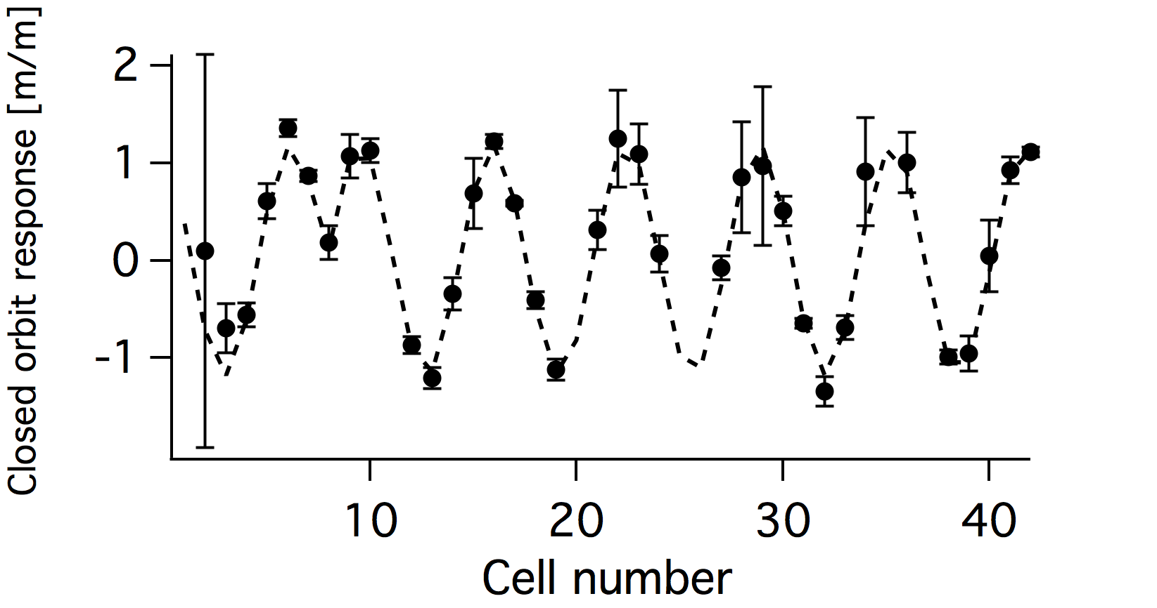
Example: Response matrix measurement
Mathematica script by James Jones automated RM data taking. Python scripts calculate closed orbits and response offline.
F quad no, position, first and last BPM file
F 1 2.5 15-08-2012\21-48-36-145.gz 15-08-2012\21-48-42-229.gz
F 1 1.5 15-08-2012\21-48-47-479.gz 15-08-2012\21-48-53-562.gz
F 2 2.5 15-08-2012\21-49-00-079.gz 15-08-2012\21-49-06-164.gz
F 2 1.5 15-08-2012\21-49-11-414.gz 15-08-2012\21-49-17-514.gz
F 3 2.5 15-08-2012\21-49-21-714.gz 15-08-2012\21-49-27-797.gz
F 3 1.5 15-08-2012\21-49-33-047.gz 15-08-2012\21-49-39-130.gz
F 4 2.5 15-08-2012\21-49-45-430.gz 15-08-2012\21-49-51-530.gz
F 4 1.5 15-08-2012\21-49-54-680.gz 15-08-2012\21-50-00-564.gz
F 5 2.5 15-08-2012\21-50-07-065.gz 15-08-2012\21-50-12-948.gz
F 5 1.5 15-08-2012\21-50-18-415.gz 15-08-2012\21-50-24-281.gz
F 6 2.5 15-08-2012\21-50-30-798.gz 15-08-2012\21-50-36-881.gz
F 6 1.5 15-08-2012\21-50-42-131.gz 15-08-2012\21-50-48-231.gz
F 7 2.5 15-08-2012\21-50-53-481.gz 15-08-2012\21-50-59-565.gz
F 7 1.5 15-08-2012\21-51-05-031.gz 15-08-2012\21-51-10-899.gz
F 8 2.5 15-08-2012\21-51-17-416.gz 15-08-2012\21-51-23-499.gz
F 8 1.5 15-08-2012\21-51-26-449.gz 15-08-2012\21-51-32-533.gz
F 9 2.5 15-08-2012\21-51-39-049.gz 15-08-2012\21-51-45-133.gz
F 9 1.5 15-08-2012\21-51-50-383.gz 15-08-2012\21-51-56-266.gz
F 10 2.5 15-08-2012\21-52-02-783.gz 15-08-2012\21-52-08-867.gz
F 10 1.5 15-08-2012\21-52-14-117.gz 15-08-2012\21-52-20-201.gz
F 11 2.5 15-08-2012\21-52-25-451.gz 15-08-2012\21-52-31-551.gz
F 11 1.5 15-08-2012\21-52-36-801.gz 15-08-2012\21-52-42-884.gz

Slide 14
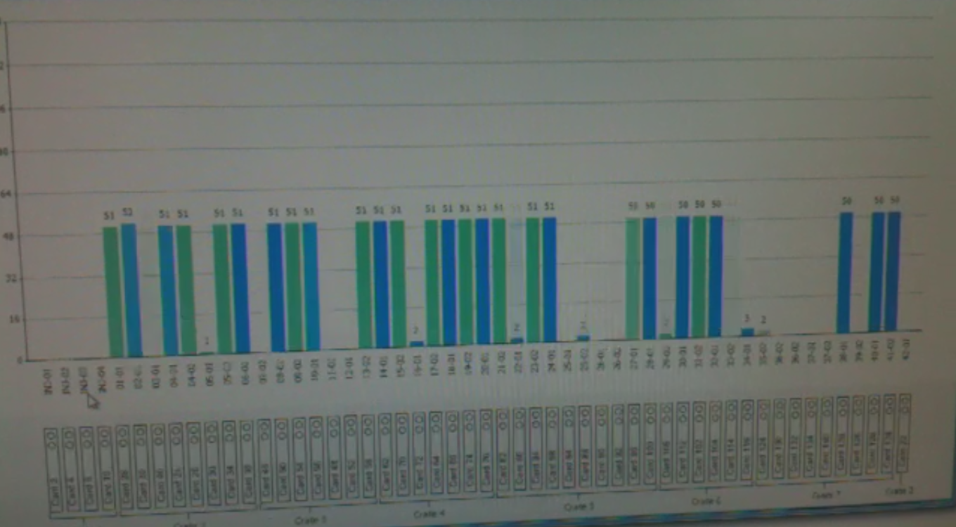
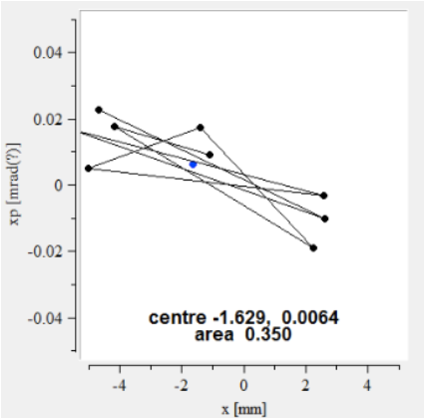
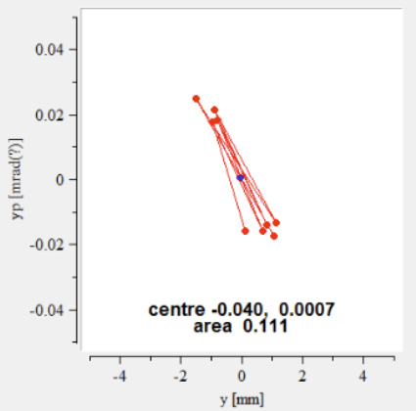
Optimising injection
Vary steering magnets in injection line, septum position and angle, kicker magnet strengths….
Phase space angle calculating using data from two BPMS at either end of long drift
July 2012: Real time turn numbers recorded by each BPM (G. Cox).
+ 2 YAG screens

Slide 15
COD : What we found
COD larger than expected given the magnet misalignments found by survey (later found that the septum stray field the major source in horizontal plane).
COD can be reduced across the momentum range using the available correctors.
Slow variation in coordinate as a function of turn number (beam loading?).
Steady drop in BPM sum signal with turn number – debunching.
For good BPM data we required an injected bunch has enough charge and an orbit that stays close to centre of BPM aperture.

Slide 16
EMMA COD timeline
Date
September 2010 | First COD measurement at single momentum.
January 2011 | Survey & realignment of magnets.
February 2011 | COD not significantly reduced following realignment.
March 2011 | COD measured at multiple momenta.
~April 2011 | Find septum stray field is major source in horizontal plane.
June 2011 | Local correction of septum stray field fails to significantly reduce COD.
~August 2011 | Begin switch to EPICS system.
March 2012 | Measurement of stray field in VC.
May 2012 | Begin response matrix measurements.
~July 2012 | Improved EPICS data acquisition.
December 2012 | Reduction in COD over momentum range demonstrated.

Slide 17
Example COD measurement

Slide 18
COD due to
We hoped that realigning the magnets would reduce the COD substantially …

Slide 19
COD comparison before and after realignment
..but a large COD remained

Slide 20
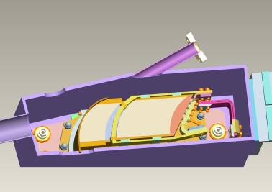

Slide 21
Predicted COD due to septum stray field
Note: Beam is always 12.5 MeV/c. Scale quad strengths to simulate various momenta.

Slide 22
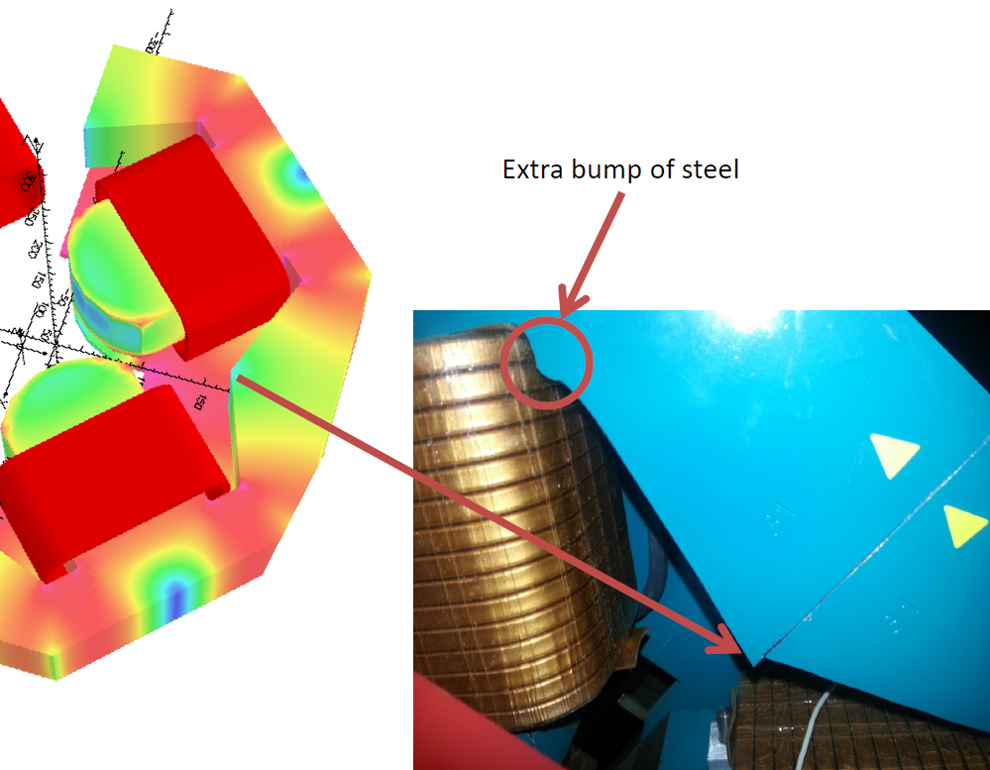
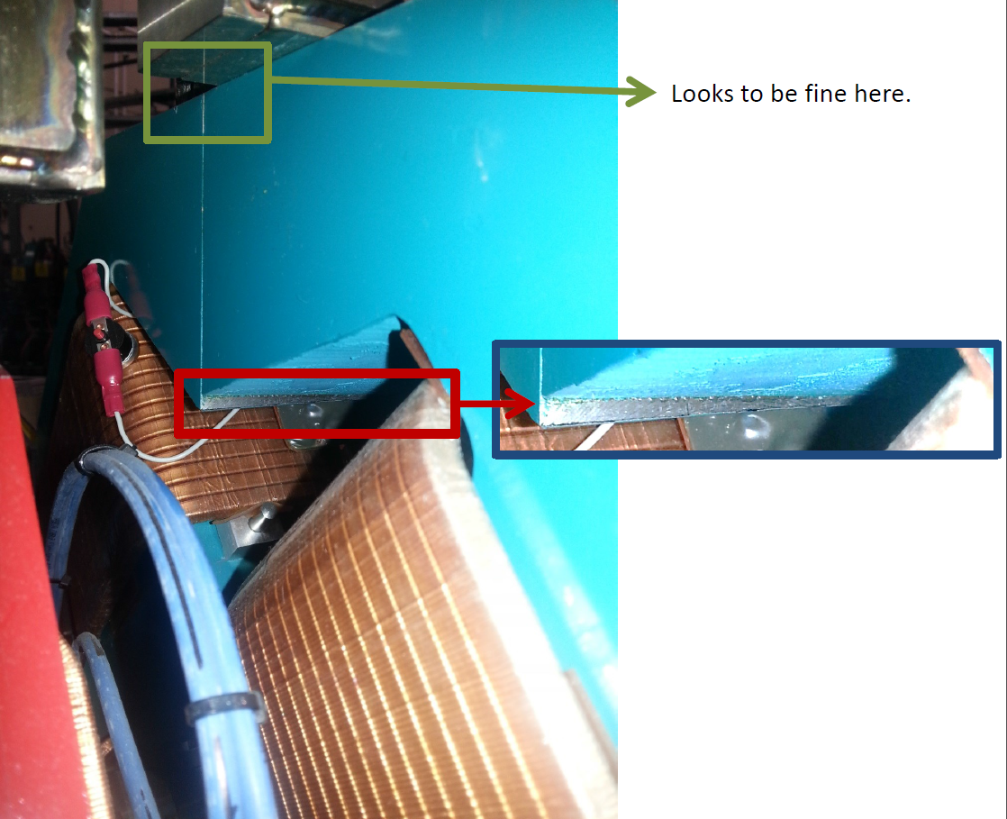
Magnet uniformity
Didn't have a great model for the magnets including the effects of the iron, and we had a lot of magnet-to-magnet variation.
Discovered by Chris Edmonds after end of operations.
C. Edmonds

Slide 23
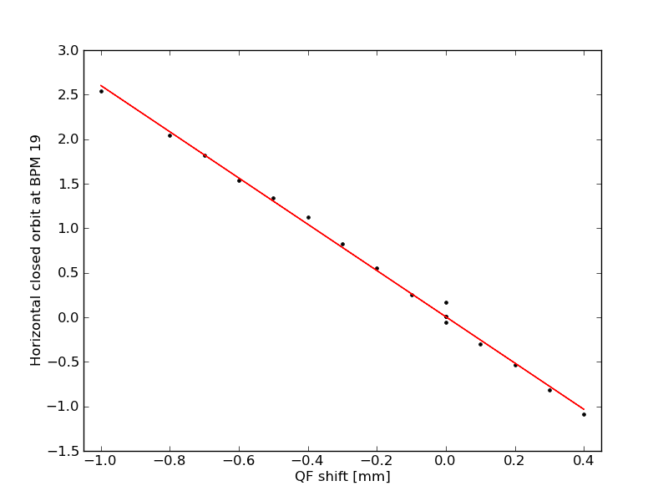
Closed orbit response at BPM
Choose to shift F quad in cell 14 increments of 0.1mm*. (Corresponds to 0.7 mT dipole change per increment)
Covered range -1 mm to +0.4mm
Fewer outward shifts as close to limit of QF allowed movement.
BPM cell 19
n_{cut}=10
slope = -2.60
R-squared = 0.997

Slide 24
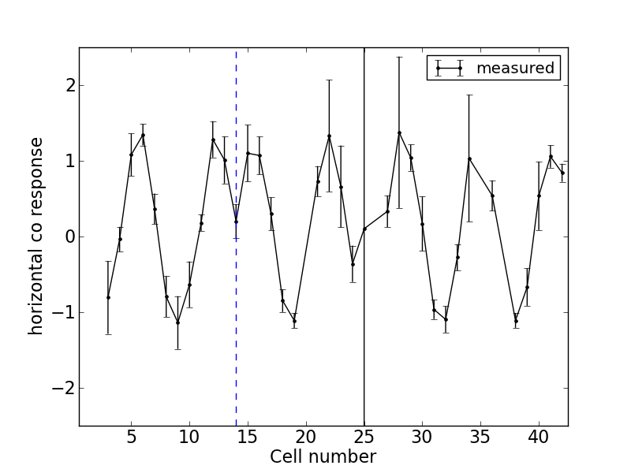
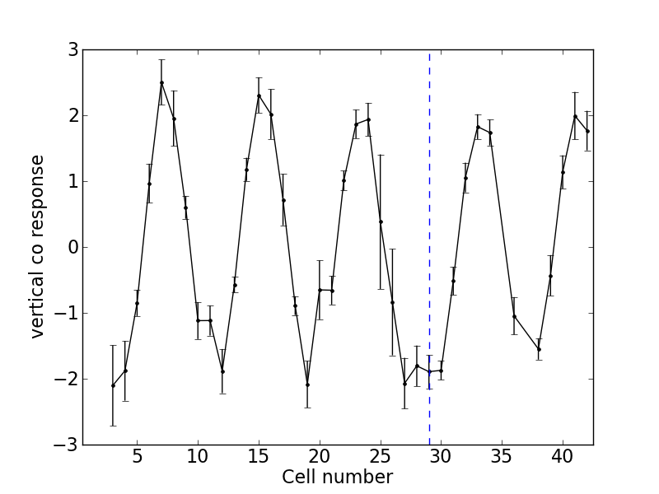
Response matrix measurement
Look at response at each BPM due to a single magnet shift.
Can see characteristic “dip” at the corrector location (depends on fractional tune).
Error bars obtained by adding in quadrature the standard deviation of closed orbit measurement over shots.
D-14 response
VC-29 response
Horizontal co response to D in cell 14 shift
Vertical co response to VC in cell 29

Slide 25
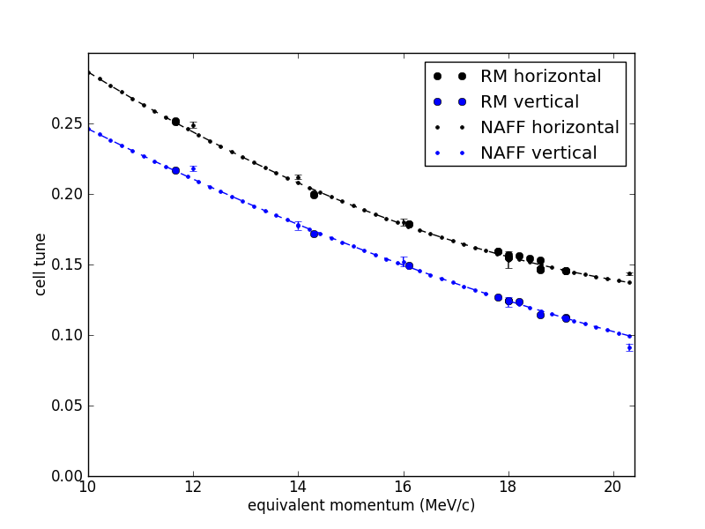
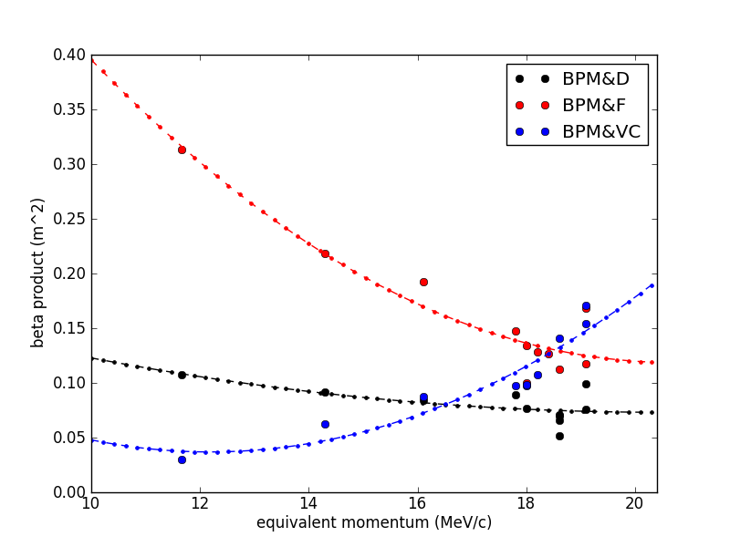
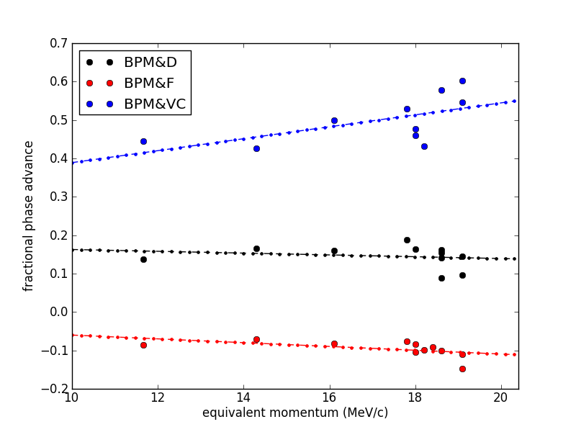
Fit RM measurements
Fit measured RM using downhill simplex algorithm to find product of β, phase advance between corrector and BPM and tune.

Slide 26
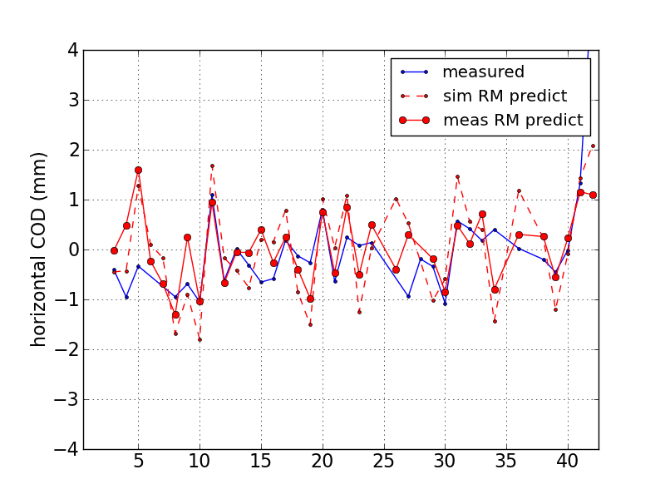
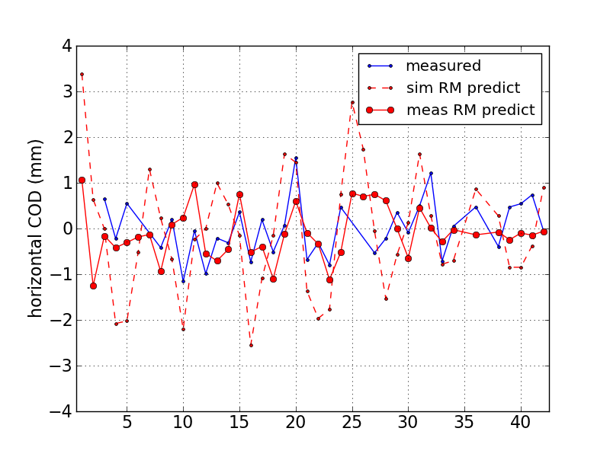
Measured vs simulated RM
14.3 MeV/c
Sim RM tune: 8.5
Meas RM tune: 8.484
16.1 MeV/c
Sim RM tune: 7.5
Meas RM tune: 7.48
Simulated response matrix generated by Zgoubi with quadrupole currents adjusted to match measured tune.

Slide 28
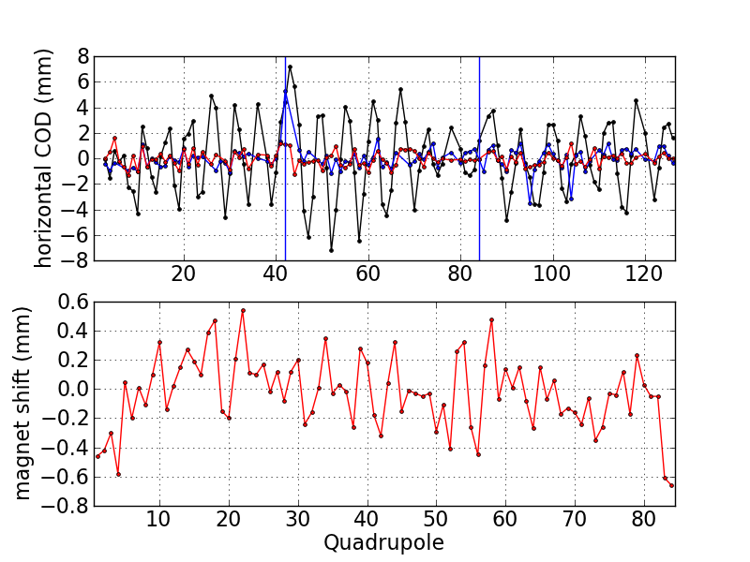
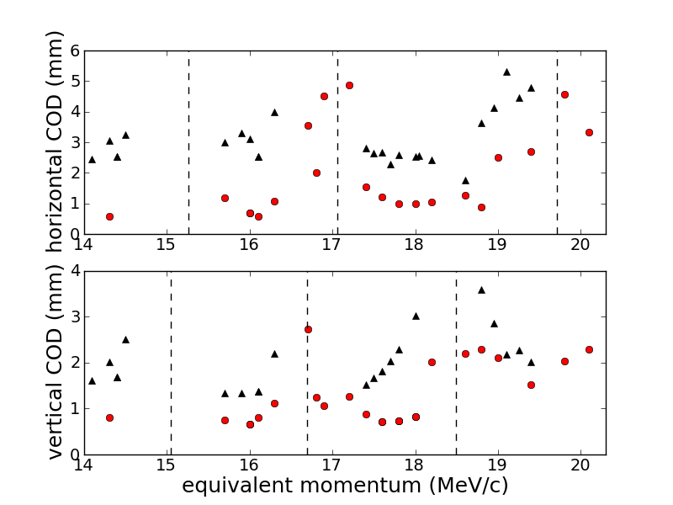
COD multi-p correction – experimental result.
14.3 MeV/c
16.1 MeV/c
18.0 MeV/c
COD profiles at three momenta
COD rms versus momentum

Slide 29
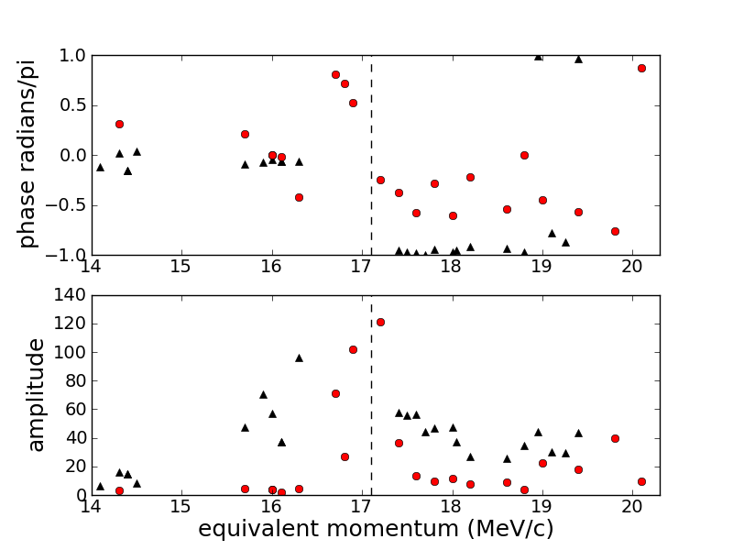
Harmonics before & after correction
Take FFT of COD profile to find strengths and phases of harmonics.
Horizontal harmonic 7.
Black: before correction.
Red: after correction.

Slide 30
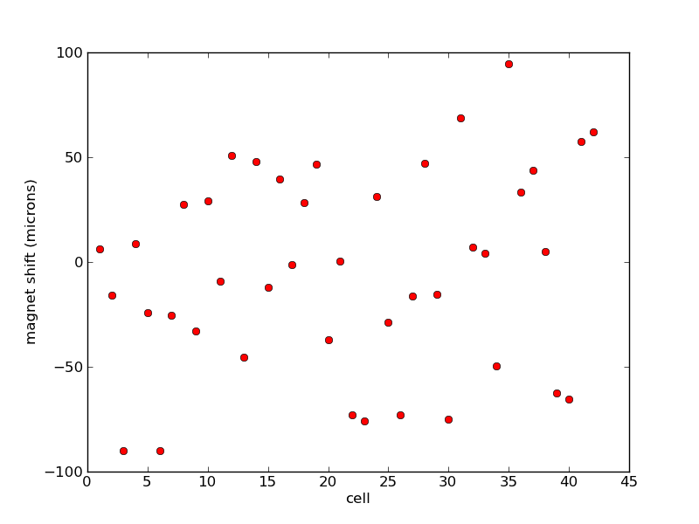
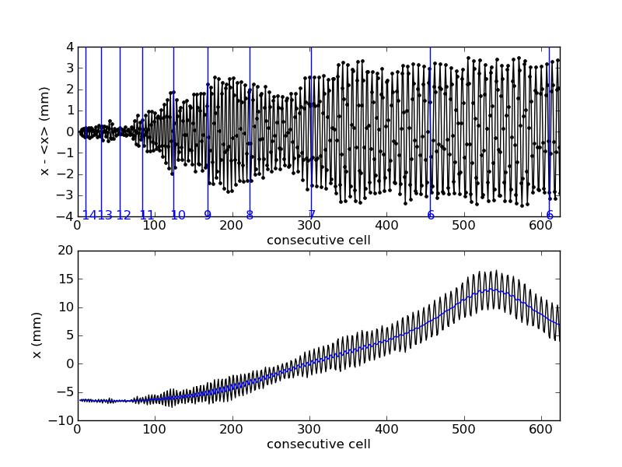
Accelerated orbit distortion
Assume D magnets randomly misaligned with σ of 50 microns. Accelerate from 10-20 MeV in ~14 turns.
21 cavities included to reduce synchro-beta effect.
No obvious pattern in distortion associated with integer tunes.
Misalignments
Distortion

Slide 31
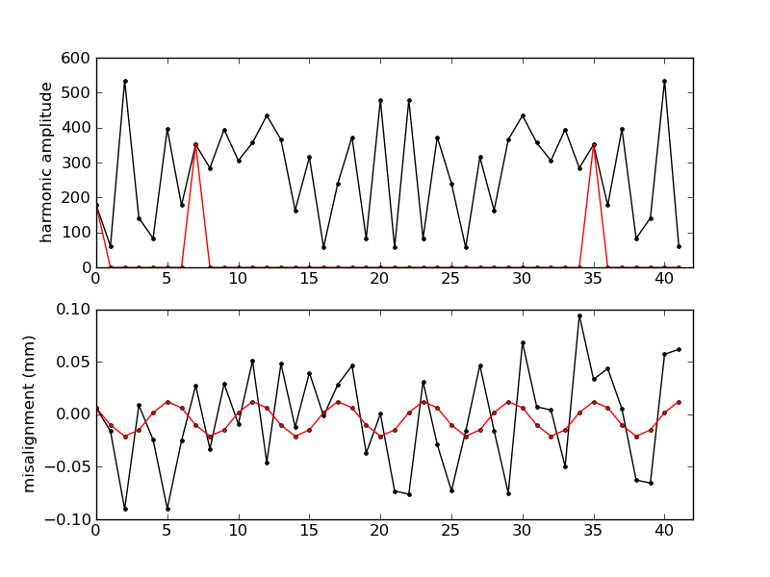
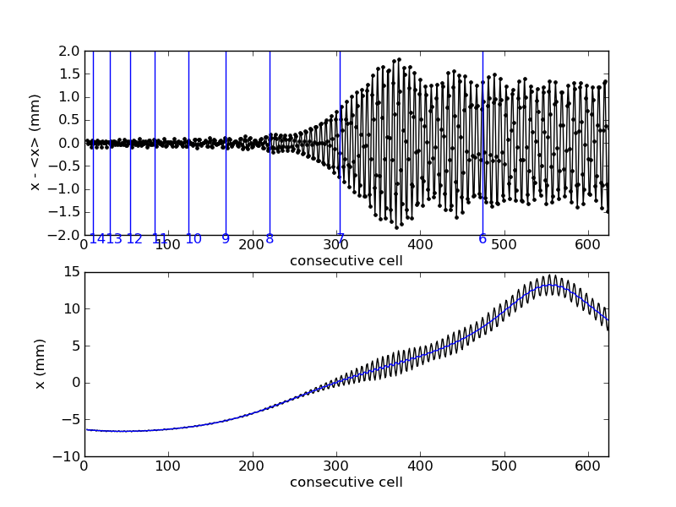
Isolate effect of harmonic of misalignment
Remove all but one harmonic from misalignments.
FFT > set other components to zero > Inverse FFT
Can now see coherent growth in distortion in vicinity of integer tune.
Effect of harmonic 7 shown below.
FFT & MIsalignments
Distortion

Slide 32
Correcting harmonics over momentum range
Correcting each harmonic of COD (left) also corrects the accelerated orbit (right).

Slide 33
Issues
Early measurements were very time consuming before EPICS came online.
It was difficult to inject at low momenta. Closed orbit displaced inwards from expected positions. Saturation effects in iron at high currents complicated equivalent momentum method of simulating low momentum injection.
The source of vertical COD not identified.
Significant differences in magnets from one cell to the next were discovered by Chris Edmonds after end of operations (e.g. distance from magnet to clamp plate).

