Slide 1
Modelling FFAGs in OPAL
S. L. Sheehy
FFAG’17, 10/9/17
Thanks to C. Rogers and A. Adelmann for much of the content of this talk!

Slide 2
OVERVIEW
Introduction to OPAL
Previous FFAG studies
Recent updates for FFAGs – thanks to C. Rogers
  Flexible geometry
  Variable frequency RF
  Spiral FFAG magnet model
  Multipole model in OPAL
Future prospects – thanks to A. Adelmann

Slide 3
OPAL: Open-Source Parallel Accelerator Library
Notes:
OPAL is an open-source community code shepherded by Andreas Adelmann at PSI

Slide 5
There are various ‘flavours’ of OPAL
… we’ve mostly worked with OPAL-CYCL

Slide 6
OPAL-CYCL has been benchmarked on PSI ring

Slide 7
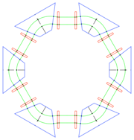
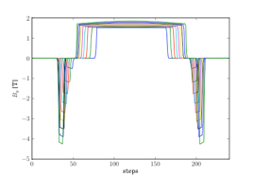
Previous Studies: 1 GeV ADS ring (Johnstone)

Slide 8
How to model?
We used to use `CYCLOTRONS’ mode (same as PSI ring)
This needed a 3D, 360 degree field map!
Only allowed fixed frequency RF
  So only single energy studies….
  (or serpentine channel)

Slide 9
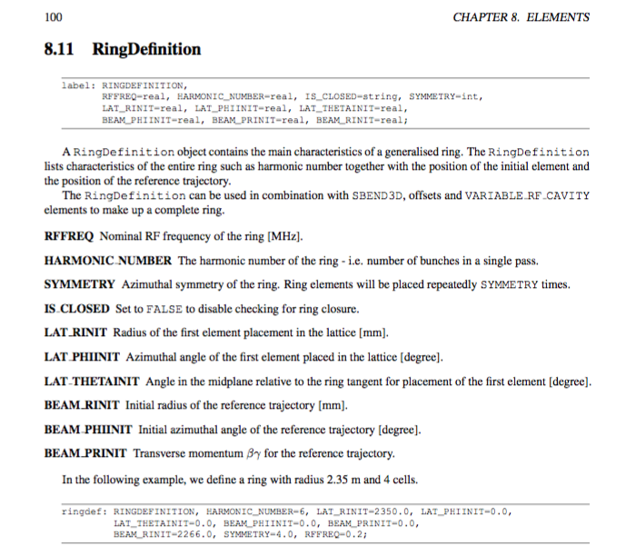
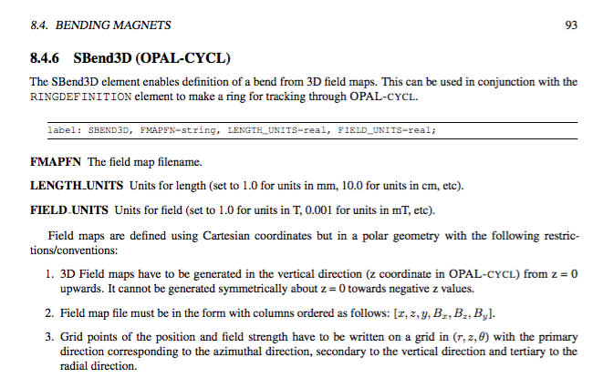
Variable RF and flexible geometry modules
RINGDEFINITION and SBEND3D
http://amas.web.psi.ch/docs/opal/opal_user_guide.pdf

Slide 10
Dec 2016 – ‘Ideal’ KURRI-FFAG
Previous benchmarking done using ‘real’ KURRI-FFAG field maps. In this case, we wanted a simple model to study dynamics
Generated 3D field maps using Francois’ new module in ZGOUBI
Imported to OPAL, find closed orbits & check with single particle tracking
Debugged some OPAL issues to allow progress

Slide 11
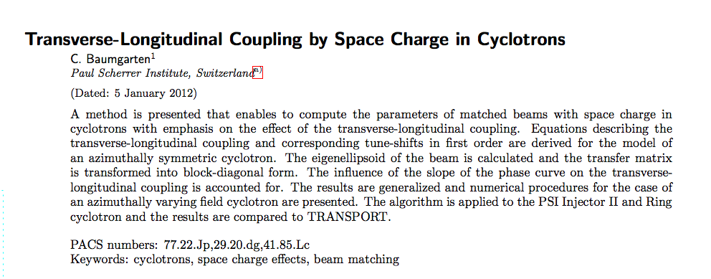
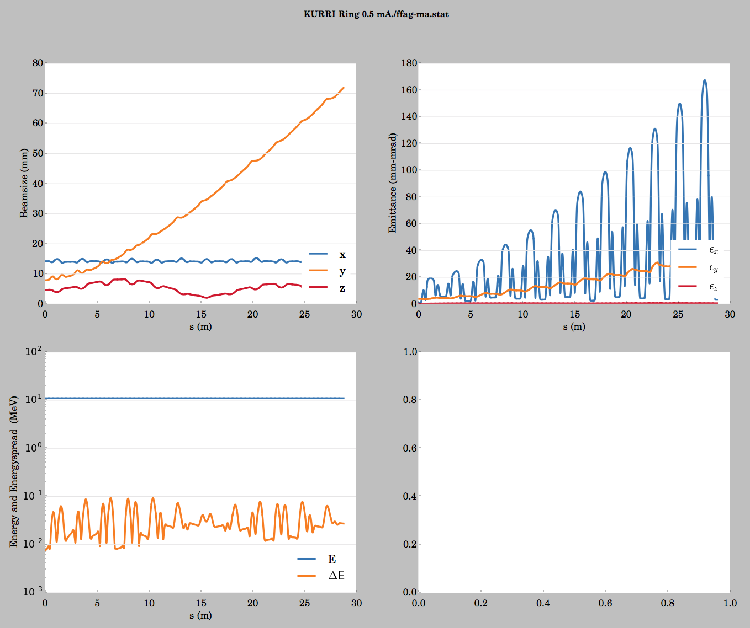
Matching with space charge
In current OPAL, model to match coupled in x-z with space charge. We ran this on the FFAG (as a test)… and it seemed to work
Implementing synchrotron-like matching would be useful too!

Slide 12
KURRI-FFAG modelling
Next step: update to SBEND3D model (using Chris’ modules) and incorporate variable frequency RF…
Continue tracking & understand matching/SC modelling in FFAG
Then re-introduce ‘real’ field maps of KURRI-FFAG

Slide 13
What about SPIRAL FFAGs?
C. Rogers, STFC/ISIS/RAL
New spiral sector magnet model in OPAL
  Fairly general fringe field model to arbitrary order
  Enable FFAG design/optimisation plus usual OPAL space charge model

Slide 14
Magnet model setup…

Slide 26
OPAL releases
Previous work was done mostly in OPAL 1.3-1.4
1.6 is the current release…
This has variable RF, SBEND3D geometry,
Does not yet have the SPIRAL FFAG magnet model or MULTIPOLE as they are currently still in testing (C. Rogers)

Slide 27
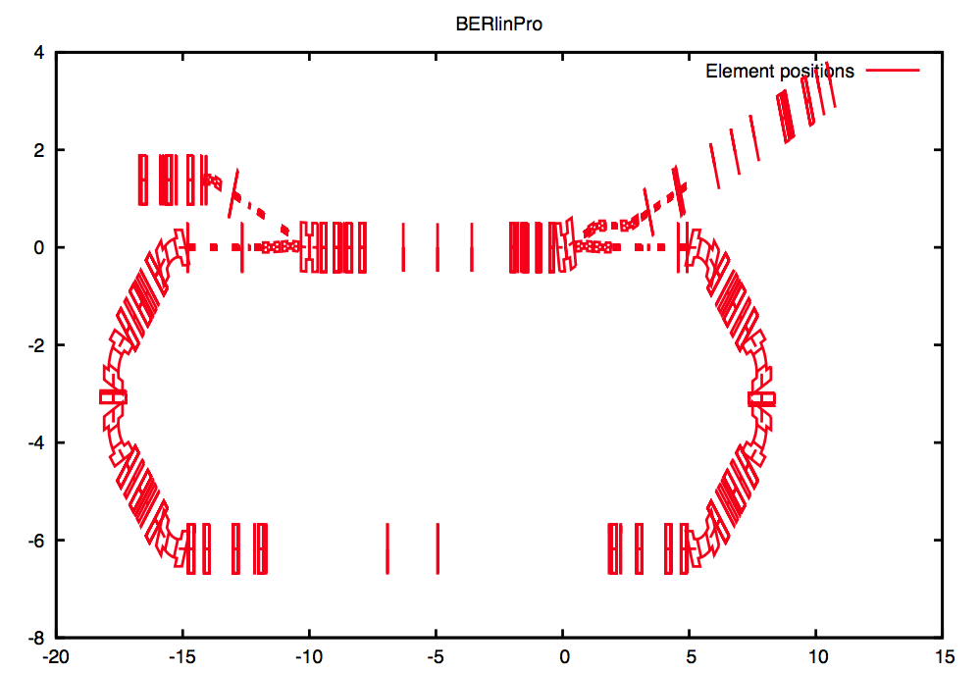
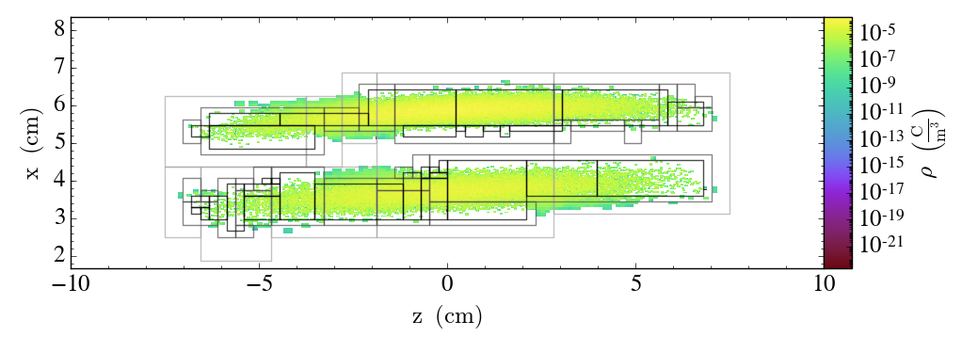
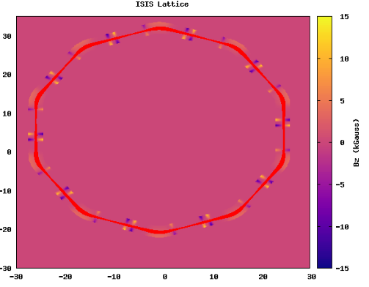
OPAL V. 2.0 (first release 1Q 2018)
Full 3D placement of Elements
  motivated by BerlinPro (ERL) requirements
  overlapping fringe fields
Multiobjective Optimizer integrated in OPAL
Adaptive Mesh Refinement (PhD. project)
  neighboring bunches
  more resolution in space charge calc.
Multipoles in curved coordinate system incl. fringe fields
All Information: https://gitlab.psi.ch/OPAL/src/wikis/home
  all information Wiki based (incl. Manual)
A. Adelmann

Slide 28
Summary
FFAGs are very demanding for simulation with full 3D space charge
However, in OPAL many of the tools are now in place
Mainly thanks to Chris Rogers & Andreas Adelmann since 2012
OPAL is a free, collaborative and powerful simulation toolkit.
Let’s get to work and use it further!

Slide 29
Thanks
suzie.sheehy@physics.ox.ac.uk

Slide 30
Extra slides…

