Slide 1
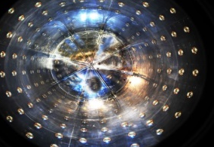
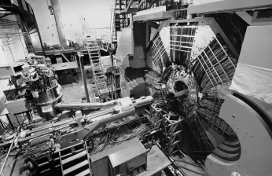
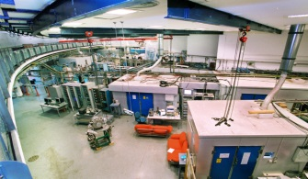
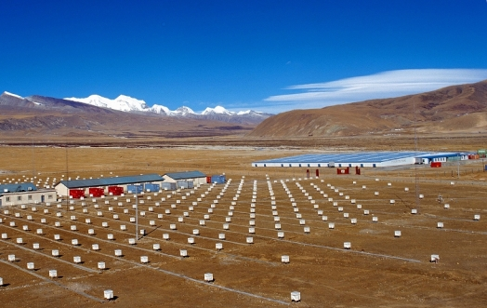
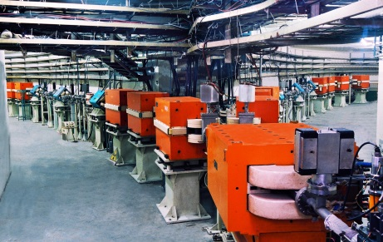
Particle Physics in China
Yifang Wang
Institute of High Energy Physics, Beijing
BNL, April 23, 2025

Slide 2
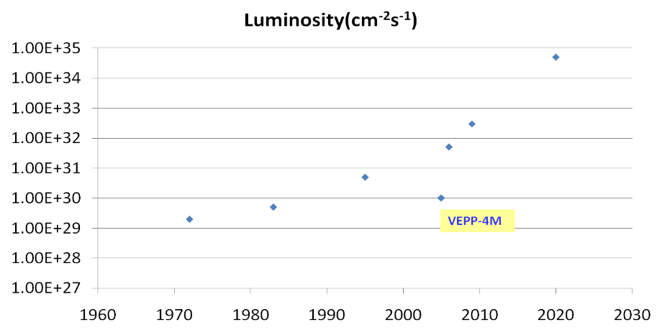



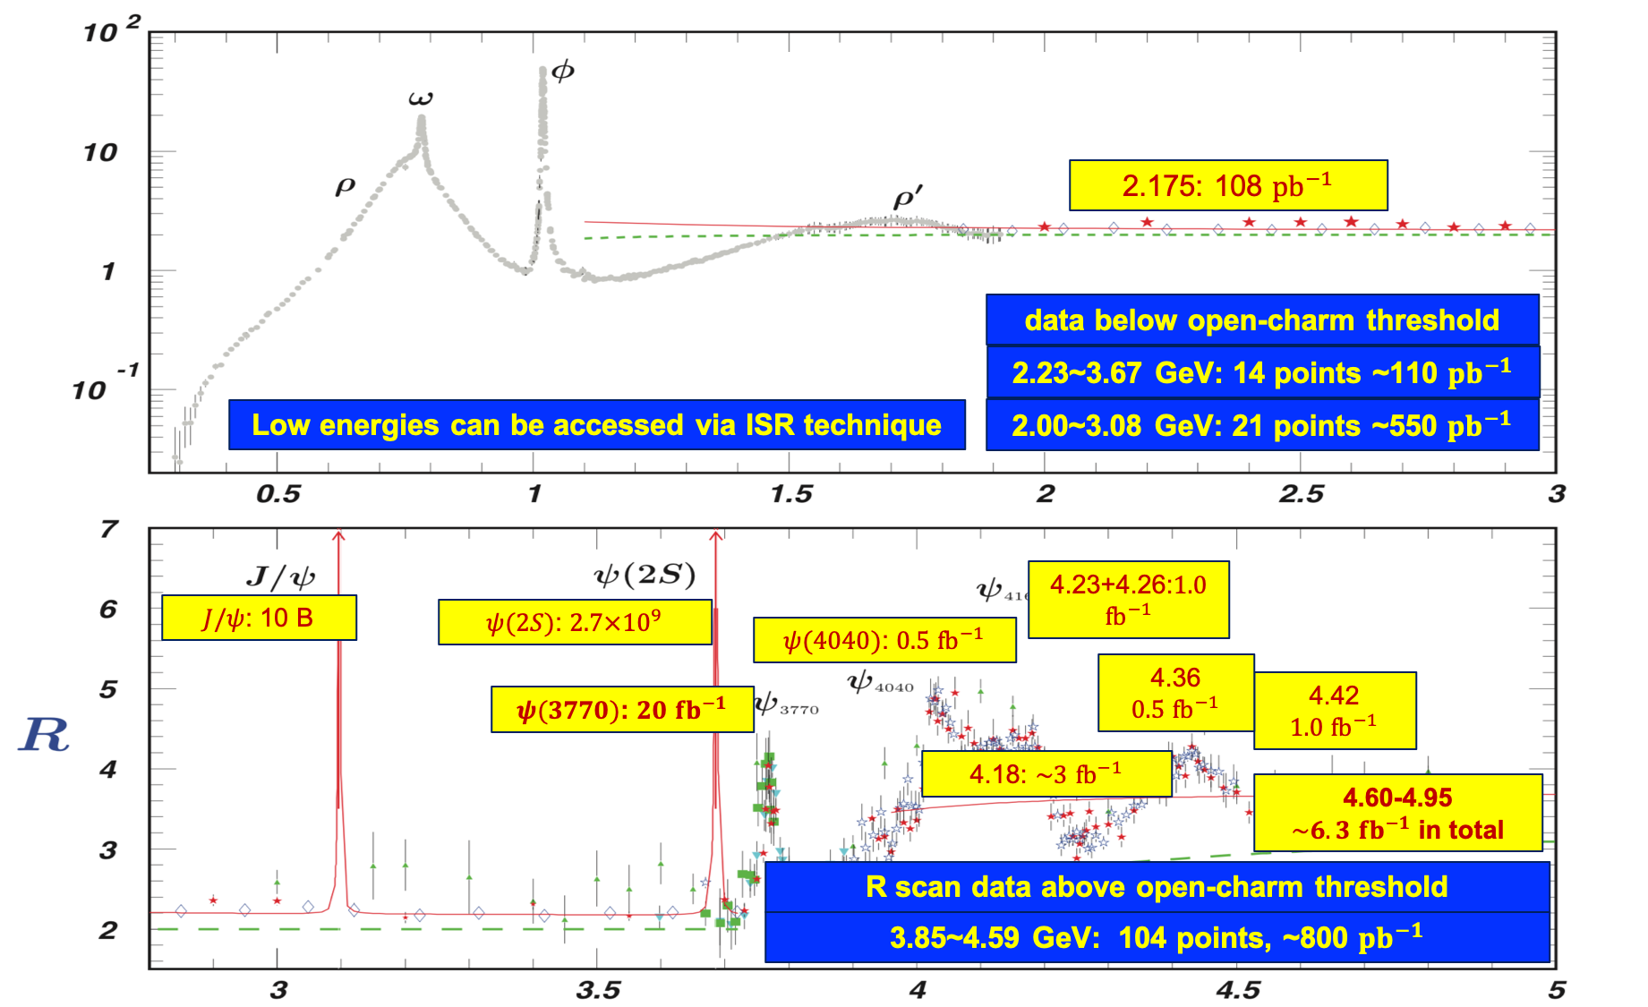


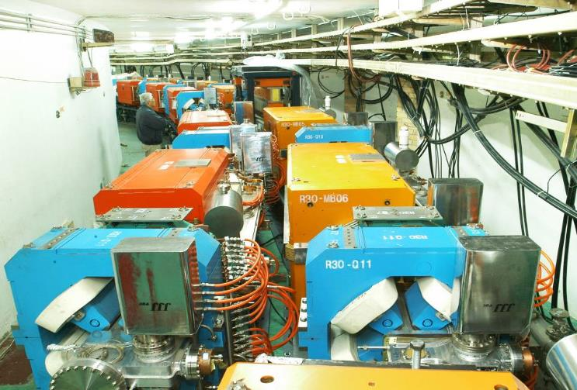
BEPC/BES: The Start of HEP in China
Construction in 1984-1988, upgraded to BEPCII/BESIII in 2004-2008
Reached highest luminosity of 1.1×10³³cm⁻²s⁻¹
e⁺e⁻ colliders at 2-5 GeV
BEPCII
DORIS I
BEPC
CESRc
SPEAR
ADONE
2

Slide 3
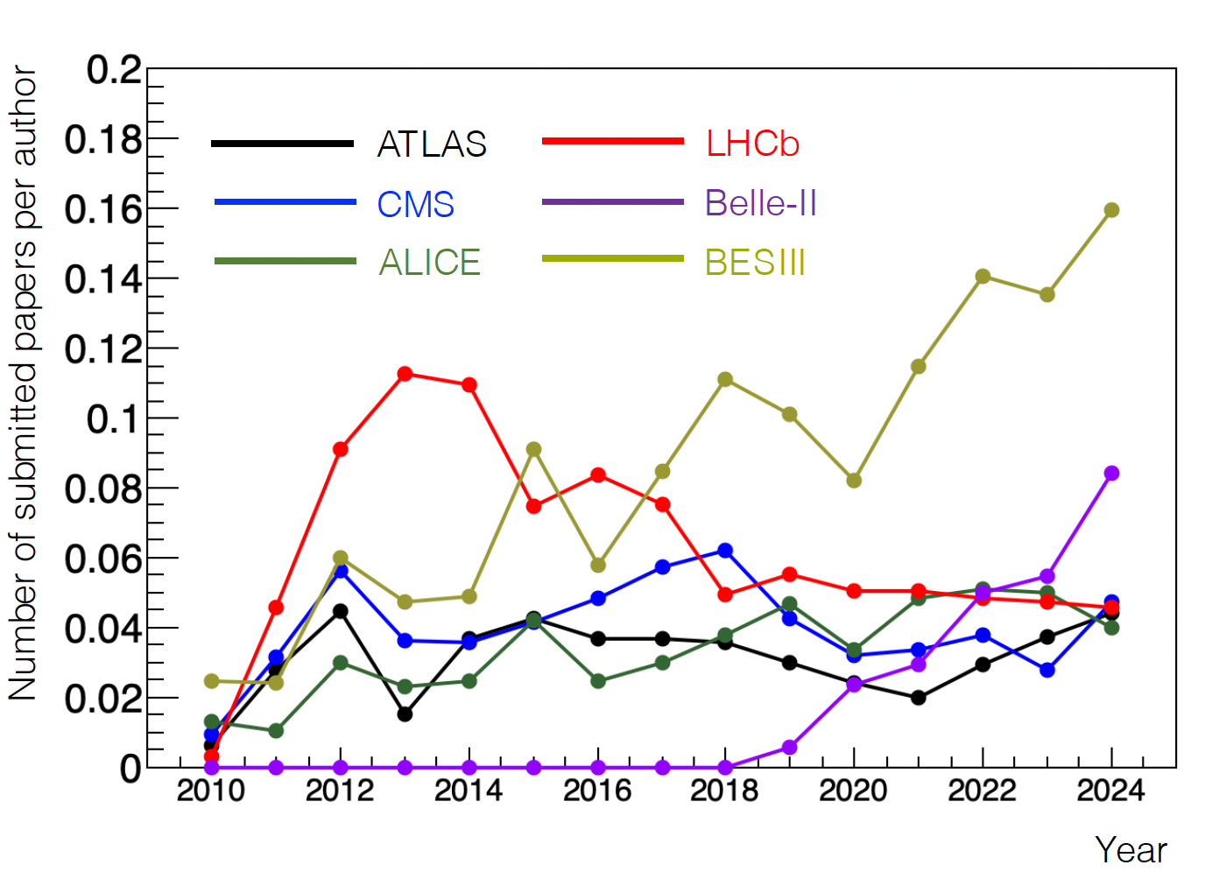
BEPCII/BESIII: Fruitful Results
A total of ~50 fb⁻¹ collected in 1.84-4.95 GeV COM
Published >660 papers, >125 at PRL
Great physics results from high statistics and high quality data with low backgrounds: 30 New hadrons discovered at BESIII
3

Slide 4
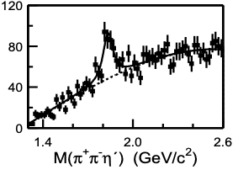
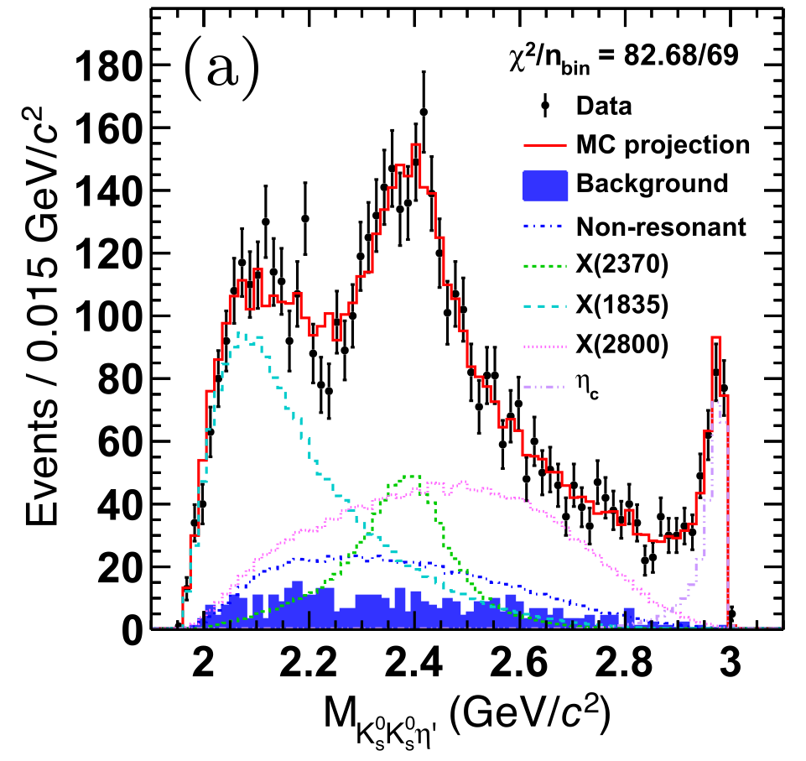
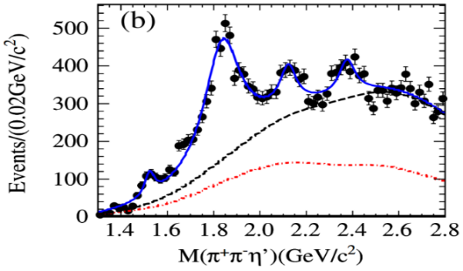
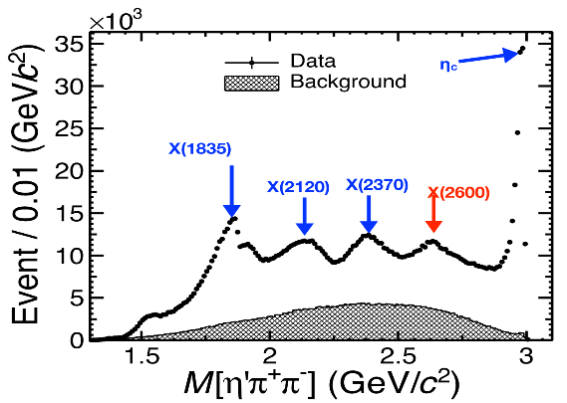
Example: Hadron Spectroscopy
X(1835) from J/ψ decays
58 million J/ψ
Structure
PRL 95(2005) 262001
PRL 132 (2024)181901
225 million J/ψ
More structures
PRL106(2011)072002
A particle made of “force” (gluons)
X(2370) with J^{pc} = 0⁻⁺ as a glueball:
  Mass and J^{PC} consistent with LQCD predictions
  Produced in a gluon-rich process of J/ψ decays, in consistent with LQCD
  Decay: no dominant decay, flavor symmetric, very similar to η_{c} (decay via gluons)
10 billion J/ψ
Fine structures
PRL129 (2022) 042001

Slide 5



BESIII collaboration
Europe (17/115)
Germany (6): Bochum University,
GSI Darmstadt, Helmholtz Institute Mainz, Johannes Gutenberg University of Mainz, Universitaet Giessen,University of Münster
Italy (3): Ferrara University, Frascati, University of Torino
Netherlands (1):KVI/University of Groningen
Poland (1)National Centre for Nuclear Research
Russia (2): Budker Institute of Nuclear Physics, JINR
Sweden (1):Uppsala University
Turkey (1):Turkish Accelerator Center Particle Factory Group
UK (2): University of Manchester, University of Oxford
Asia (6/10)
Pakistan (2): COMSATS Institute of Information Technology
University of the Punjab, University of Lahore
Mongolia (1): Institute of Physics and Technology
Korea (1): Chung-Ang University
India (1): Indian Institute of Technology madras
Thailand (1): Suranaree University of Technology
USA(4/8)
Carnegie Mellon University
Indiana University
University of Hawaii
University of Minnesota
China (58/367)
Institute of High Energy Physics (146), other units(221): Beijing Institute of Petro-chemical Technology, Beihang University,
China Center of Advanced Science and Technology, Fudan University,
Guangxi Normal University, Guangxi University,
Hangzhou Normal University, Henan Normal University,
Henan University of Science and Technology,
Huazhong Normal University, Huangshan College, Hunan University,
Hunan Normal University, Henan University of Technology
Institute of modern physics, Jilin University, Lanzhou University, Liaoning Normal University, Liaoning University, Nanjing Normal University, Nanjing University, Nankai University, North China Electric Power University,
Peking University, Qufu normal university, Shanxi University,
Shanxi Normal University, Sichuan University, Shandong Normal University,
Shandong University, Shanghai Jiaotong Univeristy, Soochow University,
South China Normal University, Southeast University, Sun Yat-sen University,
Tsinghua University, University of Chinese Academy of Sciences, University of Jinan, University of Science and Technology of China,
University of Science and Technology Liaoning,
University of South China, Wuhan University, Xinyang Normal University,
Zhejiang University, Zhengzhou University,YunNan University , China University of Geosciences
South America (1/1)
Chile: University of Tarapaca
~600 members
(more than 130 from outside of China)
From 84 institutions in 17 countries
Notes:
The Collaboration is well organized fully following the international practice
for large experiments

Slide 6
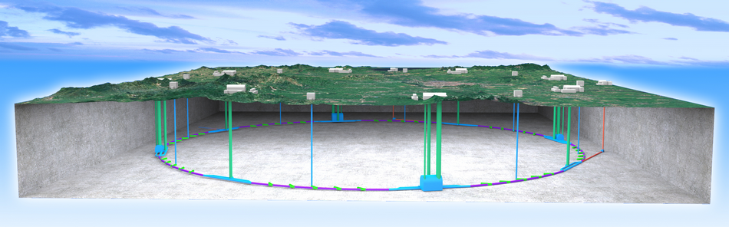
Higgs: CEPC
Since 2005, we were thinking about the next machine after BEPC
After its discovery, we realized that Higgs is the best portal for new physics and for the future of HEP
The idea of a Circular e+e- Collider(CEPC) followed by a possible Super proton-proton collider(SPPC) was proposed in Sep. 2012, and reported in Oct. 2012 at Fermilab during the workshop: “Higgs Factories 2012”
It quickly gained momentum in China and in the world

Slide 7
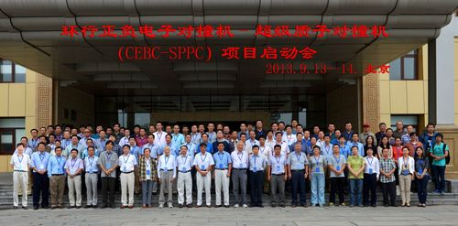
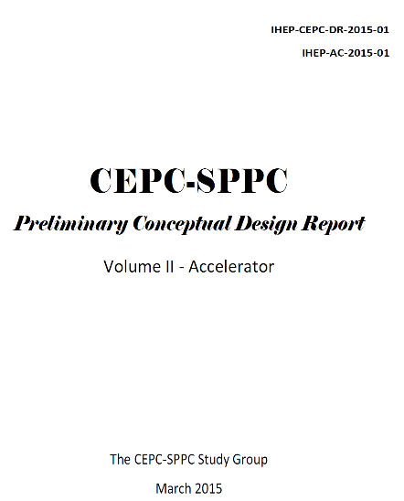
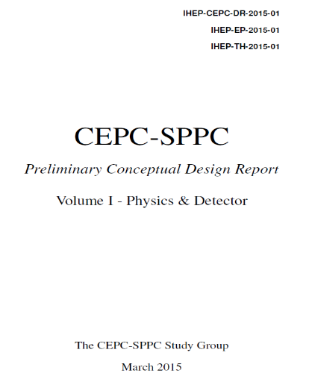
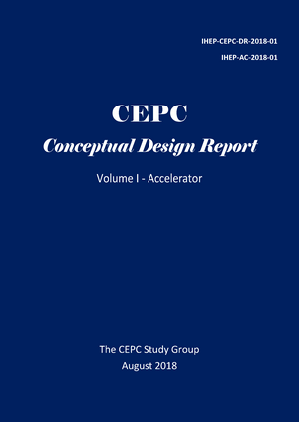
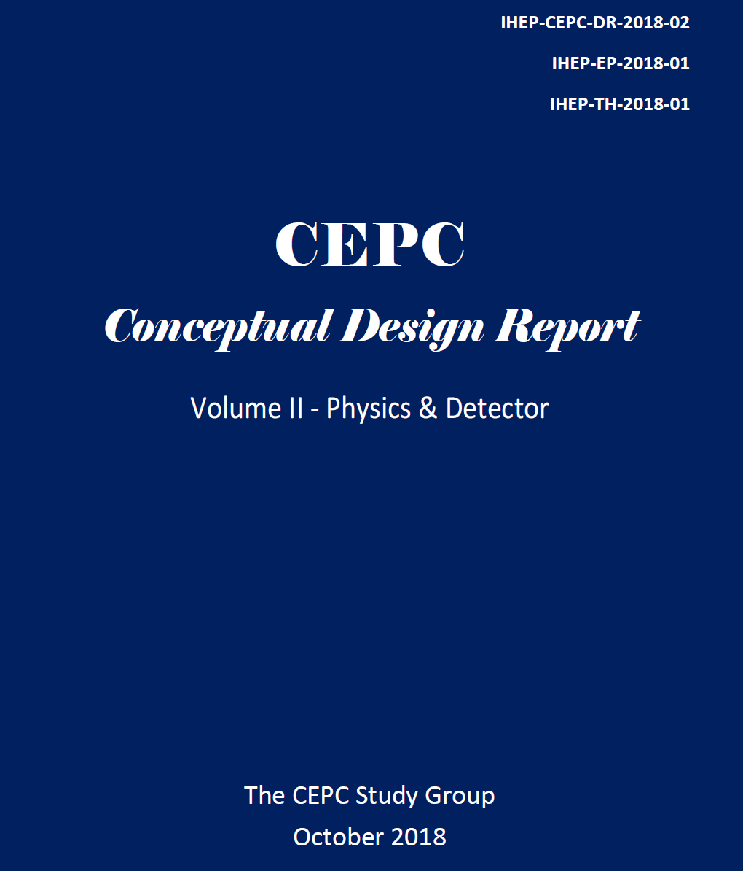
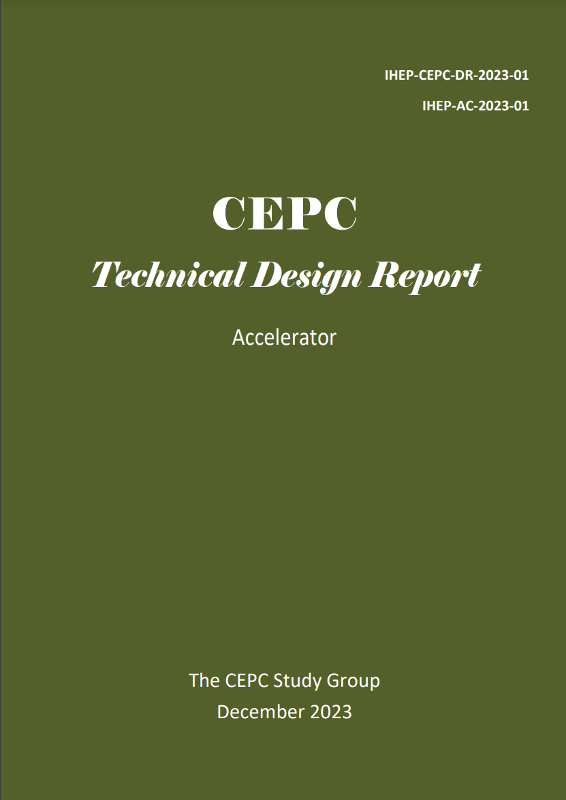
From Kick-off to TDR
2013
2015
2018
2023
http://cepc.ihep.ac.cn

Slide 8
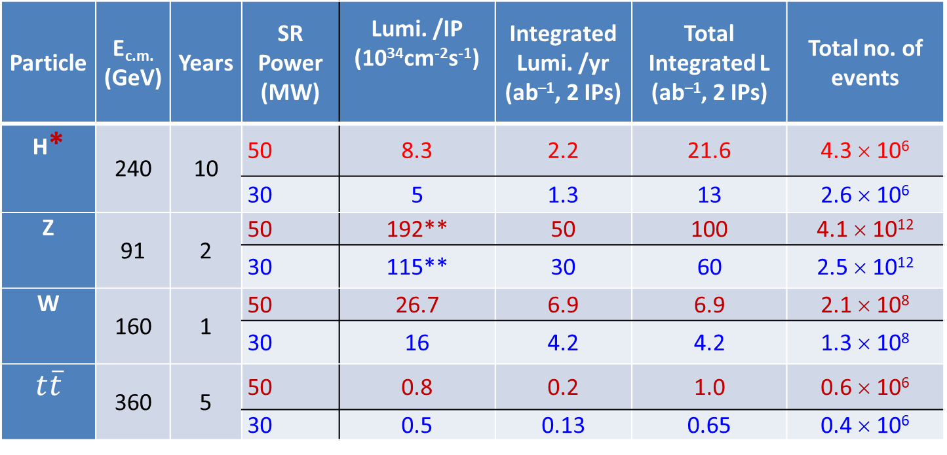
Operation Plan
Particle | E_{c.m.} (GeV) | Years | SR Power (MW) | Lumi. /IP (10³⁴cm⁻²s⁻¹) | Integrated Lumi. /yr (ab^{–1}, 2 IPs) | Total Integrated L (ab^{–1}, 2 IPs) | Total no. of events
H* | 240 | 10 | 50 | 8.3 | 2.2 | 21.6 | 4.3 × 10⁶
 |  |  | 30 | 5 | 1.3 | 13 | 2.6 × 10⁶
Z | 91 | 2 | 50 | 192** | 50 | 100 | 4.1 × 10¹²
 |  |  | 30 | 115** | 30 | 60 | 2.5 × 10¹²
W | 160 | 1 | 50 | 26.7 | 6.9 | 6.9 | 2.1 × 10⁸
 |  |  | 30 | 16 | 4.2 | 4.2 | 1.3 × 10⁸
$$t\overline{t}$$ | 360 | 5 | 50 | 0.8 | 0.2 | 1.0 | 0.6 × 10⁶
 |  |  | 30 | 0.5 | 0.13 | 0.65 | 0.4 × 10⁶
* Higgs is the top priority. The CEPC will commence its operation with a focus on Higgs.
** Detector solenoid field is 2 Tesla during Z operation, 3Tesla for all other energies.
*** Calculated using 3,600 hours per year for data collection.

Slide 9
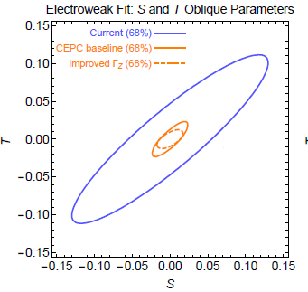
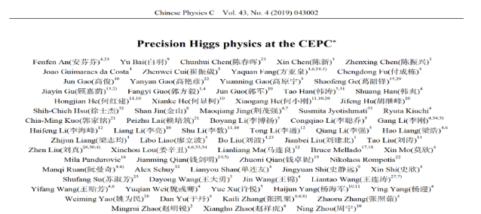
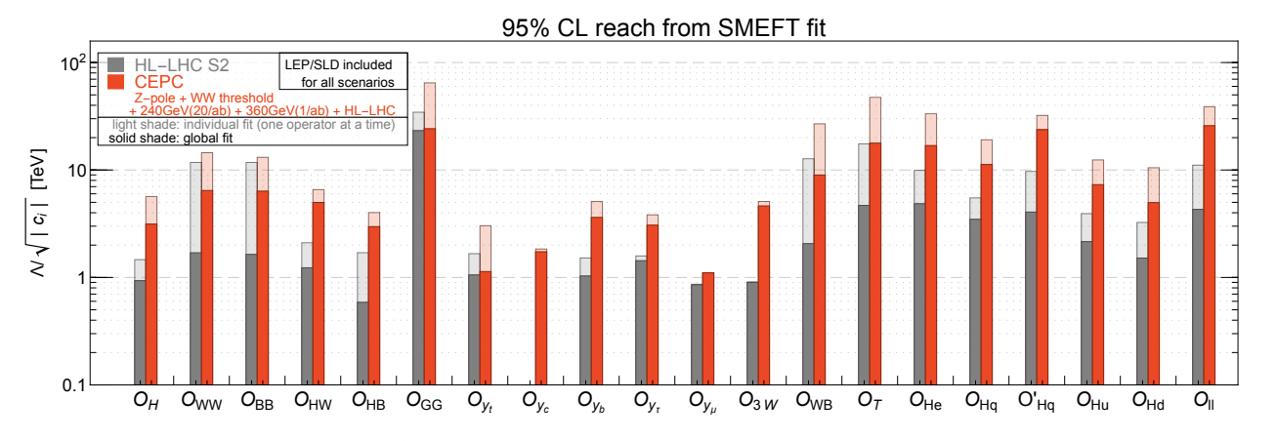
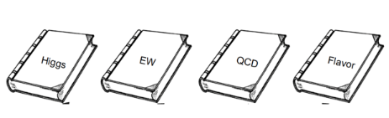
Scientific Objectives:
“Discovery + Precision Measurement”
Higgs coupling measurement can be improved by orders of magnitude
Direct and indirect probe to new physics up to 10 TeV, ×10 higher then HL-LHC
Electroweak measurement can be improved by a large factor
Physics white papers published and to be published

Slide 10
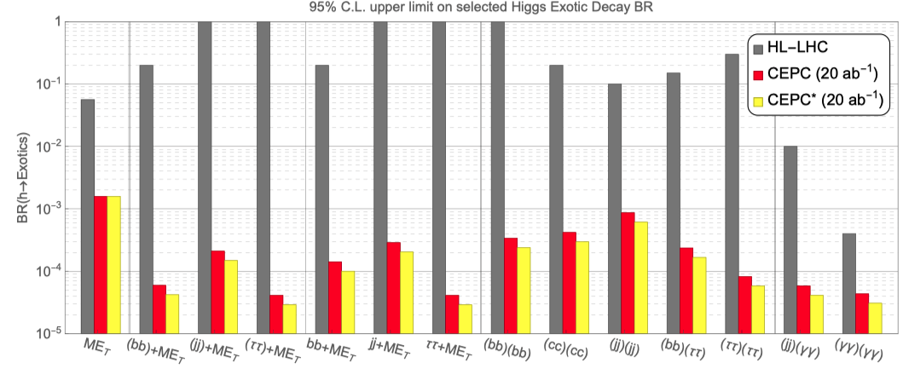
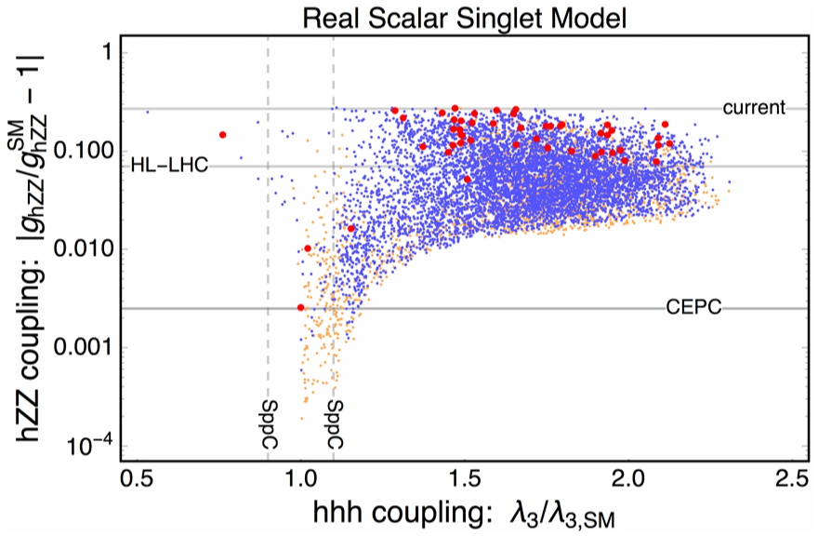
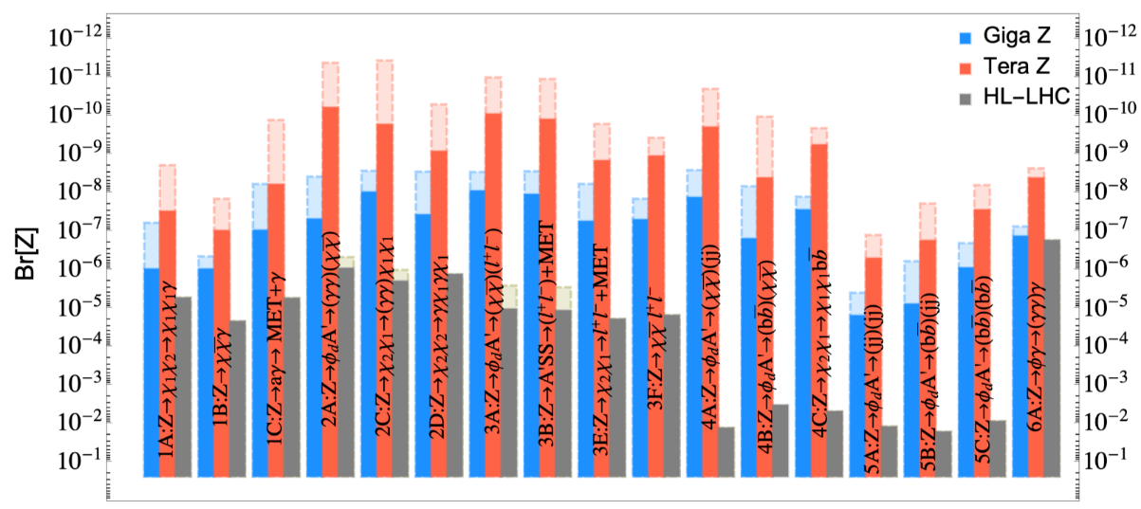
Higgs: Portal to New Physics
CDR 5.6 ab⁻¹
CDR 5.6 ab⁻¹
1712.07237

Slide 11
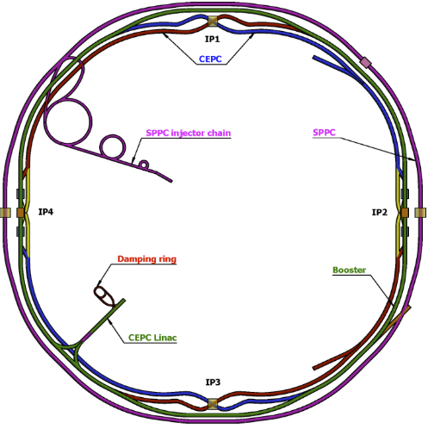
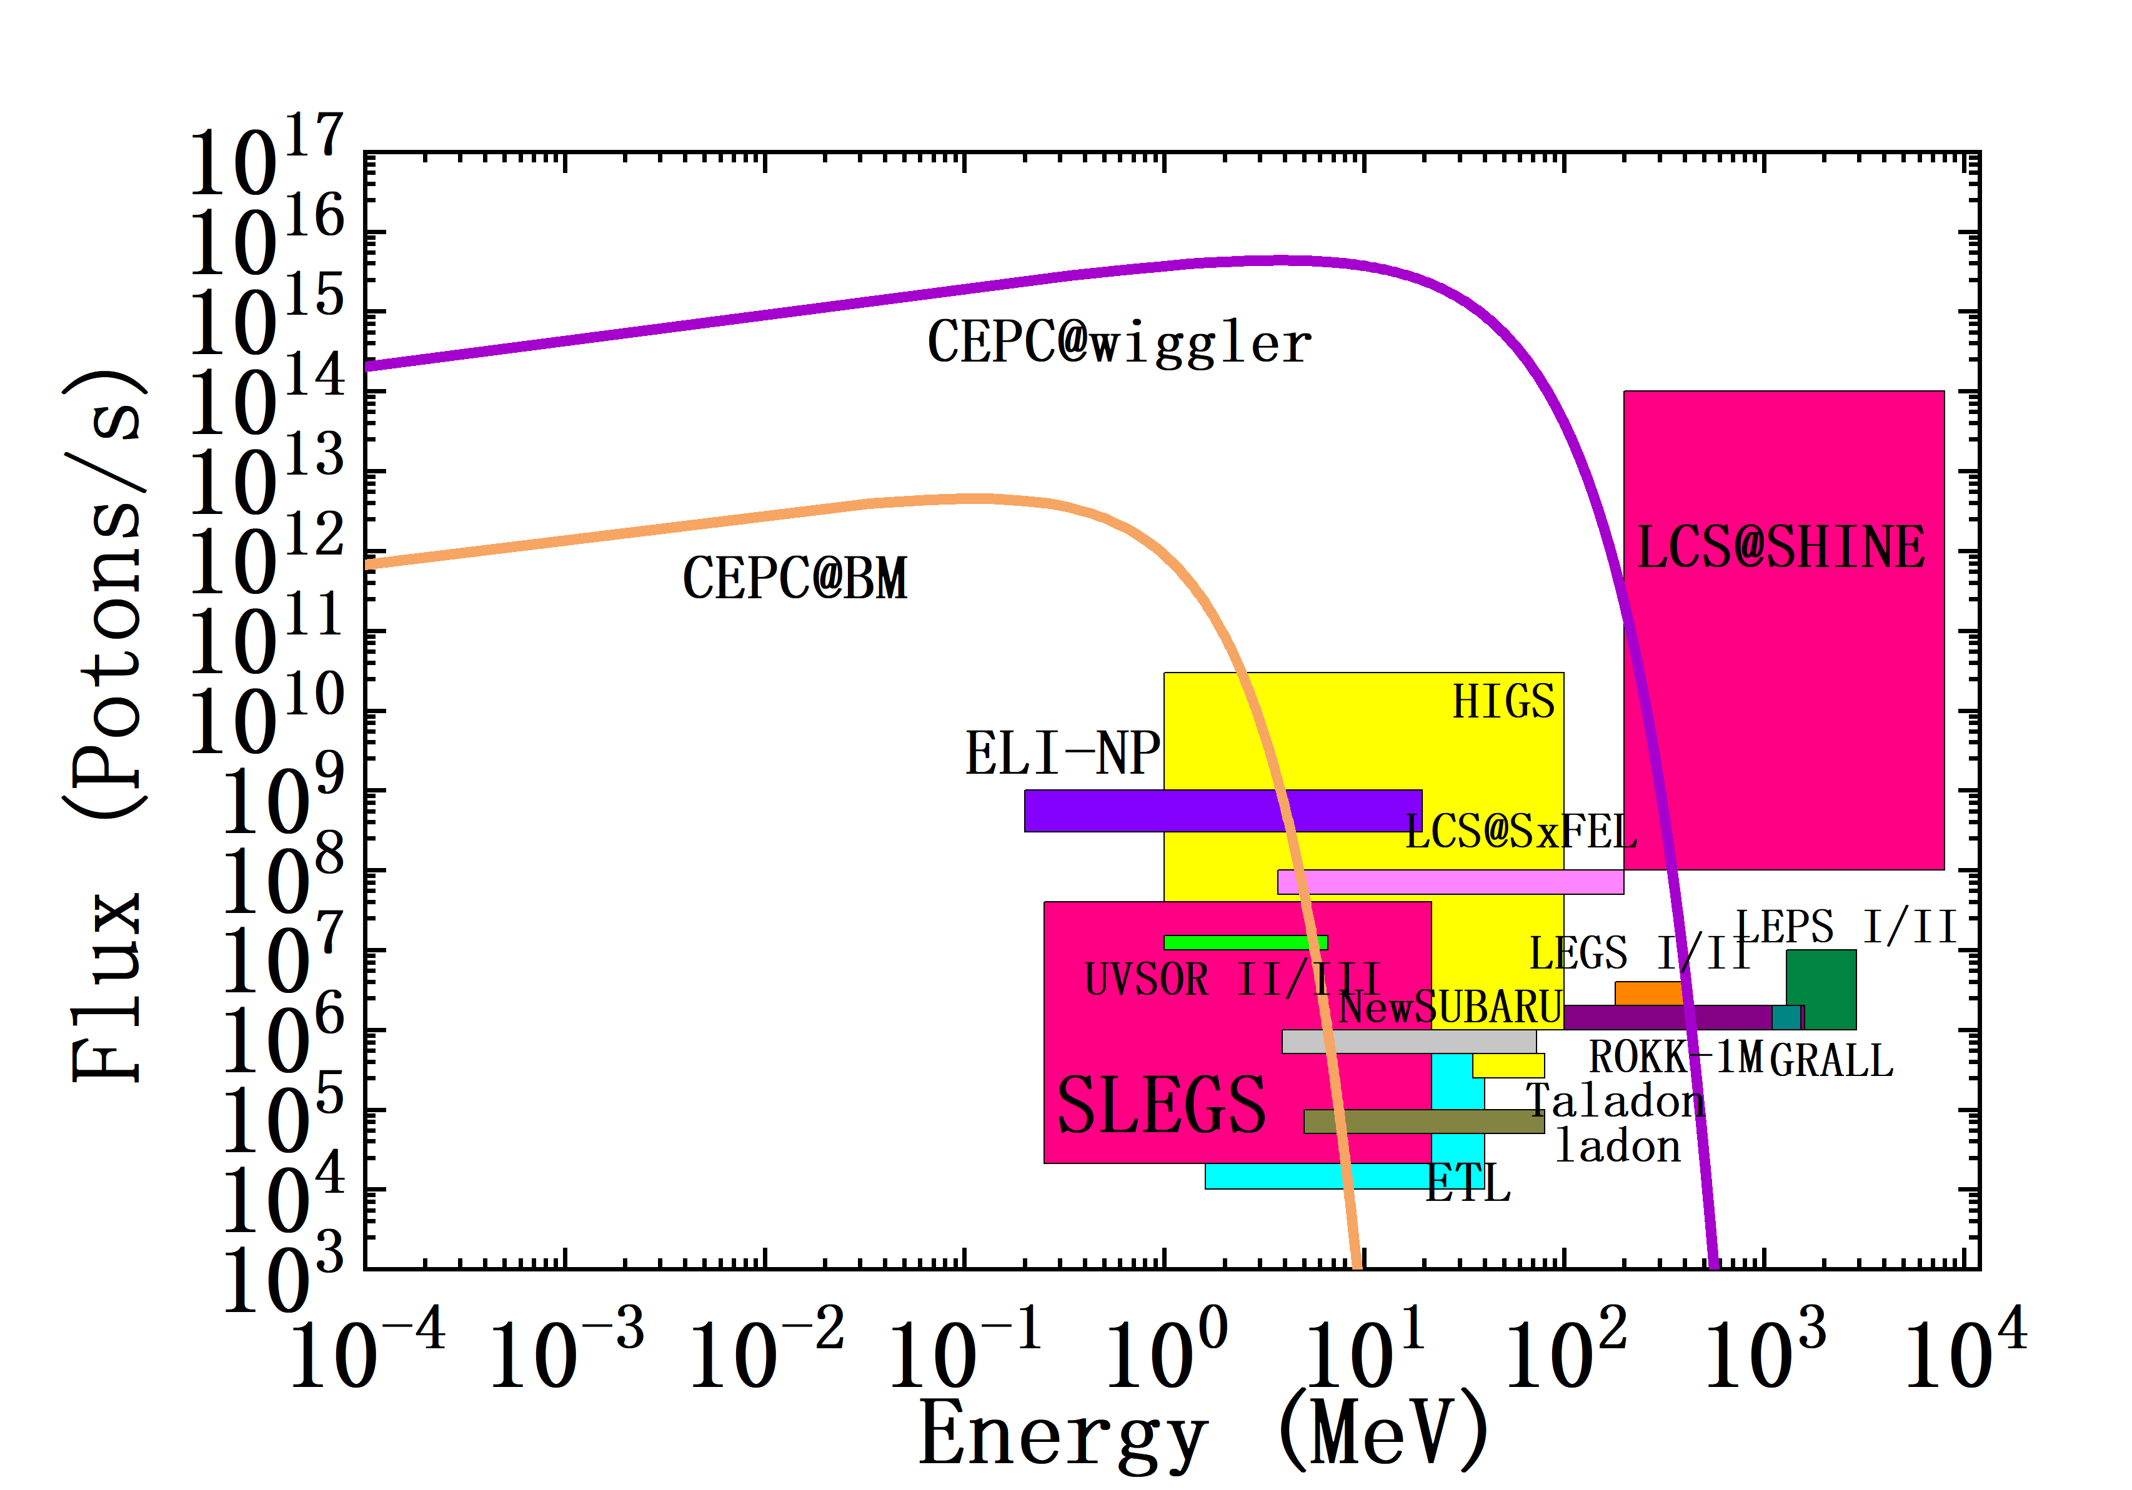
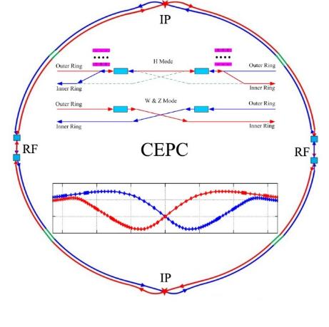
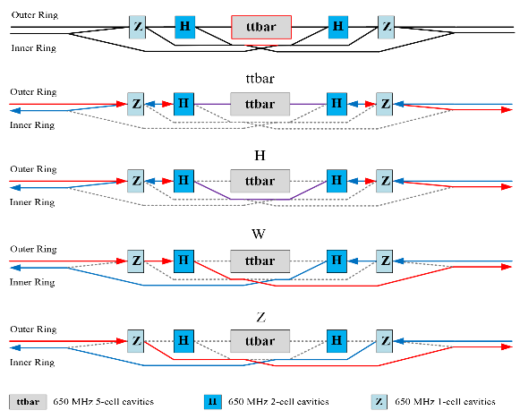
CEPC Layout and Design Essentials
100km circumference
Same tunnel for e+e- and pp
Baseline: 100 km, 30 MW;
Upgradable to 50 MW, High Lumi Z, ttbar
Switchable operation: Higgs, W/Z, top
A very high energy Synchrotron radiation facility
H/W/Z/ttbar bypass scheme

Slide 12
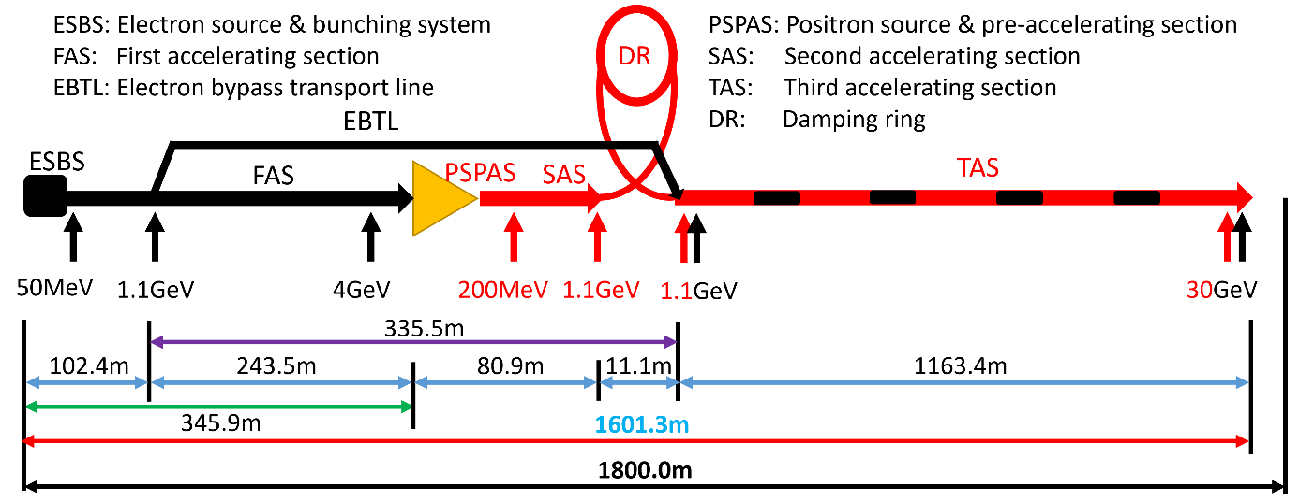

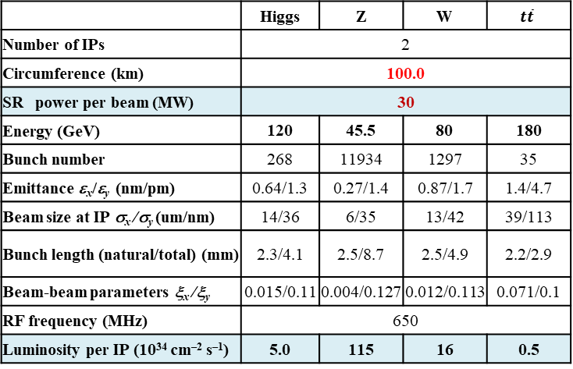
CEPC Accelerator Parameters
Linac
Booster
Collider
Parameter | Symbol | Unit | Baseline
Energy | E_{e-}/E_{e+} | GeV | 30
Repetition rate | f_{rep} | Hz | 100
Bunch number per pulse |  |  | 1 or 2
Bunch charge |  | nC | 1.5 (3)
Energy spread | σ_{E} |  | 1.5×10⁻³
Emittance | ε_{r} | nm | 6.5
 |  | tt | H |  | W | Z
 |  | Off axis injection | Off axis injection | On axis injection | Off axis injection | Off axis injection
Circumfer. | km | 100
Injection energy | GeV | 30
Extraction energy | GeV | 180 | 120 |  | 80 | 45.5
Bunch number |  | 35 | 268 | 261+7 | 1297 | 3978 | 5967
Maximum bunch charge | nC | 0.99 | 0.7 | 20.3 | 0.73 | 0.8 | 0.81
Beam current | mA | 0.11 | 0.94 | 0.98 | 2.85 | 9.5 | 14.4
SR power | MW | 0.93 | 0.94 | 1.66 | 0.94 | 0.323 | 0.49
Emittance | nm | 2.83 | 1.26 |  | 0.56 | 0.19
RF frequency | GHz | 1.3
RF voltage | GV | 9.7 | 2.17 |  | 0.87 | 0.46
Full injection from empty | h | 0.1 | 0.14 | 0.16 | 0.27 | 1.8 | 0.8
 | Higgs | Z | W | $$t\overline{t}$$
Number of IPs | 2
Circumference (km) | 100.0
SR power per beam (MW) | 30
Energy (GeV) | 120 | 45.5 | 80 | 180
Bunch number | 268 | 11934 | 1297 | 35
Emittance ε_{x}/ε_{y} (nm/pm) | 0.64/1.3 | 0.27/1.4 | 0.87/1.7 | 1.4/4.7
Beam size at IP σ_{x} /σ_{y} (um/nm) | 14/36 | 6/35 | 13/42 | 39/113
Bunch length (natural/total) (mm) | 2.3/4.1 | 2.5/8.7 | 2.5/4.9 | 2.2/2.9
Beam-beam parameters ξ_{x} /ξ_{y} | 0.015/0.11 | 0.004/0.127 | 0.012/0.113 | 0.071/0.1
RF frequency (MHz) | 650
Luminosity per IP (10³⁴ cm^{–2} s^{–1}) | 5.0 | 115 | 16 | 0.5
Electron and Positron Injection Linac
Transport lines
③
④
⑤
⑦
①
②
Collider
Linac
Booster
⑥
⑧
⑨
30~180GeV
180GeV
dump
DR
1.1GeV
⑩

Slide 13
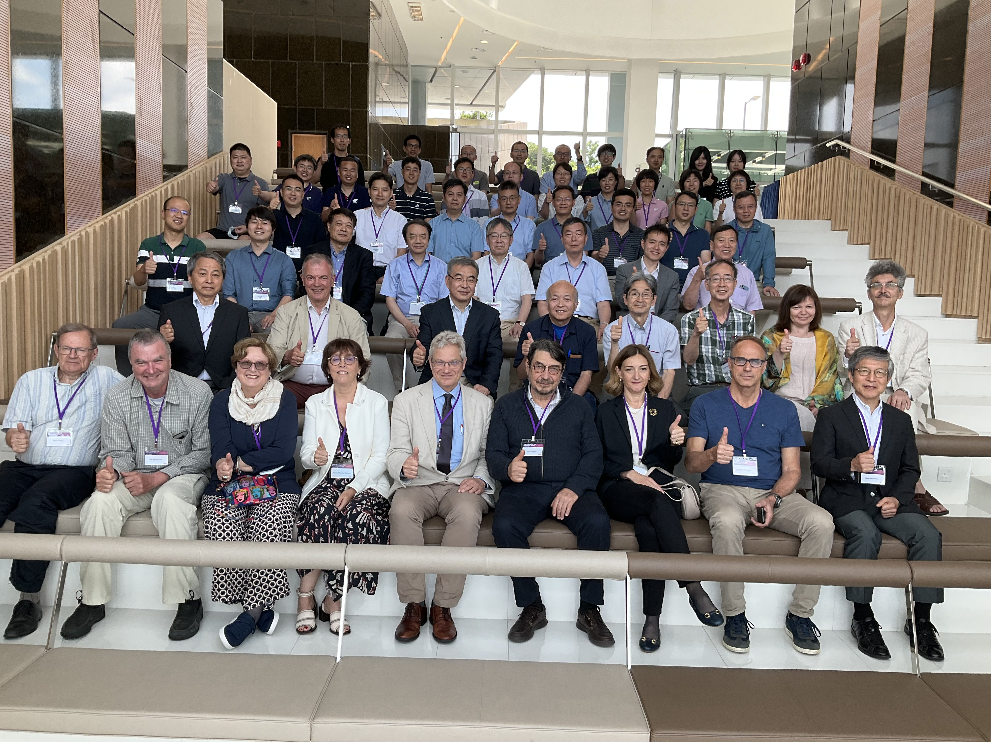
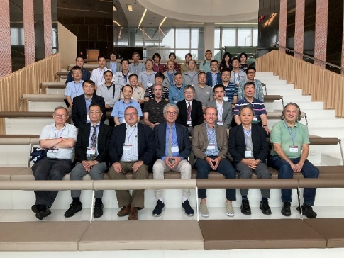
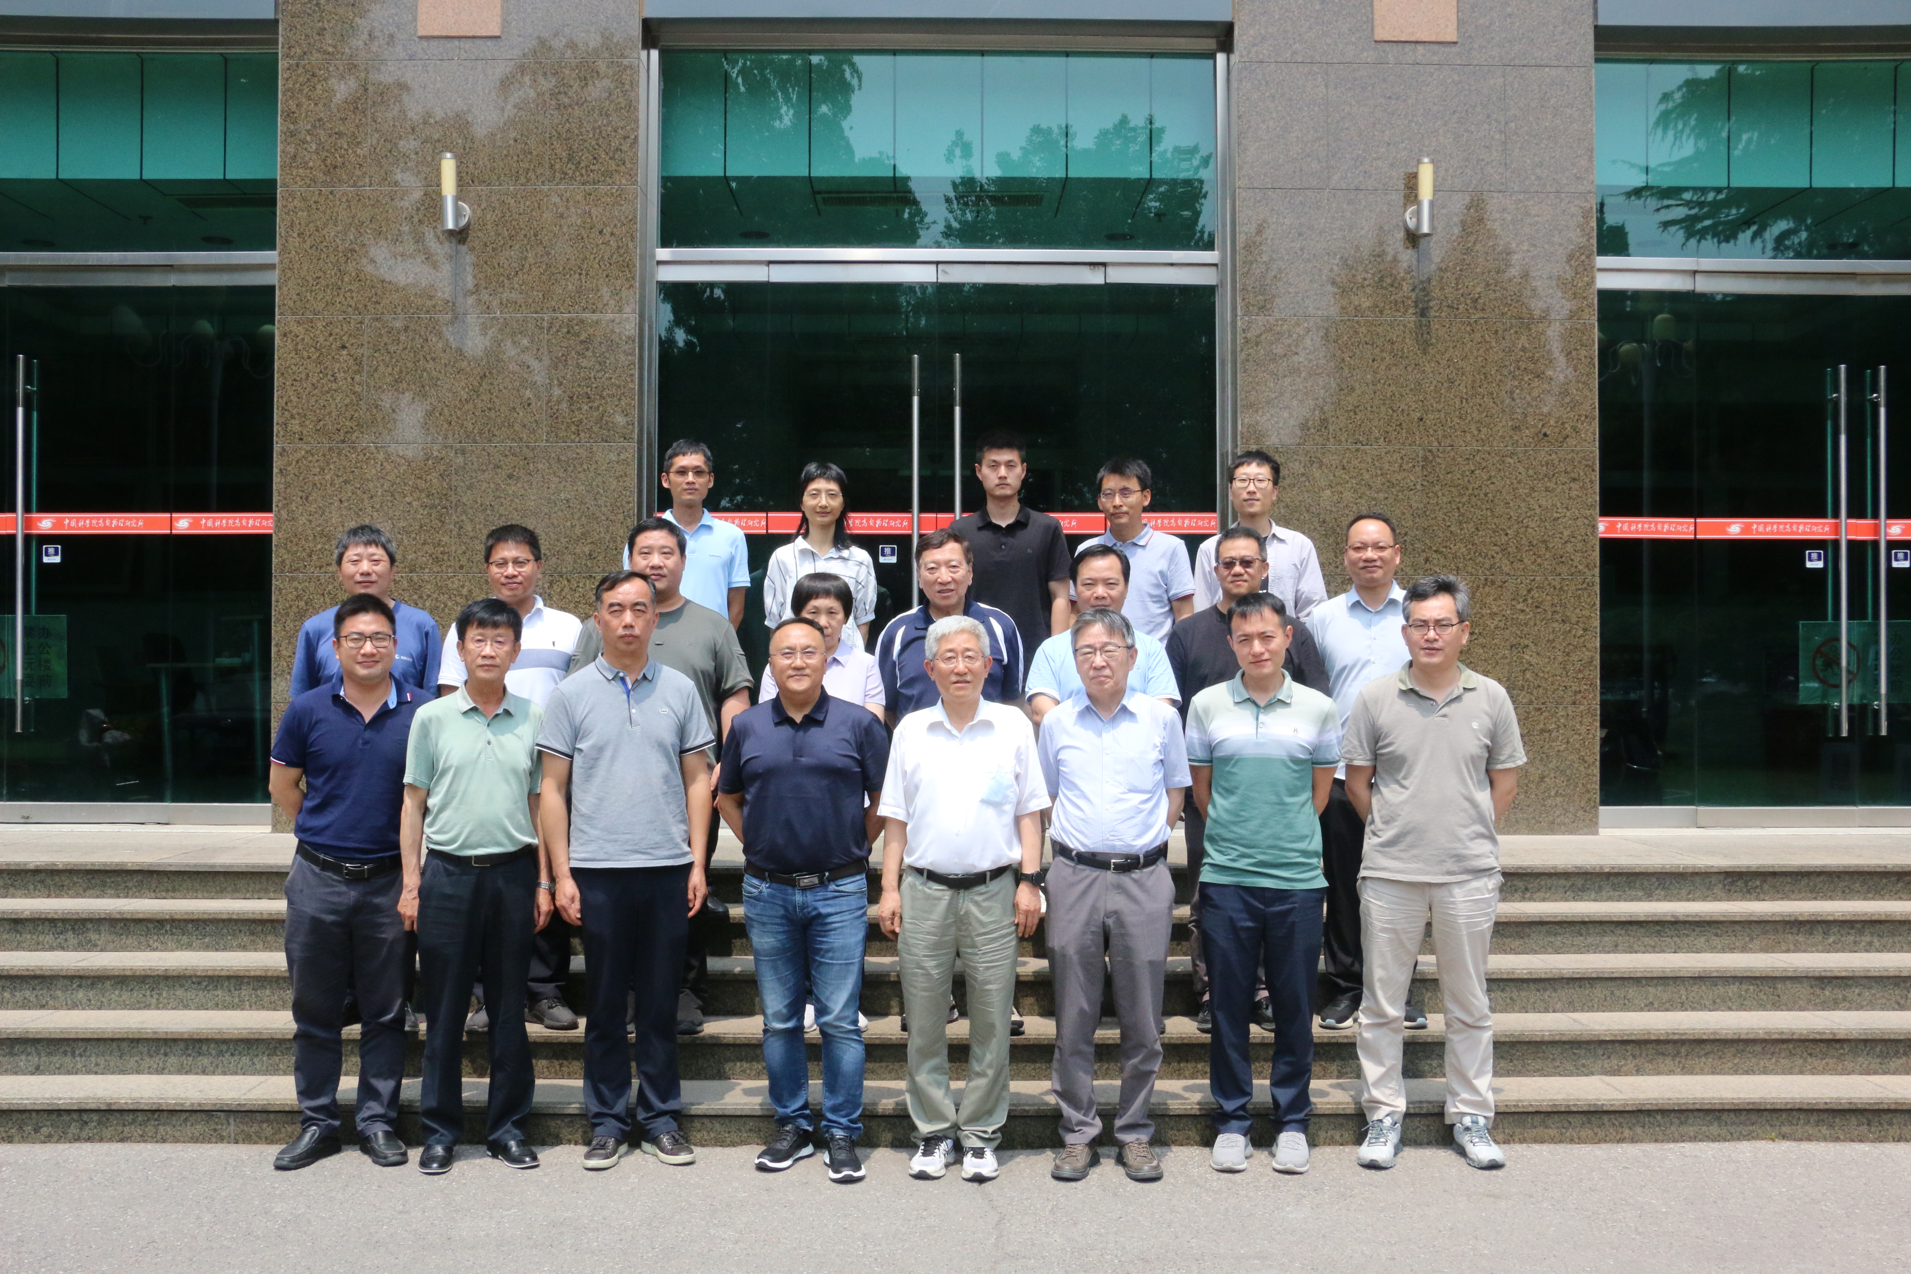
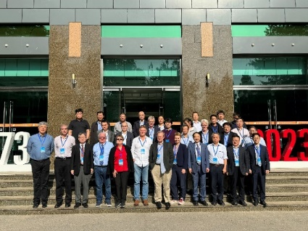
Accelerator TDR Published
Accelerator TDR Review
June 12-16, 2023, Hong Kong
arXiv:2312.14363
1114 authors
278 institutions
38 countries
1090 pages
Accelerator TDR Cost Review
Sept. 11-15, 2023, Hong Kong
Domestic Civil Engineering
Cost Review, June 26, 2023, IHEP
Distribution of CEPC Project total TDR cost of 36.4B RMB (~ 5B €)
CEPC accelerator TDR link:（arXiv： 2312.14363）
CEPC accelerator TDR releasing news:
http://english.ihep.cas.cn/nw/han/y23/202312/t20231229_654555.html
9th CEPC IAC 2023 Meeting
Oct. 30-31, 2023, IHEP

Slide 14
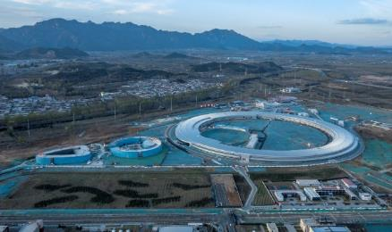
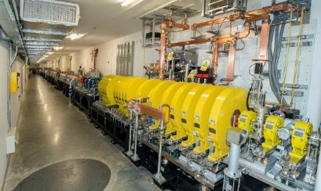
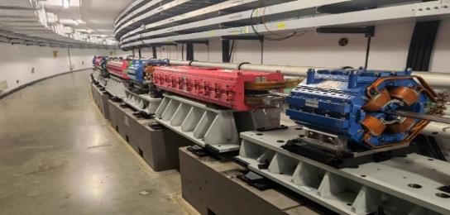
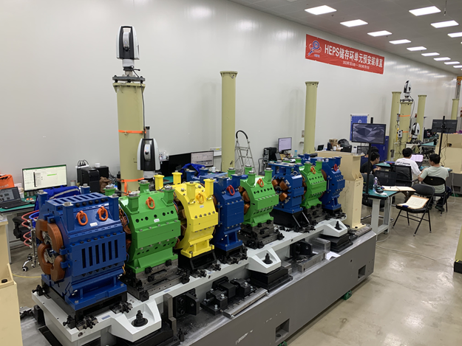
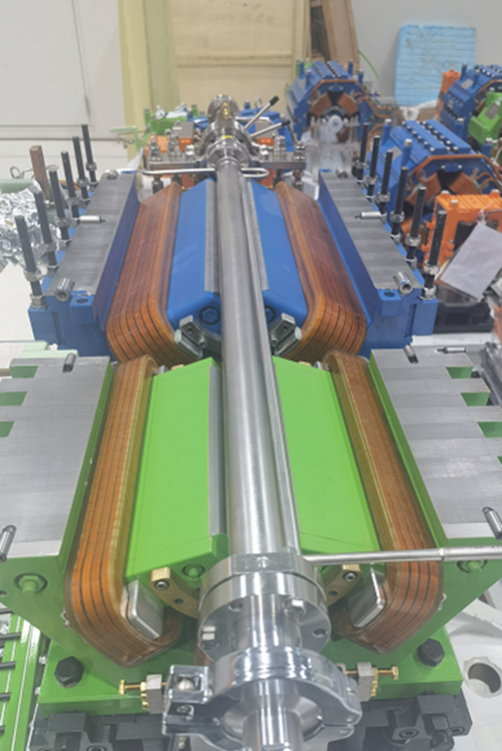
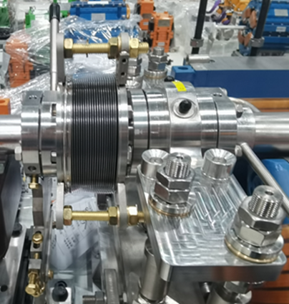
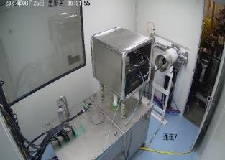
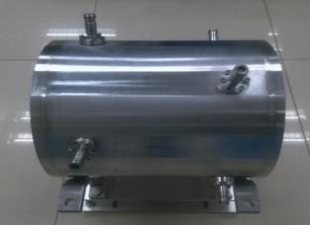
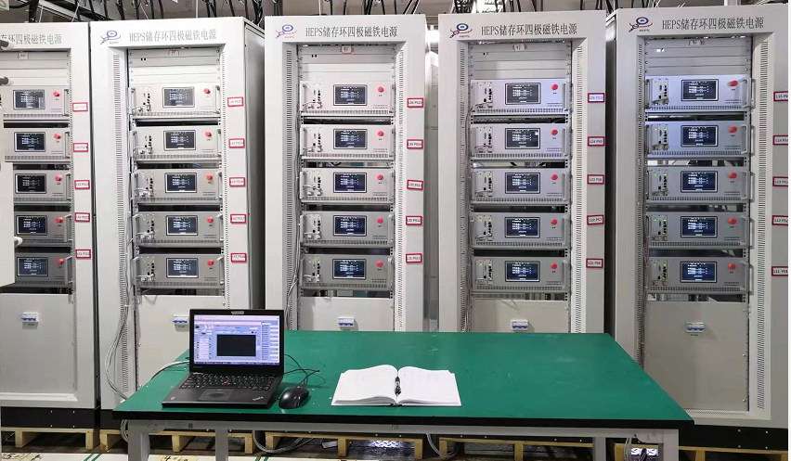
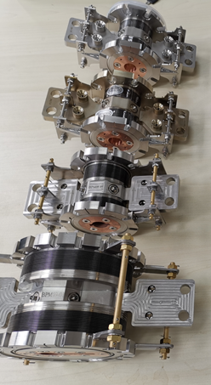
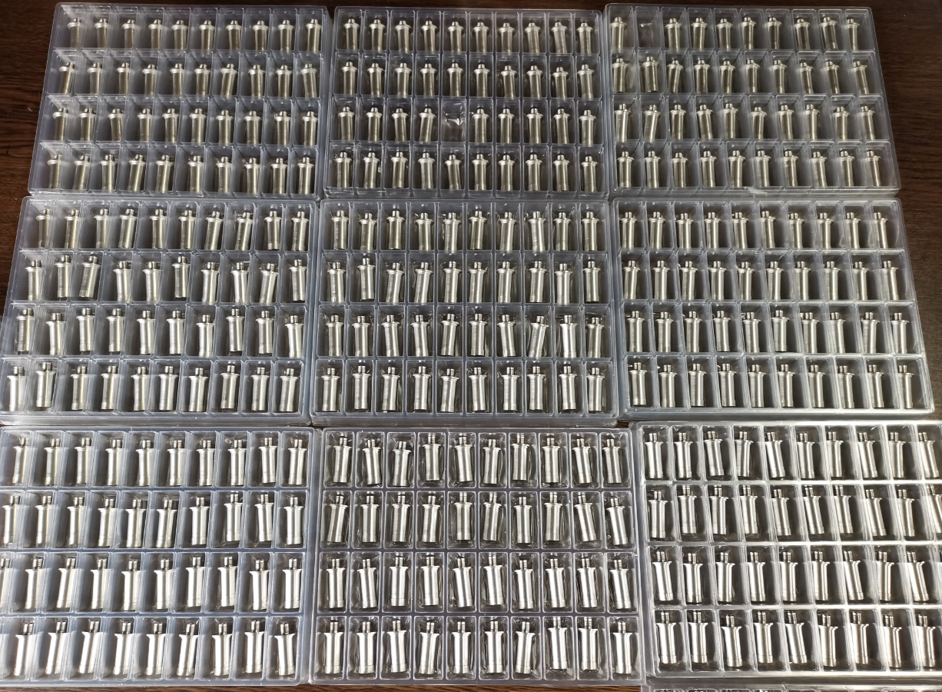
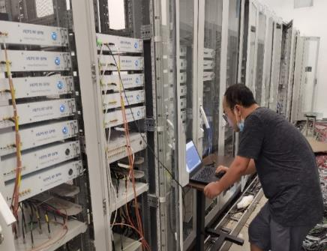

Experience at HEPS
6 GeV, 36 nm⋅rad
Magnets & alignment
Vacuum pipe and NEG coating
Electron gun
L. Feedback kicker
Power source
BPM, feedthrough and electronics

Slide 15


Experience in e-e+ Collider: BEPC/BEPCII
  40 years experience for the construction and stable operation of BEPC/BEPCII
  Beam current exceeds 900mA and the peak luminosity above 1.1×10³³cm⁻²s⁻¹
  Machine running time is typically ~10 months/year (with 2.5 months for synchrotron radiation)

Slide 16

Accelerator R&D: Key Technologies
  Key technologies R&D span over all components listed in CDR.
  About 10% remaining (eg. RF power source, control, alignment, SC magnets, machine integration) to be completed by 2026.
✔ Specification Met ✔ Prototype Manufactured
Accelerator | Fraction
✔ Magnets | 27.3%
✔ Vacuum | 18.3%
✔ RF power source | 9.1%
✔ Mechanics | 7.6%
✔ Magnet power supplies | 7.0%
✔ SC RF | 7.1%
✔ Cryogenics | 6.5%
✔ Linac and sources | 5.5%
✔ Instrumentation | 5.3%
✔ Control | 2.4%
✔ Survey and alignment | 2.4%
✔ Radiation protection | 1.0%
✔ SC magnets | 0.4%
✔ Damping ring | 0.2%

Slide 17


Next Step for the Accelerator：EDR
EDR tasks start with 35 WGs aiming for issues like further R&D of new technologies, mass production, mockup for installation, etc.
A full cryomodule containing six 650 MHz 2-cell cavities
Higher efficiency klystrons
Automatic production for NEG coated vacuum chambers
Automatic production for magnets
More prototypes of magnets
C-band LINAC test band
CCT type SC quadrupole magnet for final focusing
MDI design and background studies
Control and timing
Alignment and installation plan
Mockup for installation
PWFA test facility
….

Slide 18






EDR Example 1: SRF Cavities and Modules
High G High Q 1.3GHz 9-cell Cavity
In TDR phase: 650MHz 2*cell short module and 1.3GHz full module has been completed OK
In EDR: a full 11 m-long cryomodule containing six 650 MHz 2-cell cavities will be built
Status： construction started

Slide 19








EDR Example 2: Higher Efficiency Klystrons
Energy recovery Klystron: a test stand reached eff. of ~88%
In TDR phase: CW 800 kW klystron reached effi. of ~78%
In EDR: A full Energy recovery Klystron aiming for an efficiency >85%

Slide 20

EDR Example 3: Automatic Production for Magnets
Starting from booster dipole magnet: ~15000 magnets needed
Can work 24h/day, 7days/week, may reduce the cost by ~30-50%
Thanks for your attention
Status： design completed and construction started

Slide 21





EDR Example 4: Automatic Production for NEG Coated Vacuum Chamber
A total of 200 km needed
Can work 24h/day, 7days/week, may reduce the cost by ~30-50%
Assembling for NEG coating
NEG coating
Cleaning
Spraying heating film
Layout of production line
NEG coating facility by horizontal method
Thanks for your attention
Production line of NEG coating, spraying
AGV(Automatic Guided Vehicle) transport
7-axis robot for assembling
Status：design completed and construction started

Slide 22





R&D for Future: Plasma accelerator as the CEPC Injector
  Conceptual design based on simulation
  Experimental proof and prototyping is the key
  A dedicated test facility under construction based on the BEPCII LINAC
    Cascading, positron acceleration,…
    Technology: electron gun, laser, …
~ 661 MeV
e+ target, ~240 MeV
PWFA lab
Diagnostics
2.5 GeV e-/e+ beamline + PW-level high performance laser system
22

Slide 23



R&D for Future: Iron-Based HTS Magnet
IBS 2026
IBS 2022
IBS 2019
IBS 2016
Why:
“Metal”, isotropic, …
Cheap: material(Ba_{0.6}K_{0.4}Fe₂As₂) and production(PIT)
Status
Cable length >1000m with good Jc
Stainless-steel IBS tube achieved good J_{c}
Small-scale cable production techniques understood
Test coil successful
Plan
Continue to improve Jc by × 5
Mid-scale cable production line
Test magnet
      First short coil with 40%Jc@24T
      First long coil with 80%Jc@10T
1st Iron-based Superconducting solenoid Coil at 24T

Slide 24



Efforts Towards a Green Accelerator
Experience at HEPS
  Solar panel: 10 MW ➔ 10% saving
  Permanent magnet: 5.6 GWh saving/yr
  Hot water(13 MW@42ºC) for heating: more than what HEPS needs
R&D for CEPC
  High eff. Klystron, energy recovery Klystron, Solid State Transformer, permanent magnet, …
  Design and R&D of a “cooling-compressor + heating-pump system” to recover hot water in winter and cooling water in summer for use at HEPS
  Continue to investigate power generator using low-T hot water
Solar panel on the roof of HEPS

Slide 25
CEPC Detector：Reference Detector TDR
International collaboration may only be established after the CEPC project is approved by the Chinese government
For the approval, a design and budget is needed
Solution: A reference TDR to demonstrate a working design, the feasibility, technologies, budget, etc.
CEPC international advisory committee suggested and approved this plan
An international review of the Ref-TDR held in April 14-16
TDR will be released in the mid of this year, after being reviewed by IDRC
Draft, to be published
~ 100 institutions involved

Slide 26


Reference Detector: A new Concept
Yoke +
Muon (PS+SiPM)
Silicon tracker+TPC: precision tracking combined with PID
  Inner tracker: three barrel layers and 2×4 endcap layers of MAPS HV-CMOS pixel sensors using 65nm tech.
  TPC for PID and tracking: Pixelated readout (500×500mm²) of Micromegas for good tracking and PID
  Outer tracker: one barrel layer and two endcap disks based on AC-LGAD to measure timing and position simultaneously
PFA-oriented ECAL: 18 layers of BGO crystal bars(1.5×1.5×40 cm³), arranged in the x-y direction alternatively, in perpendicular to the beam, to achieve fine 3D granularity, and good position and energy resolution
PFA-oriented HCAL: 48 layers of glass scintillator tiles(4×4 cm²) interspersed with steel plates for good 3D granularity and resolution
SC Magnet
(3T/2T)
PFA HCAL
(Scintillation Glass)
LumiCal
Crystal PFA ECAL
(Transverse bar)
OTK
(AC-LGAD)
TPC
(Pixelated readout)
Vertex
(MAPS SiPixel)
ITK
(MAPS SiPixel)

Slide 27

Vertex and Silicon Tracker
Vertex: MAPS silicon sensors bend to a tube, for σ of 3-5 μm
20 m² Inner tracker using HV-CMOS pixel for σ <10 μm
80 m² outer tracker using AC-LGAD strips for σ<10 μm, σ_{t}<50 ps
TPC for tracking and PID for σ<150 um, dN/dx ~ 3%
  A dummy wafer, thinned to 40μm, can be curved to 12mm
12 mm 14 mm
8 μm for 150 μm strip pitch
38 ps
AC-LGAD test Performance

Slide 28








Electromagnetic Calorimeter
Newly arranged crystal ECAL with good 3D shower reconstructed for PFA
Energy resolution from beam test: 1.3%/√E⊕0.7%
5 GeV 𝜸 − 𝜸 separation: 3cm
5 GeV 𝜸 − 𝝅 separation: 3cm
72 BGO bars for a tower of 12×12×24 cm³ (21.4 $X_{0}$)

Slide 29


Hadron Calorimeter
High density glass scintillator for HCAL: much higher sampling ratio(~30%) and good energy resolution ~30%/√E
Technically feasible size of glass pieces: good for PFA:
New type of Glass R&D:
  Novel Gadolinium Fluoro-Oxide glass
  Density: 6g/cm³
  Size: 40*40*10 mm³
  Light yield: 1500 ph/MeV
  Decay time: 600 ns
Light yield of Glass scintillators

Slide 30

CEPC Planning and Schedule
TDR (2023), EDR(2027), start of construction (~2027)
CEPC plans to submit the proposal to the central government(NDRC) within the “15th five year plan”
CAS organized the 1st review of all proposals at the end of last year. CEPC was the top 2 for Basic Science
Waiting for the 2nd review by CAS in the mid of this year
Waiting for the “call for proposals” by NDRC by the end of this year
Once CEPC is (preliminarily) approved in China, a call for proposal will be released by IHEP
Although the management system is still to be settled, most likely IHEP will be the host lab
15th FY
16th FY

Slide 31



Neutrinos: Daya Bay Experiment
ν₁
ν₂
ν₃
Corr. uncertainty
θ₁₂ Solar ν Osci.
θ₁₃ ?
θ₂₃ Atmo. ν Osci.
Daya Bay
Uncorr. uncertainty
  Cross check; Reduce errors by 1/√N

Slide 32

Daya Bay Collaboration
BNL

Slide 33


First Results from Daya Bay
Electron anti-neutrino disappearance:
R = 0.940 ±0.011 (stat) ±0.004 (syst)
Announced on Mar. 8, 2012
Sin²2θ₁₃ = 0.092 ± 0.016(stat) ± 0.005(syst)
χ²/NDF = 4.26/4, 5.2 σ for non-zero θ₁₃
F.P. An et al., Phys. Rev. Lett. 108, (2012) 171803

Slide 34




Great Success
  Together with colleagues from BNL and other institutions, we shared great excitement and success
    σ(sin²2θ₁₃) from 20% to 2.8%, and σ(Δm²₃₂) ~ 2.2%
    Reactor neutrino flux deficit is mostly from ²³⁵U, sterile neutrinos unlikely
    Numerous awards
sin²2θ₁₃
Δm²₃₂ (NO)
Δm²₃₂ (IO)
Oscillation picture is now complete
Sin²2θ₁₃ is almost ×10 bigger than originally expected:
  Possible to start the next generation neutrino experiments for the mass hierarchy and CP phase δ ➔ JUNO, DUNE, HyperK
Compiled by Maxim Gonchar at git.jinr.ru/nu/osc

Slide 35


JUNO Experiment
Continue reactor neutrino experiments using the liquid scintillator: mainly for the neutrino mass hierarchy
Idea since 2008, construction started in 2015, data taking this year
Daya Bay
Overburden ~ 700 m
JUNO
Previous site candidate
Guang Zhou
2.5 h drive
Lufeng
NPP
Shen Zhen
Huizhou
NPP
Daya Bay NPP
Zhu Hai
Hong Kong
 | Target mass [t] | Light yield (PE/MeV) | energy resolution
JUNO | 20,000 | >1200 | 3% @ 1 MeV
Borexino | 300 | 500 | 5% @ 1 MeV
KamLAND | 1,000 | 250 | 6% @ 1 MeV
Daya Bay | 20 | 100 | 8% @ 1 MeV
53 km
Macau
53 km
Taishan
NPP
Yangjiang NPP

Slide 36






Mass Ordering by Reactor Neutrinos
Δm²₂₁
|Δm²₃₂|
~ 3%
Δm²₃₂
S. Petcov and Piai, Phys. Lett. B 553, 94-106(2002)
J. Learned et al., PRD 78(2008)071302
L. Zhan, YFW et al., PRD 78(2008)111103

Slide 37


JUNO Collaboration
Project firstly approved in China in 2013 and later in other countries. Construction started in 2015
Collaboration established in 2014, with now ~750 collaborators from 72 institutions in 17 countries/regions
Country | Institute | Country | Institute | Country | Institute | Country | Institute
Armenia | Yerevan Physics Institute | China | Shanghai JT U. | France | IJCLab Orsay | Italy | INFN-Roma 3
Belgium | Universite Libre de Bruxelles | China | IGG-Beijing | France | LP2i Bordeaux | Pakistan | PINSTECH (PAEC)
Brazil | PUC | China | SYSU | France | CPPM Marseille | Russia | INR Moscow
Brazil | UEL | China | Tsinghua U. | France | IPHC Strasbourg | Russia | JINR
Chile | SAPHIR | China | UCAS | France | Subatech Nantes | Russia | MSU
Chile | UNAB | China | U. of South China | Germany | RWTH Aachen U. | Slovakia | FMPICU
China | BISEE | China | Wu Yi U. | Germany | TUM | Taiwan-China | National Chiao-Tung U.
China | CAGS | China | Wuhan U. | Germany | U. Hamburg | Taiwan-China | National Taiwan U.
China | ChongQing University | China | Xi'an JT U. | Germany | GSI | Taiwan-China | National United U.
China | DGUT | China | Xiamen University | Germany | U. Mainz | Taiwan-China | NKNU
China | Guangxi U. | China | Zhengzhou U. | Germany | U. Tuebingen | Taiwan-China | NTUT
China | Harbin Institute of Technology | China | NUDT | Italy | INFN Catania | Thailand | NARIT
China | IHEP | China | CUG-Beijing | Italy | INFN di Frascati | Thailand | PPRLCU
China | Jinan U. | China | ECUT-Nanchang City | Italy | INFN-Ferrara | Thailand | SUT
China | Nanjing U. | China | CDUT-Chengdu | Italy | INFN-Milano | U.K. | U. Liverpool
China | Nankai U. | China | SUSTech-Shenzhen | Italy | INFN-Milano Bicocca | U.K. | U. Warwick
China | NCEPU | Czech | Charles U. | Italy | INFN-Padova | USA | UMD-G
China | Shandong U. | Finland | University of Jyvaskyla | Italy | INFN-Perugia | USA | UC Irvine

Slide 38




~ 600m vertical shaft, ~1300m sloped tunnel

Slide 39


JUNO Detector
Underground cavern: 50m diameter, 70m high
Liquid Scintillator (LS) ➔ 20 kt Linear Alkali Benzene (LAB) + PPO + Mis-MSB + BHT
Acrylic tank holding 20 kt LS ➔ 35.4 m diameter, 260 pieces of 12 cm thick acrylic panels
44.5m
43.5m

Slide 40






Construction: Stainless Steel Structure and Acrylic Tank
Bottom structure
Platform for Acrylic assembly
Top structure
5 layers of Acrylic
20 layers of Acrylic
23 layers of acrylic

Slide 41


PMT and readout electronics
 | LPMT (20-inch) |  | SPMT (3-inch)
 | Hamamatsu | NNVT | HZC
Quantity | 5000 | 15012 | 25600
Charge Collection | Dynode | MCP | Dynode
Photon Detection Efficiency | 28.5% | 30.1% | 25%
Coverage | 75% |  | 3%
Reference | Eur.Phys.J.C 82 (2022) 12, 1168 |  | NIM.A 1005 (2021) 165347

Slide 42


JUNO Detector: Top & Bottom
42

Slide 43


Final Cleaning and the Liquid Filling Scheme
Reduce Rn, dust to class <1000
Complete CD construction
days settlement with proper moisture
Remove the protective film
and wash the acrylic surface
by the high pressure water spray
replacing water in CD by LS
Fill CD and VETO by high purity water
Water for CD: U/Th<10⁻¹⁵ g/g, ²²⁶Ra<0.1 mBq/m³
Water for VETO: U/Th<10⁻¹⁴ g/g

Slide 44



Construction Completed and Filling in Progress
Liquid and air pressure kept the same between the inside and outside of the acrylic tank
Water pipes and acrylic tank “breath” with N2
Stress of the detector structure closely monitored, in good agreement with expectations
bottom
middle
Stress of the supporting bar during water filling and LS replacement
top
Water filling completed: 60 kt, 43.5m
Water qualities meet requirements:
  Attenuation length: >60m
  Particle counts: ~800/20mL
  Resistivity: ~ 4 MΩ*cm
  U/Th<10⁻¹⁵ g/g, ²²²Rn<10 mBq/m³, ²²⁶Ra<10 uBq/m³
Comparison of FEA with Measurement

Slide 45


First muons events in water pool
PMTs works fine !

Slide 46








Liquid Scintillator Production
Four purification plants for a radio-purity of 10⁻¹⁷ g/g(U/Th) and 20 m attenuation length at 430 nm
5000 m³ LAB tank
Al₂O₃ to remove particles
Distillation to remove radioactive impurities
Add 2.5 g/L PPO and 3 mg/L bis-MSB
15%
JUNO
OSIRIS for LS qualification
Gas stripping to remove Rn and O₂
Water extraction to remove radioactive impurities
85%

Slide 47



Liquid Scintillator Filling
  Comprehensive QC/QA program at every step of the LS production, frequent measurement for batches:
  UV-Vis for every batch
  Attenuation length for sampling batches, ~20m
  Radiopurity by ICP-MS every week: U/Th <~ 1$×$10⁻¹⁶ g/g
  ²²²Rn by test facility(OSIRIS): ~ 0.5 mBq/m³
  Radiopurity monitoring for N2 and water
  Leak control and checks
UV-Vis
Attenuation length

Slide 48



Performance：PMT & LS
Dark rate of 20” PMTs in CD
Waveform of a typical PMT
Performance of LS in CD
  ²²²Rn in fresh LS: < 1mBq/m³
  Current Rn level: ~ 0.1mBq/m³
  U/Th: <10⁻¹⁵ g/g
from AmBe calibration
Attenuation length: ~20m
Light yield: > 1600/MeV
20 kHz/PMT
Good grounding and low noise:
RMS ~2.8 ADC ch. ➔ ~0.055 PE
PMT threshold: 0.2 PE/ch.
Trigger: ~ 300 PMTs/225ns
➔ ~150 KeV
Total PMTs installed: 17596
Dead: 8
Unstable or Flashing: ~130
Gain stable within 1%
All in agreement with the design and expectations

Slide 49




Expected Performance
Bkg. (U/Th/K) in LS is less than < 10⁻¹⁵ g/g
Light yield can achieve ~1660/MeV
We should be able to reach the energy resolution < 3%@1MeV, as predicted by full simulation, including calibration and reconstruction
We can achieve the goal for ν mass Hierarchy:
4σ in 6 yrs, independent of the CP phase
$$\frac{σ}{E_{v_{i}s}}=\sqrt{{\left(\frac{2.614\%}{\sqrt{E_{v_{i}s}}}\right)}^{2}+{0.64\%}^{2}+{\left(\frac{1.205\%}{E_{v_{i}s}}\right)}^{2}}$$
Photon statistics
Constant term
Annihilation-induced $γ$s
Dark noise
arXiv: 2405.17860, Chinese Phys. C 49 (2025) 013003
arXiv: 2405.18008
Chinese Phys. C 49 (2025) 033104

Slide 50



Other Physics at JUNO
Neutrino oscillation：mixing parameters < 1%, and test the unitarity
Burst supernova neutrino events: ~5000 @10 kpc
Discovery of diffused supernova neutrinos if ⟨E⟩ > 15 MeV
  Geoneutrinos: determining U/Th ratio in earth
Solar neutrinos: improvements over Borexino
Proton decays
 | Current (PDG2020) | JUNO (100 d) | JUNO (6 y)
Δm²₃₁/Δm²₃₂ | 1.3% | 0.8% | 0.2%
Δm²₂₁ | 2.4% | 1.0% | 0.3%
sin²θ₁₂ | 4.2% | 1.9% | 0.5
sin²θ₁₃ | 3.2% | 47.9% | 12.1%
JCAP10(2023)022）

Slide 51


JUNO-TAO
A near detector located in the Taishan nuclear power plant, 44 m from the reactor core(4.6 GW )
For a precise reference spectrum of reactor neutrinos, 700k events/year
Design: Gd-loaded LS @-50ºC + SiPM
  Energy resolution: ~1.5%/√E, 4500 p.e./MeV
  10 m² SiPM (>94% coverage) w/ PDE > 50%
  Operating at -50 ºC to reduce the SiPM dark rate by 10³ to 100 Hz/mm², SPE sensitive
  2.8 ton(1t fiducial volume) new type of Gd-LS for -50 ºC
Construction and installation close to completion, data taking soon

Slide 52



Future Upgrade: JUNO-ββ
In 10 years from now, oscillation will be mostly understood.
0ν ββ decay will be the next focus point:
J. Cao et al., arXiv:1908.08355
 | Isotope | Mass(t) | <m_{ββ}>,meV
SNO+ | ¹³⁰Te | 8 | 19-46
KamLAND2-Zen | ¹³⁶Xe | 1 | ~20
NEXT-HD | ¹³⁶Xe | 1 | 14-40
nEXO | ¹³⁶Xe | 5 | 7-22
Darwin/Panda-nT | ¹³⁶Xe | 3-5 | 7-22
LEGEND-1000/CDEX-1t | ⁷⁶Ge | 1 | 10-40
AMoRE-II | ¹⁰⁰Mo | 0.1 | 12-22
CUPID | ¹⁰⁰Mo | 0.24 | 12-20
CUPID-1T | ¹⁰⁰Mo | 1 | 4-7
JUNO-ββ | ¹³⁶Xe | 50 | 4-10
 | ¹³⁰Te | 100 | 3-14
Insert a balloon filled with ¹³⁶Xe-loaded LS (or ¹³⁰Te) into the JUNO detector
Zhao et al., arXiv: 1610.07143, CPC 41（2017）5

Slide 53





Summary
Particle physics in China progressed well in the last 40 years
JUNO and CEPC will lead us to the forefront of the world
High energy physics has a great future, even though we often encounter pessimistic opinions/people and/or disappointing events
Science is global, international collaboration is a must for HEP
JUNO
BEPC
CEPC
Daya Bay
250 m
20 t
20,000 t
100,000 m

