Slide 1
LED Measurements Progress
2025-04-30
Miklos CZELLER / Gabor NAGY / Norbert NOVITZKY

Slide 2
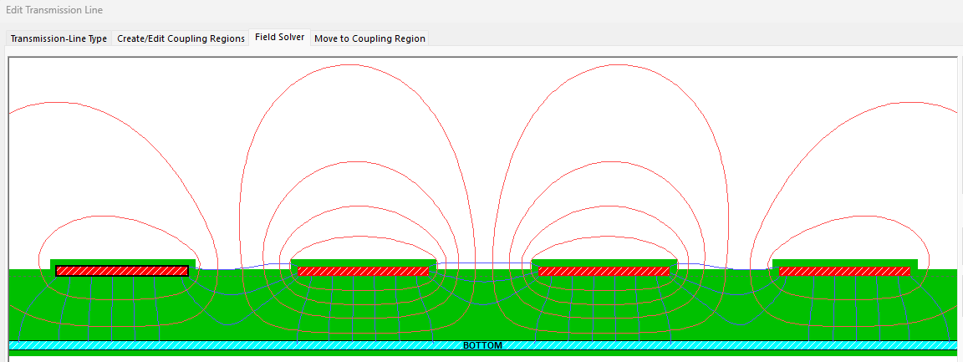
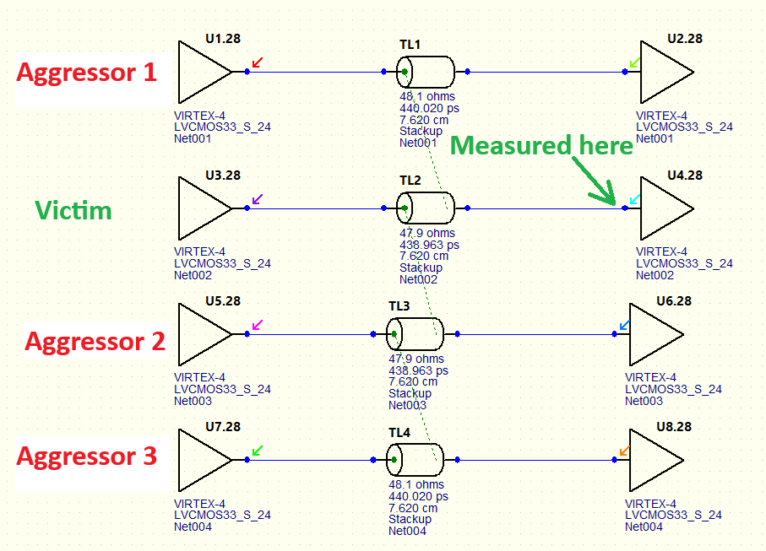
Crosstalk simulation basic idea (HyperLynx)
PCB geometry is used from CAD program.
All PCB nets (wires) driven by an ideal/selected driver except one which is measured in the same time, how much signal coupling from the others.
Driven nets are the „aggressors”
Measured net is a „victim”
„Batch” simulation measures all nets one by one while all other is an „aggressor”.

Slide 3
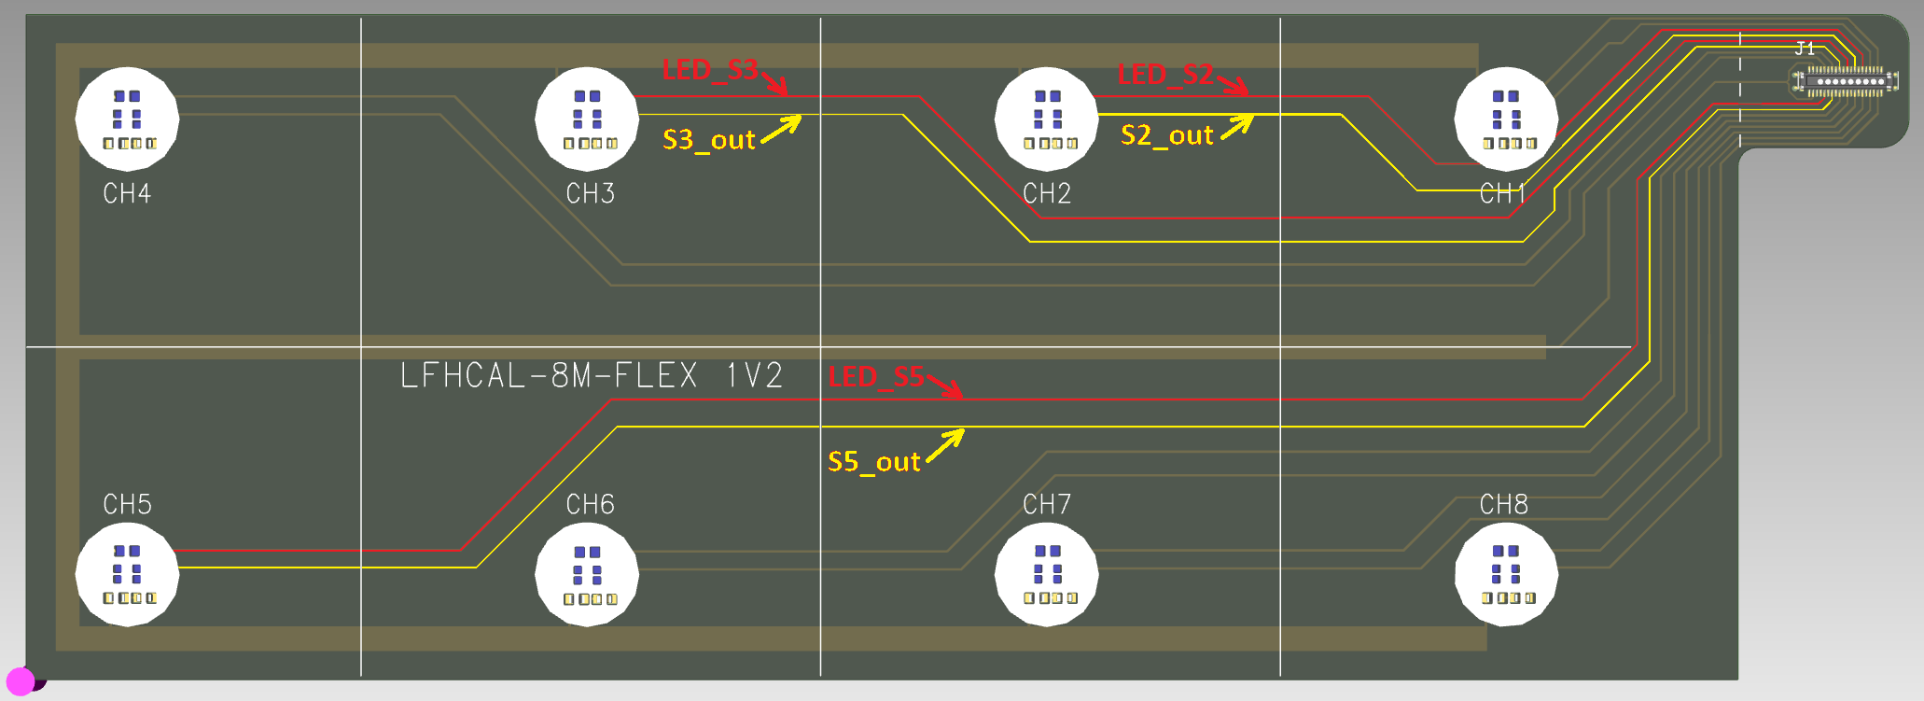
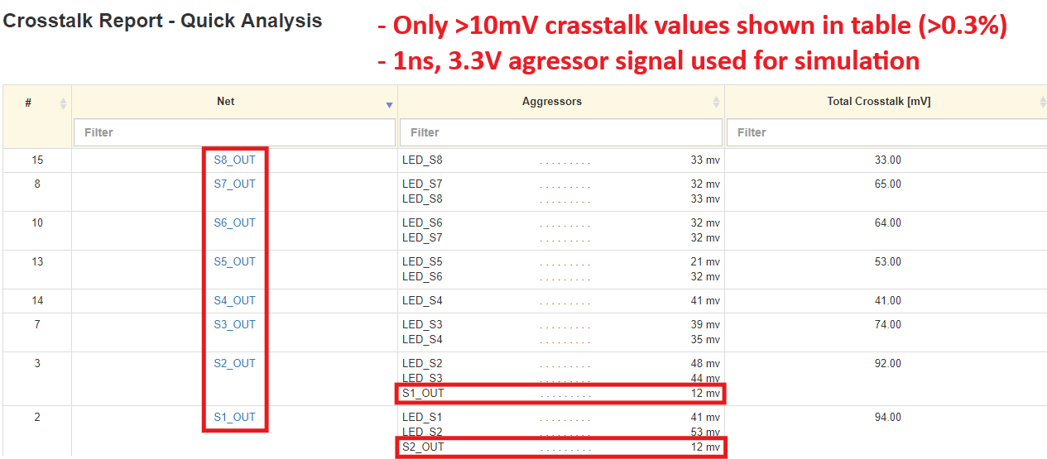
FlexPCB crosstalk simulation
Based on this simulation we should not see >3% crosstalk even when all LED is driven in a same time and all othe SiPM output is pulsed.

Slide 4
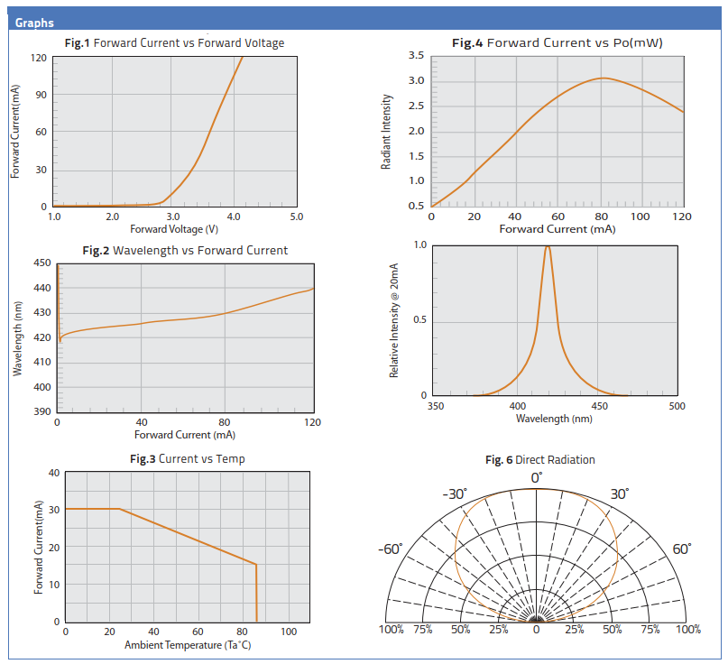
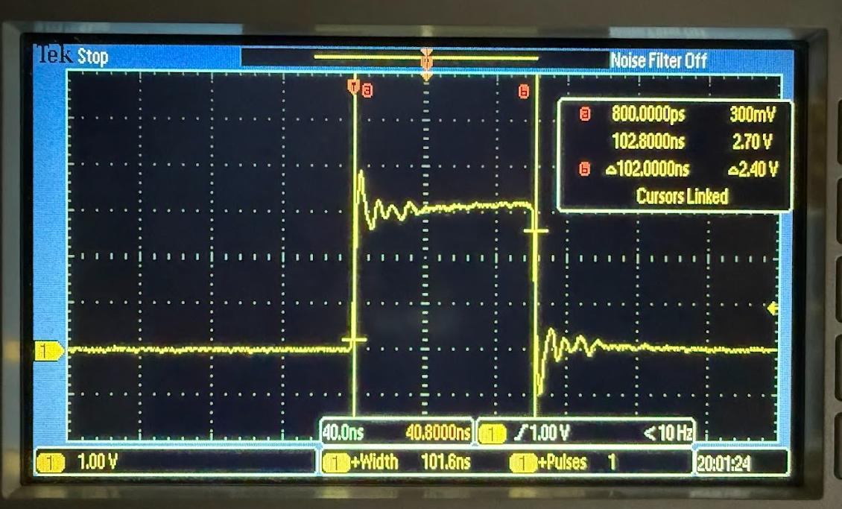
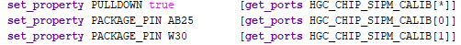
LED parameters
LED (CTL0603FPU1T - Chip Type LED, 0603, Flat Lens, Purple) Pulse length = 100ns
Resistor Value = 100R

Slide 5
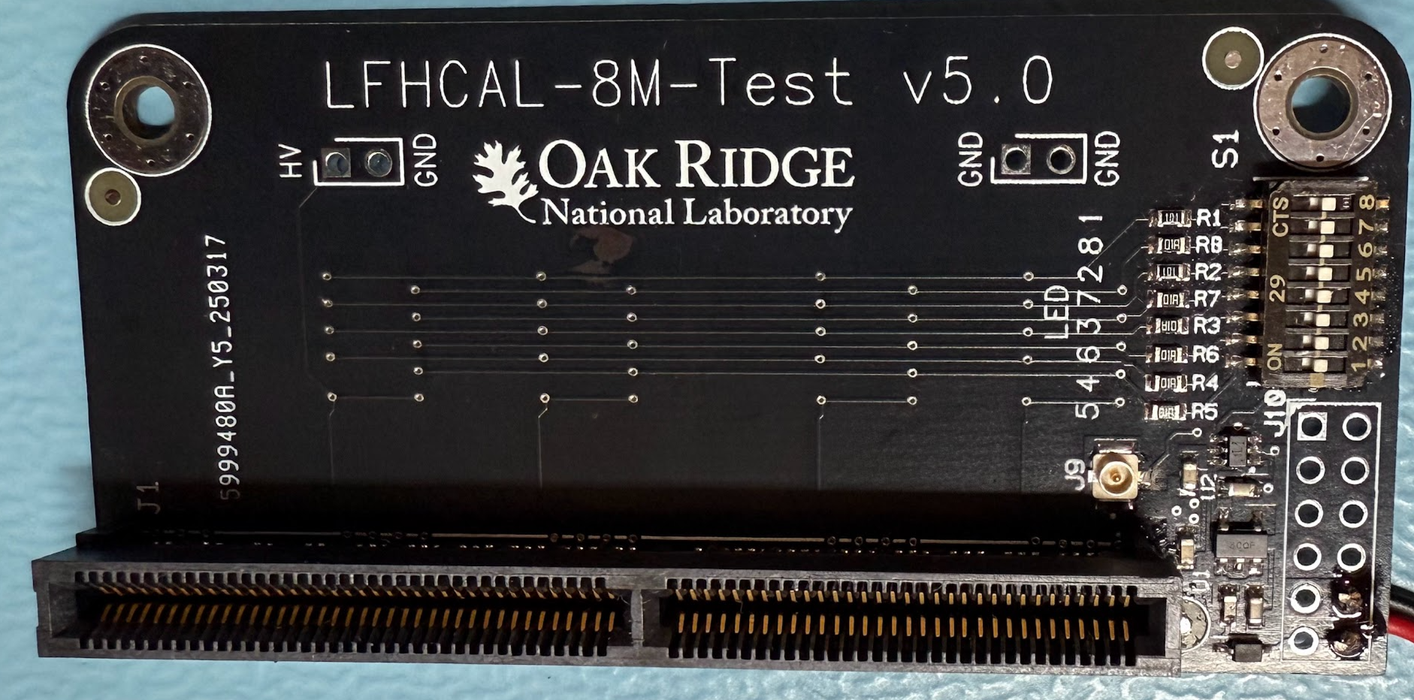
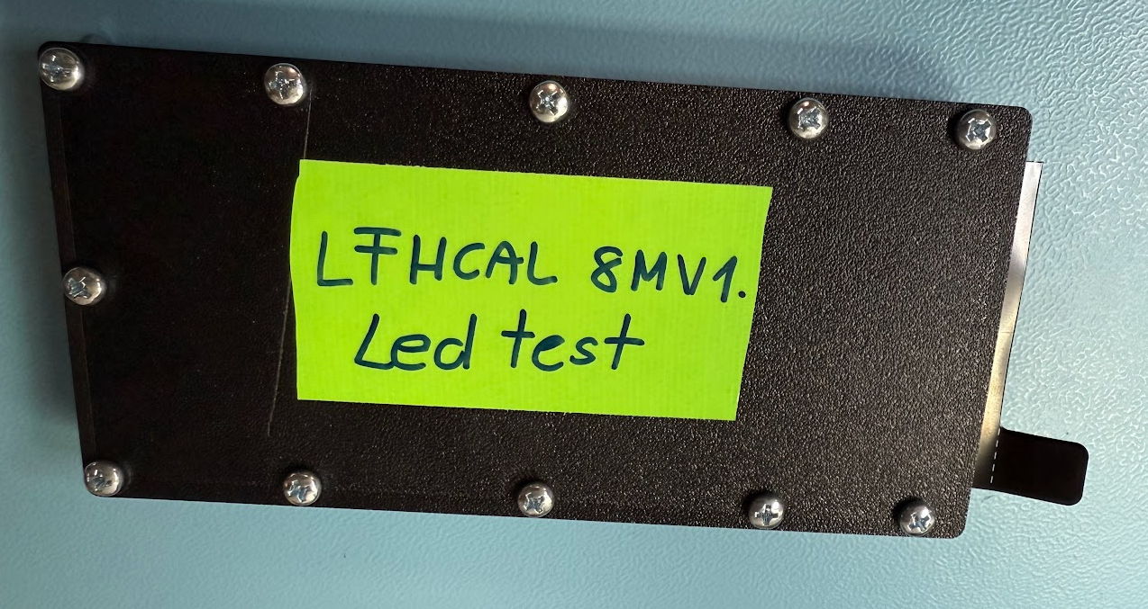
Setup
ProtoBoard v2
H2GCROC
chip
H2GCROC
chip
SiPM Signals
SiPM Calib signals
100ns pulse
KCU 105
Test Board
Flex board with
8LEDs and 8SiPMs
In a small 3D printed JIG
LPC Conn.
FPGA
Trigger for
LED
LED Pulse length: n x 6.25nsec
CalPulseExt: send STROBE pulse to the external pin SiPM_calibration. The STROBE pulse length is 4 Bx at 40 MHz = 100ns. The STROBE pulse phase depends on the main digital clock from Fast Commands module (clk40_fc).
Serial resistor here
Before each LED

Slide 6
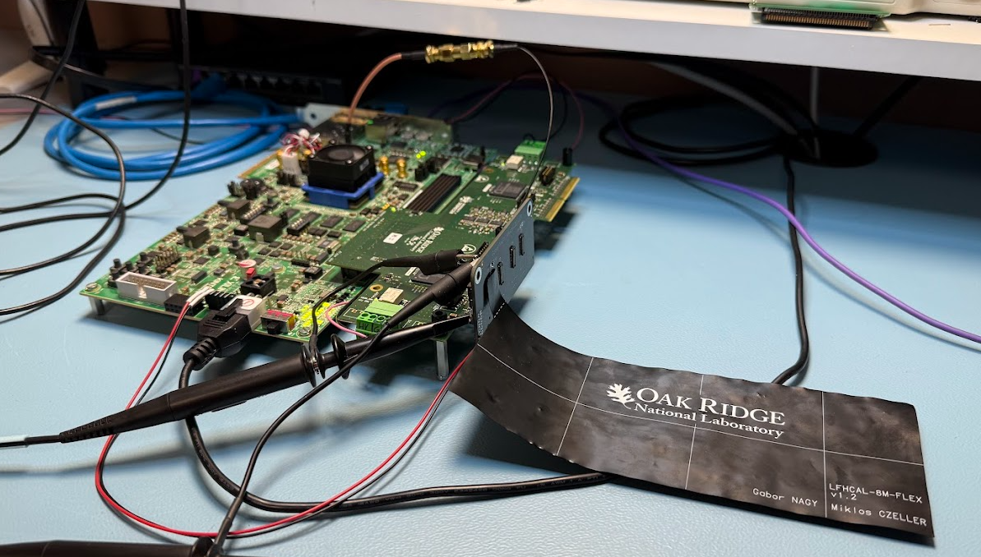
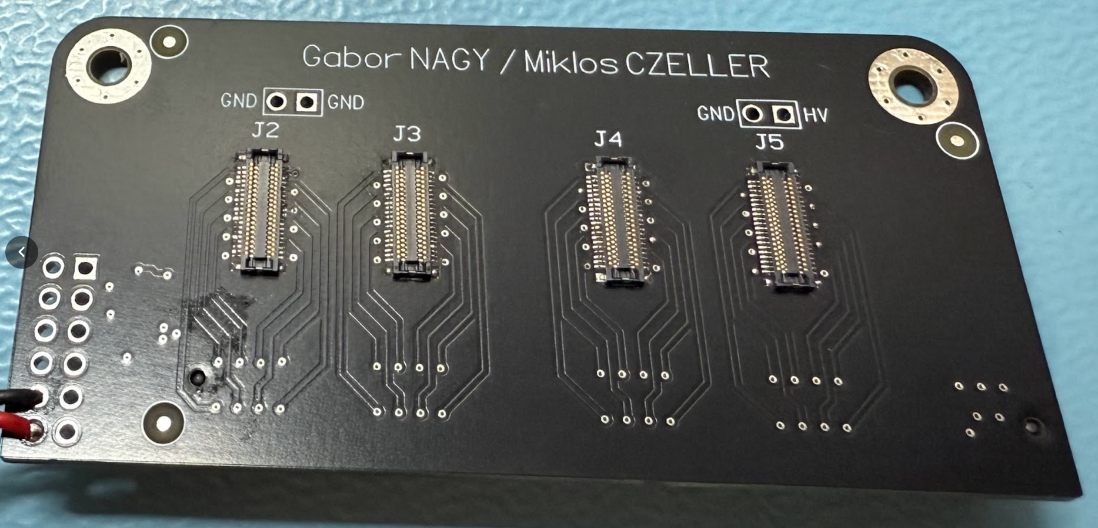
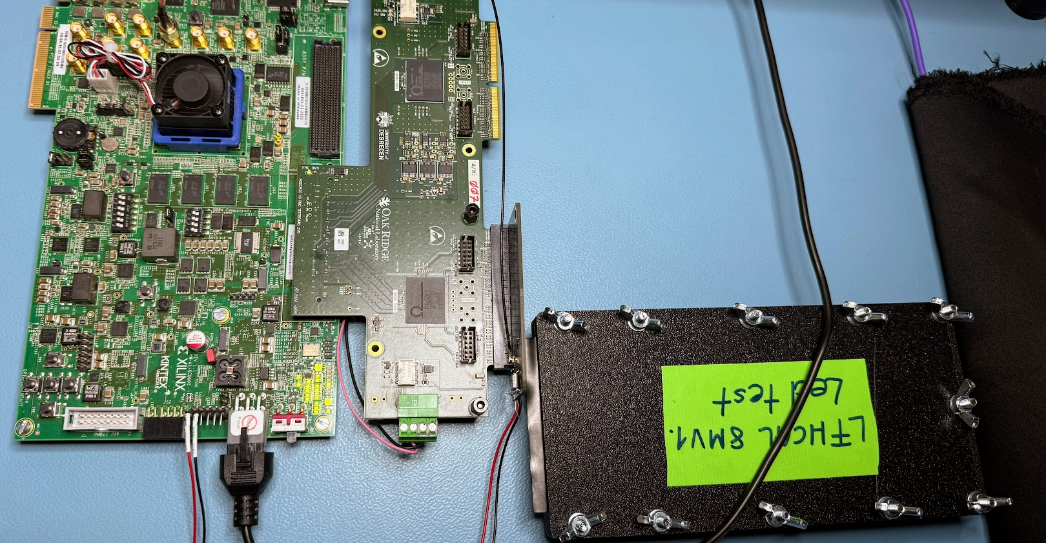
New TestBoard and setup

Slide 7
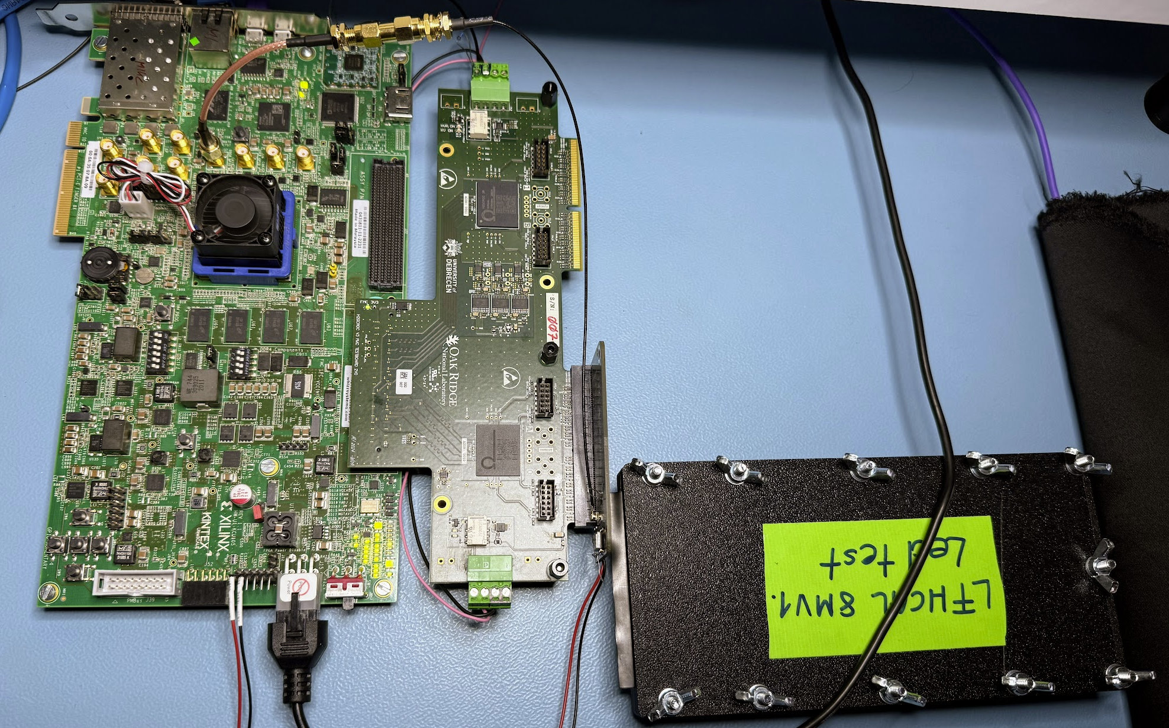
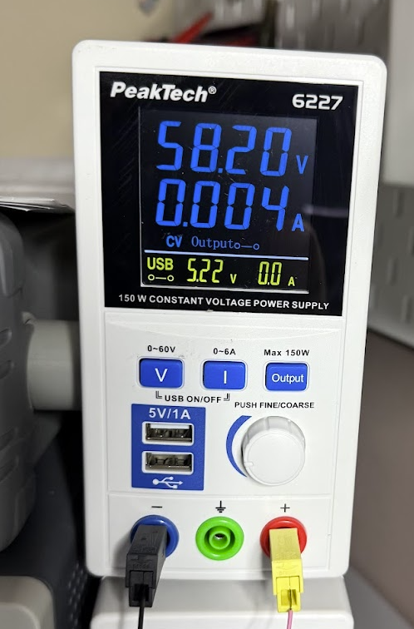
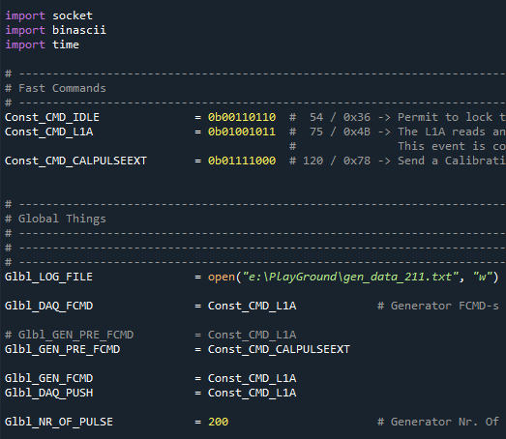
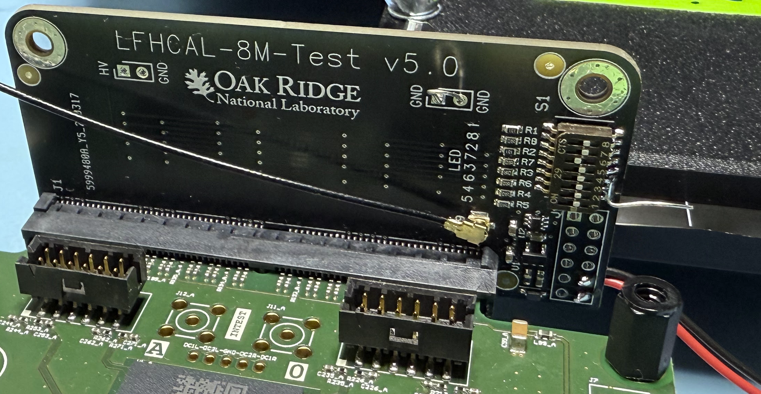
Measurements - #10
102_LedTest_DAQ_001.py
103_LedTest_CheckDataCh_004_Mult
HV = 58.2V / 200 pulse
gen_data_210.txt – All Off >> On this slide
gen_data_211.txt – DIP8 is ON
gen_data_212.txt – DIP7 is ON
gen_data_213.txt – DIP6 is ON
gen_data_214.txt – DIP5 is ON
gen_data_215.txt – DIP4 is ON
gen_data_216.txt – DIP3 is ON
gen_data_217.txt – DIP2 is ON
gen_data_218.txt – DIP1 is ON
gen_data_219.txt – DIP1/2/3 is ON >> On this slide
gen_data_221.txt – DIP1/2/3 is ON >> No LED Pulse
HV = 0V / 200 pulse
gen_data_220.txt – DIP1/2/3 is ON
DIP1 – CH2
DIP2 – CH4
DIP3 – CH3

Slide 8
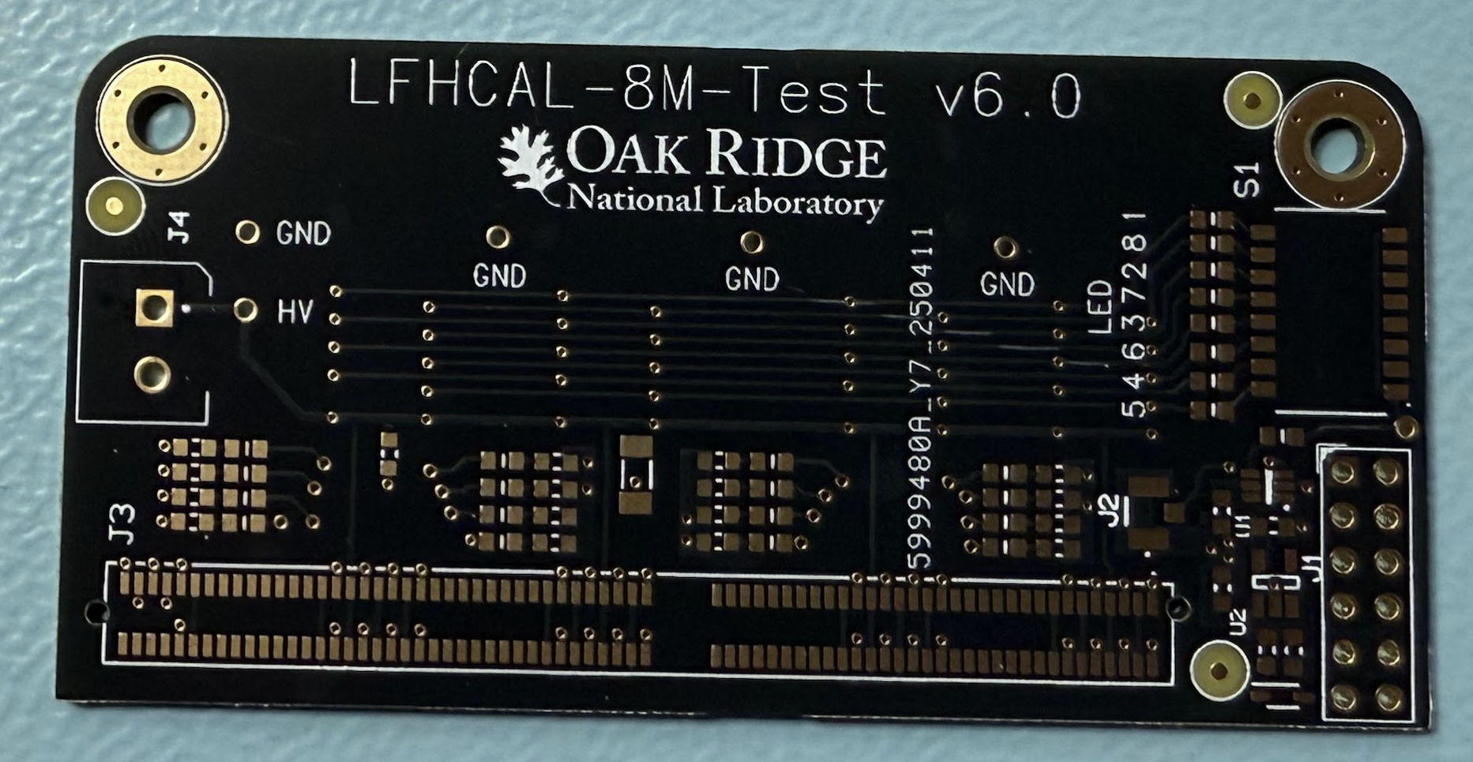
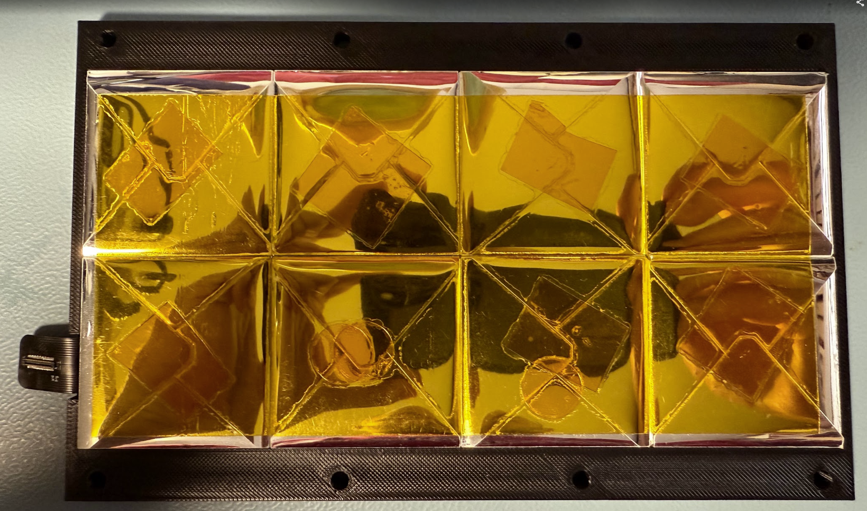
Trials – Ideas – Conclusions
Tried many changes
Tune the resistor value
Tune the pulse lengths → We have configuration
FB change / HV test
GND
Tune the test PCB led driver
Ideas / ToDo
New board is arrived yesterday → We can measure the flex PCB without HGC board
Soldering
New JIG with scintillator is under printing
Maybe We could change the driver circuit
Conclusion
Currently there is no...

Slide 10


Slide 11
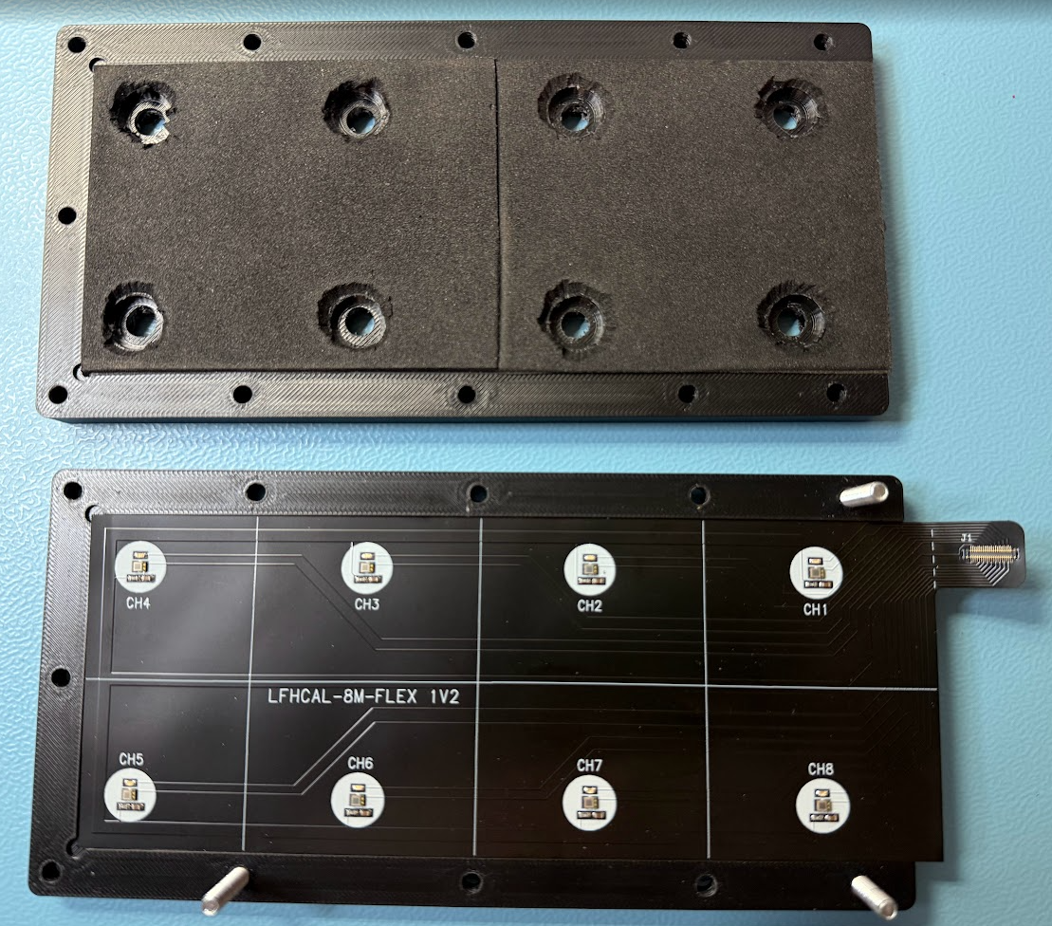
Measurements - #12 External LED
Different Pulse Length
102_LedTest_DAQ_001.py / 103_LedTest_CheckDataCh_004_Mult
HV = 58.2V / 200 pulse / 100R Serial resistor
gen_data_330.txt – Ext LED – Calib Length: 0 – 2CLK >> 12.5ns
gen_data_331.txt – Ext LED – Calib Length: 1 – 3CLK >> 18.75ns
gen_data_332.txt – Ext LED – Calib Length: 2 – 4CLK >> 25 ns
gen_data_333.txt – Ext LED – Calib Length: 3 – 5CLK >> 31.25ns

Slide 12
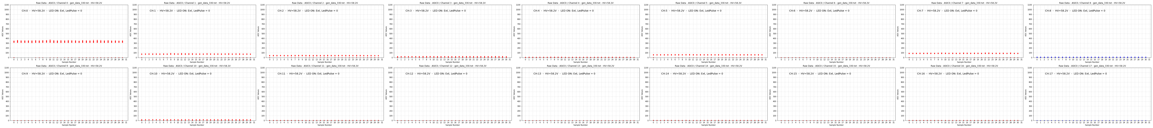
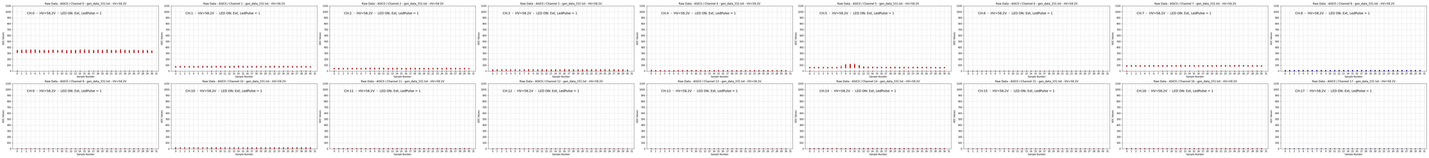
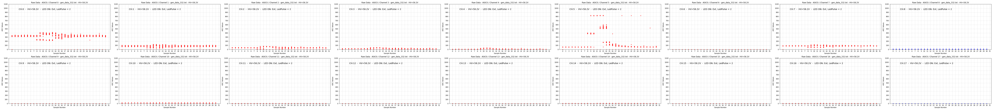
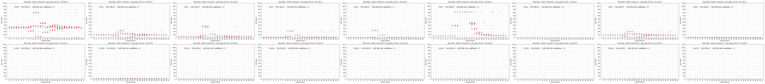
2CLK >> 12.5ns
3CLK >> 18.75ns
4CLK >> 25ns
5CLK >> 31.25ns

Slide 13
Measurements - #12 External LED
Different Resistors
102_LedTest_DAQ_001.py / 103_LedTest_CheckDataCh_004_Mult
HV = 58.2V / 200 pulse / 4CLK – 25ns
gen_data_340.txt – Ext LED – N/A
gen_data_341.txt – Ext LED – 100R
gen_data_342.txt – Ext LED – 200R
gen_data_343.txt – Ext LED – 330R
gen_data_344.txt – Ext LED – 330||200 → 124.5R
gen_data_345.txt – Ext LED – 470||200 → 140.3R
gen_data_346.txt – Ext LED – 2000||470||200 → 131.1R
gen_data_347.txt – Ext LED – 1600||470||200 → 128.9R
gen_data_348.txt – Ext LED – 330||200 → 124.5R
gen_data_349.txt – Ext LED – 330||200 → 124.5R
gen_data_350.txt – Ext LED – 330||200 → 124.5R
gen_data_351.txt – Ext LED – 330||200 → 124.5R
gen_data_352.txt – Ext LED – 330||200 → 124.5R
gen_data_353.txt – Ext LED – 330||200 → 124.5R
gen_data_354.txt – Ext LED – 330||200 → 124.5R
100R, 200R, 330R, 470R, 820R, 1000R, 1200R, 1600R, 2000R, 3300R, 3900R

Slide 14
25ns @ 100R
25ns @ 200R
25ns @ 330R
25ns @ 124.5R
25ns @ 140.3R
25ns @ 131.1R
25ns @ 128.9R

Slide 16
Measurements - #14 - External Led – Fix Res., Variable pulse length
102_LedTest_DAQ_001.py / 103_LedTest_CheckDataCh_004_Mult
HV = 58.2V / 200 pulse / 4CLK – 25ns - 2
gen_data_360.txt – Ext LED – 330||200 → 124.5R
gen_data_361.txt – Ext LED – 330||200 → 124.5R
gen_data_362.txt – Ext LED – 330||200 → 124.5R
gen_data_363.txt – Ext LED – 330||200 → 124.5R
HV = 58.2V / 200 pulse / 5CLK – 31.25ns - 3
gen_data_364.txt – Ext LED – 330||200 → 124.5R
HV = 58.2V / 200 pulse / 6CLK – 37.5ns - 4
gen_data_365.txt – Ext LED – 330||200 → 124.5R
HV = 58.2V / 200 pulse / 7CLK – 43.75ns - 5
gen_data_366.txt – Ext LED – 330||200 → 124.5R
HV = 58.2V / 200 pulse / 8CLK – 50ns - 6
gen_data_367.txt – Ext LED – 330||200 → 124.5R
100R, 200R, 330R, 470R, 820R, 1000R, 1200R, 1600R, 2000R, 3300R, 3900R

Slide 17
Measurements - #15 - External Led – Fix Res., Variable pulse length
102_LedTest_DAQ_001.py / 103_LedTest_CheckDataCh_004_Mult
HV = 58.2V / 200 pulse / 4CLK – 25ns - 2
gen_data_370.txt – Ext LED – 1K
HV = 58.2V / 200 pulse / 8CLK – 50ns - 6
gen_data_371.txt – Ext LED – 1K
HV = 58.2V / 200 pulse / 12CLK – 75ns - 10
gen_data_372.txt – Ext LED – 1K
HV = 58.2V / 200 pulse / 16CLK – 100ns - 14
gen_data_373.txt – Ext LED – 1K
100R, 200R, 330R, 470R, 820R, 1000R, 1200R, 1600R, 2000R, 3300R, 3900R

Slide 18
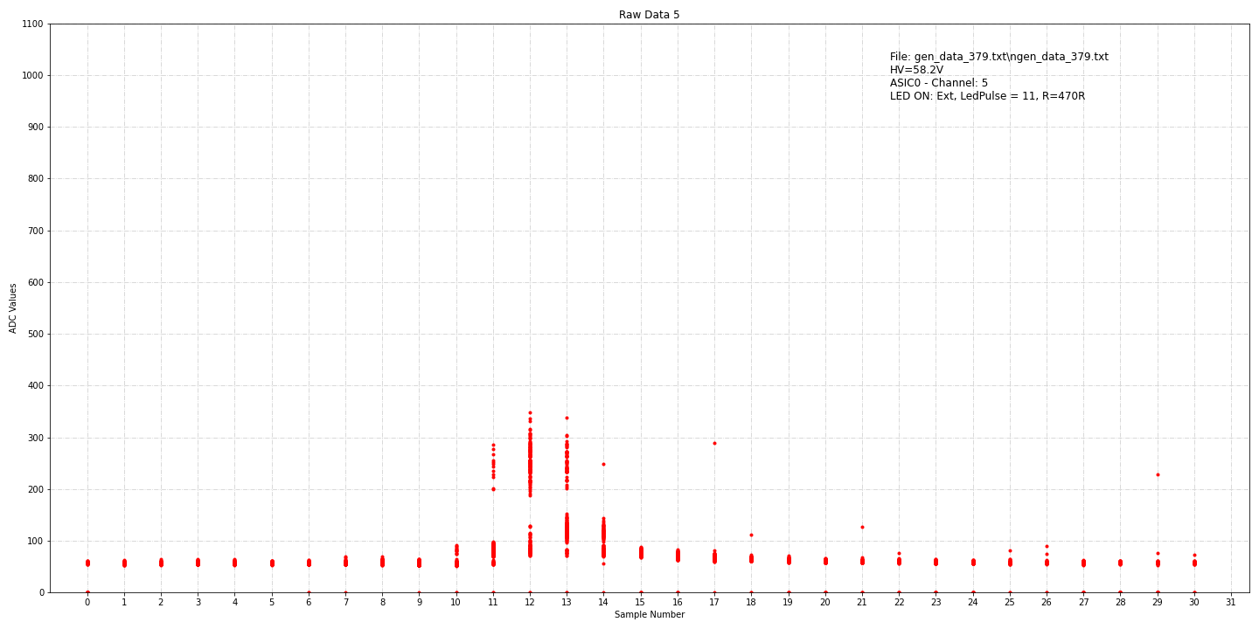
Measurements - #16 - External Led – Fix Res., Variable pulse length
102_LedTest_DAQ_001.py / 103_LedTest_CheckDataCh_004_Mult
HV = 58.2V / 200 pulse / 4CLK – 25ns - 2
gen_data_375.txt – Ext LED – 470R
HV = 58.2V / 200 pulse / 8CLK – 50ns - 6
gen_data_376.txt – Ext LED – 470R
HV = 58.2V / 200 pulse / 12CLK – 75ns - 10
gen_data_378.txt – Ext LED – 470R
HV = 58.2V / 200 pulse / 13CLK – 81.25ns - 11
gen_data_379.txt – Ext LED – 470R
HV = 58.2V / 200 pulse / 14CLK – 87.5ns - 12
gen_data_380.txt – Ext LED – 470R
HV = 58.2V / 200 pulse / 15CLK – 93.75ns - 13
gen_data_381.txt – Ext LED – 470R
HV = 58.2V / 200 pulse / 16CLK – 100ns - 14
gen_data_377.txt – Ext LED – 470R
100R, 200R, 330R, 470R, 820R, 1000R, 1200R, 1600R, 2000R, 3300R, 3900R

Slide 19
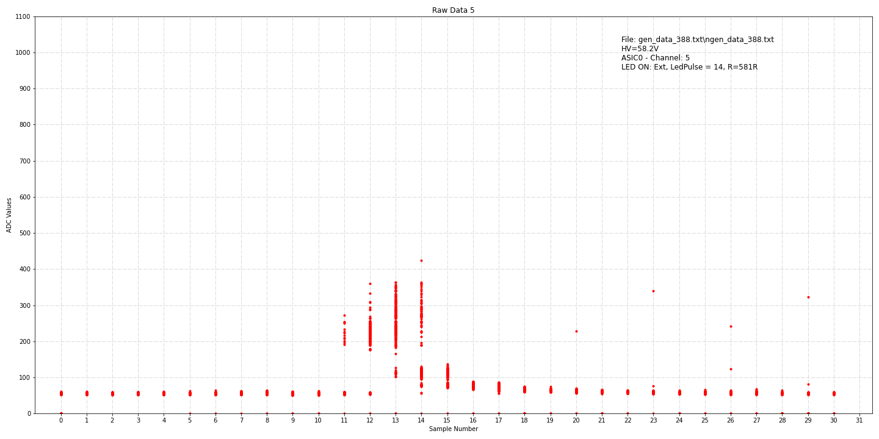
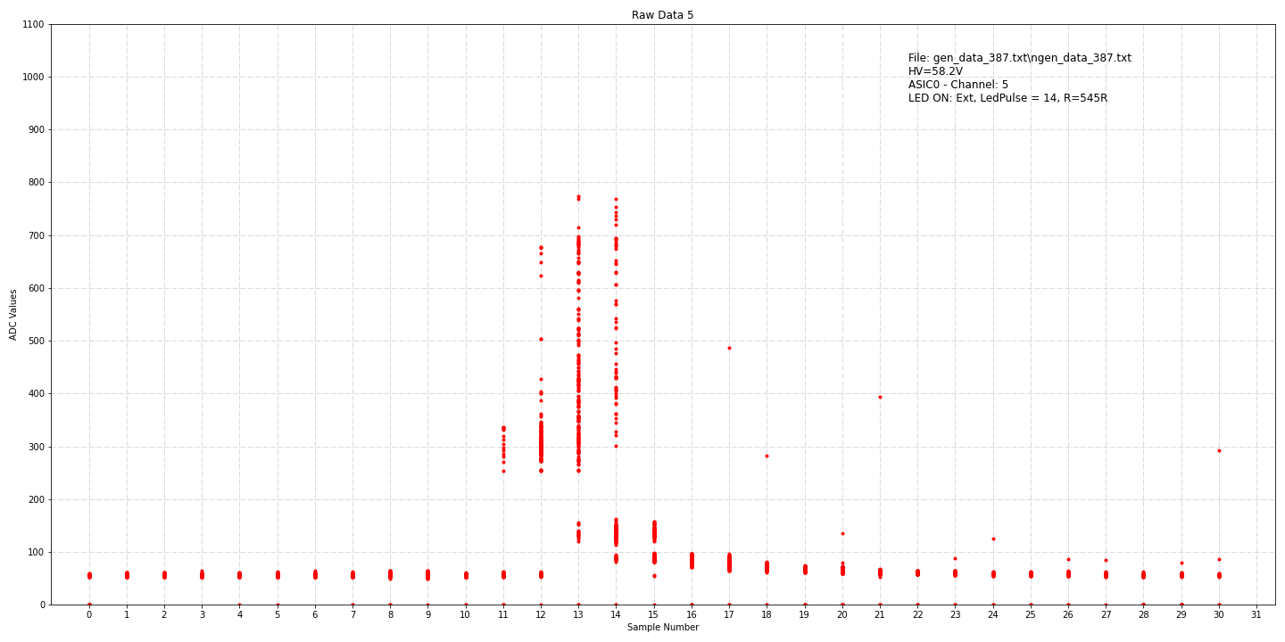
Measurements - #17 - External Led – Resistor tuning for HGC Pulse
102_LedTest_DAQ_001.py / 103_LedTest_CheckDataCh_004_Mult
HV = 58.2V / 200 pulse / 16CLK – 100ns - 14
gen_data_385.txt – Ext LED – 666R
HV = 58.2V / 200 pulse / 16CLK – 100ns - 14
gen_data_386.txt – Ext LED – 615R
HV = 58.2V / 200 pulse / 16CLK – 100ns - 14
gen_data_388.txt – Ext LED – 581R
HV = 58.2V / 200 pulse / 16CLK – 100ns - 14
gen_data_387.txt – Ext LED – 545R

Slide 20
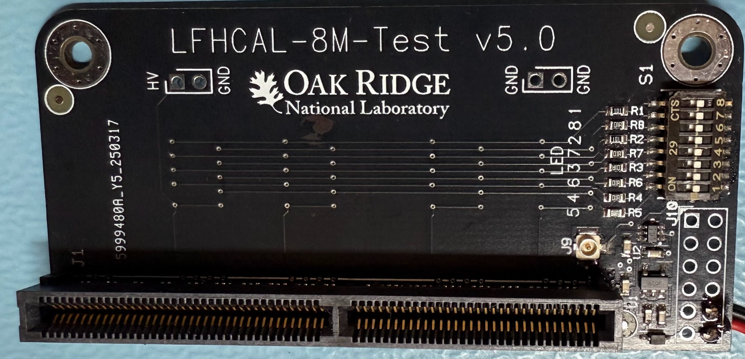
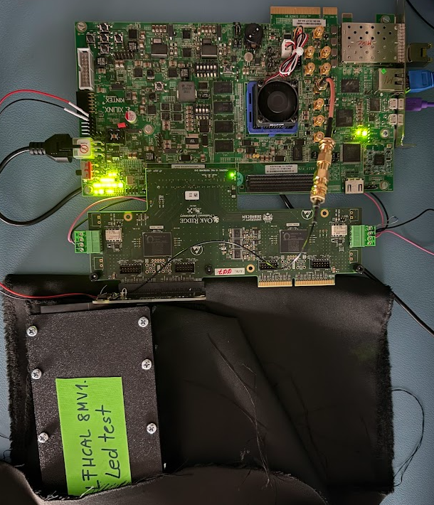
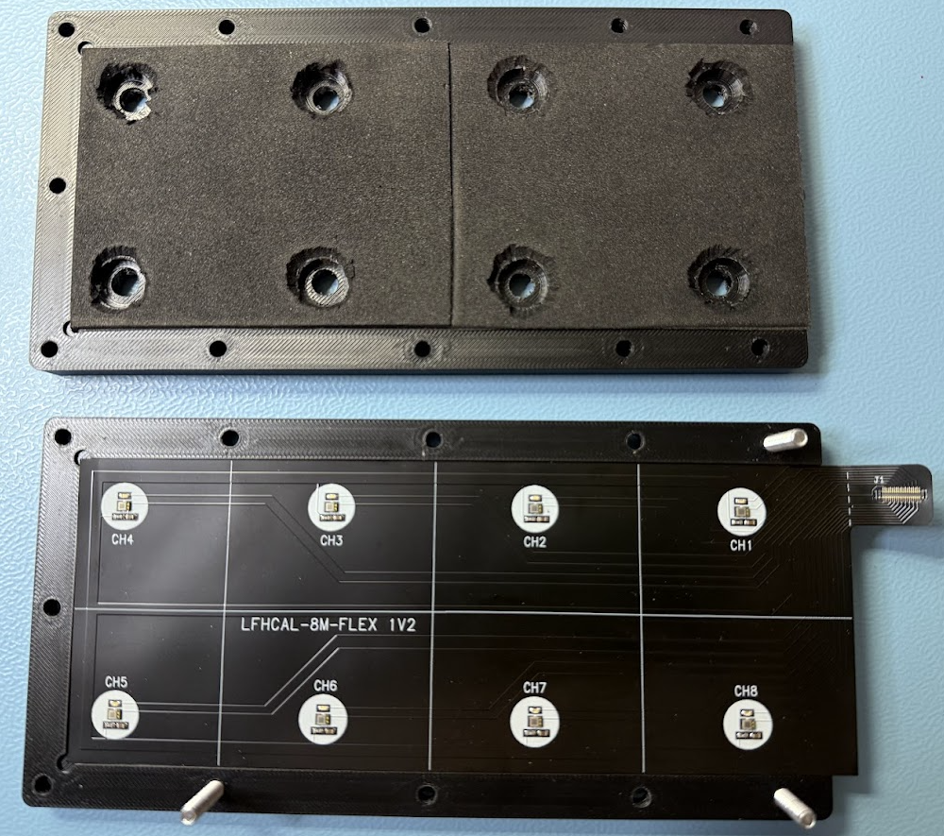
Measurements - #18 – Full (brand new) flex test
102_LedTest_DAQ_001.py
103_LedTest_CheckDataCh_004_Mult
HV = 58.2V
DAQ = 200 generator pulse
LED Serial resistor = 560R
gen_data_420.txt – No LED
gen_data_421.txt – LED1 – Pulse:16
gen_data_422.txt – LED2 – Pulse:120
gen_data_423.txt – LED3 – Pulse:120
gen_data_424.txt – LED4 – Pulse:23
gen_data_425.txt – LED5 – Pulse:22
gen_data_426.txt – LED6 – Pulse:22
gen_data_427.txt – LED7 – Pulse:19
gen_data_428.txt – LED8 – Pulse:18

Slide 23
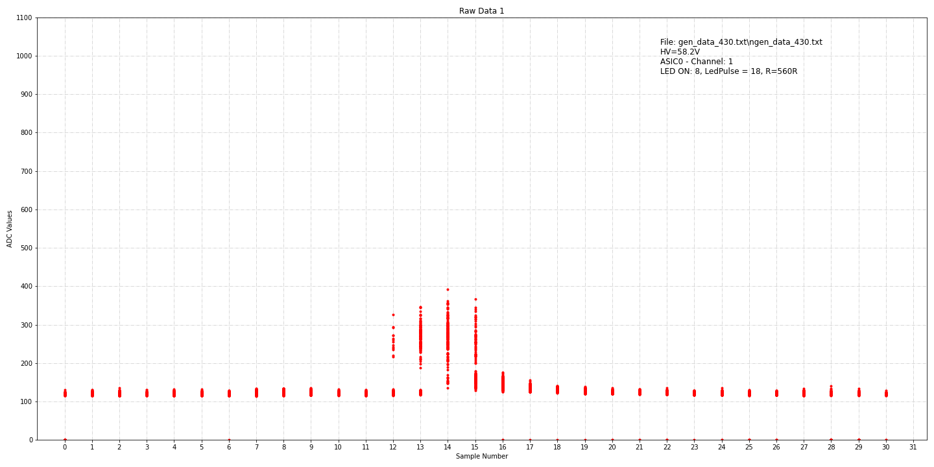
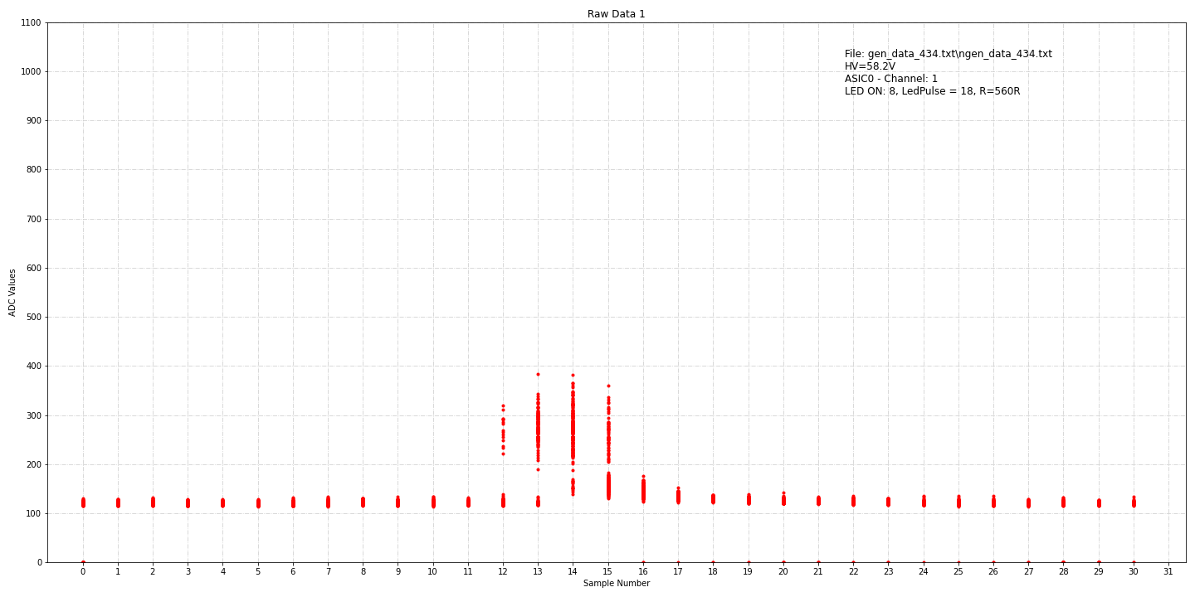
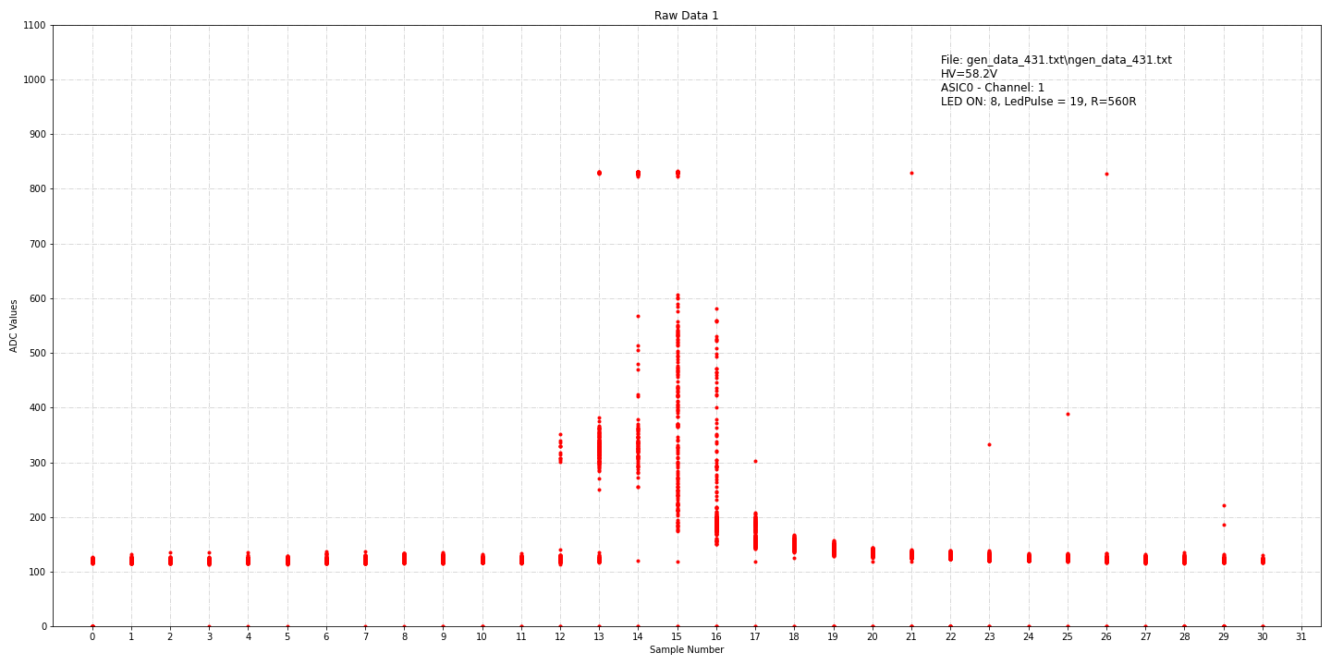
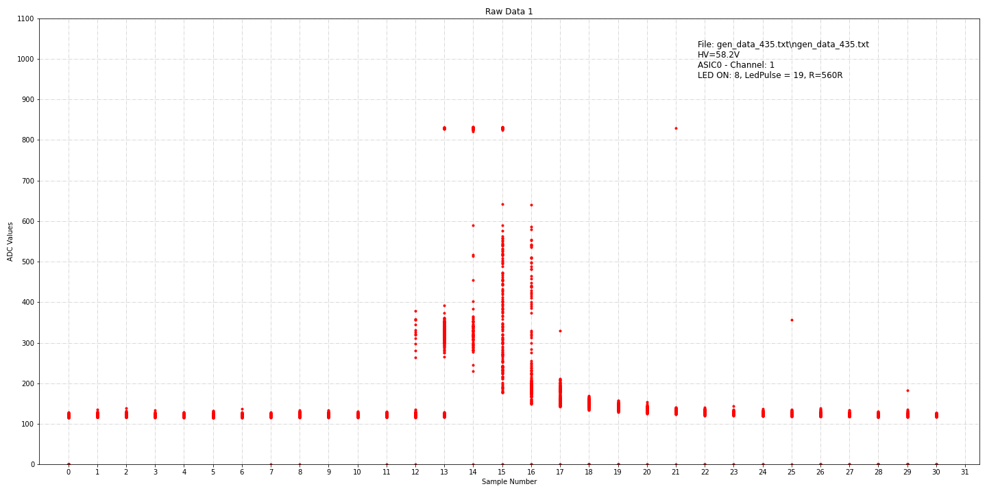
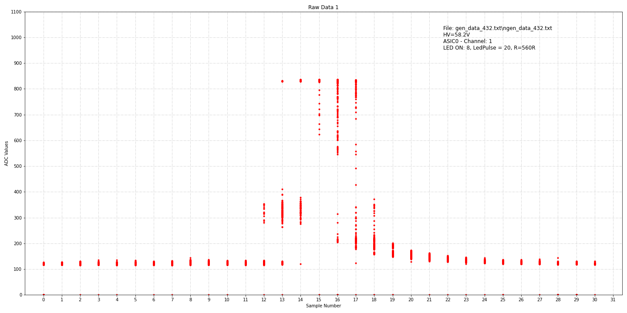
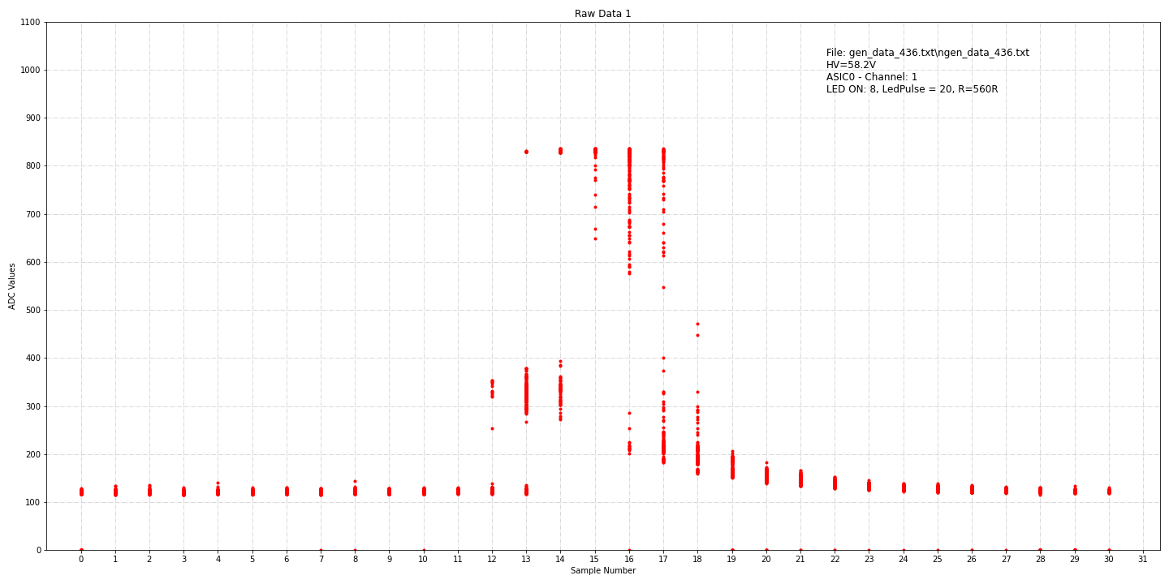
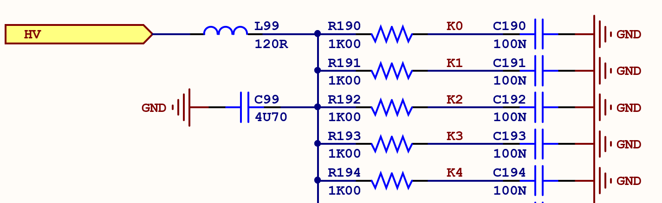
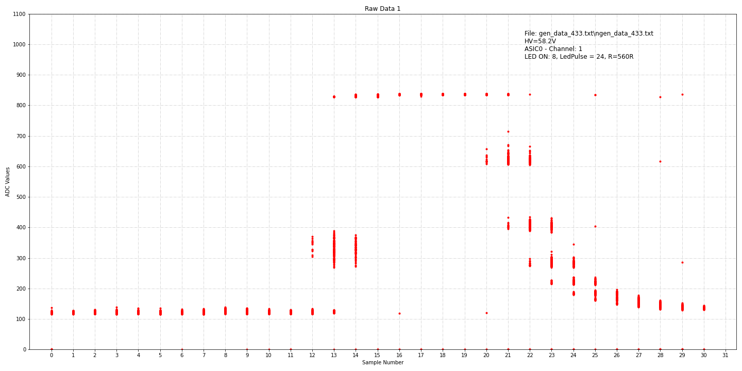
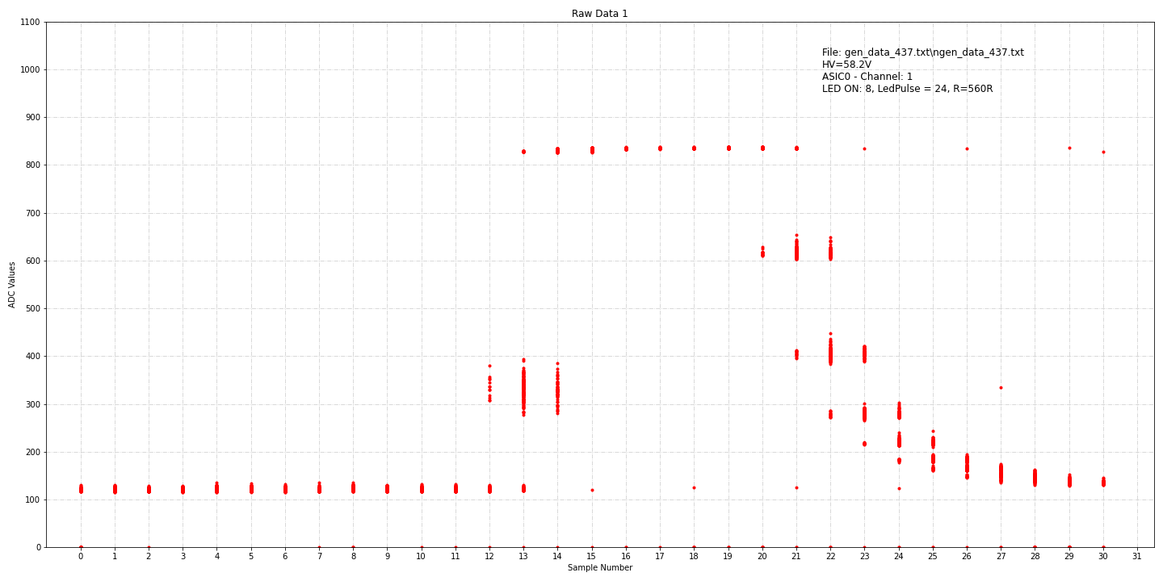
Measurements - #19 – High Voltage FB Hack
102_LedTest_DAQ_001.py
103_LedTest_CheckDataCh_004_Mult
HV = 58.2V
DAQ = 200 generator pulse
LED Serial resistor = 560R
gen_data_430.txt – LED8 – Pulse:18
gen_data_431.txt – LED8 – Pulse:19
gen_data_432.txt – LED8 – Pulse:20
gen_data_433.txt – LED8 – Pulse:24
After L99 Short
gen_data_434.txt – LED8 – Pulse:18
gen_data_435.txt – LED8 – Pulse:19
gen_data_436.txt – LED8 – Pulse:20
gen_data_437.txt – LED8 – Pulse:24

Slide 24
Measurements - #19 – High Voltage FB Hack

Slide 25
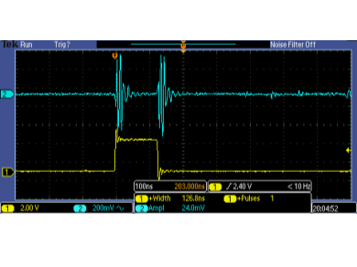
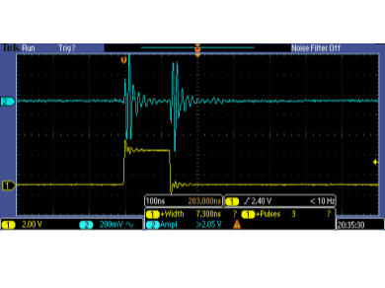
Measurements - #19 – High Voltage FB Hack

Slide 26
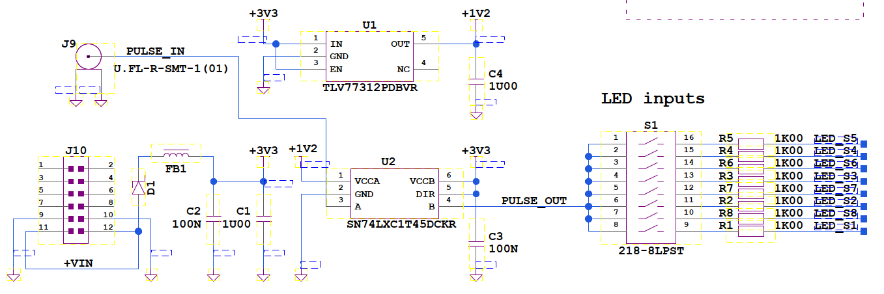
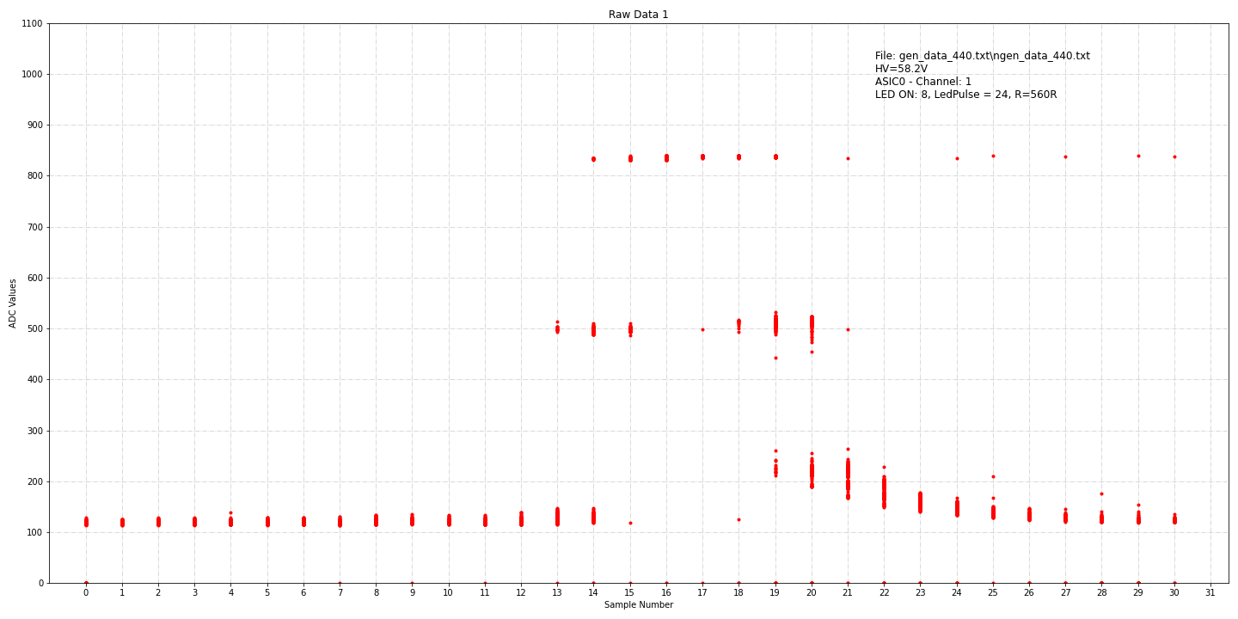
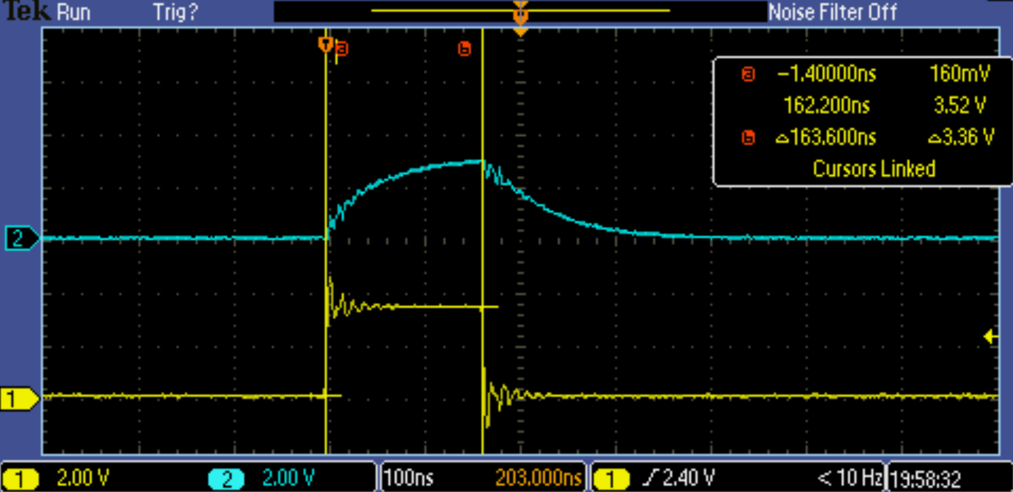
Measurements - #20 – LED PULSE
102_LedTest_DAQ_001.py
103_LedTest_CheckDataCh_004_Mult
HV = 58.2V
DAQ = 200 generator pulse
LED Serial resistor = 560R
After L99 Short
gen_data_440.txt – LED8 – Pulse:24
gen_data_441.txt – LED8 – Pulse:24
gen_data_442.txt – LED8 – Pulse:24, No scope
gen_data_443.txt – LED8 – Pulse:30, No scope
gen_data_444.txt – LED8 – Pulse:30
gen_data_445.txt – LED8 – Pulse:24
gen_data_446.txt – LED8 – Pulse:24, 1nF
gen_data_447.txt – LED8 – Pulse:24, 100pF
gen_data_448.txt – LED8 – Pulse:40, 100pF
gen_data_449.txt – LED8 – Pulse:50, 100pF

Slide 27
Measurements - #20 – LED PULSE

Slide 28
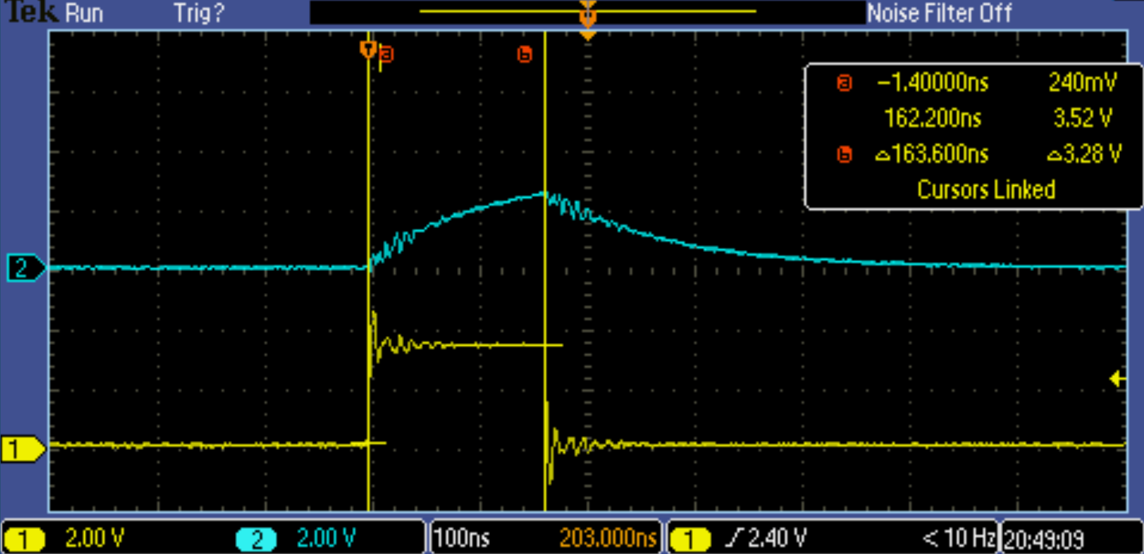
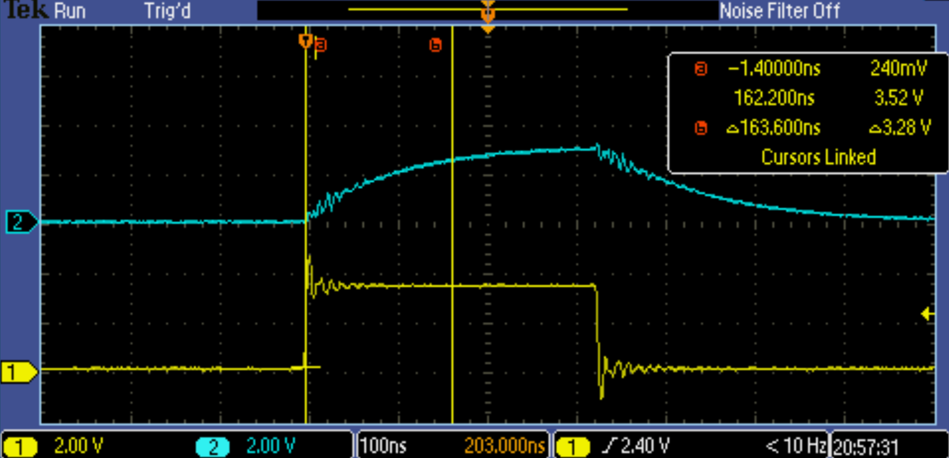
Measurements - #20 – LED PULSE
Scope + 100pF
Scope

Slide 29
Measurements - #21 – LED PULSE Cap

Slide 30
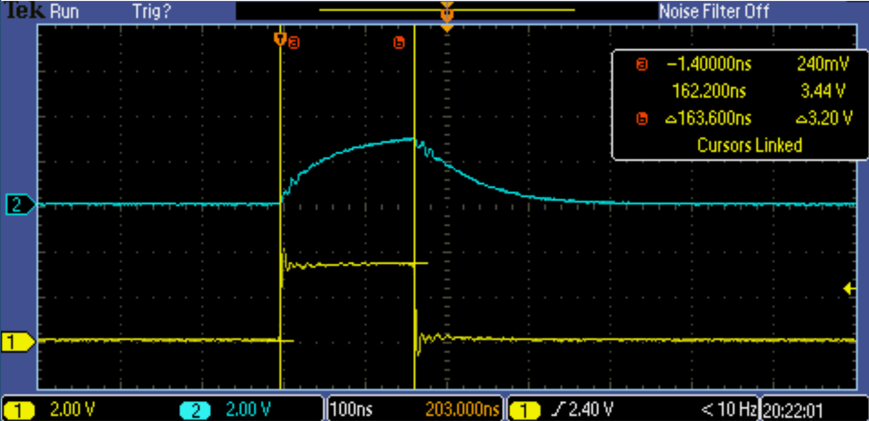
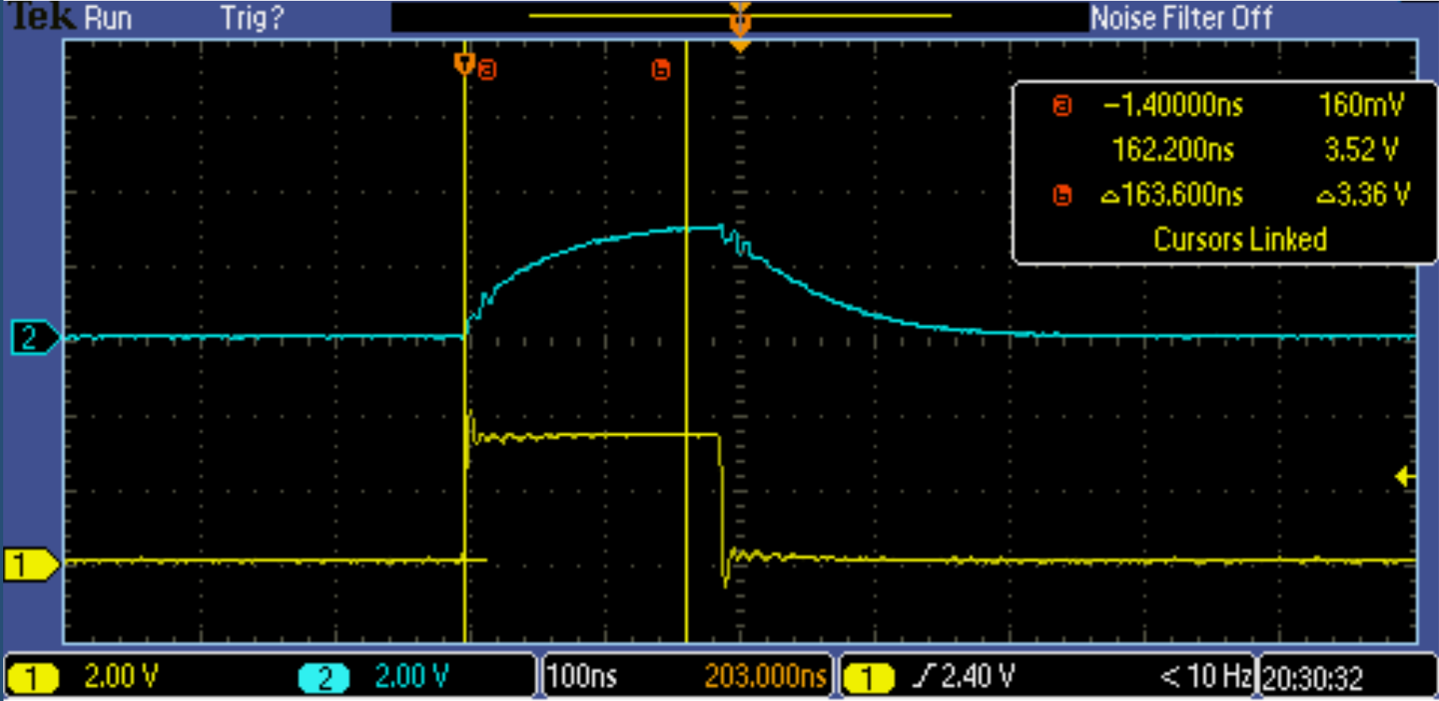
Measurements - #21 – 33R
102_LedTest_DAQ_001.py
103_LedTest_CheckDataCh_004_Mult
HV = 58.2V
DAQ = 200 generator pulse
LED Serial resistor = 560R
After L99 Short
gen_data_452.txt – LED8 – Pulse:24
gen_data_453.txt – LED8 – Pulse:28

Slide 31
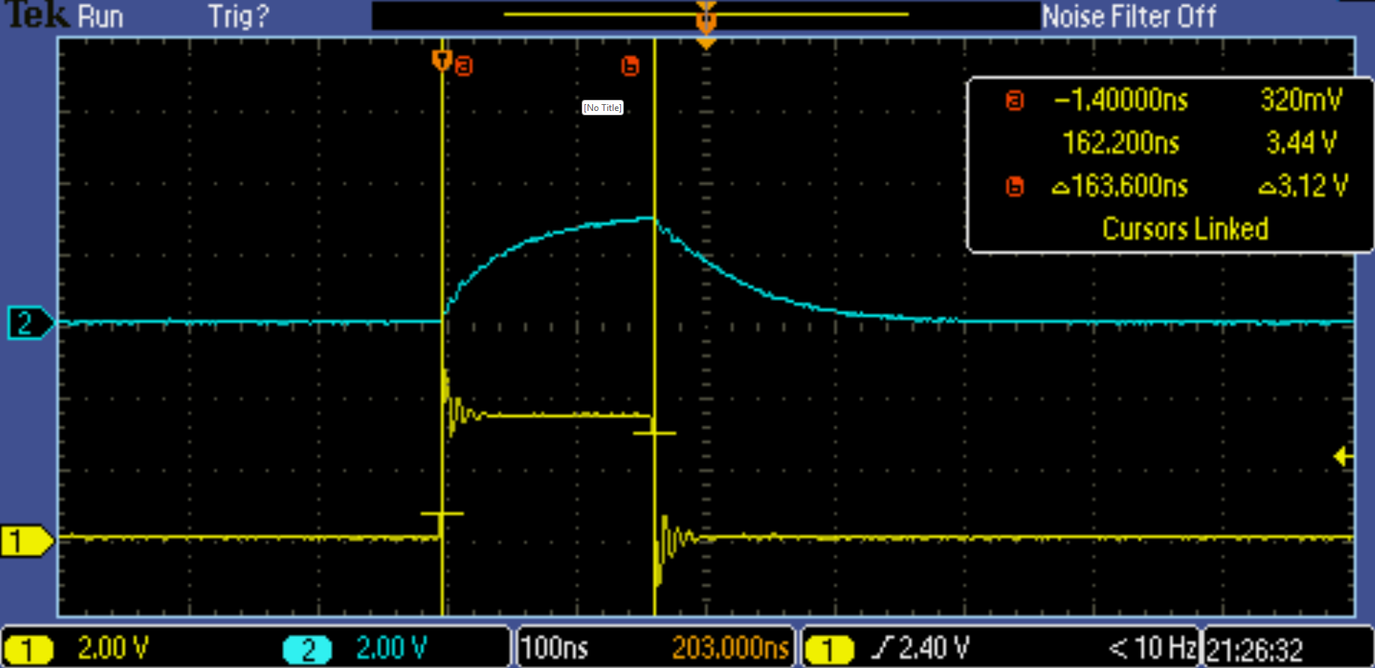
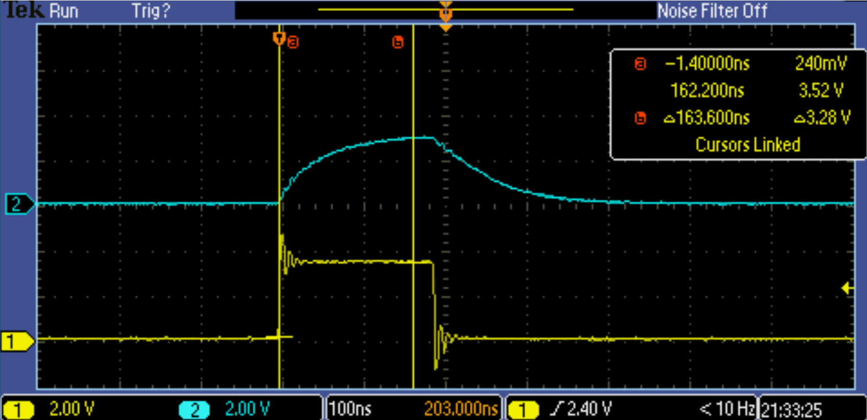
Measurements - #22 – Strong GND
102_LedTest_DAQ_001.py
103_LedTest_CheckDataCh_004_Mult
HV = 58.2V
DAQ = 200 generator pulse
LED Serial resistor = 560R
After L99 Short
gen_data_454.txt – LED8 – Pulse:24
gen_data_454.txt – LED8 – Pulse:28

Slide 32
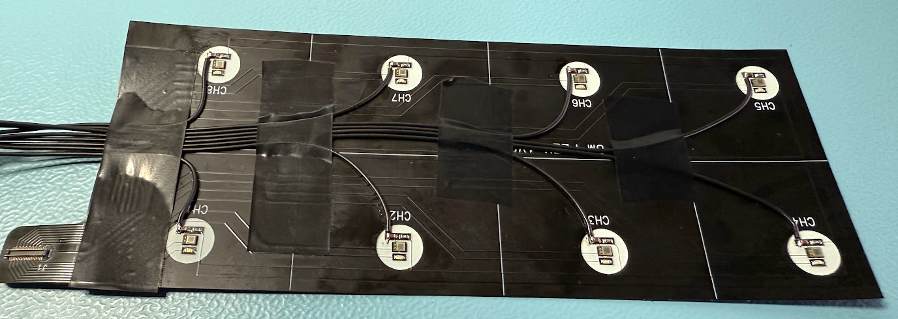
Measurements - #22 – Strong GND

