Slide 1
SX Beam Commissioning for Mu2e at Fermilab
October 6, 2025
Vladimir Nagaslaev
6th Slow Extraction Workshop, Stony Brook

Slide 2
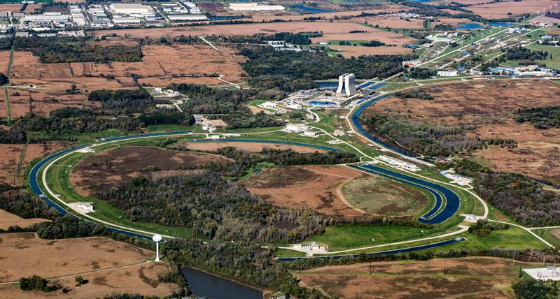
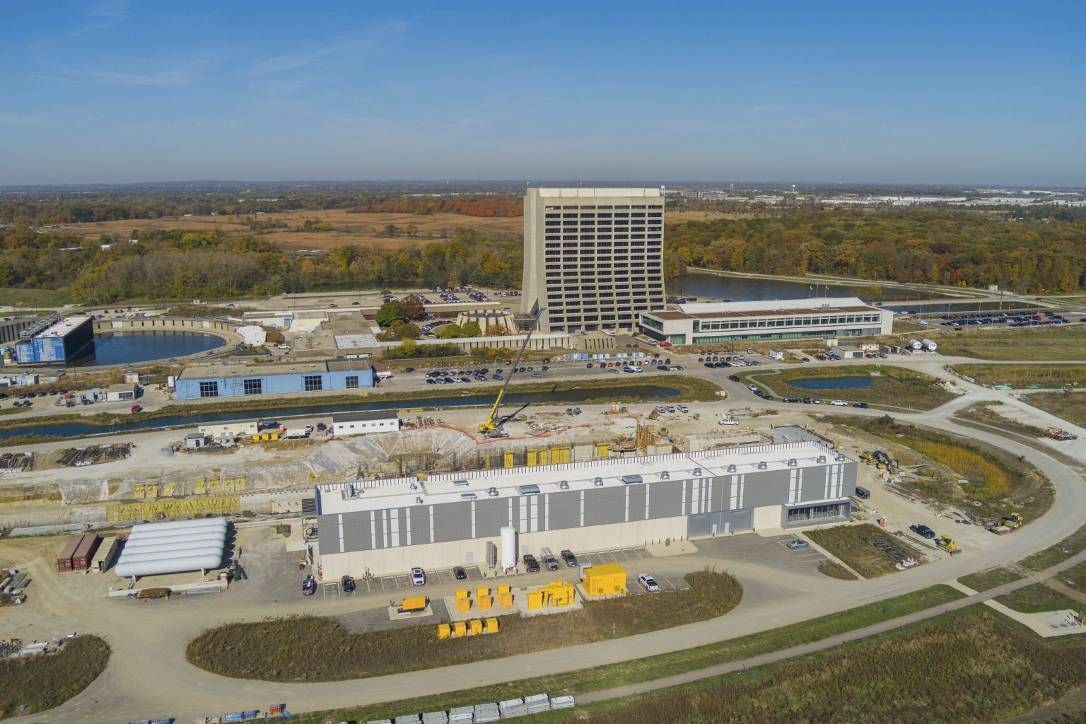
Main Beam Facilities at Fermilab
FAST,
IOTa
Ext. Beamlines
120GeV transport
Proton Source
Muon Campus
Delivery Ring
8GeV transport
Recycler
Main Injector

Slide 3
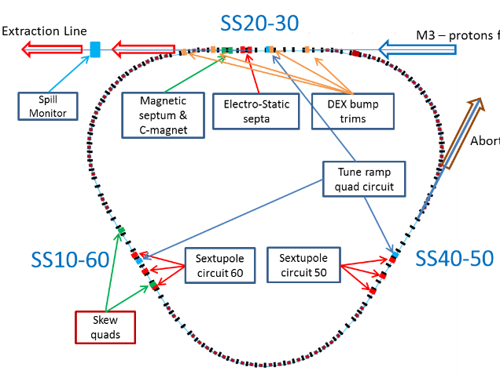
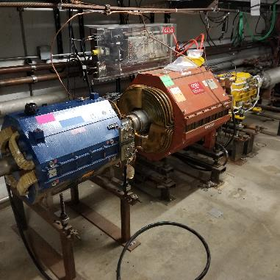
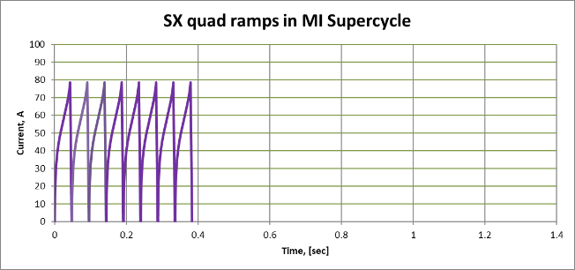
Mu2e SX overview
Delivery Ring:
  Circumference 505m (T_{r}=1.7usec)
  FODO lattice, β_{max}=15m
  Dispersion suppressed in SS
  Single bunch, T_{length}<200ns
Extraction:
  3rd integer, Q_{x}=29/3-Δ
  Q-squeeze
  Spill corrections: Quads + RFKO
RFKO kicker
Mu2e Beam design figures | 8GeV
Average beam power | 8kW
Intensity per spill | 1e12p
Spill length | 43ms
Reset time bw spills | 5ms
Spill Duty Factor | >60%
Efficiency | >98%

Slide 4
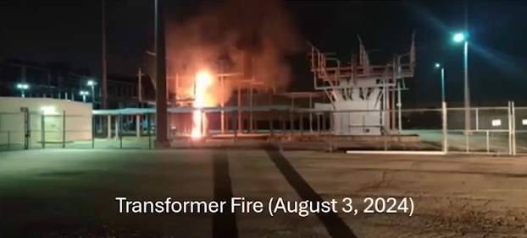
Delivery Ring Mu2e beam time, brief history
FY2023: Semi-Engineering Run; Parasitical; 2 weeks
FY2024: Engineering Run, 2 weeks
FY2025: Full capability; 2 months
  Fire in Main substation
  Main Injector heat exchanger failure
  PIP-II construction – power interruptions
  Fire in Muon Campus
FY2026: Min time for tunnel works during SS
2 substations; 8 Main 345kV transformers
Have 3 out of 8 until summer 2026
No Main Injector, Switchyard, neutrino

Slide 5
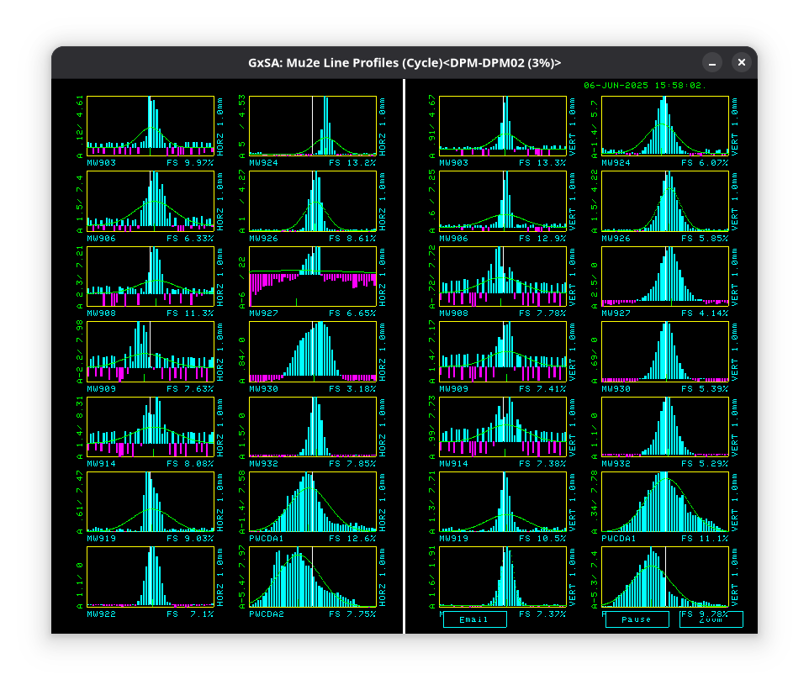
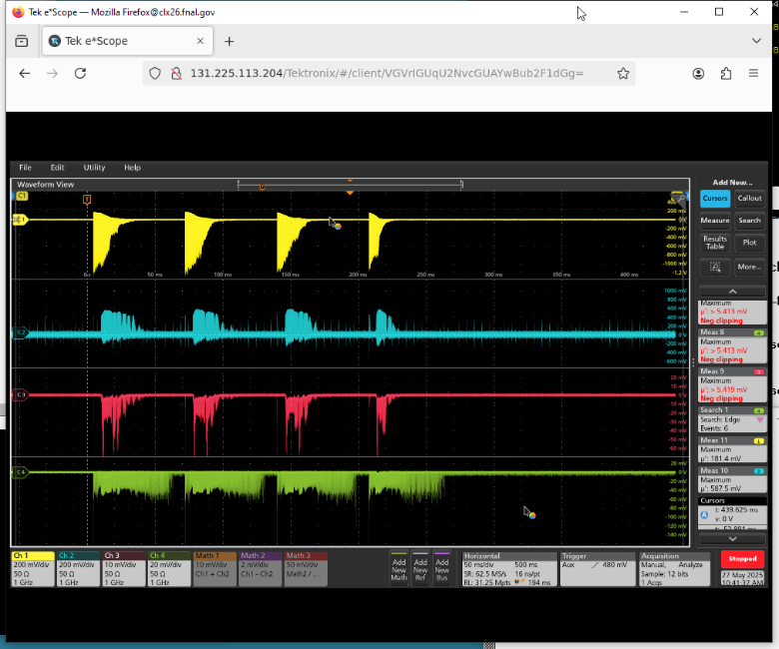
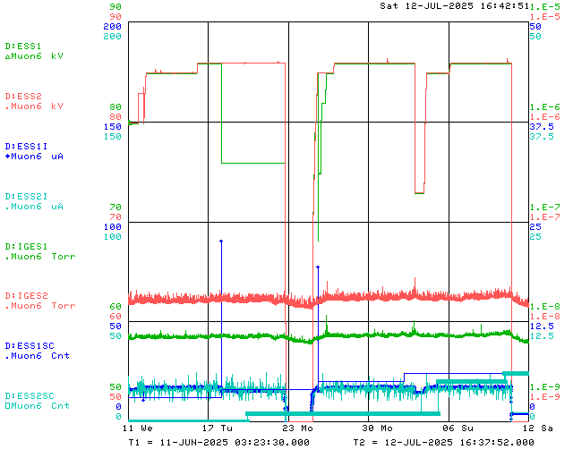
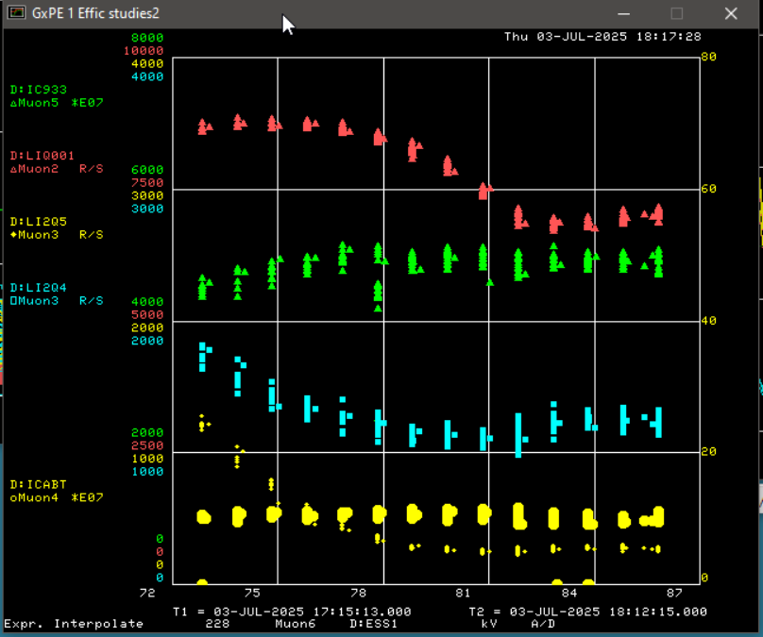
First positive observations
  Instrumentation/Diagnostics
  Improved optics and injection closure stability
  Energy matching
  Beam lifetime
  Multi-spill mode
  Stable ESS field
M4 beamline profile monitors
Circ. current
ESS HV
BL WCM
Yield
BL OTR
Operating voltage
Losses
Operating voltage,
86kV
BL BLM
Vacuum, current, sparks
Spill scope display,
4 spills in 0.25 sec
ESS HV
Losses and yield vs ESS voltage

Slide 6
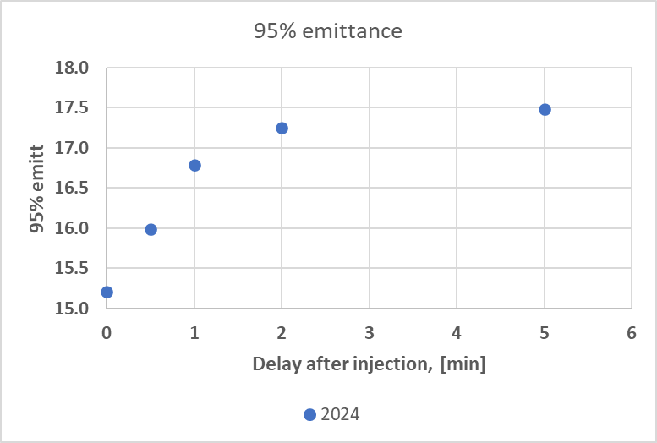
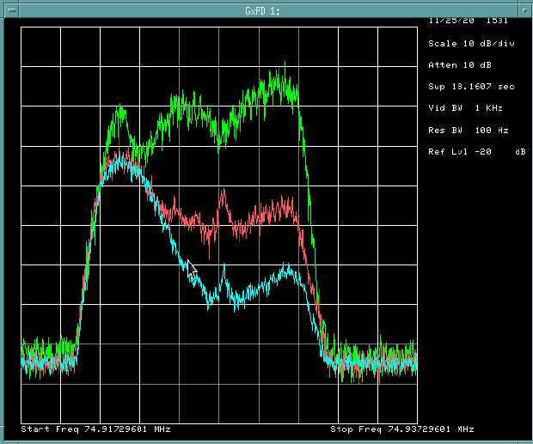
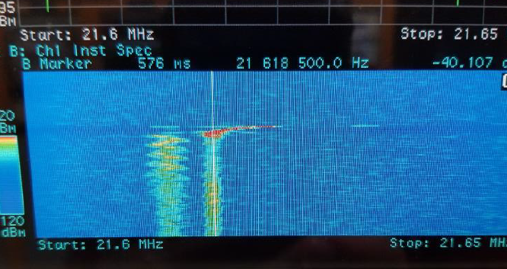
Injection stability concerns from previous runs
Observations from previous years:
Emittance from scraper scans, indicating fast emittance blow up
Fast longitudinal spectrum blow up
Fast tune drift at injection
Indicating a possibility of presence of some instabilities. This would make efficient extraction very difficult.
Initial emittance too high
Momentum blow up
Observation of fast tune drift

Slide 7
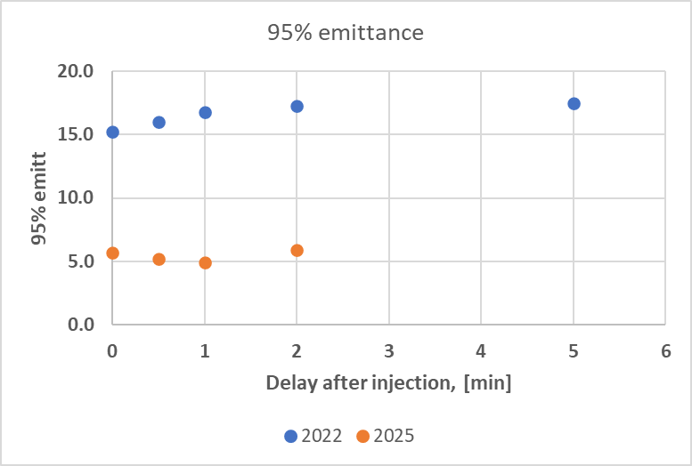
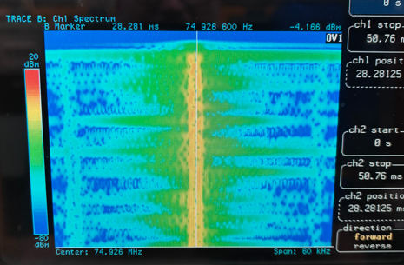
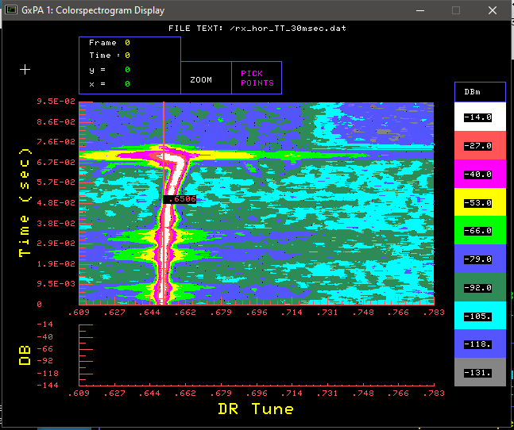
New injection stability studies
Emittance:
Emittance is not growing in 1min time scale
Initial emittance is high, but lower than before
No dependence on intensity, chromaticity, tune
Longitudinal spectrum:
No transition effects observed
Tune drift at injection:
Still present, will be discussed later
Need to continue investigation, but we
rule out instability effects

Slide 8
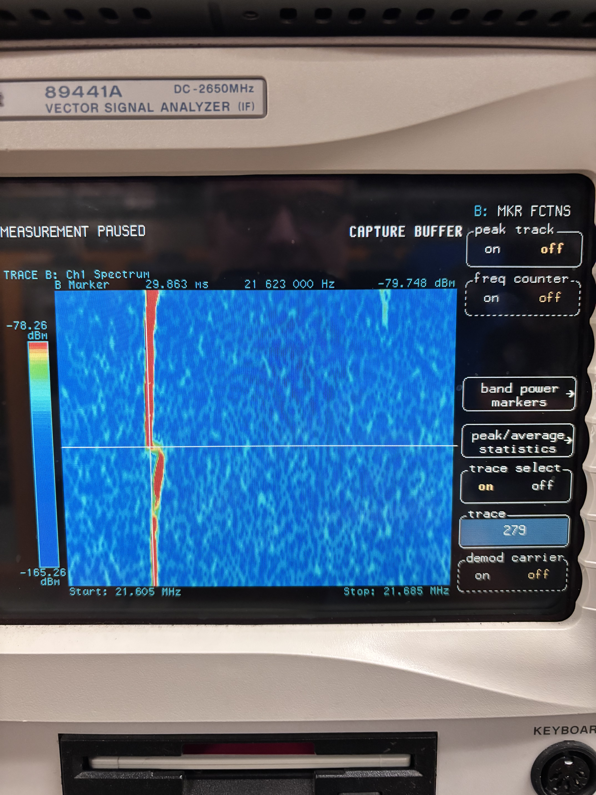
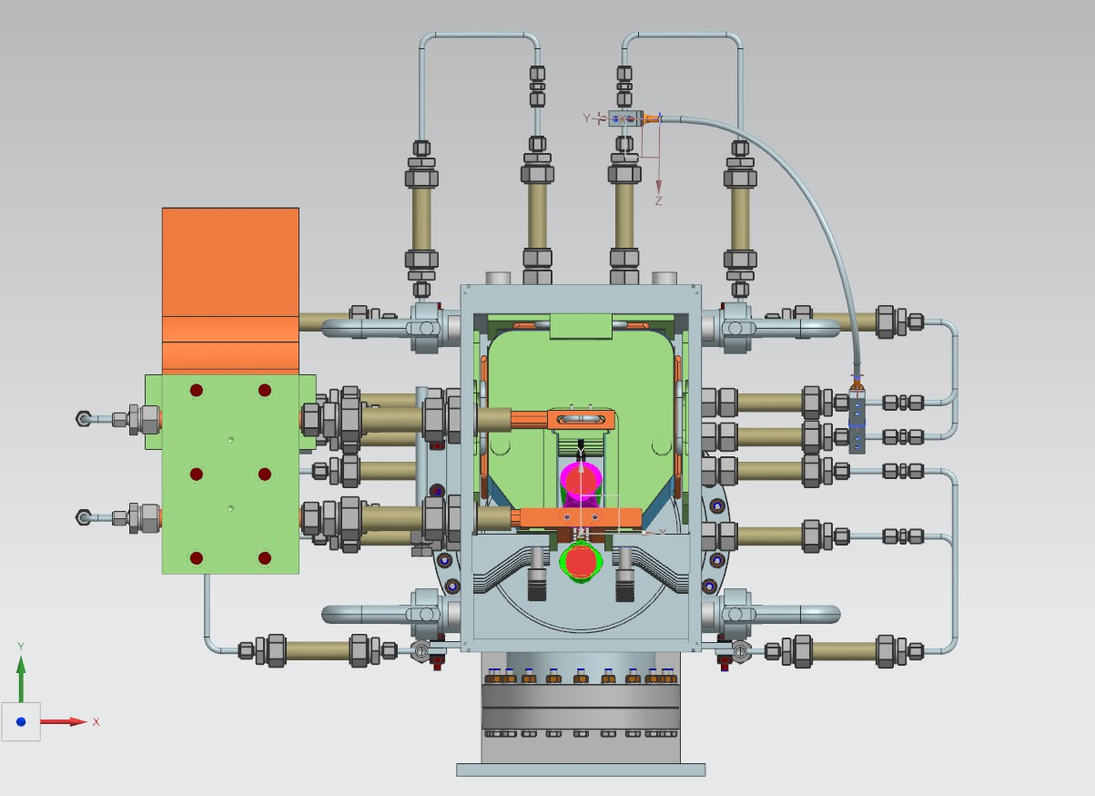
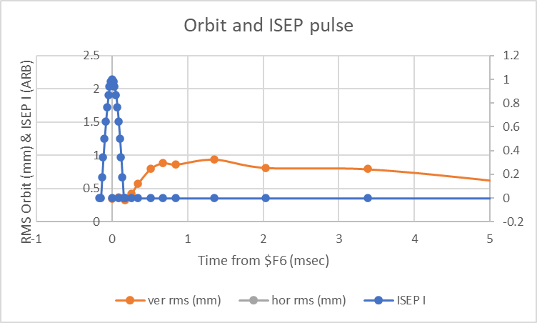
Tune drift
The tune drift observed in VSA waterfall at injection
Tune excursion is about 0.01
Takes about 1ms to reach max and relaxes in 10ms
There is a COD shift, pointing back to ISEP magnet
Multiple checks verified that it is caused by ISEP
Similar tune shift is produced by pulsing the ASEP
The puzzle: ISEP pulse takes only 0.3ms
Waterfall display of upper sideband
Tune drift caused by ASEP
Cross section of the ISEP magnet
ISEP pulse shape and tune drift

Slide 9
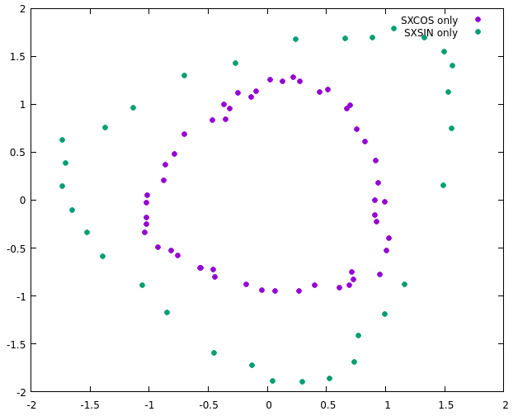
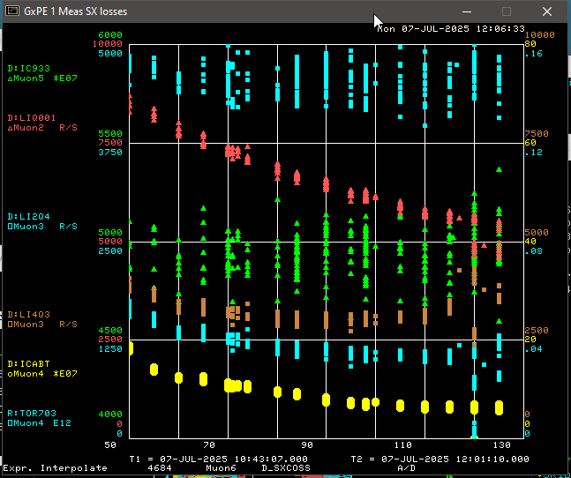
Sextupole fields strength and phase
Beam PS near ESS1
Two sextupole circuits: SXCOS and SXSIN
SXCOS is very close in phase to ideal
Were able to ramp the SXCOS close to design strength
Were not able to mix two circuits, as SXSIN appeared to be misaligned
SXCOS
SXSIN
Yield
Losses
I(SXCOS)
SXCOS strength scan

Slide 10
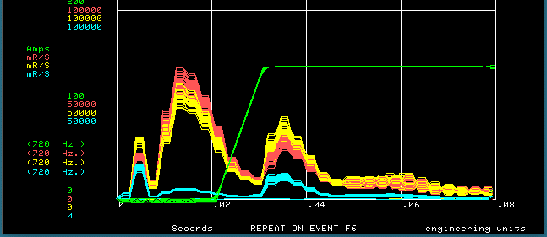
Losses and efficiency
Group 1: fast injection loss
Group 2: second injection loss
Group 3: Extraction losses
  Septum losses
  Extraction aperture losses
Not visible: M3&M4 beam line losses
2
1
3
Injection
Group 2:
Strongly depends on BL matching
Weekly depends on Qx&Qy shifts
Scales linearly with intensity
Not understood
Spill
Septum losses
Estimated at 2%
If alone, would satisfy Mu2e requirements

Slide 11
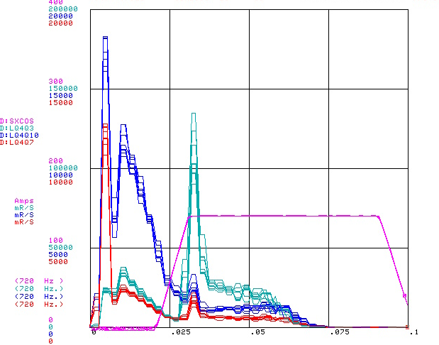
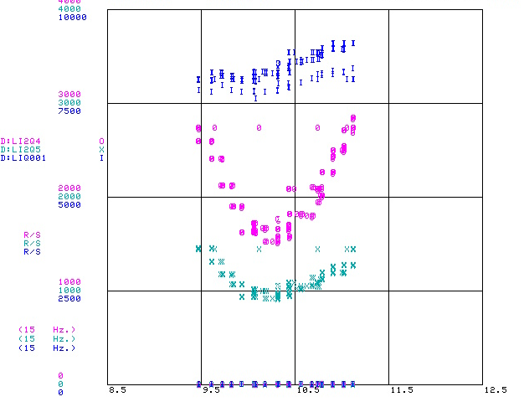
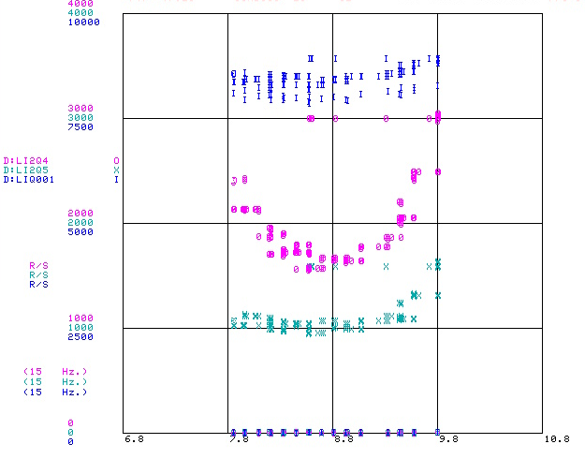
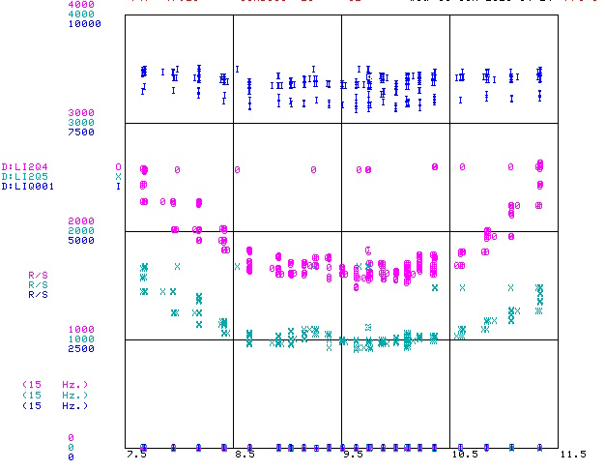
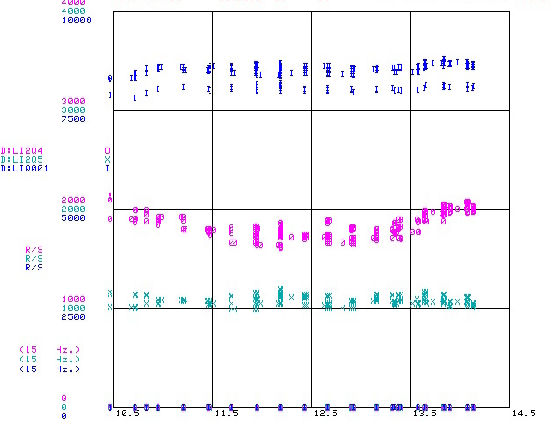
Septa alignment with beam
Sextupole ramp
Extraction septa aligned with the beam
Alignment performed using the loss monitors
Due to high losses BLM HV had to be strongly reduced
To separate extraction losses spill delayed ~30msec
Loss counters timed to extraction losses
Alignment turned out to be limited by the ELAM motion range
Had to reduce the ESS distance to the beam to accommodate
ELAM motion range to be fixed during this summer shutdown
Extraction Losses

Slide 12
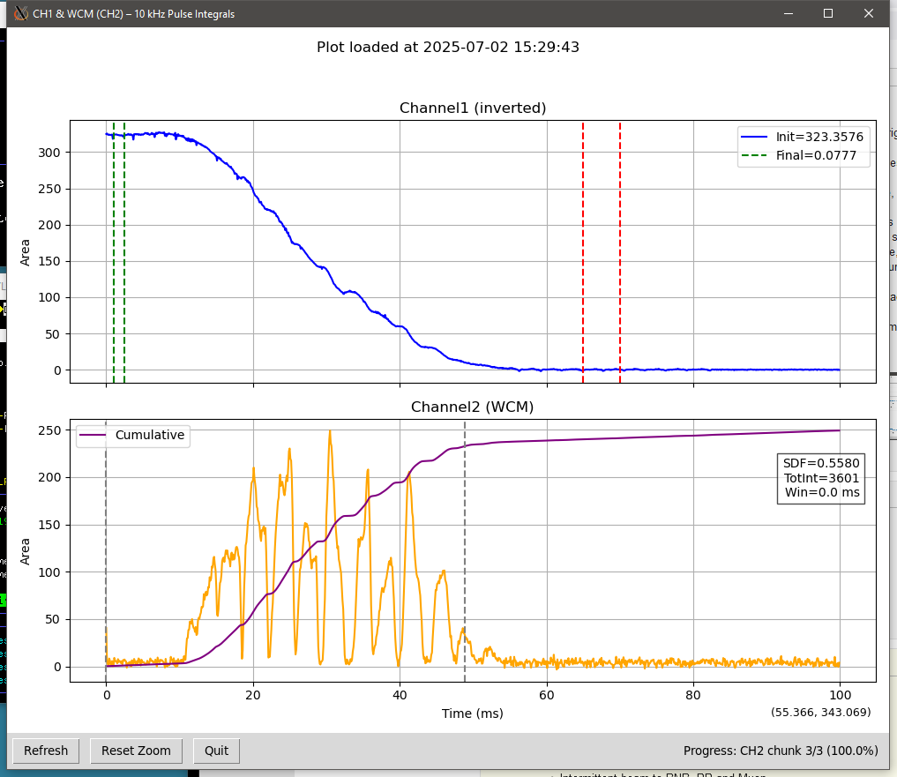
Spill variations
Spill Duty factor close to 60%
Satisfies requirements
Mu2e mostly concerned about spikes
Still, we will investigate the sources
Circulating beam
Extracted beam

Slide 13
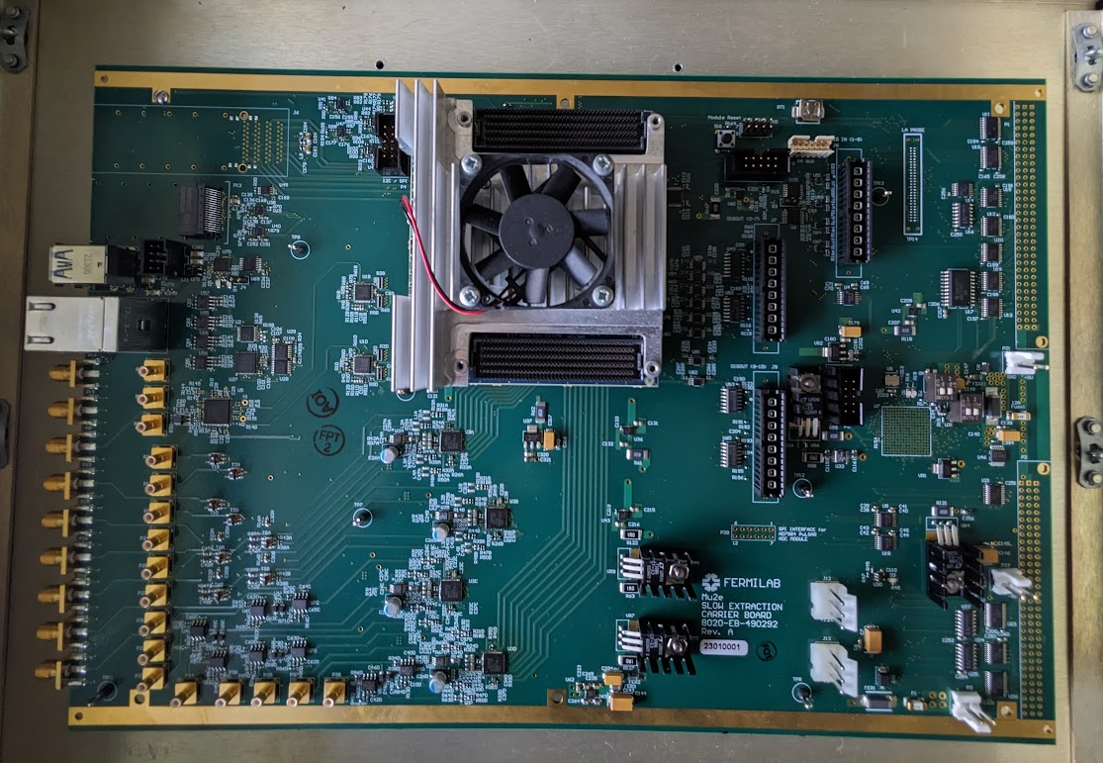
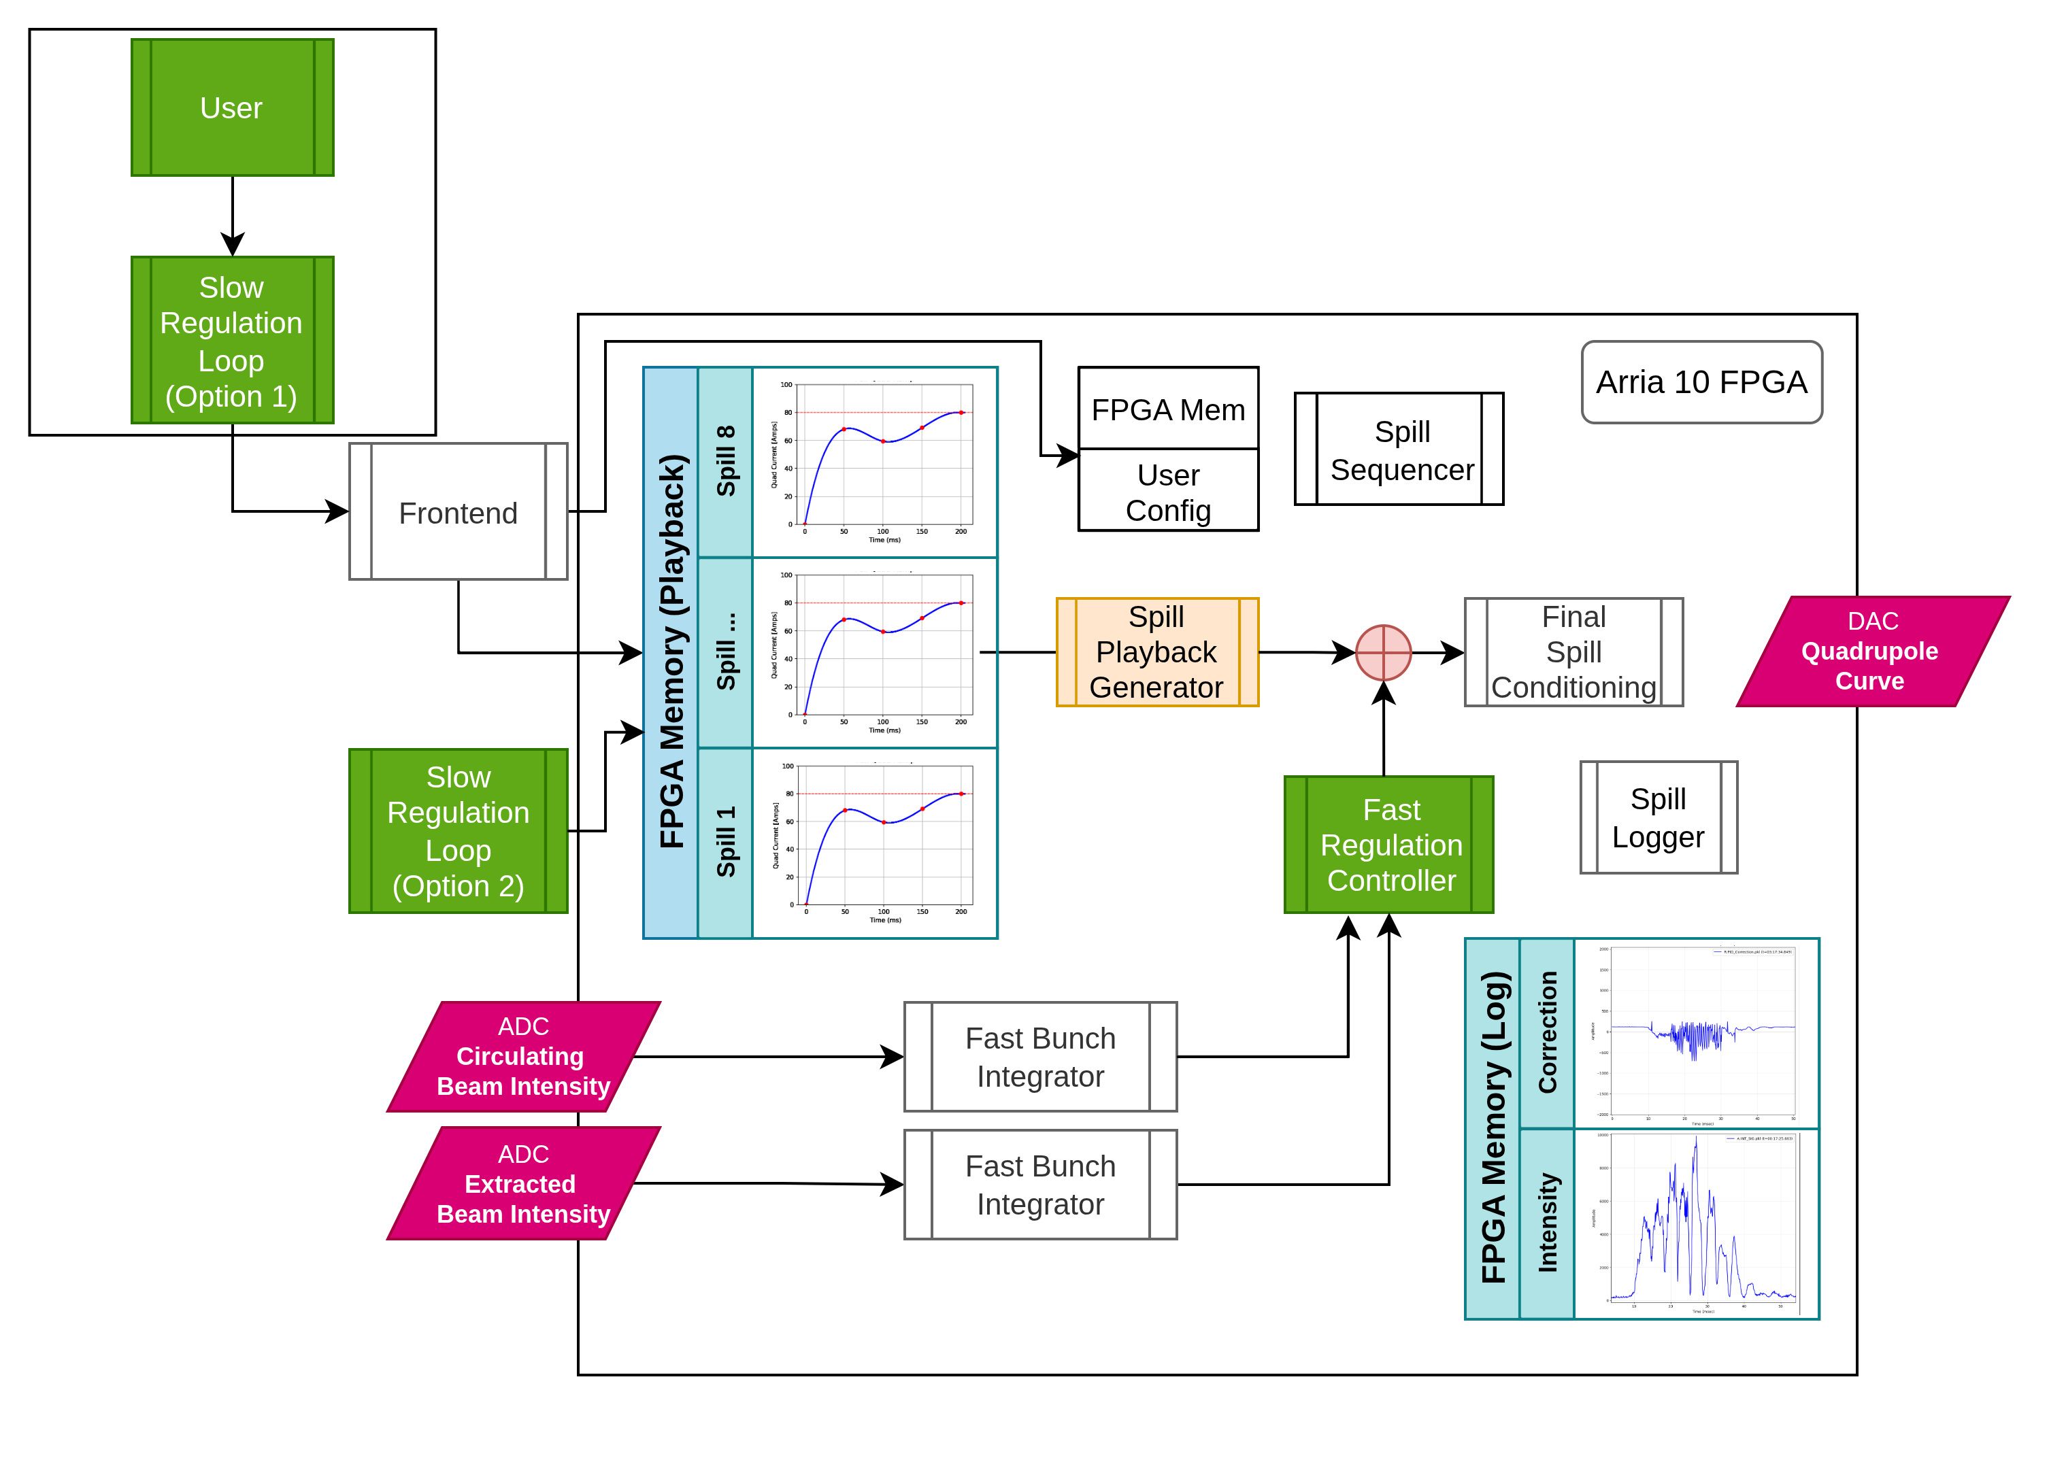
Spill regulation system
ARIA-10 SoM/SoC board with analogue IO
  125MSPS -> 10kHz decision rate
  16 14bit ADC/125MHz; 4 high-speed DACs; 3 QSFP
  2 Ethernet ports
  Runs the Q-squeeze to the QX PS
  Digitizes and integrates the WCM, GapMon, ExtMon
  Use them in fast regulation PID loop
  Slow regulation
  Harmonic filter controller
  Up to 8 spills management
Was commissioned in limited capability in this run
Run the QX PS
Digitize and integrate the SpillMon
Exercised the PID loop with QX regulation

Slide 14
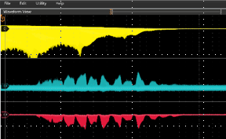
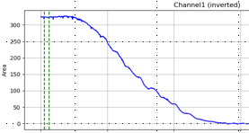
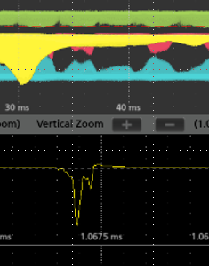
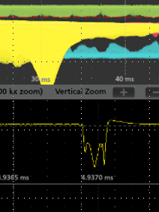
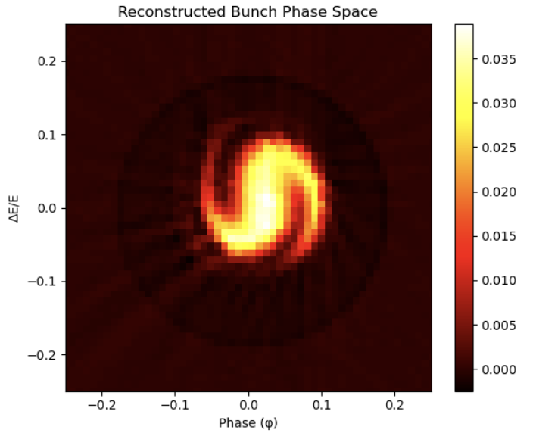
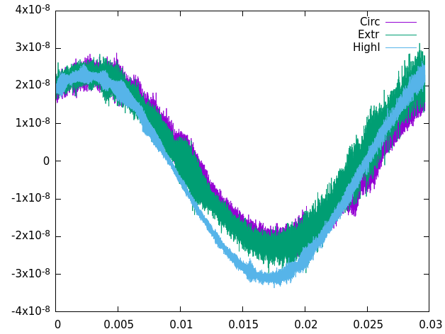
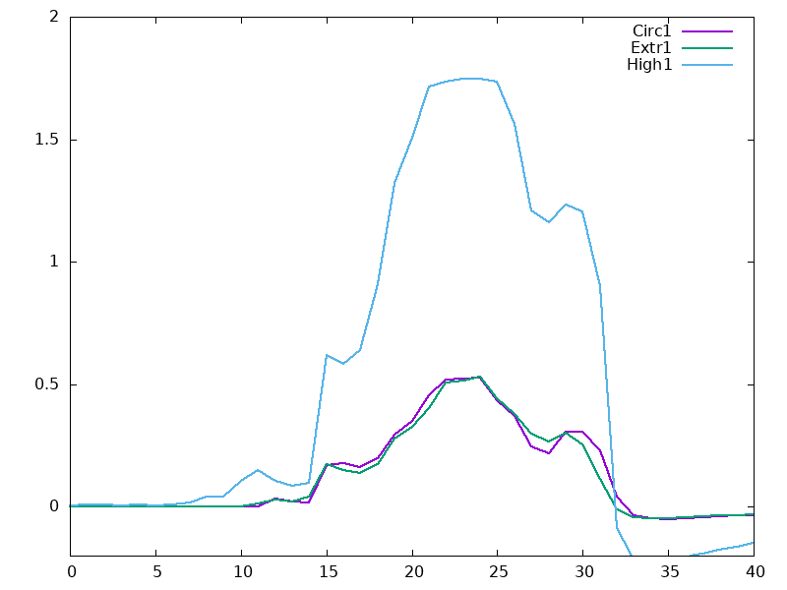
Longitudinal motion
Circulating beam intensity
raw
filtered
Analysis motivated by
  Extinction concerns (leakage from the bucket)
  Injection losses investigation
Big acquisition overhead for sampling the beam signals
Found that there is a significant RF phase error
Will be addressed with the new RF system
No obvious correlation with losses observed
Need fast sampling, 125 MHz
Pulse shape
modulations
Bunch tomography
Pulse COG motion,
~20ns

Slide 15
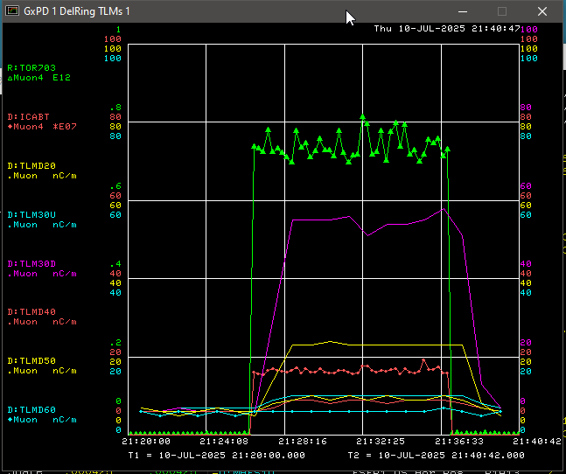
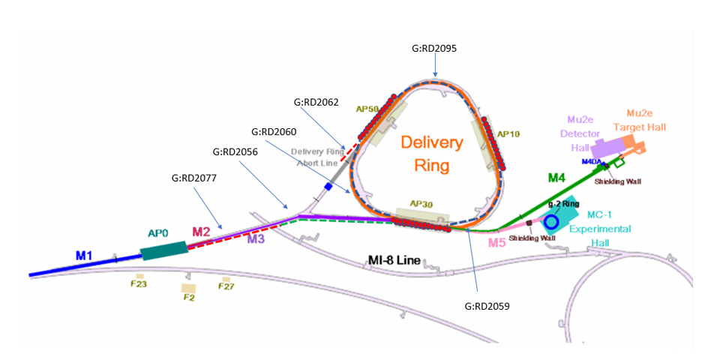
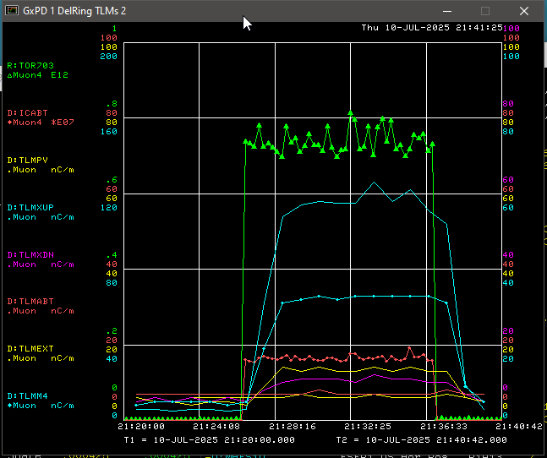
High beam intensity running/RadMonitors
High intensity runs
~0.8e12 p/spill – close to design
Every 15 sec; limited at 13W average power
Needed to see consistent readback from RadMons
For each RadMon calculate the max allowable beam power
Max restrictions – in the Transport – this should be straightforward
More work needed at Extraction, but this is encouraging
6.0 kW
1.7 kW
3.7kW
RadMon readbacks
during high intensity run

Slide 16
Main issues and further plans
Main issues
Delivery Ring acceptance
Orbit offsets
Tune drift at injection
DEX (dynamic) bump
Beam losses in the BL and Extraction
Harmonic spill ripples
Further plans
Continue SX commissioning
Spill Regulation System:
  Implement the RFKO regulation
  Implement the harmonic correction filter
Build and install the magnet ripple sensors
Build and install the Extraction Profilometer
Build and install the Crystal Station

Slide 17
END

Slide 18
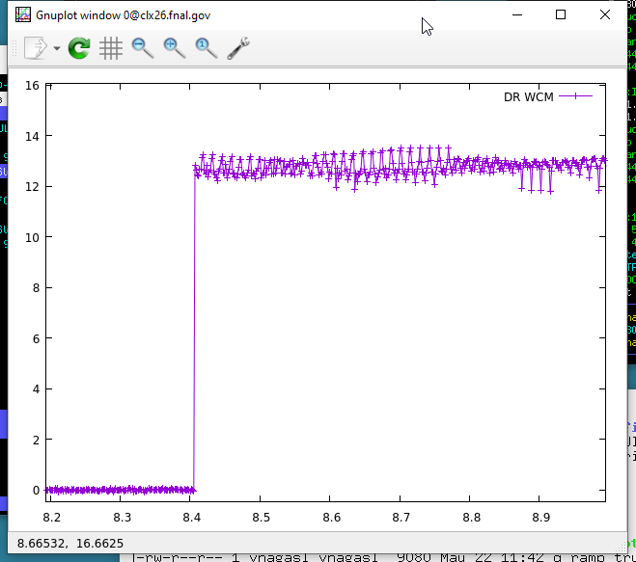
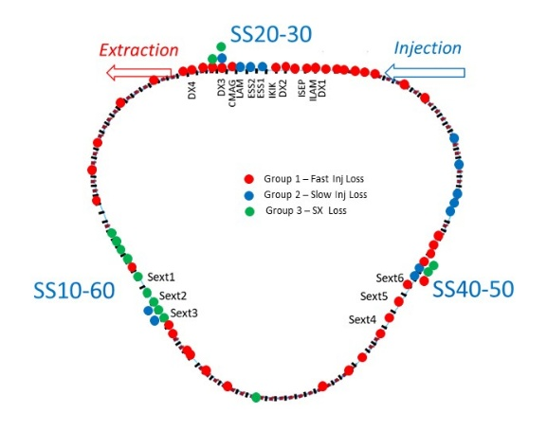
Understanding the beam losses and efficiency
How much do we deliver?
We know what we get
We can calibrate what we bring to 907
How is IC933 calibrated?
We get
We deliver
Losses structure
Fast injection loss
Second injection loss (yet a mystery…)
Extraction losses
  Septum losses → est. 2%
  Extraction aperture losses
  M4 beam line losses
Transport losses
2
1
3
Injection
Spill

