Slide 1


HEARTS at LEIR: radiation testing of electronics for space applications
Cristopher Cortés on behalf of the HEARTS@LEIR initiative
6th Slow Extraction Workshop (SX 2025)
Oct 6 – 9, 2025 Stony Brook, NY, USA

Slide 2
Acknowledgments
Many thanks to the CERN Knowledge Transfer team for partially funding the studies
Special thanks to R. Alemany Fernandez, T. Argyropoulus, M. Slupecki, O. Hans, D. Bodart, G. Le Godec, S. Joffe, S. Deleval, C. Mutin, A. Waets, N. Emriskova, R. Tomas Garcia, M. Jebramcik, J. Borburgh, SY-ABT-BTP group, D. Gamba, G. Khatri, R. Garcia Alia, M. Fraser, and technical groups involved

Slide 3
Outline
Introduction and motivation
HEARTS project
Motivation
Low Energy Ion Ring accelerator
CERN Ion Complex Chain
LEIR
Resonant slow extraction from LEIR
Summary

Slide 4
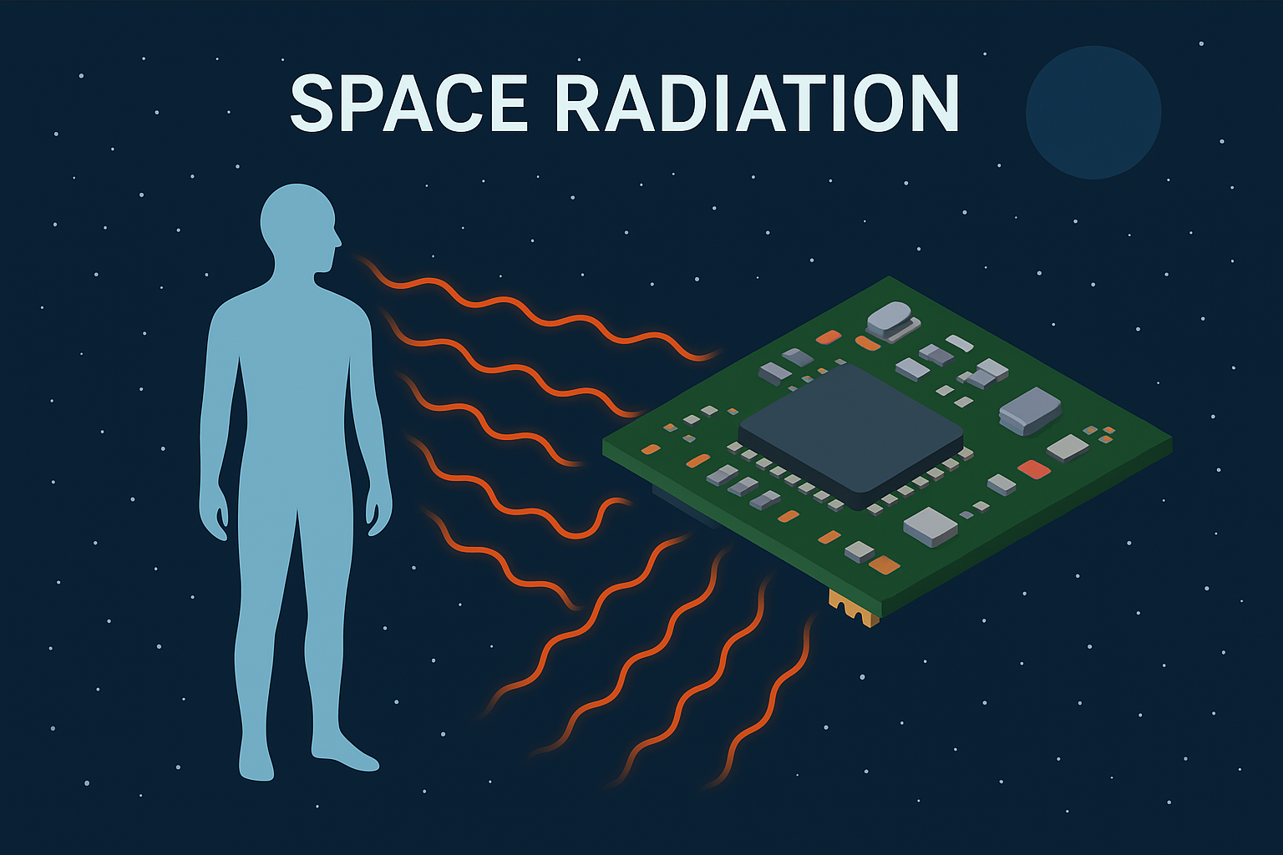
High-Energy Accelerators for Radiation Testing and Shielding
EU-funded project (2023 - 2026)
Aim: build and upgrade infrastructures in Europe for radiation testing for space exploration (mimic Galactic Cosmic Rays)
Focus
Electronics testing, shielding, and radiobiology
Consortium:
CERN, GSI, University of Padua and industrial partners (ThalesAlenia Space, Airbus, COSYLab)
Picture generated by ChatGPT

Slide 5
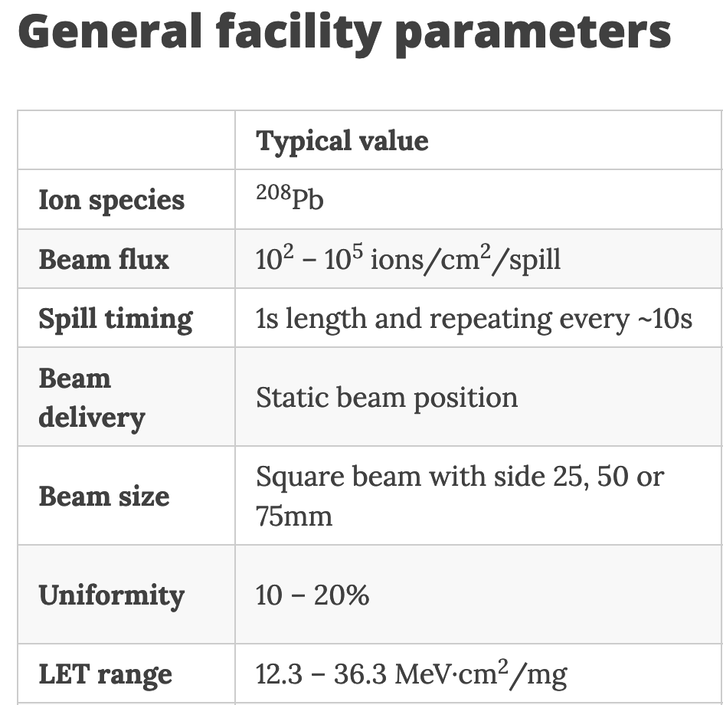
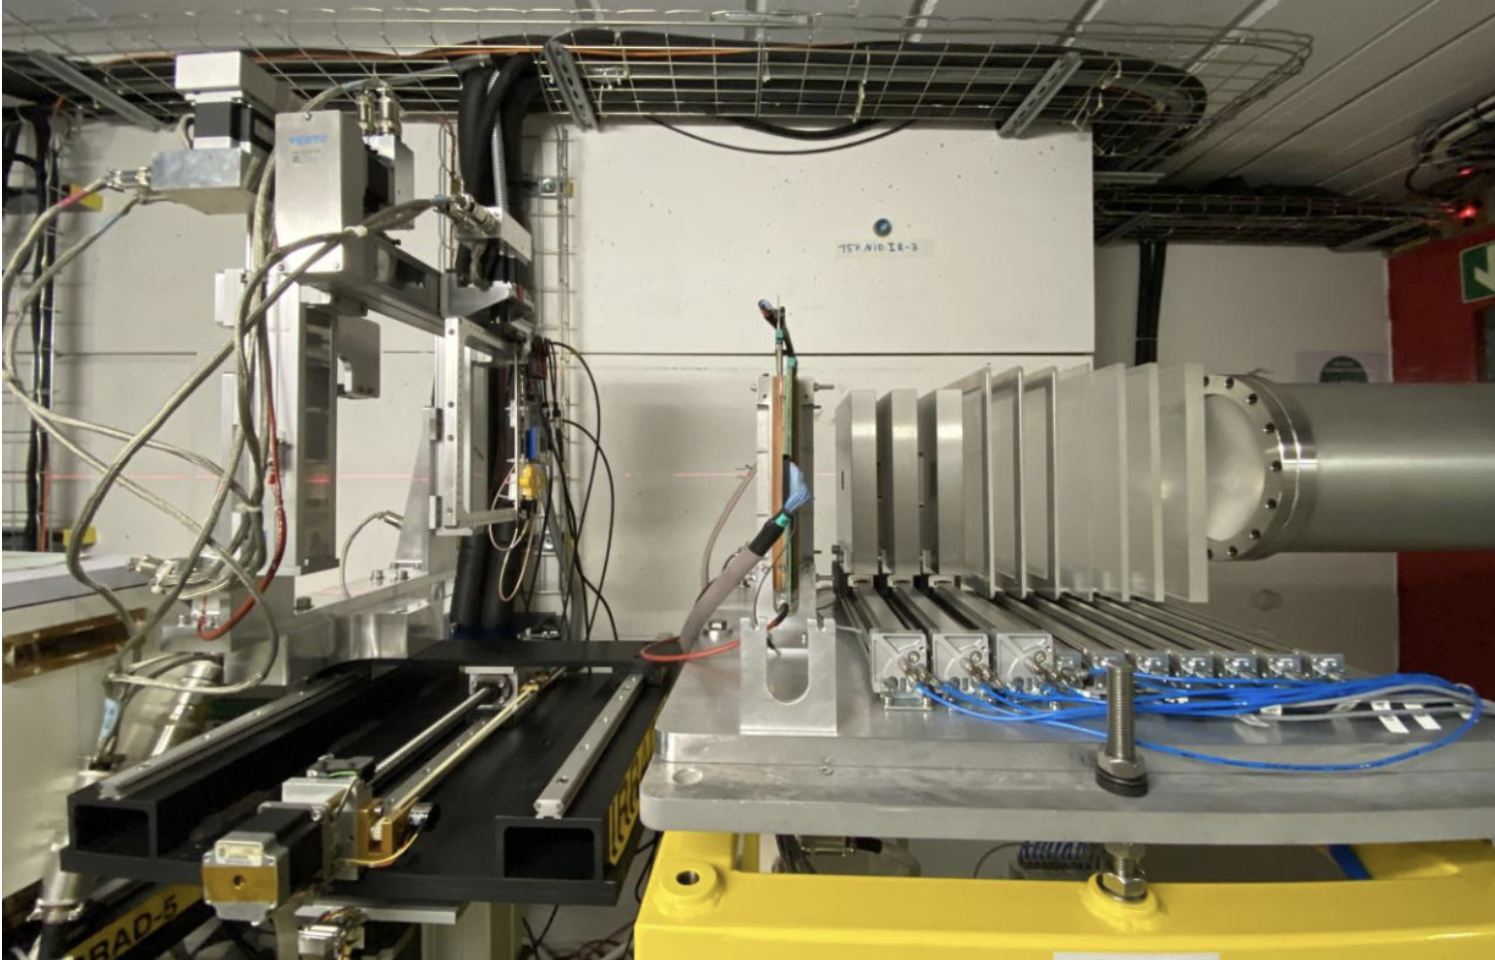
HEARTS 2024-2025
Successful pilot user run at CERN, 2024
Access to consortium partners as well as external users
10 companies and institutions
168 hours of beam time
Second run planned for Nov/Dec 2025
Approx. 200 hours of beam time have been allocated

Slide 6
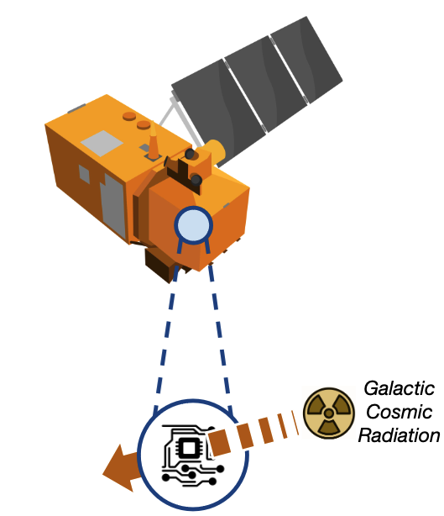

Motivation
Electronics are essential in any space mission
Space sector turns to commercial-off-the-shelf (COTS) components for cost, performance and availability
Exposure to ionizing radiation from space
can generate failures
can be emulated by heavy ion beams available in synchrotron facilities
Space exploration requires testing of radiobiology constraints
Amongst many other applications
Picture generated by ChatGPT

Slide 7
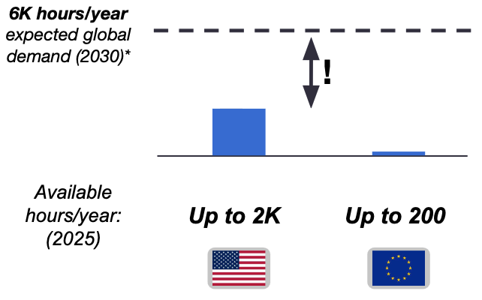


Motivation
High-energy ion supply gap
(crude estimate)
A global supply gap exists in terms of availability of heavy ion beams
Low- and standard-energies
(< 50 MeV/nucleon or < 1mm range in Silicon)
High-energy
(> 50 MeV/nucleon or > 1mm range in Silicon)
Access can take time (approval time at NSRL is approx. 1 year)
What comes next ?
Take advantage of existing CERN infrastructure potential
Middle to long term plan (>2030)
* Taken from [2] based on [3]
Other important key players not yet considered:

Slide 8
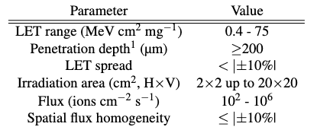
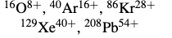
Objective
Concept Design Report
Add 2000 hours/year of high-energy ions to the global supply around 2030
High-energy ion supply gap
Energies from 20 to 100 MeV/nucleon
At least five ions
* Taken from [2] based on [3]

Slide 9
Outline
Introduction and motivation
HEARTS project
Motivation
Low Energy Ion Ring accelerator
CERN Ion Complex Chain
LEIR
Resonant slow extraction from LEIR
Summary

Slide 10
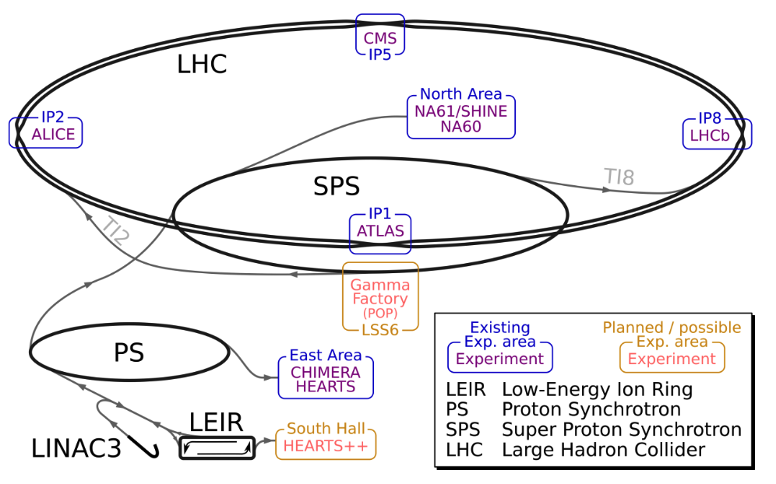
CERN Ion Chain Complex
Ion physics program at CERN
LHC dedicated experiments
SPS North Area: HiRadMat (p+ and Pb)
PS East Area: HEARTS
Runs of approx. 5 weeks/year at LHC with ions
LEIR remains idle for most of the year and is available for exploitation
Injector complex runs approx. 9 months with ion beams:
22 weeks in 2023
36 weeks in 2024
36 weeks in 2025
Higher availability of ion source, Linac3 and LEIR !

Slide 11
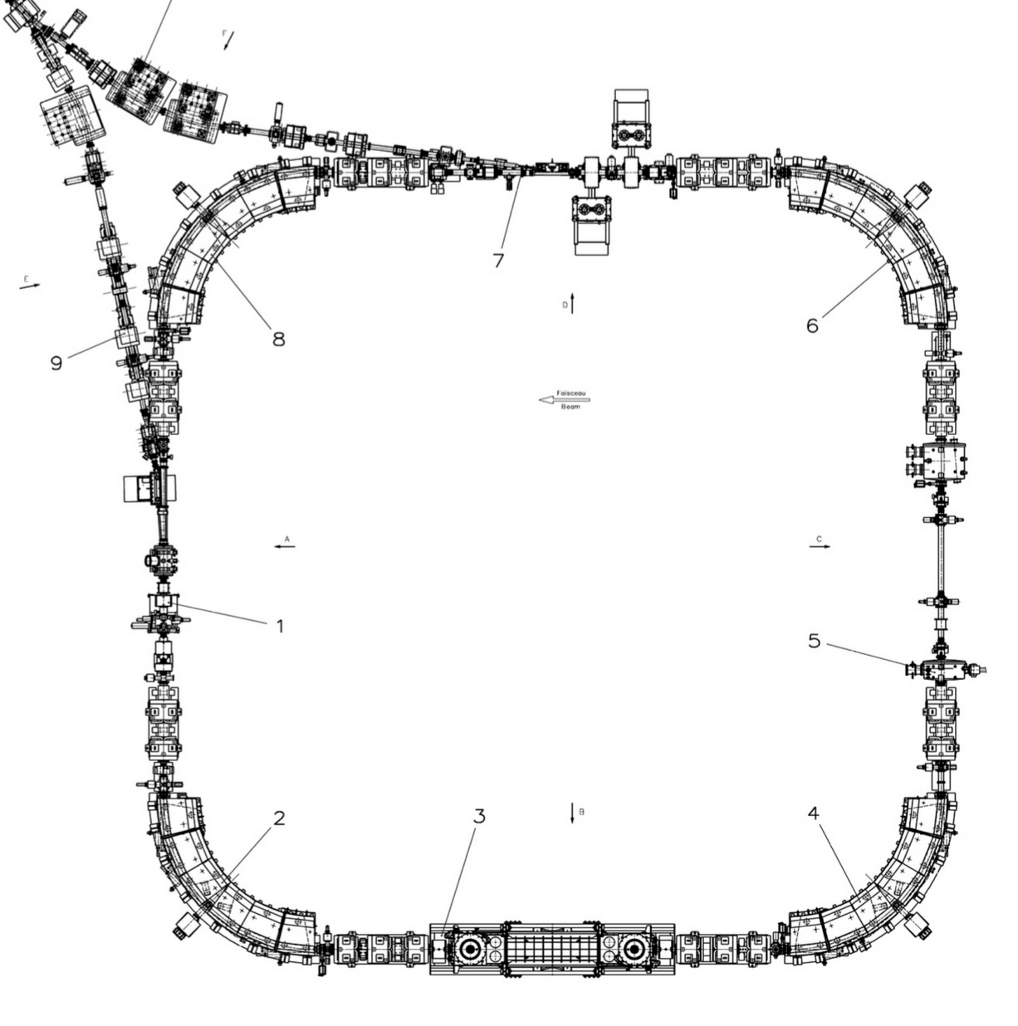
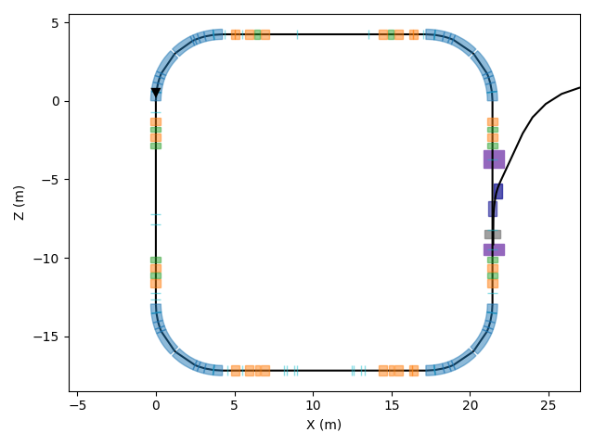
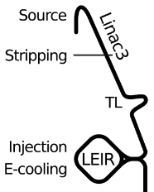
Low Energy Ion Ring layout
Fast extraction
Injection
Slow extraction
E-cooling

Slide 12
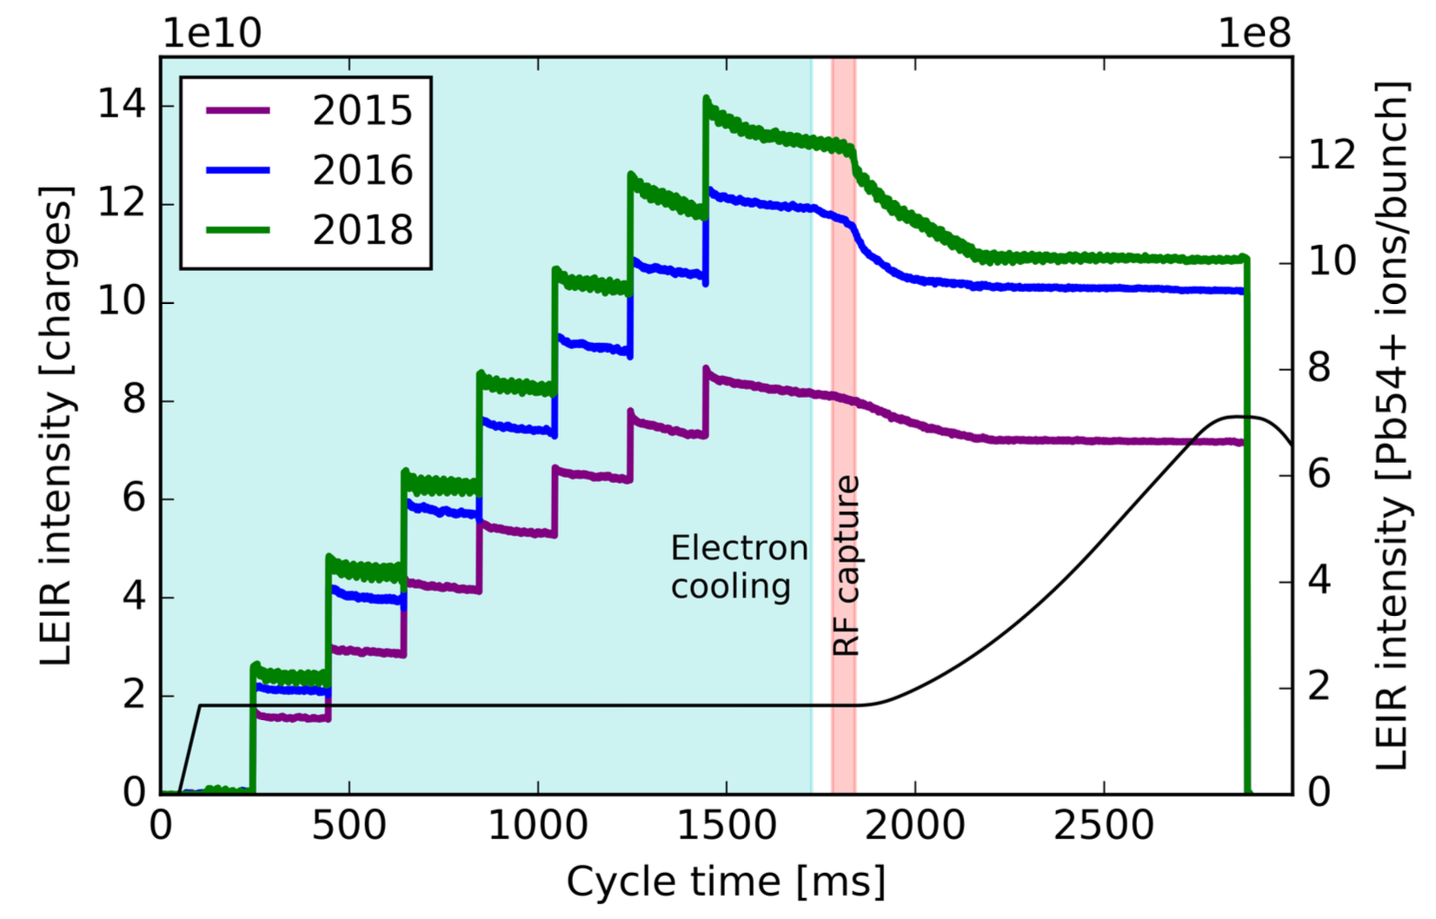
Low Energy Ion Ring
Lead ion beams are injected at 4 MeV/nucleon
Accumulation is enabled by multi-turn injection together with e-cooling
Fast extraction
Charge accumulation at LEIR
Injection
E-cooling
Figure taken from [4]

Slide 13
Low Energy Ion Ring
Lead ion beams are injected at 4 MeV/nucleon
Accumulation is enabled by multi-turn injection together with e-cooling
Upgrade the injection chain to allow fast ion switching (<15 min)
2000h of beam time (~3 months)
Duty cycle: >10%
Figure of merit:
Time to achieve 10^7 ions / cm^2 in a 20cmx20cm irradiation field
Always less than 1min
3 to 4 orders of magnitude of dynamic range available at user’s request
Five LET values (ions) in ~1.5 hours
Charge accumulation at LEIR
Figure taken from [4]

Slide 14
Outline
Introduction and motivation
HEARTS project
Motivation
Low Energy Ion Ring accelerator
CERN Ion Complex Chain
LEIR
Resonant slow extraction from LEIR
Summary

Slide 15
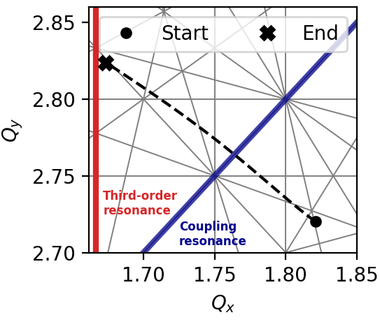
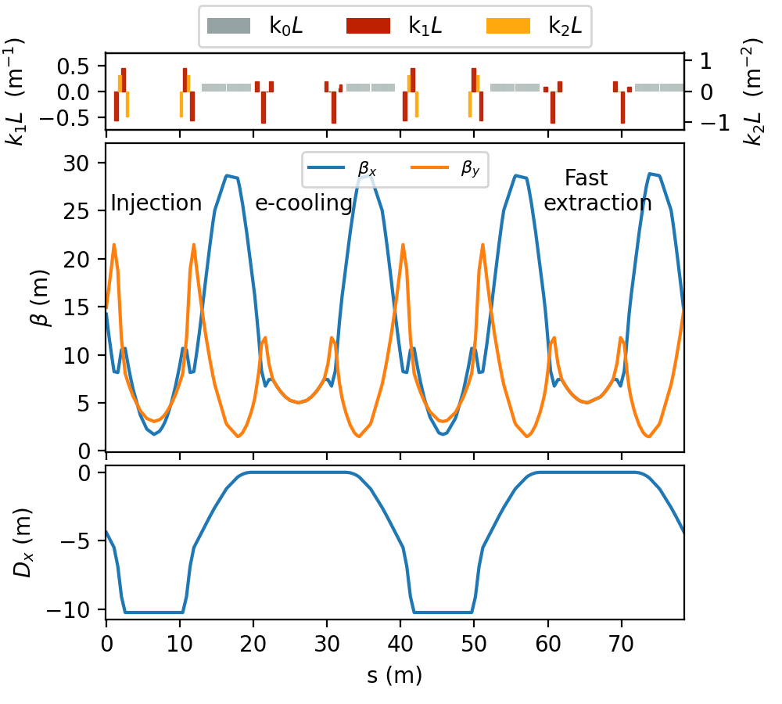
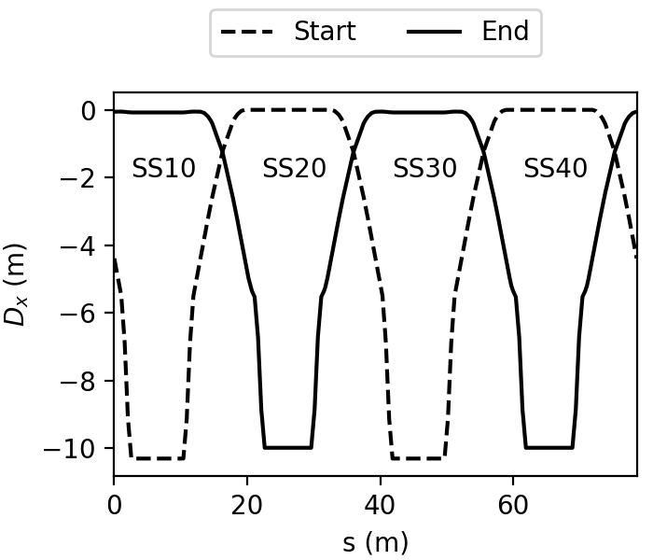
Slow extraction from LEIR
Optics optimized for RF-KO
Optics optimized for e-cooling
Adjust working point near the third order resonance
Displace dispersion-wave by one sector

Slide 16
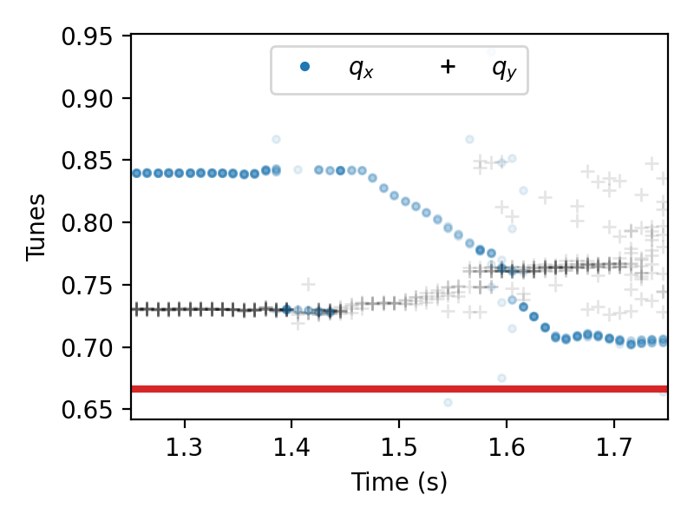
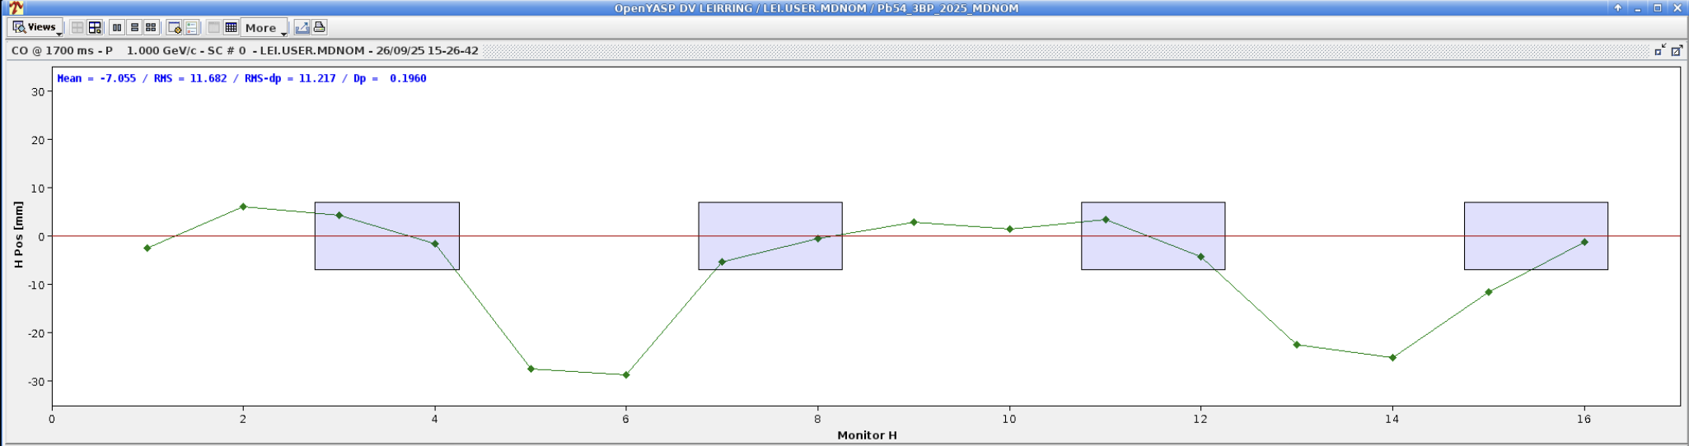
Slow extraction from LEIR
Optics test on 26 Sept. 2025
(M. Jebramcik, T. Argyropoulus, M. Slupecki)
Courtesy of M. Jebramcik
Measured tune ramp to prepare the optics
Dispersion wave
E-cooler
Slow extraction
20-
Hor. Position (mm)
-20-
Monitor index (s-pos)

Slide 17
Practical considerations
Fast extraction should not be impacted negatively
Septa specifications:
E-septum
Max. E-field < 7 MV/m
Effective blade thickness : 200 microns
M-Septum
Thinnest blade in-vacuum is 5 mm
Vertical aperture 3cm
Max. possible beam rigidity at LEIR: 6.6 Tm
Study to extract without E-Septum:
Approx. 30% extraction efficiency
Fast kickers

Slide 18
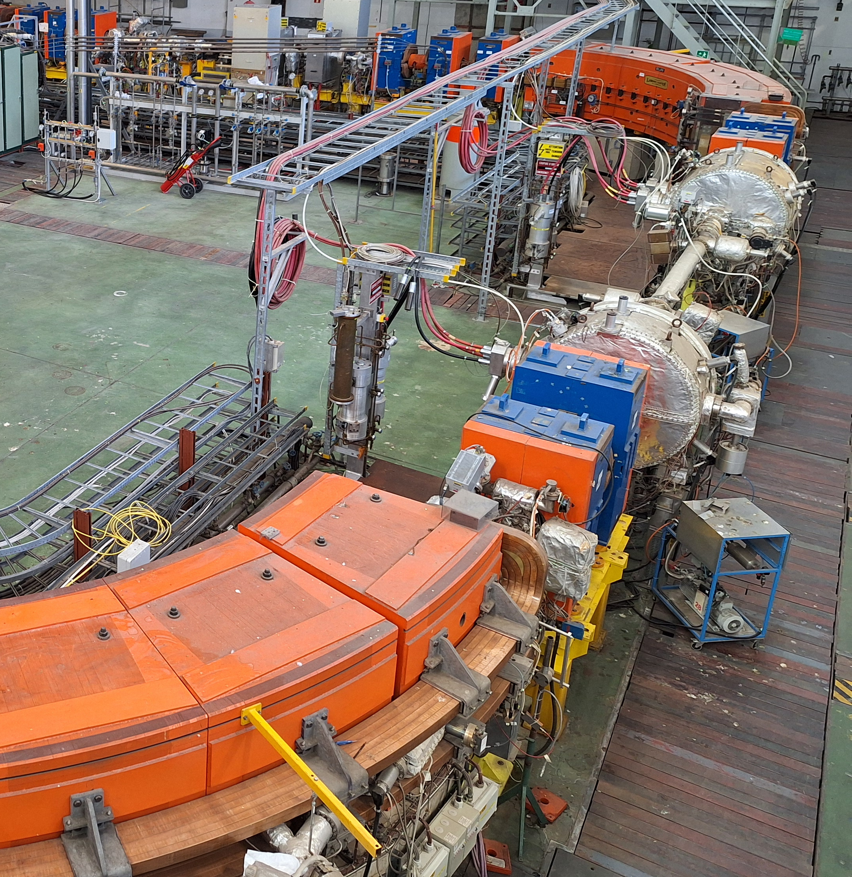
Practical considerations
Fast extraction should not be impacted negatively
Septa specifications:
E-septum
Max. E-field < 7 MV/m
Effective blade thickness : 200 microns
M-Septum
Thinnest blade in-vacuum is 5 mm
Vertical aperture 3cm
Max. possible beam rigidity at LEIR: 6.6 Tm
Study to extract without E-Septum:
Approx. 30% extraction efficiency
Fast kickers

Slide 19
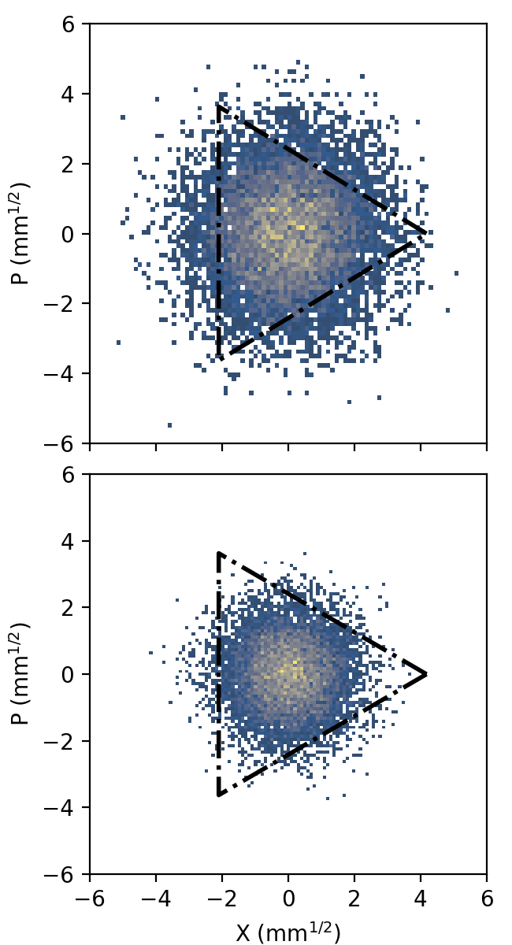
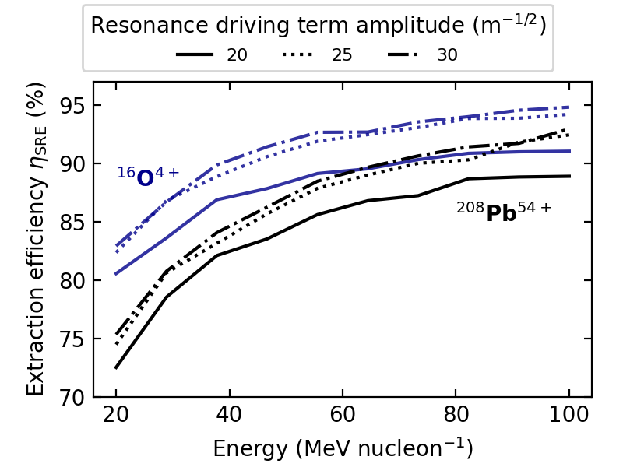
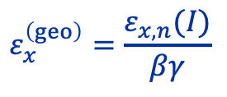
Extraction efficiency
Beam cut-off illustration due to sextupoles strengths with resonant slow extraction optics
Low energy
$$ε_{x}^{\left(geo\right)}=\frac{ε_{x,n}(I)}{βγ}$$
Emittance scales inversely proportional to the beam energy
Also proportional to the bunch intensity
High energy
 | Lead ions | Oxygen ions
Emittance (mm mrad) | 0.4 | 0.3
(*) Emittance is RMS and normalized

Slide 20
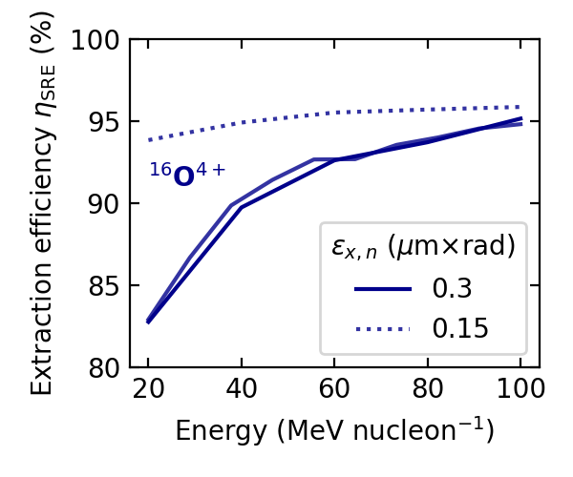
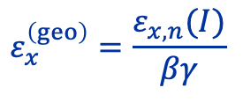
Extraction efficiency
Beam cut-off illustration due to sextupoles strengths with resonant slow extraction optics
Extraction efficiency for Oxygen with two different normalized emittances
$$ε_{x}^{\left(geo\right)}=\frac{ε_{x,n}(I)}{βγ}$$
Emittance scales inversely proportional to the beam energy
Emittance also scales proportionally with beam intensity

Slide 21
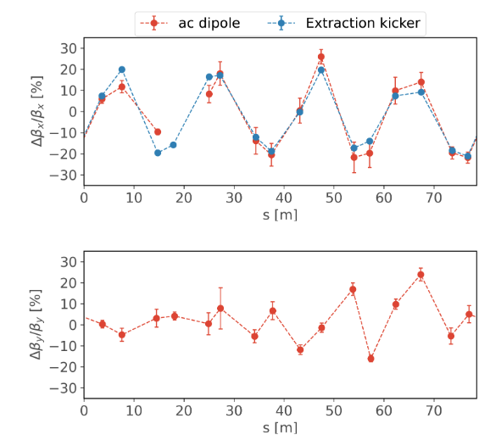
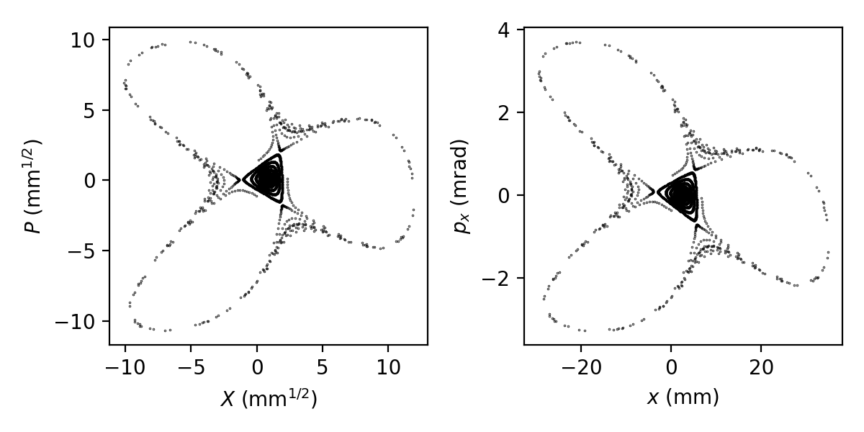
Model and non-linear dynamics
Attempt to increase spiral step with large RDT amplitudes leads to the formation of stable islands in simulation
Driven by second order amplitude detuning from sextupoles and terms in the main dipole definition
Nonlinear dynamics must be characterized
(MD planned in collaboration with M. Jebramcik)
Measured beta-beating at LEIR from [5]
Stable island formation at LEIR
Systematic horizontal beating due to main bend model
Model refinement being lead by Halil Deveci and Marc Jebramcik

Slide 22
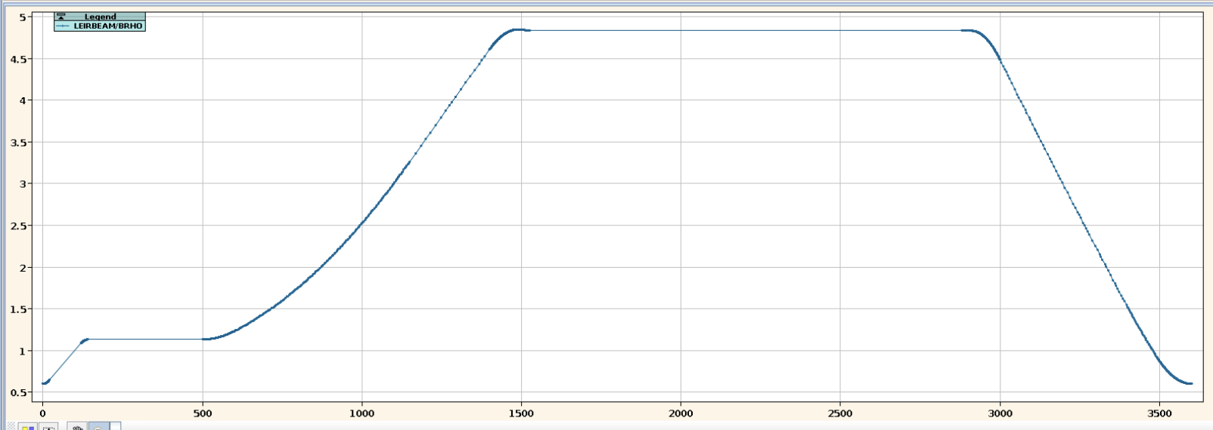
Preliminary flattop extension test (D. Bodart, S. Deleval, G. Le Godec, T. Argyropoulos, M. Slupecki)
Evaluate the machine performance with extended flattop on 22 Sep. 2025
Validation of cooling power, power converter capabilities and magnet performance
Heating test of magnet coils: temperature measurements
Two hours test run with extended flattop
From 0.15s to 1.5s
1.5 s
Beam rigidity (Tm)
Time (ms)

Slide 23
Outline
Introduction and motivation
HEARTS project
Motivation
Low Energy Ion Ring accelerator
CERN Ion Complex Chain
LEIR
Resonant slow extraction from LEIR
Summary

Slide 24
Summary
Global heavy ion supply is scarce
HEARTS at LEIR aims to close/reduce the gap
Concept design report is being developed at CERN
Machine readiness test have been planned/performed
Slow extraction optics and extraction efficiency have been evaluated

Slide 25
Sources
https://report2024-kt.web.cern.ch/boosting-europes-space-radiation-testing-capabilities
Waets, A., García Alía, R. and Emriskova, N. Introduction to HEARTS@LEIR, 2025.
National Academies of Sciences, Engineering, and Medicine. Testing at the Speed of Light: The State of U.S. Electronic Parts Space Radiation Testing Infrastructure (2018). https://doi.org/10.17226/24993.
A. Sa Hernandez, et. al., Detailed Characterization of the LEIR Intensity Limitations for a Pb Ion Beam, in Proc. IPAC'19, Melbourne, Australia, May 2019, pp. 3196-3199. doi:10.18429/JACoW-IPAC2019-WEPTS042
F. Carlier et al., "Towards optics measurements with a new LEIR BPM system", in Proc. IPAC'23, Venice, Italy, May 2023, pp. 1644-1647. doi:10.18429/JACoW-IPAC2023-TUPA150

Slide 26
Thanks for your attention !

Slide 27
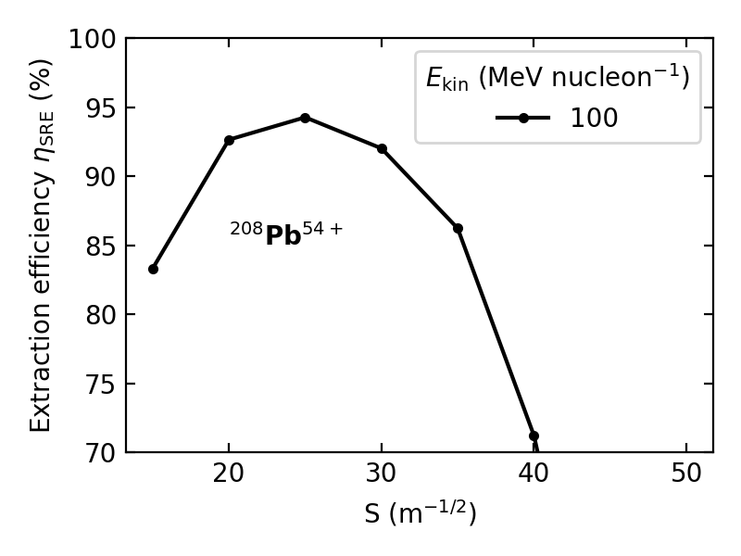
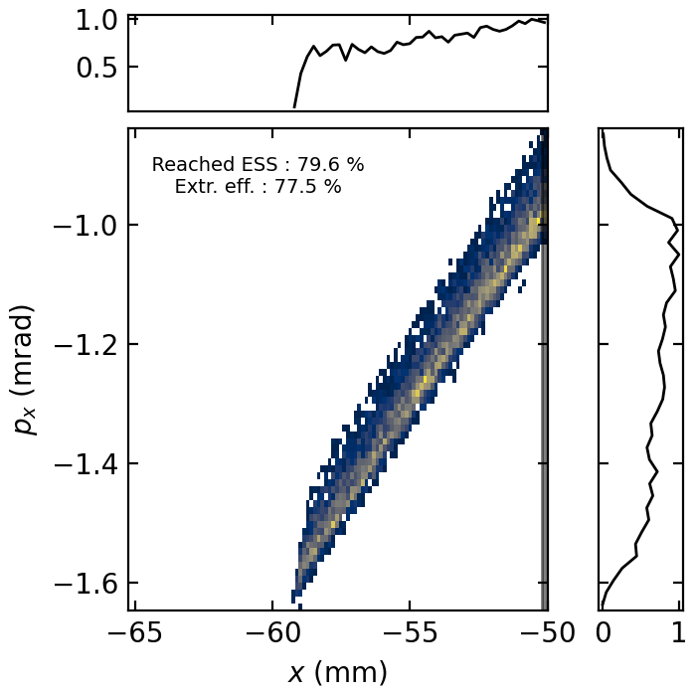
Extraction efficiency vs RDT
Extracted beam distribution in phase-space RDT=25 m^{-1/2}, Ekin=40 MeV per nucleon
Extraction efficiency dependency on RDT strength

