Slide 1




Slow Extraction of Mixed Ion Beams
,
Slow Extraction Workshop 2025 | Stony Brook, Long Island | 06-10-2025
Elisabeth Renner, TU Wien
David Ondreka, GSI
Andrii Pastushenko, GSI
C. Becker¹, B. Galnander², C. Graeff², K. Holzfeind^{1,3}, M. Kausel³, A. Mereghetti⁴, F. Plassard³, M. Pullia⁴, S. Savazzi⁴, C. Schmitzer³, J. Stadlmann², L. Volz², M. Wolf³
[1] Atominstitut, TU Wien
[2] GSI Helmholtzzentrum für Schwerionenforschung GmbH
[3] MedAustron
[4] CNAO

Slide 2
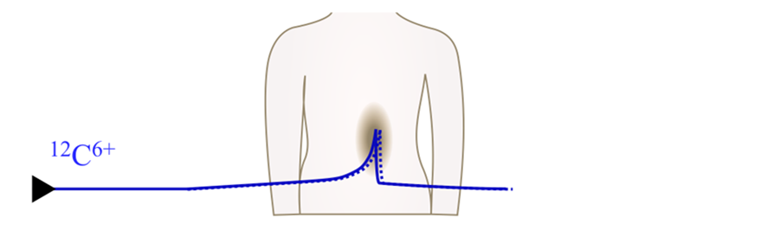
Mixed Ion Beams for Concurrent Therapy and Monitoring
Ion beam therapy vs. conventional radiotherapy
Improved dose conformity (Bragg peak) & higher biological effectiveness
More sensitive to uncertainties
Accurate treatment planning & monitoring crucial*
* Various proposals for monitoring in addition to routine regular treatment plan verification CTs: e.g. prompt gamma, nuclear fragmentation imaging, pRad,...

Slide 3
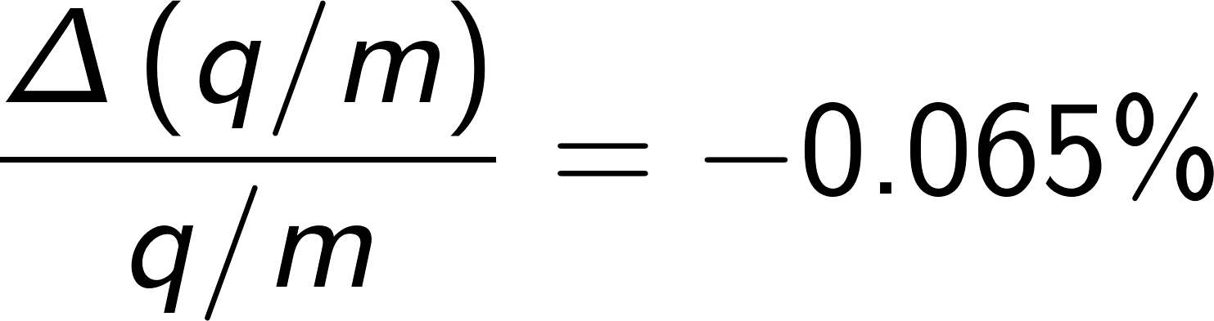
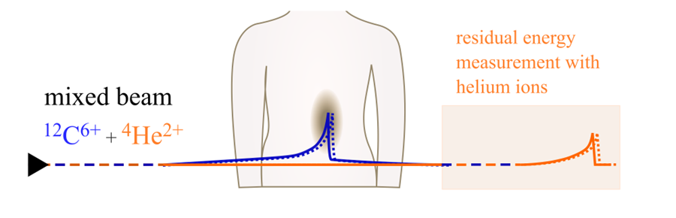
Mixed Ion Beams for Concurrent Therapy and Monitoring
Ion beam therapy vs. conventional radiotherapy
Improved dose conformity (Bragg peak) & higher biological effectiveness
More sensitive to uncertainties
Accurate treatment planning & monitoring crucial*
Proposal: Add small ⁴He²⁺ contribution to therapeutic ¹²C⁶⁺ beam for monitoring [1,2]
similar charge-to-mass ratio (≈0.5)
Extracted with similar E/m → range of ⁴He²⁺ approx. 3x larger than of ¹²C⁶⁺
Preliminarily aim: approx. 10% helium ions throughout the spill:
He still distinguishable from C fragments
acceptable dose contribution from He (~1%)
* Various proposals for monitoring in addition to routine regular treatment plan verification CTs: e.g. prompt gamma, nuclear fragmentation imaging, pRad,...
[1] D. Mazzucconi et al., CNAO, Med. Phys. 45 (11), 2018
[2] C. Graeff et al., GSI, Physica Medica 52, 2018

Slide 4
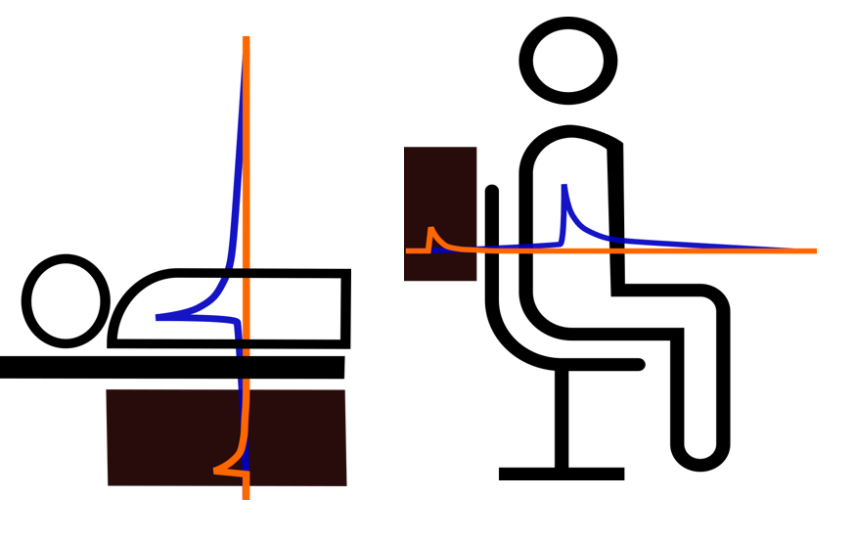
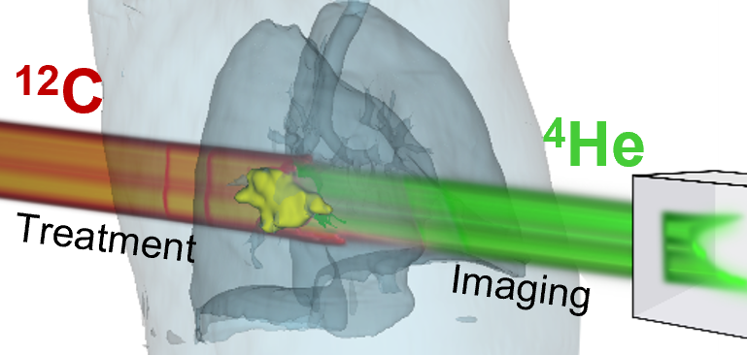
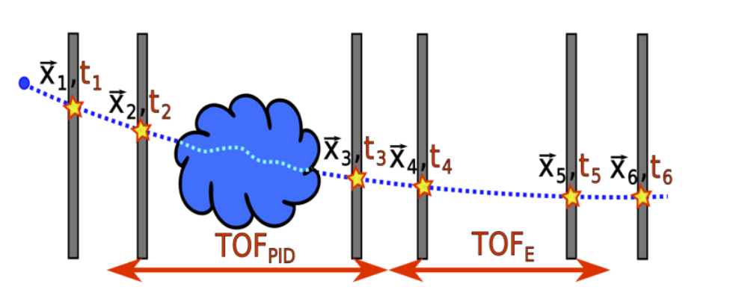
Towards Mixed Beam Radiography Systems
Particle-integrating approach
Single-particle tracking
He/C-fragment distinction e.g., via dE/dx measurement
Clinical flux may require system without front tracker**
Figure: ERC PROMISE project, C. Graeff [7]
Obtain WET map (e.g. per energy layer)
E.g. range telescope, scintillator, ...
Figure: F. Ulrich-Pur [12]
Measure residual He energy e.g., via TOF
Needs to detect as wide a range as possible of residual He energies, while enabling distinction of He from C fragments
* alternative: range shifter between between nozzle and patient and/or patient and detector to increase dynamic range
** would require sophisticated 4D-clustering to deal with increased hit multiplicity

Slide 5
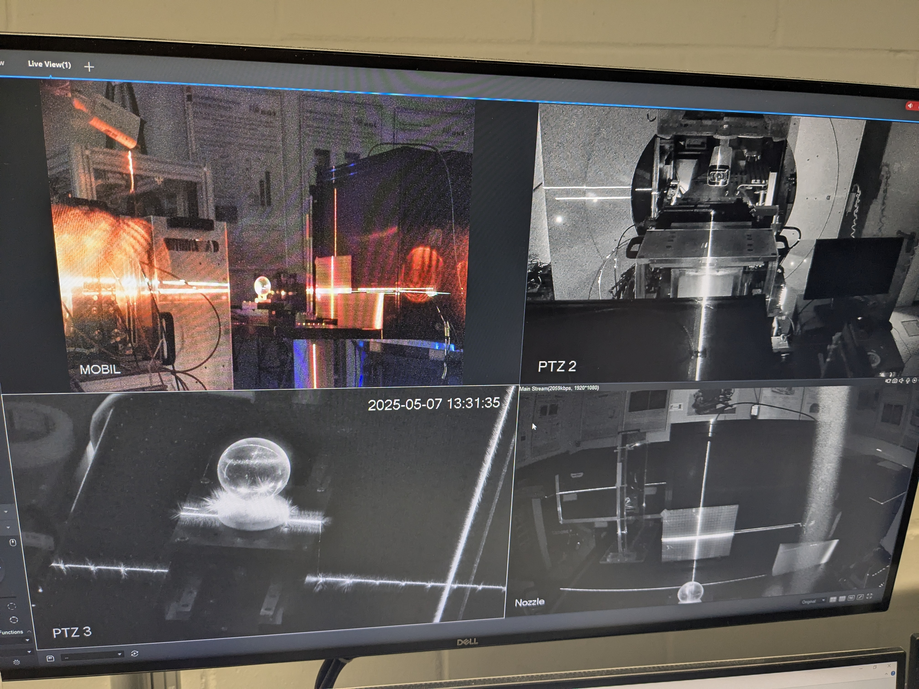
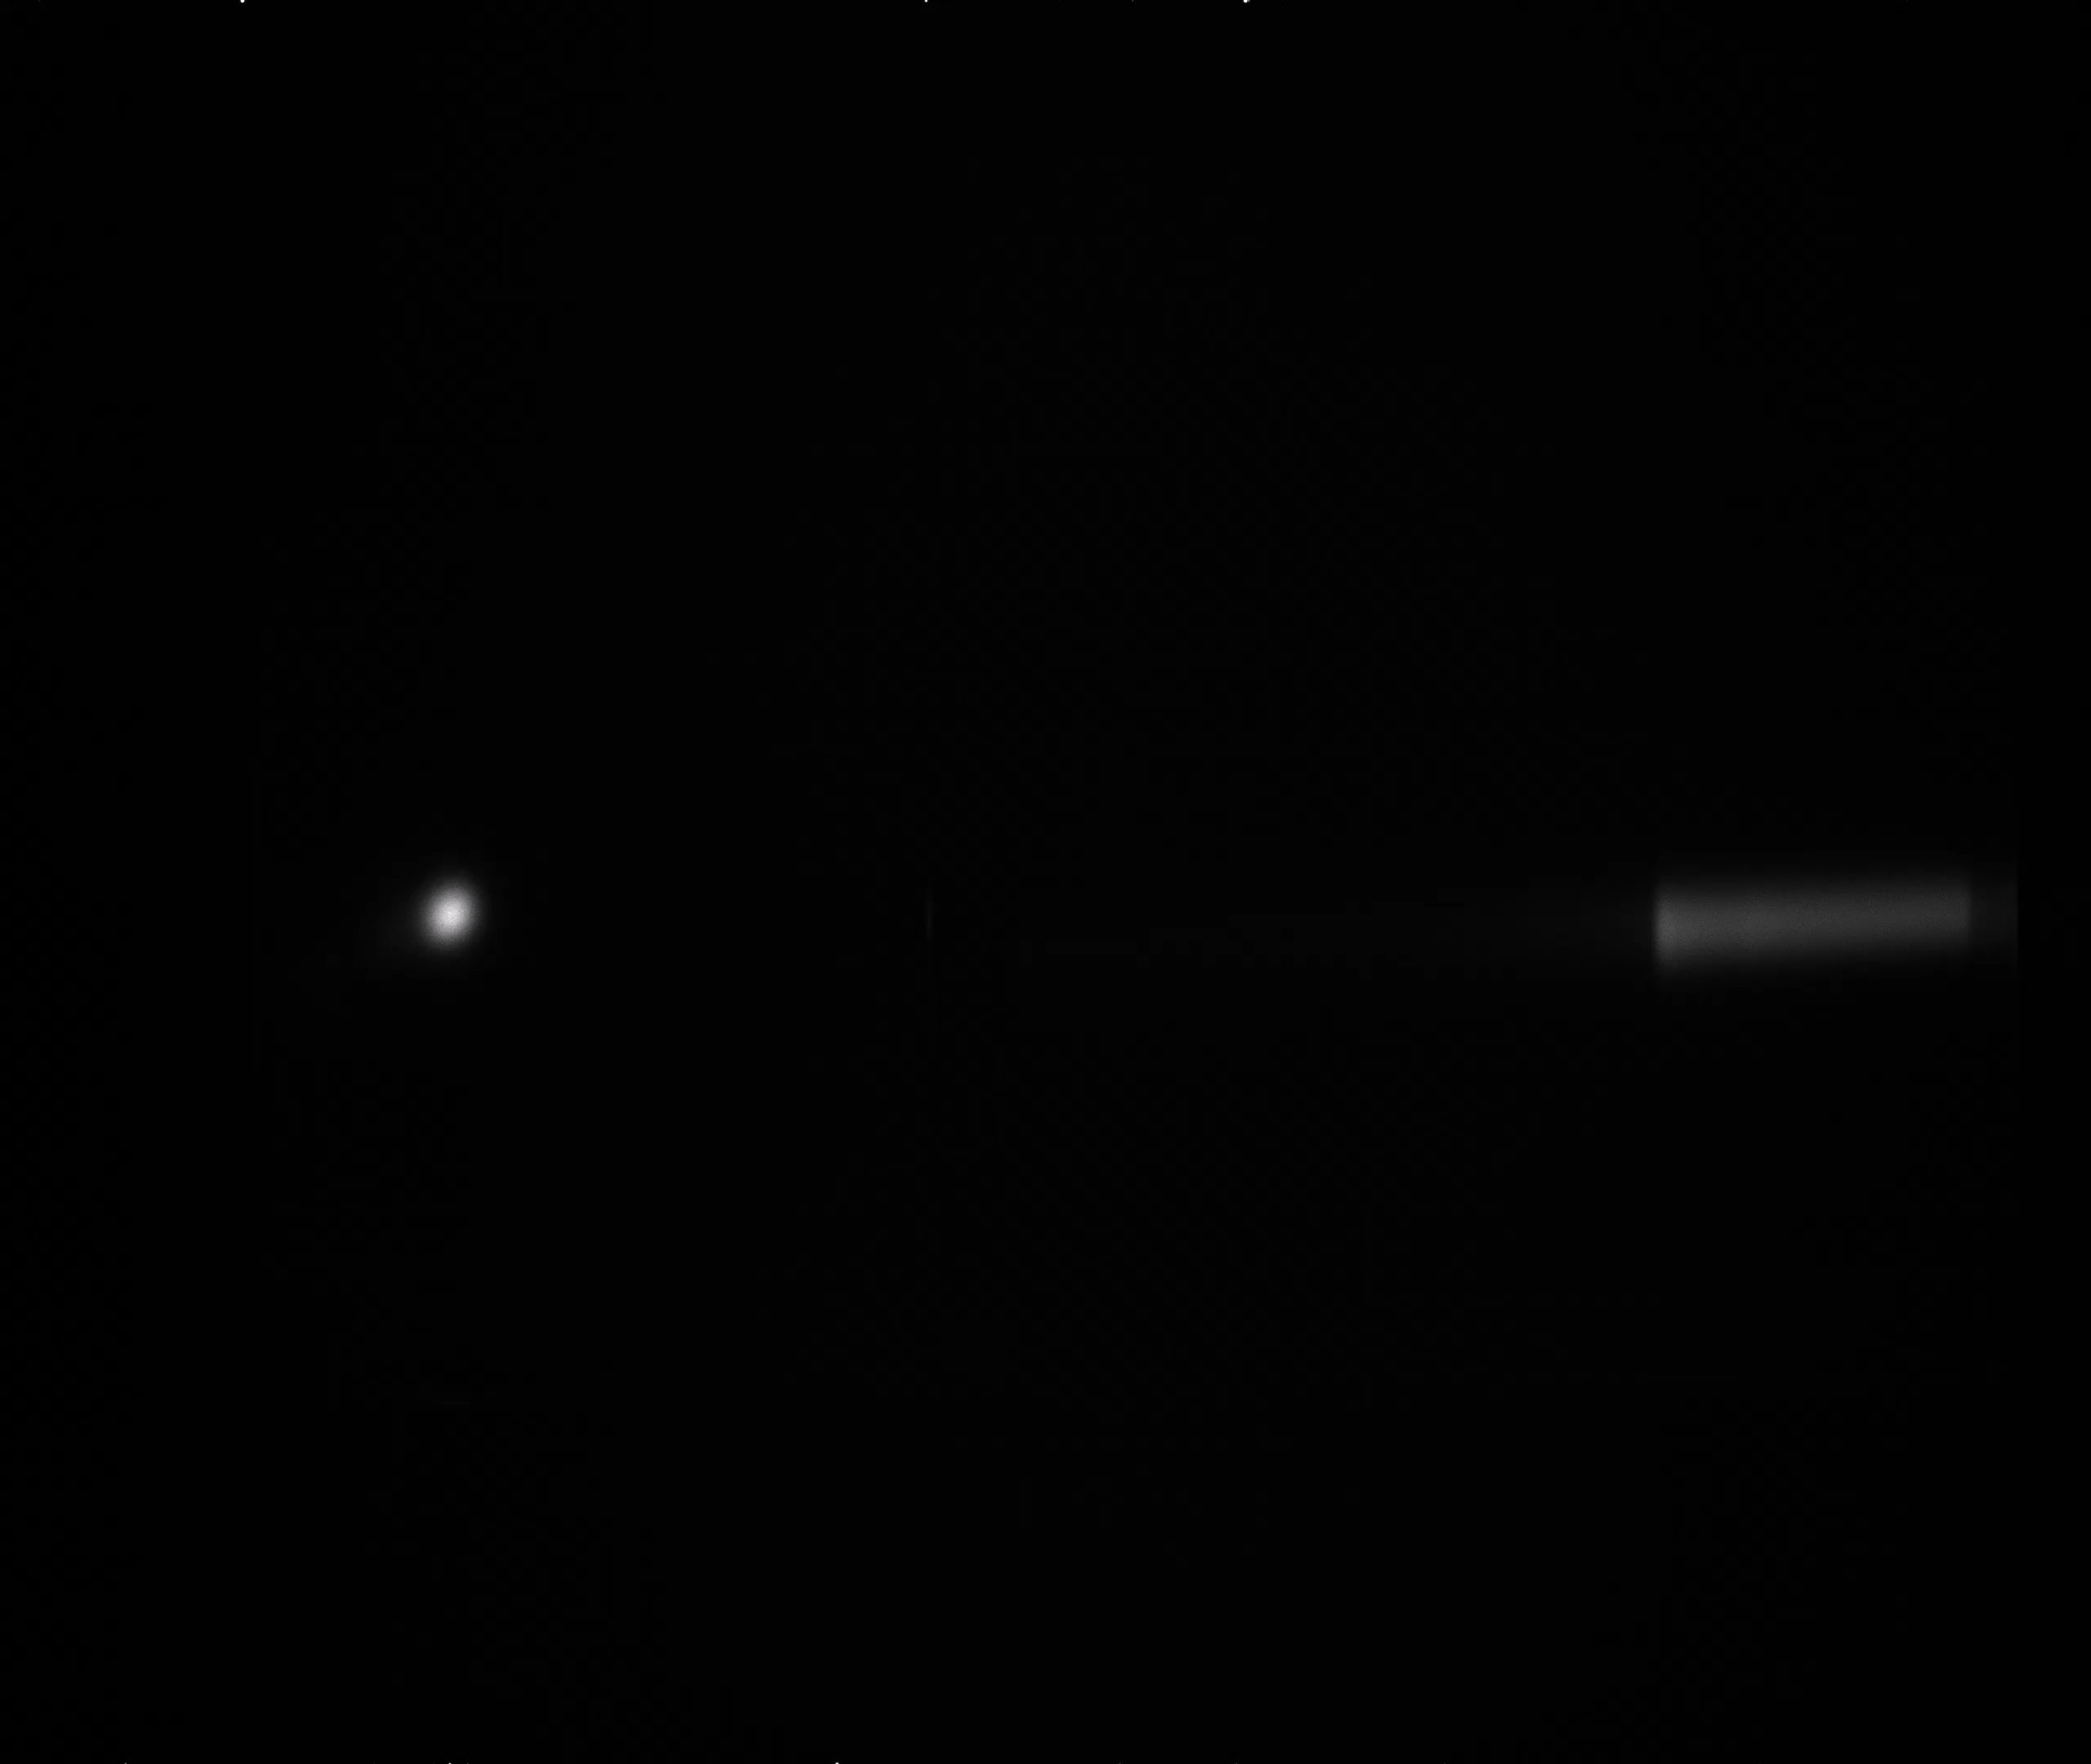
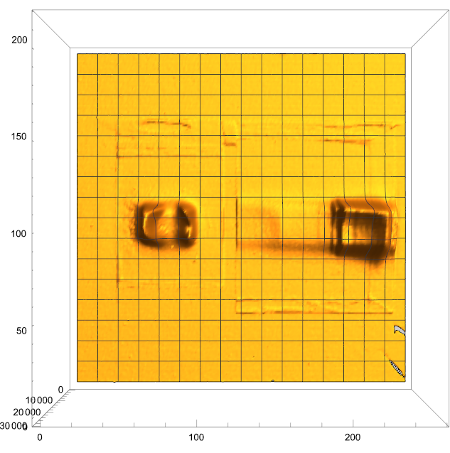
Example: Scintillator Based Monitor I
Experiments at GSI in May 2025: scan of a dual beam through a sphere
Cubic plastic (BC408) scintillator, 20x20x20 cm
sphere
Beam
Beam
CMOS camera
[1] D. Mazzucconi et al., CNAO, Med. Phys. 45 (11), 2018
Slide courtesy of M. Pullia & Simone Savazzi (CNAO)
Figure and video: C+He#21 with sphere, no range shifter.

Slide 6
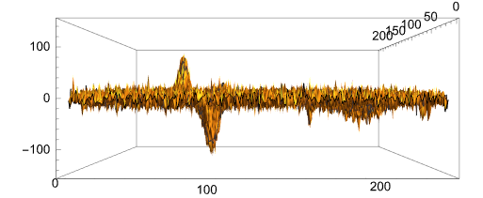
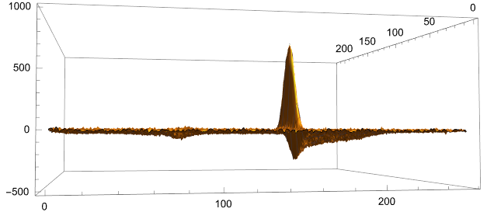
Example: Scintillator Based Monitor II
Figures: difference between the present image, taken after the target has changed, and the reference image.
3 mm sphere displacement
4 mm range variation
Slide courtesy of M. Pullia & Simone Savazzi (CNAO)
Experiments performed in 05/2025 at GSI (C. Graeff)

Slide 7
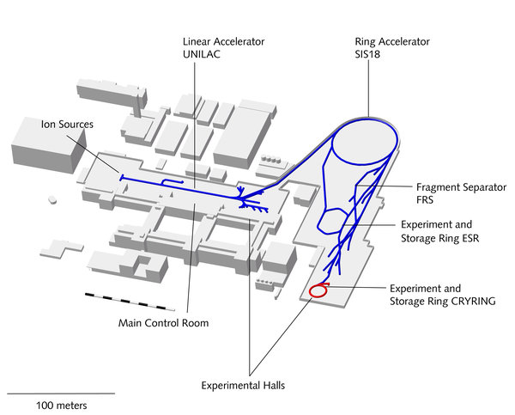
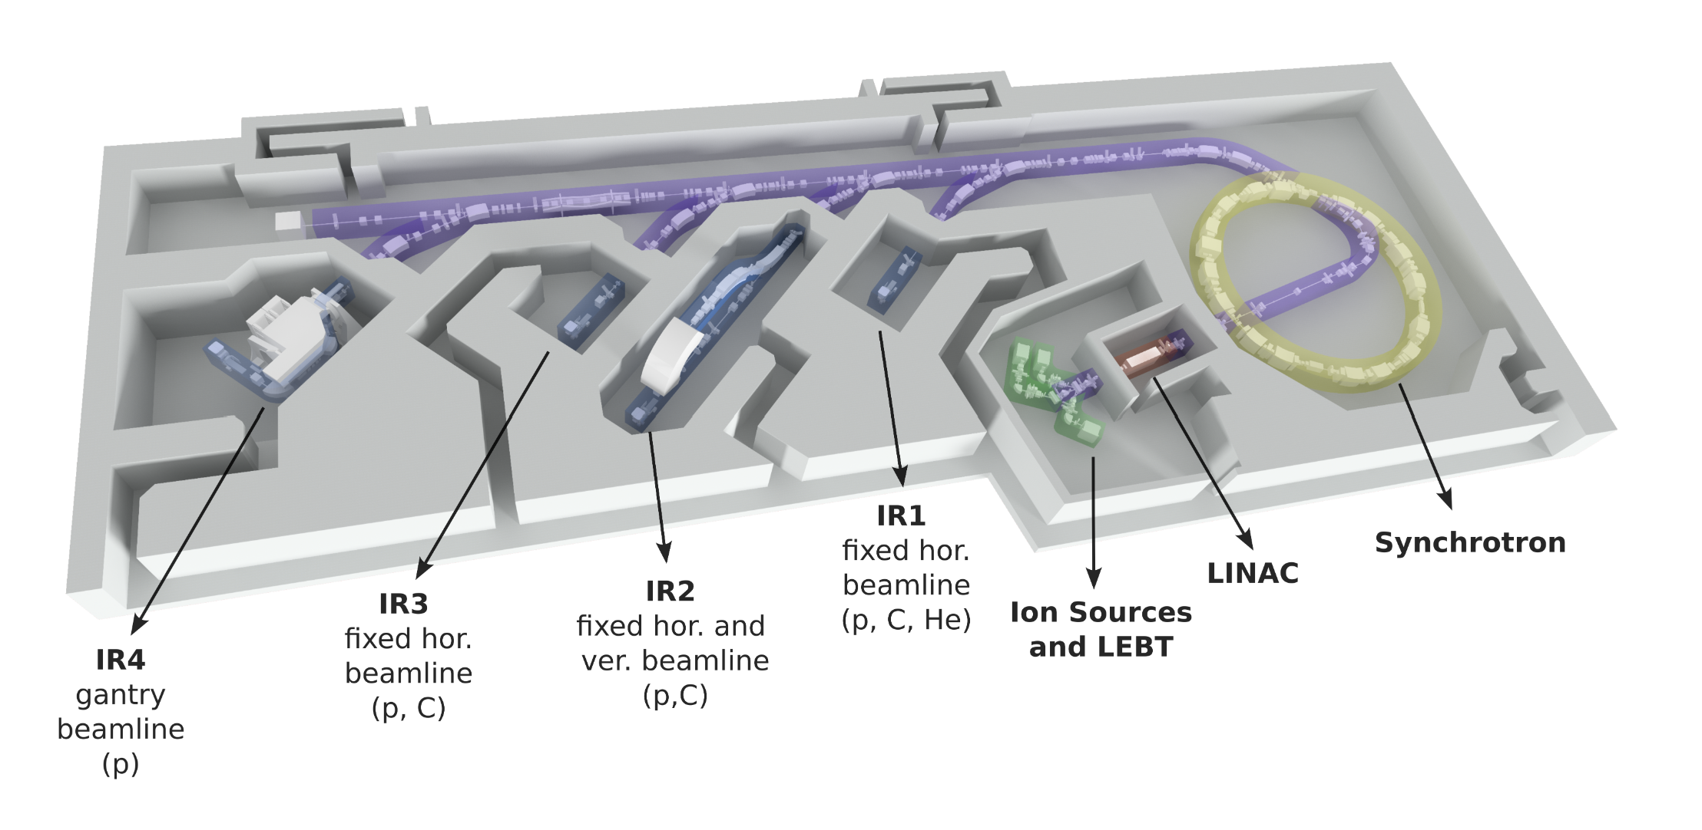
Outline
GSI
aka: how to deliver a mixed beam to get such nice videos?
Overview: ongoing mixed helium-carbon ion beam experiments
Mixed beam slow extraction at GSI
Mixed beam slow extraction at MedAustron
Conclusion and Outlook
MedAustron

Slide 8
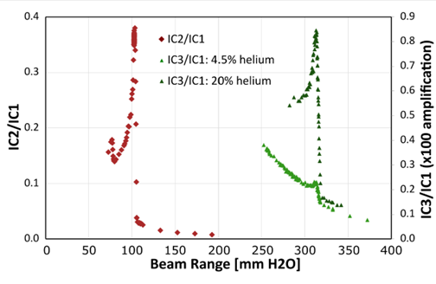
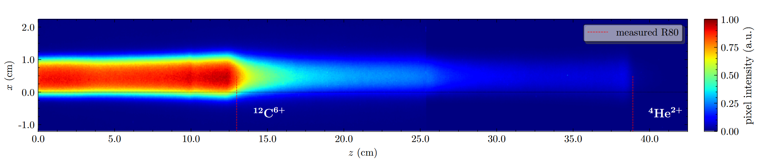
Recent Activities
[1] D. Mazzucconi et al., CNAO, Med. Phys. 45 (11), 2018
[2] C. Graeff et al., GSI, Physica Medica 52, 2018
[3] L. Volz et al., DKFZ, Phys Med Biol 65/2, 2020
[4] J. Hardt, DKFZ, Phys Med Biol 69/5, 2024
Since <2018: Initial concept studies (CNAO [1], GSI [2], DKFZ [3,4])
No mixed beam experimentally available back then
Detection & treatment planning (simulations, sequential irradiation, ...)
Since 2023: ERC project PROMISE at GSI (C. Graeff et al. [5-7]).
“Portal Range Monitoring in Mixed Ion Beam Surgery”
Imaging & mixed beam delivery concepts, ...
Nov. 2023: First delivery of mixed ¹²C³⁺ and ⁴He¹⁺ beam (single ion source)
Very successful beam time in May 2025.
Since 2023: Collaboration between TU Wien & MedAustron [8-10].
Focus: Mixed ion beam delivery in medical synchrotron facilities
Summer 2024: First delivery of a mixed beam in a medical facility (¹²C⁶⁺ & ⁴He²⁺, double injection)
[5] M. Galonska et al., GSI, IPAC’24
[6] D. Ondreka et al., GSI, IPAC’24
[7] C. Graeff et al. PROMISE Project, GSI
[8] E. Renner et al., IPAC ‘24
[9] M. Kausel, E. Renner et al. Submitted to PRAB, 2025
[10] M. Kausel, et al. IPAC ‘25

Slide 9
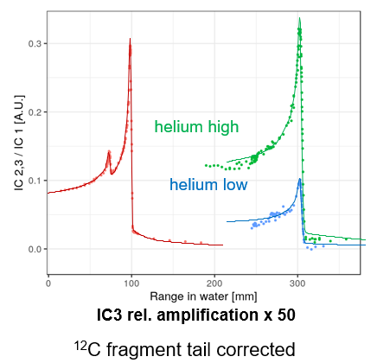
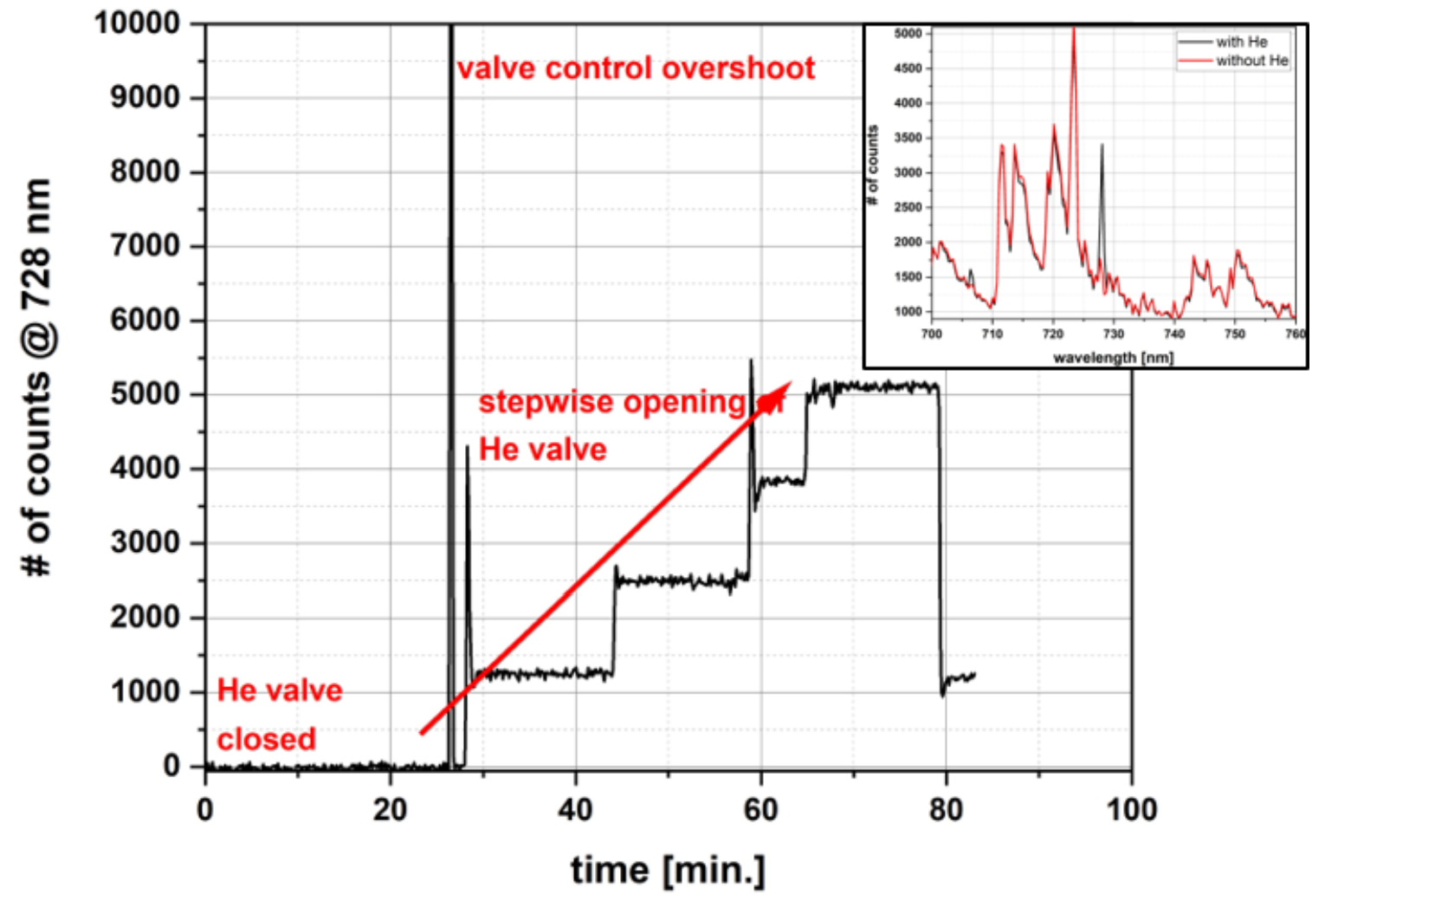
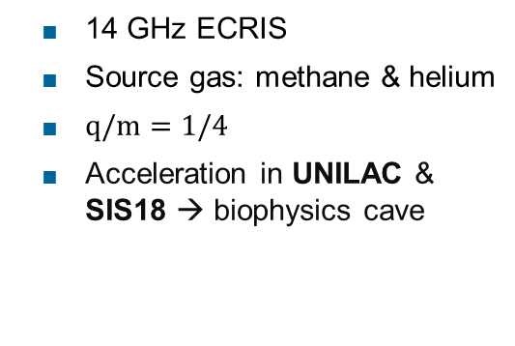
Mixed Ion Beams at GSI
Direct extraction of ¹²C³⁺ & ⁴He¹⁺ mixture from single ion source [5]
14 GHz ECRIS
Source gas: methane & helium
$q/m=1/4$
Acceleration in UNILAC & SIS18 → biophysics cave
Figure: Mixed beam depth-dose curve measured in 2023 at GSI. Signal from IC3 and IC2 are carbon fragment tail corrected [11].
⁴He¹⁺ content tailored by stepwise addition of helium flow to ion source plasma
Monitor He contribution using optical emission spectroscopy
2023 ¹⁶O⁴⁺ contamination of less than 10%
2025 ¹⁶O⁴⁺ contamination significantly reduced.
Figure: Number of counts at 728 nm wavelength (He I) for stepwise increase of He flow in a methane / helium plasma [5].
[5] Galonska et al. IPAC ‘24
[11] L. Volz et al, Ion Imaging ‘24

Slide 10
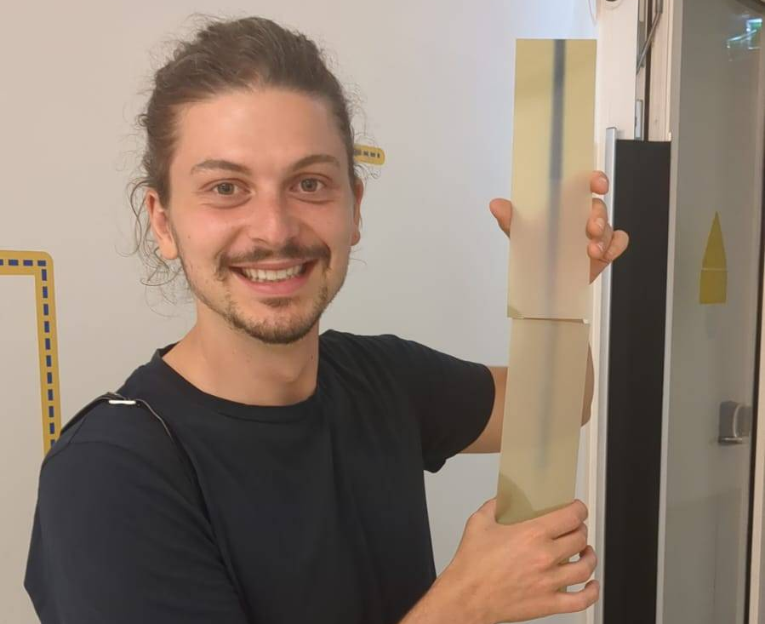


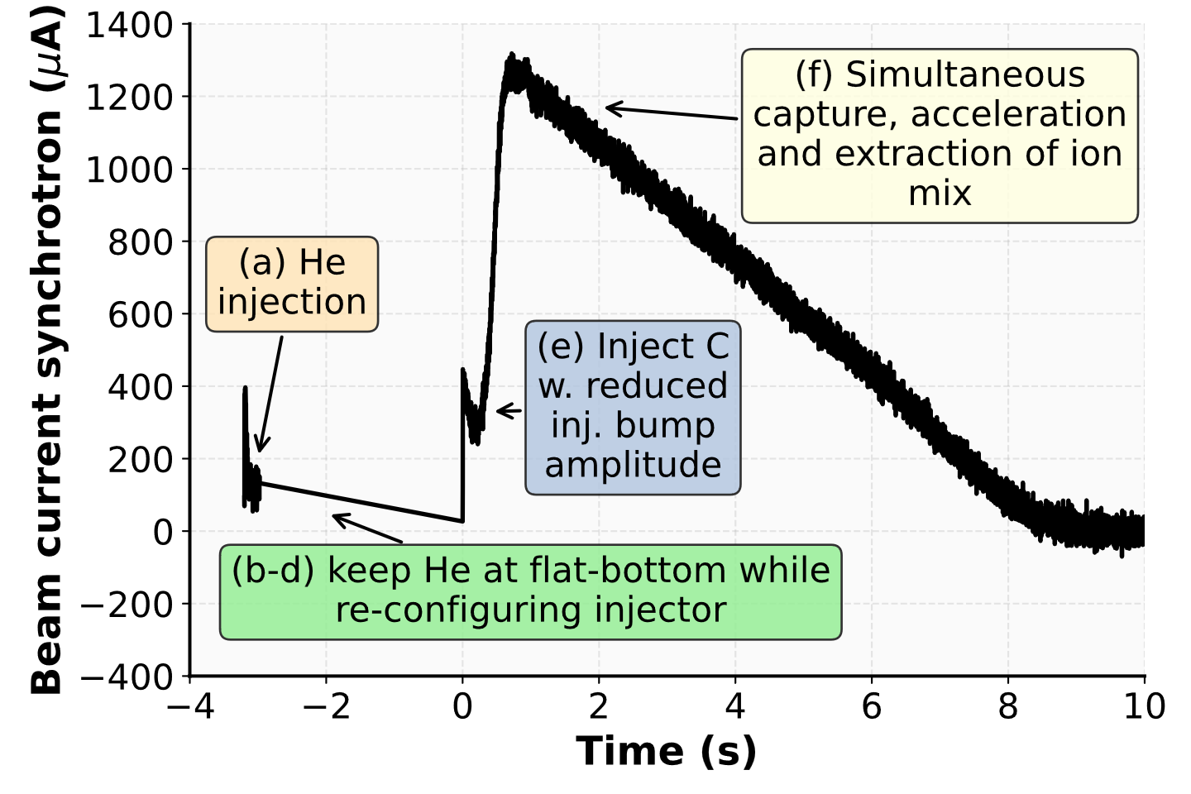
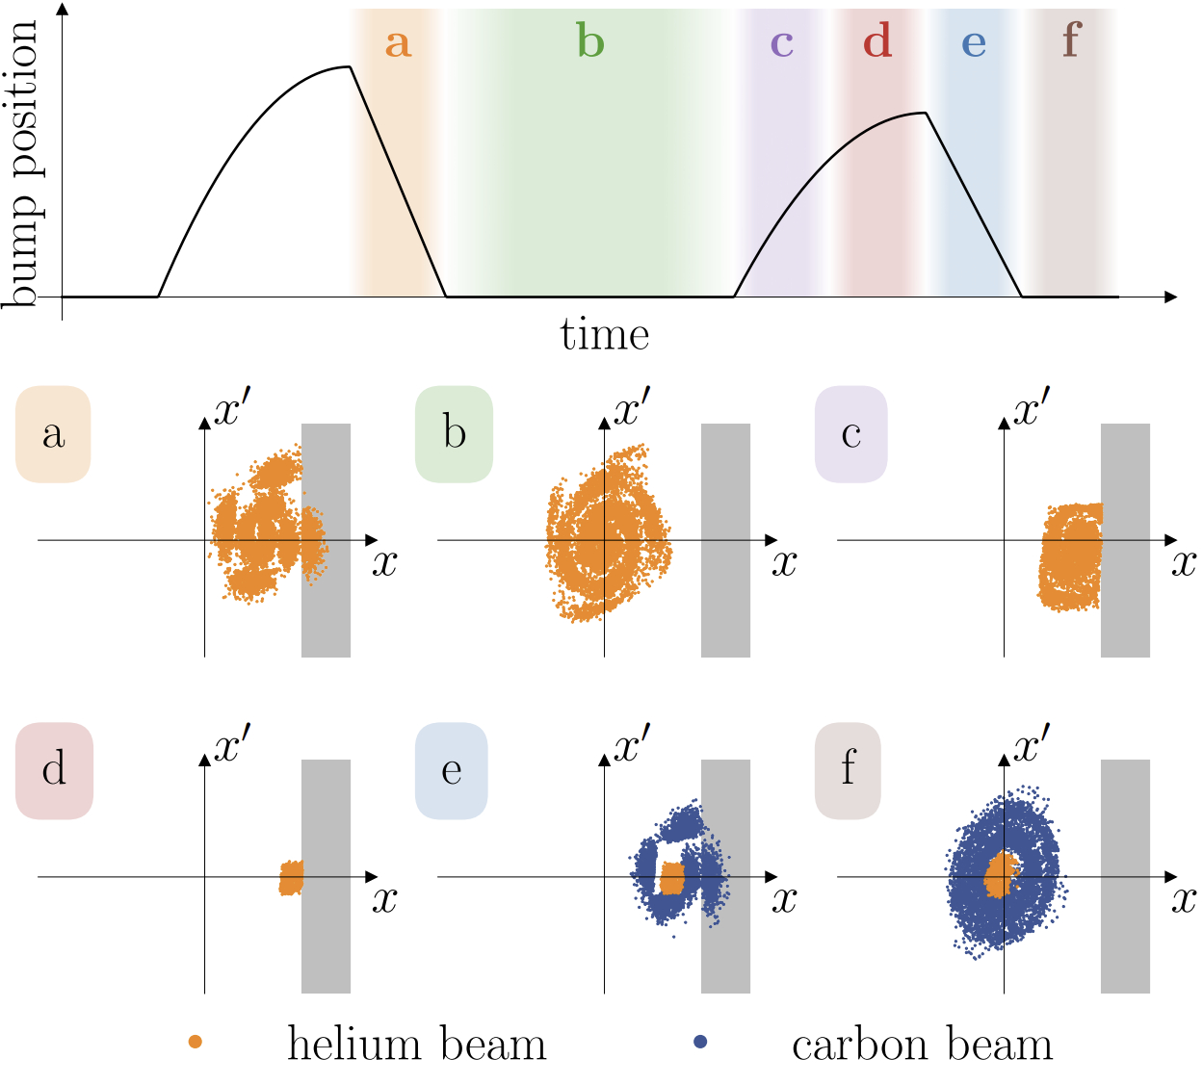
Mixed Ion Beams at MedAustron
Poster - F. Plassard
MedAustron Facility Overview
Mixed beam from single ion source not deliverable in current medical synchrotron facilities.
⁴He¹⁺ + ¹²C³⁺ → cannot be accelerated in LINAC (requires q/m ≤ ⅓)
⁴He²⁺ + ¹²C⁶⁺ → insufficient ¹²C⁶⁺ yield with 14 GHz ECRIS
³He¹⁺ + ¹²C⁴⁺ → limited energy range + large ΔBρ/Bρ in synchrotron
[9] M. Kausel et al., submitted to PRAB
Alternative: mixing via sequential multi-turn injection of ⁴He²⁺ and ¹²C⁶⁺ into synchrotron
Aim: provide beam for research*
Stripping foil
(a) ⁴He²⁺ from Source 3
(e) ¹²C⁴⁺ from source 2
*In the current configuration, mixed beam setup not suitable for clinical use.
Tailor He:C ratio: adapt 2nd inj. bump amplitude
First mixed beam in summer ‘24

Slide 11
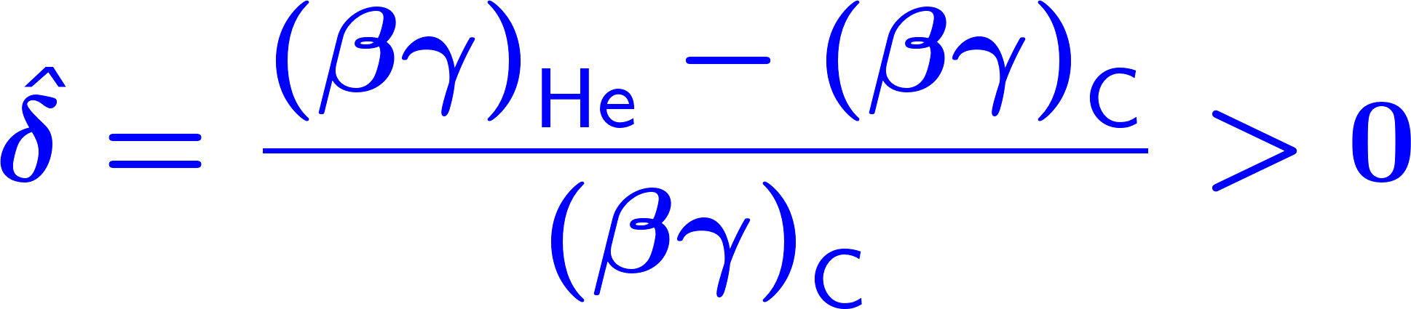
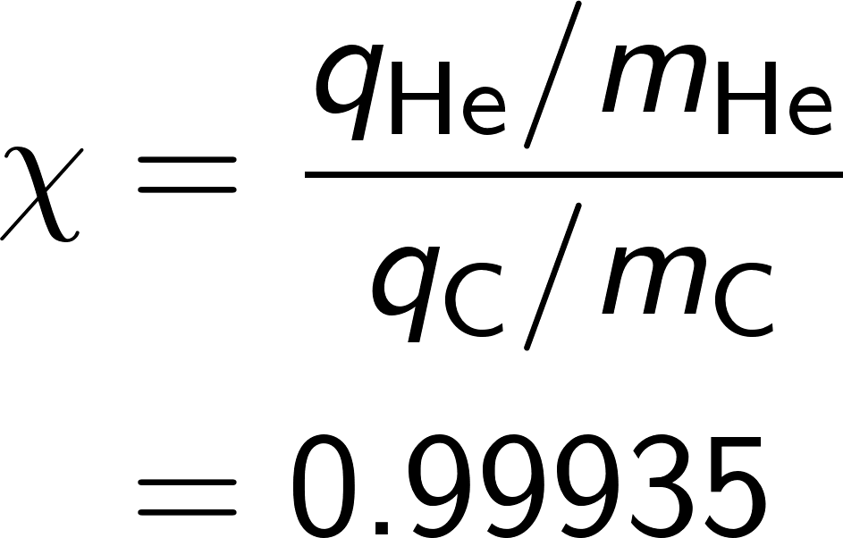
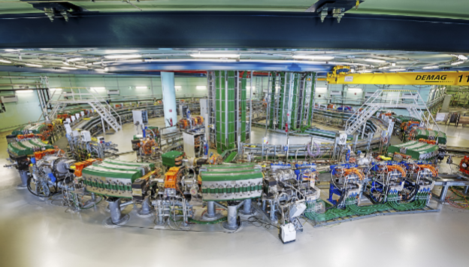
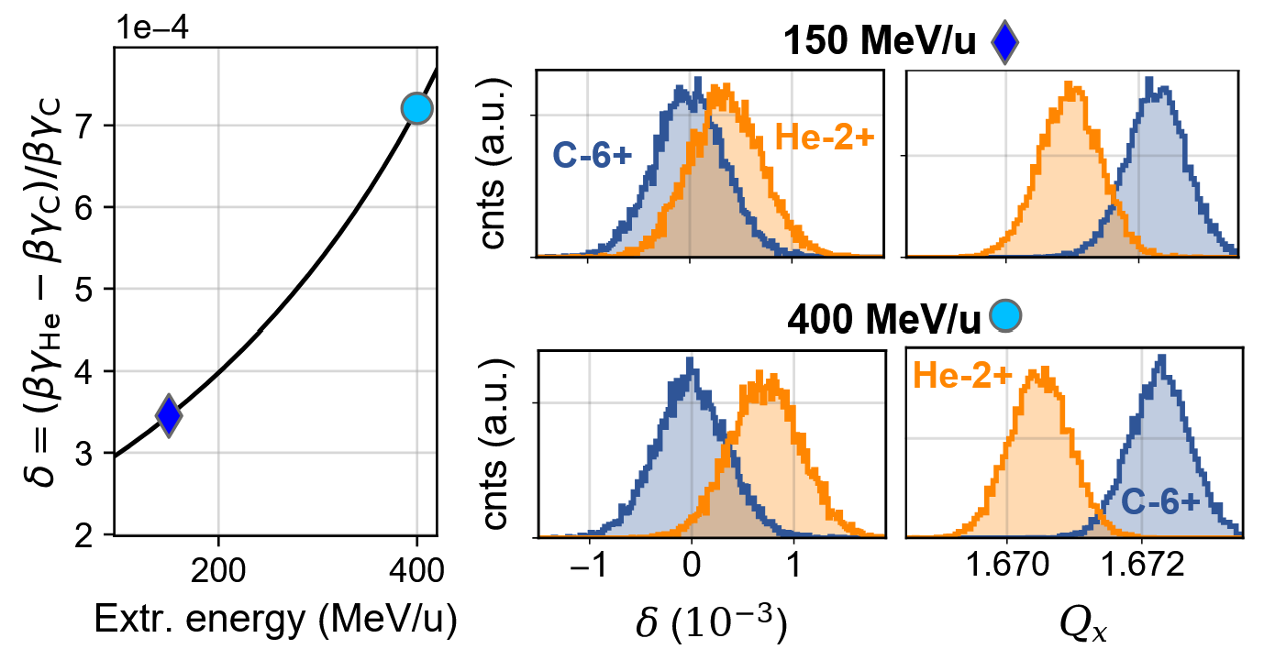
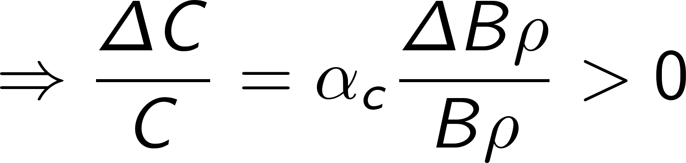
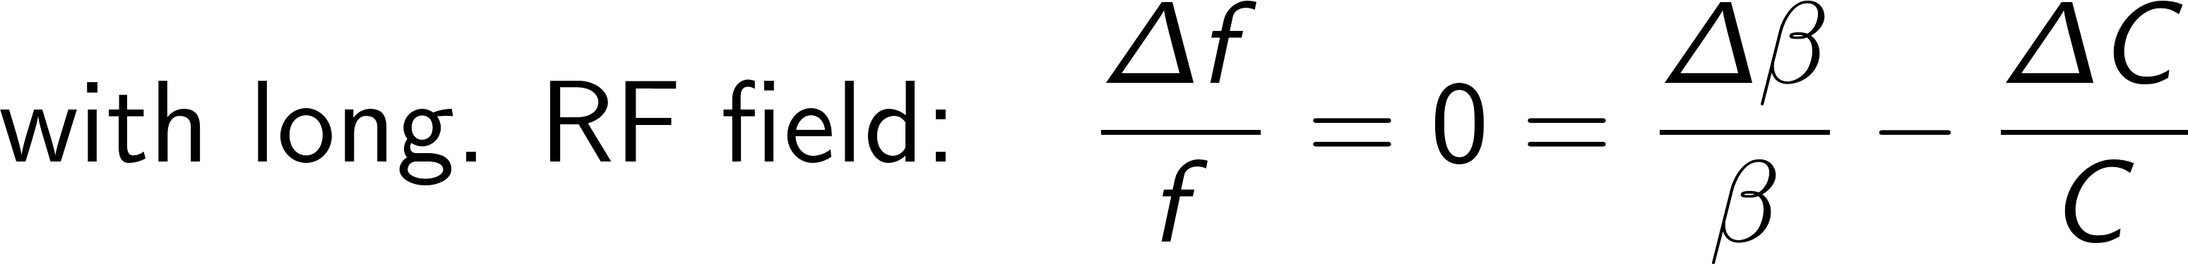
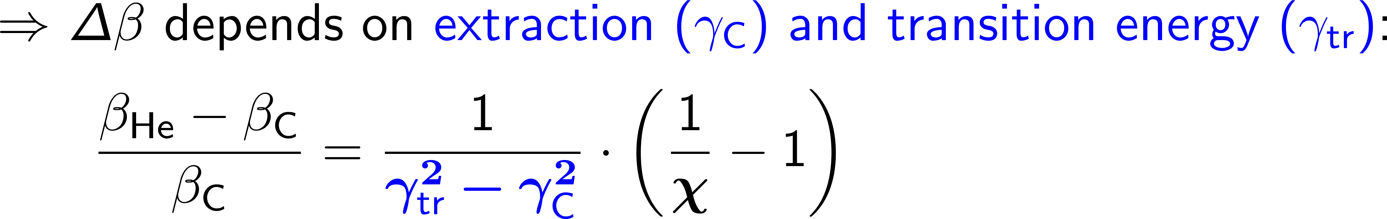
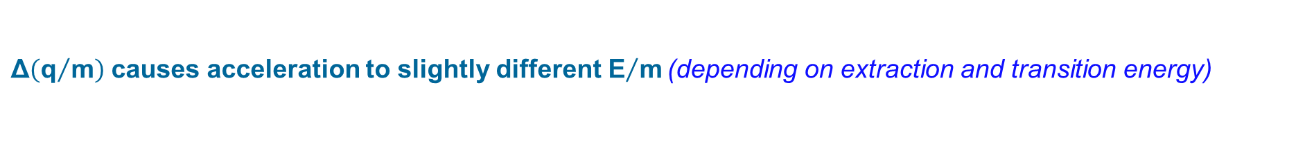
Implication of Charge-to-Mass Ratio During RF Acceleration
$\text{Δ}\left({\text{q}}/{\text{m}}\right)$ causes acceleration to slightly different${ \text{E}}/{\text{m}}$ (depending on extraction and transition energy)
Example: Relative momentum per mass offset (𝛿) between the two ion species in a PIMMS-like synchrotron (𝛾tr≈2, $δ_{rms}≈0.35 {10}^{−3}$)
[8] E. Renner, IPAC ‘24

Slide 12
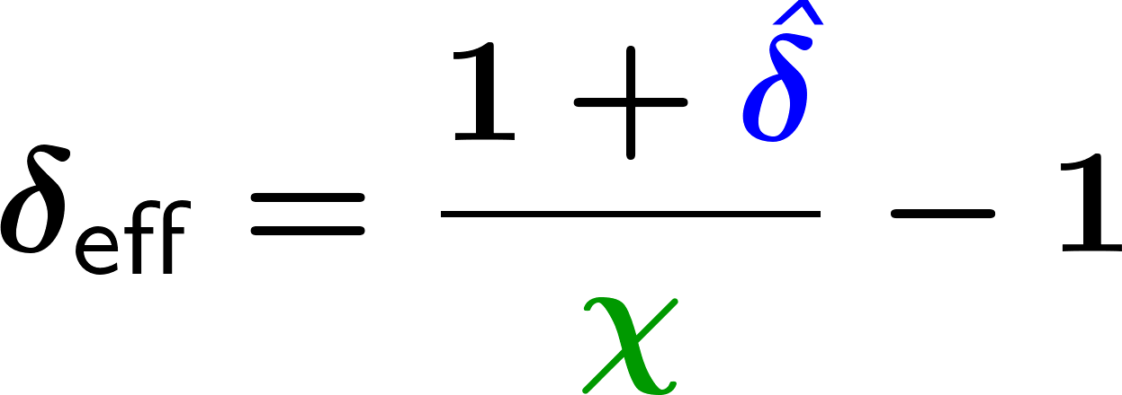

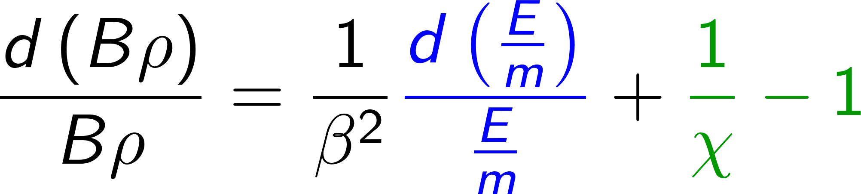
Take Away: Mixed Beams & RF Acceleration
Both contributions add up to total rigidity offset (depending on extraction and transition energy) ....
... & hence affect closed orbit and tune.
Example: Relative momentum per mass offset (𝛿) and horiz. tune (𝑄𝑥 ) separation between 4He2+ and 12C6+ in a PIMMS-like synchrotron (𝛾_{tr}≈2, here 𝑄′_{𝑥} = − 1.3 and $δ_{rms}≈0.35 {10}^{−3}$).
[8] E. Renner, IPAC ‘24

Slide 13

Slow Extraction Requirements in a Nutshell
Helium and carbon feature
different rigidity distributions (depending on extraction and transition energy),
in case of sequential injection also different horizontal phase space distributions.
Goal: Ideally extract mixed beam with (roughly) constant He:C ratio throughout the spill.
Long term goal: custom tailoring of He:C ratio throughout the spill.

Slide 14
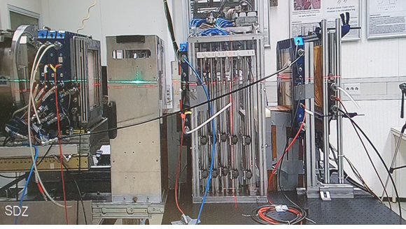
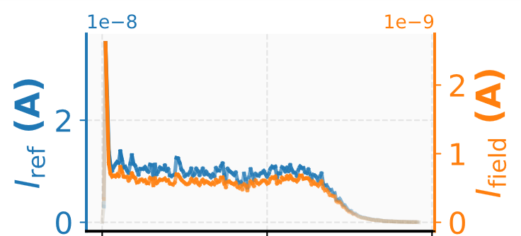
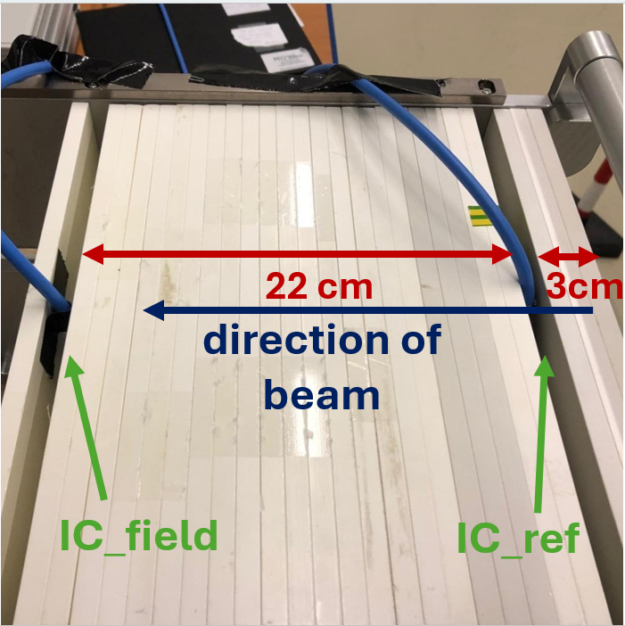
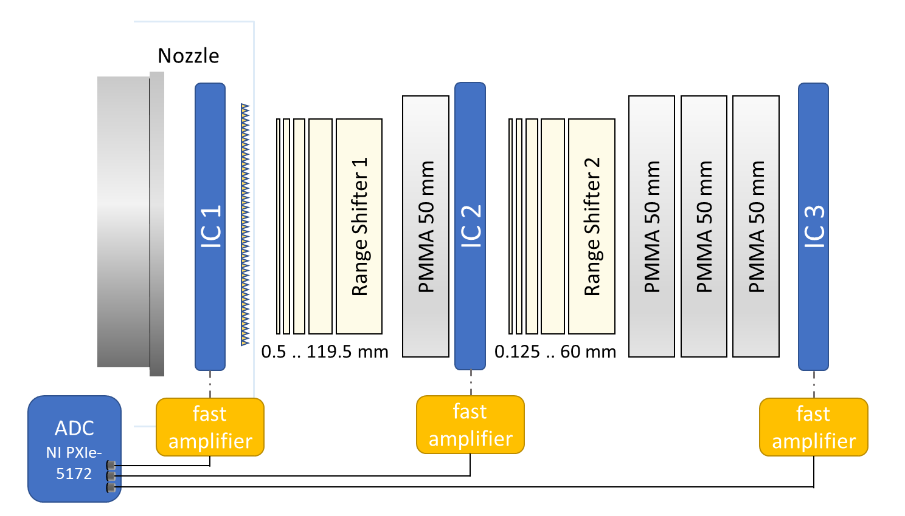
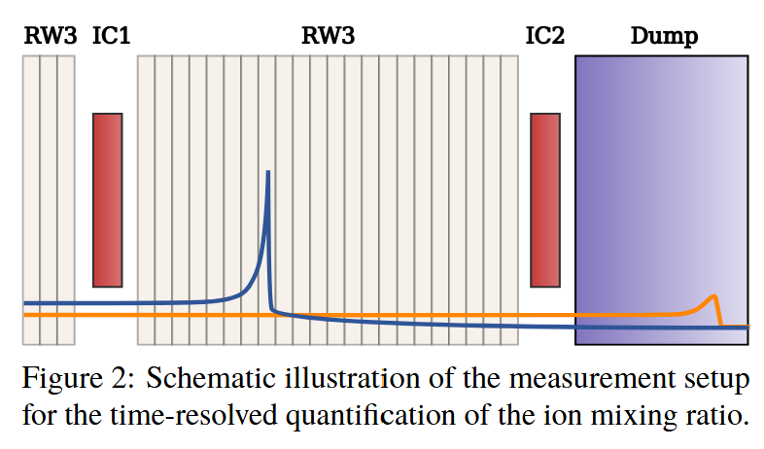
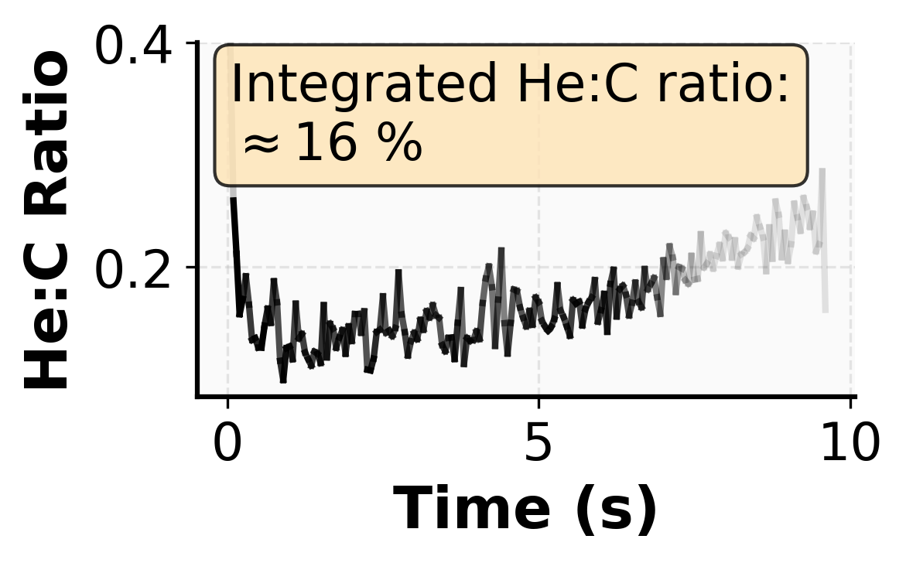
Selected Tools for Mixed Beam and Spill Characterization I
(A) Time-resolved characterization of the extracted He:C ratio (e.g., using ionization chambers at different depths)
Set-up at GSI (Biophysics cave)
Set-up at MedAustron
He:C ratio obtained from I_{field} / I_{ref} (corrected for C fragments).
Courtesy of C. Graeff, L. Volz et al. [5, 11]
M. Kausel, C. Becker, et al. IPAC’25 [10]

Slide 15
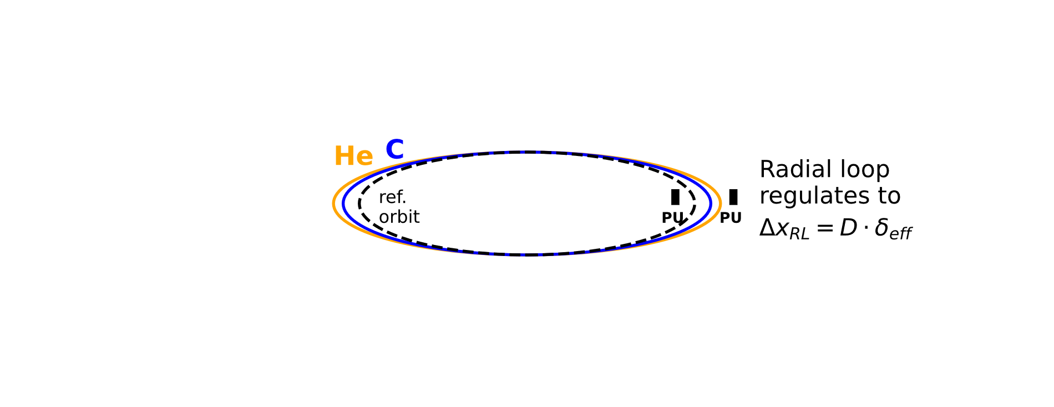
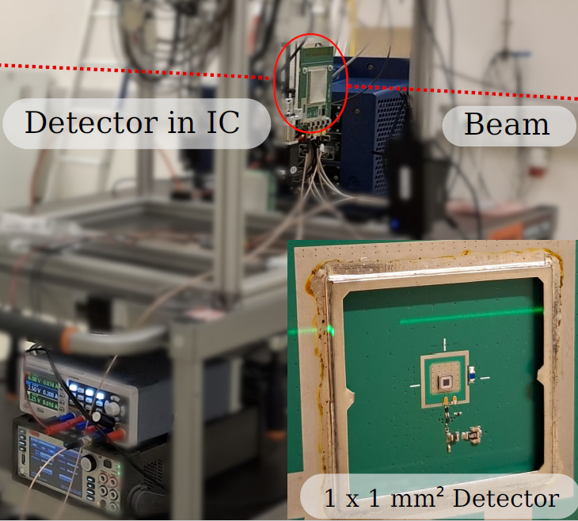
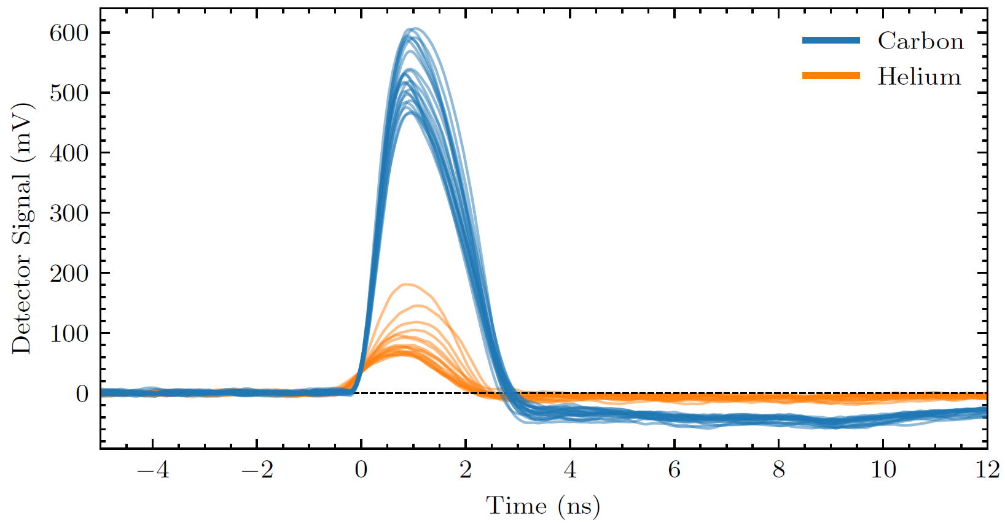
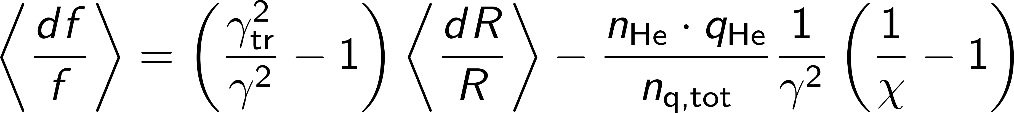
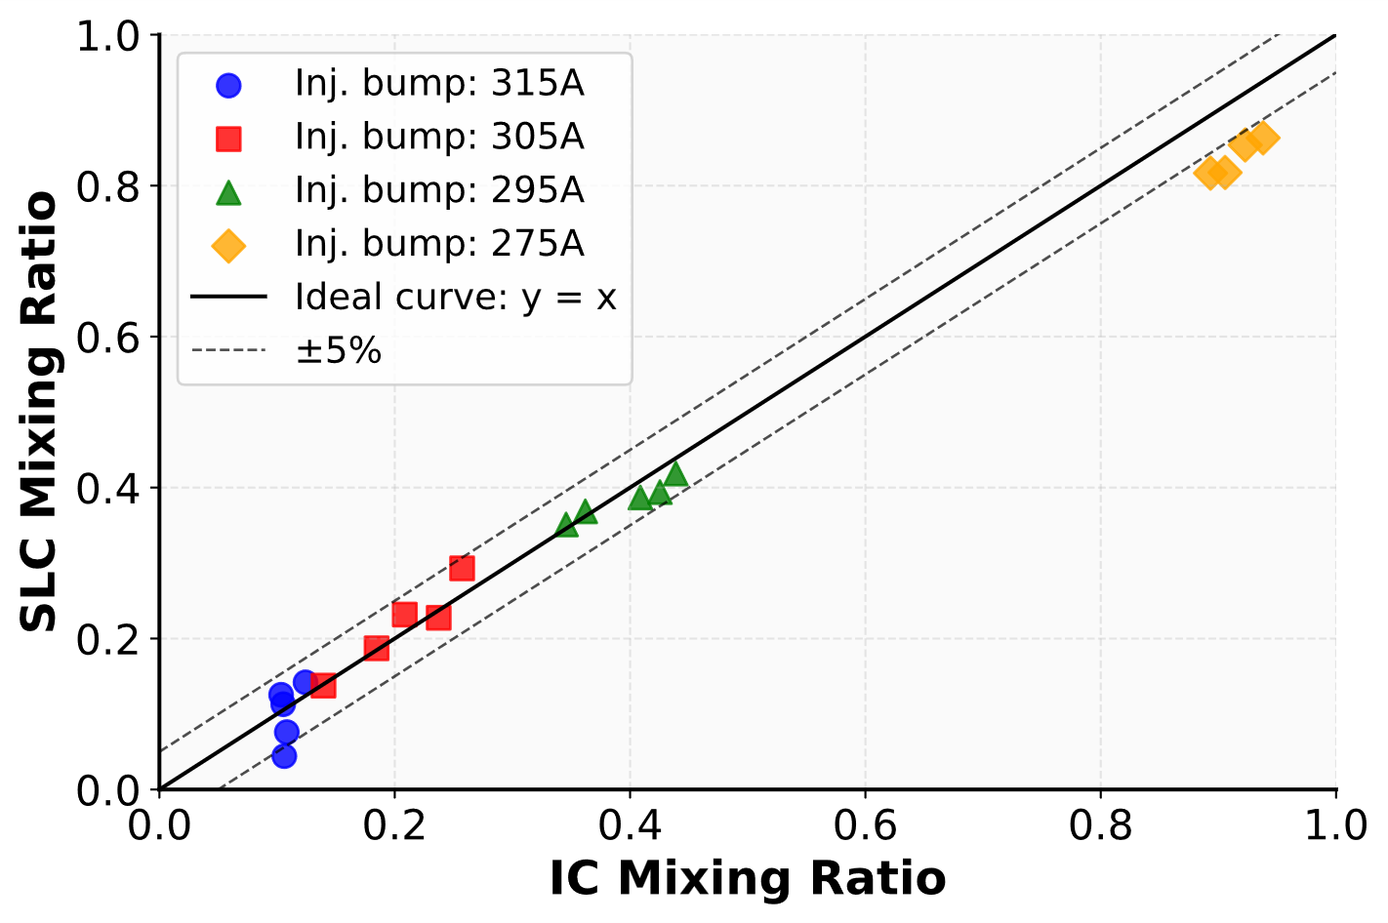

Selected Tools for Mixed Beam and Spill Characterization II
(B) Alternative: Single particle distinction via dE/dx, e.g., with 50 µm Si sensor.
(C) Non-invasive mixing ratio quantification based on RF regulation loop corrections.
Preliminary results: Mixing ratio estimate from synchrotron RF (y-axis) and ionization chambers in irradiation room (x-axis) agree within a few %.
Figure: Ekin=262 MeV, RL: 29.9mm. Extracted using Phase displacement extraction.
Not routinely employed in current studies
A. Gsponer, M. Kausel
N. Okropiridze

Slide 16
Outline
GSI
Overview: ongoing mixed helium-carbon ion beam experiments
Mixed beam slow extraction at GSI
Mixed beam slow extraction at MedAustron
Conclusion and Outlook
MedAustron

Slide 17
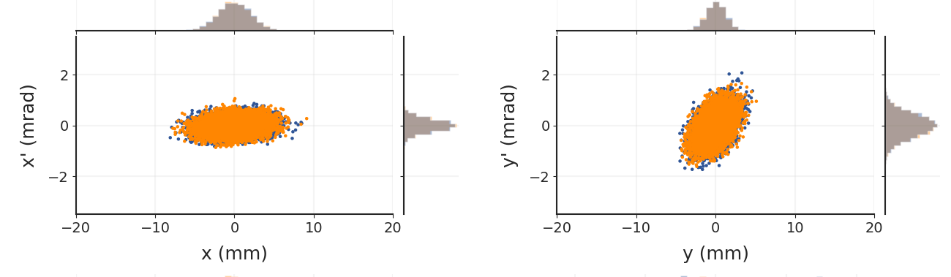

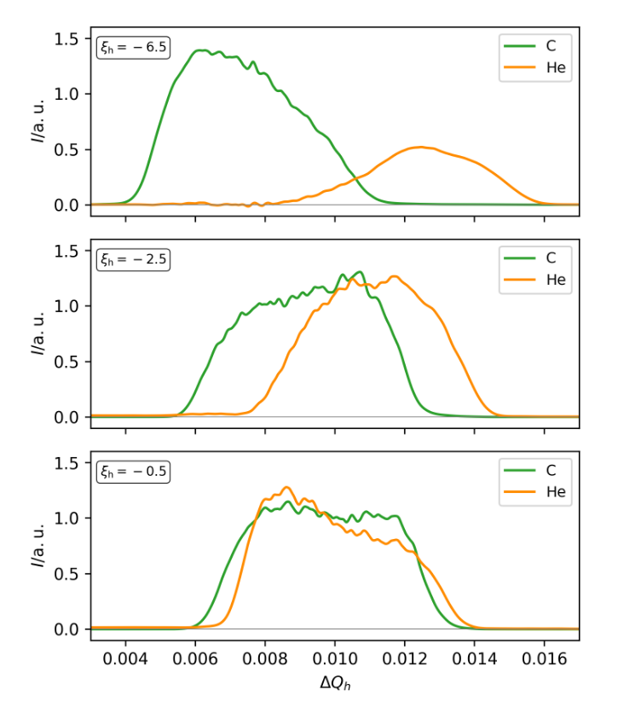

Mixed Beam Slow Extraction at GSI: Overview
A
He-2+
C-6+
Single ion source: He and C with similar initial horiz. emittances
Beam time in 2023: tune sweep and RFKO
Successful, but further studies needed.
Δx=1-2mm between He and C at isocenter → most likely due to D_{x} (see appendix)
Q
Schematic illustration. Proportions not to scale
In May 2025: main on achieving stable He-to-C ratio across spill.
RFKO, utilize spill feedback for rectangular spill.
Check chromaticity and dispersion in transfer line (see appendix)
Poster - A. Pastushenko: Flat C/He spills for online range monitoring in particle therapy
Slide courtesy of A. Pastushenko
Figure: tune sweep extr. with different chromaticities (2023)
D. Ondreka et al. IPAC’24 [6]

Slide 18
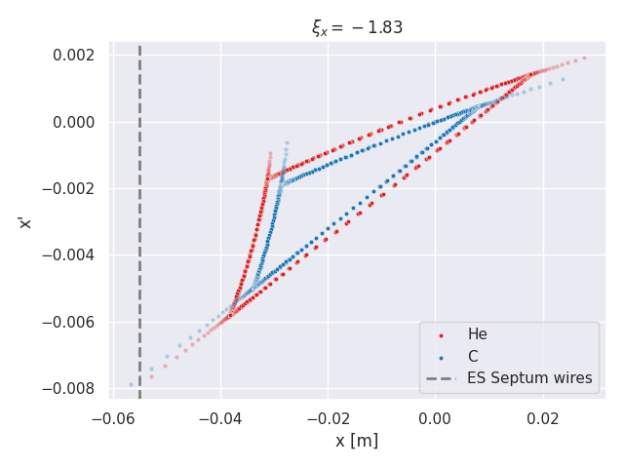
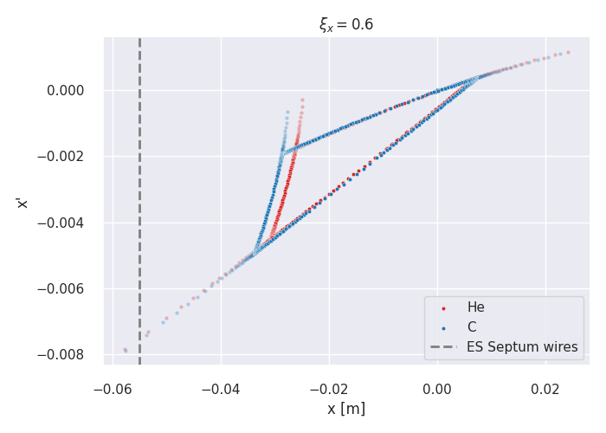
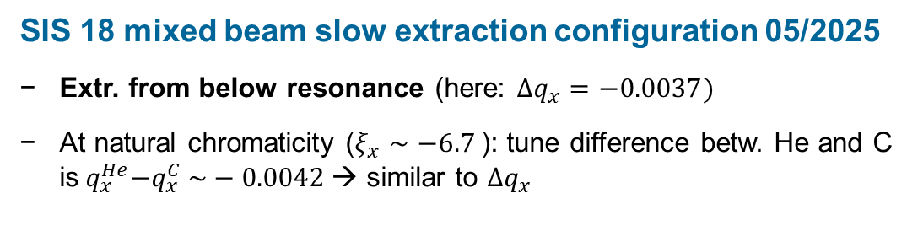


Mixed Beam Slow Extraction at GSI: Settings
A
He-2+
C-6+
SIS 18 mixed beam slow extraction configuration 05/2025
Extr. from below resonance (here: $Δq_{x}=−0.0037)$
At natural chromaticity ($ξ_{x}∼−6.7$): tune difference betw. He and C is${ q}_{x}^{He}−q_{x}^{C} \sim −0.0042$→ similar to $Δq_{x}$
Q
Schematic illustration. Proportions not to scale
$$Δq_{x}\text{= }\text{−}\text{0}\text{.}\text{0037}\text{, }ξ_{x}\sim \text{−}\text{1}\text{.}\text{83}$$
$$Δq_{x}\text{= }\text{−}\text{0}\text{.}\text{0037}\text{, }ξ_{x}\sim \text{0}\text{.}\text{06}$$
→ To set up the condition for the simultaneous extraction of C and He one has to adjust the chromaticity.
Simulations: Xsuite
Slide courtesy of A. Pastushenko

Slide 19
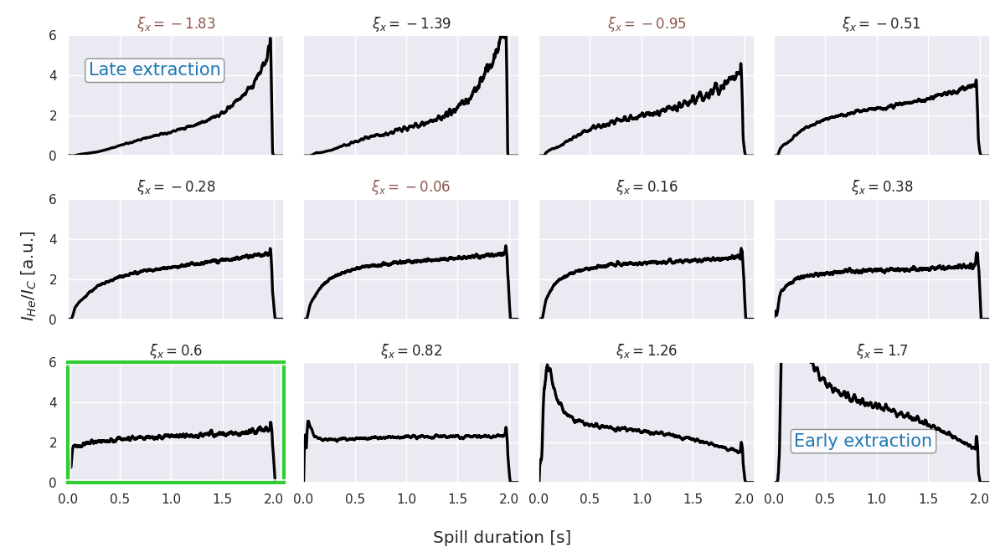
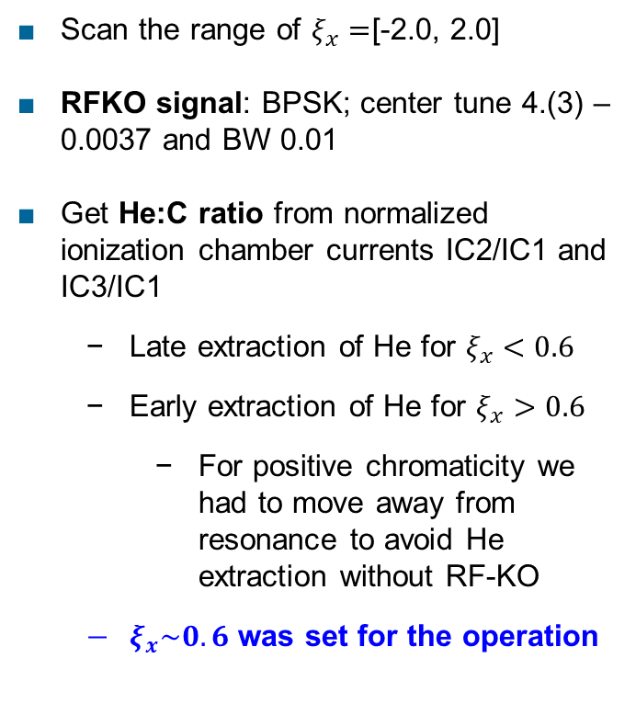
Mixed Beam Slow Extraction at GSI: Chromaticity Scan
Estimate impact of horizontal chromaticity on the extracted He:C ratio throughout spill:
Scan the range of $ξ_{x}=$[-2.0, 2.0]
RFKO signal: BPSK; center tune 4.(3) – 0.0037 and BW 0.01
Get He:C ratio from normalized ionization chamber currents IC2/IC1 and IC3/IC1
Late extraction of He for $ξ_{x}<0.6$
Early extraction of He for $ξ_{x}>0.6$
For positive chromaticity we had to move away from resonance to avoid He extraction without RF-KO
$ξ_{x}\sim 0.6$ was set for the operation
*labels in brown – chromaticity was measured
Slide courtesy of A. Pastushenko

Slide 20
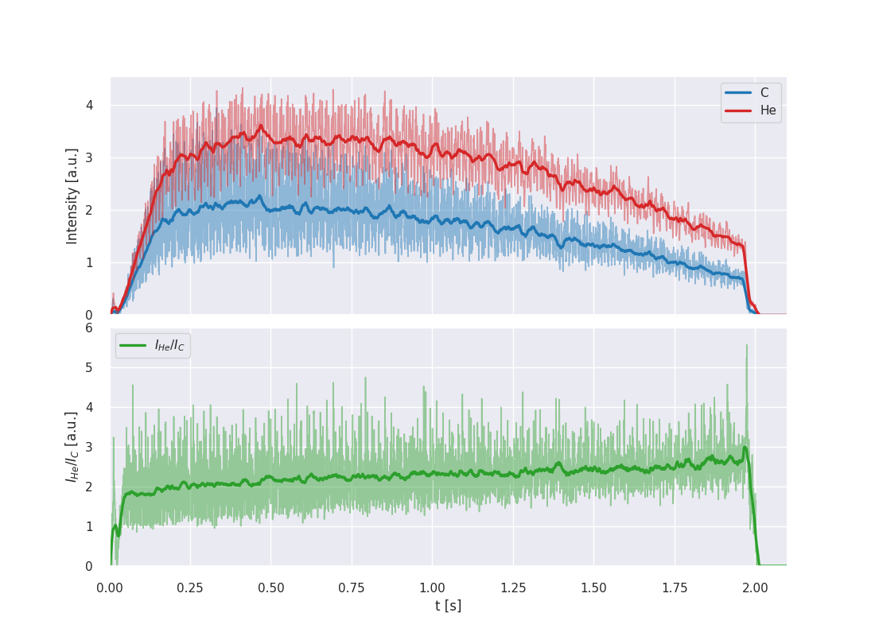

Mixed Beam Slow Extraction at GSI: Spill Optimization
Spill for the chromaticity of $ξ_{x}\sim 0.6,$ with and without spill optimization system
BPSK
Spill feedback on
Average of ~20 cycles
Talk - P. Niedermayer:
Spill feedback and optimisation system for RFKO and tune scan extraction
Slide courtesy of A. Pastushenko

Slide 21



Mixed Beam Slow Extraction at MedAustron: Overview
First mixed beam extracted in summer 2024
Betatron core (clinically used for extraction) currently not operational in double cycle setup for mixed beams
Until 01/2025: Preliminarily extract using Phase Displacement Extraction, without focus on spill characteristics.
Since winter 2025: baseline RFKO
Investigate effects due to differences in initial horizontal He & C (x,x’) and dpp distributions (double injection)
Application of different RFKO signals & combinations, both for bunched and coasting beams
A
Talk (Wednesday) - F. Plassard
Status of RF knock-out extraction development at MedAustron
Talk (Tuesday) - K. Holzfeind
Investigations into multi energy extraction at MedAustron
Poster - F. Plassard
MedAustron Facility Overview
Poster – C. Schmitzer
Ultra High Dose Rate Beam Monitoring with Radiation-Hard SiC-Based Detectors
Employ experimental RFKO setup as described in:
He-2+
Q
C-6+

Slide 22





Putting the glasses on: Where are He and C located?
Frequency sweep (several seconds)
Example: Slow RFKO frequency sweep through coasting beam stack (from higher frequencies towards resonance).
He and C with the expected offset in $f_{β}$
← Schematic illustration (!) based several assumptions
* Assumed value
See appendix

Slide 23









Mixed Beam SX at MedAustron: Simulations
In this configuration, Xsuite simulations suggest that when applying a
... broadband phase shift keying excitation centered at C tunes,
... He extraction begins with a delay due to the initially smaller horizontal He emittance.
(1) Initial losses during sextupole ramp: mainly C.
* Disclaimer: Conceptual simulations: initial (x, x′) and δp/p distributions for He and C, are based on assumptions.

Slide 24





Mixed Beam SX at MedAustron: Measurements
However, measurements show more constant He:C ratio throughout spill than expected.
Nice, but not fully understood ... Even when varying the 2nd injection bump and hence the (expected) ${ϵ_{x, He}}/{ϵ_{x, C}}!$
Coasting, BPSK
Bunched*
Lucky? Shift BPSK spectrum (coasting)
*presence of quadrupolar-mode synch. osc. during extr.
Follow-ups: sensitivity studies (RFKO signals, optics, extraction energies), refine simulation model (x,x’, dpp dist); assess off-momentum losses in transfer line, increase resolution of measurements, ....

Slide 25


Outlook: Mixed Beams with Different Charge-to-Mass Ratios
Multiple, independent RF frequencies allow simultaneous acceleration of ion species with different q/m
Milestone in May 2025 at GSI (SIS18)
First successful acceleration and fast extraction of ion species with different q/m
Simultaneous acceleration
²⁰⁹Bi⁶⁸⁺
Paves way for new ion combinations & respective range differences for treatment monitoring
Simultaneous p+/C acceleration: feasibility tests at MedAustron in preparation
f/Hz
Acceleration Fe
Injection
Bi
Injection Fe
⁵⁶Fe²⁵⁺
time / us
D. Ondreka
Opportunities for broader scientific communities. Any potentially interested user groups?

Slide 26
Conclusion & Outlook
Mixed helium and carbon beams are now available for experimental studies
GSI: generated in single ion source → similar horizontal He and C emittances
MedAustron / TU Wien: sequential multi-turn injection → different horizontal He & C emittances
Mixed beam slow extraction studies ongoing
Managed to extract constant He:C ratios.
Demonstrated sensitivity of He:C ratio to chromaticity and RFKO excitation signals.
Follow-up experiments and Xsuite simulations ongoing
Long term goal: Flexibly tailor extracted He:C ratio across the spill (multiple RFKO signals?)
Outlook: First simultaneous acceleration of ions with different q/m (Fe, Bi)
→ paves the way for new research applications
Our test set-ups are flexible – any ideas welcome!
Many thanks for your time!
Questions?
Poster - A. Pastushenko: Flat C/He spills for online range monitoring in particle therapy

Slide 27
References
[1] D. Mazzucconi, M. Pullia et al., “Mixed particle beam for simultaneous treatment and online range verification in carbon ion therapy: Proof-of-concept study” Med. Phys. 45 (11), 2018
[2] C. Graeff et al. “Helium as a range probe in carbon ion therapy”, Physica Medica 52, 2018
[3] L. Volz “Experimental exploration of a mixed helium/carbon beam for online treatment monitoring in carbon ion beam therapy” et al., Phys Med Biol 65/2, 2020
[4] J. Hardt “The potential of mixed carbon–helium beams for online treatment verification: a simulation and treatment planning study”, Phys Med Biol 69/5, 2024
[5] M. Galonska et al., “First dual isotope beam production for simultaneous heavy ion radiotherapy and radiography”, IPAC’24
[6] D. Ondreka et al., “Slow extraction of a dual-isotope beam from SIS18”, IPAC’24
[7] C. Graeff et al. ERC PROMISE, https://www.gsi.de/work/forschung/biophysik/erc_barb/promise
[8] E. Renner et al., “Towards the slow extraction of mixed He-2+ and C-6+ beams for online range verification” IPAC’24
[9] M. Kausel et al. “A double multi-turn injection scheme for generating mixed helium and carbon ion beams at medical synchrotron facilities” submitted to PRAB, https://arxiv.org/abs/2501.12797, 2025
[10] M. Kausel et al., “Recent developments in delivering mixed helium and carbon ion beams for online treatment monitoring research at MedAustron”, IPAC ‘25
[11] L Volz et al., “Portal imaging with mixed beams: Status and future Potential”, 5th Ion Imaging Workshop, 2024
[12] F. Ulrich-Pur “First experimental time-of-flight-based proton radiography using low gain avalanche diodes” Phys Med Biol 69 (2024)

Slide 28
Spare Slides

Slide 29




GSI SIS 18 Machine Properties: Chromaticity
Chromaticity in the ring is set with a parameter (ks.offset). We checked if the relation agrees with the simulations.
We measure on/off – momentum tunes. The beam is excited with a broad noise.
Agreement is reached with $k_{2l}=0.04$ m⁻² component in the dipoles.
Measurements were done with resonance sextupoles on and off.
For one setting (ks.offset = 0.14, $ξ_{x}\sim −0.06$), tune was measured for a bigger range of momentum offsets. Nonlinear chromaticity hints nonlinearities in magnets ($k_{3l}$ in quads, ..)

Slide 30


GSI SIS 18 Machine Properties: Transfer Line Dispersion
In 2023, horizontal positions of He and C at isocenter were 1 – 2 mm apart. Most likely explanation – horizontal dispersion.
Due to the lack of time, measurements were done at 2 locations, upstream of the medical cave.
Reconstructed dispersion shows large amplitudes along the transfer line. Need to be measured again (+) in other locations along the transfer line.
Measured $D_{x}$:
17.4 m
6.7 m
Estimate at the end
~ -4 m

Slide 31





Supplementary Material for Mixed Beam SX at MedAustron
Overshoot in BPSK signal
With PSK seed reproducible ripple in intensity and He:C ratio.

Slide 32




Supplementary Material for Mixed Beam SX at MedAustron
Slow RFKO frequency sweep through waiting beam stack

Slide 33


Supplementary Material for Mixed Beam SX at MedAustron
200 MeV/u
Broadband PSK with amplitude modulation
He:C ratio tailored by adapting the 2nd injection bump amplitude.
Mixing ratio estimate based on synchrotron RF frequency
Extraction He:C ratio throughout the spill
Beam current measurement in the synchrotron
Current measurement: only 1 measurement per setting

Slide 34


Supplementary Material for Mixed Beam SX at MedAustron
In this double-cycle configuration, the vertical beam size of He appears to be smaller than that of C.

Slide 35









Single Ion Source in Clinical Facilities?
⁴He¹⁺ and ¹²C³⁺
After stripping
LINAC: $\text{q}\text{/}\text{m}\text{ > }\text{1}\text{/}\text{3}$
standard at e.g. MedAustron, CNAO, HIT
$\frac{q}{m }≈\frac{1}{4}$ $\frac{d\left(q/m\right)}{q/m}≈−6.5∙{10}^{−4}$
Source ✔ LINAC ❌ Synchrotron ✔
Stripping foil
⁴He²⁺ and ¹²C⁶⁺
$\frac{q}{m }≈\frac{1}{2}$ $\frac{d\left(q/m\right)}{q/m}≈−6.5∙{10}^{−4}$
No stripping required
Source ❌ LINAC ✔ Synchrotron ✔
ECR ion sources: different source branches
⁴He²⁺
¹²C⁴⁺
³He¹⁺ and ¹²C⁴⁺
$\frac{q}{m }≈\frac{1}{3}$ $\frac{d\left(q/m\right)}{q/m}≈−5.3∙{10}^{−3}$
No stripping; q/m=1/3
Source ✔ LINAC ✔ Synchrotron ❌
($E_{kin,max}≈200 MeV/u$ < 400 MeV/u)
Take away
Mixed beam generation within single ion source currently not possible in state-of-the-art medical synchrotron facilities.

Slide 36






Double Multi-Turn Injection: Technical Challenges @ MedAustron
[9] M. Kausel et al., submitted to PRAB ‘25
S3: ⁴He²⁺
Different injection energies due to $\text{Δq}\text{/}\text{m}$ in LINAC
Mitigation measures (decelerate helium):
Injector: debuncher cavity (allows to inject He into the synchrotron) and
Synchrotron: deceleration prior to carbon inj. (using radial loop regulation; facilitates simultaneous capture)
S2: ¹²C⁴⁺
(1)
Measurement
Xsuite Simulation
2) RL offset
+20 mm
(2)
RL regulation
1) RL offset
-20 mm
Meas.
(1) Capture + decelerate helium prior to carbon injection.
(2) Inj.. C; capture und acc. He+C

