Slide 1

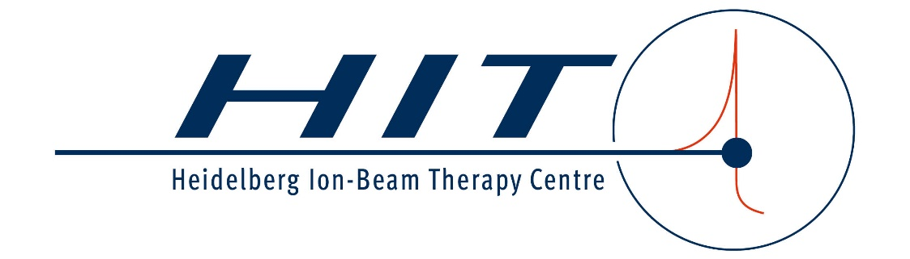
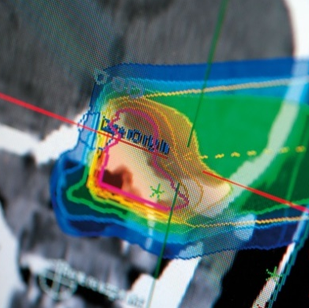
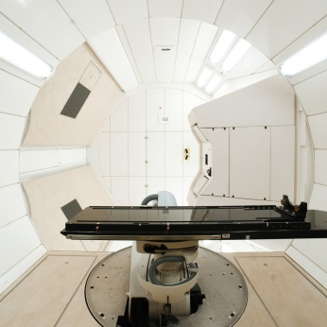
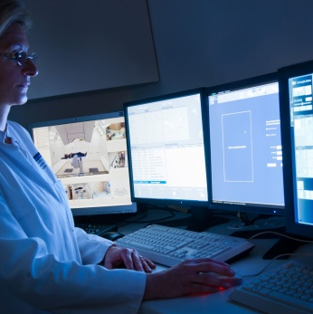

Less ripple – higher intensity: What is the "ideal" intensity in SX for raster-scanning at HIT?
Christian Schömers, Stephan Brons, Julian Horn, Jakob Naumann, Marcus Winter, Eike Feldmeier
6th SX Workshop, Oct. 2025

Slide 2
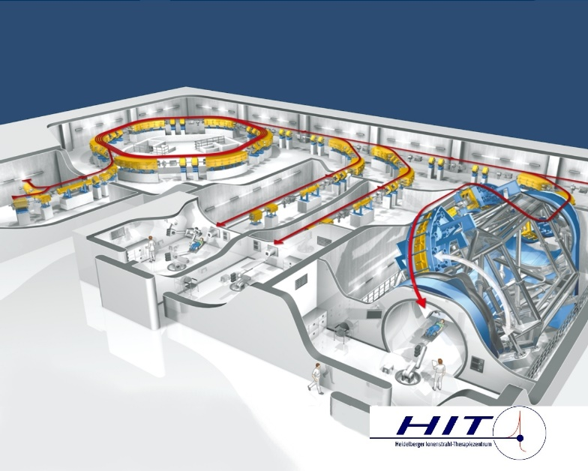
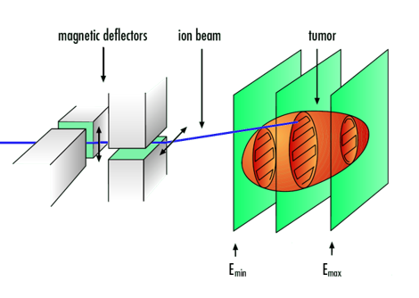
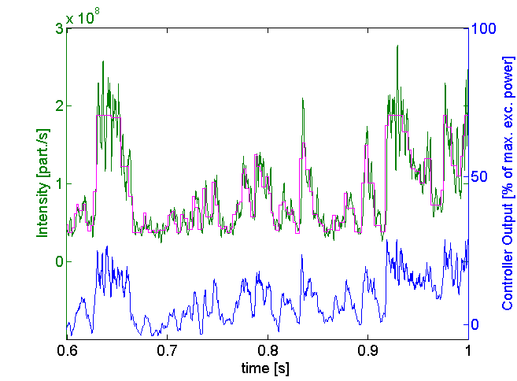
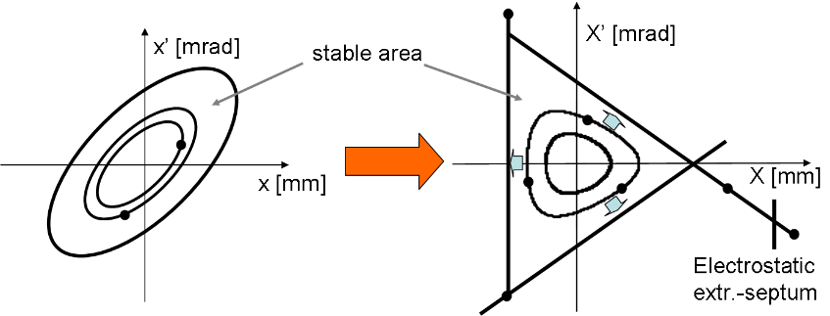
Introduction HIT
HIT is a medical accelerator facility in Heidelberg treating ≈ 700 patients / year with carbon ions, helium ions and protons since 2009
Synchrotron-based facility with full 3D intensity controlled raster-scanning
3rd order resonance extraction via transverse RF-knockout
Intensity amplitude modulation with feedback loop to control spill on a scale > 1ms.

Slide 3
Introduction Review of Previous Work
RF-KO excitation signal has a significant impact on spill micro structure
Studies of horizontal beam response via BTF measurements
Find optimal excitation spectrum
beam response
horizontal tune Qx
[1] Cortés García, E. C. (2022). Investigation of RF-signals for the slow extraction at HIT’s medical synchrotron. Heidelberg / Darmstadt: TU Darmstadt..
[2] Cortés García, E. C. et al. (2022). Optimization of the spill quality for the hadron therapy at the Heidelberg Ion-Beam Therapy Centre, Nuclear Inst. and Methods in Physics Research, A 1040 (2022) 167137.
[3] Krantz, C. et al. (2018). Slow Extraction Techniques at the Marburg Ion-Beam Therapy Centre in Proc. 9th Intl. Particle Accelerator Conf. (IPAC’18), Vancouver, BC, Canada

Slide 4
Introduction Review of Previous Work
Implemented in therapy
operation Oct. 2023
New excitation spectrum required new signal generation hardware for operation
Use 3 RF-KO frequencies instead of 1
Spill micro structure considerably improved
[4] Feldmeier, E. et al. (2022). Upgrade of the Slow Extraction System of the Heidelberg Ion-Beam Therapy Centre’s Synchrotron. Proc. 13th Intl. Particle Accelerator Conf. (IPAC’22), Bangkok, Thailand
power [dBm]
frequency [MHz]

Slide 5
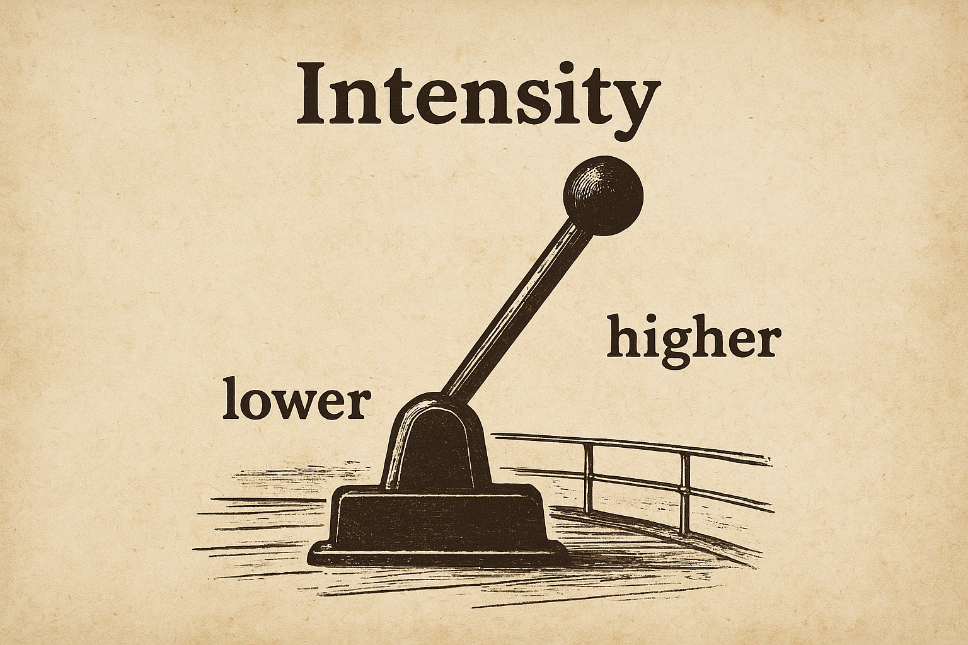
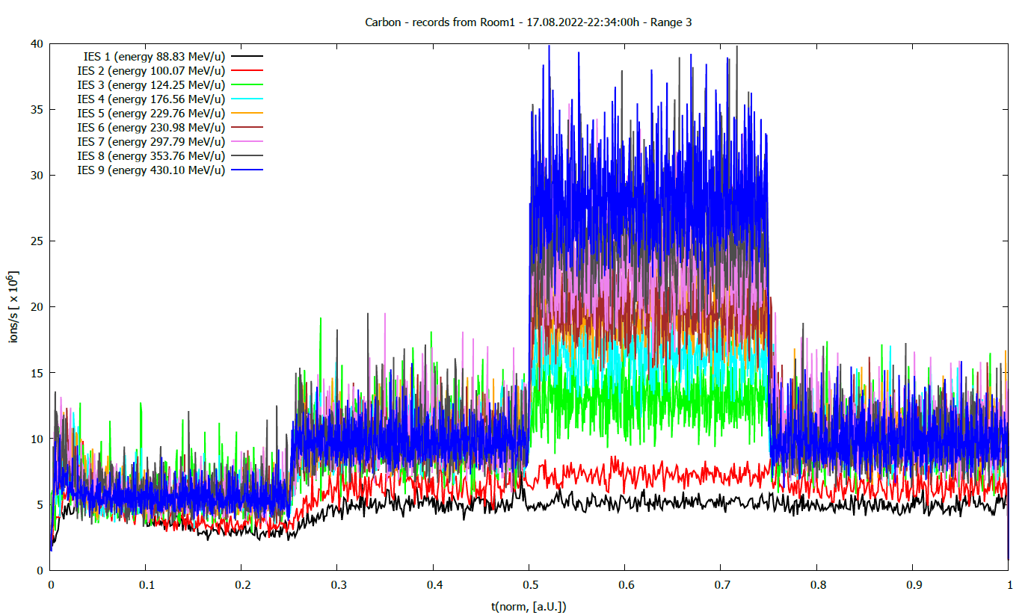
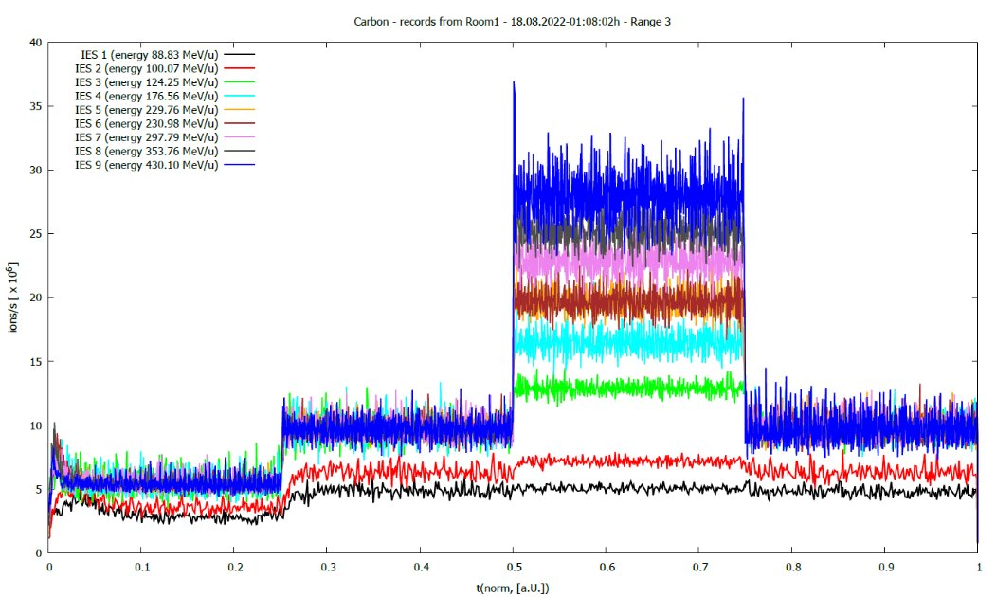
Introduction Summary
Still open: Go higher with intensity!
Spill micro structure improved
No. of intensity related interlocks reduced
Carbon spills of different energies with different intensity levels within one spill
before Oct. 2023 after Oct. 2023
ions/s e6
30
20
10
430 MeV/u
297 MeV/u
…
89 MeV/u
t
t

Slide 6
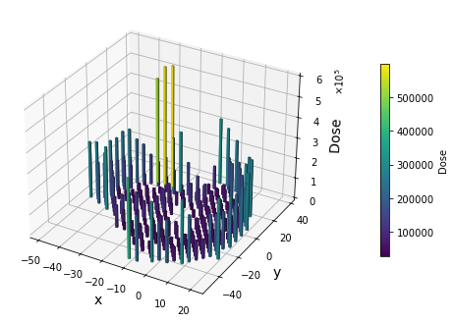
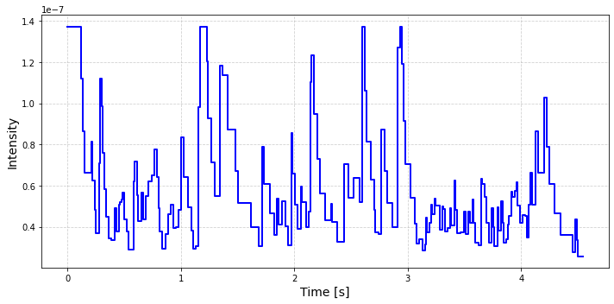
Materials and Methods: Process-Data-Generation (PDG)
Part of therapy control system
One task of PDG: translates the patient specific dose distribution into… …a machine specific intensity pattern along the scan path

Slide 7
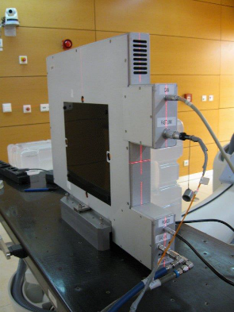
Criteria for Intensity Pattern in Raster-Scanning Technique
MWPC
@ HIT
I
Intensity for each raster-point is set within several runs:
How fast is the position measurement detector system?
Take intensity fluctuations into account
Do not loose too much dose on the way while scanning
Intensity too high for the intensity monitors?
Dynamic effects: intensity cannot be varied instantaneously
…
Real Intensity (less fluctuations)
Real Intensity (more fluctuations)
t
beam
I
intensity monitor limit
Description of task: find new parameters for the intensity pattern according to the lower spill noise, to reduce treatment time without increasing the No. of interlocks
t

Slide 8

Materials and Methods First step: Simulation
→ Many parameters with complex interplay
Cannot try all combinations of parameters at the machine
Process Data generation simulation tool to save beam time:
Calculates intensity pattern according to real PDG
Get theoretical beam on time
Try different configurations
Check the possible reduction of beam time
Find most promising parameters
Run with all patients treated at HIT in 2024
PDG- Sim

Slide 9
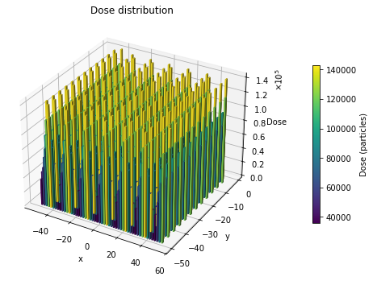


Materials and Methods Second step: Check with beam time at the accelerator
Dedicated cutting edge QA test plans (12)
For statistics: realistic and representative patient treatment plans (21 patients, 55 fields)
Main observables:
reduction of irradiation time
raster-points potentially with interlock

Slide 10
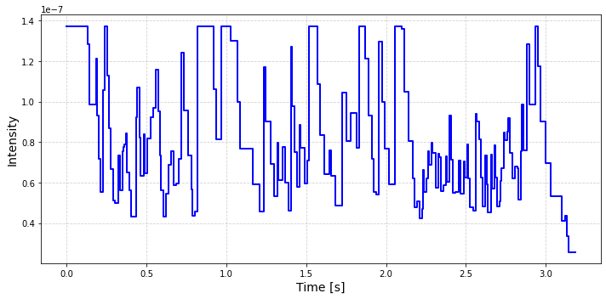
Results
Example of 1 iso-energy-slice of 1 patient:
Higher intensity in average, but no constant scaling factor
Not every raster point is affected equally
Pattern before optimization Pattern after optimization

Slide 11

Results
Time saved:
27 % beam on time
10 % overall irradiation time → 45 min per day!
3 more patients can be treated in one day!
With same level of interlocks
Will be implemented in therapy in one of the next maintenance slots
+3 patients
per day!

Slide 12
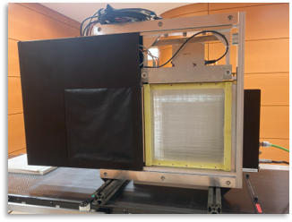
Outlook How can the intensity be further increased?
Use faster detector systems for dose delivery system
currently HIT uses MWPCs
scintillating fiber detector under investigation
Check the interlock conditions
currently position is measured twice during irradiation; why not just once?
currently interlock after 4 raster points irradiated too fast; why not 5 or 6?
The truth is the applied dose
Elimination of low-dose raster points possible?
Try to reduce the dynamic range
…

Slide 13

New order of raster points Improved treatment time by sorting spots?
Current Situation
Scan path design based on a greedy Traveling Salesman Problem (TSP) approach
Beam crossings are fully avoided
Particle distribution at grid points is not considered
Intensity is adjusted according to particle occupancy, but not with unlimited dynamic range
Approach
TSP with weighted edges (Lin-Kernighan-Helsgaun/Roskilde University, Denmark)
Allow beam crossings, but strictly avoid spill-induced interruptions
Test-Irradiation of 52 plan/weight combinations
Implement via script into TPS (RayStation)
[5] K. Helsgaun,
“An Effective Implementation of the Lin-Kernighan Traveling Salesman Heuristic”.
European Journal of Operational Research 126 (1), 106-130 (2000).

Slide 14
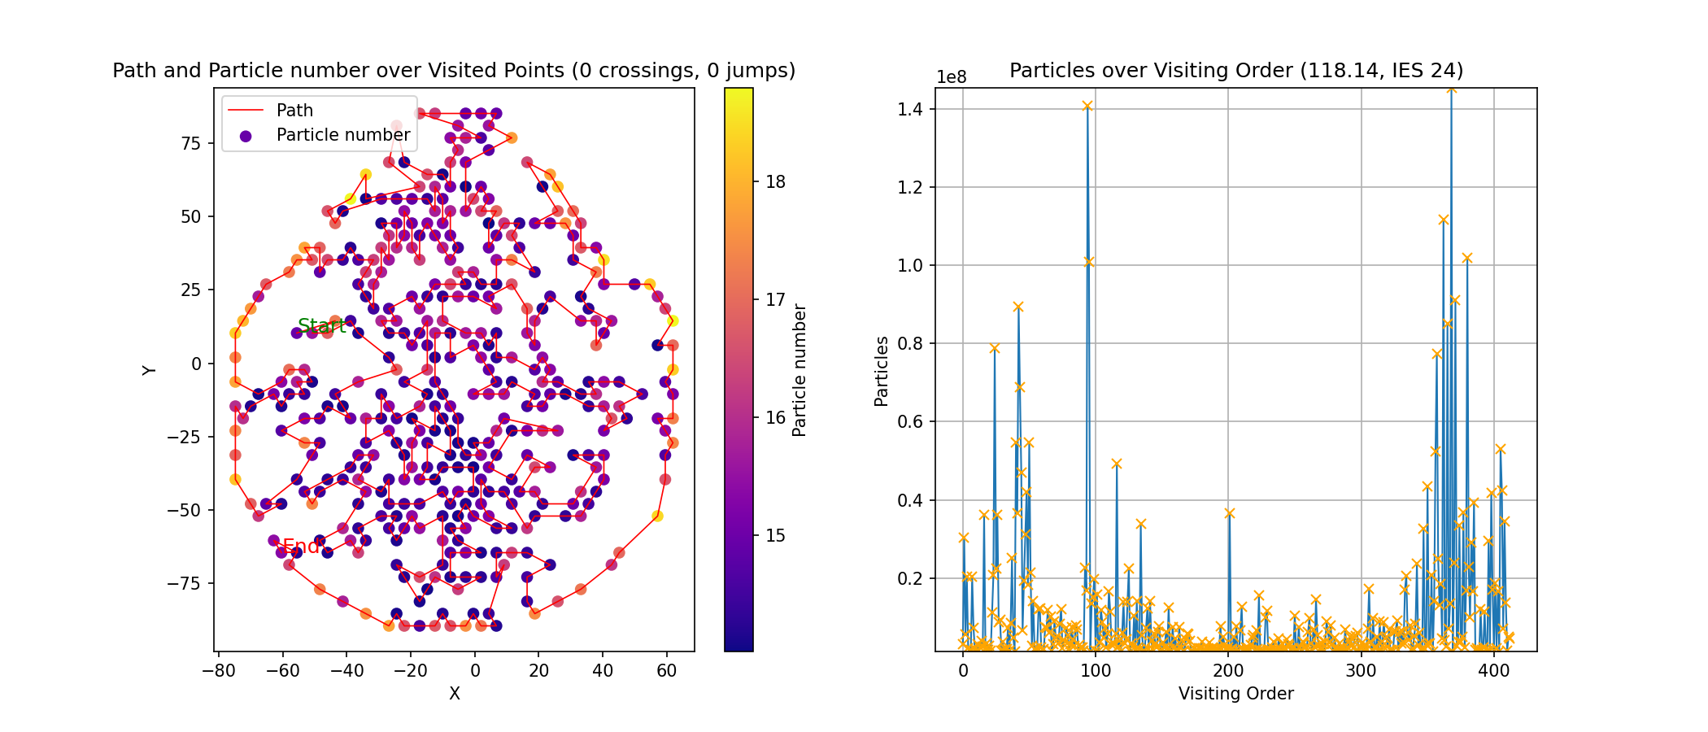
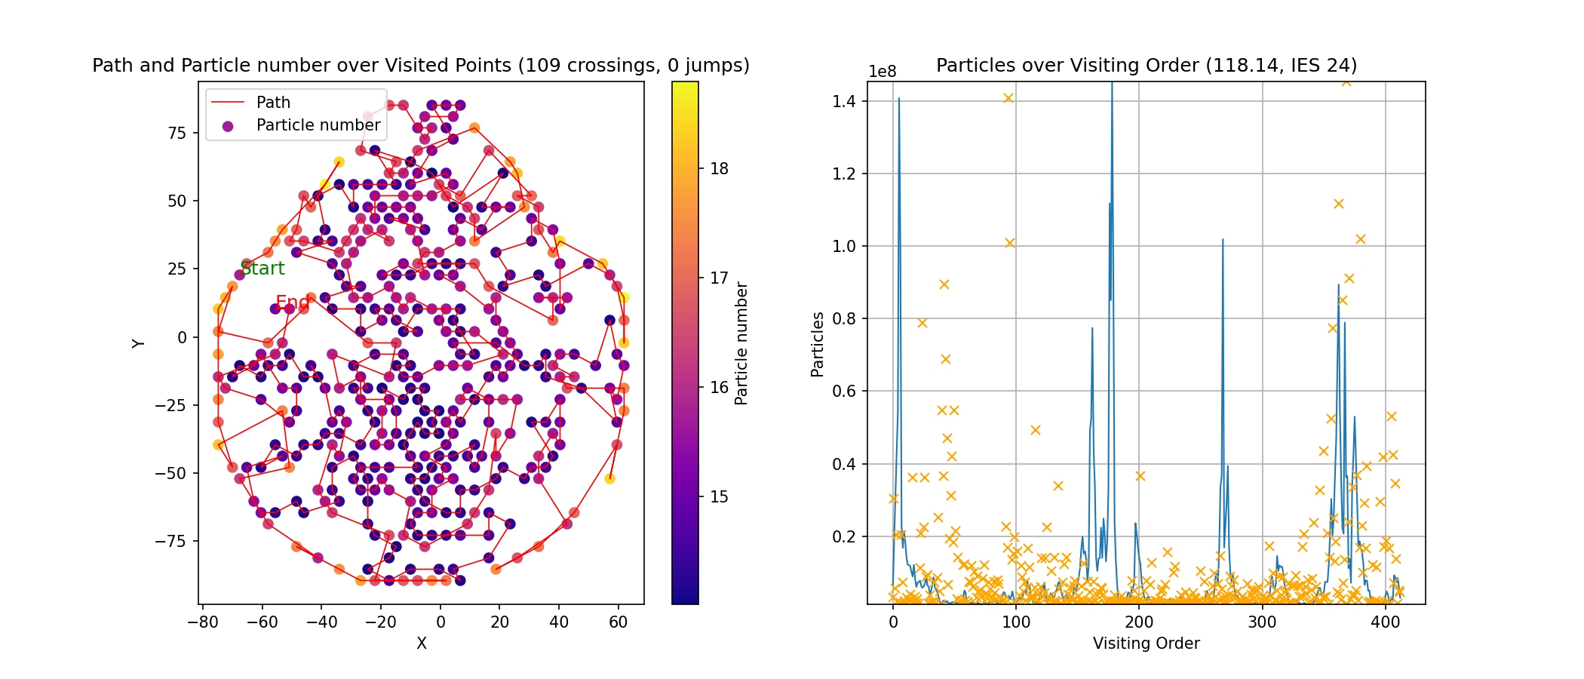
Moderate weights yield improved particle distribution
Single Energy Slice
Original path
Complete Beam Plan
Y
Particles
Original path
Optimized path
X
Order
Optimized path
Y
Particles
Theoretical Maximum
(100% sorted, not clinical)
X
Order

Slide 15
New order of raster points Results
Limited Potential Benefit
Currently, most part of irradiation time is spent during non-extraction
Net gain would correspond to ~90 hours of beam time saved per year (~3%)
Outstanding Issues
Effect of beam crossings on dose distribution
Integration into clinical treatment workflow
Validation of the TPS implementation
Licensing requirements for the LKH algorithm
Ion | net irradiation time improvement
Protons | 30% (10% to 50%)
Carbon | 12% (0 to 30%)

Slide 16
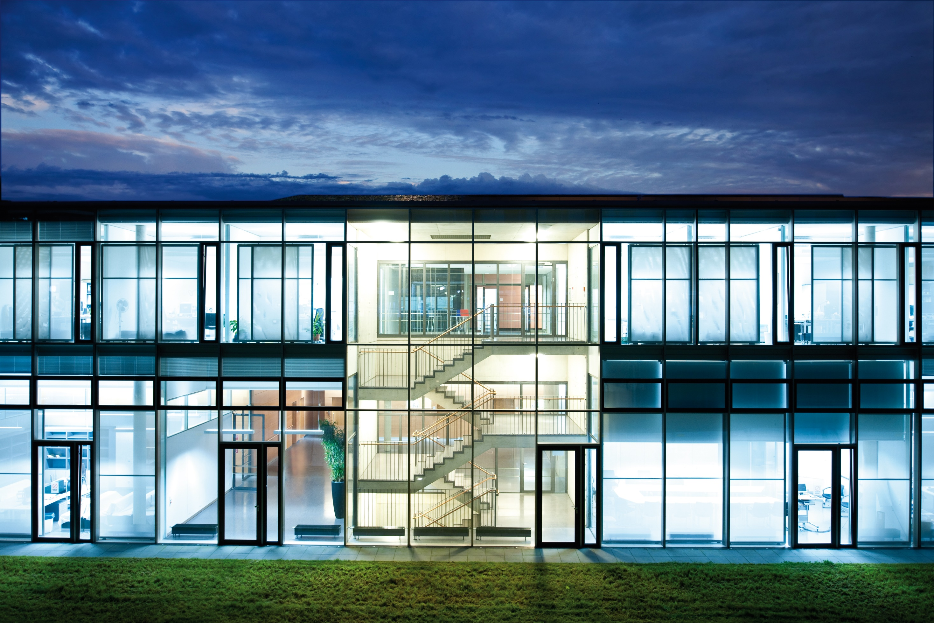
Thank you for your attention! References
[1] Cortés García, E. C. (2022). Investigation of RF-signals for the slow extraction at HIT’s medical synchrotron. Heidelberg / Darmstadt: TU Darmstadt.
[2] Cortés García, E. C., Feldmeier, E., Galonska, M., Schömers, C., Hun, M., Brons, S., Cee, R., Scheloske, S., Peters, A., Haberer, T., (2022). Optimization of the spill quality for the hadron therapy at the Heidelberg Ion- Beam Therapy Centre, Nuclear Inst. and Methods in Physics Research, A 1040 (2022) 167137,
[3] Krantz, C., Fischer, T., Kröck, B., Scheeler, U., Weber, A., Witt, M., Haberer, T., Cee, R. ,Faber, F., Feldmeier, E., Galonska, M., Scheloske, S., Schömers, C., Peters, A. (2018). Slow Extraction Techniques at the Marburg Ion-Beam Therapy Centre in Proc. 9th Intl. Particle Accelerator Conf. (IPAC’18), Vancouver, BC, Canada
[4] Feldmeier, E, Cortés García E. C., Cee, R., Galonska, M., Haberer, T., Hun, M., Peters, A., Scheloske, S., Schömers, C. (2022). Upgrade of the Slow Extraction System of the Heidelberg Ion-Beam Therapy Centre’s Synchrotron. Proc. 13th Intl. Particle Accelerator Conf. (IPAC’22), Bangkok, Thailand
[5] K. Helsgaun. An Effective Implementation of the Lin-Kernighan Traveling Salesman Heuristic. European Journal of Operational Research 126 (1), 106-130 (2000).

