Slide 1





Resonant Slow Extraction Simulations using SciBmad
Eiad Hamwi
PhD Candidate, Cornell ERL/EIC Group
PI: Georg Hoffstaetter de Torquat

Slide 2
Outline
Beamline description
Orbit, optics, and chromaticity
Nonlinear Normal Form
Separatrix & Extraction
Ramping
CESR Resonant Island Studies
Summary and Conclusion

Slide 3
Beamline Description
Bends
Arbitrary field strength
Multipoles
Arbitrary tilts
Arbitrary combinations
Up to 21st order
Cavities
Standing wave pseudo-TM₀₁₀
Alignment & Apertures
Dislocation, tilts, rolls
Rectangular, elliptical apertures
Patch
Coordinate transformations
Time-dependent parameters
Updated per-particle
Updated per-bunch
Notes:
Elements are all the same type
All elements are differentiable w.r.t. their parameters

Slide 4
Orbit, Optics, Chromaticity
Orbit: High-order symplectic integration
Optics: Arbitrary order Truncated Power Series Algebra (c.o. Laurent Deniau)
Chromaticity & More: Elliptical Nonlinear Normal Form Analysis (c.o. Etienne Forest)
Future: Hyperbolic Normal Form Analysis? (unstable fixed points dynamics)

Slide 5
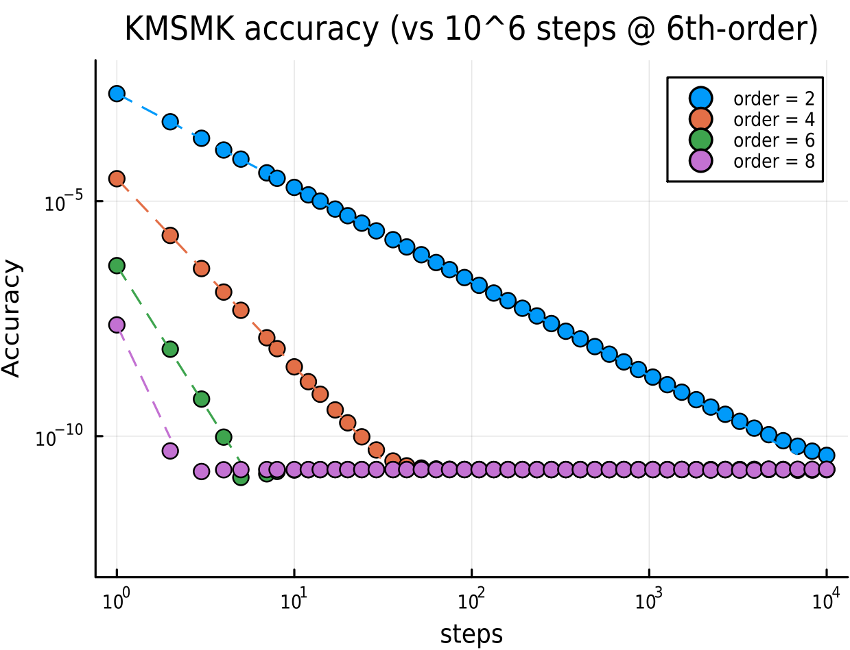
Orbit, Optics, Chromaticity
Orbit: High-order symplectic integration
Drift – Kick – Drift
Bend – Kick – Bend
Matrix – Kick – Matrix
Solenoid – Kick – Solenoid
Optics: Arbitrary order Truncated Power Series Algebra (c.o. Laurent Deniau)
Chromaticity & More: Elliptical Nonlinear Normal Form Analysis (c.o. Etienne Forest)

Slide 6
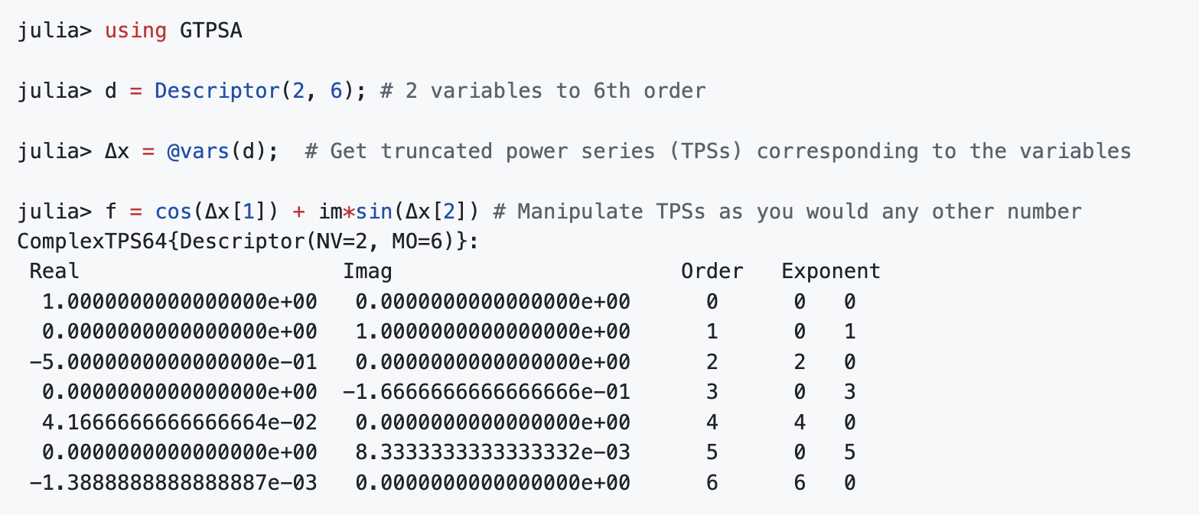
Orbit, Optics, Chromaticity
Orbit: High-order symplectic integration
Optics: Arbitrary order Truncated Power Series Algebra (c.o. Laurent Deniau)
Chromaticity & More: Elliptical Nonlinear Normal Form Analysis (c.o. Etienne Forest)

Slide 7
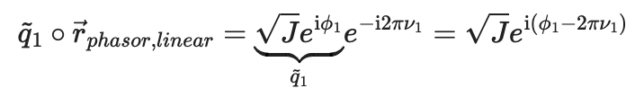
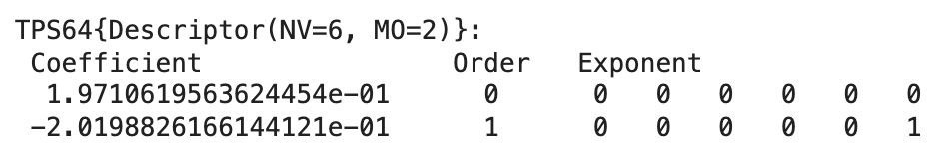

Orbit, Optics, Chromaticity
Orbit: High-order symplectic integration
Optics: Arbitrary order Truncated Power Series Algebra (c.o. Laurent Deniau)
Chromaticity & More: Elliptical Nonlinear Normal Form Analysis (c.o. Etienne Forest)

Slide 8
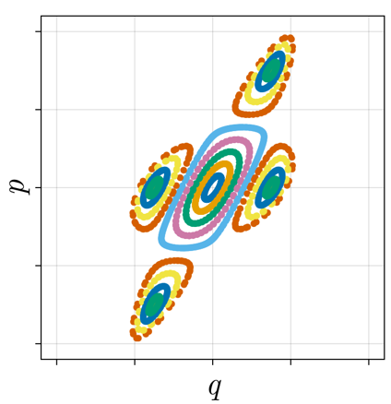
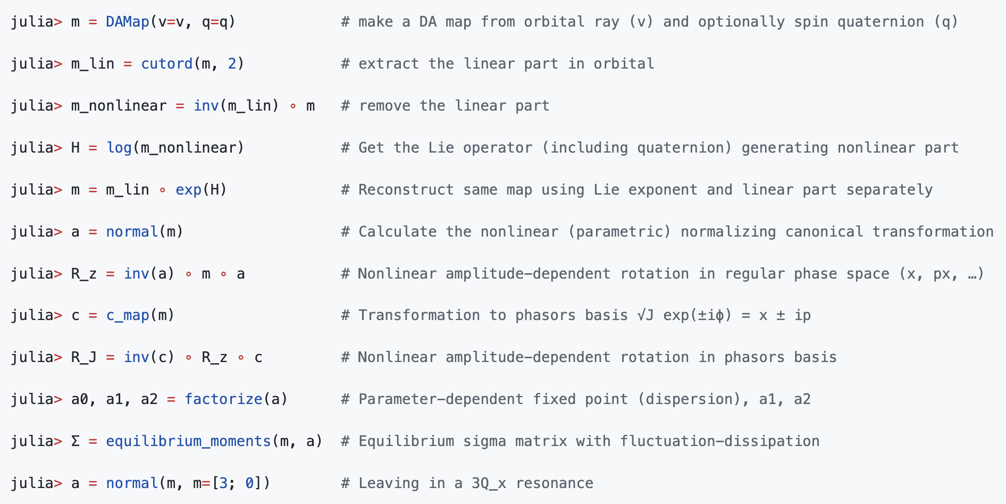
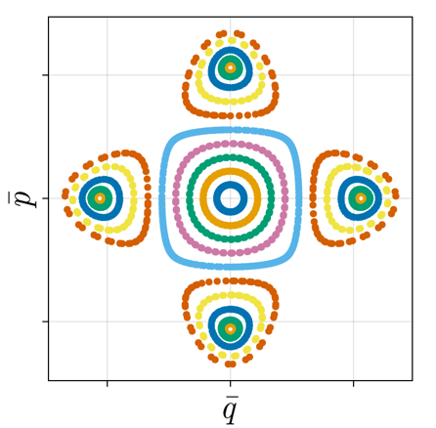

Nonlinear Normal Form
$$ℳ≡e^{:H:}=Me^{ :H_{2} :}e^{:H_{3} :}…$$

Slide 9
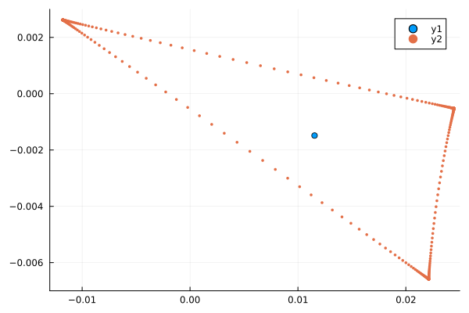
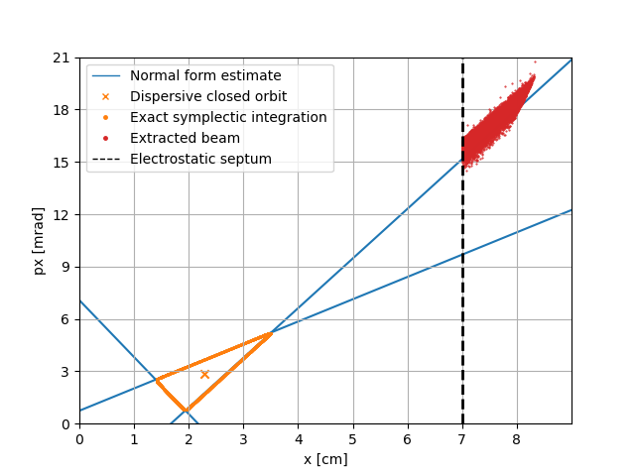
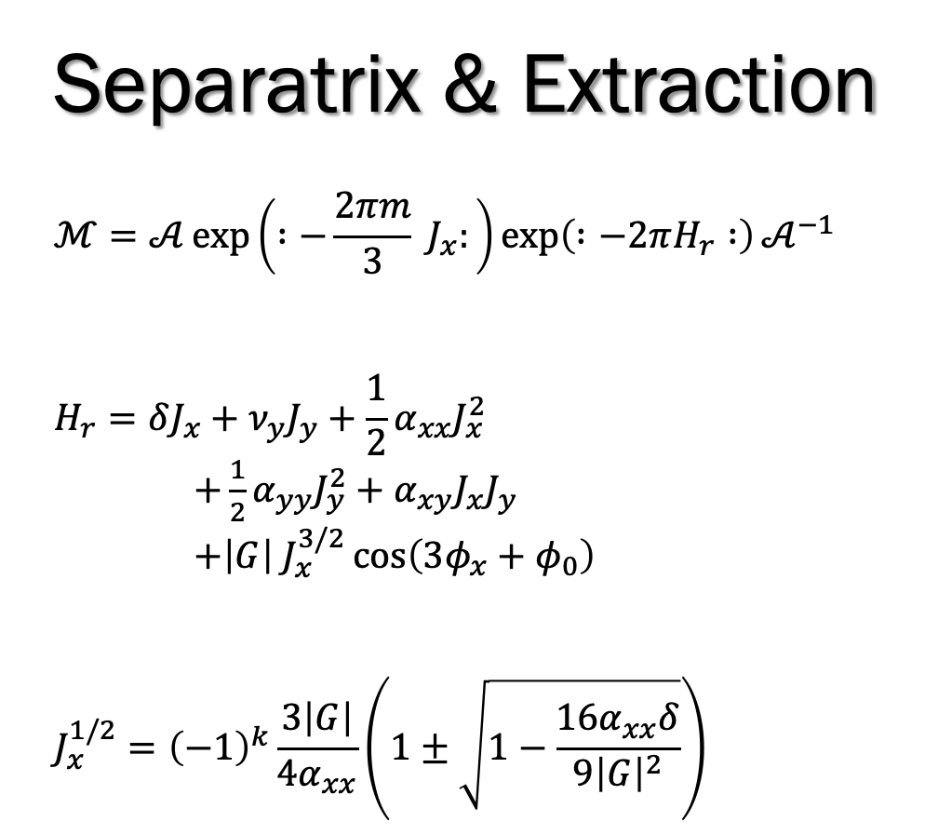


Separatrix & Extraction
$$ℳ=𝒜\exp\left( :−\frac{2πm}{3} J_{x}:\right)\exp\left( :−2πH_{r} :\right)𝒜^{−1}$$
$$H_{r}=δJ_{x}+ν_{y}J_{y}+\frac{1}{2}α_{xx}J_{x}^{2}$$
$+\frac{1}{2}α_{yy}J_{y}^{2}+α_{xy}J_{x}J_{y}$
$+\left|G\right| J_{x}^{3/2}\cos\left(3φ_{x}+φ_{0}\right)$
$$J_{x}^{1/2}={\left(−1\right)}^{k}\frac{3\left|G\right|}{4α_{xx}}\left(1±\sqrt{1−\frac{16α_{xx}δ}{9{\left|G\right|}^{2}}}\right)$$
Notes:
Analytical derivation of approx. fixed points
NNF can be used to compute ALL coefficients

Slide 10
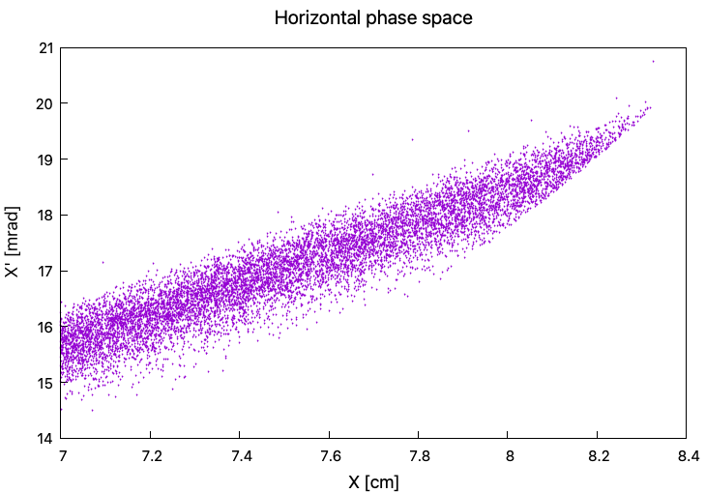
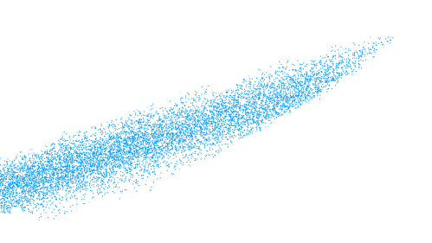
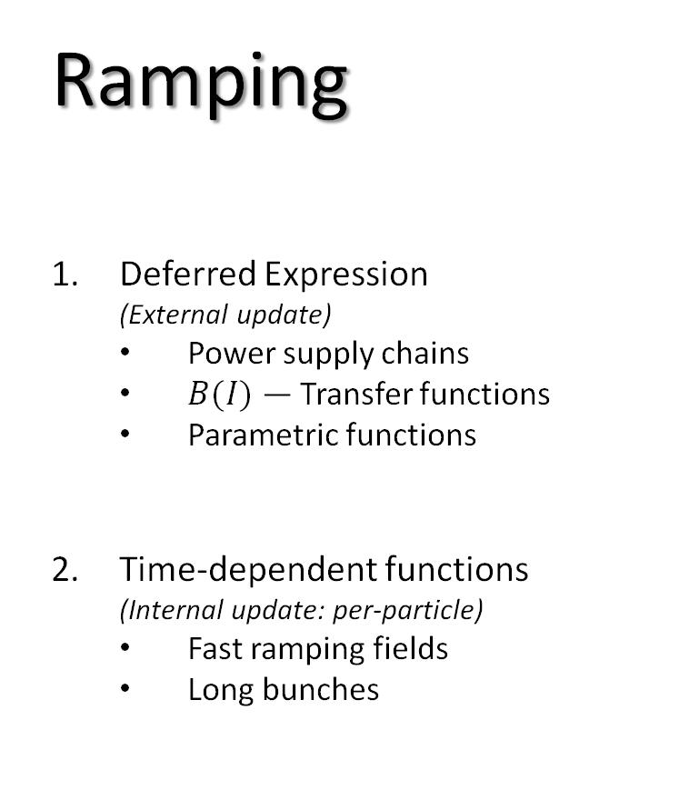
Ramping
Deferred Expression
(External update)
Power supply chains
$B(I)$ — Transfer functions
Parametric functions
Time-dependent functions
(Internal update: per-particle)
Fast ramping fields
Long bunches
Bmad
SciBmad

Slide 11
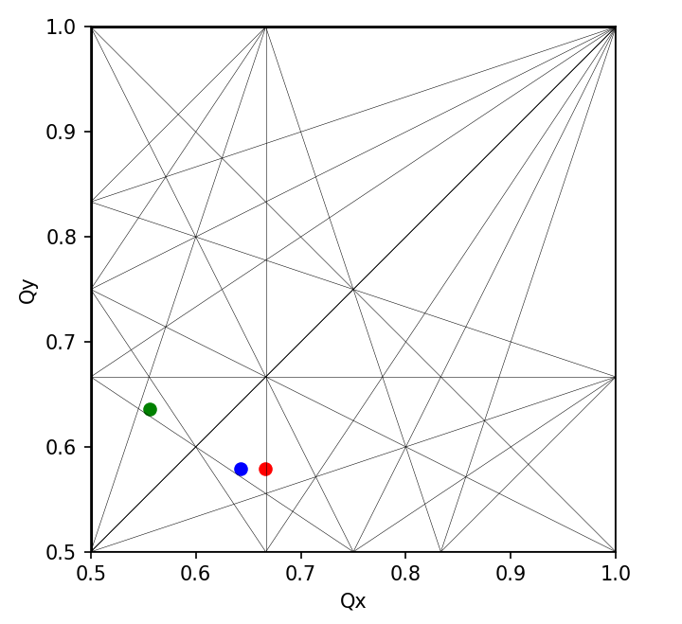

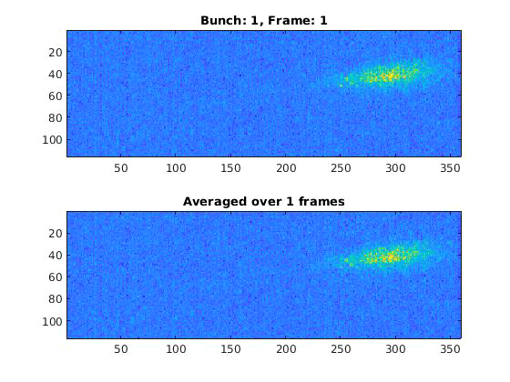
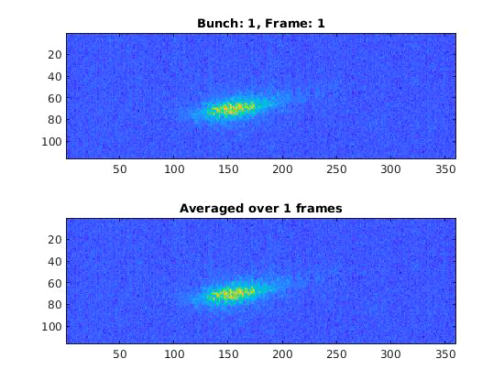

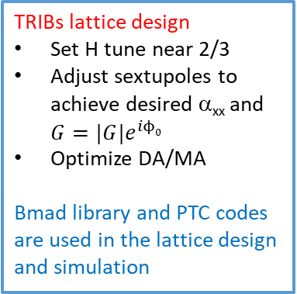

TRIBs study at Cornell Electron Storage Ring (CESR)
CESR is a 6-GeV electron storage ring, 768m circumference, no global symmetry
Normal operation lattice has very small ADTS detune coefficient α_{xx}
The fixed points near a 3rd-order resonance
$$Q_{x}<\frac{2}{3}$$
$$Q_{x}>\frac{2}{3}$$
TRIBs lattice design
Set H tune near 2/3
Adjust sextupoles to achieve desired α_{xx} and $G=|G|e^{iϕ0}$
Optimize DA/MA
Bmad library and PTC codes are used in the lattice design and simulation
Normal run tune
2/3 resonance
TRIBs lattice tune
Adjust horizontal tune Q_{x} 0.670 -> 0.664
Stable islands appear in horizontal phase space near 3rd-order resonance
Drive particles into single island with sinusoidal kicks at resonance
CESR TRIBs optics is established at both 3rd and 4th order resonances
Experiments are conducted and verified the appearance of islands near both resonances by adjusting the horizontal tune or driving
Excitation of a single or multiple bunches into a single or multiple islands is demonstrated
S.T. Wang, V. Khachatryan, P. Nishikawa, PRAB 26, 104001 (2023)
S.T. Wang, V. Khachatryan, NIMA 1075, 170423 (2025)
3rd order, Q_{x}=0.666, f=2/3
4th order, Q_{x}=0.749, f=3/4

Slide 12
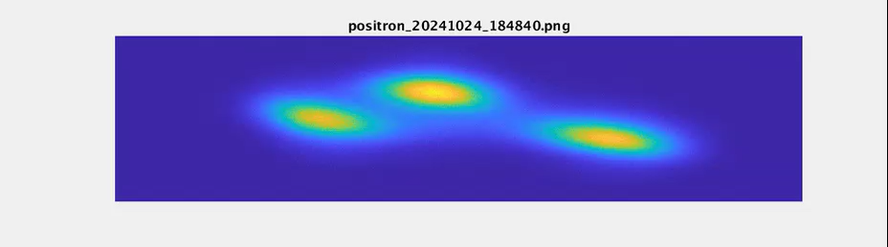
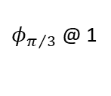
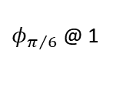
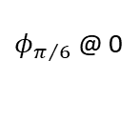
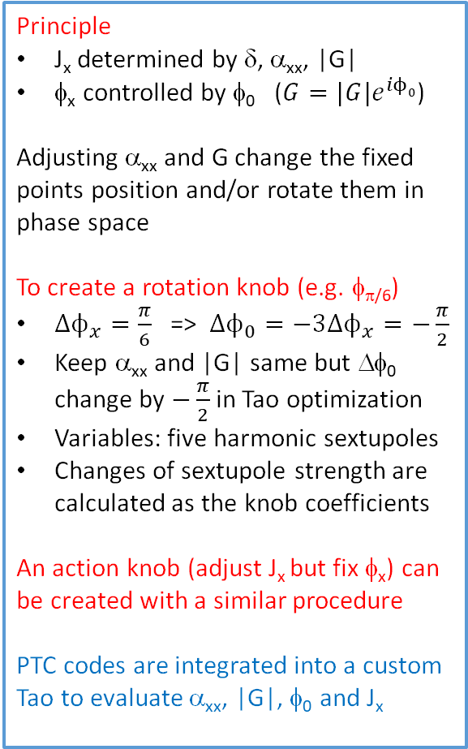
Manipulating TRIBs in phase space
Rotation knob
Action knob
$φ_{π/6}$ @ 0
$φ_{π/6}$ @ 1
$φ_{π/3}$ @ 1
Principle
J_{x} determined by δ, α_{xx}, |G|
φ_{x} controlled by φ₀ ($G=|G|e^{iϕ0}$)
Adjusting α_{xx} and G change the fixed points position and/or rotate them in phase space
To create a rotation knob (e.g. φ_{π/6})
${Δϕ}_{x}=\frac{π}{6}$ => ${Δϕ}_{0}=−3{Δϕ}_{x}=−\frac{π}{2}$
Keep α_{xx} and |G| same but Δφ₀ change by $−\frac{π}{2}$ in Tao optimization
Variables: five harmonic sextupoles
Changes of sextupole strength are calculated as the knob coefficients
An action knob (adjust J_{x} but fix φ_{x}) can be created with a similar procedure
PTC codes are integrated into a custom Tao to evaluate α_{xx}, |G|, φ₀ and J_{x}
Calculated (J_{x}, φ_{x}) as the φ_{π/6} knob changes
No drive
Sinusoidal kick on
-600cu
-400cu
-200cu
0cu
100cu
200cu
φ_{π/6} knob changes from 0 to 1 with a step of 0.2 (200cu)
J_{x} knob changes from -0.6 to 0.2 (-600cu -> 200cu)
More discussion of phase space control knobs and applications of TRIBS can be found in the paper: S.T. Wang, V. Khachatryan, NIMA 1075, 170423 (2025)

Slide 13
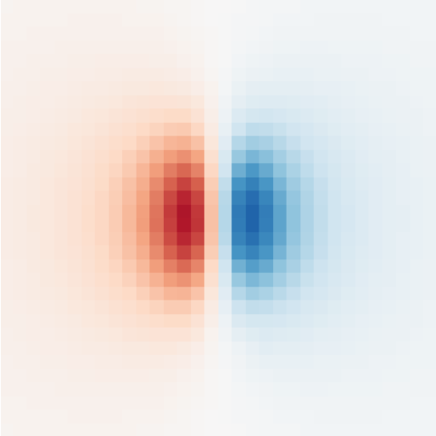
Other effects
Synchrotron radiation
Deterministic damping
Stochastic emission
Map of bunch moments
3D space charge
GPU enabled

Slide 14
Summary
New modern code in town
Differentiable, high-performance, GPU-compatible
Almost complete vertical integration
Highly-capable of slow extraction simulation and optimization

Slide 15
Acknowledgements
Development of this code would not have been possible without:
David Sagan
Matthew Signorelli
Georg Hoffstaetter
Laurent Deniau
Étienne Forest
And 20+ more!

Slide 16
Thanks for Listening!
Questions?

