Slide 1

Stable islands and bent crystals for slow extraction
D. Veres, M. Giovannozzi, G. Franchetti
Acknowledgements: P. Arrutia, F. Asvesta, H. Bartosik, P. Bestmann, G. Franchetti, P. Hermes, K. Li, B. Lindström, G. Papotti, L. Pauwels, S. Redaelli, B. Salvant, R. Taylor, F. van der Veken, F. M. Velotti and SPS OP Crew

Slide 2
Outline
Introduction
Proposed method
Simulation results
Proof-of-principle test at CERN SPS
Conclusions and outlook

Slide 3
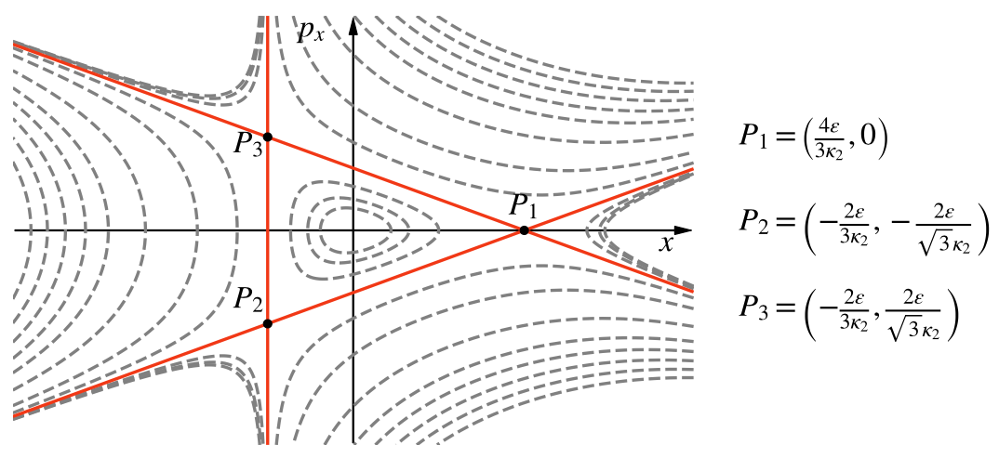
Introduction
Slow extraction is a well-established extraction method from circular accelerators
It exploits the third-order resonance
Particles are driven to large amplitudes by the unstable dynamics generated by hyperbolic fixed points
The expanding motion has an intrinsic stochastic character that prevents a full control of the dynamics
Beam losses at the extraction septum are essentially unavoidable
Is it possible to find alternative ways to push particles to large amplitude and reduce beam losses?

Slide 4
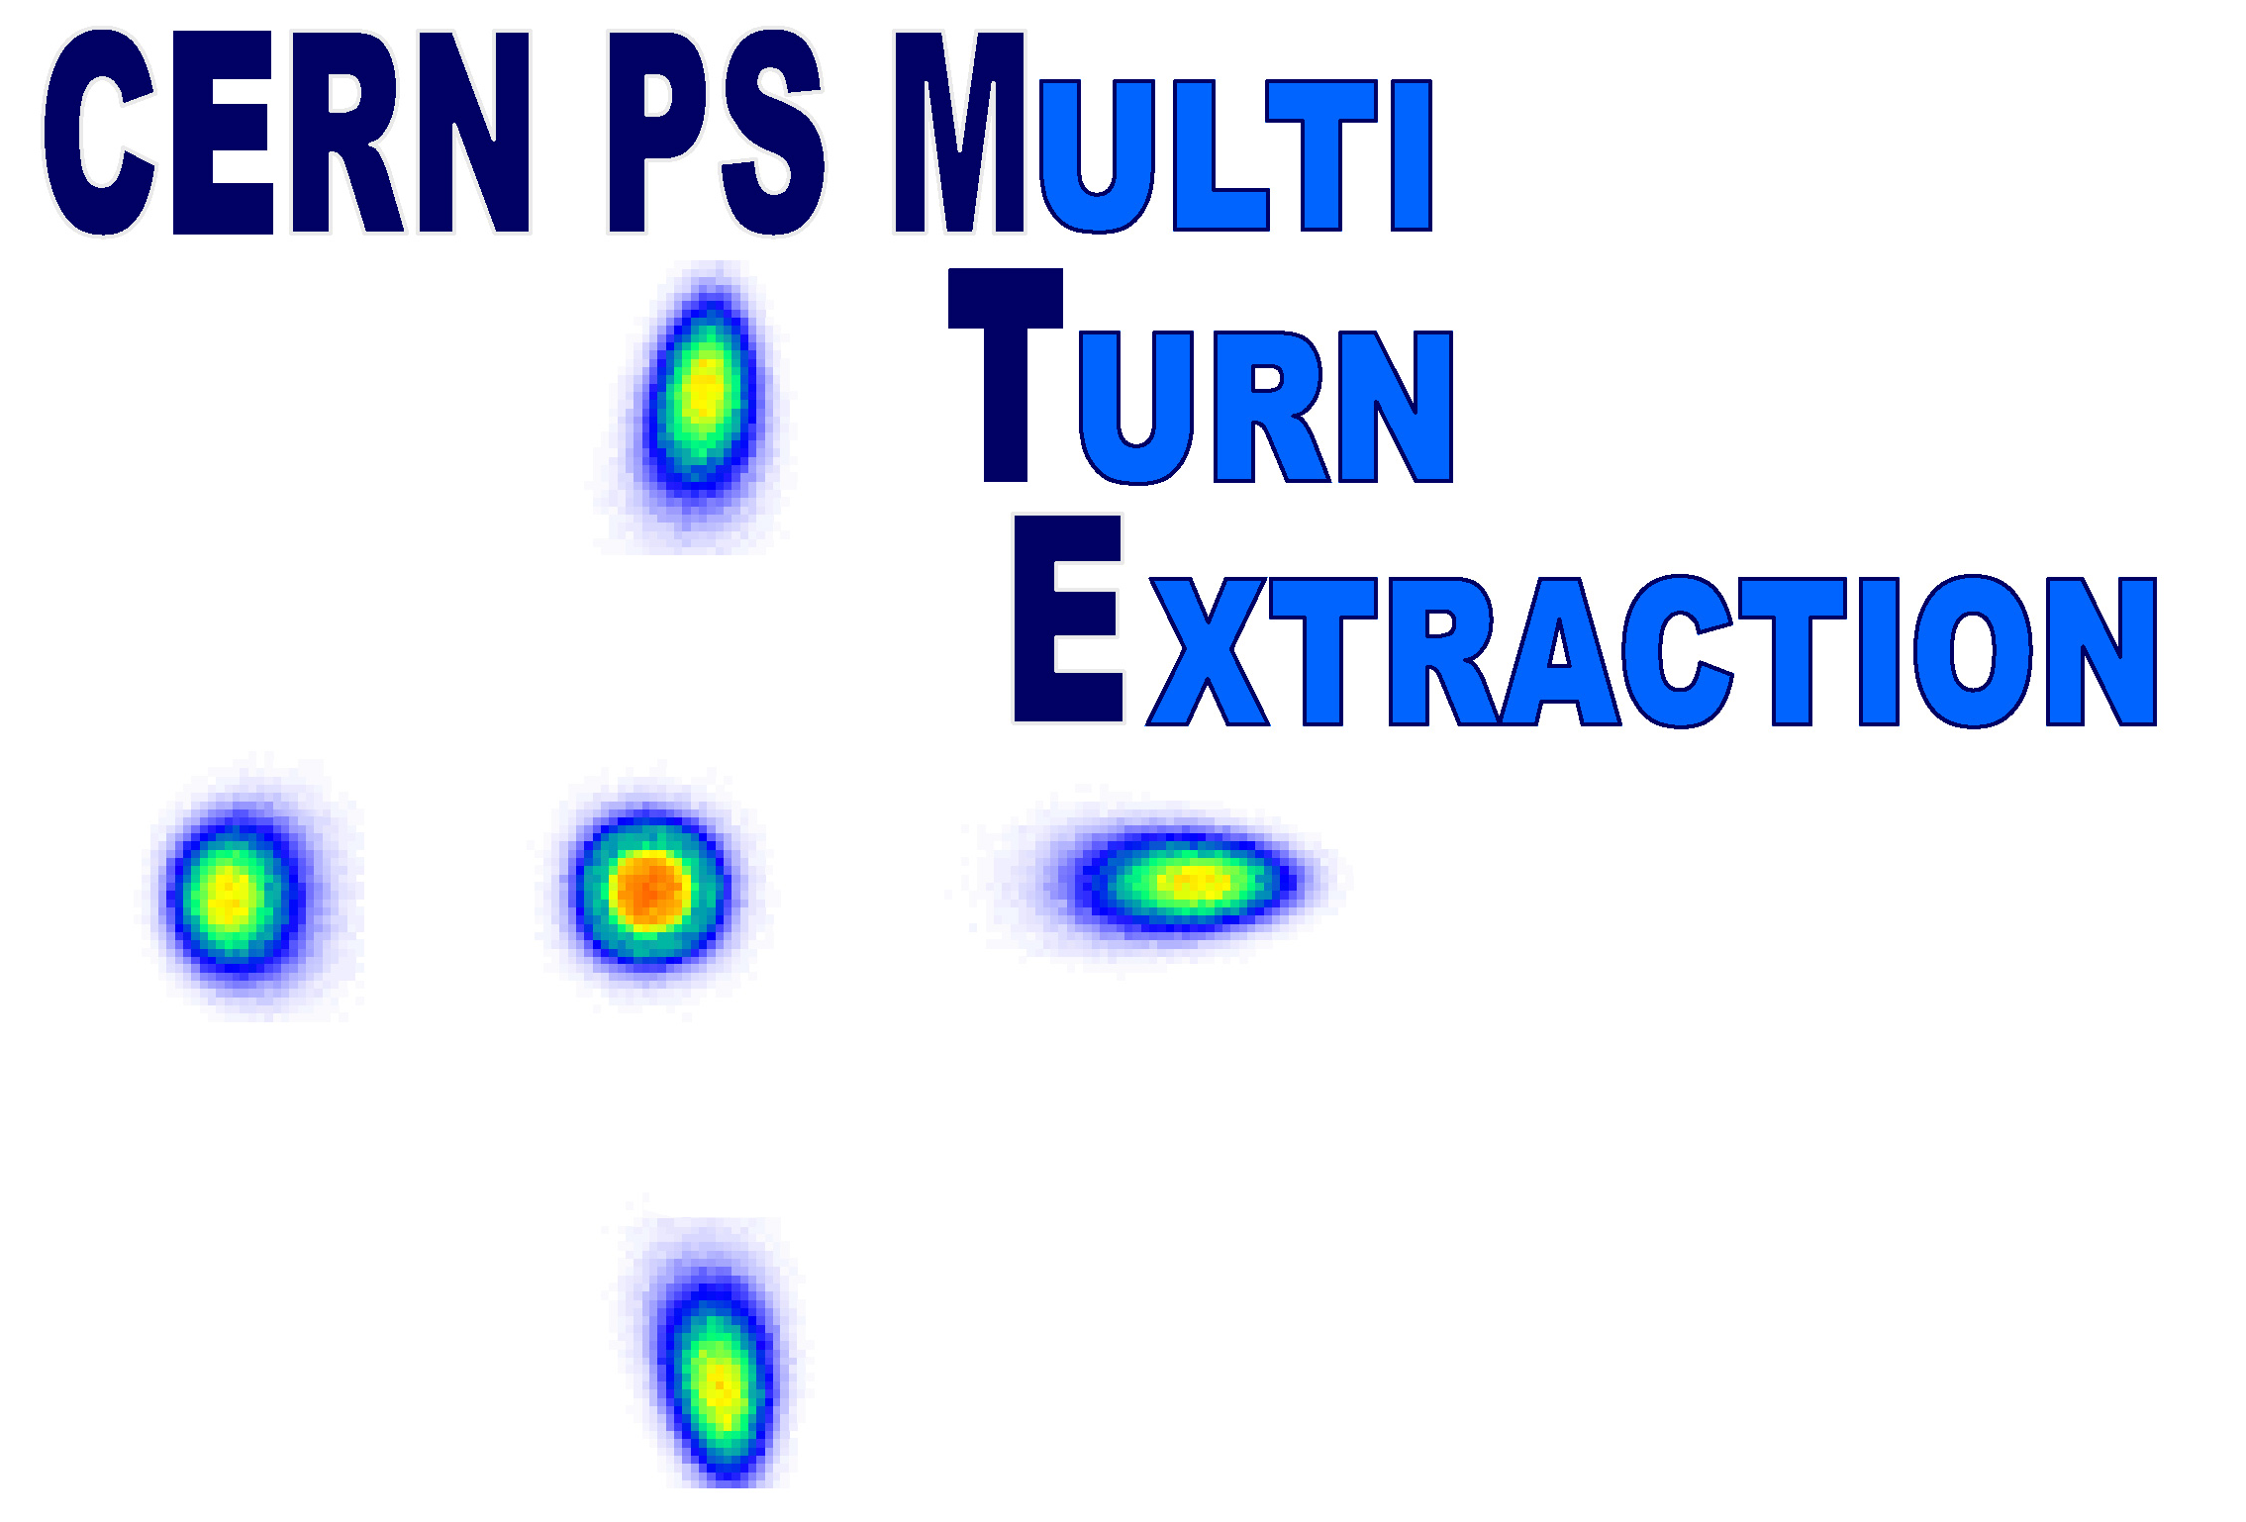
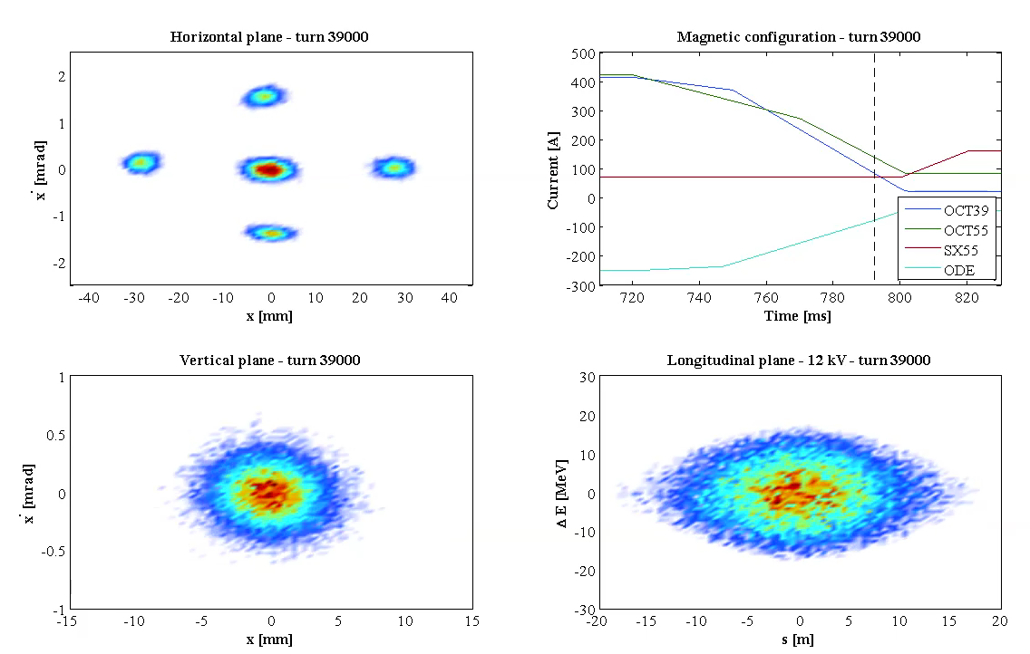
Introduction
Since 2015, the CERN PS delivers beam to the SPS using Multi-turn Extraction (MTE)
It is based on beam splitting by crossing the fourth-order resonance
Particles are trapped and transported in stable islands
The extraction is performed over five turns
Stable islands, instead of unbounded separatrices, allow for a regular dynamics and transport to large amplitudes.
Courtesy A. Huschauer

Slide 5
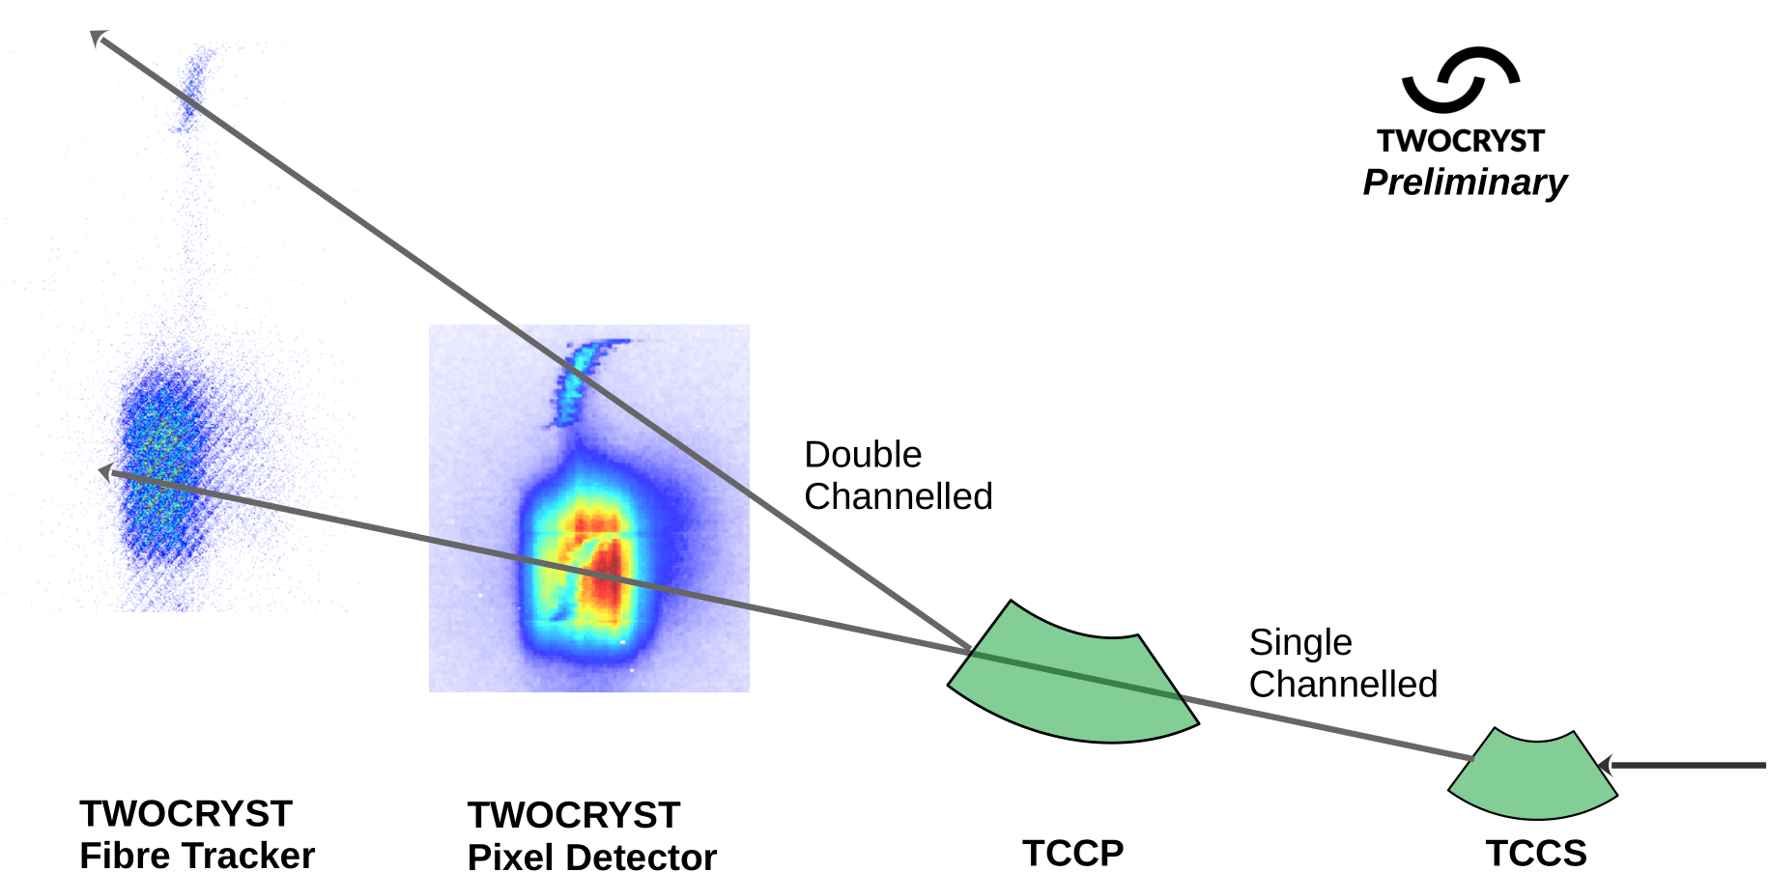
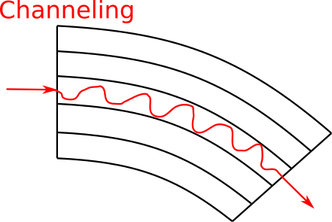
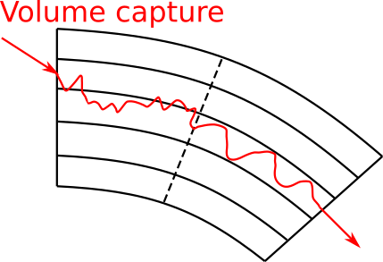
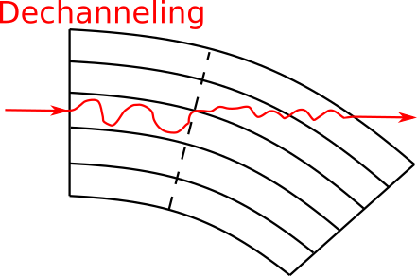
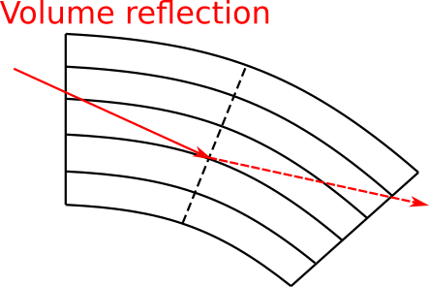
Introduction
Bent crystals are becoming more and more popular in circular accelerators
Collimation system in the CERN LHC
Shadowing of extraction septum in the SPS
Fixed-target experiment in the LHC

Slide 6
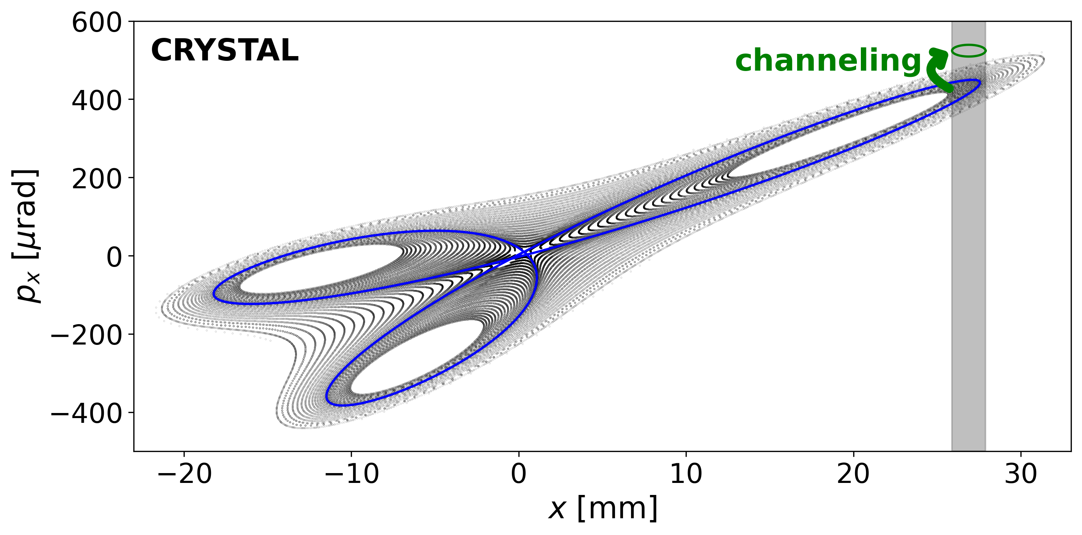
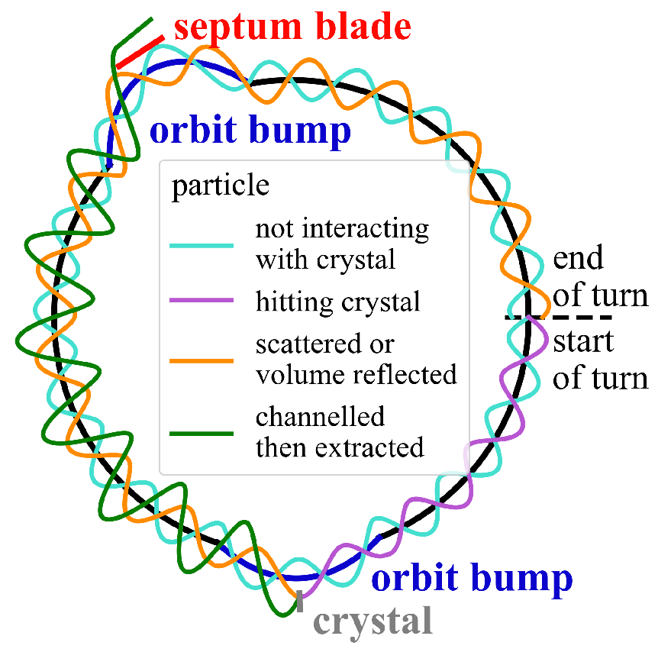
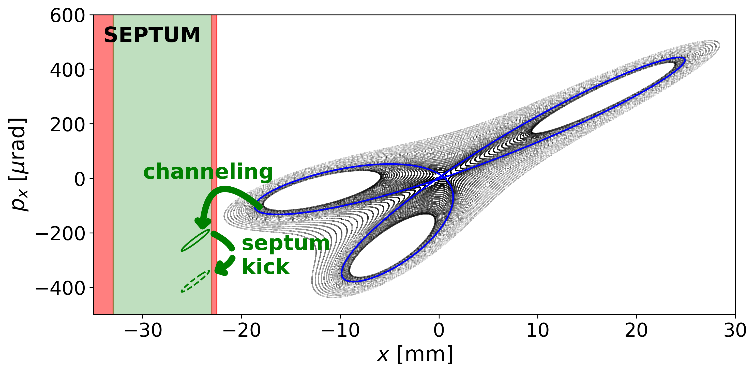
Proposed method
We propose to combine
Stable islands to trap and transport particles to large amplitudes
Bent crystals to deflect particles and separate them from circulating beam

Slide 7
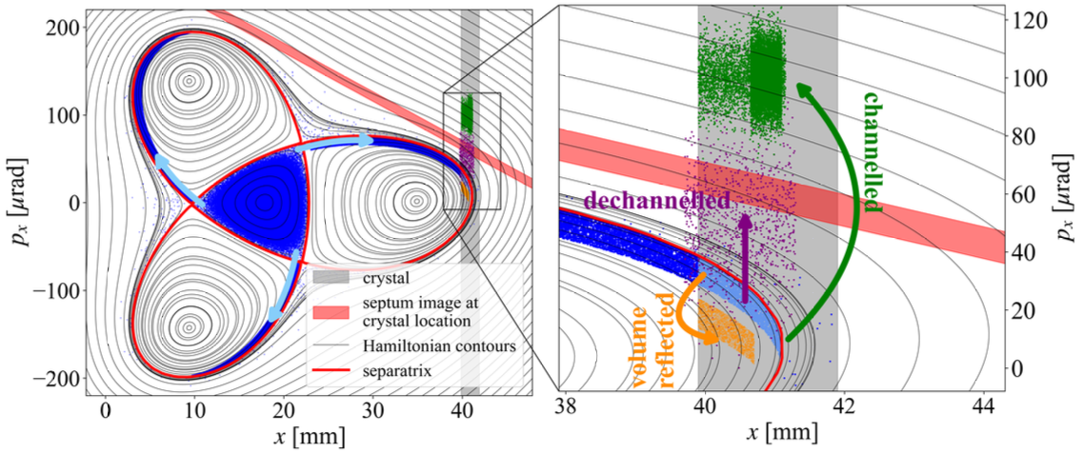
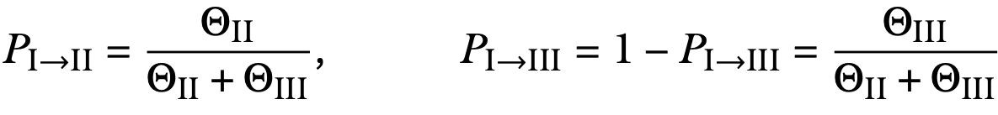
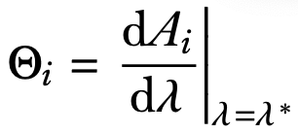
Proposed method
Some considerations
Stable islands imply a compact separatrix. The motion outside of the separatrix is regular. Hence, multiple interactions of the particle with the crystal are possible, which enhances the overall efficiency of the process.
Particles are pushed from the triangular-shaped central region to the islands by a time variation of the system parameter. If the variation is adiabatic, then the process is described by a trapping probability that can be engineered by considering the time variation of the areas of the various phase-space regions.
The time variation of the system parameters can be performed in various ways:
Change the ring tune (this is what is done for MTE).
Change the reference momentum by introducing a ramp of the magnetic flat top where the slow extraction takes place.
Region III
Region I
Region II
A. Neishtadt. “Passage through a separatrix in a resonance problem with a slowly-varying parameter”. J. Appl. Math. Mech. 39(4) (1975), pp. 594–605.
Neishtadt. “On the accuracy of conservation of the adiabatic invariant”. J. Appl. Math. Mech. 45(1) (1981), pp. 58–63.
A. Neishtadt. “Change of an Adiabatic Invariant at a Separatrix”. Fiz. Plasmy 12(992) (1986).

Slide 8
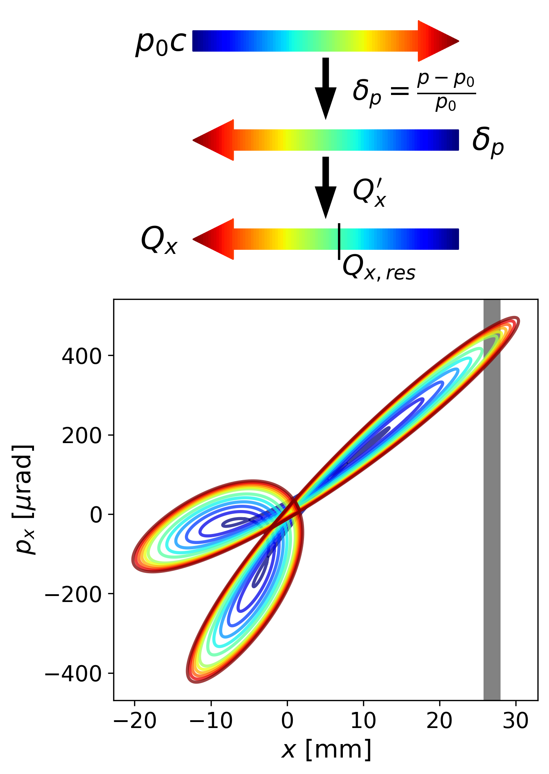
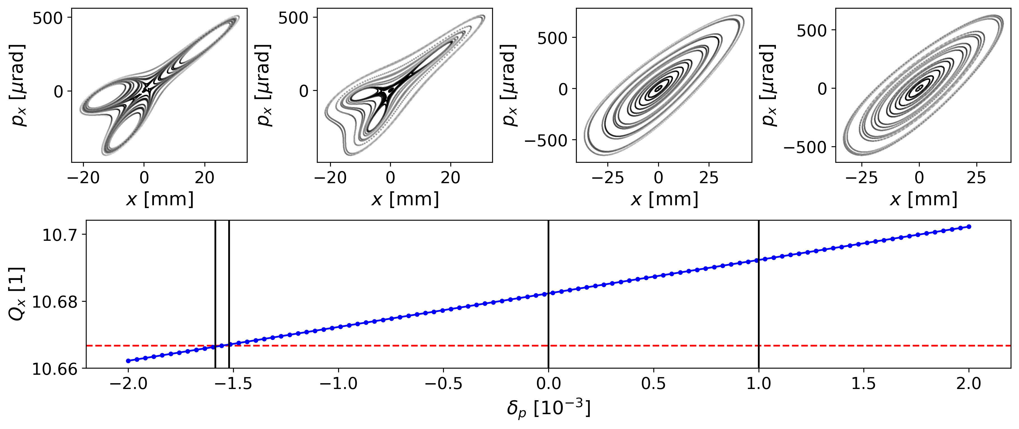
Proposed method
Transport in stable islands
Change of the reference momentum has been selected for compatibility with current SPS slow extraction process
The beam is debunched prior to extraction
Large negative chromaticity is used
All magnetic elements are varied with the change of reference momentum
This approach keeps the phase-space topology almost constant (Constant Optics Slow Extraction - COSE)

Slide 9
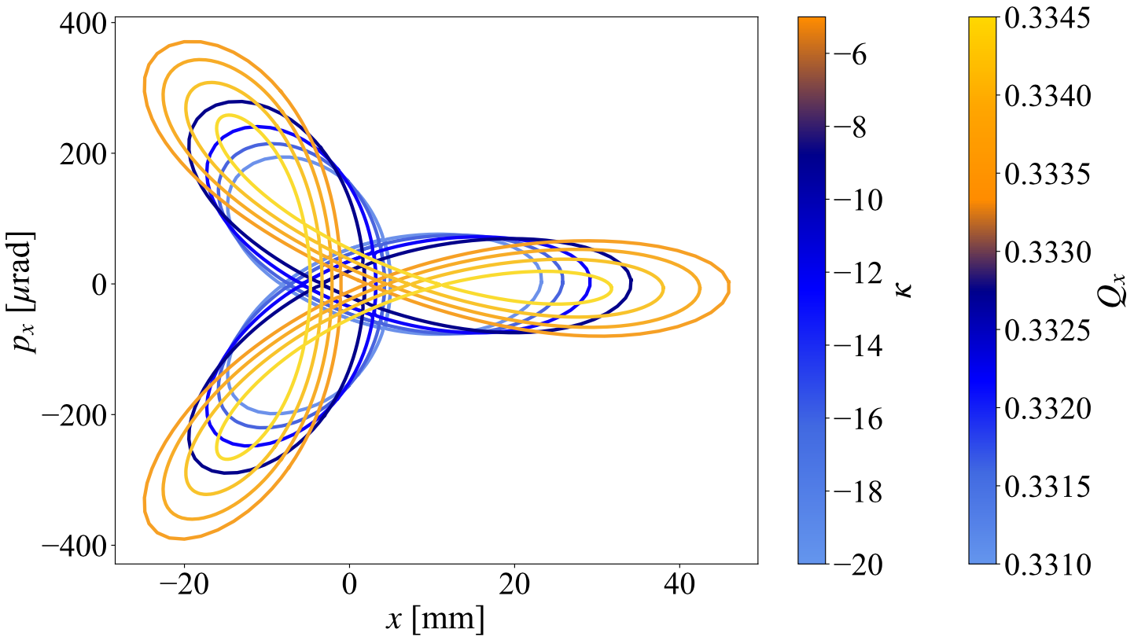
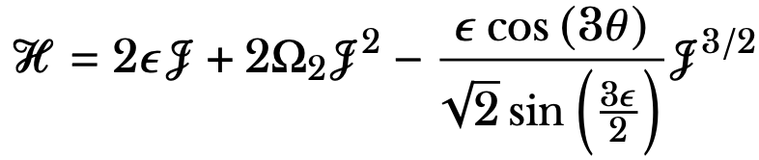


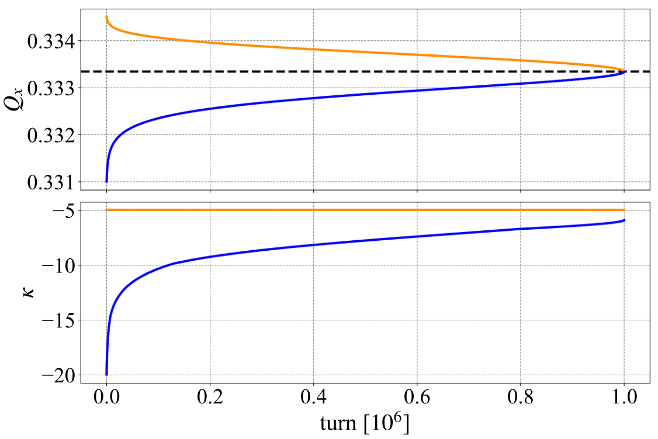


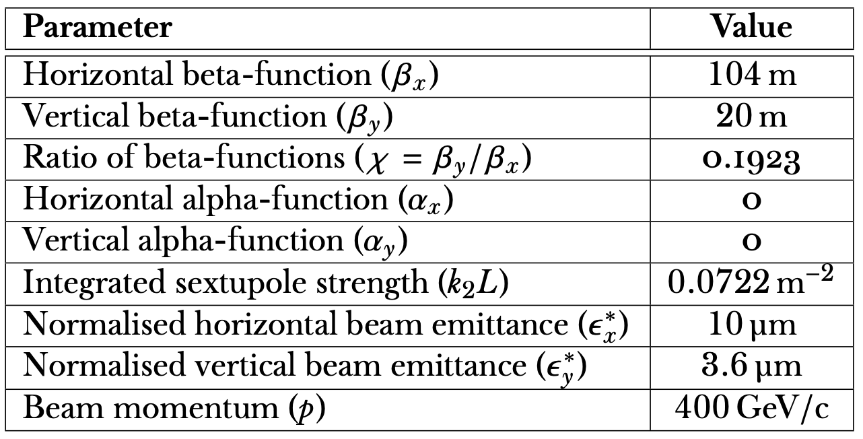
Simulation results
The nonlinearities are varied too to control the trapping probability
Some considerations
A simple 4D polynomial map (Hénon map with sextupoles and octupoles), with parameters inspired by the SPS case has been used.
The Hamiltonian of the system is
Optimised variation of tune and nonlinearities for the two sides of the resonance

Slide 10
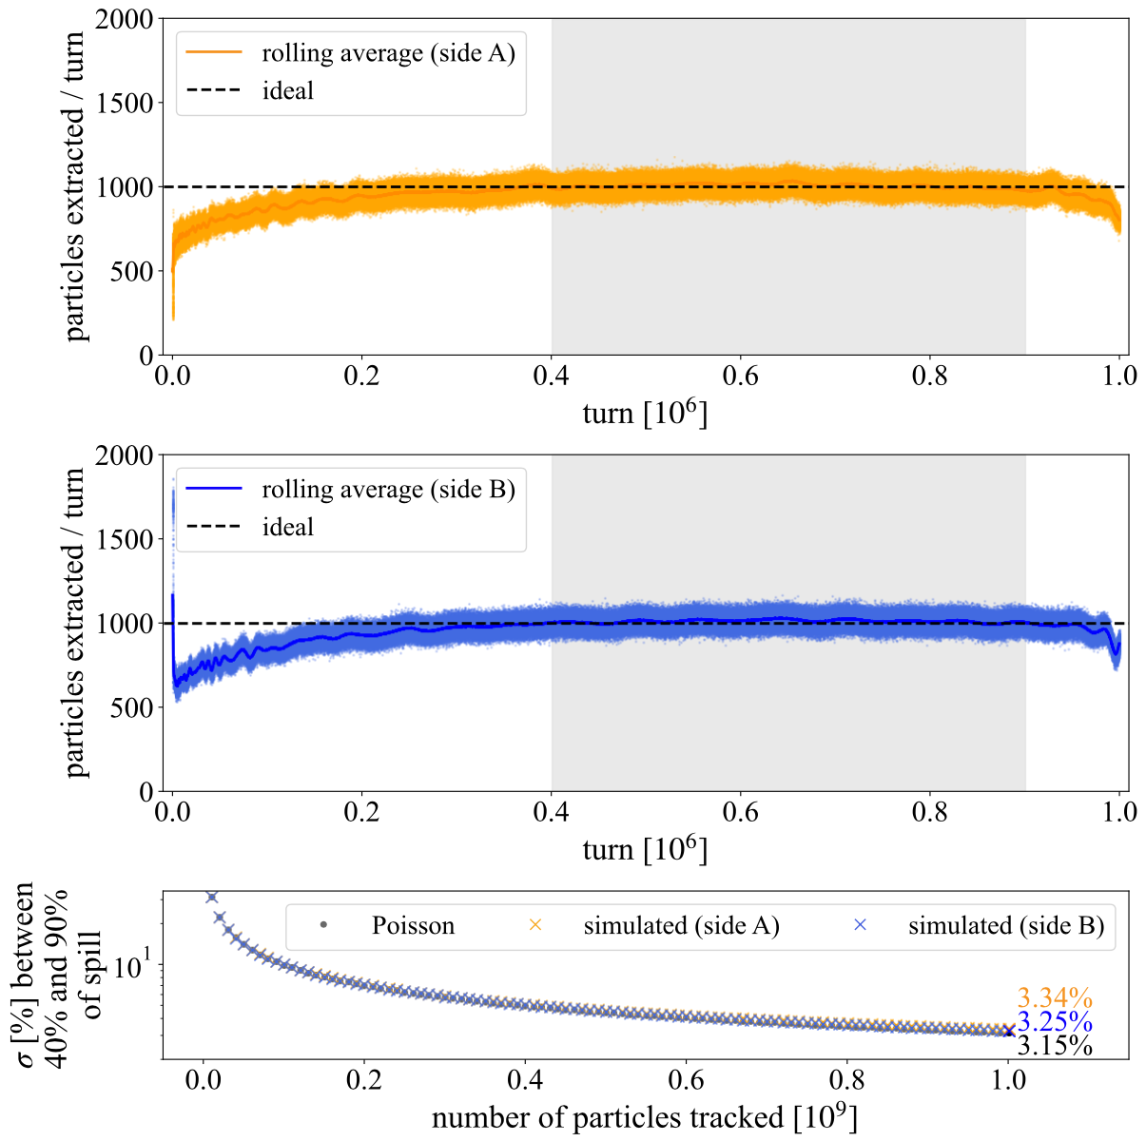
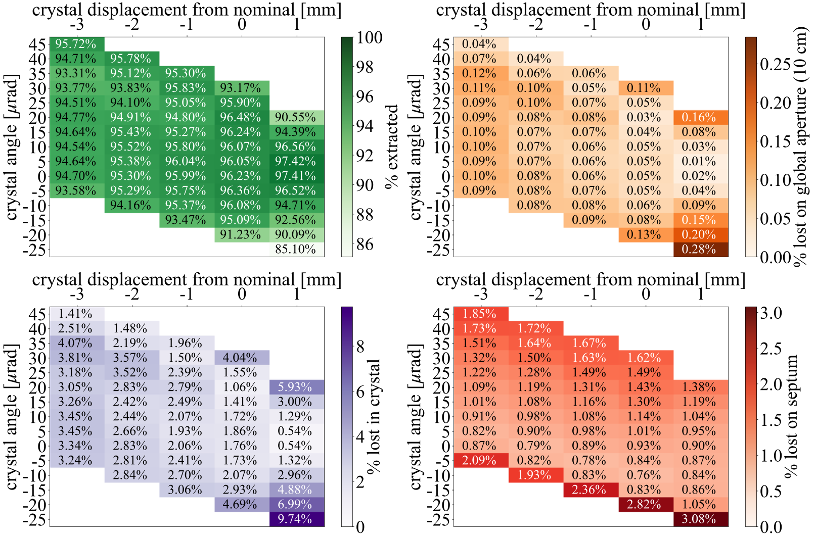
Simulation results
Typical spill. Addition of 50 Hz ripple and harmonics affects the spill similarly to a classic slow extraction
Some considerations
A simple 4D polynomial map (Hénon map with sextupoles and octupoles), with parameters inspired by the SPS case has been used.
Simulated performance vs crystal alignment (position and angle)

Slide 11
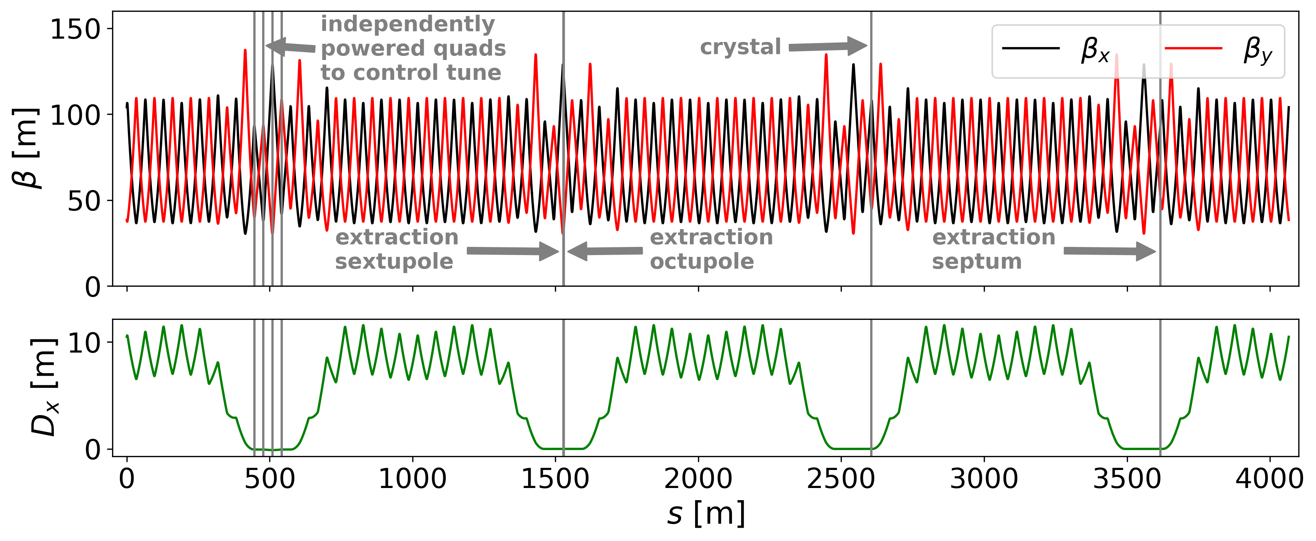
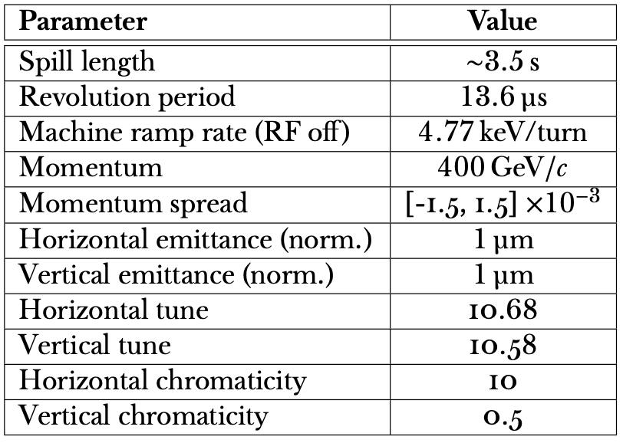

Simulation results
Some considerations
A lattice inspired by the CERN SPS has been built to perform 6D simulations
Zero-dispersion straights are used to located key elements
400 GeV protons, extracted over about 3.5 s
2.8 mm long Si crystal bending 100 μrad
500 μm septum thickness (pessimistic estimate from SPS)
Xsuite and Xcoll used as tracking tools
Main parameters of the SPS-like ring
G. Iadarola et al., Xsuite: an integrated beam physics simulation framework, 2023.
G. Iadarola et al., Xsuite. Available at https://xsuite.readthedocs.io/en/latest/, 2023.

Slide 12
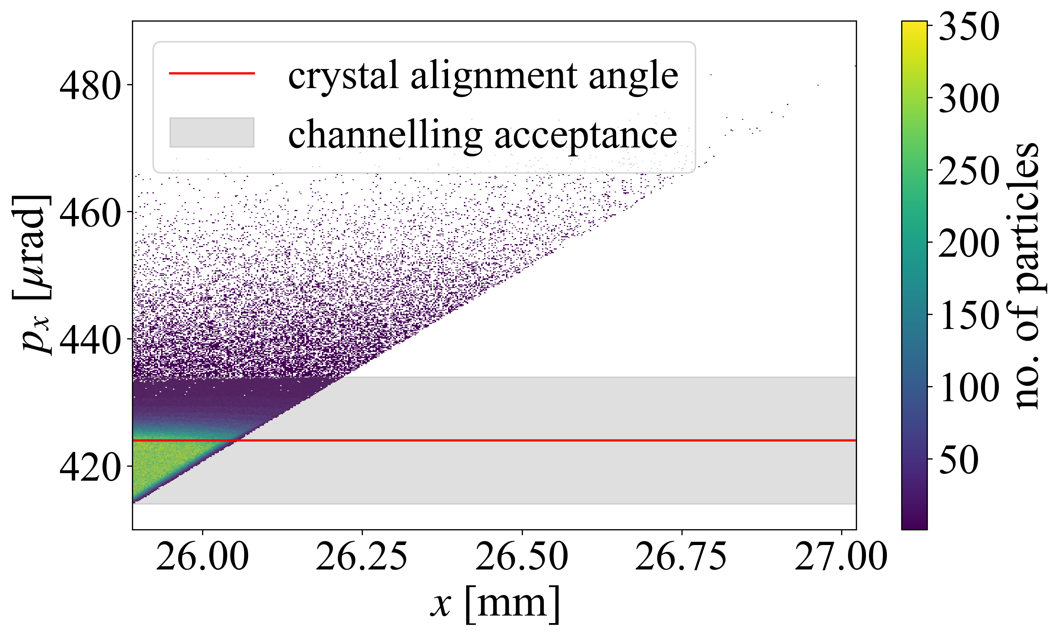
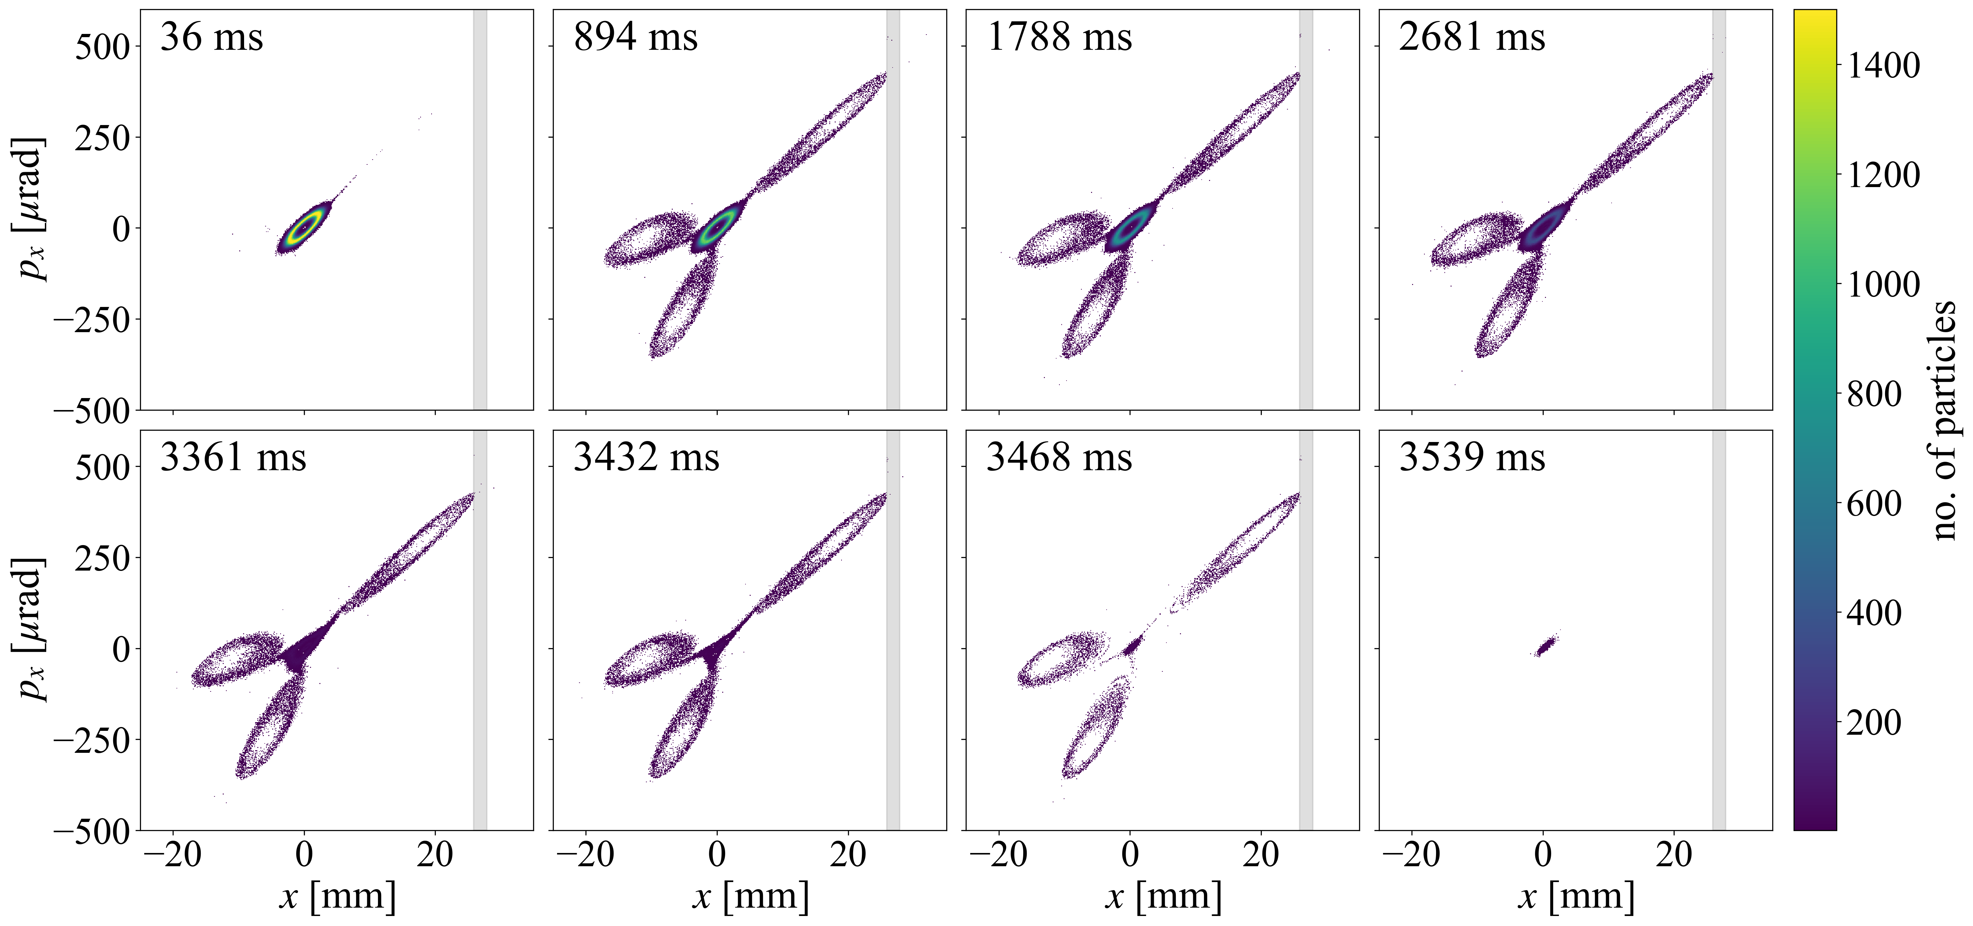
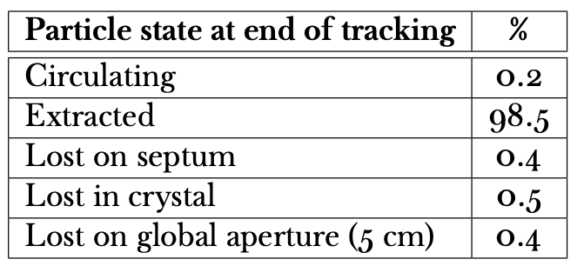
Simulation results
Some considerations
The shape of the stable islands can be used to control the beam spot on the crystal.
The shape of the stable islands can be used to make the particles fall in the channelling acceptance of the crystal.
98.2% of first impacts in within channelling acceptance
Global performance analysis of the proposed extraction (without ripple or orbit jitter). Aperture limits are black absorbers.

Slide 13
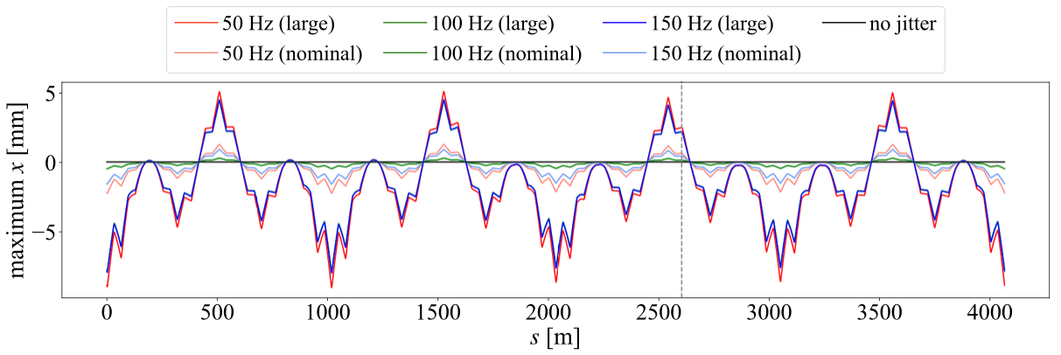
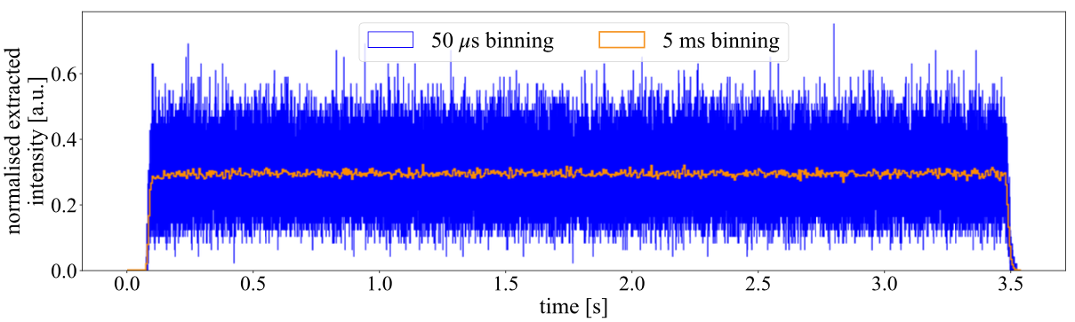
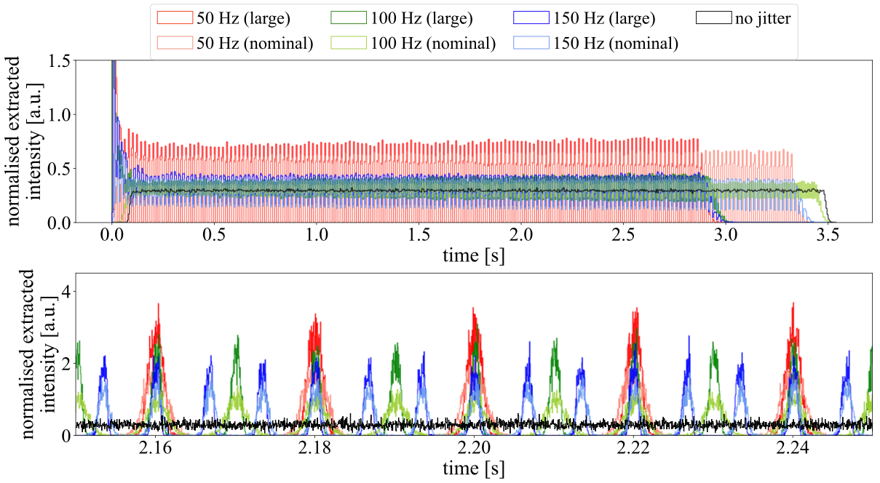
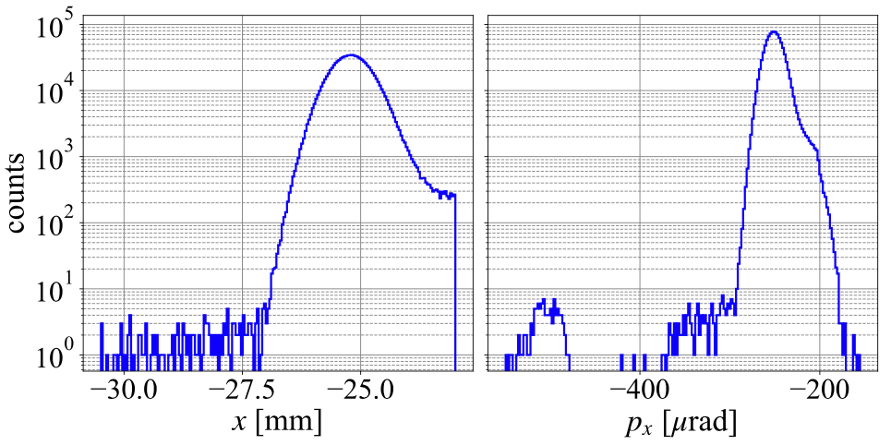
Simulation results
Some selected results
Orbit jitter along ring circumference
Typical spill structure
Distribution of extracted beam
Spill with orbit jitter

Slide 14
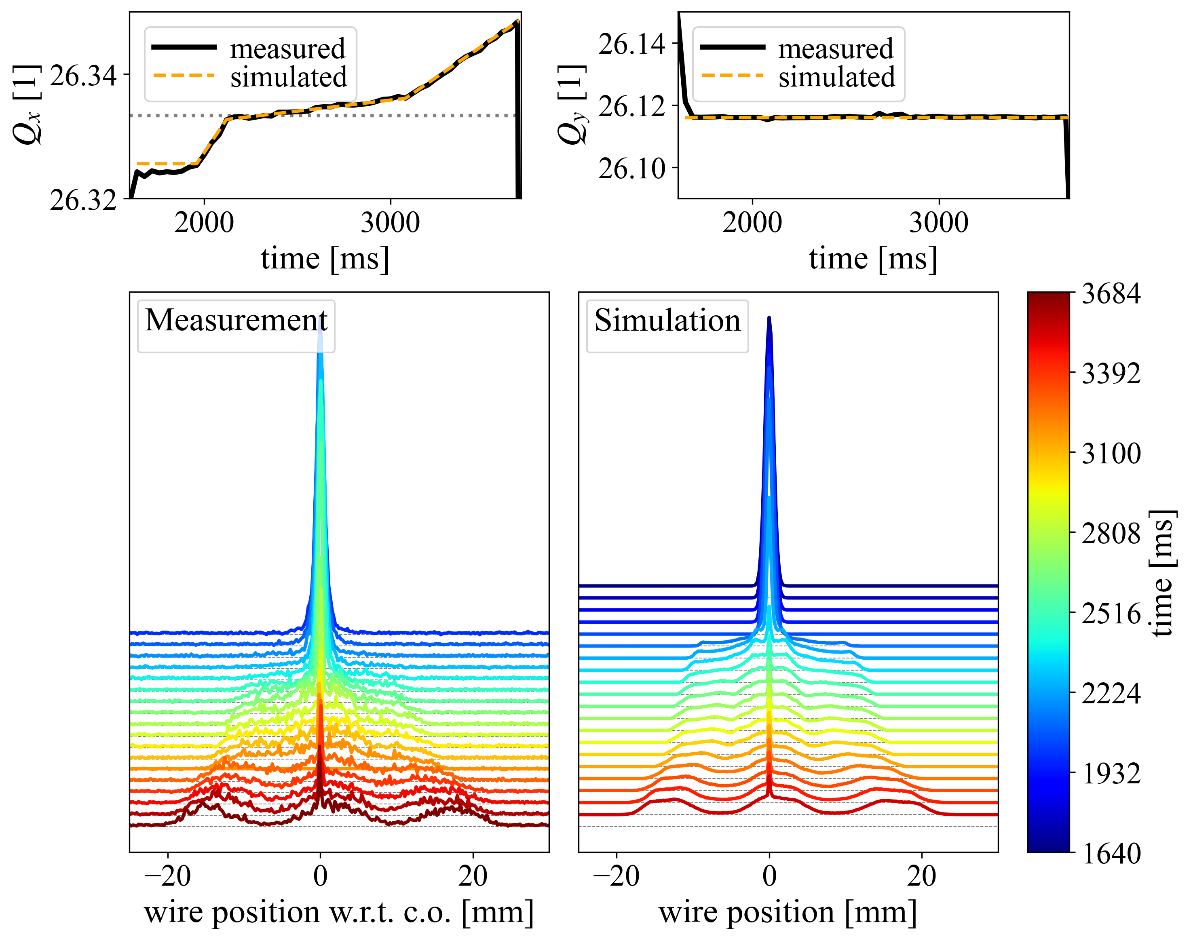
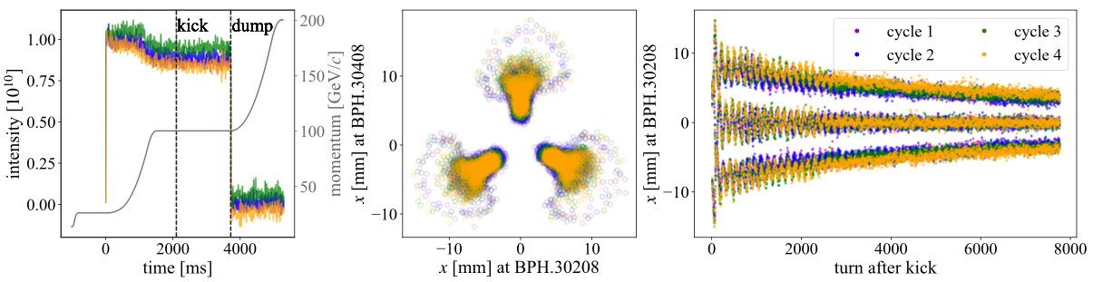
Proof-of-principle test at CERN SPS
Experimental activities were carried out in 2024-25 SPS runs
Preparatory tests in 2024
Generation of stable islands
Phase-space reconstruction
Beam splitting by tune change.
Promising but inconclusive proof-of-principle test
Successful proof-of-principle test in 2025
Demonstrate transport in stable islands to the crystal
Demonstrate channelling onto a collimator
No extraction to protect septa.
Beam splitting by crossing the third-order resonance
Phase-space reconstruction by kicking thew beam into one island

Slide 15
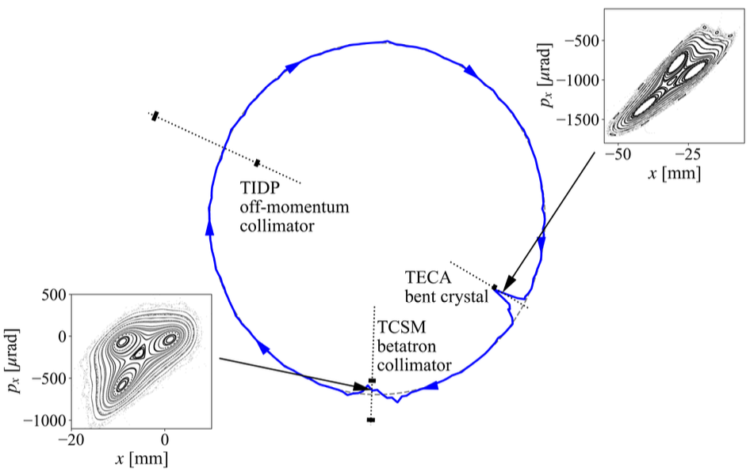
Proof-of-principle test at CERN SPS
This island interacts with the collimator jaw
This island interacts with the crystal
Experimental procedure
General strategy
The entire beam manipulation (beam is split using stable islands and a ramp of all magnetic elements) is implemented
Three configurations are probed
No crystal
Crystal in amorphous condition
Crystal in channelling condition
Beam behaviour is probed by means of a collimator
Scan of the inner jaw position
Measurement of the beam intensity vs time and of local losses
A wire scanner provide information about the transverse beam profile
Channelled particles land close to this island
Special orbit bumps are created around crystal and collimator

Slide 16
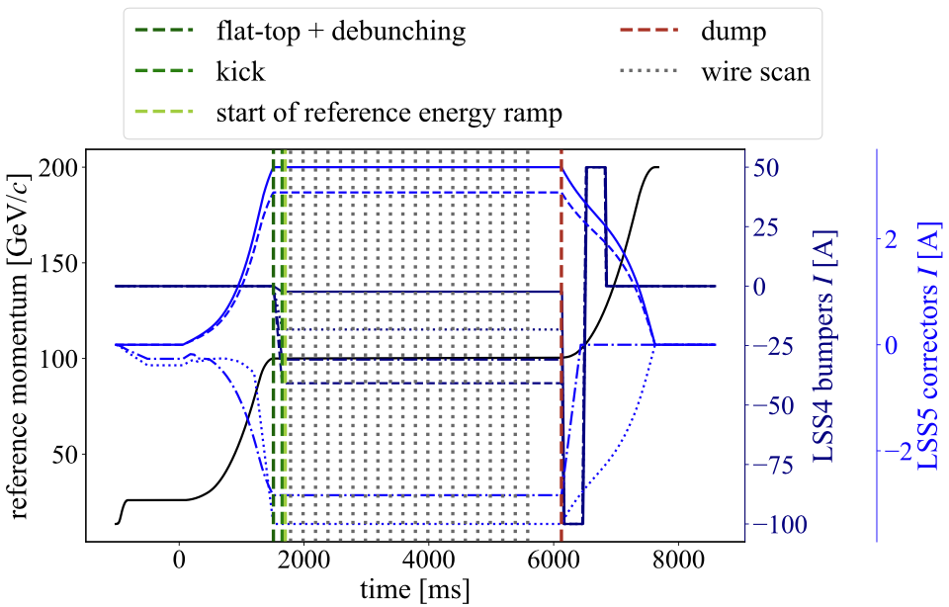
Proof-of-principle test at CERN SPS
Sequence of events in the SPS cycle for the proof-of-principle experiment
SPS ring configuration
Ring optics
Qx →26.31, Qy →26.11, Q′x →−21.5
Energy: 100 GeV
Beam properties
Four bunches
Intensity: 10¹⁰ p/b
Normalised emittance: about 0.56 μm
Nonlinear elements
One extraction sextupole (LSE.40602) to excite the resonance and control the orientation of islands
LOF octupoles to generate the stable islands
Ramp all magnetic elements
0.33 GeV over 4 s
Special orbit bumps
Around crystal and collimator

Slide 17
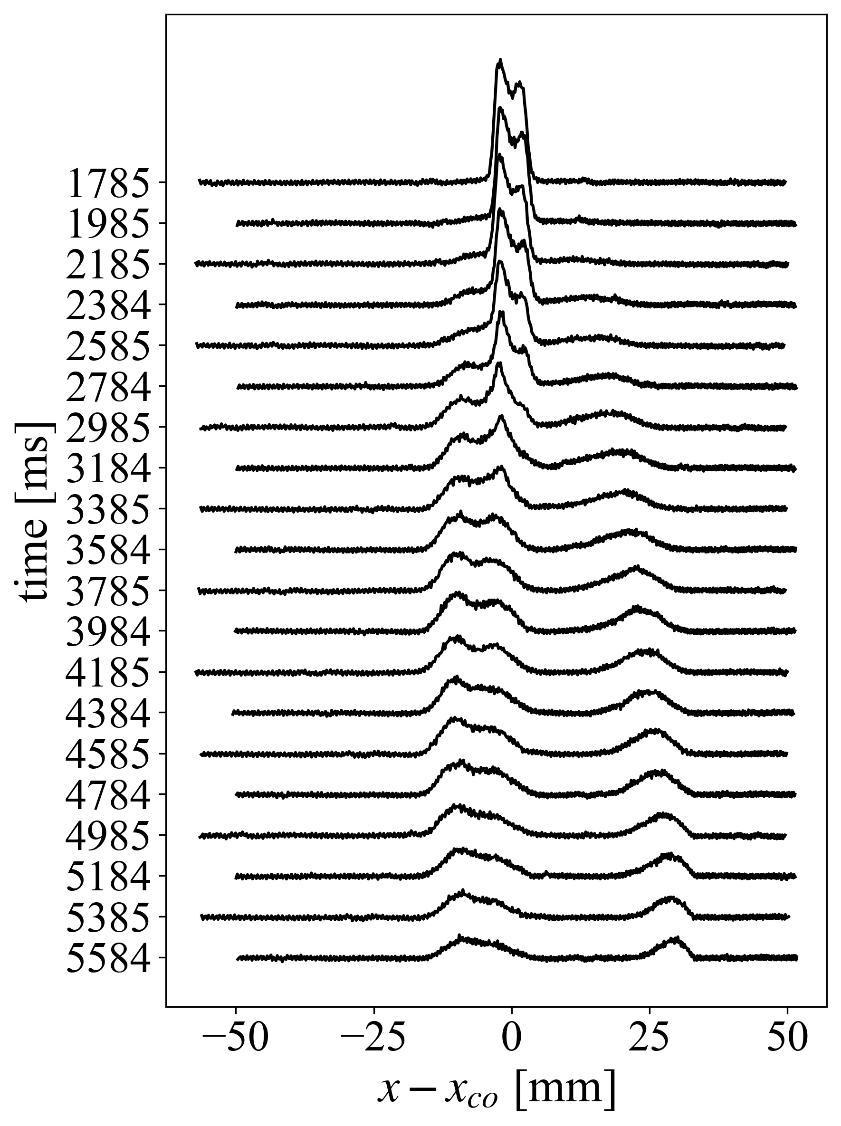
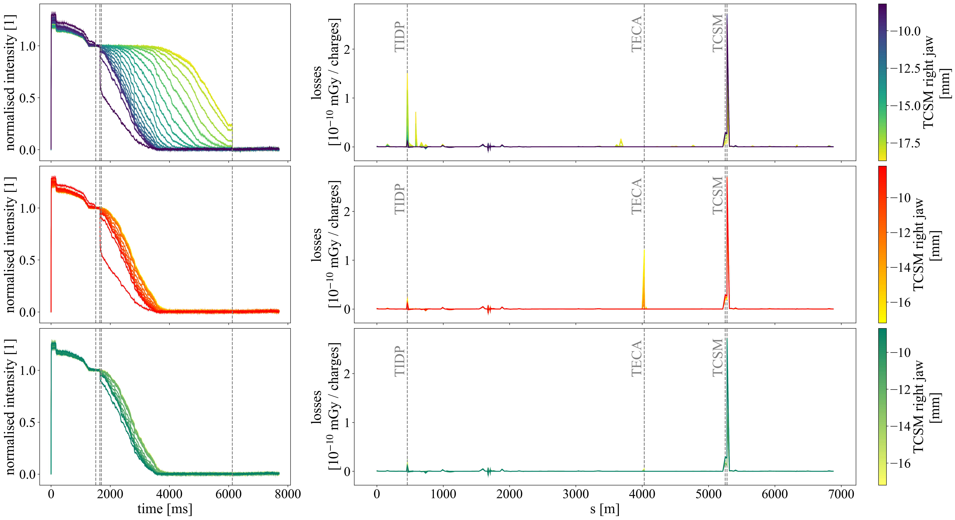
Proof-of-principle test at CERN SPS
TECA ➛ Crystal TCSM ➛ Collimator TIDP ➛ Momentum collimator
No crystal
Observables and expectations
Stable islands visible in wire scanner profiles
Beam intensity is steadily depleted
Clear difference in the start of losses with and without crystal as a function of collimator jaw position
Losses only at collimator(s) and crystal, magnitude consistent with crystal orientation
✓
✓
Crystal in amorphous orientation
✓
Crystal in channelling orientation

Slide 18
Proof-of-principle test at CERN SPS
TECA ➛ Crystal TCSM ➛ Collimator TIDP ➛ Momentum collimator
No crystal
Observables and expectations
Stable islands visible in wire scanner profiles
Beam intensity is steadily depleted
Clear difference in the start of losses with and without crystal as a function of collimator jaw position
Losses only at collimator(s) and crystal, magnitude consistent with crystal orientation
✓
✓
Crystal in amorphous orientation
✓
Crystal in channelling orientation
✓

Slide 19
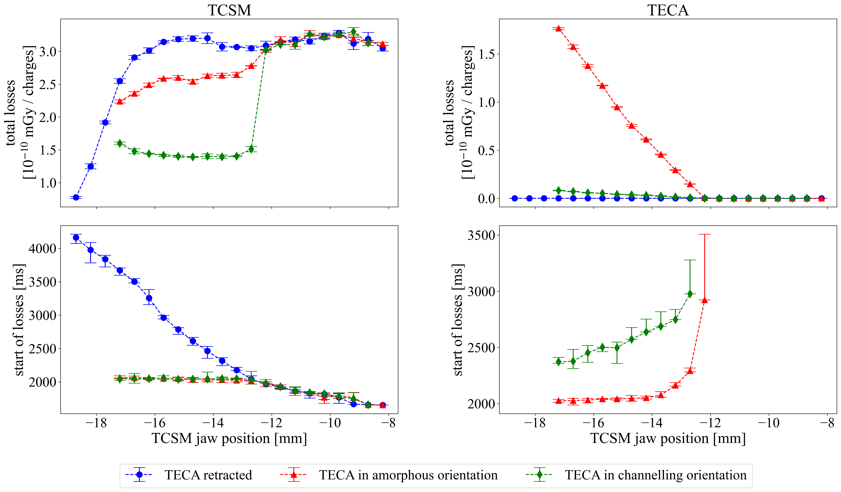
Proof-of-principle test at CERN SPS
TECA ➛ Crystal TCSM ➛ Collimator TIDP ➛ Momentum collimator
Observables and expectations
Stable islands visible in wire scanner profiles
Beam intensity is steadily depleted
Clear difference in the start of losses with and without crystal as a function of collimator jaw position
Losses only at collimator(s) and crystal, magnitude consistent with crystal orientation
✓
✓
✓
✓

Slide 20
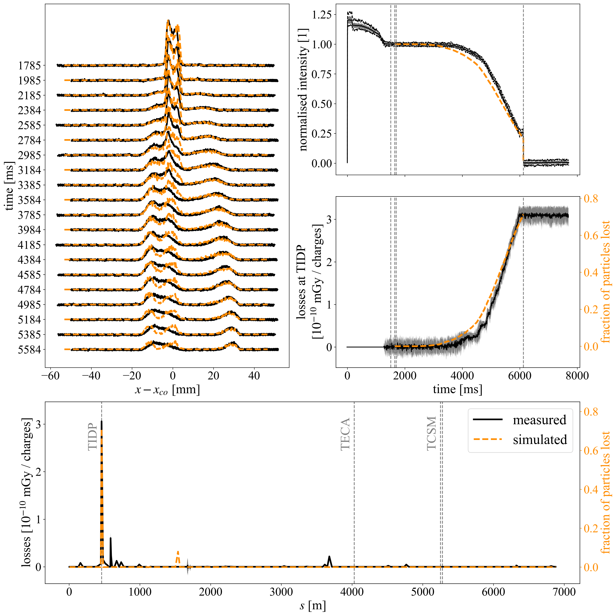
Proof-of-principle test at CERN SPS
TECA ➛ Crystal TCSM ➛ Collimator TIDP ➛ Momentum collimator
Comparisons with simulations
Profiles measured with collimator and crystal retracted. Losses are in momentum collimator (TIDP).
Good agreement between measurement and simulation results. The small discrepancies are probably linked to the details of the initial beam distribution.
The simulations detected a misalignment of the TIDP, confirmed a posteriori by survey measurements!

Slide 21
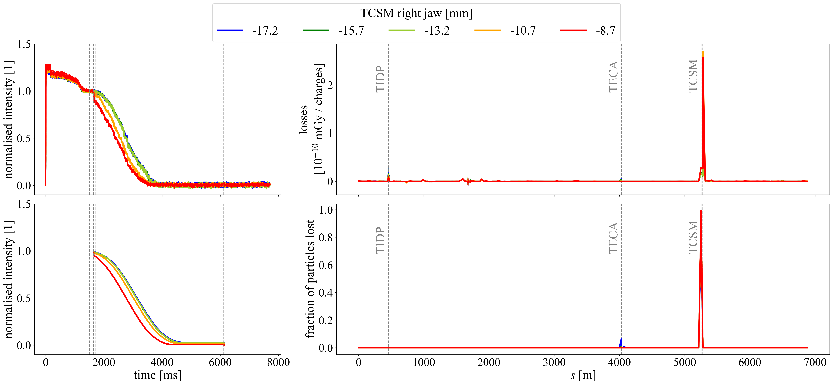
Proof-of-principle test at CERN SPS
Comparisons with simulations
Intensity evolution and losses around the ring as a function of the collimator jaw position. The crystal is in channelling mode.
Good agreement between measurements and simulation results.
Measurements
Simulations
TECA ➛ Crystal TCSM ➛ Collimator TIDP ➛ Momentum collimator

Slide 22
Conclusions and outlook
A novel method of slow extraction from hadron accelerators combining stable islands and planar channelling by a bent crystal was developed
The use of stable islands to transport particles to the crystal allows for good control over the type of interactions with the crystal. This makes it possible to exploit the higher efficiency of multiple interactions with the crystal.
Successful proof-of-principle tests were conducted at the CERN SPS, which showed very good agreement with expectations and simulations results.

Slide 23
Thank you for your attention!!!

Slide 24
Selected references - I
M. A. Fraser et al. SPS Slow Extraction Losses and Activation: Challenges and Possibilities for Improvement. In Proc. IPAC’17, p. 611–614.
F. M. Velotti et al. Reduction of Resonant Slow Extraction Losses with Shadowing of Septum Wires by a Bent Crystal. In Proc. IPAC’17, p. 631–634.
M. A. Fraser et al. Slow Extraction Efficiency Measurements at the CERN SPS. In Proc. IPAC’18, p. 834–837.
M. A. Fraser et al. Demonstration of slow extraction loss reduction with the application of octupoles at the CERN Super Proton Synchrotron. Phys. Rev. Accel. Beams, 22:123501, 2019.
L. S. Esposito et al. Crystal for Slow Extraction Loss-Reduction of the SPS Electrostatic Septum. In Proc. IPAC’19, p. 2379–2382.
F. M. Velotti et al. Demonstration of Loss Reduction Using a Thin Bent Crystal to Shadow an Electrostatic Septum During Resonant Slow Extraction. In Proc. IPAC’19, p. 3399–3403.
F. M. Velotti et al. Septum shadowing by means of a bent crystal to reduce slow extraction beam loss. Phys. Rev. Accel. Beams, 22:093502, 2019.
V. Kain et al. Resonant slow extraction with constant optics for improved separatrix control at the extraction septum. Phys. Rev. Accel. Beams, 22:101001, 2019.
B. Goddard et al. Reduction of 400 GeV/c slow extraction beam loss with a wire diffuser at the CERN Super Proton Synchrotron. Phys. Rev. Accel. Beams, 23:023501, 2020.

Slide 25
Selected references - II
D. E. Veres, M. Giovannozzi, and G. Franchetti. Exploring the potential of resonance islands and bent crystals for a slow extraction from circular hadron accelerators, Phys. Rev. Research 6, L042018, 2024.
D. E. Veres, G. Franchetti, M. Giovannozzi. An innovative method for slow extraction in circular hadron accelerators with resonance islands and bent crystals, Nucl. Instrum. & Methods A 1073, 170286, 2025.
D. E. Veres, H. Bartosik, G. Franchetti, M. Giovannozzi, K. Paraschou. Demonstrating Beam Splitting Through Stable Islands Formed by the Third-Order Resonance at the CERN Super Proton Synchrotron, J. Phys.: Conf. Ser. 3094, 012037, 2025.

