Slide 1
Octupole assisted slow extraction from SPS to the North Area at CERN
Aleksandr Gorn, Matthew Alexander Fraser, Francesco Maria Velotti, et al. (SY-ABT-BTP)
06.10.2025

Slide 2

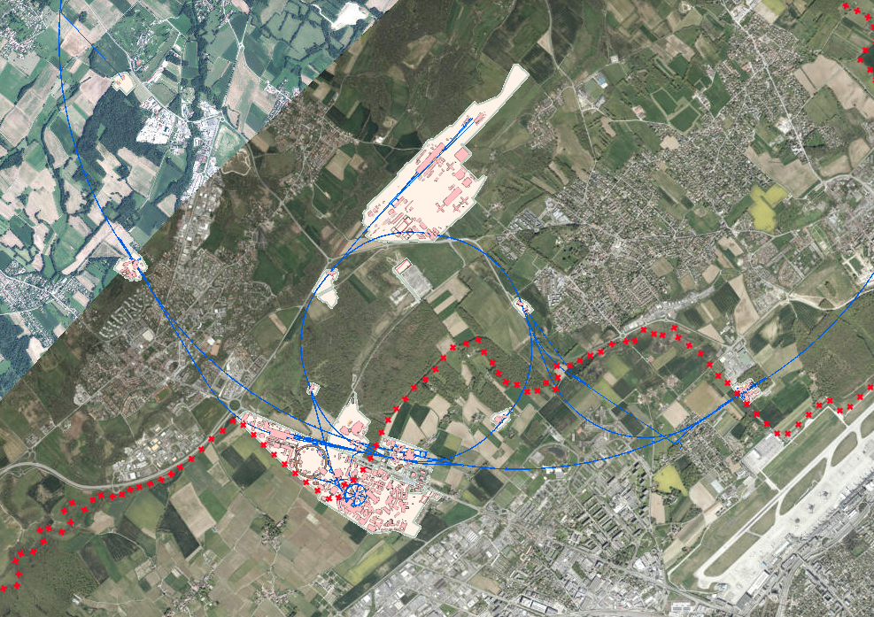
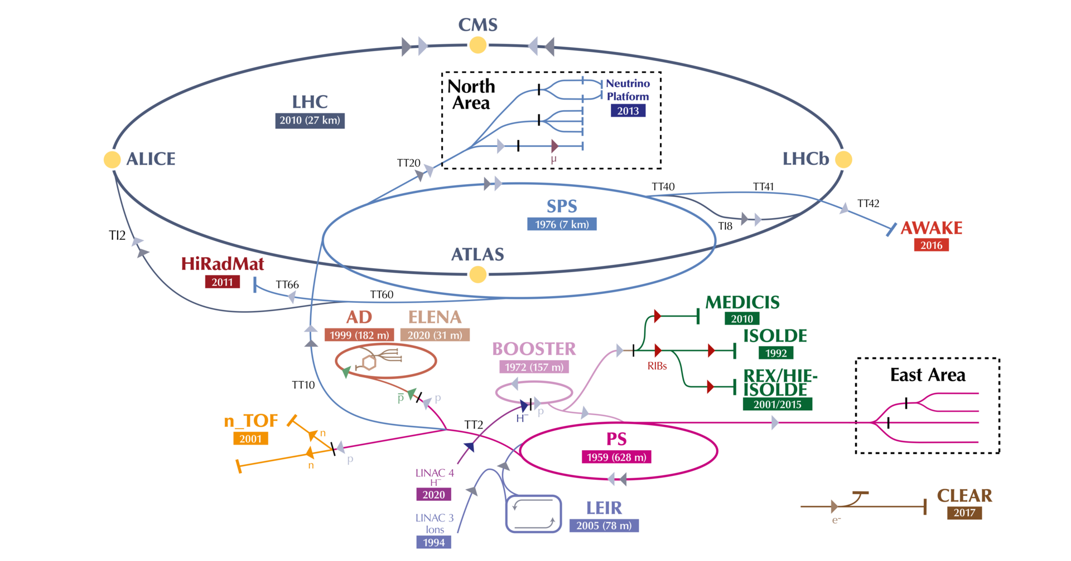
CERN’s North Area and HI-ECN3 project
North Area
Prévessin-Moëns
LHC
SPS
PS
Meyrin
The North Area (NA) unites various fixed target experiments. It utilizes proton and ion beams slow extracted from the Super Proton Synchrotron (SPS). This work is motivated by the HI-ECN3 project that aims to deliver high intensity (4 x 10¹³ per spill and 4 x 10¹⁹ POT/yr) 400 GeV proton beam to the future Beam Dump Facility target complex located in the ECN3 experimental area, which will be a part of SHiP experiment.

Slide 3
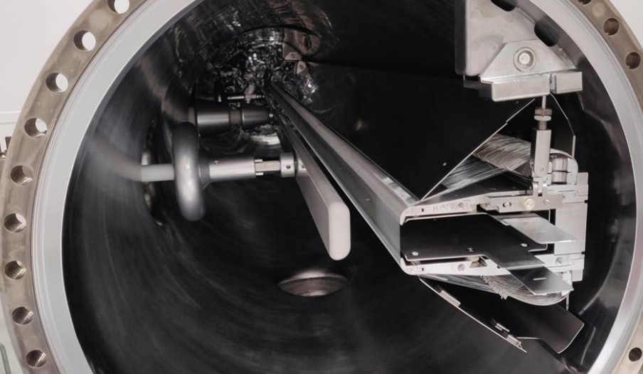
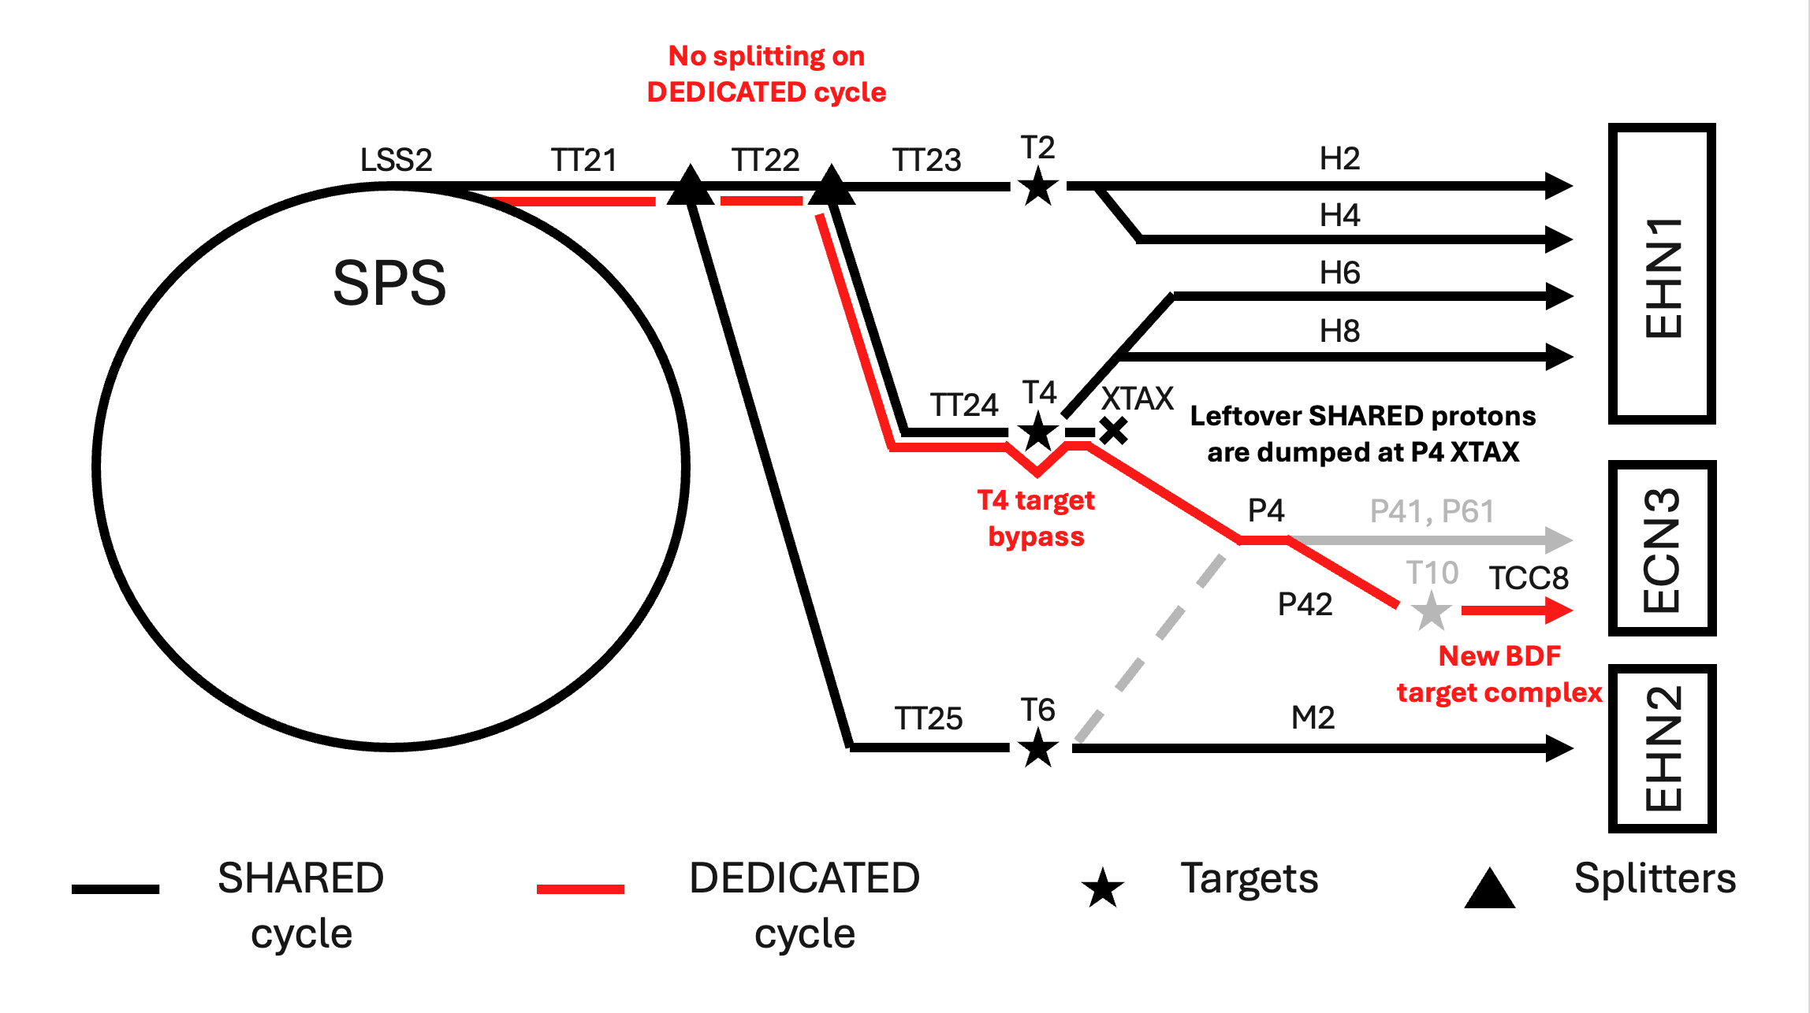
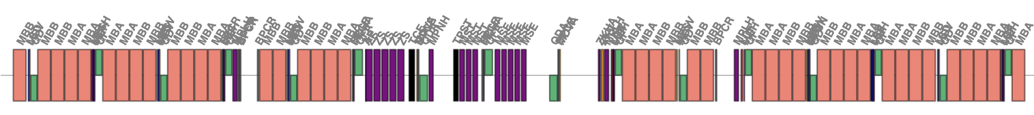
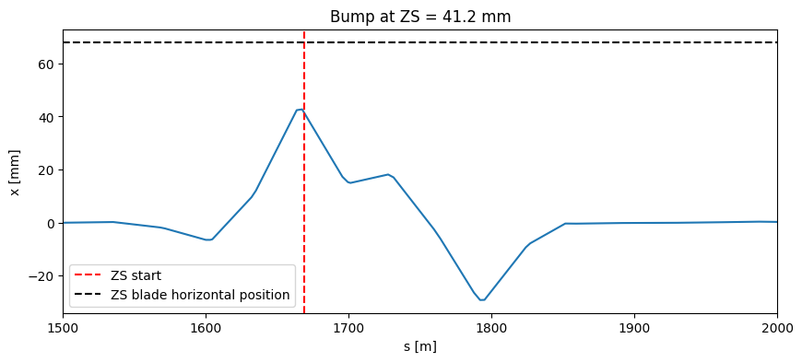

Motivation: HI-ECN3 Project
Electrostatic Septum (ZS)
CERN’s North Area
$$U^{−}$$
beam
* F. Lackner et al., “Improvements of the SPS slow extraction electrostatic septum”, in Proc. IPAC’24, Nashville, TN, May 2024, pp. 1176-1179. doi: 10.18429/JACoW-IPAC2024-TUPC72
LSS2 Extraction bump
The extraction to the NA starts in the Long Straight Section 2 (LSS2) of SPS at the location of the Electrostatic Septa (ZS). This device provides separation of the protons from the beam core. The core circulates in a hollow anode, which has its outer part made of tungsten rhenium alloy wires (ZS blades). If a proton crosses such a blade, it exhorts an electrostatic kick and gets extracted.

Slide 4
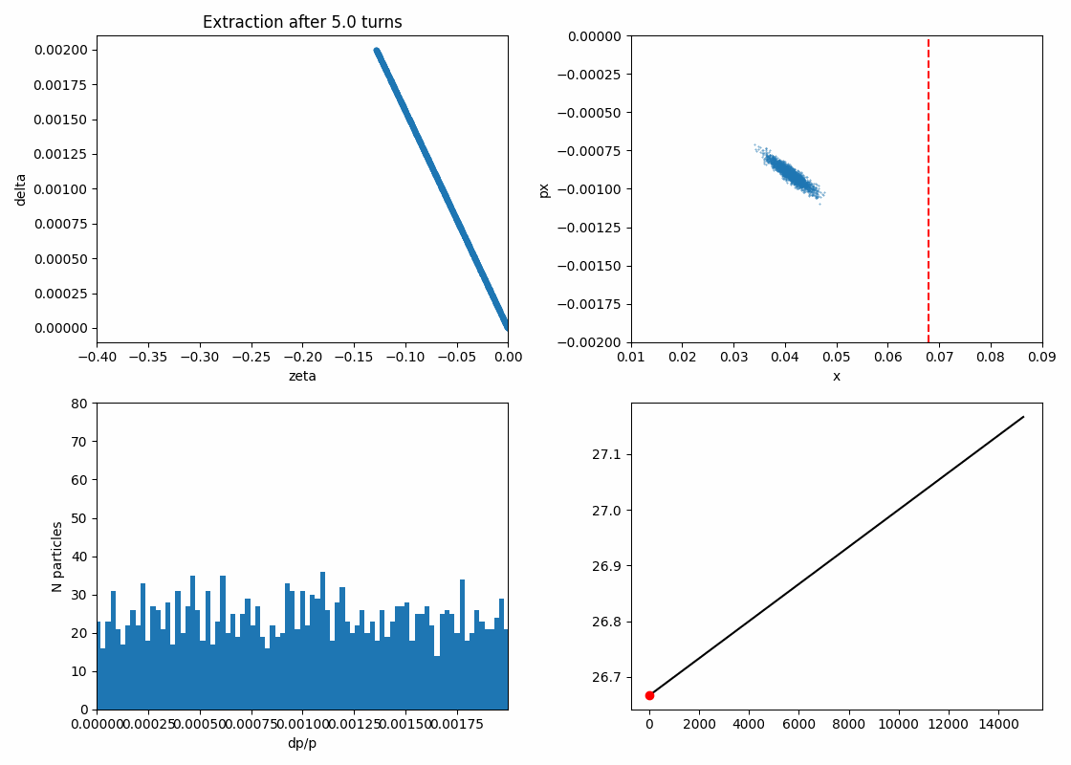

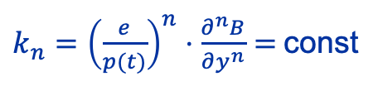
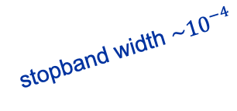




Slow extraction from SPS: COSE
$$A=\sqrt{X^{2}+X^{′2}}$$
stopband width $\sim {10}^{−4}$
$k_{n}={\left(\frac{e}{p(t)}\right)}^{n}⋅\frac{∂^{n}B}{∂y^{n}}=$const
ramping $p(t)$
$$z$$
$$y$$
beam
$$x$$
* F. Lackner et al., “Improvements of the SPS slow extraction electrostatic septum”, in Proc. IPAC’24, Nashville, TN, May 2024, pp. 1176-1179. doi: 10.18429/JACoW-IPAC2024-TUPC72
ZS blade
$$\frac{δp}{p_{0}}$$
resonance
$$\sim 3⋅{10}^{−3}$$
Current operational cycles use Constant Optics Slow Extraction technique (COSE). It implies slowly changing all the magnets’ strengths in the ring making the reference momentum ramp linearly while keeping the optics constant.

Slide 5
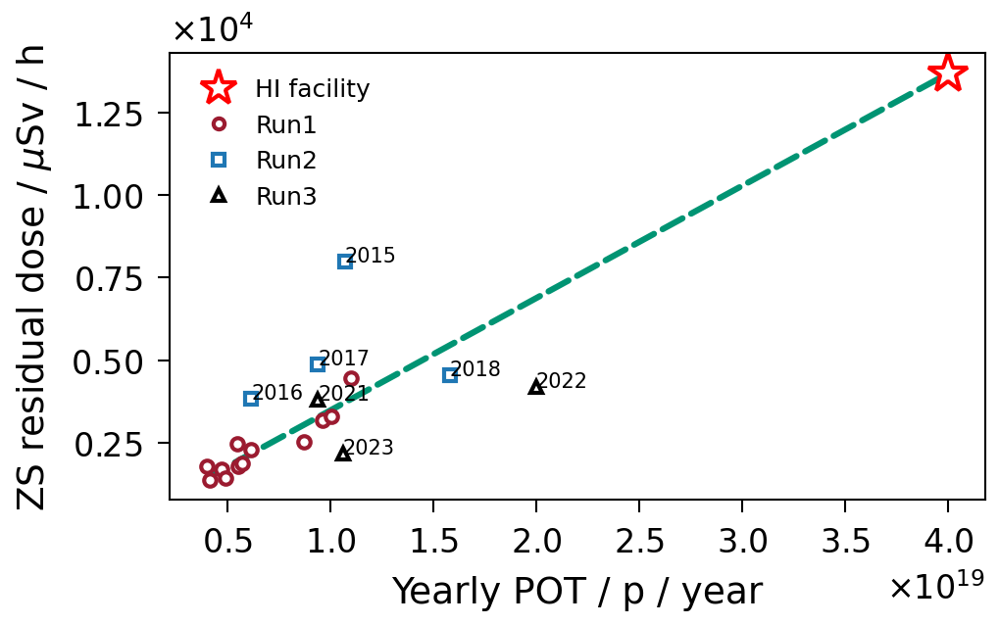
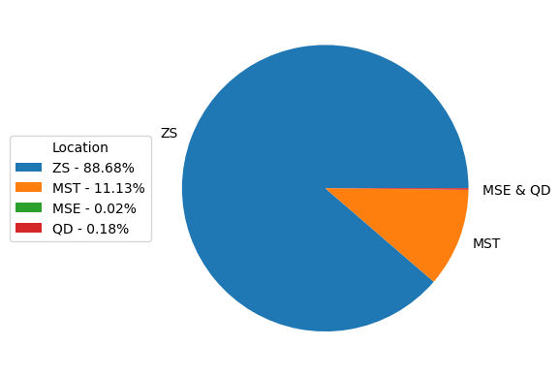
Slow extraction from SPS: ZS activation problem
Beam loss in LSS2
Beam losses on the ZS cause activation and, thus, limit max number of protons delivered to NA targets (POT).
Given the POT required for SHiP beam loss at the ZS must be reduced by x4 to keep the dose at the level of Run 3.

Slide 6
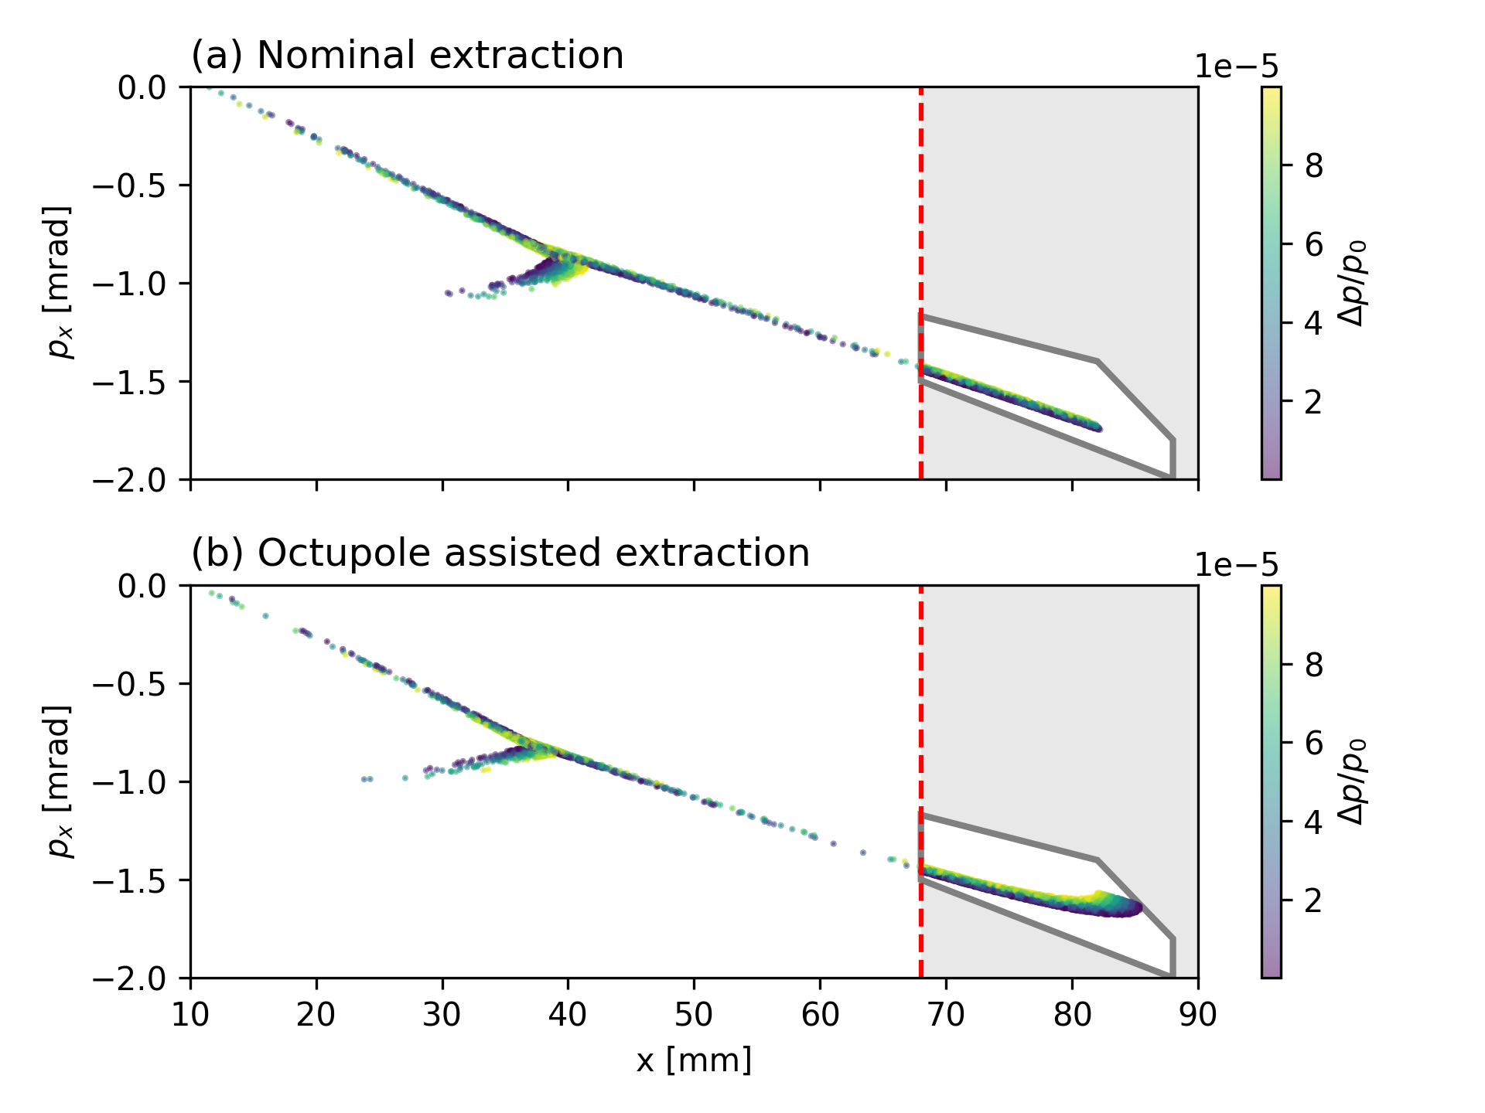
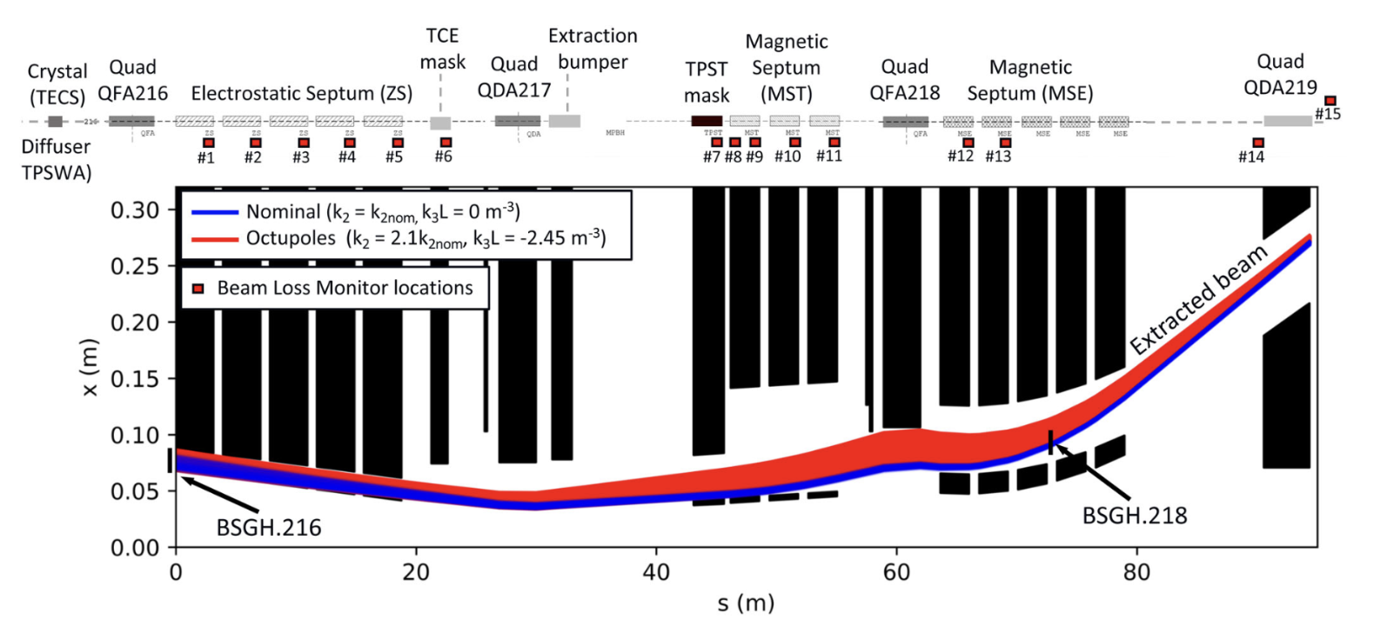
Octupole folding technique
The idea of octupole folding is to reduce the beam density on the ZS blade folding the beam in phase space together with increasing the spiral step.
Main challenge: folding increases beam divergence that complicates transfer through the extraction channel.
*M. Fraser, et al., Phys. Rev. Accel. Beams 22, 123501

Slide 7
Uncertainty on the beam position
Slow extraction is very sensitive to the amplitude of the extractions bump, which is not fully defined, due to the uncertainty in the closed orbit relative to the ZS blade. Changing of it acts similarly to extraction sextupoles: it increases or reduces the spiral step. It is important to resolve this uncertainty for better understanding of the extraction process. One way to do it is to perform a spiral step scan and match the bump amplitude until the best possible agreement with simulations.

Slide 8
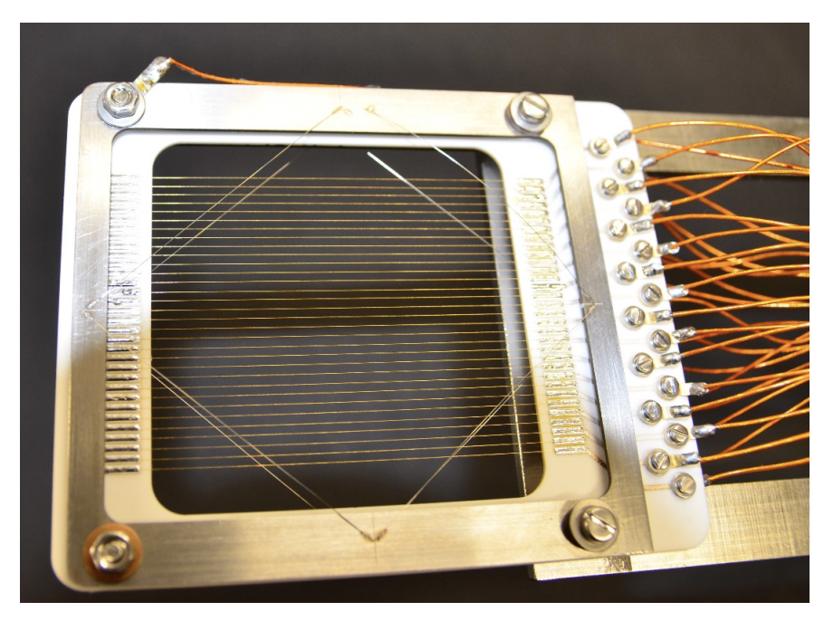
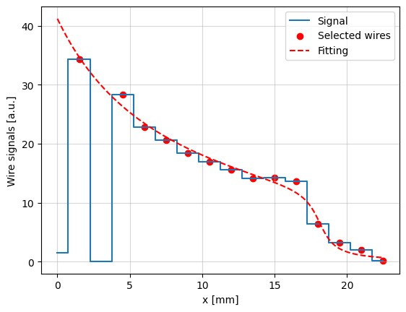

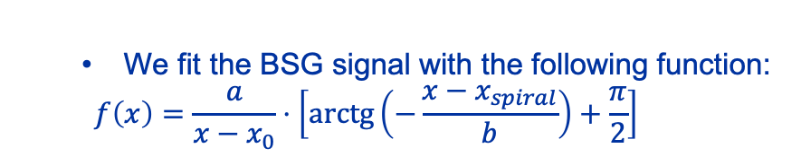
Spiral step measurement processing
Typical reading from BSGH.216
Example of a Secondary Emission Monitor (SEM) grid or BSG from one of CERN accelerators.
BSGH.216 is installed right in front of the ZS.
$$x=x_{spiral }$$
We fit the BSG signal with the following function:
$$f\left(x\right)=\frac{a}{x−x_{0}}⋅\left[\operatorname{arctg}\left(−\frac{x−x_{spiral}}{b}\right)+\frac{π}{2}\right]$$
After that $x_{spiral }$is taken as the spiral step

Slide 9
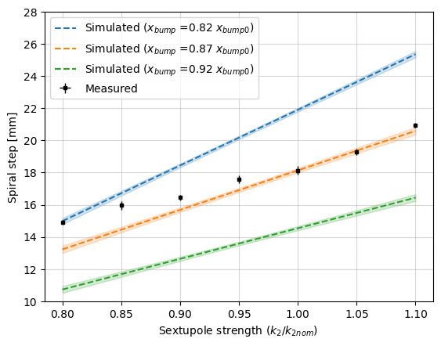
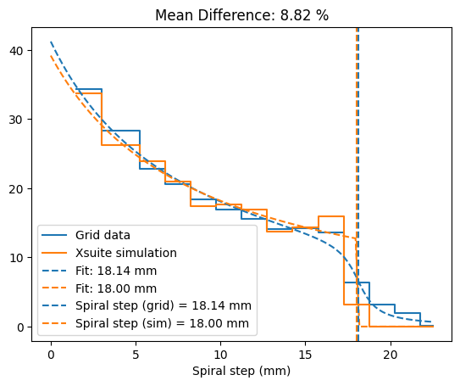
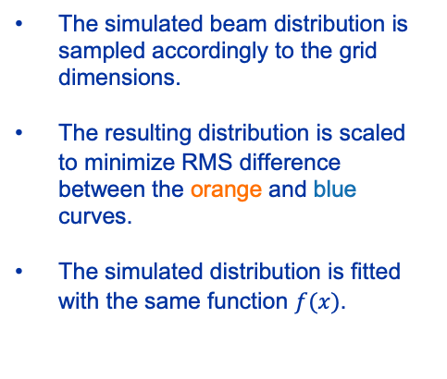
Extraction loss optimization: Spiral step scan
Simulations show the best agreement at the bump amplitude equal to 87% of the nominal value, which corresponds to the beam position of 41.2 mm at the start of ZS.
Even 5% error in this number leads to 20% mismatch with the model.
The simulated beam distribution is sampled accordingly to the grid dimensions.
The resulting distribution is scaled to minimize RMS difference between the orange and blue curves.
The simulated distribution is fitted with the same function $f(x)$.

Slide 10
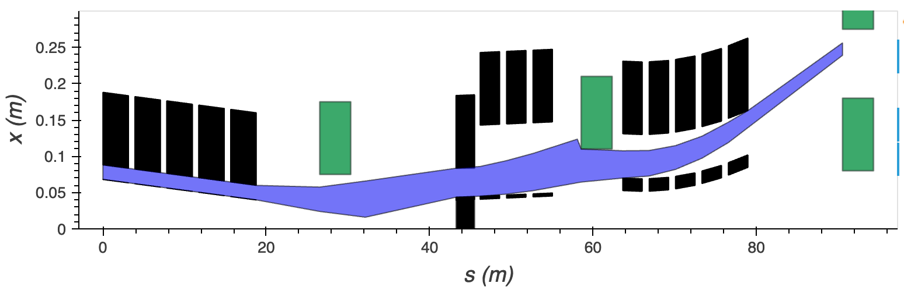
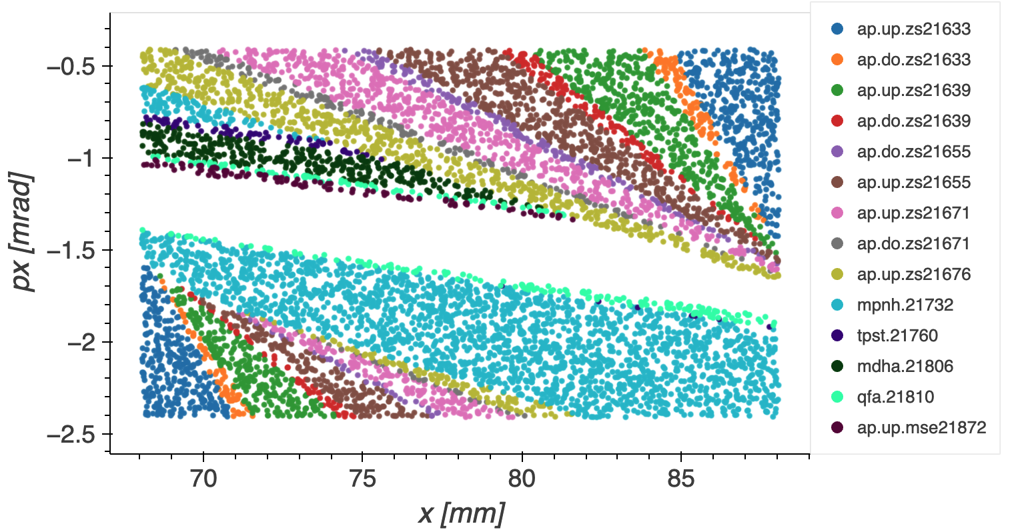
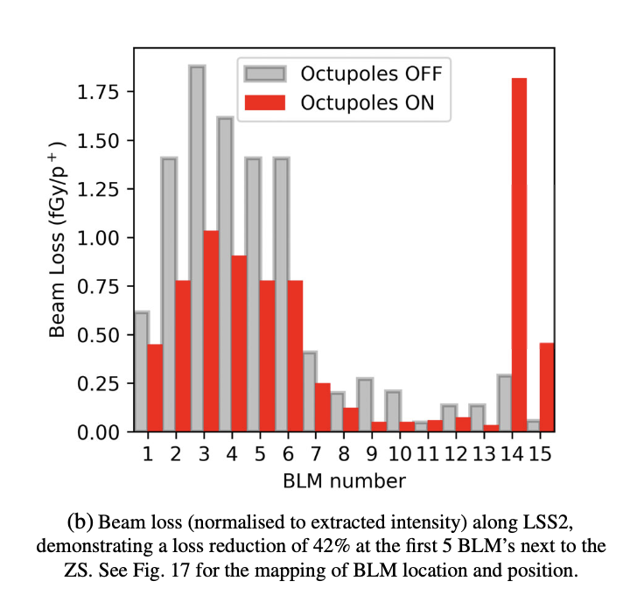
Extraction loss optimization: Extraction line acceptance
QDA.219
MST
QFA.218
MSE
To simplify the comparison with simulation results and identify possible bottle necks in the LSS2 we studied acceptance of this line.
Besides the ZS, apertures of TPST and MSE limit the transmission of the downstream part of the extraction channel.
ZS
QDA.217
TPST
BSG.216
BSG.218
TPST
ZS
QFA.218
During MD tests in 2018 we were limited by high beam loss on the last quadrupole in the line QDA.219, so we paid special attention to this region in this study.
MSE
TPST and MST blade
ZS
*M. Fraser, et al., Phys. Rev. Accel. Beams 22, 123501

Slide 11
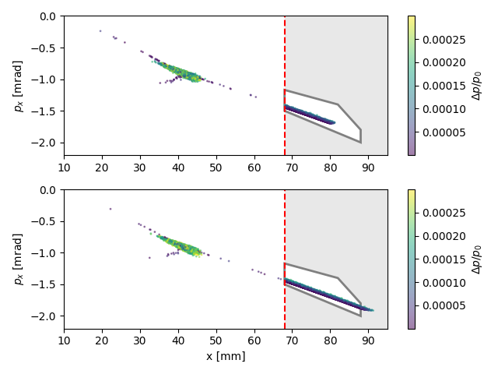
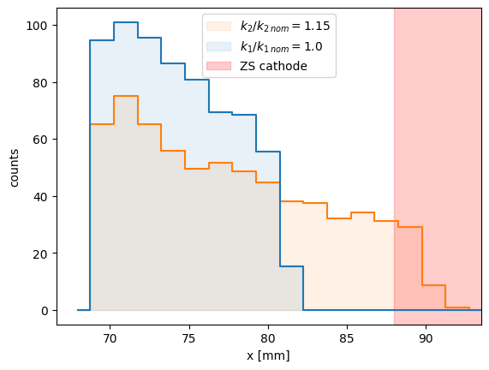

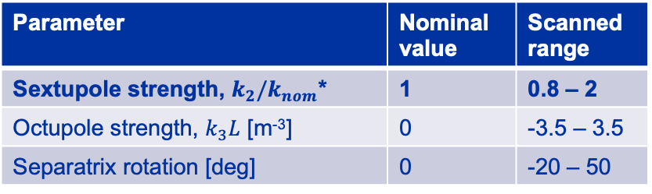


Degrees of freedom: Sextupole strength
Parameter | Nominal value | Scanned range
Sextupole strength, $k_{2}/k_{nom}$* | 1 | 0.8 – 2
Octupole strength, $k_{3}L$ [m⁻³] | 0 | -3.5 – 3.5
Separatrix rotation [deg] | 0 | -20 – 50
$k_{2}/k_{nom}$ = 1
*$k_{nom}L$ = 0.089 m⁻²
$k_{2}/k_{nom}$ = 1.15
Using sextupoles we can increase the spiral step and, thus, reduce the number of protons hitting the ZS blade. However, ZS aperture limits the maximum beam size.
Simulated
Measured

Slide 12
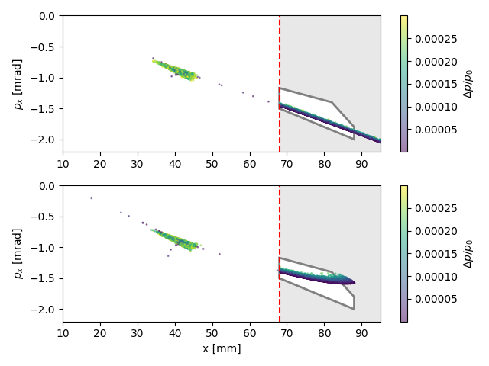
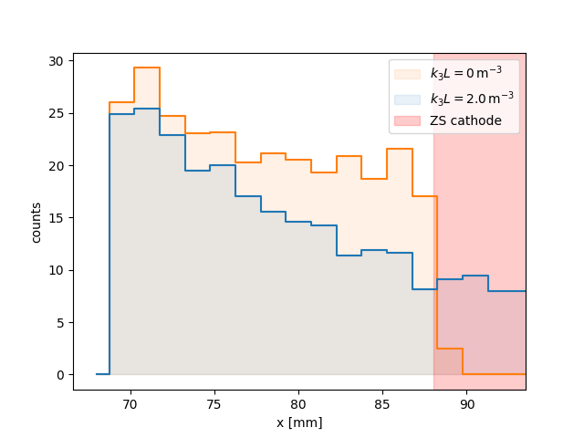
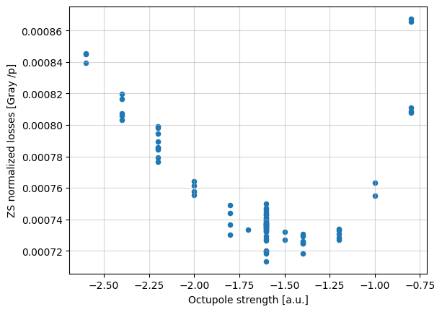

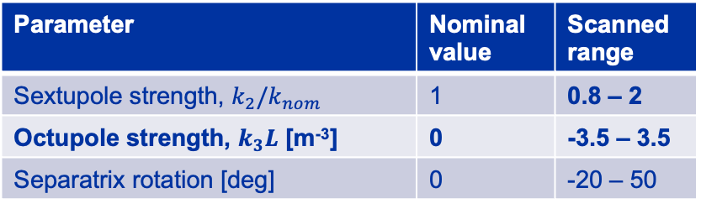

Degrees of freedom: Octupole strength
Parameter | Nominal value | Scanned range
Sextupole strength, $k_{2}/k_{nom}$ | 1 | 0.8 – 2
Octupole strength, $k_{3}L$ [m⁻³] | 0 | -3.5 – 3.5
Separatrix rotation [deg] | 0 | -20 – 50
$k_{3}L$ = 0 m⁻³
*$k_{nom}L$ = 0.089 m⁻²
$k_{3}L$ = -2 m⁻³
Folded distribution can fit between the blade and cathode, but octupoles not only increase the angular spread, but also the mean angle. -> Steering is required.
[m⁻³]
Simulated
Measured

Slide 13
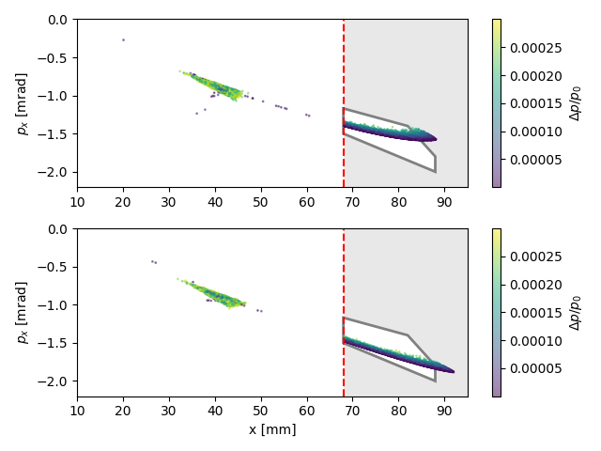
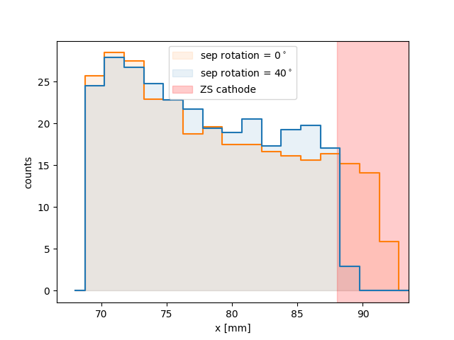

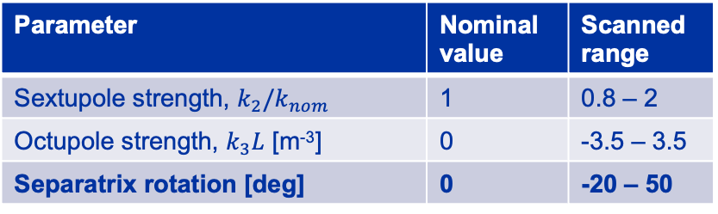

Degrees of freedom: Separatrix rotation
Parameter | Nominal value | Scanned range
Sextupole strength, $k_{2}/k_{nom}$ | 1 | 0.8 – 2
Octupole strength, $k_{3}L$ [m⁻³] | 0 | -3.5 – 3.5
Separatrix rotation [deg] | 0 | -20 – 50
sep rotation = ${\text{0}}^{∘}$
*$k_{nom}L$ = 0.089 m⁻²
sep rotation = 4${\text{0}}^{∘}$
Additional sextupoles installed in SPS ring were used to rotate beam’s separatrix and adjust the angle at which the extracted protons hit the ZS blade. Unfortunately, this leads to increase of spiral step again.
Simulated

Slide 14
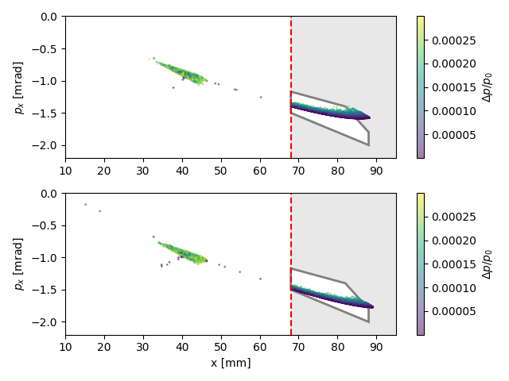
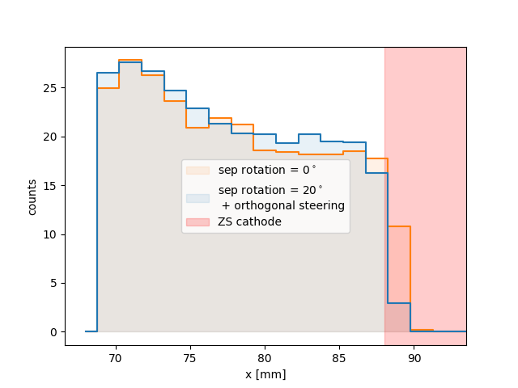
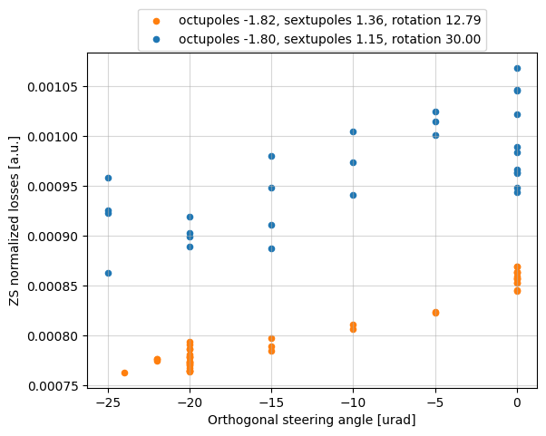

Degrees of freedom: Orthogonal steering
Parameter | Nominal value | Scanned range
Sextupole strength, $k_{2}/k_{nom}$ | 1 | 0.8 – 2
Octupole strength, $k_{3}L$ [m⁻³] | 0 | -3.5 – 3.5
Separatrix rotation [deg] | 0 | -20 – 50
sep rotation = ${\text{0}}^{∘}$
+ Orthogonal steering
*$k_{nom}L$ = 0.089 m⁻²
sep rotation = 2${\text{0}}^{∘}$
+ steering
We had to use LSS2 bumpers to steer the beam orthogonally as much as possible until we reached the bumpers’ maximum strength.
Simulated
Measured

Slide 15
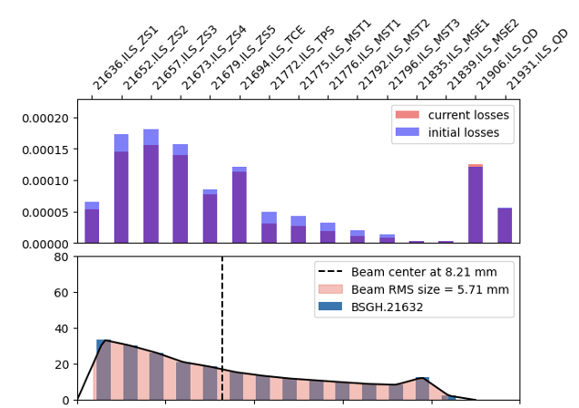
Extraction loss optimization: First tests
The approach was iterative:
Increase spiral step with sextupoles as much as possible
Fold the beam with octupoles to reduce the beam size
Steer the beam if needed
Finally, we managed to transfer the beam through the entire LSS2 without significant beam loss increase at the QD.219.
0
5
10
15
20
25
x [mm]

Slide 16
Summary
A combined tuning of extraction sextupoles, LOF octupoles, and extraction bump parameters was performed to optimize the transmission through the LSS2 line.
Experimental results demonstrate that this approach can achieve a reduction in beam losses at the ZS by approximately 25%,and an overall beam loss reduction along the LSS2 of about 20%, without degrading transmission efficiency.
Next steps
Evaluate the impact of this configuration on splitting efficiency in the downstream NA beamlines to understand if this can be used on the operational beam today or on the SHiP beam in the future.
Perform combined tests with the crystal shadowing scheme.

Slide 17
Thanks for your attention!

Slide 18
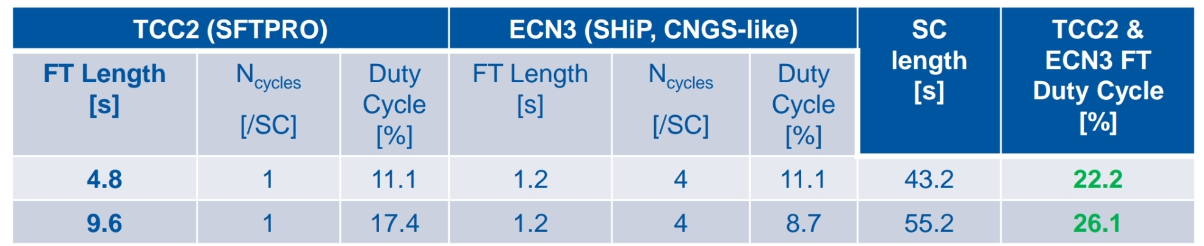
Delivery for ECN3: beam parameters
 | Momentum [GeV/c] | Spiral step [mm] | $ε_{ny}$ extraction [mm mrad] | $ε_{ny}$ TCC2 [mm mrad] | Intensity per spill [10¹³] | Spill length [s]
SFTPRO (Shared) | 400 | 15 | 5 (8)* | 1.4-4.75** | 0.22 | >4.5
ECN3 (Dedicated) | 400 | 15 | 8 | 8 | 0.05 – 4 | >1
* operational emittance (maximum achievable)
** depends on the sharing in the splitters
Beam delivery for ECN3 starts in SPS LSS2 with slow-extraction to TT21. Then the beam is either split at the end of TT21 and TT22 or not depending on scenario. Downstream the line it passes through the T4 target in TCC2 and P42 line until it is finally transferred to the new BDF target.

Slide 19
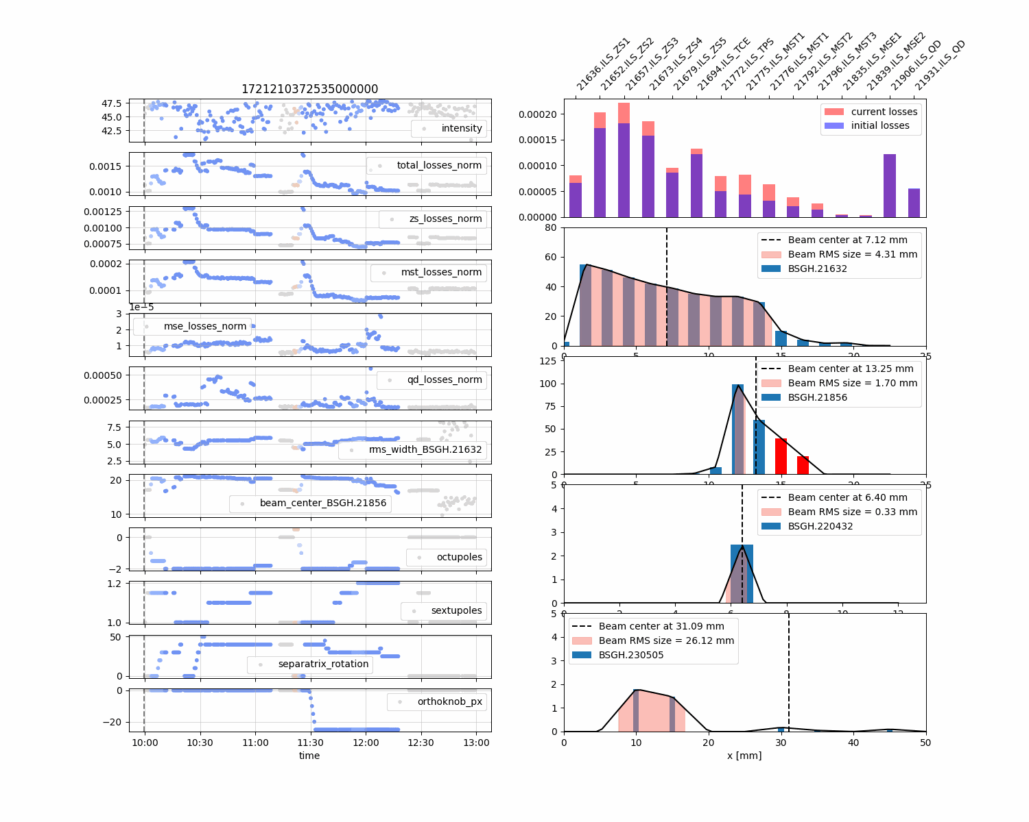
Extraction loss optimization: First tests
The approach was iterative:
Increase spiral step with sextupoles as much as possible
Fold the beam with octupoles to reduce the beam size
Steer the beam if needed
Finally, we managed to transfer the beam through the entire LSS2 without significant beam loss increase at the QD.219.

