Slide 1
SX schemes for SIS100 in the presence of higher-order field errors
D. Ondreka, B. Galnander, S. Sorge, GSI
6th SX Workshop, Stony Brook 6 October 2025

Slide 2
Contents
Recap of status from last WS
Overview of SIS100
Magnetic field measurements
Effect of systematic errors
Modified multipole correctors
SX schemes with field errors
Modified SX design
Random error studies
Next steps
Summary

Slide 3
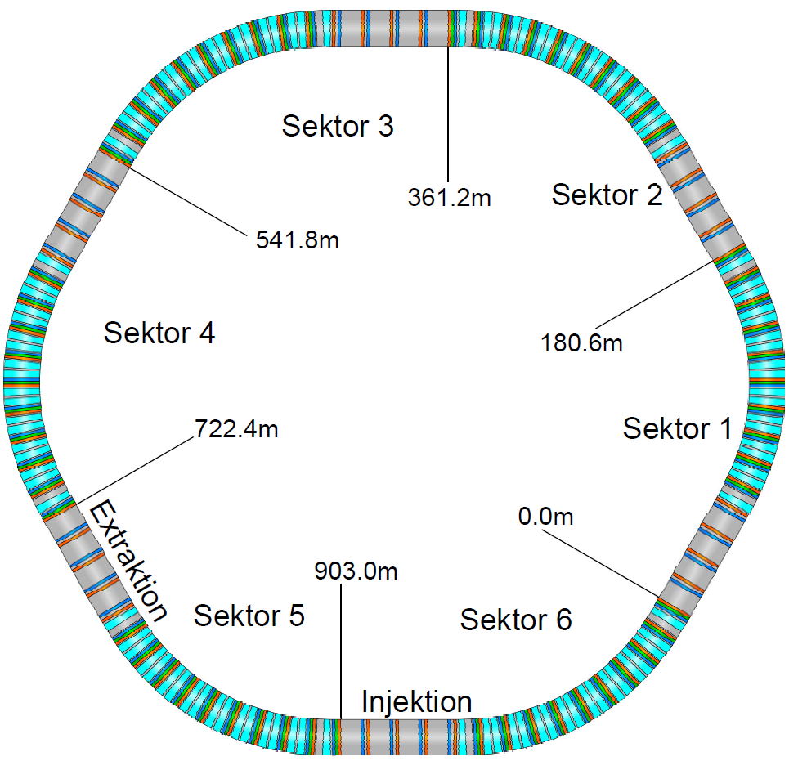
SIS100: Overview
Workhorse of FAIR facility
Primary heavy ion beams
Factor 100 higher intensities than SIS18
Basic parameters
Circumference 1083 m (= 5 x SIS18)
Max. magnetic rigidity 100 Tm
Max. ramp rate 4 T/s
Super-ferric main magnets
Ion optical layout
Super-periodicity 6, 14 cells per period
DF focusing structure (charge separator lattice)
Optimized for operation with intermediate charge state ions
Working modes
Batch injection from SIS18
Slow extraction to fixed targets
Fast extraction to fixed targets or storage rings
SIS100
SX Experiments
Optical parameters (SX)`
Q_{h} / Q_{v} | 17.31 / 17.4
Q’_{h} / Q’_{v} | -17.5 / -22.7
α_{p} | 0.005
γ_{t} | 14.2

Slide 4
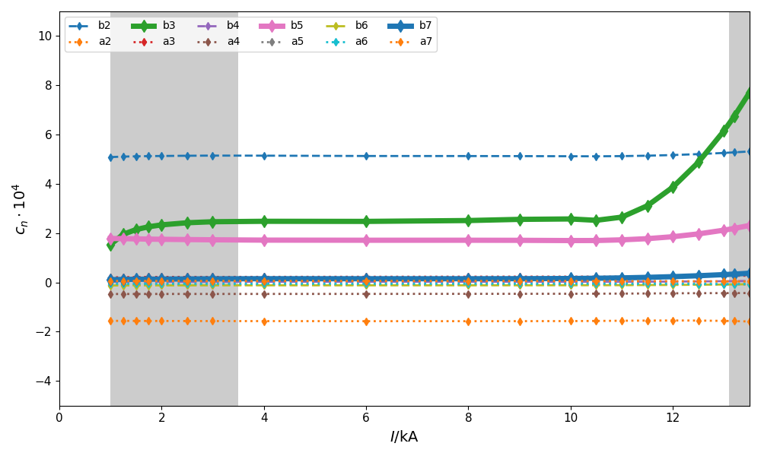
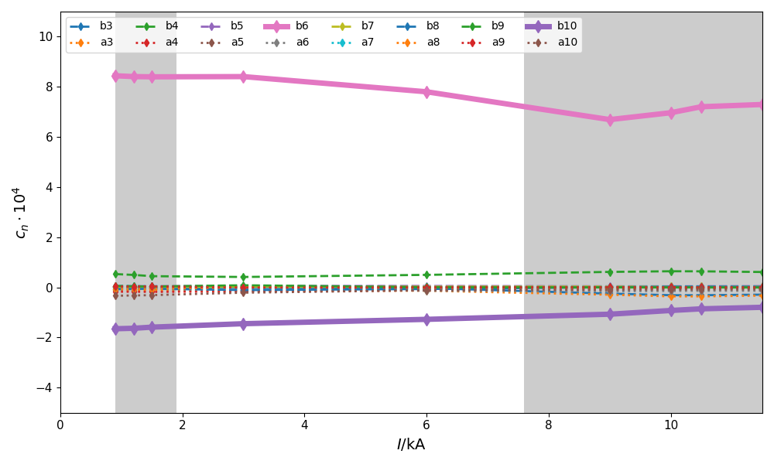
Magnetic Measurements: Field Errors
Systematic field errors in dipoles
Measurements of SF main magnets
Dipoles: all magnets measured (108 + 2)
Quadrupoles: data from 53 magnets available
Analyzed data as function of current
Variation of integral field
Harmonics at R_{ref} (dipole: n ≤ 7, quad: n ≤ 10)
Unexpectedly large systematic components
Dipoles: decapole (b₅)
Quadrupoles: dodecapole (b₆)
Systematic components influence SX strongly
Systematic field errors in quadrupoles

Slide 5
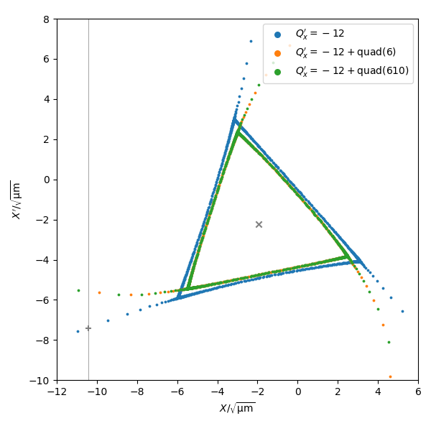
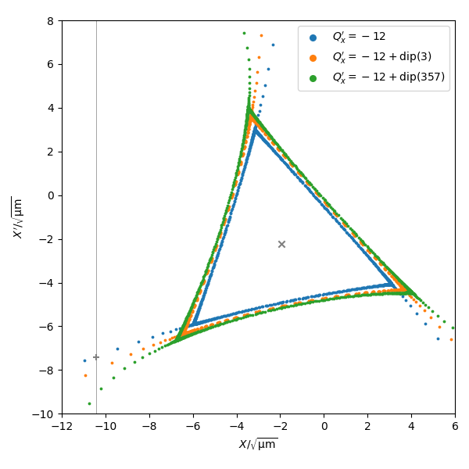
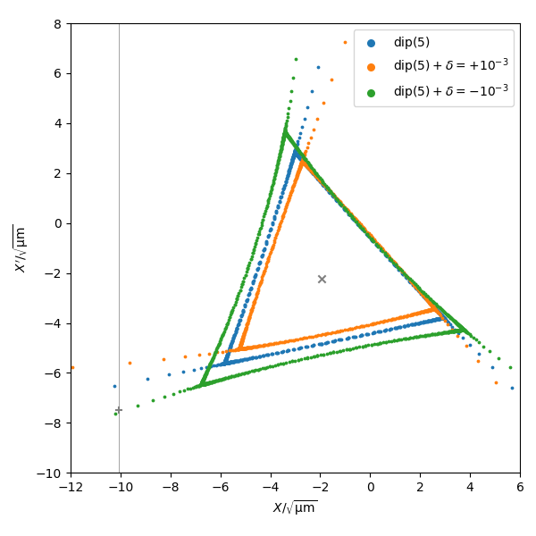
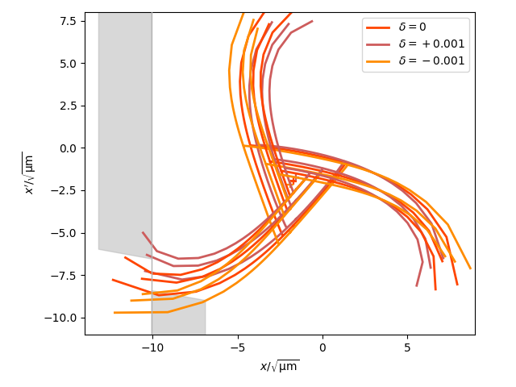
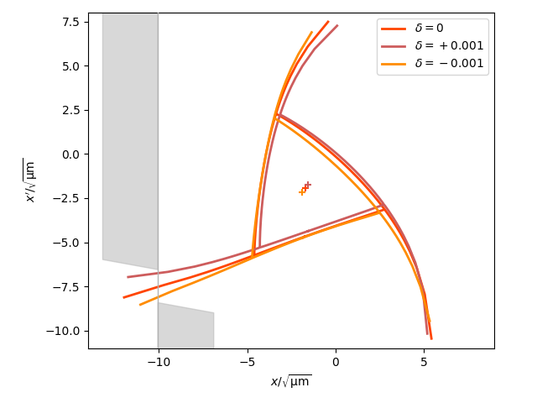
SX: Effect of Systematic Errors
SX affected by ADTS bending separatrix
Effects independent of momentum
ADTS in first order of strengths: b₆
ADTS in second order of strengths:
b₃∙b₃ (considered in baseline design)
b₅∙b₃ (coupling with sextupoles)
Effects depending on momentum
Momentum-dependent ADTS by feed-down from dispersion in first order of strength:: b₅∙δ
Effects on SX in SIS100
Larger angular spread at ES through b₅∙δ
Strong bending by b₆, larger for small tune distance
Compensation options in SIS100 (baseline)
No b₅ or b₆ corrector magnets
Two families of octupoles effecting ADTS by b₄
Baseline: compensate b₃∙b₃ from chroma sextupoles
Can be used to mitigate effects of b₆ and b₅∙b₃
No compensation of b₅∙δ in baseline lattice
b₆
b₅∙b₃
b₅∙δ
Tune-sweep: no compensation
KO: b₆ mitigated by octupoles

Slide 6
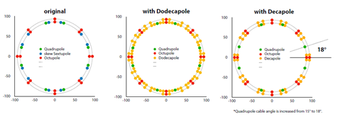
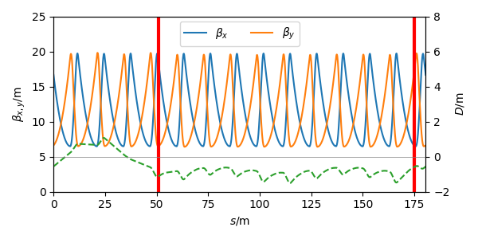


Multipole correctors
Baseline corrector
Nested cos(θ) coils comprising b2, a3, b4
Two families, six each (large and small β_{x} / β_{y})
Options for b5 and b6 coils studied
Constraints on modified corrector
Only three types per magnet
b₅ corrector would need location with large β_{x}∙D
b₆ corrector would need location with large β_{x}
Final decision:
Corrector with b5 at beginning of arc (b2, b4, b5)
Baseline corrector at end of arc (b2, a3, b4)
Mitigate b₆ using baseline octupoles
Courtesy K. Sugita

Slide 7
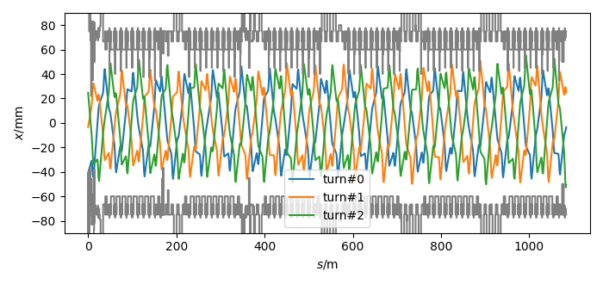
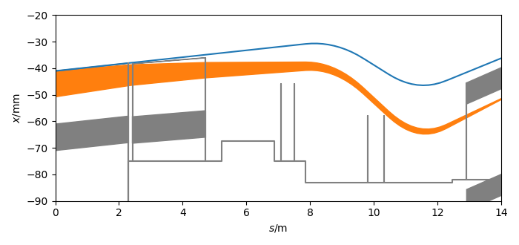
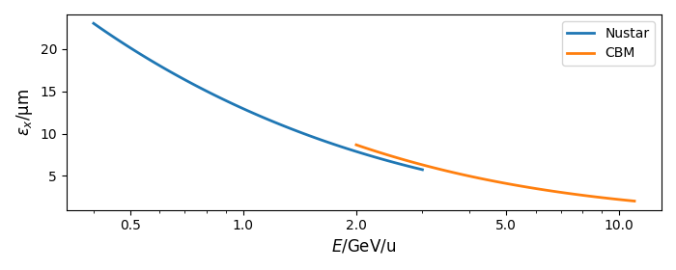
SX schemes with field errors
Requirements
Separatrix sizes up to 25-30 um
Extraction efficiency > 95% (activation)
Losses on first wire ~ 1% (ES protection)
Robustness against random magnet imperfections
KO extraction plus one fallback scheme
Avoid b₅ compensation if possible (simplicity)
Constraints
No major changes to lattice (under construction)
Acceptance of ring limited by cryo catchers
Small acceptance of extraction channel
Challenge
Large emittance for separatrix shrinking schemes
Particle trajectories over last three turns
Beam transport from ES to LS
left margin
LS
ES1
ES2
right margin
Separatrix shrinking
Design horizontal emittances on flattop
x’
ES
x

Slide 8
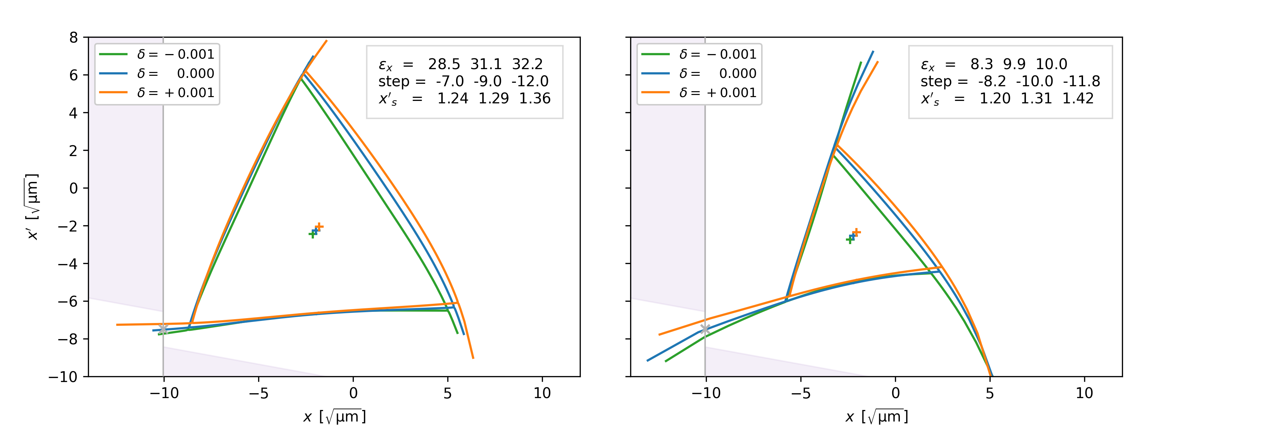
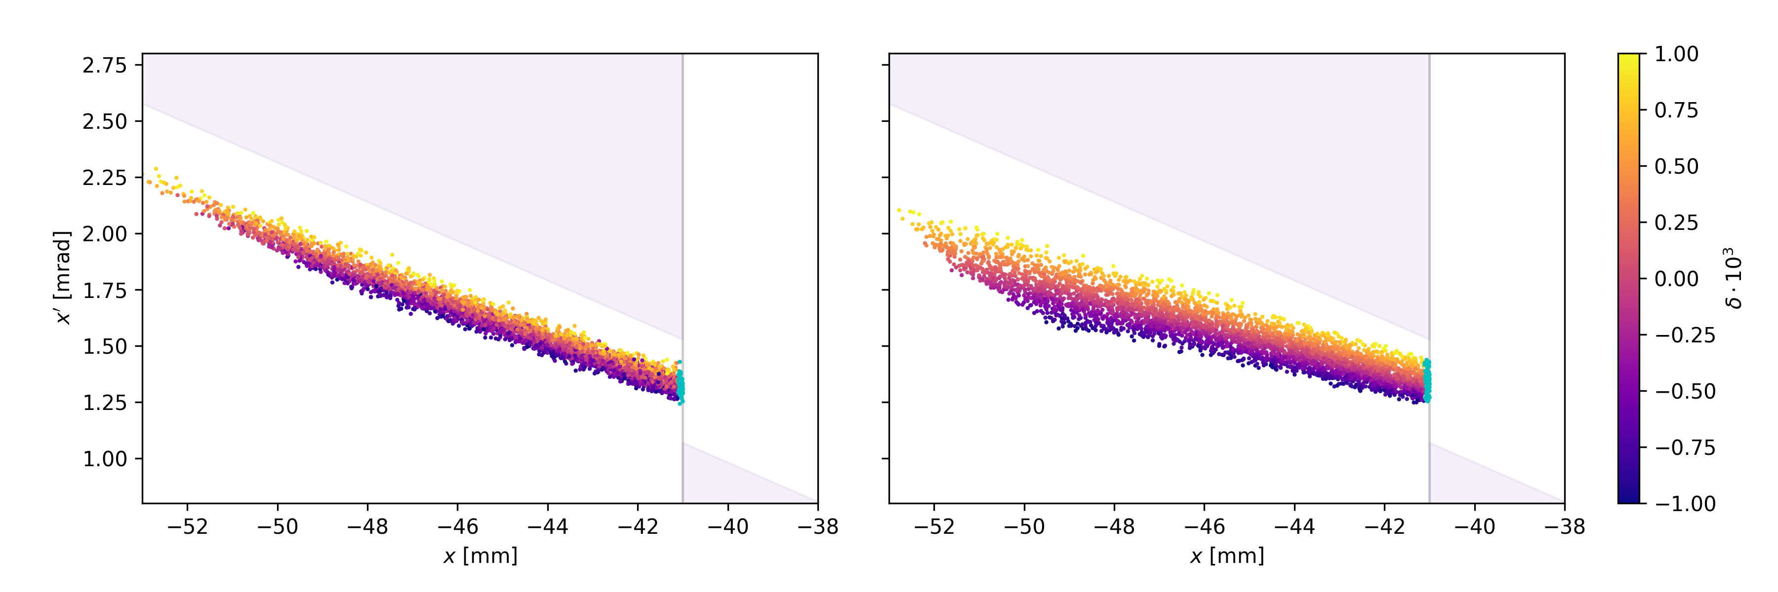
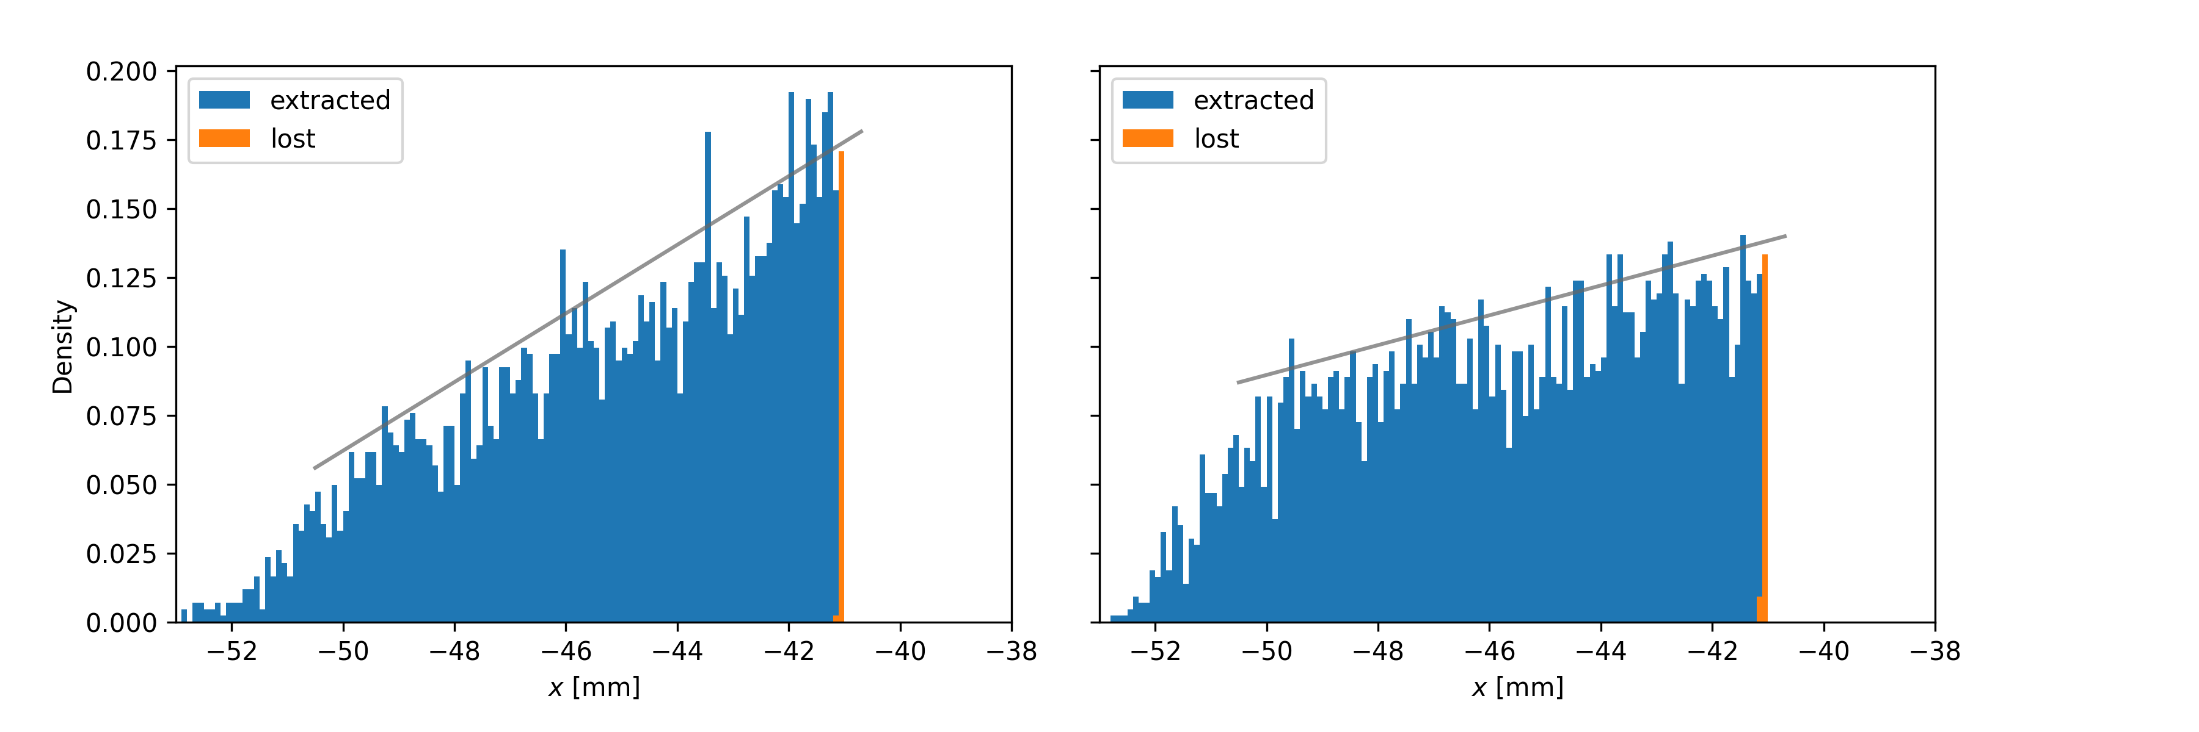
SX Schemes: KO
B. Galnander
Specific challenges
Small and large separatrix
Different ion species and energies
Power saving for KO exciter
Characteristics
Small chromaticity for good separatrix overlap
Bending by b₆ mitigated with octupoles
Usage of b₅ correctors not necessary
Increased spread through b₅∙δ acceptable
Total losses well within budget
First wire losses a bit higher than expected (~1%) due to non-uniform distribution
Sepratrix size | 28 π∙μm | 8 π∙μm
Hor. chromaticity | -3 | -1
Sextupole amplitude | 0.70 m⁻² | 0.45 m⁻²
Octupole strength | -1.0 m⁻³ | 1.9 m⁻³
Total losses | 2.2% | 1.8%
Losses first wire | 1.7% | 1.5%
Distribution of extracted particles at ES

Slide 9
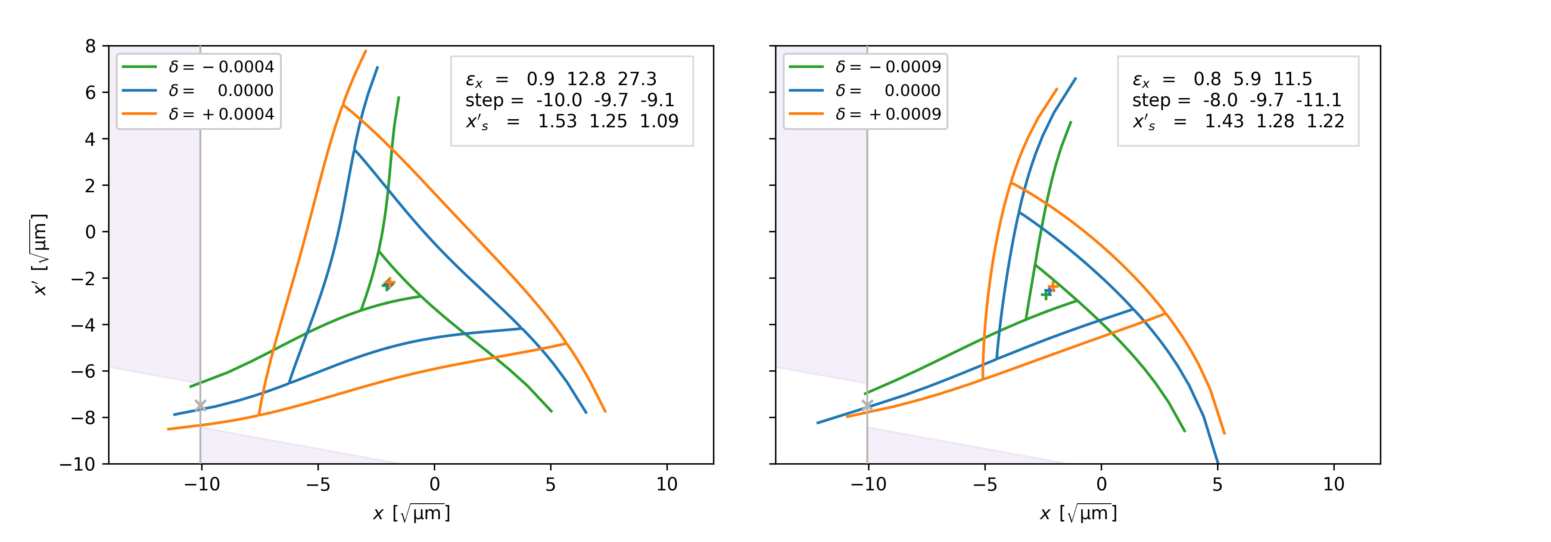
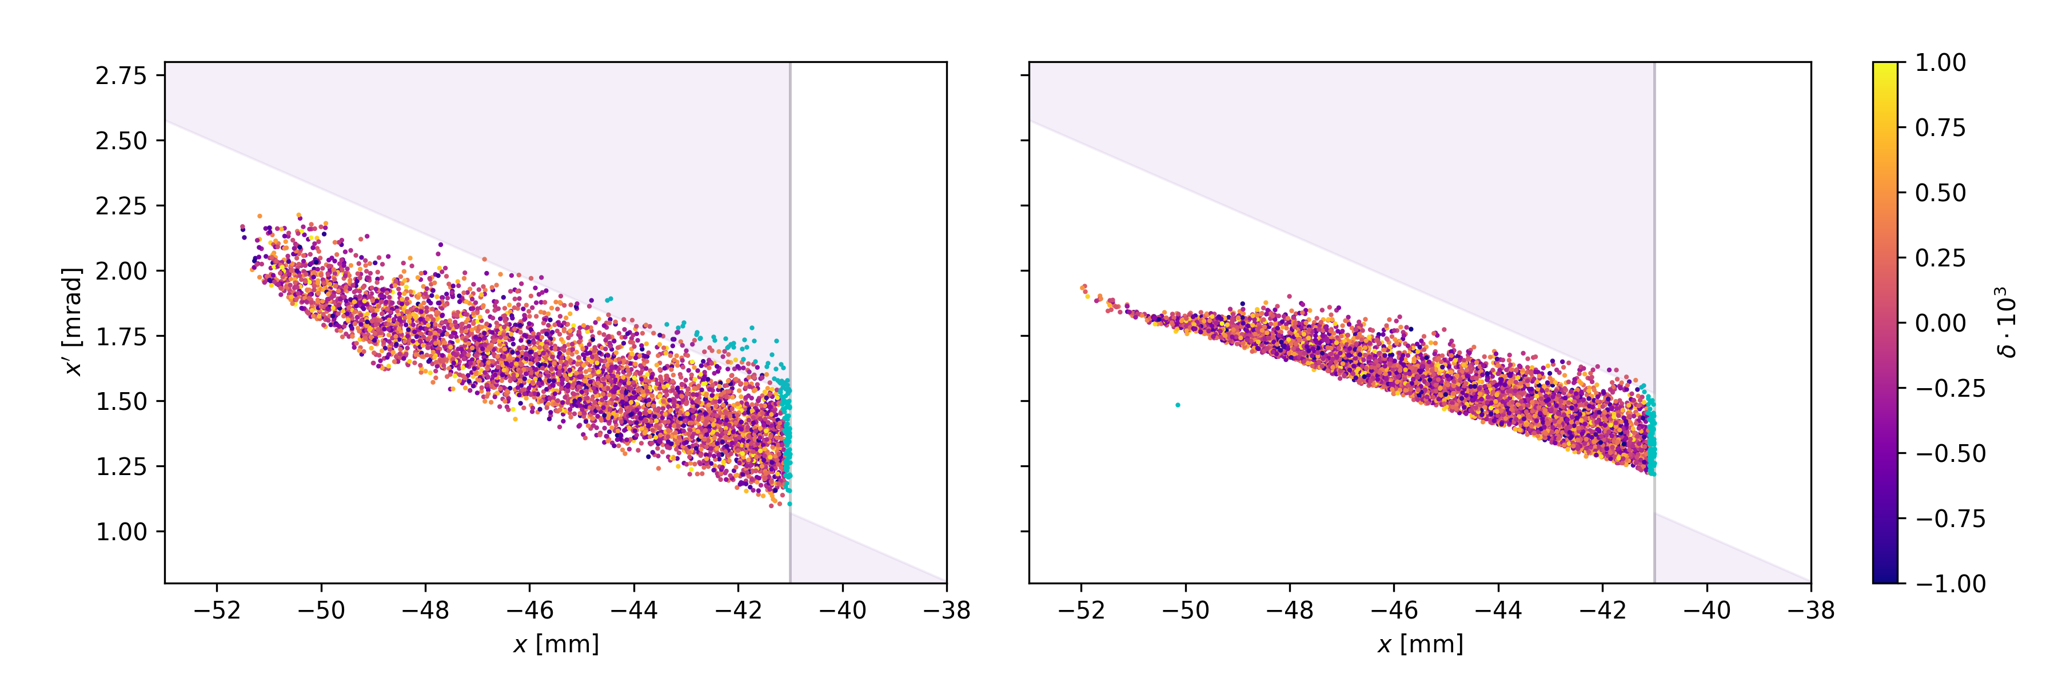
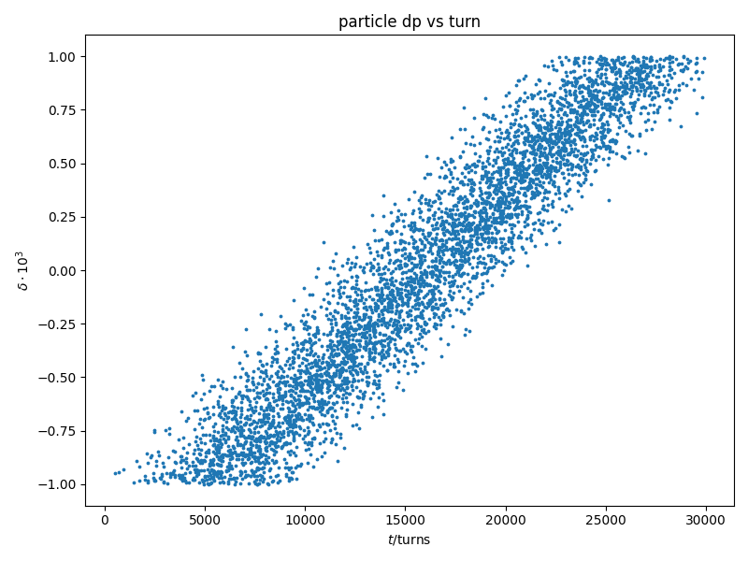
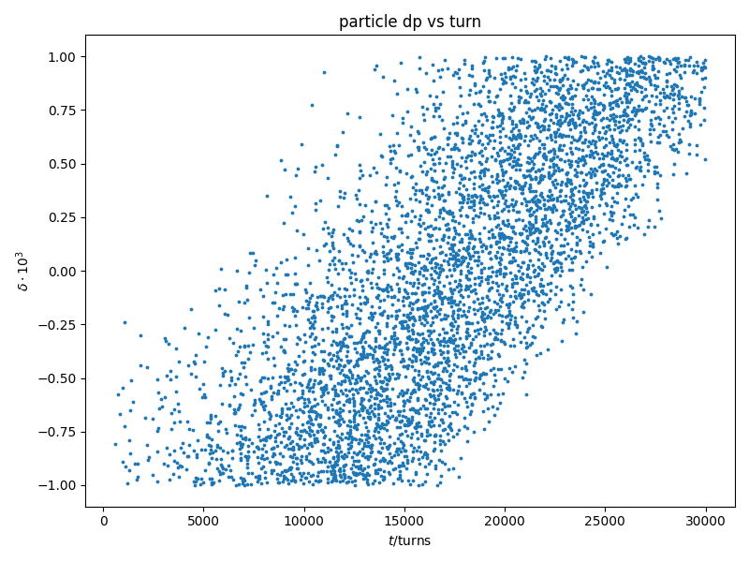
SX Schemes: COSE
B. Galnander
Specific challenges
Large emittance difficult to handle
‘Linear’ Hardt condition for Q’_{x} ≈ 0
Small angular acceptance
Characteristics
Usage of b₅ correctors not necessary
b₅∙δ bending actually improves alignment
Large chroma preferred due to smaller ΔBρ
More δ selective → constant phase space at ES
Strong octupoles for larger chromaticity
ADTS cross-term a_{xy} must be removed
Preferred fallback scheme
Momentum deviation vs. turn number
Sepratrix size | 28 π∙μm | 10 π∙μm
Hor. chromaticity | -10 | -3.5
Sextupole amplitude | 0.40 m⁻² | 0.32 m⁻²
Octupole strength | -/+9.2 m⁻³ | 1.5 m⁻³
Total losses | 3.5% | 2.1%
Losses first wire | 1.5% | 1.5%

Slide 10
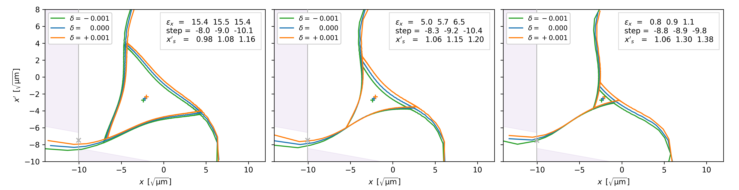
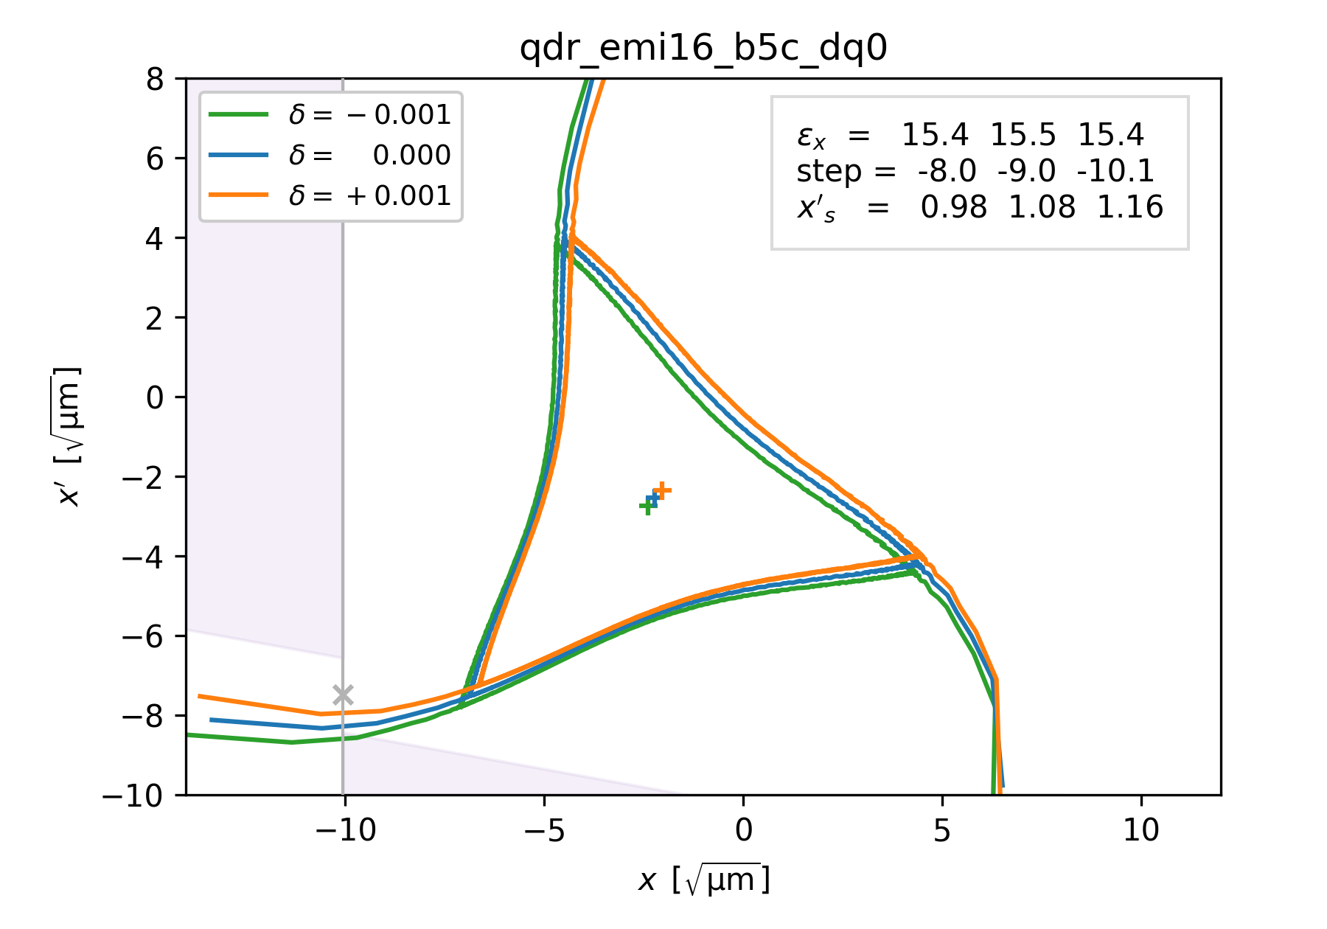
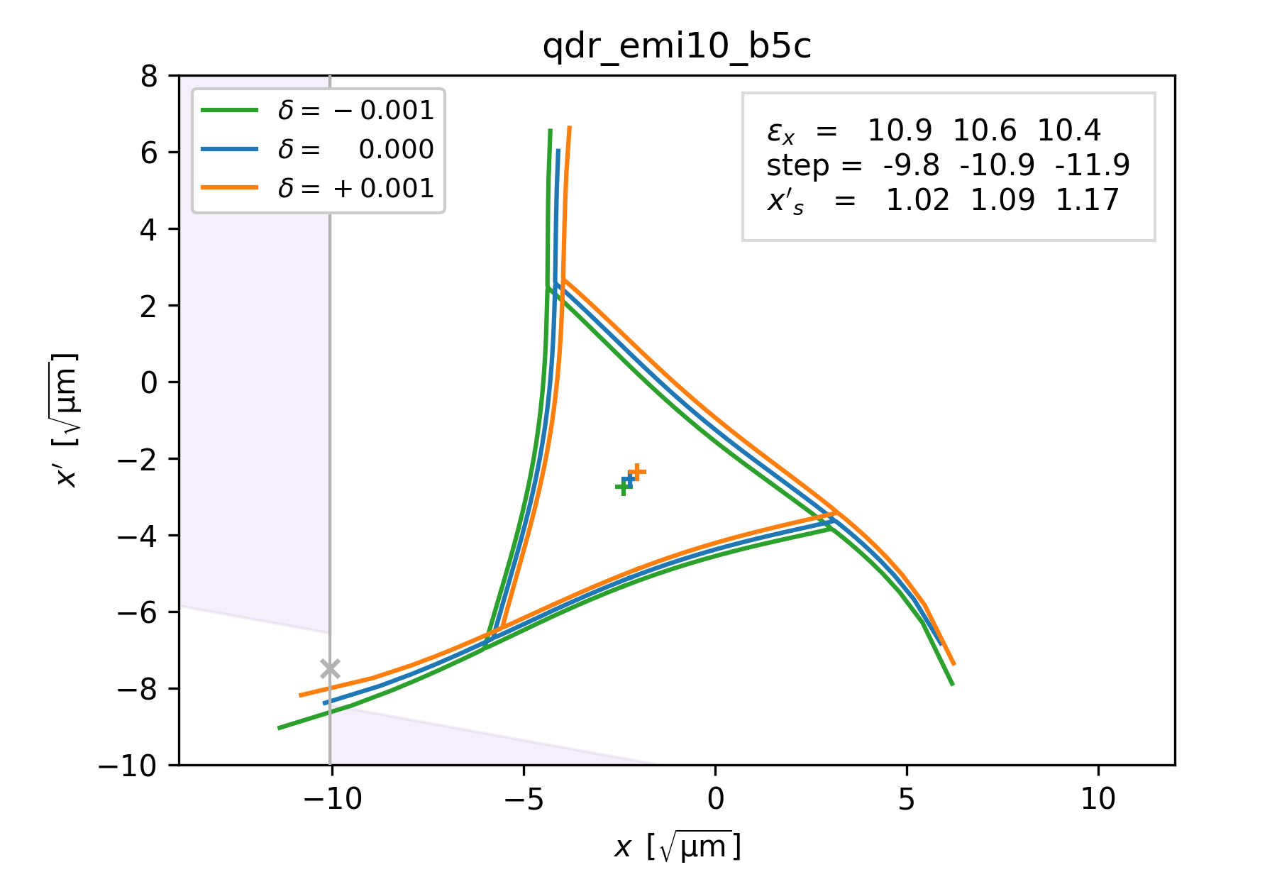
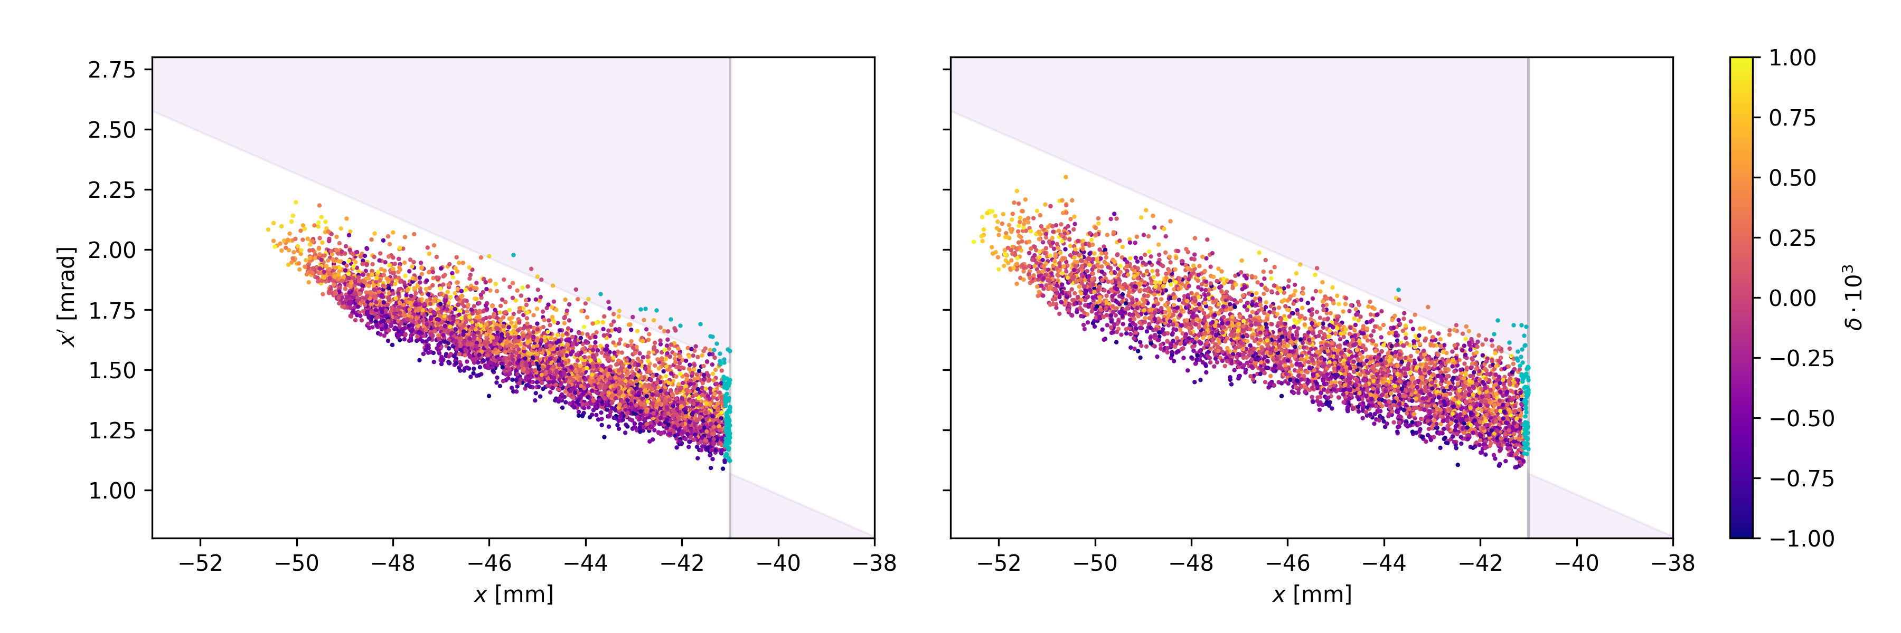
SX Schemes: Tune-Sweep
B. Galnander
Specific challenges
Large emittance difficult to handle
Large angular spread favors b₅ compensation
Characteristics
Chromaticity uncorrected
Very large octupole strengths required
ADTS cross-term a_{xy} must be removed
Large angular spread due to shrinking separatrix
Acceptable losses only for sepa size <= 15 π∙um
Possibly useful as commissioning scheme
Shrinking separatrices for different momenta
Sepratrix size | 15 π∙μm | 10 π∙μm
Hor. chromaticity | -17.5 (nat.) | -17.5 (nat.)
Res. sext. ampl. | 0.33 m⁻² | 0.38 m⁻²
Octupole strength | -/+12.7 m⁻³ | -/+9.2 m⁻³
Total losses | 3.9% | 3.2%
Losses first wire | 1.5% | 1.2%

Slide 11
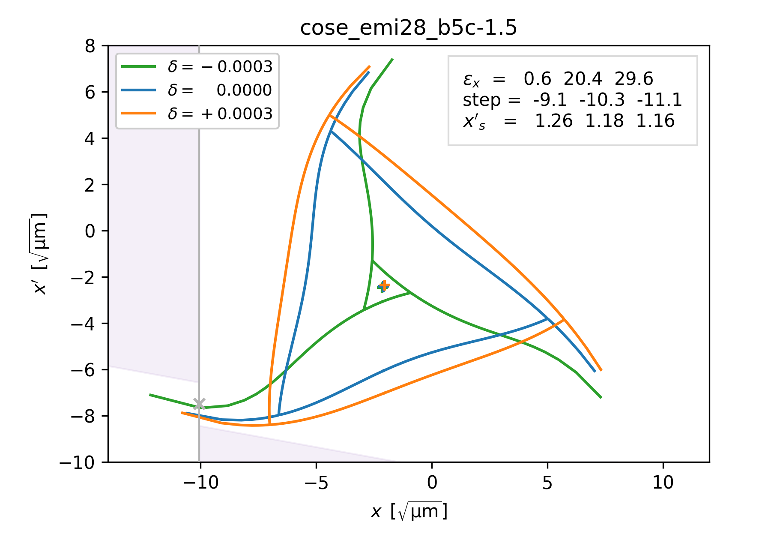
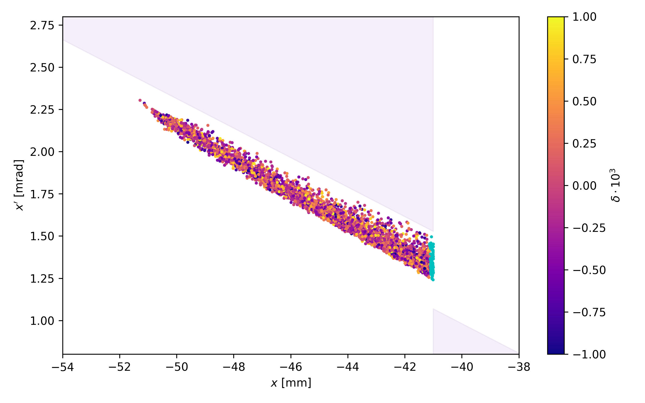
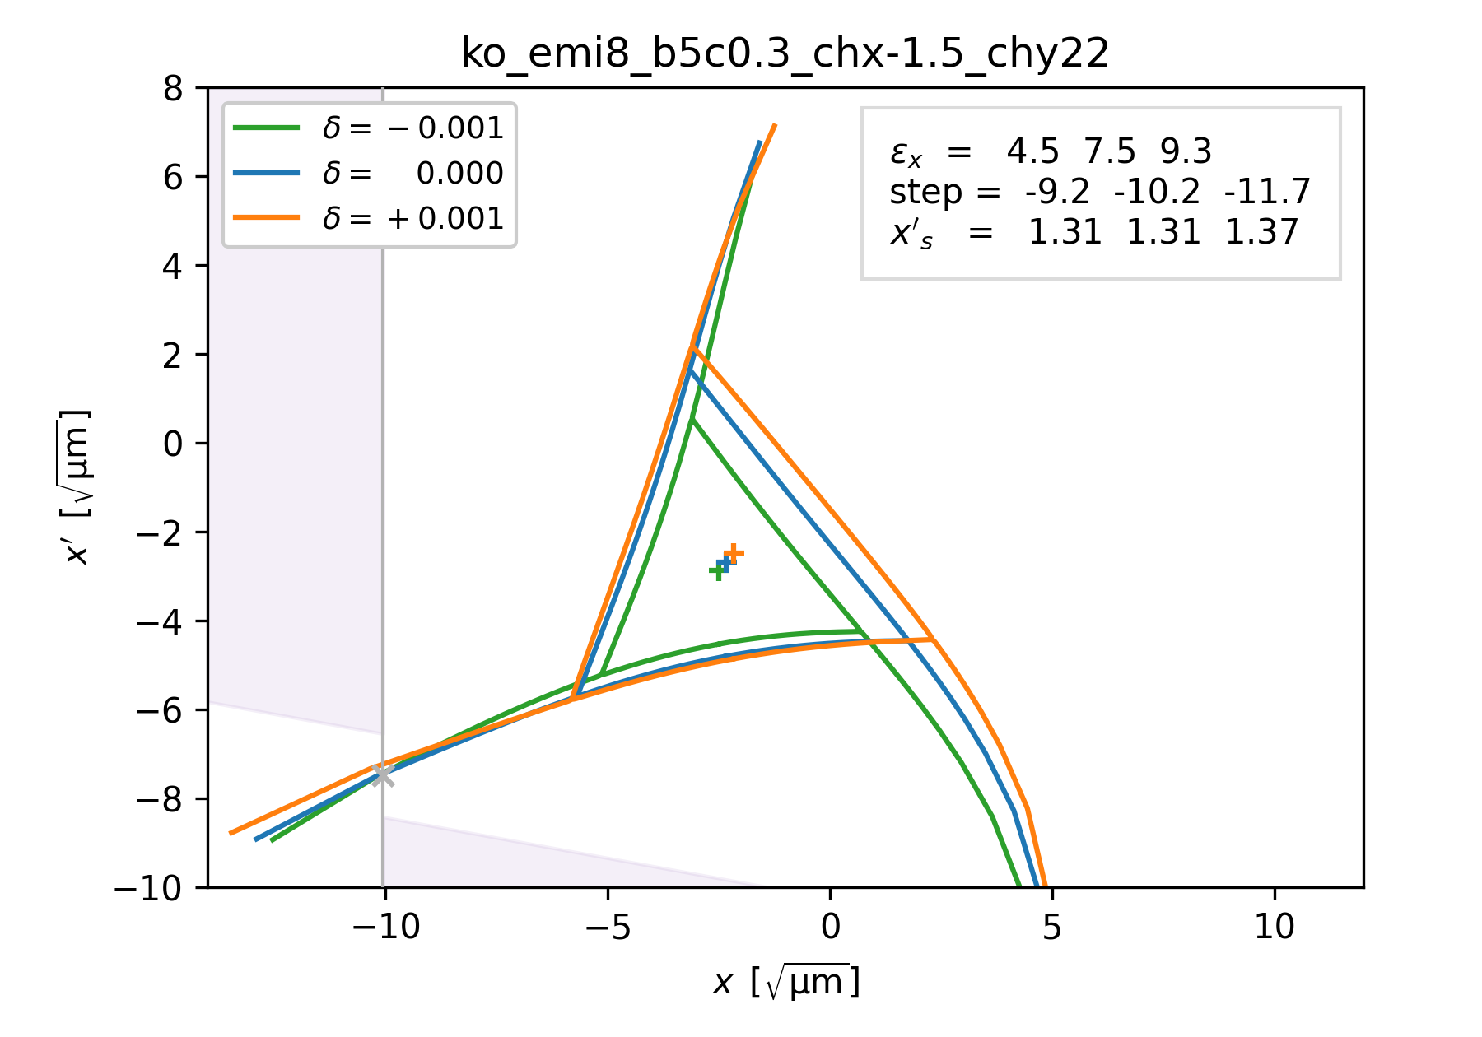
Options for employing b₅ correctors
Goal: better separatrix alignment
COSE: ‘anti-compensation’
Amplify effect of b₅ from dipoles
Increased b₅∙δ bending improves overlap
Small losses (2.3%) even for large emittance
Robustness yet to be checked
KO: limits for small separatrix
Compensation of b₅ not independent
Better overlap at price of stronger size dependence
Hard to get around acceptance limit at LS
Benefits to be investigated in further studies
COSE without and with b5 ‘anti-compensation’
KO extraction without and with b5 compensation

Slide 12
SX with Magnet Imperfections: Random Error Studies
S. Sorge
Goal: Verify robustness of SX schemes against magnet imperfections
Magnet alignment errors
Magnetic field errors (variations in integral field, harmonics)
Simulation procedure per scenario
10 random error seeds chosen from Gaussian distribution truncated at 2σ
Nelder-Mead optimizer to match separatrix
Target parameters: separatrix size, spiral step, crossing angle
Variables: tune distance, virtual sextupole, orbit bump, octupole strengths
Tracking of 1000 particles over 25000 turns with MAD-X to evaluate performance
Preliminary results on SX without b₅ compensation
KO extraction and COSE robust against errors
Limitations
Optimistic distributions for quadrupoles’ roll and variation of integral field
Matching of separatrix can lead to non-optimal settings due to ignorance of distributions
MAD-X tracking times not suitable for use of optimizer with multi-particle simulations

Slide 13
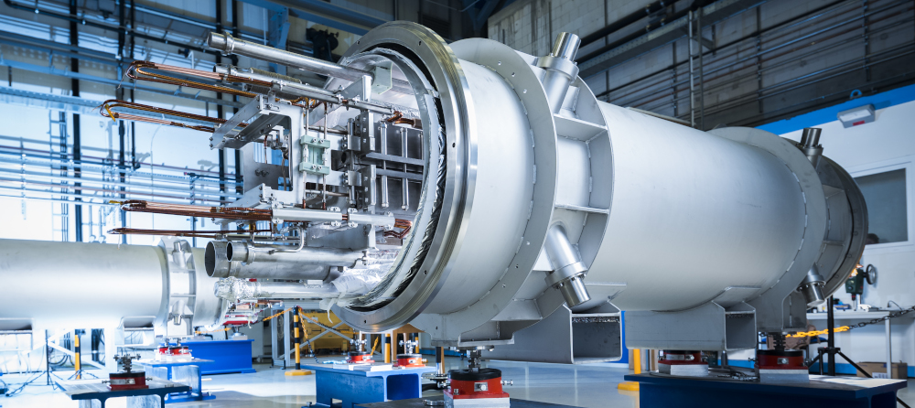
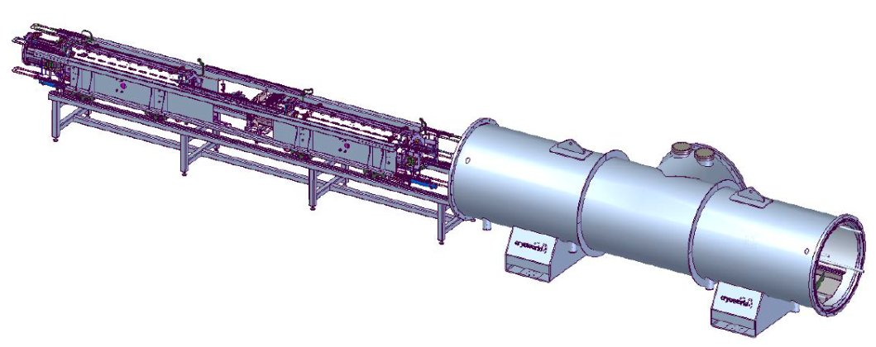
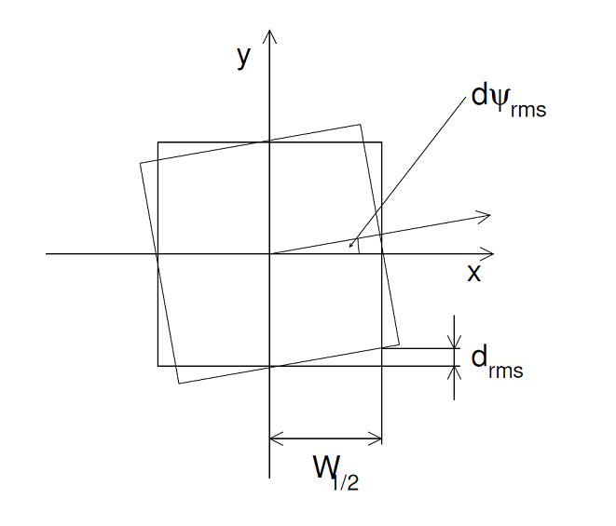
Magnet Imperfections: Alignment Errors
S. Sorge
Sources of alignment errors for SF magnets
Mismatch between geometric and magnetic axis
Tolerance for positioning magnet on girder
Tolerance for positioning girder in cryostat
Motion during cool-down
Alignment tolerance of cryostat
Conservative values in simulations
Lateral shifts of with σ = 1 mm
Roll estimated from mechanical tolerances

Slide 14
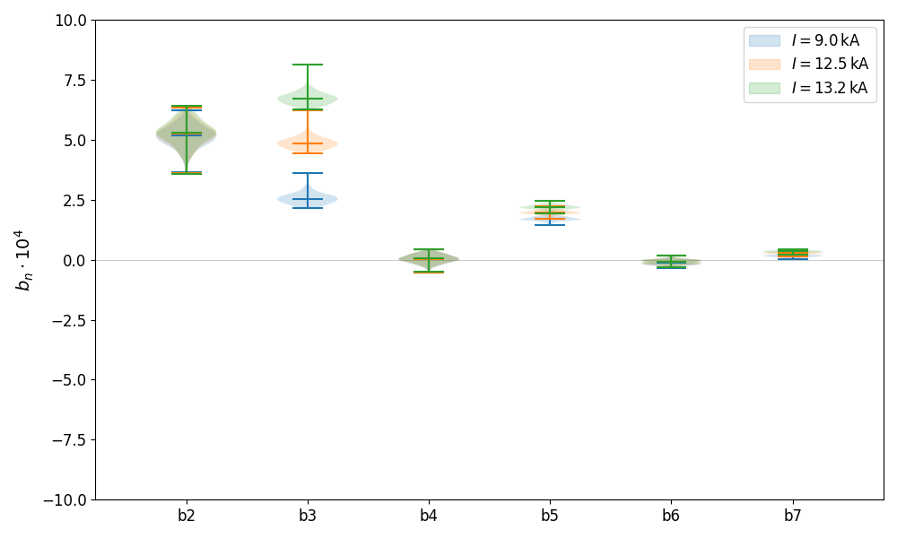
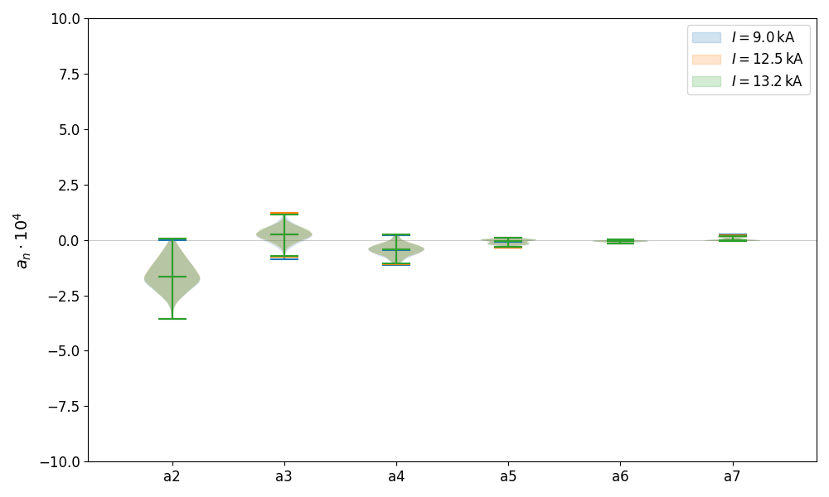
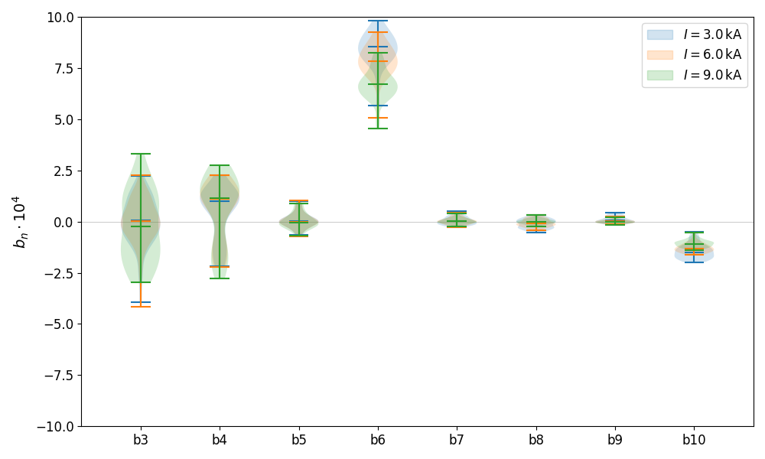
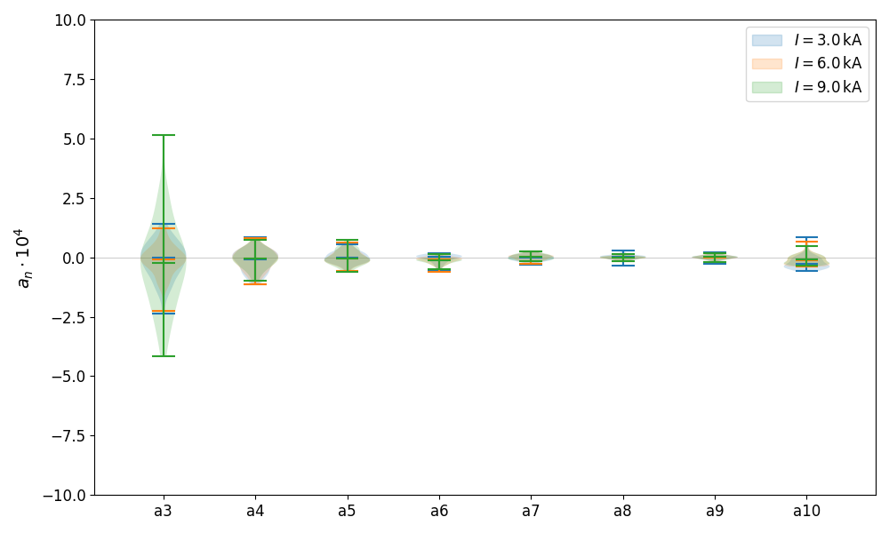
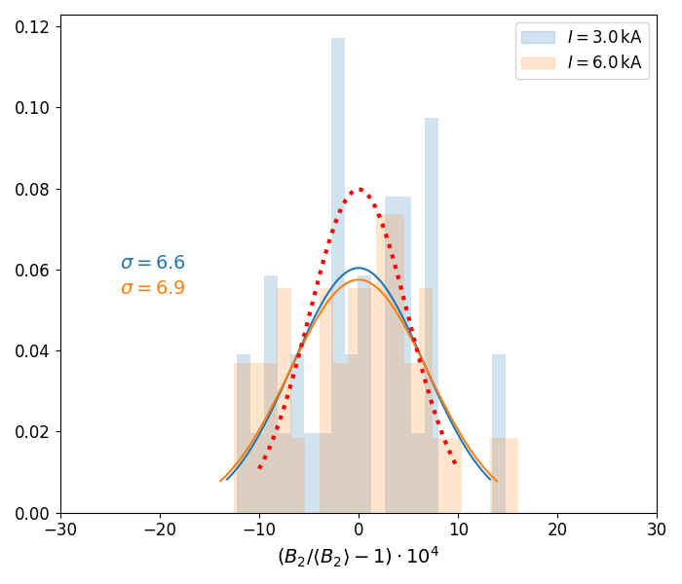
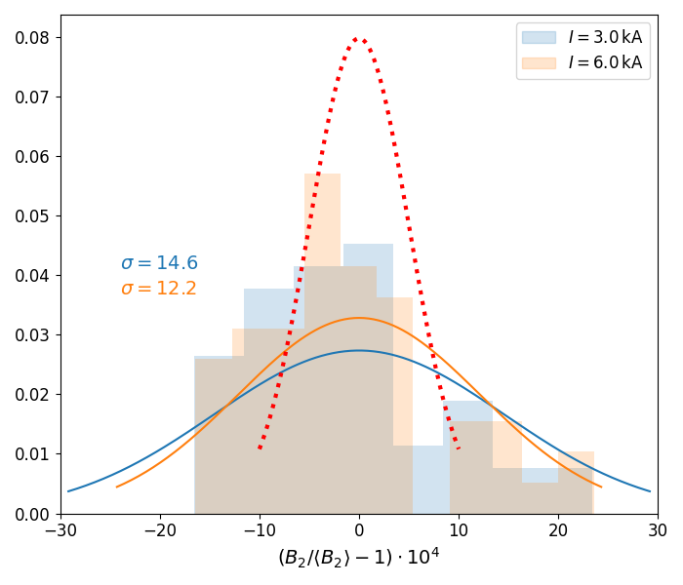
Magnet Imperfections: Model for Field Errors
S. Sorge
Measured multipole errors in dipoles
Dipoles
Systematic allowed components: b₃, b₅, b₇
Mean values of forbidden components discarded
b₂ artifact from measurement geometry
Random components: standard deviation used as σ
Integral field variation: σ_{mod} = 4∙10⁻³ > σ_{meas} = 3∙10⁻⁴
Kept for comparison with previous studies
Quadrupoles
Systematic allowed components: b₆, b₁₀
Mean values of forbidden components zero
Random components: standard deviation used as σ
Integral field variation: σ_{mod} = 5∙10⁻⁴ < σ_{meas} > 7∙10⁻⁴
Kept for comparison with previous studies
Calibration uncertainty for quadrupoles
Systematic offsets between magnetometers
Not fully removed by official cross-calibration
Factor 2 difference in expected beta beating
Measured multipole errors in quadrupoles
ΔB₂/B₂: magnetometer #2
ΔB₂/B₂: all magnetometers

Slide 15
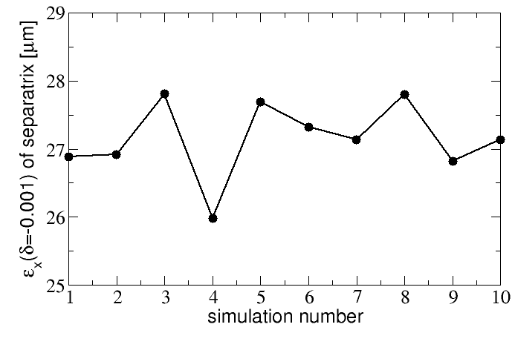
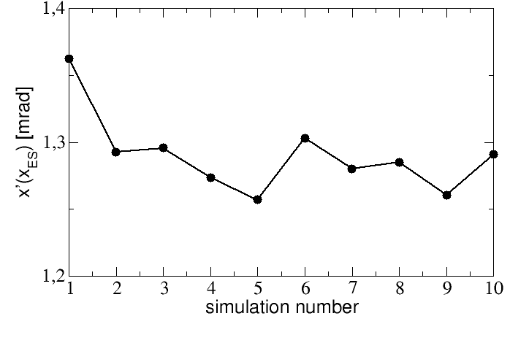
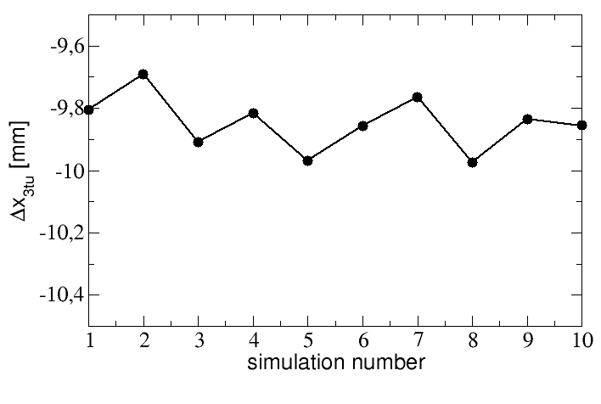
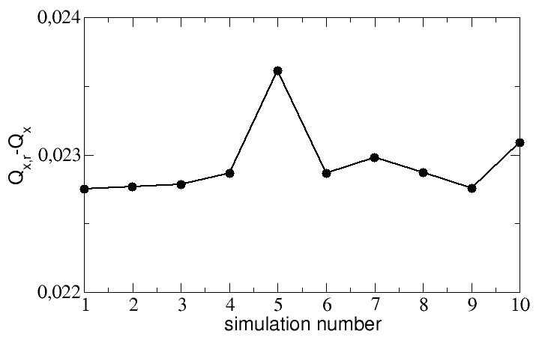
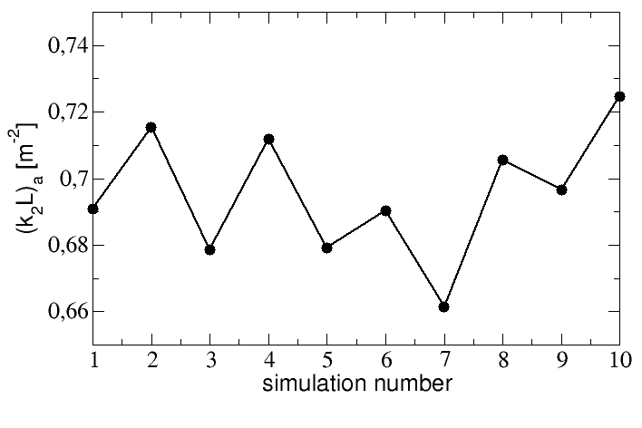
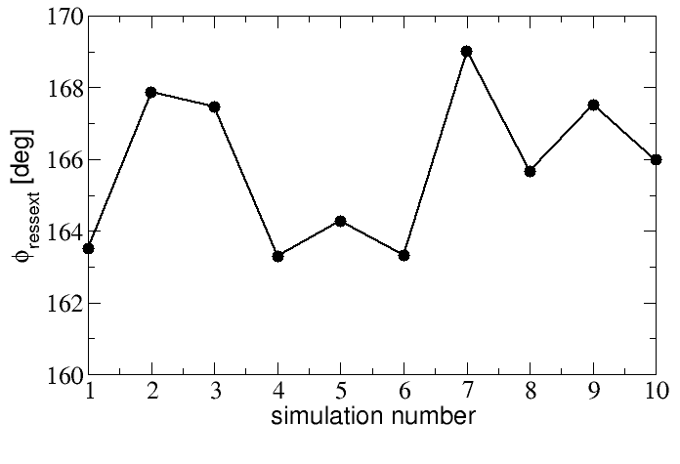
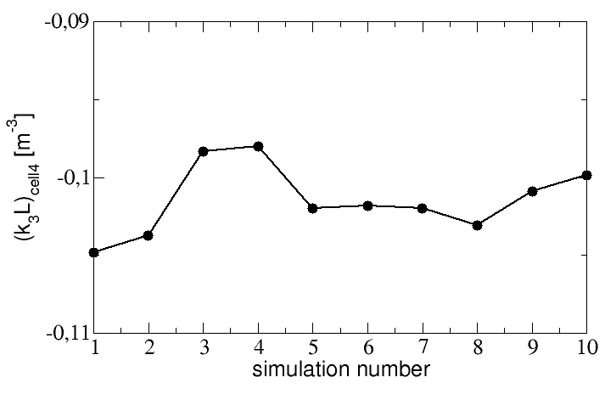
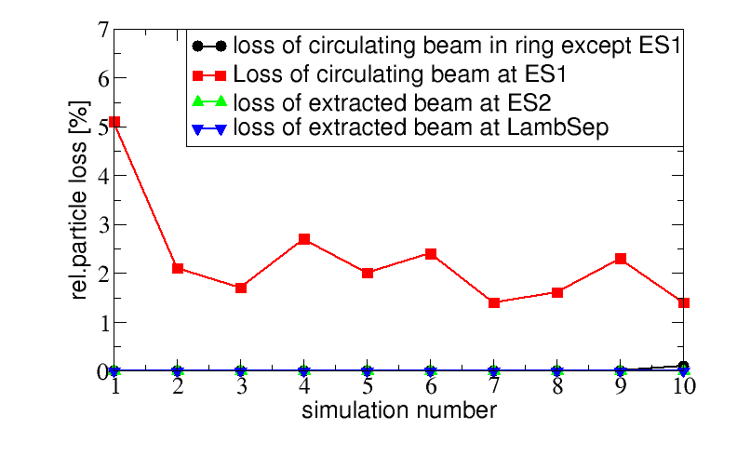
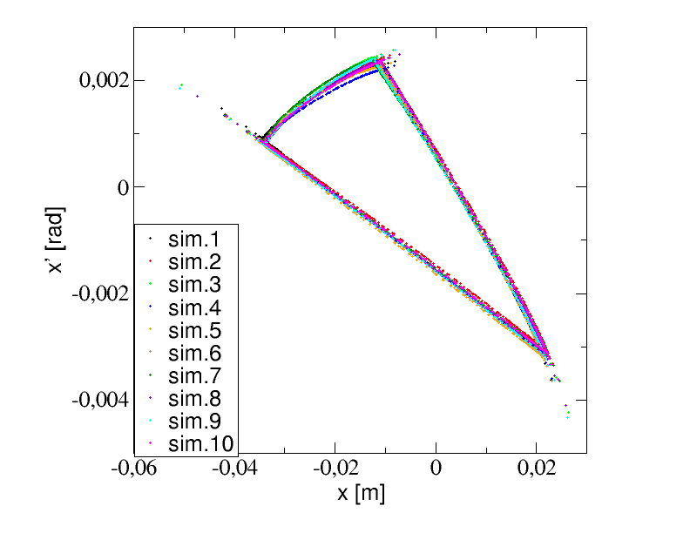
Random Error Studies: KO Extraction (U28+, 400 MeV/u)
S. Sorge
Separatrix size
Crossing angle
Spiral step
Target parameters
Separatrix size | 28 um
Spiral step | 10 mm
Crossing angle | 1.3 mrad
Tune distance
Sextupole amplitude
Sextupole phase
Octupole strength
Performance (errors / ideal)
Total losses | 2.3% / 2.2%
Losses 1st wire | 1.5% / 1.5%

Slide 16
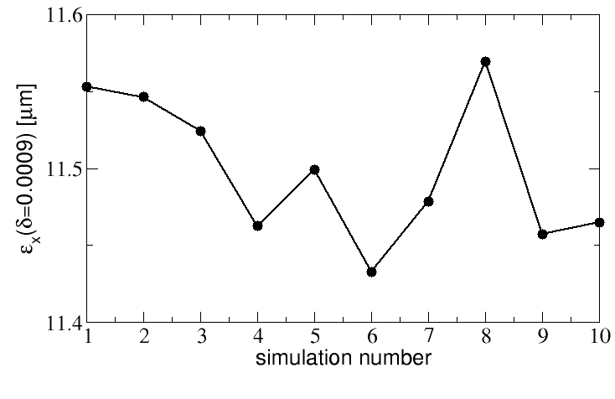
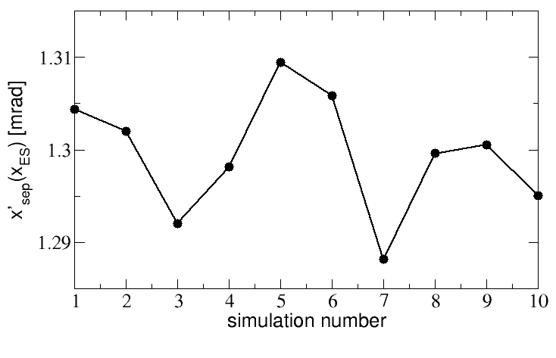
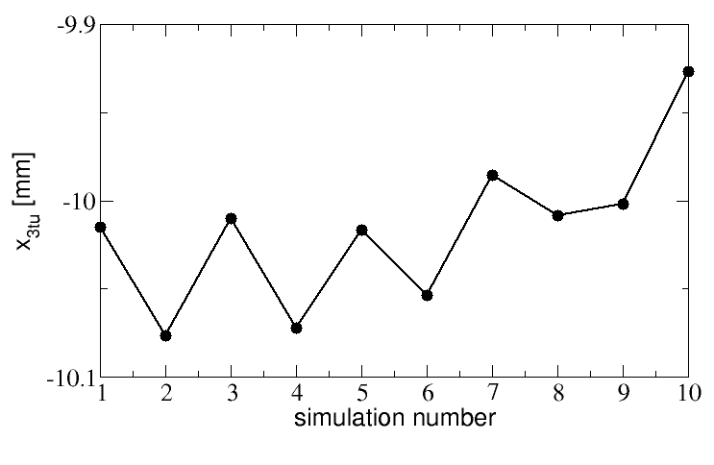
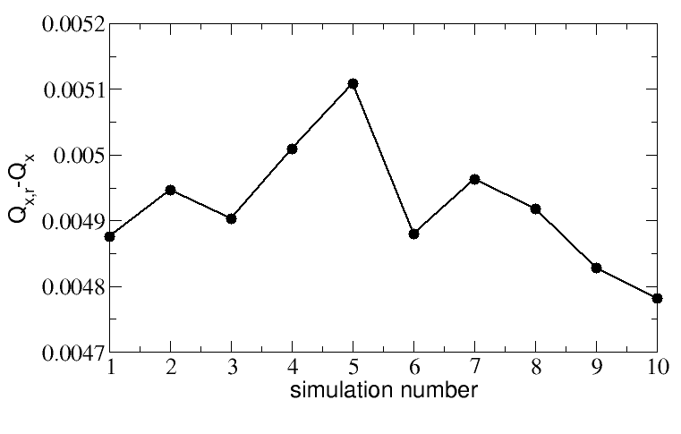
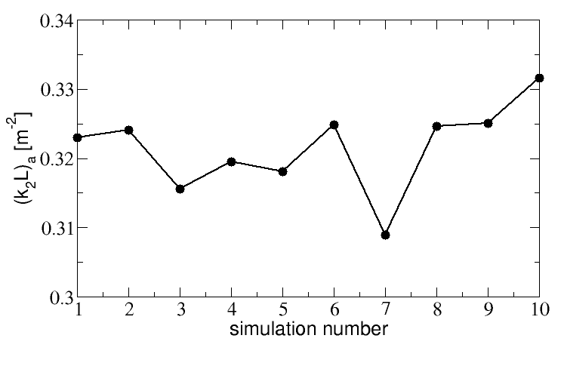




Random Error Studies: COSE (U28+, 1.5 GeV/u)
S. Sorge
Separatrix size
Crossing angle
Spiral step
Target parameters
Separatrix size | 11.5 um
Spiral step | 10 mm
Crossing angle | 1.3 mrad
Tune distance
Sextupole amplitude
Sextupole phase
Octupole strength
Performance (errors / ideal)
Total losses | 3.9% / 2.1%
Losses 1st wire | 1.3% / 1.5%
artefact from matching issues

Slide 17



Next Steps
Continuation of error studies
Schemes with b₅ compensation
Pessimistic quadrupole roll and field variation
More statistics (larger number of seeds)
Studies for commissioning and operation
Commissioning strategy
Robust settings for design schemes
Step-wise approach starting with simpler schemes
Models for tuning of SX in operation
ML for coupled, non-linear multi-parameter space
Optimizers for fast tuning
Moving to Xsuite for faster tracking
On GPU farm: 0.1Mpart * 0.6Mturns in few hours
First runs (U²⁸⁺, 1.5 GeV/u) by Ph. Niedermayer
Benchmarked with Elegant for ideal machine
Phase space plots from Xsuite…
Courtesy Ph. Niedermayer
… and Elegant

Slide 18
Summary
SX from SIS100 affected by systematic b₅ and b₆ errors from main magnets
Multipole corrector family modified to include b₅ corrector
SX design adapted to account for b₅ and b₆
KO SX and COSE work without b₅ corrector
Tune-sweep SX requires b₅ corrector, COSE and KO may profit from it
Random error studies with MAD-X indicate robustness
Optimizer used to determine settings based on single-particle tracking
Some error estimates may be on the optimistic side, to be redone
Further studies will be based on Xsuite for faster tracking times
Allows increased statistics and optimization using multi-particle simulations
Special thanks for their invaluable contributions go to: B. Galnander , Ph. Niedermayer, S. Sorge, and K. Sugita

Slide 19
Thanks for your attention!
Impressions from the ongoing installation of SIS100
More info and media: https://www.gsi.de/en/researchaccelerators/fair/fair_civil_construction
Drone video of construction site: https://www.youtube.com/watch?v=tKuXUgJyirQ

Slide 20





Reminder: SX schemes
Control of separatrix parameters required
Size and orientation (crossing angle)
Spiral step and pitch
Fixing chromaticity, parameters depend on
Machine tune Q_{x,0}
Momentum deviation δ
Comparison of SX schemes
Quad-driven SX
2D dependence on Q_{x,0}(t) and δ
Parameters must be matched for each Q_{x,0} and δ
Transverse knock-out SX
Fixed Q_{x,0}, matching for δ only
Ideally small difference in separatrix sizes
Momentum-driven SX
Fixed Q_{x,0}, matching for δ only
Separatrix sizes must vary down to zero
$$δ$$
Tune-sweep SX
$$∆Q_{x}\sim \sqrt{ε_{x}}$$
$$∆Q_{x,0}(t)$$
$$δ$$
KO SX
hor. excitation
$$∆Q_{x}\sim \sqrt{ε_{x}}$$
$$∆Q_{x,0}$$
$$δ$$
Momentum-driven SX
For SIS100, KO and δ-driven SX are the only reasonable choices due to strong δ-dependence of separatrix parameters
$$∆Q_{x}\sim \sqrt{ε_{x}}$$
δ-change
$$∆Q_{x,0}$$

