Slide 1



Investigations into Multi-Energy Extraction at MedAustron
Katrin Holzfeind, Elisabeth Renner (TU Wien)
Fabien Plassard, Markus Wolf (MedAustron)

Slide 2
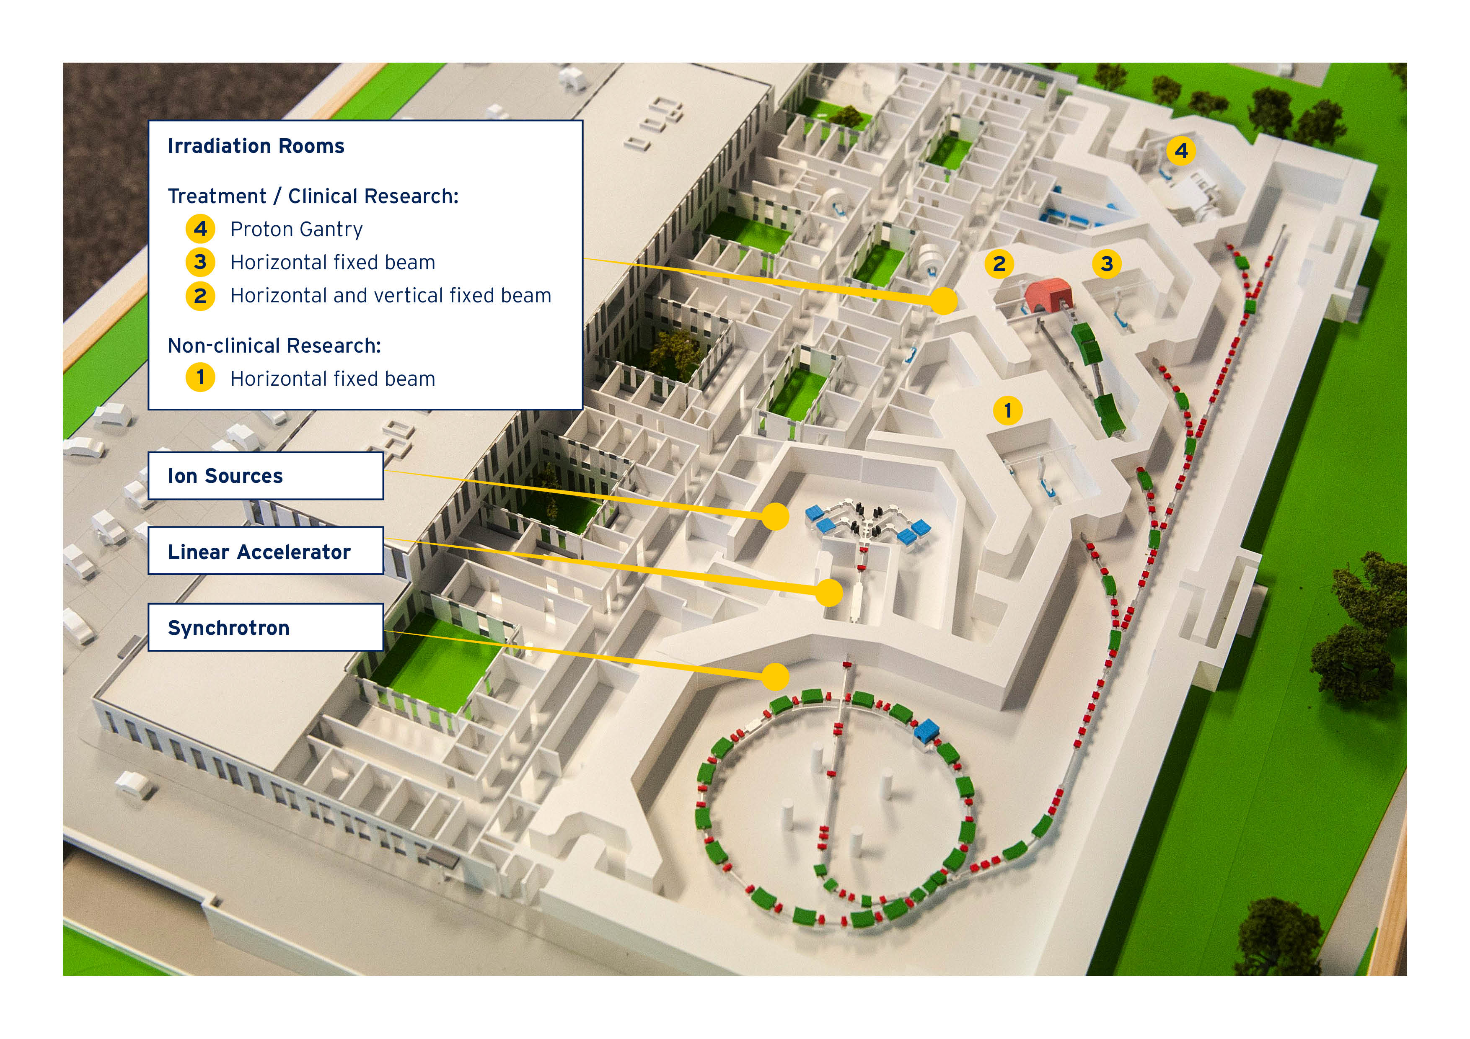
MedAustron
Located in Wiener Neustadt, Austria
Based on PIMMS [1] study
Synchrotron/ main ring
Clinical treatment
Proton: 62 –252 MeV
Carbon: 120 – 402 MeV/u
© MedAustron

Slide 3
MedAustron
Located in Wiener Neustadt, Austria
Based on PIMMS [1] study
Synchrotron/ main ring
Clinical treatment
Proton: 62 –252 MeV
Carbon: 120 – 402 MeV/u
Non-clinical research in first irradiation room (IR)
Low flux
Helium
800 MeV p+
Different research fields!
TU Wien Technical University Vienna
© MedAustron

Slide 4
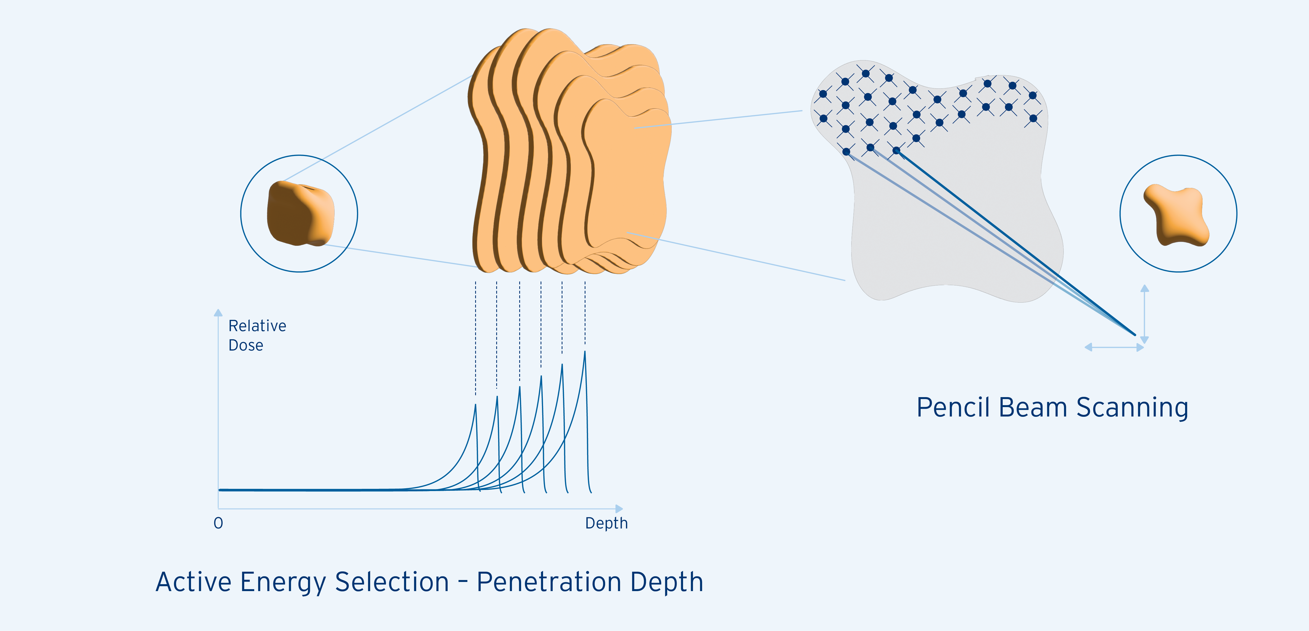
Multi-Energy-Extraction (MEE)
Motivation
Ion beam therapy: Bragg-peak is used to irradiate cancerous tissue layer by layer [1]
Depth of Bragg-peak depends on energy of ions
Currently: Single energy extraction
Duration of treatment can be reduced significantly
Efficiency of machine can be improved
© MedAustron

Slide 5
Multi-Energy-Extraction (MEE)
Motivation
Ion beam therapy: Bragg-peak is used to irradiate cancerous tissue layer by layer [1]
Depth of Bragg-peak depends on energy of ions
Currently: Single energy extraction
Duration of treatment can be reduced significantly
Efficiency of machine can be improved
Study goals
Bunched RFKO
Beam dynamics during energy changes and effects on the spill
Identify performance constraints
This presentation: establishing and benchmarking of setup
© MedAustron

Slide 6
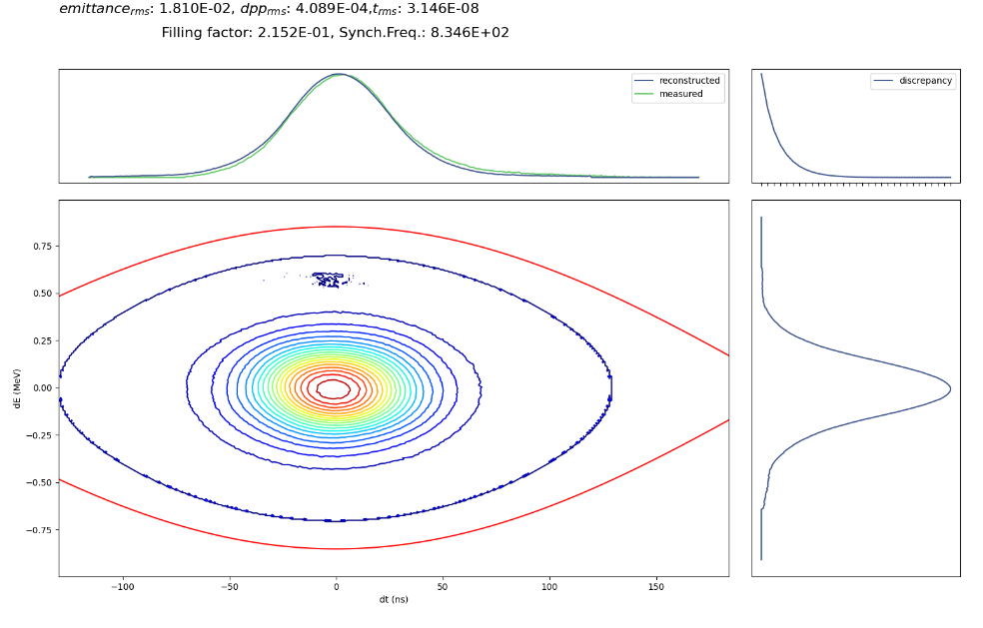
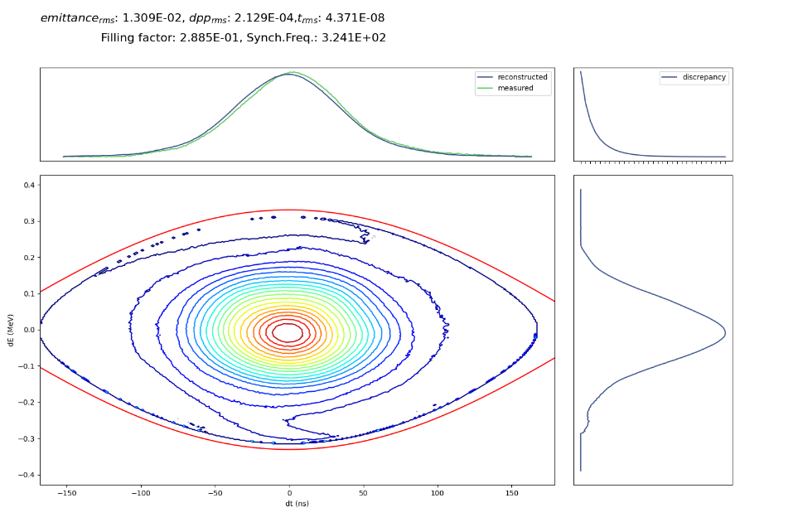
Previous Studies at MedAustron
930 V
Summary of studies done by Florian Kühteubl [2], Dale Prokopovich and Fabien Plassard [3]
MEE test with COSE
10 energy steps of 1 MeV [4]
RFKO
Optic settings with similar spill characteristics as betatron driven extraction for clinical use [4]
Loss mitigation studies for bunched RFKO
Reduce bucket height
Increase tune-distance by using radial loop offset
140 V

Slide 7
Developments for RFKO MEE
Newly implemented MEE
Custom waveform for power converters of all main ring magnets and the RF cavity
Enables up- and downwards operation for arbitrary energy steps

Slide 8
Developments for RFKO MEE
Newly implemented MEE
Custom waveform for power converters of all main ring magnets and the RF cavity
Enables up- and downwards operation for arbitrary energy steps
New RFKO setup: µTCA-crate
Combination of different signals, amplitude modulation and triggering are possible [5]
First benchmark measurements
Binary phase shift keying with same band width but appropriate central frequency applied for extraction

Slide 9
Developments for RFKO MEE
Newly implemented MEE
Custom waveform for power converters of all main ring magnets and the RF cavity
Enables up- and downwards operation for arbitrary energy steps
New RFKO setup: µTCA-crate
Combination of different signals, amplitude modulation and triggering are possible [5]
First benchmark measurements
Binary phase shift keying with same band width but appropriate central frequency applied for extraction
Implications of setup
All main ring magnets are current regulated
Possible mismatches in energy

Slide 10
Developments for RFKO MEE
Newly implemented MEE
Custom waveform for power converters of all main ring magnets and the RF cavity
Enables up- and downwards operation for arbitrary energy steps
New RFKO setup: µTCA-crate
Combination of different signals, amplitude modulation and triggering are possible [5]
First benchmark measurements
Binary phase shift keying with same band width but appropriate central frequency applied for extraction
Implications of setup
All main ring magnets are current regulated
Possible mismatches in energy → B-field regulation in near future [6]

Slide 11
Developments for RFKO MEE
Newly implemented MEE
Custom waveform for power converters of all main ring magnets and the RF cavity
Enables up- and downwards operation for arbitrary energy steps
New RFKO setup: µTCA-crate
Combination of different signals, amplitude modulation and triggering are possible [5]
First benchmark measurements
Binary phase shift keying with same band width but appropriate central frequency applied for extraction
Implications of setup
All main ring magnets are current regulated
Possible mismatches in energy → B-field regulation in near future [6]

Slide 12
Developments for RFKO MEE
Newly implemented MEE
Custom waveform for power converters of all main ring magnets and the RF cavity
Enables up- and downwards operation for arbitrary energy steps
New RFKO setup: µTCA-crate
Combination of different signals, amplitude modulation and triggering are possible [5]
First benchmark measurements
Binary phase shift keying with same band width but appropriate central frequency applied for extraction
Implications of setup
All main ring magnets are current regulated
Possible mismatches in energy → B-field regulation in near future [6]
Quadrupoles, sextupoles and correctors → offsets in tune, chromaticity and momentum offset possible
Hysteresis effects

Slide 13
Developments for RFKO MEE
Implications of setup
All main ring magnets are current regulated
Possible mismatches in energy → B-field regulation in near future
Quadrupoles, sextupoles and correctors → offsets in tune, chromaticity and momentum offset possible
Hysteresis effects
Open questions
Speed limitations
Ramping of dipoles: definition of waveform (steps, round off)
Repeated ramping of sextupole necessary?
Sensitivity to mismatches
Caused by hystersis effects?
Suitable RFKO excitation

Slide 14
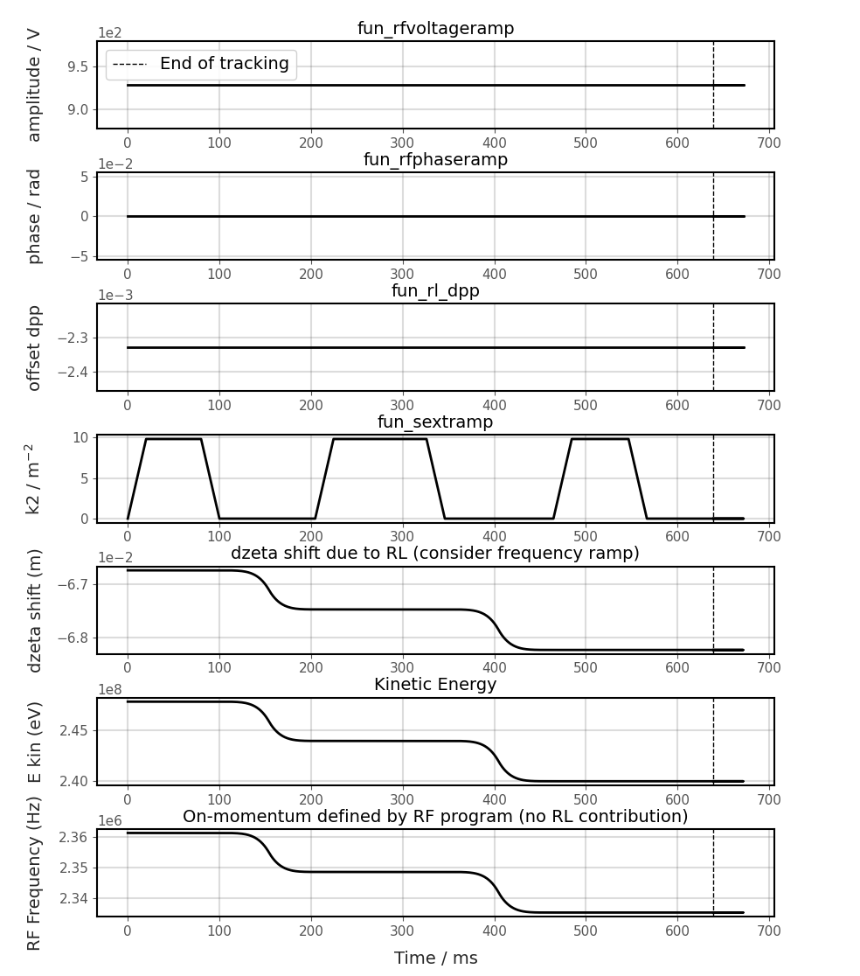
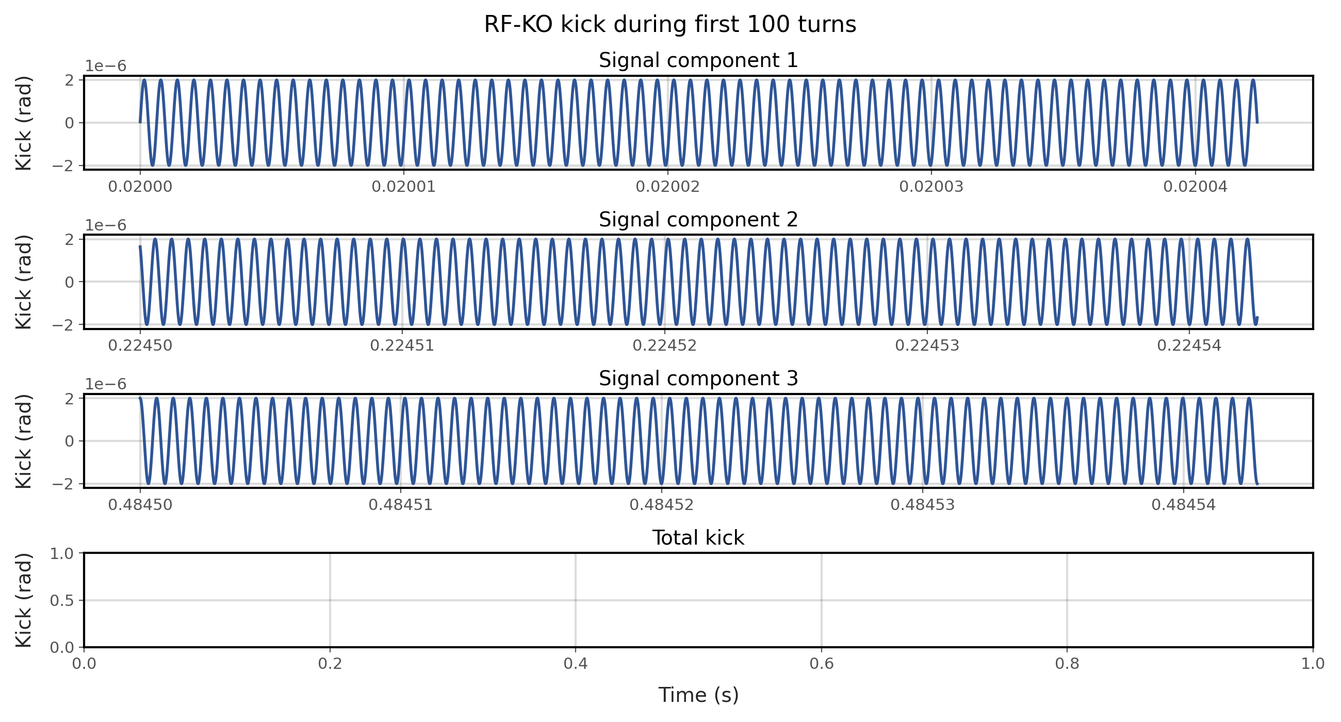
Xsuite Simulations
Time dependent 6D particle tracking [7]
Beneficial for our studies
MEE: ramping of elements
RFKO: fast-changing exciter element
Special characteristics in PIMMS
Radial regulation loop for off-momentum operation
ZetaShift shifts particles i.r.t. synchronous particle

Slide 15
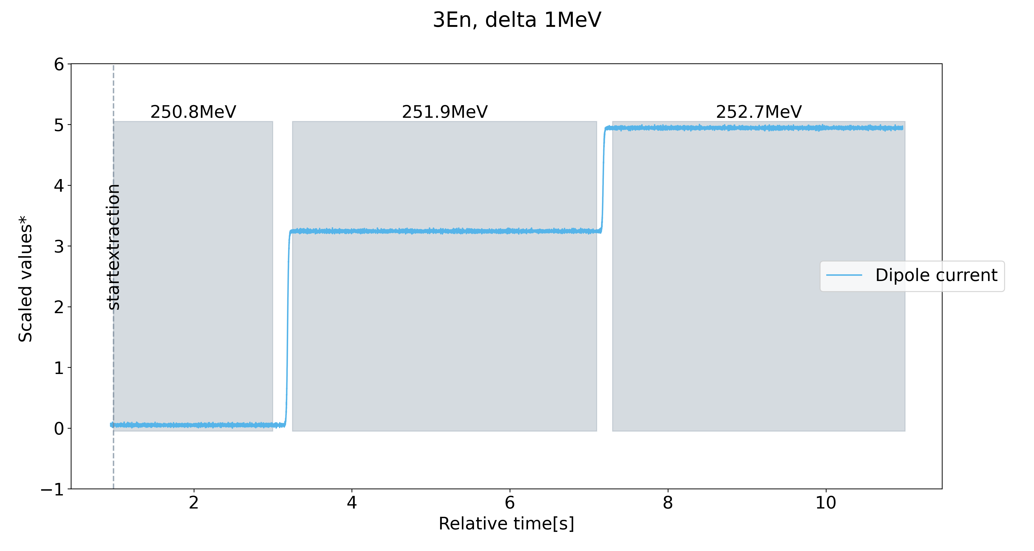
System Implementation Tests: ΔE = 1 MeV
1 MeV ≈ 1 mm depth difference
* Adjusted values to visualize behavior over time.

Slide 16
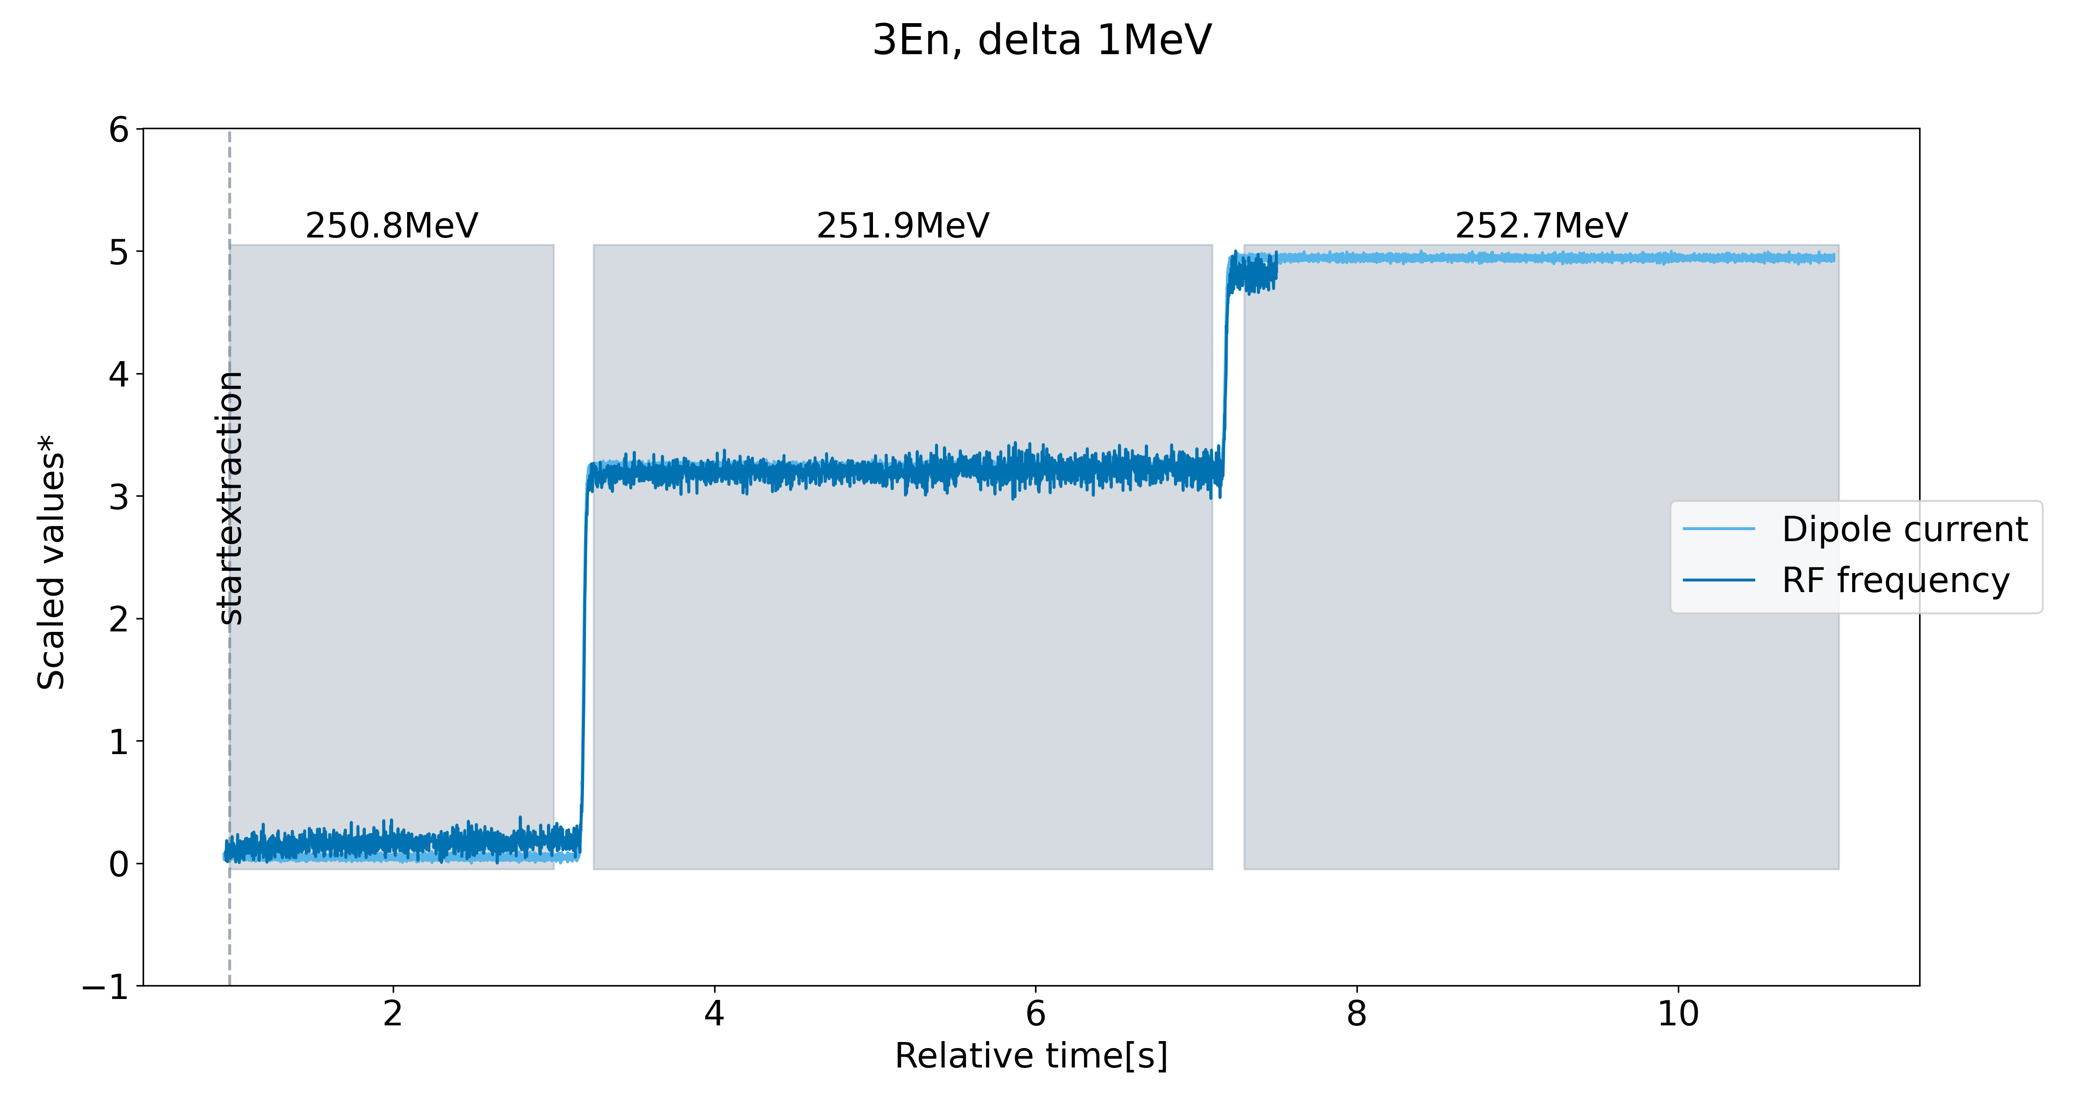
System Implementation Tests: ΔE = 1 MeV
RF frequency follows current of main dipoles
* Adjusted values to visualize behavior over time.

Slide 17
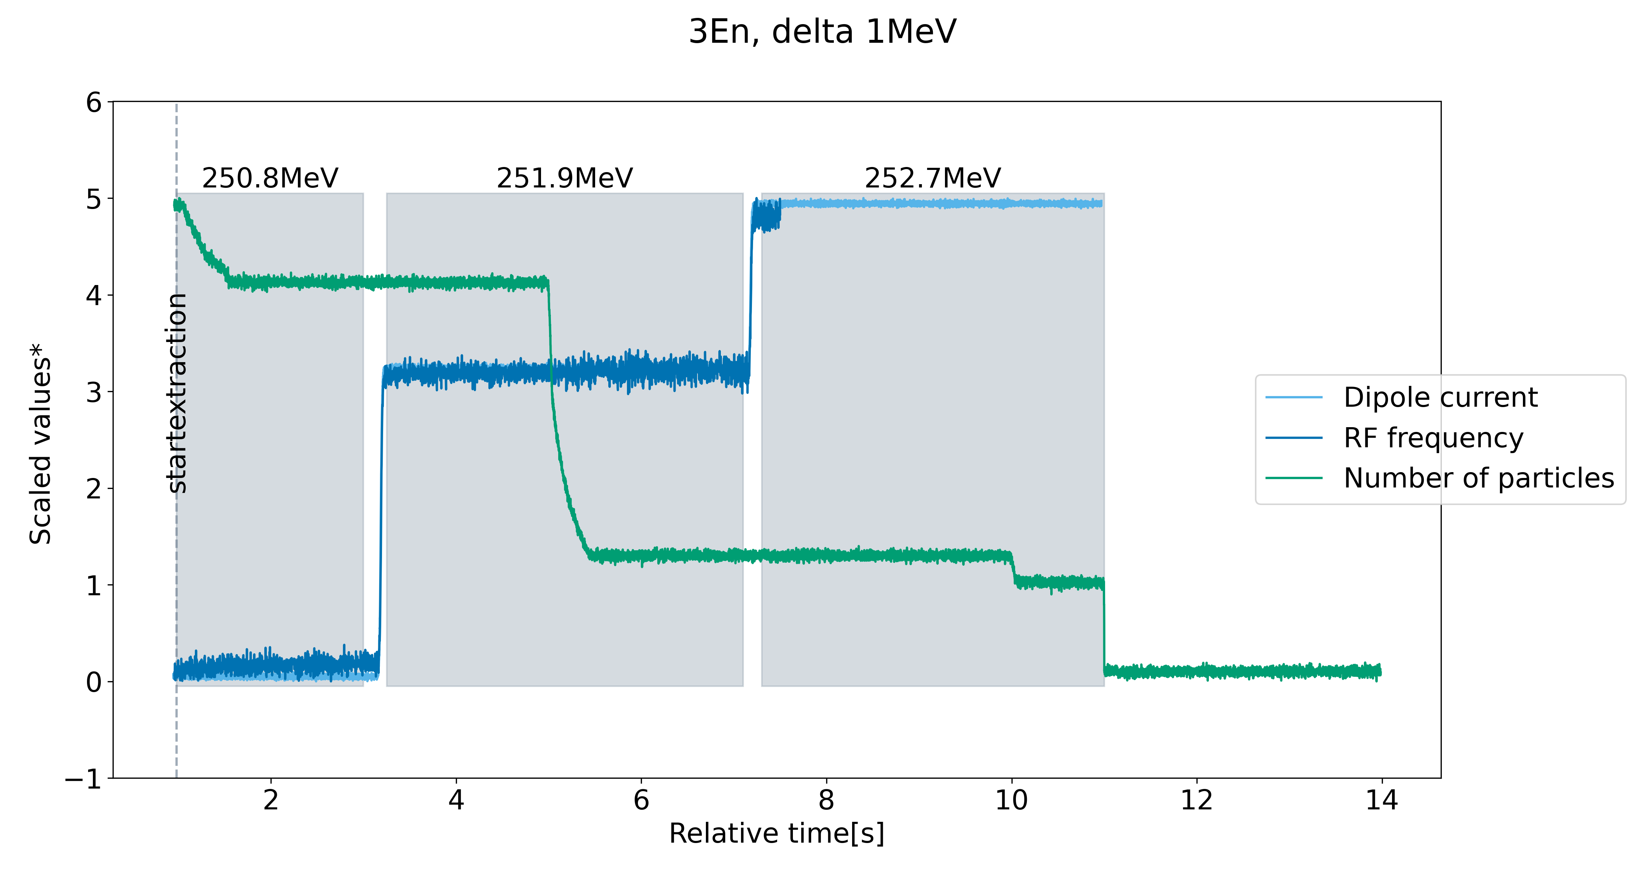
System Implementation Tests: ΔE = 1 MeV
No losses during energy change
* Adjusted values to visualize behavior over time.

Slide 18
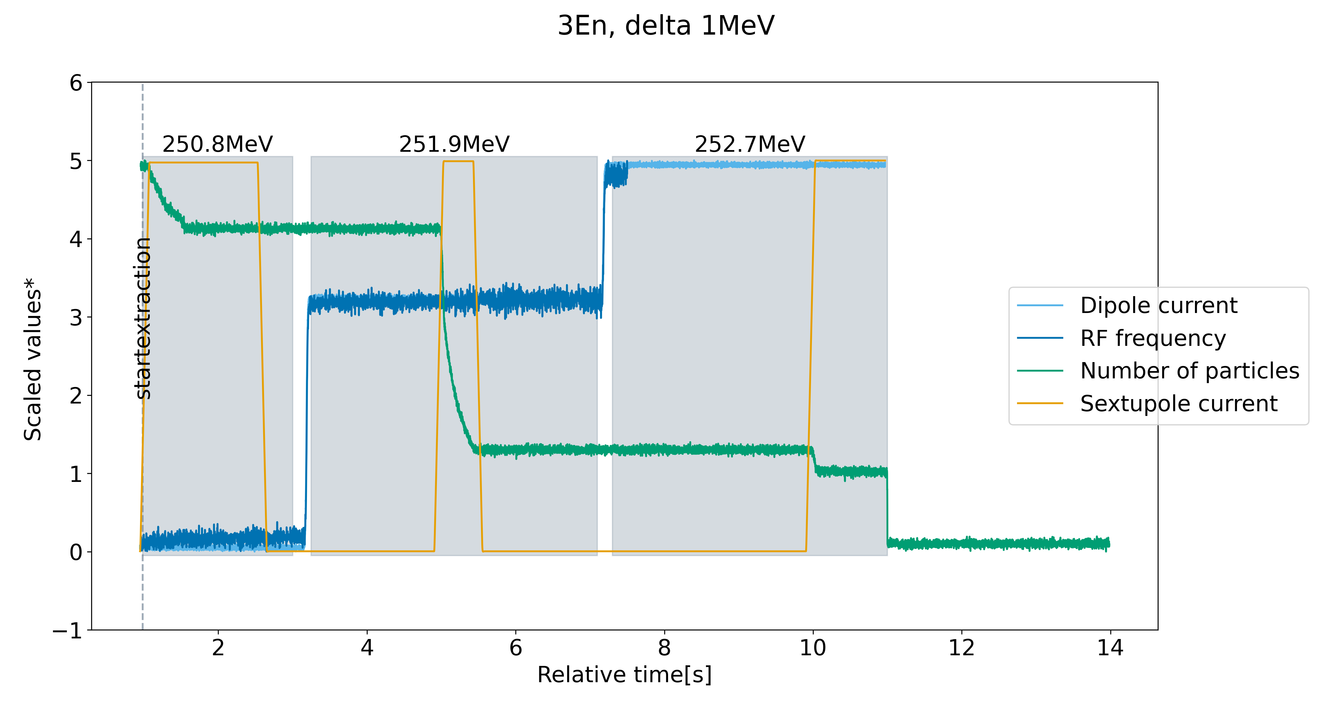
System Implementation Tests: ΔE = 1 MeV
Ramp of resonant sextupole and gated application of RFKO signal
RFKO signal on
RFKO signal off
* Adjusted values to visualize behavior over time.

Slide 19
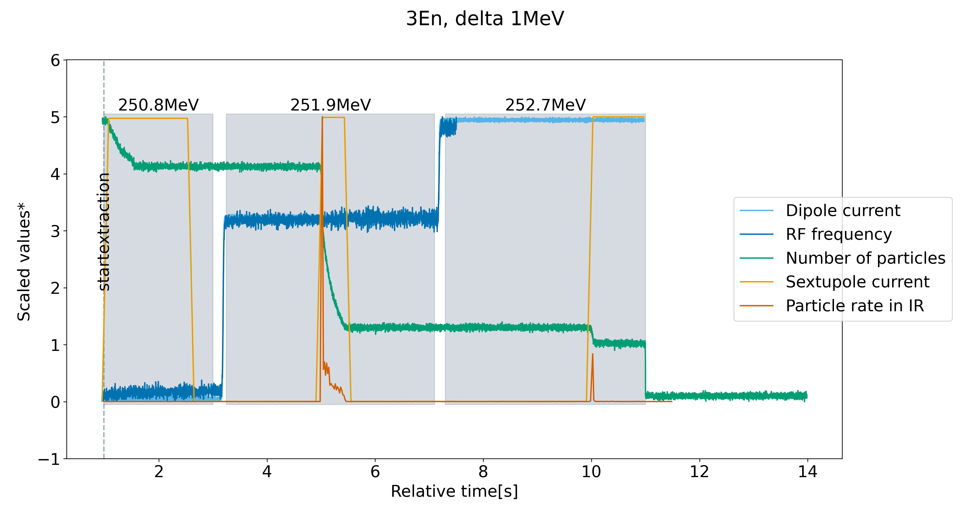
System Implementation Tests: ΔE = 1 MeV
Transfer line to irradiation room (IR) configured for second energy
RFKO signal on
RFKO signal off
* Adjusted values to visualize behavior over time.

Slide 20
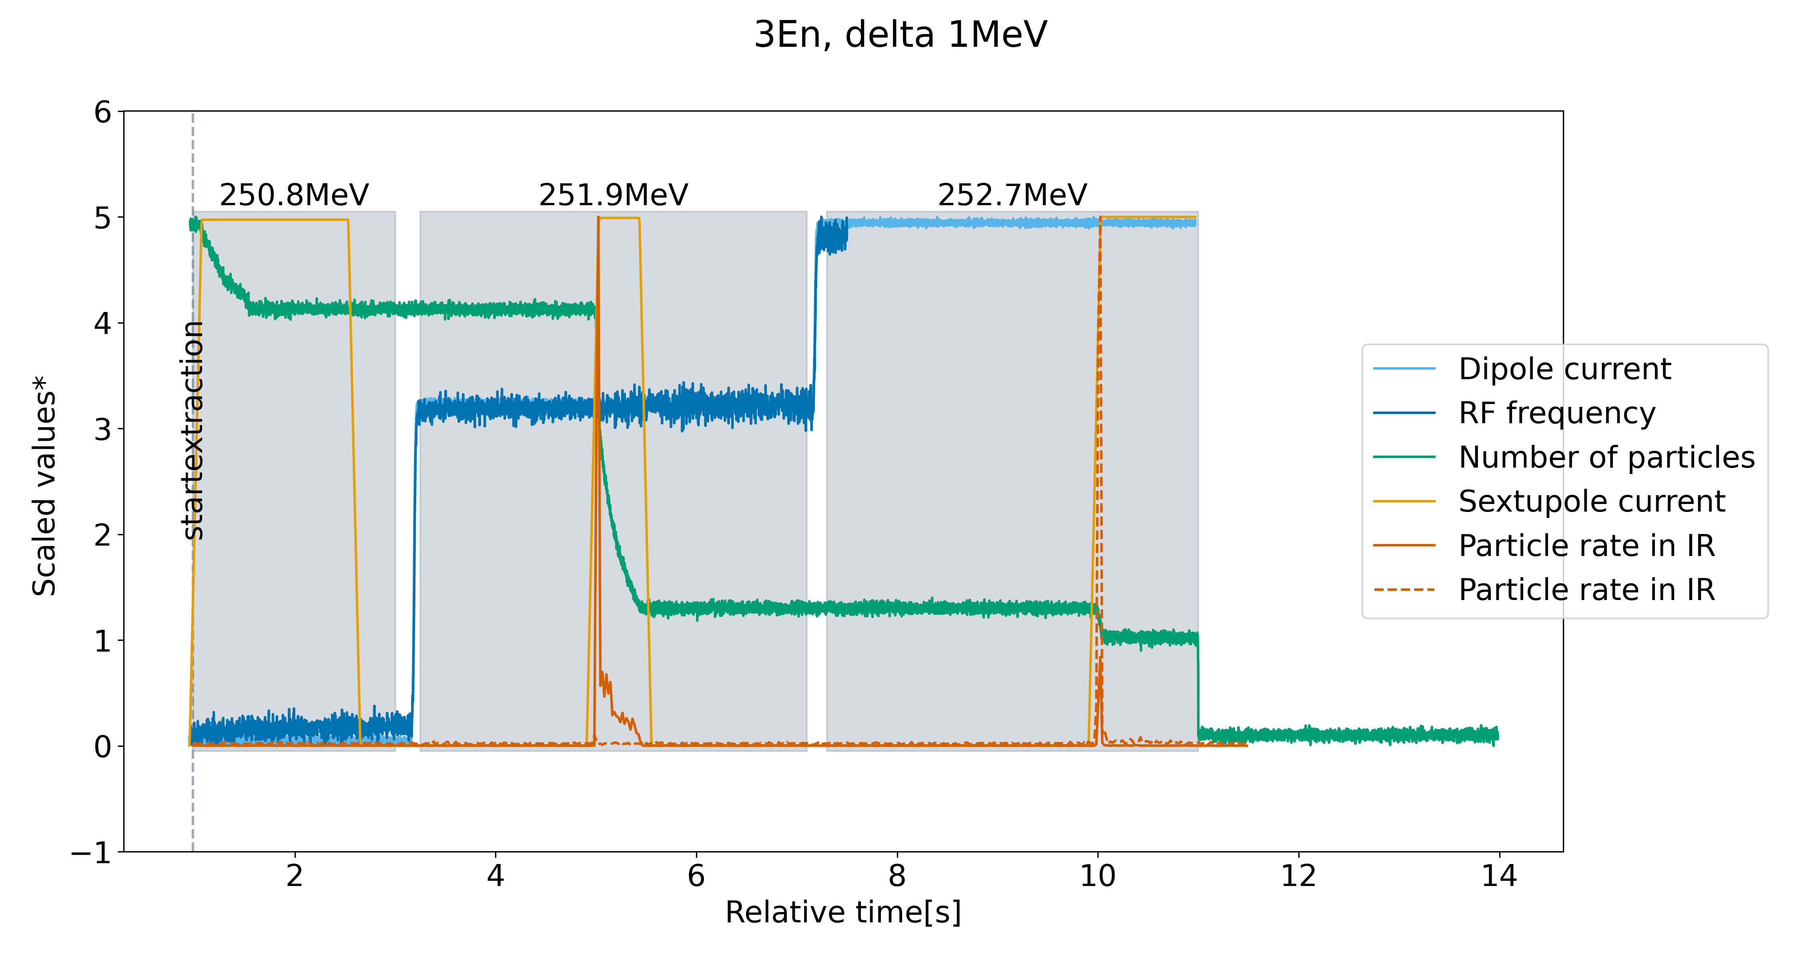
System Implementation Tests: ΔE = 1 MeV
Transfer line configured for third energy
RFKO signal on
RFKO signal off
* Adjusted values to visualize behavior over time.

Slide 21
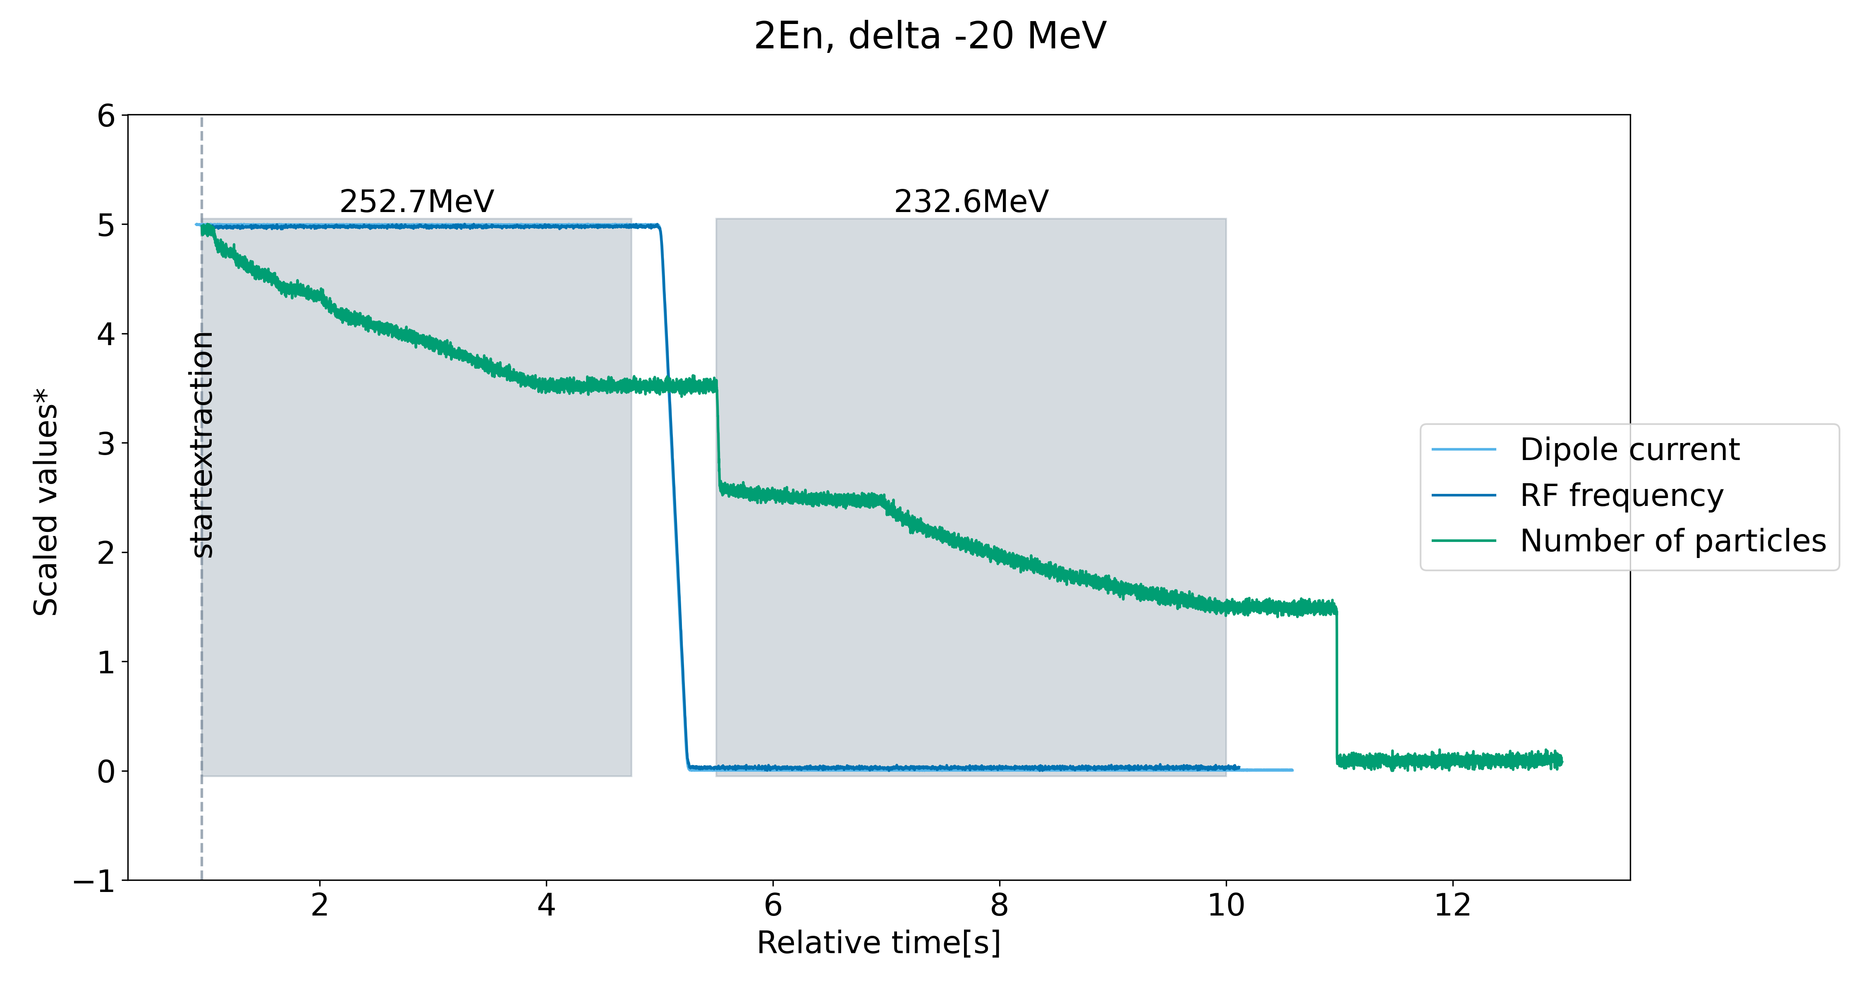
System Implementation Tests: ΔE = −20 MeV
Slow ramp (200 A/s) of main ring dipoles with low RF voltage
RFKO signal on
RFKO signal off
* Adjusted values to visualize behavior over time.

Slide 22
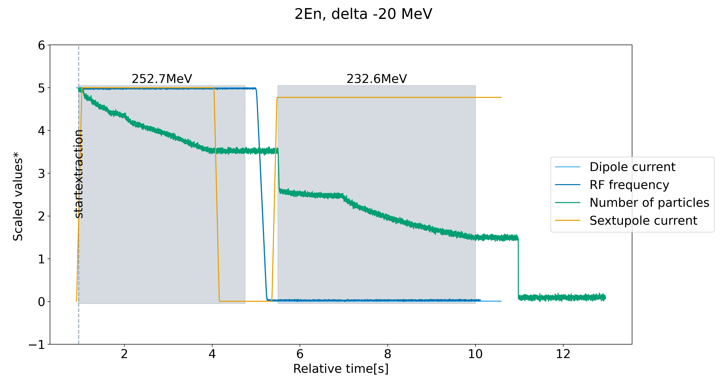
System Implementation Tests: ΔE = −20 MeV
Losses as sextupole ramps up
RFKO signal on
RFKO signal off
* Adjusted values to visualize behavior over time.

Slide 23
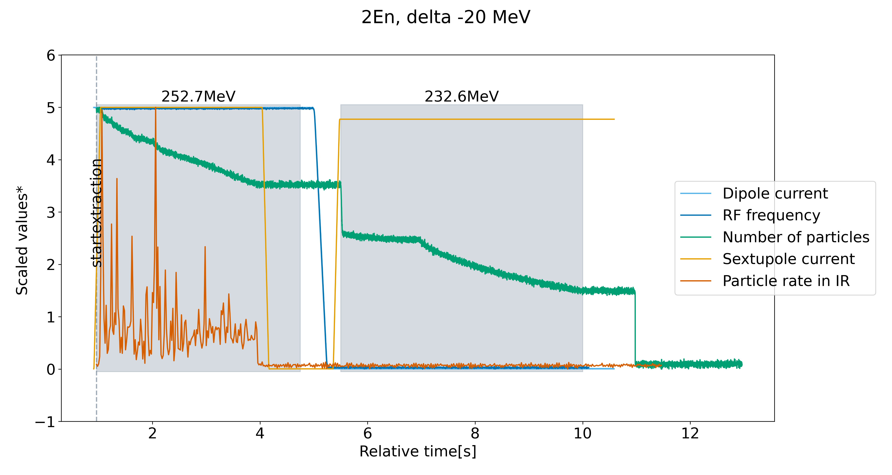
System Implementation Tests: ΔE = −20 MeV
Transfer line configured to first energy
RFKO signal on
RFKO signal off
* Adjusted values to visualize behavior over time.

Slide 24
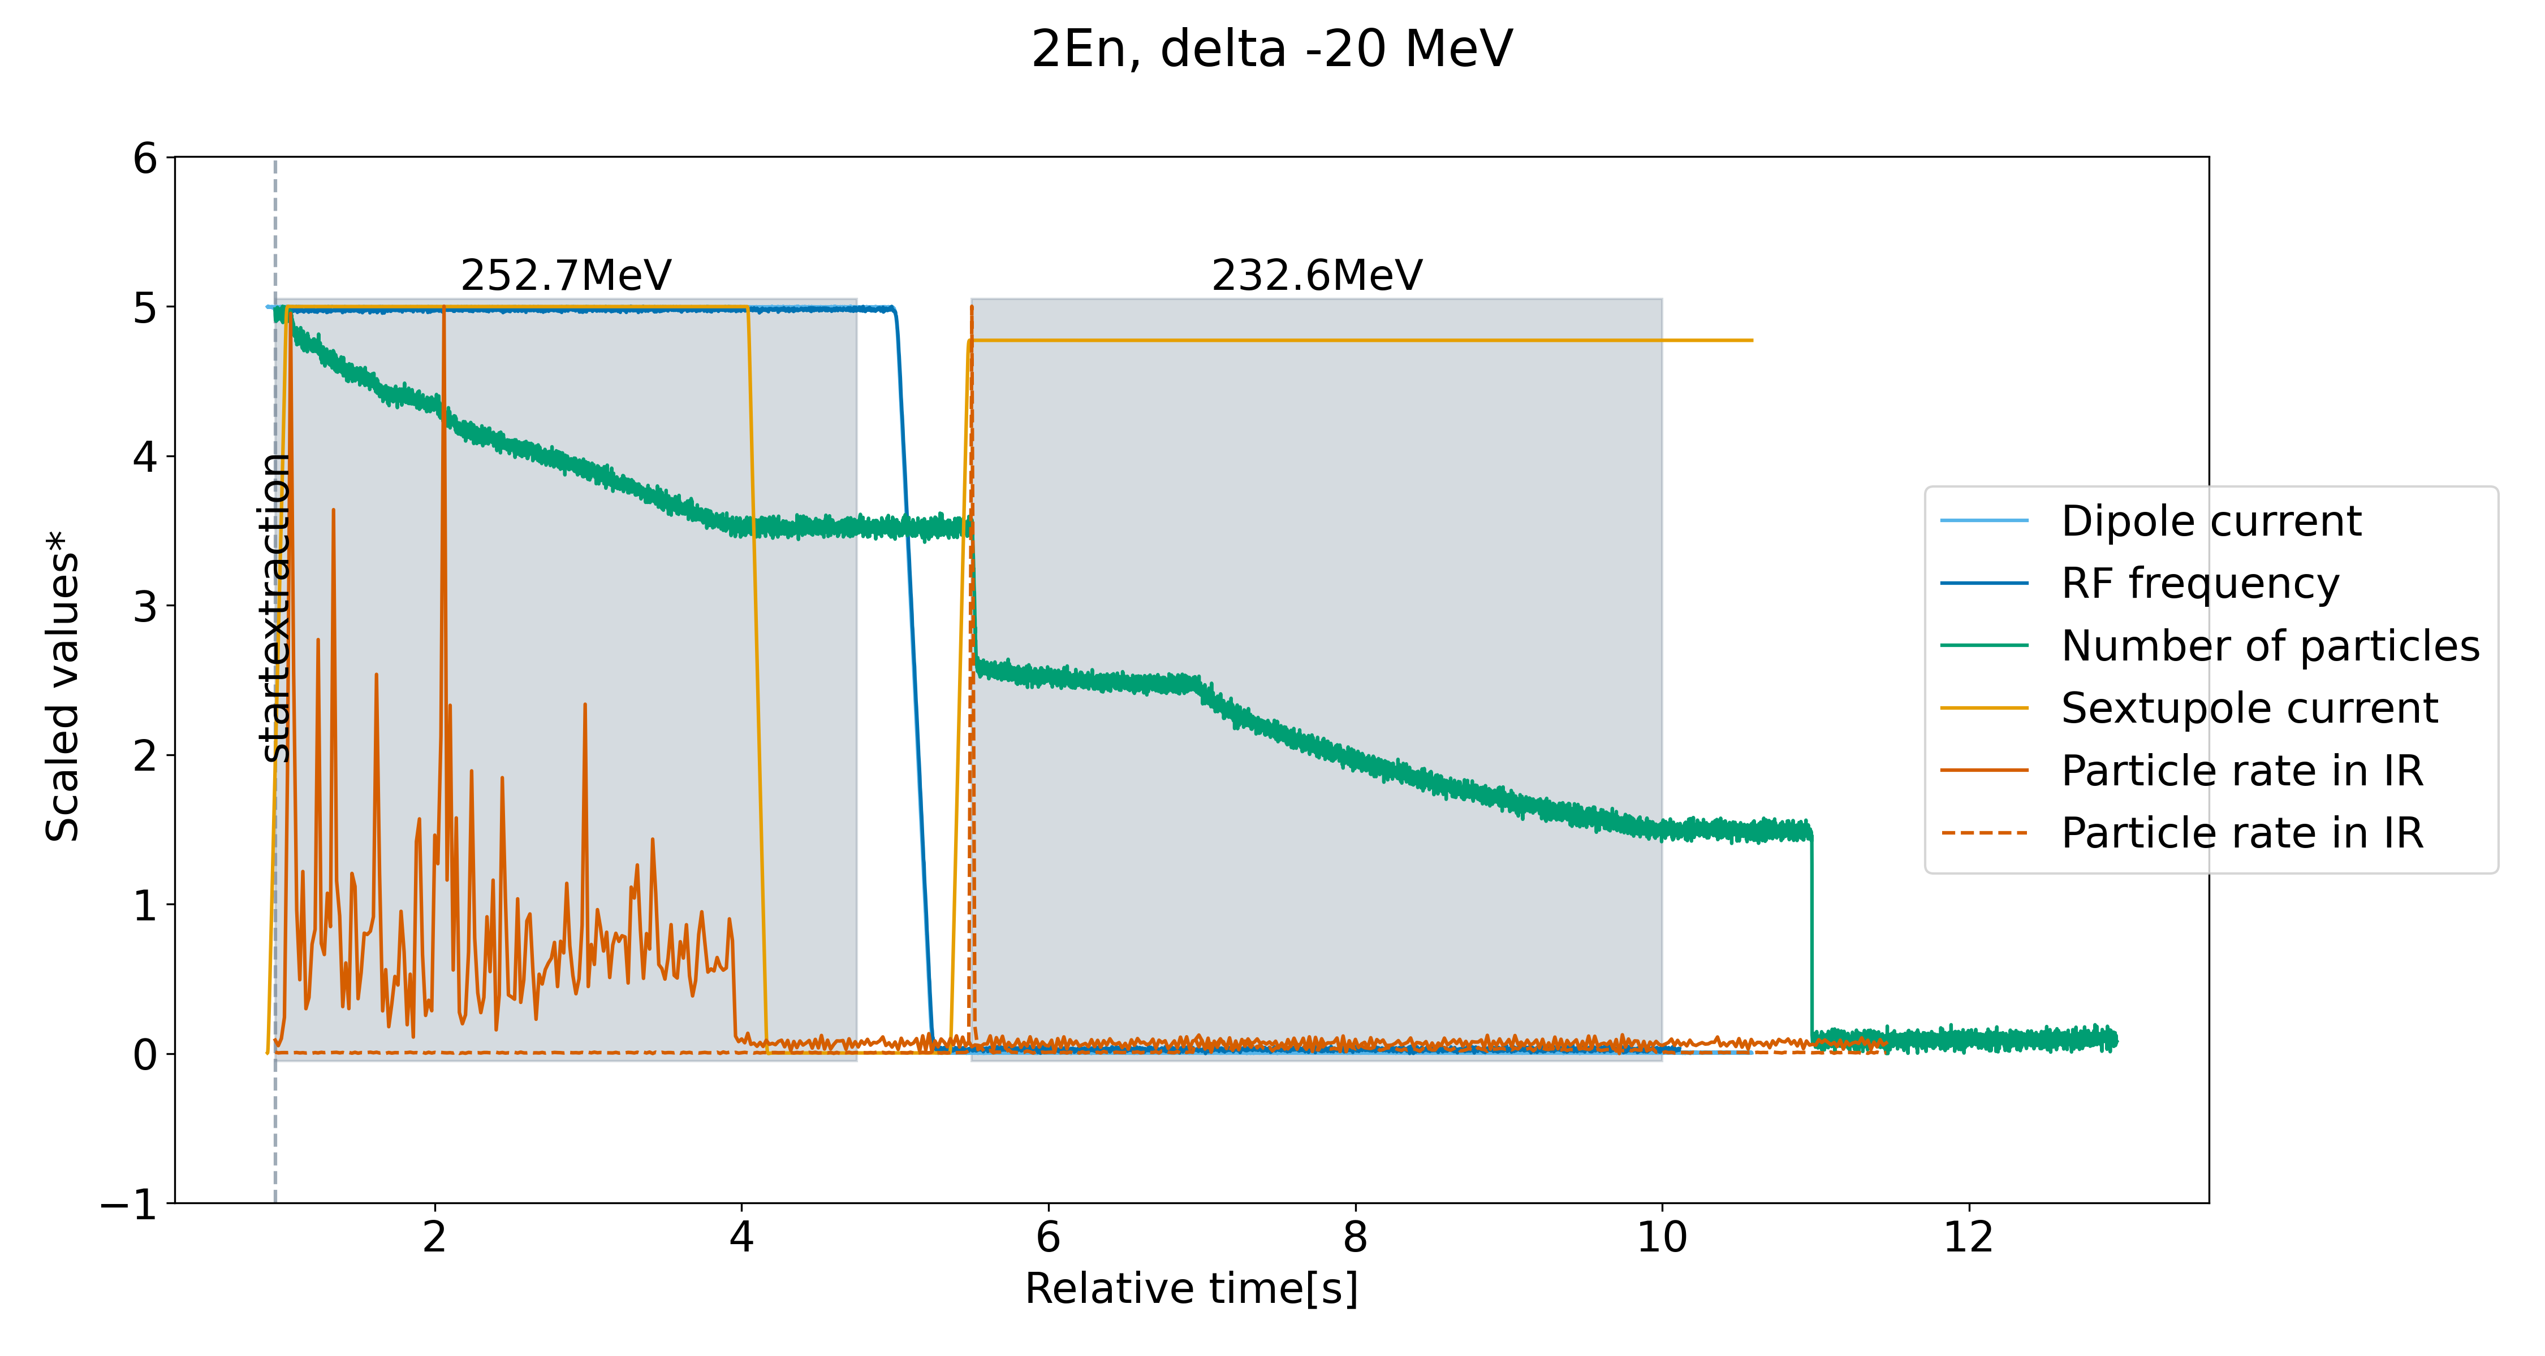
System Implementation Tests: ΔE = −20 MeV
Transfer line configured to second energy
* Adjusted values to visualize behavior over time.
RFKO signal on
RFKO signal off

Slide 25
System Implementation Tests: ΔE = −20 MeV
Transfer line configured to second energy → Peak in IR
* Adjusted values to visualize behavior over time.
RFKO signal on
RFKO signal off

Slide 26
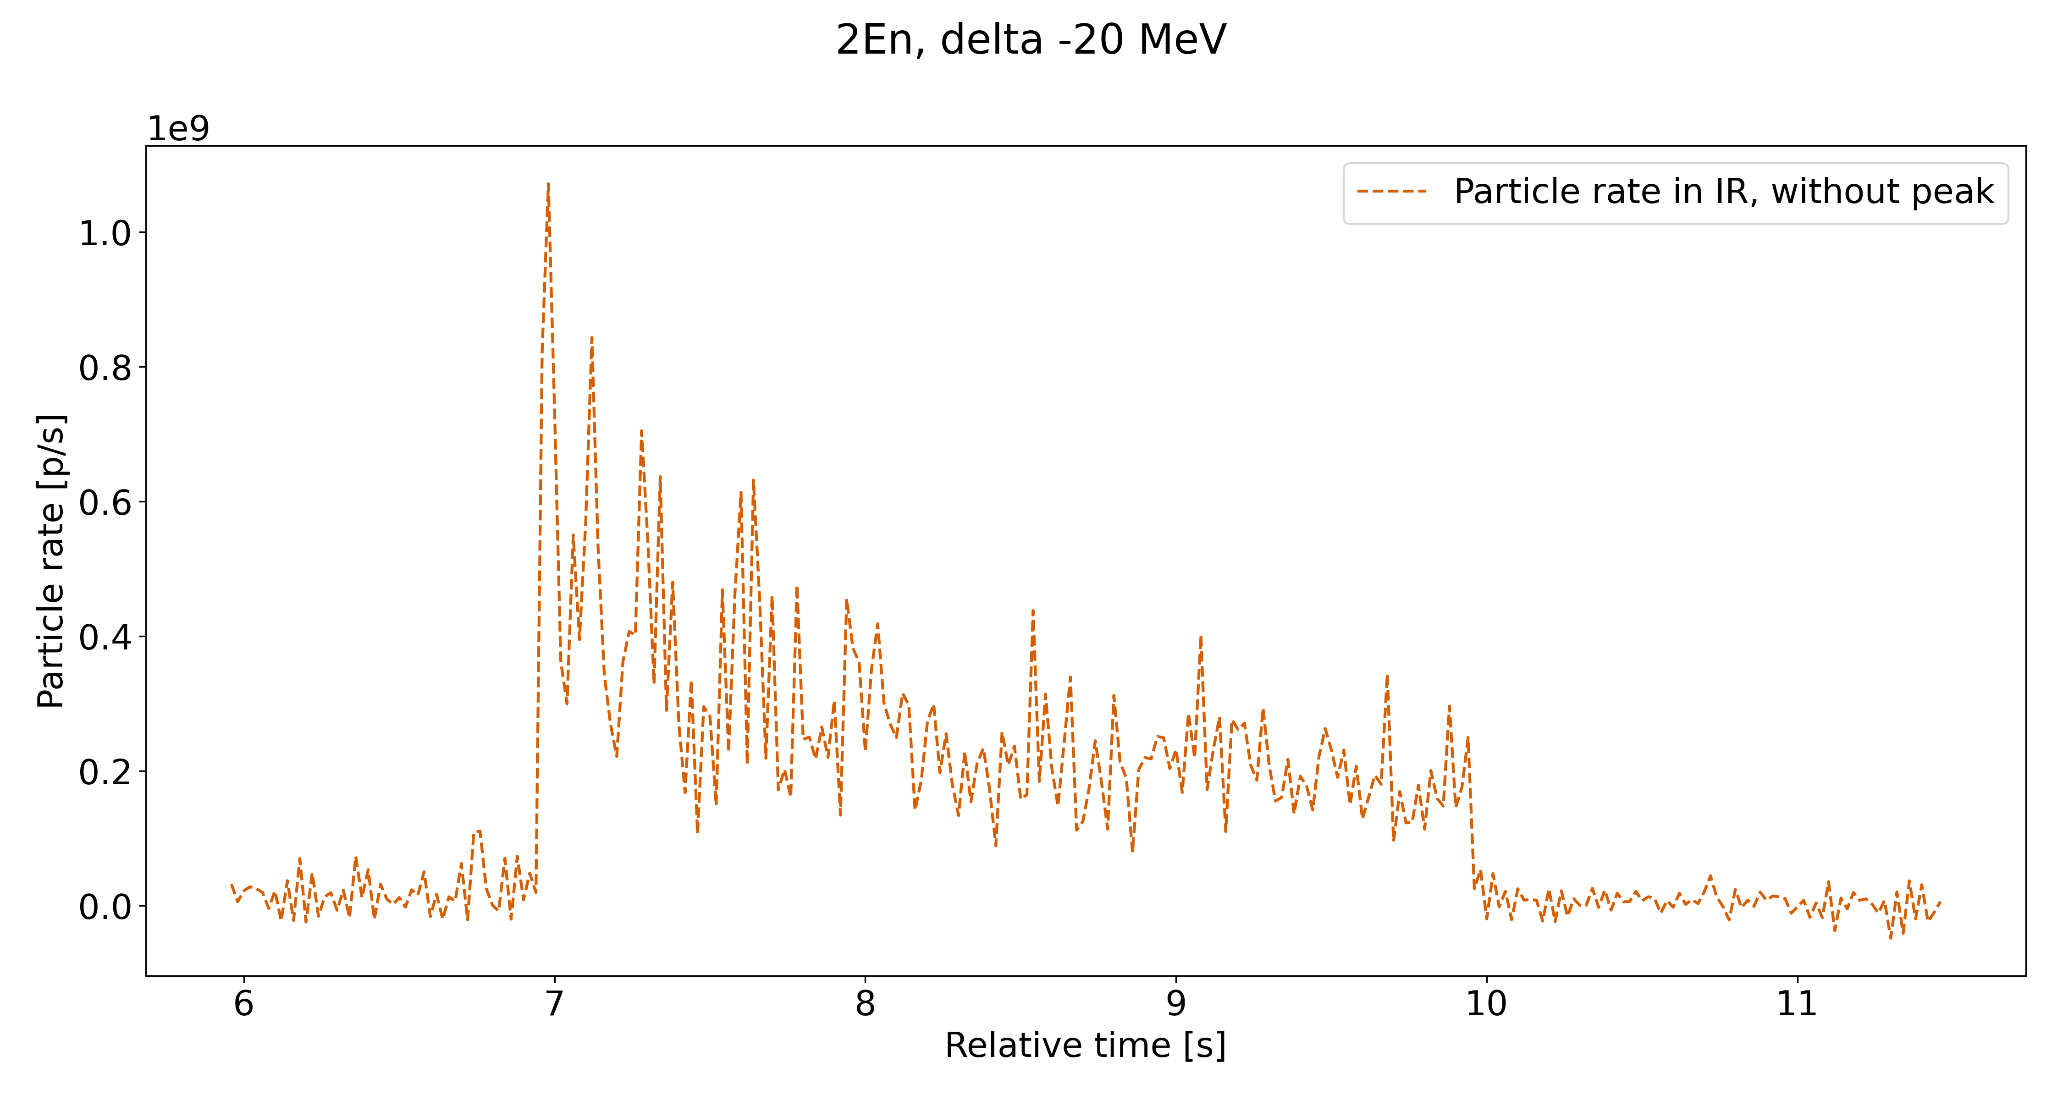
System Implementation Tests: ΔE = −20 MeV
Transfer line configured to second energy → Peak in IR
Mismatch in energy due to current regulation → low transport efficiency
* Adjusted values to visualize behavior over time.
RFKO signal on
RFKO signal off

Slide 27
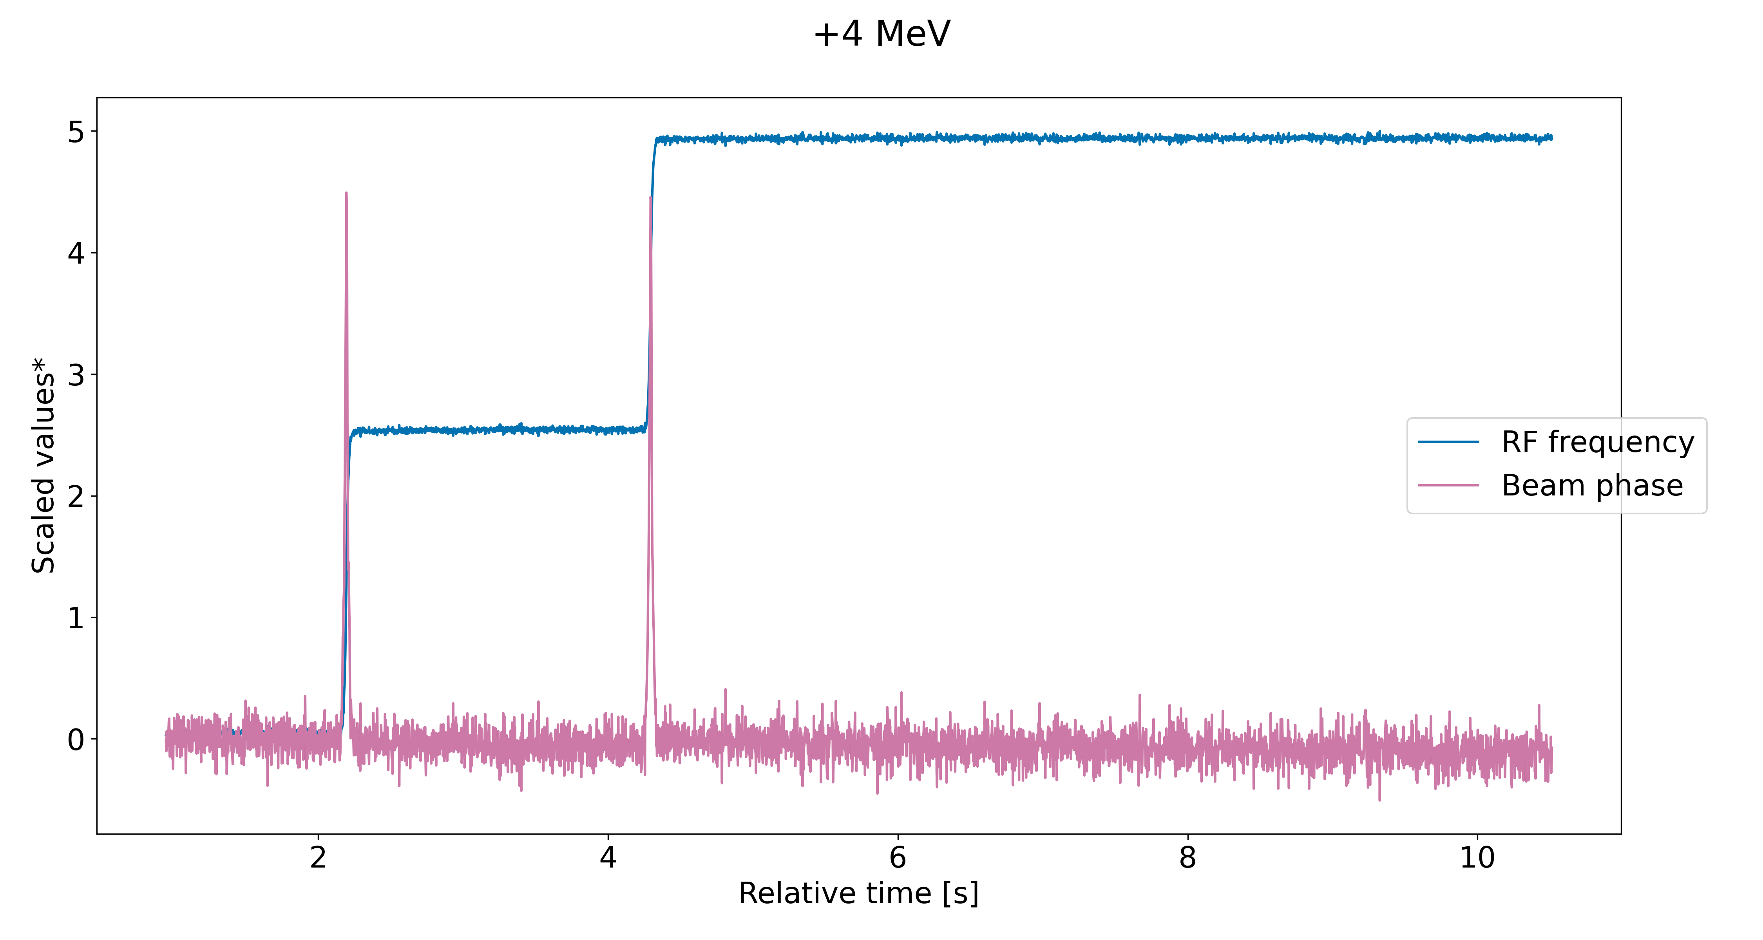
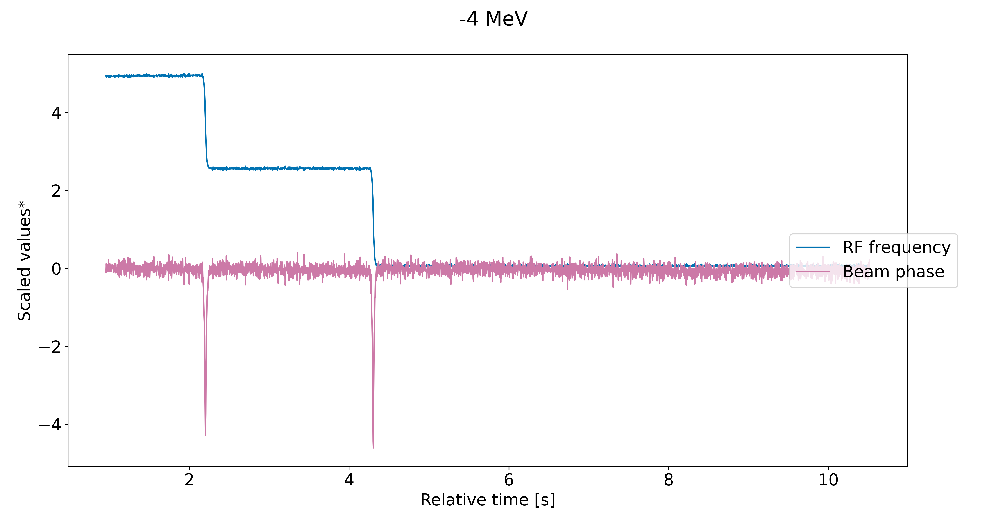
System Implementation Tests: ΔE = ± 4 MeV
Comparison of up- / downwards operation
RF voltage kept constant at 140 V

Slide 28
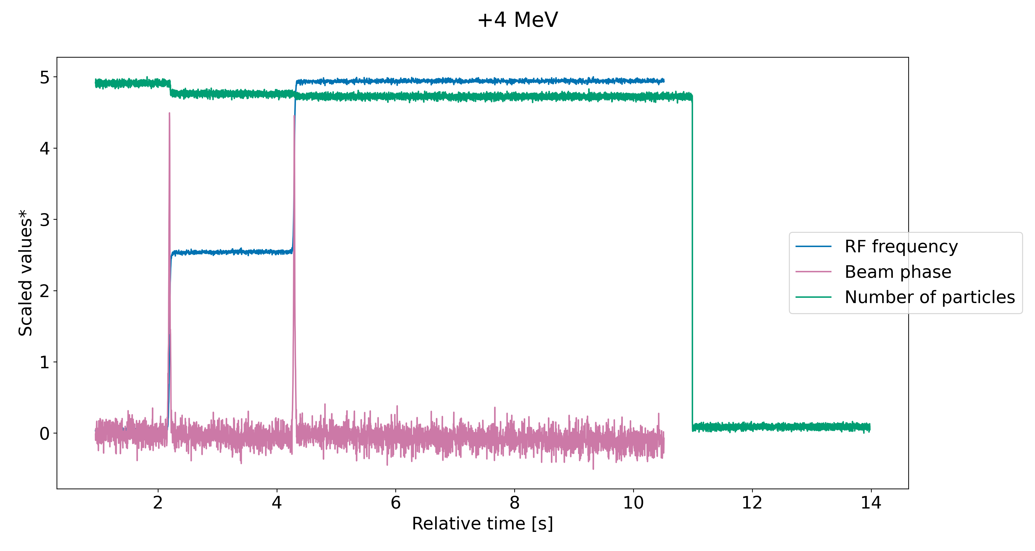
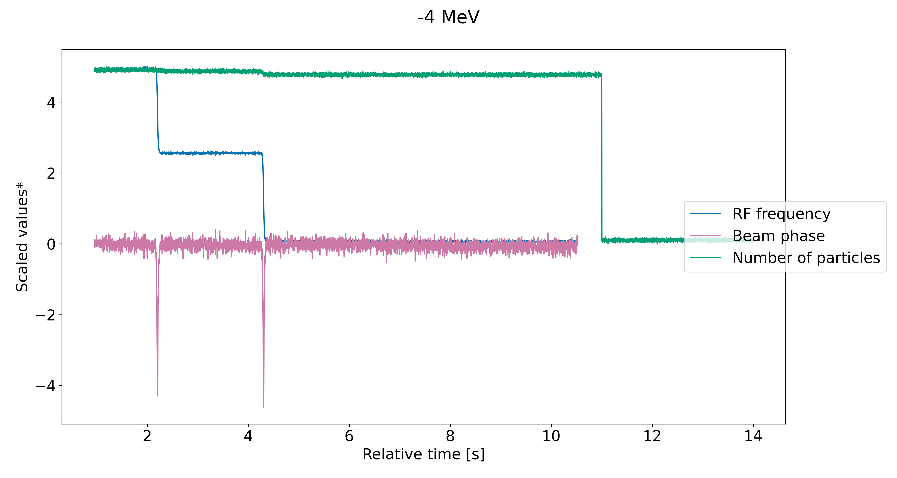
System Implementation Tests: ΔE = ± 4 MeV
Losses in both up- and downwards operation
RF voltage kept constant at 140 V
* Adjusted values to visualize behavior over time.

Slide 29
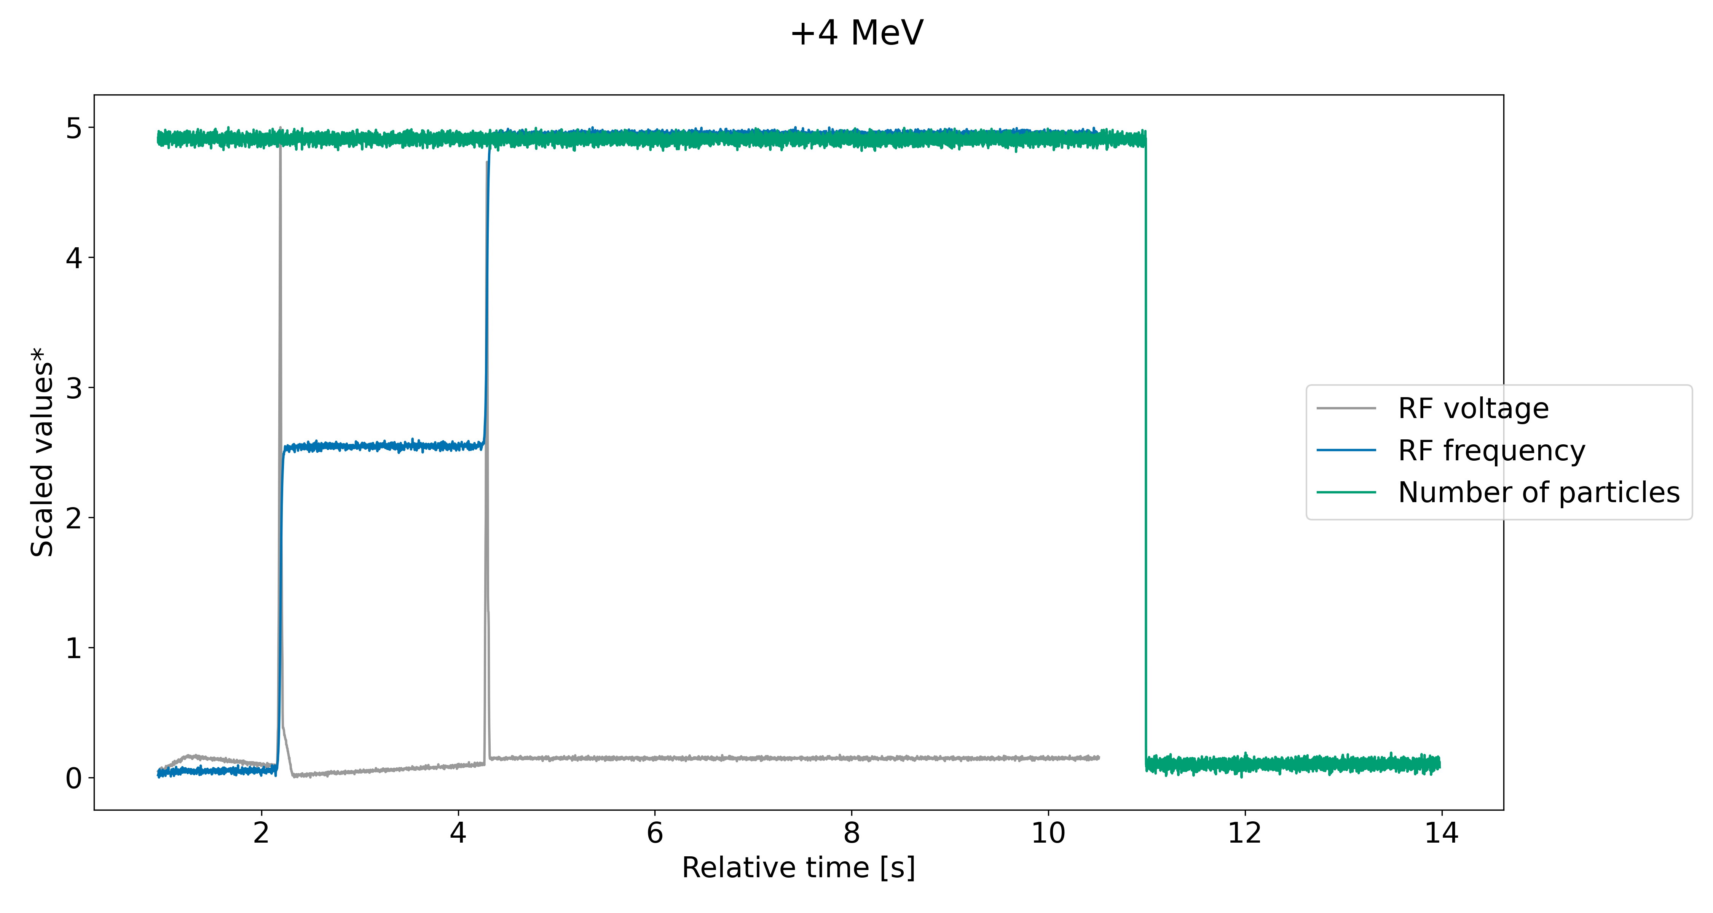
System Implementation Tests: ΔE = ± 4 MeV
RF voltage kept constant at 140 V
RF voltage ramped to ~ 300 V during energy change
As expected: No more losses!
* Adjusted values to visualize behavior over time.

Slide 30
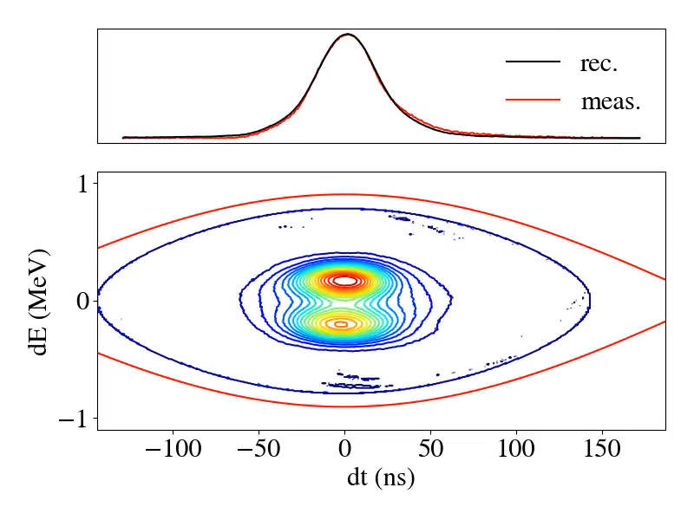
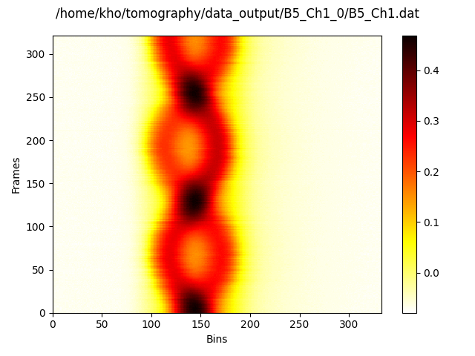
Longitudinal Tomography after Energy Change
Kept at high RF voltage (930 V) during energy change
Observed:
Quadrupolar-mode oscillations
Splitting of beam in beamlets

Slide 31
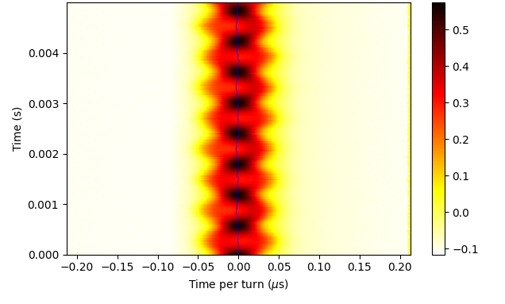
Longitudinal Mismatches at Flat Top
If bunched at flat top (~ seconds)
Coherent oscillations
Observed with RF regulation loops on and off; different characteristics
With loops:
Mostly quadrupolar-mode oscillations
Occasionally splitting of the beam in beamlets
Investigation ongoing
Dependence on chromaticity?
WHY?

Slide 32
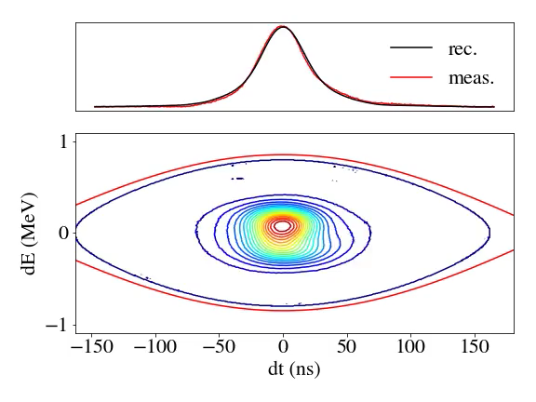
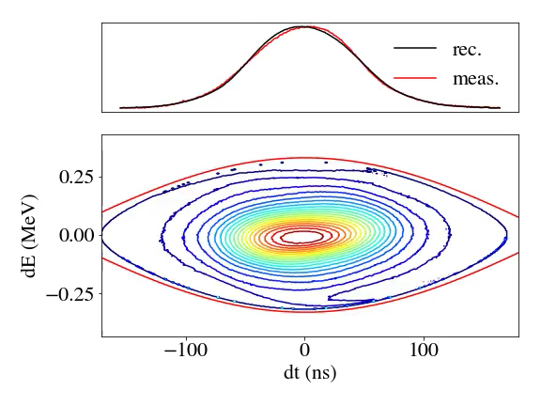
930 V
Longitudinal Tomography at Flat Top
140 V
[8] Longitudinal tomography

Slide 33
Summary and Outlook
So far:
Workflow for arbitrary energy steps established
First exploratory measurements with new MEE and new RFKO exciter control system
Compatibility with Xsuite simulations
Next steps:
Finding cause of and mitigating coherent longitudinal oscillations
Faster energy changes and effects on the spill
Different RFKO excitations signals
Thanks to all contributors at TBU MedAustron and students at TU Wien!

Slide 34
Summary and Outlook
So far:
Workflow for arbitrary energy steps established
First exploratory measurements with new MEE and new RFKO exciter control system
Compatibility with Xsuite simulations
Next steps:
Finding cause of and mitigating coherent longitudinal oscillations
Faster energy changes and effects on the spill
Different RFKO excitations signals
Thank you for your attention!
Questions and input are appreciated!
Thanks to all contributors at TBU MedAustron and students at TU Wien!

Slide 35
References
[1] L. Badano, M. Benedikt, P. J. Bryant, M. Crescenti, P. Holy, A. T. Maier, M. Pullia, S. Rossi, P. Knaus. „Proton-Ion Medical Machine Study (PIMMS), 1,” CERN-TERA Foundation-MedAustron Oncology Collaboration, CERN (2000), https://cds.cern.ch/record/385378.
[2] F. Kühteubl. „Slow extraction developments at MedAustron,” 5th Slow Extraction Workshop, Wiener Neustadt, Austria (2024).
[3] F. Plassard. „Beam loss optimisation for slow extraction at MedAustron,“ 5th Slow Extraction Workshop, Wiener Neustadt, Austria (2024).
[4] F. Kühteubl. „Slow extraction optimisation for the MedAustron synchrotron,” Dissertation, Technische Universität Wien (2024), https://doi.org/10.34726/hss.2024.88260.
[5] M. Wolf. „Development of an RF system for slow extraction signal generation and measurement,” 5th Slow Extraction Workshop, Wiener Neustadt, Austria (2024).
[6] T. Margreiter. „High-Power Modular GaN Based Power Supply for MedAustron Scanning Magnets,” IPAC(2024).
[7] G. Iadarola, R. De Maria, S. Łopaciuk, A. Abramov, X. Buffat, D. Demetriadou, L. Deniau, P. Hermes, P. Kicsiny, P. Kruyt, A. Latina, L. Mether, K. Paraschou, G. Sterbini, F. F. Van Der Veken, P. Belanger, P. Niedermayer, D. Di Croce, T. Pieloni, L. Van Riesen-Haupt, M. Seidel. „Xsuite: An Integrated Beam Physics Simulation Framework,” JACoW HB2023 (2024), TUA2I1.
[8] S. Hancock. „ A simple algorithm for longitudinal phase space tomography,” CERN-PS-RF-Note-97-06 (1997).

