Slide 1
Studies on collective phenomena
related to J-PARC slow beam extraction
SX 2025, Stony Brook
Oct. 7, 2025
KEK/J-PARC M. Tomizawa
Acknowledgment:
SX-G: R. Muto, T. Asami, K. Itahashi (Soken-Univ.)
RF-G: Y. Sugiyama, K. Seiya, F. Tamura
Monitor-G: T. Toyama, A. Kobayashi, T. Nakamura
Vacuum-G: M. Uota
Beam instability during debunching
mitigations for the beam instability
2. Observed “rebunching” at high beam intensity
3. Summary

Slide 2
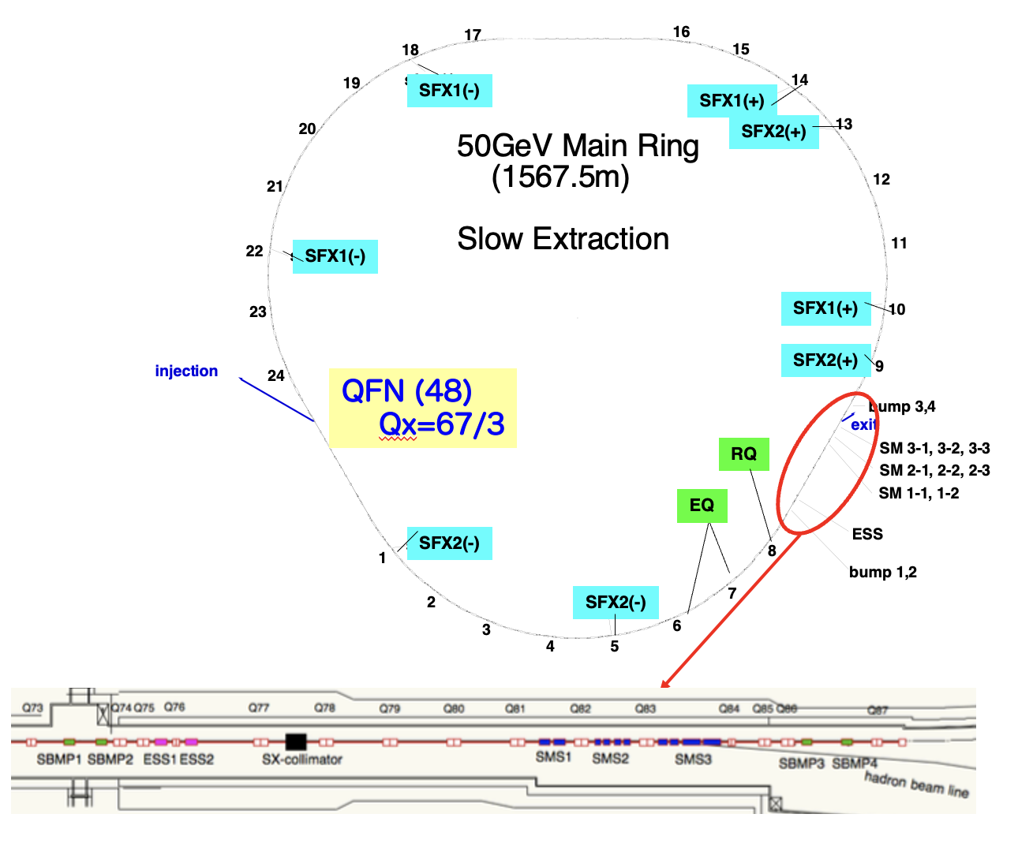
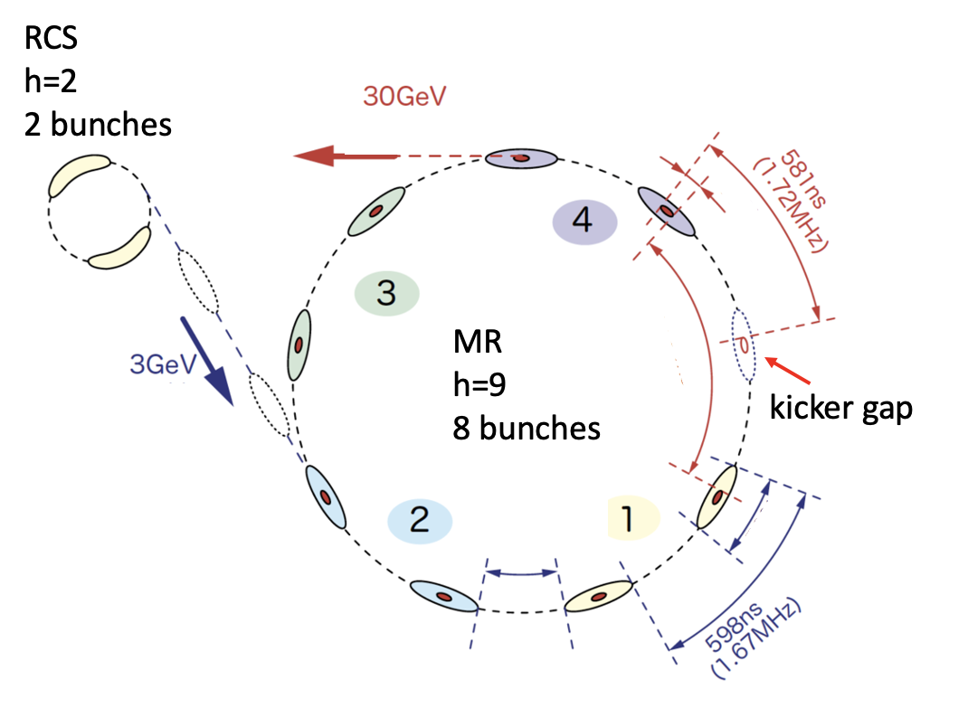
J-PARC MR Slow Extraction Devices
J-PARC MR Beam Bunches
A debunching manipulation
before slow extraction at 30GeV

Slide 3
J-PARC SX operation history
Current 30GeV SX
4.24s cycle
92kW
8.1x10¹³ ppp
〜3.3x10²⁰ protons

Slide 4

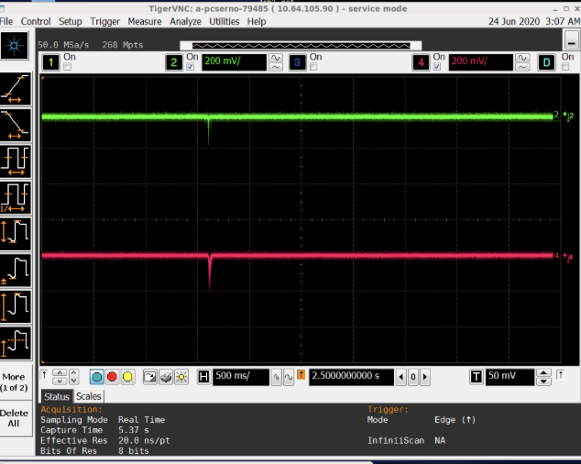
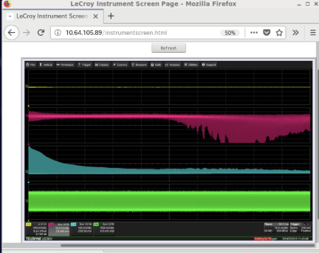
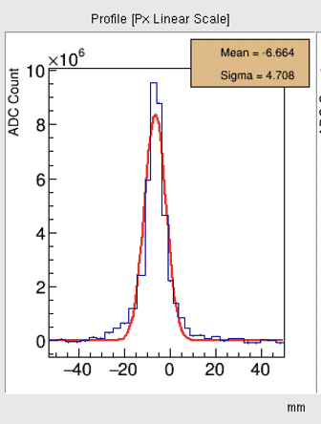
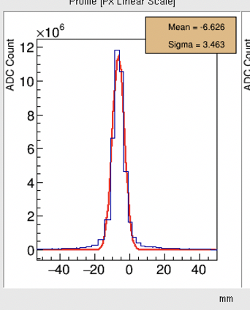
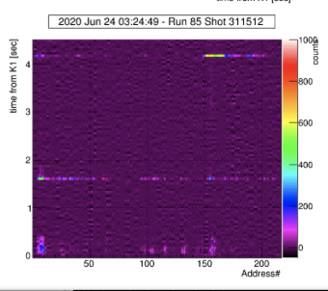
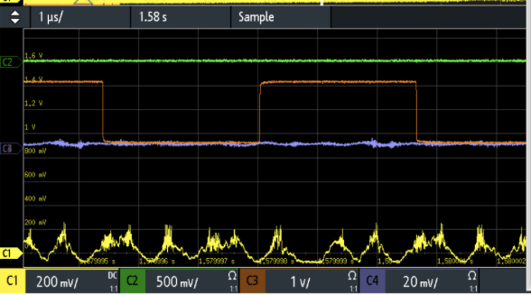
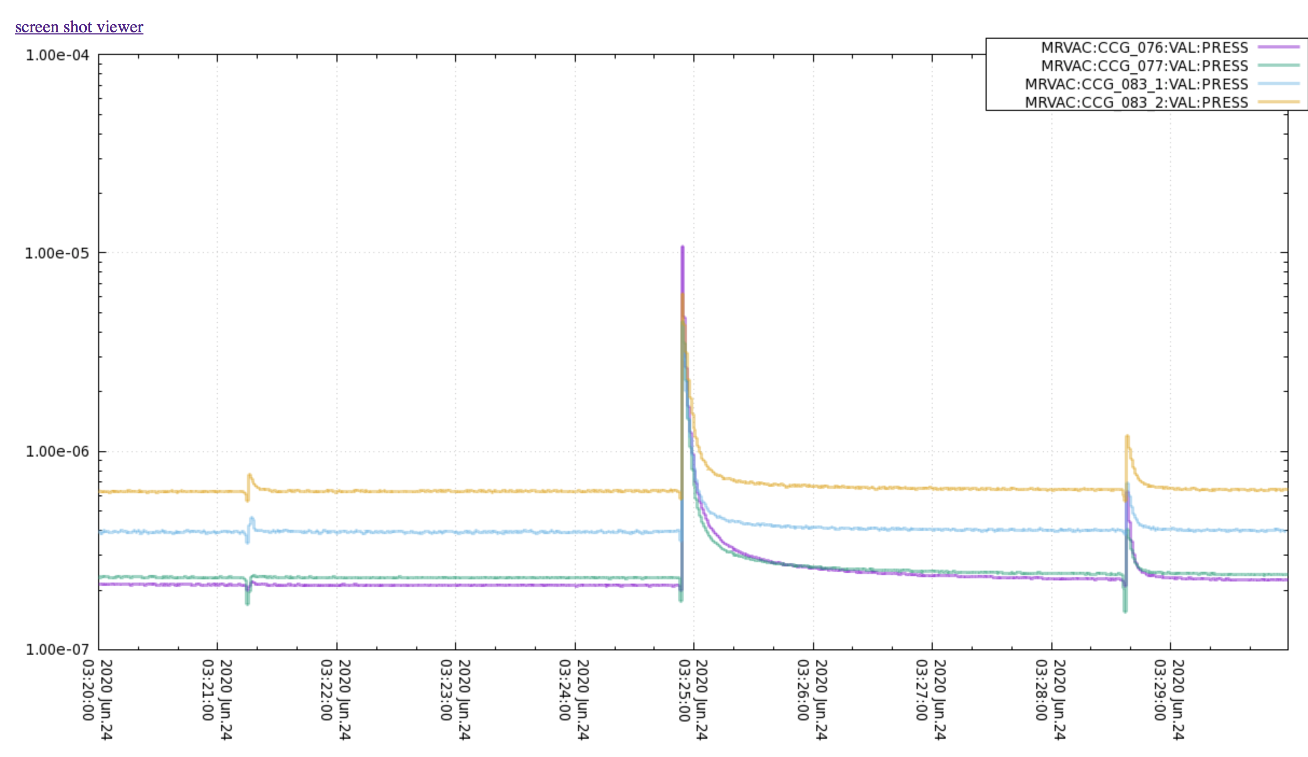
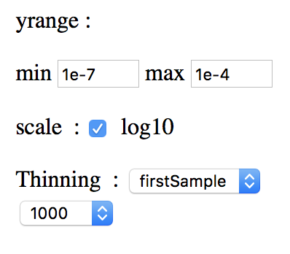
Beam Instability during debunching
Currently Limiting SX beam intensity (large beam loss for SX)
Abort destination, 60kW debunch , RF offset 65deg
H, V beam size growth
BPM
EC monitor
56kW
w/Insta.
w/o Insta.
H-oscillation
E-cloud
run86
#67143
run86
#67145
56kW
56kW
V-oscillation
BLM
50deg 0kV @0ms
53deg 17kV@80ms
Wall Current Monitor
occurs in the whole MR ring
Debunch beam Loss
ESS, SMS vacuum rise
Microwave structure
ESS OFF

Slide 5
The Debunch Instability Mechanism Estimation
A longitudinal microwave structure during debunching is generated
by longitudinal impedances Z_{L}
The microwave structure enhances the electron cloud generation (multipactor process)
Proton beam oscillates transversely by interaction with the electron cloud.
-> results in the transverse instability and beam loss

Slide 6
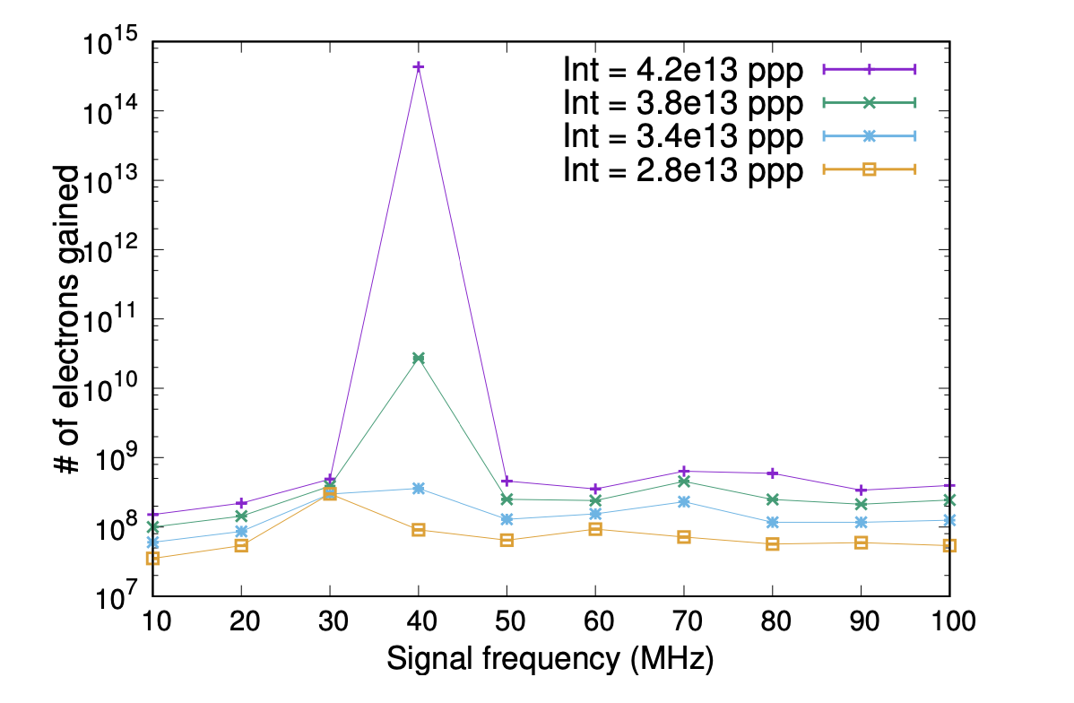
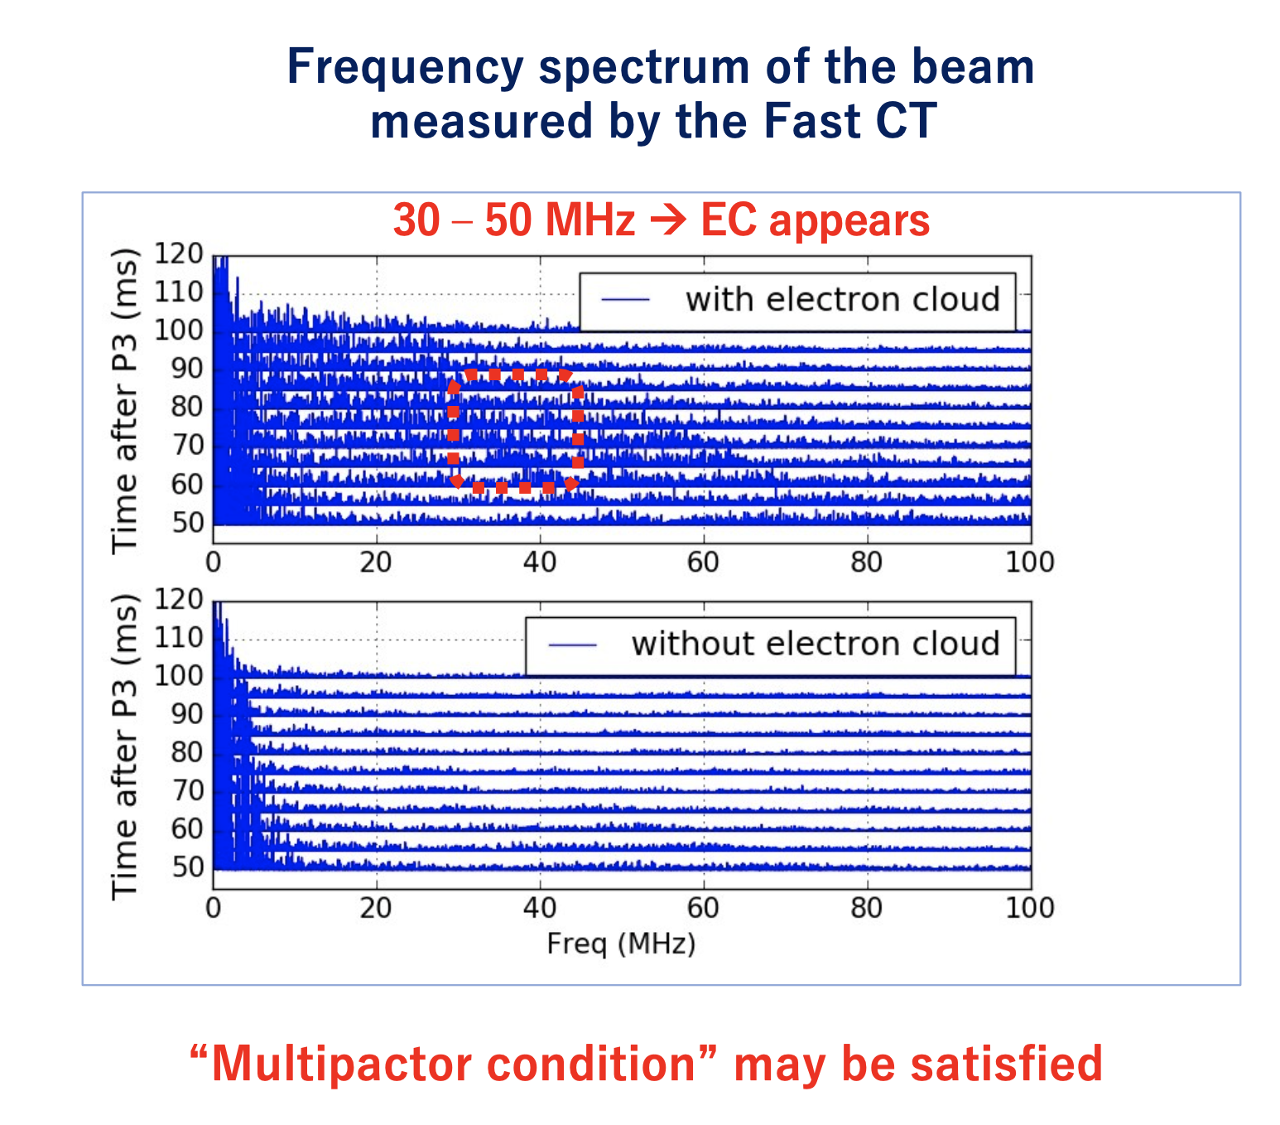

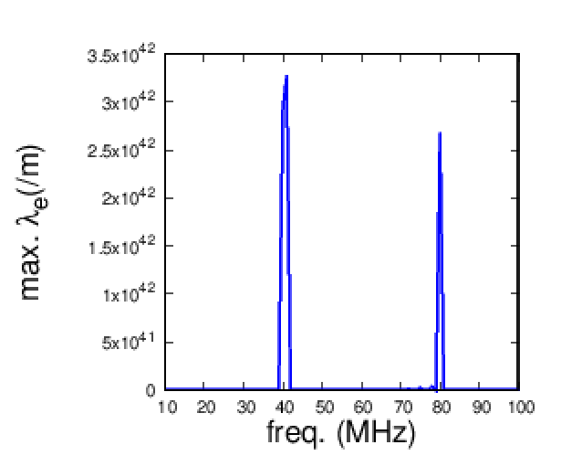
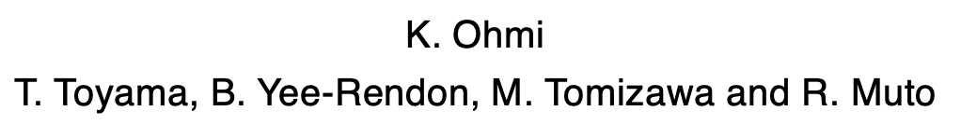
e-cloud simulation by B. Yee-Rendon
Measured Beams Time Structure (FCT)
e-cloud seen
Bruce Yee-Rendon et. al, Journal of Physics: Conf. Series 874(2017)012065
e-cloud not seen
Multipactor condition around 40MHz
1-D e-cloud simulation
6x10^13 ppp
The e-cloud/FCT measurements and the simulations indicate that
e-cloud is strongly built up
by longitudinal 30-50MHz beam time structure.
Evidence to explain the assumed mechanism
M. Tomizawa, Ecloud2022

Slide 7
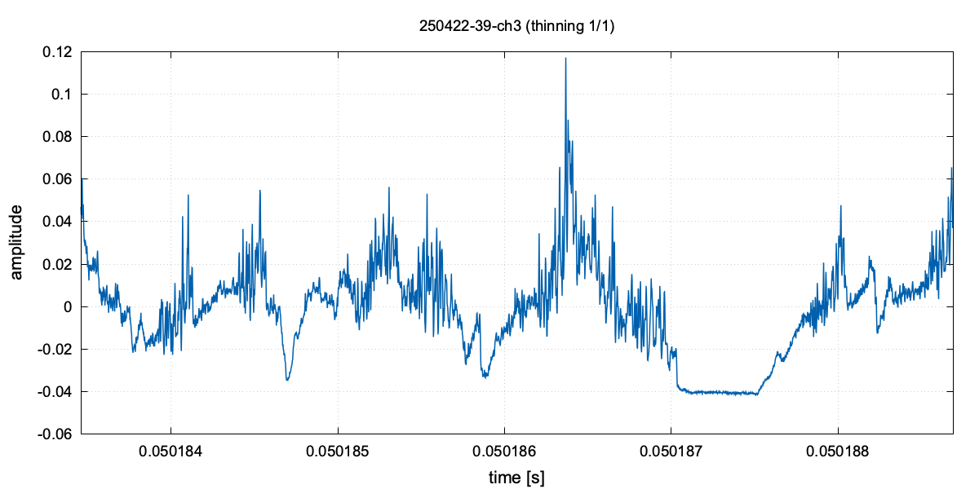
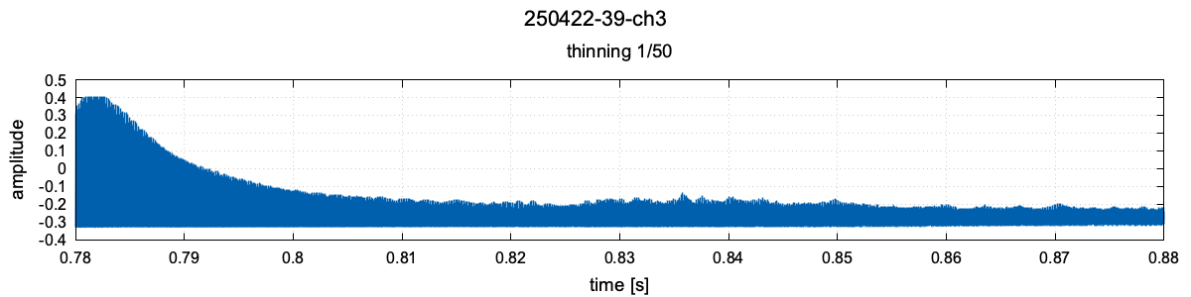
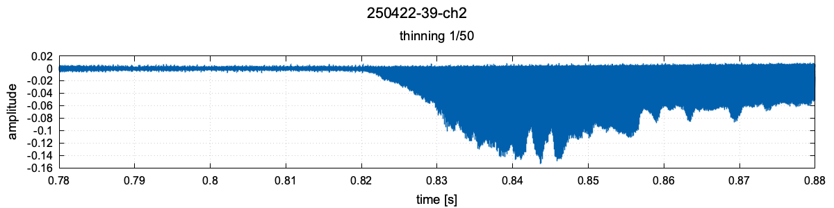
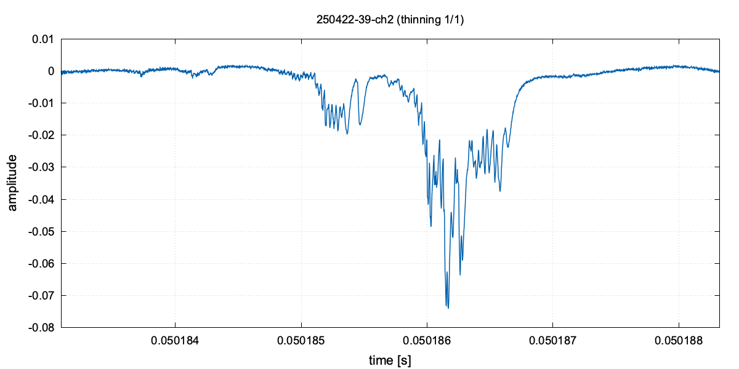
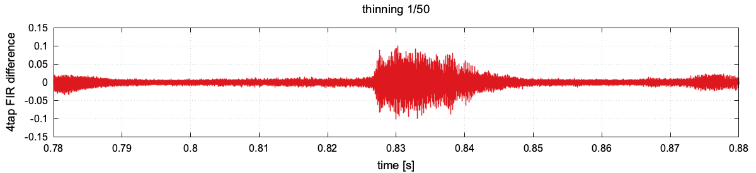

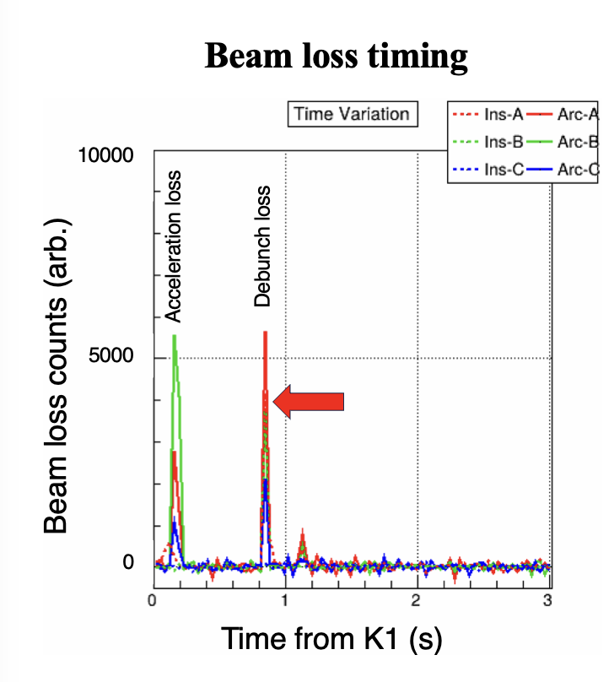
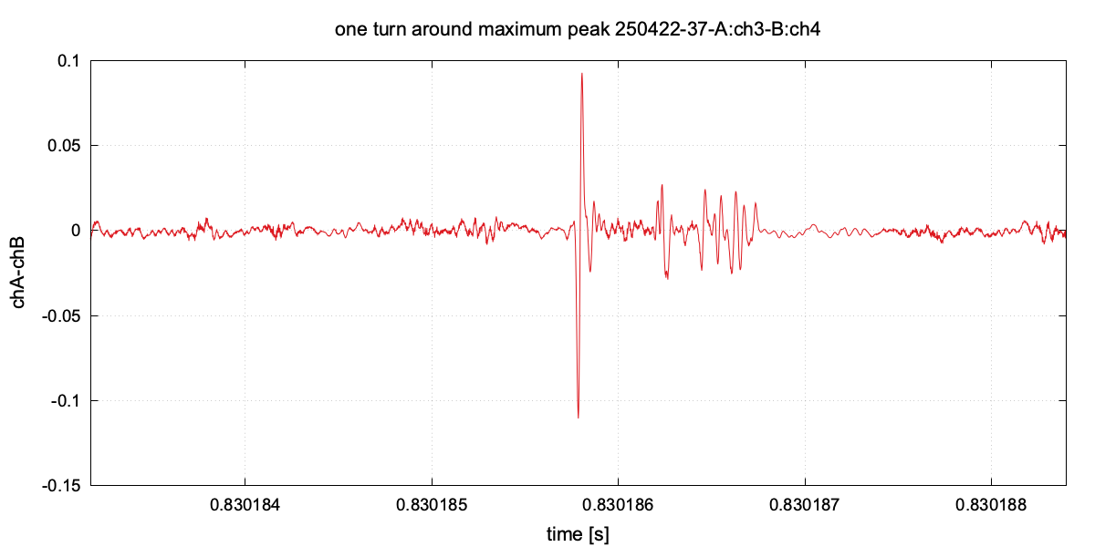
Fundamental and second RF+Phase offset
one step debunch 94 kW
One turn (5.2μs)
Run92 #1885806
RF OFF (P3)
Instability was intentionally induced
FCT
100ms
FCT
EC
BPM Up-Down diffrerence
EC
BPM (Up-Down)
10MHz LPF, 4taps FIR
Detailed data analysis: poster by K. Itahashi in this WS

Slide 8
Direct Transverse Instability Suppression
・H and V chromaticity corrections (negative value) are weakened during debunching.
J-PARC slow extraction needs a zero Qx’ for high slow extraction efficiency.
This weakening is constrained by the power supply limitations.
-> partially works to suppress the instability, but not enough.
P3
SX start
timingchart2_run92_2_newgnu.plt
chromaticity

Slide 9
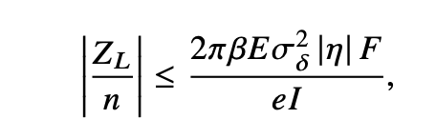

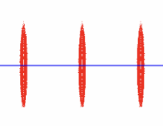


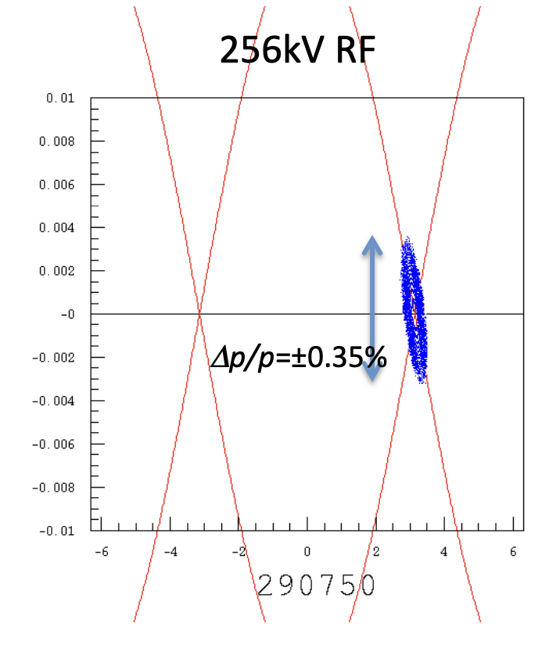
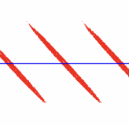

Our current main strategy to mitigate the instability with e-cloud
is to suppress the longitudinal microwave time structure
Longitudinal microwave instability threshold (Keil-Schnell criterion)
Before debunch
local rms-momentum spread
large Δp/p
large eI
local beam current
Phase jump did not work well
in the early beam test.
Reduce L-impedance
in debunch
$$<$$
RF manipulations
Phase offset injection
2 step debunch
small Δp/p
small eI
Enlarge |η|
local space
Increase longitudinal emittance
HB2018, M. Tomizawa
Debunching progress
tougher

Slide 10
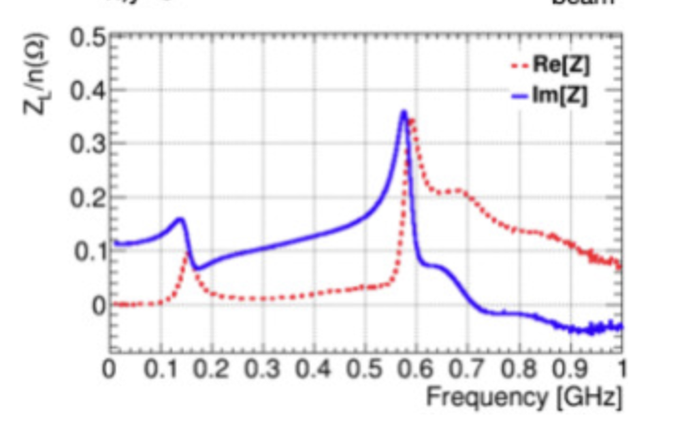
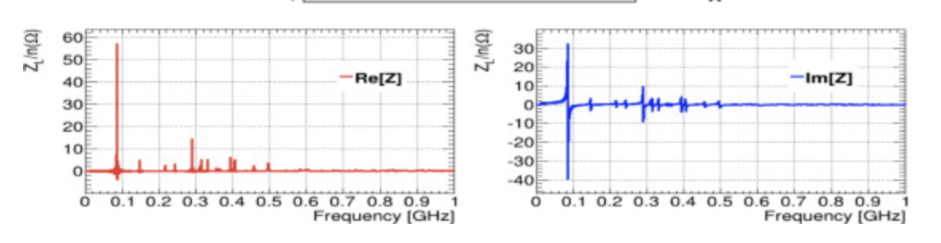
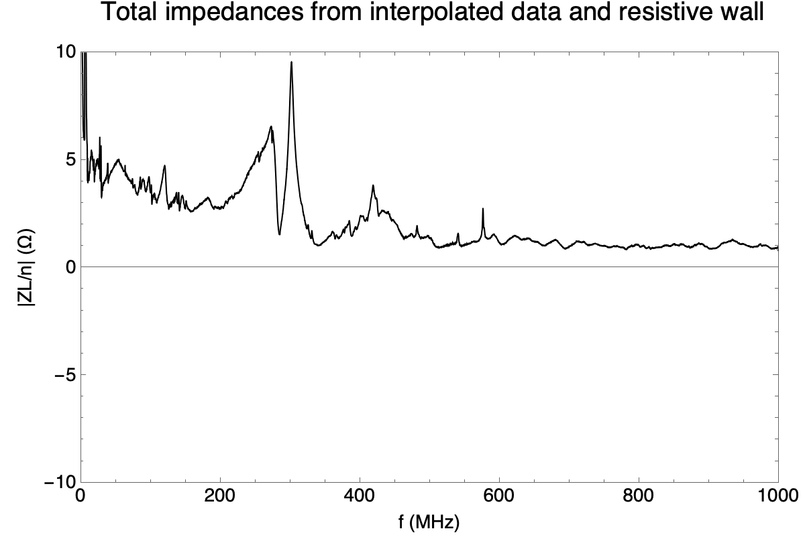
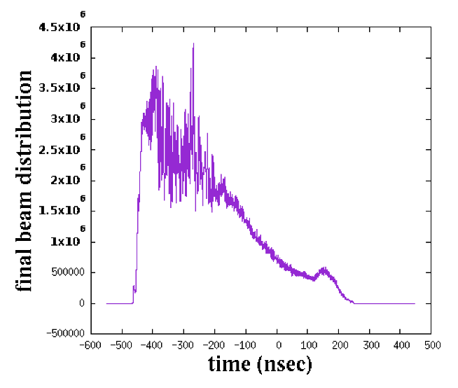
MR L-Impedance Reduction
FX Eddy Current septa impedance reduction
A. Kobayashi et al., NIM A 1031, 2022, 166515
after EC2022
RW bug fixed
Total MR L-impedances (RF, FX-MS, SX-MS, FX-KI, INJ-KI,COR-KI, Resistive Wall)
Two step debunching simulation
(60kW beam,6.5x10^13ppp)
・4.2s cycle, JFY 2022 operation
8 RF cavities ON, 3 cavities shorted, New FXMS
2022 5.2s ZL, bunch2
24000 turn
125.5ms from P3
RF
microwave structure
019_02_04
M. Tomizawa ecloud2022

Slide 11
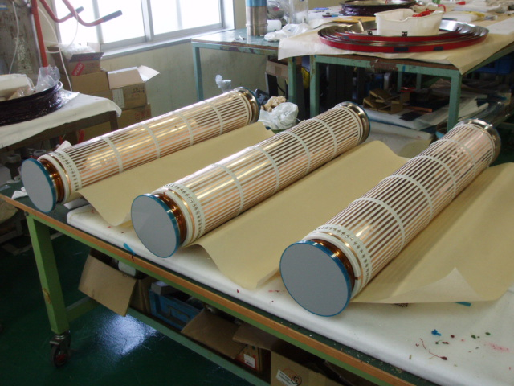
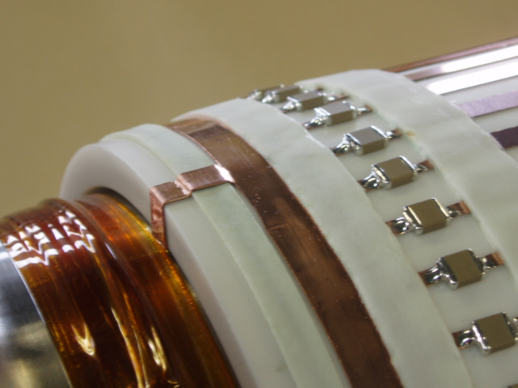
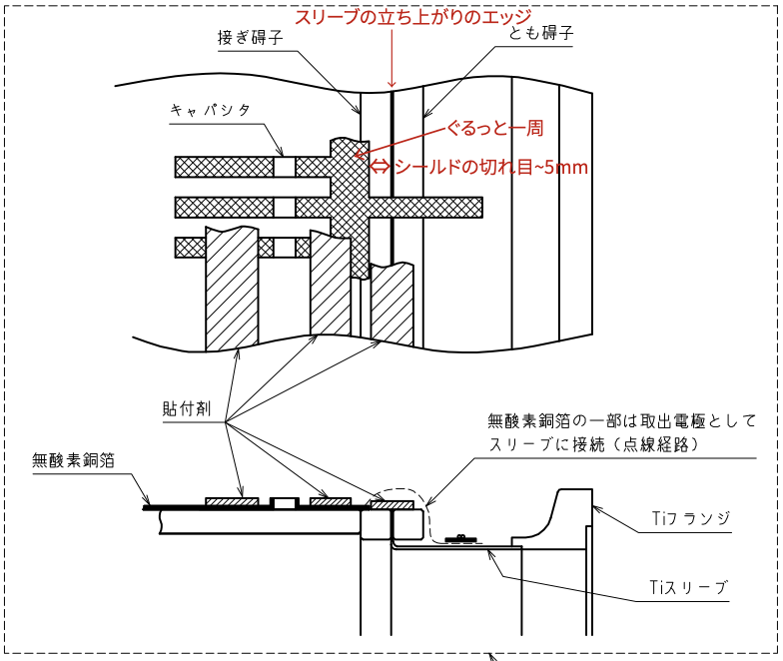
L-impedance reduction of spill feedback quadrupoles (EQ1-2,RQ) ceramic ducts
Duct body 47-Cu stripes
Duct end 1-Cu stripe
RF shield cramps
Installed
w/o air exposure
maintaining the existing strips
1 -> 16 wall current paths
M. Tomizawa et al., Proc. of Annual Meeting of Particle Accelerator Society of Japan, 2025, WEP035, to be published
Multiple copper strips are mounted on the ceramic duct.

Slide 12

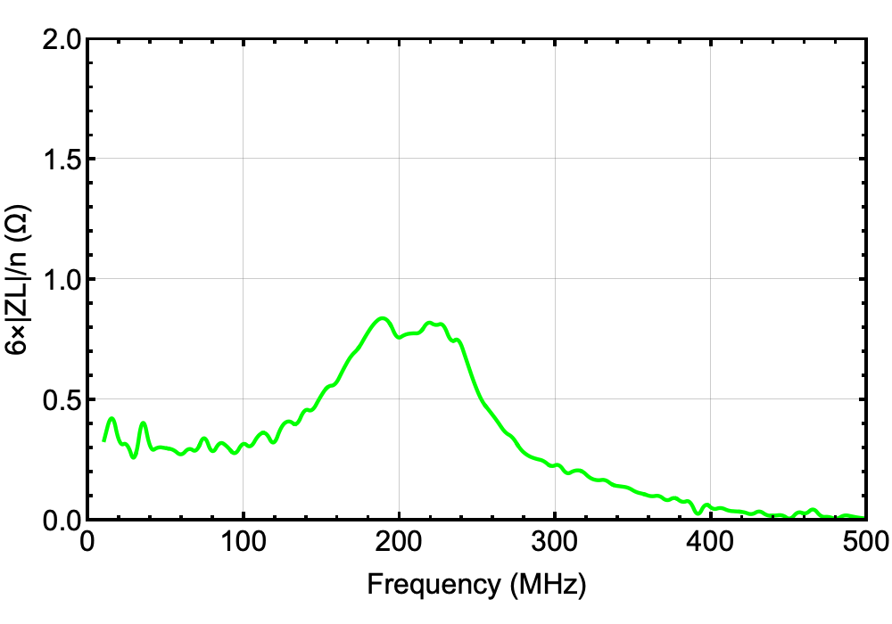
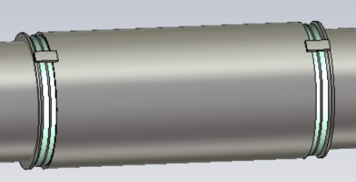
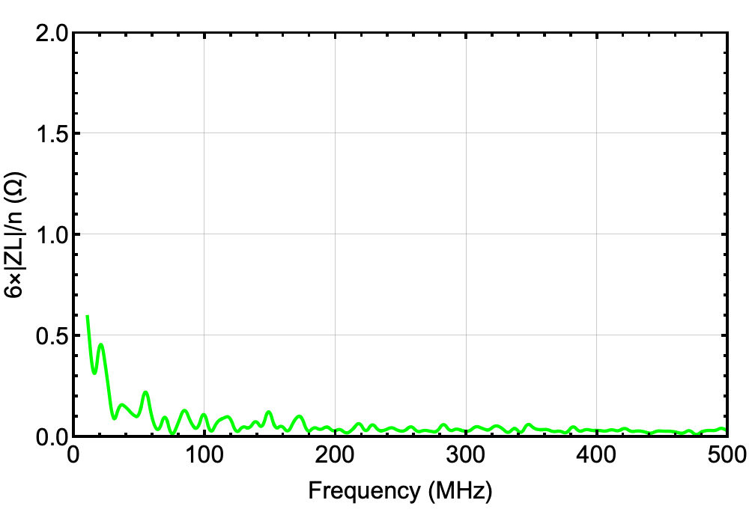
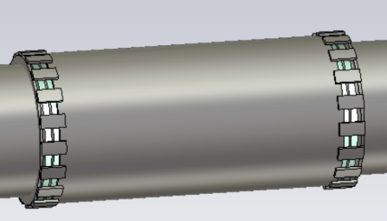
CST Studio model (by T. Nakamura)
w/o cramp
w/o cramps
7-8% contribution for MR total ZL
w/ 6-cramps
w/ cramps
vacuum gauge noise
in very high-intensity FX runs
drastically improved

Slide 13
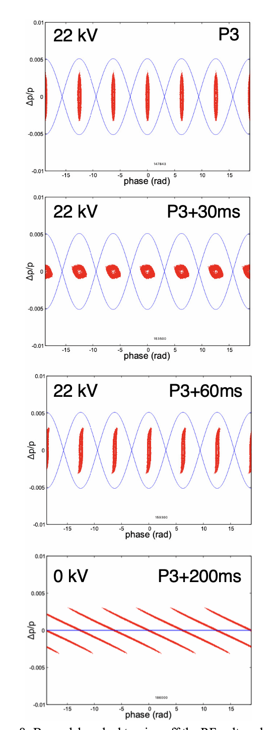
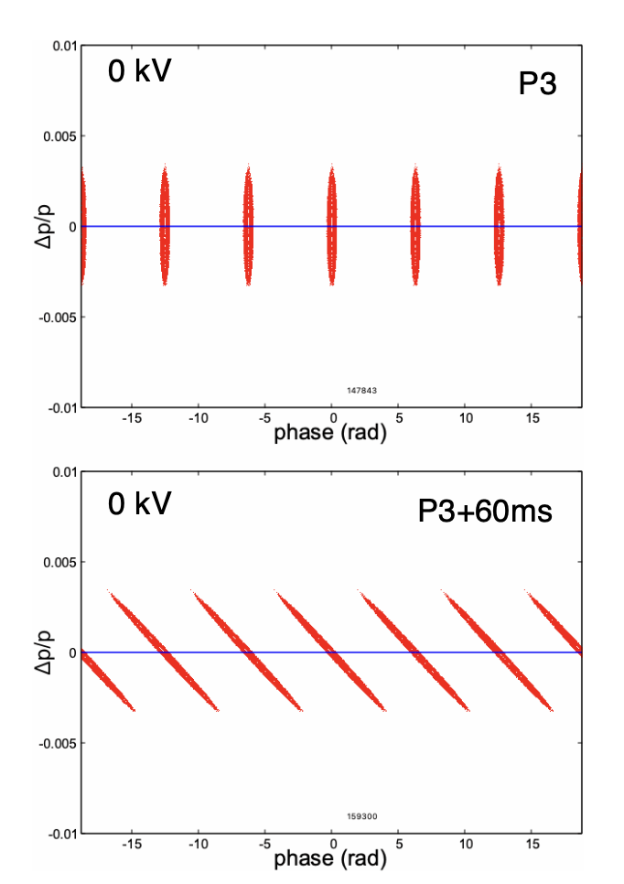
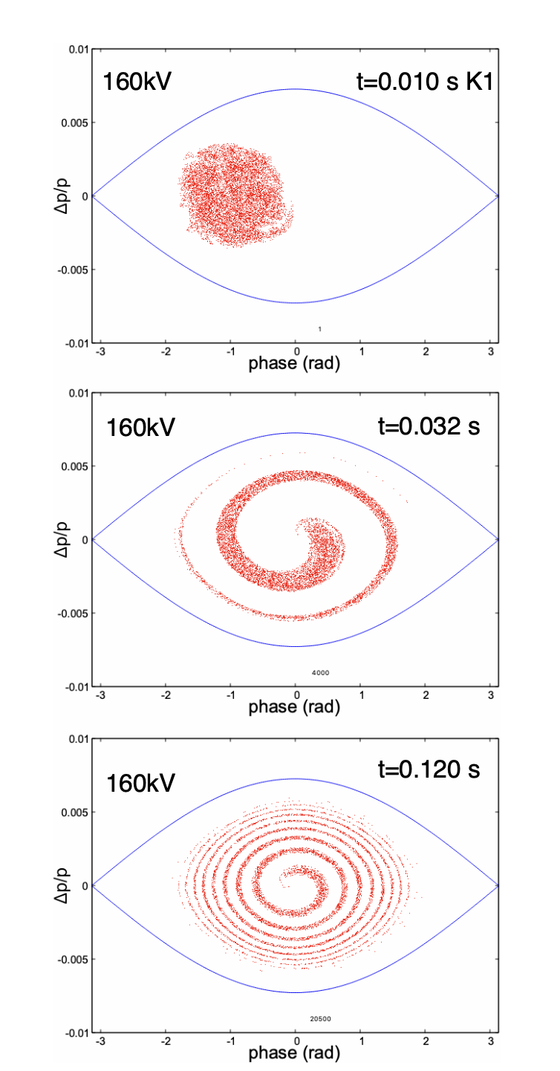
RF manipulations to suppress the instability
Two step debunch
One step debunch
Phase offset injection
256kV
256kV
0kV
also suppress T-instability at the FB
30 -> 45 kW (5.52s) since Oct.,2015
(30kW=3.5x10^13 ppp)
45 -> 50kW (5.20s) since Jan.,2018
50 -> 65kW (5.20s) since Dec., 2020
65 -> 80kW (4.24s) since Dec., 2022
timingchart2_run92_2_newgnu.plt

Slide 14

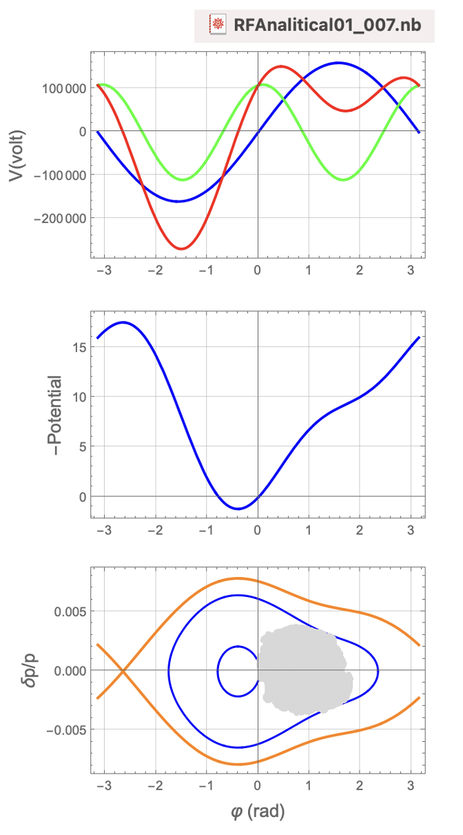
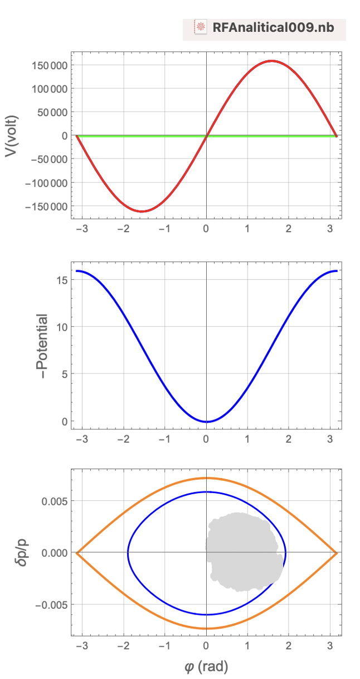
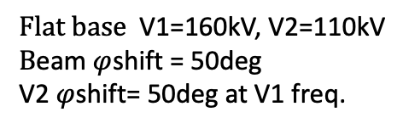
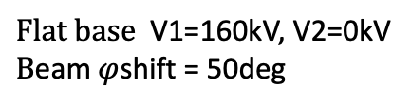
Recent RF manipulation to suppress instability
$Flat base$ V1=160kV, V2=110kV
$B\text{eam} φ$shift = 50deg
V2 $φ$shift= 50deg at V1 freq.
$Flat base$ V1=160kV, V2=0kV
$B\text{eam} φ$shift = 50deg
smearing area
smearing area
Hollow area

Slide 15
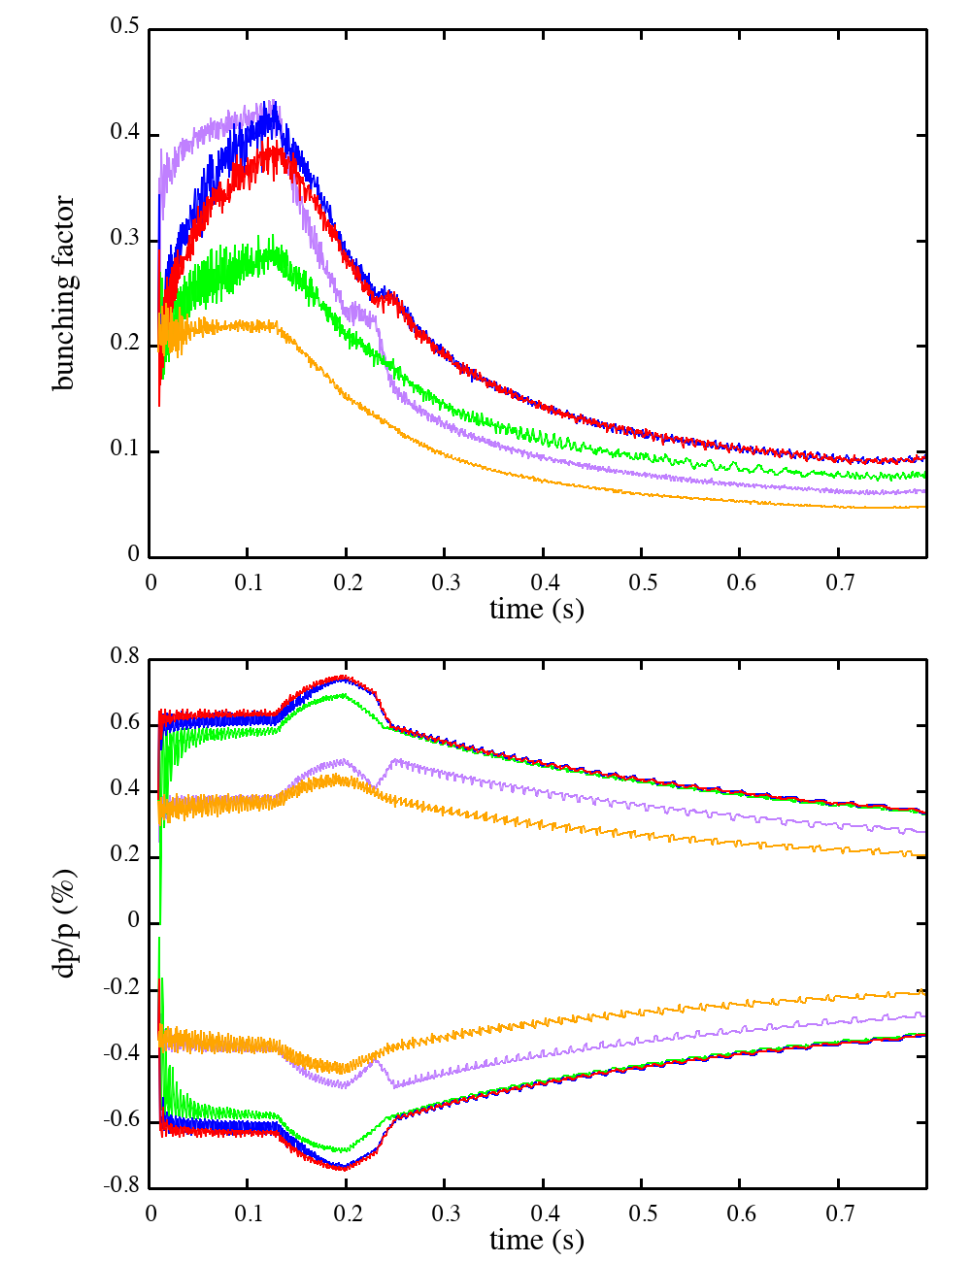
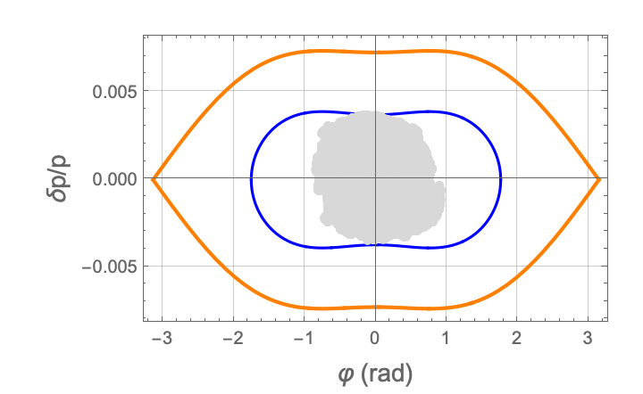
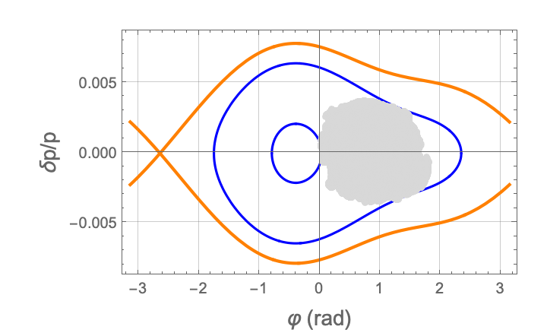
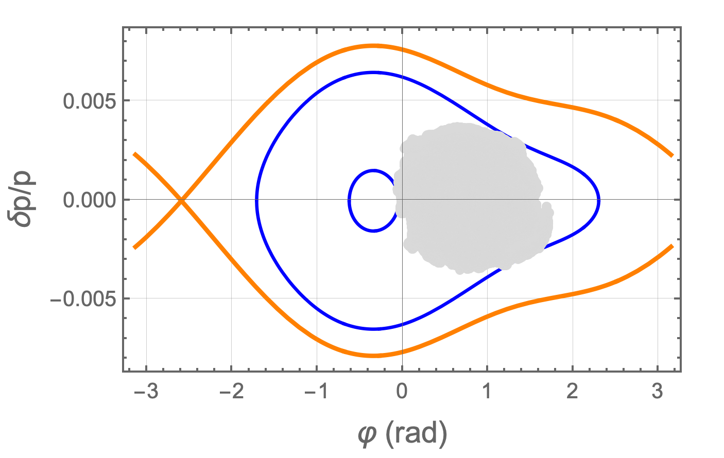
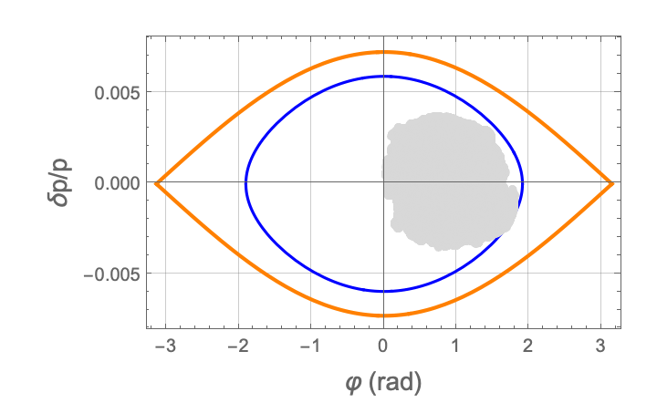
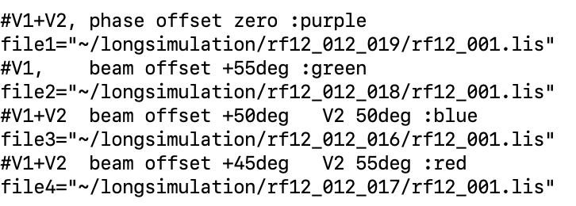
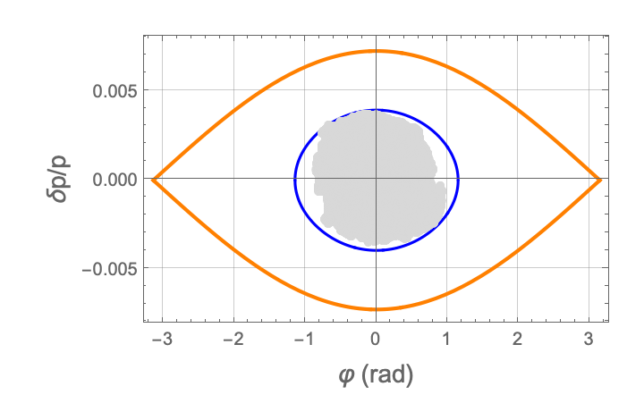
Longitudinal tracking simulations (w/o space charge, ZL)
t=0.01s->0.79s plots. every 100 turn
V1 0.13-0.20s:160-400kV, 0.69-0.79s:400-256 kV
V2 0.23-0.25s:110-0 kV
End of acceleration
Injection
w/ 2nd no offset
L-ε_{rms} = 0.41 eV L-ε_{full} = 7.8 eV
SX: (coupled bunch) T-instability after injection
w/ 2nd beam 50deg. V2 50deg
L-ε_{rms} = 1.0 eV L-ε_{full} = 11.8 eV
w/ 2nd beam 45deg. 2nd 55deg
L-ε_{rms} = 0.9 eV L-ε_{full} = 11.7 eV
w/o 2nd offset +50deg
timingchart2_run92_2_newgnu.plt
L-ε_{rms} = 0.67 eV L-ε_{full} = 11.4 eV
~/longsimulation
bfdpppattern.plt
w/o 2nd offset 0deg
L-ε_{rms} = 0.23 eV L-ε_{full} = 4.5 eV

Slide 16




beam +50deg, 2ndRF +50deg for 1st RF center
2-step debunch
efficiency 〜99.65% (tentative) w/ diffuser1
beam +45deg, 2ndRF +55deg for 1st RF center
2-step debunch
efficiency 99.68% (tentative) w/ diffuser1
8.1e+13 ppb 91.8kW
physics run
8.95e+13 ppb 101.5kW
One shot mode (total 5 shots -> no instability)
Run92 #2262320
Run92 #2265807
SX area beam Loss during SX
SX area beam Loss during SX
intensity normalized
BLM counts
intensity normalized
BLM counts
ESS
MS
ESS
MS
MR ring beam Loss before SX
MR ring beam Loss before SX
collimator
collimator
intensity unnormalized
BLM counts
intensity unnormalized
BLM counts
Beam loss at the FB has been reduced by the introduction of the 2nd RF

Slide 17


Beam splitting operation for slow-extracted beam
A-line: main beam (high intensity 8.1x10^13 ppp)
B-line: vertical halo only (5-10x10^9 ppp).
The two beams are delivered at the same time.
The beam splitter is located in the vertical slope.
The beam intensity of B-line is extremely sensitive to
the vertical beam halo fluctuation.
Fine beam tunings for the SX and the HD transport line are required.

Slide 18




Effects of Linear coupling resonance on the B-line intensity
3D Gauss distribution analytical
3GeV, 5.5/8*10^13 ppb
Space charge tune shift -0.15 @3 GeV
2020.10.26 by Y. Komatsu mail
5.5*10^13 ppp
A-Line
B-Line
〜5*10^9 ppp
The intensity bursts suppressed
The intensity bursts frequently seen
A linear coupling resonance correction by skew quads
in the MR has drastically improved the strong burst spills.
F.F. Vertical corrector ramping (by HD-G)

Slide 19

Vacuum pressure rise induced by e-cloud
90kW (4.24s cycle)
2025.4.22 21:30
-> 2025.4.28 9:00
full scale 5.5 days
IG_172
A-line only operation
not so serious instability
no BLM failure
V-halo might grow
for vacuum rise shots
For A+B operation,
vacuum rise shots
may induce
the B-line BLM failure
Further instability
suppression effort might
be necessary
for the A+B operation
threshold level
normal vacuum level
5000shots=5.9h
one shot 4.24s
net 〜89h
Good news:
”debunch beam scrubbing”
Improve the rise rate.

Slide 20


Slippage change during debunching for instability suppression
IPAC2025, WEPM028
M. Tomizawa et al.
|η| enlarging during debunching
is expected to suppress the microwave structure.
J-PARC MR has an imaginary transition-γ lattice.
Momentum compaction factor
can be flexibly changed maintaining H and V tunes
< 0
A beam test is planned.

Slide 21





VHF cavity for instability suppression
Longitudinal emittance growth by VHF cavity phase modulation
Y. Morita et al., JPS Conf. Proc. 33,011032(2021)
Controllable emittance growth with uniform distribution
Simulation example
〜P3
by Y. Morita
w/o VHF
w/ VHF
118MHz case
not yet funded
(large cost 〜2M$)

Slide 22



"rebunching" phenomenon
Wall current signal
wfm250221_00_ch1.trc
83kW 7.35x10^13ppp
Slow Extraction
(RF fundamental only, 2 step debunch)
P3+1.0s
t=P3+0.5s
P3+0.5s
t=P3+1.0s
P3+0s
one turn
one turn
Our spill monitor is insensitive to such a MHz structure.
The impact of the experiments should be carefully investigated.
P3+0s
P3+0.5s
P3+1.0s
Checking Analytical non-debunch simulation w/ 2nd !

Slide 23
Summary
Beam instability during debunching is a major limiting factor
in increasing the J-PARC SX beam intensity.
RF phase offset injection into the RF bucket and 2-step debunching
effectively suppress the beam instability.
The recent implementation of a 2nd RF system increased the beam power
from 82 kW to 92 kW (4.24 s cycle).
Further optimizations of the current RF manipulation scheme will be pursued.
Slippage factor modification and VHF cavity installation have been proposed
as future strategies to further suppress the instability.
The "rebunching" phenomenon and its impact on experiments
should be carefully investigated, and mitigation measures
will be implemented if necessary.

Slide 24


wakefittest05_01.wls
Dipole Impedance and coasting beam threshold
Transverse coasting instability threshold (K.Y.Ng text)
|Z₁ | $≤$ 4πω_{β}E₀/(3^{1/2} e I₀ c)|S_{β}| (δp/p)_{FWHM} F
|S_{β}|=|Q’-(n+ν_{β})η|
F $\sim 1$
ν_{x}=22.296, ν_{y}=20.808
Q’_{x}=-5, Q’_{y}=-7
η=-0.00192
I₀ =3.72A (see next page)
(δp/p)_{FWHM} =0.0009697 (see next page)
n= -1273
n= -1265
The impedance is above threshold!

Slide 25


