Slide 1


Design of a resonant slow extraction from low-emittance electron booster rings using transverse resonance island buckets
Cristopher Cortés, I. Agapov and W. Hillert
6th slow extraction workshop (SX 2025)
Oct 6 - 9 , 2025 Stony Brook, NY, USA

Slide 2

Contents
Introduction
Future light sources
Electron booster rings
Theory overview
Transversal dynamics
Slow extraction
DESY IV layout
Slow extraction setting
Example: Extraction at 6 GeV
Summary
DESY.

Slide 3
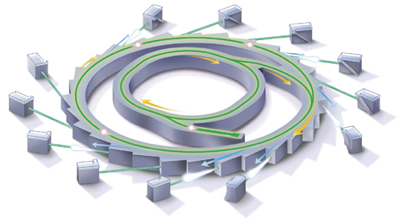
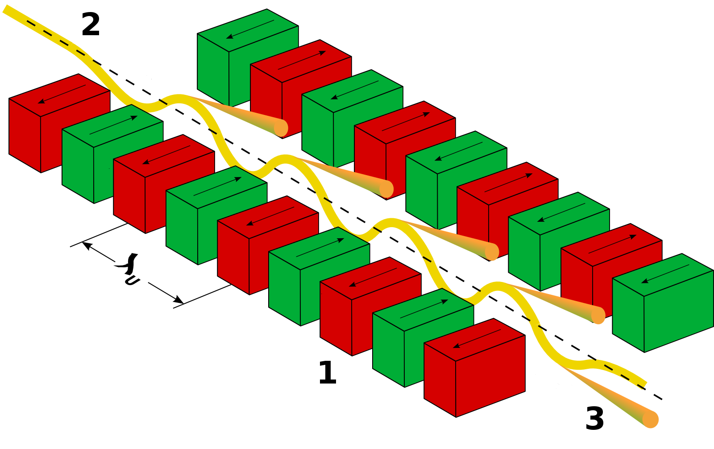
Introduction
Electron storage rings are science enablers for many photon users
PETRA III at DESY
2.3km circumference
6 GeV electron beam
Around 25 beamlines
Schematic of a synchrotron light source
Synchrotron light is produced with specialized insertion devices (undulators)
Figure taken from https://synchrotron.royalsociety.org.nz/science/
DESY.
Notes:
Success story -> proliferation of light sources

Slide 4
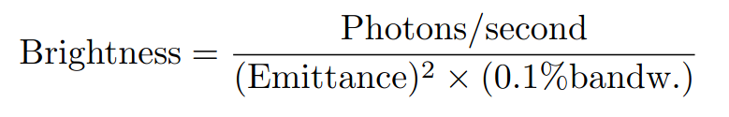
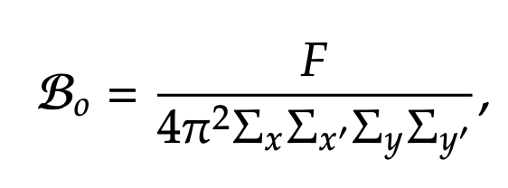
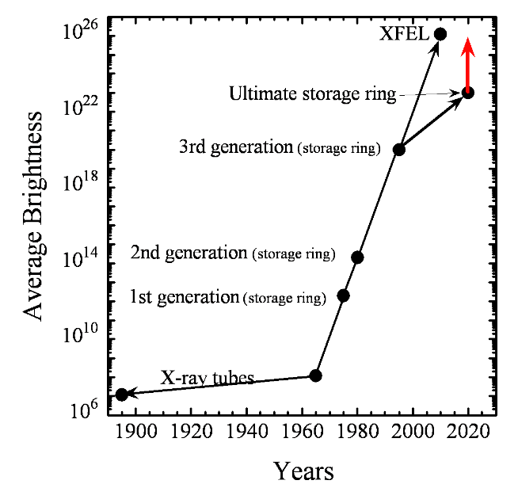
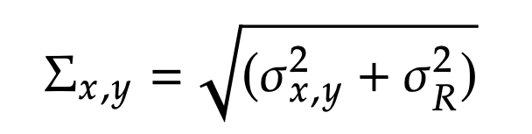
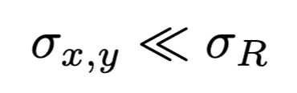
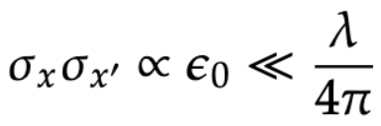
Introduction
Photon beam brightness
Average brightness evolution of light sources in time
Brightness increased by three orders of magnitude every 10 years since 1960s
Fourth-generation enabled by ultra-low emittances (electron beam sizes and divergences)
Electron beam
Photon beam
Figure taken from https://doi.org/10.1142/S1793626810000361
DESY.

Slide 5
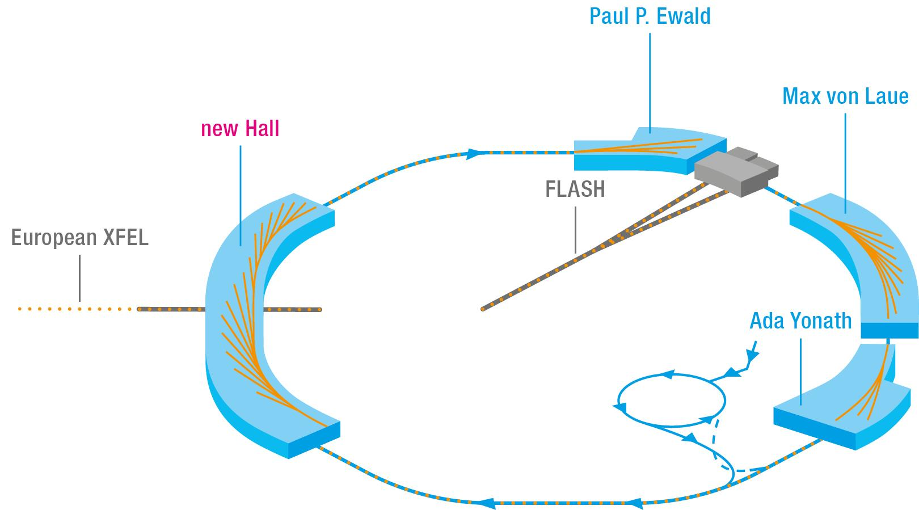
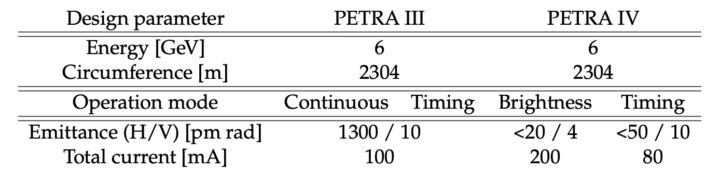
Introduction
Planned upgrade at DESY, Hamburg
Arc cells are hybrid six-bend achromats
New experimental hall to accommodate half of the beamlines
New low emittance booster based on multi-bend achromat cells
Will supply diffraction limited X-rays up to about 10 keV
New storage ring
(2.3 km)
New booster
[1] I. Agapov et al. Beam dynamics performance of the proposed PETRA IV storage ring. August 16, 2024. Pre-print: https://arxiv.org/pdf/2408.07995
DESY.

Slide 6
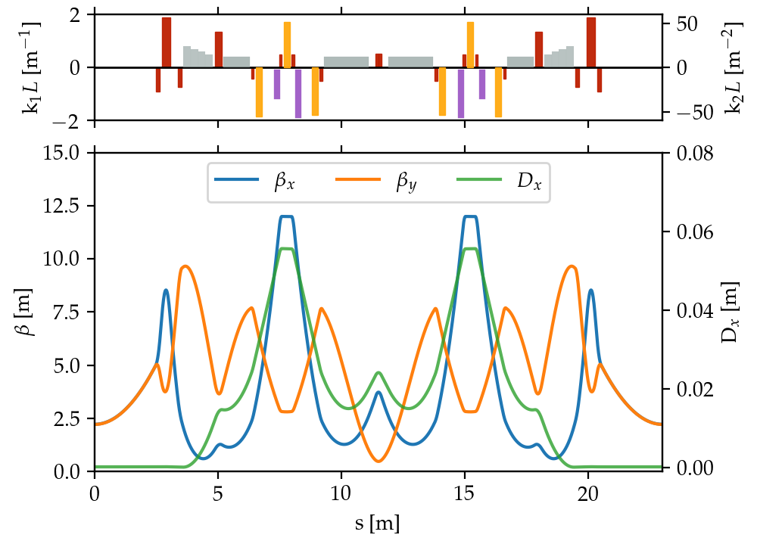
Introduction
Arc cells are hybrid six-bend achromats
New experimental hall to accommodate half of the beamlines
New low emittance booster based on multi-bend achromat cells
Will supply diffraction limited X-rays up to about 10 keV
Optical functions for the new cells
Bending magnets
Sextupole magnets
Quadrupole magnets
Octupole magnets
[1] I. Agapov et al. Beam dynamics performance of the proposed PETRA IV storage ring. August 16, 2024. Pre-print: https://arxiv.org/pdf/2408.07995
DESY.

Slide 7
Introduction
Hybrid multi-bend achromats
Optical functions for the new cells
Bending magnets
Sextupole magnets
Very low emittances achievable (< nm)
High quadrupole strengths
High natural chromaticity + Low dispersion
Strong sextupole strengths
Limited dynamic aperture
(< cm)
Low emittance booster is needed
(either LINAC, achromat synchrotron or plasma injector)
Quadrupole magnets
Octupole magnets
[1] I. Agapov et al. Beam dynamics performance of the proposed PETRA IV storage ring. August 16, 2024. Pre-print: https://arxiv.org/pdf/2408.07995
DESY.

Slide 8
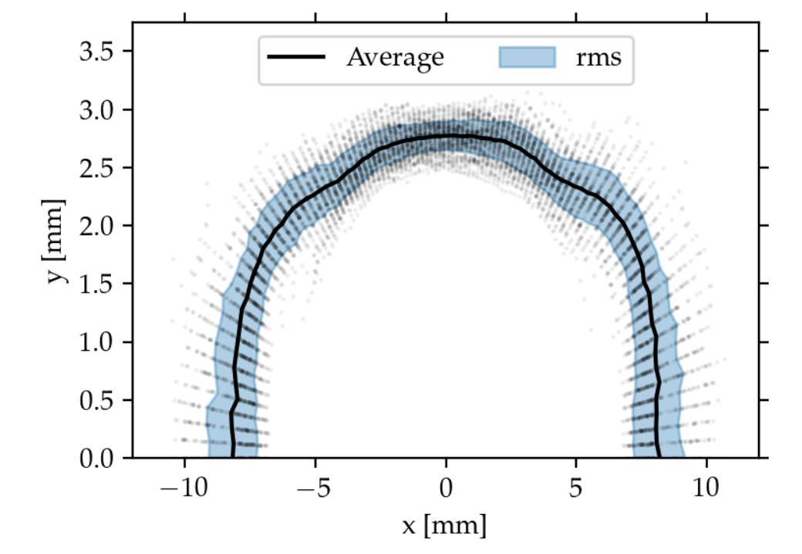
Injection and charge accumulation
Off-axis injection
PETRA IV dynamic aperture
PETRA IV will feature off-axis injection for initial charge accumulation and top-up
Horizontal aperture is limited by non-linear dynamics
Vertical aperture is limited by physical restrictions (Insertion Devices)
Injected beam
Stored beam
DESY.

Slide 9
Injection and charge accumulation
New booster is required!
PETRA IV dynamic aperture
Specification:
20 nm rad eq. emittance @ 6 GeV
Requirements:
max. 50 nm rad (for off-axis injection)
1 nC single bunch charge
Injected beam
Stored beam
DESY.

Slide 10
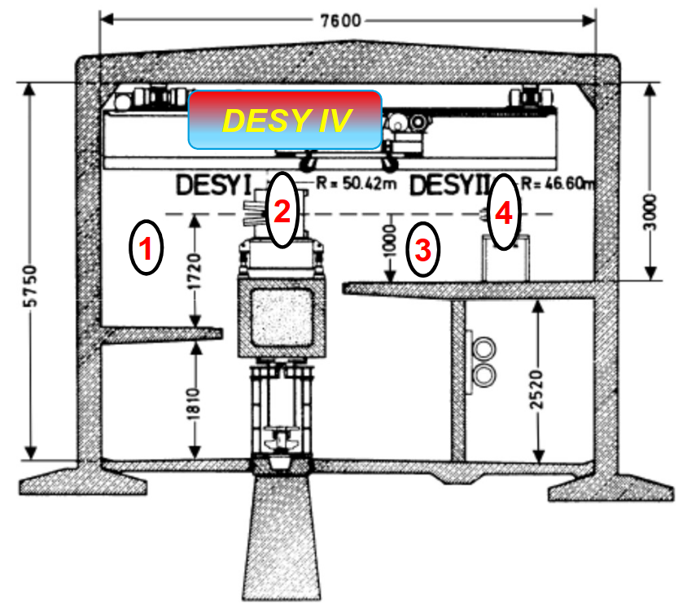
Introduction
Status of booster synchrotron
Installation possibilities of DESY IV
in booster cave
Specification:
20 nm rad eq. emittance @ 6 GeV
Structural analysis ruled out installation in the ceiling (mid-2023)
Design was revisited in winter 2023
DESY.

Slide 11
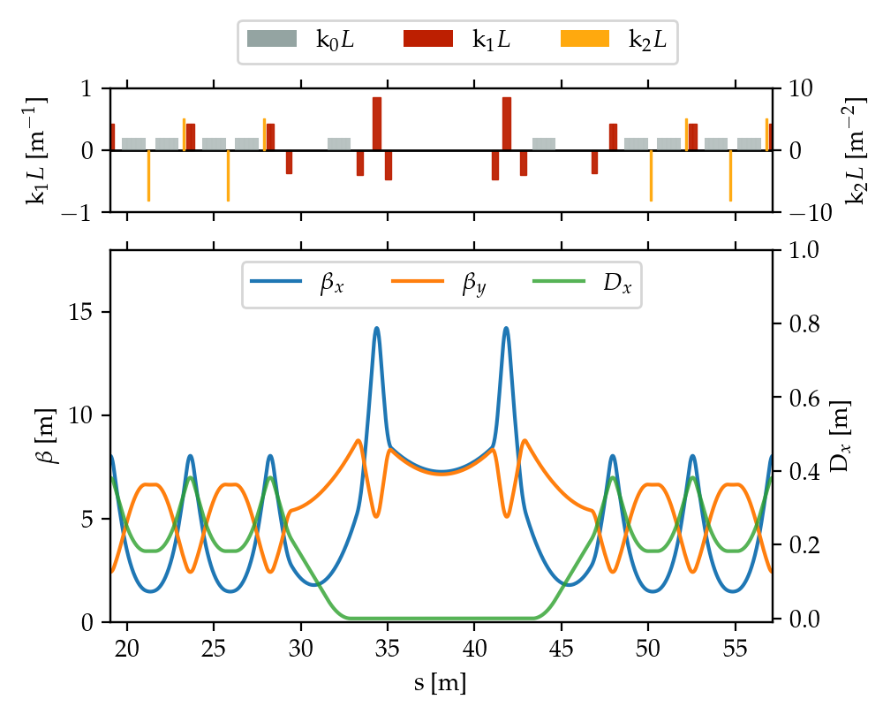
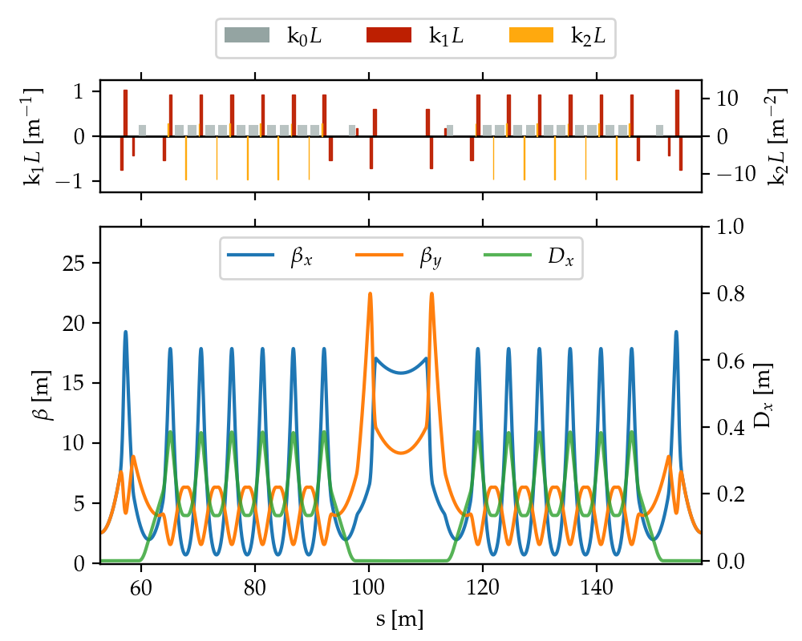
Introduction
Optical functions of the possible DESY IV boosters
Eight-fold symmetric ring cell
Six-fold symmetric ring super-cell
DESY.

Slide 12
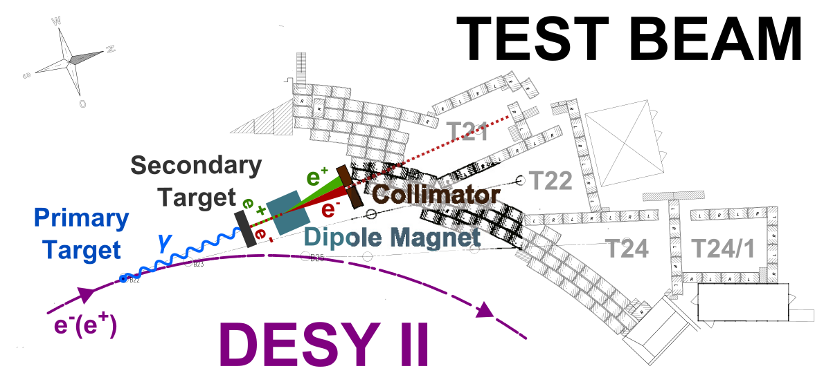
Introduction
Status of booster synchrotron
Sketch of the test beam facility at DESY
Requirement:
20 nm rad eq. emittance @ 6 GeV
Structural analysis ruled out installation in the ceiling
Design was revisited in winter 2023
Test beam capabilities (?)
Multi-GeV positron and electron beams
1266 users from 2013-2017
R&D of detector technology
(mainly ATLAS & CMS)
J. Dreyling-Eschweiler, et. al. The DESY II test beam facility, NIM-A, Vol. 922, 2019,
https://doi.org/10.1016/j.nima.2018.11.133.
DESY.

Slide 13
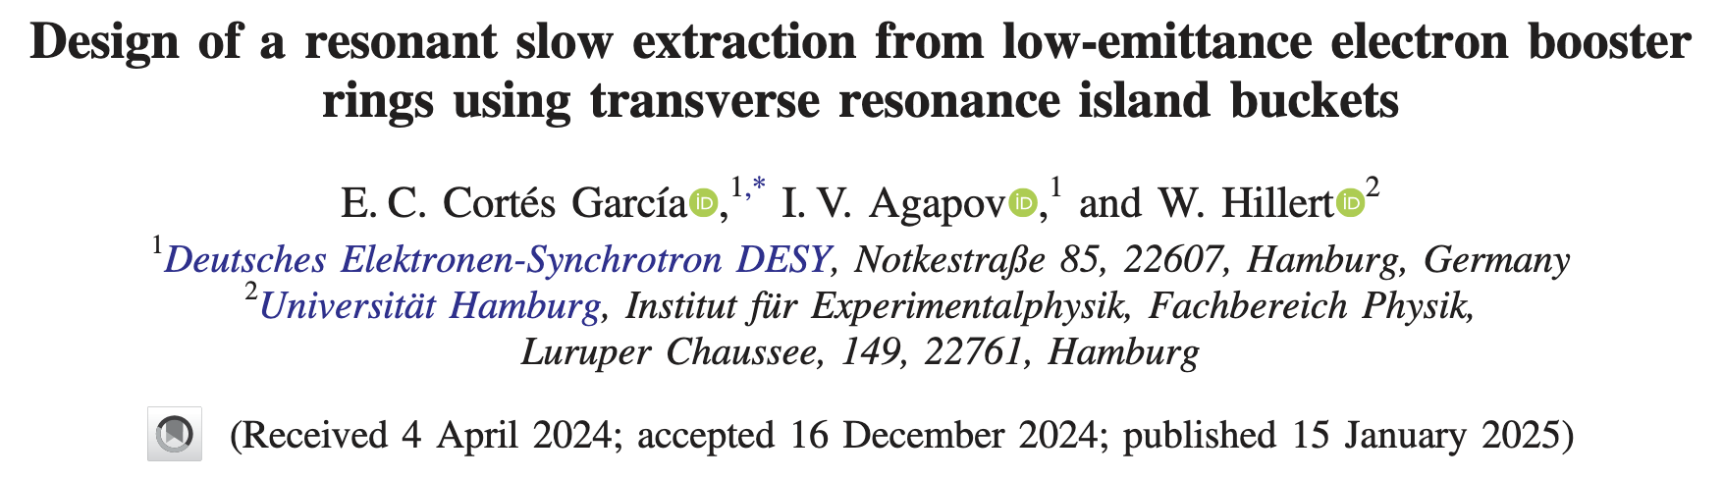
Introduction
Status of booster synchrotron
Sketch of the test beam facility at DESY
Requirement:
20 nm rad eq. emittance @ 6 GeV
Structural analysis ruled out installation in the ceiling
Design was revisited in winter 2023
Test beam capabilities (?)
Multi-GeV positron and electron beams
1266 users from 2013-2017
R&D of detector technology
(mainly ATLAS & CMS)
J. Dreyling-Eschweiler, et. al. The DESY II test beam facility, NIM-A, Vol. 922, 2019,
https://doi.org/10.1016/j.nima.2018.11.133.
DESY.

Slide 14
Contents
Introduction
Future light sources
Electron booster rings
Theory overview
Transversal dynamics
Slow extraction
DESY IV layout
Slow extraction setting
Example: Extraction at 6 GeV
Summary
DESY.

Slide 15
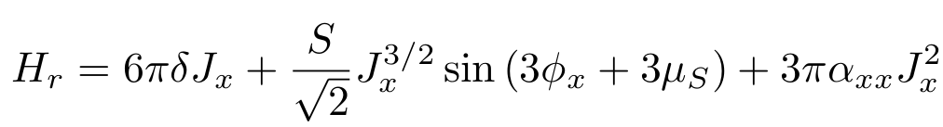
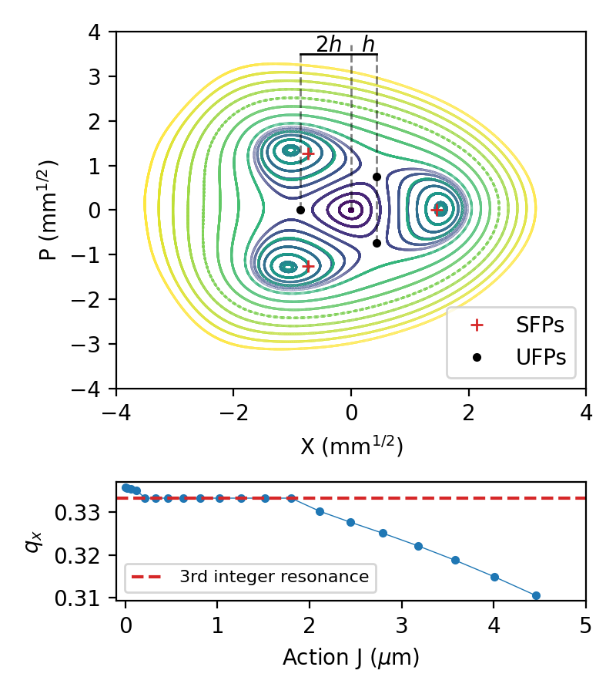

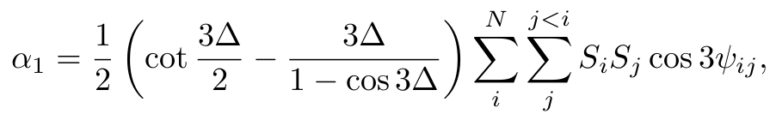
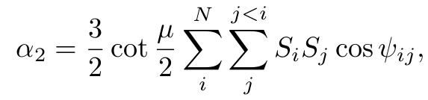
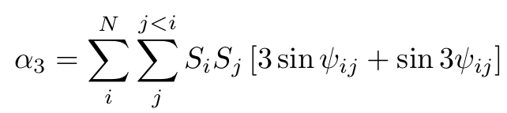

Transversal dynamics
Kobayashi part
Assume high sextupole strengths as in future electron booster rings
Sextupoles generate amplitude detuning (second order effect) extended Hamiltonian
extension (K.Symon, 1968)
Amplitude detuning
DESY.

Slide 16

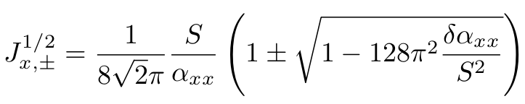
Transversal dynamics
Kobayashi part
Assume high sextupole strengths as in future electron booster rings
Unstable and stable fixed points can be estimated with formulas
Make use of this optics to extract
extension (K.Symon, 1968)
DESY.

Slide 17
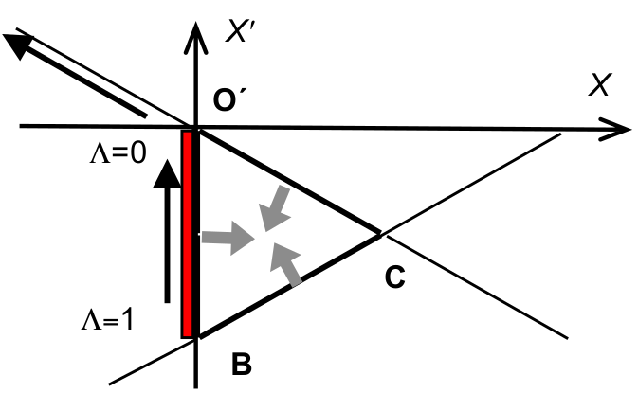
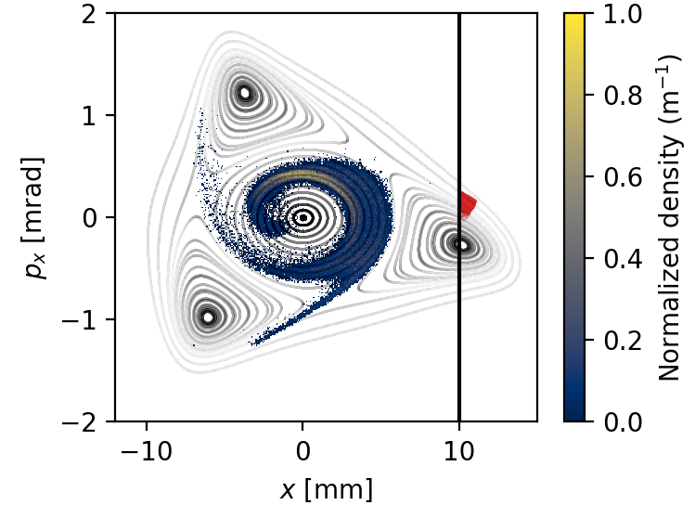
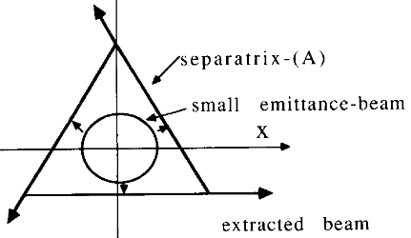
Resonant slow extraction
Quadrupole driven
Reduce the tune difference to shrink the stable triangle area
RF-KO with TRIBs optics
Picture taken from: PJ Bryant. Resonant Extraction. CAS-CERN Accelerator School: Beam injection, extraction and transfer. Italy, 2017.
RF-KO
Keep the optics constant. Blow-up the beam by exciting the betatron oscillations
M. Tomizawa, et. al.
Slow beam extraction
at TARN II. NIM-A, 1992.
DESY.

Slide 18
Contents
Introduction
Future light sources
Electron booster rings
Theory overview
Transversal dynamics
Slow extraction
DESY IV layout
Slow extraction setting
Example: Extraction at 6 GeV
Summary
DESY.

Slide 19
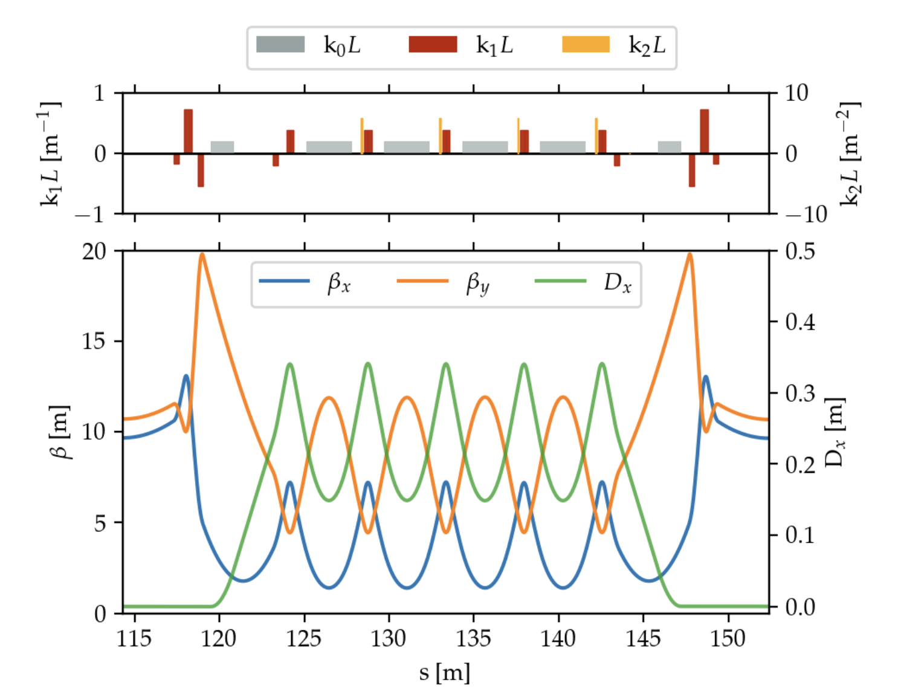
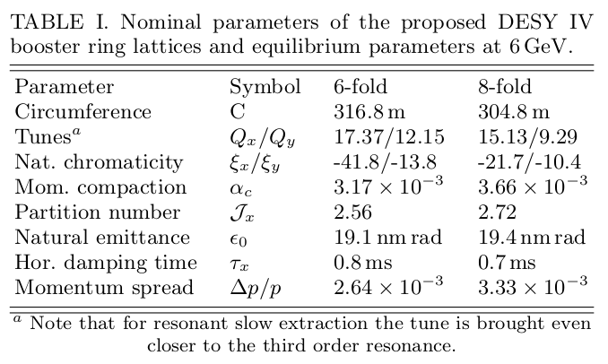
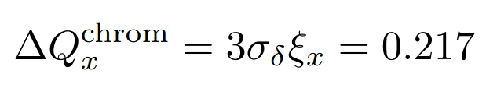
DESY IV
Less aggressive optics
Crossing of half-integer stop-band
DESY.

Slide 20
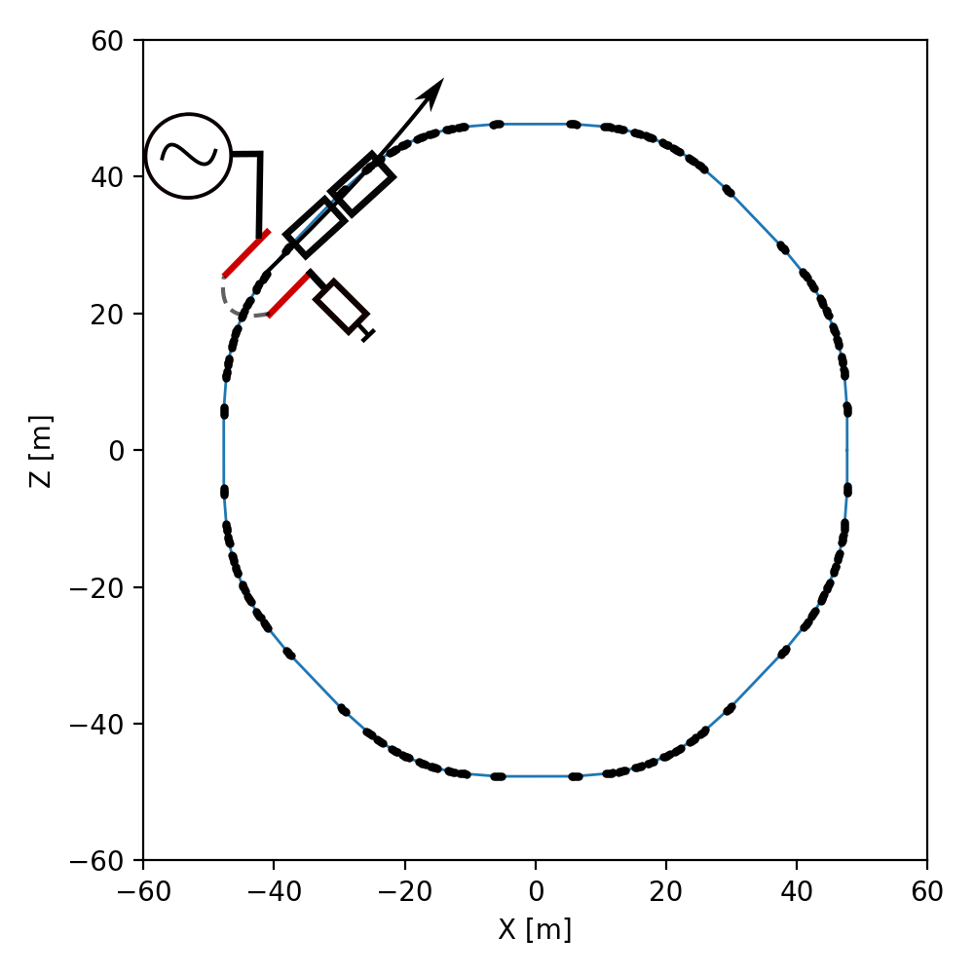
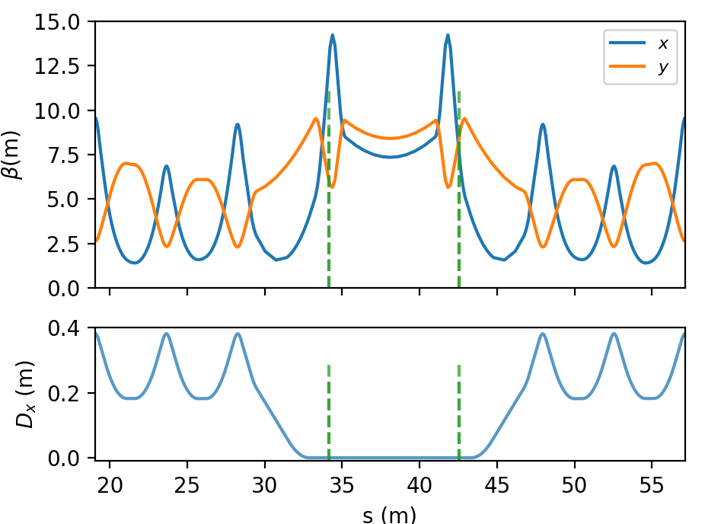
Setting up the slow extraction
Hardware necessary
Two harmonic sextupole families
Stripline kicker for the emittance blow-up
Thin-electrostatic septum (ESS)
Magnetostatic septum (MSS)
Harm. sext.
DESY.

Slide 21
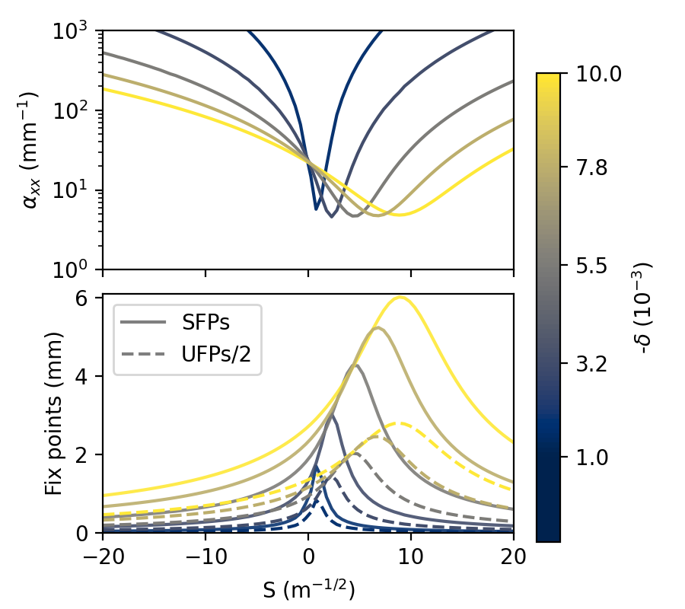
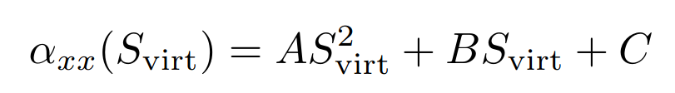
Setting up the slow extraction
Functional dependency of amplitude detuning and virtual sextupole strength
Parameter scan for 8-fold lattice
Scan over tune distance to resonance and sextupole strength to determine optimal working point for extraction
Unstable fixed point determine the available area in phase-space for the “waiting beam”
For the 8-fold lattice the amplitude detuning is very sensitive to the virtual sextupole strength
Working point
Tune distance to resonance
Virtual sextupole strength
DESY.

Slide 22
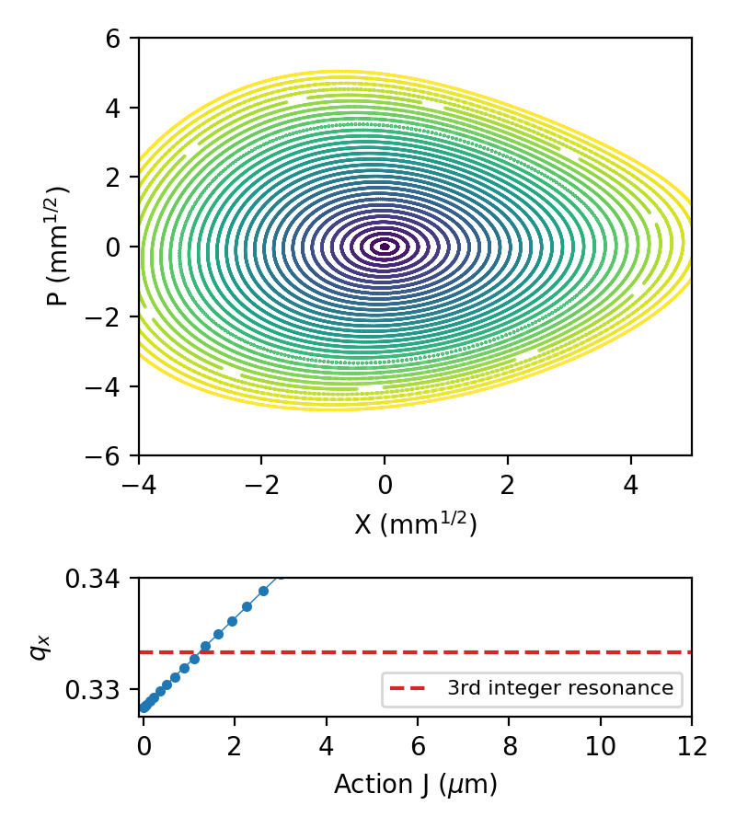
Setting up the slow extraction
Phase-space portrait at feasible working point
Parameter scan for 8-fold lattice
Working point
Tune distance to resonance
Virtual sextupole strength
DESY.

Slide 23
Setting up the slow extraction
Phase-space portrait at feasible working point
Parameter scan for 8-fold lattice
No islands were generated!
Working point
Tune distance to resonance
Virtual sextupole strength
DESY.

Slide 24
Setting up the slow extraction
Hardware necessary
Two harmonic sextupole families
Stripline kicker for the emittance blow-up
Thin-electrostatic septum (ESS)
Magnetostatic septum (MSS)
Add one harmonic octupole family
Harm. octupole
Harm. sext.
DESY.

Slide 25
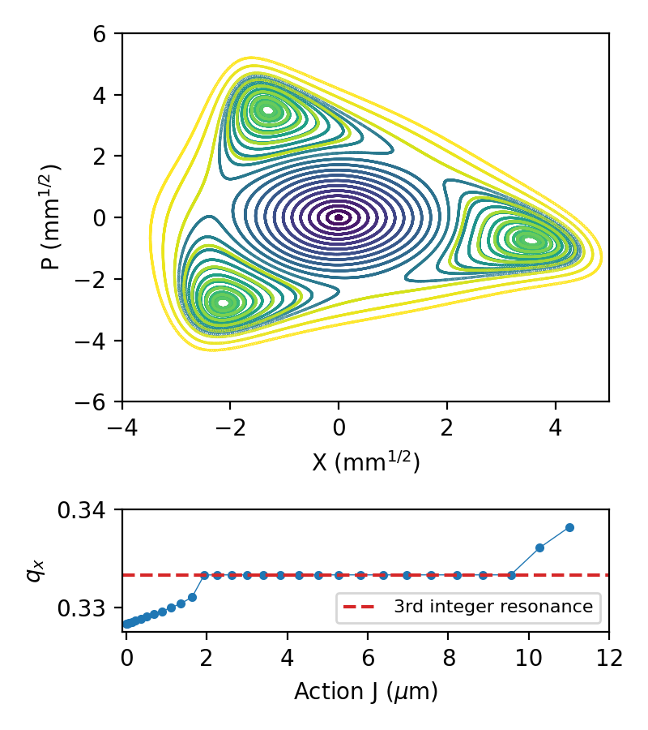
Setting up the slow extraction
Phase-space portrait at feasible working point with corrected amplitude detuning
Parameter scan for 8-fold lattice
Now islands are generated
Working point
Tune distance to resonance
Virtual sextupole strength
DESY.

Slide 26
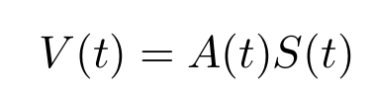
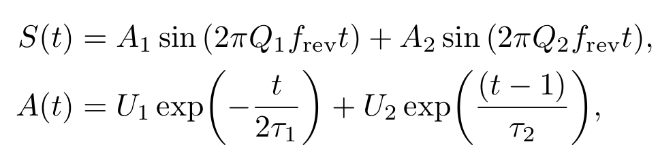
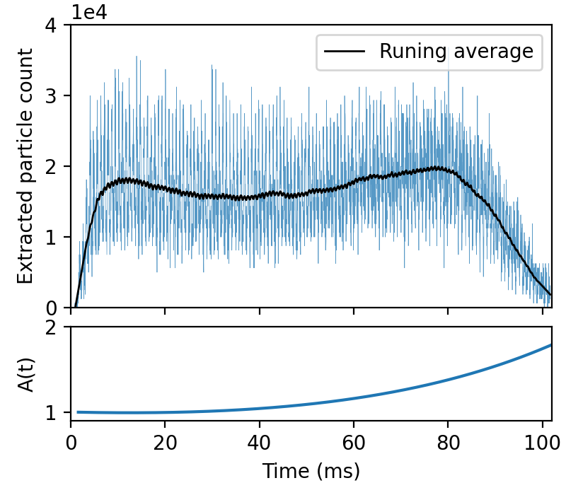
Example: Extraction at 6 GeV
Test for proof-of-concept
Excitation waveform
Escape rate
(extraction region)
Diffusion rate
(diffusion region)
Simulation performed with Xsuite
DESY.

Slide 27
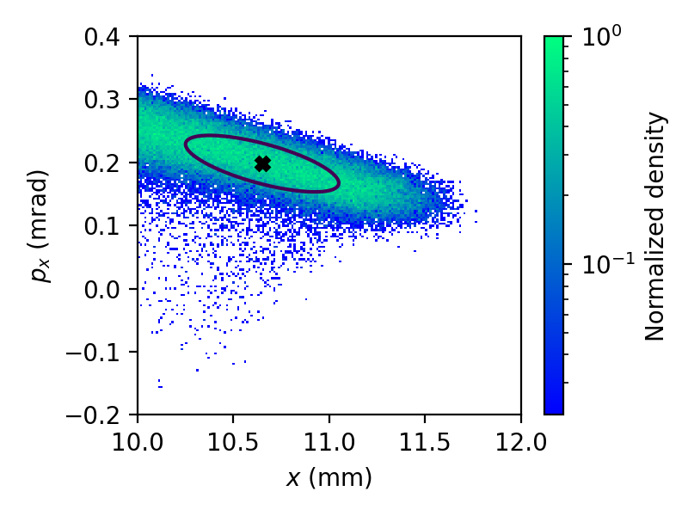
Example: Extraction at 6 GeV
Test for proof-of-concept
Extracted beam
100 ms spill example
Emittance -> 13 nm rad
Converging beam
(negative correlation between angle and position)
DESY.

Slide 28
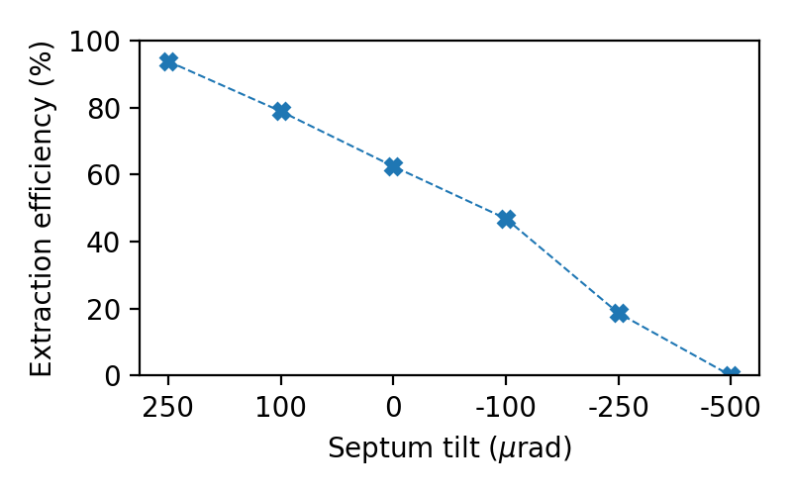
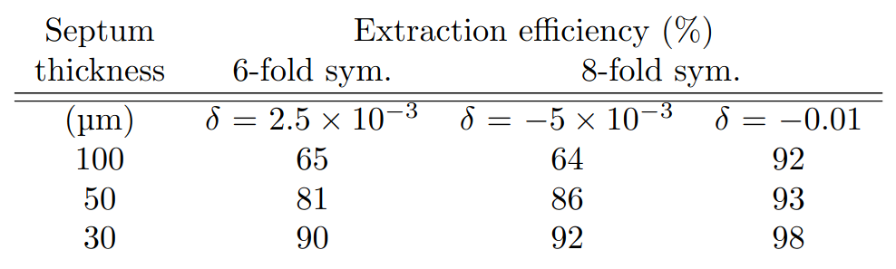
Example: Extraction at 6 GeV
Extraction efficiency
Tentative considerations:
5.5 m available length for ESS & MSS
2m-long ESS
30 - 100 micron wire/ribbon width (ESS)
4mm blade for the MSS
Extraction efficiency as function of the ESS tilt misalignment
Extraction efficiency (%)
DESY.

Slide 29
Summary
New low-emittance booster ring is needed for efficient charge accumulation
Low emittances lattices have a considerable amplitude detuning term
Test beam facility should offer beams after upgrade
Setting slow extraction with resonant island buckets is possible
E. C. Cortés García, I. Agapov and W. Hillert. Design of a resonant slow extraction from low emittance electron booster rings using transverse resonance island buckets. PRAB, Jan 2025. DOI: 10.1103/PhysRevAccelBeams.28.011601
E. C. Cortés García et al. Design of a resonant slow extraction from the planned DESY IV booster synchrotron. IPAC25, June 2025. DOI: 10.18429/JACoW-IPAC25-TUPM053
DESY.

Slide 30
Cristopher Cortés
edgar.cristopher.cortes.garcia@cern.ch

