Slide 2
Studies on replacement of electrostatic septa with crystal technology
Y. Dutheil, P. Arrutia, M. Fraser, M. Giacomelli, A. Gorn, F. Velotti SY-ABT-BTP, CERN, Geneva, Switzerland

Slide 3
Outline
Context
SPS extraction layout and new scheme constraints
Crystal characteristics
Drop-in replacement concept
Momentum driven concept
Implementation with the present equipment
Beam time results from summer 2025
Conclusion

Slide 4
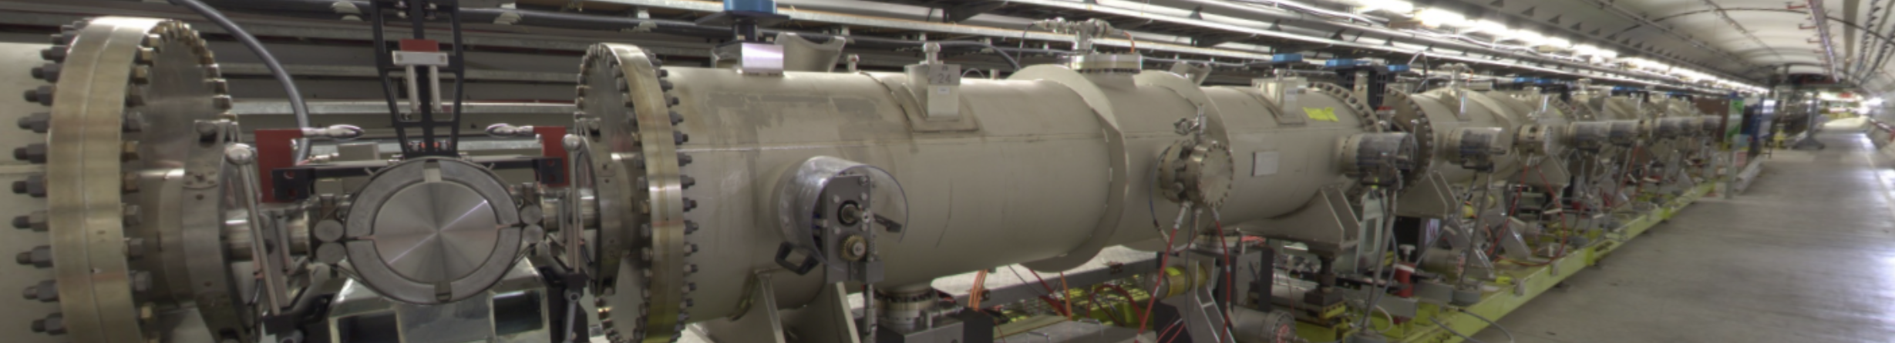
Context
Slow extraction of 400 GeV/c proton beam towards North Area
Presently extracting in the order of 10¹⁹ protons per year
Radiation levels
Consequences for personnel intervention, equipment lifetime, …
Ongoing improvements
Loss reduction with beam dynamics and crystal enhancement of slow extraction
Activation reduction with different material
Intervention time mitigation
Electrostatic septa in the SPS tunnel LSS2

Slide 5
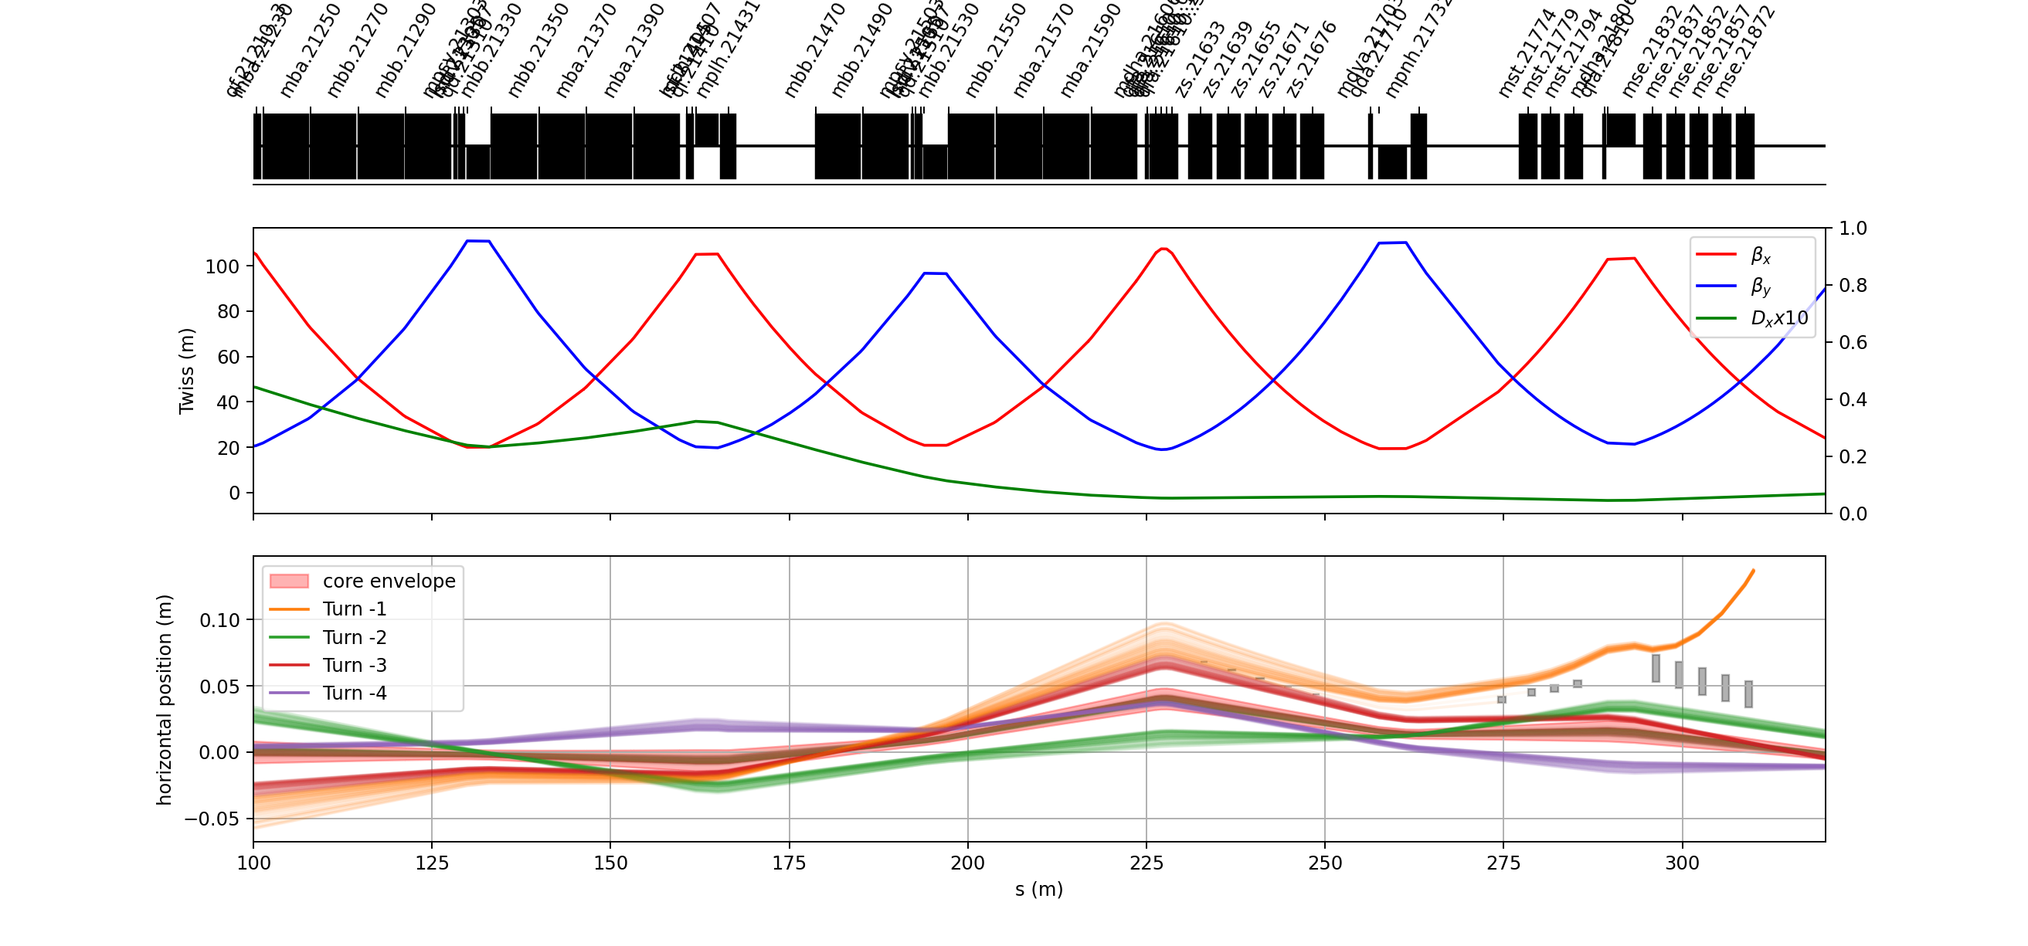
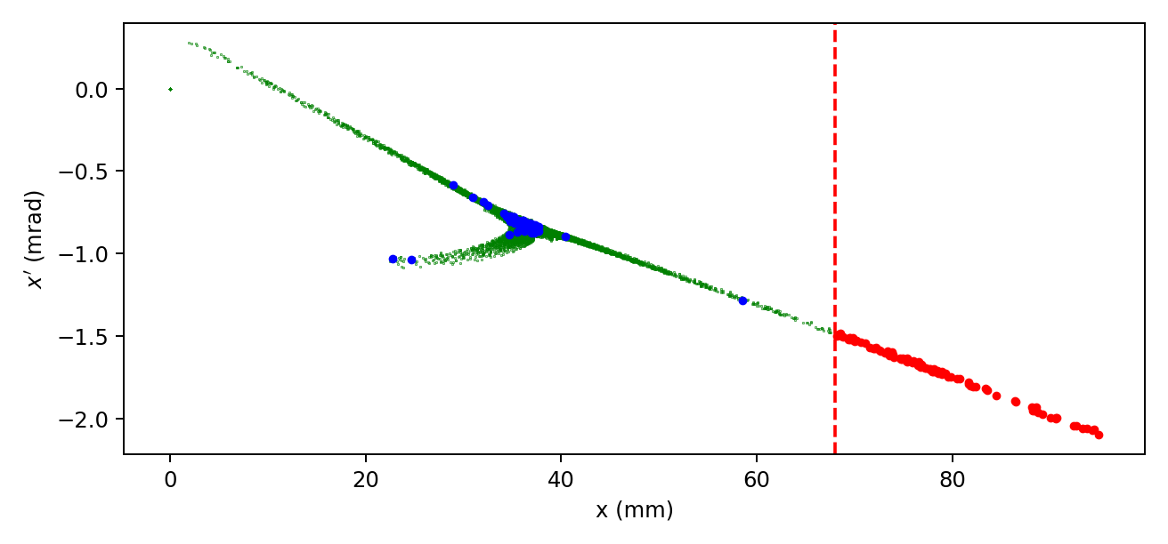
Layout of SPS extraction
Magnetic septa protection absorber
Electrostatic septa
Nominal slow extraction conditions
Third integer resonant scheme at Qx=26.666
COSE (momentum driven)
Electrostatic septum
Combined deflection of 440 µrad
Magnetic septum
Thickness of ~5 mm
Present gap opened ~20 mm
Phase space at the entrance to the first electrostatic septum
G. Ladarola & F. Velotti, gitlab.cern.ch/sps-projects/sx_xsuite_sps
G, Ladarola et. al., github.com/xsuite

Slide 6
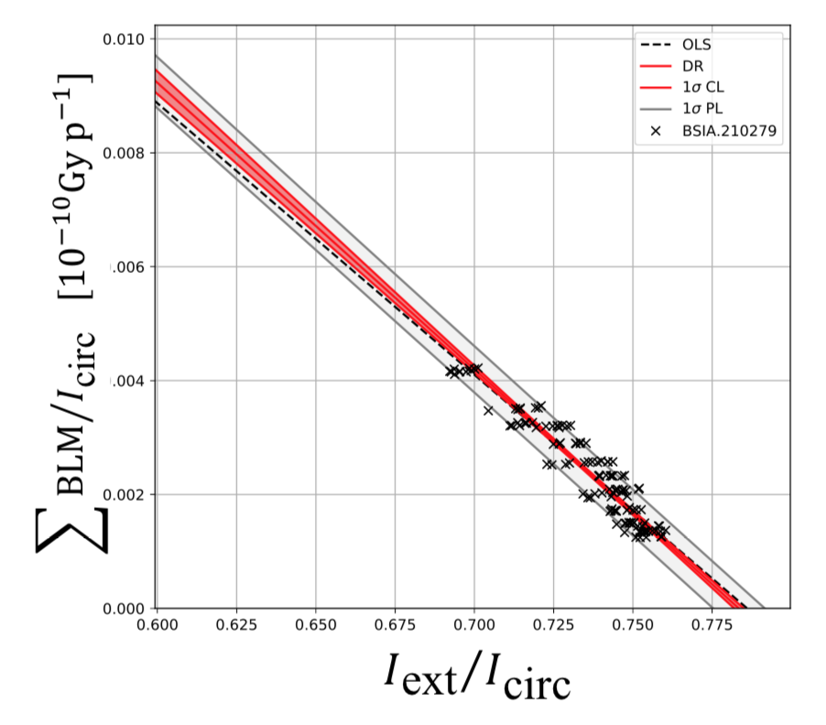
Constraint
Removal of the electrostatic septum
A large gap (~5 mm) is required between circulating and extracted beams
Extraction efficiency >99%
Estimated extraction inefficiency measured in ~2018 of 3.4 ± 0.7 % with significant improvements since then
A new scheme could only be implemented
Reliability
Despite complexity, the present slow extraction system is highly reliable and stable
A new scheme must ensure reliable and stable beam delivery
Spill structure performance
SPS north area users are sensitive to spill rippled up to high frequencies
A new scheme must provide a good spill structure and control over spill-frequency content
M.A. Fraser et al., Slow Extraction Efficiency Measurements at the CERN SPS, contribution TUPAF054 at IPAC’18, Vancouver, BC, Canada

Slide 7
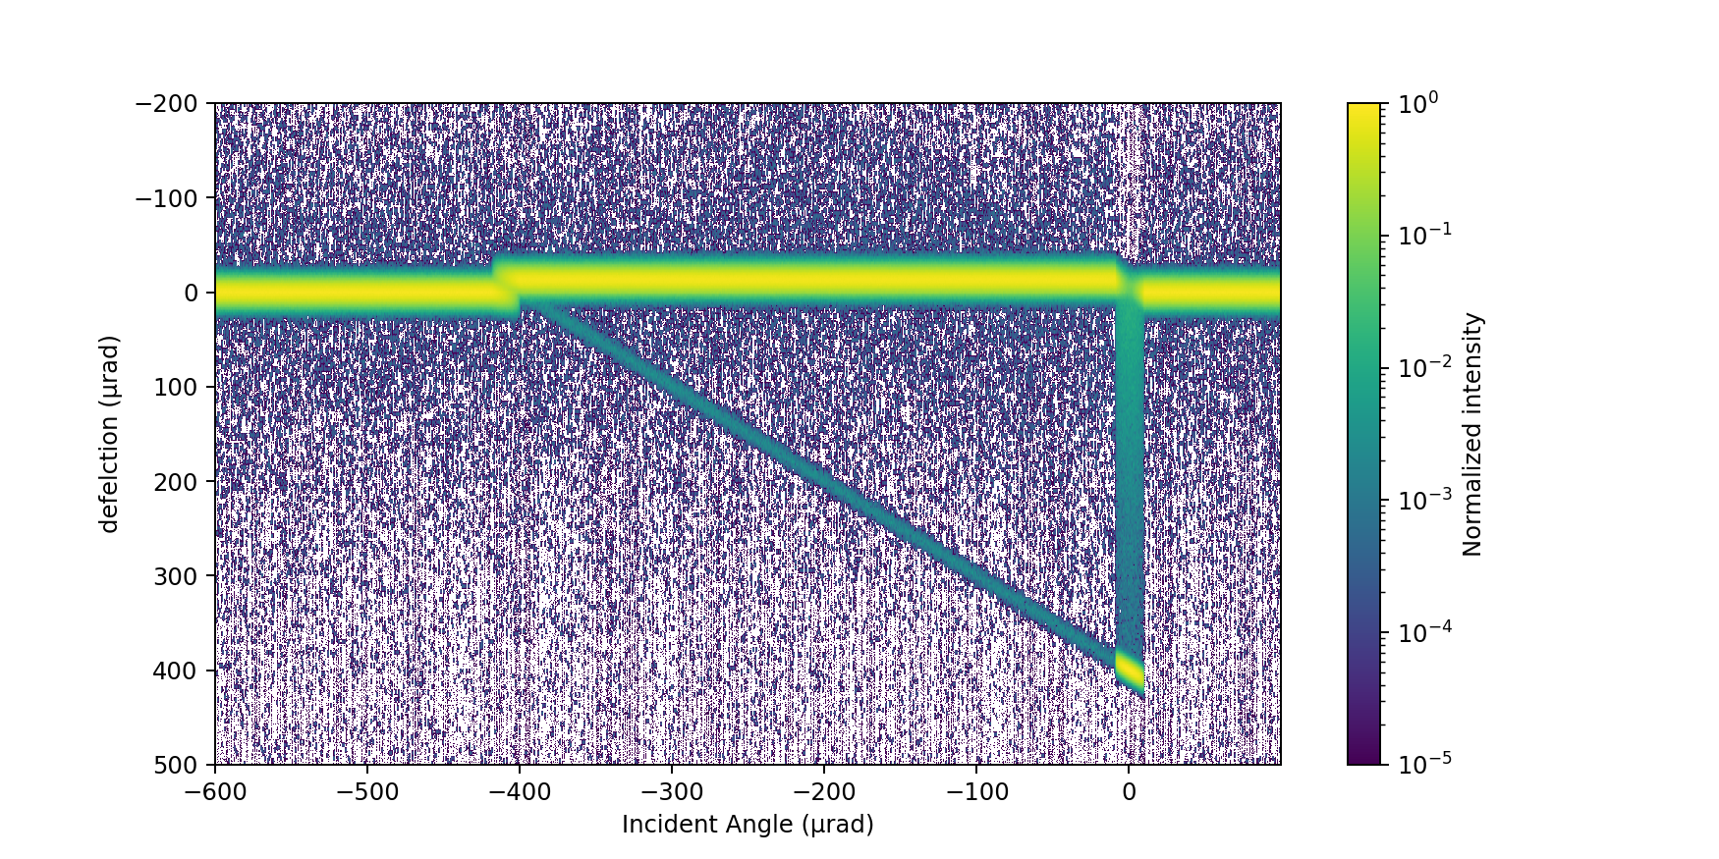
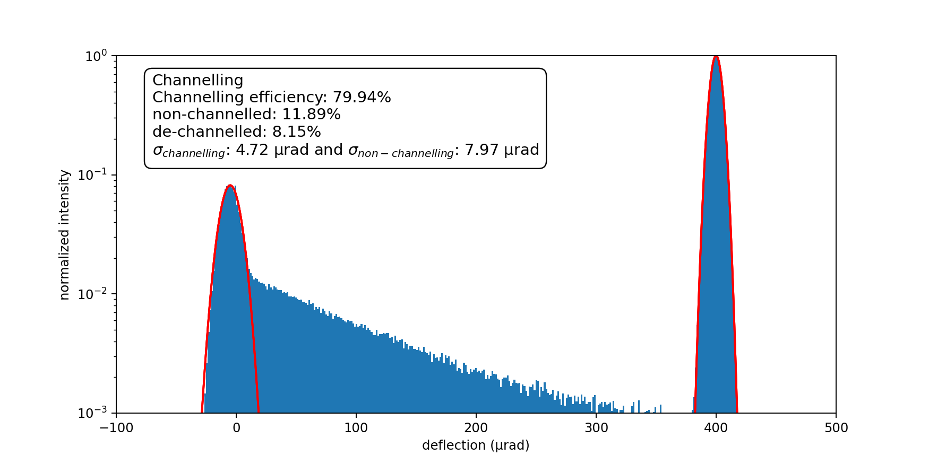
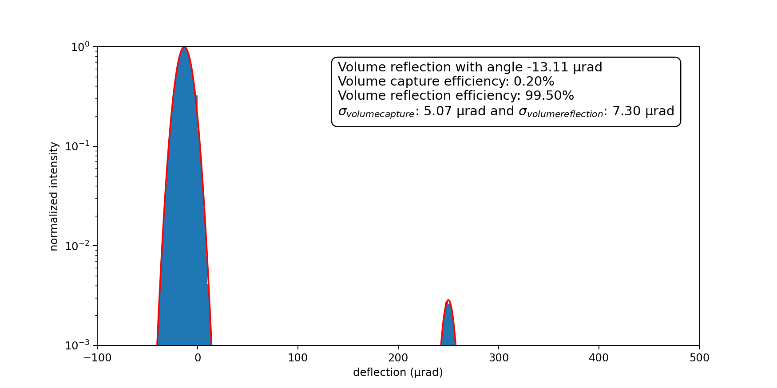
Crystal characteristics
Model
Xsuite EverestCrystal with SiliconCrystal material
Probed with a perfect pencil beam of protons at 400 GeV/c
Case of a Silicon crystal 4 mm long and R=10 -> 400 µrad
1
4
1
Incoming
Angle
0 µrad
2
5
3
5
4
2
Incoming
Angle
-150 µrad
Scattering
Volume reflection
Volume capture
channelling
Dechannelling
3
G, Ladarola et. al., github.com/xsuite

Slide 8
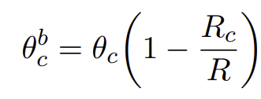

What crystals do ?
Several crystal types have been manufactured and tested [2,3]
Wide range of size (2 to 70 mm) and angle (30 µrad to 13 mrad)
Thick crystal up to 20 mm are possible but not the whole surface is exploitable [2]
Critical angle for straight silicon crystal at 400 GeV is 10urad and R_{c}=1m
For a bent crystal
For 10m radius, crystal provides 100 µrad/mm but 200 µrad/mm is feasible mechanically
Volume reflection ~14 µrad
Efficiency measured at 400Gev [2]
channelling up to 68% and 54% respectively for angular spread within 5 µrad (1/2 θ_{c}) and 10 µrad (1θ_{c})
Volume reflection up to 90%
Present discussion on the feasibility of crystal slow extraction overlooks crystal manufacturing methods and limitations on the resulting crystals
[1] M. D'andrea, application of crystal collimation to LHC, PhD 2021, link
[2] R. Rossi, Measurements of coherent interactions of 400 GeV protons in silicon bent crystals, link
[3] S. Cesare, Analysis of long crystal channelling efficiency from hadron beam test data, Workshop FixedTarget ICJLAB, 2023, link

Slide 9
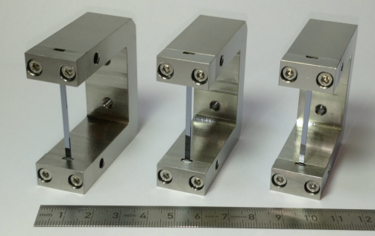
What crystals are available ?
TECS
Installed in LSS2
2 mm length
174 µrad channelling angle towards the outside of the ring
TECA
Installed in LSS4
1.1 mm length
190 µrad channelling angle towards the inside of the ring
Future crystal-array
See earlier talk by L. Esposito
[1]
[1] L. Esposito, et al., Crystal for slow extraction loss-reduction of the SPS electectrostatic septum, IPAC2019, Melbourne, Australia
[2] V. Rodin, et al., channelling performance of ben crystals developed at CERN, IPAC2024, Nashville, TN, USA

Slide 10
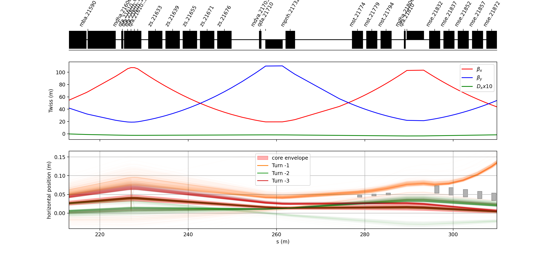
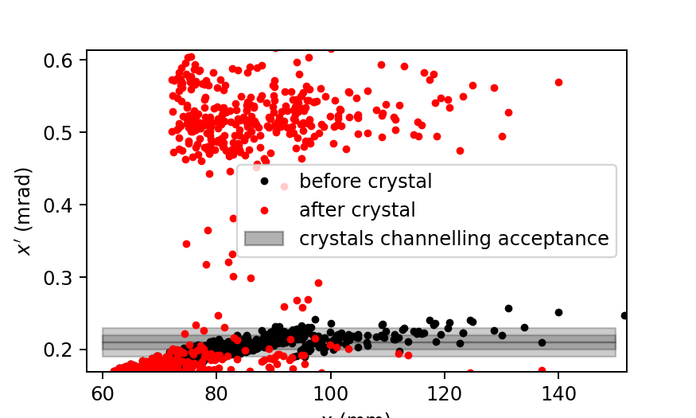
Concept : drop-in septa replacement
Nominal slow extraction scheme on third order resonant tune
Extraction with 3 arrays of crystal to increase efficiency and depopulate the beam density at the septum
Trajectories clear the present thin septum aperture
Pros
No change to the slow extraction scheme
Local scheme with only changes near present
Cons
Large channelling required of 400 µrad
Single pass channelling limits the efficiency of the scheme
Not possible with present hardware and unrealistic with the nominal slow extraction spiral step

Slide 11




Concept : non-local, momentum driven extraction
Extract particles from the SPS through a non-resonant extraction scheme in which the particles receive a kick at the TECA (crystal) in LSS4 and get extracted in LSS2
Primarily single-turn scheme
Objectives
Use channelling and linear optics to create a large gap at the extraction region
Control extraction rate with ring relative momentum change
Characterise efficiency and frequency content of the spill
$$Crystal acceptance$$
$$P_{x}(μrad)$$
$$Reference$$
$$momntum change$$
x$(mm)$
[1] P. Arrutia, Non-resonant momentum-driven SX, SLAWG#73, CERN, 2023

Slide 12
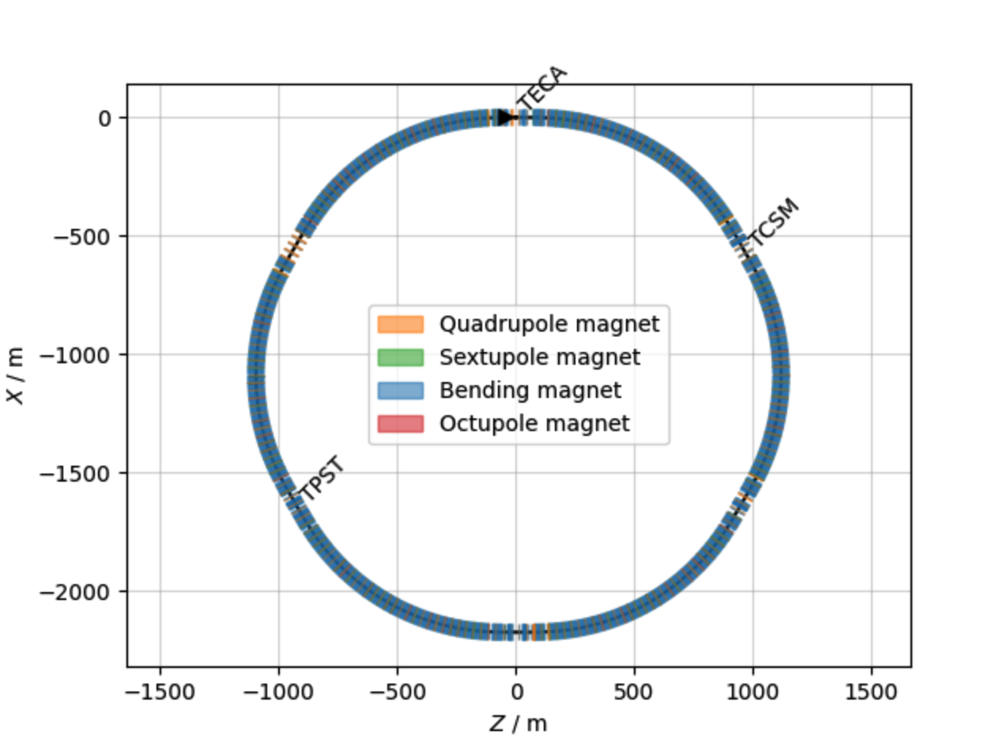





Momentum driven extraction : proof-of-principle
Hardware requirements
Crystal channelling from the TECA position
Transport to nominal slow extraction straight section (LSS2)
Retracted electrostatic septa -> first element is TPST (~5 mm thick protection device in front of the first magnetic septum)
Possible use of existing collimator for development (TCSM)
Optics requirements
High dispersion and low horizontal beta function at the crystal location
~π/2 phase advance between the crystal and the extraction magnetic septum
$$channeled particles$$
$$P_{x}(μrad)$$
$$channelling$$
$$Crystal acceptance$$
x$(mm)$

Slide 13
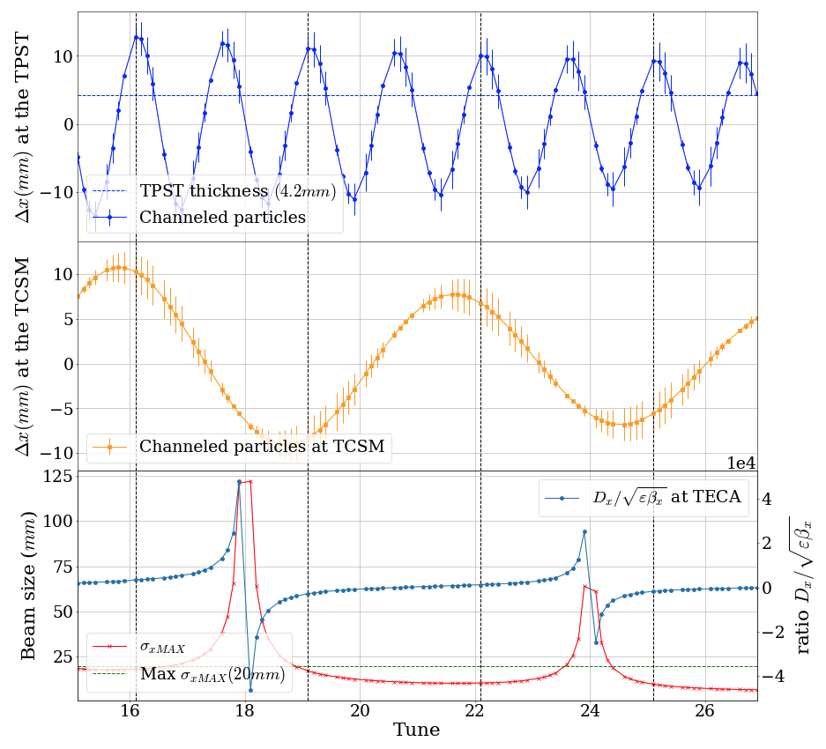
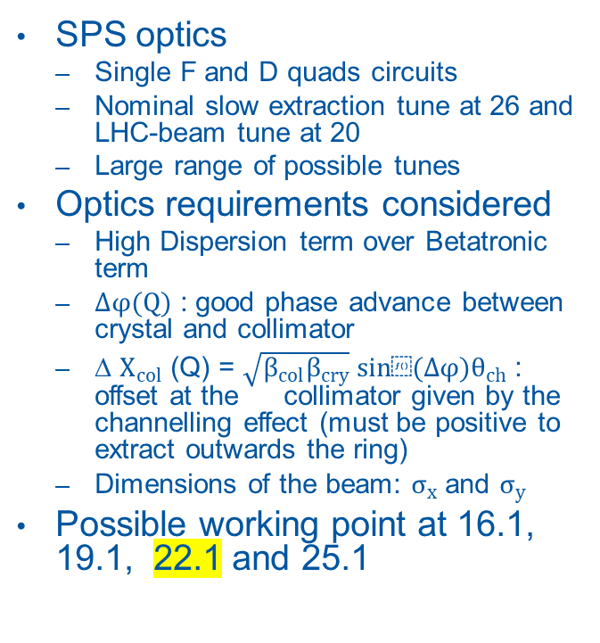
Momentum driven extraction : SPS optics
SPS optics
Single F and D quads circuits
Nominal slow extraction tune at 26 and LHC-beam tune at 20
Large range of possible tunes
Optics requirements considered
High Dispersion term over Betatronic term
$∆φ(Q)$ : good phase advance between crystal and collimator
∆ $X_{col}$ (Q) = $\sqrt{β_{col}β_{cry}} sin⁡(∆φ)θ_{ch}$ : offset at the collimator given by the channelling effect (must be positive to extract outwards the ring)
Dimensions of the beam: $σ_{x}$ and $σ_{y}$
Possible working point at 16.1, 19.1, 22.1 and 25.1

Slide 14
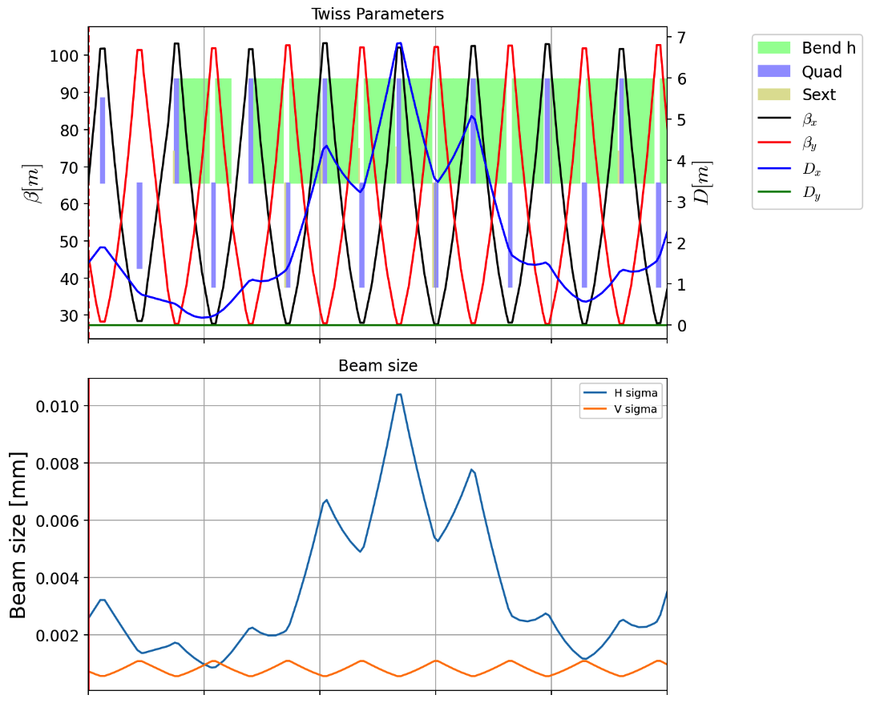
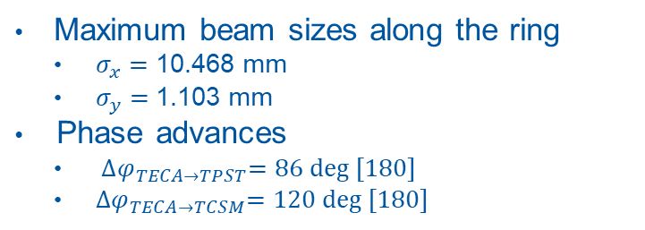
Momentum driven extraction : SPS optics Q=22
Maximum beam sizes along the ring
$σ_{x}=$ 10.468 mm
$σ_{y}=$1.103 mm
Phase advances
${∆φ}_{TECA→TPST}=\text{86 }\text{deg}\text{ [180]}$
${∆φ}_{TECA→TCSM}=\text{120 }\text{deg}\text{ [180]}$

Slide 15
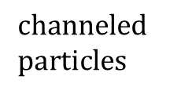

Momentum driven extraction : crystal orientation
TECA crystal is placed on the inside, channelling towards the inside of the machine
x’
x’
Dispersion vector
x
crystal acceptance
x
$$channelling$$
Resulting offset at the extraction is from the wrong side of the beam because dispersion remains large at both location
$$channeled \\ particles$$
TPST blade

Slide 16
Momentum driven extraction : crystal orientation
Context
Large and positive dispersion at both the crystal and extraction septum
No local control of independent quadrupole
Optics at both straight sections cannot be different
Moving the beam to the other side of the crystal
x’
x
Resulting offset at the extraction is now on the correct side of the beam
x
TPST blade

Slide 17
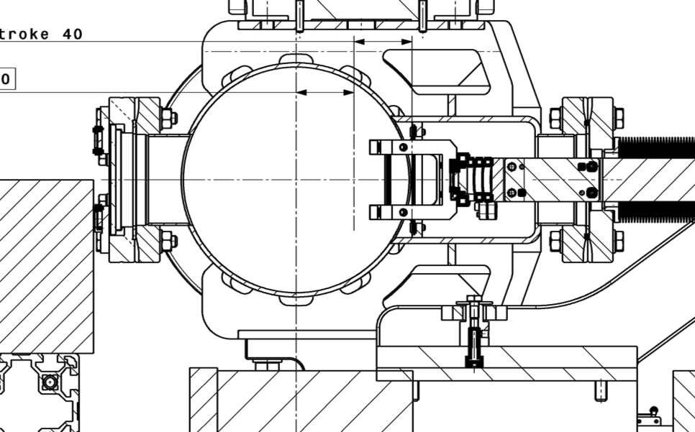
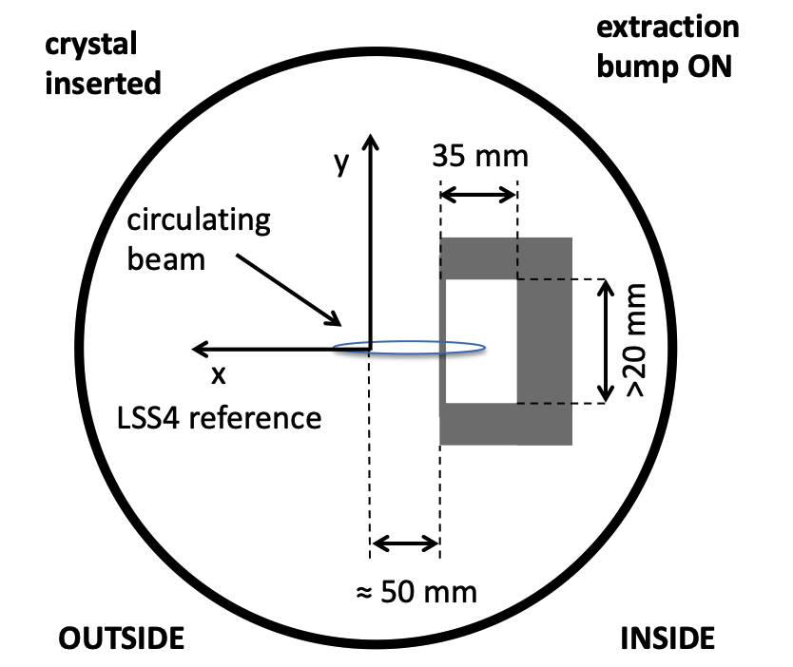
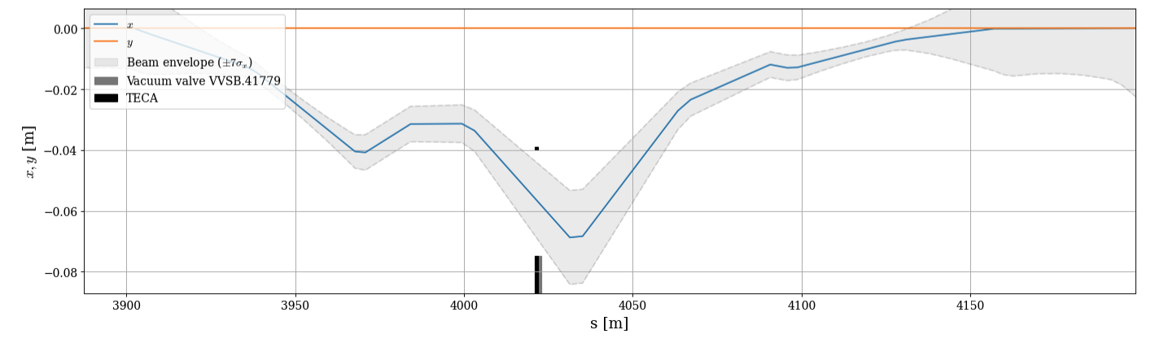
Momentum driven extraction : crystal orientation
New requirement
Inject and circulate the beam between the crystal and its holder
Predicted beam size and local bump using existing magnets confirmed the feasibility of injecting and circulating in the frame of the crystal

Slide 18
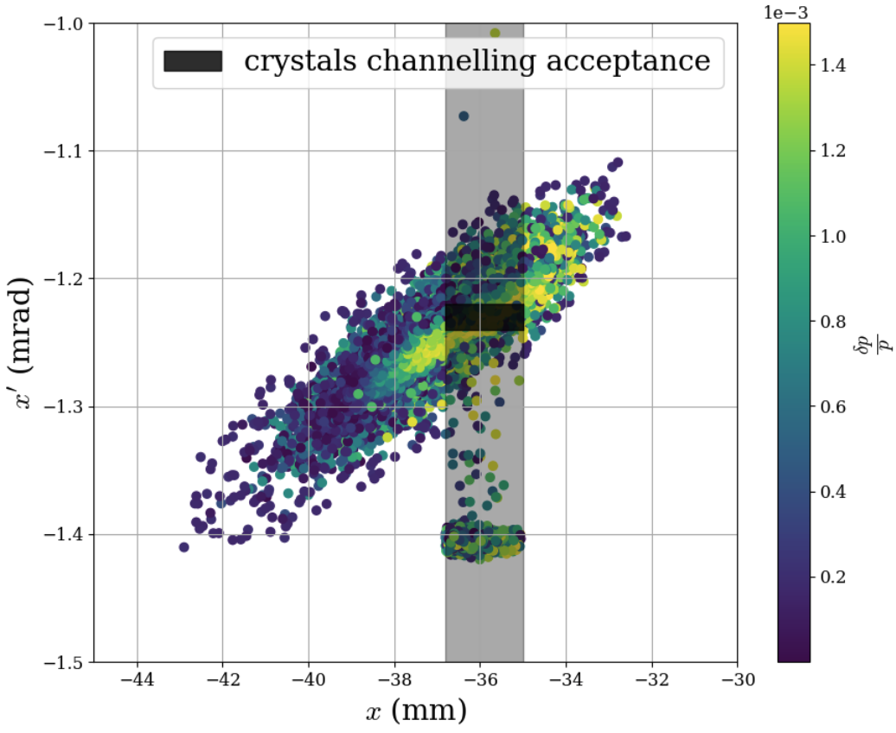
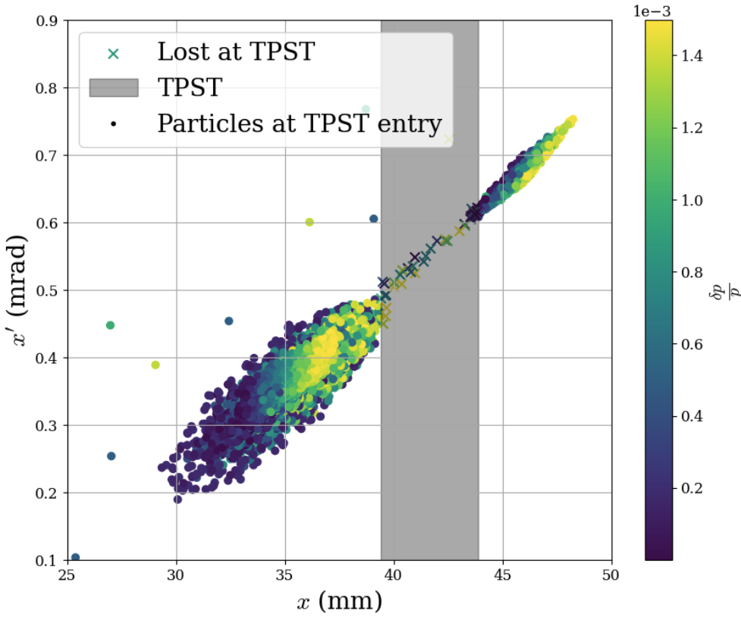
Momentum driven extraction : tracking results
Focus of the simulation on the geometry and beam driving concept
Encouraging possibility for direct beam extraction
Overall efficiency is much higher than single-pass efficiency (~94 %)
Losses at the septum (4%) and the crystal (2%)

Slide 19
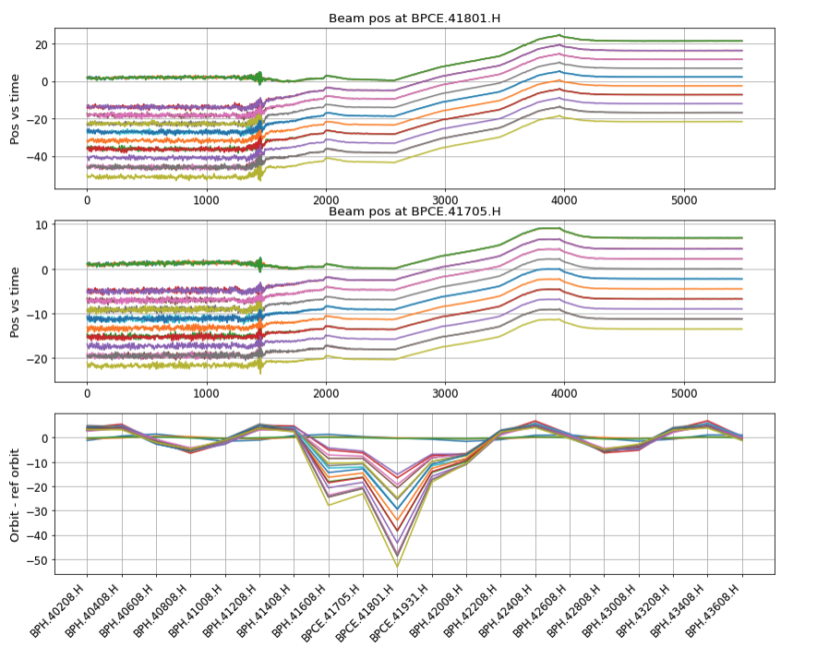
Momentum driven extraction : beam experiment summer 2025
Creation and setup of the cycle by the SPS-operation
Support for crystal operation and machine expertise by D. Veres
Results
Validation of the injection and acceleration at a tune of 22.1
Test and validation of the orbit bumps and machine settings prepared

Slide 20
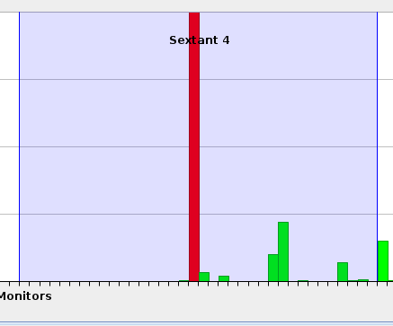
Momentum driven extraction : beam experiment summer 2025
Issues encountered
Large closed orbit, developing with energy
Sensitive settings and large radial excursion during transition crossing
Beam lost at injection with bump and crystal IN preventing direct channelling to the extraction region
Fast losses at injection around the crystal location and no beam circulation
New virtual monitor to reconstruct the beam position and angle at the crystal -> direct feedforward correction of the beam position at the crystal along the cycle

Slide 21
Conclusion
Status
SPS crystal provide sufficient channelling angle to jump over the extraction magnetic septum
Momentum driven, non resonant extraction is possible with the present hardware
Injection and circulation inside the crystal frame could not be acheived
Next steps
Review of the aperture model around the LSS4 crystal
New cycle with injection above transition -> simpler cycle without adjustment
Review of possible usage of the new MVRA crystal
Characterise the frequency content and stability of non-resonant extraction
Prospects
Direct channelling scheme doesn’t seem capable of providing high extraction efficiency -> New schemes with a control of dechannelled beam should be considered
Direct channelling characterisation to be continued in 2026
Exploration of additional schemes to optimise the efficiency

