Slide 1



High Resolution Power Supply Ripple Measurements
Frank Stulle, Laurent Dupuy, Hervé Bayle, Bergoz Instrumentation
This project has received funding from the European Union’s Horizon 2020 Research and Innovation programme under GA No 101004730.

Slide 2









Collaboration
Development performed within EU project “I.FAST”, Work Package 5, Task 5.3, “Improvement of resonant slow extraction spill quality”
Collaboration consists of several groups with different accelerators and magnets.

Slide 3


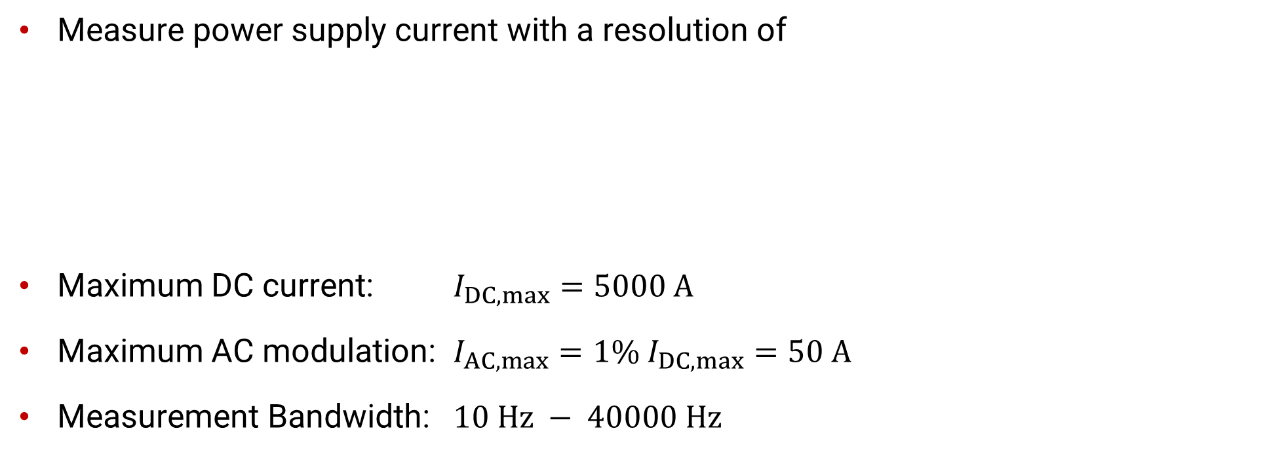

Objective
Measure power supply current with a resolution of
Maximum DC current: $I_{DC,max}=5000 A$
Maximum AC modulation: $I_{AC,max}=1\% I_{DC,max}=50 A$
Measurement Bandwidth: $10 Hz − 40000 Hz$
$$\frac{∆I}{I_{DC,max}}≈{10}^{−7}$$
$$\frac{∆I}{I_{DC,max}}<{10}^{−6}$$
official spec:

Slide 4




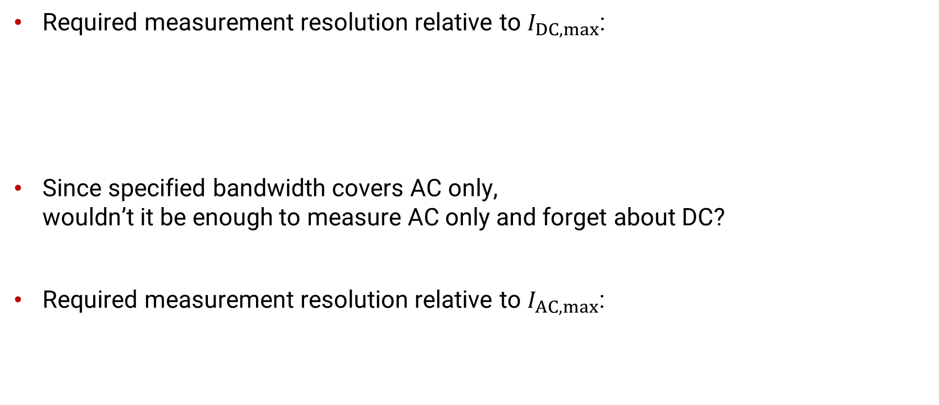

Challenge
Required measurement resolution relative to $I_{DC,max}$:
Since specified bandwidth covers AC only, wouldn’t it be enough to measure AC only and forget about DC?
Required measurement resolution relative to $I_{AC,max}$:
$$\frac{∆I}{I_{DC,max}}≈{10}^{−7}$$
$$\frac{∆I}{I_{AC,max}}≈{10}^{−5}$$

Slide 5
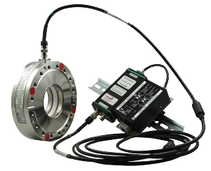

(Too) Quick Solution
10⁻⁵ is a rather realistic resolution that should be reachable with a variant of an existing transformer.
AC resolution and bandwidth are almost achieved by ACCT: ACCT bandwidth 1 Hz – 1 MHz ACCT resolution <5×10⁻⁵ relative to full scale current
Assuming flat noise spectrum, low pass filtering to 40000 Hz should result in <10⁻⁵ resolution.

Slide 6

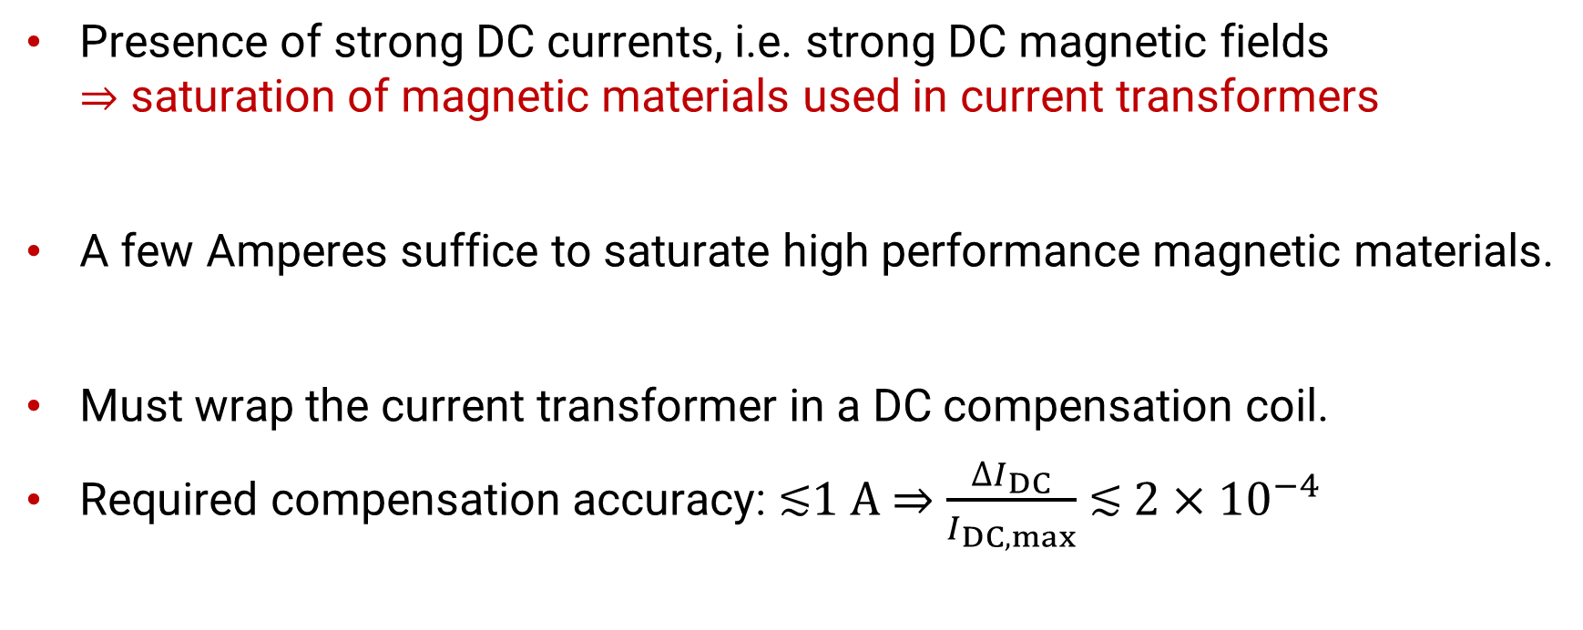
Extra Complication
Presence of strong DC currents, i.e. strong DC magnetic fields ⇒ saturation of magnetic materials used in current transformers
A few Amperes suffice to saturate high performance magnetic materials.
Must wrap the current transformer in a DC compensation coil.
Required compensation accuracy: ≲1 A $⇒$ $\frac{{∆I}_{DC}}{I_{DC,max}}$ $≲$ $2×{10}^{−4}$

Slide 7
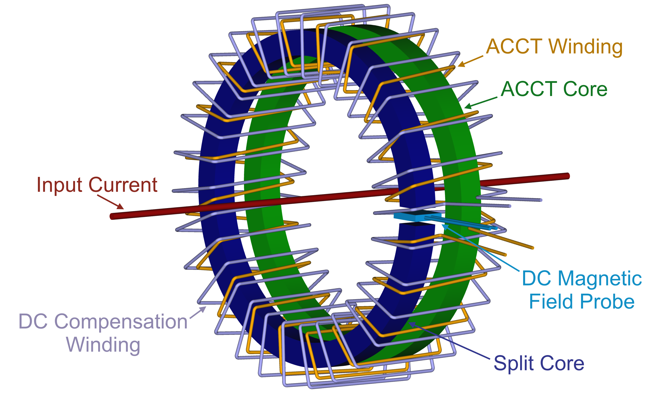
Basic Principle

Slide 8
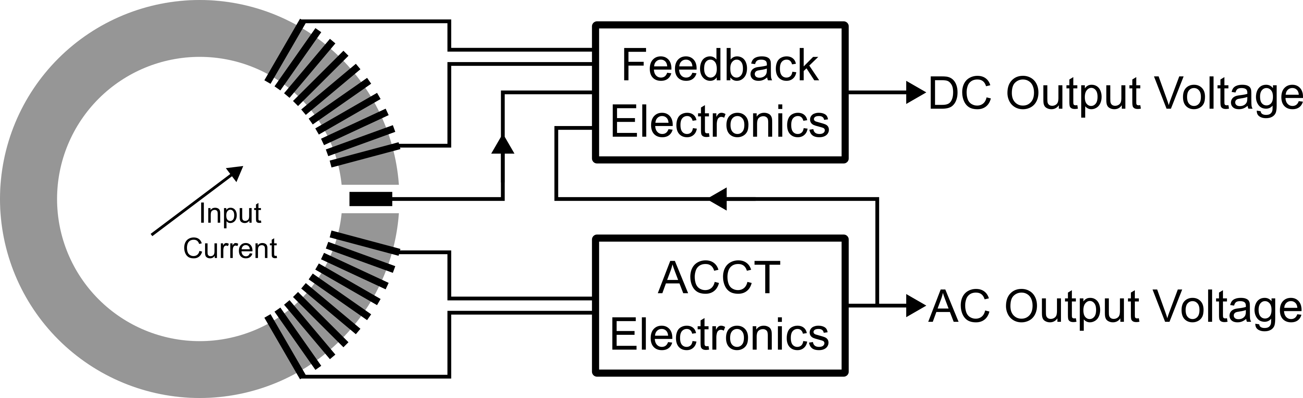
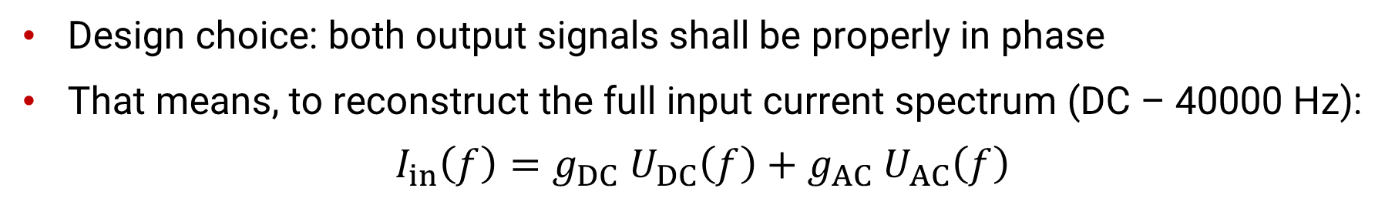


Basic Principle
$$U_{DC}\left(f\right)$$
(DC – 10 Hz)
$$U_{AC}\left(f\right)$$
(10 Hz – 40000 Hz)
Design choice: both output signals shall be properly in phase
That means, to reconstruct the full input current spectrum (DC – 40000 Hz):
$$I_{in}\left(f\right)=g_{DC} U_{DC}\left(f\right)+g_{AC} U_{AC}\left(f\right)$$

Slide 9
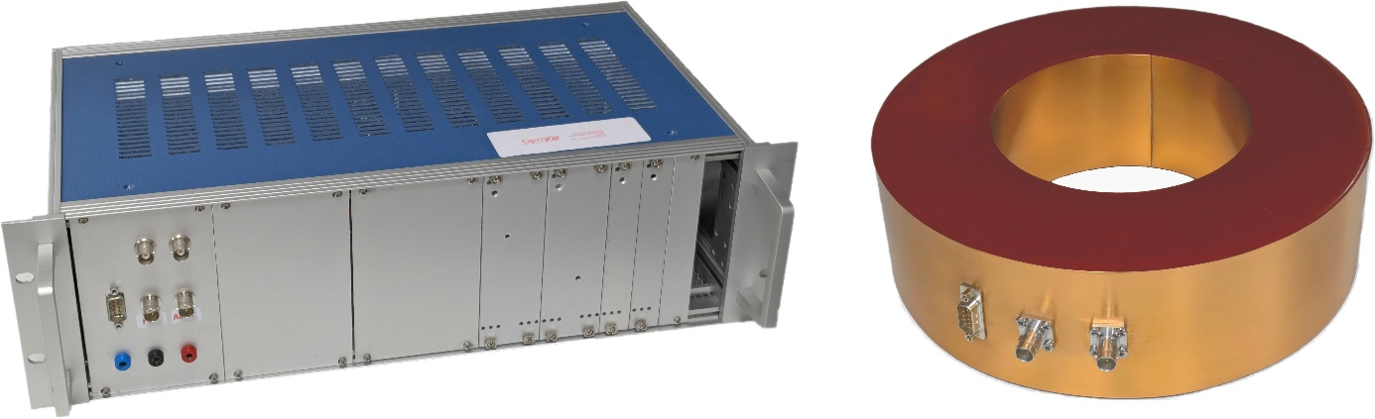
Last Year’s Status and Advancements
I reported on very nice measurements already during last year’s SlowEX workshop.
However, given the tight requirements “very nice” is insufficient.
We had to improve the electronics.
And the sensor.
Second Prototype Sensor
2x 1500turns transformer with integrated DC magnetic field probe
Second Prototype Electronics
DC feedback + ACCT electronics external power supply

Slide 10
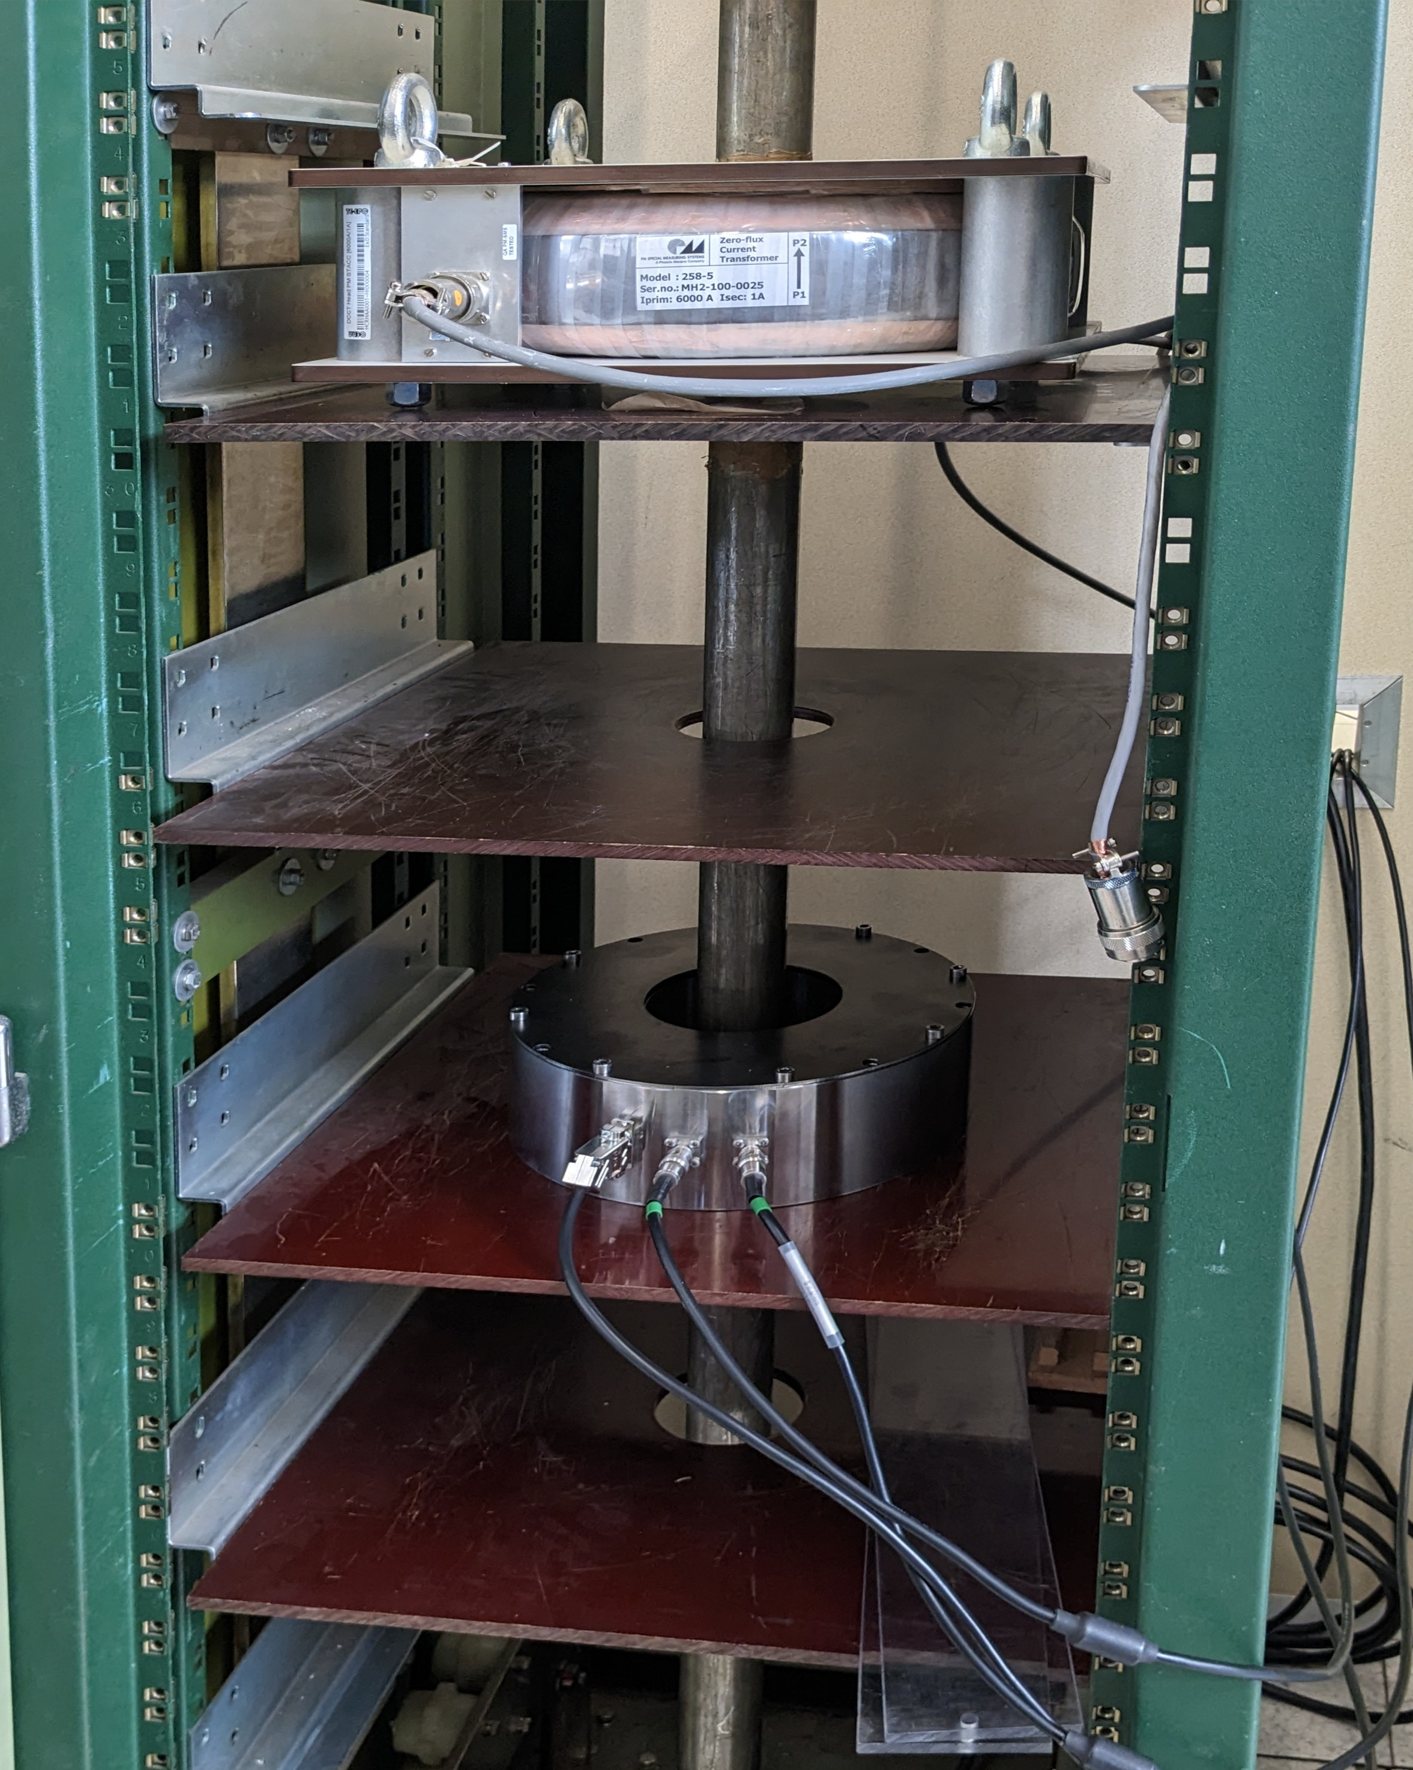
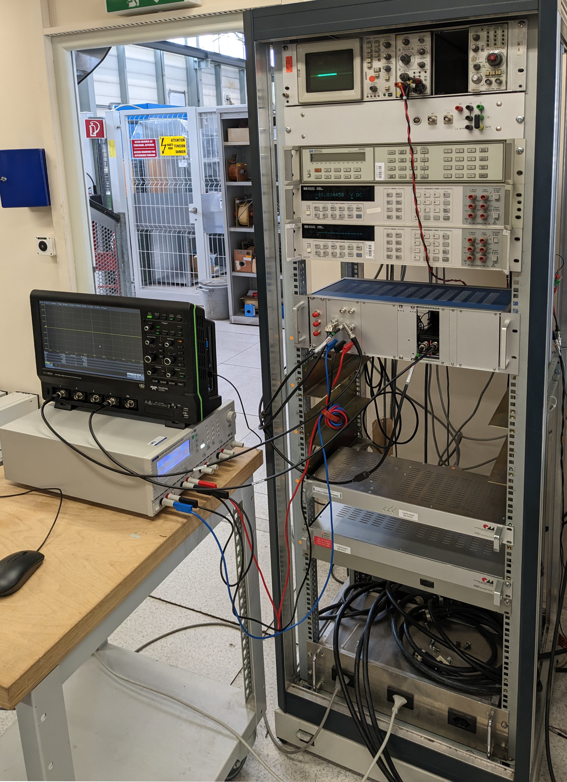
Prototype Tests at CERN
6000 A DC Test Stand
Precision Voltmeters
Reference Fluxgate DCCT
(First) Prototype Electronics
(First) Prototype Sensor
Reference Fluxgate DCCT Electronics
Not visible on photos: parallel loop for AC current injection and 24bit digitizer for high-resolution and high-bandwidth measurements

Slide 11
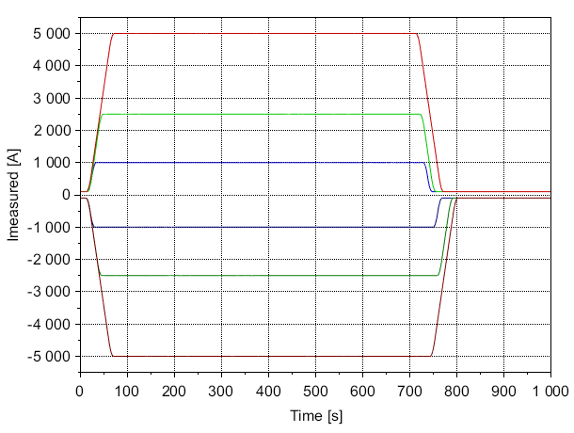
Second Prototype Measurements @ CERN
― ±5000 A
― ±2500 A
― ±1000 A

Slide 12
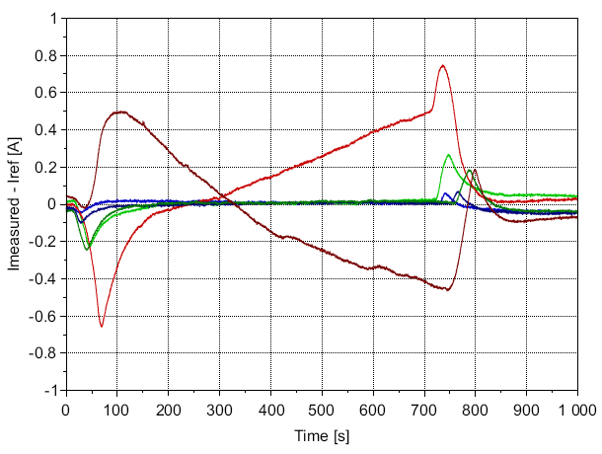
Second Prototype Measurements @ CERN
― ±5000 A
― ±2500 A
― ±1000 A
Small deviations are expected during ramp, all within specs.
Related to heating, mainly electronics, can be reduced by active cooling, further investigations required.

Slide 13
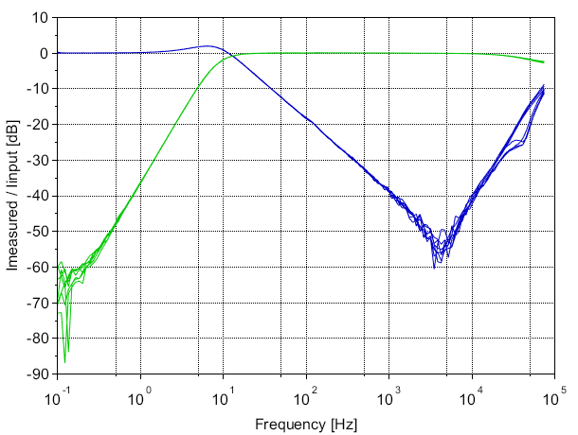
Second Prototype Measurements @ CERN
― DC Output
― AC Output
Frequency responses measured at DC offsets of 0 A, ±1000 A, ±2500 A and ±5000 A.
Traces overlap, i.e. they are independent of DC offset.

Slide 14
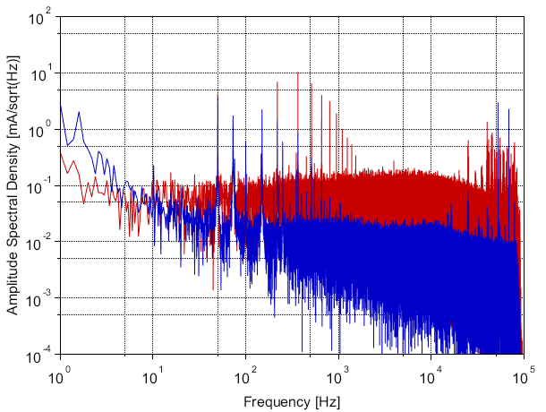
Second Prototype Measurements @ CERN
― IFast Sensor (AC + DC)
― Reference DCCT
0 A primary current (i.e. power supply off, but bus-bar still connected).
Below ~10 Hz the reference DCCT has less noise.
Above ~10 Hz the IFast sensor has less noise.

Slide 15
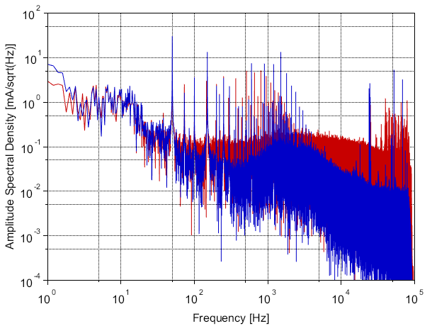
Second Prototype Measurements @ CERN
― IFast Sensor (AC + DC)
― Reference DCCT
5000 A primary current
A lot noise is common to both traces, i.e. it stems from input signal or environment.
Several spectral rays come from 50 Hz + harmonics and DCCT excitation frequency + harmonics.

Slide 16

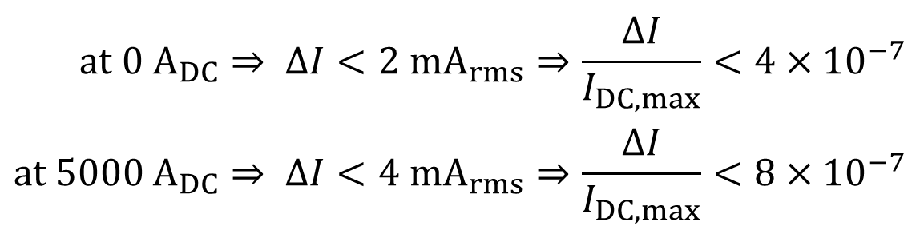
Achieved AC Resolution @ CERN
$$at 0 A_{DC}⇒ ∆I<2 {mA}_{rms}⇒\frac{∆I}{I_{DC,max}}<{4×10}^{−7} \\ at 5000 A_{DC}⇒ ∆I<4 {mA}_{rms}⇒\frac{∆I}{I_{DC,max}}<{8×10}^{−7}$$
To deduce resolution, features common to IFast sensor and reference DCCT were removed from the noise spectra.
Unfortunately, this is neither simple nor unambiguous.
And it yields at best an upper limit for the resolution.

Slide 17
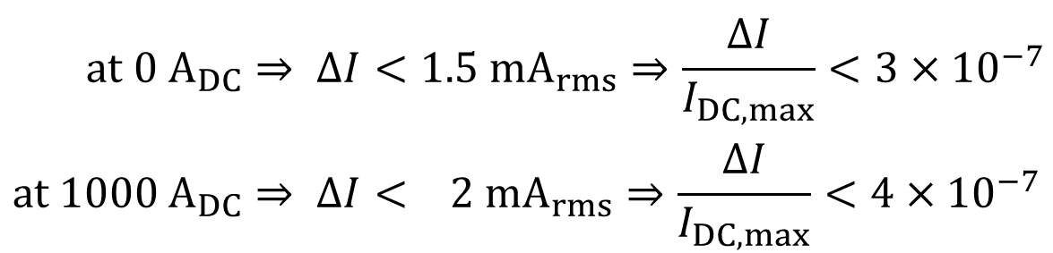
Achieved AC Resolution @ Bergoz
We also deduced resolution from lab measurements, hoping that we could better determine input signal and that environmental noise would be lower.
But we had the same problems as at CERN.
However, results are basically the same. Which makes us confident that they are realistic.
$$at 0 A_{DC}⇒ ∆I<1.5 {mA}_{rms}⇒\frac{∆I}{I_{DC,max}}<{3×10}^{−7} \\ at 1000 A_{DC}⇒ ∆I< 2 {mA}_{rms}⇒\frac{∆I}{I_{DC,max}}<{4×10}^{−7}$$
Specifications fulfilled!

Slide 18
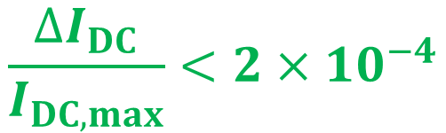
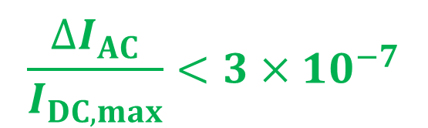
Summary
A high-resolution measurement system for magnet power supplies was developed and tested.
Exceptional AC resolution was achieved for a bandwidth of 10 Hz to 40000 Hz:
DC measurement accuracy is also very good:
$$\frac{{∆I}_{AC}}{I_{DC,max}}<{3×10}^{−7}$$
$$\frac{{∆I}_{DC}}{I_{DC,max}}<{2×10}^{−4}$$

Slide 19
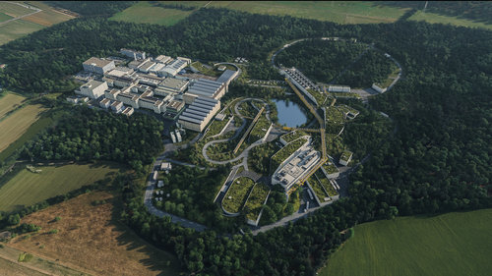
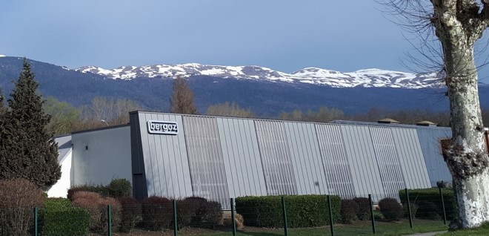
Outlook
I.FAST project (officially) comes to an end in a few weeks.
Work continues.
Next step is the installation at GSI.
This will allow to evaluate long-term performance in a real accelerator environment.

