Slide 1
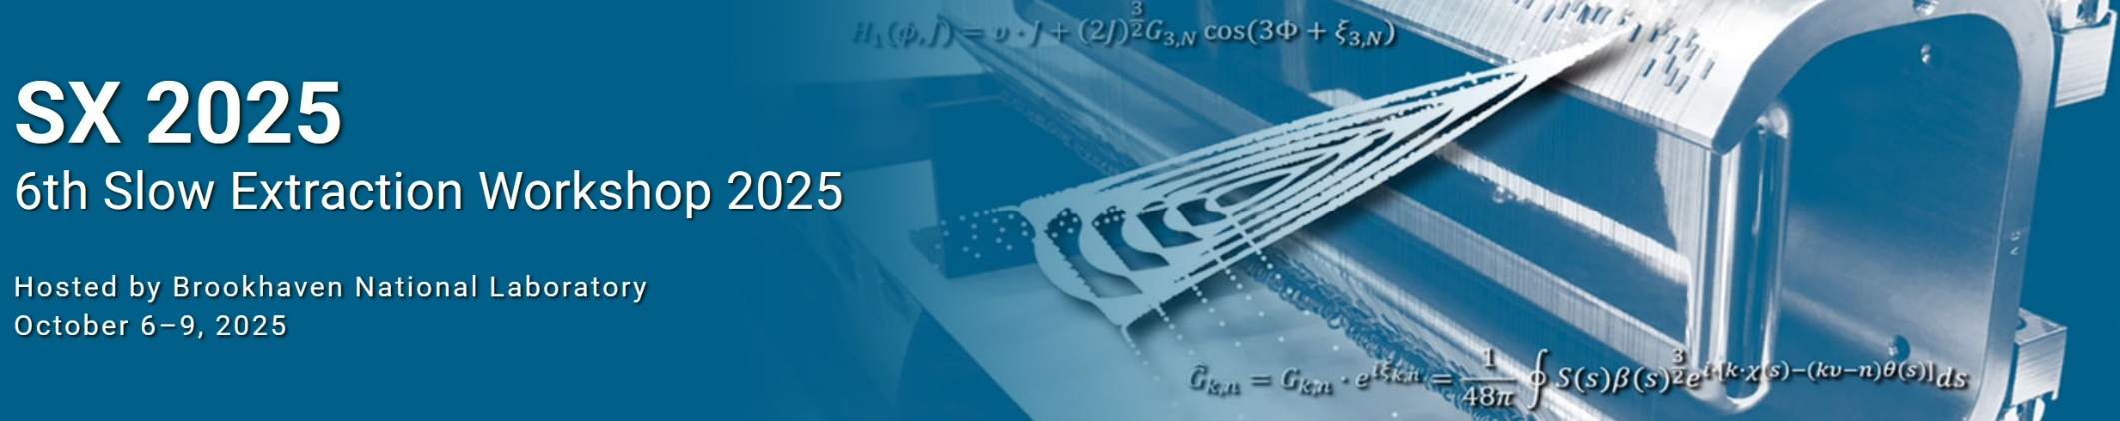
R&D on low-Z electrostatic septa at CERN
F. Lackner, B. Balhan, M. Fraser, A. Prost, C. Rebiere

Slide 2
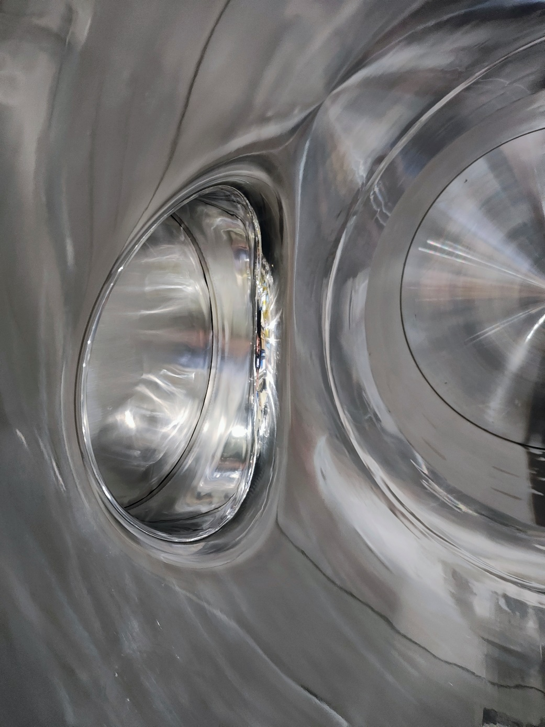
Outline:
Reminder of motivation, project overview
Low-Z tank - R&D:
  Short length prototype conclusions
  Long tank production status
Anode studies:
  Enhanced anode metrology and R&D aspects
  Low-Z anode

Slide 3
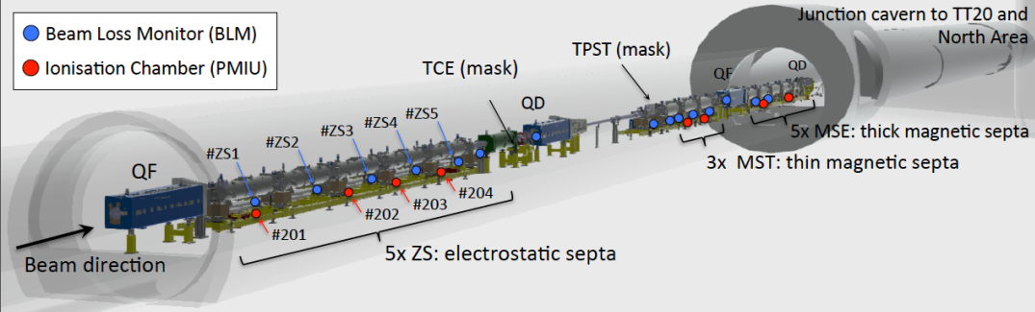
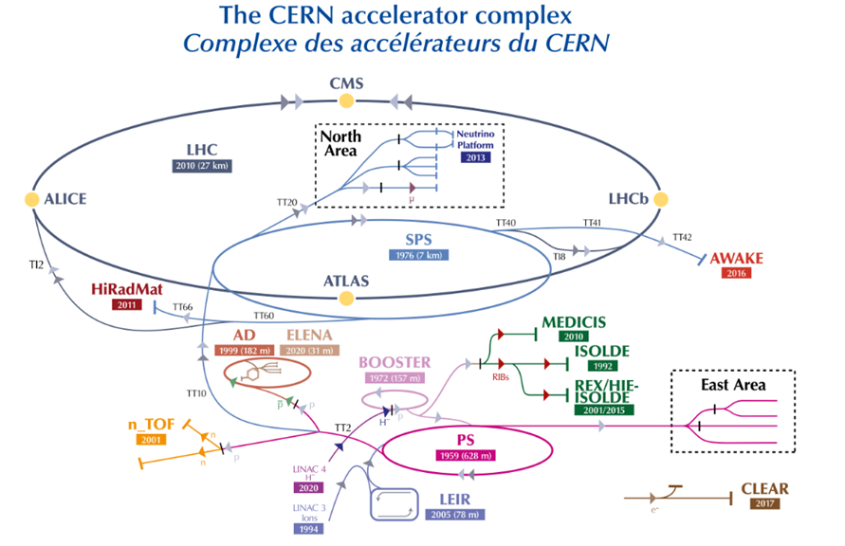
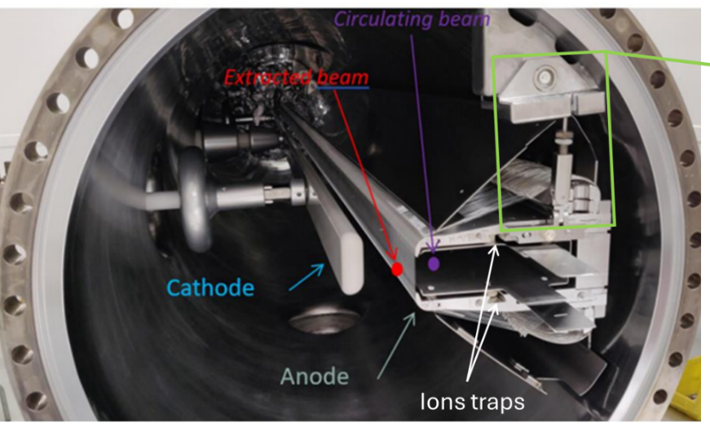
Introduction – ZS anode
Invar ZS1,ZS2, ZS3 ; Stainless steel ZS4 & ZS5
Electrostatic septa
Septum : 2080 wires (ø60 & 100 μm)

Slide 4
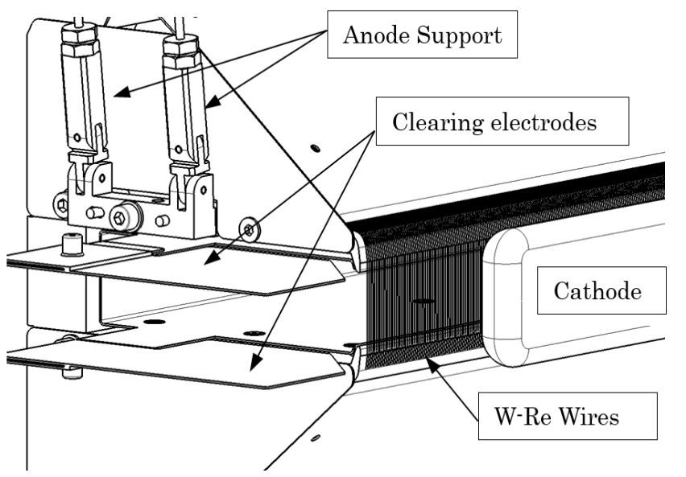
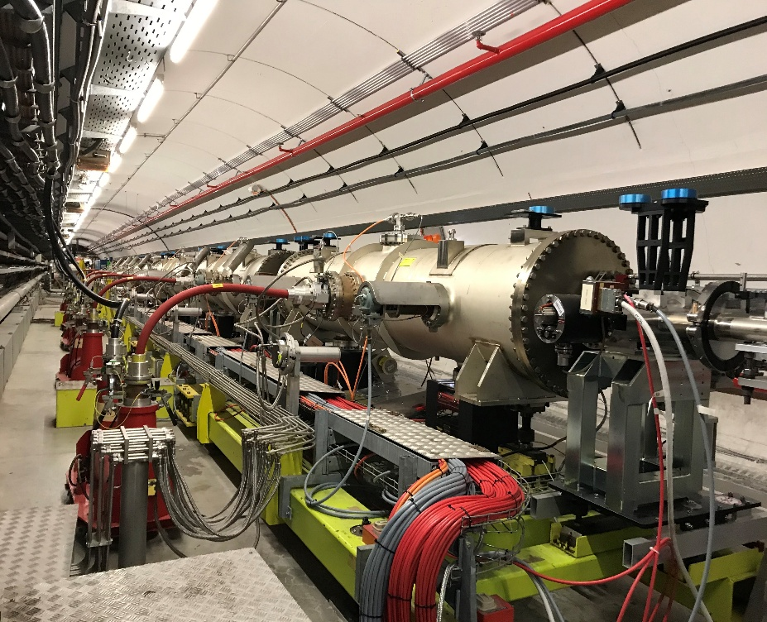
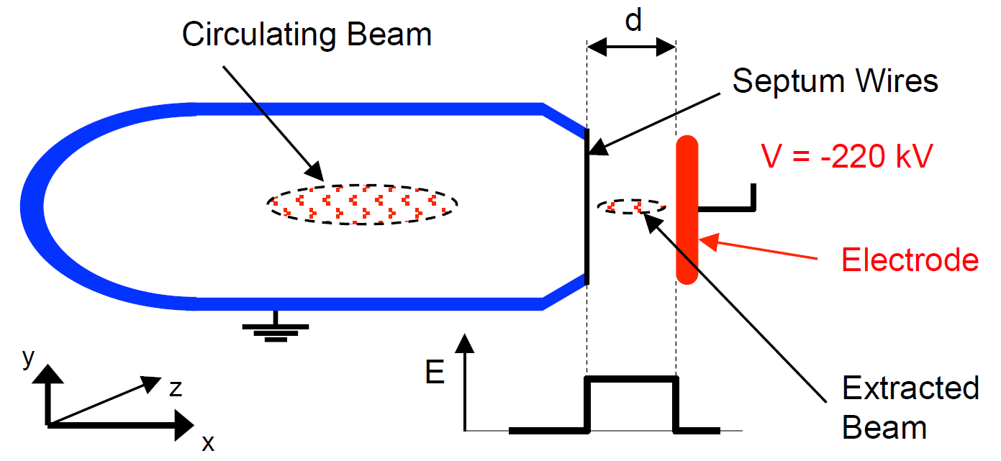
SPS ZS Layout
5 ZS installed, each 3.0 m long
Individual anode positioning range: +/- 2 mm
Individual cathode displacement range: 17- 40 mm
Common HV generator 0 - 300 kV:
Individual clearing electrode power supplies: 0 - 10 kV
Nominal operational Field: 11 MV/m
All 5 ZS installed on a common motorised girder (stroke of +/- 30 mm)
Cleaning electrodes
High Field Region 11 MV/m

Slide 5
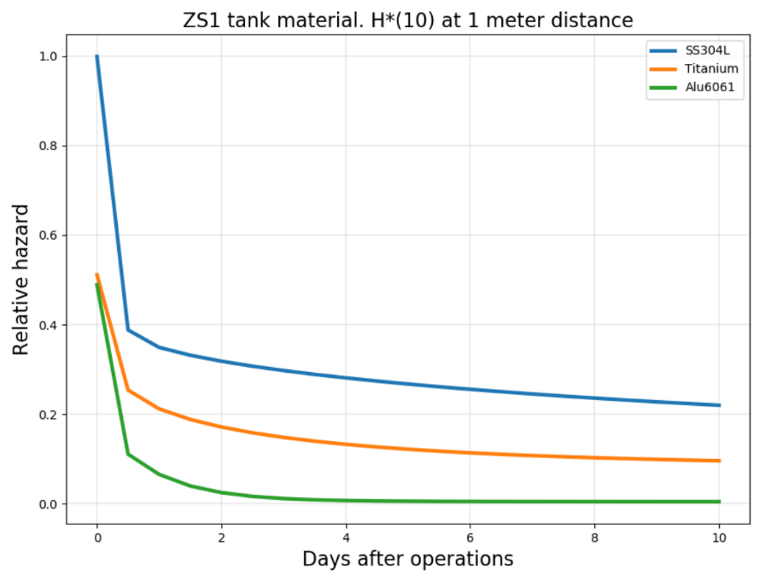
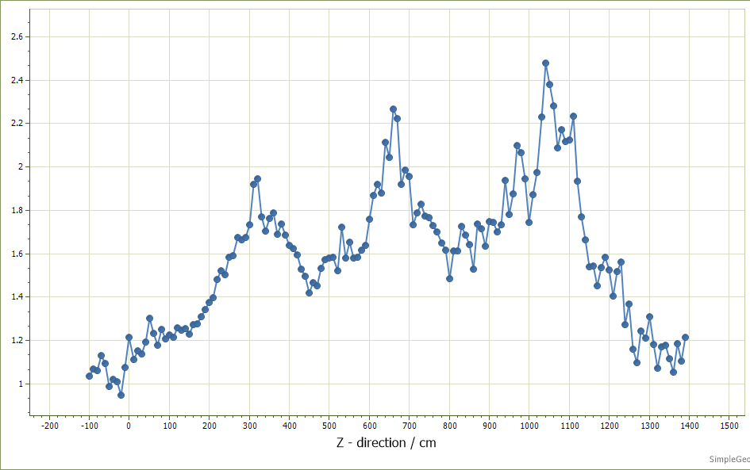
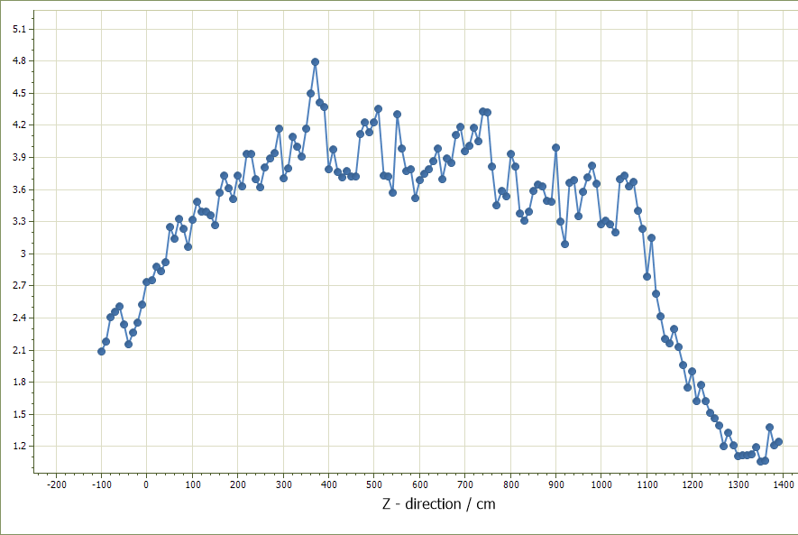
Motivation
Radiological impact of the material choice of the
ZS elements (CERN-HSE: H. Vincke)
Reduce activation of SPS ZS region:
Low-Z materials for hardware.
Further improve tolerances, will reduce beam losses.
Improve status awareness by implementing monitoring.
Time Frame: 1-week cooling period.
Comparison Volume: Purple bar in picture.
Ratio of current material/low-Z
Szenario | Tank | Anode | Improvement
1 | 304L | 304L
2 | Al5083 | 304L | 2
3 | Al5083 | Al5083 | 4
1/2
1/3

Slide 6
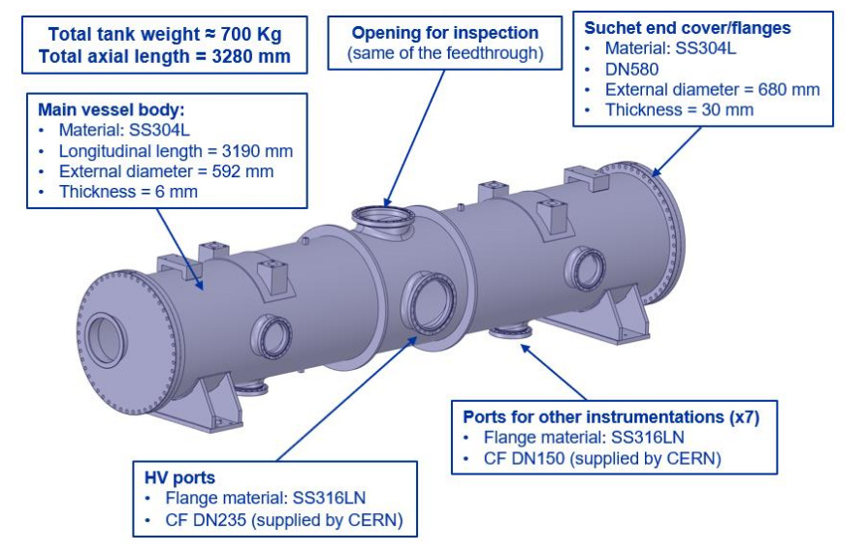
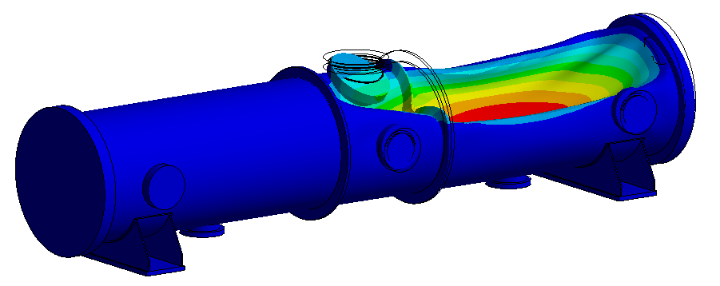
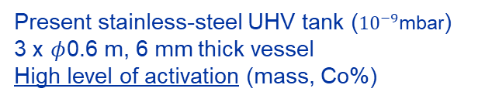
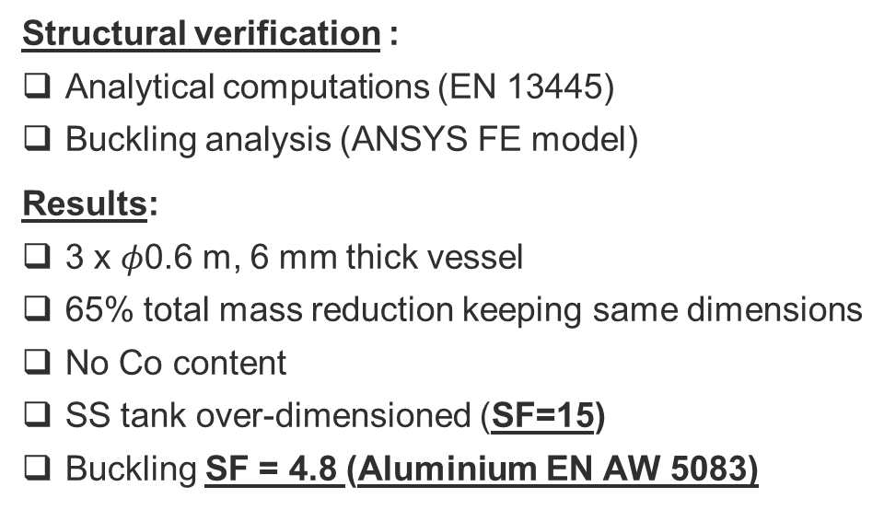
Feasibility study → Main vessel body
Structural verification :
Analytical computations (EN 13445)
Buckling analysis (ANSYS FE model)
Results:
3 x $φ$0.6 m, 6 mm thick vessel
65% total mass reduction keeping same dimensions
No Co content
SS tank over-dimensioned (SF=15)
Buckling SF = 4.8 (Aluminium EN AW 5083)
Present stainless-steel UHV tank (${10}^{−9}$mbar)
3 x $φ$0.6 m, 6 mm thick vessel
High level of activation (mass, Co%)
FEA on non-linear buckling

Slide 7
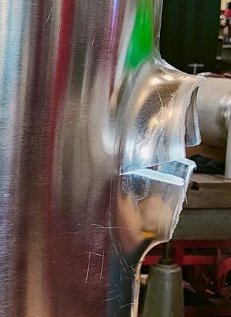
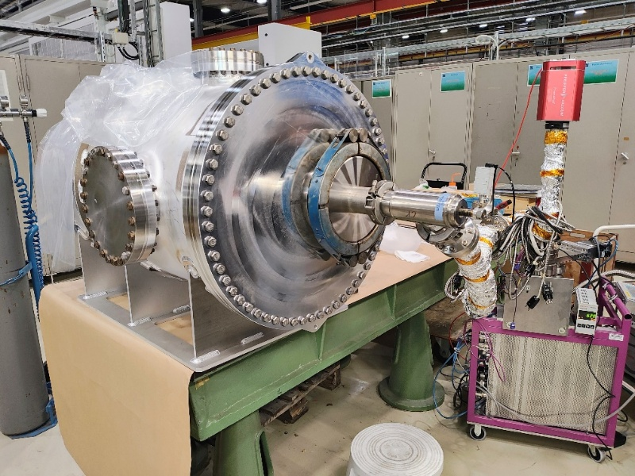
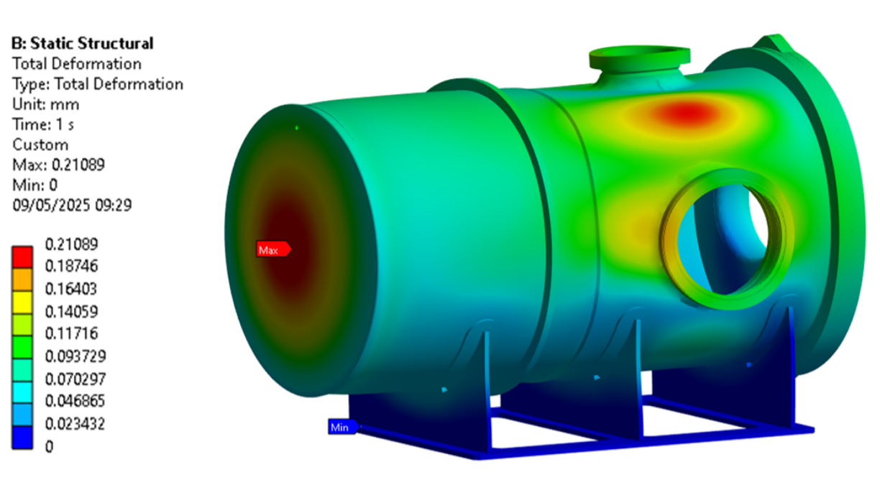
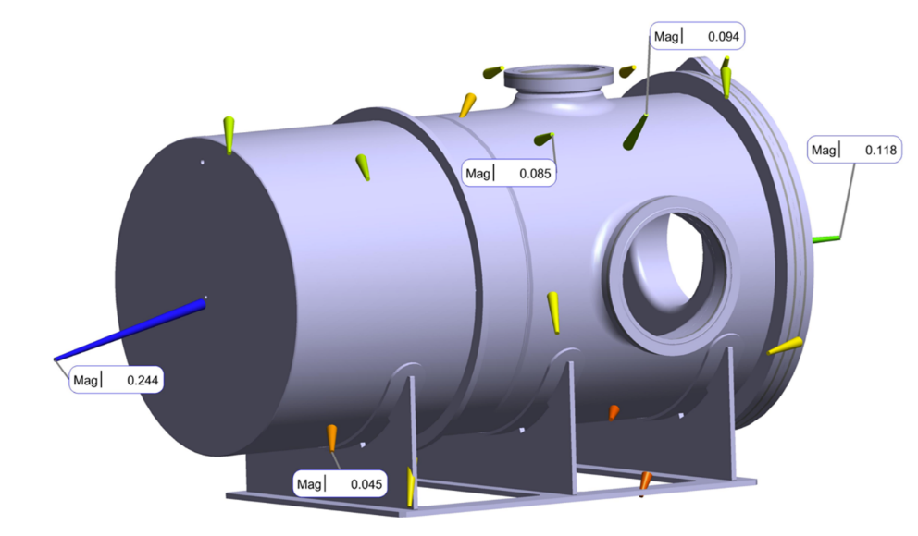
Short-length mock-up fabrication (Length 1.5m)
Validating critical design and operation aspects:
Manufacturing :
  Process validation (Al5083)
  Rolling, welding, ports extrusion, cleaning, polishing
  Assembly test → weld of bimetallic CF flanges
  Metrology (flange positions)
Operation:
  He-leak test → leak-tightness of non-standard CF sealing system
  Ultra-High Vacuum test
  Metrology of deformation
  High Voltage test
✅
Conclusion from tests:
Conform to requirements, launch production.

Slide 8
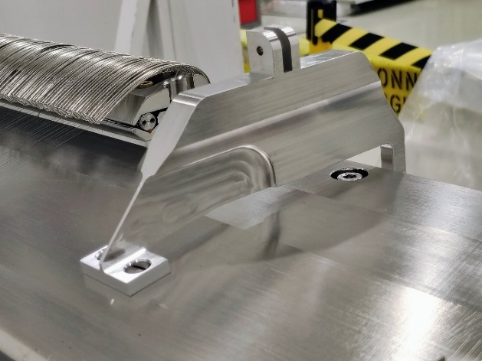
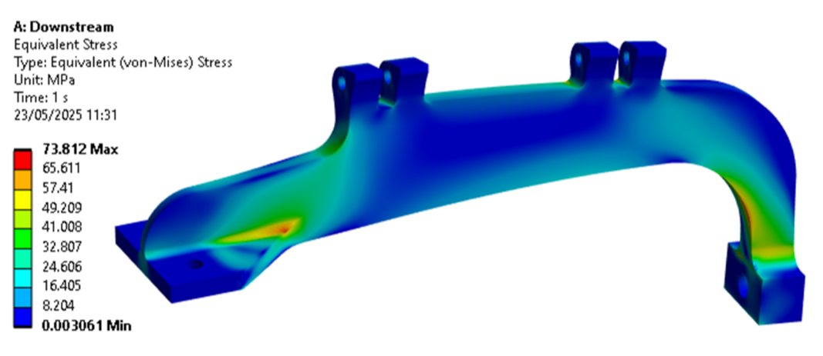
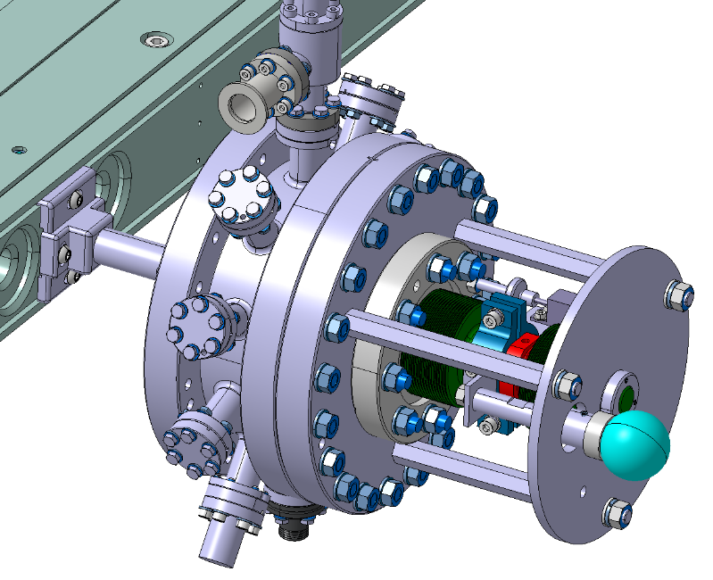
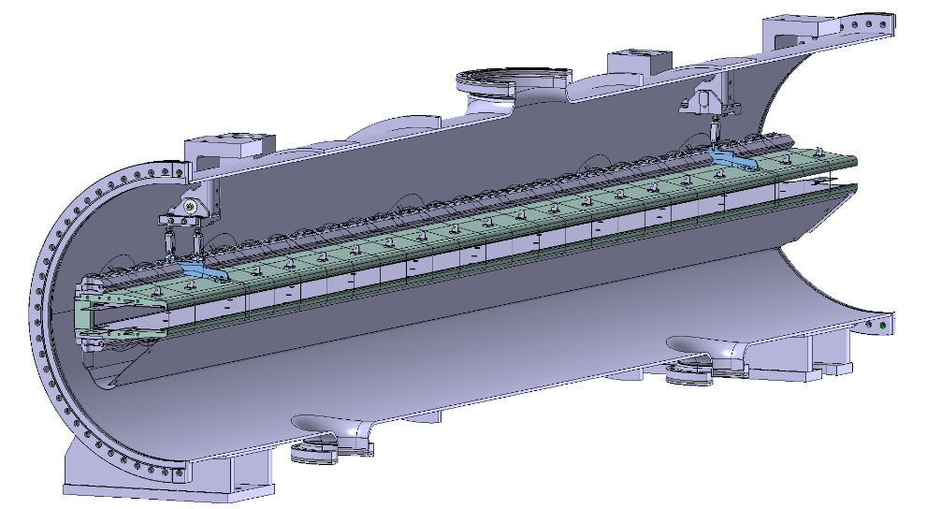
Added additional features:
Straightness & monitoring features:
Anode supports
  impacts wire holder + shield
Increase amount PT100s
Add displacement monitoring
Support connection to anode
Integration of modified support location
3rd measurement point (potentiometer)
* SX 2024, B. Balhan - Operational experience with electrostatic septa at CERN

Slide 9
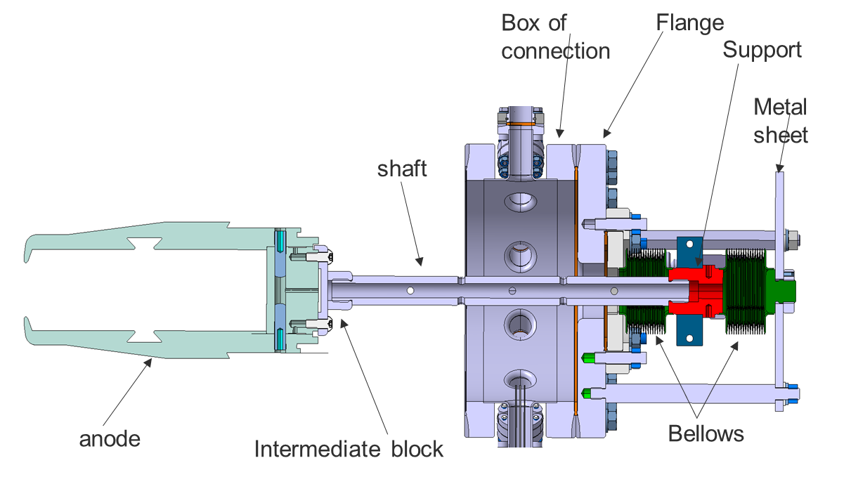
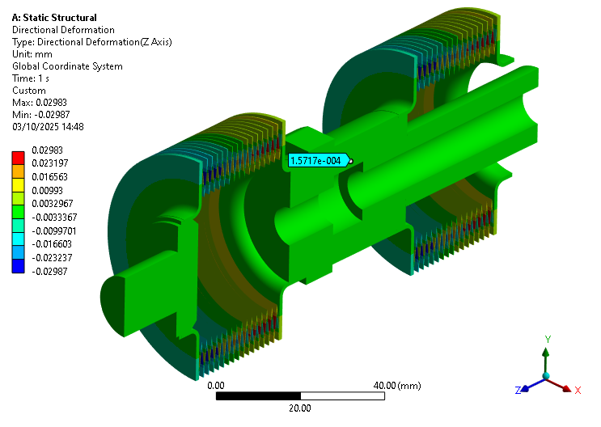
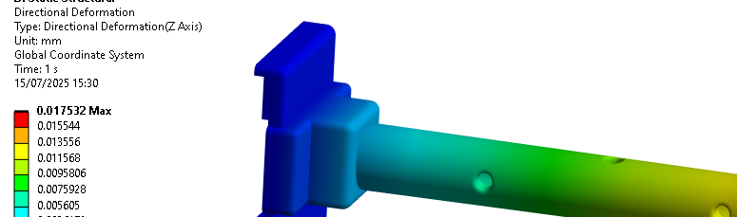
3rd measuring point
Max. displacement of the measurement point: ±5mm
No major change, use of existing feedthrough
Requires lab testing and calibration measurements (f{x,T}:
  Impact from self-weight of anode
  Stiffness impact of bellows (indicated by manufacturer)
  Reading precision (potentiometer ±15µm)
  Validate CTE impact (Invar shaft + Intermediate block)
Material | Dilatation (100°C)
All 304L | 202µm
Intermediate block Ti | 193µm
Shaft INVAR | 48µm
Shaft + Inter block INVAR | 25µm
All INVAR | 18µm

Slide 10
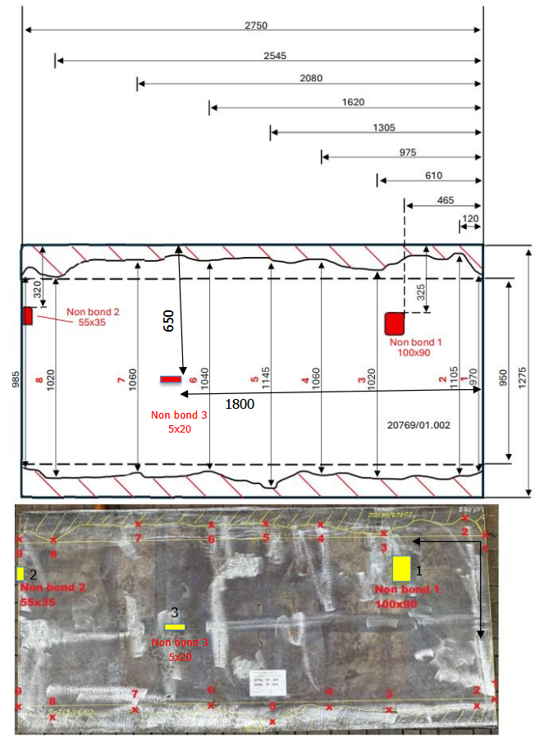
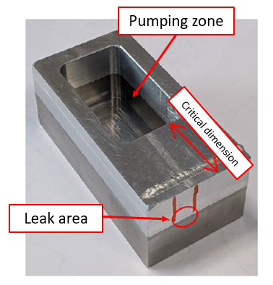
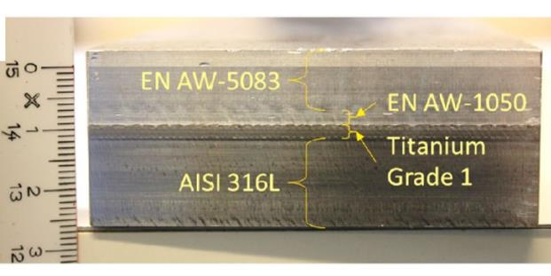
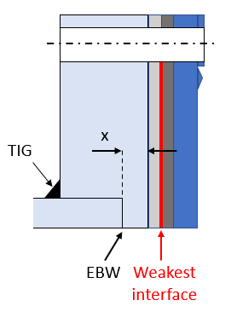
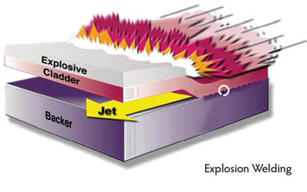
NDT, US (PAUT & CONTACT)
Bi-metal CF flanges – increase durability
Explosive bonding process (Nobelclad):
  Raw material inspection
  Mating surfaces & grinding
  Assembly (Backer, Clader, Explosive)
    Explosion
    Flattening
    US NDT (onsite and inhouse)

Slide 11
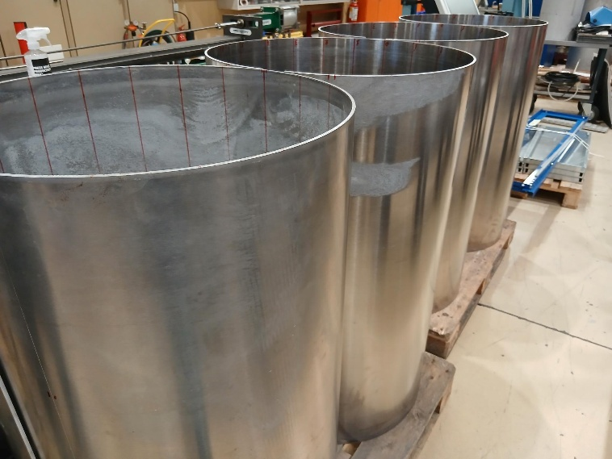
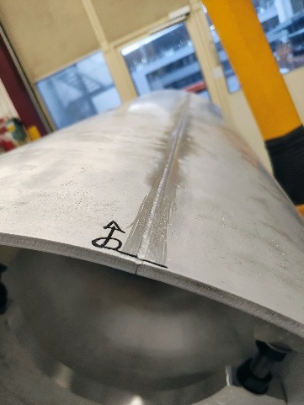
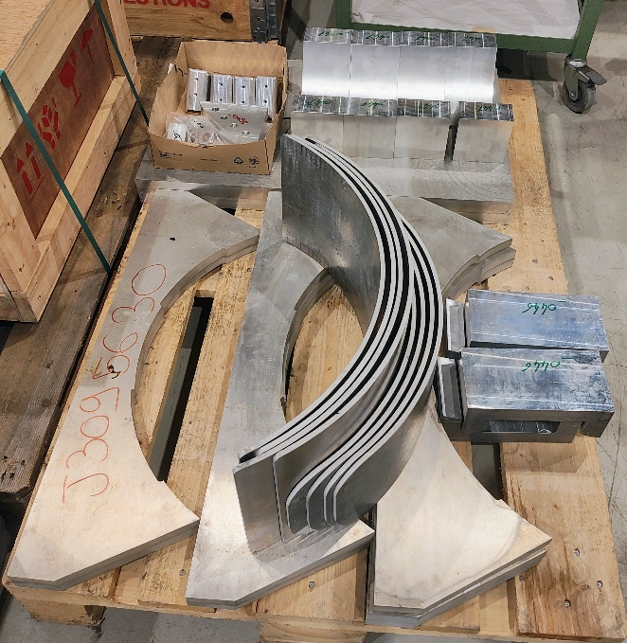
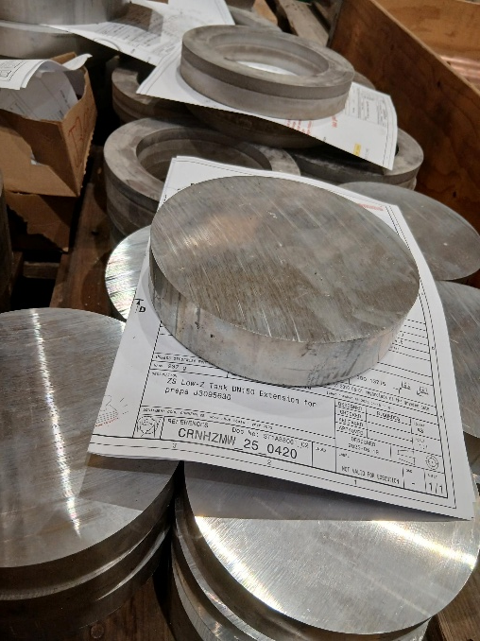
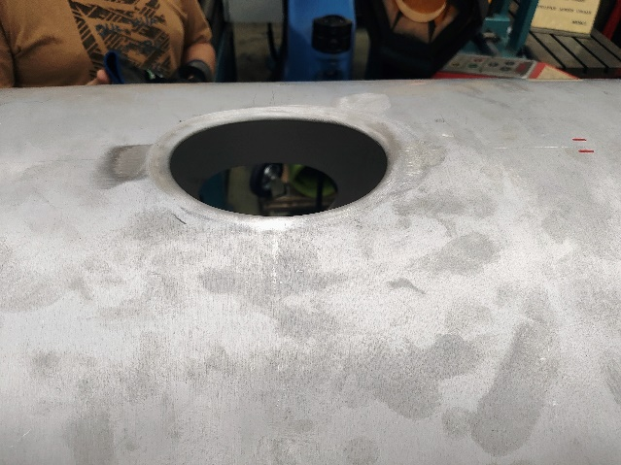
Series fabrication, status
Objectives:
Manufacturing steps:
  Process validation (Al5083) – fine adjustments of parameters:
  Rolling, welding (EB), port machining, polishing, ports extrusion, final surface polishing
  Assembly & welding of CF flanges (TIG)
  Metrology for flange positions
Validation:
  He-leak test → leak-tightness of non-standard CF sealing system
  Ultra-High Vacuum test
  Metrology of deformation
  Anode integration
  Conditioning/HV test

Slide 12
Preliminary schedule
 | 2025 |  |  |  |  |  |  |  |  |  |  |  | 2026
 | Jan | Feb | Mar | Apr | May | Jun | Jul | Aug | Sep | Oct | Nov | Dec | Jan | Feb | Mar | Apr | May | Jun | Jul
3D design finalization
Material procurement (launched 12.2024)
Prototype validation
+ documentation
ND inspection for
bimetallic material (series)
Launch tank and flanges
Manufacturing (2x), welding, cleaning + polishing
SE - reception & assembly + QC
Anode preparation with new support position – ongoing
Installation in SPS foreseen in 2028 (One tank)
2nd tank installation includes optimized anode, installation post LS3

Slide 13
ZS anode straightness study & R&D aspect

Slide 14
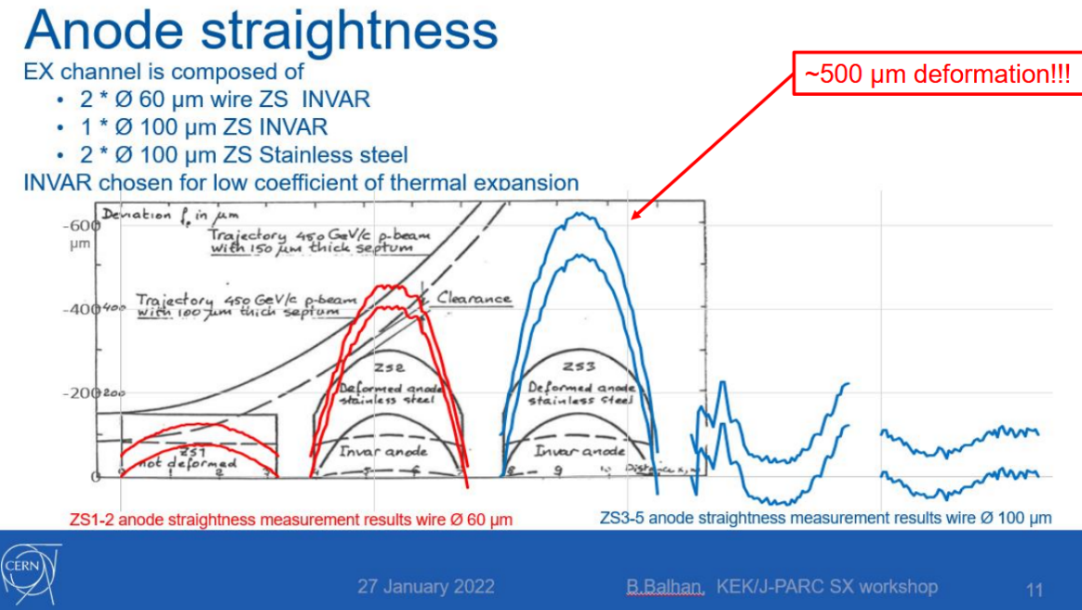
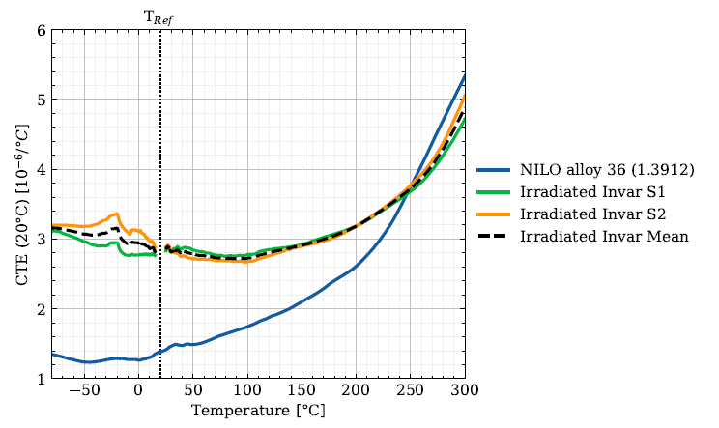
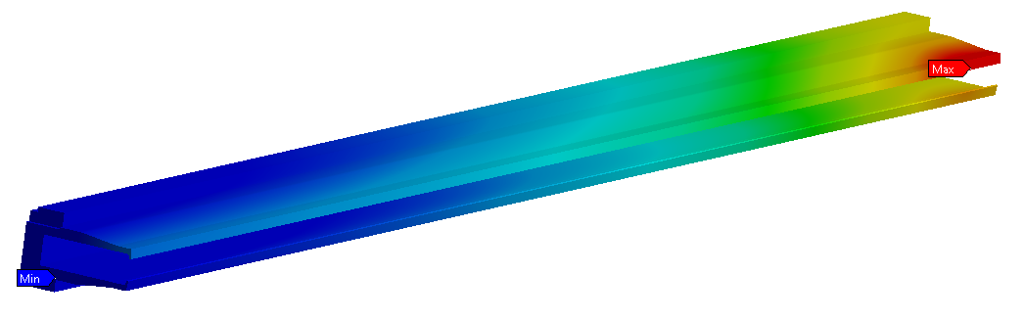
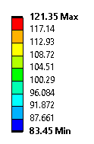
Observations, reported at SX2022, SX2024
Degradation of straightness on INVAR (Nilo36):
Support condition, long duration stress exposure (~45years)
Const. load from wire tension
No critical creep sensitivity reported for Nilo36, but:
High irradiation
Temperature “cycling” (beam & past bakeout campaigns)
Mitigation, reconditioning:
Metrology of anode structure (nose, unwired !)
CNC milling campaign in CERN central workshop
Ductile palping on CNC centre
Optical metrology in ABT cleanroom
Sample X-ray Diffraction (XRD):
Computed steady-state temperature distr. [$°$C]

Slide 15
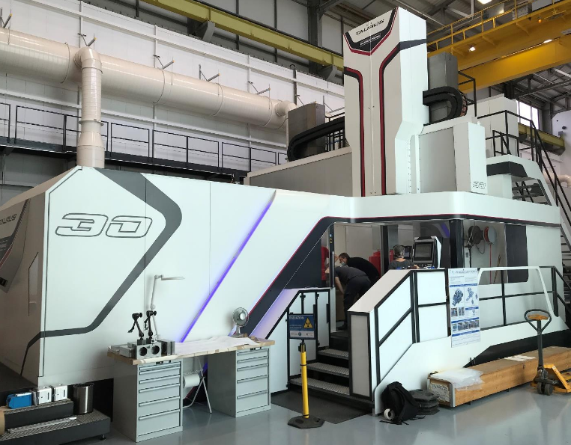
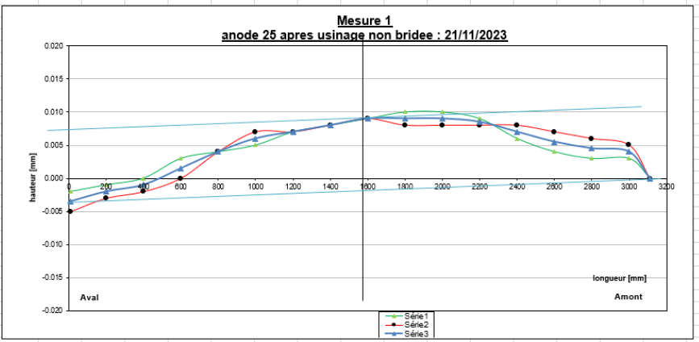
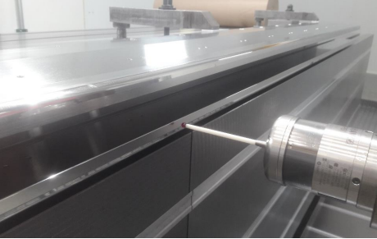
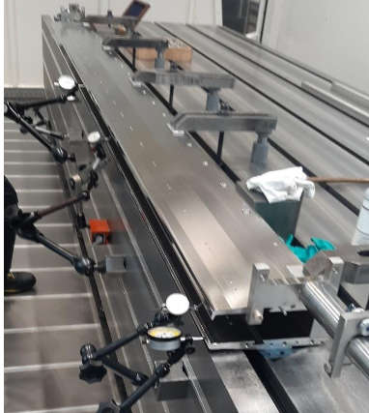
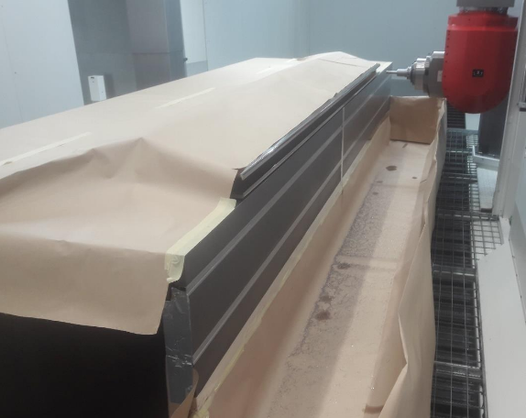
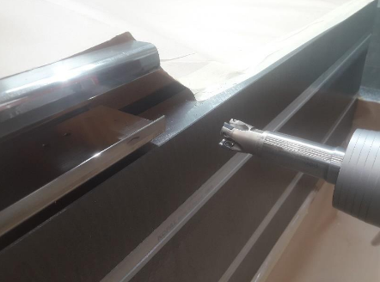
Anode machining:
CNC CERN workshop
Ductile palping
Requires to apply radio protection measures
Ductile metrology (CNC machine) prior process
Avoid stress/strain from clamping
Reduce irregular oscillations or vibrations (jitter)
Repeat metrology prior transport to ABT cleanroom
Perform optical metrology
Supporting under equal load
Machining

Slide 16
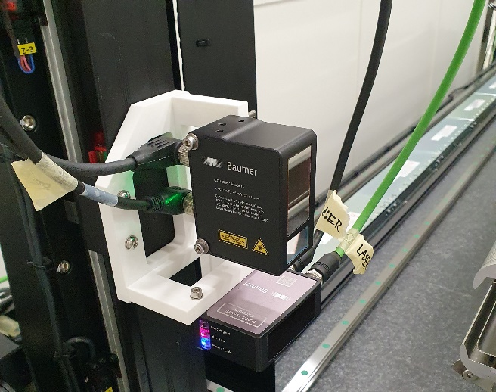
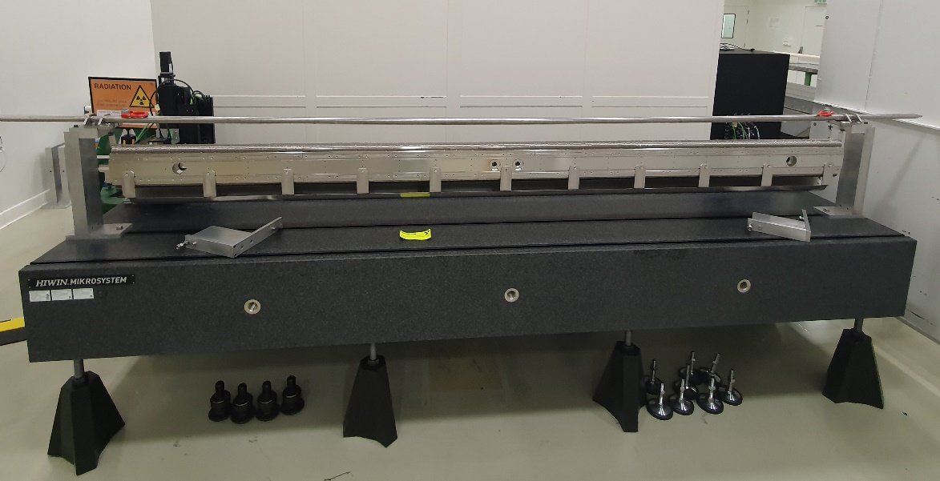
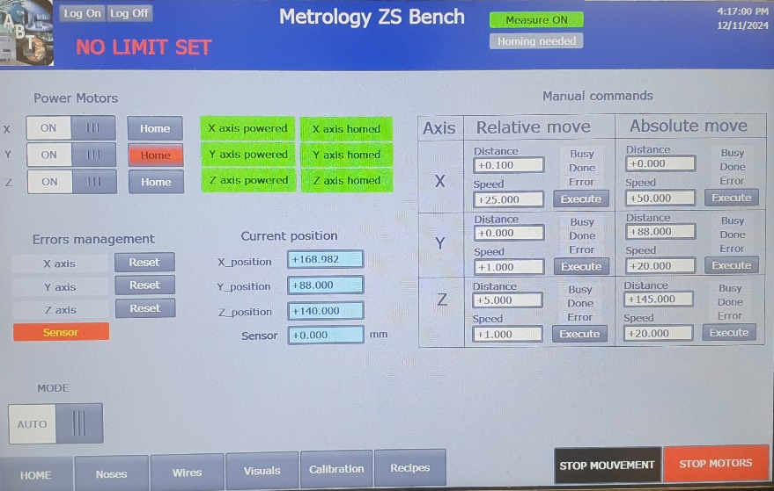
Status of metrology + Sensors
Profilometer technical data
Working range | 60-85mm
Field of View | 20-28mm
X resolution | 30-40µm
Z resolution | 5µm
Z repeatability | 2µm
Laser point distance sensor technical data
Working range | 30-70mm
Sweet spot | 48mm
Resolution | 0.7-1µm
Repeatability | 0.1-0.3µm
Metrology bench ABT cleanroom
Sensor heads
Successful integration sensor heads, wire scan + anode nose
Control system development inhouse (ABT control section)
User manual and procedures available
Online data collection
Implement improved UI for the data analysis by end-user
Regular system validation

Slide 17
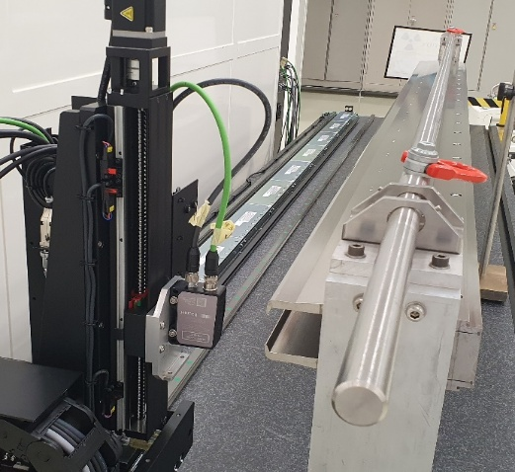




Concept of Bessel points
FEA simulations showing an 85% improvement in straightness.
Bessel points are the support points which minimizes the sag of the beam
The following formula is used to calculate the beam length:
$∆L=\frac{1}{2}\int_{0}^{L}{{\left(\frac{∂v}{∂x}\right)}^{2}dx}$
The optimal distance would be 0.2203*L (689.5 mm) from extremities.
Reducing exposure when mounting/dismounting the anode requires to place the supports at 400 mm.
Bessel points vs standard support
Standard support
Bessel point support

Slide 18


Metrology of an unwired anode
Different methods of measurements have been developed for an unwired anode.
Optical palping
Quick method of measuring the straightness of the anode along a specified height (Similar to CNC palping).
Full nose (without wires in place)
This method scans the nose at intervals of 80 mm using the laser point sensor. Data analysis is used to derive the highest points.
Machined area (without wires in place)
Takes the full nose measurements and filters out only the points in the machined area.
Sag measurement (without wires in place)
This method measures the sag the anode has due to its own weight, using a dial gauge.

Slide 19


Profilometer metrology for wires
The data gathered is compiled into a trendline to analyse the data.
This is done to limit the impact reflections have on the measurement results.
The highest and lowest points are calculated using the trendlines.
5 different straightness's are calculated along the anode. Most importantly is the straightness in the beam line.
Despite low-cost sensor, results show great repeatability.
Mock-up of the wired anode
Wire metrology method

Slide 20




Profilometer metrology
Location along the anode | Straightness (µm) | Angle (degrees)
Start of the anode | 78.8 | 0.15
Middle of the anode | 101.6 | 0.194
End of the anode | 90.8 | 0.173
Full anode | 282.7
Beam path (center line) | 198.1
Trendline based analysis for the wire measurements
Scanning three paths along the anode

Slide 21




Anode activation – Low-Z?
Improved cross-section
3130 mm
210 mm
AM - segment
Improved topology
Contact points
2080 wires (W26Re), 291 kg
Invar (Nilo36) or inox (304L)
Topology optimization for a 300 mm segment, initially studied to be produced by AM
  AM not yet adequate in terms technology maturity (UHV, HV, cost, surface quality, dimensions)
Al5083, will increase straightness, optimization of support points to reduce long-term bending stress, while improving straightness
Optimization of cross-section
Wire to anode contact point definition varies in function of length

Slide 22

Low-Z anode, initial thoughts:
Material | Mass (kg) | Straightness (µm)
FeNi36 | 291 | 12
SS304L | 284 | 7
Ti6Al4V | 157 | 12
Al5083 | 96 | 22
Degrading straightness when changing towards Al5083
Mass reduction to reduce straightness to acceptable levels
Implicates integration of active cooling (water or CO₂)

Slide 23

Strategy:
Baseline:
Integrate low-Z tank incl. machined invar anode incl. Bessel points in 2028
Modify anode support and combs for new support position (ongoing for SS tank)
Includes additional measurement point in central position (production launched)
PT100 to trace gradients (available)
Bessel point support, assembly of wire holder
Continue R&D towards a low-Z anode:
Al alloy considered, incl. topology optimization
Integrate active cooling, thermal harmonization – minimize thermal deformation
Also includes additional measurement point in central position (as currently implemented)
Instrumentation (Thermocouples tracing temperature gradients)
Requires R&D (ideally short length validation), e.g. cooling channel integration into extruded AL5083

Slide 24
Conclusions
Low-Z tank development:
Short length prototype fully validated:
  Conform: Leak tightness, vacuum performance, HV and deformation metrology.
  Metrology at AP & VP, confirm FEA prediction.
Design for full-length tank validated.
Agreement on initial production schedule
Material procurement finalized – production ongoing, confident to meet schedule
Final implementation in 2028 (towards the end of LS3).
Anode metrology and development:
ABT metrology bench commissioned and operational.
Integrate machined Invar®36 alloy anode incl. new Bessel support points.
Agreement on continuing R&D on low-Z anode requires the feedback from CERN SLAWG.
  Impact on straightness in case of change to low-Z Al alloy. Active cooling mandatory.
  Gain factor 2 in radiation cool-down time after one week of standby.
  Applying latest technologies show potential to further improve anode straightness

Slide 25
References
[1] J. Borburgh et al., “Experimental Results of Low-Z Materials as a High Voltage Septum Anode”
[2] D. Bjorkman, “Alternative Material Choices to reduce activation of extraction equipment”
[3] M. Fraser, “Improvement to the SPS Slow Extraction for High Intensity Operation”
[4] H. Vincke, “Dose rates around the LSS2 ZS elements”
[5] F. Pirozzi, “Design optimization of aluminium vessel for ZS extraction equipment via non-linear buckling analysis”
[6] F. Pirozzi, “Development of Low-Z Bimetallic ConFlat Flanges for ZS Tanks”
[7] F. Pirozzi, “Non-Straightness Study of the Anode Support for ZS Septa”
[8] N. Roudaut, “Study of a low-Z material-based anode for the ZS electrostatic septa”
[9] T.v. Uffelen, “Development of a control system for the ZS anode metrology”
[10] H. Vincke, “Study of RP improvements for the ZS elements in LSS2_technical note_vs2”
[11] F. Lackner, et al. “Improvements of the SPS slow extraction electrostatic septum”, IPAC 2024
[12] Reyn v.d. Kieboom, ZS electrostatic anode metrology, internship report, 2025
[13] F. Lackner, et al. “Status of the low-Z SPS slow extraction electrostatic septum development”, IPAC 2025
[14] F. Lackner, et al. “A novel approach to qualify the straightness of electrostatic septa for the SPS slow extraction”, IPAC 2025
F. Lackner, SX workshop 2024 - Low-Z septa CERN

