Slide 1
Extraction Bump Digital Twin for NSRL slow extraction
Weijian (Lucy) Lin, Trevor Olsen, Eiad Hamwi, Kevin Brown, et al.
wlin1@bnl.gov
6th Slow Extraction Workshop
Oct 6-9, 2025

Slide 2
Introduction to NSRL

Slide 3
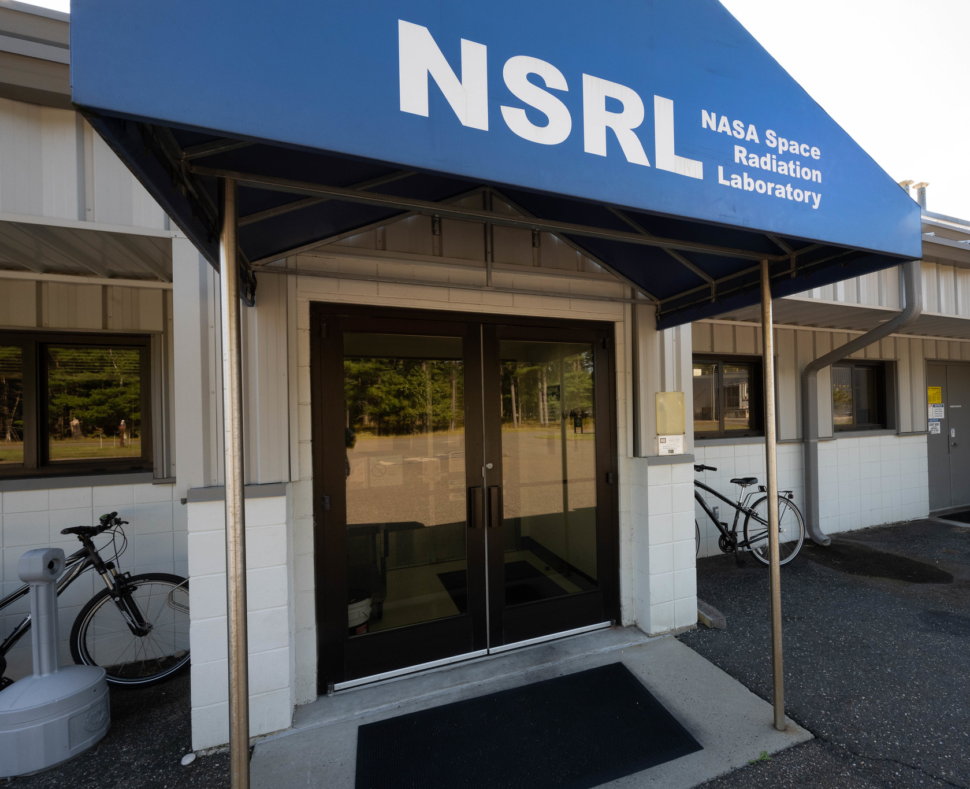
NASA Space Radiation Laboratory (NSRL)
Understanding the risks and uncertainties from the space radiation environment is crucial for NASA missions:
“In space, astronauts are exposed to ionizing radiation that is quantitatively and qualitatively different from terrestrial radiation. This environment includes protons and high-Z, high-energy (HZE) ions together with secondary radiation, including neutrons and recoil nuclei that are produced by nuclear reactions in spacecraft materials or tissue.”
- Risk of Radiation Carcinogenesis (2016)
NASA HRP Space Radiation Element

Slide 4
NSRL Users and Experiments:
Three main types of experiments
Radiobiology – Primary objective of NSRL and NASA interest in a synchrotron facility
Users often from university biomedical research labs receiving grants from NASA HRP
Microelectronics – Little interest in early years, now represents majority of beam hours
Users from space and defence industry
Scientific Measurements – a handful of experiments per year, usually detector testing
Users often from university or national physics labs

Slide 5
Sources & Synchrotron Complex
Target
Source machines:
Linac (proton)
EBIS (ion)
Tandem Van de Graaffs (ion)
Slow Extraction
NSRL
Booster
LtB
Linac
TtB
AGS Booster synchrotron:
Accelerate beam to KE between 50 and 2500 MeV/n
EtB
Tandem
Ebis

Slide 6
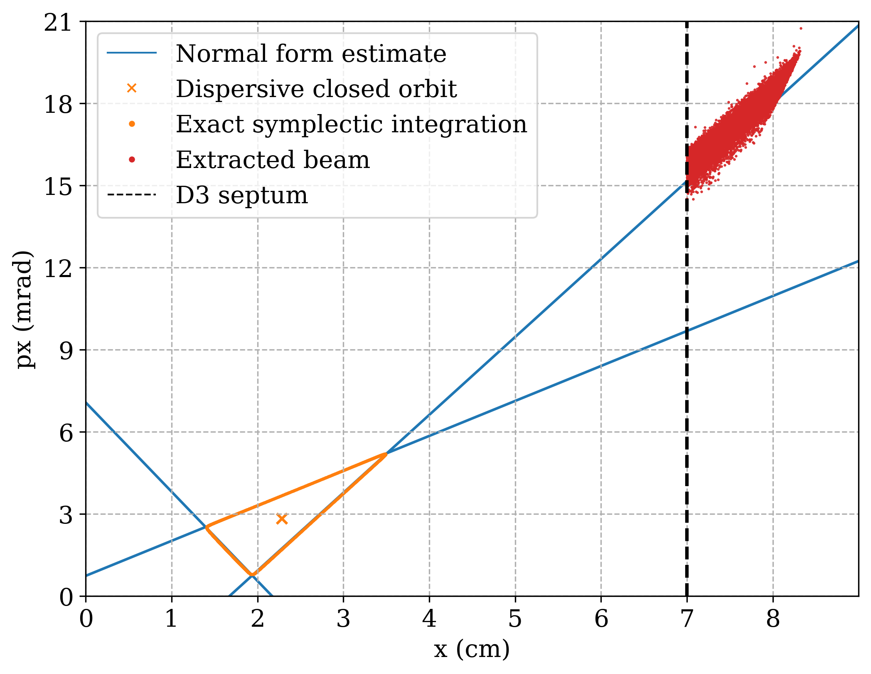
Resonant Slow Extraction
Thin septum (0.76 mm) at D3 + thick septum (15.2 mm) at D6 in the Booster
Third-integer (13/3) resonance created by four sextupoles: C8, F8, B4, E4
Triangular stable region in horizontal phase space, brought closer to the septa via local extraction bump
Particles with turn-by-turn orbit deviation larger than D3 septum thickness are extracted and kicked into D6 aperture
See Eiad’s presentation on SciBmad simulation

Slide 7
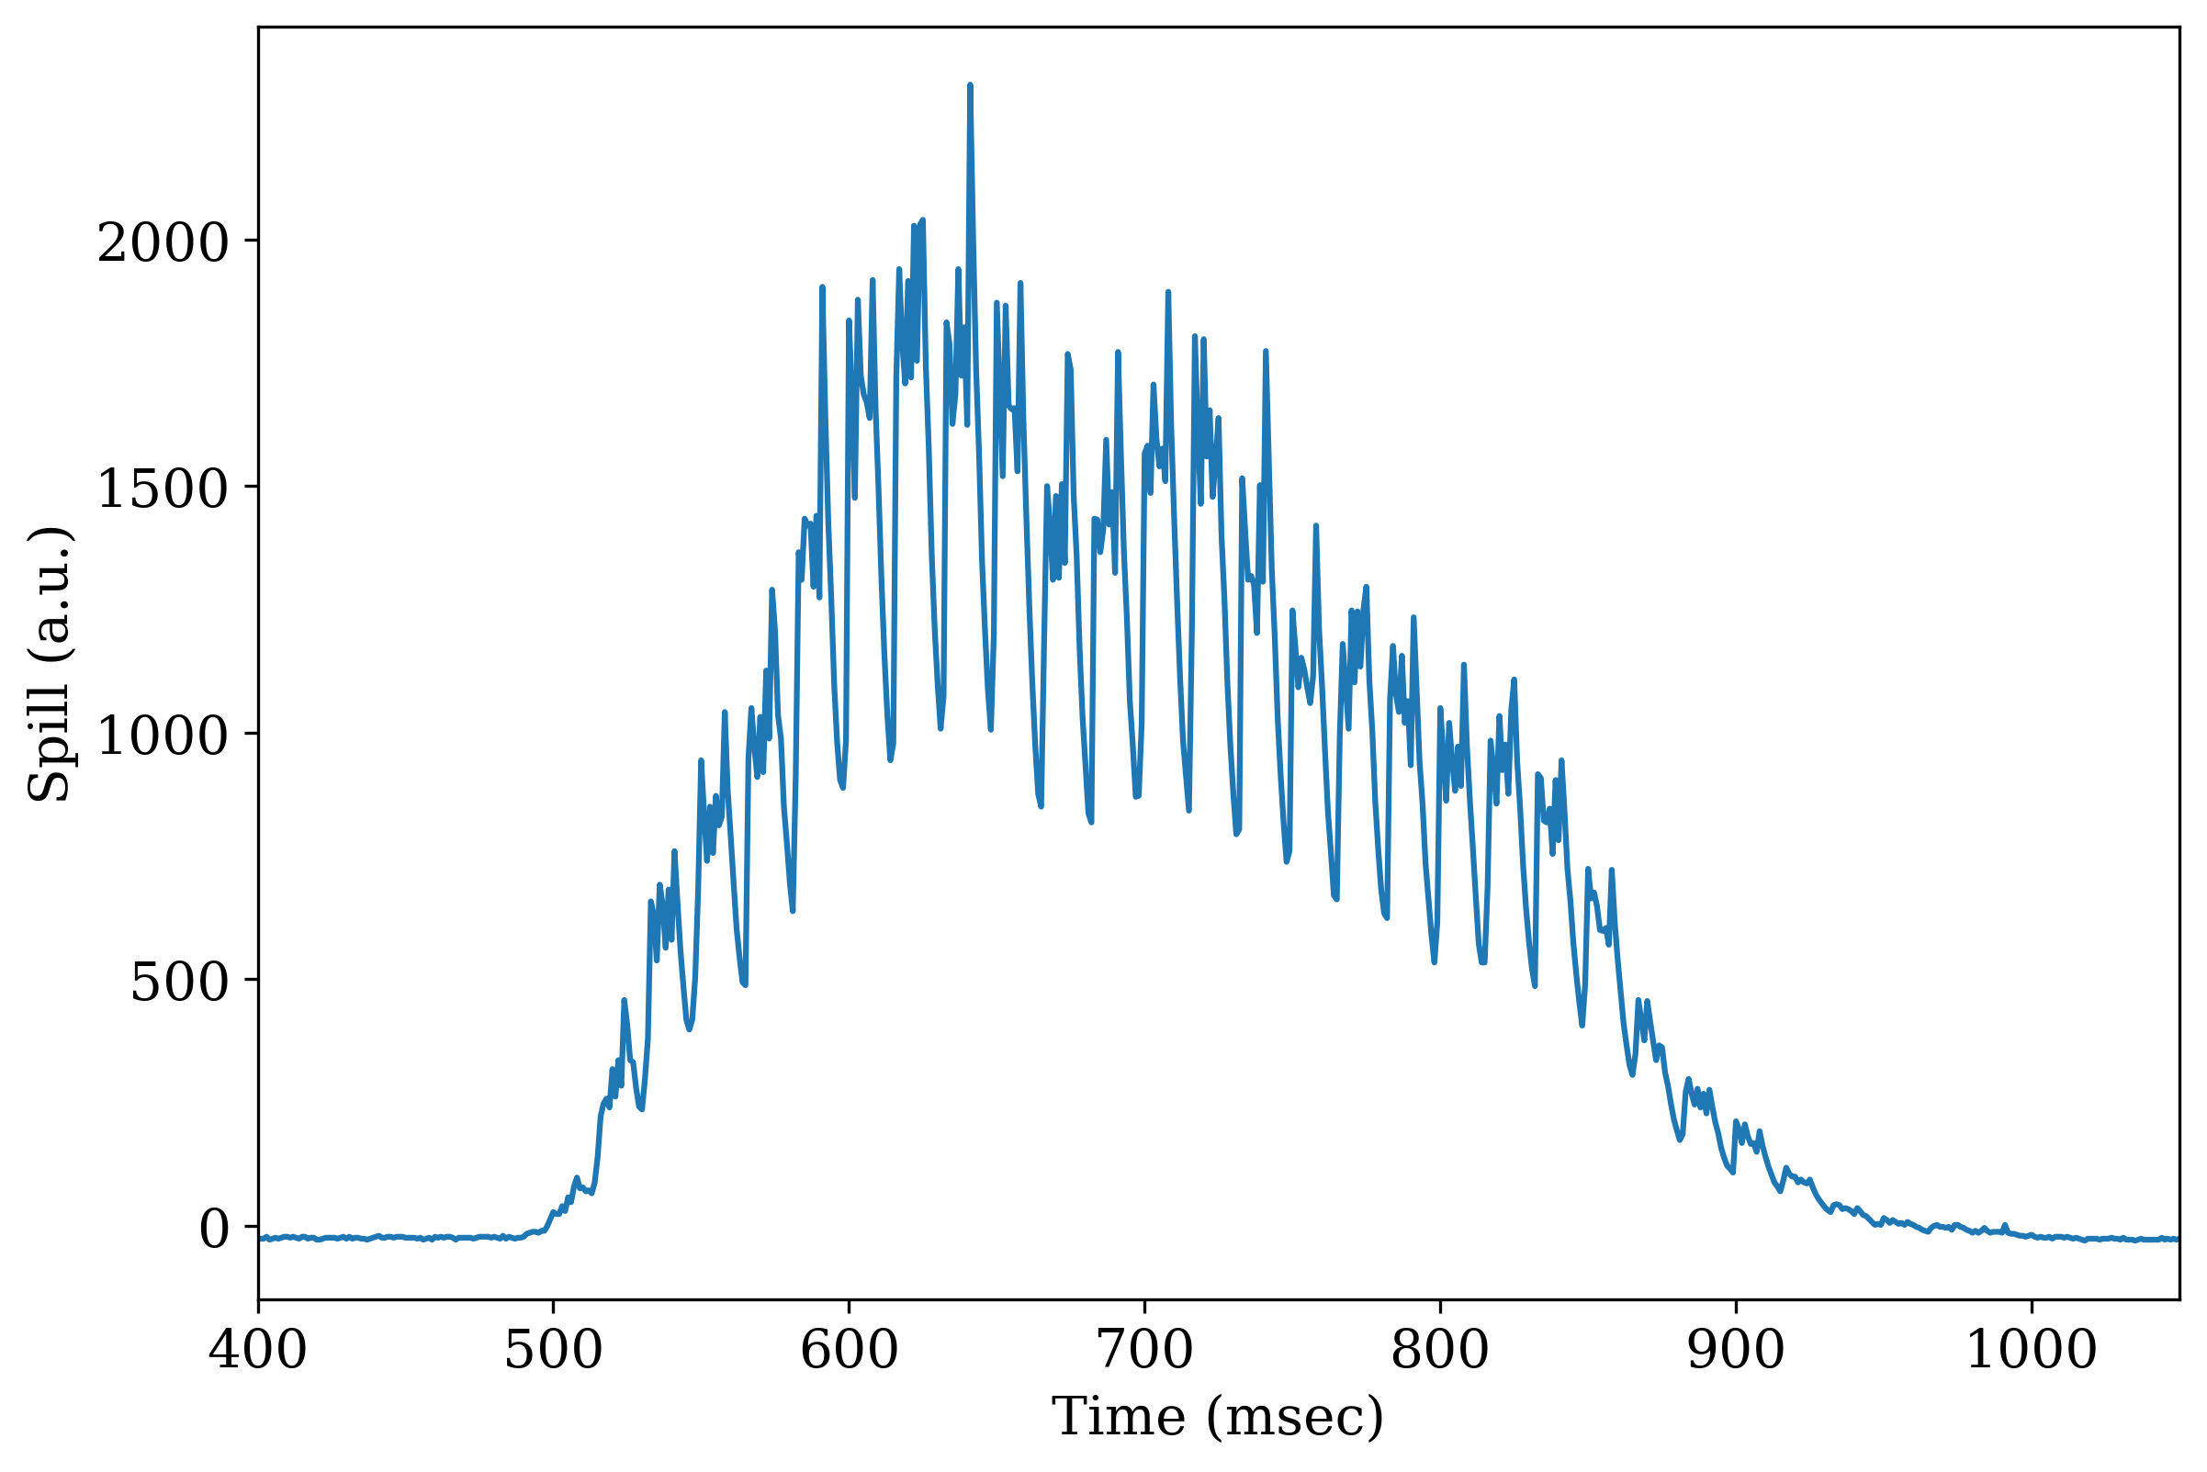
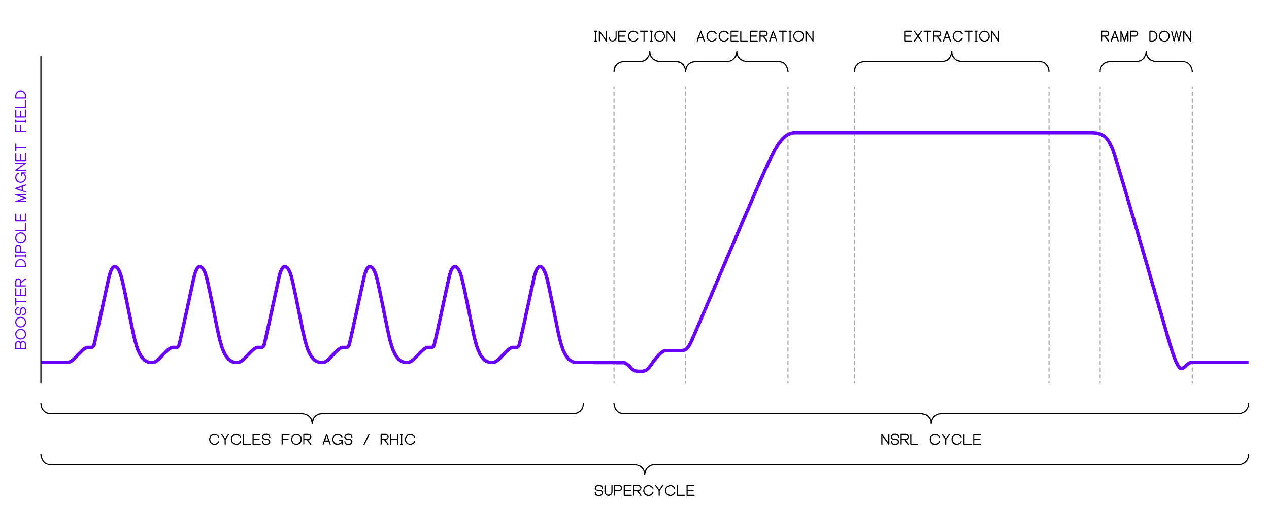
Extracted Beam Spill
Beam is extracted over 400 ms, every 4 to 6 seconds (~10% duty cycle)
6 sec
7

Slide 8
Booster Extraction Bump

Slide 9
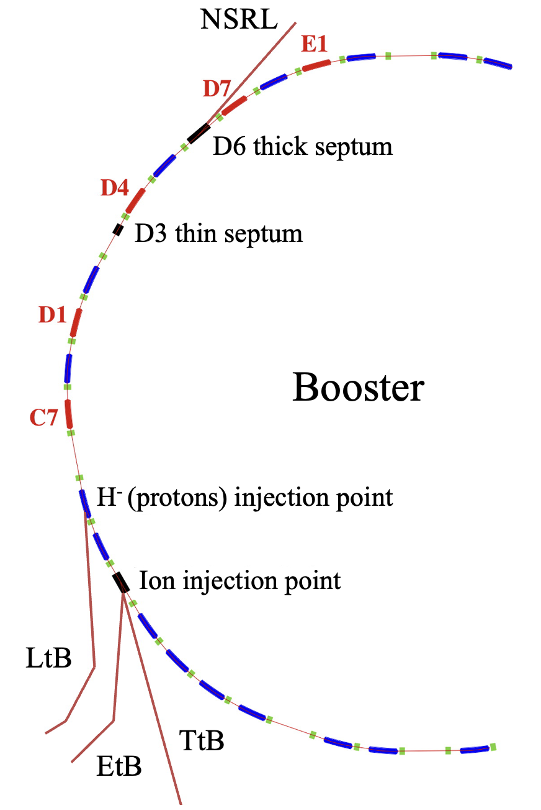
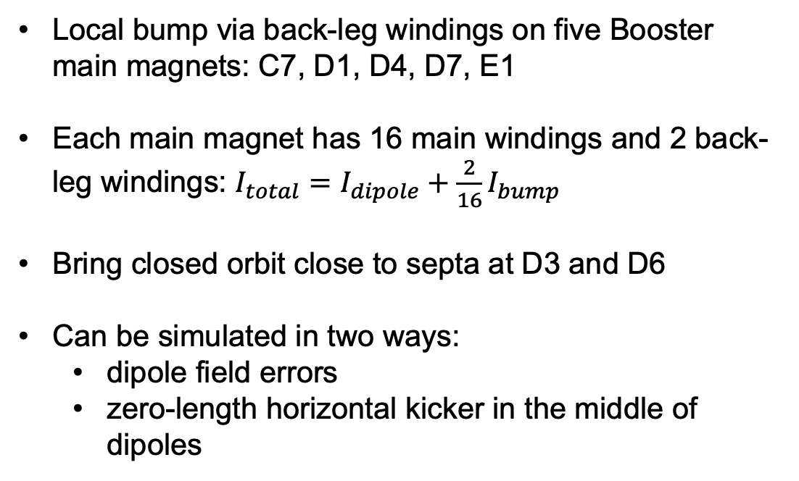
Booster extraction bump
Local bump via back-leg windings on five Booster main magnets: C7, D1, D4, D7, E1
Each main magnet has 16 main windings and 2 back-leg windings: $I_{total}=I_{dipole}+\frac{2}{16}I_{bump}$
Bring closed orbit close to septa at D3 and D6
Can be simulated in two ways:
dipole field errors
zero-length horizontal kicker in the middle of dipoles

Slide 10
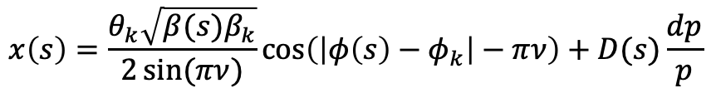
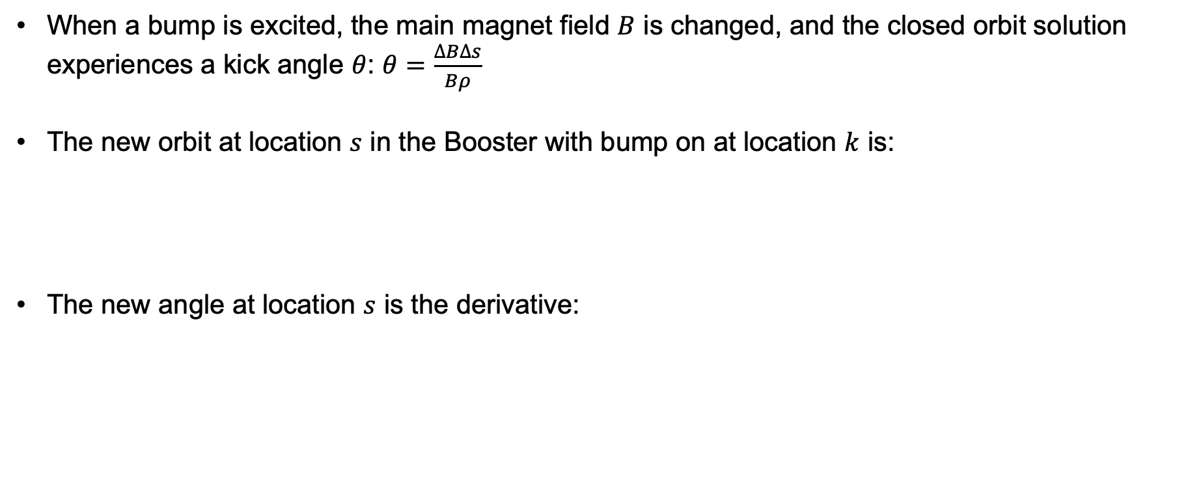
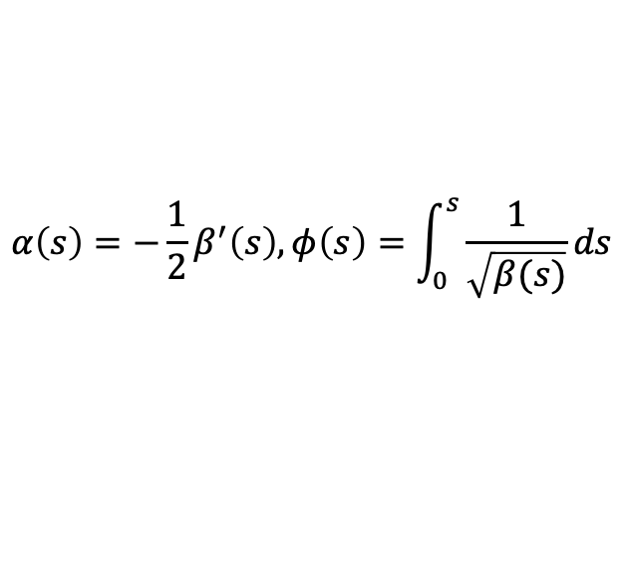
Orbit distortion via local bump
When a bump is excited, the main magnet field $B$ is changed, and the closed orbit solution experiences a kick angle $θ$: $θ=\frac{∆B∆s}{Bρ}$
The new orbit at location $s$ in the Booster with bump on at location $k$ is:
The new angle at location $s$ is the derivative:
$$x\left(s\right)=\frac{θ_{k}\sqrt{β(s)β_{k}}}{2\sin{(πν)}}\cos\left(\left|φ\left(s\right)−φ_{k}\right|−πν\right)+D(s)\frac{dp}{p}$$
$$x^{′}(s)=\frac{θ_{k}β_{k}}{2\sin\left(πν\right)\sqrt{β\left(s\right)β_{k}}}\left[α\left(s\right)\cos\left(\left|φ\left(s\right)−φ_{k}\right|−πν\right)+\sin\left(\left|φ\left(s\right)−φ_{k}\right|−πν\right)\right]+D′(s)\frac{dp}{p}$$
$$α\left(s\right)=−\frac{1}{2}β^{′}\left(s\right), φ\left(s\right)=\int_{0}^{s}{\frac{1}{\sqrt{β(s)}}ds}$$

Slide 11
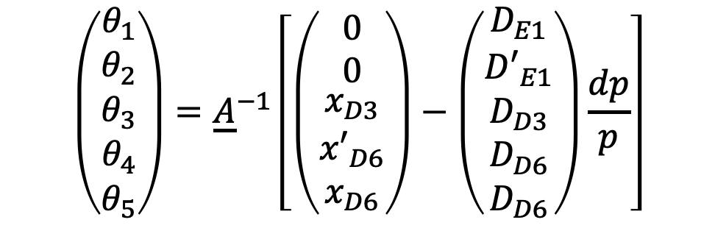
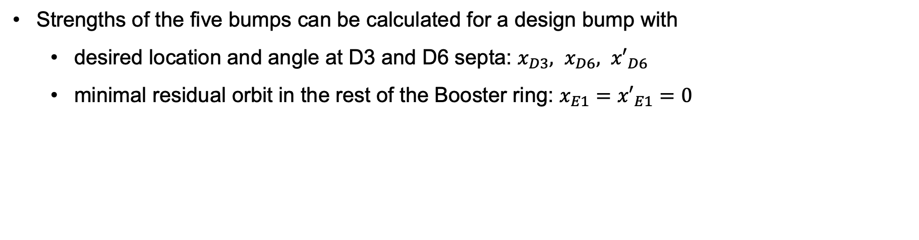
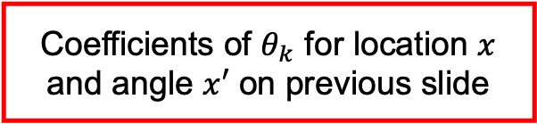
Design bump strength calculation
Strengths of the five bumps can be calculated for a design bump with
desired location and angle at D3 and D6 septa: $x_{D3}, x_{D6}, {x′}_{D6}$
minimal residual orbit in the rest of the Booster ring: $x_{E1}={x′}_{E1}=0$
$$\left(\begin{matrix}\begin{matrix}θ_{1} \\ θ_{2}\end{matrix} \\ θ_{3} \\ \begin{matrix}θ_{4} \\ θ_{5}\end{matrix}\end{matrix}\right)={\underline{A}}^{−1}\left[\left(\begin{matrix}\begin{matrix}0 \\ 0\end{matrix} \\ x_{D3} \\ \begin{matrix}{x′}_{D6} \\ x_{D6}\end{matrix}\end{matrix}\right)−\left(\begin{matrix}\begin{matrix}D_{E1} \\ {D′}_{E1}\end{matrix} \\ D_{D3} \\ \begin{matrix}D_{D6} \\ D_{D6}\end{matrix}\end{matrix}\right)\frac{dp}{p}\right]$$
Coefficients of $θ_{k}$ for location $x$ and angle $x′$ on previous slide

Slide 12
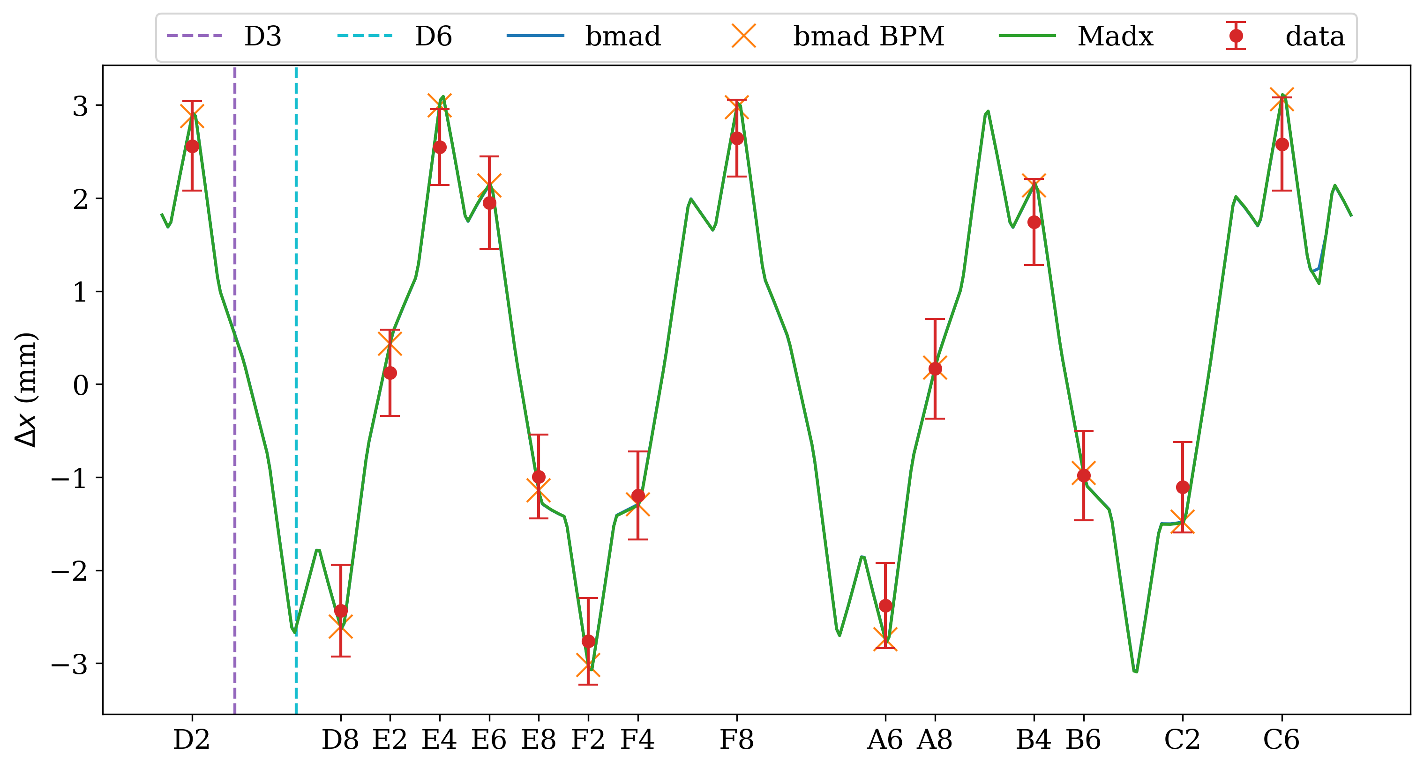
Bump simulation vs. measurement
618 MeV/n Silicon
Single bump measurement (C7 bump = 80 Amp shown) show good agreement with simulation
Bump defined as horizontal kicker in MAD-X, dipole field error in Bmad

Slide 13
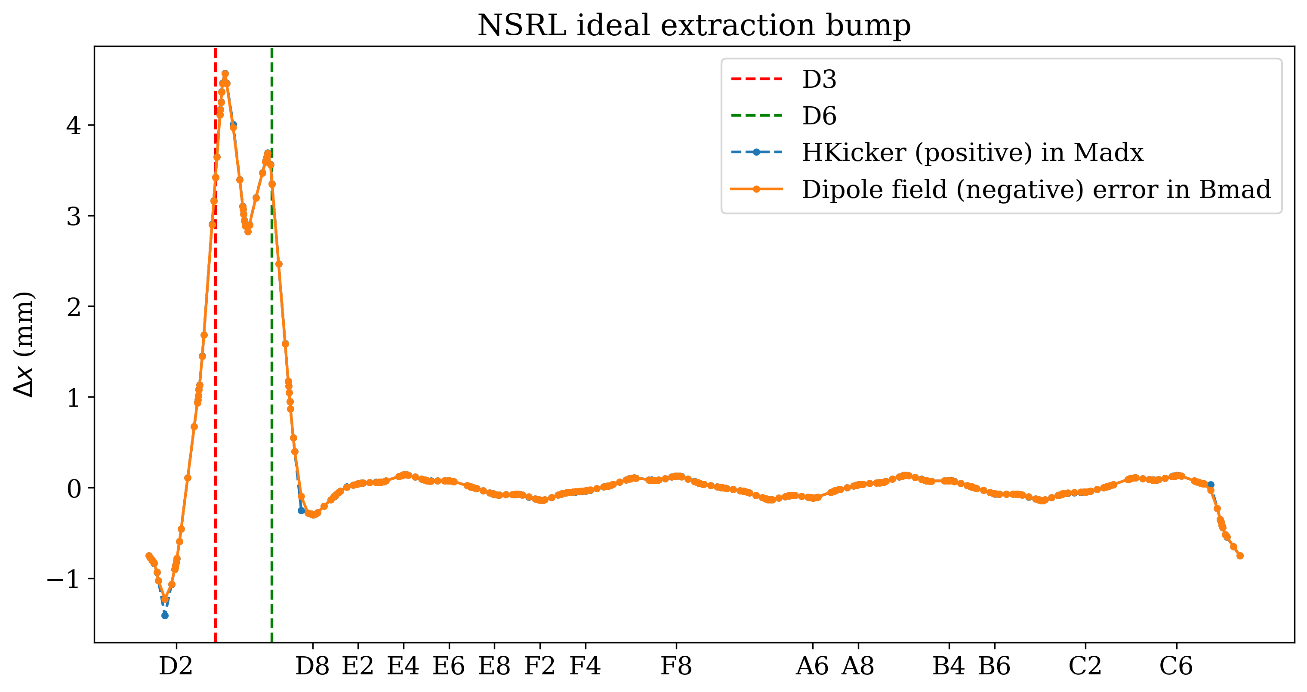
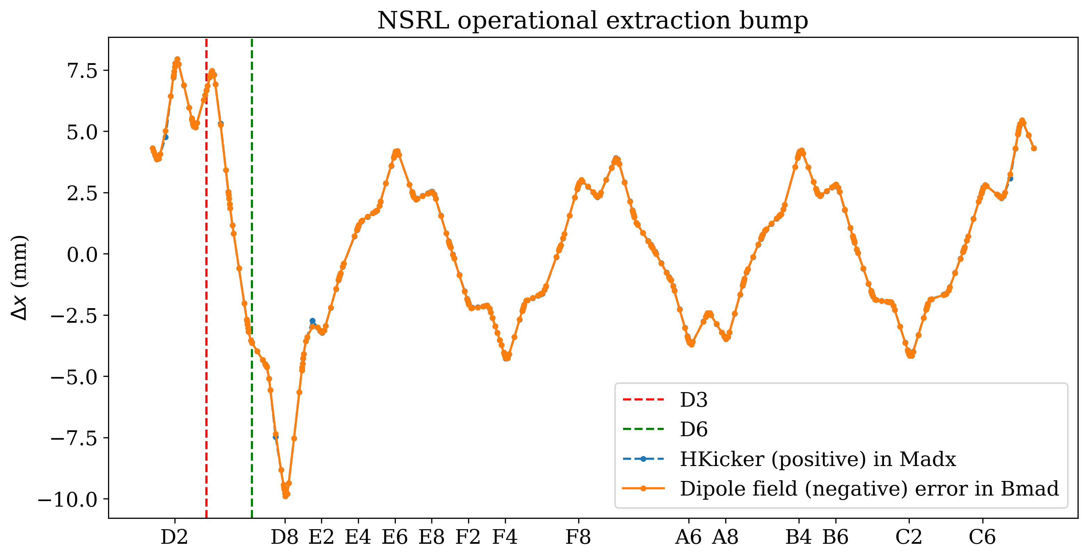
Bump design vs. Reality
618 MeV/n Silicon
Surprise discovery: operational bump is miles away from design bump due to years of blind tuning

Slide 14
Digital Twin interface

Slide 15
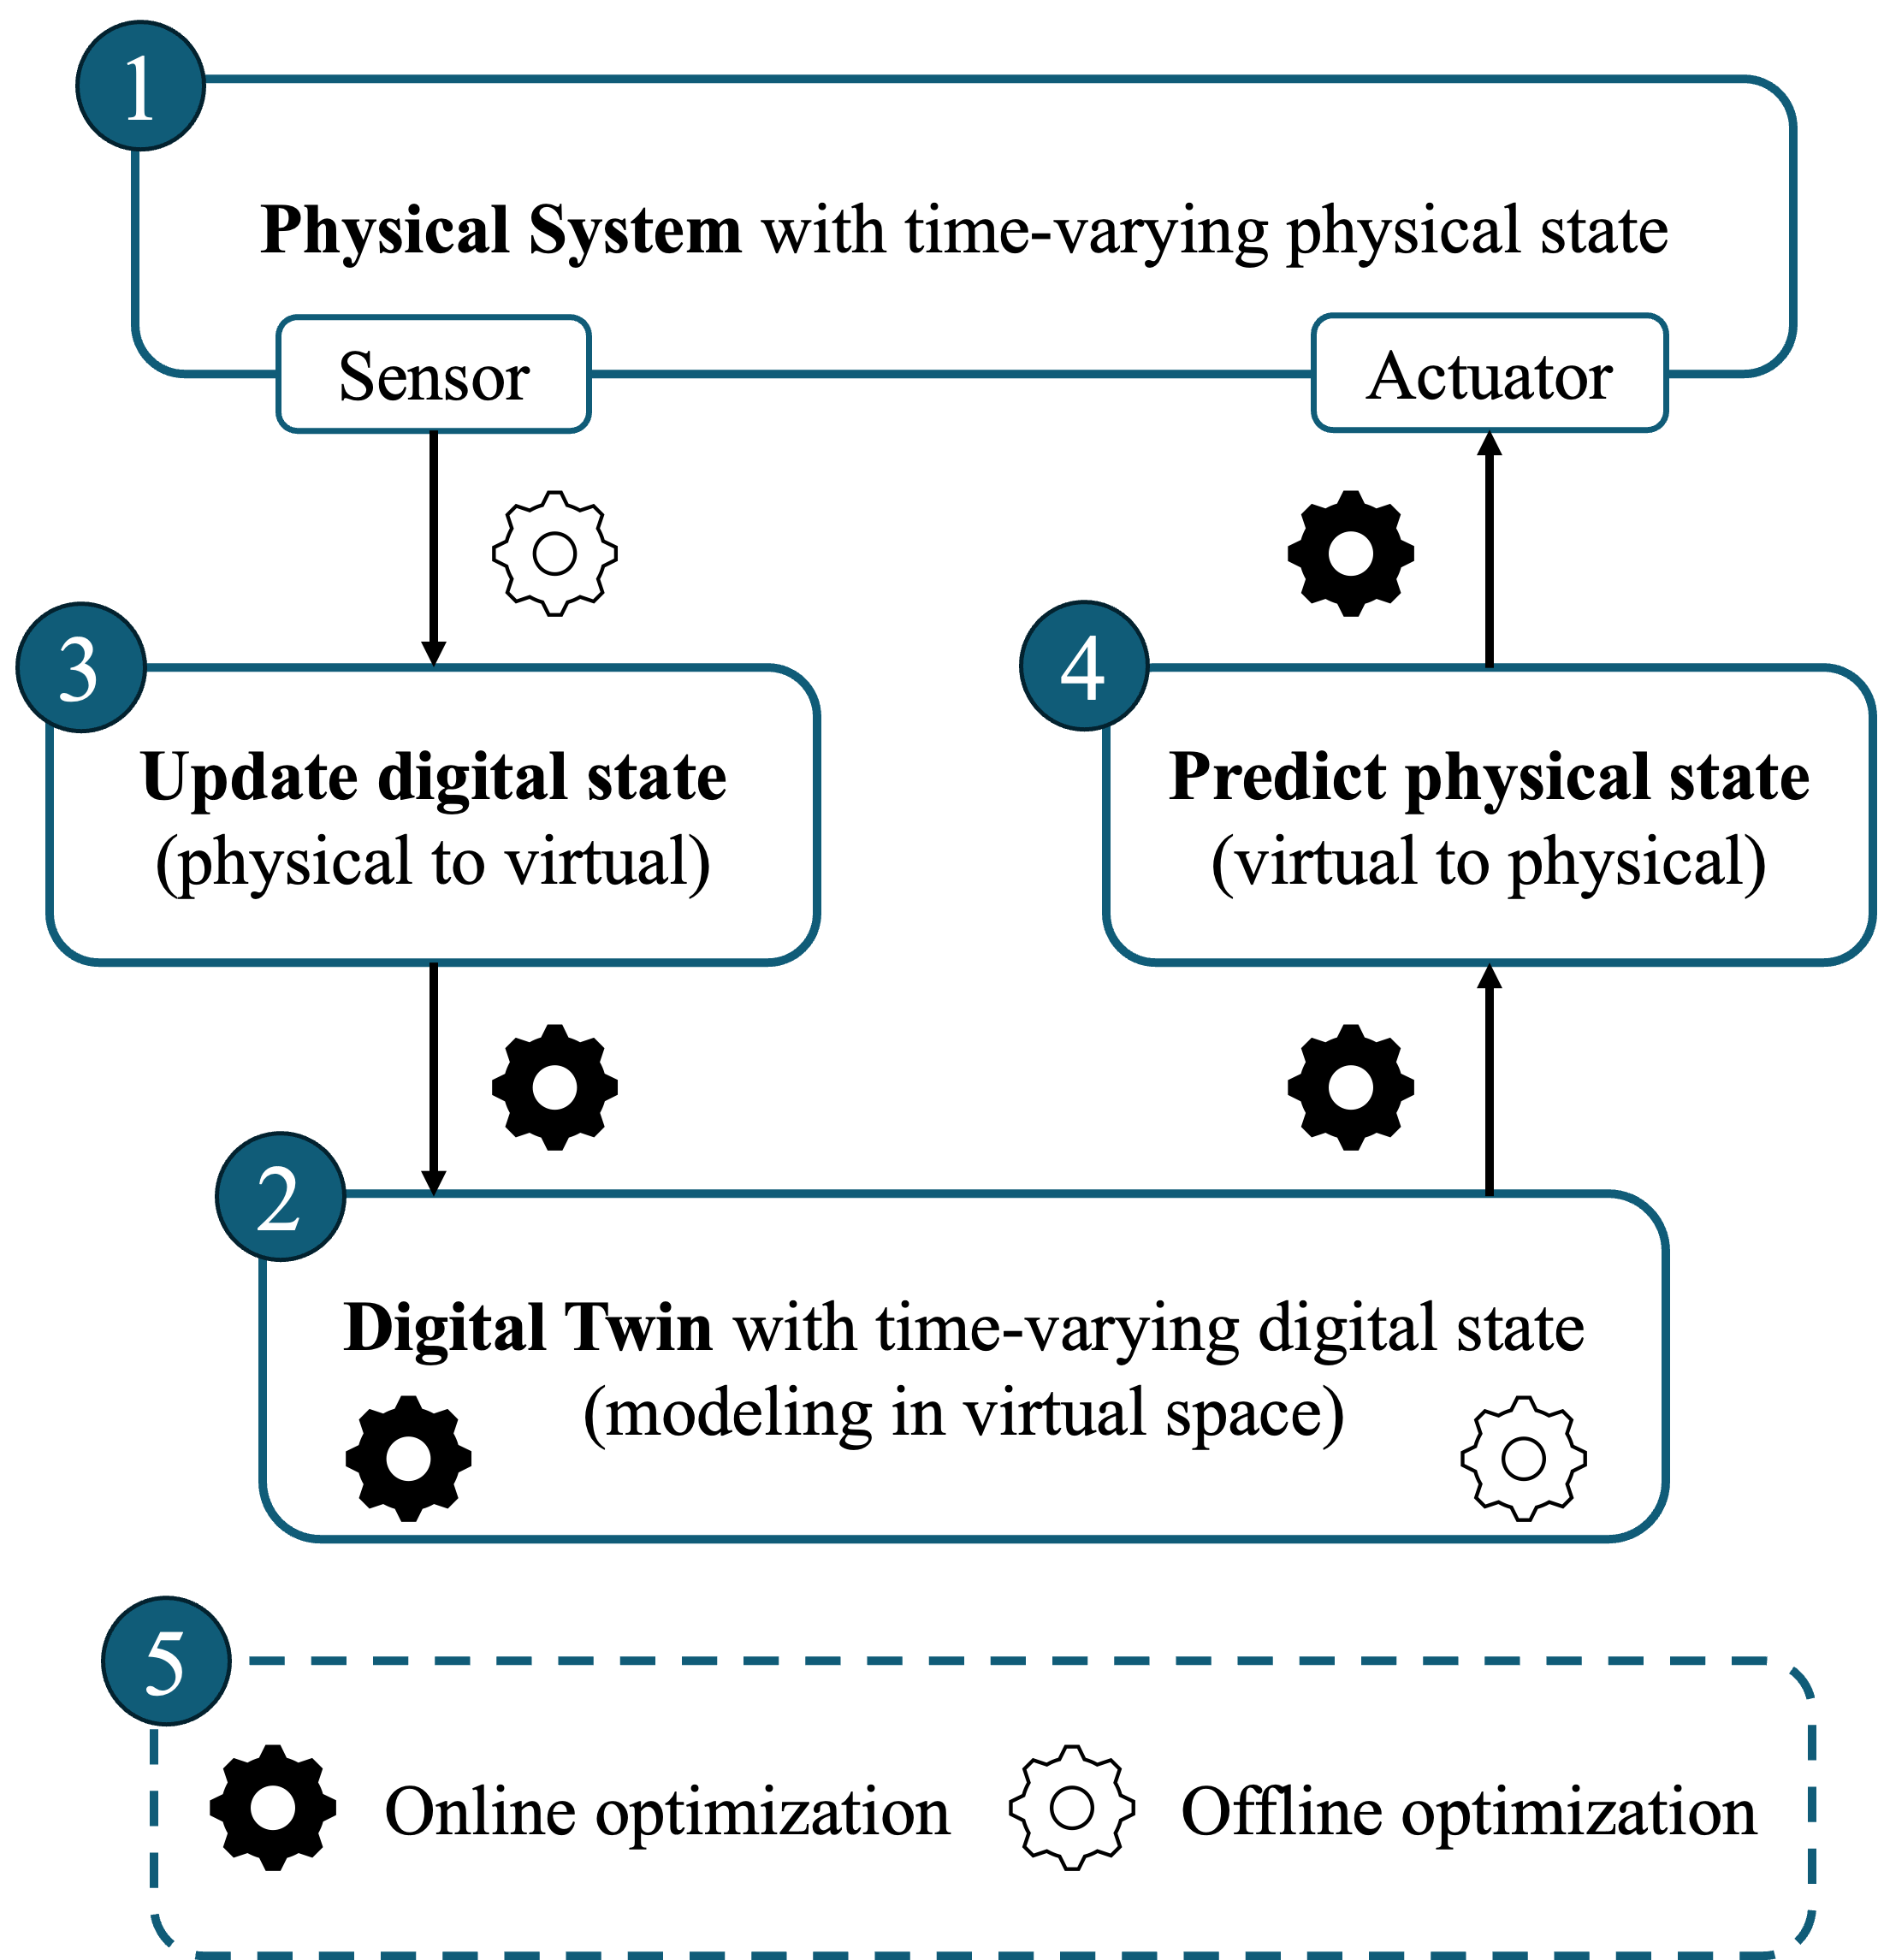
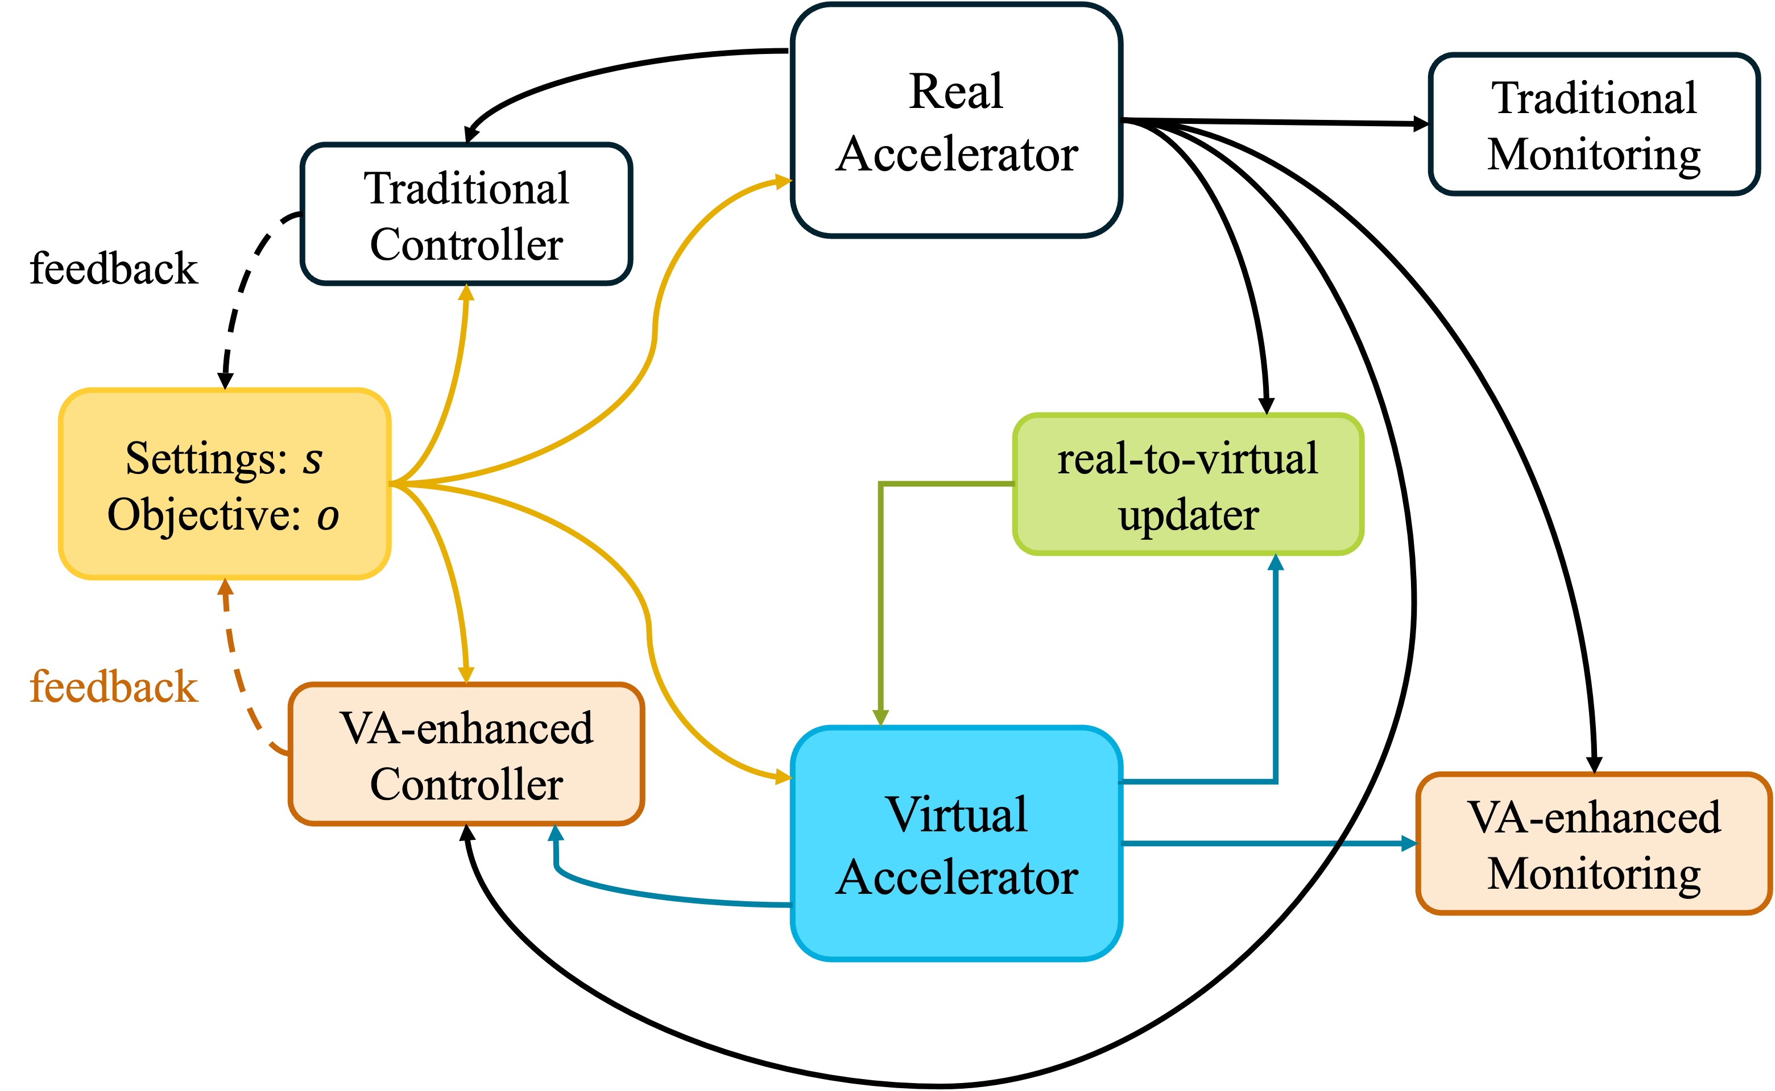
What is digital twin (DT)?
"A digital twin is a set of virtual information constructs that mimics the structure, context, and behavior of a natural, engineered, or social system (or system-of-systems), is dynamically updated with data from its physical twin, has a predictive capability, and informs decisions that realize value. The bidirectional interaction between the virtual and the physical is central to the digital twin.”
- Foundational Research Gaps and Future Directions for Digital Twins (2024)
National Academies of Sciences, Engineering, and Medicine report

Slide 16
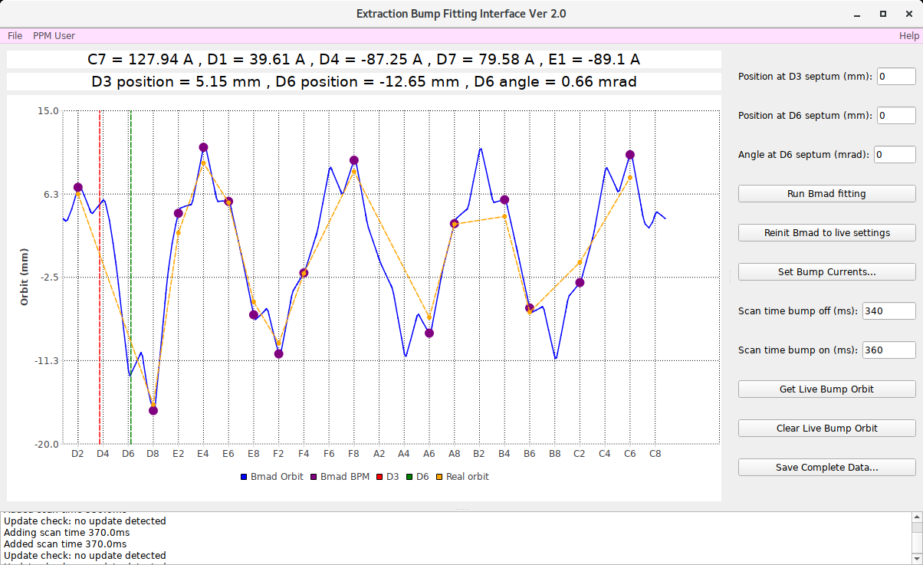
Digital Twin for extraction bump
1 GeV/n Proton
Load live bump currents from real machine
Simulated D3 + D6 orbit info using live bumps
Simulated bump orbit using live bumps
Real bump orbit measured by beam position monitors

Slide 17
Digital Twin for extraction bump
1 GeV/n Proton
Use Bmad to fit any design bump shape
Send calculated bump currents to real machine
Time stamps in Booster cycle used to measure bump orbit
Save simulated and measured data

Slide 18
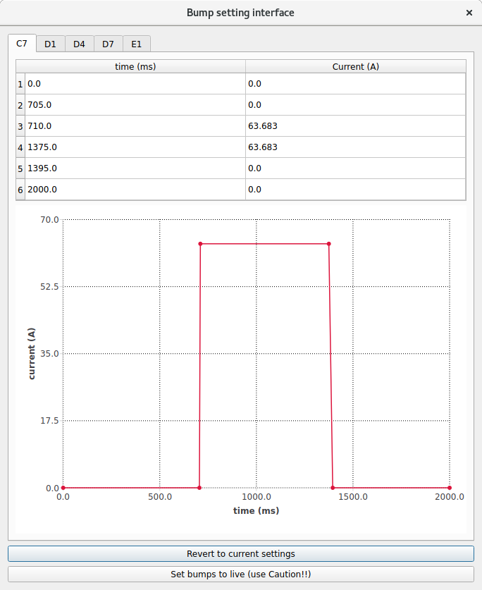
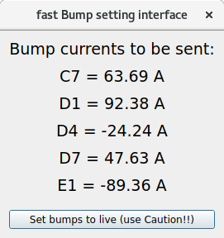
Digital Twin for extraction bump
370 MeV/n Silicon
Booster magnet currents are time-dependent
Bump currents are only turned on during NSRL extraction
Full bump setting interface allows changes to both timing and current
For normal operation, timing stays the same, fast setting interface allows changes to only current

Slide 19
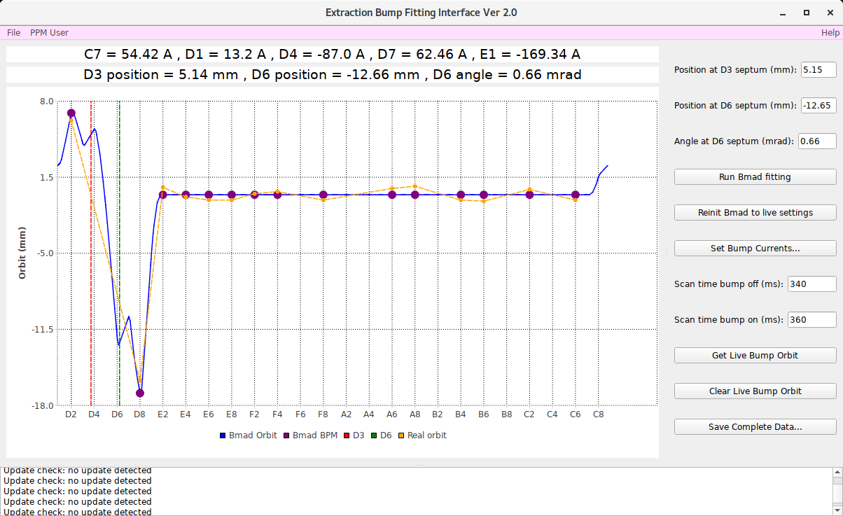
DT-assisted bump tuning
1 GeV/n Proton
Optimize operational bump by minimizing the residual orbit across the Booster ring

Slide 20
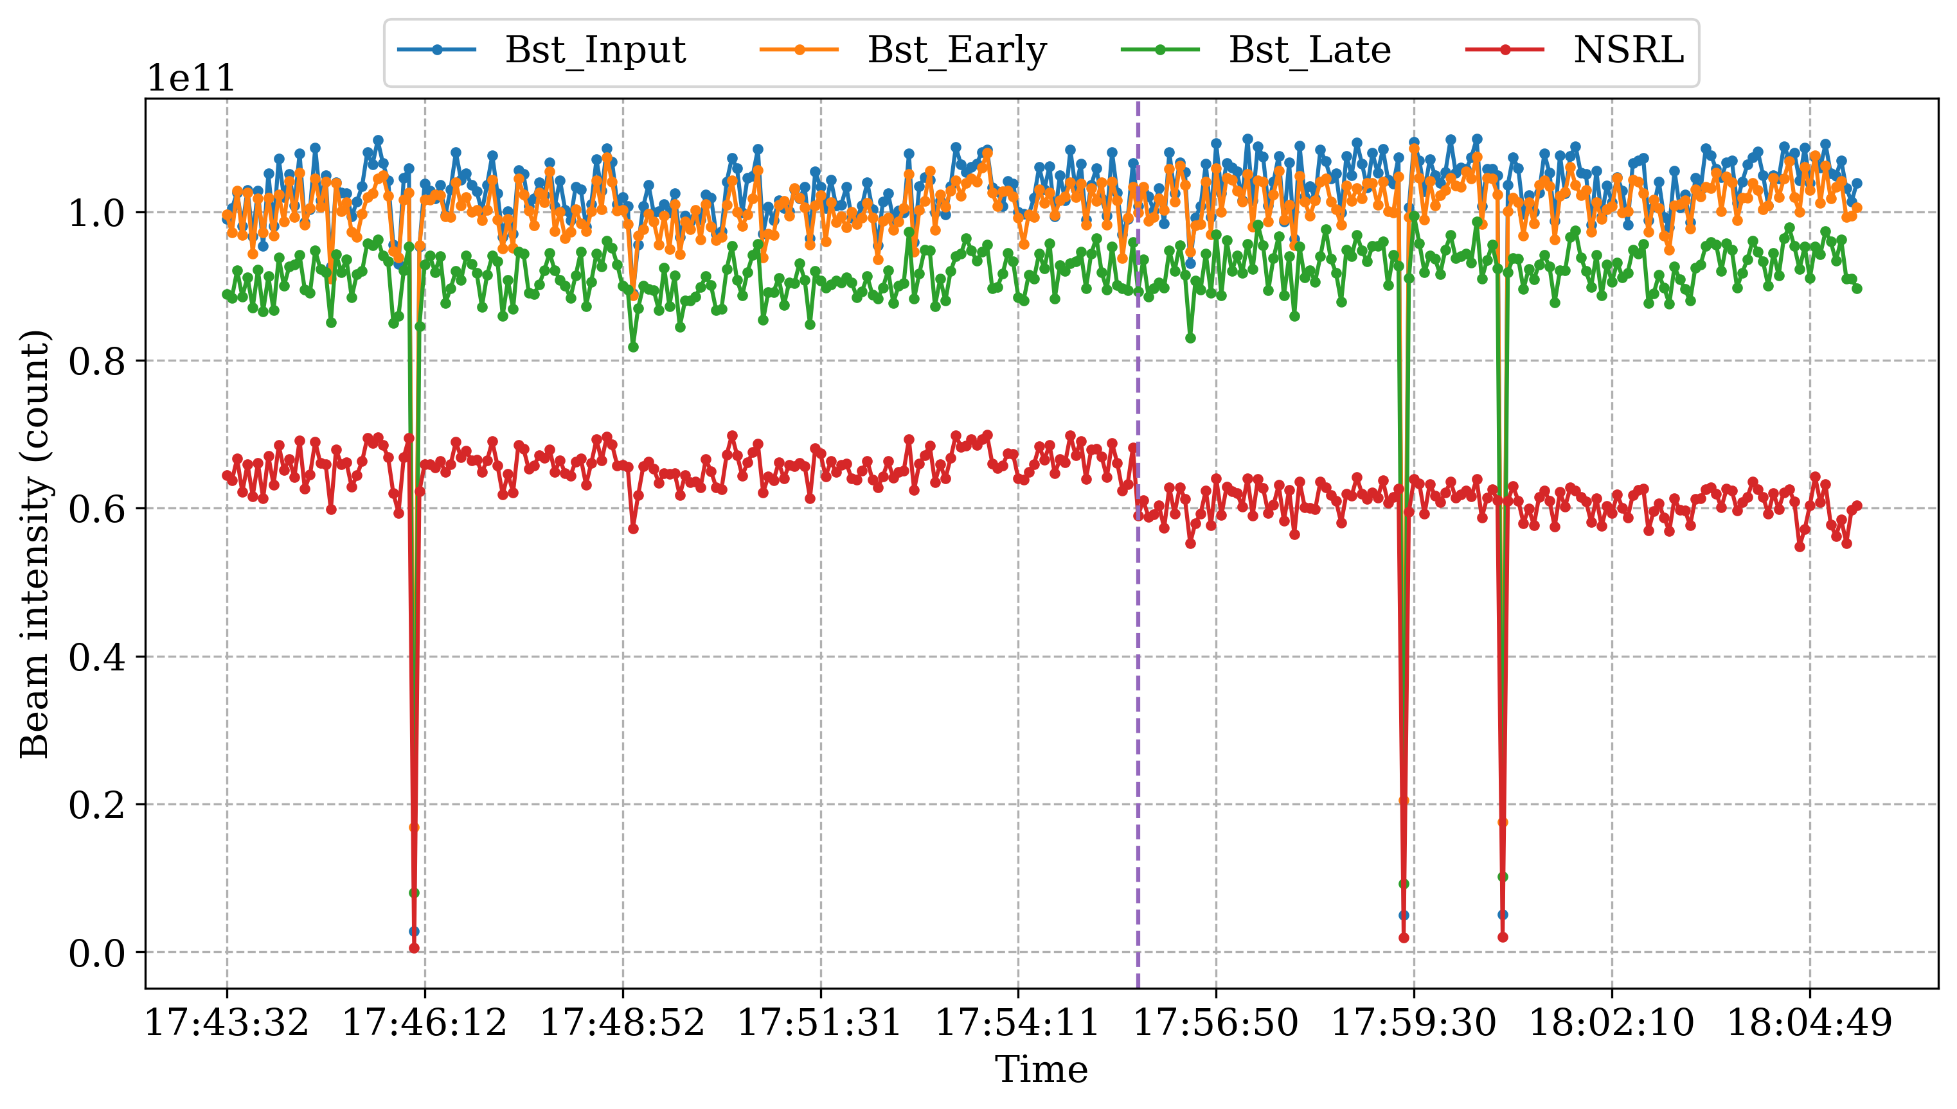
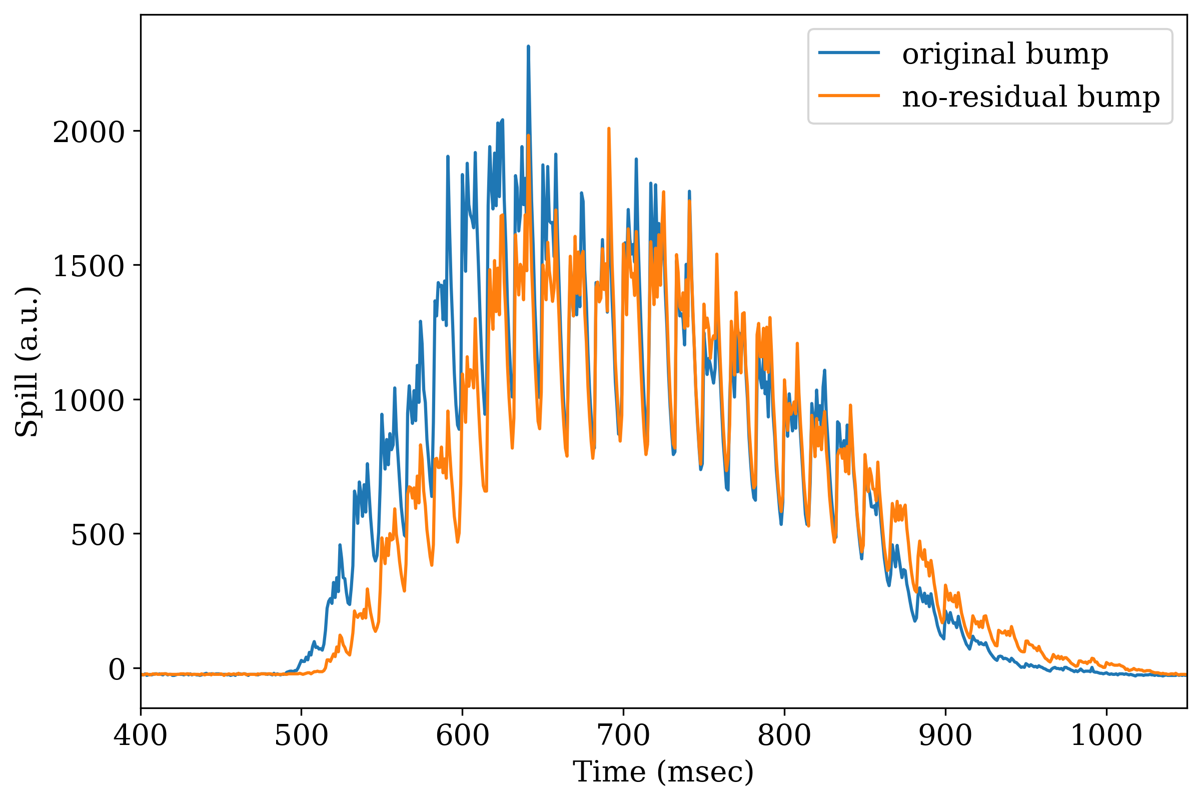
DT-assisted bump tuning
1 GeV/n Proton
Minimal change in intensity and spill for optimized bump with minimal residual orbit

Slide 21
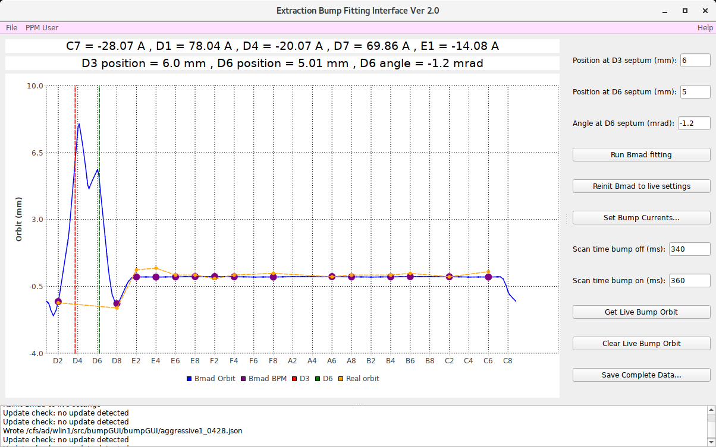
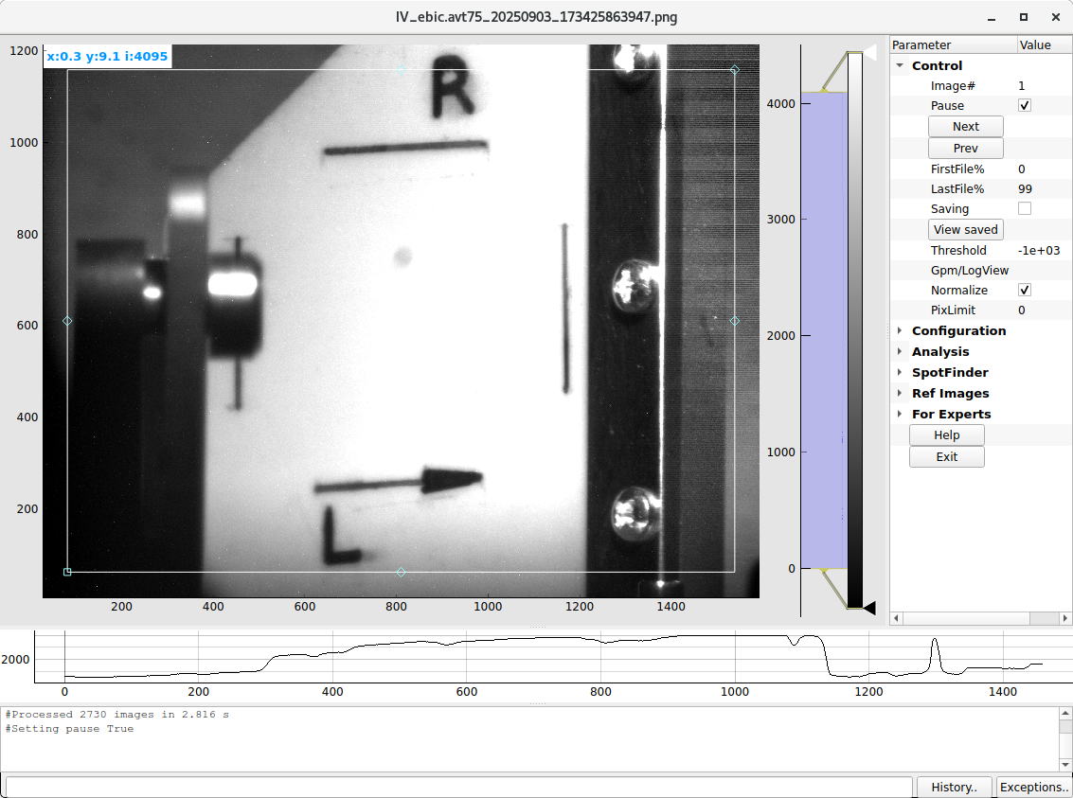
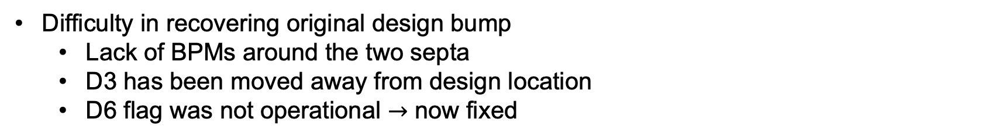
DT-assisted bump tuning
Difficulty in recovering original design bump
Lack of BPMs around the two septa
D3 has been moved away from design location
D6 flag was not operational $→$ now fixed

Slide 22
NSRL Beam Line

Slide 23
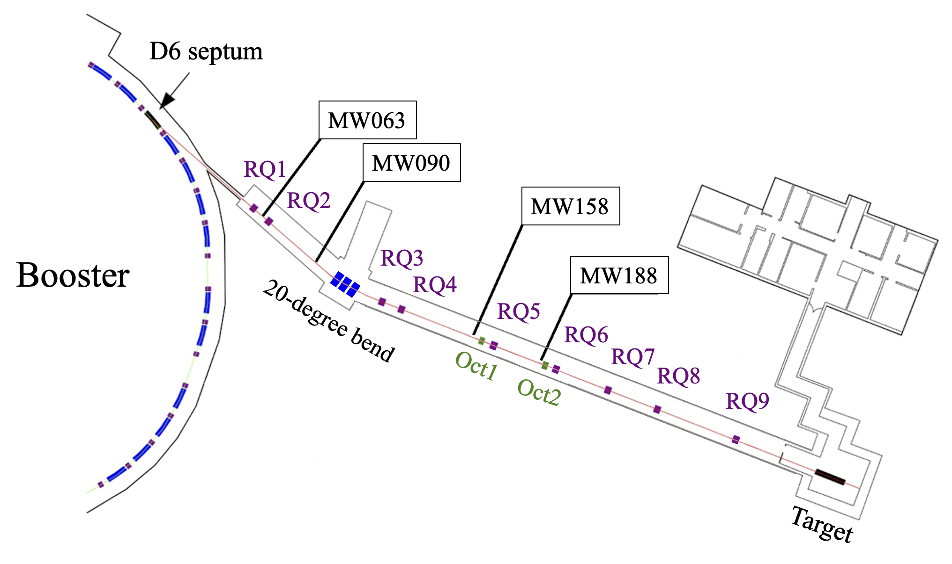
NSRL beam line
Nine quadrupoles, three dipoles (20 degree), two octupoles, four multi-wires
Designed to be achromatic after the 20-degree bend
Two octupoles create uniform square beam at the target

Slide 24
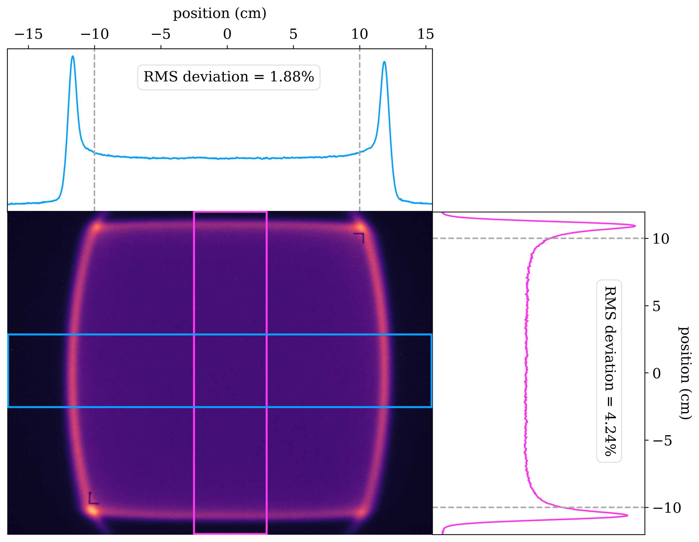
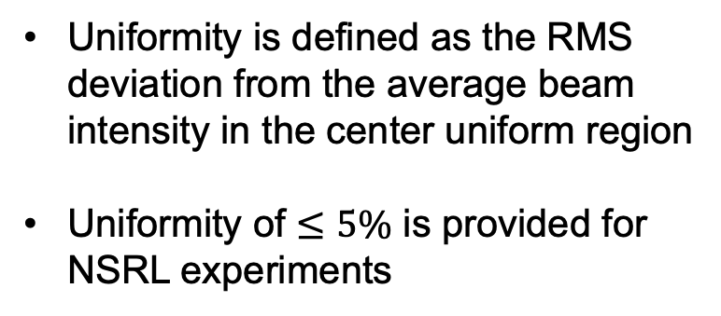
Uniform beam with octupoles
480 MeV/n Iron
Uniformity is defined as the RMS deviation from the average beam intensity in the center uniform region
Uniformity of $≤5\%$ is provided for NSRL experiments

Slide 25
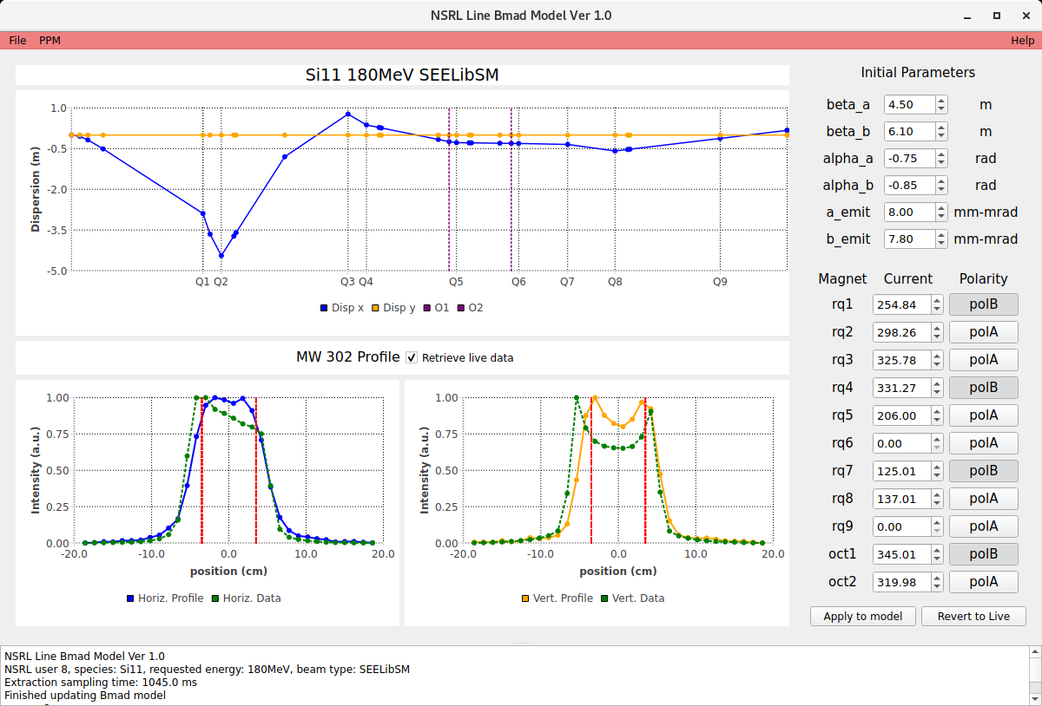
Digital Twin for NSRL line
180 MeV/n Silicon
Initial beam parameters used by model
Currents and polarities of quadrupoles from live machine
Simulated dispersion of NSRL line using live machine info
Simulated vs. real transverse beam profile at MW302

Slide 26
Summary
NSRL is a unique facility that utilizes slow extraction to provide high quality heavy-ion beam for industry and academia to conduct space radiation testing
Booster extraction bump plays a key role in the slow extraction process, but years of empirical tuning has shifted the operational bump very far away from design
We developed and tested a complete digital twin system for the extraction bumps, with bidirectional interaction between physical and virtual machines.
Future bump tuning will be easier and more streamlined with the help of DT
DT for NSRL line also under development, will facilitate beam uniformity optimization

