Slide 1
Status of rfko extraction development at medaustron
Fabien Plassard, E. Renner, K. Holzfeind, M. Wolf, T. Margreiter, M. Kausel, D. Prokopovich, M. Pivi, V. Rizzoglio, A. Wastl, C. Schmitzer

Slide 2
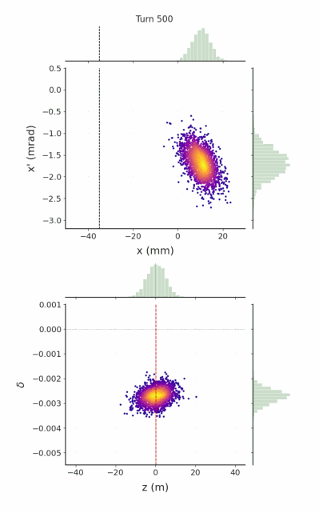
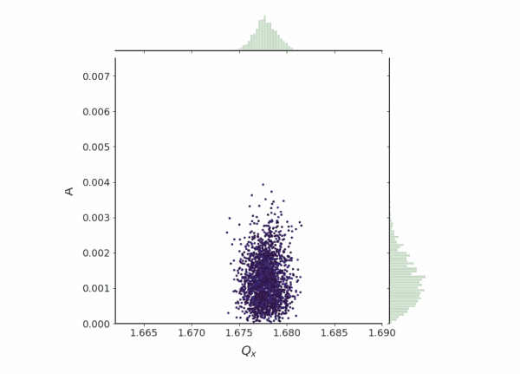
OVERVIEW OF RFKO Implementation STUDIES
Current Slow extraction method at MA:
Betatron Core
Coasting beam at extraction
RF phase jump to obtain large and uniform momentum spread
Betatron core pushes the beam energy towards resonance condition via chromatic tune shift
Spill ripple correction with empty RF bucket Channelling

Slide 3
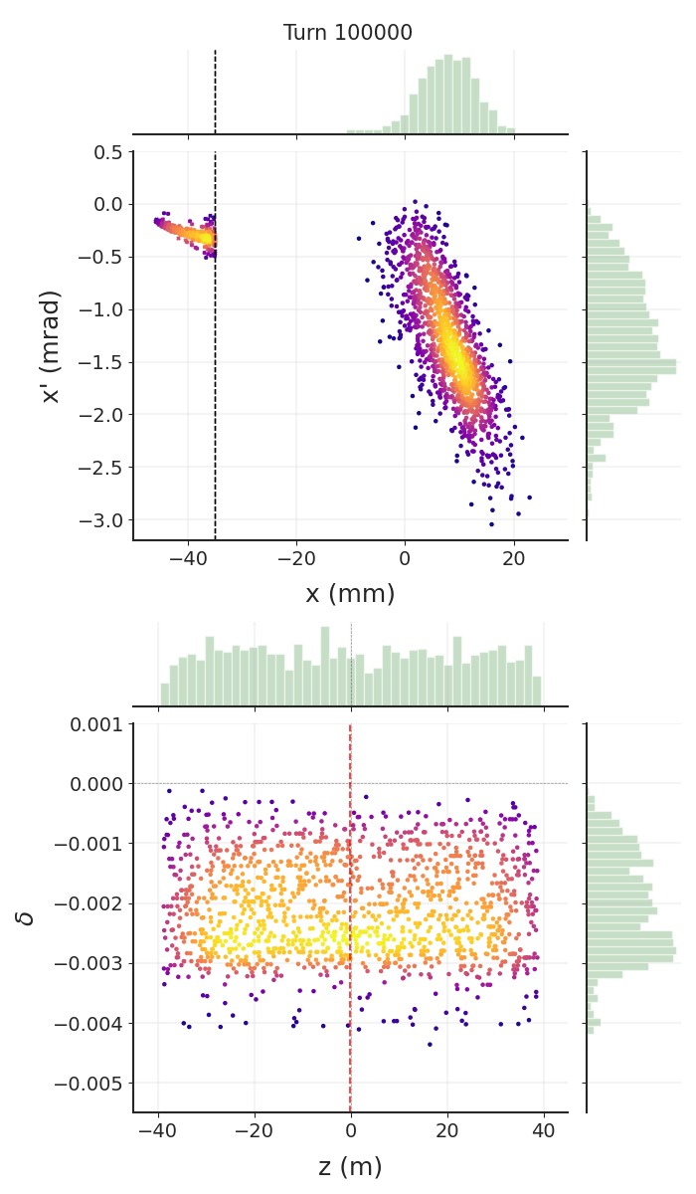
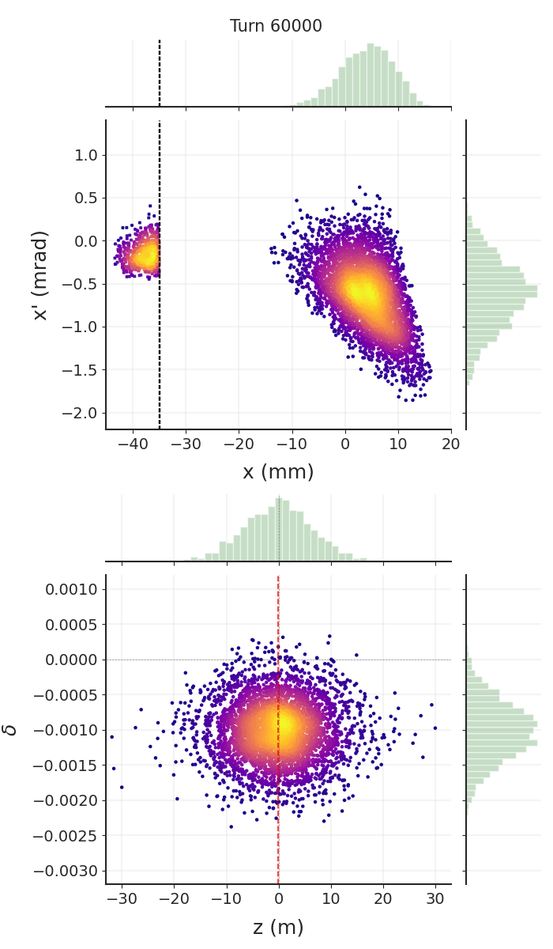
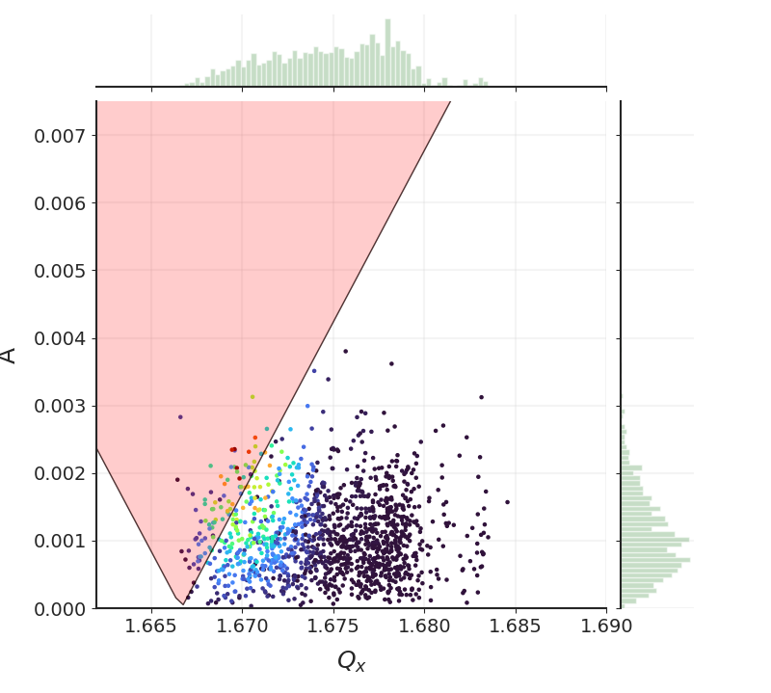
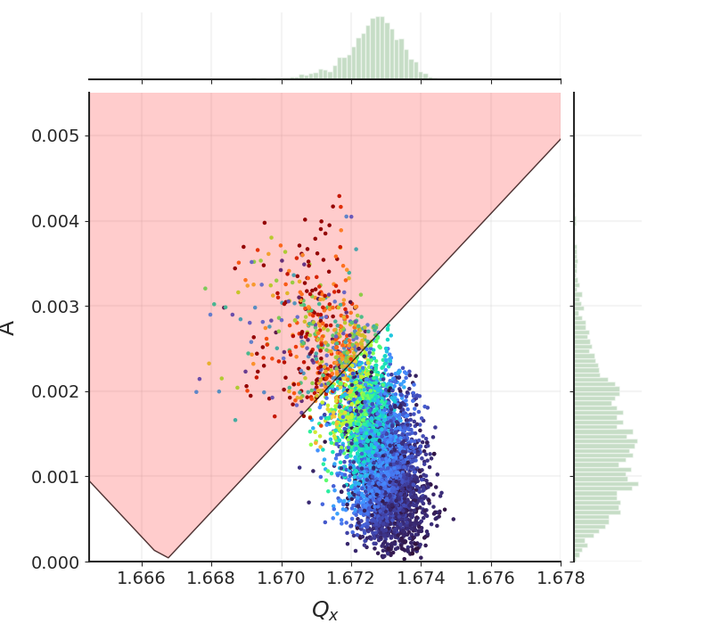
OVERVIEW OF RFKO Implementation STUDIES
Current Slow extraction method at MA:
Betatron Core
Future Slow extraction method at MA:
RF-Knock Out
Coasting beam at extraction
RF phase jump to obtain large and uniform momentum spread
Betatron core pushes the beam energy towards resonance condition via chromatic tune shift
Spill ripple correction with empty RF bucket Channelling
Bunched beam at extraction
RFKO exciter coherently increase horizontal emittance till 3rd order resonant condition
Extracted flux quality depends on RFKO excitation signal
Compatible with MEE and DIC

Slide 4
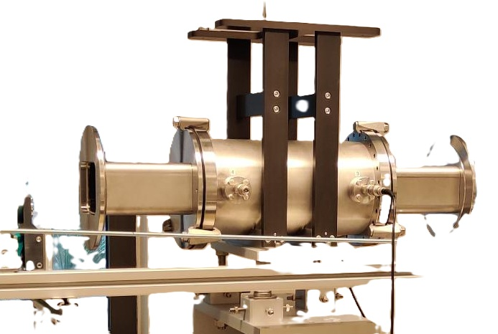
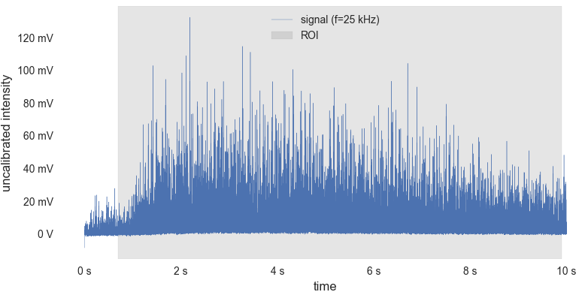
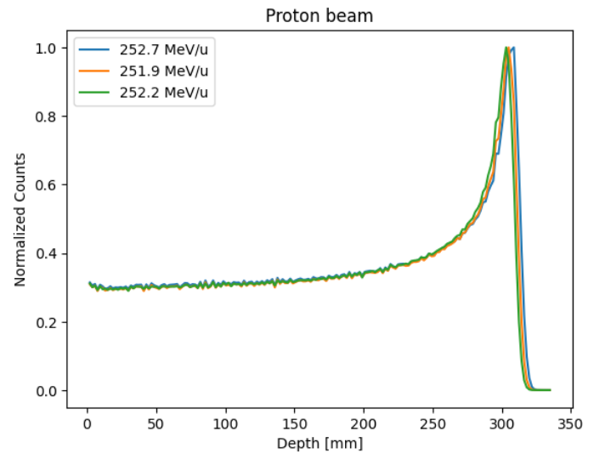
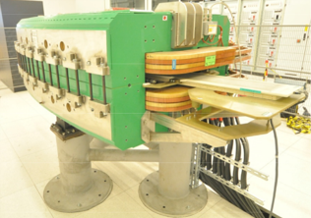
OVERVIEW OF RFKO Implementation STUDIES
Hardware and Control system
Spill quality studies
Testing shifts with Schottky monitor as RFKO exciter
Synchrotron optics optimization
Exciter signal optimization
Spill intensity ripple and extracted beam properties
Testing of the RFKO cavity exciter
Adaptation of MA control system
Data workflow
Compatibility to MEE, DIC
Safety and Impact analysis
Pre-requisite project
Update of safety system (energy verification)
Risk analysis and testing
Regulatory compliancy
Synchrotron dipole B-field regulation

Slide 5
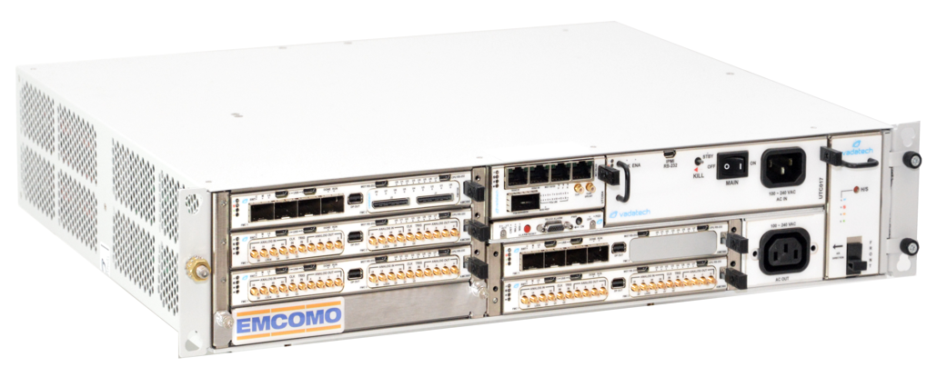
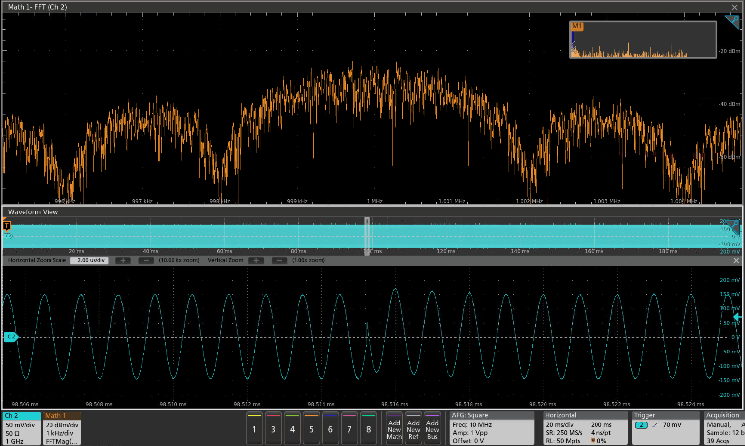
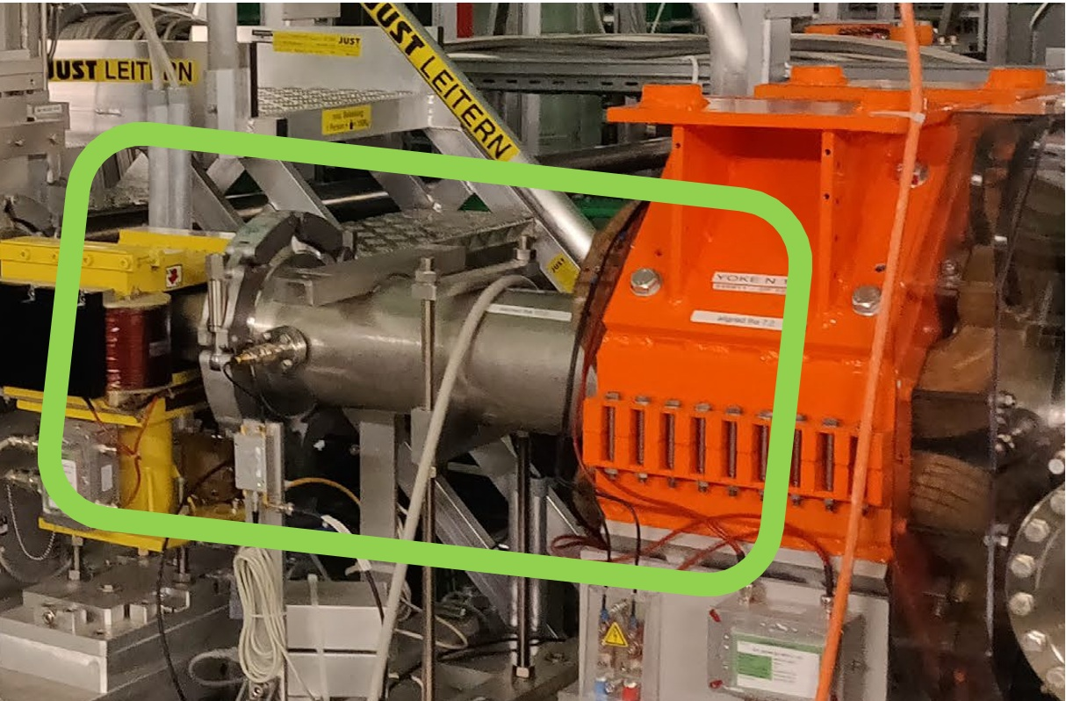
RFKO Hardware setup
RFKO exciter manufactured and tested on bench but not installed
Use of Schottky monitor plates for RFKO extraction testing
Use of the mTCA based LLRF crate for signal generation
Compatible interface with our control system and intended use
Same LLRF for Injector, Synchrotron, RFKO and beam diagnostics
See “Development of an RF system for slow extraction signal generation and measurement” SlowEx 2024 workshop by Markus Wolf

Slide 6
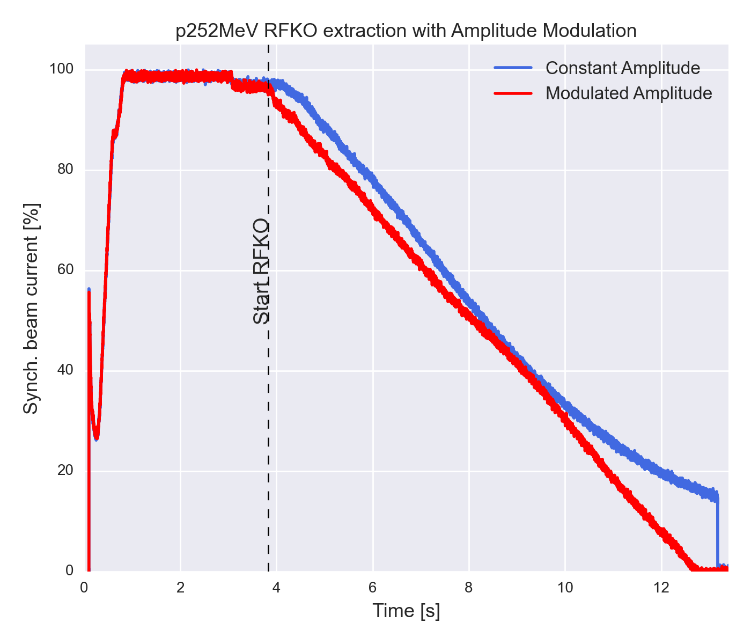
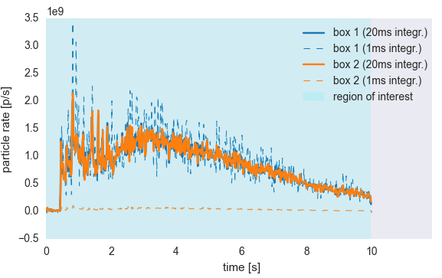
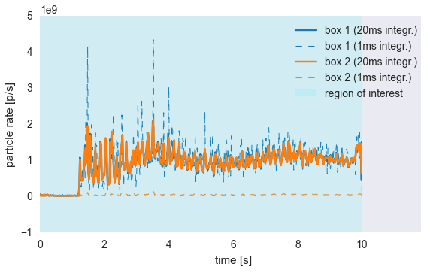
Beam extraction optimization
Pre-computed Amplitude Modulation for constant flux extraction
No amplitude feedback based on extracted dose implemented yet.

Slide 7
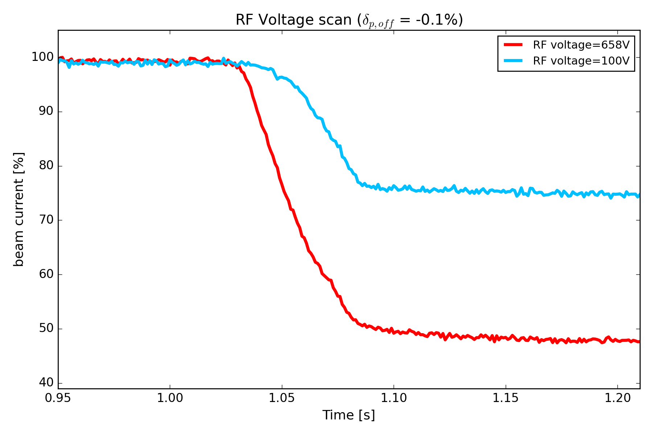
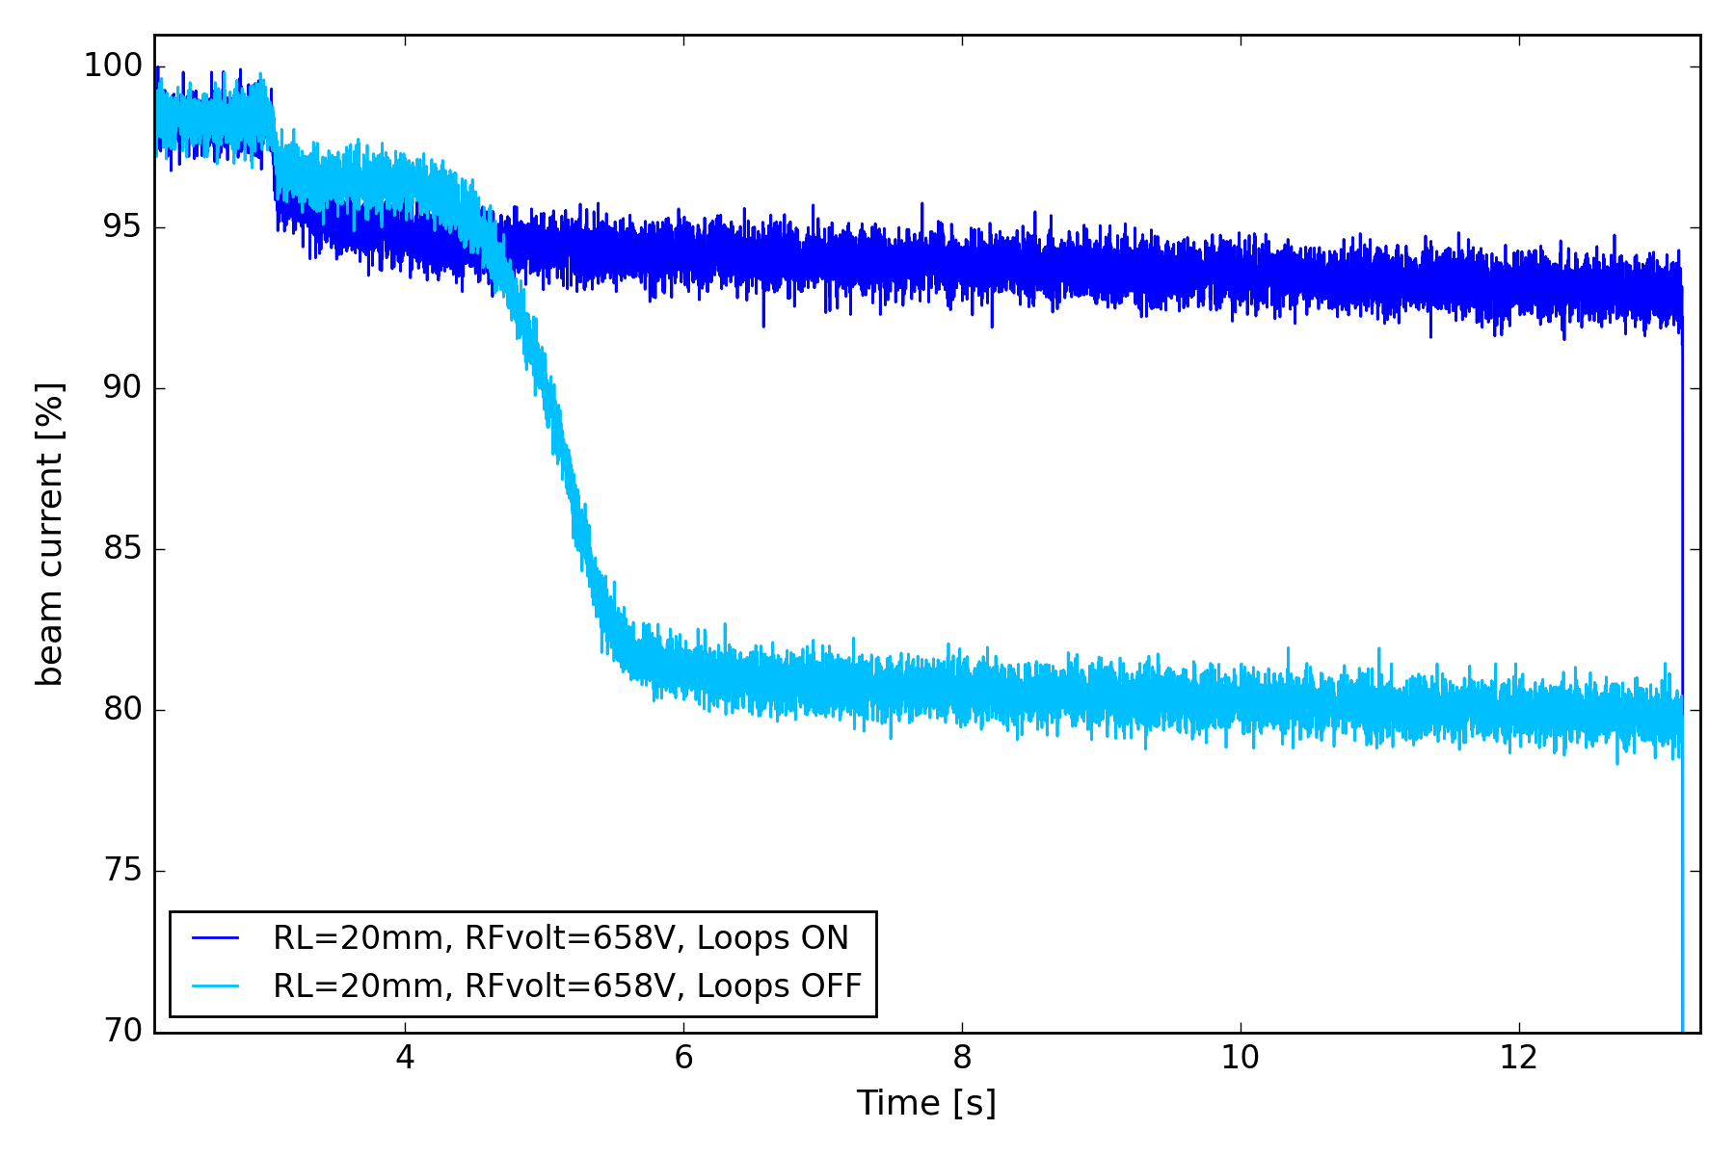
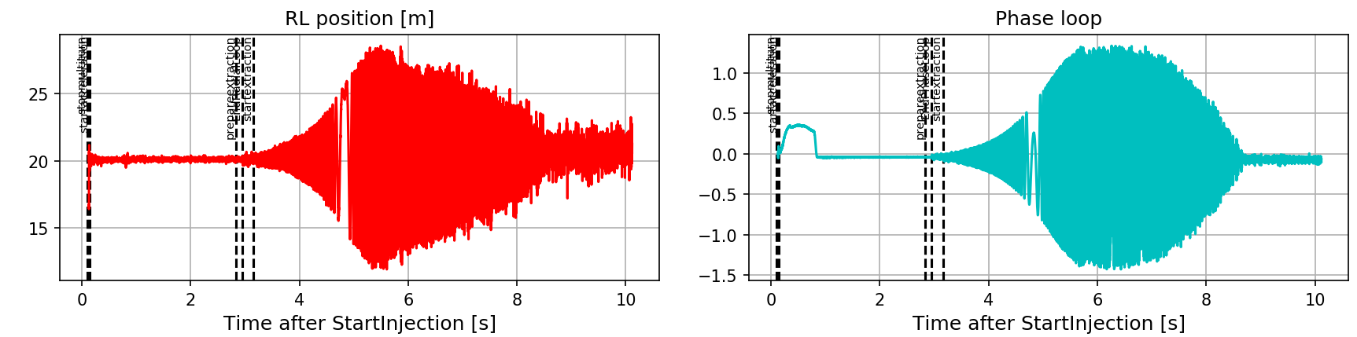
Beam extraction optimization
Synchrotron optics optimized for RFKO (Tunes, chromaticity, Sext. Strength, mom. Offset) → see F. Kühteubl Thesis (“Slow extraction optimisation for the MedAustron synchrotron”)
Voltage optimization: Reduce the amplitude of the energy offset by reducing the bucket height closer to the beam to contain the oscillations
LLRF loops during extraction
See “Beam loss optimization for slow extraction at MedAustron”
(SlowEx 2024)

Slide 8
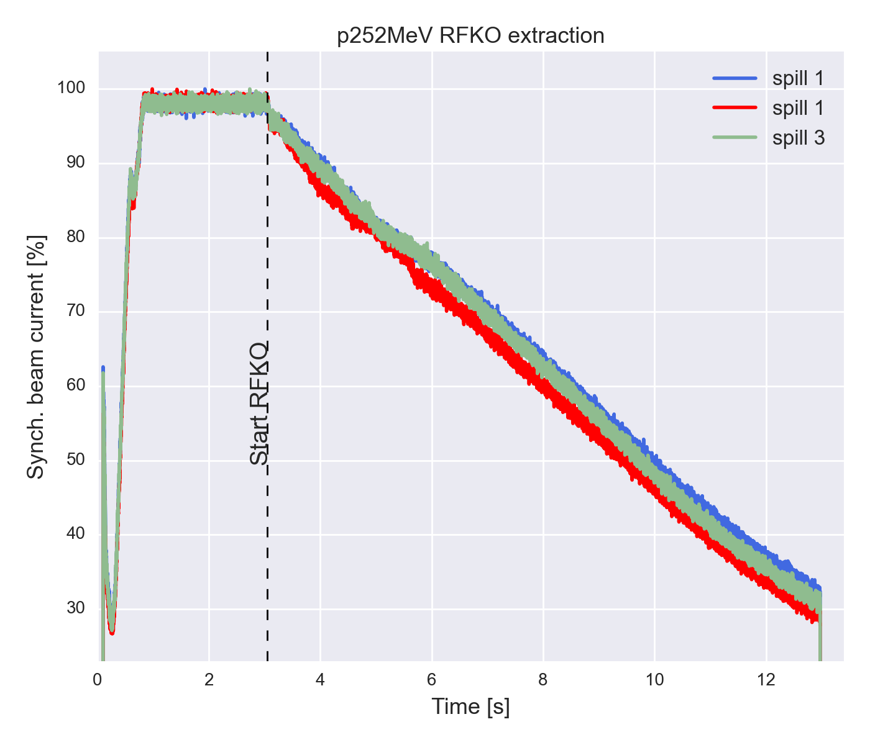
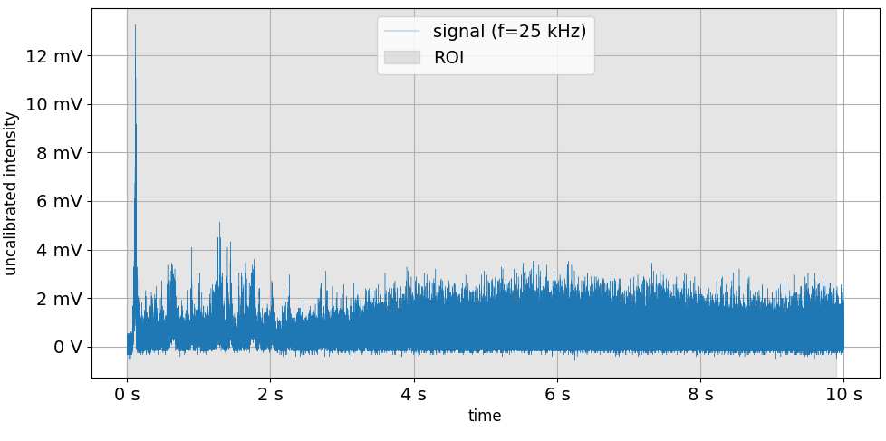
Beam extraction optimization
Observation of strong intensity ripples on the first part of extracted beam
The effect is strong with proton and bunched beams

Slide 9
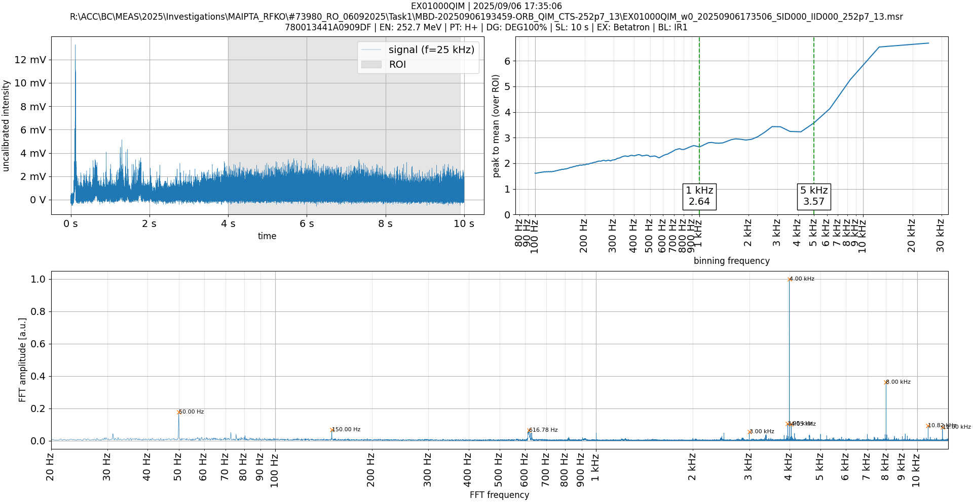
Beam extraction optimization

Slide 10
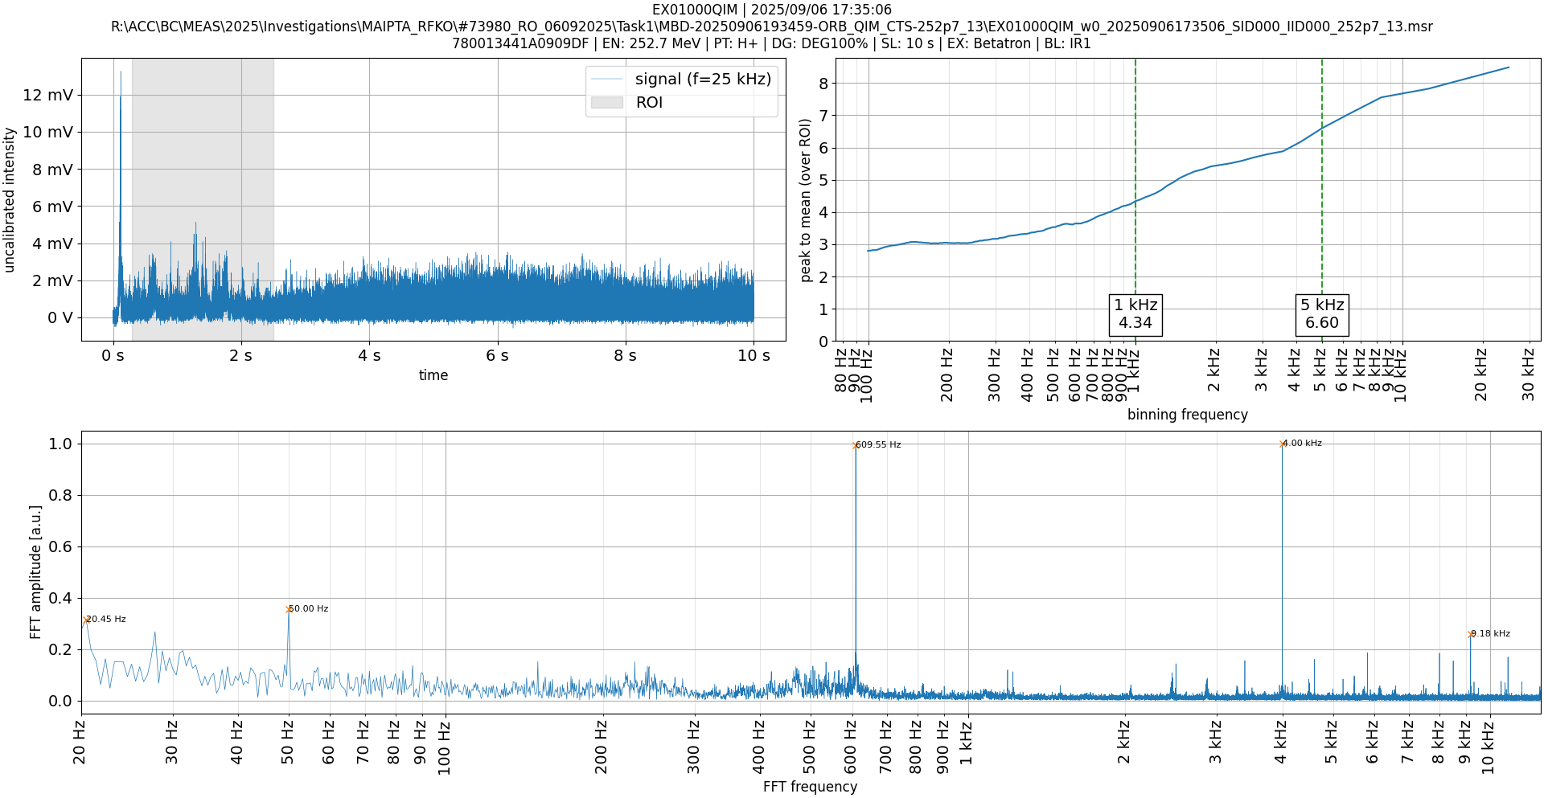
Beam extraction optimization

Slide 11
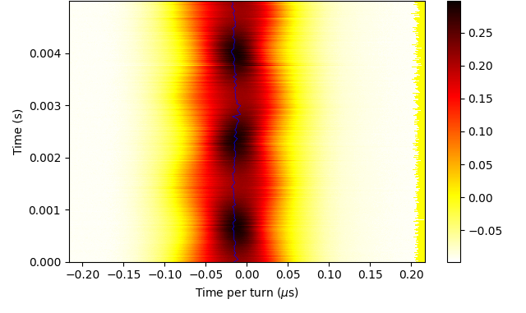
Beam extraction optimization
Longitudinal tomography p252MeV
Courtesy of K. Holzfeind
Observation of strong intensity ripples on the first part of extracted beam
First part of the spill shows strong frequency signature at twice the synchrotron frequency
Contribution from the observed longitudinal quadrupolar oscillation at flat-top energy
Collective effect contribution?
Ongoing investigation….

Slide 12
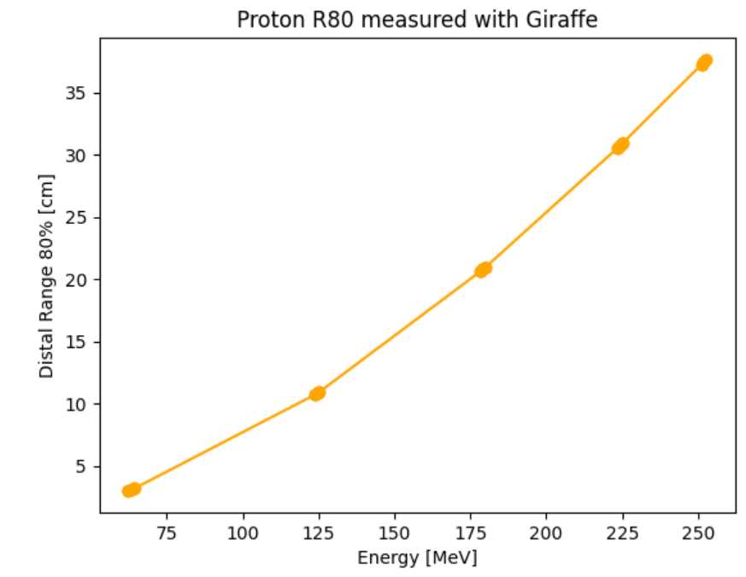
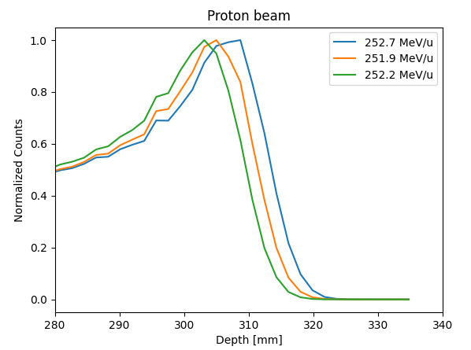
Energy Verification with RFKO
Measurements were conducted to ensure that the energy of the delivered beam is within the intended limits
Establish a workflow for energy verification during clinical operation with RFKO:
Define the limits of the relevant beam parameters and their correspondance to extracted energy and range
Courtesy of V. Rizzoglio and D. Skrijelj

Slide 13
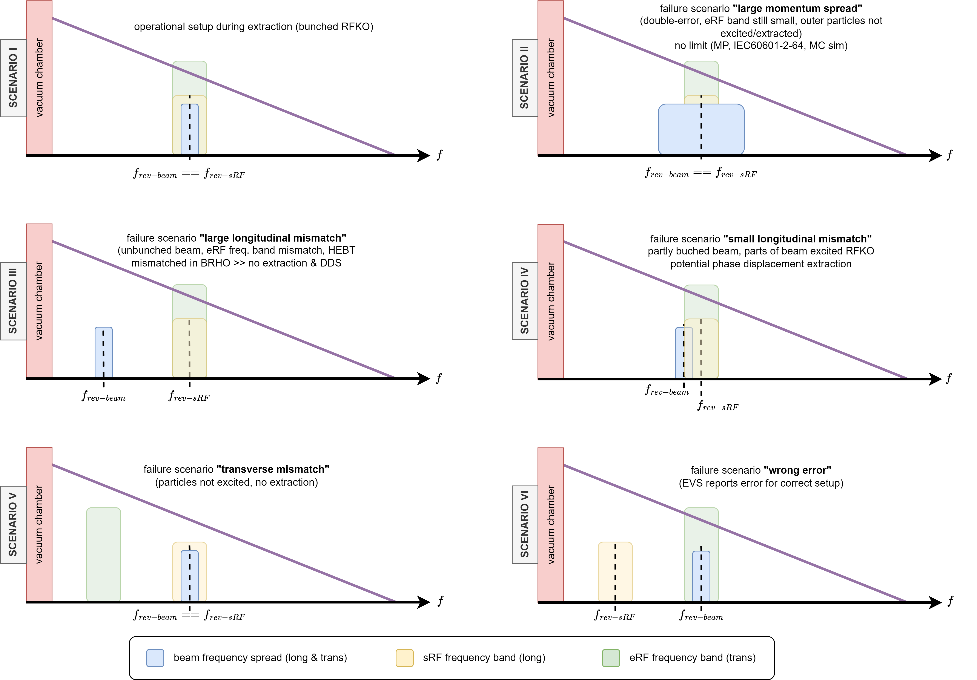
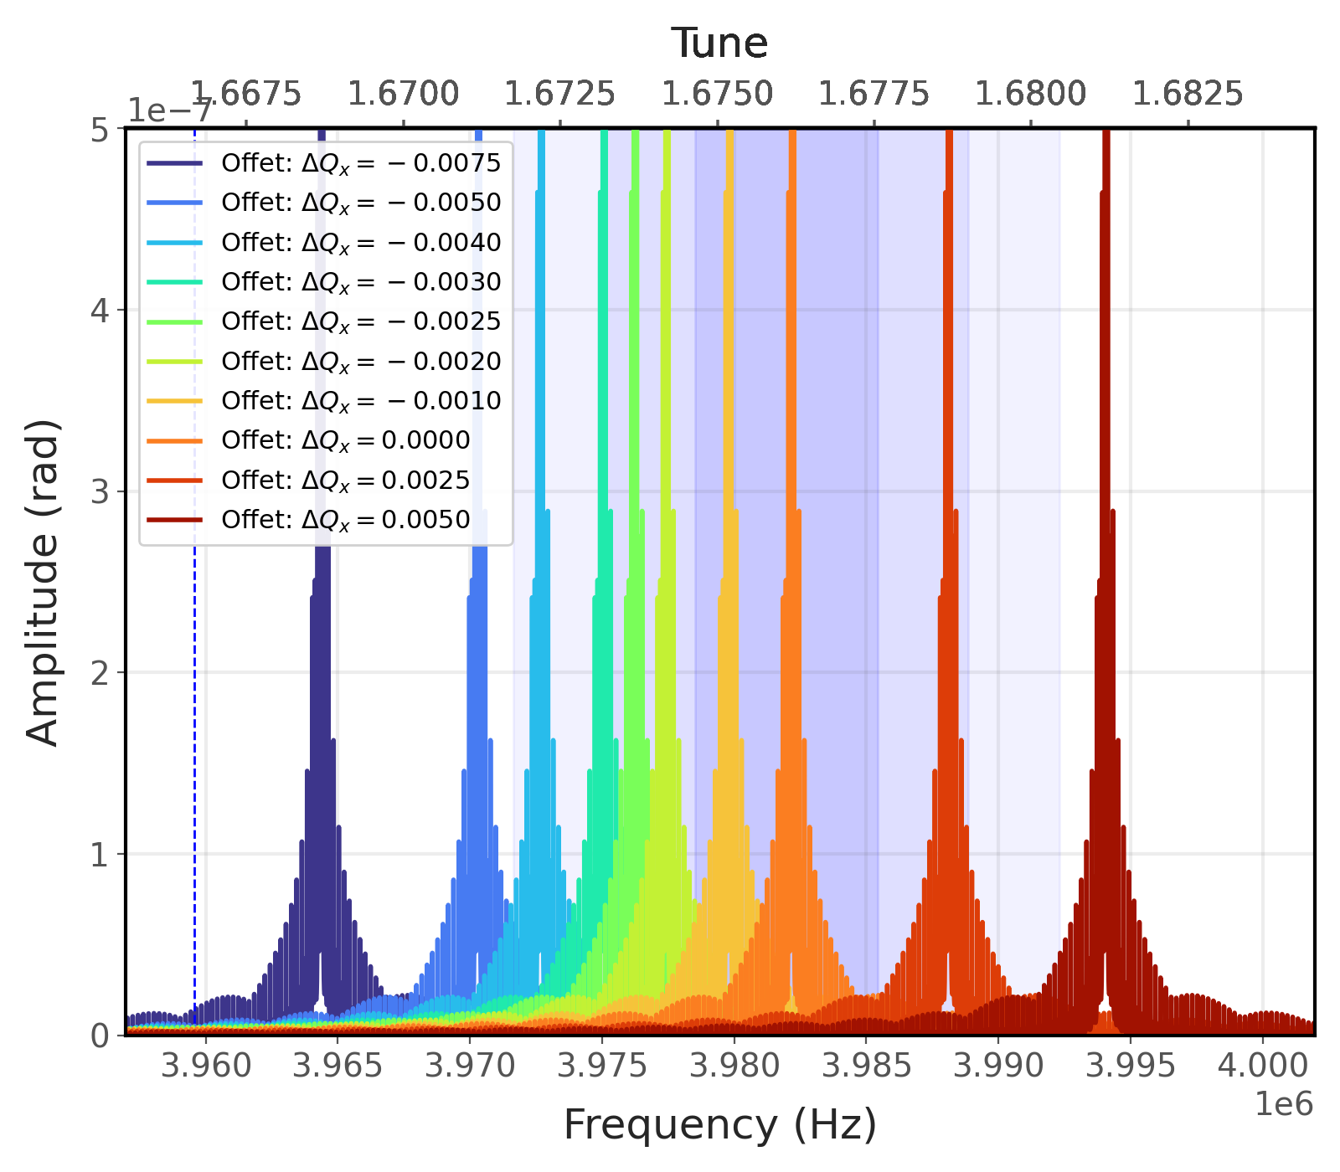
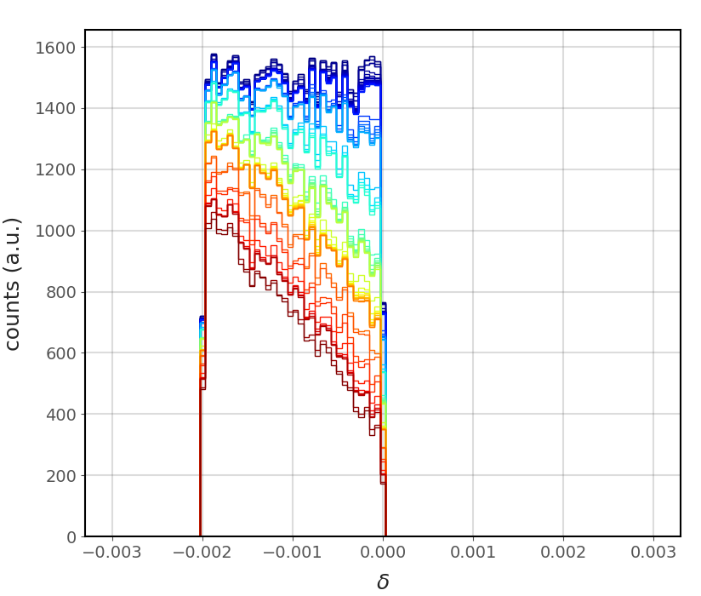
Risk Analysis of RFKO extraction
Courtesy of A. Wastl
Measurements and simulations conducted to assess the risks associated with RFKO extraction
Test all relevant failure scenarios during beam extraction with RFKO
Example of RF-KO extraction simulation during single fault scenario
Courtesy of E. Renner

Slide 14
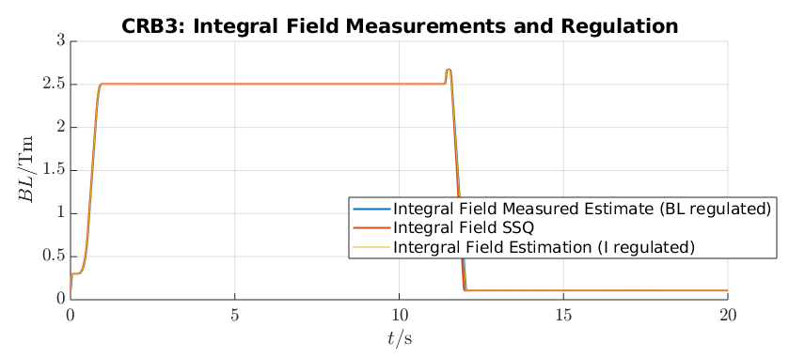
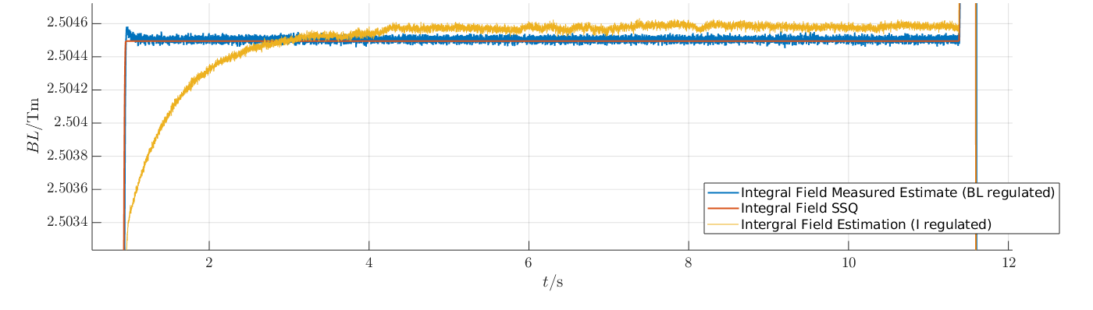
B-field regulation with RFKO
Ongoing implementation of B-field regulation at MA for the Synchrotron dipoles
Pre-requisite for the RFKO extraction:
Long B-field stabilization time at FT energy in current-regulation mode
Stable field at flat-top preferred with RFKO to prevent beam condition drift during extraction
First RFKO extractions in B-field regulation at MA
T. Margreiter
(“Magnetic field control in the MedAustron synchrotron” IPAC25)

Slide 15
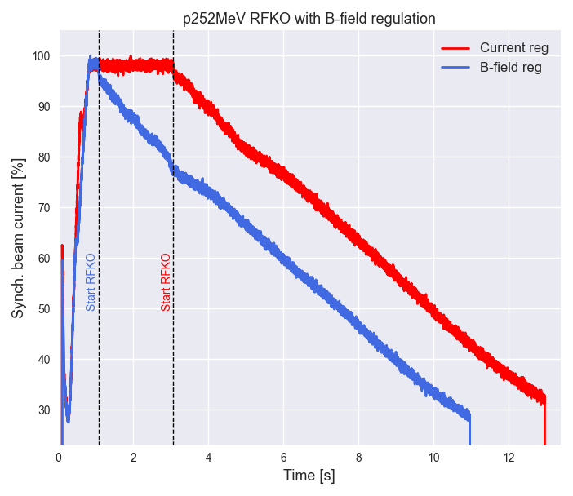
B-field regulation with RFKO
T. Margreiter
(“Magnetic field control in the MedAustron synchrotron” IPAC25)

Slide 16
Conclusions
Progress in machine preparation for RFKO implementation:
RFKO exciter manufactured
New version of MA control system with compatibility to RFKO extraction
Safety and RFKO impact analysis performed
Important issues need to be takled before the start of RFKO commissioning:
Understand the beam instabilities observed before and during extraction
Understand the mechanism of high intensity ripple at the start of the spill
Optimization of tailored RFKO signals for spill for proton and carbon beams for their entire energy range

Slide 17
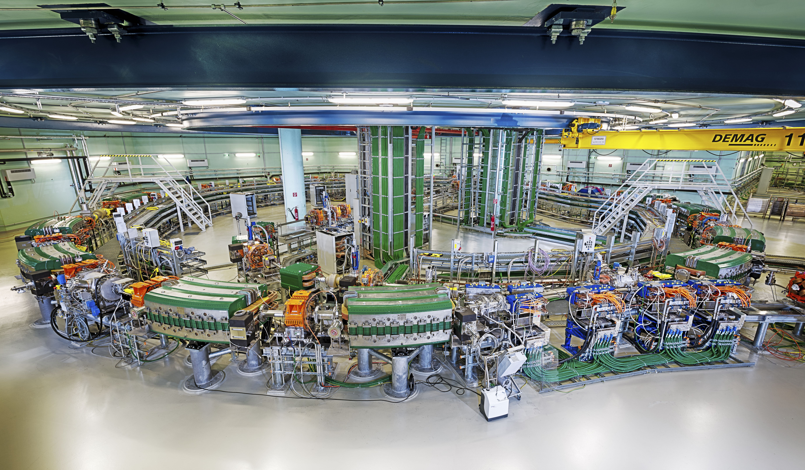
THANK YOU!

