Slide 1
Far-Forward / Far-Backward
Detector Integration
Jonathan Smith (JLAB), Ron Lassiter (JLAB),
India Krehbiel (JLab), David Powell (JLAB)
April 14th, 2025

Slide 2
Primary Updates Outline
Far-Forward Region
  B0 Detector Railing Update
  B0 Known Issues
  B0 Cable Routing
  ZDC ‘Dark Box’
  ZDC Maintenance Questions Responses

Slide 3
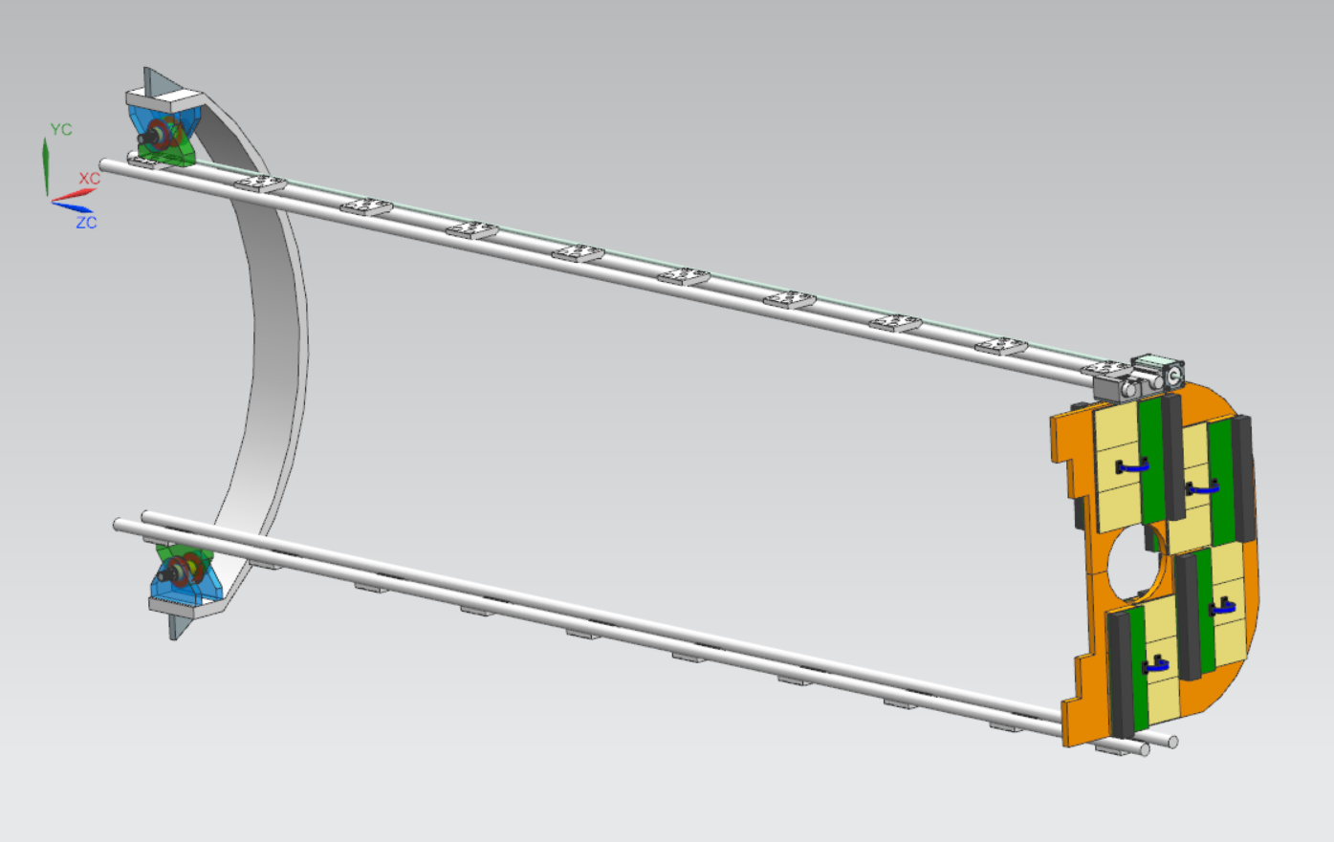
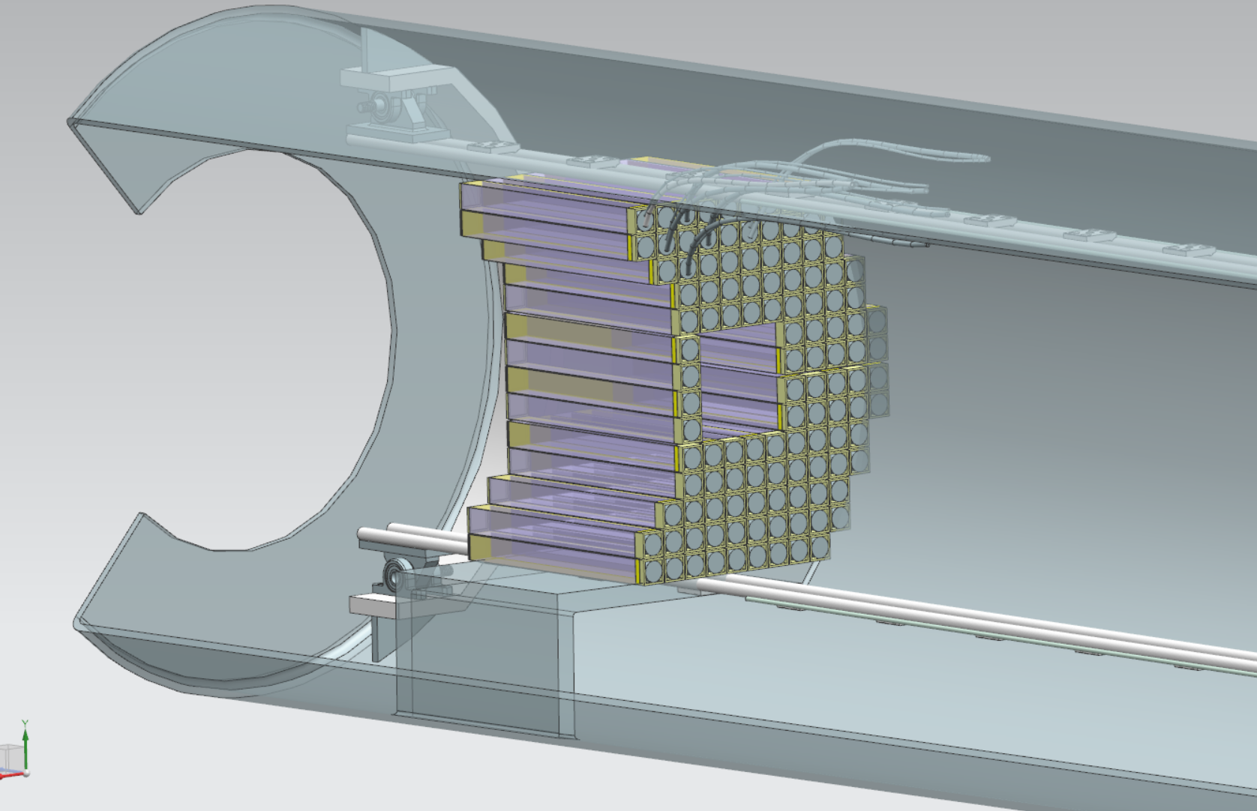
B0 Detector Railing Update
Previous rail concept was limited to just the detector layers
Latest update expands the detector rail removal/install to include the Calorimeter

Slide 4
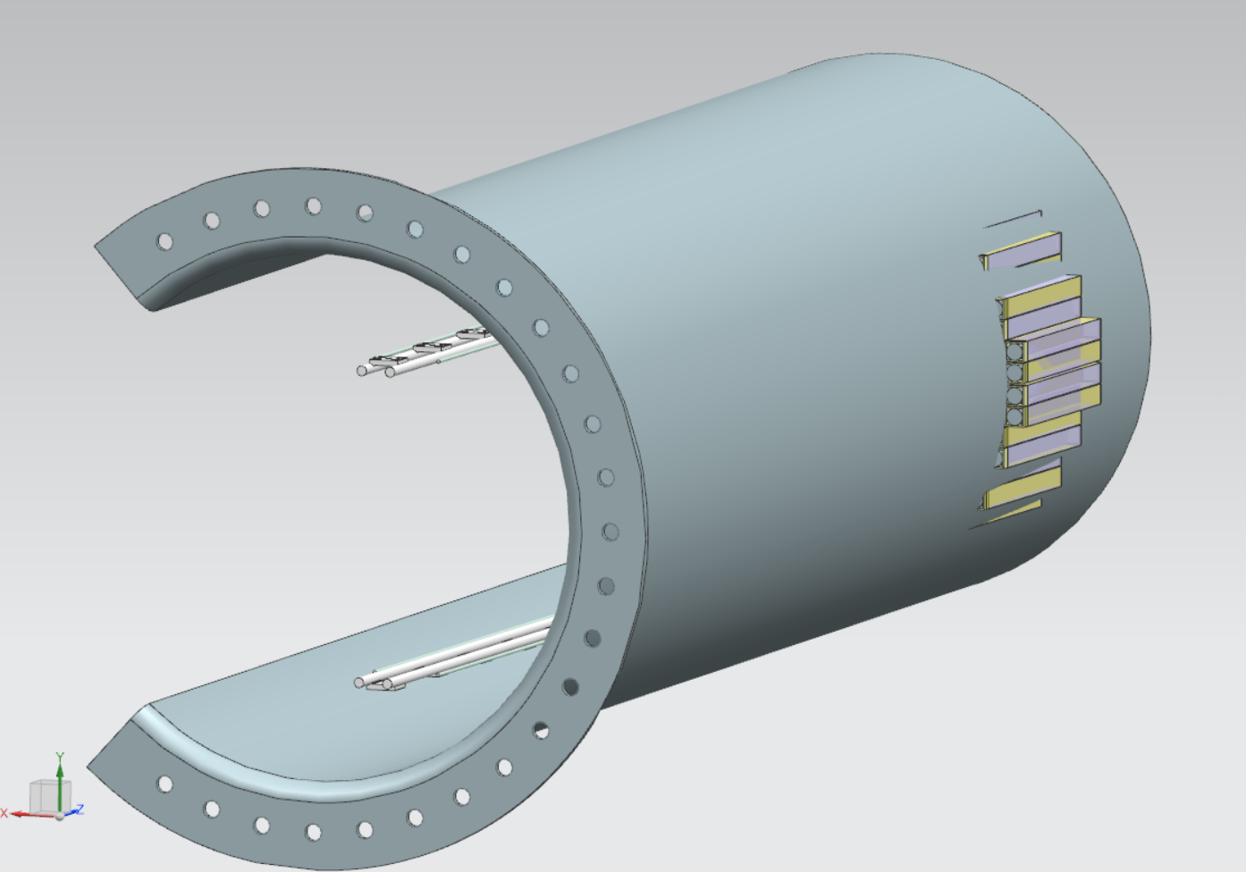
Known Issues
Calorimeter is too large
  Current B0 Calorimeter protrudes 1 crystal (20cm) through the inner walls of the B0.
  The upcoming 76.20mm OD beampipe in way of Calorimeter will further increase the overall size of the calorimeter
  Pictured does not include a support frame nor cooling, as necessary.

Slide 5
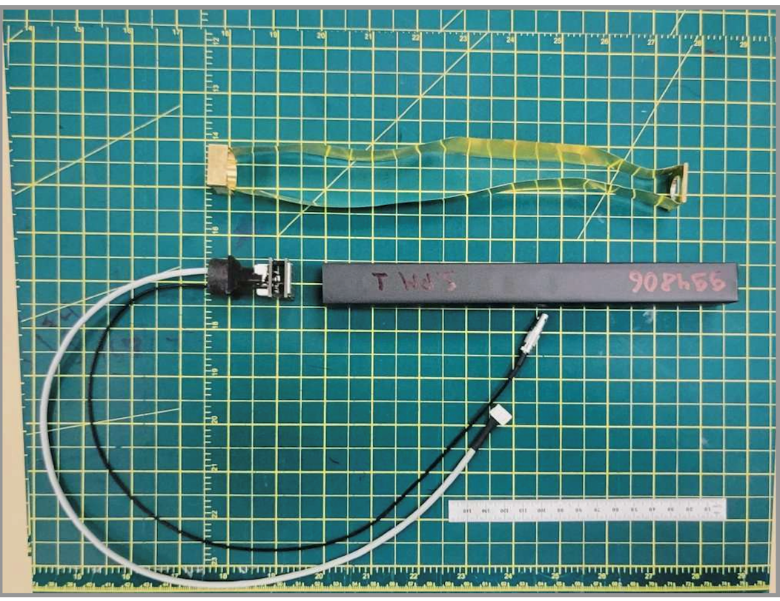
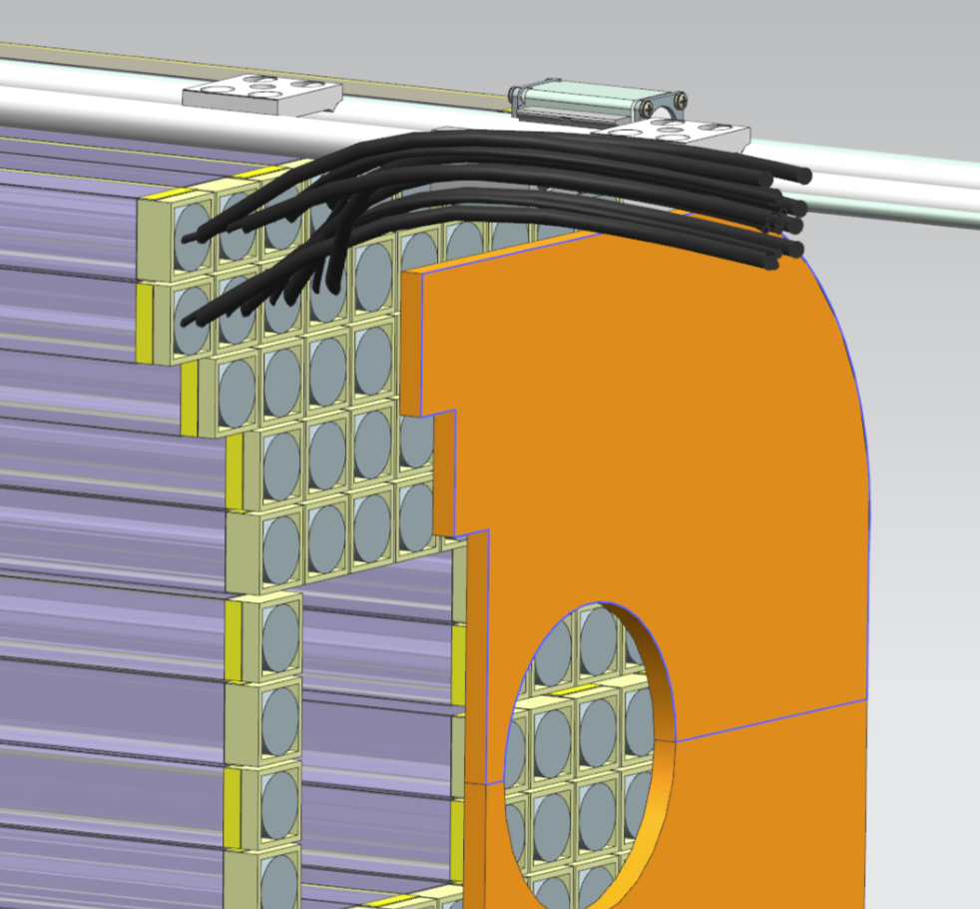
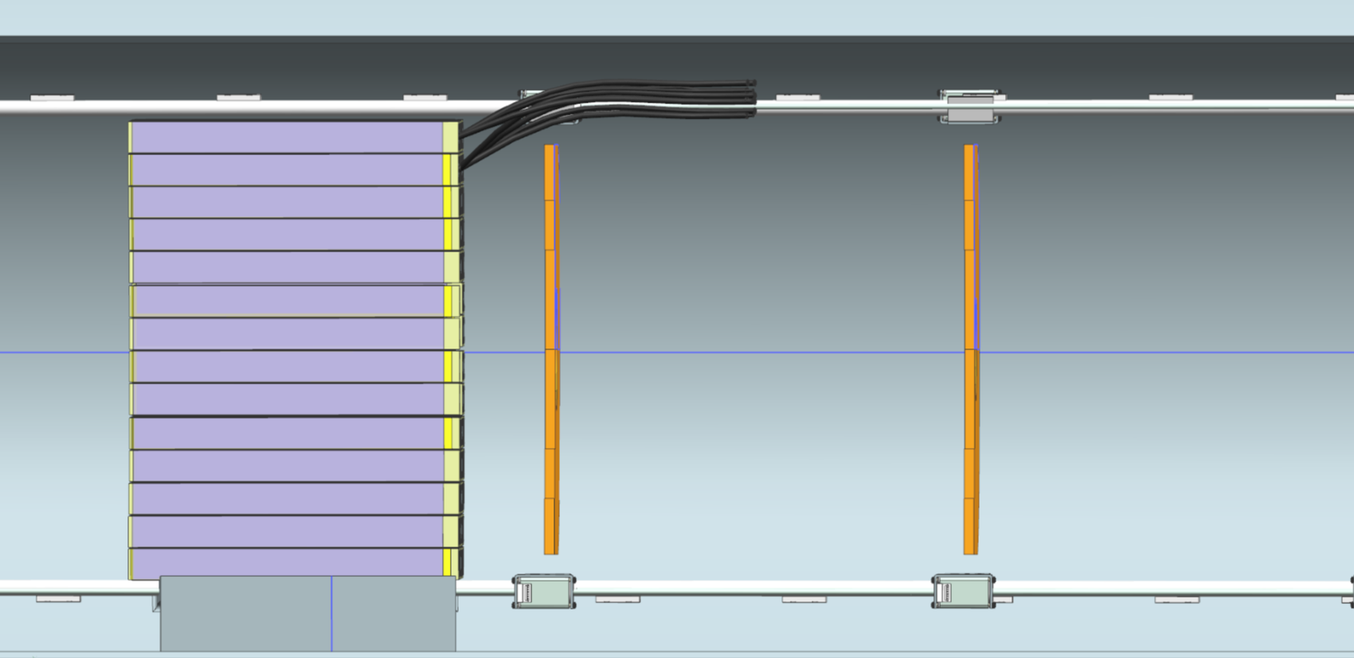
B0 Cable Routing
Currently do not know exactly what size the cables are going to be for both the detectors layers and calorimeter
Investigating a separate cable management railing system to use in conjunction with the detector layers

Slide 6
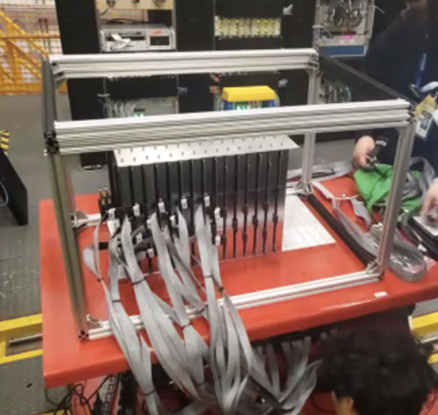
ZDC ‘Dark Box’
Latest design requirement for ZDC includes a ‘Dark Box’ to place over the blocks
(Pictured protype at JLAB)

Slide 7
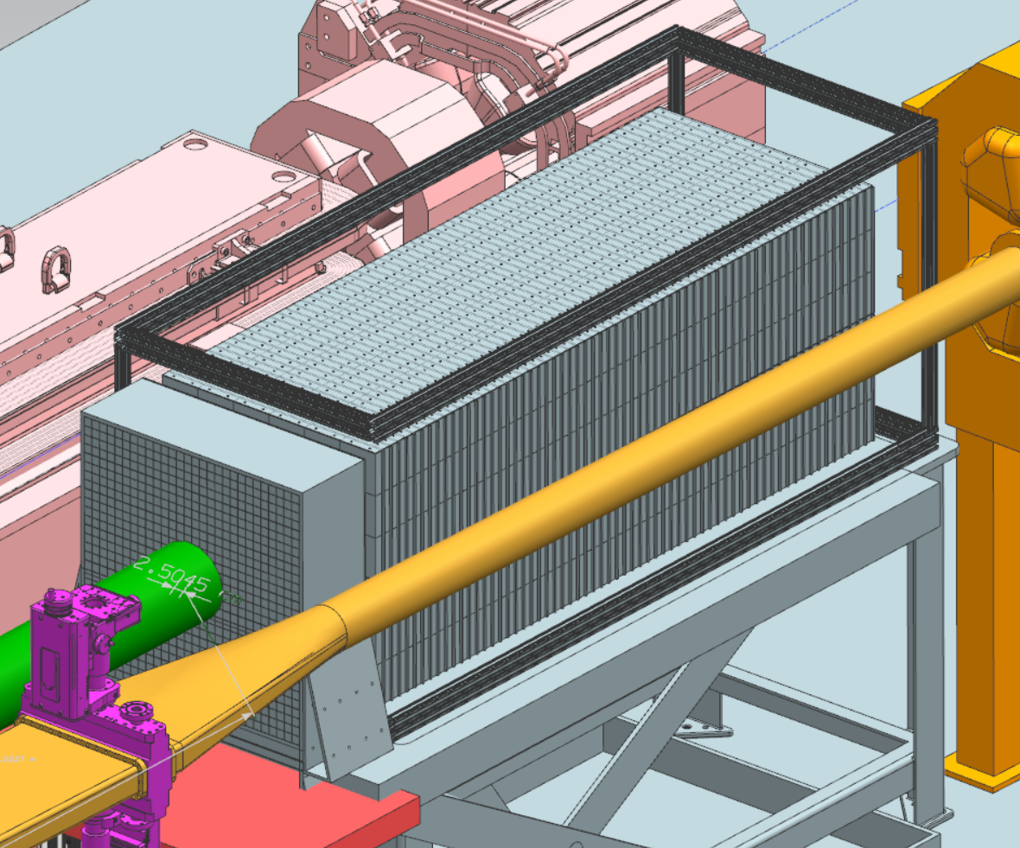
ZDC ‘Dark Box’
Current design utilizing 80/20 framing around ZDC Blocks
Circled Red – ZDC is too close to nearby beampipe for dark box support leg. However, application of dark box will not be affected.

Slide 8
ZDC Questions/Answers
Is the maintenance for the electronics, individual blocks, or the whole system?
                Maintenance will be needed for the readout modules located between each layer of Fe blocks. The ZDC group is currently re-designing these boards. Estimated size will be 30x60cm (x:y) and will slide/insert from the top.
                Will the maintenance be performed during bake-out, or will it also need to be performed while operational?
                We would like to have access to them ‘during operation’, but only as needed.
                3. How often do we estimate the maintenance to be required?
                As-needed.
4. JLab is submitting an Inquiry Sheet with Southworth to get an estimate for a suitable lift table.

