Slide 1
BiC Update
Triple I Engineering Meeting Update
Kevin Bailey
April 21, 2025

Slide 2
BIC Workshop @ Argonne 4/9-11/25
Successful workshop
- Most updates in person
Small breakout working groups
Schedule timeline reviews
AstroPix Module clean room tour

Slide 3
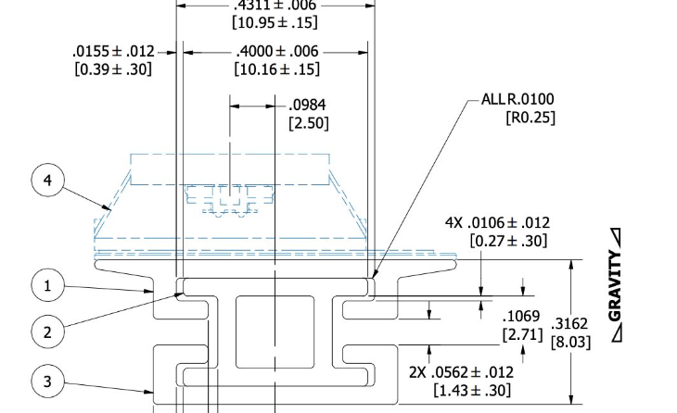
Detector Views – Astropix Update
*Prototype Stave Design!
110” long Al parts
OLD DESIGN
Parts expected in May

Slide 4
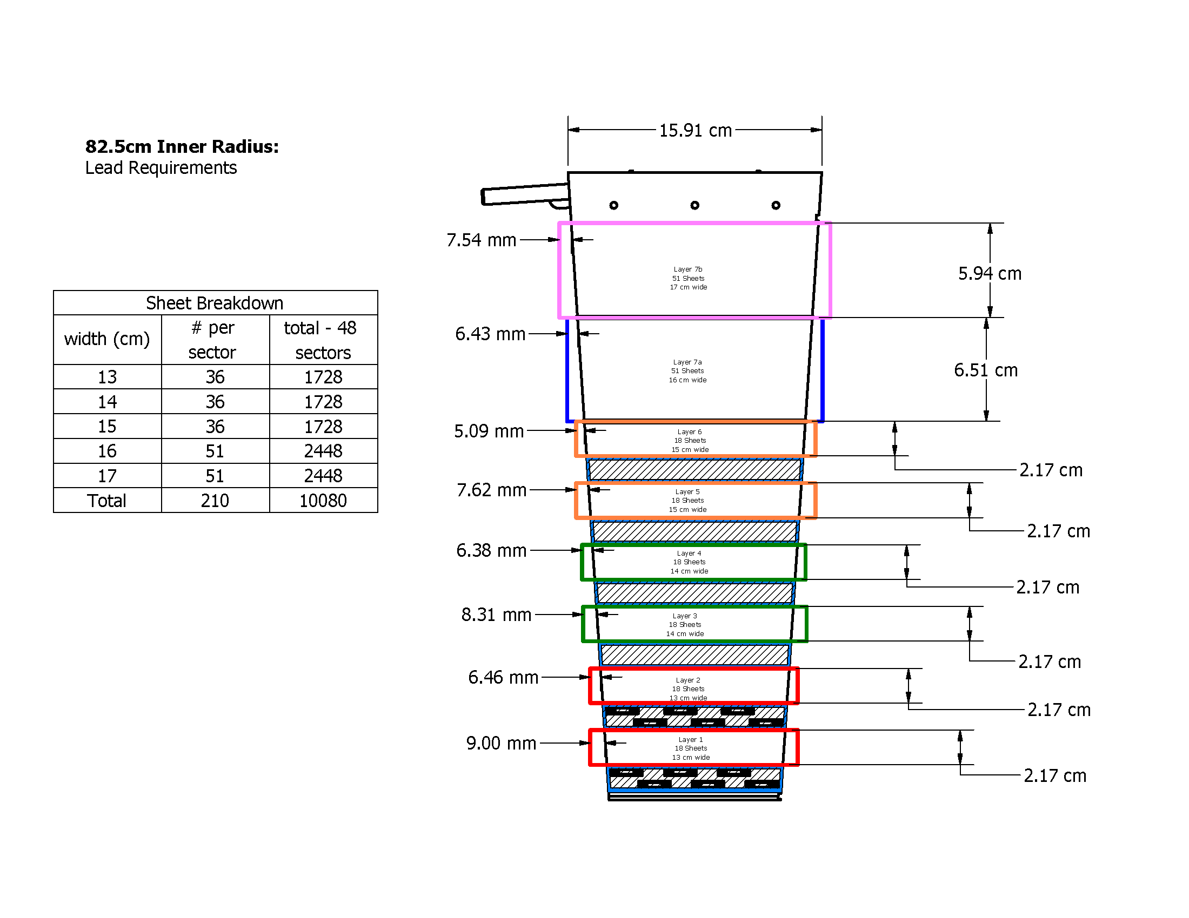
Detector Views – Lead Update
Fresh lead on order
Due in May for test articles
Quote for 50 sectors within budget

Slide 5
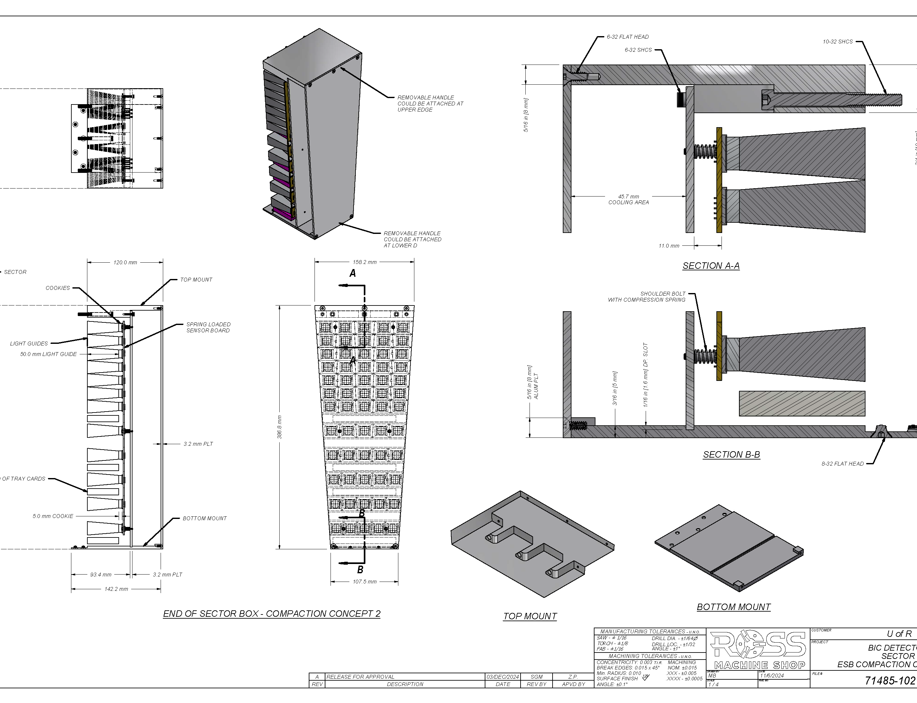
Detector Views – End of Sector Box
Workshop Highlight
In person discussions
Between groups working on Astrolinx and ESB electronics
OLD
DESIGN

Slide 6
Status / Updates
Prototype stave/rail parts on order
Pb ordered 0.5m test articles
Pb ordered 3m test articles
Pb quote for entire detector within budget
ESB design progressing
Production at Argonne space being prepared
Work control documents approved for swaging and pressing lead operations in our small lab space
Some swaging and Pb press operations have been done

Slide 7
Question & Comments

