Slide 1
pfRICH
Triple I Engineering Meeting Update
Alex Eslinger

Slide 2
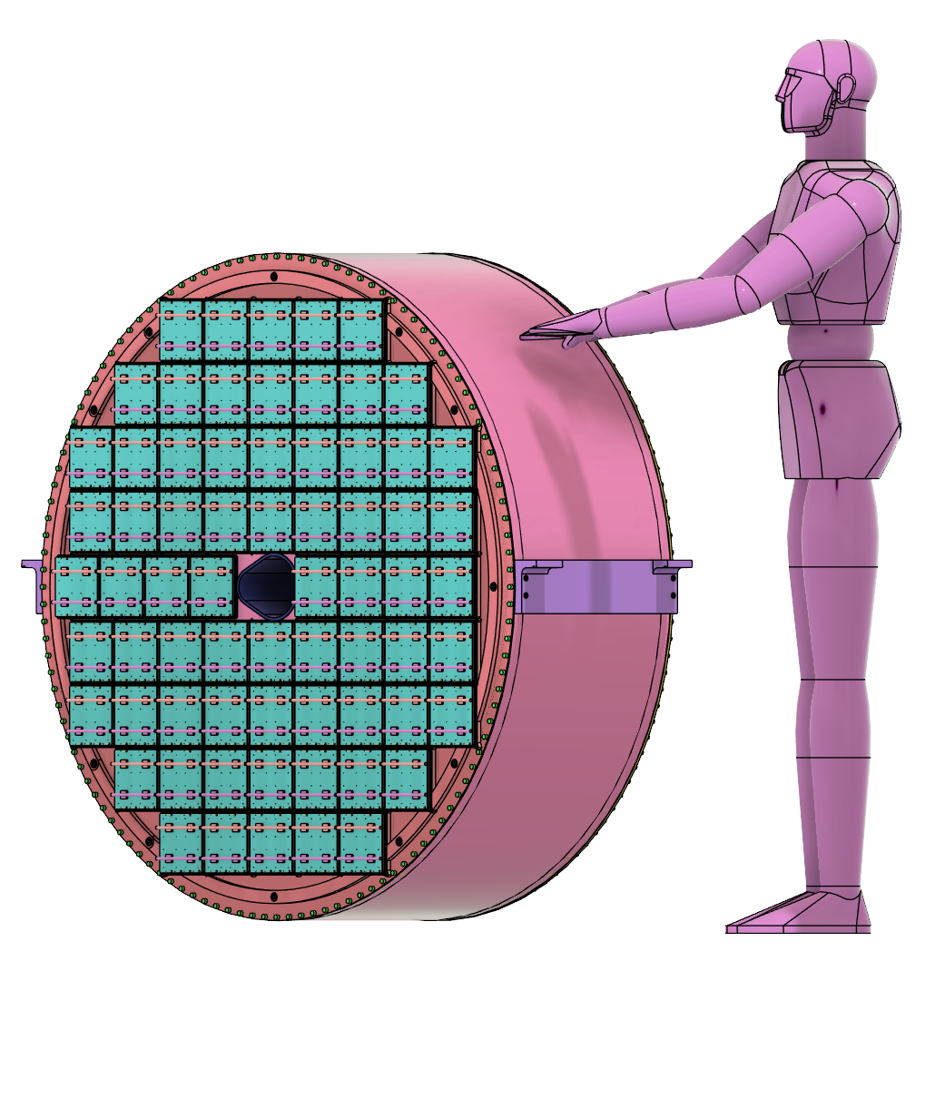
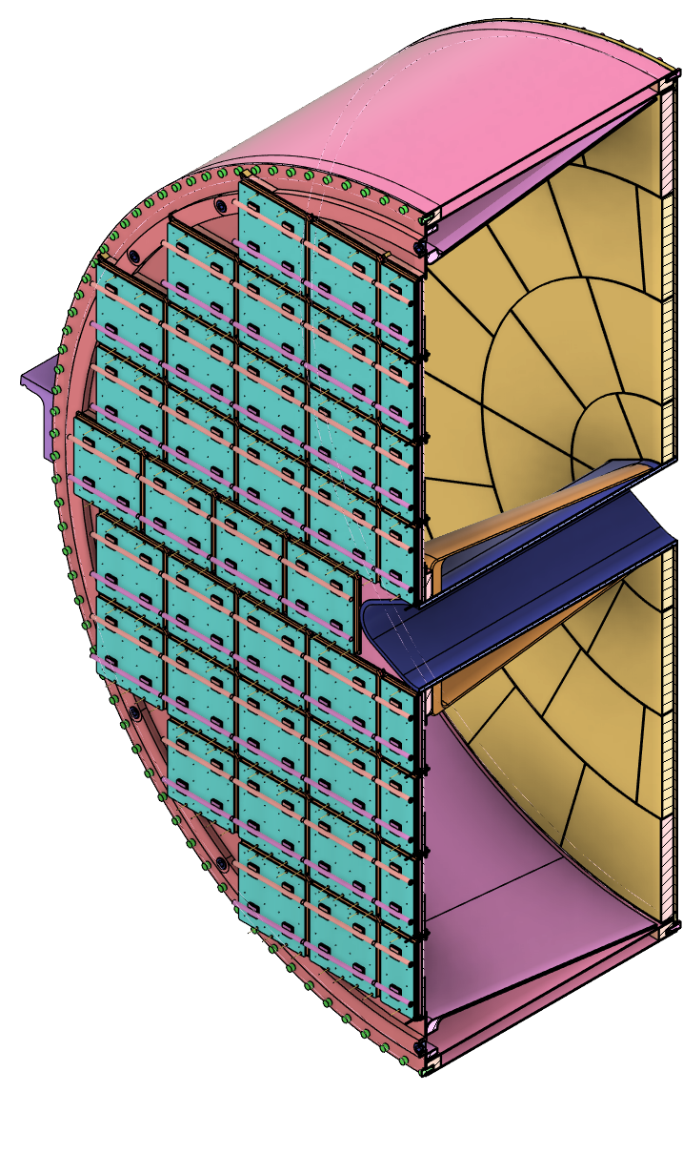
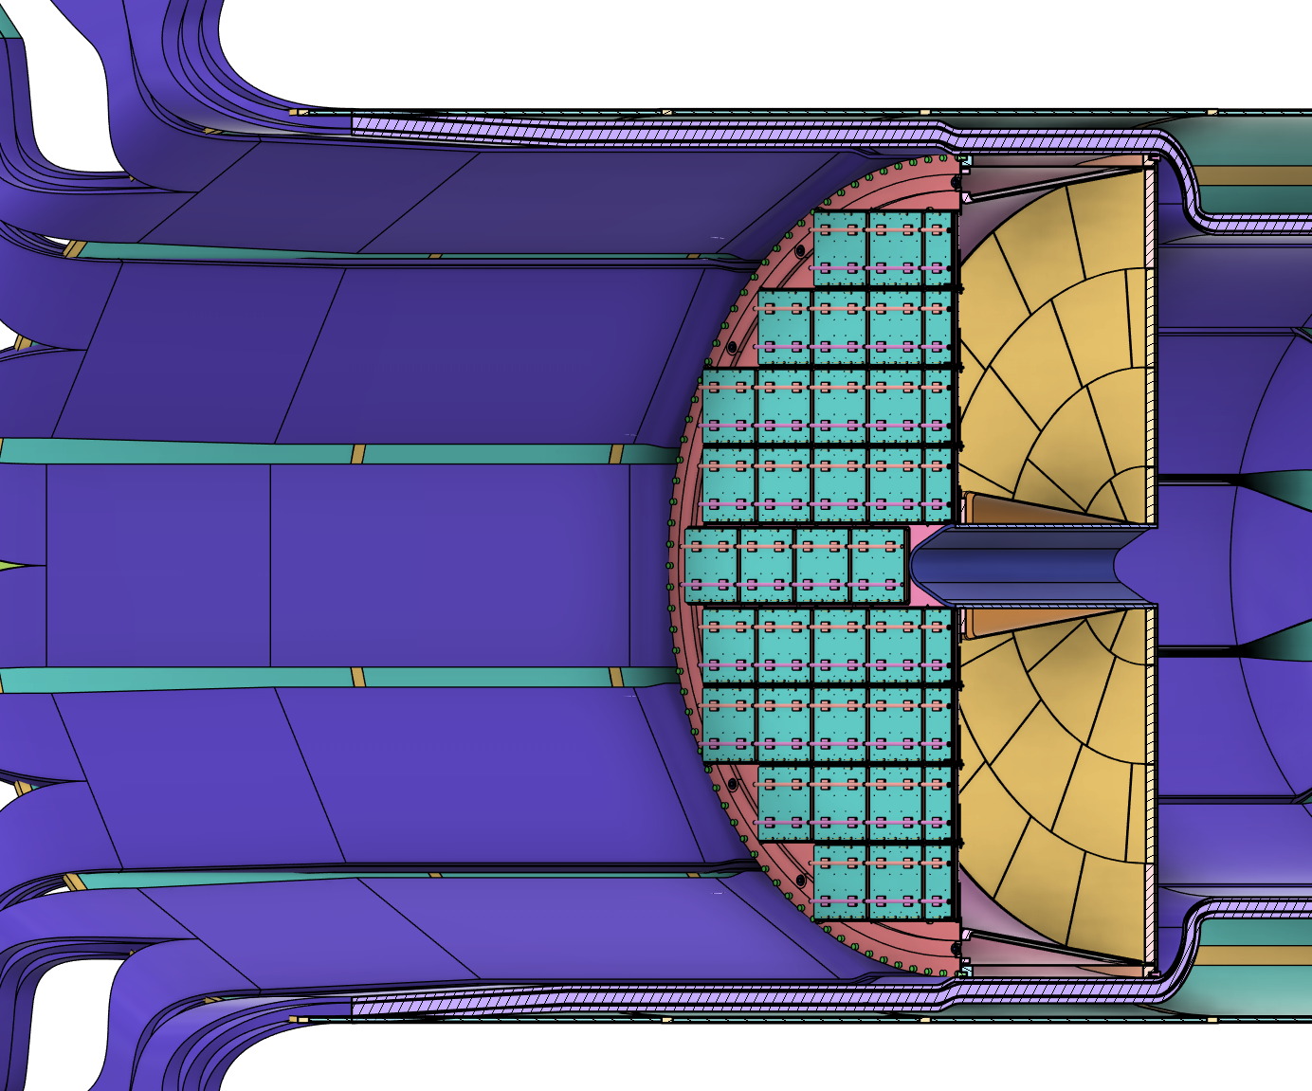
pfRICH: Overview
Vessel
Inner
Conical Mirrors
Size and scale:
Outer Diameter: 130cm
Weight: ~200kg
Major components:
Vessel
Sensor Plane with 68 HRPPDs
Aerogel Plane with radially-tiled aerogel
Inner Conical Mirrors
Outer Conical Mirrors
Gas Ports
Size and Scale
68 HRPPDs
12 Outer
Conical Mirrors
Radially-Tiled
Aerogel
Services Estimate from Inner Detectors
A. Eslinger
Notes:
We can start by looking at the graphic in the top right corner, which provides a sense of scale for the overall size of the detector. The pfRICH has an outer diameter of approximately 130 cm and the envelope for the pfRICH extends just over 49 cm in the Z-direction. The current estimate for the pfRICH’s weight still remains at around 200 kilograms.
On the left-hand side of the slide, you can see a half-cut view that reveals the inner details of the detector. Including:
A containment vessel constructed from a composite honeycomb structure. This vessel serves as a light-tight and gas-tight enclosure and a structure used to mount the detector.
Similar to the ARICH at Belle II, the pfRICH utilizes a radially-tiled aerogel design. The size of the aerogel is determined by the largest tiles we believe can be manufactured and procured.
The detector also features inner and outer conical mirrors. These mirrors are strategically placed to maximize light acceptance and enhance the detection efficiency.
The sensor plane consists of 68 HRPPD sensors. These sensors are affixed to the backside of the containment vessel to capture the emitted Cherenkov light.
On the right side of the slide, there is a mockup depicting the services exiting the inner detectors. These services are planned to fit within the available space in the GST frame, located just outside the outer radius of the pfRICH.

Slide 3
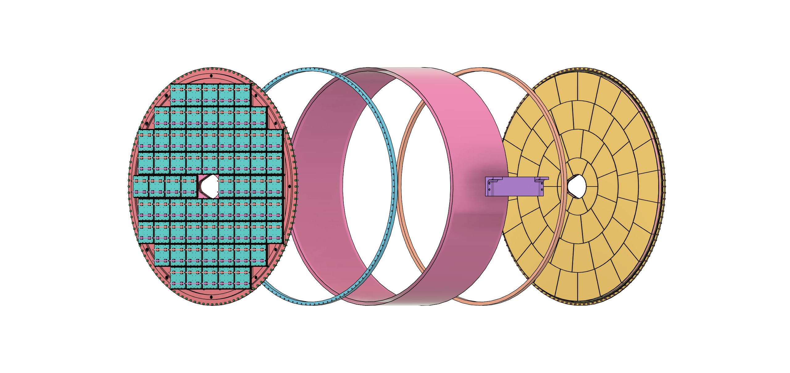
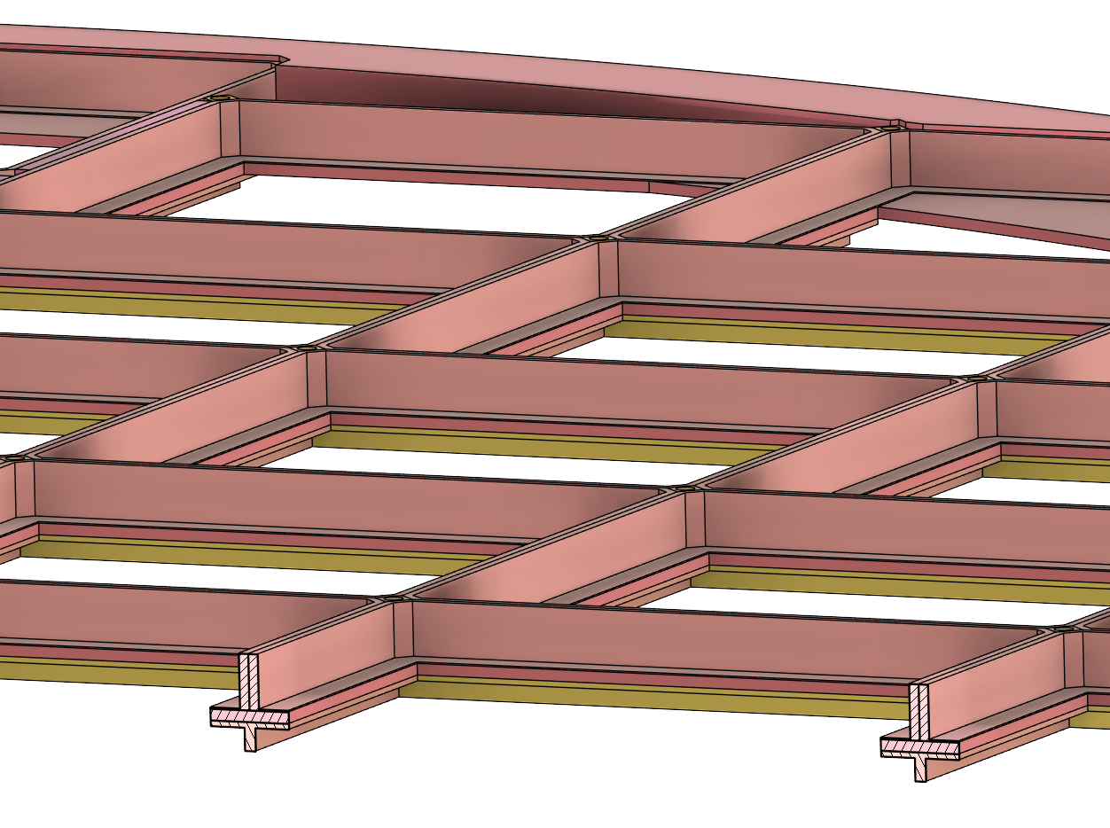
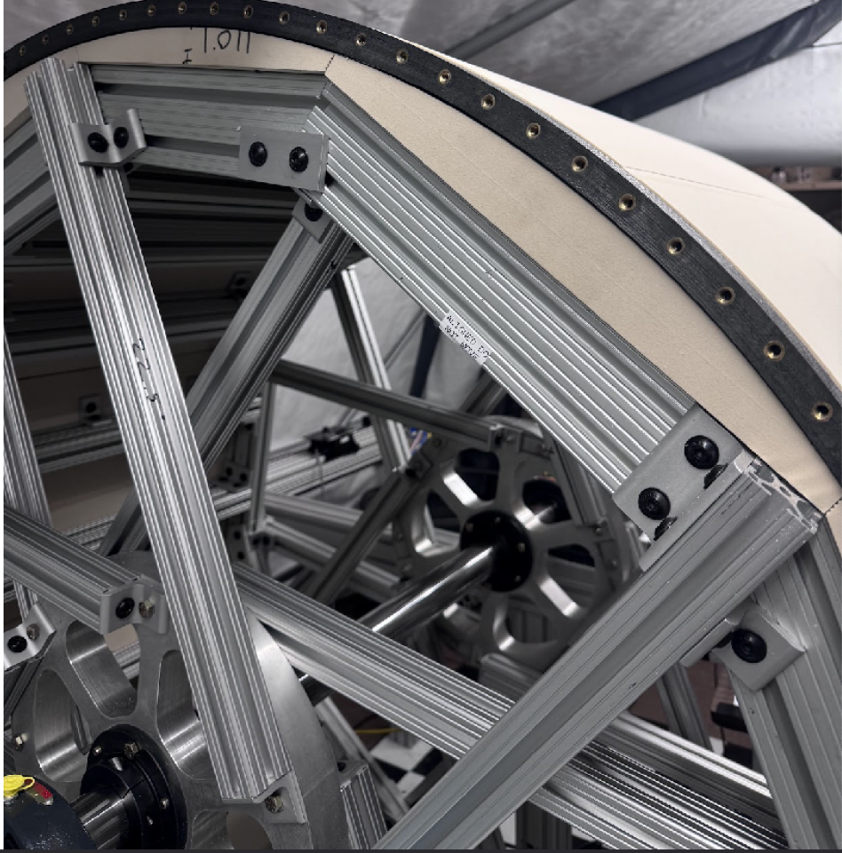
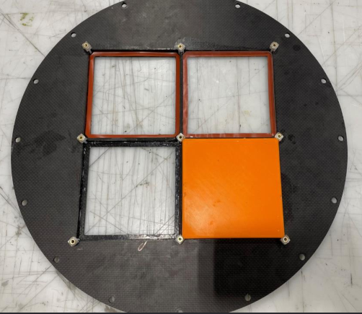
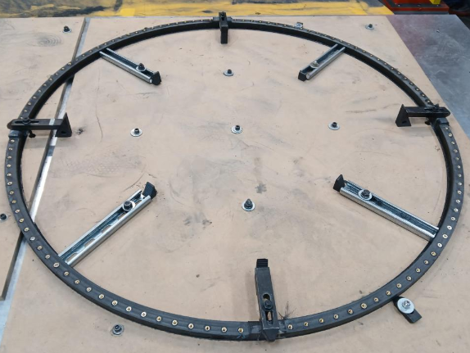
pfRICH: Components (External)
Prototyping has been ongoing for the various components to verify manufacturing techniques and validate the design
Stony Brook University (SBU) and Purdue University have been working to create a full-scale prototype (and small-scale test prototypes)
One of the design changes that came from this prototyping was the layering of the sensor plane (shown in the C-S view)
HRPPDs &
Sensor Plane
End Ring
Vessel
End Ring
Aerogel Plane
Mounting Rail
Prototyping the Sensor Plane (Purdue)
Prototyping the Vessel (SBU)
Prototyping the End Rings (Purdue)
C-S of Sensor Plane
A. Eslinger
Notes:
A lot of the work we have been doing since the last review is related to a full-scale prototype of the pfRICH. The idea is to create the vessel and mirrors to verify design methodology and make changes through feedback and iteration, since they should – in theory – be able to be utilized for the final pfRICH. You can see an exploded view of the external vessel components that we’re using. We have a vessel constructed of two identical end rings with a honeycomb layup in between. The jig for manufacturing this vessel is shown here where we are continuing to make progress at SBU. You can also see the actual end ring in the middle of being manufactured at Purdue. You can also see that we turned the sensor plane into a multiple piece and layered structure allowing for accuracy and precision where it is needed as well as creating a simplified manufacturing process.

Slide 4
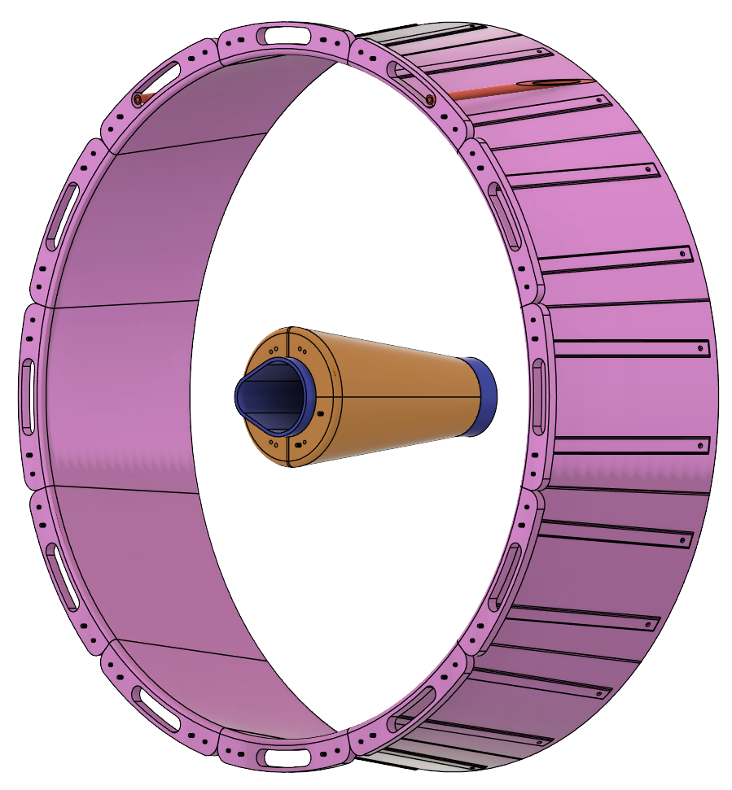
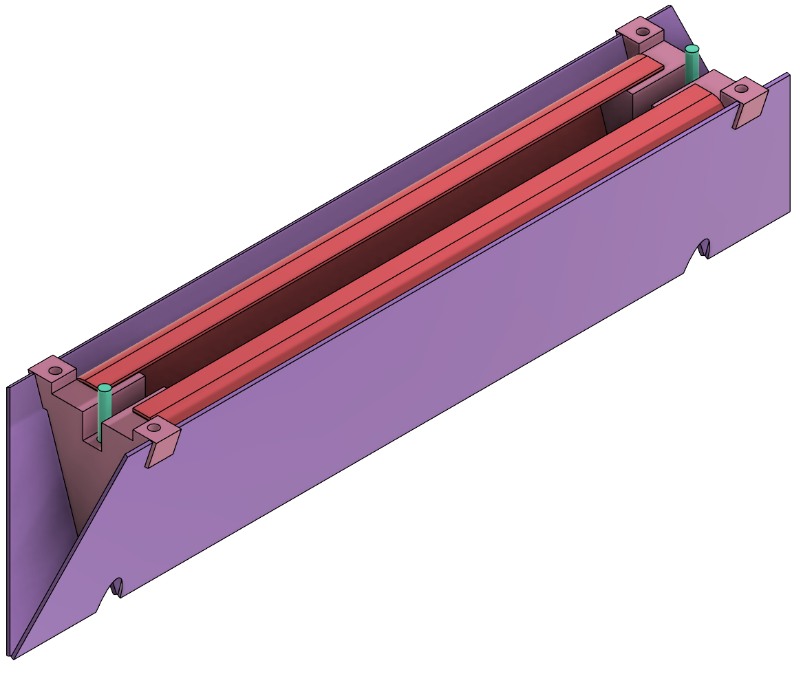
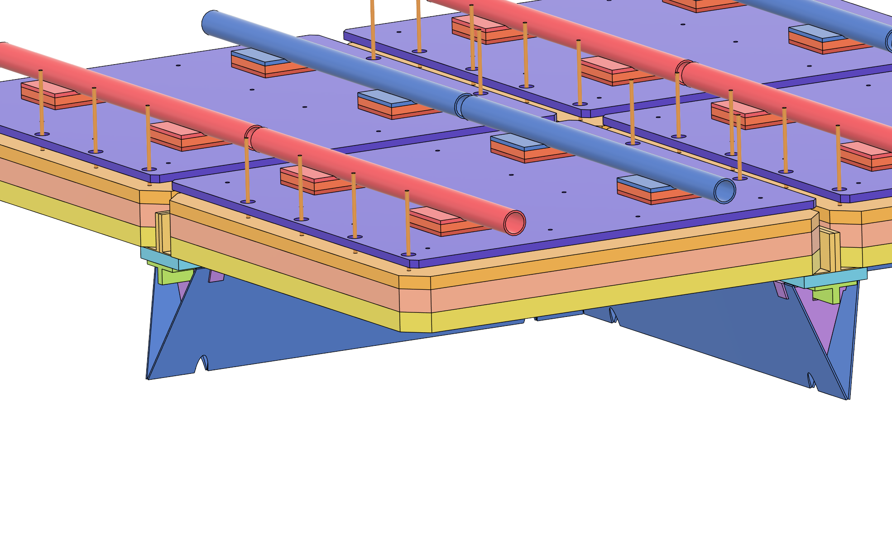
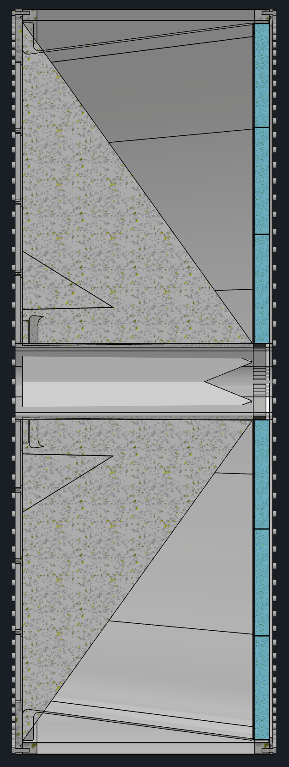
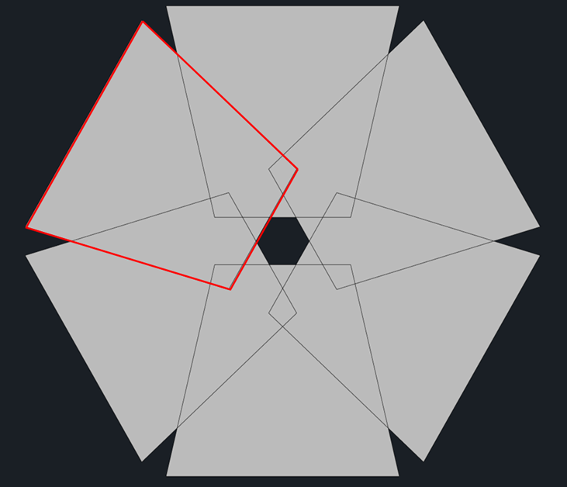
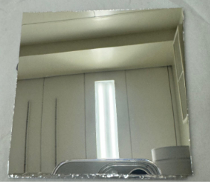
pfRICH: Components (Internal)
Internal components consist of:
Conical Mirrors (Inner/Outer)
The central support tube
“Pyramid” Mirrors
Nitrogen gas hardware
Laser Monitoring System
Inner and outer mirrors have been undergoing full scale prototyping
Pyramid mirror design being considered for an engineering sample to confirm the design
Inner and Outer Conical Mirrors
Nitrogen Gas Ports
Central Tube
Pyramid Mirror Design
Mirror Coating
(SBU/Purdue)
Laser Monitoring System
A. Eslinger
Notes:
Internal components are shown throughout this slide. We have, what we call a “pyramid mirror” design which integrates onto the opposing side of the sensor plan and allows “funneling” of light that would otherwise be lost to dead area at the edge of the sensor. You can see the central tube, the nitrogen gas ports, and the laser monitoring system. Lastly, I wanted to talk about the mirror system. It is designed in such a way that it attaches directly to the sensor plane only in order to maintain the appropriate critical reference (as in, the most critical reference is that the mirrors need to be angled appropriately to the sensors and sensor plane). These mirrors are going through rounds of prototyping right now, as well. You can see a mirror coating sample that we have done showing a substrate produced by Purdue that was coated at SBU.

Slide 5
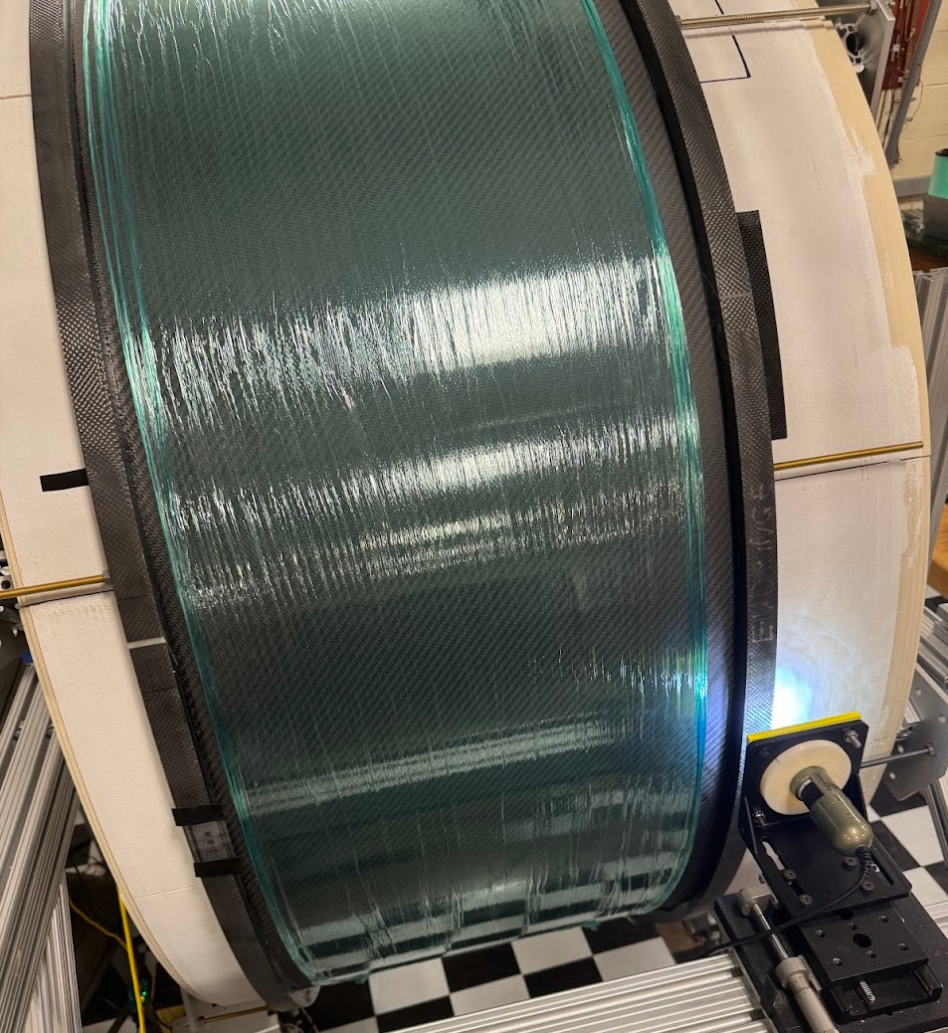
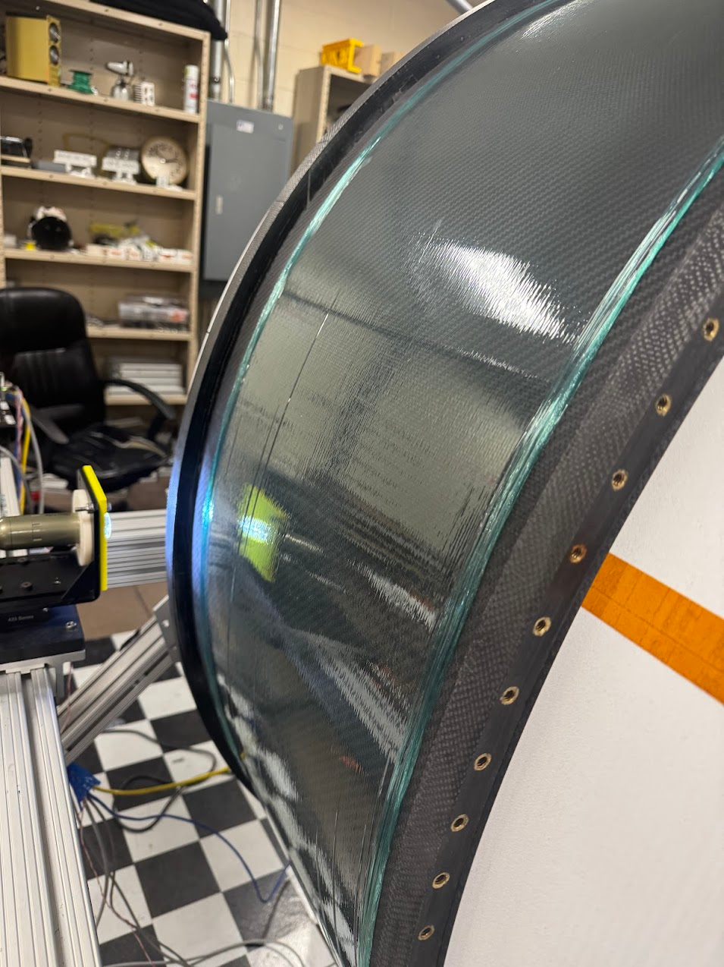
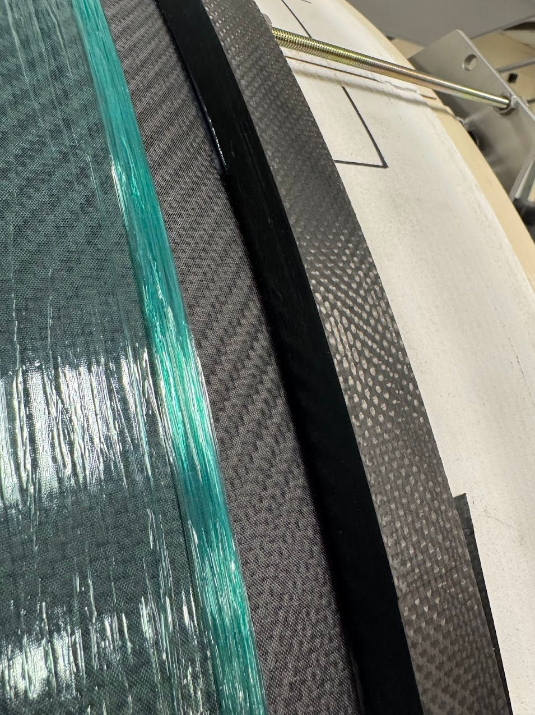
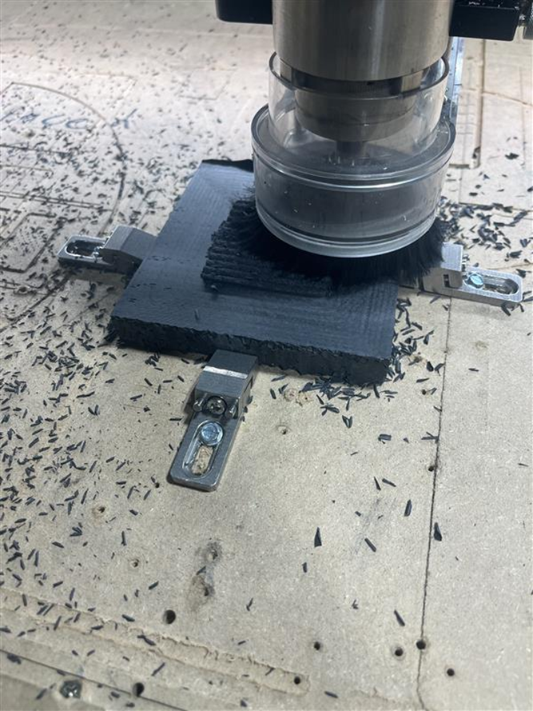
Status / Updates
Latest updates:
Prototype vessel has been mocked up and glued. Once cured, we will glue the honeycomb inside and the outer skin. This marks a major milestone in our full-scale prototype construction
Curved mirror forms are being fabricated at Purdue. Once they are complete, they will be sent to SBU to be coated. All mirror coatings so far have been on small flat samples.
The sensor plane design is being finalized as we have just finished the sealing test. The design has been modified to change the way we stack up each piece to also accommodate the “pyramid mirror” additions

Slide 6
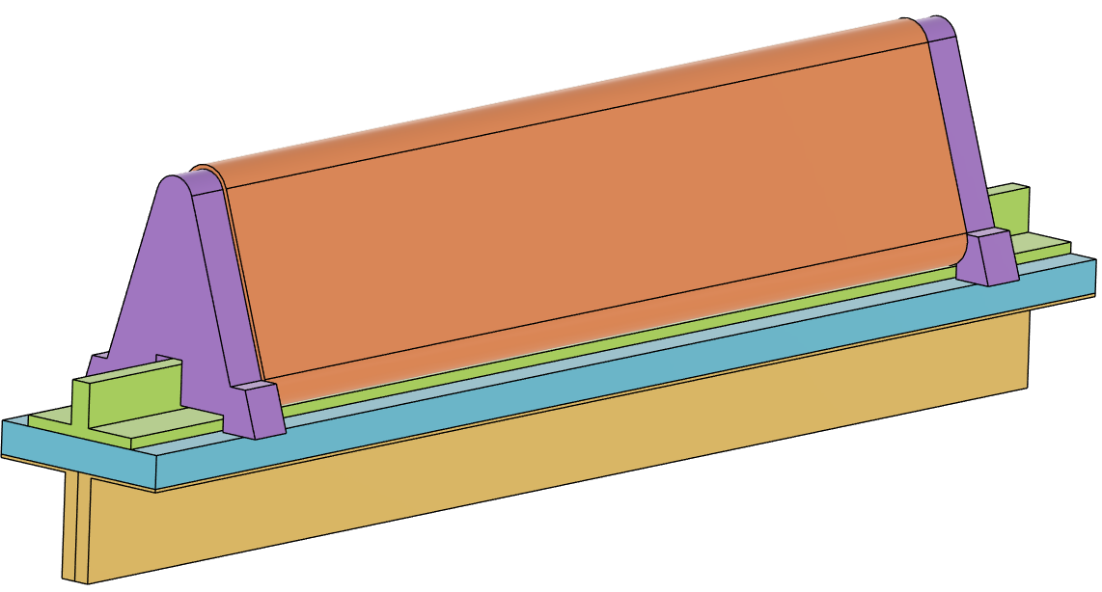
pfRICH: “Pyramid Mirrors”
Implementation:
Once each mirror support module is built, it is pinned and glued into the sensor plane
Stiffeners/Fixturing
TO I.P. / Aerogel Plane
Gluing Surface
T-Beam
Pinning Locations (Base plate to Stiffeners)
Base Plate
Mirror Indexing Tabs
Sensor Frame / “Picture Frame”

Slide 7
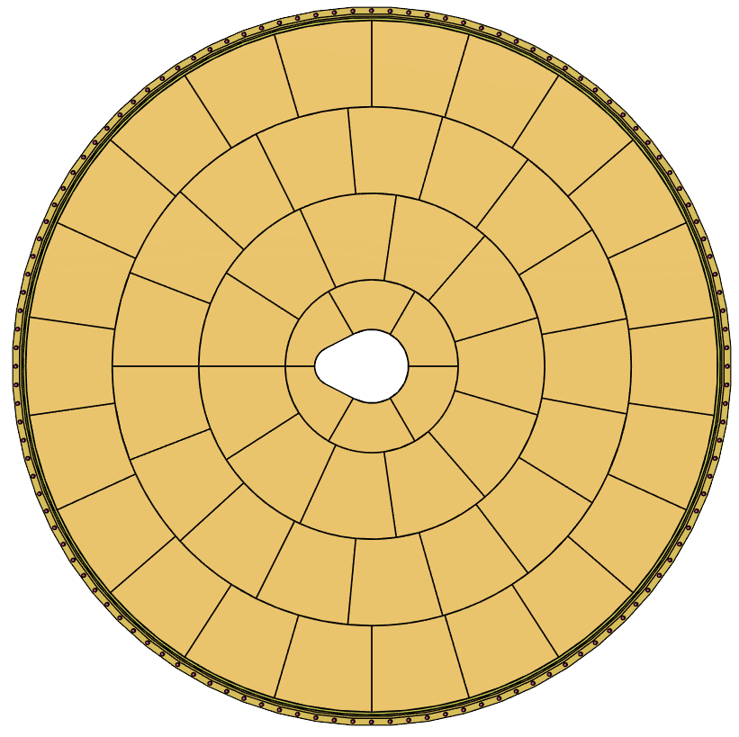
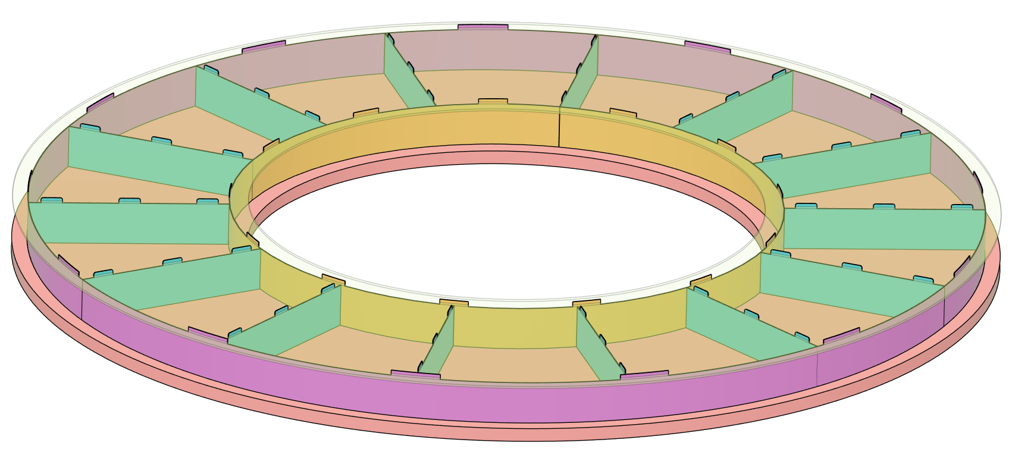
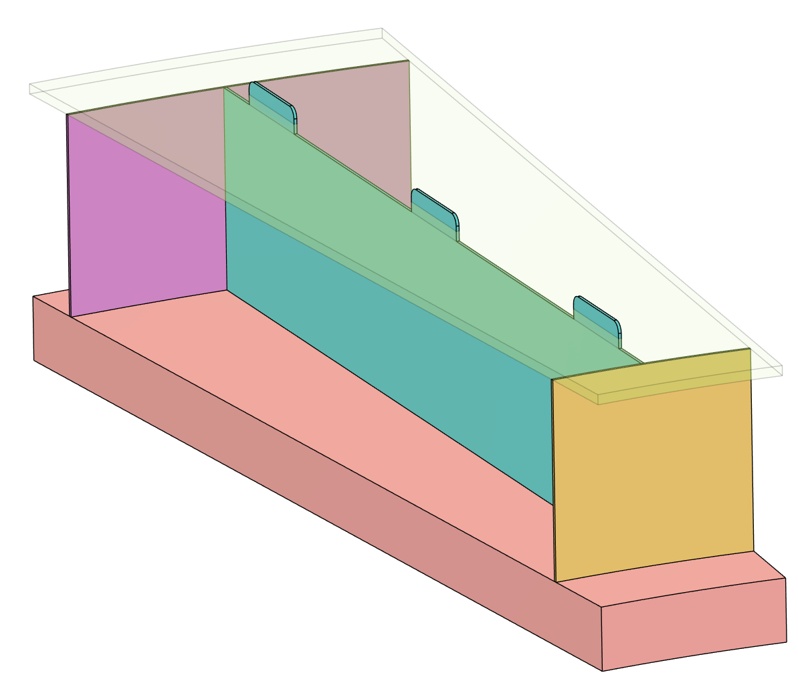
pfRICH: Aerogel Plane
Just a middle ring is
shown
Acrylic
Dividing Walls
(Separators)
Dividing Walls
(Rings)
Aerogel Plane
(Foam Core)
Tab and slot

Slide 8
Plans Towards PDR
We need to finalize the vessel construction and work through any remaining issues related to the fabrication.
Prototype the aerogel and pyramid mirror concepts
Services routing needs to be finalized with a focus on installation and entry/exit points and patch panel placement
Laser Monitoring subsystem needs to be finalized
Installation support is being co-developed with the GST/PST conversations
Depending on the ASIC configuration:
Cooling is still in a “draft” form awaiting final electronics layout for HRPPDs
There may be a need to sink the sensors into the expansion volume depending on the electronics layout (concept design already considered)
We’re still considering vessel grounding/shielding to protect sensors from noise and to aid in light-tightening the vessel
Still an ongoing concern about the beampipe bakeout effects on pfRICH componentry
Destructive testing of a small carbon fiber mirror sample has shown that it can withstand significant heat
The HRPPD has an indium seal which is only good for ~70C

Slide 9
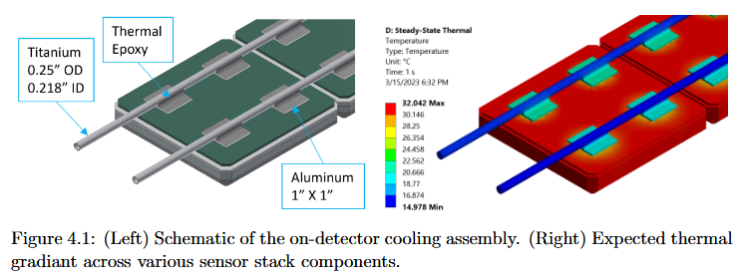
Services Estimates
Current estimate for power for the whole detector remains unchanged at less than ~500w
68 HRPPD sensors in total:
340 HV Lines (5 HV Lines per HRPPD)
68/136 LV Lines (1 or 2 LV Lines per HRPPD)
340 Fibers (5 total fibers per HRPPD)
~2mm diameter per fiber
Laser Monitoring System: ~12 fiber lines
Vessel Gas (N2): 4 lines (2 inlet & 2 outlet)
Designed to attach to either ¼” NPT or 3/8” NPT fittings (bulkhead)
Cooling: Liquid lines 15C, ¼” OD at HRPPD, design still dependent on ASICs
OUTDATED

Slide 10
Question & Comments

