Slide 1




UCSC ePIC BTOF assembly plans

Slide 2
Pre-assembly activities
R&D Activities
  Sensor testing: IV/CV/laser
  Sensor irradiation
  Sensor redistribution and assembly on boards
  Boards design and production
  Support of the TB (DESY, JLAB, CERN)

Slide 3
Assembly plan at SCIPP
Task 1: Assembly ‘stavelets’ (16cm long parts with sensors and ASIC)
Volume: 144 staves, ~300 half staves made of ~8 stavelets
  Wirebonds per stavelet: ((128 + 128)x2 (sensors-> interposer ->chip) + ~20(chip))x4
    ~2000 bonds
  Assuming 4 BTOF assembly sites: ~500 stavelets per site in 2 years, around 1 stavelet per day which is a ~low volume!
Assembly procedure
  Receive bare sensors, QC on sensors (visual, IV)
  Receive bare chips, QC on chip (or already done)
  Fabricate interposer boards
  Glue and assemble sensors and chips, QC (metrology, mechanical)
  Wirebond, QC

Slide 4
Assembly plan at SCIPP
Task 1: Assembly ‘stavelets’ (16cm long parts with sensors and ASIC)
Identify funds and space needed
  Fraction of tech, >1 day per week
  Postdoc
  Space → we have a laminar flow bench available and a bit of space in the clean room should open in a few years
Equipment: glue robot, dry cabinets, a fraction of a wirebonder?
  We have some funds from past PED request that we’ll use for some of this equipment
  → need communication to buy equipment not in the original PED

Slide 5
Assembly plan at SCIPP
Task 2: Development of assembly procedure and components
Development of jigs and supports for assembly, QC and shipping
Define the choice of glue
Identify the correct glue machine for the assembly
…

Slide 6
Assembly plan at SCIPP
Task 3: Development of stavelet DAQ for QC
Once stavelet is assembled we need a way to do QC on chips and sensors
Develop a board that ‘clamps on’ or need to be connected via wirebonds to operate chips and sensors
Develop a test station (source/X-ray gun) to scan all channels connected
Need engineer time to develop board and DAQ
…

Slide 7
Assembly plan at SCIPP
Task 4: Assembly of full stave?
Harder because of funding and space
Would need significant support as we need extra equipment and construction
The number of wirebonds is minimal, it’s mostly gluing and positioning
But we can develop jigs and supports for it
Maybe done at Purdue? (where final stave sandwiching will happen)

Slide 8
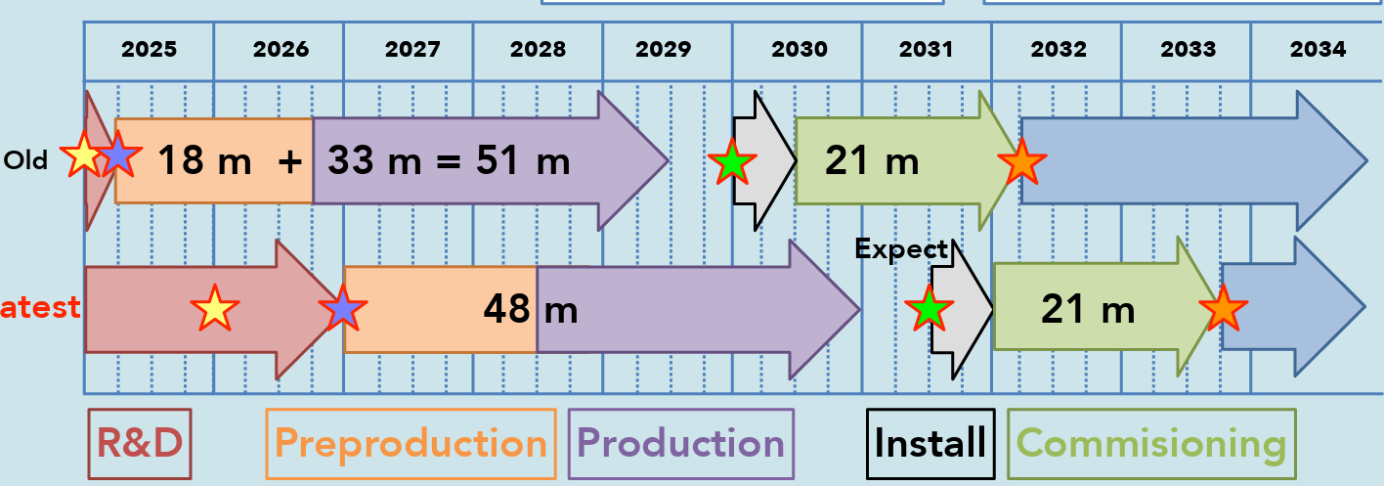
SCIPP road-to-assembly
Demonstrator assembly
Develop tooling
Assembly X stavelets
Full assembly
ITk (ATLAS) assembly

