Slide 1

Tile Aging Study (Update)
Jerad Johanningmeier
Advisor: Dr. Megan Connors
4/18/2024

Slide 2
Objectives
How does aging affect the performance of the scintillator tiles?
Tile Testing:
Monitor the performance of scintillator tiles over time and ensure that they will maintain consistent performance for their reuse in ePIC.
Tile Baking:
By baking tiles we accelerate their aging, allowing us to measure how they will perform in the future.

Slide 3
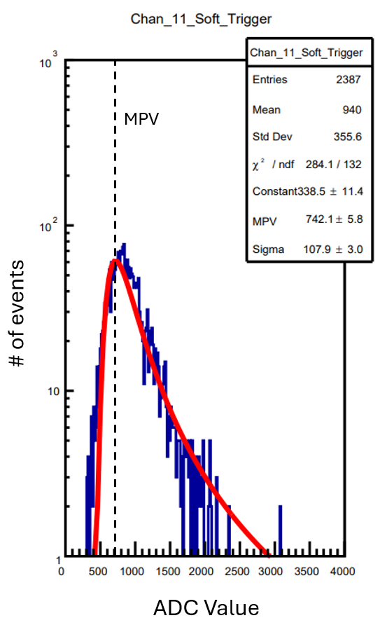
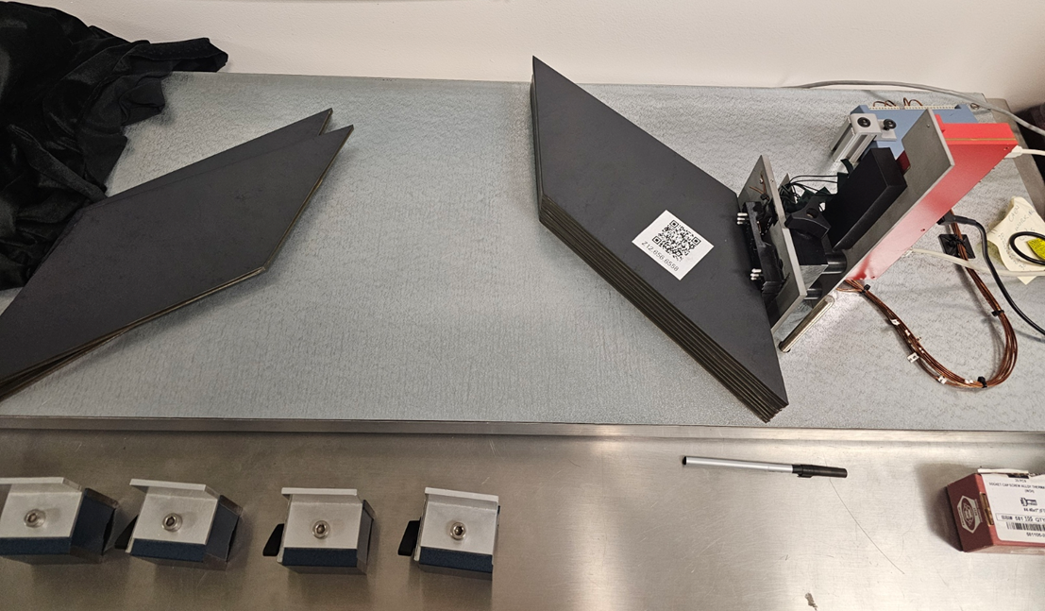

Recap
Tile Testing:
10 Tiles are attached to Hamamatsu S12572-33-015P SiPMs at 68V. (Top and bottom tiles are reference tiles)
The performance of the tiles is determined by a Performance Ratio (PR). MPVs are found from the landau curve of the events histogram.

Slide 4
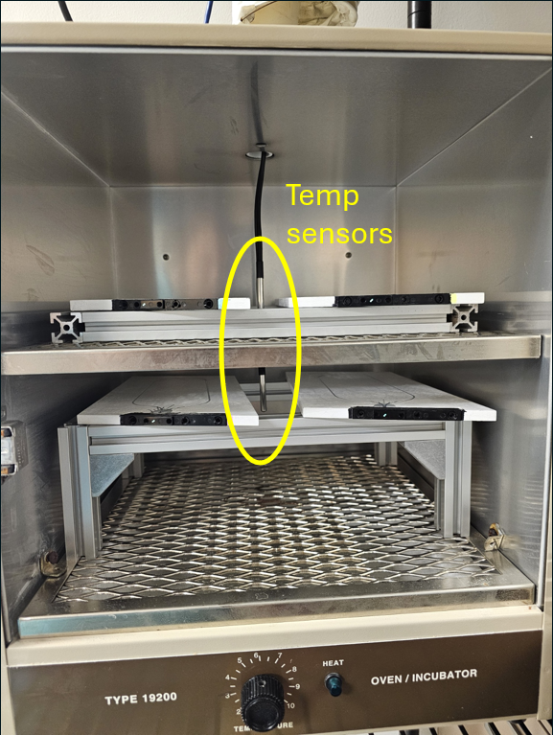
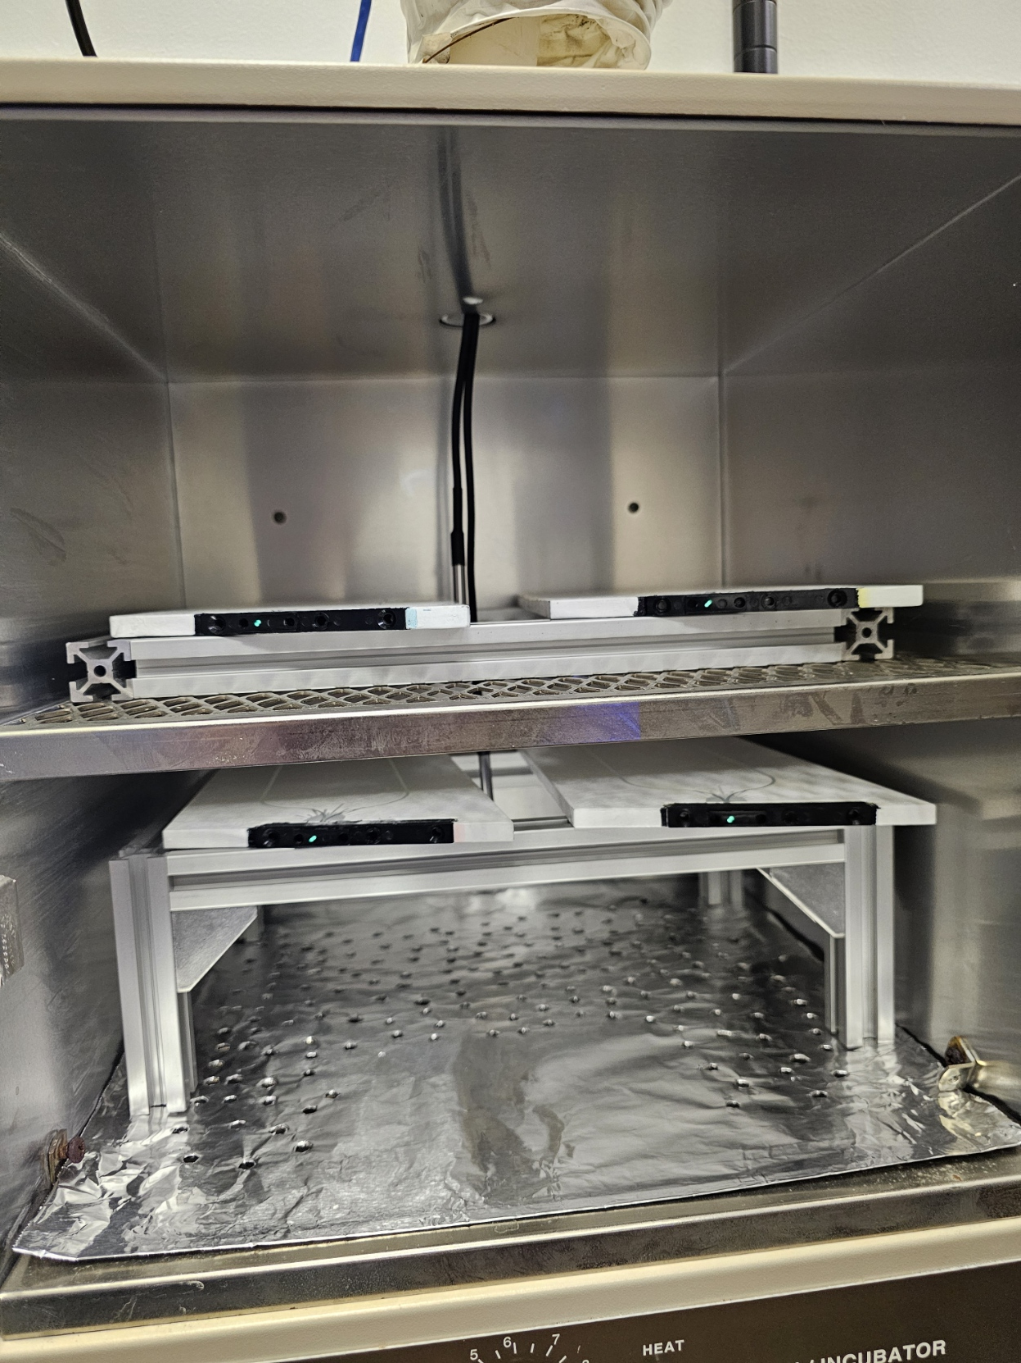
Recap
Tile Baking:
Procedure had tiles baked 4 at a time, at a target temperature of 60°C with testing breaks every 72 hours.
3x DS18B20 temperature sensors for the temperature of each shelf in the oven as well as the room. (data recorded by an Arduino and read by python script)
It was found that the heating element was causing additional aging through radiation, aluminum shielding was added, after 10 years of aging, to prevent this.

Slide 5

$Arrhehius Reaction Rate: \frac{dA}{dt}=Ak_{0}e^{E/RT}$ [1]
Where A is the concentration of the scintillation dopants, $k_{0}$ is the reaction constant, E is the activation energy, R is the gas constant and T is temperature.
By taking a ratio of the reaction rate in the oven to the reaction rate at room temp we obtain a factor that can be used to scale the elapsed time to the proper accelerated age.
$$Average aging=\frac{e^{\frac{−E}{RT_{oven}}}}{e^{\frac{−E}{RT_{room}}}}∙∆t$$
My python script uses a constant room temperature of 20°C and the $∆t$ is the time between measurements. Aging is calculated for each sensor in the oven and then averaged to obtain the average aging for all 4 tiles being baked. These average age values for each measurement are then summed over the course of the bake.
J. Abdallah, et al., The production and qualification of scintillator tiles for the ATLAS hadronic calorimeter, ATLAS note ATL-TILECAL-PUB-2007-010, (2007)

Slide 6
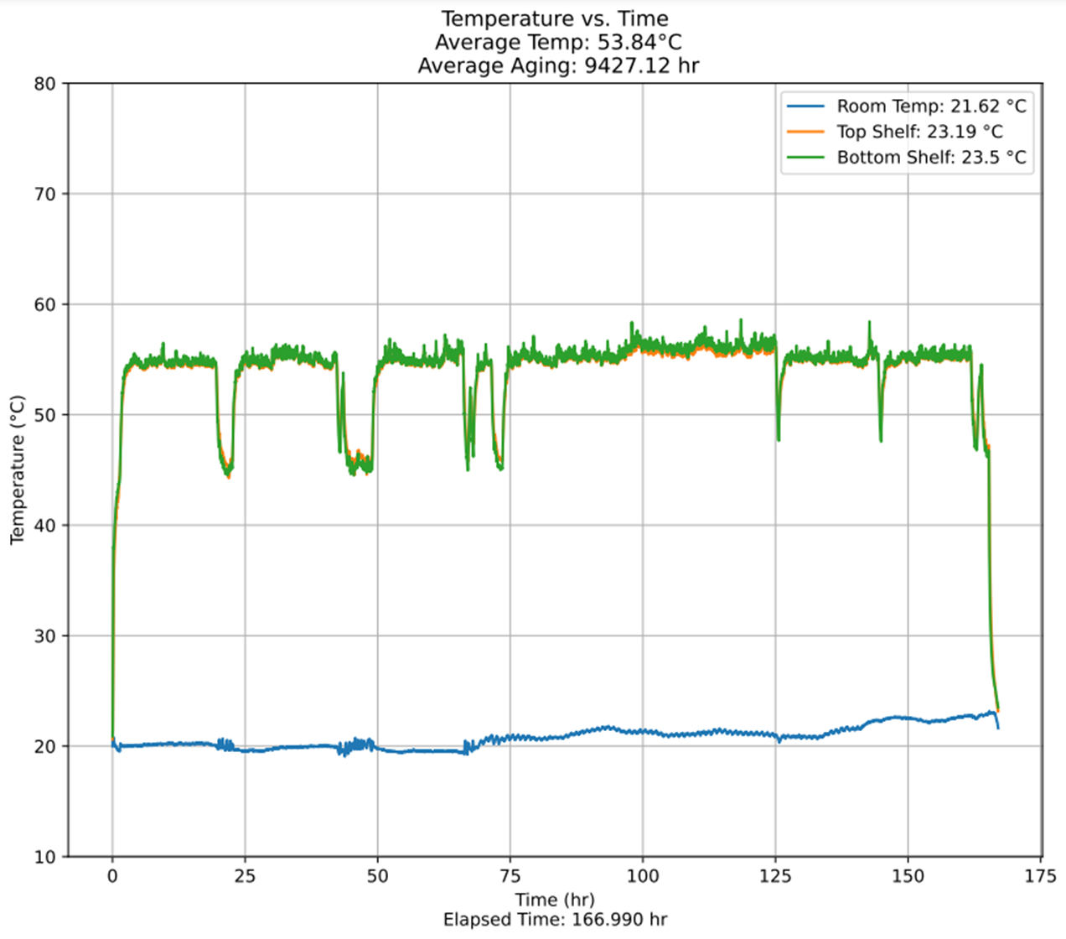
Recap
Tile Baking:
This shows how temperature/aging data is recorded
The oven thermostat was not working properly for the last two months of baking. This resulted in random dips in temperature.
This was left alone as the decrease in temperatures did not result in any additional stress and the effects should be statistically insignificant.

Slide 7
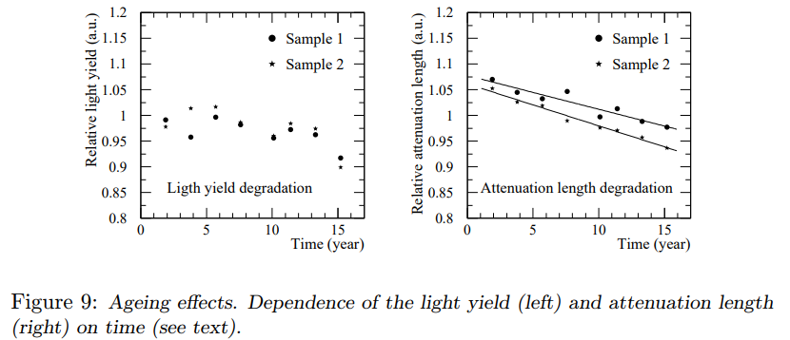
ATLAS Baking Study
Two samples were kept at a temperature of 70°C for 25 days with intermittent breaks for measurements (approx. 16 years of aging)
This study concluded the total degredation caused by natural aging should not exceed10% after 10 years of operation
J. Abdallah, et al., The production and qualification of scintillator tiles for the ATLAS hadronic calorimeter, ATLAS note ATL-TILECAL-PUB-2007-010, (2007)

Slide 8
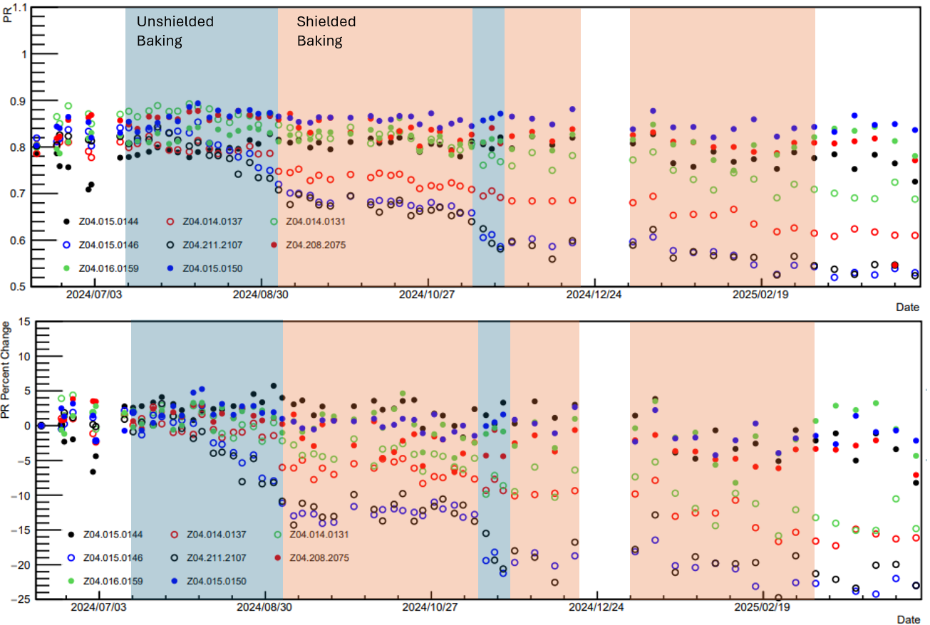
Results
*open circles are baked tiles*
Total aging: 263370.01 hr
(30.06 years)
PR/PC vs. Time
Baking is complete, tiles reached target age of 30yr. This is the projected lifespan of ePIC.
Testing continues after baking to monitor any annealing.
Unshielded baking did not exceed 10% degradation until 10yr were reached
Shielded baking vastly slowed aging rate.
Tiles did not exceed 25% degradation.
Notes:
Previous data point was at 10.2 years

Slide 9
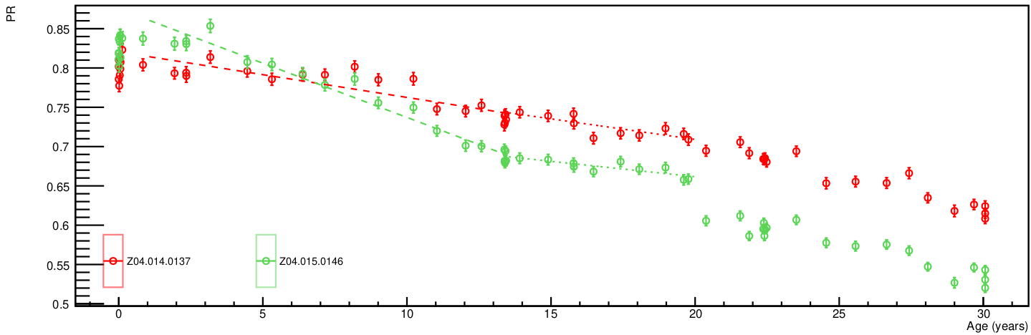
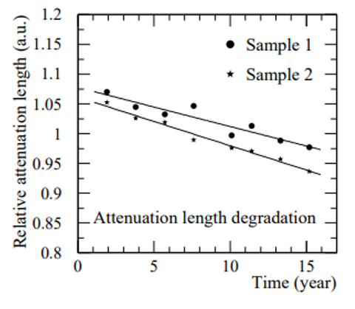
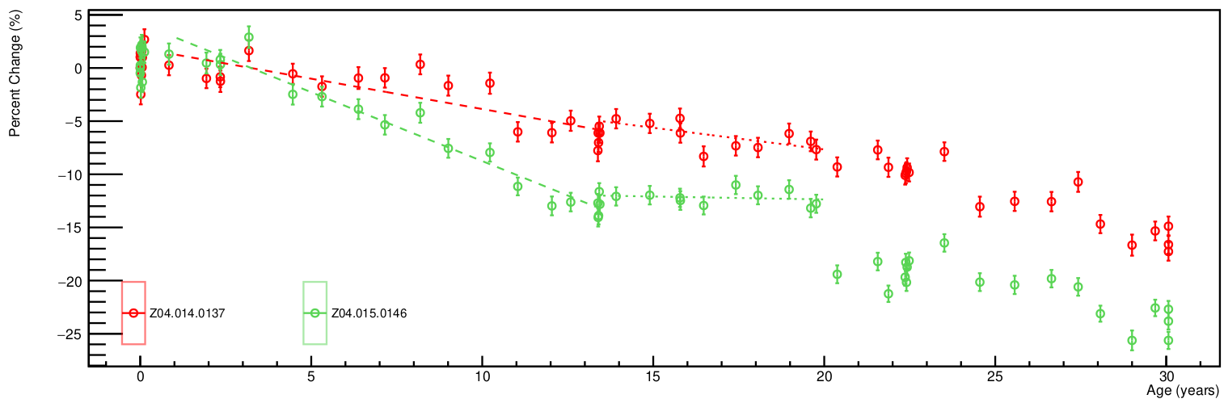





Results (cont.)
*open circles are baked tiles*
Total aging: 263370.01 hr
(30.06 years)
PR/PC vs. Accelerated age
J. Abdallah, et al., The production and qualification of scintillator tiles for the ATLAS hadronic calorimeter, ATLAS note ATL-TILECAL-PUB-2007-010, (2007)
$$\frac{−0.6\%}{year}$$
$$\frac{−0.4\%}{year}$$
Slope ~ $\frac{−1\%}{year}$
$$\frac{−1.3\%}{year}$$
$$\frac{−0.06\%}{year}$$
Notes:
Previous data point was at 10.2 years

Slide 10
Refrences
[1] J. Abdallah, et al., The production and qualification of scintillator tiles for the ATLAS hadronic calorimeter, ATLAS note ATL-TILECAL-PUB-2007-010, (2007)
[2] Aidala, C.A. Design and Beam Test Results for the sPHENIX Electromagnetic and Hadronic Calorimeter Prototypes. arXiv:1704.01461 [physics.ins-det] (2017)
[3] J. Tutterow, Aging Studies of sPHENIX Hadronic Calorimeter Scintillating Tiles (2021)
[4] S. Ali, Effects of aging on scintillating hadronic calorimeter tiles (2018)

