Slide 1
Benchmarking ePIC Simulations of PbWO₄ Against CMS Test Data
Tianhao Jin

Slide 2
Overview of the project
Comparison with CMS test beam studies¹ (Akchurin et al., CMS Note 2007/012)
Both CMS and ePIC Electromagnetic calorimeters made of PbWO4
ePIC simulations using EIC (npsim)
CMS’ ECal length: 23cm, ePIC’s 20cm. Results are scaled accordingly (about 10% of shift)
¹ N. Akchurin et al., The Response of CMS Combined Calorimeters to Single Hadrons, Electrons and Muons, CMS Note 2007/012, CERN, 27 February 2007.

Slide 3
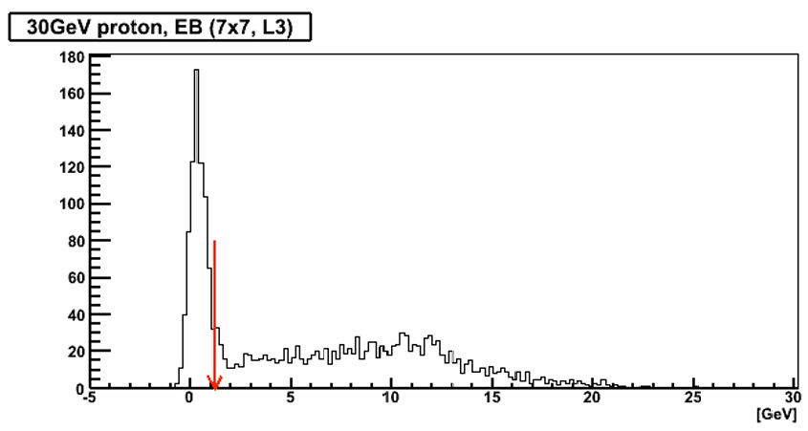
Objective of the Comparison
• Compare energy deposit distributions
• CMS data:
‣ Uses a 1.2 GeV energy cut to separate
- MIP signals (left of the arrow)
- Hadronic interactions (right of the arrow)
• Our approach:
‣ Cut set at 0.3 GeV due to lower simulated energies
• Goal:
‣ Compare the ratio of energy deposited in hadronic interactions vs. total energy
Energy deposit distribution of 30GeV proton in ECal
Adapted from Figure 10 in CMS Note 2007/012

Slide 4
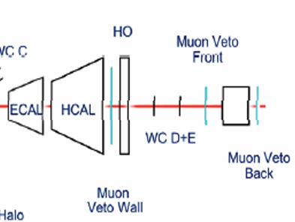
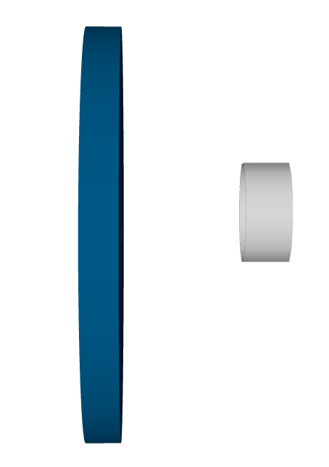
Set up comparison
ECAL
HCAL
ePIC:
Total energy = energy of shot particles
CMS:
Total energy = ECal + HCal + Muon Veto Wall

Slide 5
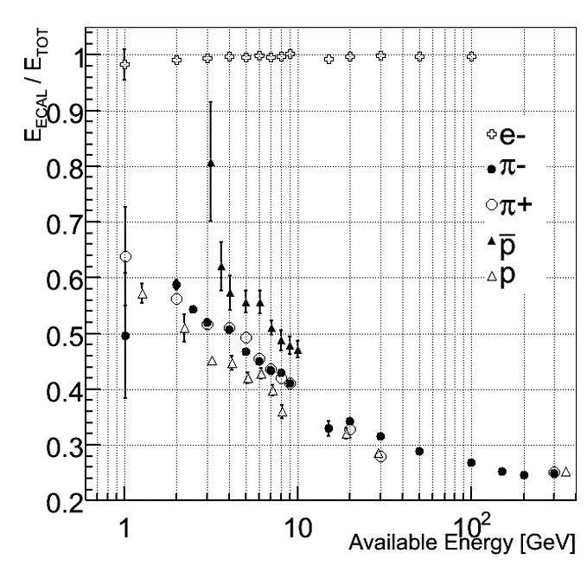
CMS result
Available energy: the portion of a particle’s energy that contributes to the calorimeter signal.
‣Pions & Kaons: kinetic energy
‣Protons: kinetic energy
‣Antiprotons: kinetic energy + 2 × proton rest mass (due to annihilation)
Total energy:
CMS: Ecal +Hcal + Muon Veto Wall
ePIC: Available energy
We are going to focus on proton, anti proton and π+
Adapted from Figure 9 in CMS Note 2007/012

Slide 6
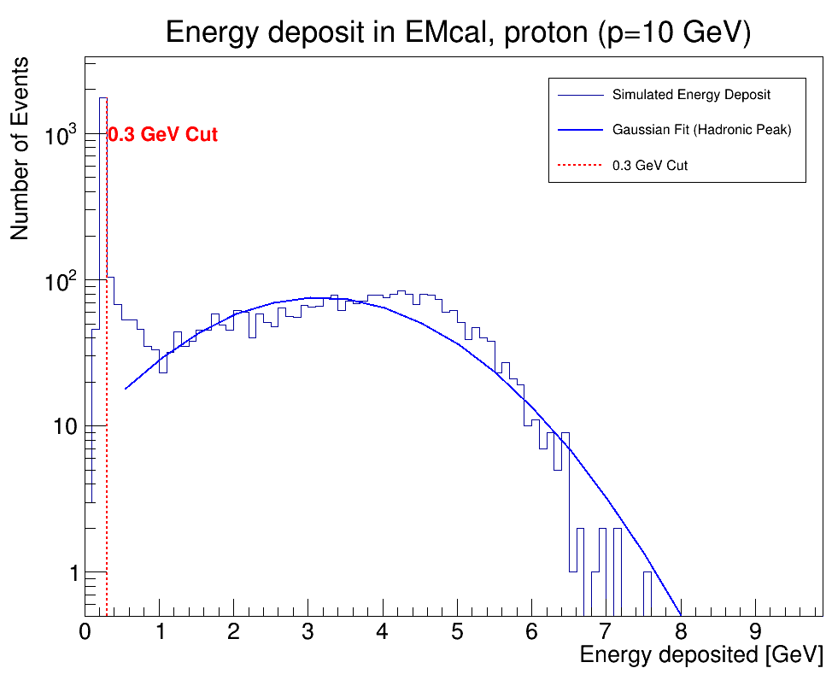
Energy deposit at Ecal at ePIC
Energy deposit is retrieved from the edm4hep::CaloHitContribution class in the ePIC simulation output
Applied a Gaussian fit to the energy deposit distribution
Observed that the peak from hadronic interactions is slightly right-shifted compared to the Gaussian peak
This trend is consistent across multiple particle types and momenta
A 0.3 GeV cut is applied to separate MIP-like events from hadronic interactions

Slide 7
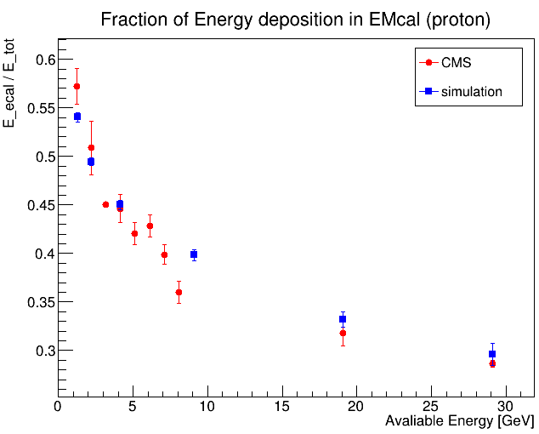
Proton
Both CMS data and simulation follow the same trend.
The data points are consistent within uncertainties.
There is only one deviation at 10 GeV.

Slide 8
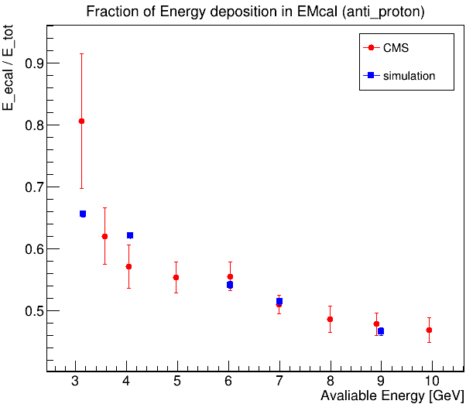
Anti Proton
Both CMS data and simulation follow the same trend.
The data points are consistent within uncertainties.
CMS’s first data point at 3GeV should because they apply a really high cutting energy.

Slide 9
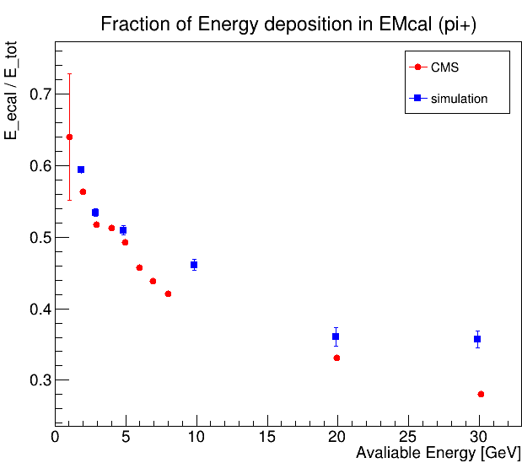
Pion+
Both CMS data and simulation follow the same trend.
Pion+ with higher energy in simulation deposit more energy comparing with CMS result.
For pion+ with low energy, simulation is consistent with the CMS data.

Slide 10
Summary
Performed simulations to reproduce CMS test beam results for energy deposition in PbWO₄
Found good agreement with CMS data, especially in the low-energy regime relevant to our study
Overall, we find the simulation of interaction with PbWO₄ is correct

Slide 11
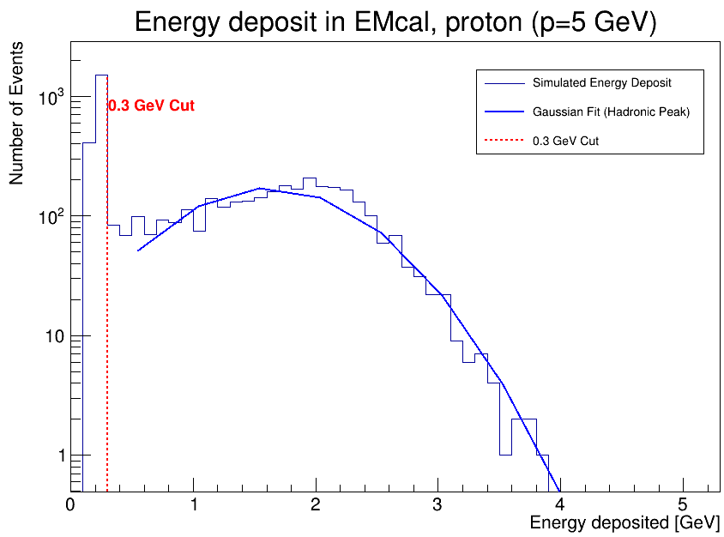
Ecal deposit proton (p=5GeV)

Slide 12
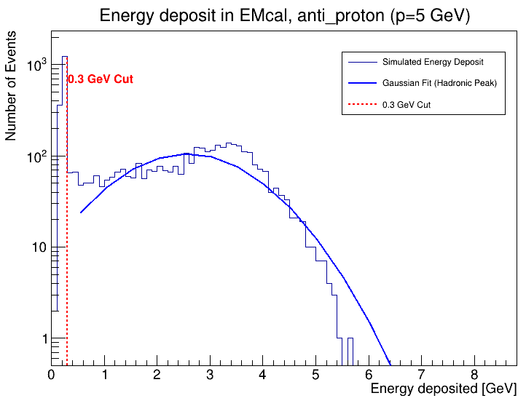
Ecal deposit anti proton (p=5GeV)

Slide 13
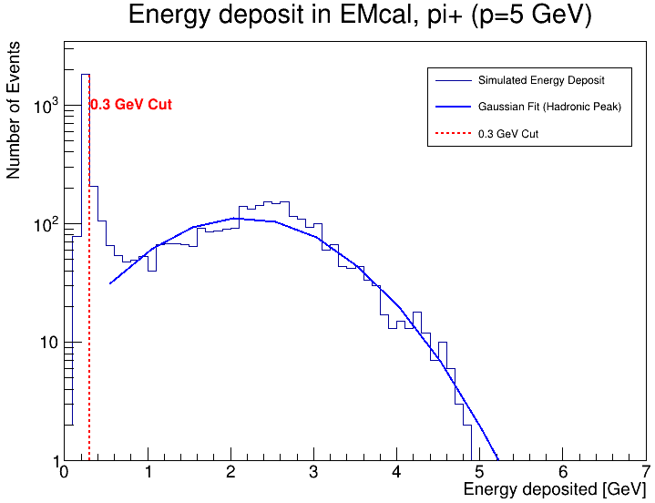
Ecal deposit pion+ (p=5GeV)

Slide 14
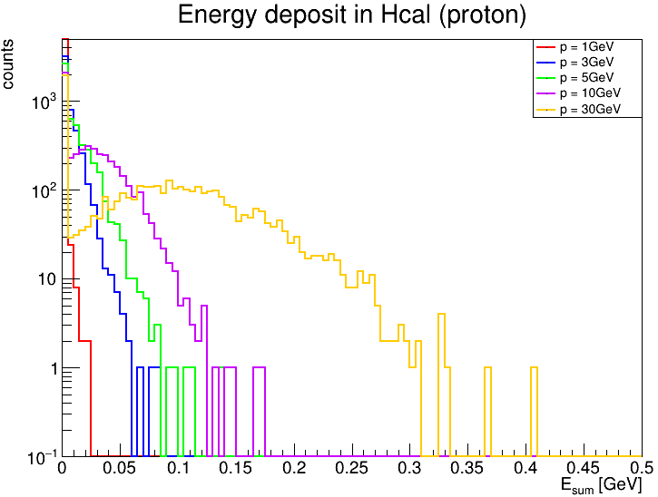
Energy deposit in Hcal

