Slide 1

The RCDAC Data Acquisition System
Martin L. Purschke
DAQ manager of sPHENIX
Previous DAQ/Electronics WG co-convener for what is now ePIC
I have been a DAQ (and notably, a calorimeter) guy since my early days at CERN

Slide 2
What I’ll be talking about today
RCDAQ is DAQ system that has been around since about 2012
It started out as your swiss army knife-type DAQ system to quickly read out whatever you need for your R&D project
It was used in pretty much all R&D campaigns for sPHENIX, but already much earlier in several EIC-themed test beams and other measurements, typically at the Fermilab Test Beam Facility
To the best of my knowledge (some I know, some I learn about when I get questions), it is in use in about 25-30 places around the world
I have step-by-step manuals with examples that seem to work for groups that set up completely autonomously. Just the other day I got a question from an outside group that I didn’t know about. They had been using RDAQ for more than a year and finally had a question.
RCDAQ was chosen to be the main DAQ system of sPHENIX, with several higher-level additions (“Run Control”) that are irrelevant here
I will mostly focus on lab-test / R&D-style / test beam setups today
Go to https://www.phenix.bnl.gov/~purschke/rcdaq for the manuals and sample data files etc

Slide 3
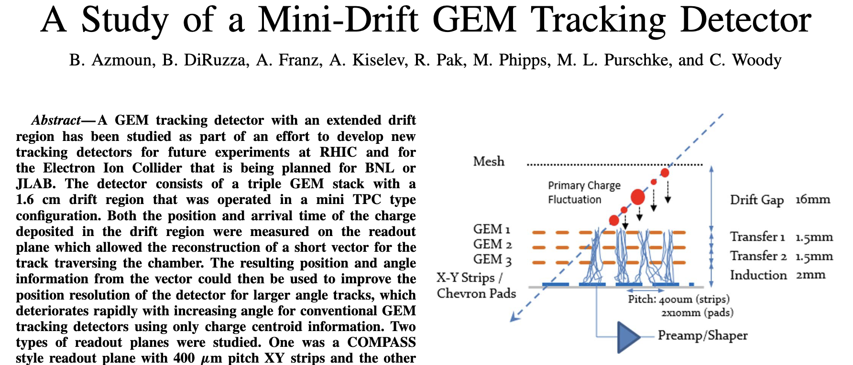
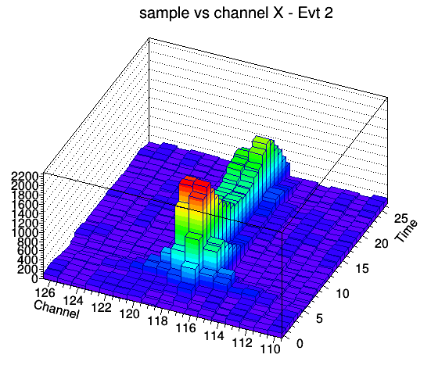
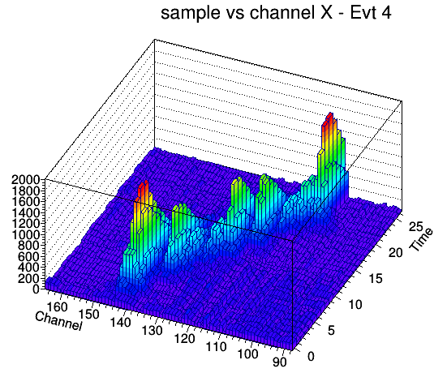
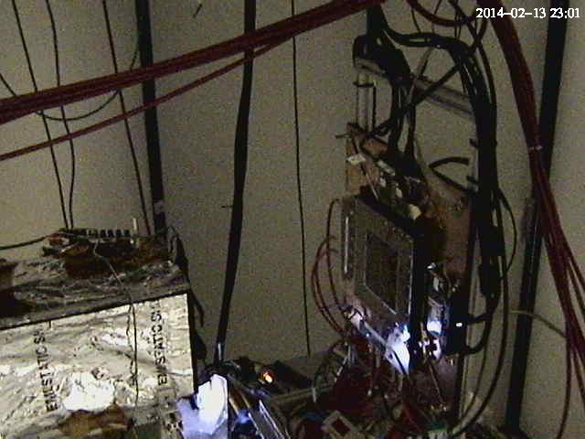
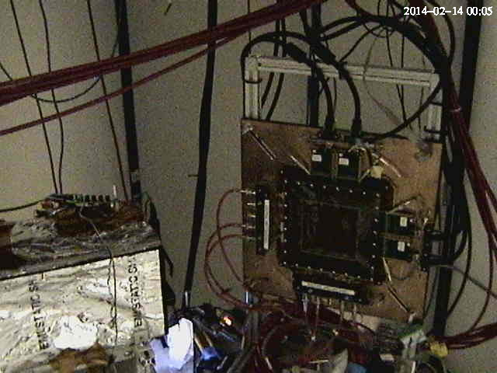
One of the early EIC test beam campaigns with RCDAQ - The Minidrift GEM tracking detector (2014)
IEEE Transactions on Nuclear Science, vol. 63, no. 3, pp. 1768-1776, June 2016
11 years ago!

Slide 4
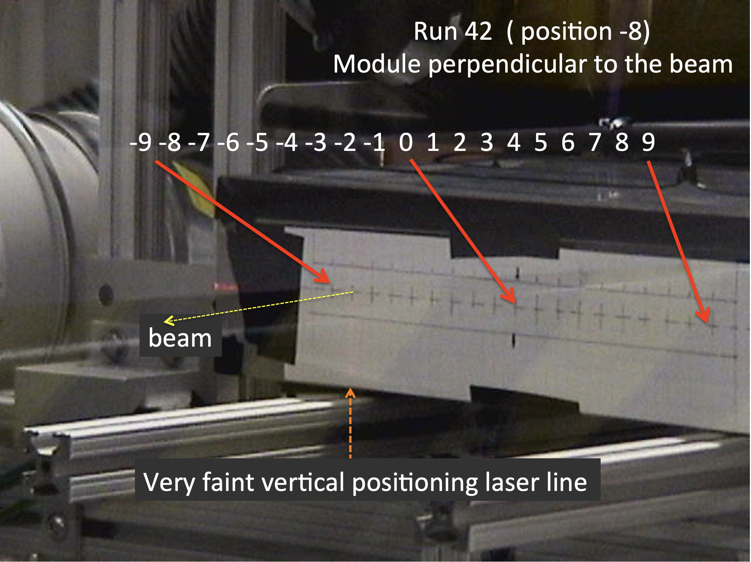
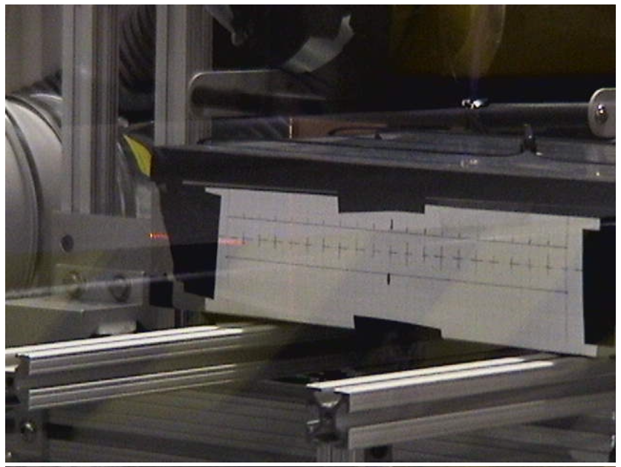
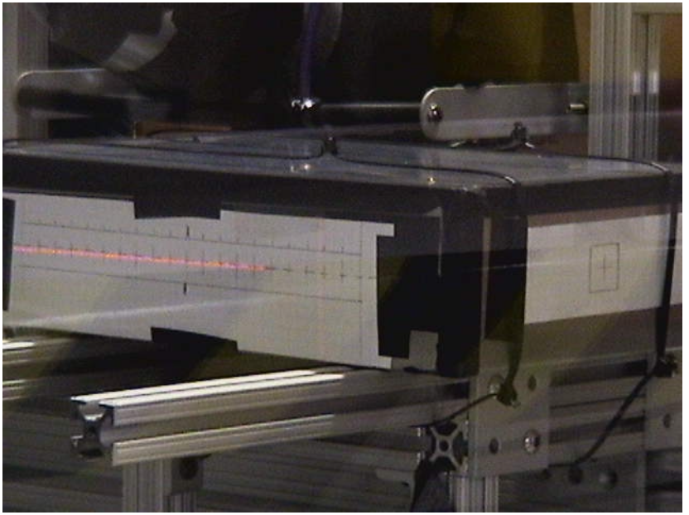
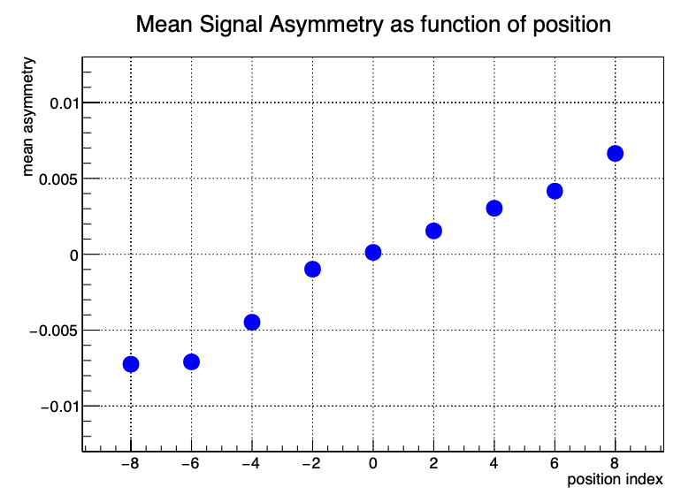
Another one from the EIC calo orbit – Oleg, Craig, myself
”Can we get more calorimeter position information by adding a dual readout and measure time?”
Moving the calorimeter in the beam for “more left” or “more right” incidence
In the end we found that it’s too small an effect to pursue, but it was worth checking!

Slide 5
What does one need?
Pretty much any Linux machine and distro will do. (I do lots of development on a Linux VM on my M2 Mac here)
I’m striving to be distro-agnostic:
RedHat and derivatives (RHEL, Fedora, CentOS, Alma… all good)
Debian and similar (Ubuntu, Mint, …)
Arch Linux
And yes, it does run on a Raspberry Pi – sometimes you want to take a few weeks worth of cosmics with some detector module without tying up a more expensive PC
The main platforms currently at work in sPHENIX are 96-core AMD EPYC PCs.
For practicing/going through the manuals, you can run everything without any actual readout hardware – RCDAQ provides “pretend-devices” that behave like an ADC

Slide 6
Data Formats in general…
One of the trickiest parts when developing a new application is defining a data format
It can take up easily half of the overall effort – think of Microsoft dreaming up the format to store this very PowerPoint presentation you are seeing in a file. We used to have ppt, now we have pptx – mostly due to limitations in the original format design
A good data format takes design skills, experience, but also the test of time
The tested format usually comes with an already existing toolset to deal with data in the format, and examples – nothing is better than a working example
Case in point: We could easily accommodate the sPHENIX Streaming Readout data in this format, event though no one had ever heard the term when I designed this
I have no time today to talk about the analysis end / online monitoring, etc of this, maybe another time

Slide 7

Modularity and Extensibility
No one can foresee and predict requirements of a data format 20 years into the future.
Must be able to grow, and be extensible
The way I like to look at this:
FedEx (and UPS) cannot possibly know how to ship every possible item under the sun
But they know how to ship a limited set of box formats and types, and assorted weight parameters and limits
Whatever fits into those boxes can be shipped
During transport, they only look at the label on the box, not at what’s inside
We will see a surprisingly large number of similarities with that approach in a minute
“packets”

Slide 8
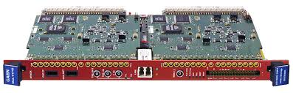
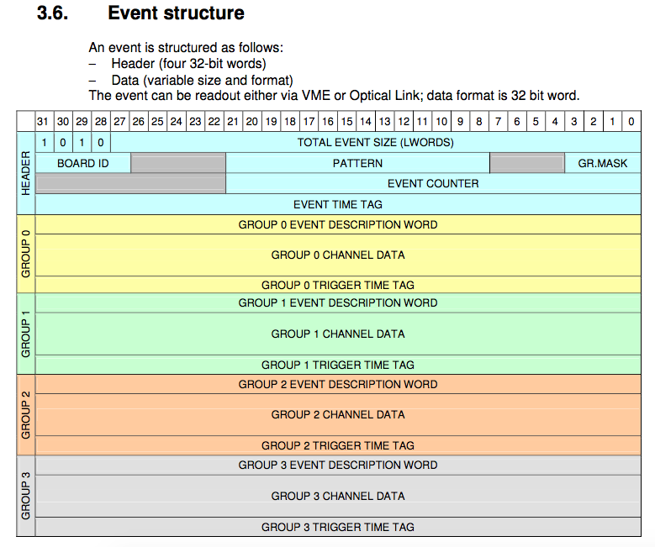
Example: CAEN’s V1742 format
We just take that blob of memory, “put it in a box”, done.
The analysis software takes care of the unpacking and interpretation later
Just grab it. Don’t waste time here.

Slide 9
RCDAQ - The High Points
Each interaction with RCDAQ is a shell command. There is no “starting an application and issuing internal commands” (think of your interaction with, say, root)
RCDAQ out of the box doesn’t know about any particular hardware. All knowledge how to read out something, say, a FELIX card, comes by way of a plugin that teaches RCDAQ how to do that.
That makes RCDAQ highly portable and also distributable – some sPHENIX FEMs use commercial drivers for the readout; I cannot re-distribute CAEN software, etc etc
RCDAQ has no proprietary configuration files. (huh? In a minute).
Support for different event types
Built-in support for standard online monitoring
Built-in support for electronic logbooks (Stefan Ritt’s Elog)
Network-transparent control interfaces

Slide 10
Everything is a shell command…
One of the most important features. Any command is no different from “ls –l“ or “cat”
Everything is inherently scriptable
You have the full use of the shell’s capabilities for if-then constructs, error handling, loops, automation, cron scheduling, and a myriad of other ways to interact with the system
In that sense, there are no proprietary configuration files – only configuration scripts.
This is quite different from “my DAQ supports scripts”!
I do not want to be trapped within the limited command set of any application!
With shell commands, the DAQ is fully integrated into your existing work environment
(And yes there are GUIs – they usually just trigger the appropriate command)

Slide 11
On Autopilot - Scripts at work
Very often – especially in your R&D days – you want to step through a range of values of a configuration parameter and see what your detector prototype has to say
Bias voltage scans (we characterized gazillions of SiPMs)
Position scans
Temperature scans
And on and on
Such a measurement is best done in a script that reads predetermined positions / voltage settings / what have you and performs the measurement
I picked an example: What is the response uniformity of a calorimeter module when a shower develops in different places? (We were very worried about this)
We were simulating different shower positions by “writing light with a light fiber” on the module front face

Slide 12
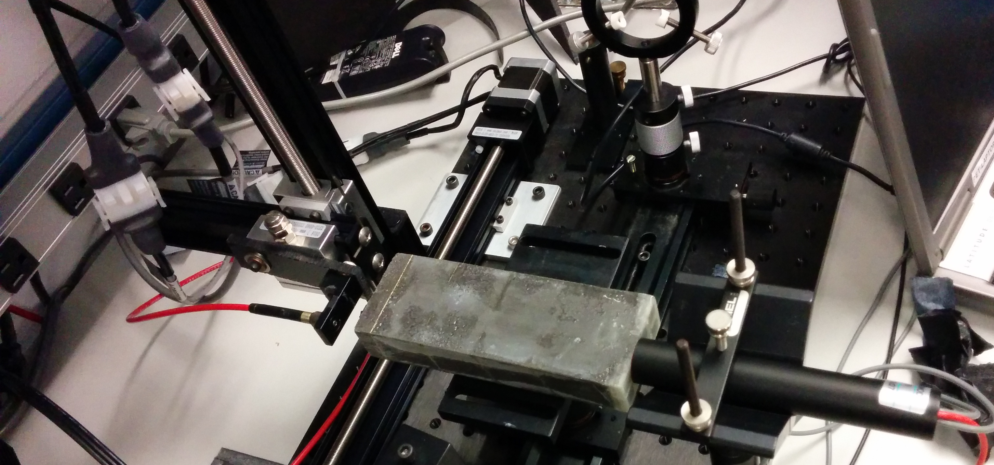
Measurements on autopilot through scripting
Simulate shower incidence positions by moving a light fiber in x and y
take a run for each position w/ 4000 events = 4000 LED pulses
50 x 25 = 1250 positions (later we had 70x70, you really want to automate that)
Let it run overnight, come back in the morning, look at the data
This early picture shows a photomultiplier. We switched to actual sPHENIX blocks and SiPMs soon after
X-Y step motor
Calorimeter Module
Light Fiber
PMT
(later SiPM)

Slide 13
The Script
#! /bin/sh
STARTPOSX=0
STARTPOSY=9900
INCREMENTX=200
INCREMENTY=-200
CURRENTPOSY=$STARTPOSY
for posy in $(seq 25) ; do
quickmove.sh $CURRENTPOSY 2
sleep 5
CURRENTPOSY=$( expr $CURRENTPOSY + $INCREMENTY)
CURRENTPOSX=$STARTPOSX
for posx in $(seq 50) ; do
echo "moving to $CURRENTPOSX"
quickmove.sh $CURRENTPOSX 1
sleep 5
CURRENTPOSX=$( expr $CURRENTPOSX + $INCREMENTX)
done
done
The DAQ operation becomes an integral part of your shell environment
25 positions in y
move the Y motor
50 positions in x
move the x motor
next x
next y
Automatic end after 4000 events
start the DAQ
rcdaq_client daq_set_maxevents 4000
rcdaq_client daq_begin
wait_for_run_end.sh

Slide 14
There’s more…
We also added more things to this RCDAQ setup to make the next-day analysis super-easy.
I first need to explain a few things, we get back to this later.

Slide 15
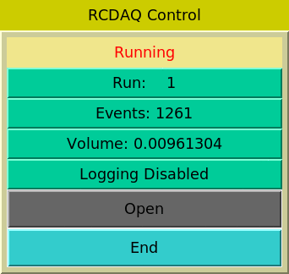

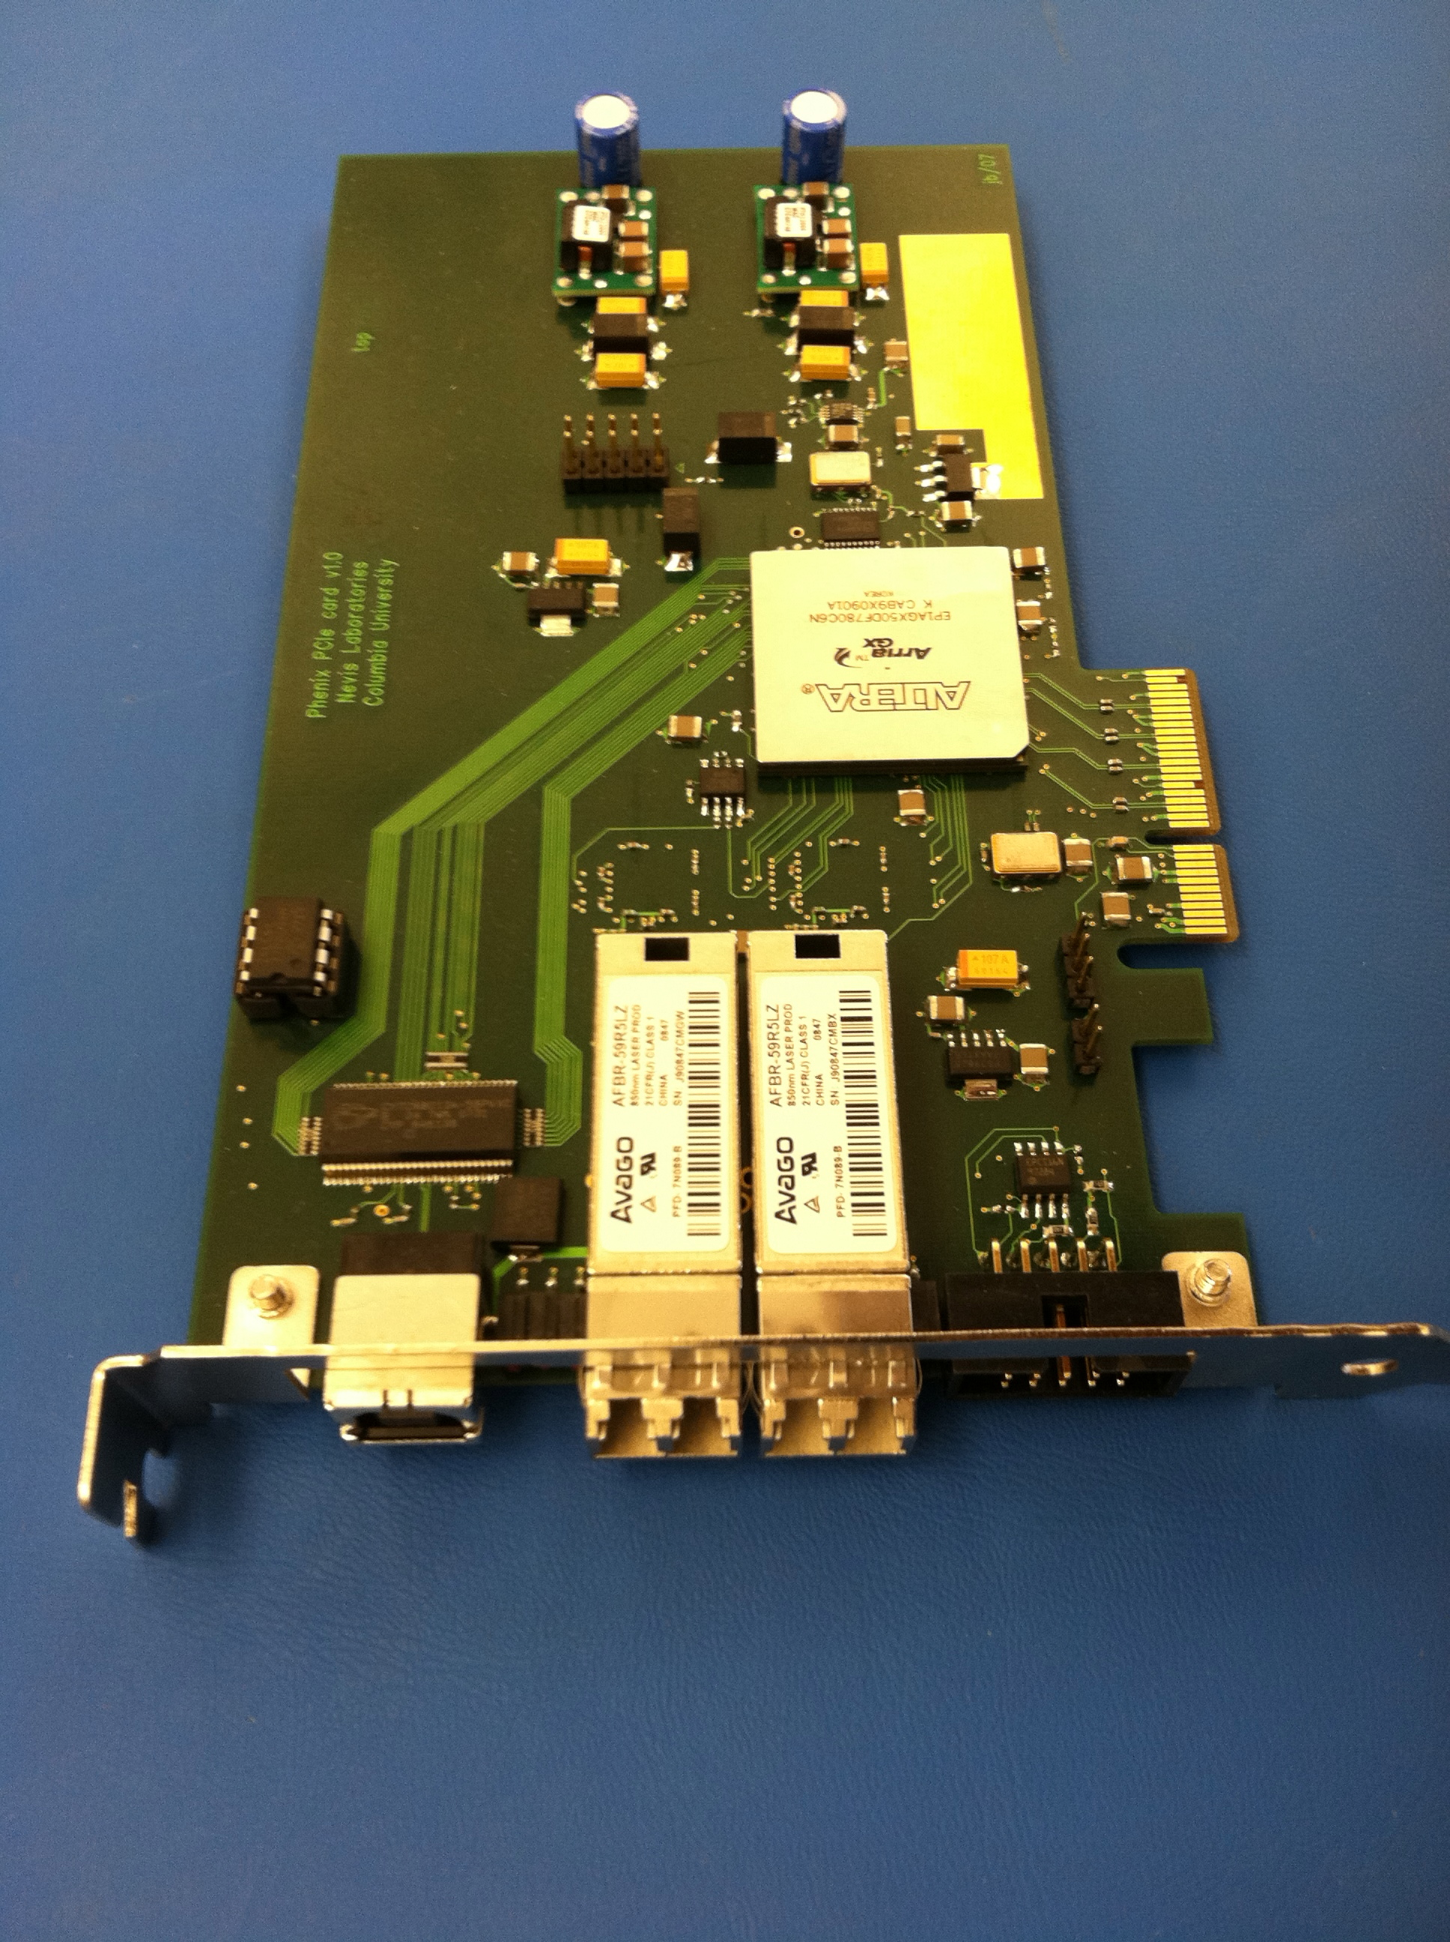

The RCDAQ client-server concept
RCDAQ Client
RCDAQ Client
scripts
Command line
RPC Protocol
RCDAQ Client
Command line
RCDAQ server
This allows an arbitrary number of processes to interact with RCDAQ concurrently
PCIe Network USB
Hardware
Hardware
Hardware
These are the 3 fundamental ways for data to get into a PC –
PCIExpress
Network
USB

Slide 16
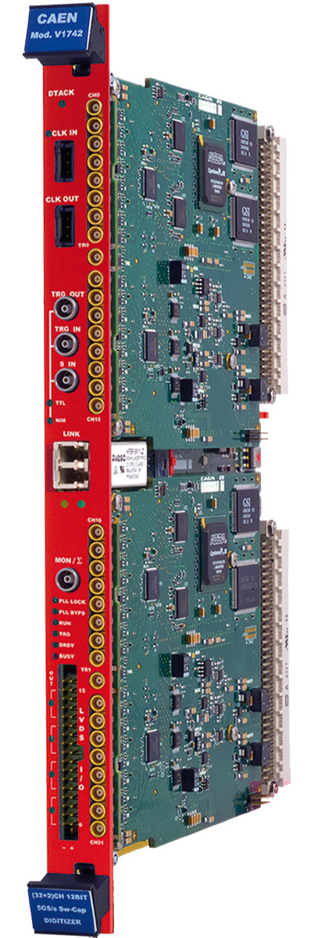
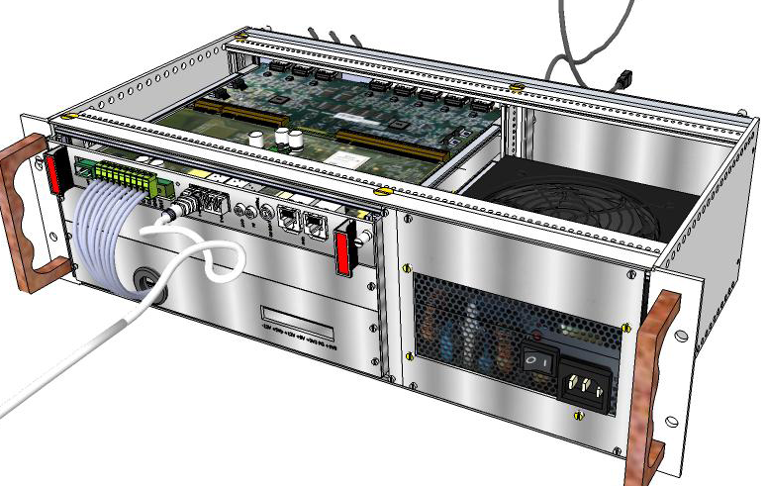
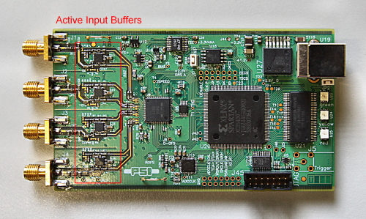
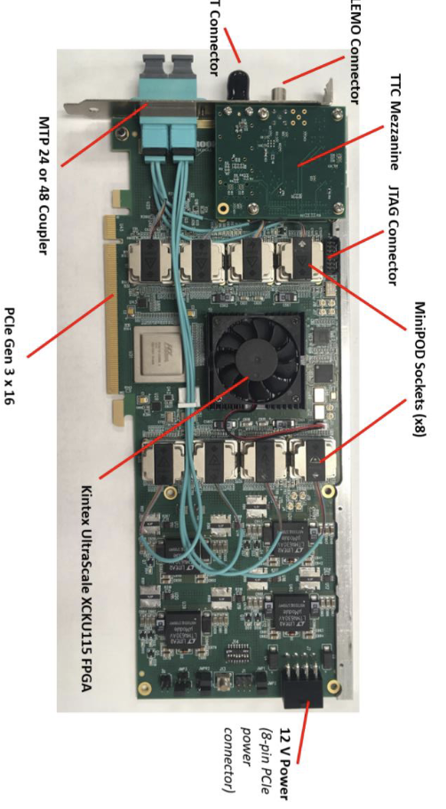
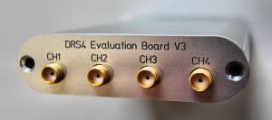
Some workhorse devices implemented in RCDAQ
RCDAQ
PCIe
PCIe
The CERN RD51 SRS System
DRS4 Eval board
“USB Oscilloscope”
The CAEN V1742 waveform digitizer
FELIX Card
There are many more not shown (all told, there are plugins for about 60)
Many devices that you can often find in your institute already, or in the CAEN catalog

Slide 17
Setting up and reading out a DRS4 Eval board
$ rcdaq_client load librcdaqplugin_drs.so
$ rcdaq_client create_device device_drs -- 1 1001 0x21 -150 negative 120 3
$ daq_open
$ daq_begin
# wait a while…
$ daq_end
BTW, this double-dash is shell standard for “stop processing command line options”
Else the later “-150” would be interpreted as -1 -5 -0 options like “ls –ltr”.
Try to delete a file named “-I”…
You see, each interaction is a separate shell command!

Slide 18
Meta Data Capturing
In the “real” experiment that’s running for a few years (think sPHENIX, ATLAS, what have you) you are embedded in an environment that supports all sorts of record keeping
At a test beam or you in your lab needs a different kind of “record keeping support”
What was the temperature? Was the light on? What was the HV? What was the position of that X-Y positioning table?
We capture this information in the raw data file itself and the data cannot get lost
I often add a webcam picture to the data so we have a visual confirmation that the detector is in the right place, or something
A picture captures everything…
Let me show you how we always capture the RCDAQ setup itself

Slide 19
Reading different things with different Event Types
You would think of the DAQ as “reading your detector”
Very often, it is necessary to read different things at different times.
Let’s go to the CERN-SPS (or the Fermilab Test Beam) for an example:
Let’s recap here:
The red lines are events that you would expect (read your detector)
The blue and yellow lines are events that read something else
acceleration
SPS or FTBF
extraction
“spill”
Begin-run event
End-run event
Spill-On event
Read and clear scalers
Flush buffers
Data Events
Read your detector channels, ADCs, TDCs...
Spill-Off event
Read and clear scalers
(allows spill intensity-based corrections)
19
In addition to your data, you need information about the spill itself – each one is different
You need to make intensity-dependent corrections on a spill-by-spill basis
So you put some signals on scalers and get an idea about the intensity, dead times, microstructures, etc

Slide 20
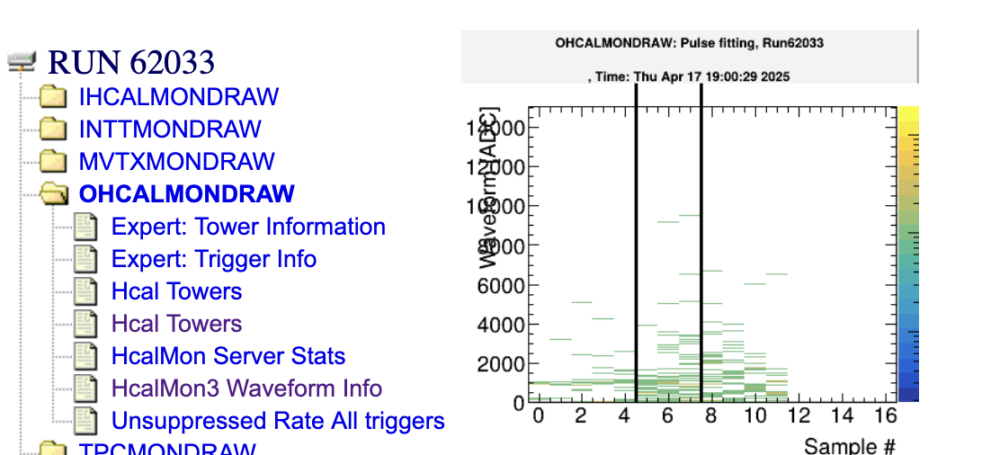
Why are begin- and endrun events so important?
In each run, they are generated exactly once
This is the place where you can keep information that is needed/valid for the entire run
Like the position information of the x/y motors that you saw before - they would get stored in the begin run.
Ditto for configuration information – we always make it so that we store it in the begin-run.
RCDAQ guarantees that the begin-run is the first, and the end-run is the last event in that run
If nothing else, if you treat your data as a stream (think online monitoring – doesn’t stop, sees many runs), these serve as convenient markers that a new run has begun, or a run has ended.
On receipt of the begin-run event, you typically clear all your monitoring histograms
On receipt of the end-run event, you save your histograms to a file
This is actually how all this online monitoring history is generated!

Slide 21
Let’s get to it - remember this?
This was our typed-in example from before
$ rcdaq_client load librcdaqplugin_drs.so
$ rcdaq_client create_device device_drs -- 1 1001 0x21 -150 negative 120 3
Now you put this into a script so you always get the same setup:
#! /bin/sh
rcdaq_client load librcdaqplugin_drs.so
rcdaq_client create_device device_drs -- 1 1001 0x21 -150 negative 120 3

Slide 22
Capturing the setup script itself for posterity
We add this very setup script file into our begin-run event for posterity
This “device” captures a file as text into a packet
This “9” is the event type of the beg-run
And this refers to the name of the file itself
#! /bin/sh
rcdaq_client create_device device_file 9 900 ”$0”
rcdaq_client load librcdaqplugin_drs.so
rcdaq_client create_device device_drs -- 1 1001 0x21 -150 negative 120 3
So this gets added as packet with id 900 in the begin-run
It’s not quite right yet - $0 is usually just “setup.sh”, so the server may not be able to find it.
Let me show the “end product”:

Slide 23
A typical RCDAQ Setup Script
#! /bin/sh
# this sets up the DRS4 readout with 5GS/s, a negative
# slope trigger in channel 1 with a delay of 140
if ! rcdaq_client daq_status > /dev/null 2>&1 ; then
echo "No rcdaq_server running, starting..."
rcdaq_server > $HOME/rcdaq.log 2>&1 &
sleep 2
fi
MYSELF=$(readlink -f $0)
rcdaq_client daq_clear_readlist
rcdaq_client create_device device_file 9 900 "$MYSELF”
rcdaq_client load librcdaqplugin_drs.so
rcdaq_client create_device device_drs -- 1 1001 0x21 -150 negative 120 3
We comment a lot as a way of documentation
If no server is running, we start one here.
We convert the script filename into a full path
We clear all existing definitions
We load the plugin(s) and define the device(s)

Slide 24
Here is the actual setup script for our TPC/FELIX readout
Abridged version, just the essentials
#!/bin/bash
RunType=beam
H=$RCDAQHOST
[ -z "$H" ] && H=$(hostname)
MYSELF=$(readlink -f $0)
rcdaq_client daq_clear_readlist
rcdaq_client create_device device_file 9 900 "$MYSELF"
rcdaq_client load librcdaqplugin_dam.so
rcdaq_client create_device device_dam 1 4${H:4:2}1 1 128
rcdaq_client daq_set_runcontrolmode 1

Slide 25
Output file management
The output file names are governed by what is called a “file rule”
It acts as the format portion of a c-program “printf” statement
The startup default is “rcdaq-%08d-%04d.evt” – called with 2 int parameters, one the run number, and one a “file sequence number” if we roll over files
You can try this even on the command line ( I added the \n to have it by itself on a line)
The %08d and %04d parts make an 8- or 4-digit number with leading zeroes – we want to avoid spaces in filenames.
We usually give a file run with a full and complete path
$ printf "rcdaq-%08d-%04d.evt\n" 100 0
rcdaq-00000100-0000.evt

Slide 26
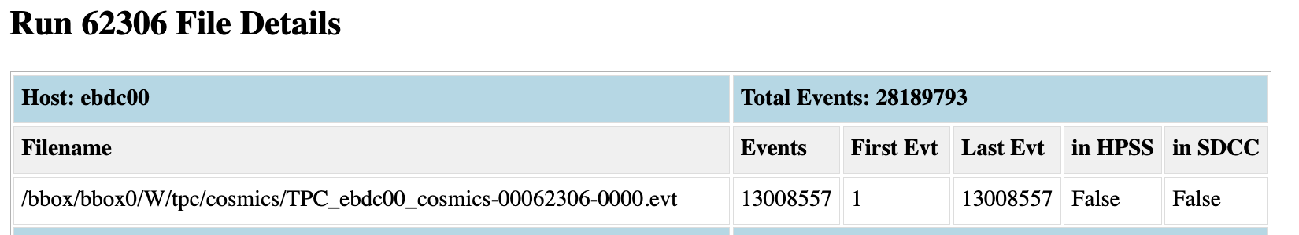
Output file management
Let’s look at our TPC
We also have “run types”, which are pre-made file rules that we can switch between quickly
But these just set the file rule when selected – you can still override any type with a custom setting
phnxrc@ebdc00:~$ daq_status -l
ebdc00 - Stopped
Filerule: /bbox/bbox0/W/tpc/cosmics/TPC_ebdc00_cosmics-%08d-%04d.evt
-- defined Run Types:
beam - /bbox/bbox0/W/tpc/beam/TPC_ebdc00_beam-%08d-%04d.evt
calib - /bbox/bbox0/W/tpc/calib/TPC_ebdc00_calib-%08d-%04d.evt
cosmics - /bbox/bbox0/W/tpc/cosmics/TPC_ebdc00_cosmics-%08d-%04d.evt
junk - /bbox/bbox0/W/tpc/junk/TPC_ebdc00_junk-%08d-%04d.evt
line_laser - /bbox/bbox0/W/tpc/line_laser/TPC_ebdc00_line_laser-%08d-%04d.evt
local_junk - /scratch/TPC_ebdc00_junk-%08d-%04d.evt
pedestal - /bbox/bbox0/W/tpc/pedestal/TPC_ebdc00_pedestal-%08d-%04d.evt
physics - /bbox/bbox0/W/tpc/physics/TPC_ebdc00_physics-%08d-%04d.evt

Slide 27
Again, the power of scripting -
It would be really hard to manage settings for 80+ rcdaq instances in sPHENIX - one script for all TPC nodes:
H=$RCDAQHOST
[ -z "$H" ] && H=$(hostname)
SERVERNUMBER=$(echo $H | sed 's/ebdc//')
BBOXNR=$(expr $SERVERNUMBER % 12)
STEM=/bbox/bbox${BBOXNR}/W/tpc
rcdaq_client daq_define_runtype pedestal $STEM/pedestal/TPC_${H}_pedestal-%08d-%04d.evt
rcdaq_client daq_define_runtype beam $STEM/beam/TPC_${H}_beam-%08d-%04d.evt
rcdaq_client daq_define_runtype physics $STEM/physics/TPC_${H}_physics-%08d-%04d.evt
#rcdaq_client daq_define_runtype physics_test /bbox/commissioning/bbox_test/TPC_${H}_physics-%08d-%04d.evt
rcdaq_client daq_define_runtype calib $STEM/calib/TPC_${H}_calib-%08d-%04d.evt
rcdaq_client daq_define_runtype cosmics $STEM/cosmics/TPC_${H}_cosmics-%08d-%04d.evt
rcdaq_client daq_define_runtype local_junk /scratch/TPC_${H}_junk-%08d-%04d.evt
rcdaq_client daq_define_runtype line_laser $STEM/line_laser/TPC_${H}_line_laser-%08d-%04d.evt
H = ebdc00
SERVERNUMBER = 00
BBOXNR= 0
STEM = /bbox/bbox0/W/tpc

Slide 28
More about capturing your environment
Sometimes you add meta-info to make the analysis easier, especially in the aforementioned “scanning something” setups - example later
Many times you capture things only “just in case”
I usually add a camera picture to the begin-run, especially when the detector moves in the beam for some position scan
You don’t routinely look at them in your analysis, but it’s good to have that info
If you have some inexplicable feature, you can use the meta-data to do “forensics”
Find out what, if anything, went wrong
The more data you capture, the better this gets
Think of it as “black box” on a plane…

Slide 29
Forensics (FermiLab test beam for the future ePIC HCal)
“It appears that the distributions change for Cherenkov1 at 1,8,12,and 16 GeV compared to the other energies. It seems that the Cherenkov pressures are changed. […] Any help on understanding this would be appreciated.”
Martin: “Look at the info in the data files:”
Among many other things, we capture the most relevant beamline parameters
$ ddump -t 9 -p 923 beam_00002298-0000.prdf
S:MTNRG = -1 GeV
F:MT6SC1 = 5790 Cnts
F:MT6SC2 = 3533 Cnts
F:MT6SC3 = 1780 Cnts
F:MT6SC4 = 0 Cnts
F:MT6SC5 = 73316 Cnts
E:2CH = 1058 mm
E:2CV = 133.1 mm
E:2CMT6T = 73.84 F
E:2CMT6H = 32.86 %Hum
F:MT5CP2 = .4589 Psia
F:MT6CP2 = .6794 Psia
$ ddump -t 9 -p 923 beam_00002268-0000.prdf
S:MTNRG = -2 GeV
F:MT6SC1 = 11846 Cnts
F:MT6SC2 = 7069 Cnts
F:MT6SC3 = 3883 Cnts
F:MT6SC4 = 0 Cnts
F:MT6SC5 = 283048 Cnts
E:2CH = 1058 mm
E:2CV = 133 mm
E:2CMT6T = 74.13 F
E:2CMT6H = 37.26 %Hum
F:MT5CP2 = 12.95 Psia
F:MT6CP2 = 14.03 Psia

Slide 30
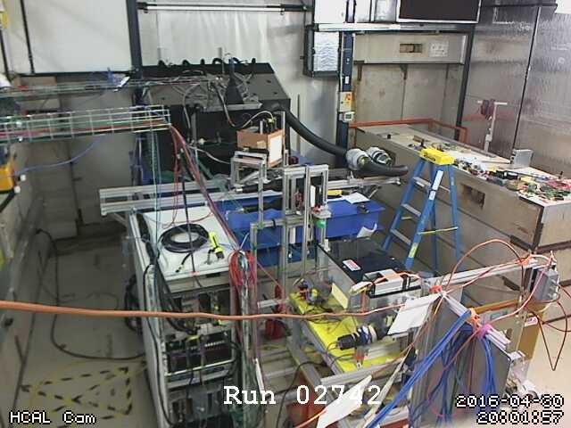
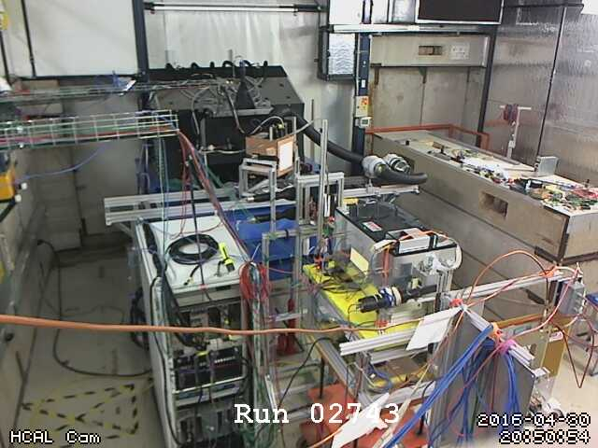
More Forensics (HCal at the Fermilab test beam again…)
“There is a strange effect starting in run 2743. There is a higher fraction of showering than before. I cannot see anything changed in the elog.”
Look at the cam pictures we automatically captured for each run:
$ ddump -t 9 -p 940 beam_00002742-0000.prdf > 2742.jpg
$ ddump -t 9 -p 940 beam_00002743-0000.prdf > 2743.jpg

Slide 31
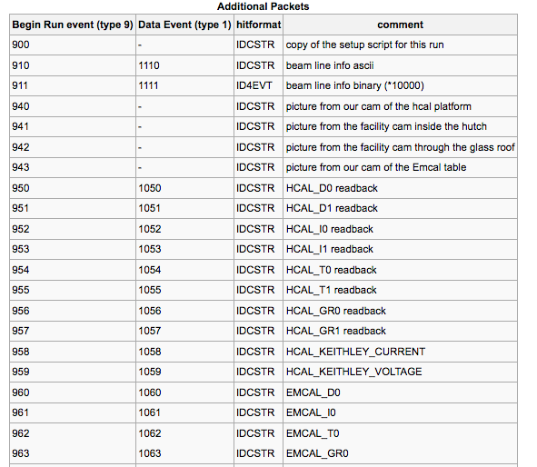
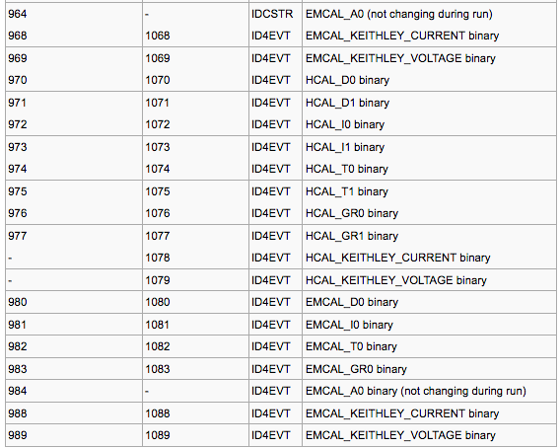
“Meta Data” Packet list from that test beam
More than 72 environment-capturing packets (accelerator params, voltages, currents, temperatures, pictures, …)
Captured at begin-run
Captured again at spill-off

Slide 32
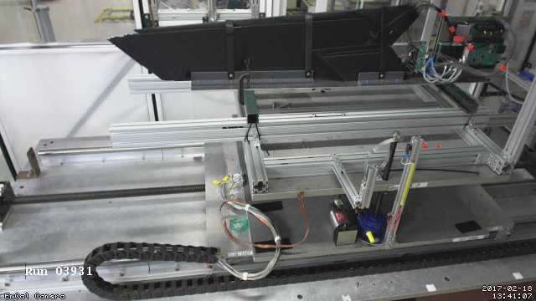
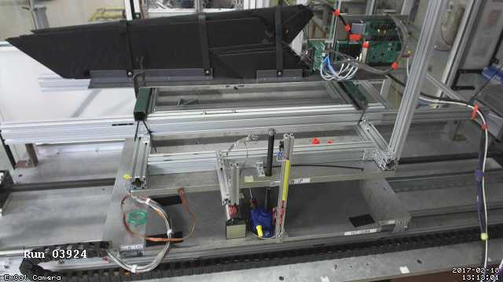
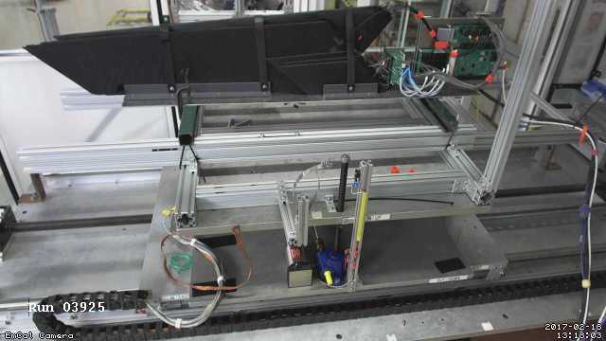
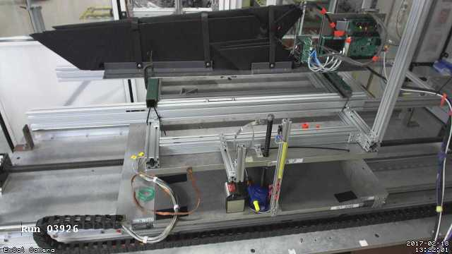
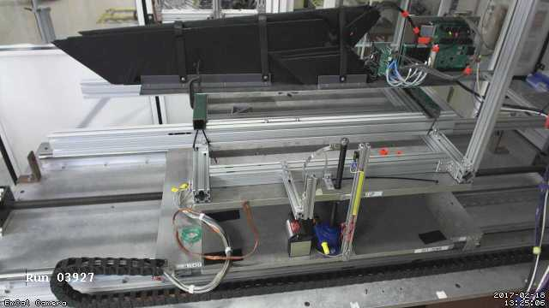
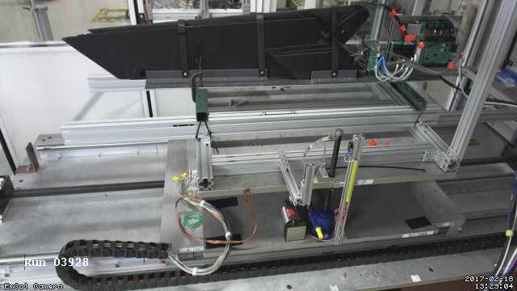
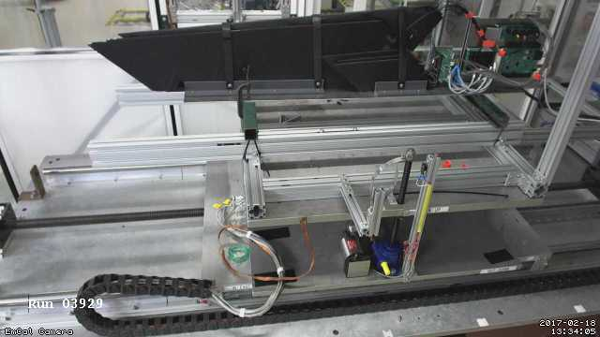
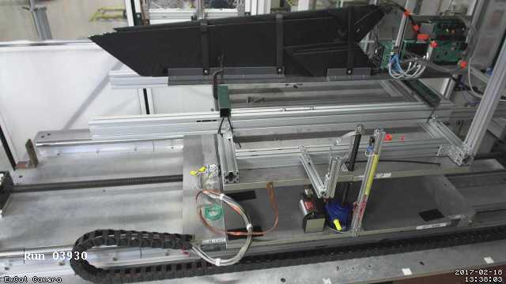
Moving Detector Example: “HCal Tile Mapping” at the Fermi Test Beam Facility
“Tile mapping” refers to mapping the position-dependent response of a hadronic calorimeter tile.
About 200 individual positions of the tile relative to the beam – you’d go nuts doing all that manually, and you are bound to make mistakes
So all is done on autopilot as explained before
And all on camera for feel-good value – does that thing move right when we think it should?
This setup exercises many of the aforementioned features: scripting and reacting to the FTBF spill, network transparency (we cannot access the table positioning from our DAQ machine, but a FTBF-owned machine can control our DAQ)

Slide 33
Wait a minute – how to I get “fresh” begin-run information??
I have shown you how you swallow an existing file (like you setup file) into the begin-run event
But this was different – for each run we got a “fresh” picture from the cam… how?
Throw in the ”daq_device_command”
It doesn’t read out anything – just when the event is triggered, it executes the assorted command
The subsequent commands grab the just-made jpg files and delete them after
So it is impossible to store stale info in case the picture-grabbing from the cam fails for some reason
# get the cameras
rcdaq_client create_device device_command 9 0 "$HOME/mlp/cam_capture.sh"
rcdaq_client create_device device_file_delete 9 940 "$HOME/mlp/hcals.jpg" 110
rcdaq_client create_device device_file_delete 9 941 "$HOME/mlp/ftbf_hut.jpg" 70
rcdaq_client create_device device_file_delete 9 942 "$HOME/mlp/ftbf_hut_birdseye.jpg" 70
rcdaq_client create_device device_file_delete 9 943 "$HOME/mlp/emcal.jpg" 110
rcdaq_client create_device device_file_delete 9 944 "$HOME/mlp/ftbf_moving_cam.jpg" 70

Slide 34
One last point: Using RCDAC features to streamline your analysis
Going back to the “calo module mapping” for a moment
You are ending up with several thousand individual data files, one per position
In each begin-run event we capture additional information, especially the x/y position where this data point is from
RCDAQ has a “command device” that doesn’t read out anything but executes a command when the event is triggered – here we execute “getmotorpositions.sh” at each begin-run
This script reaches out to the positioning system and writes a file “positions.txt” with the two numbers
We then absorb the file into the begin-run event
And we can retrieve this in the analysis (here shown with a command-line utility):
# we add a command to capture the positions to a file
rcdaq_client create_device device_command 9 0 "$HOME/getmotorpositions.sh"
rcdaq_client create_device device_file 9 920 "$HOME/positions.txt"
rcdaq_client create_device device_filenumbers_delete 9 921 "$HOME/positions.txt"
$ ddump -t 9 -p 920 scan10_0000201800-0000.evt
4600
-4400

Slide 35
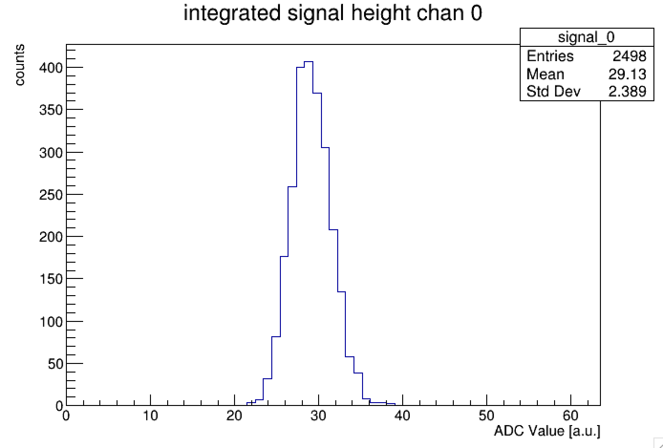
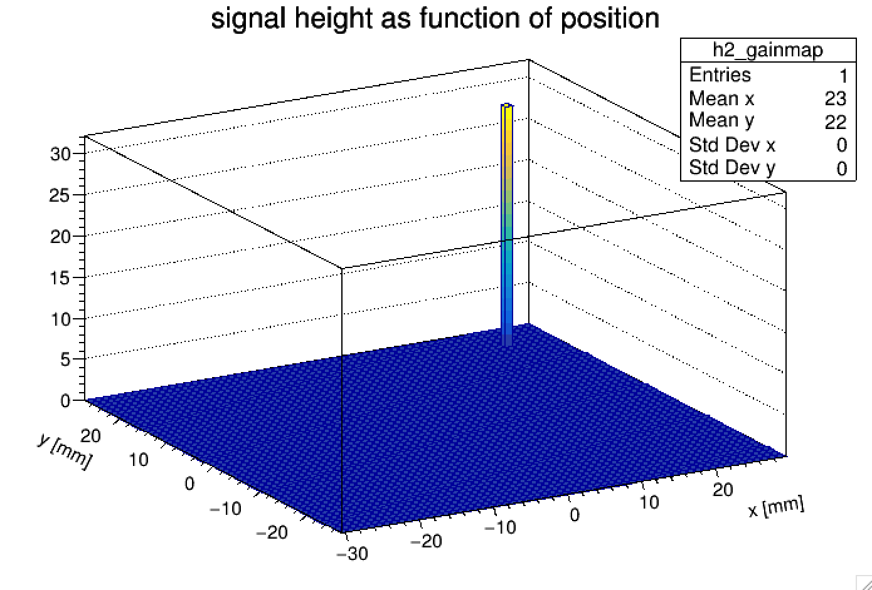
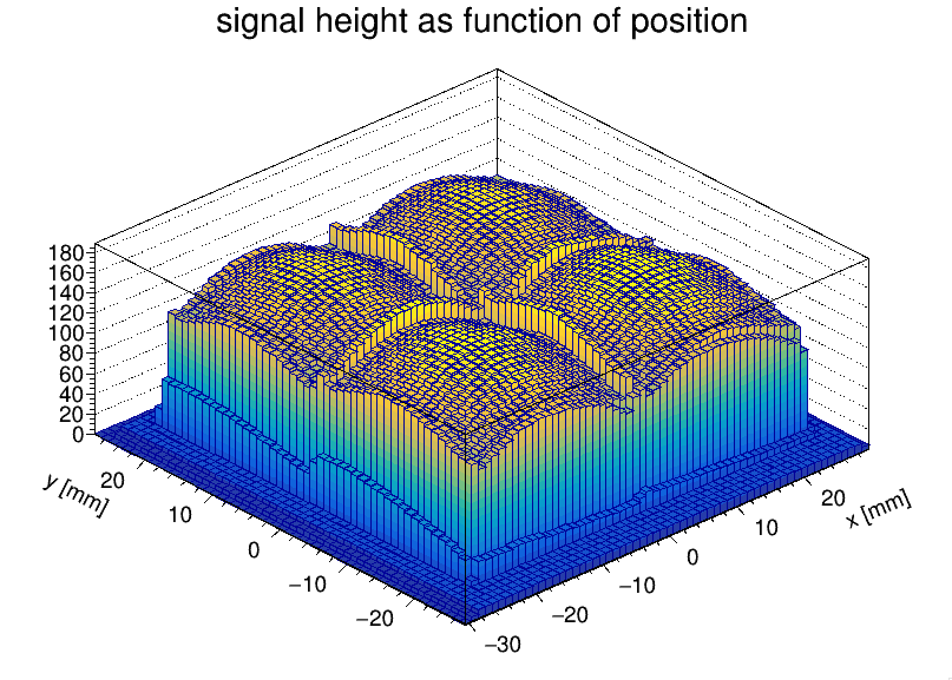
Using RCDAC features to streamline your analysis
Then we make a list of all files that belong to this scan, and throw them all at the at the analysis process
We get the begin-run event and extract and remember the x-y positions
We then histogram the signal with the actual data events
Eventually we hit end end-run event, know that this position is done. Get the mean from the histogram, and fill it in the map at the right position
Run through all files in the set, have a coffee, and see the results:
In this way you can run the analysis without burdensome additional bookkeeping
All you need to analyze the data in one fell swoop is contained in the data themselves
Notes:
/phenix/u/purschke/sipm

Slide 36
Some code snippets
Here I’m extracting the x and y position from packet 921:
if ( e->getEvtType() == BEGINRUN )
{
reset_histograms();
old_runnr = e->getRunNumber();
Packet *p921 = e->getPacket(921);
if ( p921)
{
xpos = p921->iValue(0);
ypos = p921->iValue(1);
cout << "Postions " << xpos << " " << ypos << endl;
delete p921;
}
return 0;
}
Notes:
/phenix/u/purschke/sipm

Slide 37
Some code snippets
Here I recognize the end-run event and analyze the signal distribution for this run:
if ( e->getEvtType() == 12 ) // end run
{
h2_gainmap->Fill( (xpos+400)/200., (ypos-10000)/-200., h_signal->GetMean() );
if (open_flag)
{
xlsfile << xpos << " " << ypos << " " << h_signal->GetMean() << endl;
}
return 0;
}
Notes:
/phenix/u/purschke/sipm

Slide 38
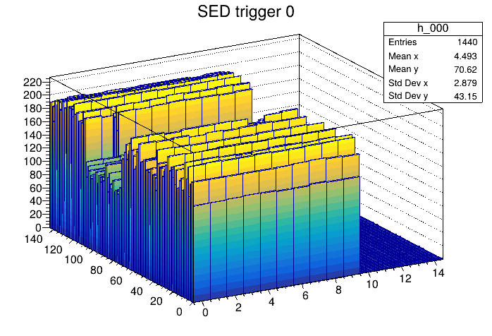
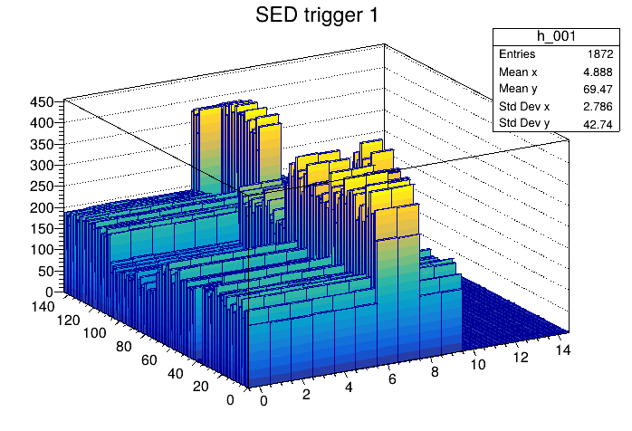

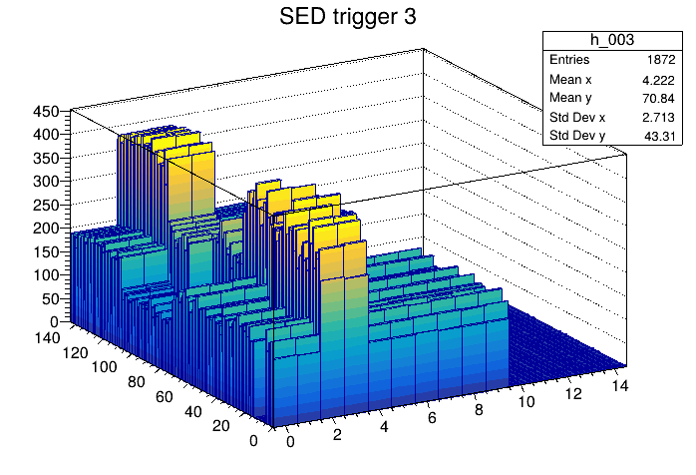
Where are we with the HGROC readout?
This is how far I can take it – waiting for the “end of event” protocol that Norbert, Miklos and I have in principle agreed on
It would probably take 30 minutes to explain all the stuff and shortcuts and so on that went into these plots…
Notes:
/phenix/u/purschke/sipm

Slide 39
This page is intentionally left blank

Slide 40
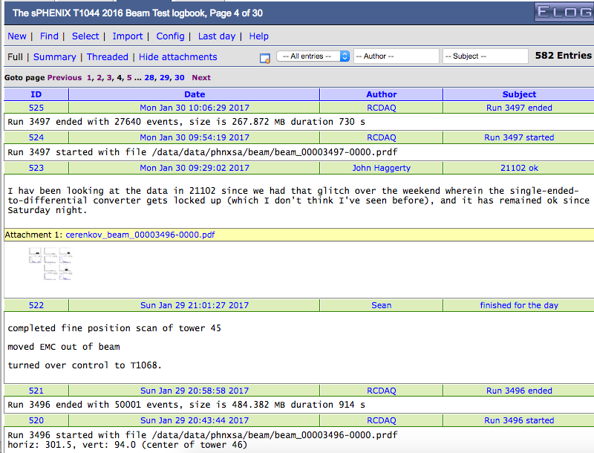
Automated Elog Entries
RCDAQ can make automated entries in your Elog
Of course you can make your own entries, document stuff, edit entries
Gives a nice timeline and log
Notes:
----- Meeting Notes (1/27/16 16:27) -----

Slide 41
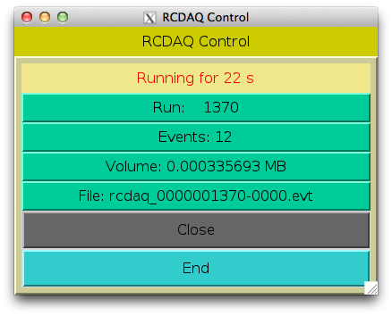
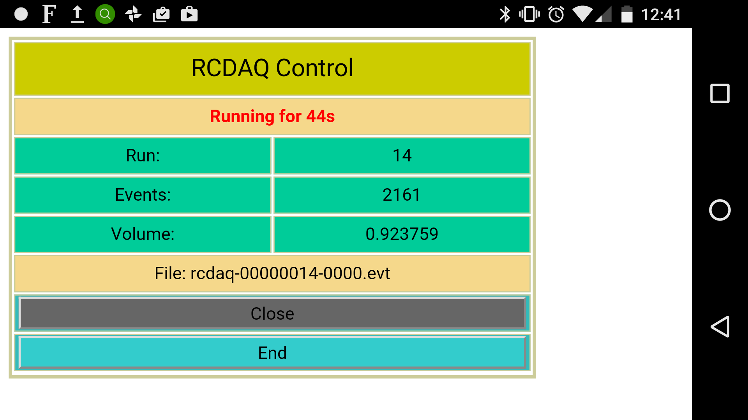
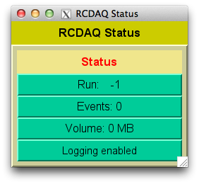
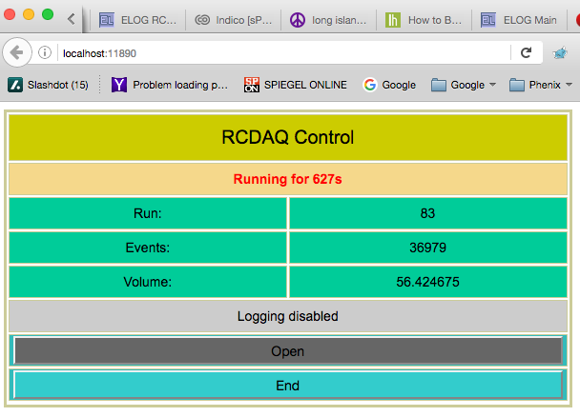
GUIs
On my phone
GUIs must not be stateful!
Statelessness allows to have multiple GUIs at the same time
And allows to mix GUIs with commands (think scripts)
(all state information is kept in the rcdaq server)
My GUI approach is to have perl-TK issue standard commands, parse the output
Slowly transitioning to Web-based controls (web sockets + Javascript)
Perl-TK
Web Browser

Slide 42
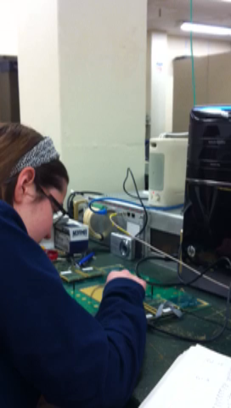
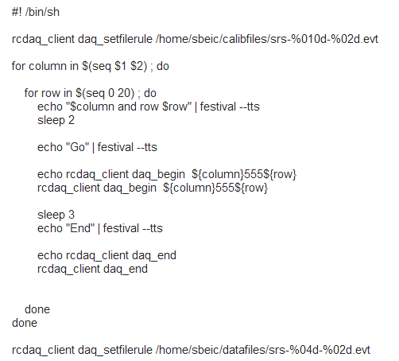
Shell integration
The Speaking DAQ

