Slide 1
Qualifying Graphite for Reactor Applications: A Materials Perspective
Presented by: Dominic Piedmont
8th July 2025

Slide 2
Motivation: Material Code Qualification
ASME standard required of all reactor grade materials prior commercial implementation that requires characterization of properties:
Physical
Mechanical
Thermal
Impact of relevant reactor conditions/environmental factors (oxidation, irradiation, etc.)
Last material that achieved this was Alloy 617 in 2019 (first in 30 years).
Currently no reactor graphite grades are qualified

Slide 3

Code Qualification
Qualification Package Preparation
Irradiation/Environmental Effects
Down-selection
Pristine Property Verification
Fabrication Methodology
You are here!
Property Modeling
Material Design
Material System Determination

Slide 4
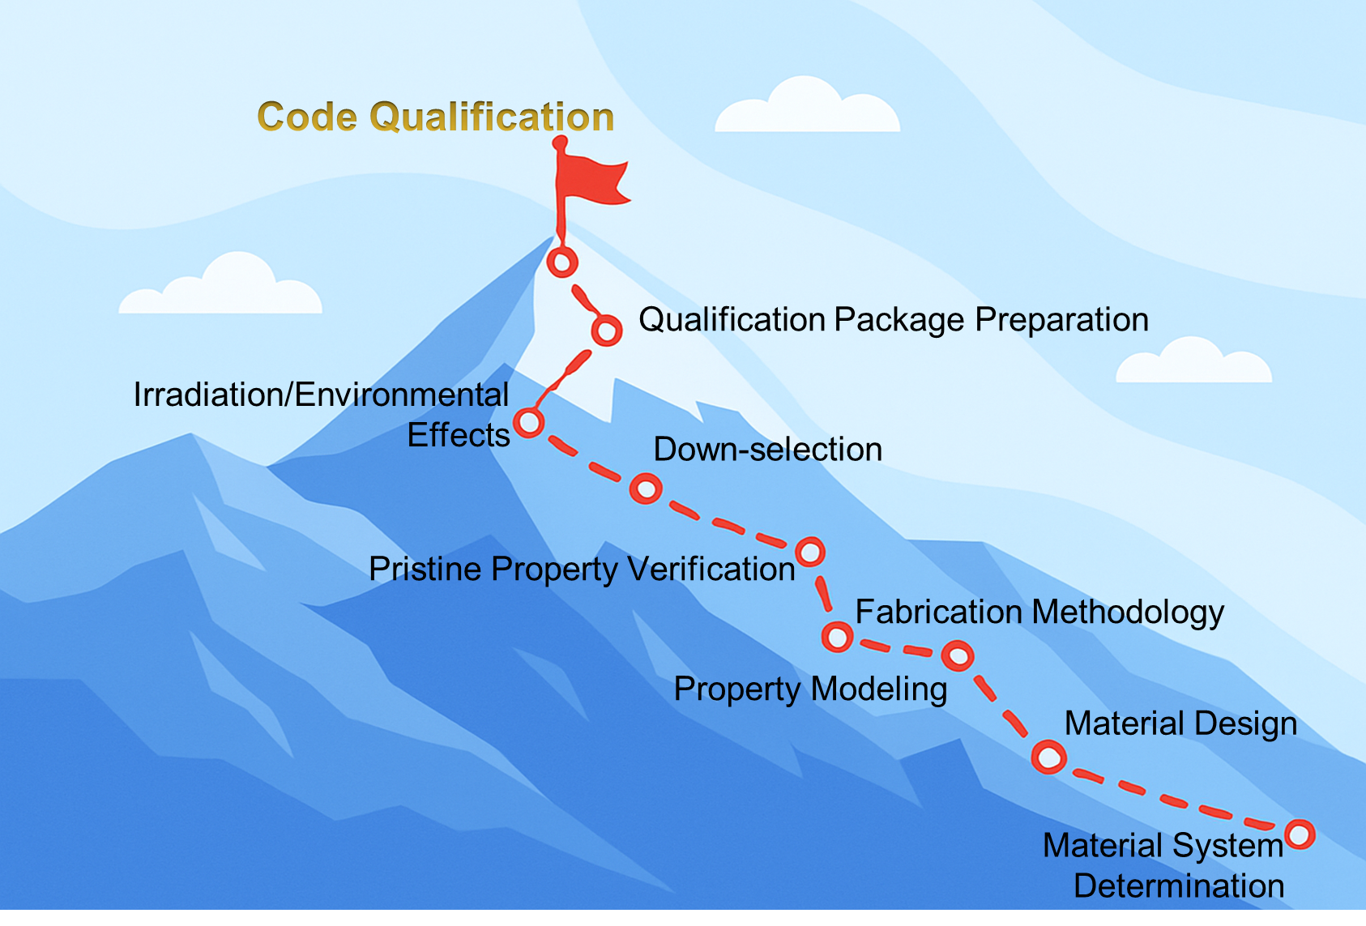
Climbing Tips
Consistent usage of terminology
Use the right tool for the job
Down-select as soon as possible
Eyes on the prize

Slide 5
Experimental Model Validation

Slide 6
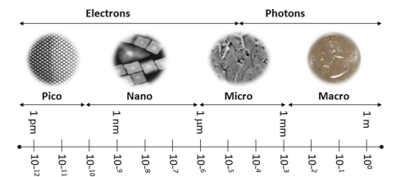
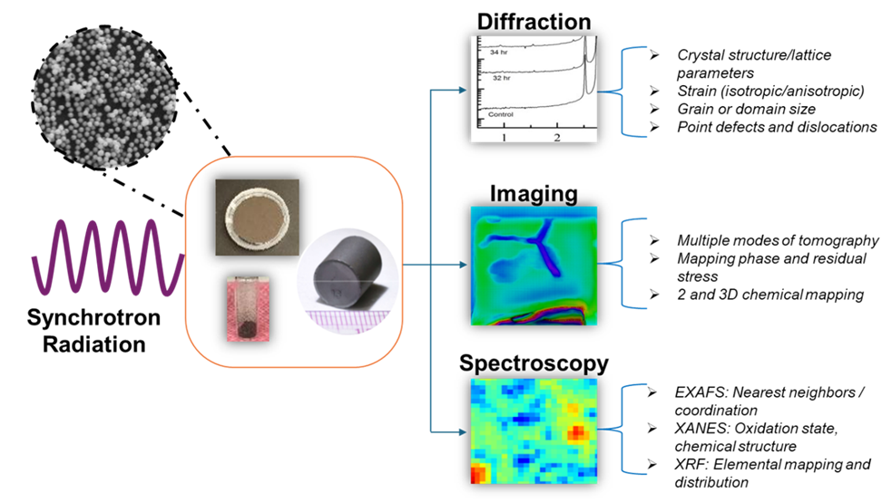
Experimental Characterization and Synchrotron
Mejía-Rosales, Sergio, et al. “Experimental techniques for structural characterization.” Nanoalloys, 2013, pp. 113–145, https://doi.org/10.1016/b978-0-12-394401-6.00004-7.
Structure-property correlation
Understand the compound nature of microstructure/properties
Imperative that modeling length scale corresponds to length scale of experimental measurement
Multimodal characterization via synchrotron techniques

Slide 7
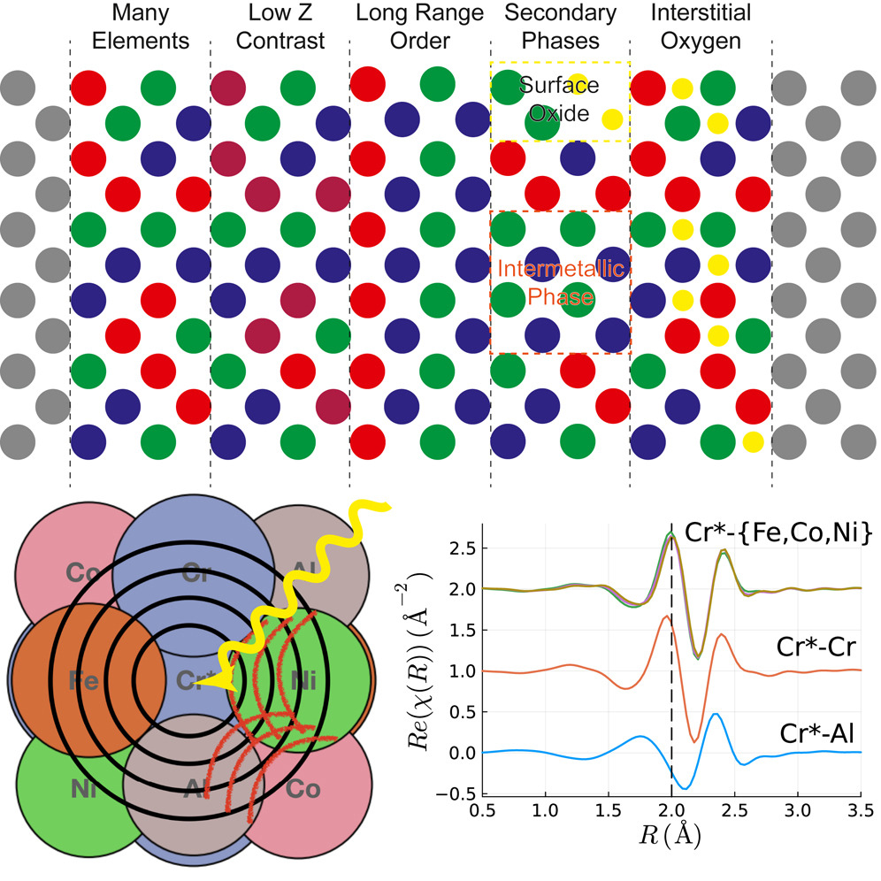
Nanoscale Measurements: X-Ray Absorption
Resolution as low as 0.002 nm
Element-specific local structure
Coordination number
Interatomic spacing
Short range order
Model validation
Joress, Howie, et al. “Why is exafs for complex concentrated alloys so hard? challenges and opportunities for measuring ordering with X-ray absorption spectroscopy.” Matter, vol. 6, no. 11, Nov. 2023, pp. 3763–3781, https://doi.org/10.1016/j.matt.2023.09.010.

Slide 8
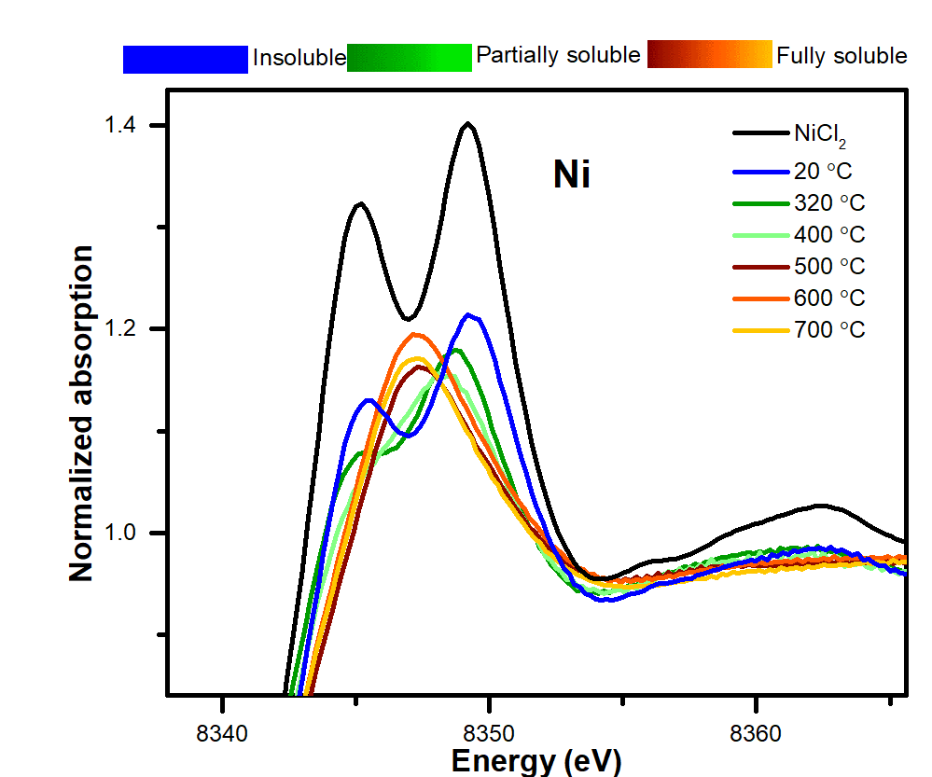
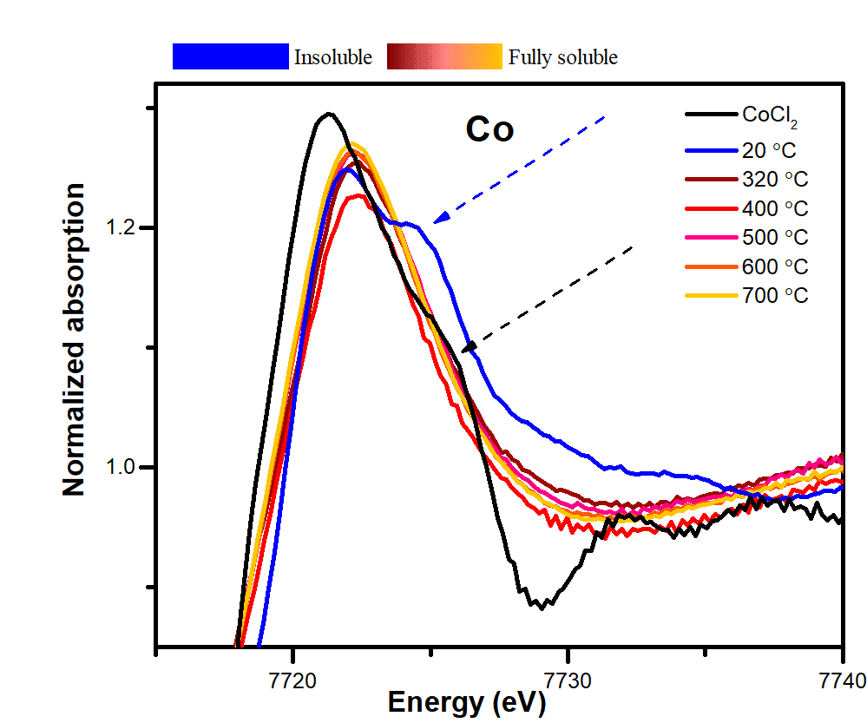
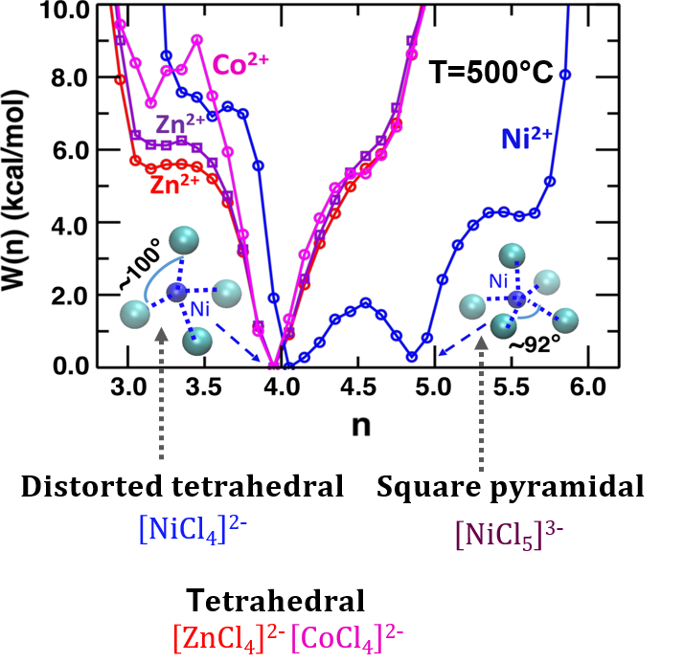
E.g. X-Ray Absorption Measurements
X-Ray Absorption Studies
Ab-initio MD simulations
Coexistence of 4- and 5-coordinate structures for Ni(II) in ZnCl₂
Clear changes in electronic structure are observed as function of T in Ni (II)
Strong dynamic heterogeneity in the coordination environments of Ni(II) may explain the lower solubility of Ni in molten ZnCl₂
Simerjeet K Gill*, Frenkel A.I.* et.al. Connections between the Speciation and Solubility of Ni(II) and Co(II) in Molten ZnCl₂.The Journal of Physical Chemistry B 2020, 124 (7), 1253-1258
8

Slide 9
Microscale Measurements: X-Ray Tomography
Enables studies of chemical and structural changes in materials down to 5-micron resolution addressing:
Early stages of fuel life cycle
Stability of cladding and reactor containment
Stability of waste forms
Our NSUF beamline has resolution down to 5 µm
Various mechanisms for contrast
Absorption, diffraction, fluorescence, etc.
Direct visualization of 3D morphology, structure, and density
Diffracting domain orientation mapping
Work on pre-irradiated UMo fuel pellets in France
[1]A. Bonnin, et al. Appl. Phys. Lett. 105, 084103 (2014)
[2]H. Palancher et al. J. Appl.d Cryst. 44, 1111 (2011).
Grain Orientation Mapping

Slide 10
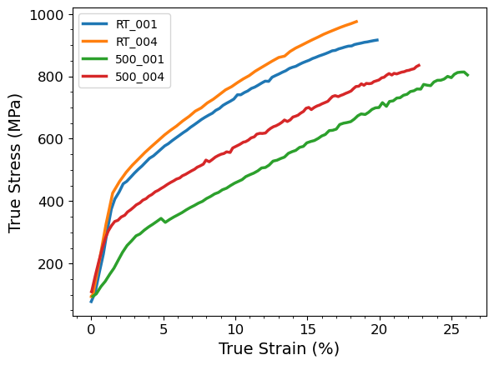
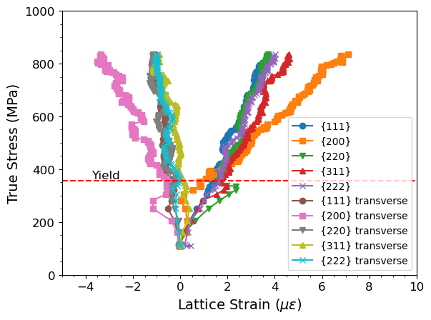
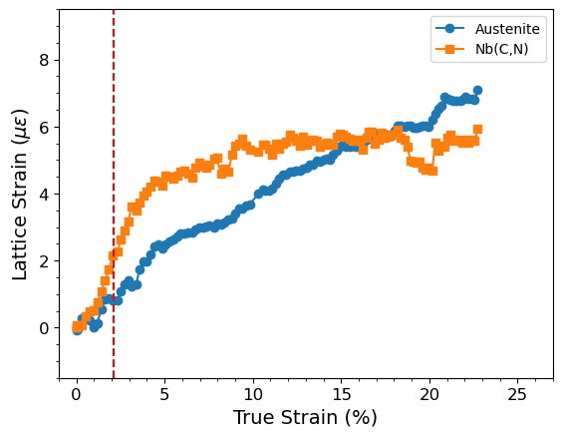
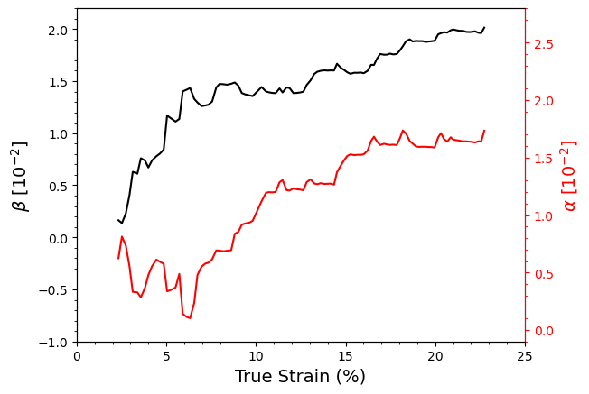
Structure Property Correlation
In-situ capabilities allow for bulk/environmental changes to occur while microscale properties are measured
High temperature (> 1000 °C)
Vapor pressure
Electrochemical
Loading
Data is at length scales appropriate for engineering scale model initialization and verification

Slide 11
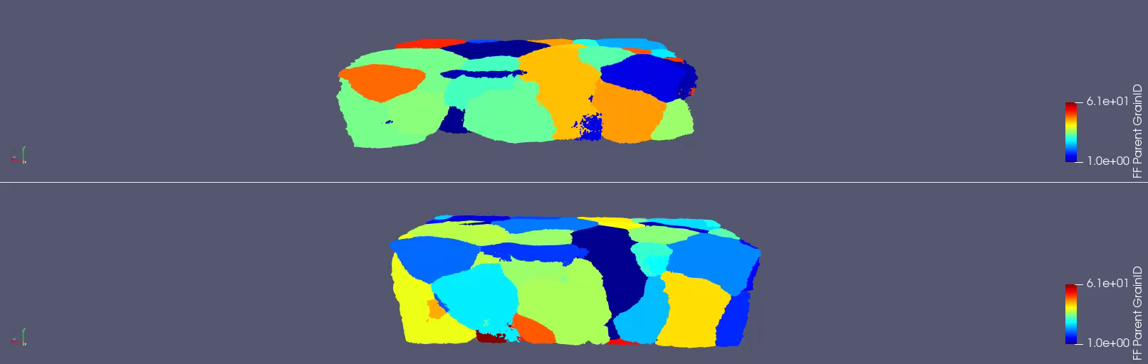
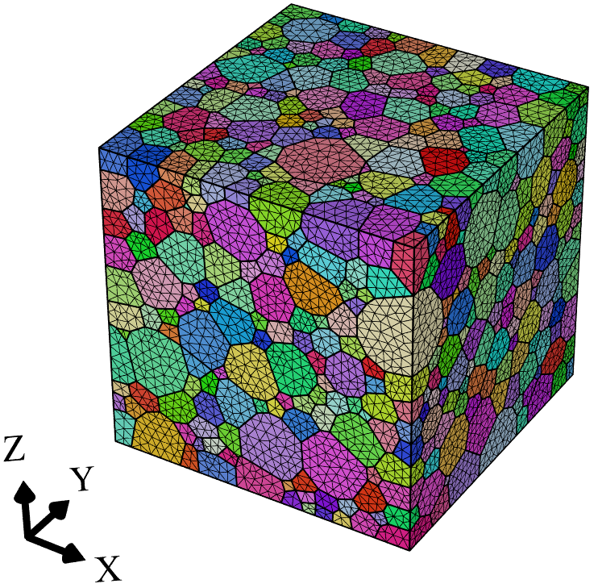
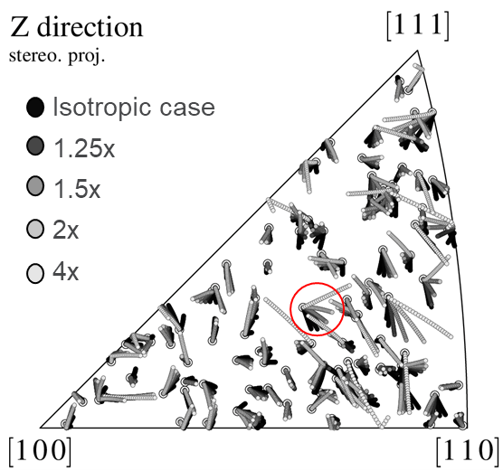
Structure Property Correlation Modeling

Slide 12
Conclusion
Reaching the summit requires: clear communication, using the right tool for the job, and focused attention
Models must be experimentally validated and are only as good as the real-world data they represent
Synchrotron offers a methodology of initializing and/or validating computational models across a range of length-scales and modalities

Slide 13
Questions?
dpiedmont@bnl.gov
Materials for Energy Applications Group

