Slide 1
NNL Perspective on Reactor-Grade Graphite
M. L. Zerkle, A. J. Trainer
1st Reactor Graphite (ReGra) Workshop
Brookhaven National Laboratory
Upton, New York
8-9 July, 2025

Slide 2
NNL Perspective
Reactor-grade graphite has a complicated fabrication process dependent structure
Effectively stochastic media
Wide range of porosity and texture
Accurate representation of thermal neutron scattering in a particular grade of reactor-graphite requires understanding of
As-fabricated microstructure
Inelastic neutron scattering properties
Bulk neutron transport (neutron transmission)
Neutron mean free path is 2.5 – 2.6 cm
Well characterized integral experiment benchmarks for validation
Current ENDF-6/GNDS formats implicitly assume isotopically oriented infinitely small fine powders
Many grades of reactor-grade graphite violate these assumptions
Let’s drill down on one of these microstructure driven complications

Slide 3


Crystallographic extinction affects coherent elastic cross section
Coherent elastic thermal scattering is characterized by a strict relationship between neutron energy and scattering angle
In a perfect crystal, there is only one scattering angle available for a given neutron energy / lattice plane scattering event
If a neutron…
Scatters multiple times in the same perfect crystal to “rejoin” the initial direction of travel
Does not change energy (elastic)
Then it would appear as if the scattering event never occurred
The observed cross section decreases
$$θ$$
$$θ$$
This phenomena is referred to as “extinction”, since the reflected (diffracted) beam may be greatly diminished

Slide 4
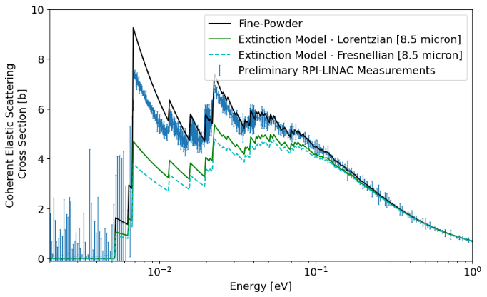
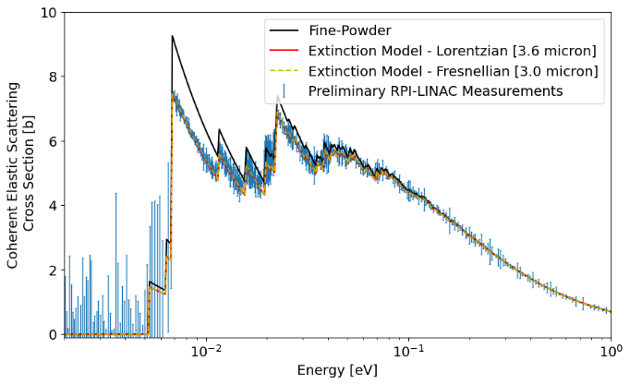
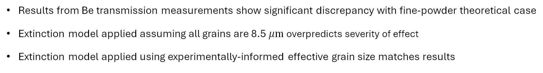
Crystallographic extinction has been an area of increased interest lately
Beryllium metal (area-averaged grain size 8.5$μ$m) [Trainer et al. 2025]
In the ND-2025 conference, two presentations focused on extinction:
[Trainer]
Modeling the Extinction Effect in Beryllium Metal
[Di Julio]
New thermal scattering libraries for beryllium metal and other polycrystalline materials including extinction effects
Extinction effect is more severe for materials with larger grain sizes (no extinction effect for fine powder)
Results from Be transmission measurements show significant discrepancy with fine-powder theoretical case
Extinction model applied assuming all grains are 8.5 $μm$ overpredicts severity of effect
Extinction model applied using experimentally-informed effective grain size matches results

Slide 5
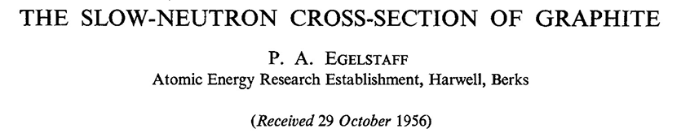
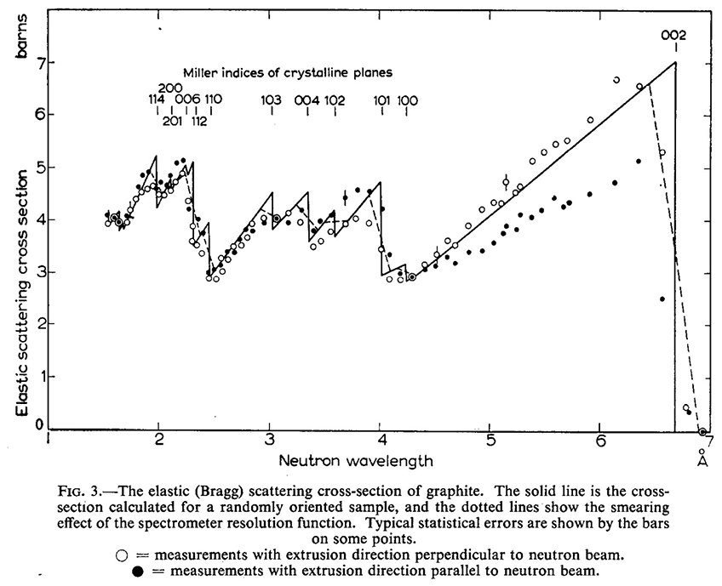
A paper by Egelstaff (1956) presented experimental results from 1952
Samples of British reactor-grade graphite used for the Harwell and Windscale piles
Measurements were taken to consider two different grain-extrusion directions
Results show a significant difference in cross section due to grain structure
No characterization of grain-size distribution
These results emphasize that extinction could affect thermal scattering in nuclear-grade graphite

Slide 6
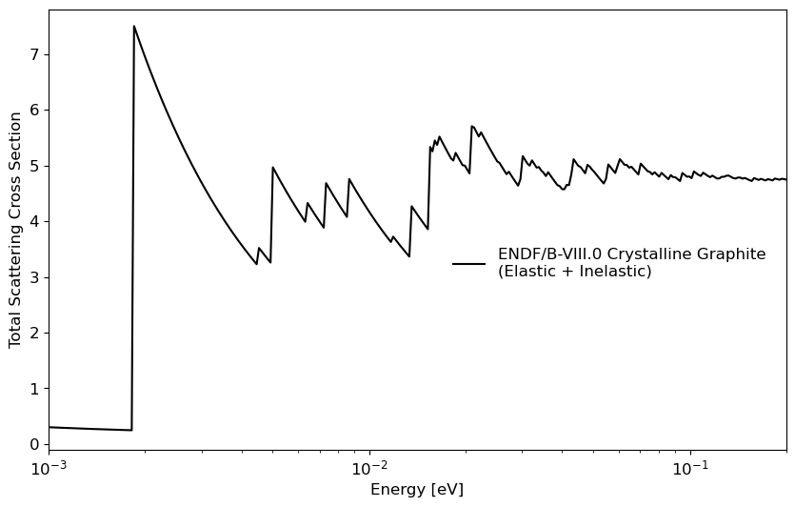
Fine powder cross section generated using
ENDF/B-VIII.0 crystalline graphite TSL
Structure factors for pyrolytic graphite [Ncrystal]
Implicit assumption is infinitely small randomly oriented crystallites

Slide 7
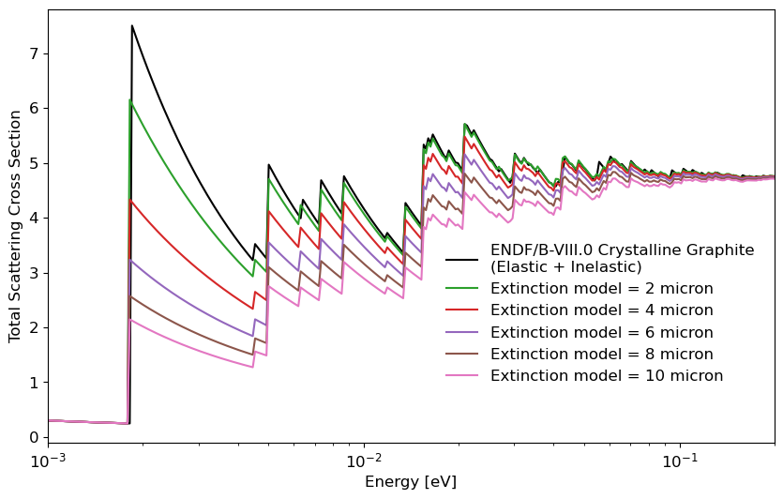
Fine powder cross section generated using
ENDF/B-VIII.0 crystalline graphite TSL
Structure factors for pyrolytic graphite [Ncrystal]
Extinction model follows the work of Sabine [1985,1988]

Slide 8
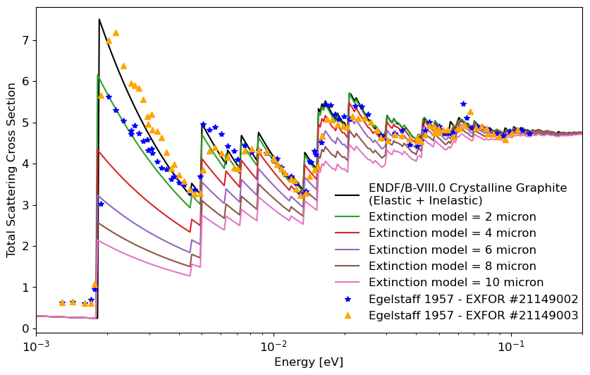
Fine powder cross section generated using
ENDF/B-VIII.0 crystalline graphite TSL
Structure factors for pyrolytic graphite [Ncrystal]
Accurate transmission experiments of well-characterized reactor-grade graphite samples are needed to further understand the real-world impact of extinction in reactor-grade graphite
Extinction model follows the work of Sabine [1985,1988]
In recent work on Be metal, extinction models have been observed to overpredict severity of extinction effect
Use of an effective grain size has been proposed
Does this also apply to reactor-grade graphite?

Slide 9
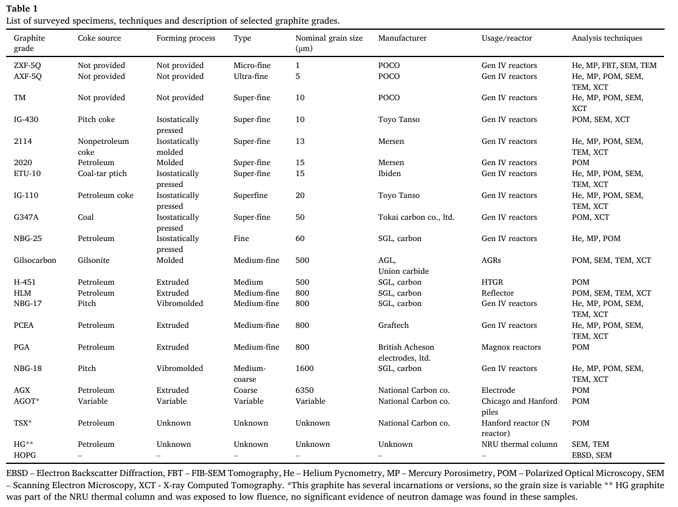
Microstructure of reactor-grade graphite can vary wildly according to manufacturing process, etc.
Wide variation in grain size
Infinitely small grain size approximation historically assumed in ENDF TSL evaluations may not apply for some of these reactor-grade graphites
Multiscale characterization and comparison of historical and modern nuclear graphite grades [Arregui-Mena et al.]

Slide 10
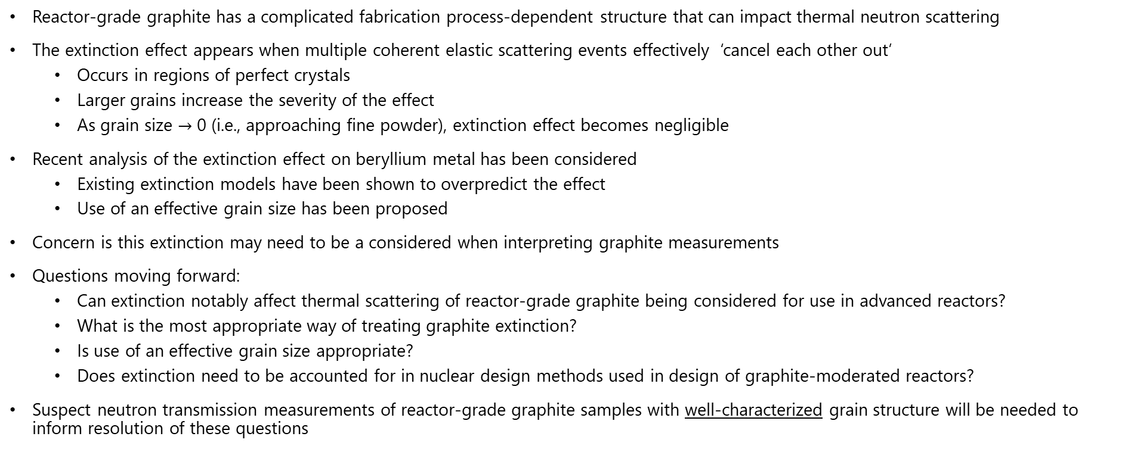
Conclusions
Reactor-grade graphite has a complicated fabrication process-dependent structure that can impact thermal neutron scattering
The extinction effect appears when multiple coherent elastic scattering events effectively ‘cancel each other out’
Occurs in regions of perfect crystals
Larger grains increase the severity of the effect
As grain size $→$ 0 (i.e., approaching fine powder), extinction effect becomes negligible
Recent analysis of the extinction effect on beryllium metal has been considered
Existing extinction models have been shown to overpredict the effect
Use of an effective grain size has been proposed
Concern is this extinction may need to be a considered when interpreting graphite measurements
Questions moving forward:
Can extinction notably affect thermal scattering of reactor-grade graphite being considered for use in advanced reactors?
What is the most appropriate way of treating graphite extinction?
Is use of an effective grain size appropriate?
Does extinction need to be accounted for in nuclear design methods used in design of graphite-moderated reactors?
Suspect neutron transmission measurements of reactor-grade graphite samples with well-characterized grain structure will be needed to inform resolution of these questions

