Slide 1

Javier Ortensi, Ph.D., P.E. (INL)
John Bess, Ph.D. (JFA)
Volkan Seker, Ph.D. (UMICH)
Olin Calvin, Ph.D. (INL)
INL/CON-25-85895 Rev:0
Updates to the HTR-PROTEUS HALEU Benchmark Using Modern Analysis Methodologies
First Reactor Graphite (ReGra) Workshop
Brookhaven National Laboratory, July 8-9, 2025

Slide 2
HTR-PROTEUS Benchmark Improvement Effort
Improvements
- quality of uncertainty evaluation
- better address uncertainties in mass, density, and composition w. modern M&S tools
- adjoint sensitivity analysis via ksen card MCNP
- reduced statistical uncertainties
- better address uncertainties in random TRISO and pebble placement
Consolidation
CRIT portions of 4 IRPhEPs into 1 ICSBEP report IEU-COMP-THERM-TBD
Investigation
- solutions from deterministic tools
- impact of newer nuclear data libraries and TSLs
- identify, and if possible, evaluate, subcritical measurement data

Slide 3
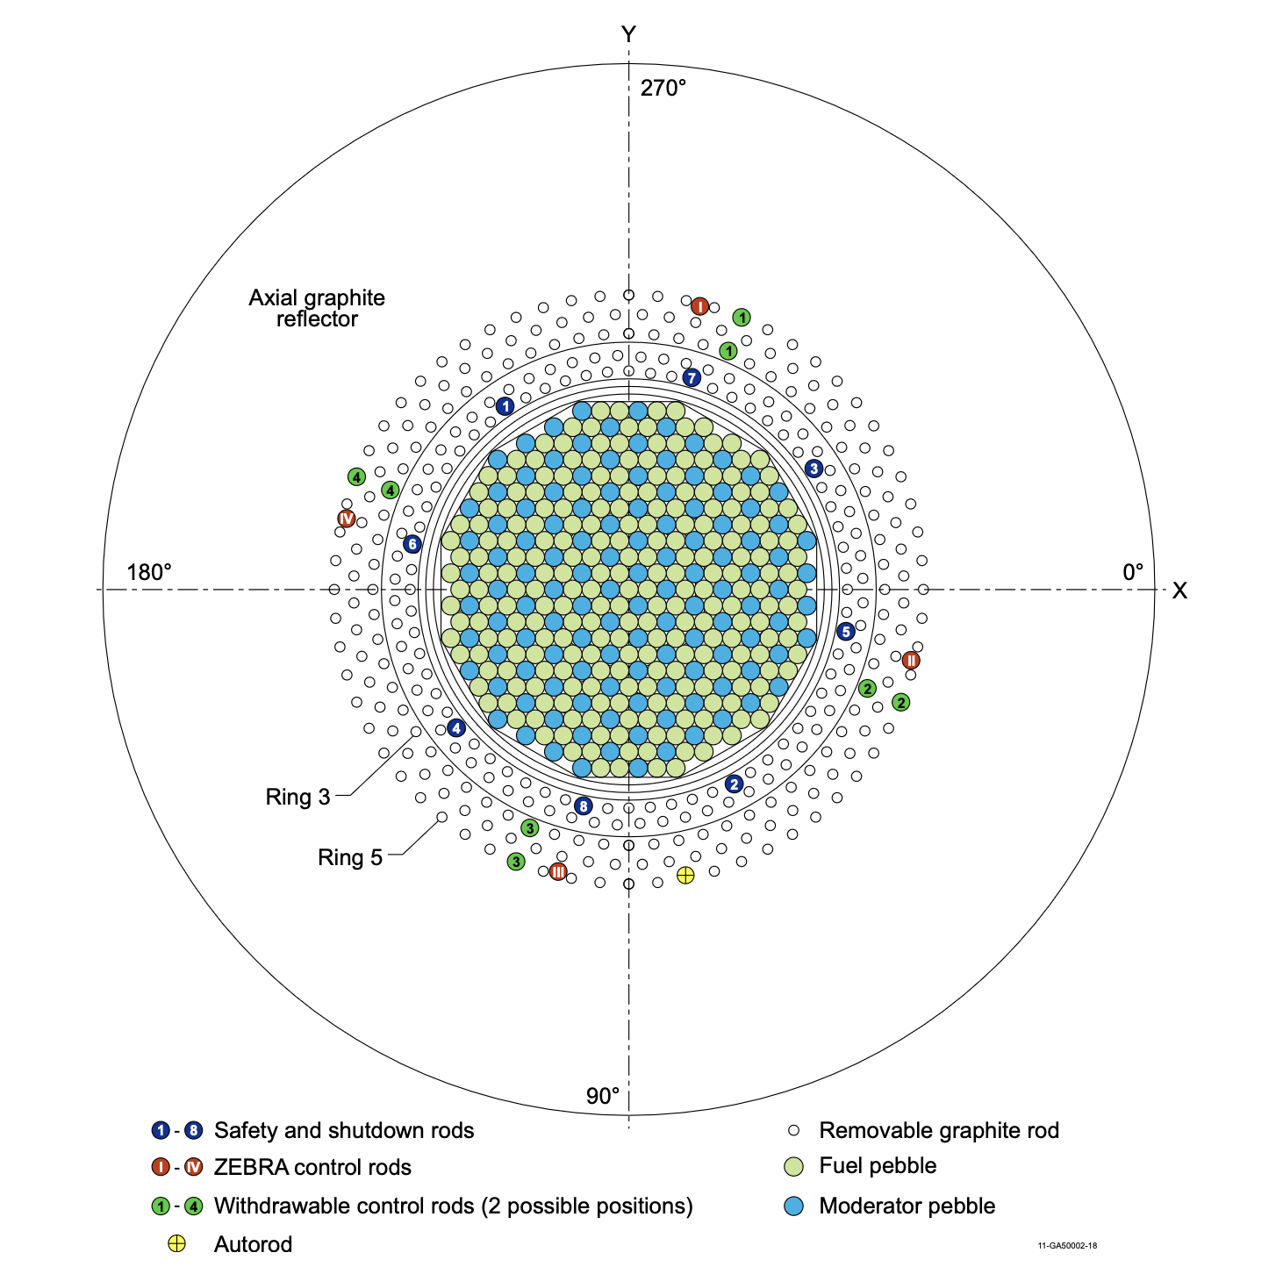
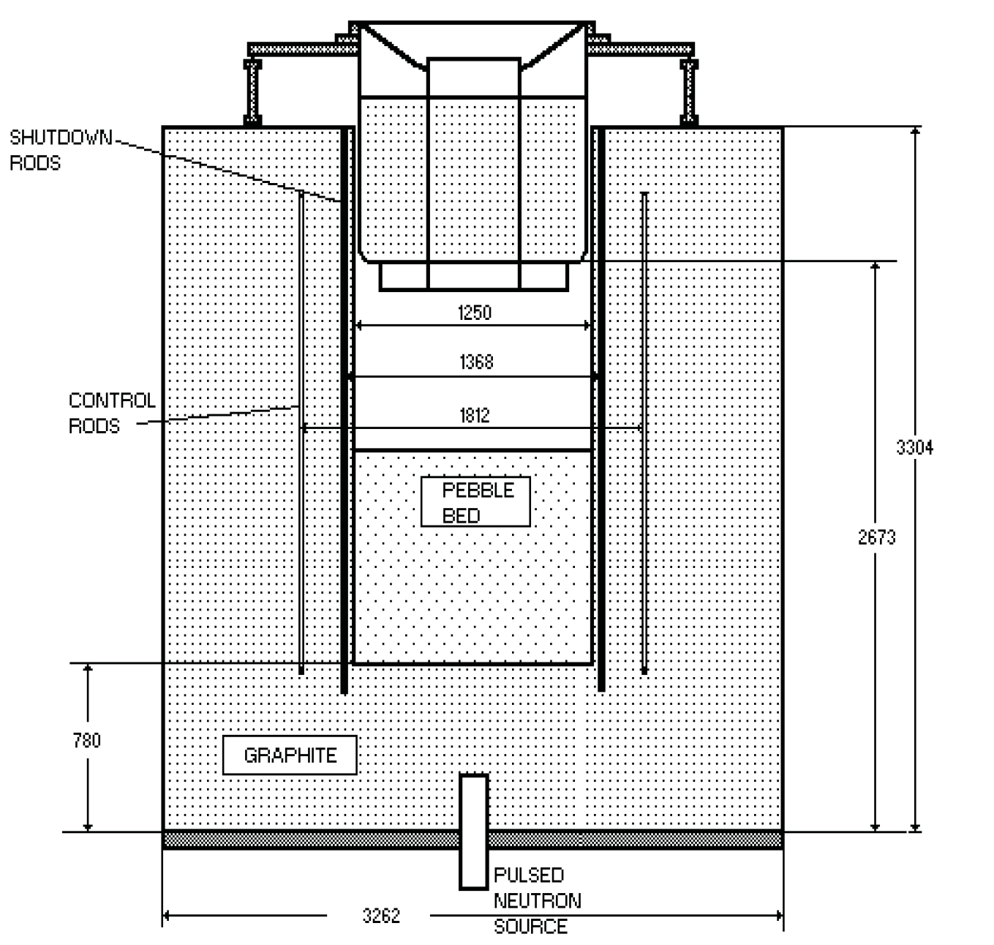
Experimental Configuration
Notes:
Graphite cylinder with an OD = 326.2 cm and a height = 330.4 m
Random or deterministic lattices
78 cm lower reflector
22-sided polygon
16.7 wt.% w/o
1235 cm upper Al tank with a 78 cm reflector
aluminum safety ring
Reactor shutdown - 4 boron-steel rods placed at a radius of 68 cm
Reactor control - 4 fine control rods at 90 cm
Core 1 - Cd Shutter, or ZEBRA type, rods were used in place of the fine control rods
Water ingress was simulated by using polyethylene rods introduced in the core gaps for det cores

Slide 4
Core Configurations (Revising Core 4 → 4.2 & 4.3)
}
Hexagonal Close Packed
}
Random
}
Columnar Hexagonal Point-On-Point
Notes:
Hexagonal Close Packed (HCP) 0.7405 theoretical PF (away from edges) | 0.692 core-averaged PF | Worst case for shipping/storage accidents
Random Packing | 0.61 PF | Real world is between 0.60 and 0.64
Columnar Hexagonal Point-On-Point (CHPOP) | 0.6046 theoretical PF (away from edges) | 0.5835 core-averaged PF | Best representation of real world using known pebble locations

Slide 5
Assumptions in Original HTR-PROTEUS Benchmarks
Limited computing resources to evaluate all uncertainties in detail
Any uncertainties not unique to a given subset of configurations was not evaluated if the evaluated uncertainty in Cores 1, 1A, 2, and 3 had a 1σ in Δk_{eff} value ≤0.00030.
The MCNP statistical uncertainty was ~0.00010
Dominant uncertainties (i.e. > 100 pcm) were radial reflector graphite density and composition, and ²³⁵U enrichment
Composition and impurity uncertainties were evaluated using min/max of the primary alloy constituent or estimation of an equivalent boron content (EBC)

Slide 6
Revised MCNP Analyses
MCNP statistical uncertainty 1σ in k_{eff} between 0.00002 and 0.00003
Contribution of statistical uncertainties towards adjoint calculations <0.00001
Initial comparison between original MCNP-5.1.60 with ENDF/B-VII.0 direct perturbation and MCNP-6.3.0 with ENDF/B-VII.1 sensitivity calculations
See next page for comparison with Core 5
Waiting for official MCNP ACER release from LANL with ENDF/B-VIII.1 (end of July, 2025)

Slide 7
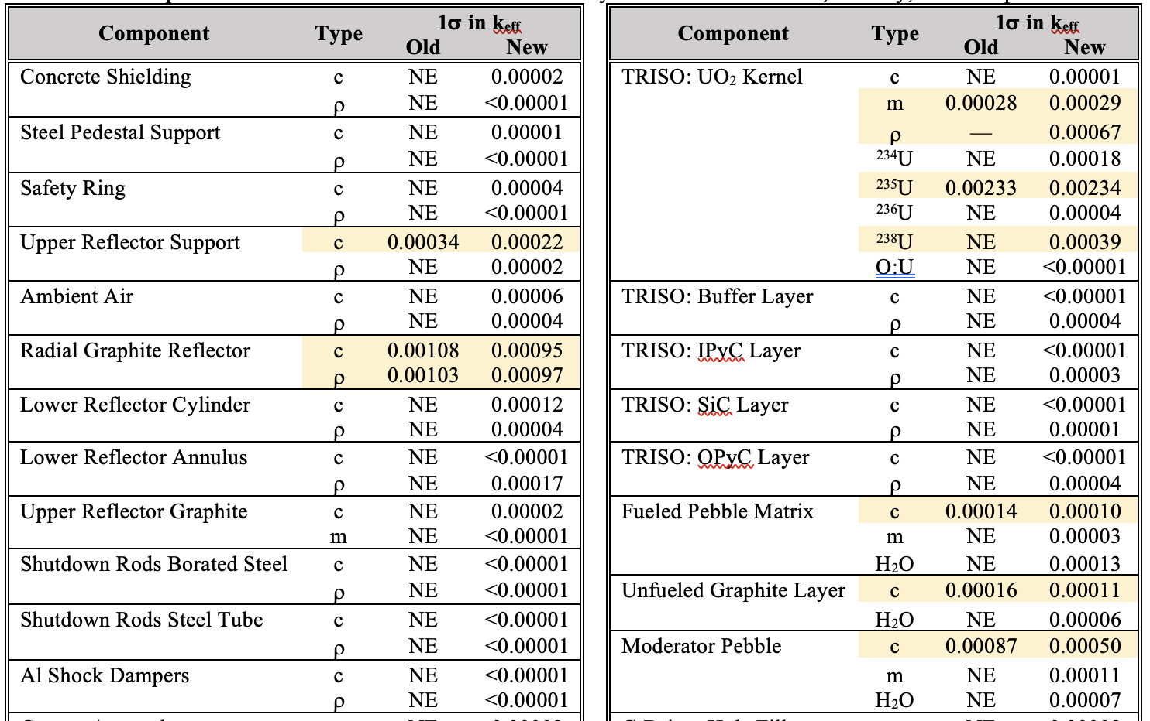
Comparison of HTR-PROTEUS Core 5 Uncertainty Calculations for Mass, Density, and Composition
Total 1σ uncertainty is still ~300 pcm

Slide 8
Core Center Reaction Rate Ratios for Core 5
30% porosity
→
→
→
20% porosity
→ ENDF/B-VIII.1
HTR-PROTEUS ~22-25 % porosity
k_{eff} = 1.00147 ± 0.00003
Δk_{eff} = -93 ± 300 pcm

Slide 9
Subcritical Measurement Data
Subcritical measurements were performed on Cores 1, 5, and 7
Evaluation of these data would enhance validation for subcritical storage/transport of TRISO-laden fuel pebbles
Cores 1 and 5 represent different PFs
Cores 5 and 7 compare water ingress effects
The challenge is to determine whether sufficient information is available regarding the detector systems, and their placement, to provide quality benchmark evaluation data

Slide 10
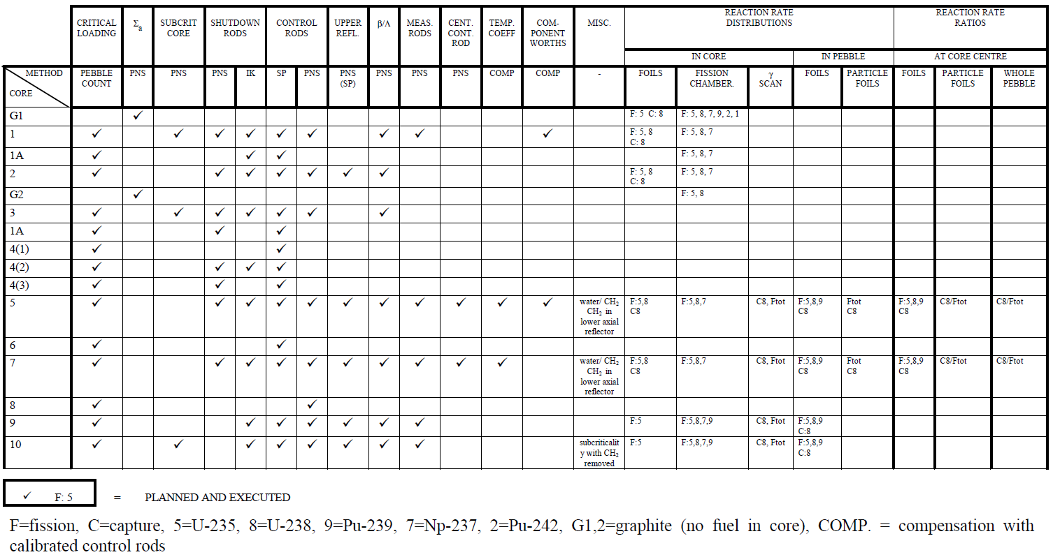
Remaining Data for Benchmark Evaluation

Slide 11
CORE 4
Random packing
Safety/Shutdown rods all out
Withdrawable control rods and auto-rod in use
1:1 fuel-to-moderator pebble ratio
3 different randomly loaded cores

Slide 12
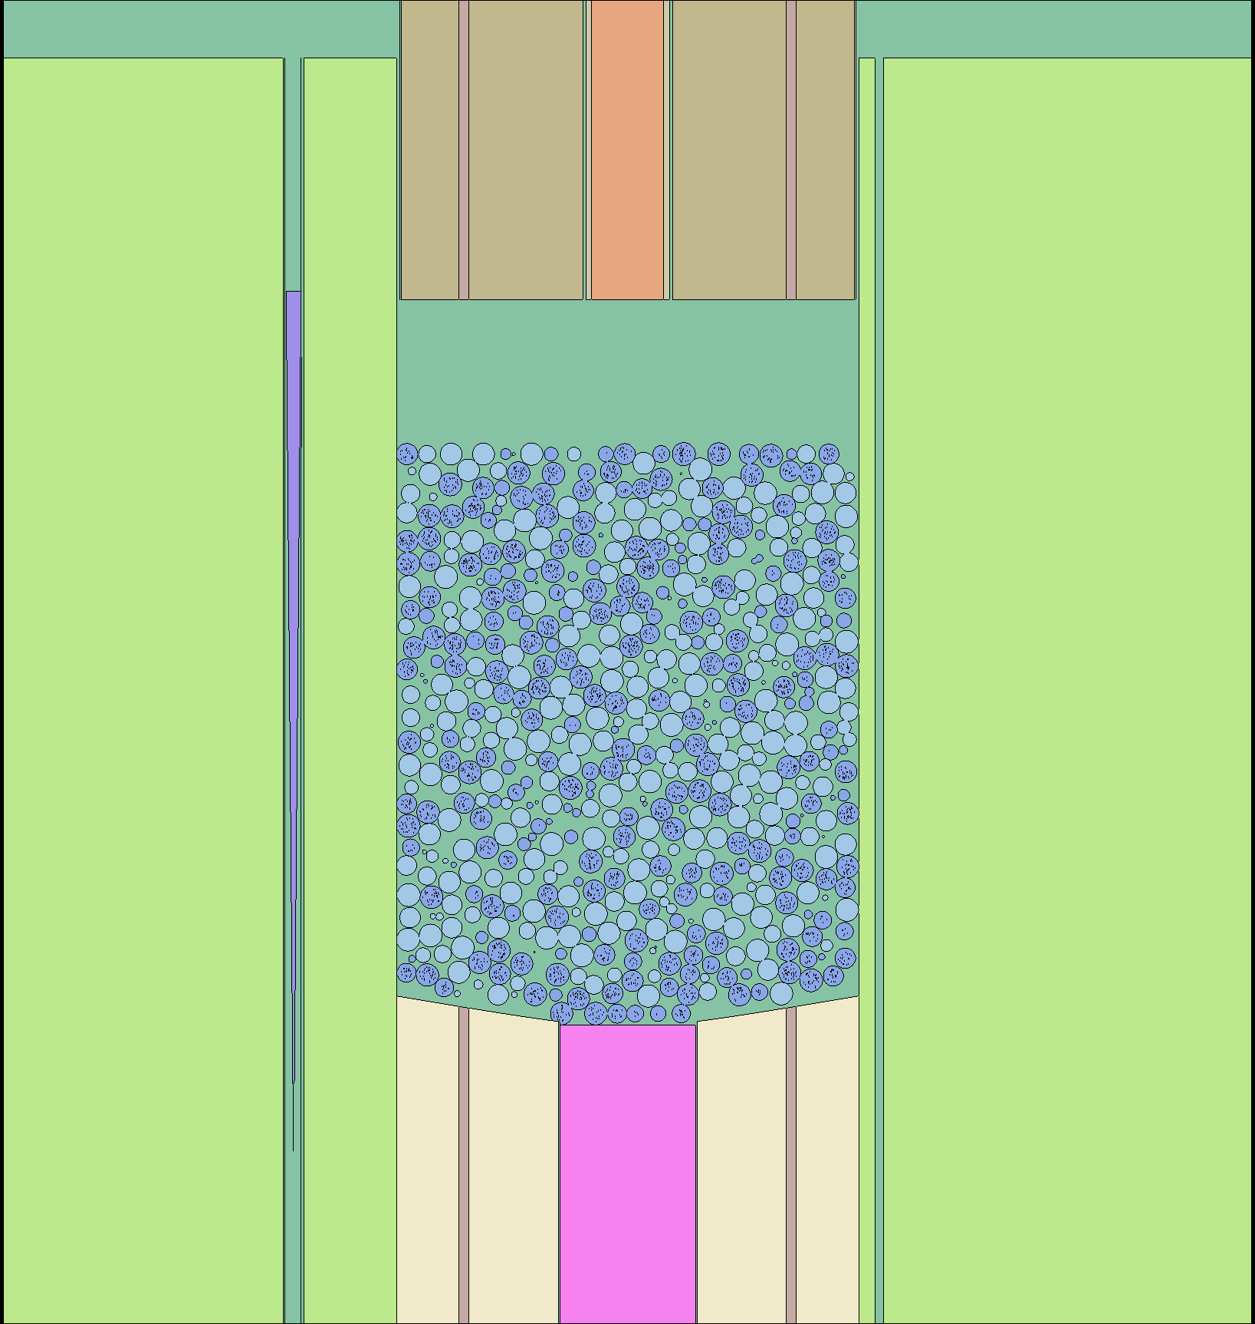
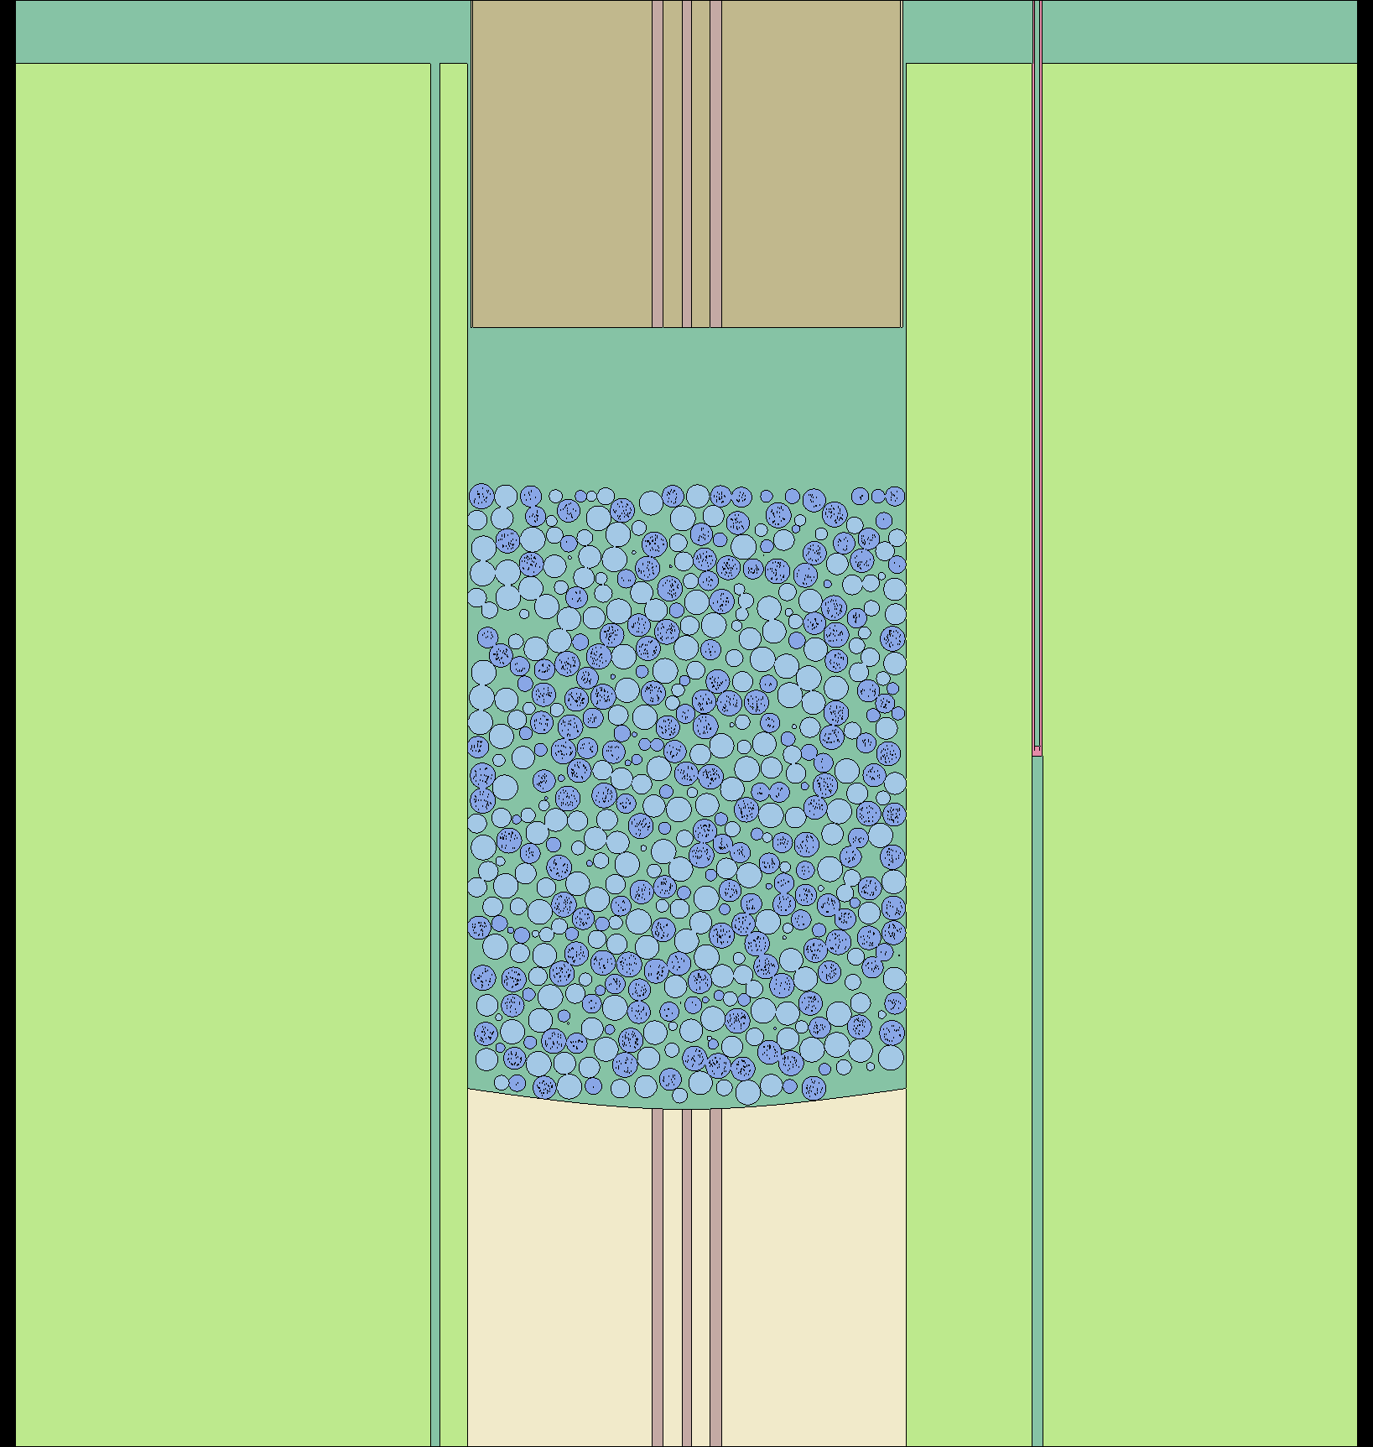
Core 4: Serpent Model

Slide 13
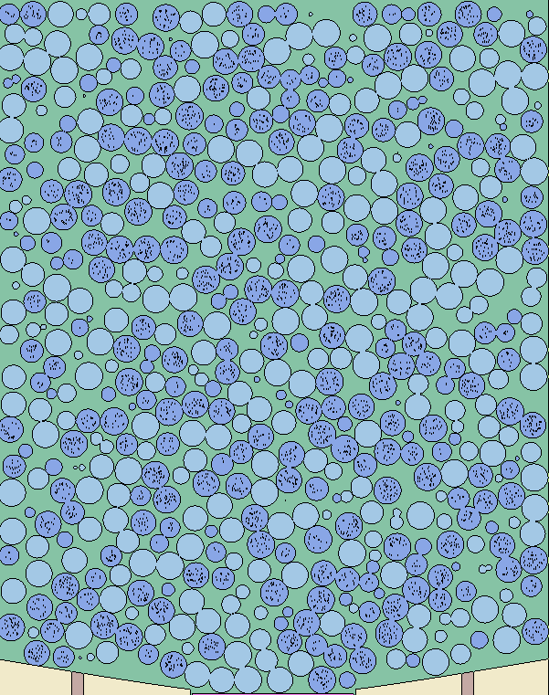
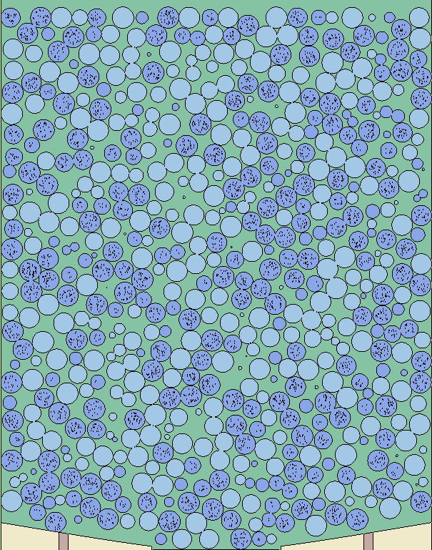
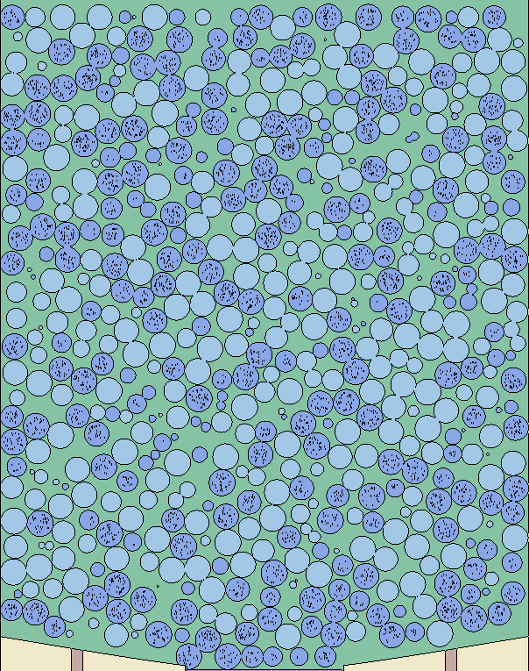
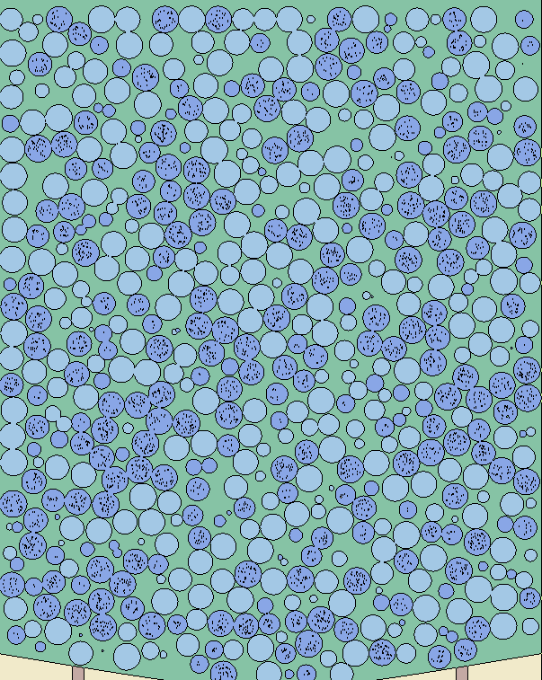
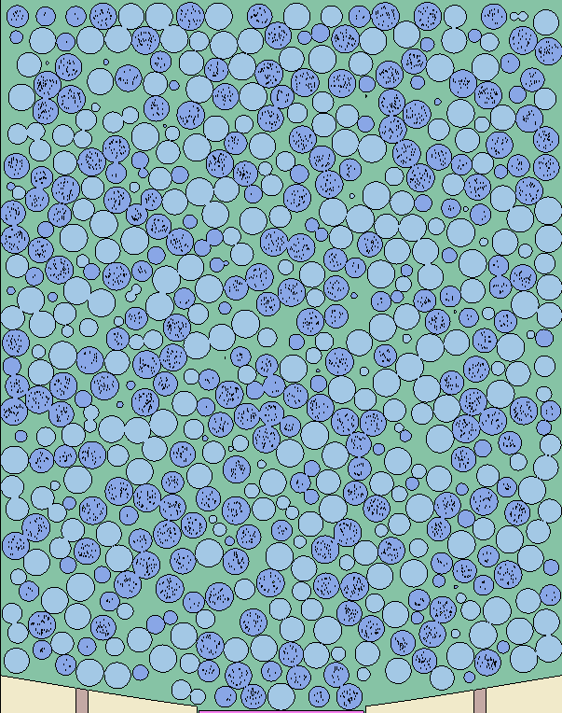
Random Packing Distributions
OpenMC and Project Chrono were used to generate random pebble positions
50 OpenMC purely random positions for Core 4.2 (and 4.3)
60 Project Chrono DEM random pebble positions for Core 4.2 (and 4.3)
Core 4.2
Core height 152cm
4940 moderator
4940 fuel
Total of 9880
+105

Slide 14
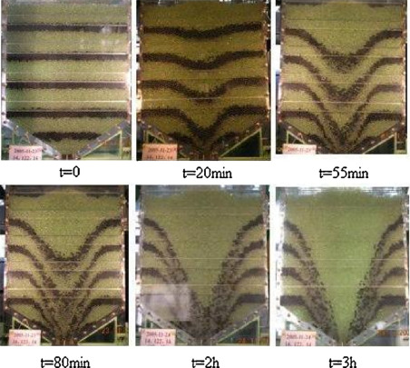

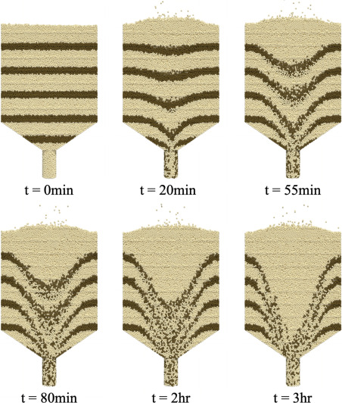
Project Chrono
DEM uses Newton’s laws of motion to determine the linear and rotational movement of particles
GPU-based (high performance compared to CPU equivalent)
A major assumption in DEM is that particles are permitted to have small amounts of intersection at points of contact (u_{n})
This intersection is then used to compute the normal and tangential (friction) forces between particles using a spring-dashpot mechanism
Another assumption is that all pebbles have the same density which is an average between fuel and moderator pebbles
To accelerate the simulation, pebbles are dropped as "sheets" into the vessel, with positions within the sheet randomly assigned.
Parameter | Value
Sphere Density | 1.736 g/cc
Elastic Modulus | 8 GPa
Poisson's Ratio | 0.12
Sliding Friction Coefficient | 0.3
Rolling Friction Coefficient | 0.01
David Reger, et al.,”Discrete element simulation of Pebble Bed Reactors on graphics processing units,” Ann. Nuc. Ene.,Vol. 190, 2023.
Notes:
The actual HTR-Proteus was loaded dropping pebbles one at a time. Doing this in Project Chrono would extend runtime for ~10 minutes to several days for each packing configuration.
Fuel pebble density ~1.78 g/cc and moderator pebble density ~1.68 g/cc

Slide 15
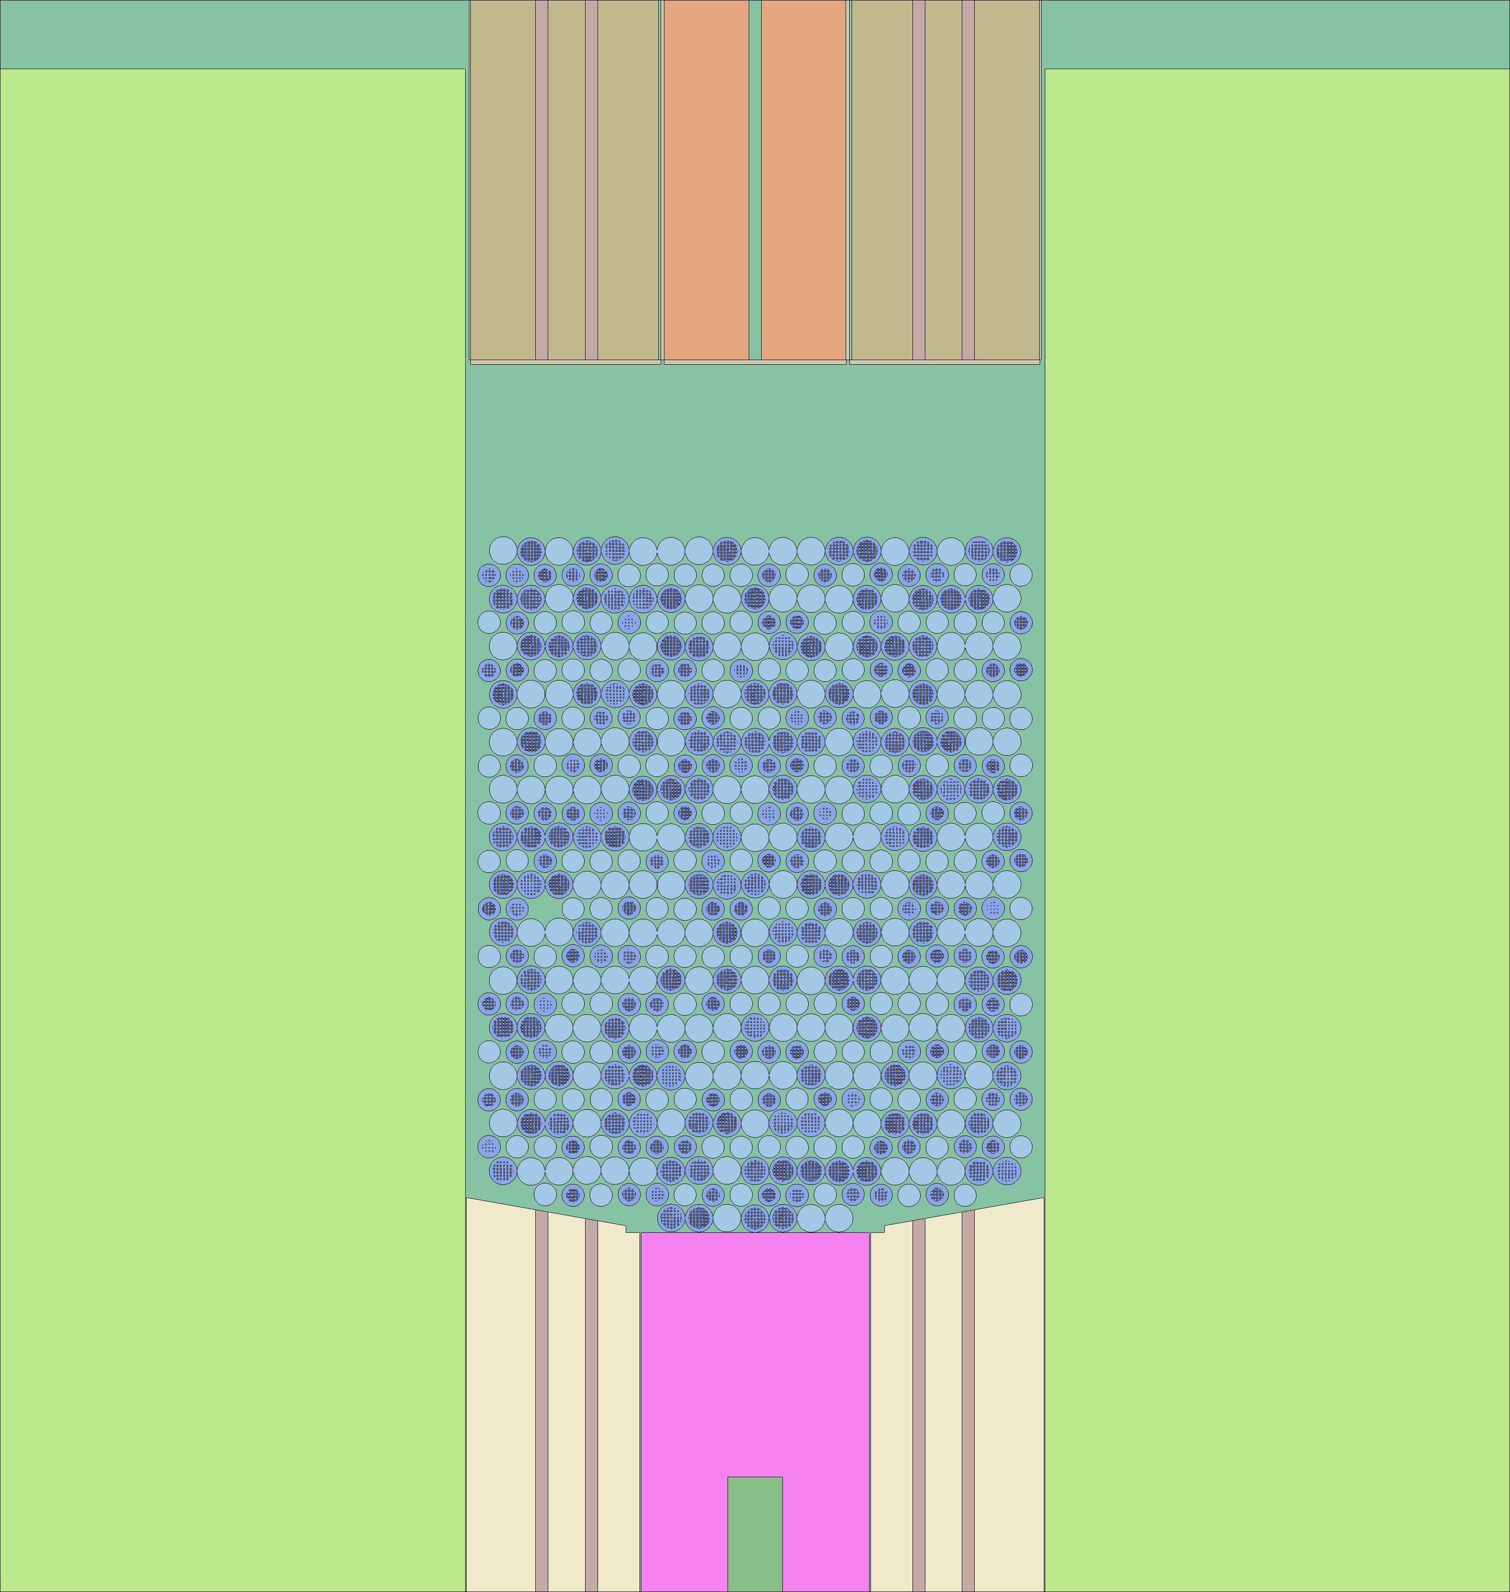
Verification of the Serpent model
IRPhEP Core 4 model were modeled with Serpent and compared to the published MCNP model result.
MCNP 6.1
ENDF/B VII.1 library

Slide 16
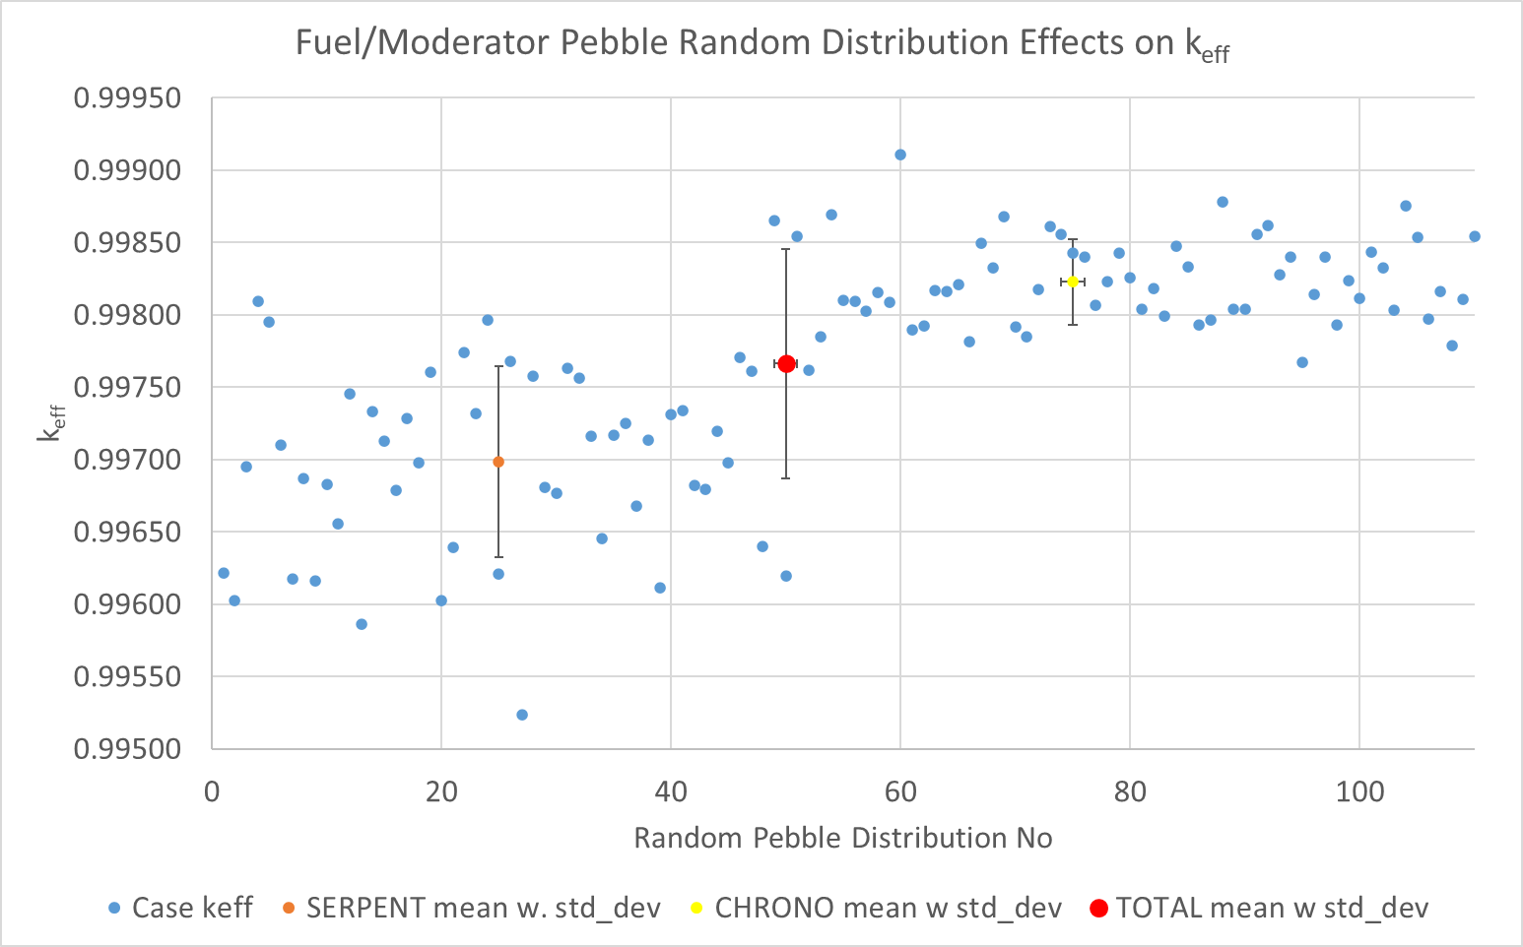
Serpent k-eff Analysis for Core 4.2
Version 2.1.32
ENDF/B VII.1 XS Library
Run params:
500,000 n/cycle
300 skipped cycles
1000 active cycles

Slide 17
Preliminary Rod Worth Analysis with Serpent
Preliminary: Rod worth is calculated from the k-eff when the rod of interest is in and out while all the other rods are at their original positions.
Worth statistical uncertainty = 0.004$

Slide 18
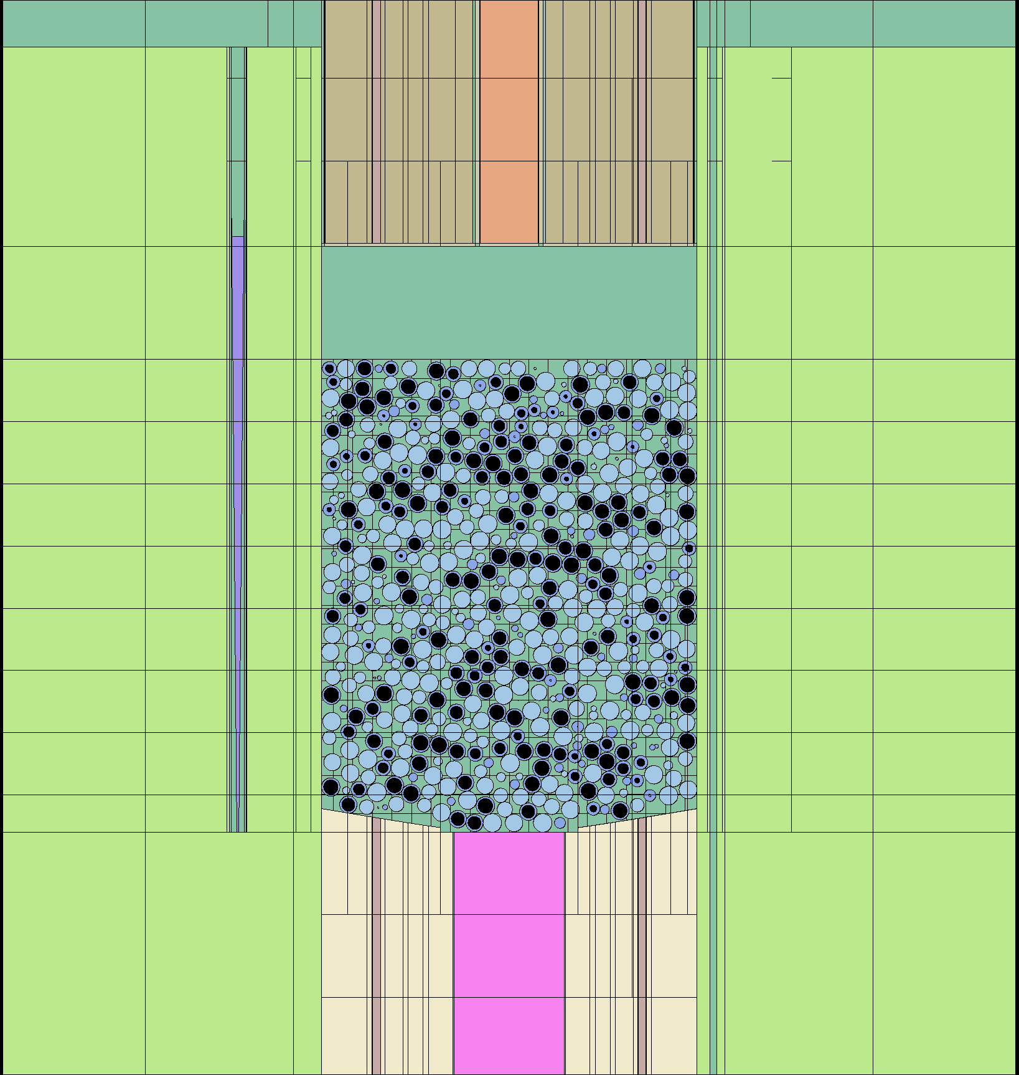
XS Generation for Deterministic Calculations
Full core Serpent model
113 homogenized regions to cover the entire core
4G/8G/14G cross-sections

Slide 19
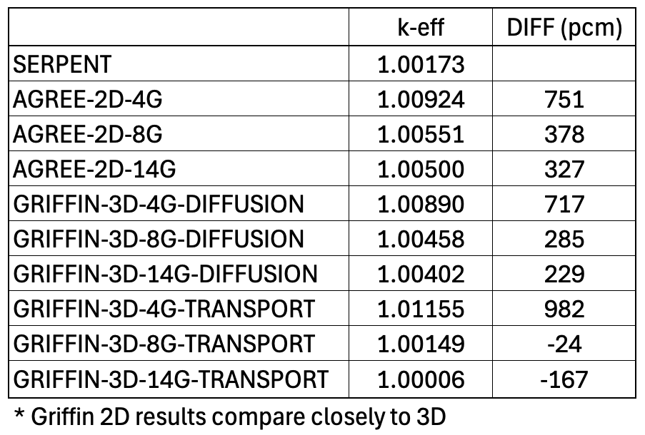
Preliminary Analysis with Griffin and AGREE
Griffin 2D (R-Z) and 3D core
Diffusion
Transport (SN)
AGREE 2D (R-Z) core
Diffusion
Lieberoth steaming correction in the core
No upper cavity special treatment (air) for diffusion

Slide 20
Conclusion
Started integration of the ICSBEP report IEU-COMP-THERM-TBD
Initial results show that MCNP and Serpent agree within 10 pcm for current IRPhEP Core 4 model
Pebble packing with Project Chrono provides a lower uncertainty in k_{eff} & improved C/E
Minor updates to sensitivity analysis
Further investigate the effect from
top aluminum safety ring
newer nuclear data libraries (TSLs & SANS data)
Perform additional sensitivity analysis
Identify, and if possible, evaluate, subcritical measurement data

Slide 21
Acknowledgements
We would like to thank the following for their support
Zachary Bevans (INL intern)
Spencer Ercanbrack (INL intern)

Slide 22
ADDITIONAL SLIDES

Slide 23
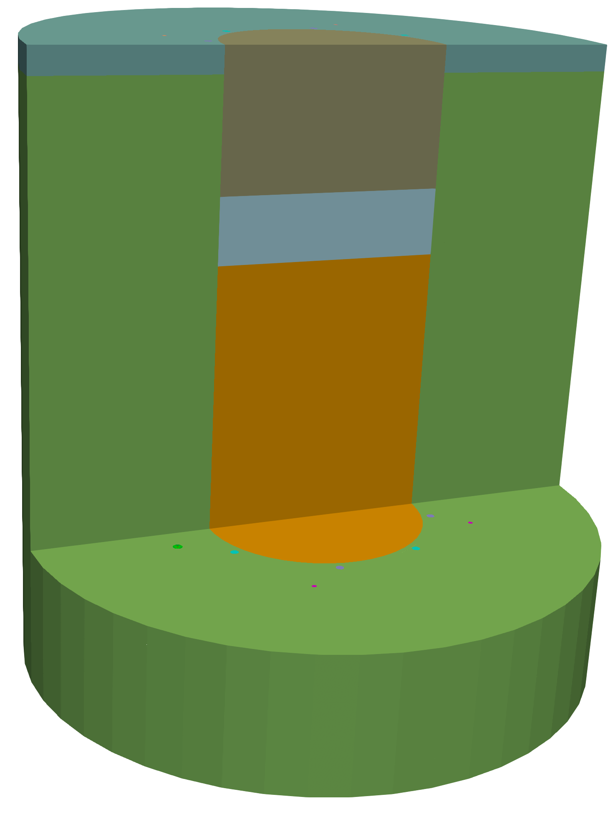
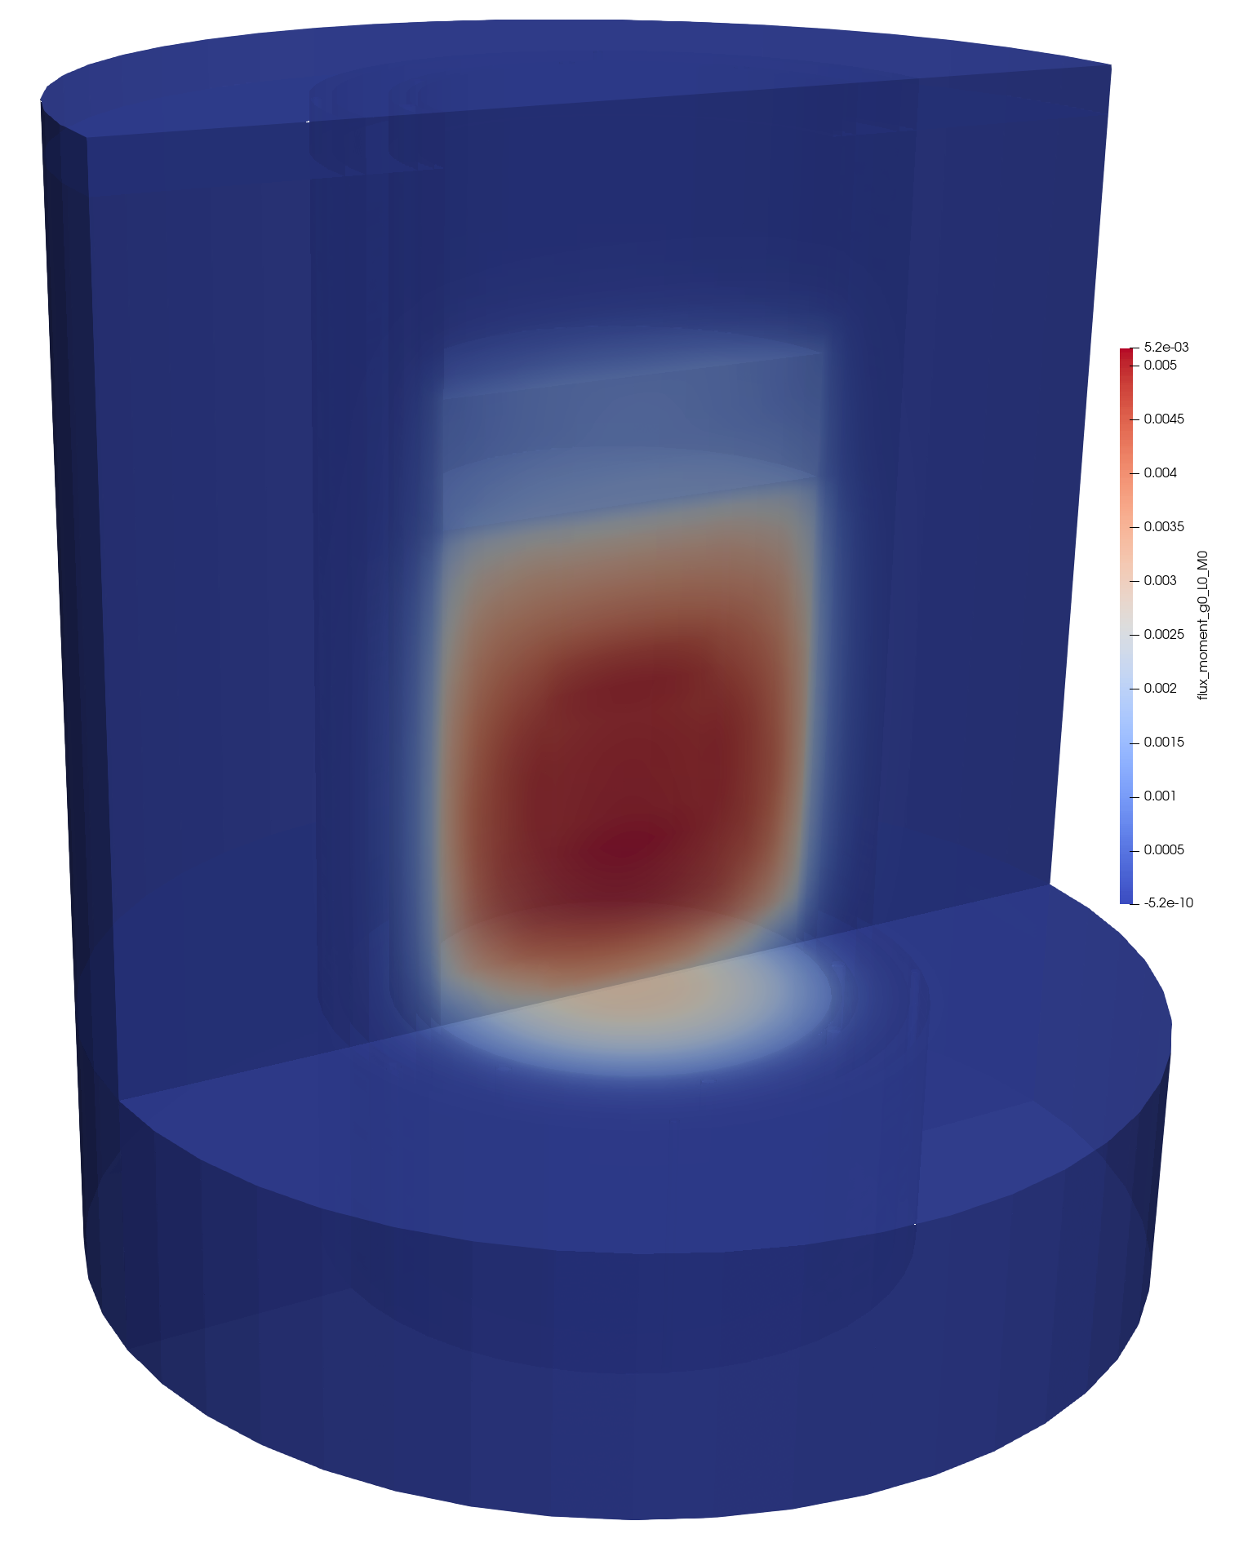
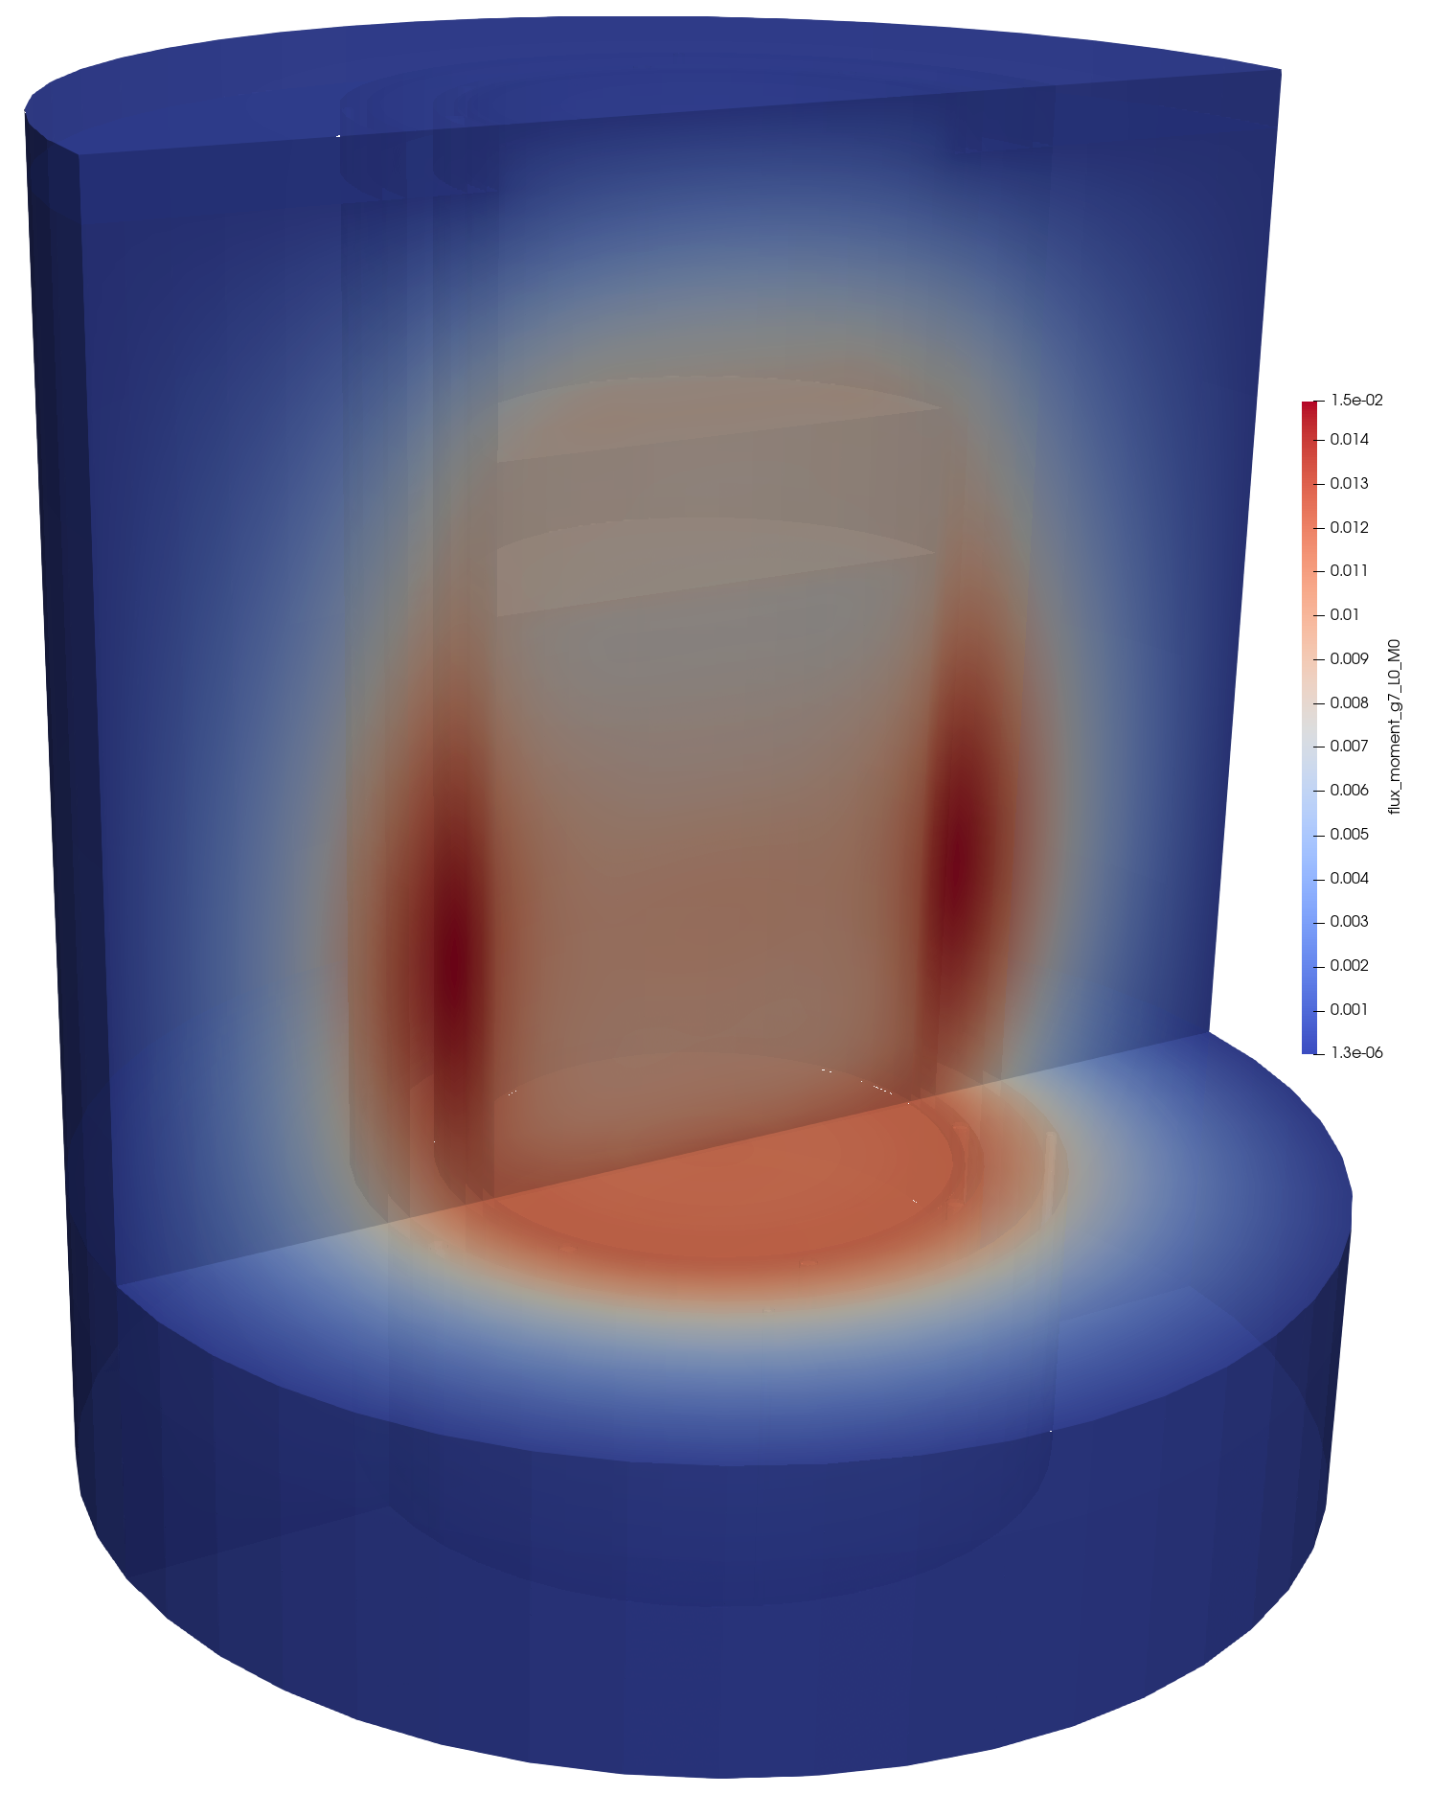
Griffin 3D Core Model
Material mesh
Fast scalar flux (G=1)
Thermal scalar flux (G=8)

Slide 24
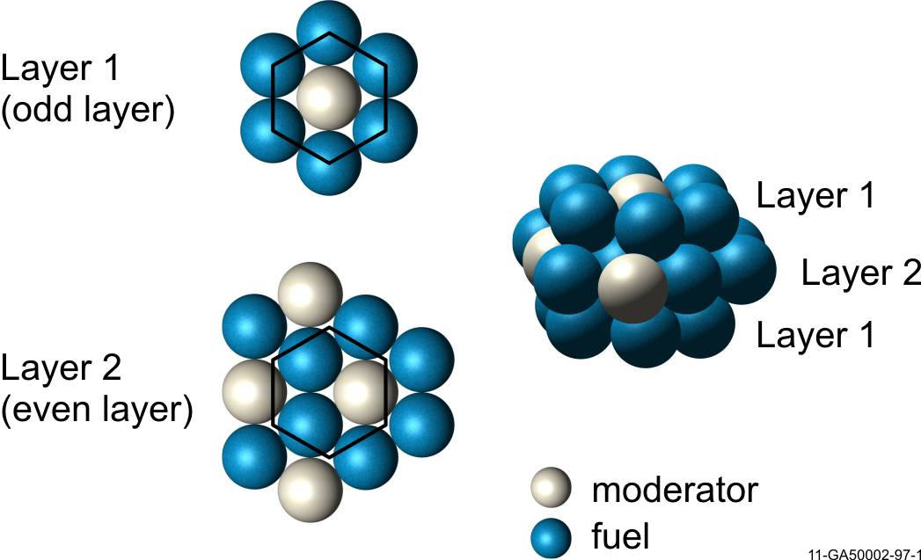
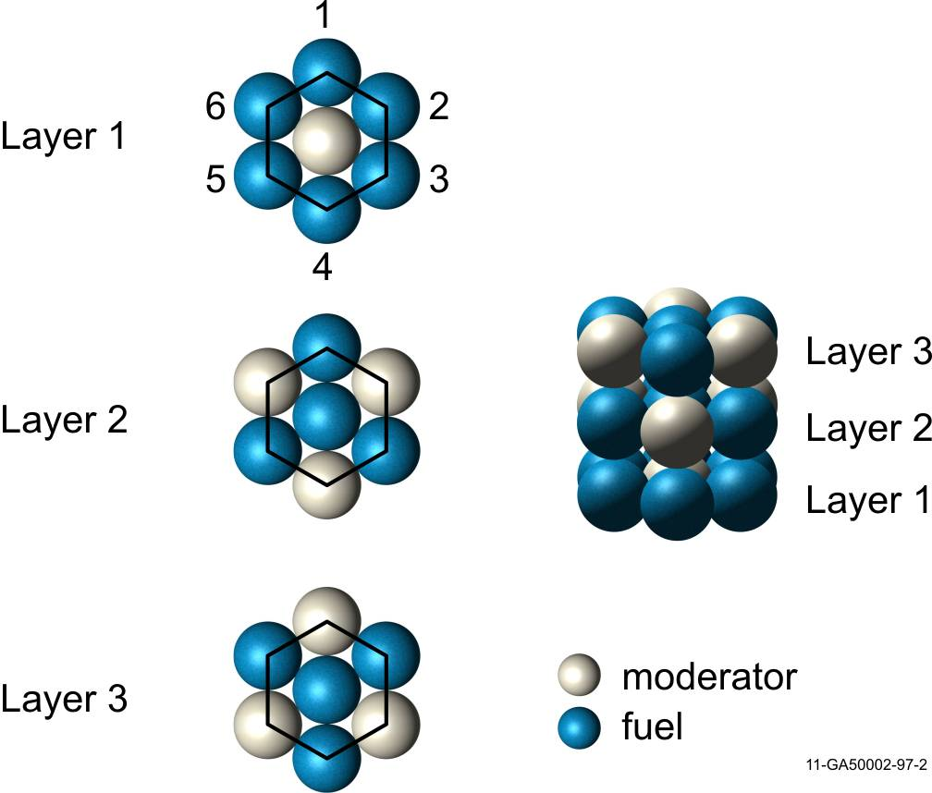
Packing Fractions (PFs)
HCP
Hexagonal Close Packed (HCP)
0.7405 theoretical PF (away from edges)
~0.692 core-averaged PF
Worst case for shipping/storage accidents
Random Packing
~0.61 PF
Real world is between 0.60 and 0.64
Columnar Hexagonal Point-On-Point (CHPOP)
0.6046 theoretical PF (away from edges)
0.5835 core-averaged PF
Best representation of real world using known pebble locations
CHPOP

