Slide 1
Overview of Historical and New Transmission Measurements of Nuclear Graphite
Chris W. Chapman, Kemal Ramić, Iyad Al-Qasir
Oak Ridge National Laboratory
ReGra – 9 July 2025

Slide 2
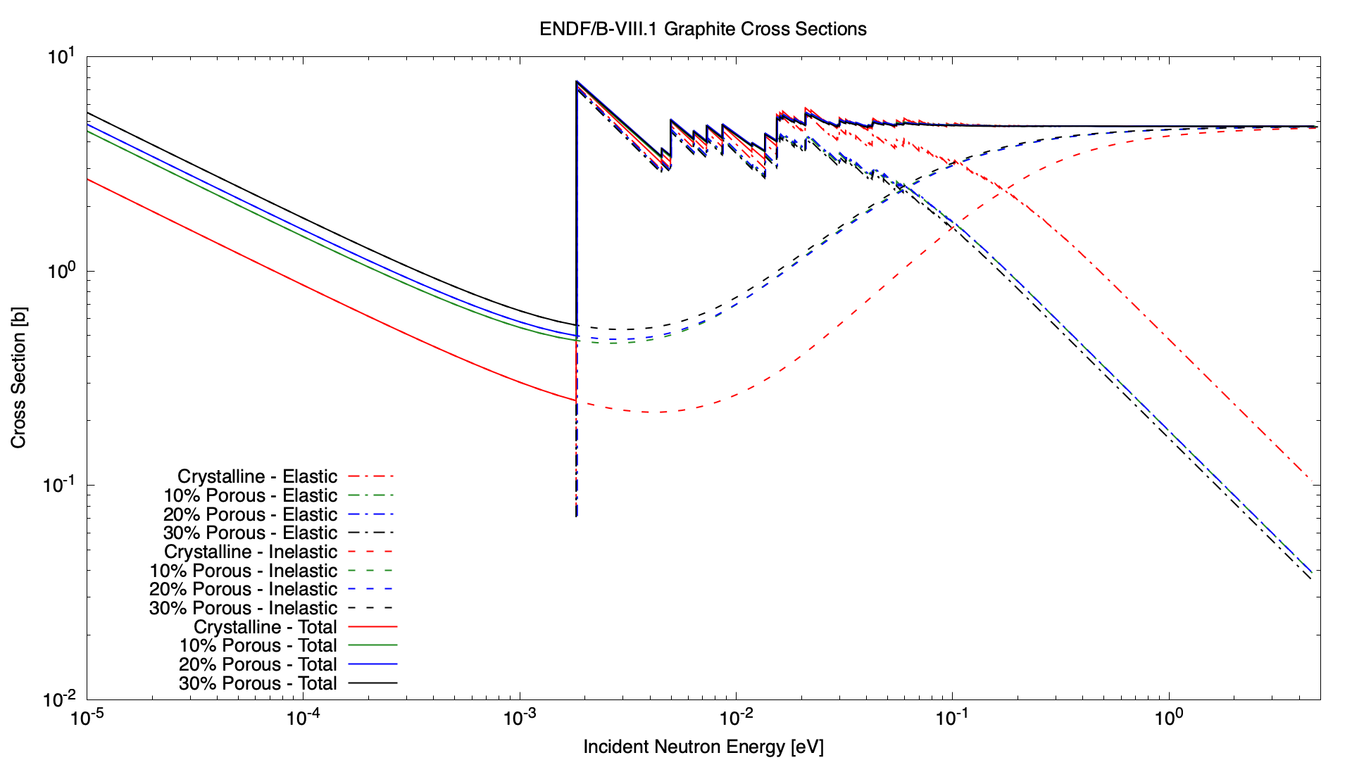
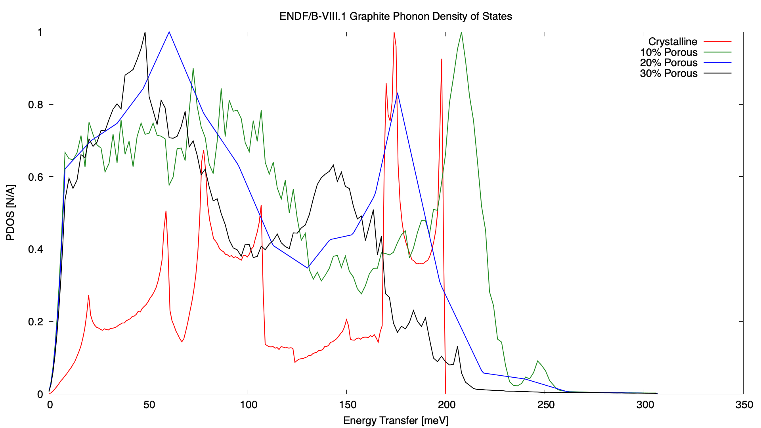
Where we are
Is this right? Is this the most accurate way to account for pores in graphite?

Slide 3
The SANS of it all
How do pores contribute to total cross section?
Small Angle Neutron Scattering (SANS)
Known about in graphite since at least Egelstaff (1957)
History of potential confusion behind underlying cause e.g. Bowman (2008)
Current consensus is that SANS manifests from porosity (e.g. Petriw (2010), Gould (2010))

Slide 4
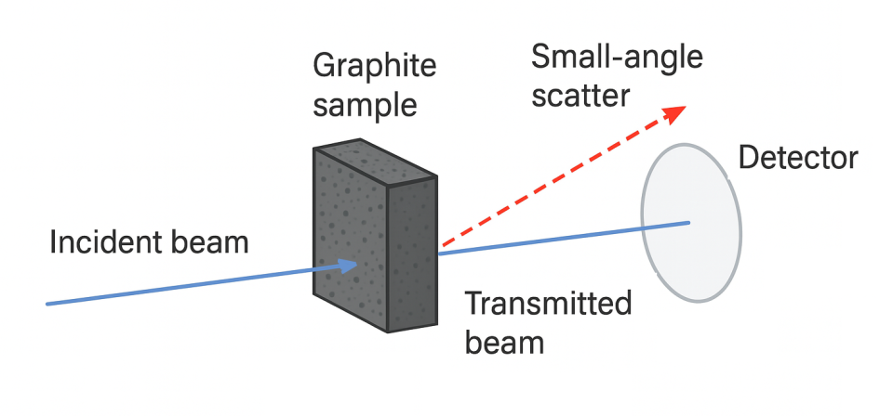
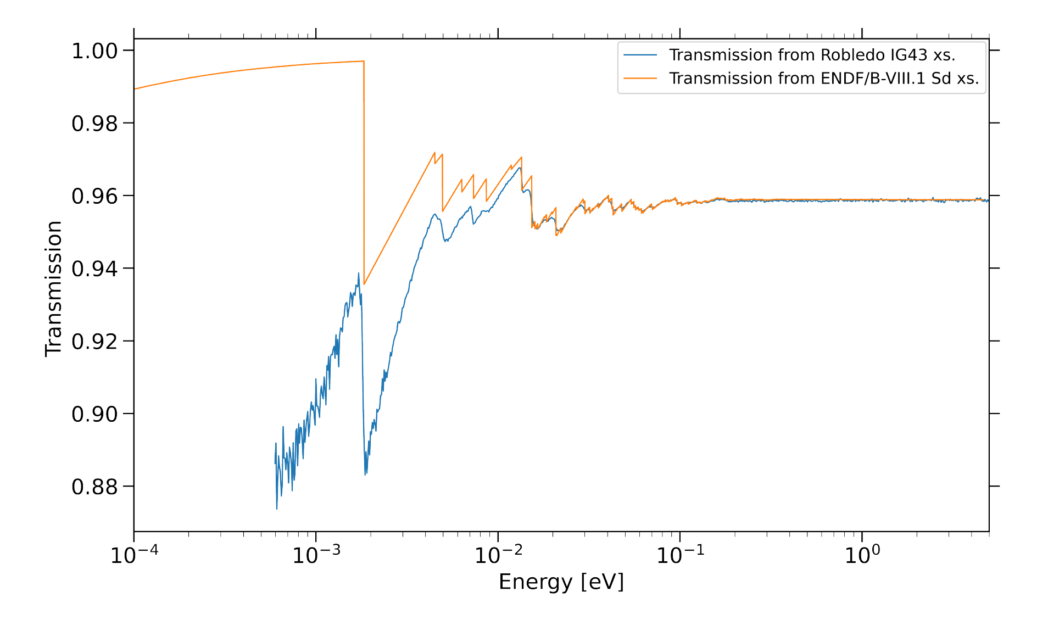
The SANS of it all
SANS is an effect based on the material characteristics (i.e., pores)
Previous attempts have been made to correct for SANS in total cross section measurements
If SANS is present, one of two things needs to be done in order to make a faithful comparison between processed & experimental data:
Experimental corrections
SANS adjustment to processed data

Slide 5
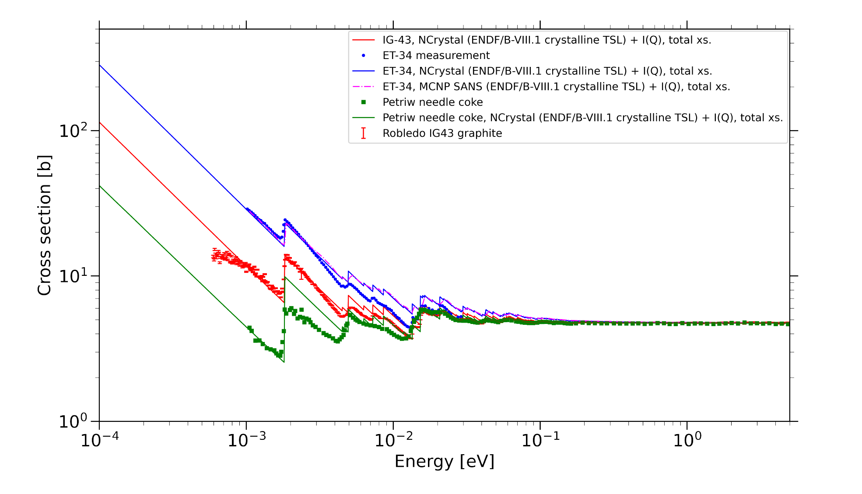
The SANS of it all
SANS adjustments to processed data can be done IF material characteristics are well known
Needs to be done CAREFULLY

Slide 6
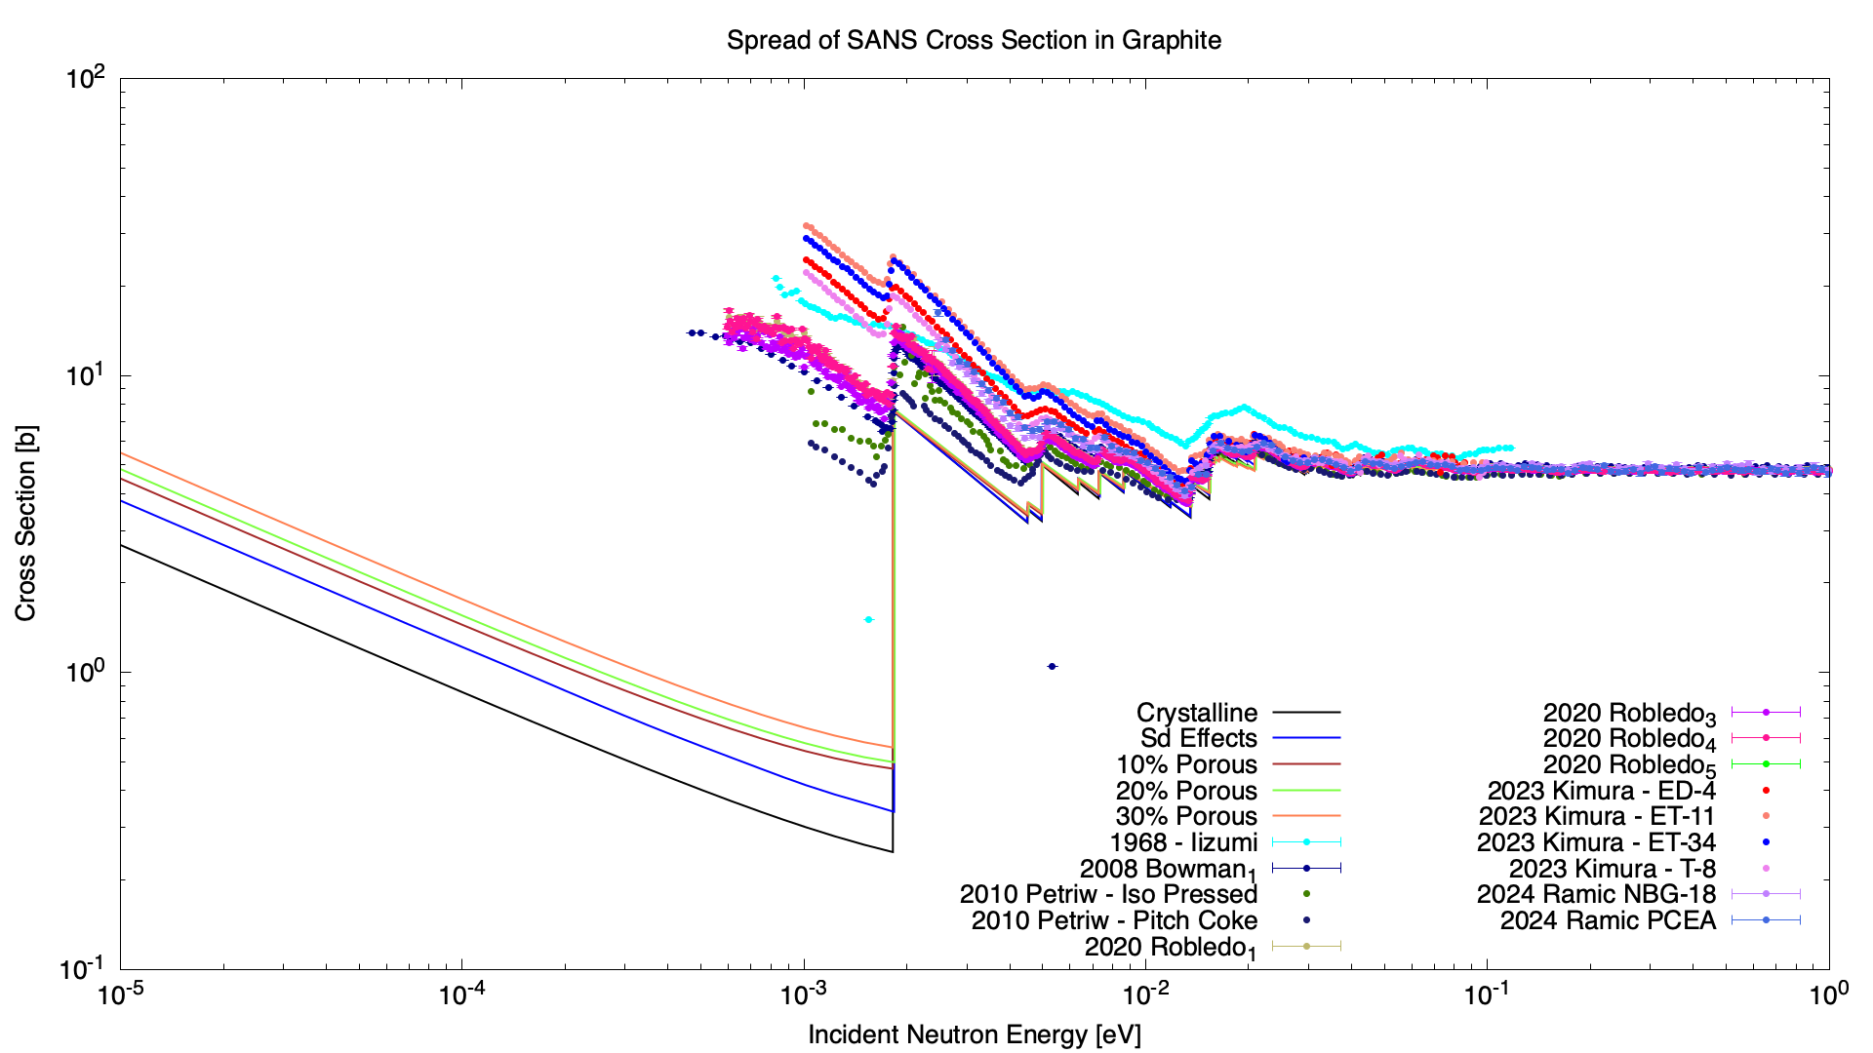
The SANS of it all
Minor changes in graphite sample can lead to significantly different SANS contributions
Must be handled with EXTREME care

Slide 7
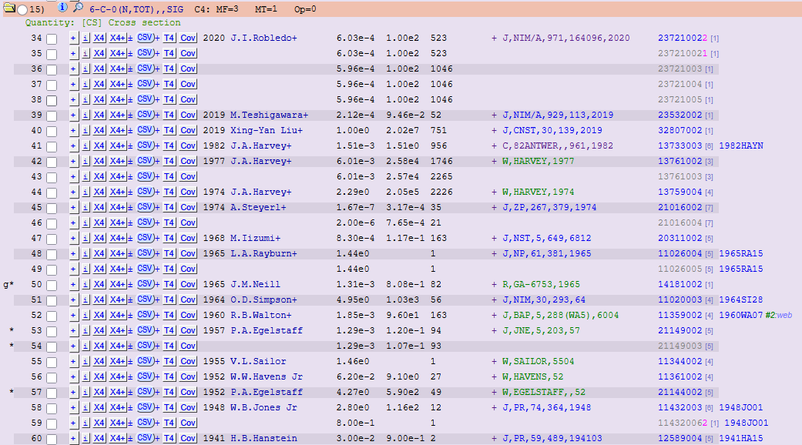
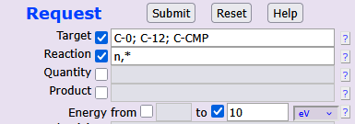
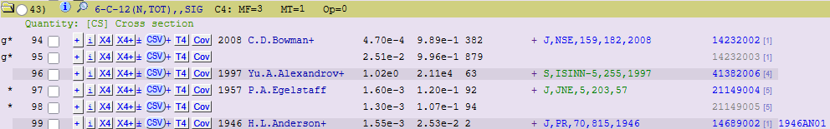
What I Searched For – EXFOR

Slide 8
What I Searched For – non-EXFOR
Internal
Ramić (ISIS, 2024, preliminary)
Dissertations
Shamasundar (Georgia Tech, 1974)
Zhou (NC State, 2006)
Other
Kimura (J-PARC, WONDER-2023, preliminary & digitized)
Petriw (2010, digitized)

Slide 9
Organization of Measurements
Measurements can be broken up into 3 categories:
Not applicable (wrong material, too high in energy, etc.)
SANS included
Previously shown on slide 6
SANS removed
This is what we’ll show

Slide 10
Data to Discuss
Of the 51 datasets, 5 of them contain data either without SANS or SANS-corrected below the first Bragg edge
Palevsky (1955)
Egelstaff (1957)
Shamasundar (1974)
Steyerl (1974)
Zhou (2006)

Slide 11
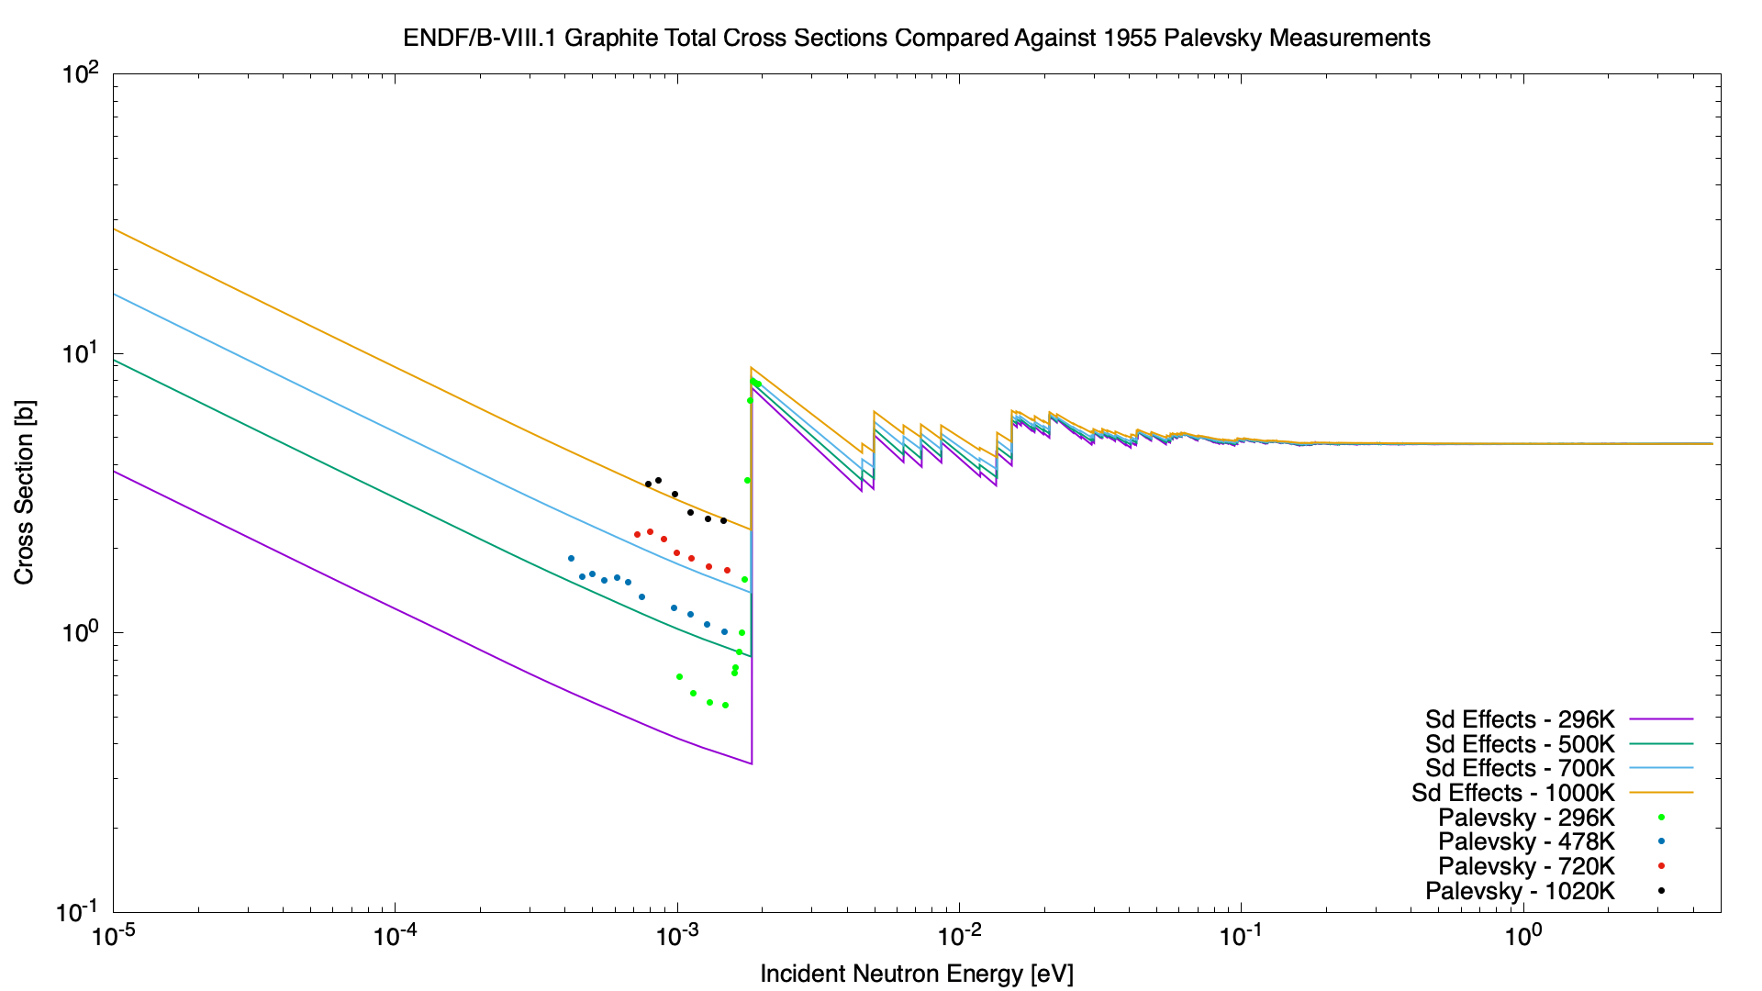
Data without SANS – Palevsky (1955)
No information provided about the sample, experimental procedure, experimental corrections (if any)
Possible that experimental apparatus described in other publication?
This information is necessary for accurate ENDF-to-experiment comparison

Slide 12
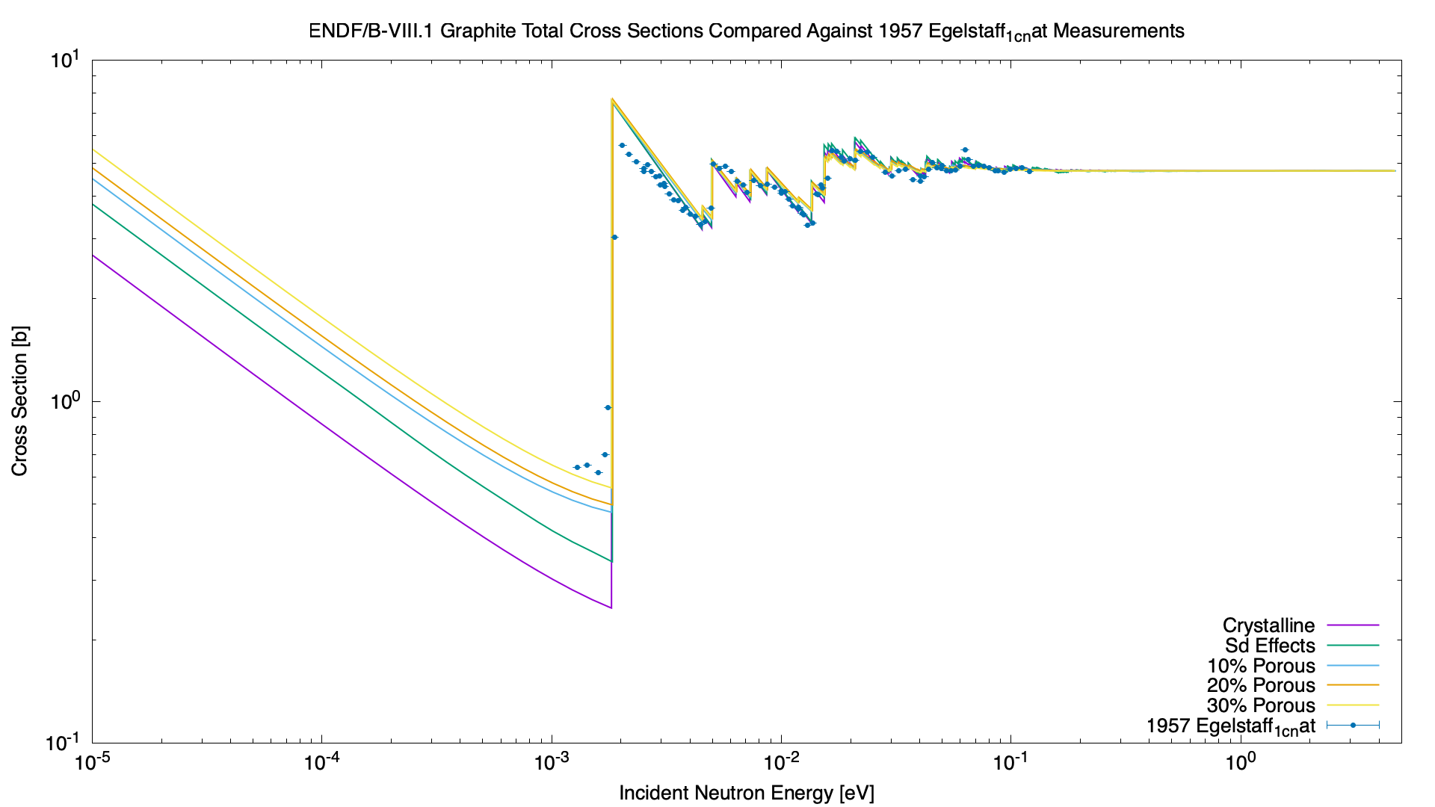
Data without SANS – Egelstaff (1957)
Details measurement in journal paper
Made corrections to their data to adjust for SANS
Mentions that the SANS contribution at 500 m/s [1.3 meV] is ~4 b

Slide 13
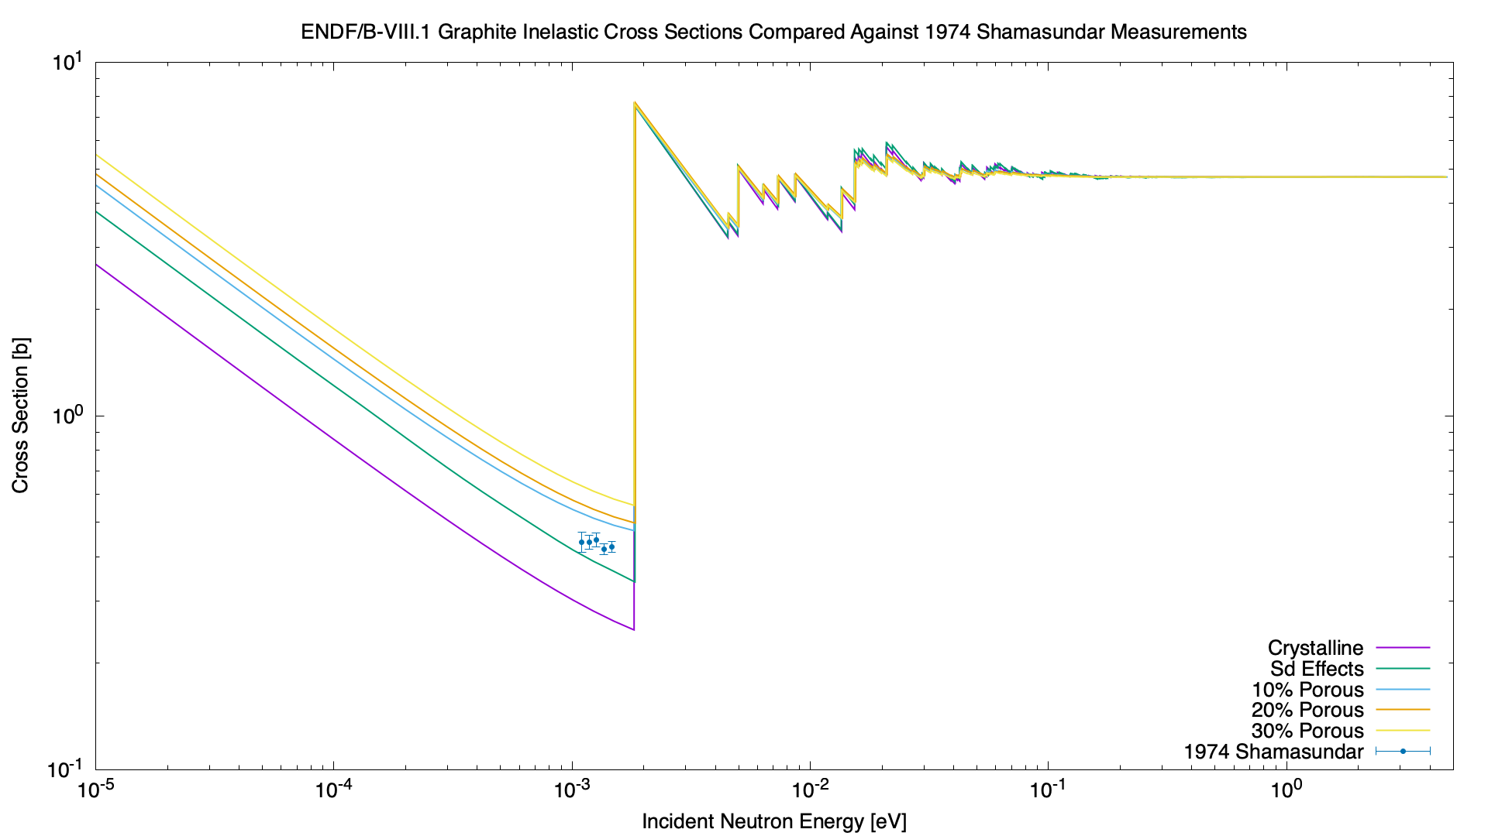
Data without SANS – Shamasundar (1974)
Reactor-grade graphite
Details measurement in dissertation
Made corrections to their data to adjust for SANS
Acknowledges disagreement with BNL-325, but does not know why

Slide 14
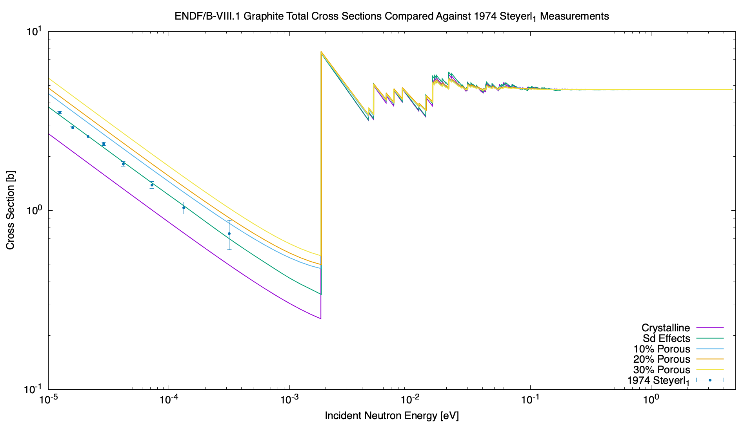
Data without SANS – Steyerl (1974)
Pyrolytic graphite (i.e., crystalline)
Agrees perfectly with Sd data
This is expected, as pyrolytic graphite contains no (or very few) pores.

Slide 15
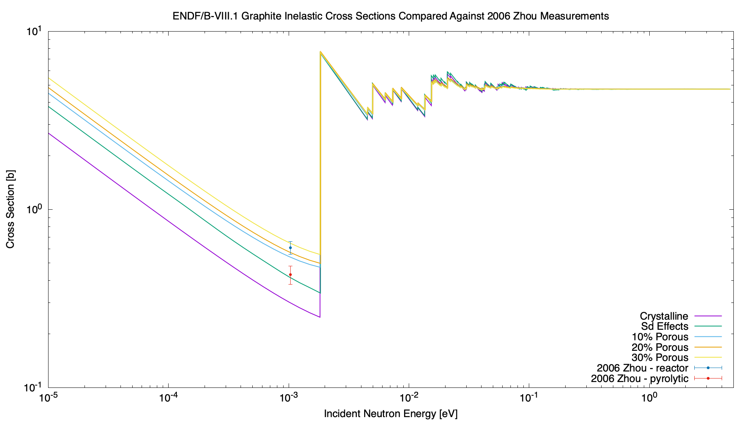
Data without SANS – Zhou (2006)
Two samples measured:
Pyrolytic
Reactor
Pyrolytic graphite measurement agrees perfectly with Sd data
Reactor graphite measurement agrees with somewhere between 20%-30%
Made corrections to their data to adjust for SANS

Slide 16
Conclusions
Many total cross sections are available for graphite
SANS is a material effect which manifests from porosity in materials
Careful considerations required when comparing processed ENDF files against experimental data
Pyrolytic graphite best sample for comparing with inelastic scattering cross section data (due to lack of SANS)
When SANS is not present (i.e., pyrolytic graphite), Sd shows best agreement with total cross section measurements

Slide 17
Questions?

Slide 18
Extra Slides
Lots of plots of total cross section measurements

Slide 19
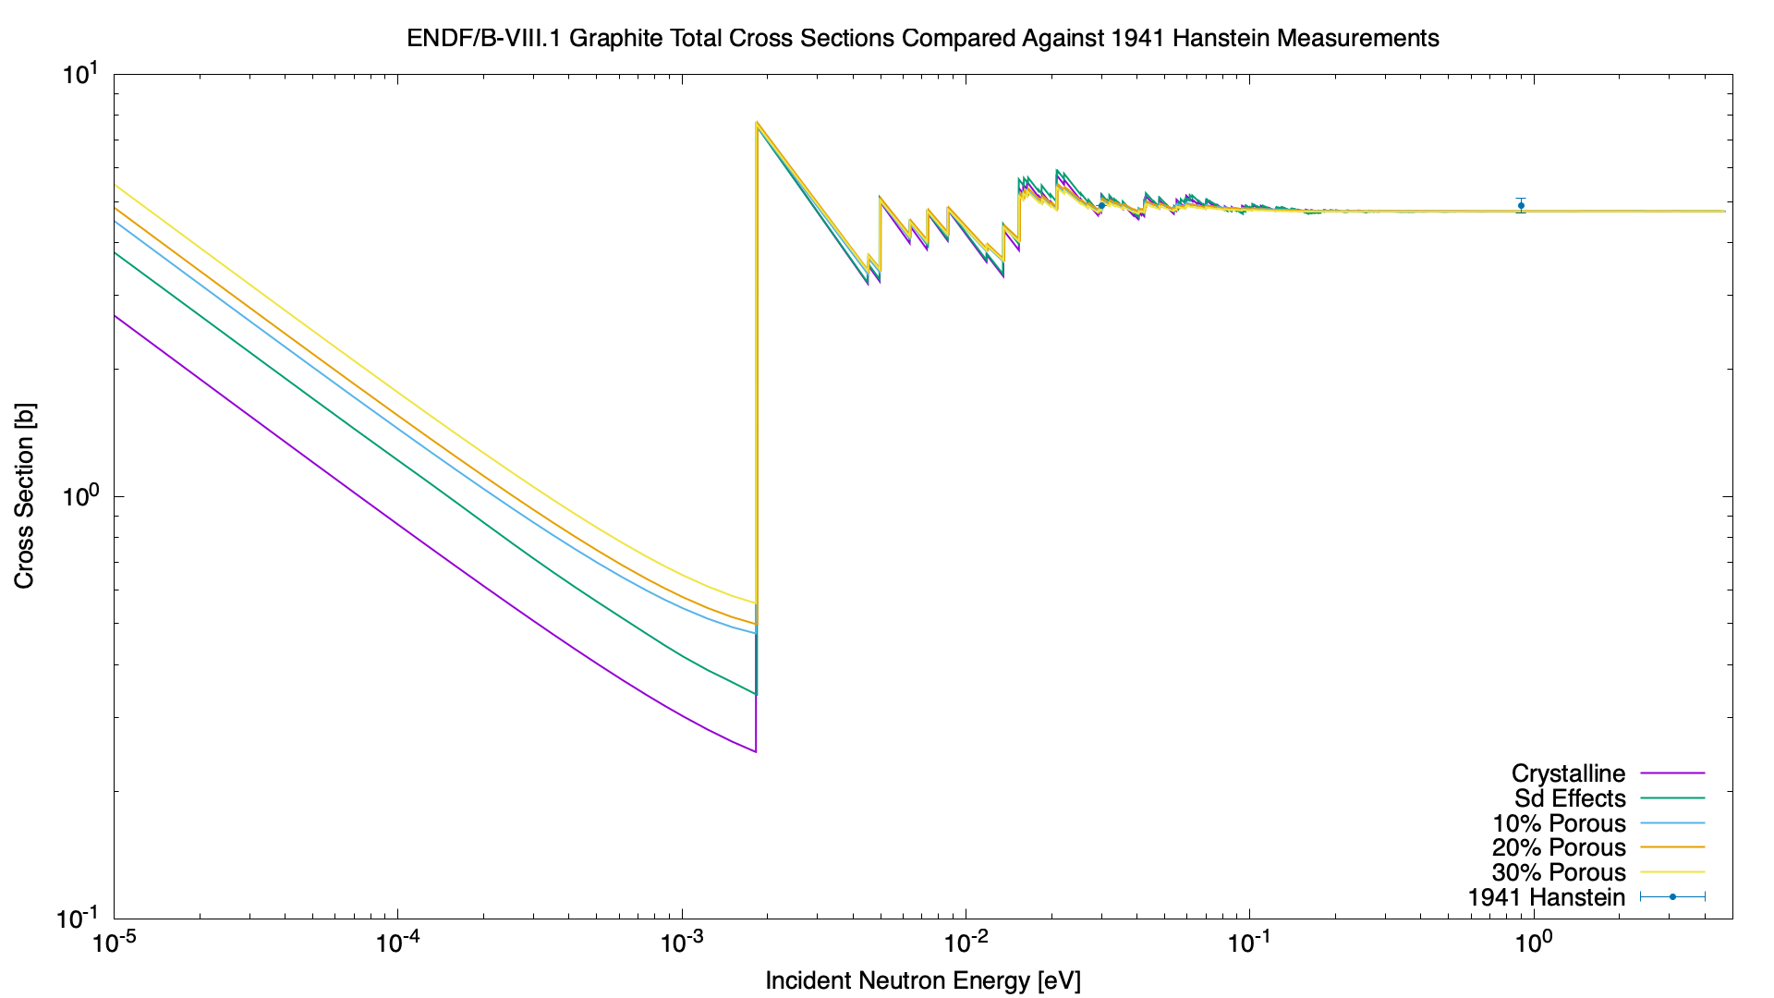
Cross Section Plot – Hanstein (1941)
Hanstein (1941)

Slide 20

Cross Section Plot – Anderson (1946)
Anderson (1946)

Slide 21
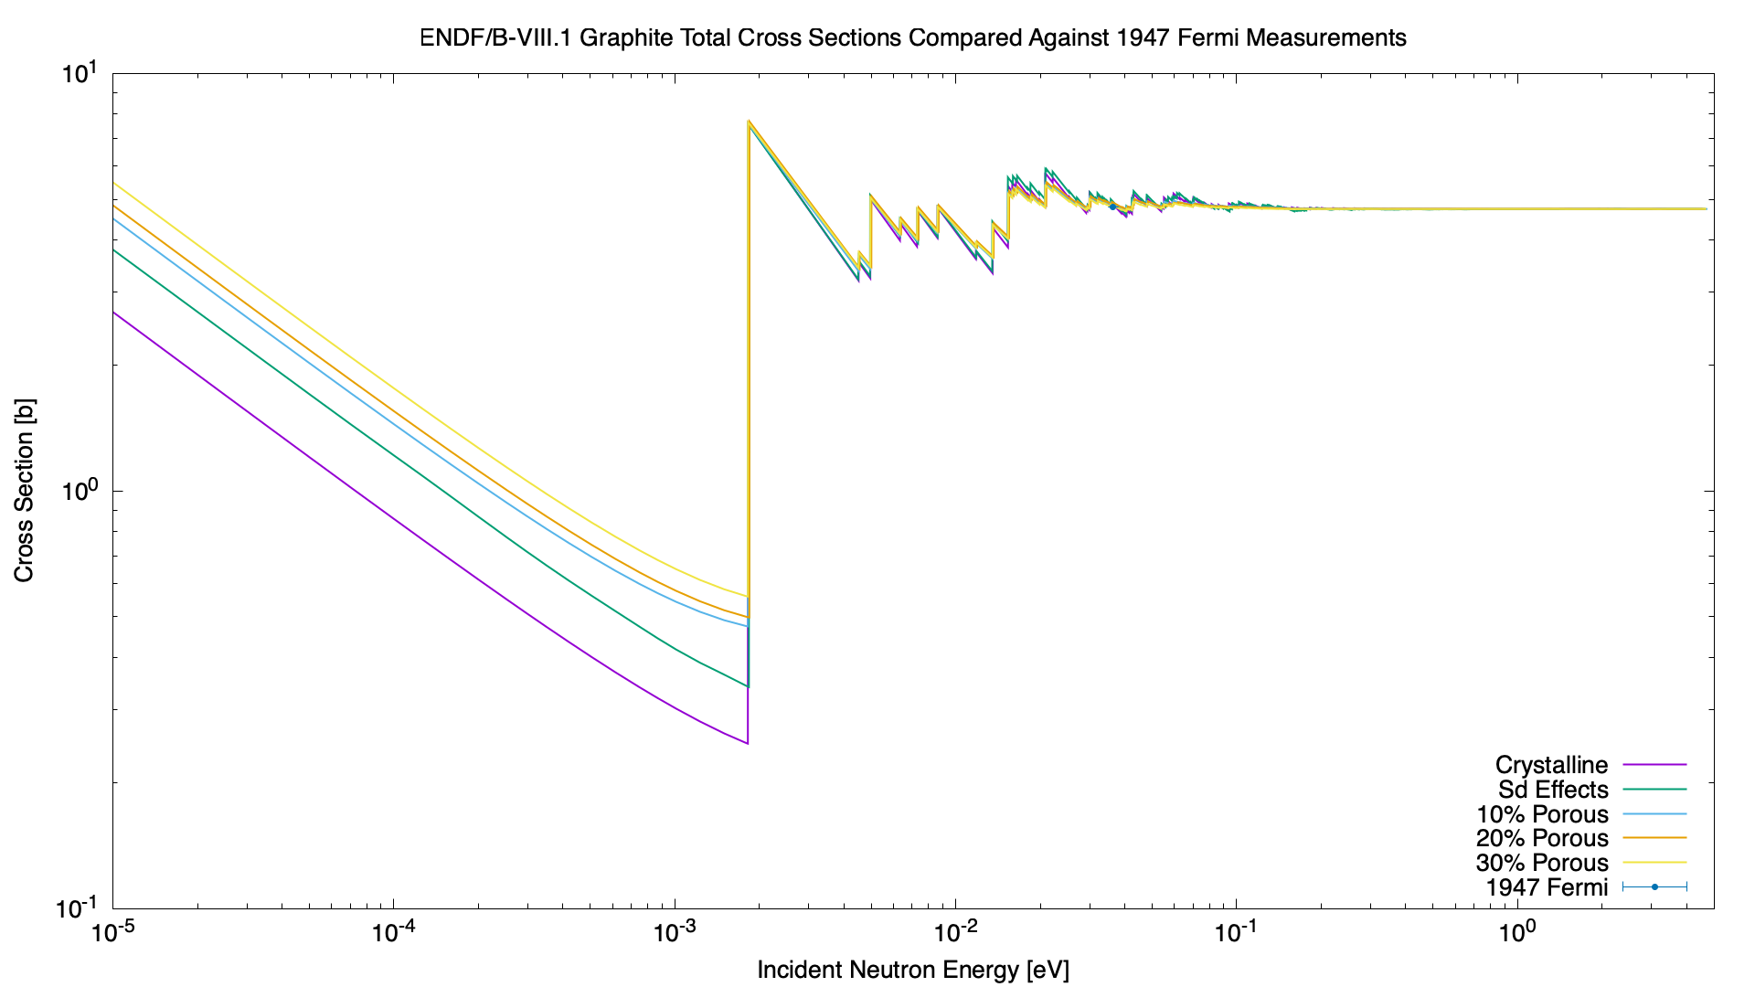
Cross Section Plot – Fermi (1947)
Fermi (1947)

Slide 22
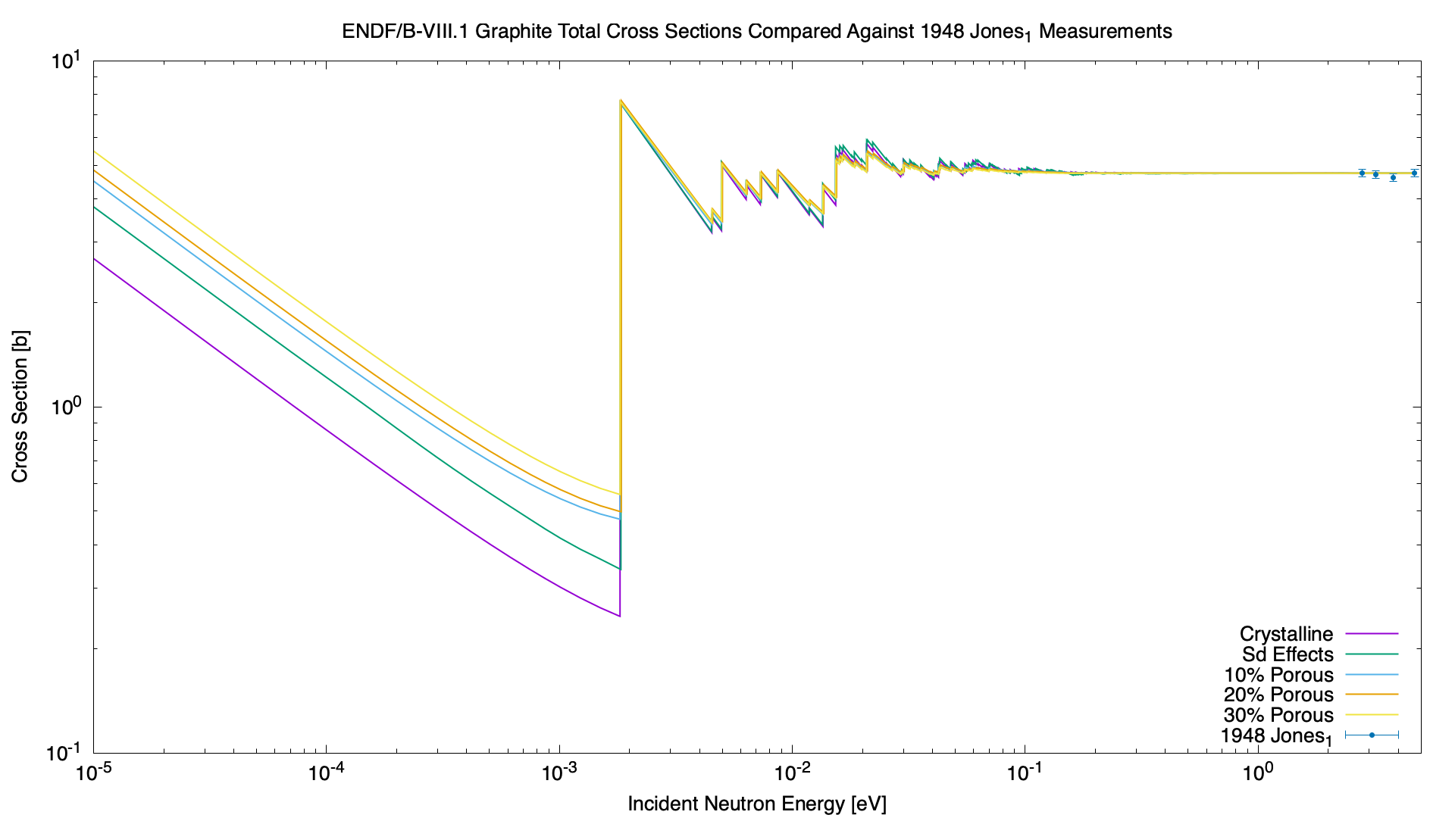
Cross Section Plot – Jones_1 (1948)
Jones_1 (1948)

Slide 23

Cross Section Plot – Jones_2 (1948)
Jones_2 (1948)

Slide 24
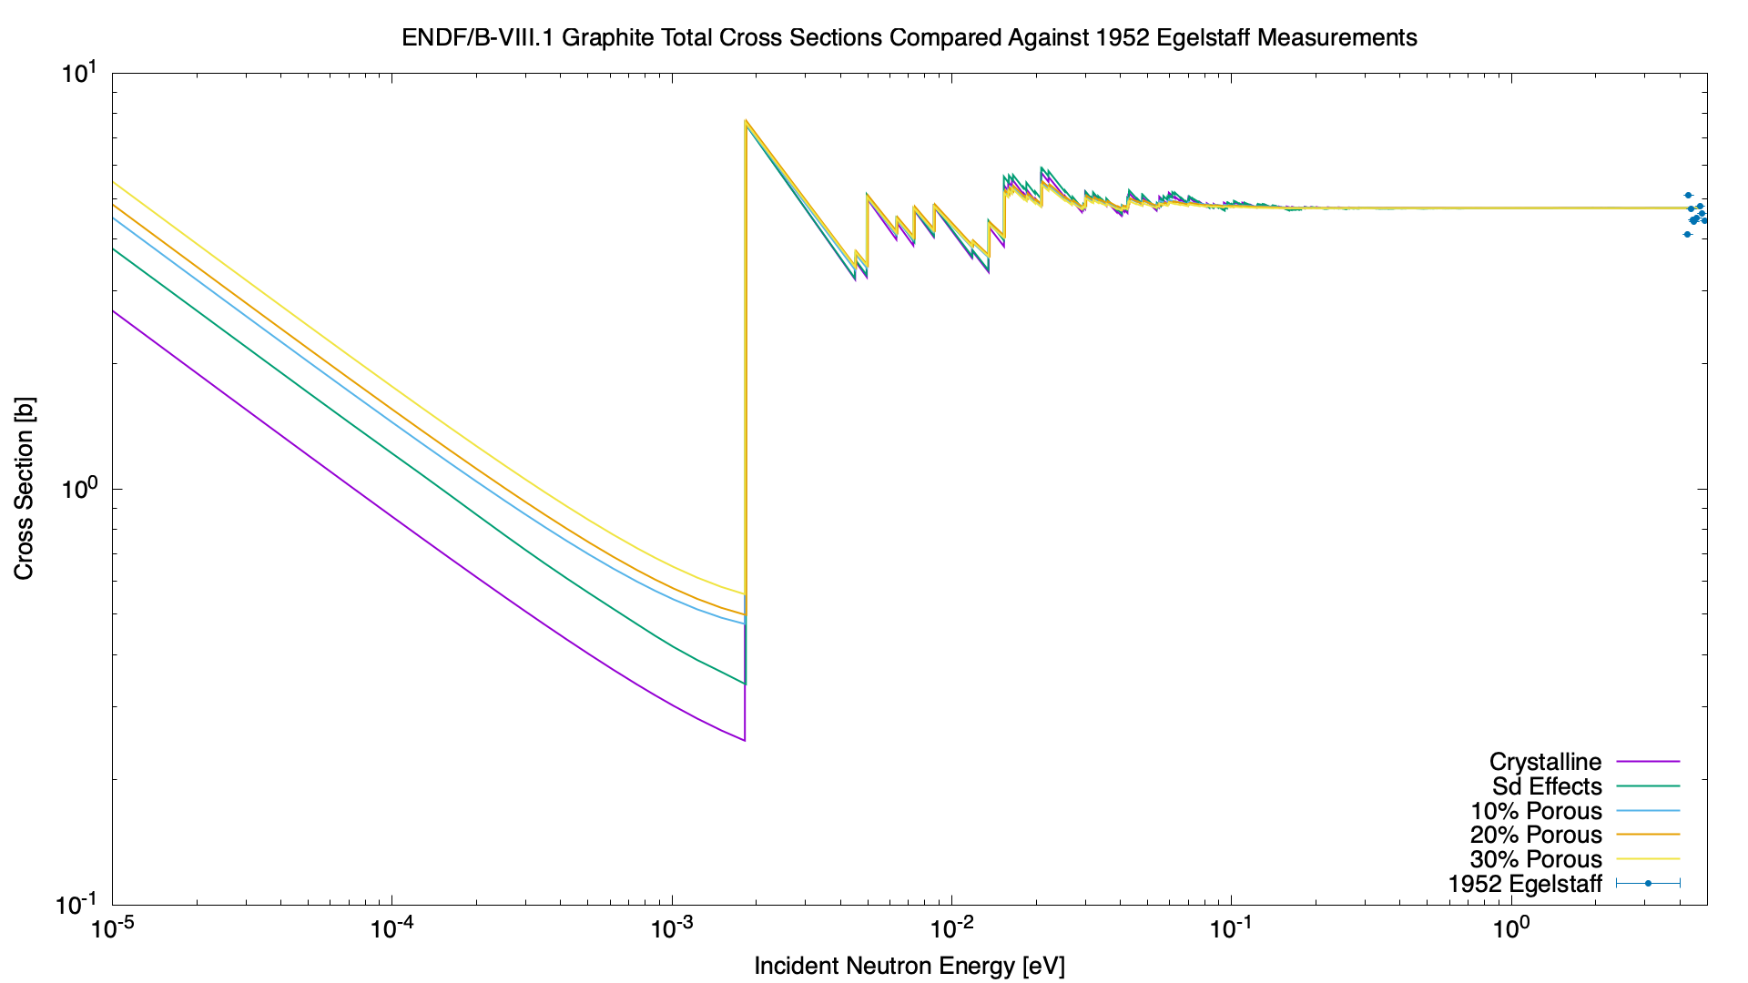
Cross Section Plot – Egelstaff (1952)
Egelstaff (1952)

Slide 25
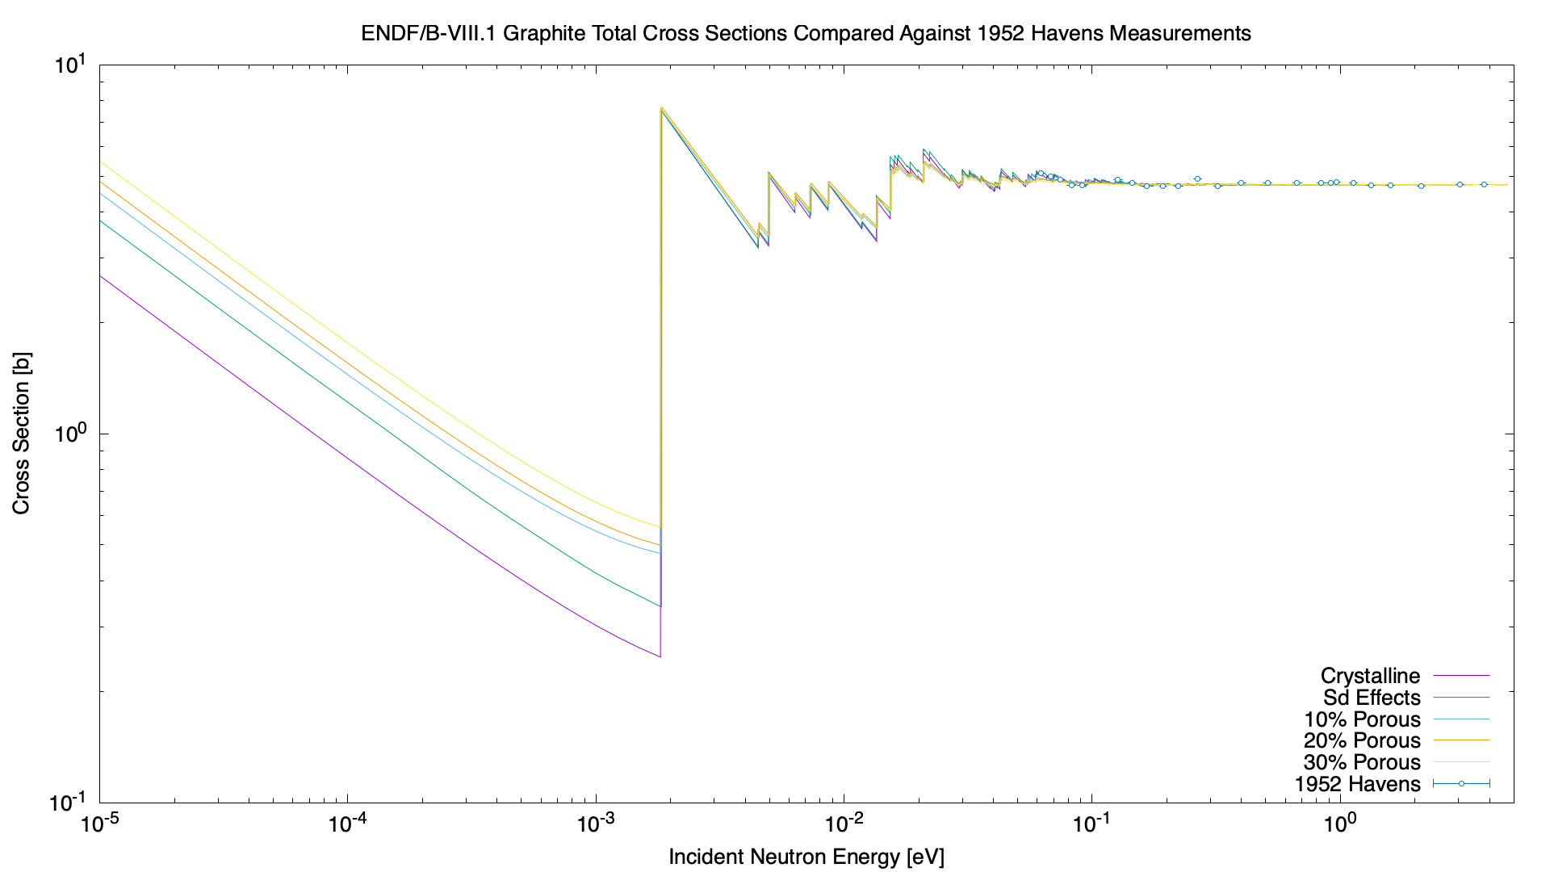
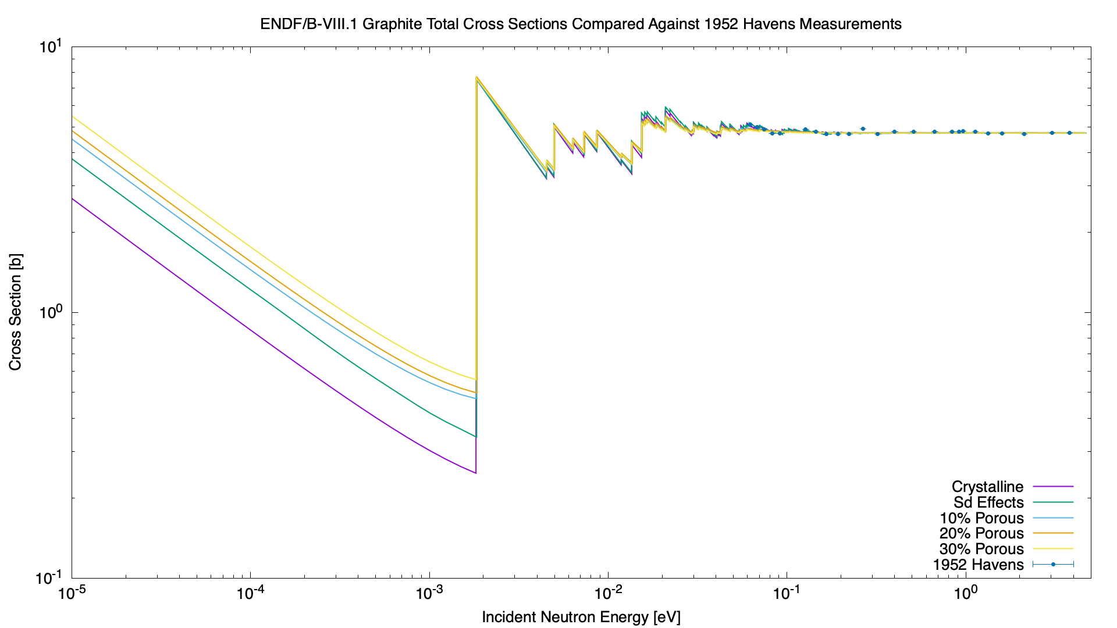
Cross Section Plot – Havens (1952)
Havens (1952)

Slide 26
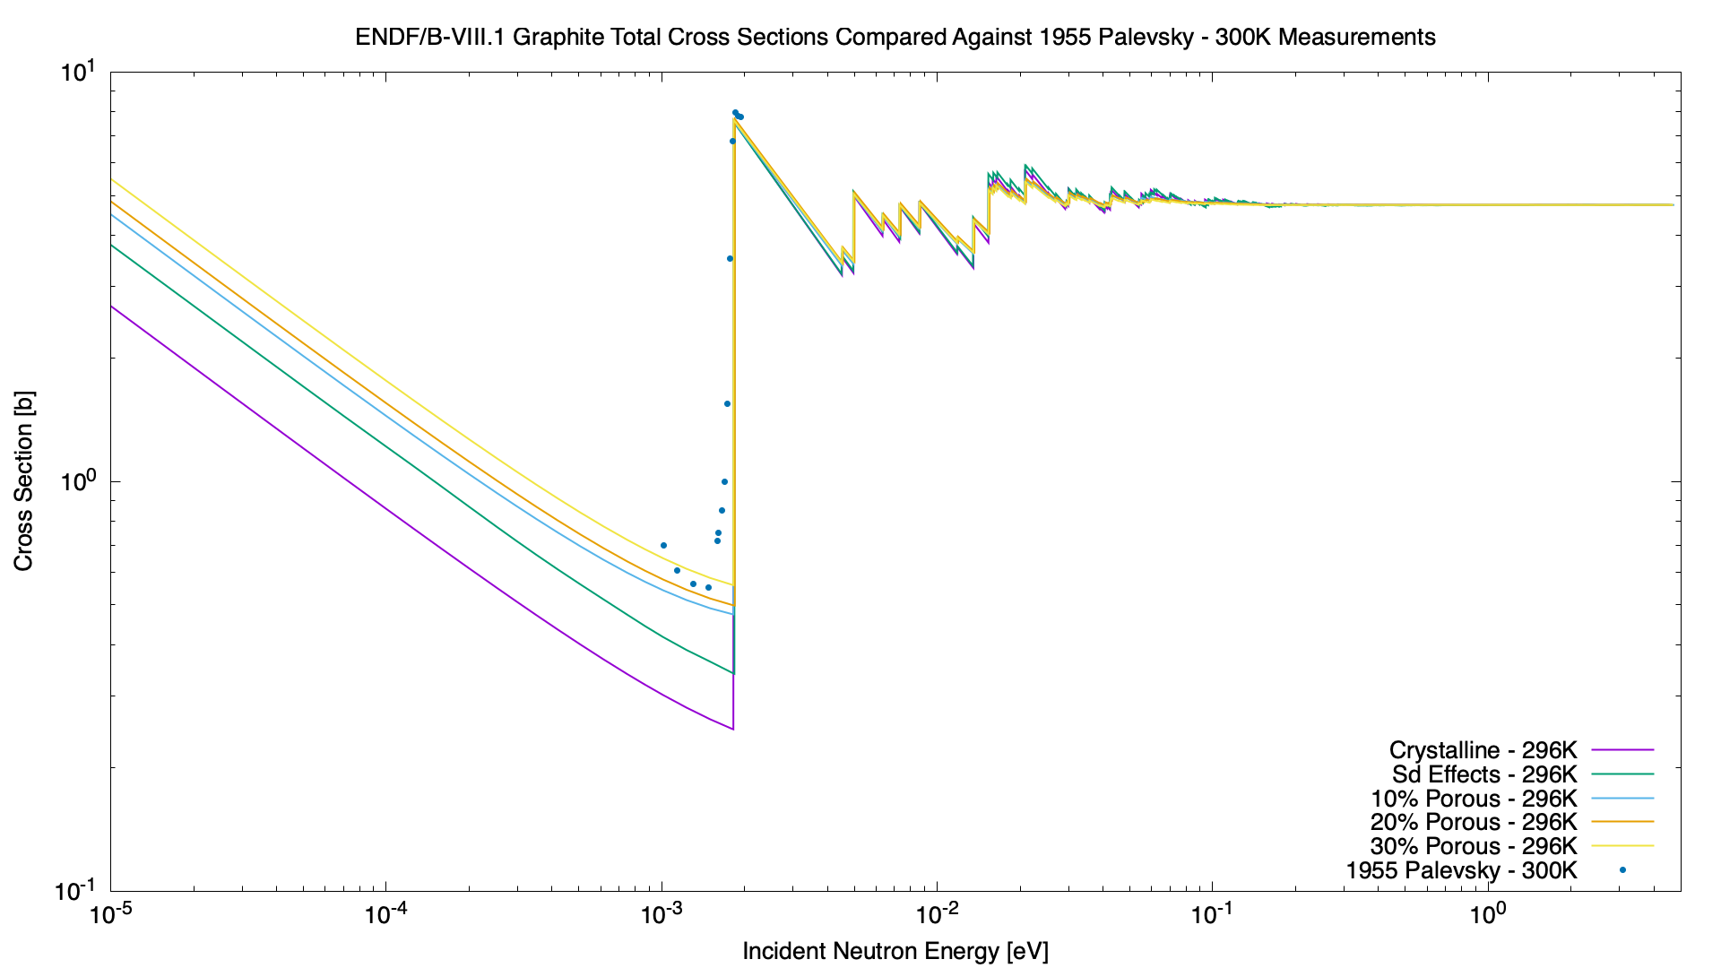
Cross Section Plot – Palevsky – 300K (1955)
Palevsky (1955)

Slide 27
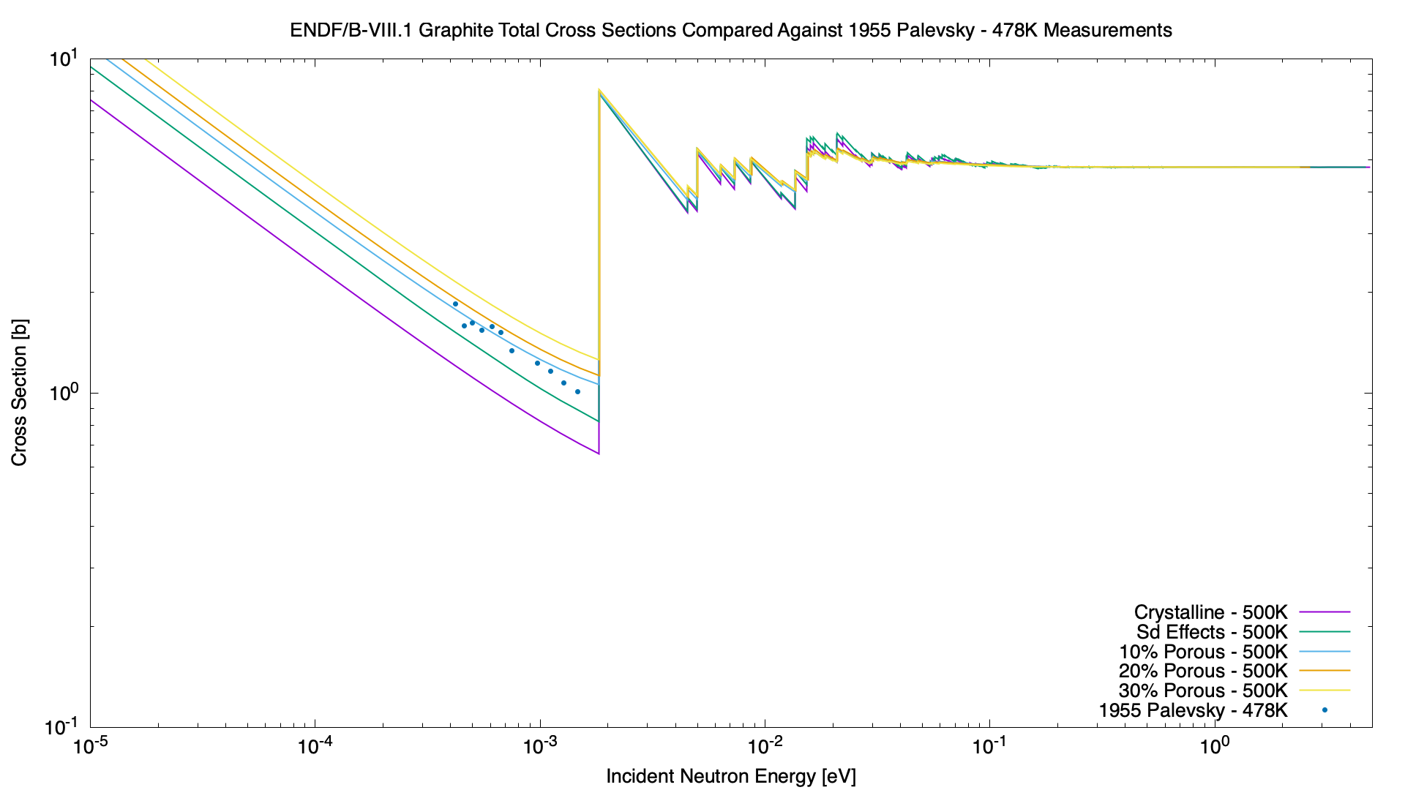
Cross Section Plot – Palevsky – 500K (1955)
Palevsky (1955)

Slide 28
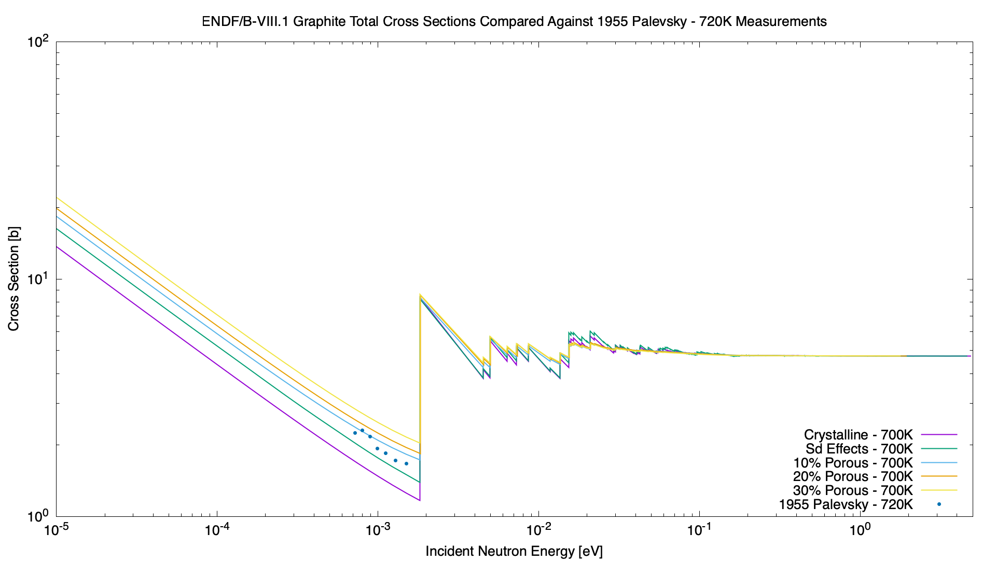
Cross Section Plot – Palevsky – 700K (1955)
Palevsky (1955)

Slide 29
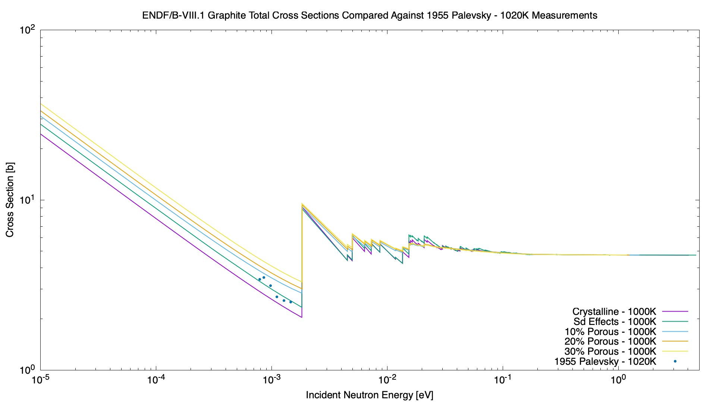
Cross Section Plot – Palevsky – 1000K (1955)
Palevsky (1955)

Slide 30

Cross Section Plot – Sailor (1955)
Sailor (1955)

Slide 31
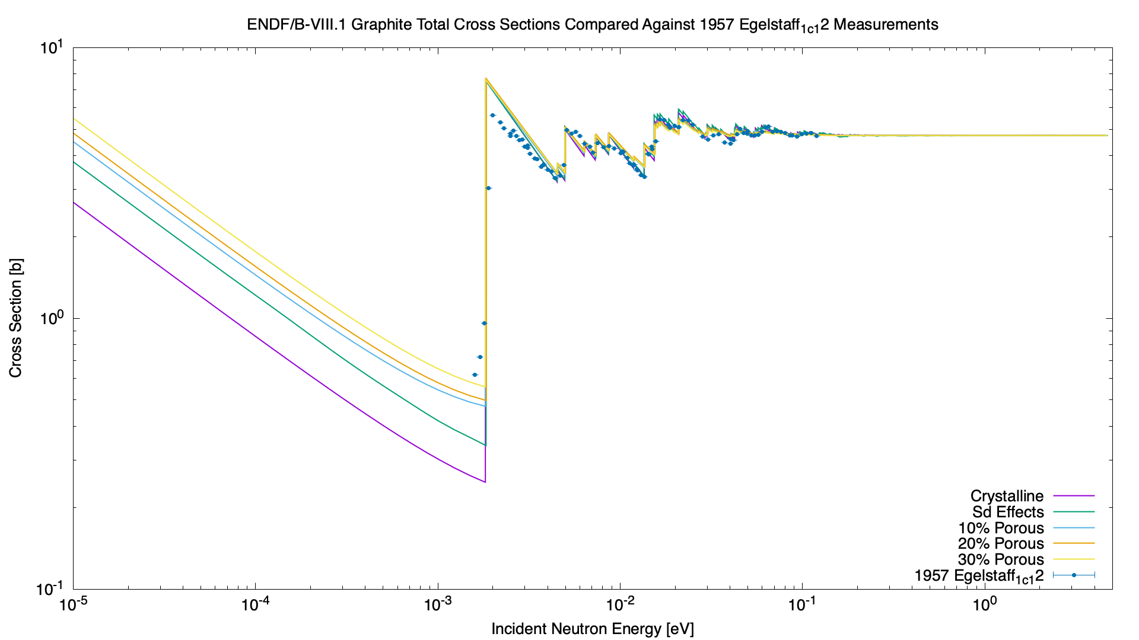
Cross Section Plot – Egelstaff_1 (1957) – C12
Egelstaff_1 (1957) – C12

Slide 32
Cross Section Plot – Egelstaff_1 (1957) – C-nat
Egelstaff_1 (1957) – C-nat

Slide 33
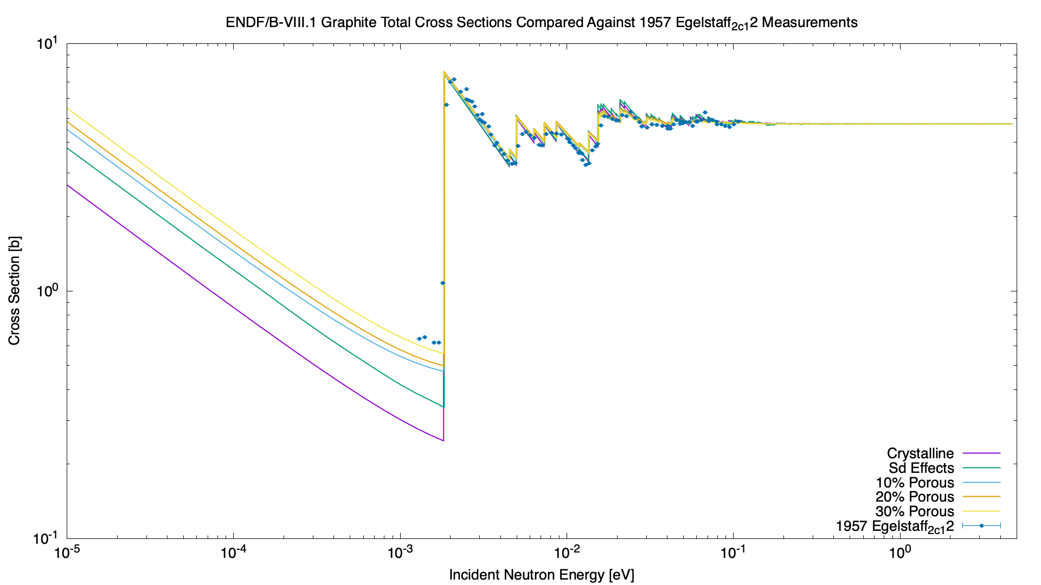
Cross Section Plot – Egelstaff_2 (1957) – C12
Egelstaff_2 (1957) – C12

Slide 34

Cross Section Plot – Egelstaff_2 (1957) – C-nat
Egelstaff_2 (1957) – C-nat

Slide 35
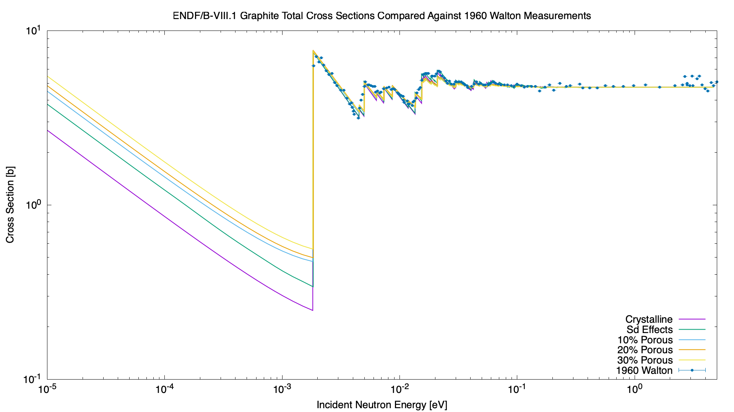
Cross Section Plot – Walton (1960)
Walton (1960)

Slide 36

Cross Section Plot – Simpson (1964)
Simpson (1964)

Slide 37
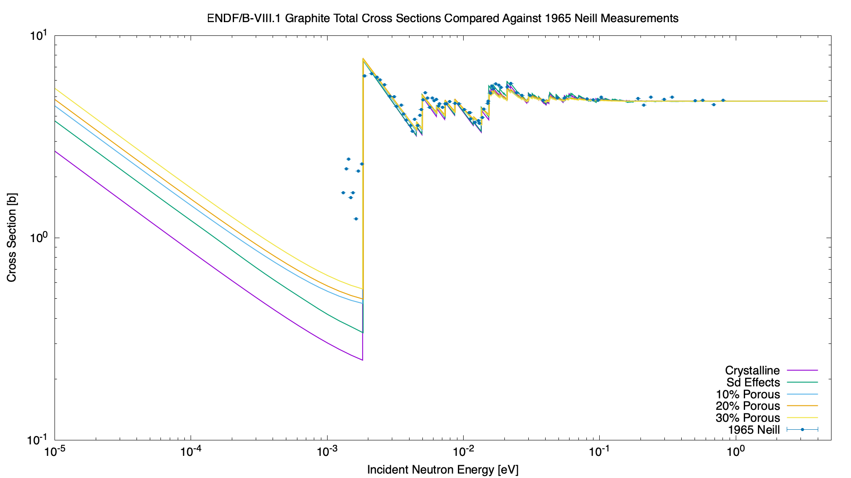
Cross Section Plot – Neill (1965)
Neill (1965)

Slide 38

Cross Section Plot – Rayburn_1 (1965)
Rayburn_1 (1965)

Slide 39

Cross Section Plot – Rayburn_2 (1965)
Rayburn_2 (1965)

Slide 40
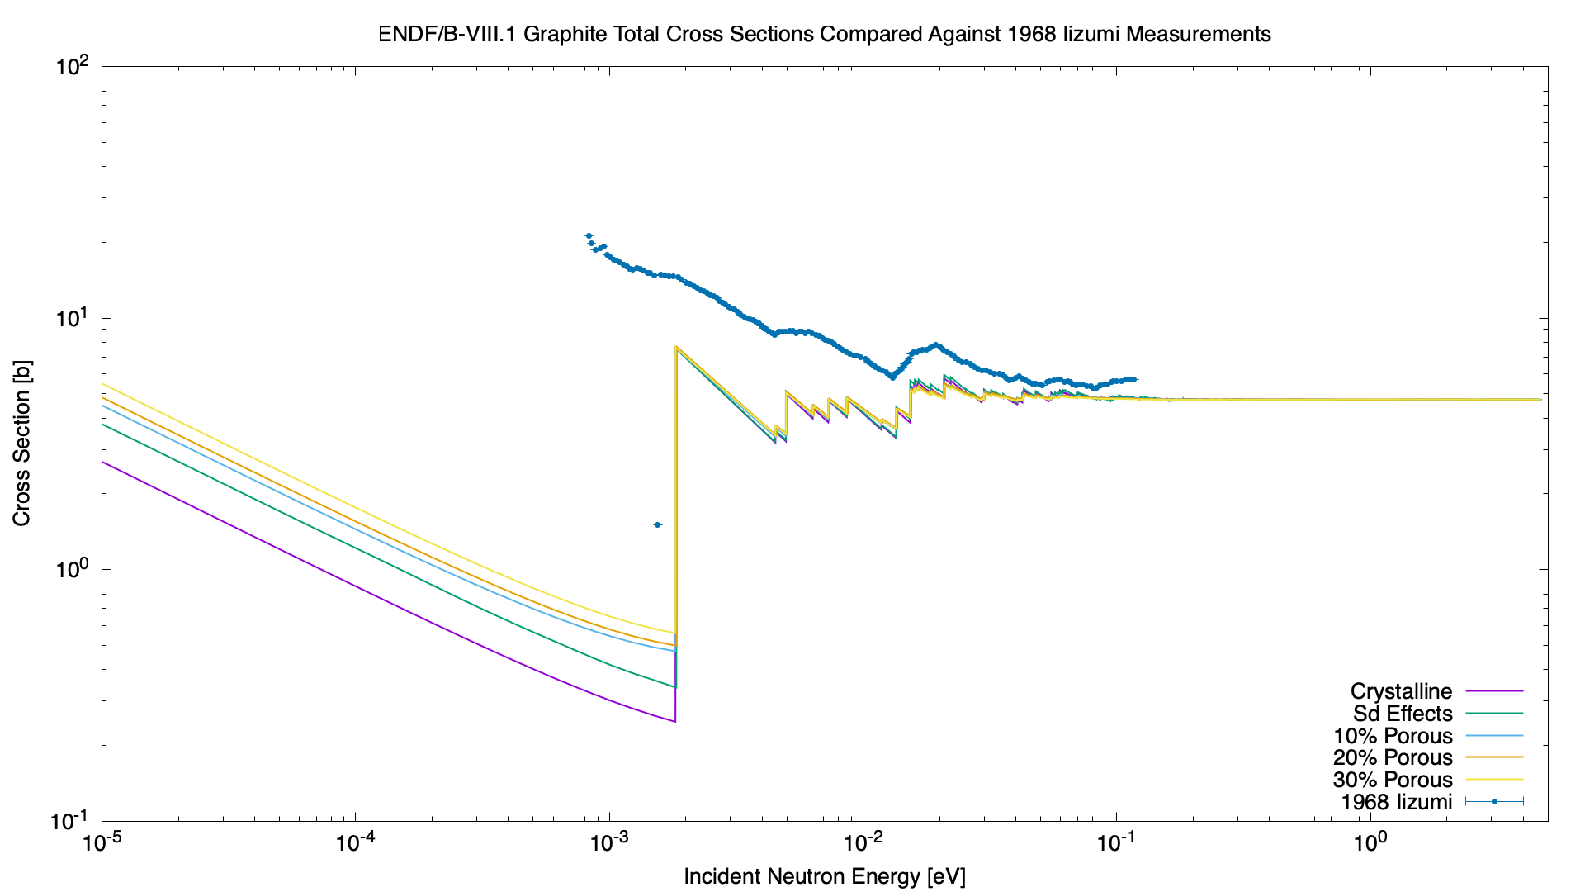
Cross Section Plot – Iizumi (1968)
Iizumi (1968)

Slide 41
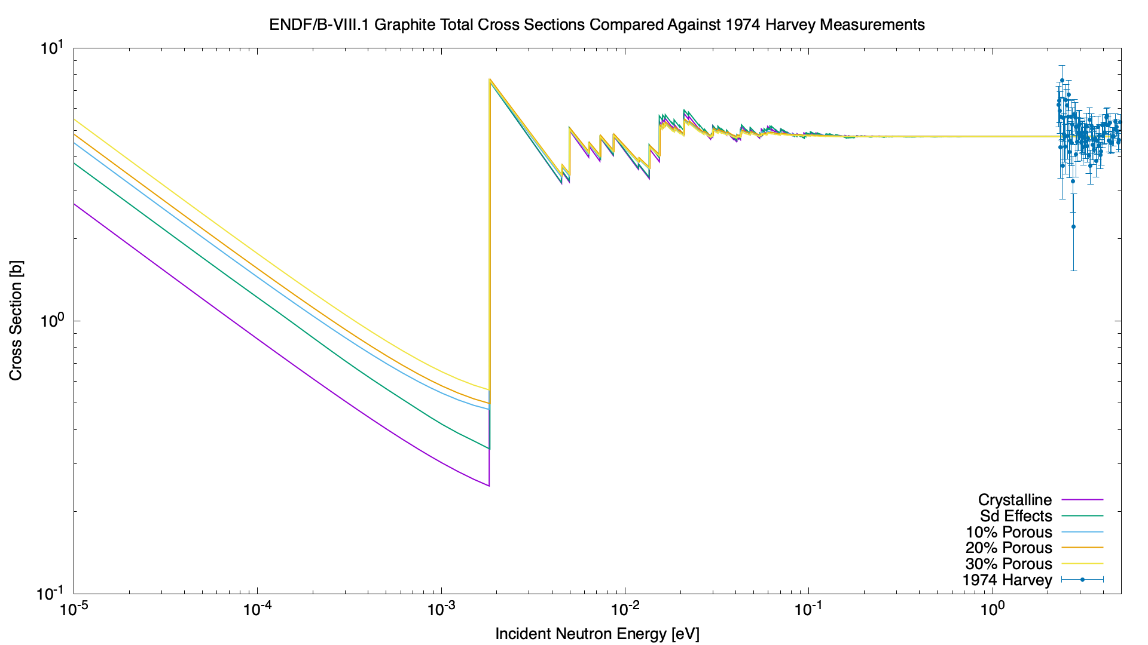
Cross Section Plot – Harvey (1974)
Harvey (1974)

Slide 42
Cross Section Plot – Shamasundar (1974)
Shamasundar (1974)

Slide 43
Cross Section Plot – Steyerl_1 (1974)
Steyerl_1 (1974)

Slide 44
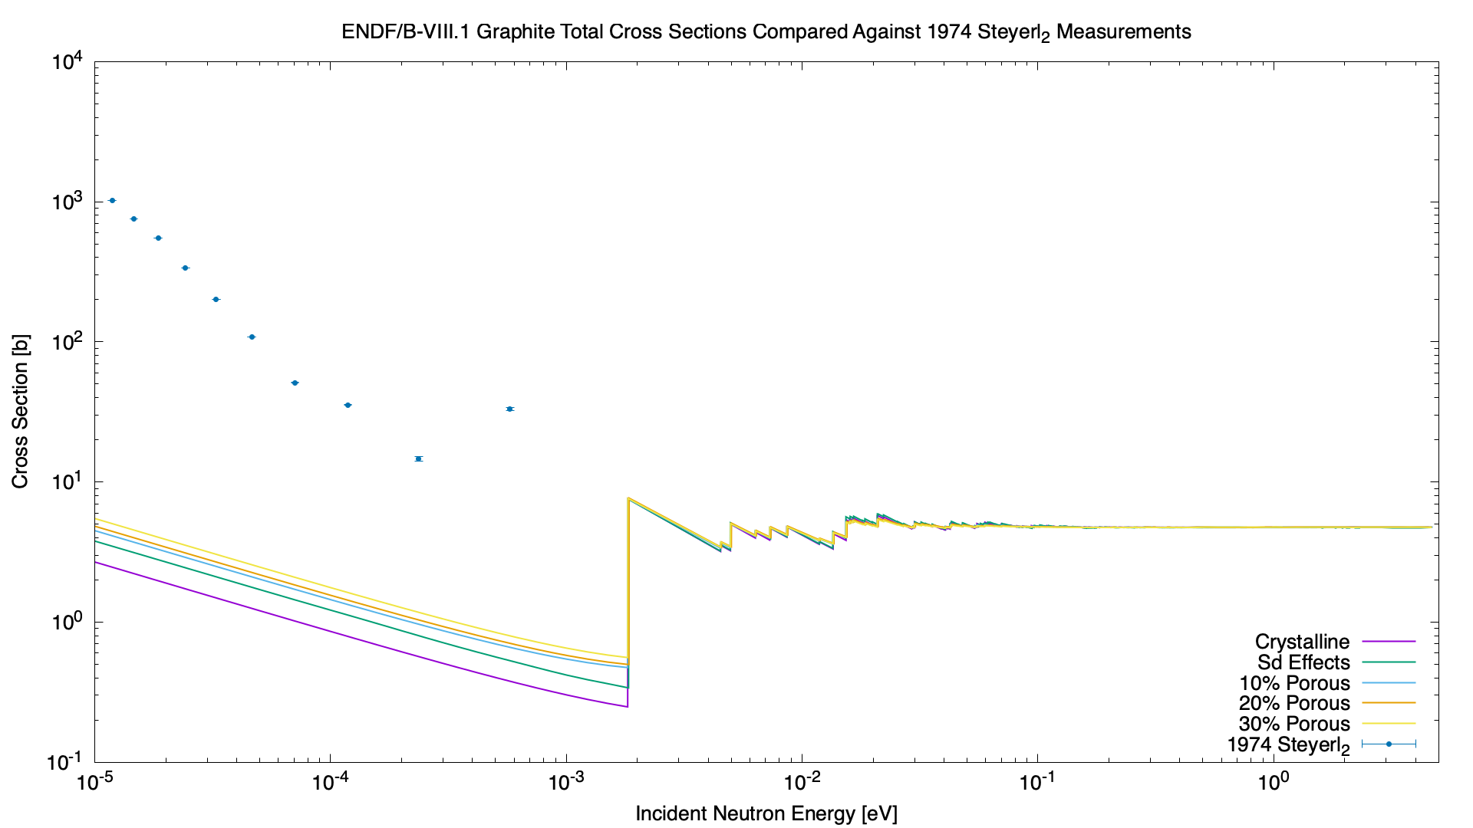
Cross Section Plot – Steyerl_2 (1974)
Steyerl_2 (1974)

Slide 45
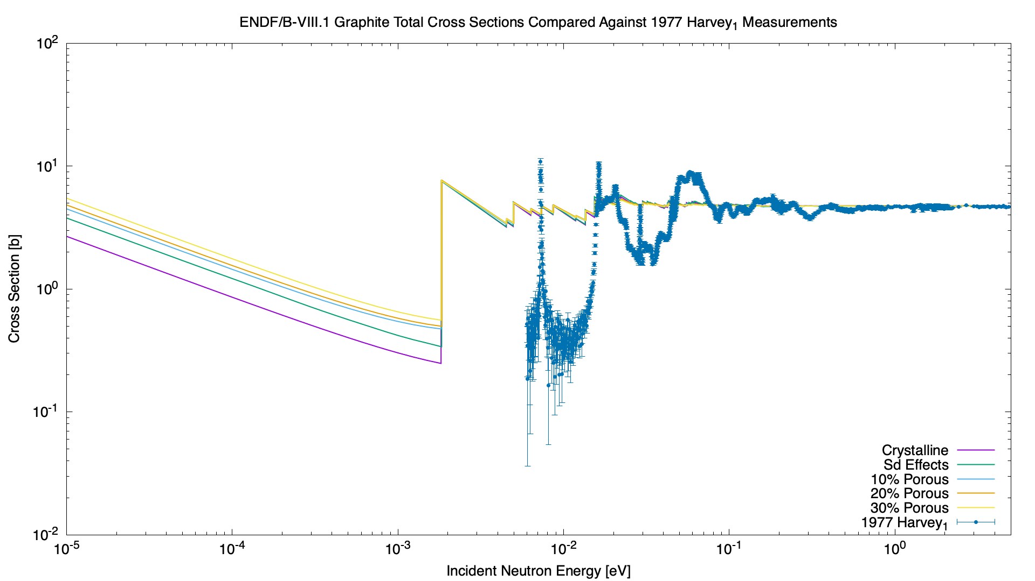
Cross Section Plot – Harvey_1 (1977)
Harvey_1 (1977)

Slide 46
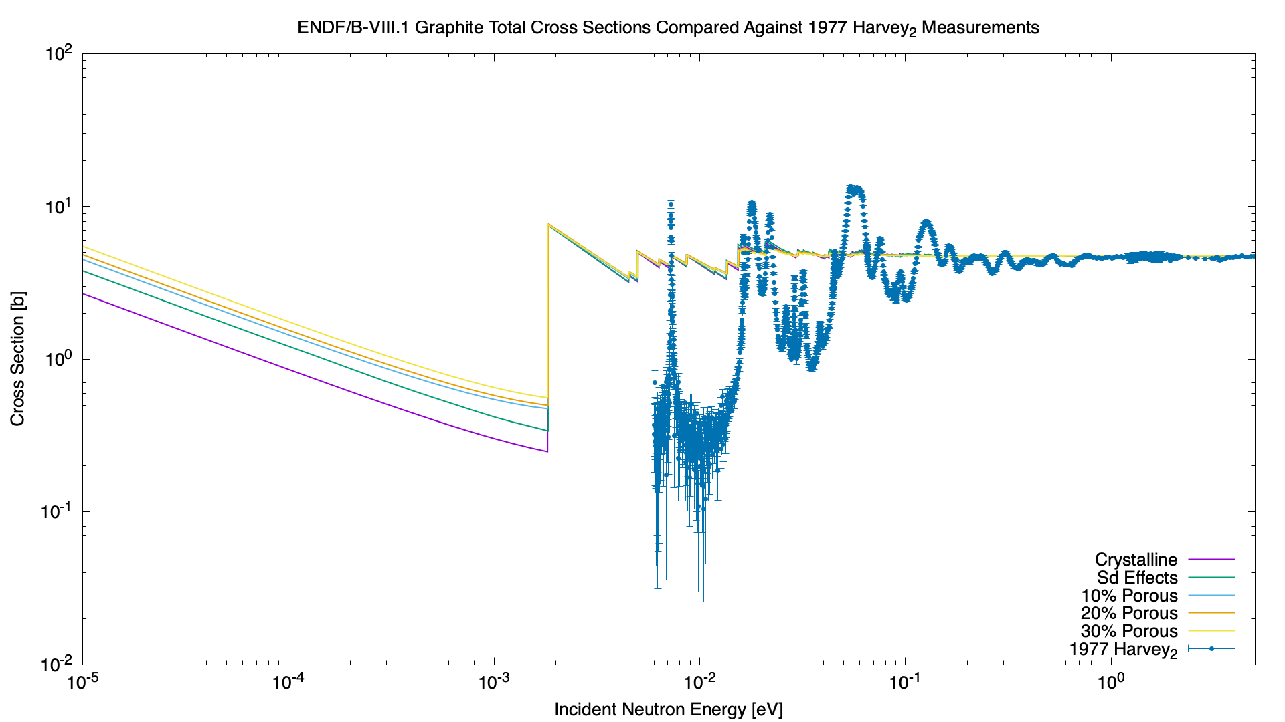
Cross Section Plot – Harvey_2 (1977)
Harvey_2 (1977)

Slide 47
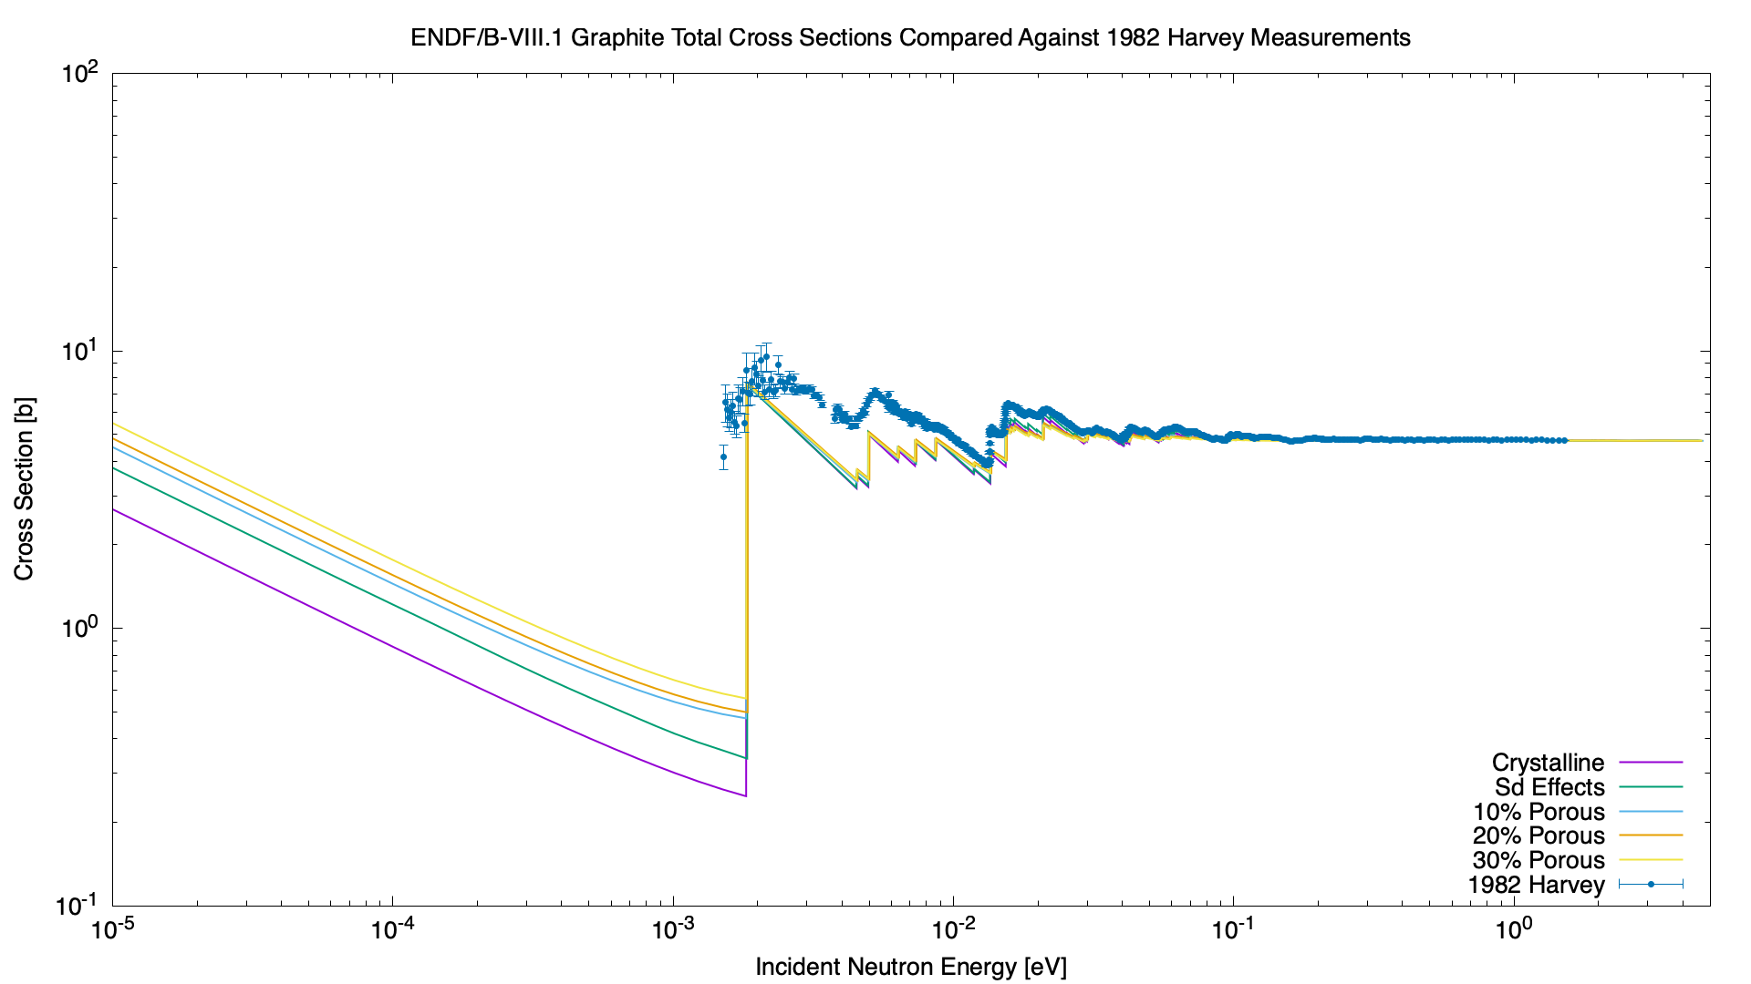
Cross Section Plot – Harvey (1982)
Harvey (1982)

Slide 48
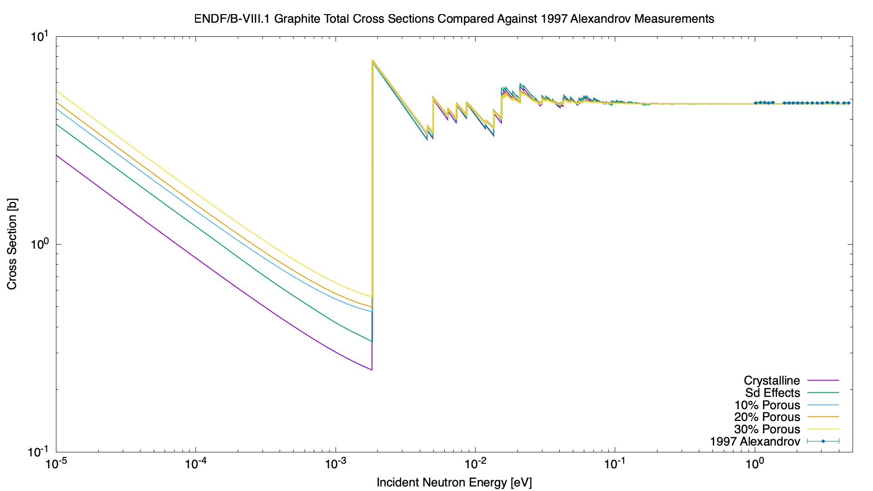
Cross Section Plot – Alexandrov (1997)
Alexandrov (1997)

Slide 49
Cross Section Plot – Zhou (2006)
Zhou (2006)

Slide 50

Cross Section Plot – Arzumanov (2008)
Arzumanov (2008)

Slide 51
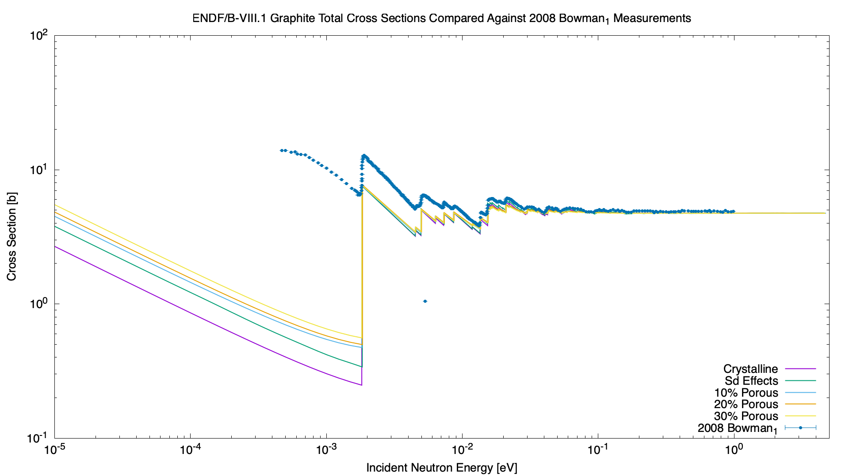
Cross Section Plot – Bowman_1 (2008)
Bowman_1 (2008)

Slide 52
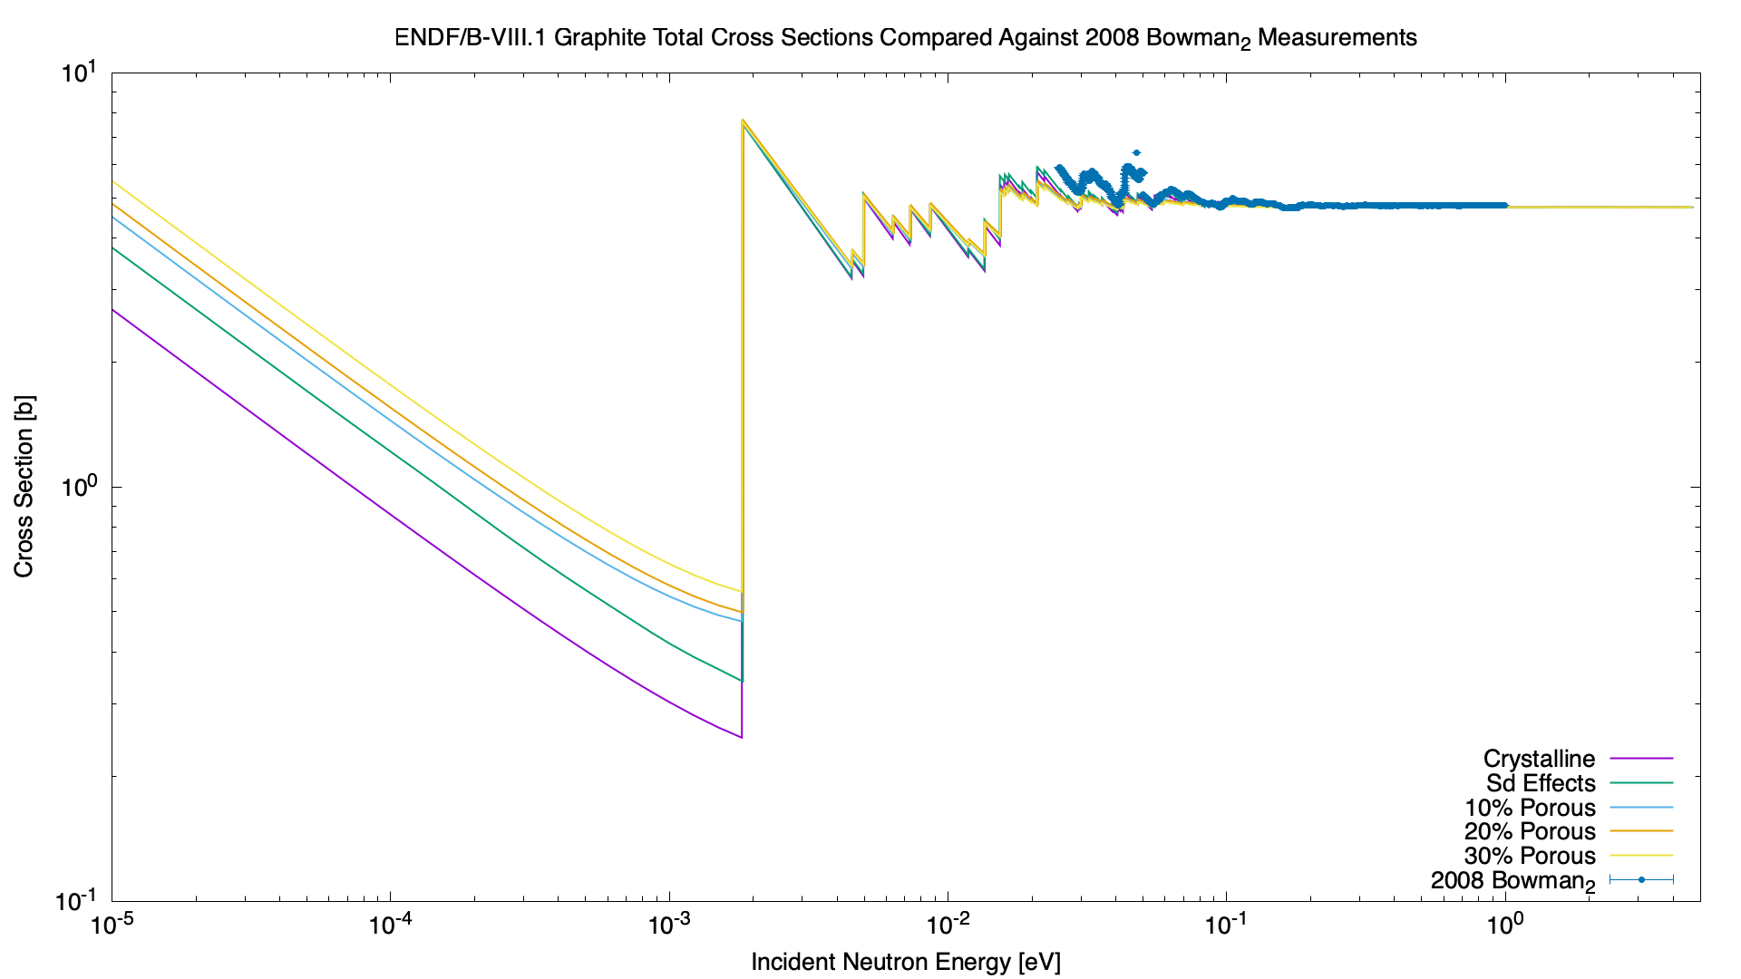
Cross Section Plot – Bowman_2 (2008)
Bowman_2 (2008)

Slide 53
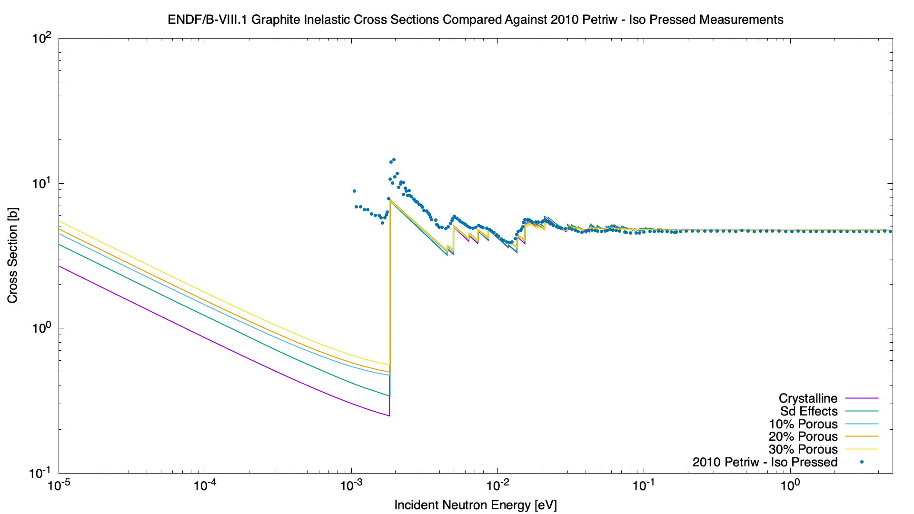
Cross Section Plot – Petriw – Iso Pressed (2010)
Petriw – Iso Pressed (2010)

Slide 54
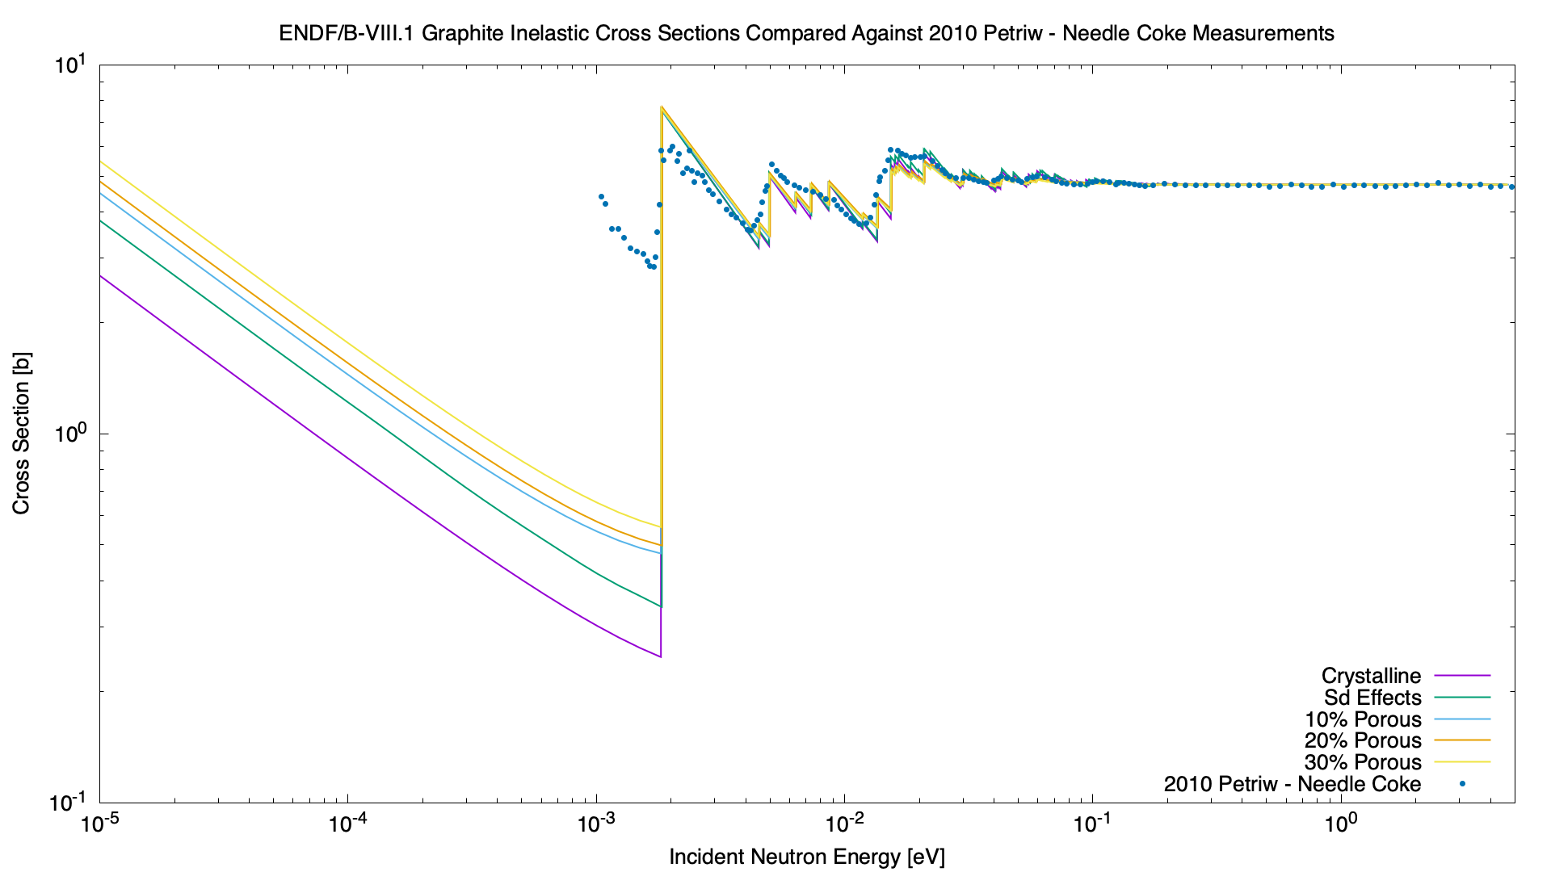
Cross Section Plot – Petriw – Needle Coke (2010)
Petriw – Needle Coke (2010)

Slide 55
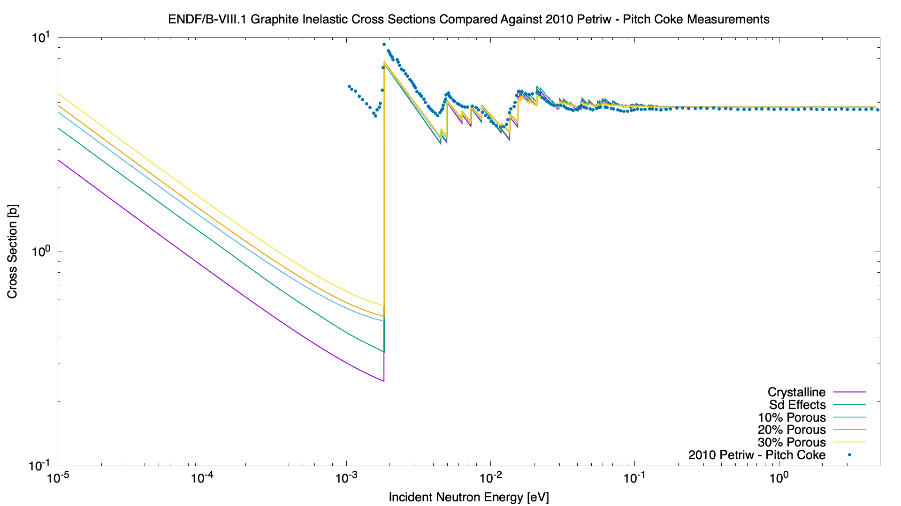
Cross Section Plot – Petriw – Pitch Coke (2010)
Petriw – Pitch Coke (2010)

Slide 56
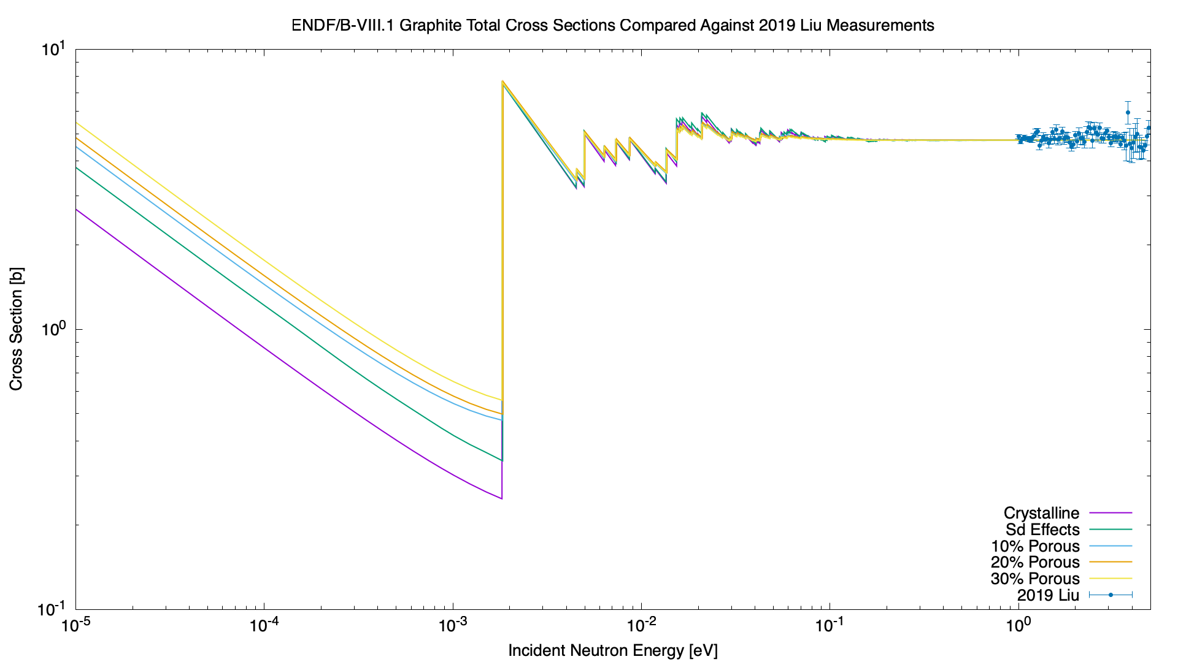
Cross Section Plot – Liu (2019)
Liu (2019)

Slide 57
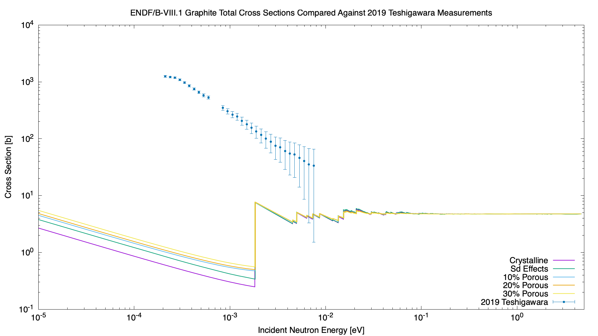
Cross Section Plot – Teshigawara (2019)
Teshigawara (2019)
Nano-diamonds, not graphite

Slide 58
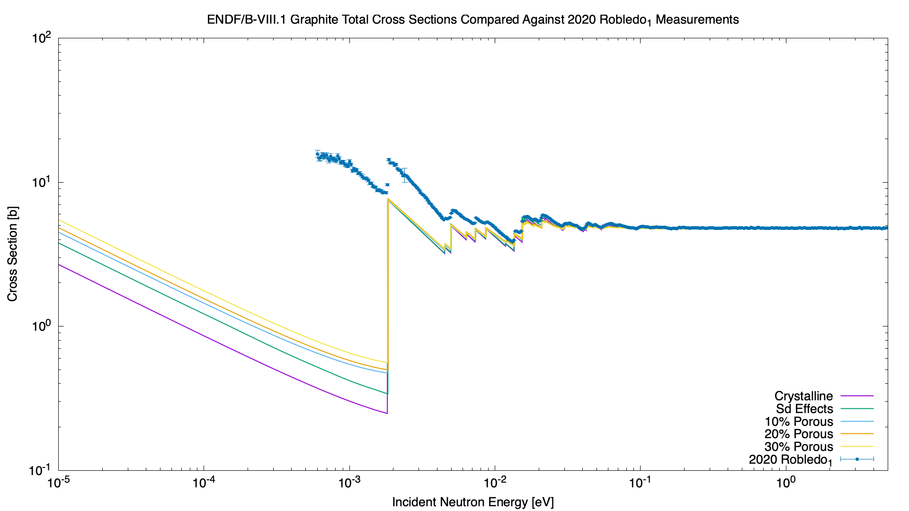
Cross Section Plot – Robledo_1 (2020)
Robledo_1 (2020)

Slide 59
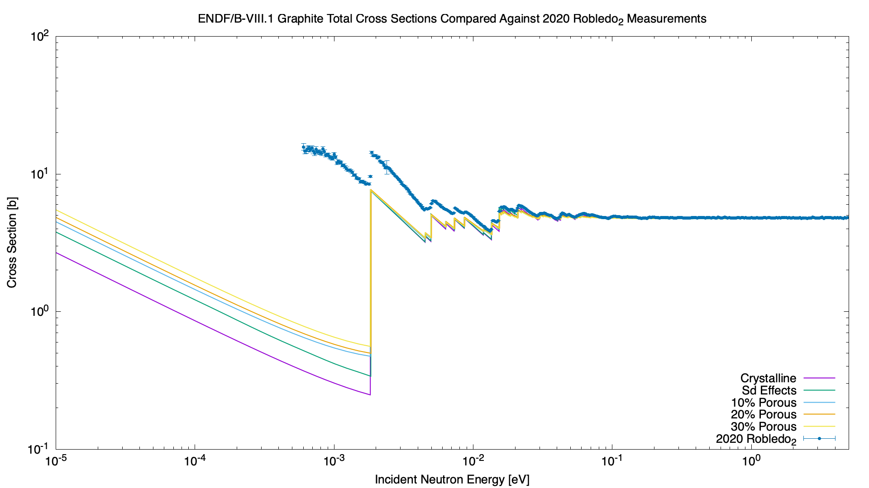
Cross Section Plot – Robledo_2 (2020)
Robledo_2 (2020)

Slide 60
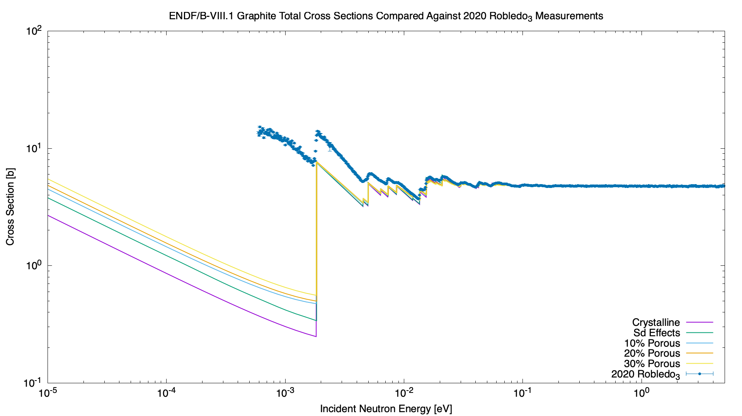
Cross Section Plot – Robledo_3 (2020)
Robledo_3 (2020)

Slide 61
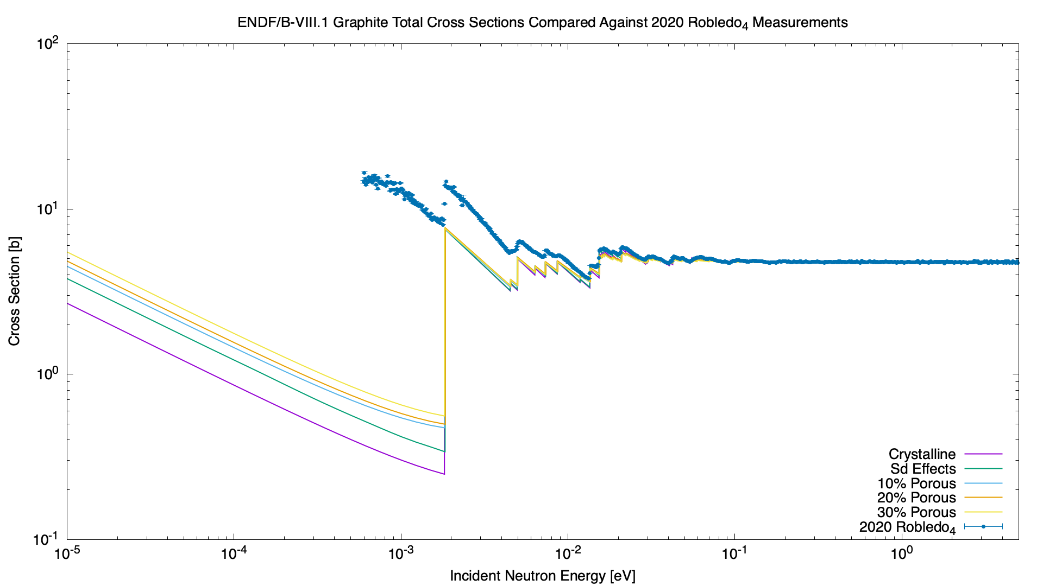
Cross Section Plot – Robledo_4 (2020)
Robledo_4 (2020)

Slide 62
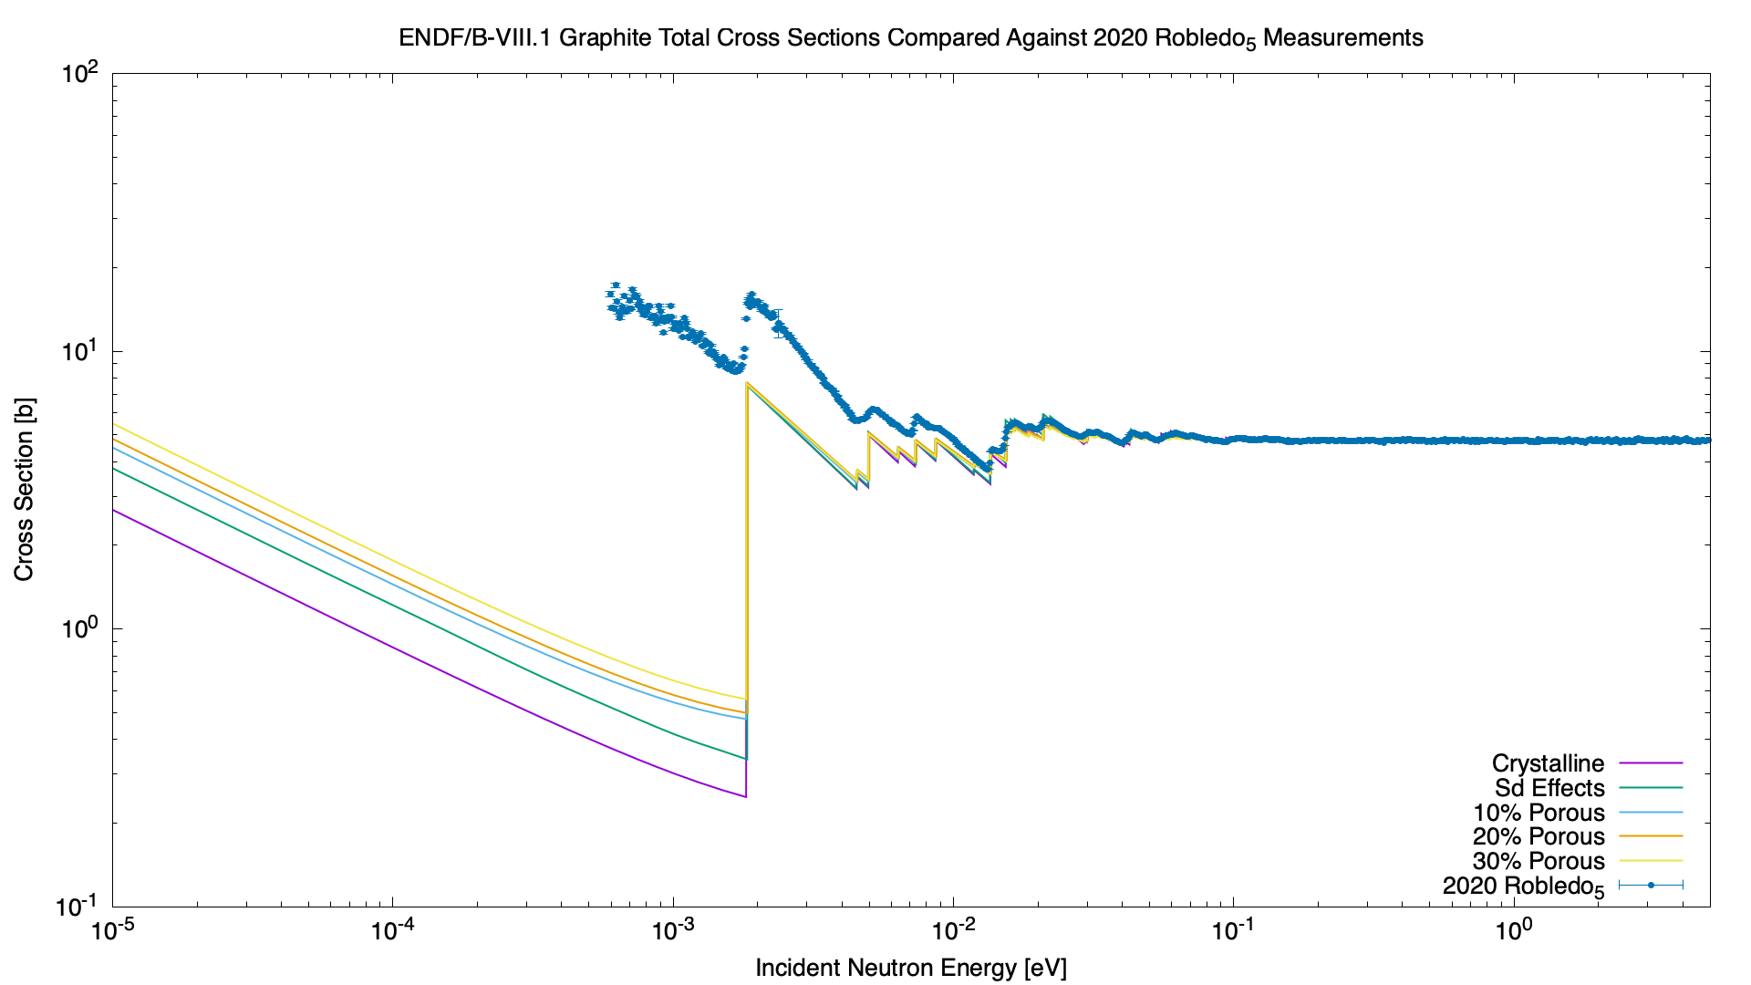
Cross Section Plot – Robledo_5 (2020)
Robledo_5 (2020)

Slide 63
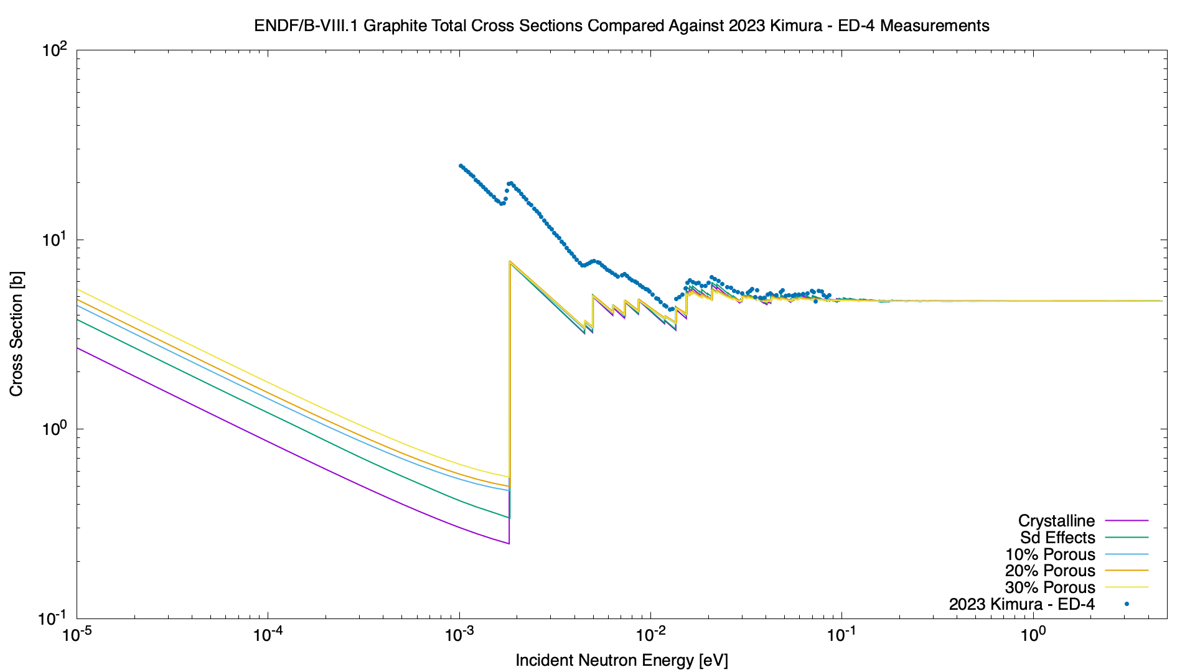
Cross Section Plot – Kimura – ED-4 (2023)
Kimura – ED-4 (2023)

Slide 64
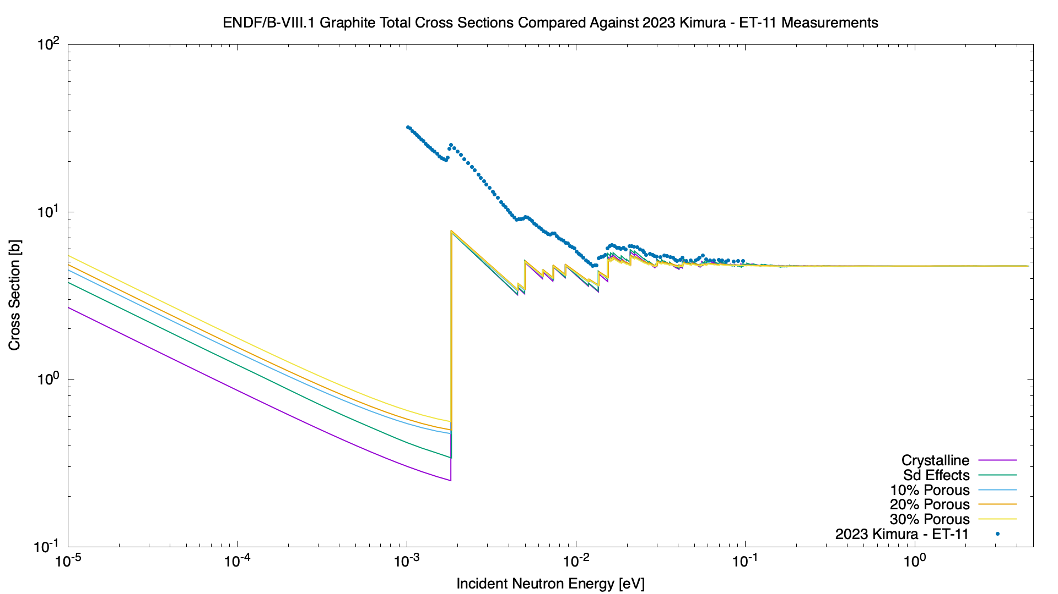
Cross Section Plot – Kimura – ET-11 (2023)
Kimura – ET-11 (2023)

Slide 65
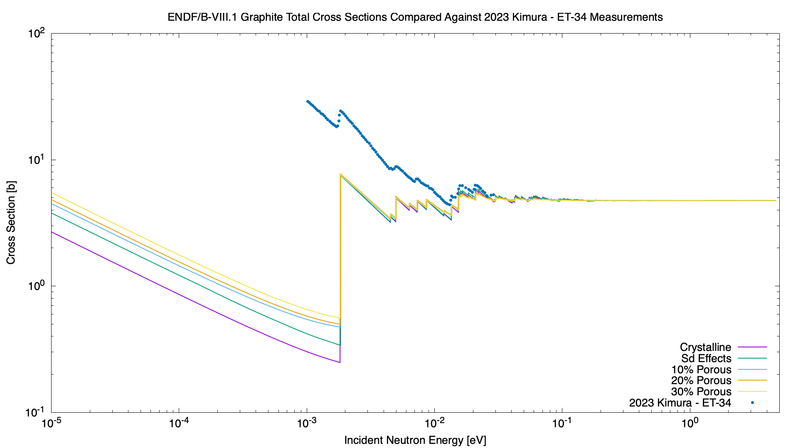
Cross Section Plot – Kimura – ET-34 (2023)
Kimura – ET-34 (2023)

Slide 66

Cross Section Plot – Kimura – T-8 (2023)
Kimura – T-8 (2023)

Slide 67

Cross Section Plot – Ramić – IG-110 1023K (2024)
Ramić – IG-100 – 1023K (2024)

Slide 68

Cross Section Plot – Ramić – NBG-18 (2024)
Ramić – NBG-18 (2024)

Slide 69

Cross Section Plot – Ramić – PCEA (2024)
Ramić – PCEA (2024)

