Slide 1
Integral Benchmarks for Validating Graphite Thermal Scattering Laws
Presented at the CSEWG Reactor Graphite (ReGra) Workshop
Brookhaven National Laboratory
July 9, 2025
Catherine Percher

Slide 2


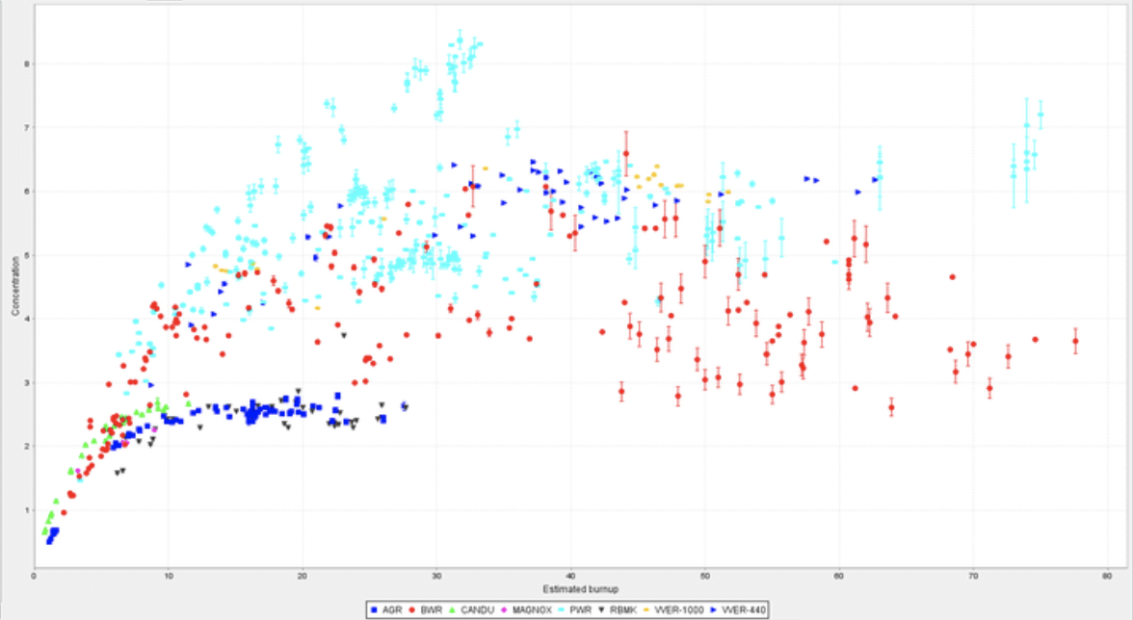
Established Integral Benchmark Handbooks
International Criticality Safety Benchmark Evaluation Project (ICSBEP)
  >5000 Critical, subcritical, shielding, and physics configurations
International Reactor Physics Evaluation Project (IRPhEP)
  200 Reactor benchmarks
  200 Spectra benchmarks
Shielding Integral Benchmark Database (SINBAD)
  Reactor shielding (46)
  Fusion neutronics shielding (31)
  Accelerator shielding (23)
Spent Fuel Composition (SFCompo)
  700 Samples

Slide 3
Established Integral Benchmark Handbooks
International Criticality Safety Benchmark Evaluation Project (ICSBEP)
  >5000 Critical, subcritical, shielding, and physics configurations
International Reactor Physics Evaluation Project (IRPhEP)
  200 Reactor benchmarks
  200 Spectra benchmarks
Shielding Integral Benchmark Database (SINBAD)
  Reactor shielding (46)
  Fusion neutronics shielding (31)
  Accelerator shielding (23)
Spent Fuel Composition (SFCompo)
  700 Samples
Less Rigorous Benchmark Uncertainty Analysis
Larger Experimental Uncertainties

Slide 4
ICSBEP Thermal Benchmarks with Graphite
ICSBEP Identifier | Title | Graphite Info | # of Cases
PU-SOL-THERM-019 | Plutonium Sulfate Solutions Reflected By Beryllium Oxide And Graphite Proserpine Reactor - Saclay | Reflector | 11
HEU-COMP-THERM-002 | Graphite and Water Moderated NRX-A3 and NRX-A4 assemblies | Fuel Matrix | 25
HEU-COMP-THERM-016 | IGR Reactor – Uranium-Graphite Blocks Reflected by Graphite | Fuel Matrix, Reflector | 6
HEU-MET-THERM-026 | Beryllium-Moderated, Graphite-Reflected Critical Experiments of Highly Enriched Uranium Tubular Fuel | Reflector | 27
HEU-SOL-THERM-046 | Highly Enriched Uranium (89.84 wt.% 235u) Sulfate Solutions Reflected by Beryllium Oxide and Graphite Proserpine Reactor - Saclay | Reflector | 13
IEU-COMP-THERM-003 | Triga Mark II Reactor: U(20) – Zirconium Hydride Fuel Rods in Water with Graphite Reflector | Reflector | 2
IEU-COMP-THERM-008 | Graphite Annular Core Assemblies with Spherical Fuel Elements Containing Coated UO2 Fuel Particles | Fuel Matrix, Reflector | 5
IEU-COMP-THERM-010 | Evaluation of the Initial Critical Configuration of the HTR-10 Pebble-Bed Reactor | Fuel Matrix, Reflector | 1
IEU-COMP-THERM-013 | Fresh-core Reload of the Neutron Radiography (NRAD) Reactor with Uranium(20)-Erbium-Zirconium-Hydride Fuel | Reflector | 1
IEU-SOL-THERM-001 | Graphite-Reflected Uranyl Sulphate (20.9% 235u) Solutions | Reflector | 4
LEU-COMP-THERM-060 | RBMK Graphite Reactor: Uniform Configurations of U(1.8, 2.0, or 2.4% 235U)O2 Fuel Assemblies, and Configurations of U(2.0% 235U)O2 Assemblies with Empty Channels, Water Columns, and Boron or Thorium Absorbers, with or without Water in Channels | Fuel Matrix, Reflector | 28
LEU-MET-THERM-003 | ZED-2 Reactor: Natural-Uranium Metal Fuel Assemblies in Heavy-water | Reflector | 3
FUND-ORELA-ACC-GRAPH-PNSDT-001 | Benchmark of Neutron Thermalization in Graphite using the Slowing-Down-Time ORELA Experiment | Test Sample | 1

Slide 5
Solution Systems Should Almost Never Be Used for ND Purposes (due to solution characterization issues)
ICSBEP Identifier | Title | Graphite Info | # of Cases
PU-SOL-THERM-019 | Plutonium Sulfate Solutions Reflected By Beryllium Oxide And Graphite Proserpine Reactor - Saclay | Reflector | 11
HEU-COMP-THERM-002 | Graphite and Water Moderated NRX-A3 and NRX-A4 assemblies | Fuel Matrix | 25
HEU-COMP-THERM-016 | IGR Reactor – Uranium-Graphite Blocks Reflected by Graphite | Fuel Matrix, Reflector | 6
HEU-MET-THERM-026 | Beryllium-Moderated, Graphite-Reflected Critical Experiments of Highly Enriched Uranium Tubular Fuel | Reflector | 27
HEU-SOL-THERM-046 | Highly Enriched Uranium (89.84 wt.% 235u) Sulfate Solutions Reflected by Beryllium Oxide and Graphite Proserpine Reactor - Saclay | Reflector | 13
IEU-COMP-THERM-003 | Triga Mark II Reactor: U(20) – Zirconium Hydride Fuel Rods in Water with Graphite Reflector | Reflector | 2
IEU-COMP-THERM-008 | Graphite Annular Core Assemblies with Spherical Fuel Elements Containing Coated UO2 Fuel Particles | Fuel Matrix, Reflector | 5
IEU-COMP-THERM-010 | Evaluation of the Initial Critical Configuration of the HTR-10 Pebble-Bed Reactor | Fuel Matrix, Reflector | 1
IEU-COMP-THERM-013 | Fresh-core Reload of the Neutron Radiography (NRAD) Reactor with Uranium(20)-Erbium-Zirconium-Hydride Fuel | Reflector | 1
IEU-SOL-THERM-001 | Graphite-Reflected Uranyl Sulphate (20.9% 235u) Solutions | Reflector | 4
LEU-COMP-THERM-060 | RBMK Graphite Reactor: Uniform Configurations of U(1.8, 2.0, or 2.4% 235U)O2 Fuel Assemblies, and Configurations of U(2.0% 235U)O2 Assemblies with Empty Channels, Water Columns, and Boron or Thorium Absorbers, with or without Water in Channels | Fuel Matrix, Reflector | 28
LEU-MET-THERM-003 | ZED-2 Reactor: Natural-Uranium Metal Fuel Assemblies in Heavy-water | Reflector | 3
FUND-ORELA-ACC-GRAPH-PNSDT-001 | Benchmark of Neutron Thermalization in Graphite using the Slowing-Down-Time ORELA Experiment | Test Sample | 1

Slide 6
Graphite as a Reflector is Just Not Very Sensitive to TSL
(TSL “off” vs TSL “on” lower than benchmark uncertainty)
ICSBEP Identifier | Title | Graphite Info | # of Cases
PU-SOL-THERM-019 | Plutonium Sulfate Solutions Reflected By Beryllium Oxide And Graphite Proserpine Reactor - Saclay | Reflector | 11
HEU-COMP-THERM-002 | Graphite and Water Moderated NRX-A3 and NRX-A4 assemblies | Fuel Matrix | 25
HEU-COMP-THERM-016 | IGR Reactor – Uranium-Graphite Blocks Reflected by Graphite | Fuel Matrix, Reflector | 6
HEU-MET-THERM-026 | Beryllium-Moderated, Graphite-Reflected Critical Experiments of Highly Enriched Uranium Tubular Fuel | Reflector | 27
HEU-SOL-THERM-046 | Highly Enriched Uranium (89.84 wt.% 235u) Sulfate Solutions Reflected by Beryllium Oxide and Graphite Proserpine Reactor - Saclay | Reflector | 13
IEU-COMP-THERM-003 | Triga Mark II Reactor: U(20) – Zirconium Hydride Fuel Rods in Water with Graphite Reflector | Reflector | 2
IEU-COMP-THERM-008 | Graphite Annular Core Assemblies with Spherical Fuel Elements Containing Coated UO2 Fuel Particles | Fuel Matrix, Reflector | 5
IEU-COMP-THERM-010 | Evaluation of the Initial Critical Configuration of the HTR-10 Pebble-Bed Reactor | Fuel Matrix, Reflector | 1
IEU-COMP-THERM-013 | Fresh-core Reload of the Neutron Radiography (NRAD) Reactor with Uranium(20)-Erbium-Zirconium-Hydride Fuel | Reflector | 1
IEU-SOL-THERM-001 | Graphite-Reflected Uranyl Sulphate (20.9% 235u) Solutions | Reflector | 4
LEU-COMP-THERM-060 | RBMK Graphite Reactor: Uniform Configurations of U(1.8, 2.0, or 2.4% 235U)O2 Fuel Assemblies, and Configurations of U(2.0% 235U)O2 Assemblies with Empty Channels, Water Columns, and Boron or Thorium Absorbers, with or without Water in Channels | Fuel Matrix, Reflector | 28
LEU-MET-THERM-003 | ZED-2 Reactor: Natural-Uranium Metal Fuel Assemblies in Heavy-water | Reflector | 3
FUND-ORELA-ACC-GRAPH-PNSDT-001 | Benchmark of Neutron Thermalization in Graphite using the Slowing-Down-Time ORELA Experiment | Test Sample | 1

Slide 7
…So What Does that Leave Us With?
ICSBEP Identifier | Title | Graphite Info | # of Cases
HEU-COMP-THERM-002 | Graphite and Water Moderated NRX-A3 and NRX-A4 assemblies | Fuel Matrix | 25
HEU-COMP-THERM-016 | IGR Reactor – Uranium-Graphite Blocks Reflected by Graphite | Fuel Matrix, Reflector | 6
IEU-COMP-THERM-008 | Graphite Annular Core Assemblies with Spherical Fuel Elements Containing Coated UO2 Fuel Particles | Fuel Matrix, Reflector | 5
IEU-COMP-THERM-010 | Evaluation of the Initial Critical Configuration of the HTR-10 Pebble-Bed Reactor | Fuel Matrix, Reflector | 1
LEU-COMP-THERM-060 | RBMK Graphite Reactor: Uniform Configurations of U(1.8, 2.0, or 2.4% 235U)O2 Fuel Assemblies, and Configurations of U(2.0% 235U)O2 Assemblies with Empty Channels, Water Columns, and Boron or Thorium Absorbers, with or without Water in Channels | Moderator, Reflector | 28
FUND-ORELA-ACC-GRAPH-PNSDT-001 | Benchmark of Neutron Thermalization in Graphite using the Slowing-Down-Time ORELA Experiment | Test Sample | 1

Slide 8
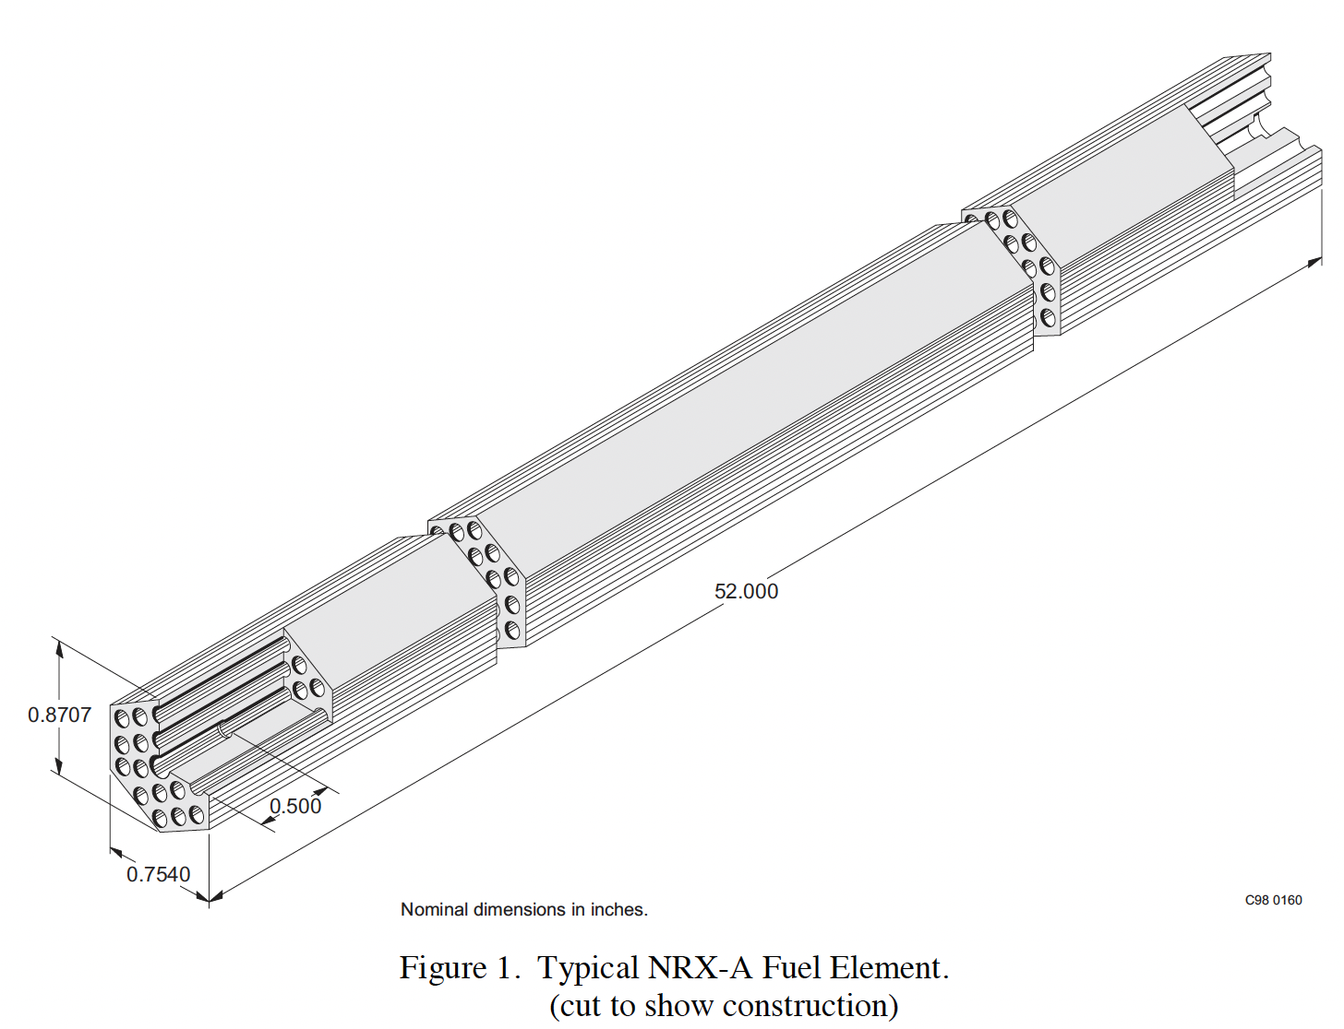
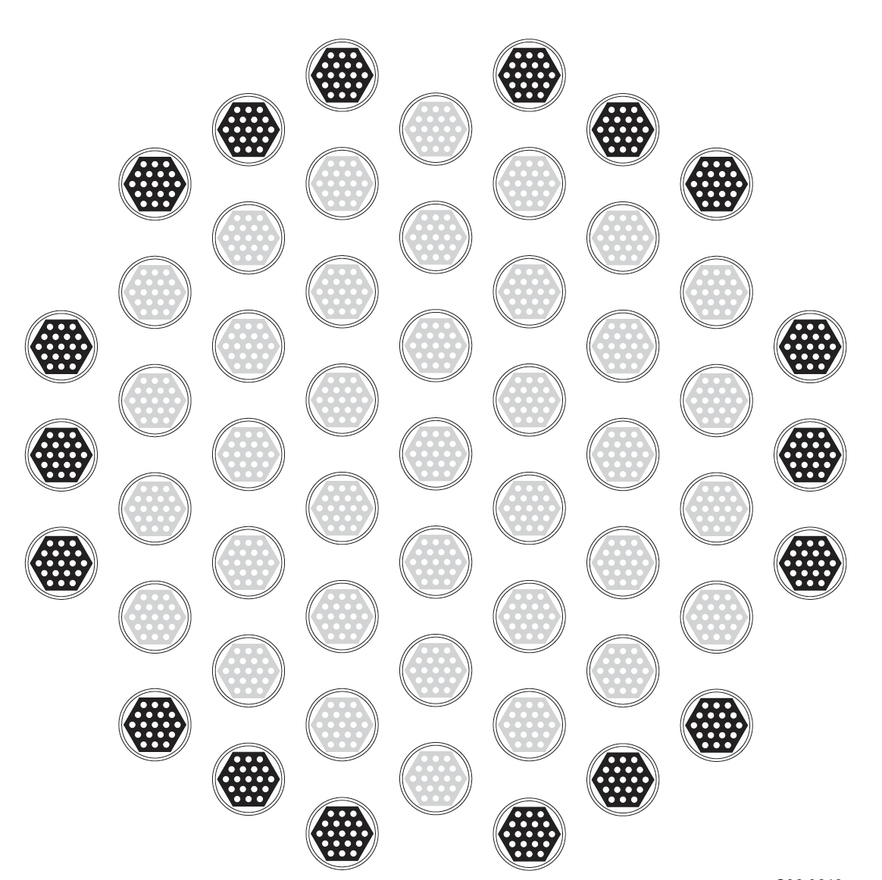
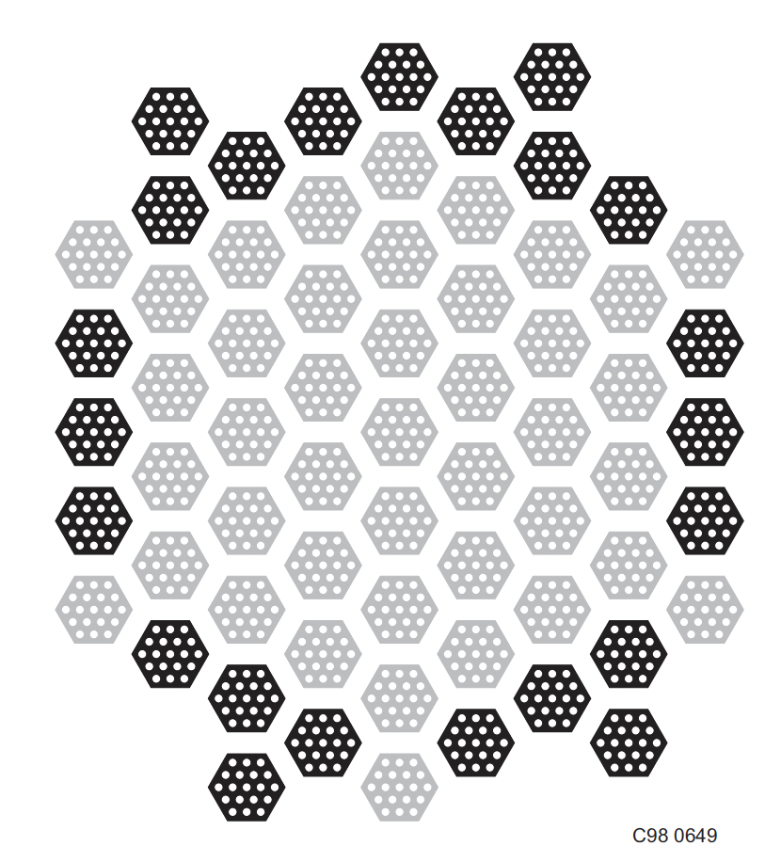
HEU-COMP-THERM-002, NRX-A3 and -A4 Assemblies with Water
Evaluation completed in 1998 by INL, review by LANL
  Experiments conducted at ORNL from 1965-1966
  Dispersion of pyrolytic-graphite coated uranium dicarbide spherical beads in a graphite matrix
22 total configurations, all at 20 °C
  Square-pitched lattices without internal moderation
  Triangular-pitched lattices without internal moderation
  Triangular-pitched lattices with internal moderation
Unfortunately, the benchmark uncertainties are quite high- ranging from 430-850 pcm
Calculated graphite TSL sensitivities were maximally 316 pcm (case 8), so these benchmarks are NOT recommended for graphite TSL validation

Slide 9
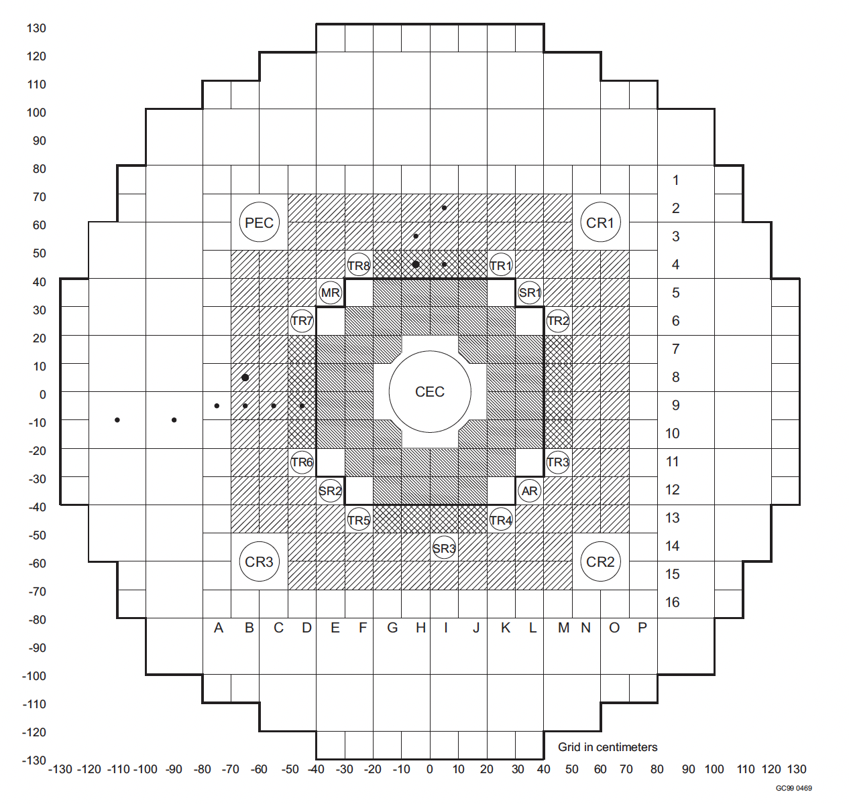
HEU-COMP-THERM-016, IGR Reactor
Evaluation completed in 2001 by Kazakhstan researchers and Kurchatov Institute, review by INL
  Experiments conducted at Semipalatinsk Nuclear Test Site from 1970-1992
  Uranium-impregnated graphite blocks (from soaking in uranyl nitrate solution) reflected by graphite with control rods
6 configurations varied by temperature
Benchmark uncertainties are quite high- 1.1%- owing mainly to uncertainties in U235 mass and distribution, light burn-up on the fuel, and B impurity in graphite
Calculated graphite TSL sensitivities for room temperature case were very high- 2.094%! Could still provide some useful information for for graphite TSL validation, especially at higher temperatures

Slide 10
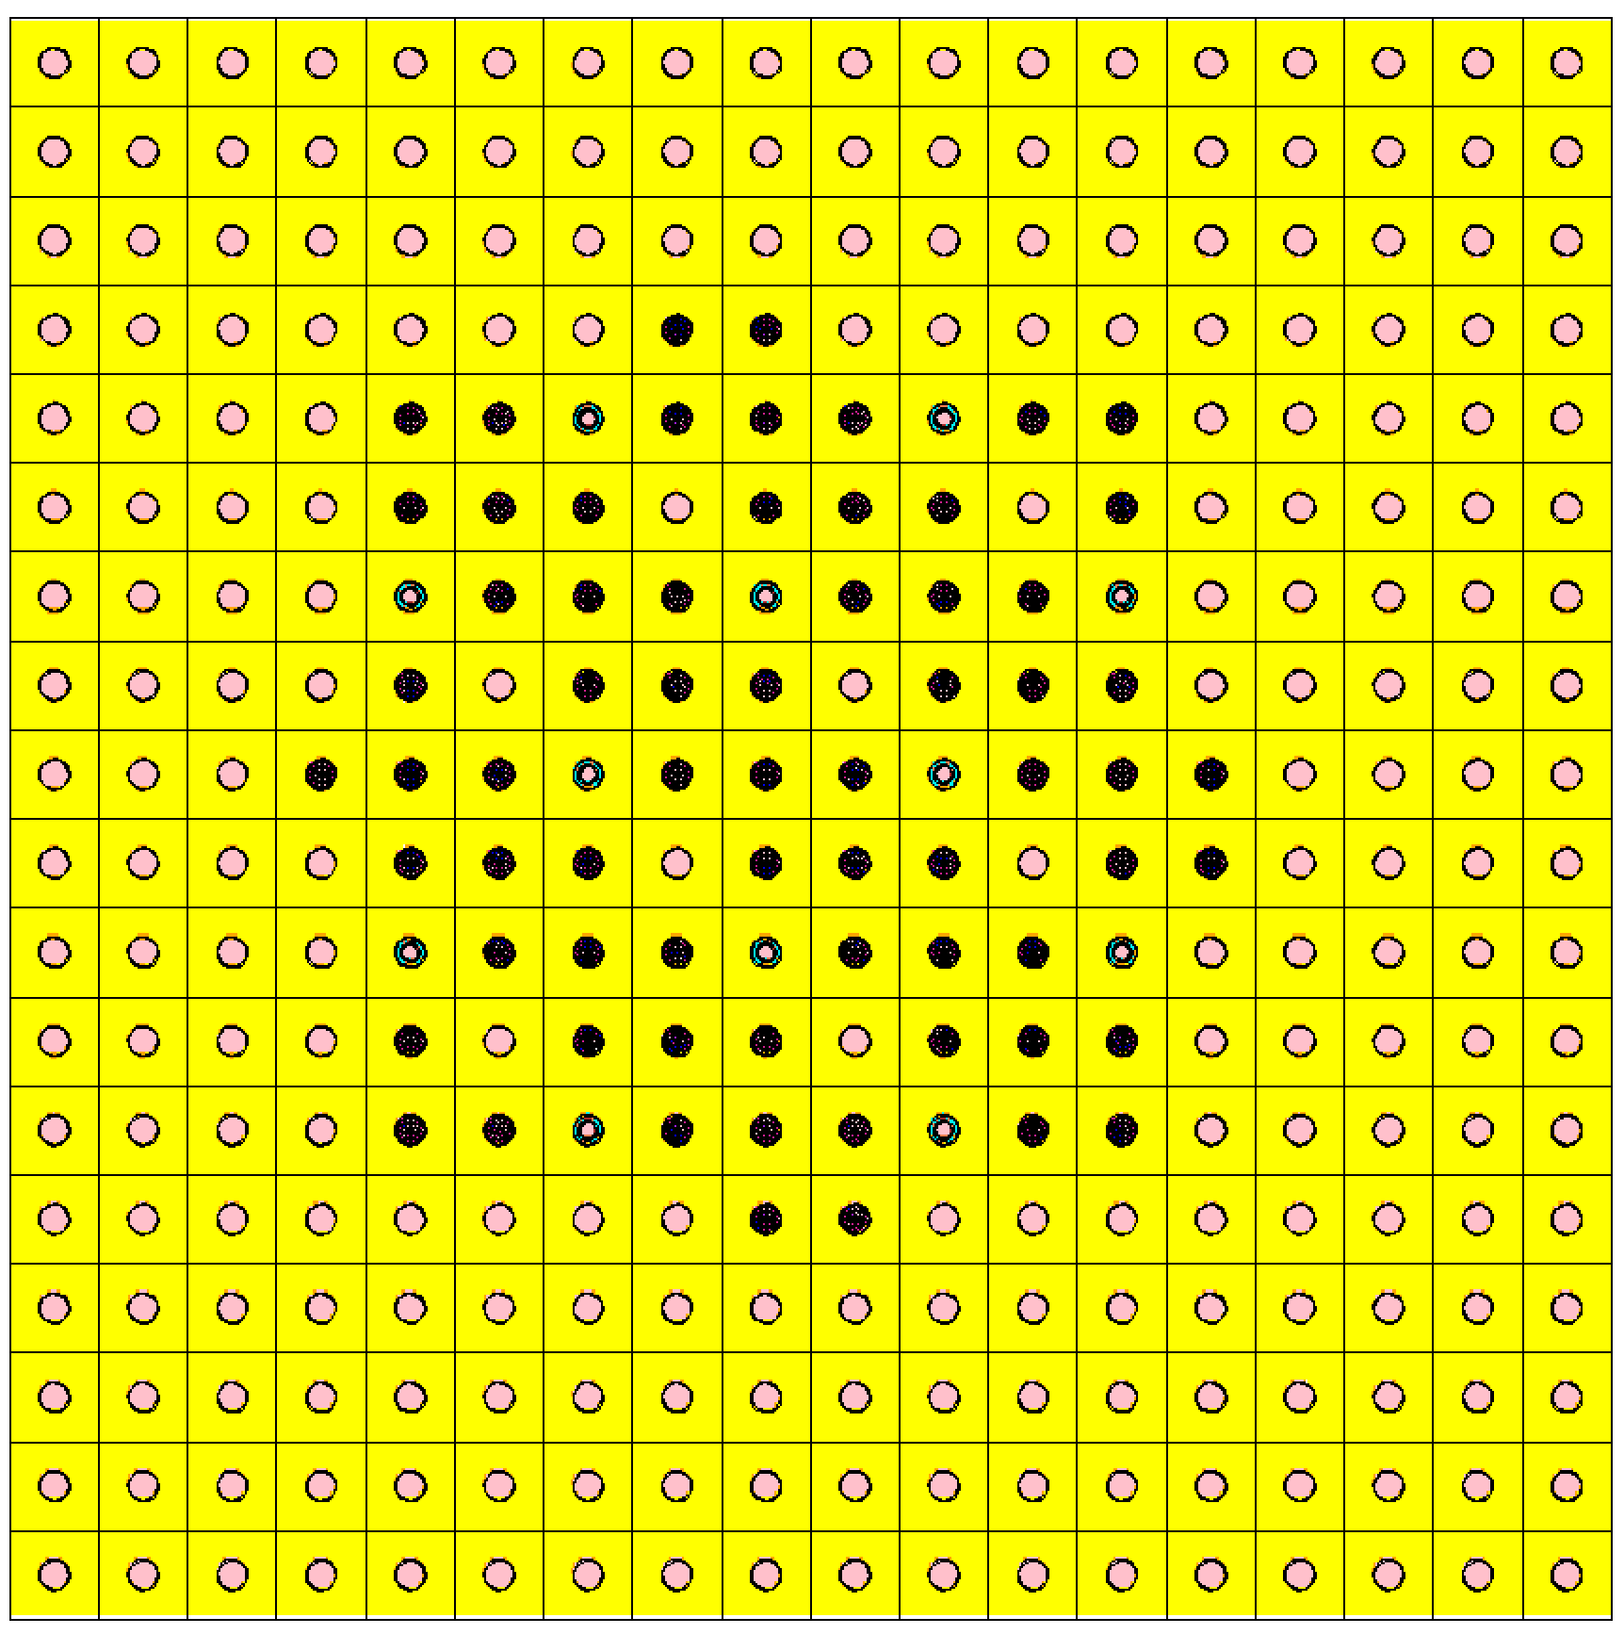
LEU-COMP-THERM-060, RBMK Graphite Reactor
Evaluation completed in 2004 by Kurchatov Institute and INL, with review by KAERI
  Experiments completed 1982-1988
28 total configurations, all at 20 °C
  Cases 1-10 had various arrangements of 1.8%, 2.0%, or 2.4% enriched fuel with and without water
  Cases 11-18 had various arrangements of 2.0% fuel with and without water and with boron absorbers
  Cases 19-28 had various arrangements of 2.0% fuel with and without thorium absorbers
Uncertainties were well characterized- even included measured impurities in fuel and graphite, which were the largest contributors to uncertainty
Uncertainties of approximately 250 pcm for all cases

Slide 11
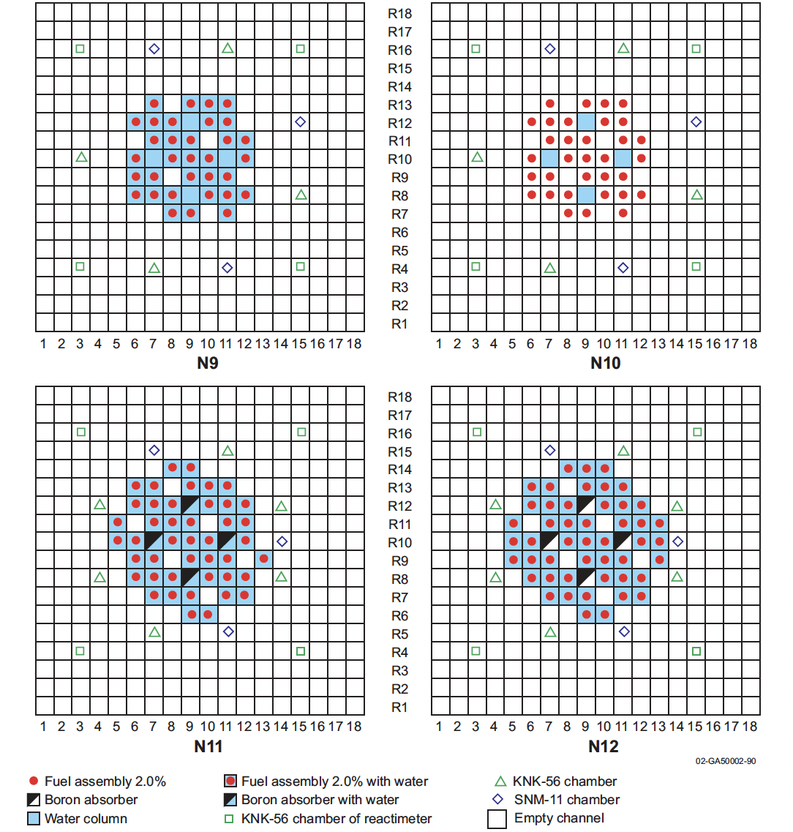
LEU-COMP-THERM-060 Graphite TSL Sensitivity
No Absorbers |  | B Absorbers |  | Th Absorbers
LCT-060 Case | TSL Δk_{eff} | LCT-060 Case | TSL Δk_{eff} | LCT-060 Case | TSL Δk_{eff}
1 | -0.00502 | 11 | -0.00523 | 19 | -0.00511
2 | 0.00472 | 12 | -0.00628 | 20 | 0.00406
3 | -0.00472 | 13 | -0.00486 | 21 | -0.00648
4 | 0.00508 | 14 | 0.00662 | 22 | 0.00310
5 | -- | 15 | -0.00655 | 23 | -0.00588
6 | -- | 16 | 0.00461 | 24 | 0.00421
7 | -0.00648 | 17 | -0.00463 | 25 | -0.00479
8 | 0.00326 | 18 | 0.00741 | 26 | 0.00605
9 | -0.00443 |  |  | 27 | -0.00705
10 | 0.00561 |  |  | 28 | 0.00272
This benchmark is recommended for TSL validation

Slide 12
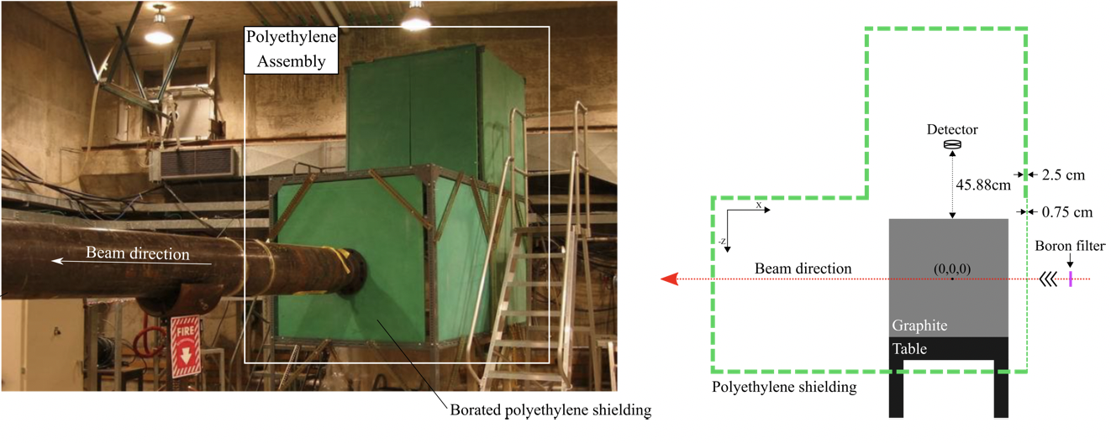
FUND-ORELA-ACC-GRAPH-PNSDT-001, Neutron Slowing Down Time through Graphite Pile
Evaluation completed in 2022 by NCSU, review by LLNL
  Experiments conducted at ORNL at the Oak Ridge Electron Linear Accelerator Facility (ORELA) from 2005-2008
1 configuration
  Pulsed spallation neutron source with electrons on tantalum
  Neutron beam incident on reactor-grade graphite block, measure neutrons as function of time in scintillator detector 45 cm from block, 90° from beam line
  Major uncertainty contributors were graphite impurities (which were measured) and detector counting statistics
  In the thermal region of interest, the benchmark uncertainties range from 0.75-1.06%

Slide 13
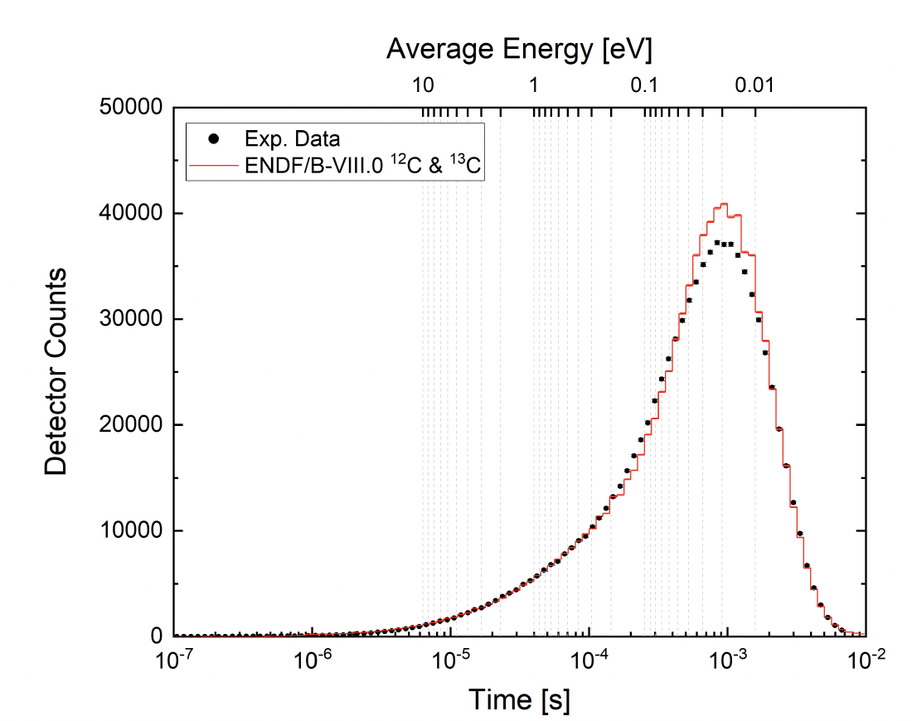
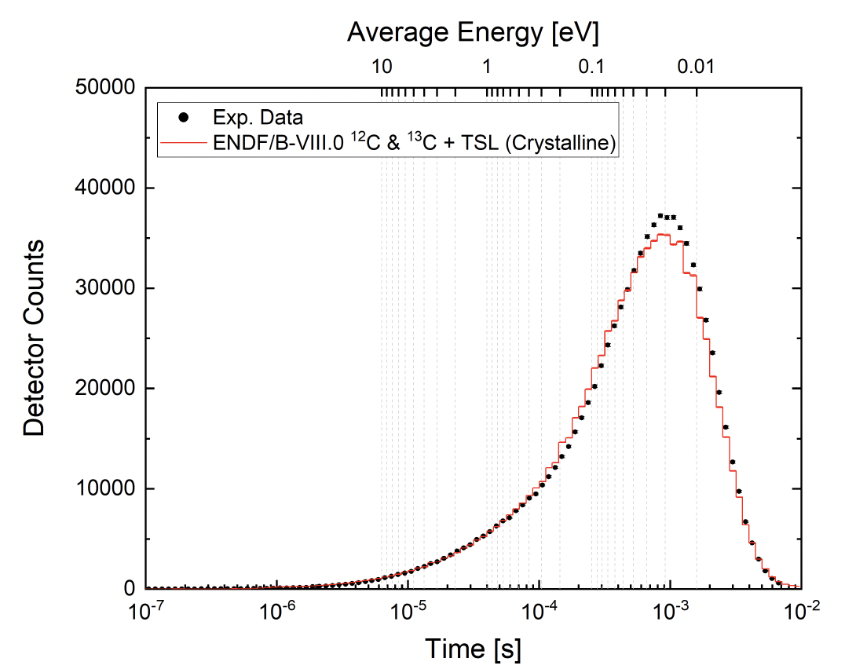
FUND-ORELA-ACC-GRAPH-PNSDT-001, Neutron Slowing Down Time through Graphite Pile
Comparison of Free Gas Scattering (TSL “off”) and ENDF/B-VIII.0 crystalline graphite TSL “on” show approximately 15% difference in counts in the thermal peak
This is a recommended benchmark for graphite TSL validation
TSL Off
TSL On

Slide 14
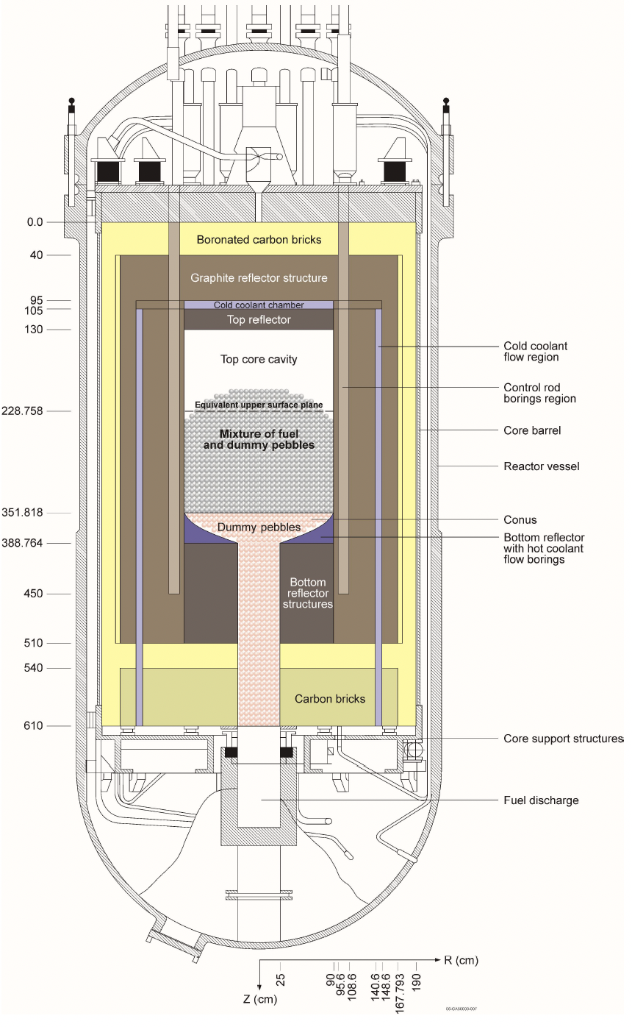
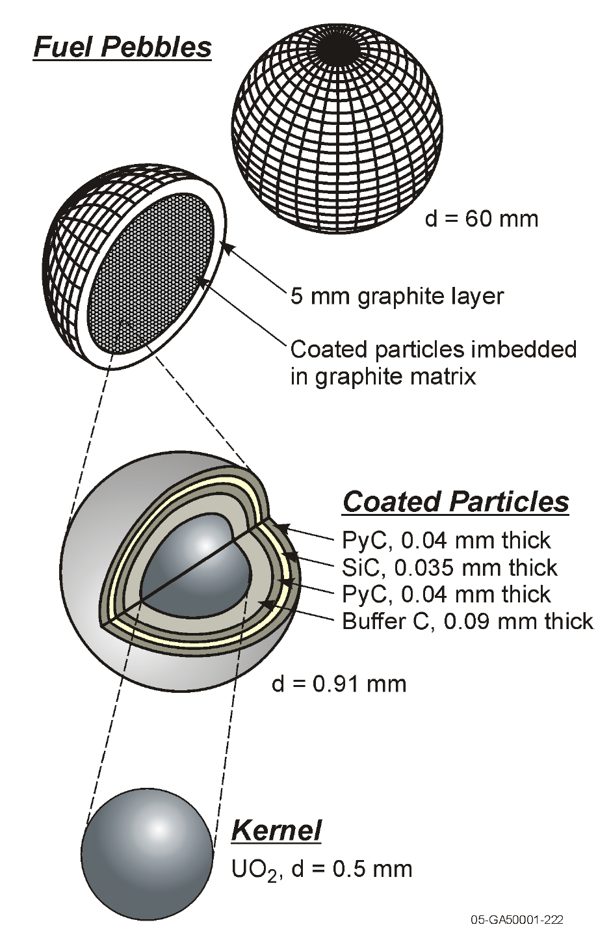
LEU-COMP-THERM-010 (HTR10-GCR-RESR-001-CRIT-REAC)
Evaluation completed in 2007 by INL with INET (China), review by INL
  Initial critical configuration HTR-10 10MWt gas cooled pebble bed reactor at Tsinghua University in Beijing in 2000
  Some participation from INET, but most of the benchmark is based on published references
  IRPhEP benchmark co-listed in ICSBEP
1 detailed and 1 simplified configuration
  Core height was not measured- calculated based on assumed packing fraction and number of pebbles
  Many assumptions had to be made due to lack of data- U mass uncertainty, boron contamination in reflector graphite, packing fraction, shape of pebble mound at top of core (each worth 100-200 pcm)
Overall uncertainty: 369 pcm for detailed configuration

Slide 15
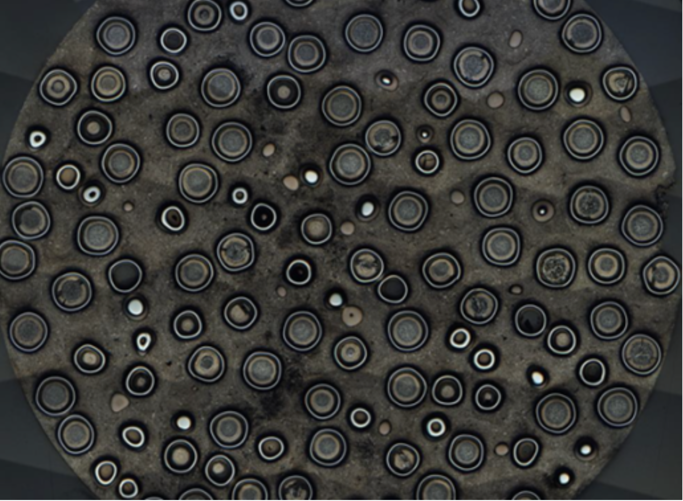
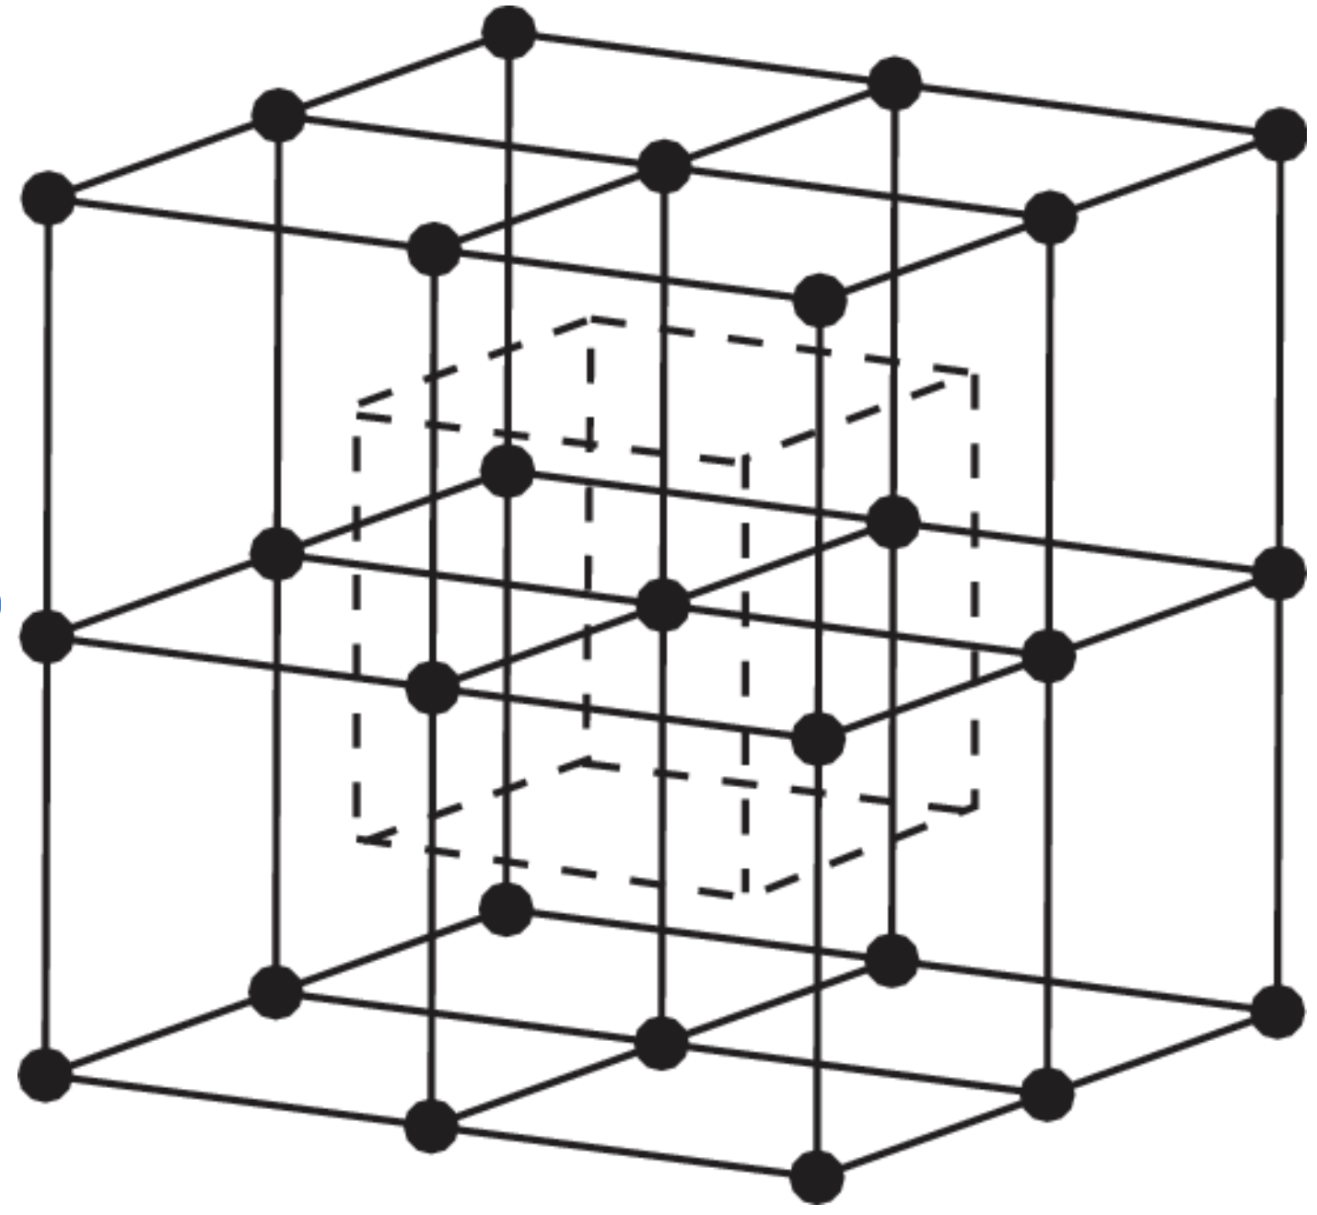
Double Heterogeneity Problem, TRISO Particle Distribution
HTR-10 benchmark models the fuel particles as a regular cubic lattice, probably a small effect (benchmark estimates 60 pcm)
TRISO fuel particles are distributed randomly in a graphite matrix inside each fuel pebble

Slide 16
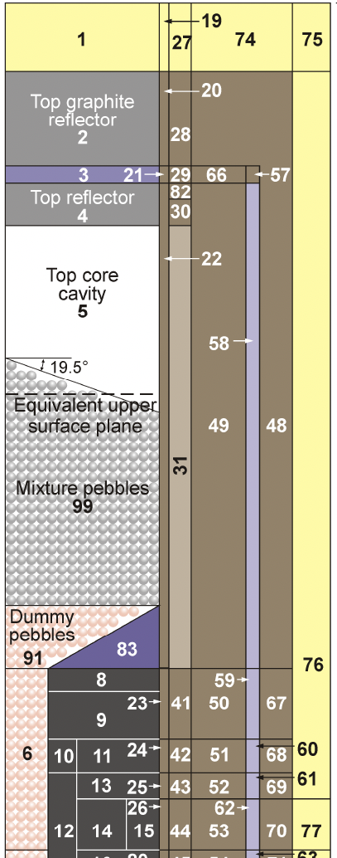
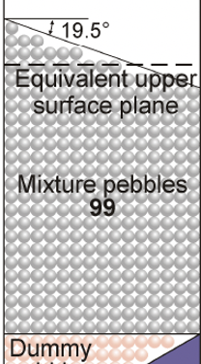
Double Heterogeneity Problem, Pebble Distribution
HTR-10 pebble distribution is modeled as close-packed hexagonal array, with each subsequent layer shifted to get desired packing fraction (not based on measurement of the core)
Designed to allow for limited random displacement of pebbles on the lattice in codes that can do stochastic geometry

Slide 17
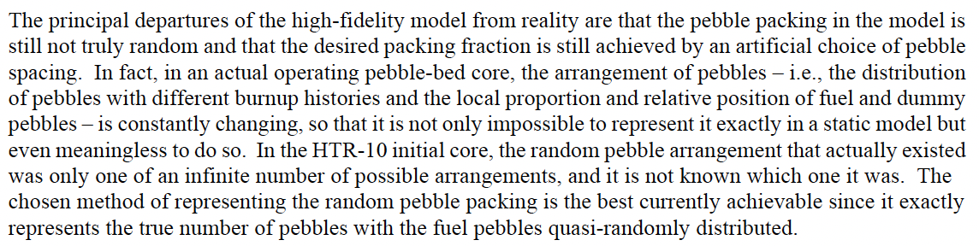
Double Heterogeneity Problem, Pebble Distribution
HTR-10 pebble distribution is modeled as close-packed hexagonal array, with each subsequent layer shifted to maximize packing fraction
Designed to allow for limited random displacement of pebbles on the lattice in codes that can do stochastic geometry
Not really random, and the effect was not assessed
From Section 3.0 of the HTR-10 Benchmark:
Impacts of this model representation are not assessed

Slide 18
Double Heterogeneity Problem, Pebble Distribution
HTR-10 pebble distribution is modeled as close-packed hexagonal array, with each subsequent layer shifted to get desired packing fraction (not based on measurement of the core)
Designed to allow for limited random displacement of pebbles on the lattice in codes that can do stochastic geometry
Not really random, and the effect was not assessed
Therefore, this benchmark is NOT recommended for graphite TSL validation

Slide 19
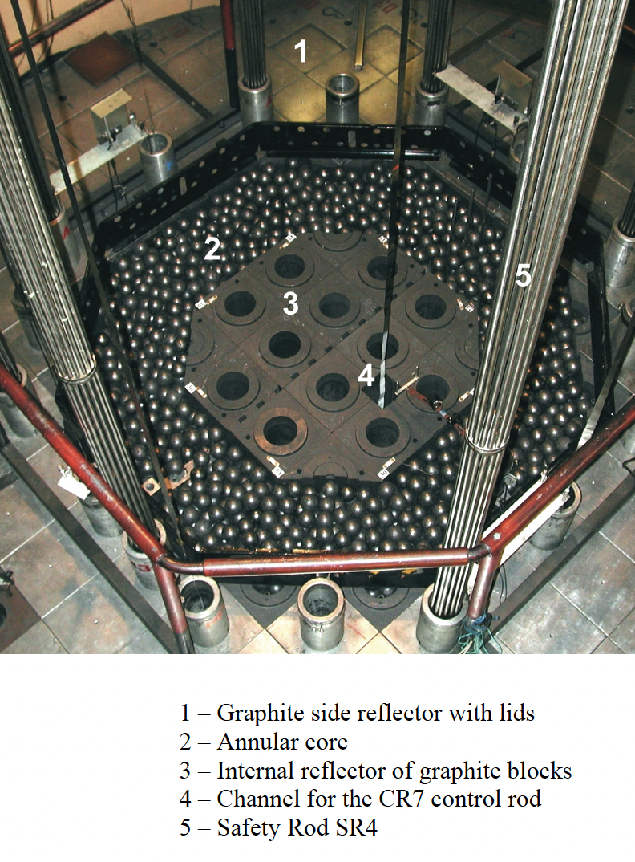
LEU-COMP-THERM-008, ASTRA Critical Facility
Evaluation completed in 2008 by Kurchatov Institute (Russia) with independent review from USA
  Experiments conducted 2003-2004 at the ASTRA critical facility
  Annular core of TRISO pebbles reflected by graphite
  ICSBEP benchmark co-listed with IRPhEP
5 critical configurations
  Variations in number of pebbles, height of control rods, and presence or absence of upper graphite pebble reflector
  Core height was measured and used to estimate packing fraction- largest contributor to uncertainty
  Uncertainties informed by lots of measurements, including impurities
Overall uncertainty: 360 pcm for all configurations

Slide 20
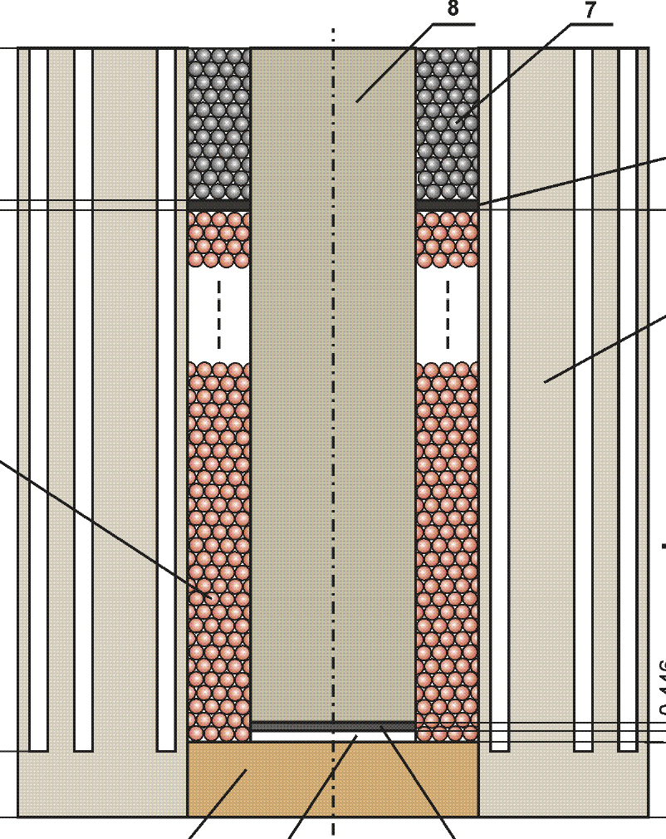
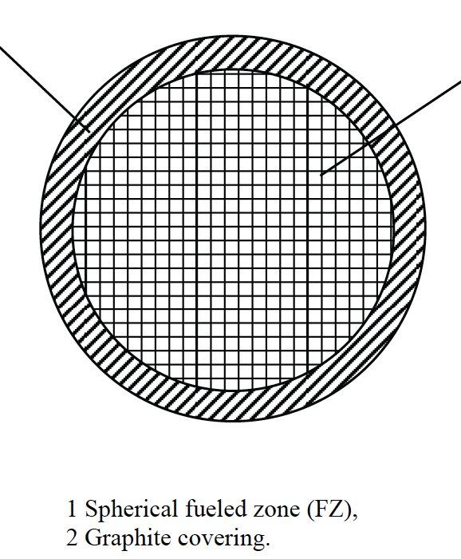
LEU-COMP-THERM-008 Double Heterogeneity Solution
TRISO modeled as a random lattice of 0.0511 cm UO₂ kernels in a homogenized matrix incorporating graphite and kernel coating layers- effect was estimated to be 50 pcm in an appendix
Pebbles modeled as regular lattice with measured packing fraction. Pebbles were allowed to be cut off at interfaces. Uncertainties are likely underestimated due to this choice, and would likely be a leading uncertainty
Benchmark is NOT recommended for graphite TSL validation

Slide 21
Recommended Graphite TSL Validation Benchmarks
ICSBEP Identifier | Title | # of Cases | Discussion
FUND-ORELA-ACC-GRAPH-PNSDT-001 | Benchmark of Neutron Thermalization in Graphite using the Slowing-Down-Time ORELA Experiment | 1 | Very sensitive to TSL, low benchmark uncertainties, single target material so few competing material effects
LEU-COMP-THERM-060 | RBMK Graphite Reactor: Uniform Configurations of U(1.8, 2.0, or 2.4% 235U)O2 Fuel Assemblies, and Configurations of U(2.0% 235U)O2 Assemblies with Empty Channels, Water Columns, and Boron or Thorium Absorbers, with or without Water in Channels | 28 | Numerous different configurations with varying degree of sensitivity to TSL, low benchmark uncertainties with good characterization of the core materials
HEU-COMP-THERM-016 | IGR Reactor – Uranium-Graphite Blocks Reflected by Graphite | 6 | High sensitivity to TSL for a k_{eff} benchmark, although also high experimental uncertainties based on measured variations. Recommended for TSL temperature validation

