Slide 1
Deimos and Graphite TSLs
Nicholas Thompson, Peter Brain, Theresa Cutler, Kristin Stolte, Adrien Terricabras
July 9th, 2025

Slide 2
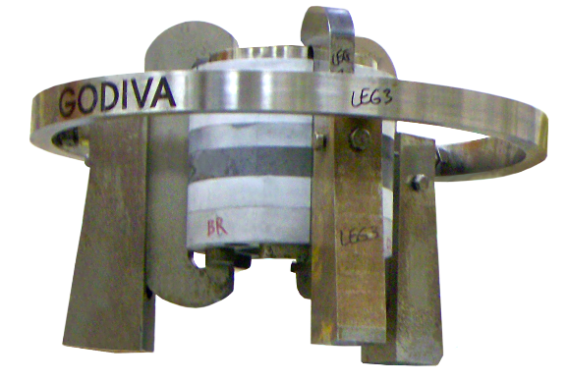
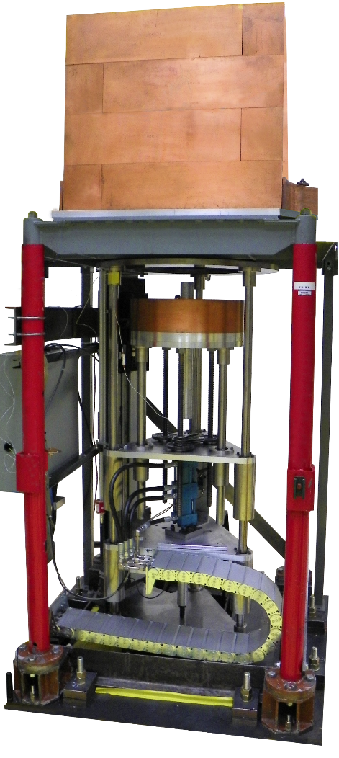
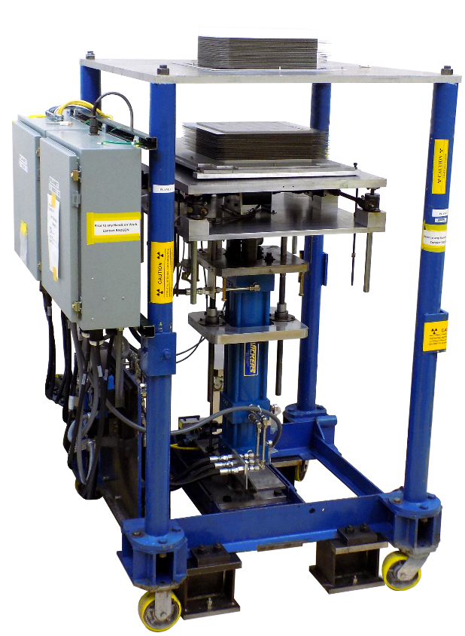
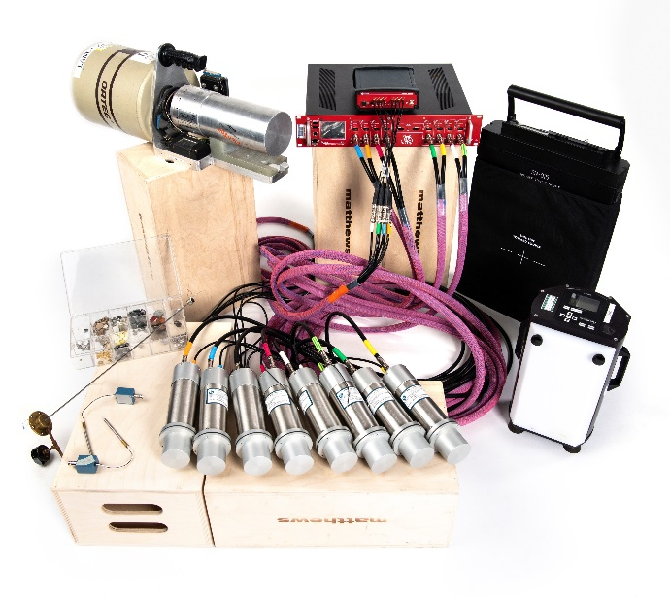
NCERC Overview
National Criticality Experiments Research Center
Located at Nevada National Security Site at the Device Assembly Facility
NCERC is operated by Los Alamos National Laboratory (LANL)
Four critical assemblies (Comet, Planet, Flattop, Godiva IV)
Large amount of special nuclear material enables a wide variety of experiments to be performed
Subcritical, critical, even up to above prompt critical
Fast, intermediate, thermal spectrum

Slide 3
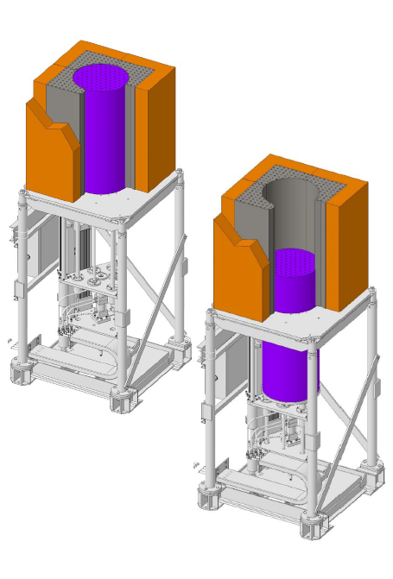
Deimos Experiment
LANL Laboratory Directed Research and Development (LDRD) for advanced reactor testbed performed at NCERC
Additional experiments funded by DOE/NRC Collaboration for Criticality Safety Support for Commercial-Scale HALEU for Fuel Cycles and Transportation (DNCSH) program
Graphite moderated, beryllium reflected, High Assay-Low Enriched Uranium (HALEU) TRi-structural ISOtropic (TRISO) fuel
Fuel is from the Compact Nuclear Power Source (CNPS) experiments from LANL in the 1990’s

Slide 4
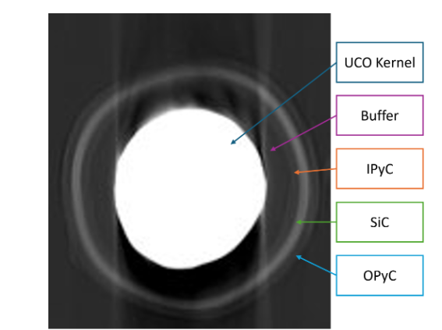
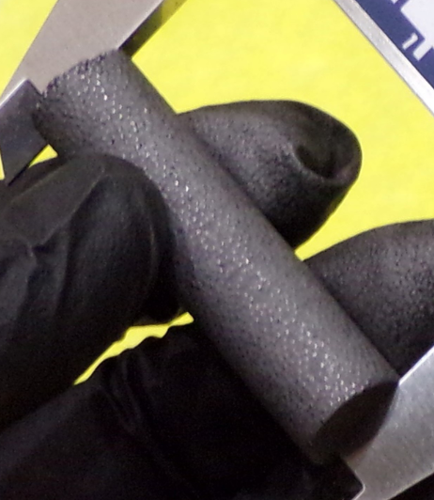
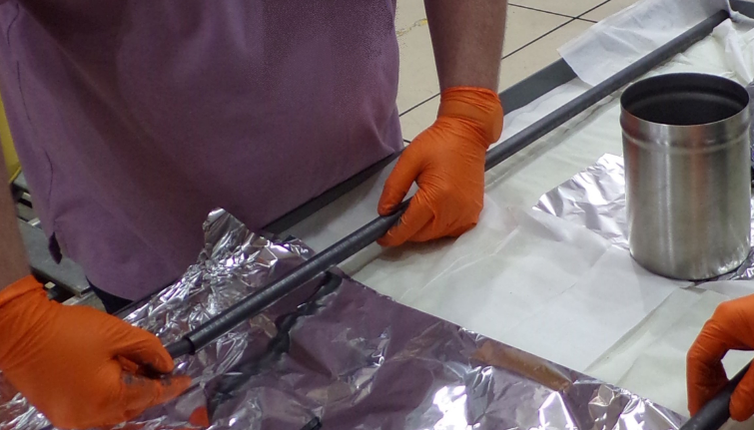
CNPS Fuel
TRISO particles are comprised of 5 concentric layers
Innermost fuel kernel is 0.5 mm in diameter
19 CNPS compacts are then stacked into a fuel cup (fuel rod) made of graphite
These cups serve as the discrete fuel for Deimos
~11,500 TRISO particles are placed into a green graphite matrix and fired to form compact

Slide 5
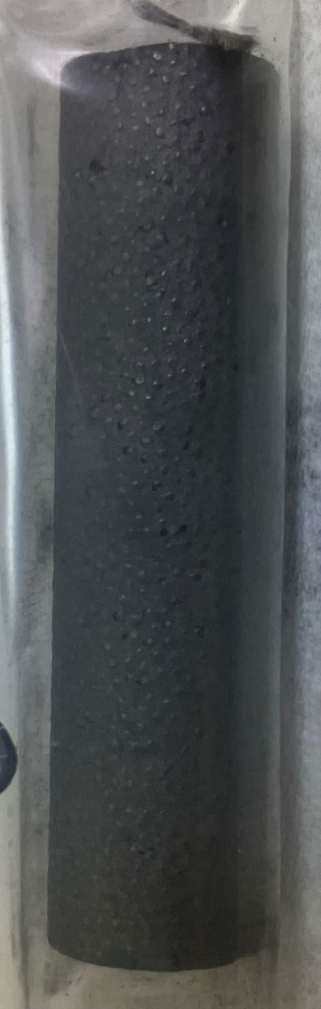
CNPS TRISO Compacts
Manufactured by General Atomics in 1988
Packing Fraction ~60%
Enrichment ~ 19.9 w/t% U-5
2” long x 0.5” diameter
5 layers (kernel, buffer, Pyrolytic C, SiC, Pyrolytic C)
Various literature through the years has vague and/or conflicting information
Needed to perform various chemical and radiograph analysis of the CNPS compacts for benchmark

Slide 6
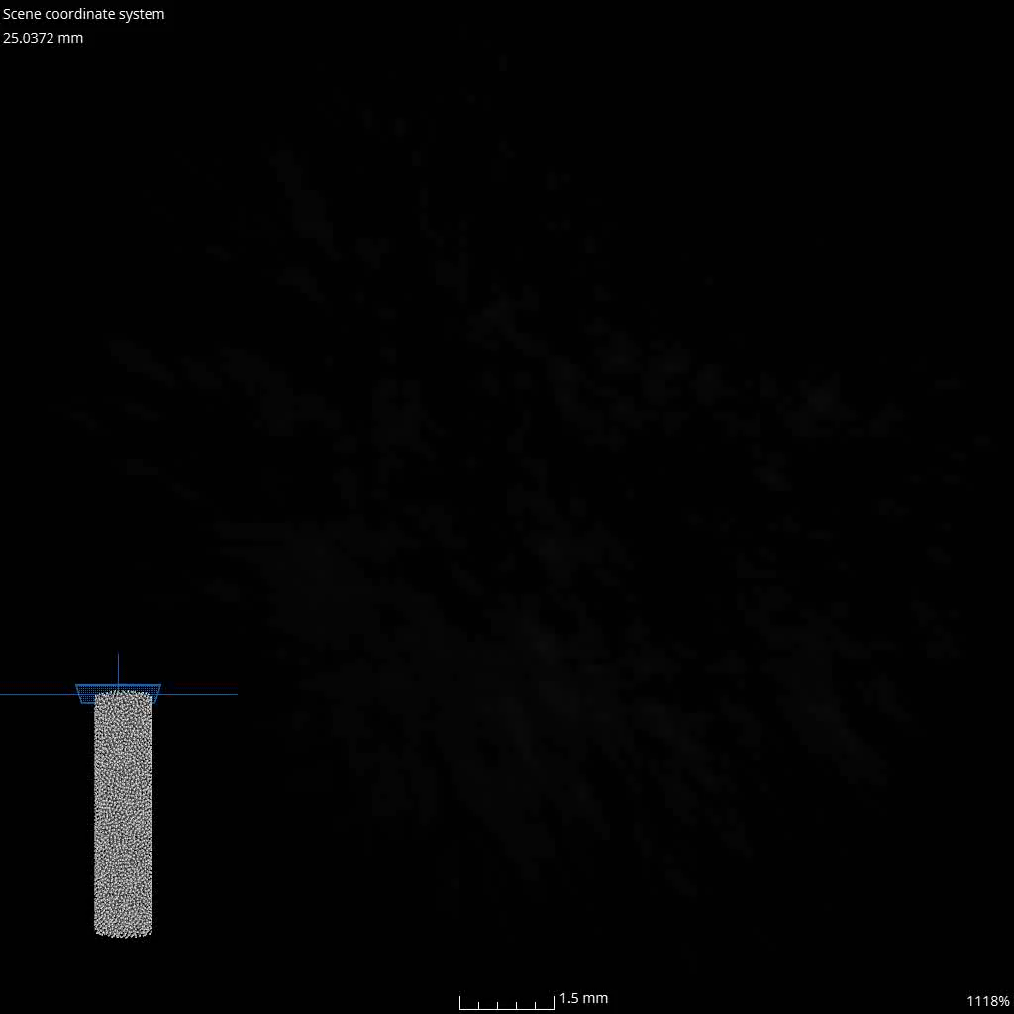
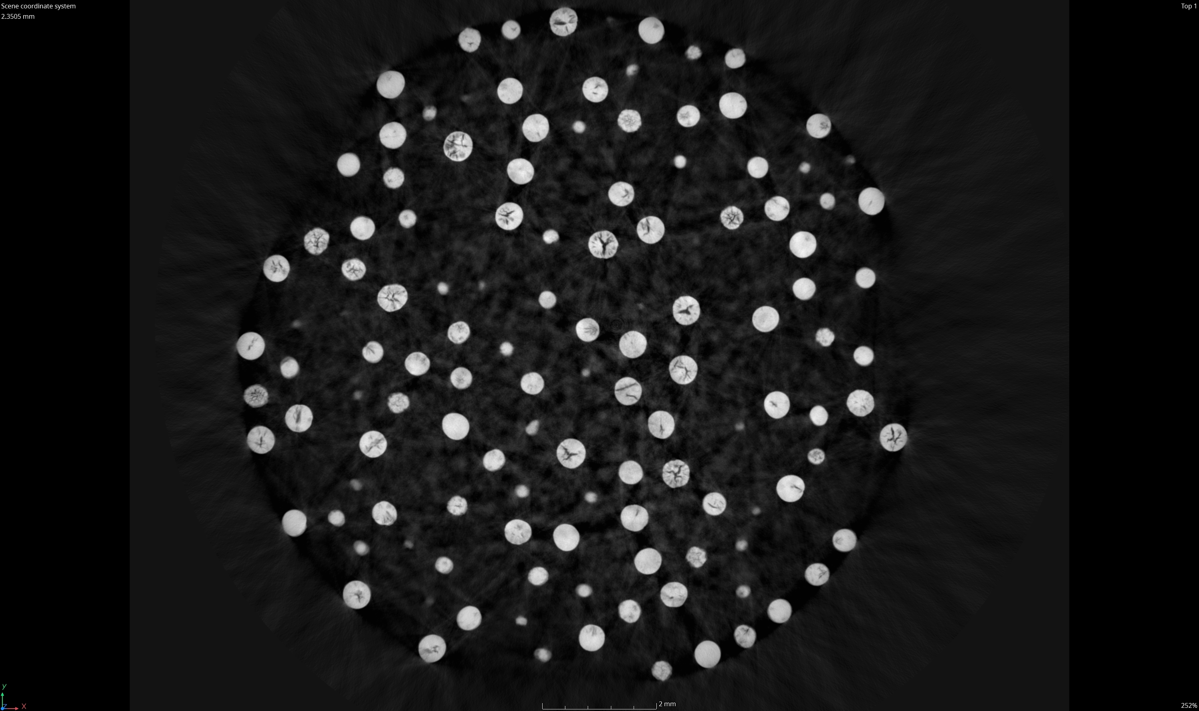
Computed Tomography
CT scans show that almost all particles
Have voids/cracks
Are not perfectly spherical
Have varying kernel size (includes fully overcoated partial kernels)

Slide 7
CNPS Fuel
The full CNPS characterization is complete and being used in the benchmarks that are in draft form
The full CNPS characterization results will be presented at the Global Top Fuels Conference in October
We do have graphite composition/ impurity info for all components

Slide 8
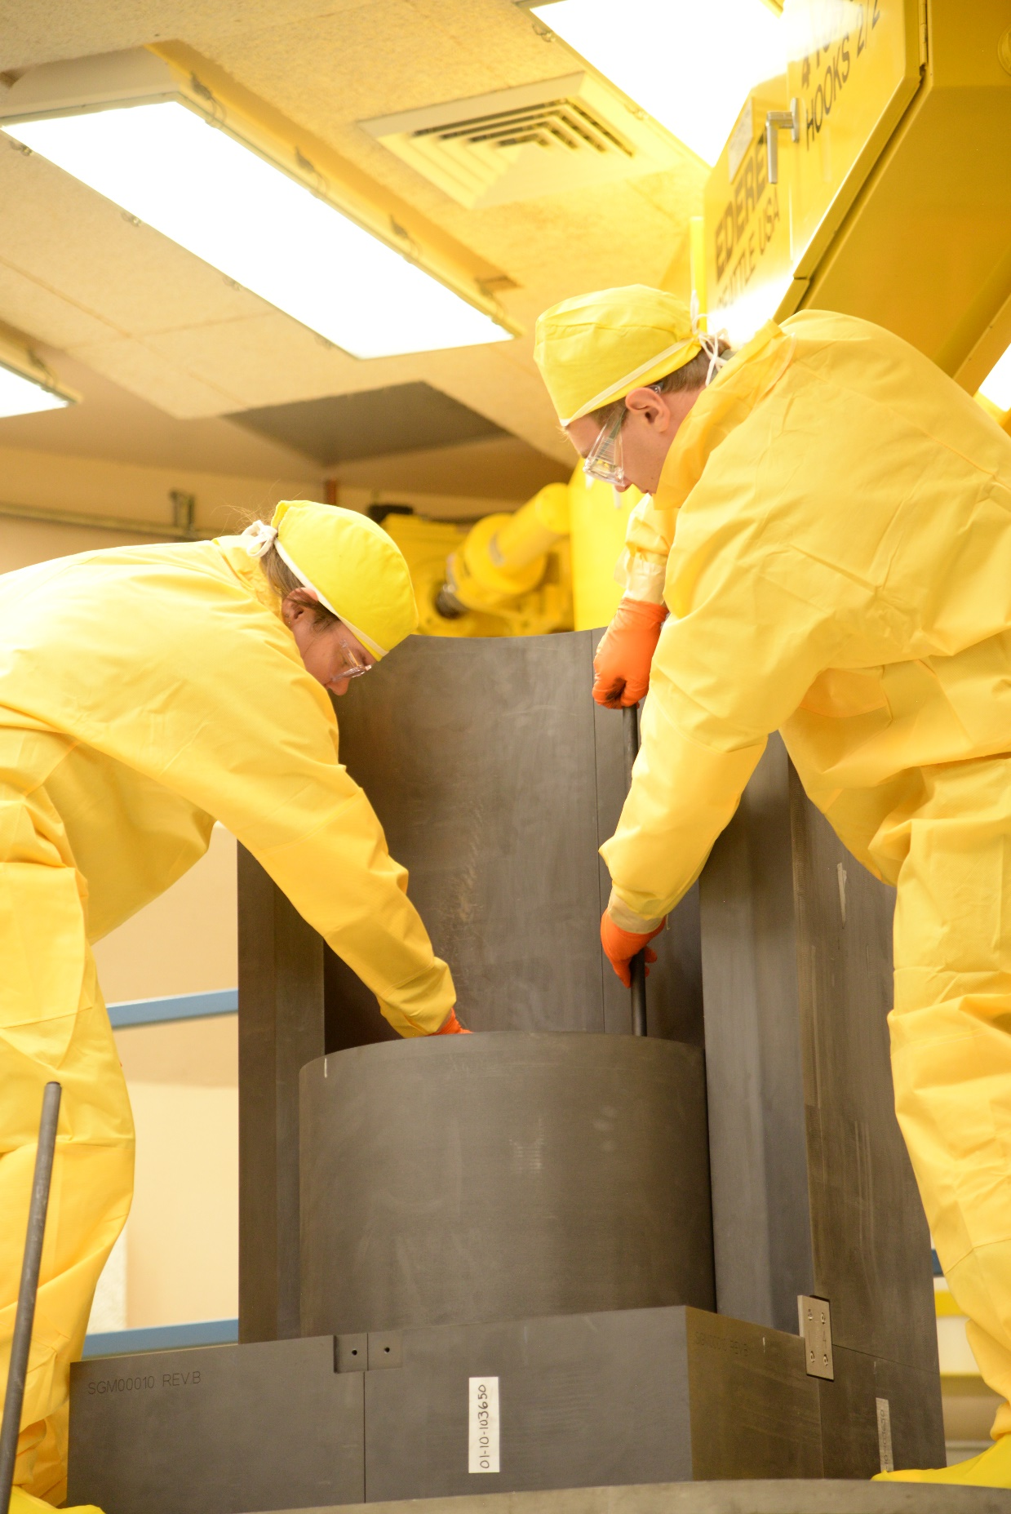
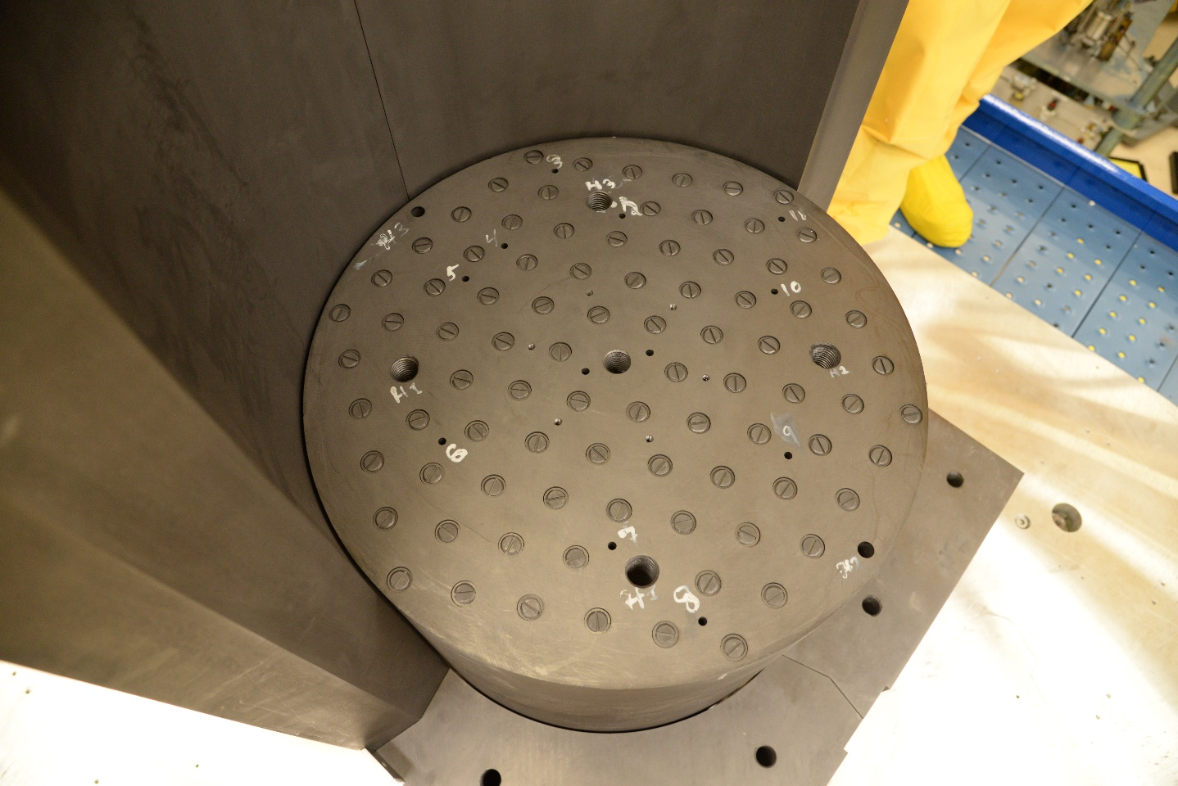
Deimos Experiment
Performed from August – November 2024
Contains an inner movable region which is lifted to bring the system critical
Outer graphite and inner region both fueled

Slide 9
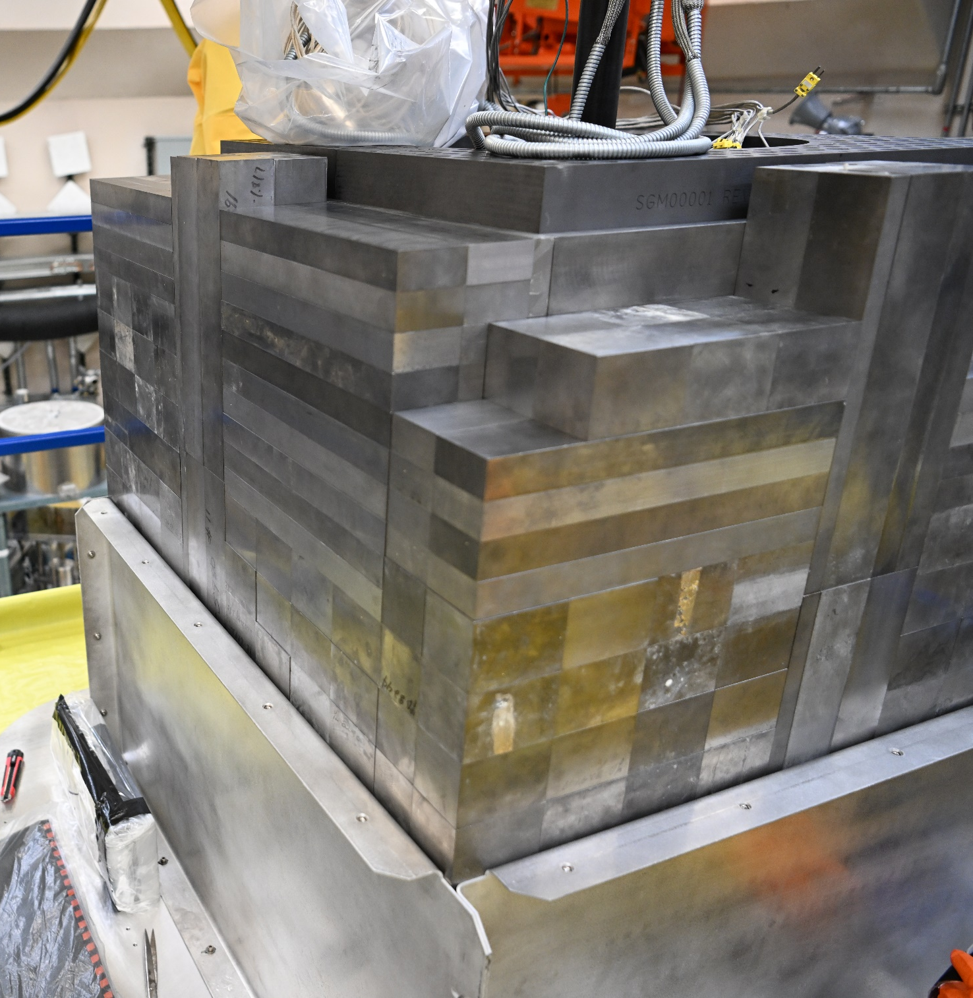
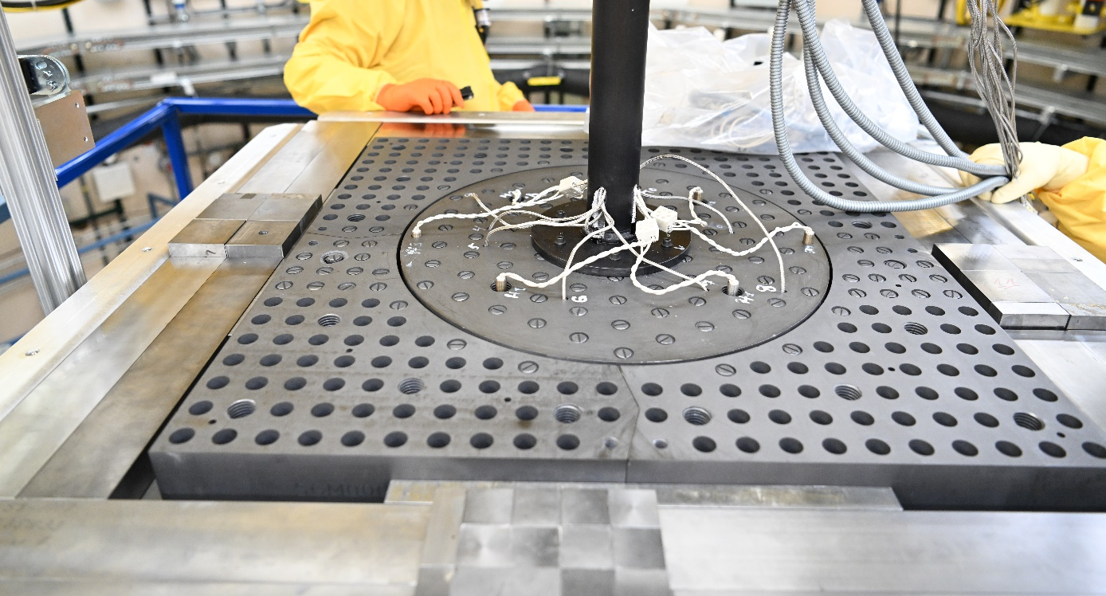
Deimos Experiment
Used beryllium blocks as a reflector
Aluminum shroud was installed around the beryllium to minimize Be contamination

Slide 10
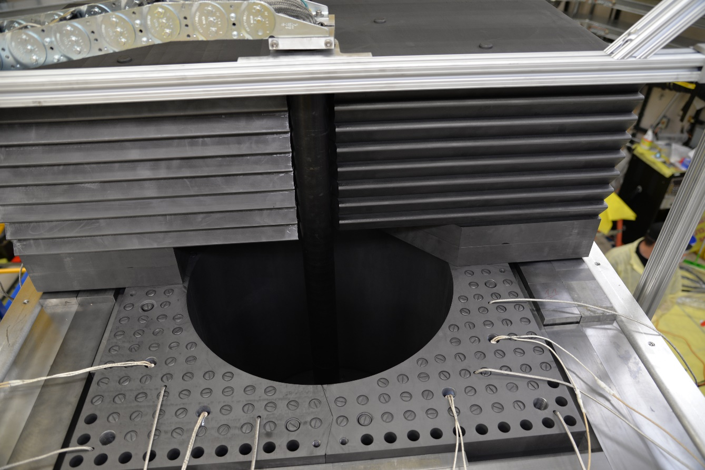
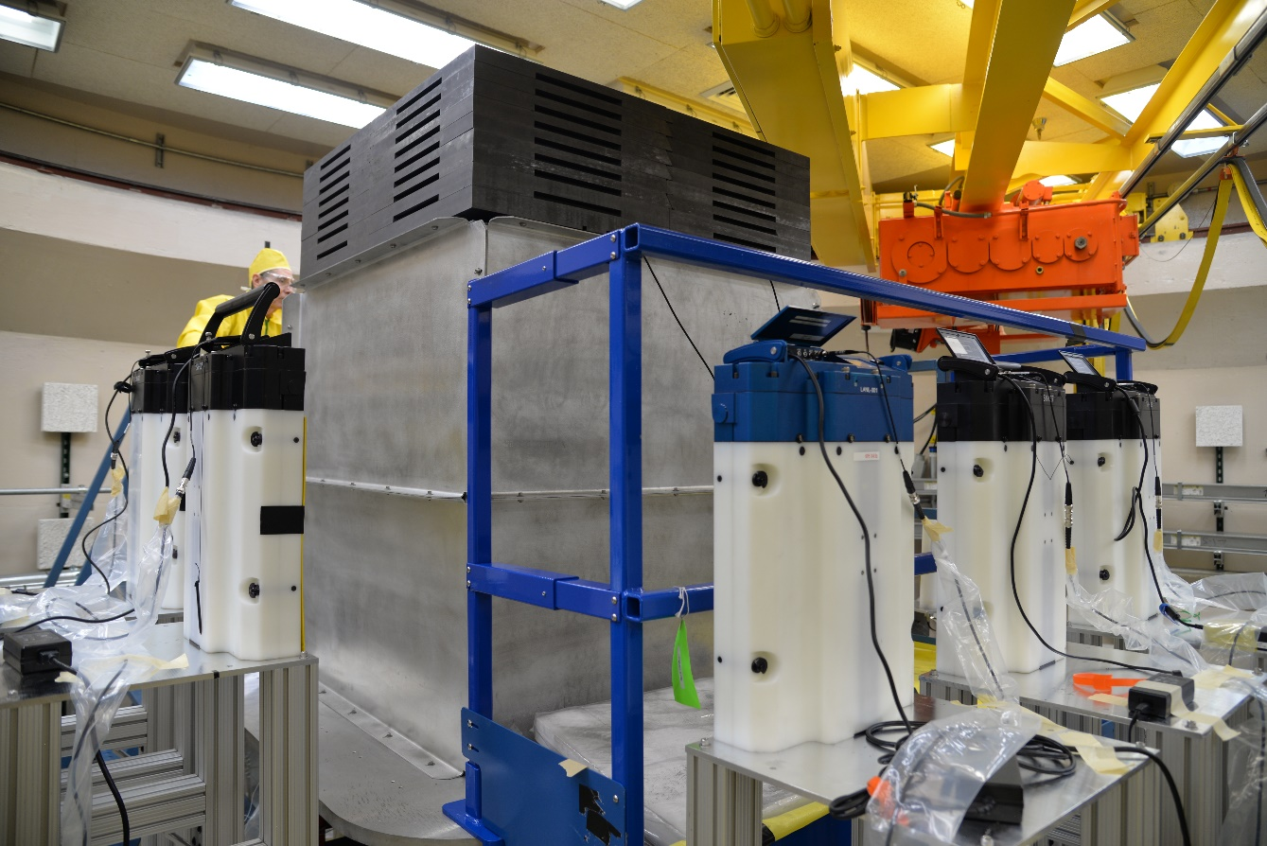
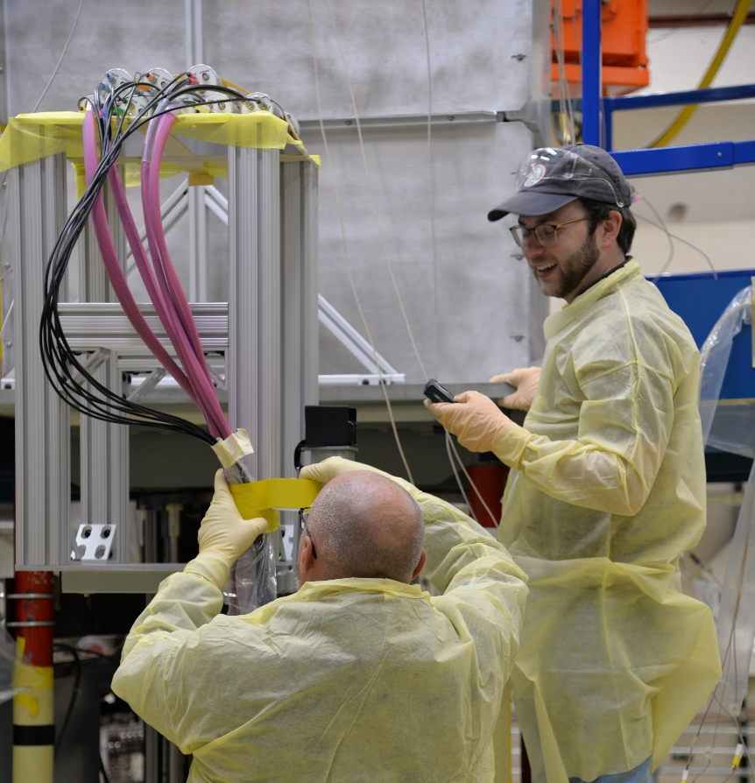
Deimos Experiment
After first critical measurements, next set of experiments focused on measurements as a function of temperature
Neutron noise measurements were also performed

Slide 11
Deimos Results
 | LC1 | LC2 | LC3 | Fuel loading | Heaters installed | Temperature | Heater info / Config
9/18/2024 | 19.12 | 19.04 | 19.21 | 296 fuel rods | yes | 11.3
9/18/2024 | 41.73 | 41.58 | 41.94 | 299 fuel rods | yes | 15.3
9/19/2024 | 42.1 | 41.94 | 42.13 | 299 fuel rods | yes | 10.9
9/19/2024 | 44.01 | 43.94 | 44.03 | 300 fuel rods | yes | 19.7
9/24/2024 | 46.27 | 46.04 | 46.26 | 300 fuel rods | yes | 14.5
9/24/2024 | 20.8 | 20.75 | 20.8 | 300 fuel rods | yes | 45.1 | full core
9/24/2024 | 7.36 | 7.31 | 7.4 | 300 fuel rods | yes | 65.1 | full core
9/24/2024 | 4.62 | 4.39 | 4.49 | 300 fuel rods | yes | 70 | full core
9/24/2024 | 0.58 | 0.56 | 0.66 | 300 fuel rods | yes | 77.5 | full core
9/25/2024 | 63.46 | 63.31 | 63.43 | 302 fuel rods | yes | 26 | center only
9/25/2024 | 53.44 | 53.28 | 53.41 | 302 fuel rods | yes | 45.3 | center only
9/25/2024 | 42.24 | 42.07 | 42.24 | 302 fuel rods | yes | 77 | center only
9/25/2024 | 29.93 | 29.8 | 29.96 | 302 fuel rods | yes | 105 | center only
9/26/2024 | 24.67 | 24.59 | 24.71 | 298 fuel rods | yes | 23 | outer core only
9/26/2024 | 14.56 | 14.52 | 14.58 | 298 fuel rods | yes | 43.7 | outer core only
9/26/2024 | 4.44 | 4.3 | 4.47 | 298 fuel rods | yes | 65 | outer core only
10/16/2024 | 17.19 | 17.2 | 17.02 | 275 fuel rods | no | 17.1 | Config 1
10/17/2024 | 14.43 | 14.39 | 14.46 | 271 fuel rods | no | 17.8 | Config 2
10/28/2024 | 13.94 | 13.8 | 13.92 | 275 fuel rods | no | 19.8 | Config 3
10/29/2024 | 21.16 | 21 | 21.18 | 270 fuel rods | no | 20.2 | Config 4
10/30/2024 | 22.79 | 22.71 | 22.84 | 258 fuel rods | no | 20.2 | Config 5
10/31/2024 | 15.71 | 15.63 | 15.73 | 275 fuel rods | no | 20.4 | Config 1 Reproducibility
10/31/2024 | 12.57 | 12.5 | 12.57 | 271 fuel rods | no | 20.4 | Config 2 Reproducibility

Slide 12
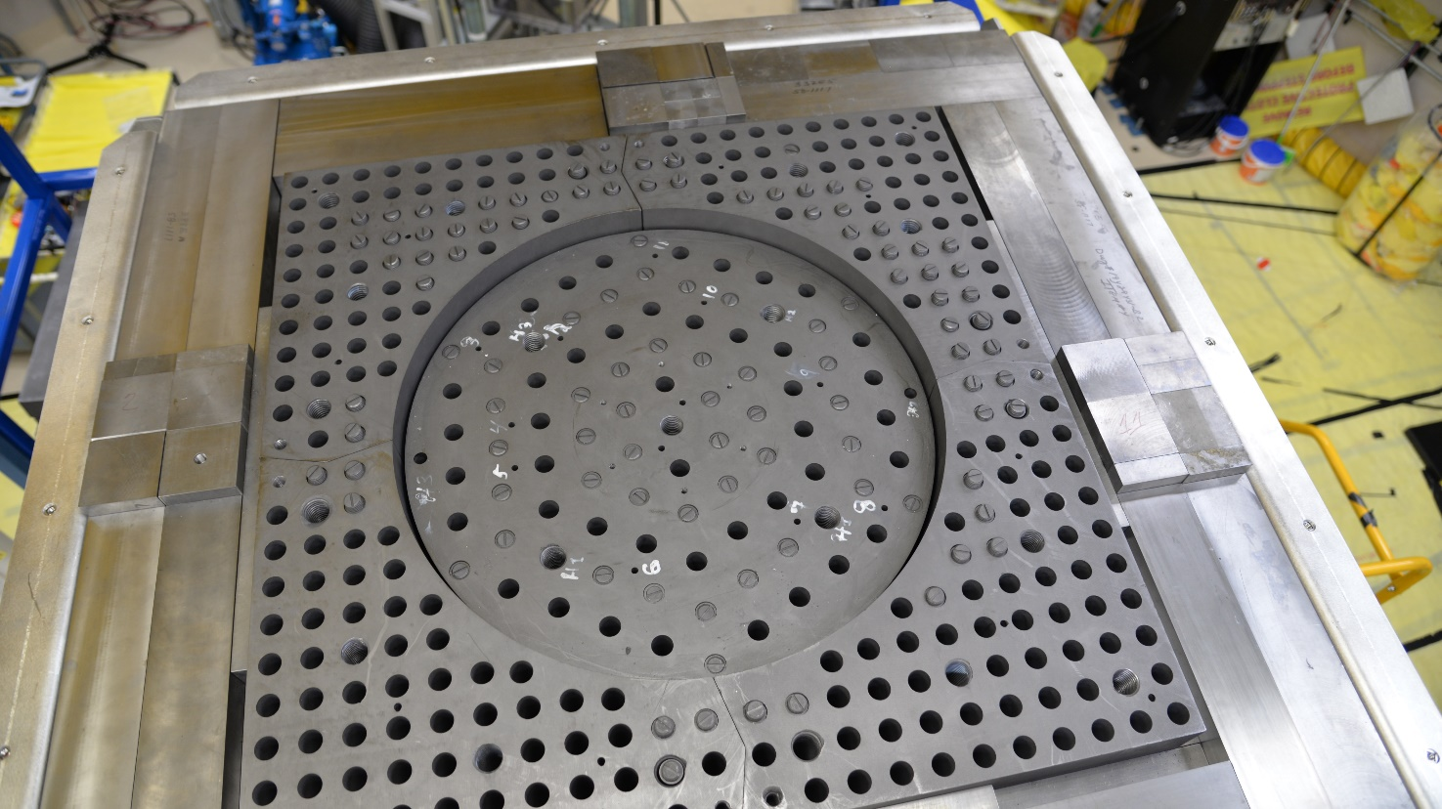
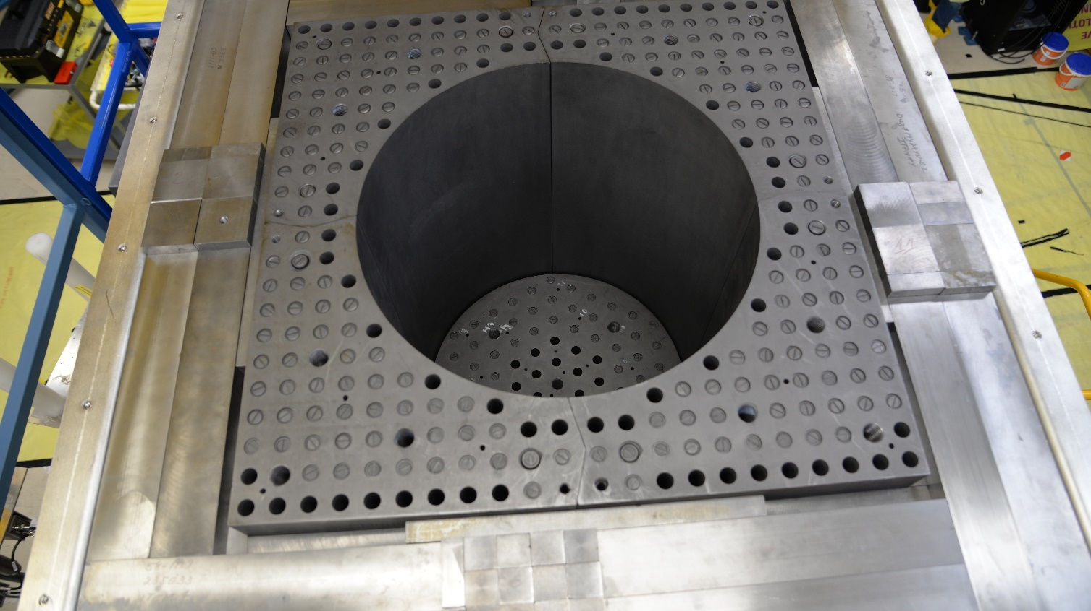
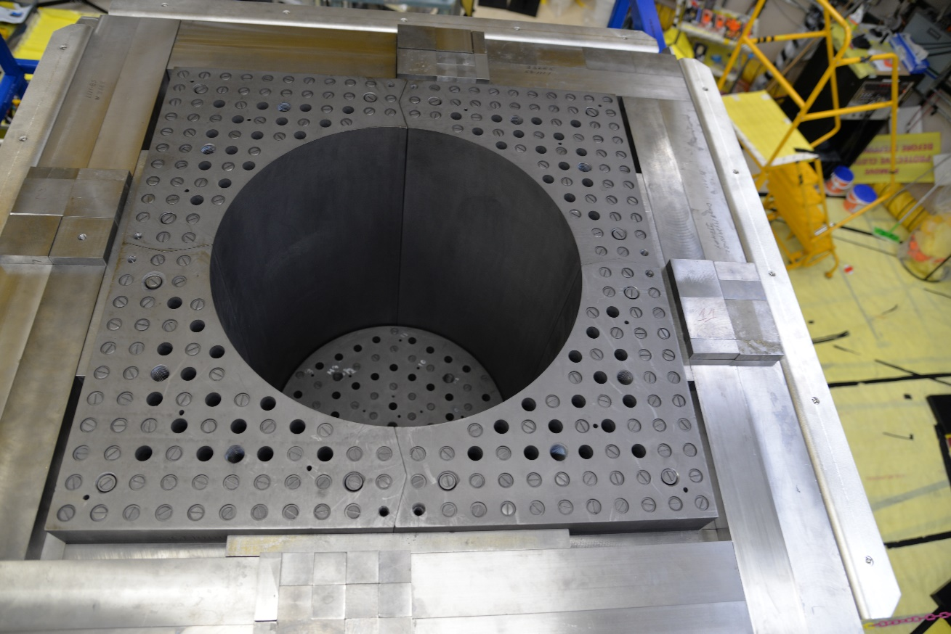
Deimos Configurations
Five different configurations built for the benchmark with different numbers of fuel pins and effective pitches

Slide 13
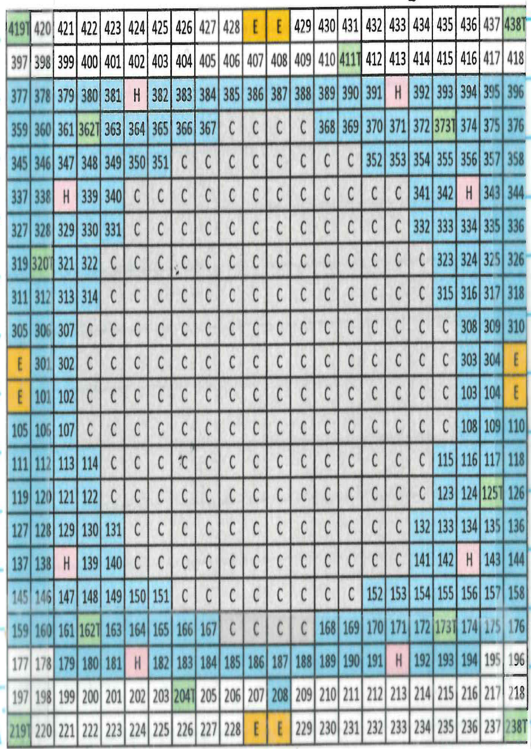
Deimos Configurations

Slide 14
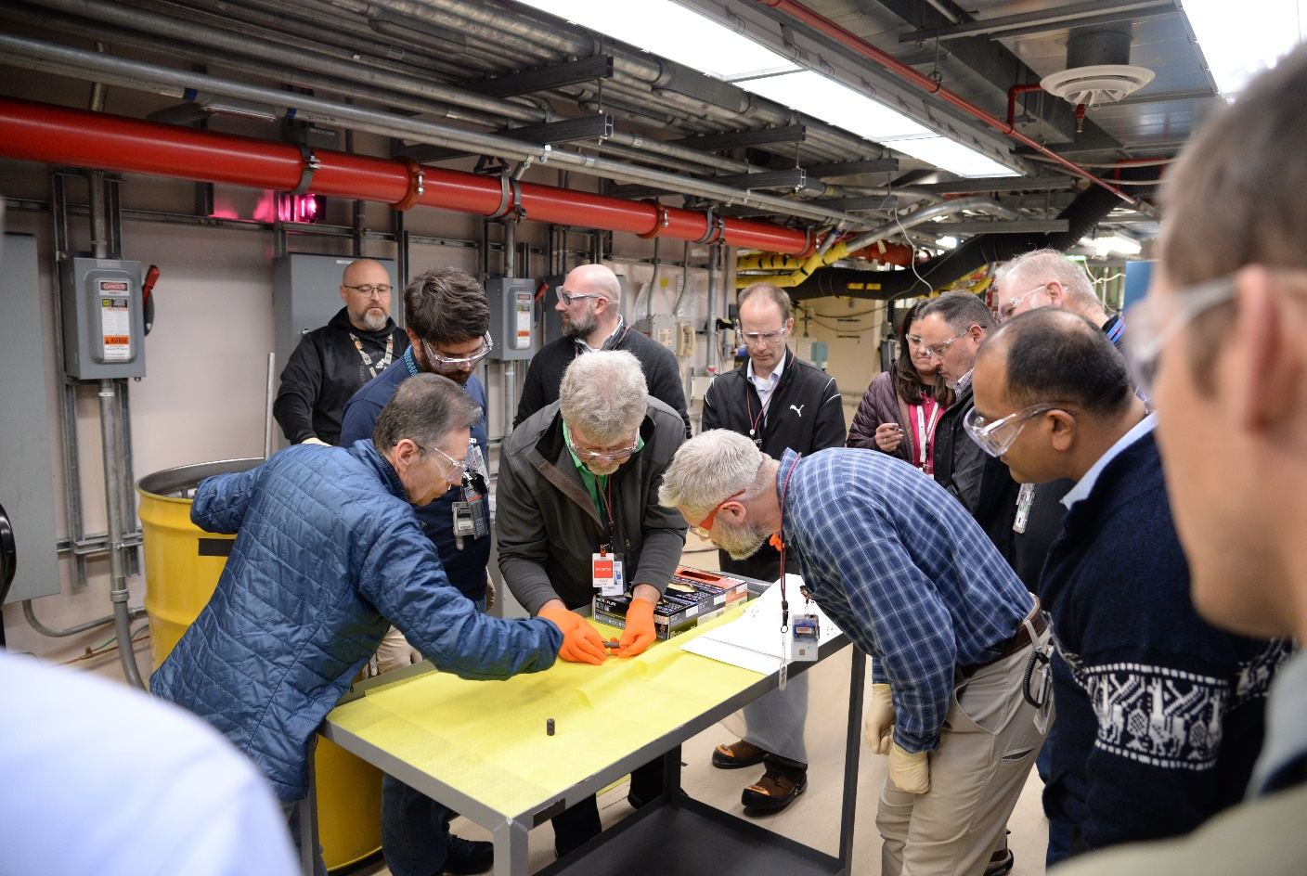
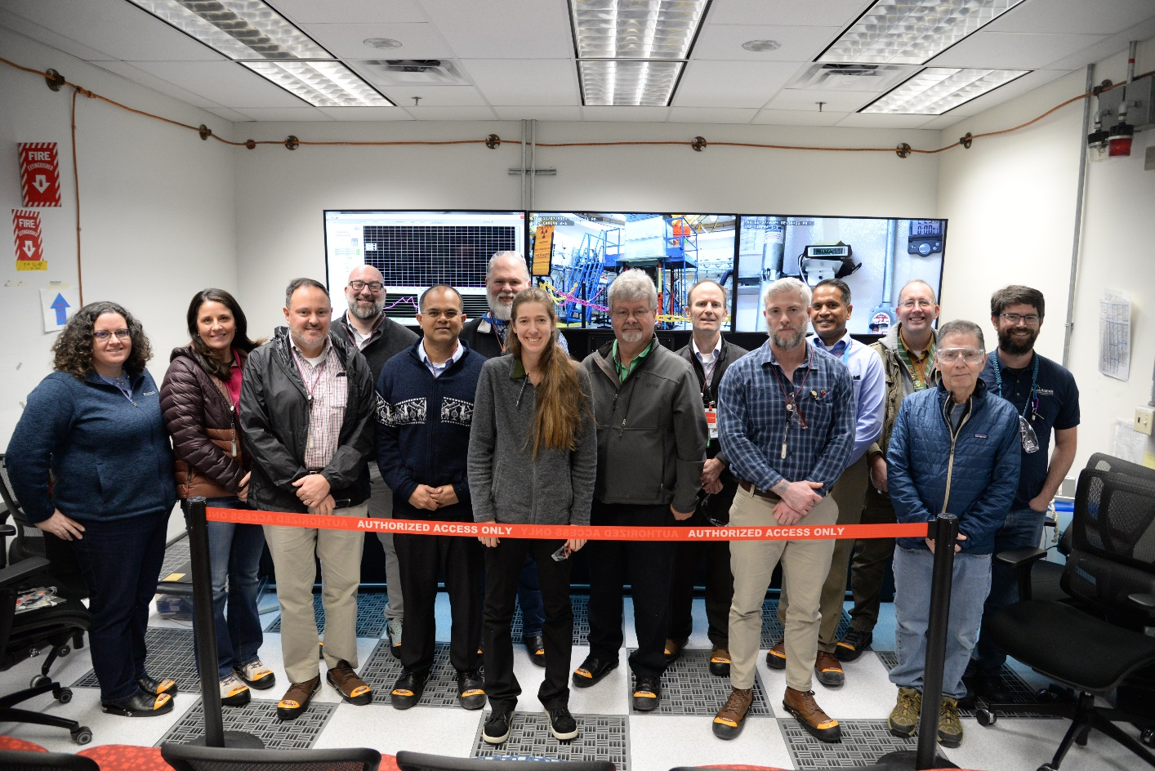
Deimos Status
Currently working on benchmarking and analysis of experimental results
Expect many papers in the next few years!
Follow-on work – Theta (already completed!), Westinghouse critical experiment, ZiaCore LDRD

Slide 15
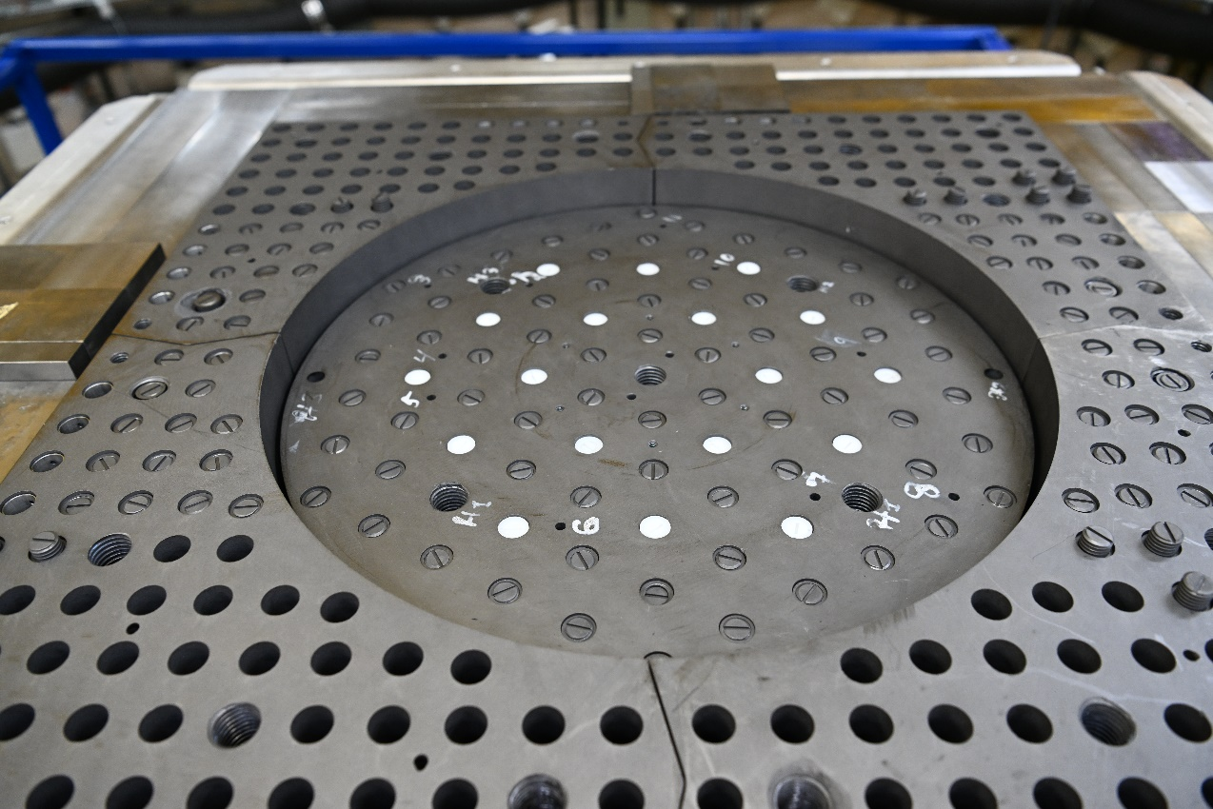
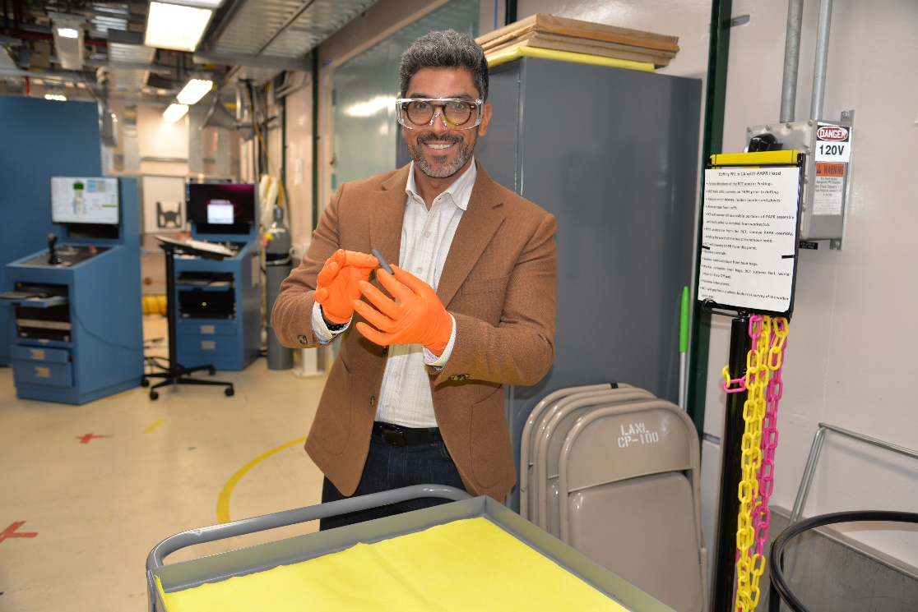
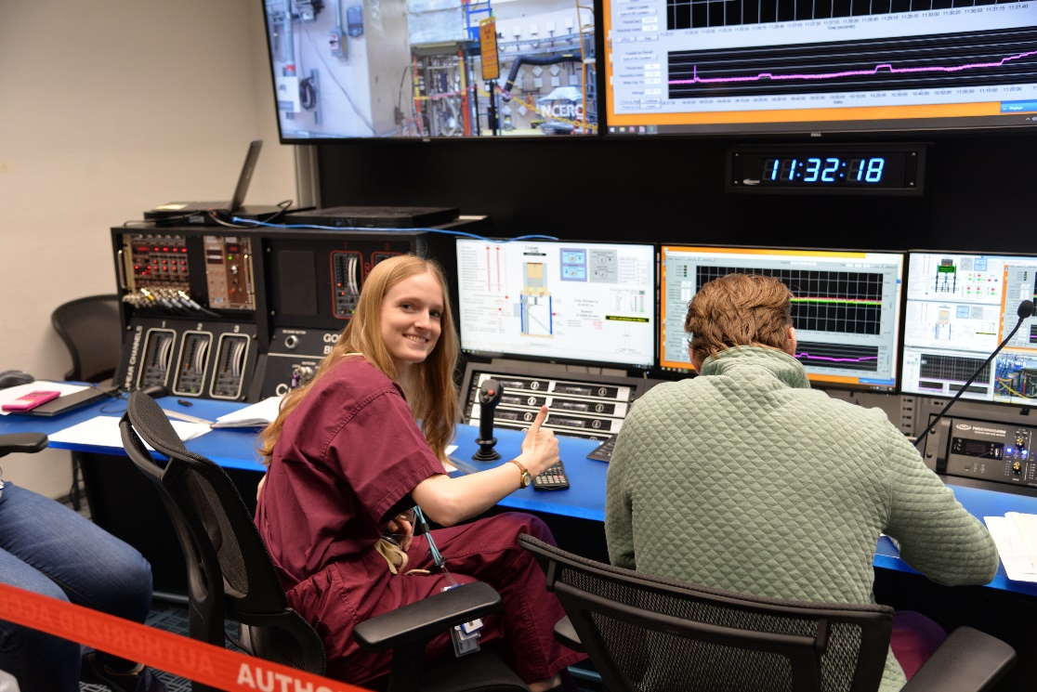
THETA
Funded by DNCSH and collaboration with Kairos Power – performed in Feb 2025
Three configurations based on Deimos platform, but adding polyethylene, stainless steel, and borated polyethylene rods
Will also become benchmarks in the ICSBEP

Slide 16
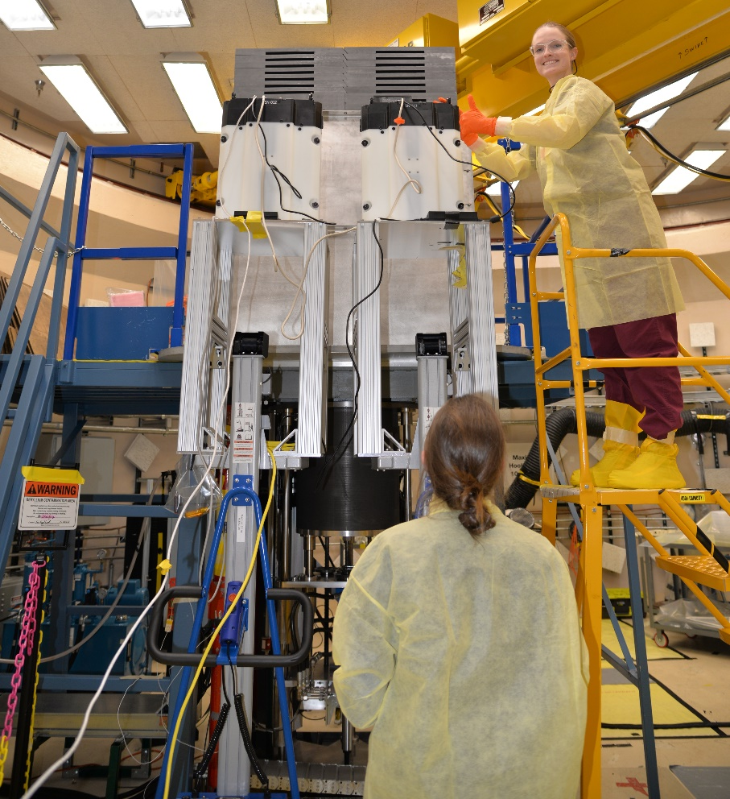
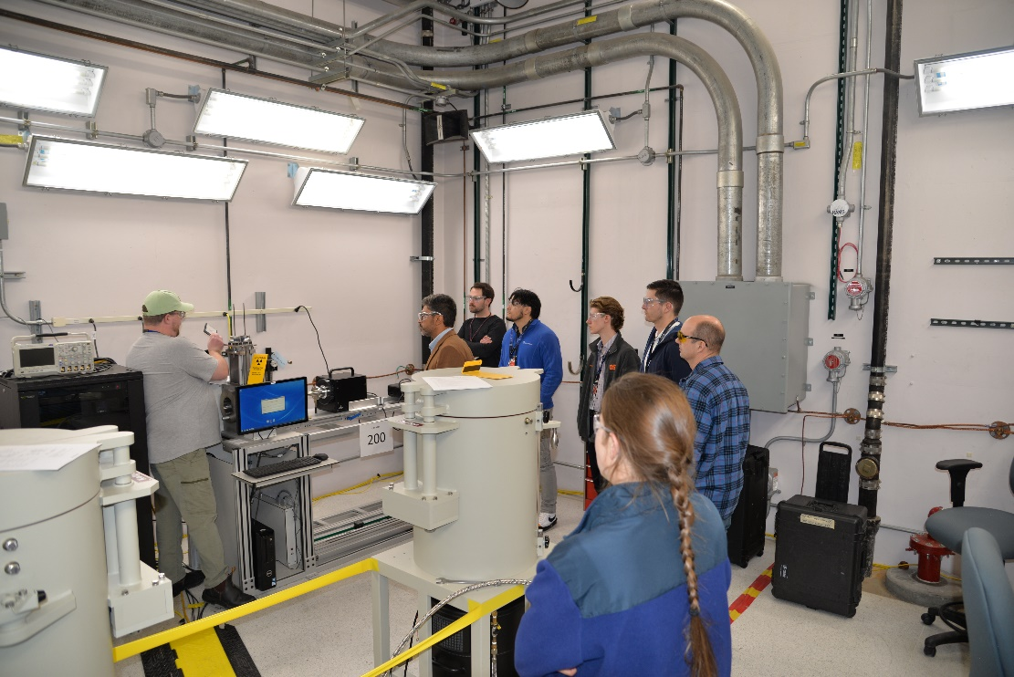
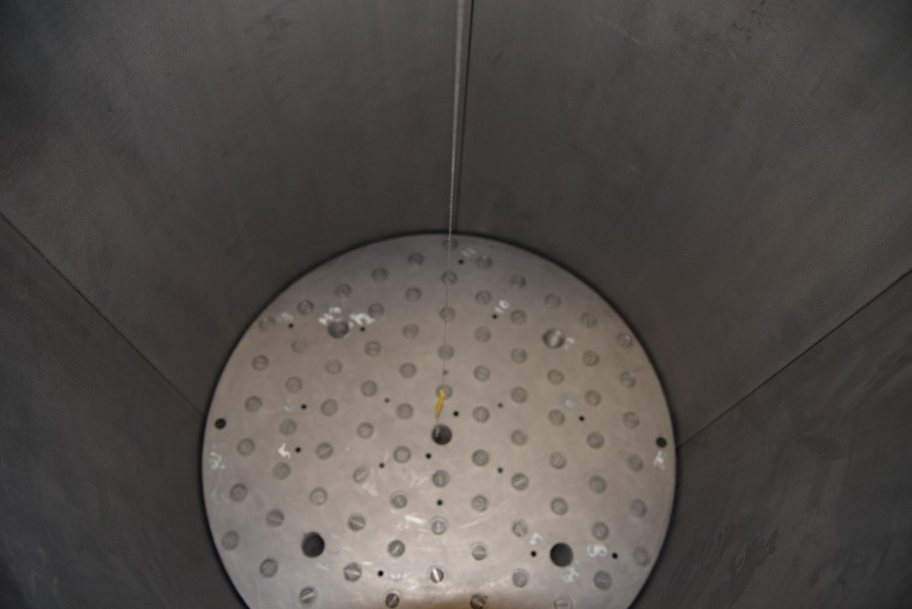
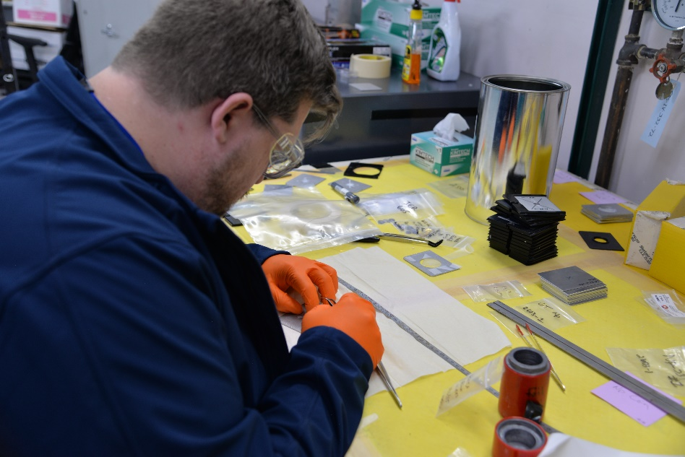
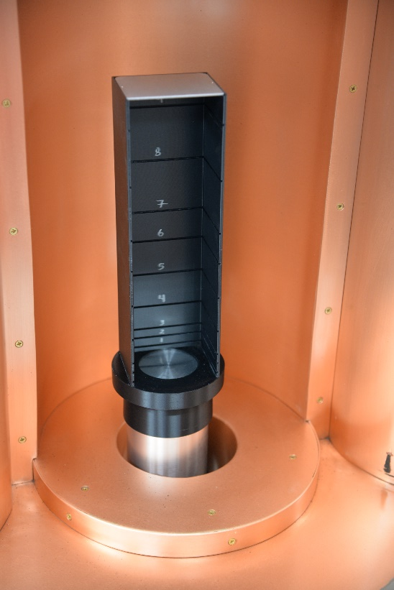
THETA
Also performed ‘add on’ experiments including neutron noise and flux wire irradiation

Slide 17
Simulations of Deimos
Since Deimos is still in the benchmarking process, there is no official ‘benchmark model’ yet, and so any comparisons between experimental and simulated results are very preliminary and need to be taken with a grain of salt
Modeling of the TRISO particles is quite difficult to get right!
However, these results will give an indication of how sensitive to graphite TSLs Deimos is
Once they are official benchmarks in the ICSBEP, they will be useful tools, especially for the nuclear criticality safety community

Slide 18
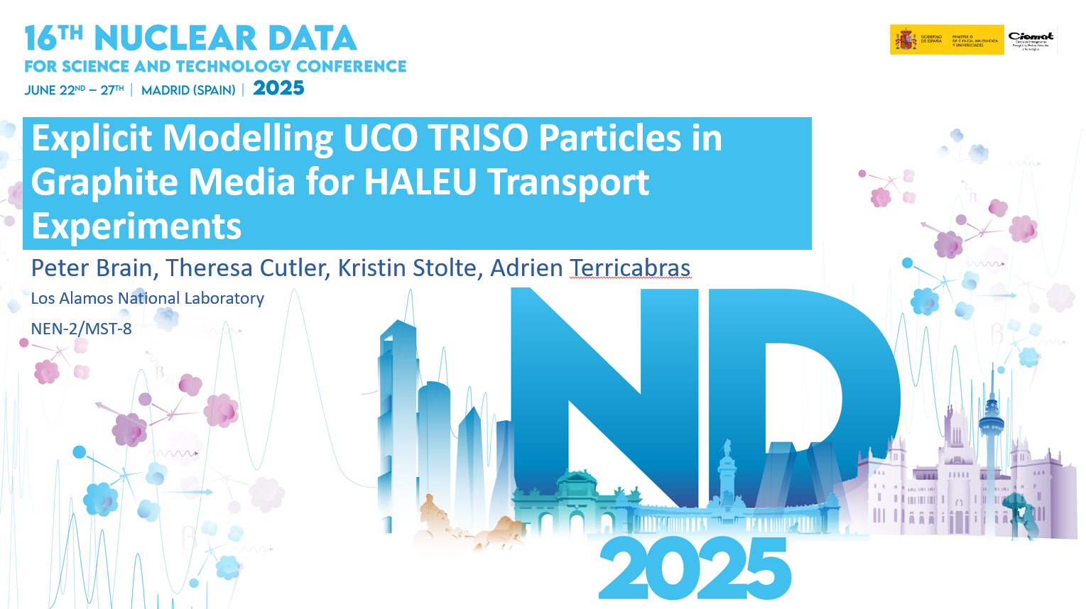
Simulations of Deimos
Peter Brain has done a lot of work on this
He presented at ND2025 two weeks ago
He looked at k_{eff} as a function of packing fraction, sphericity, and TSLs
If you want his full talk, let me know!
ENDF80SaB2
grph, grph10, grph30

Slide 19
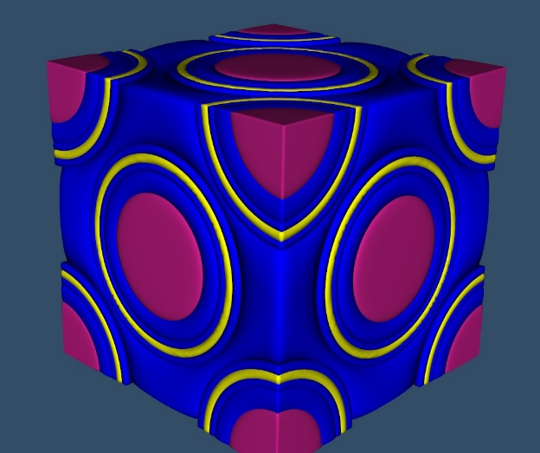
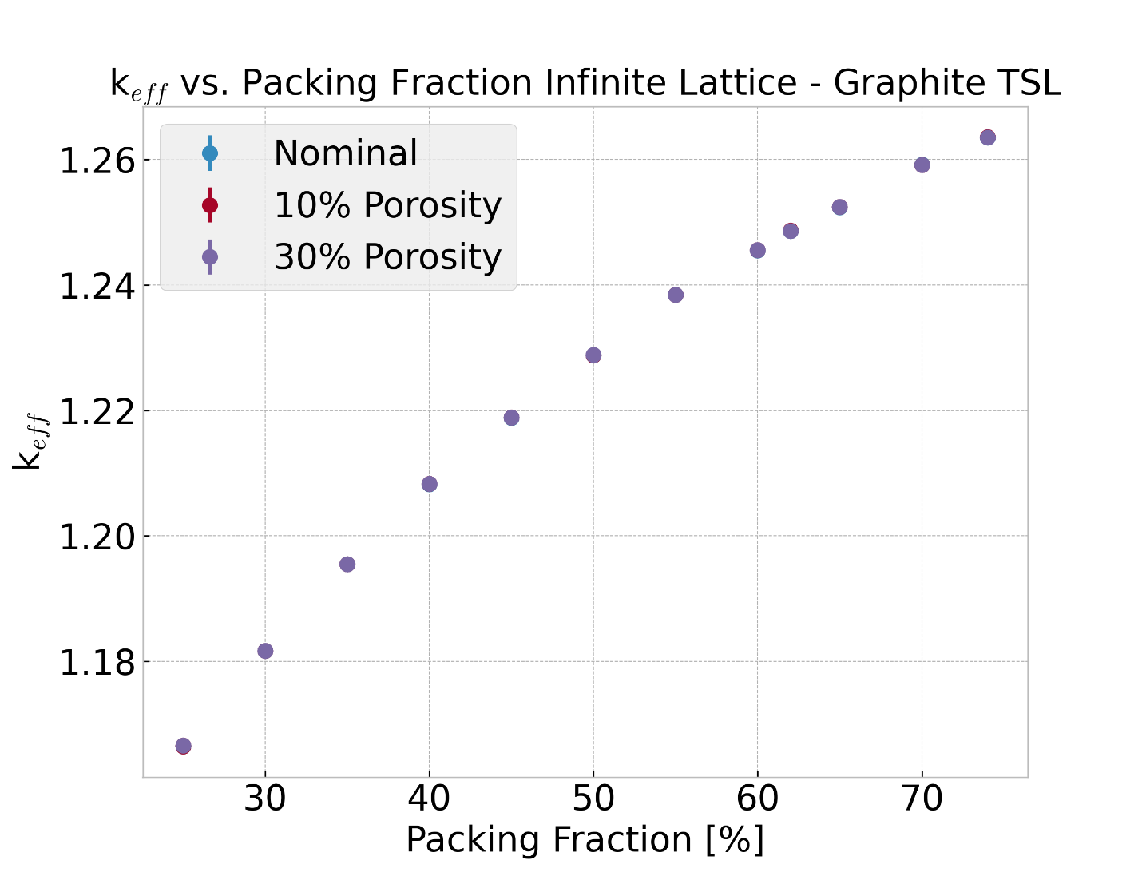
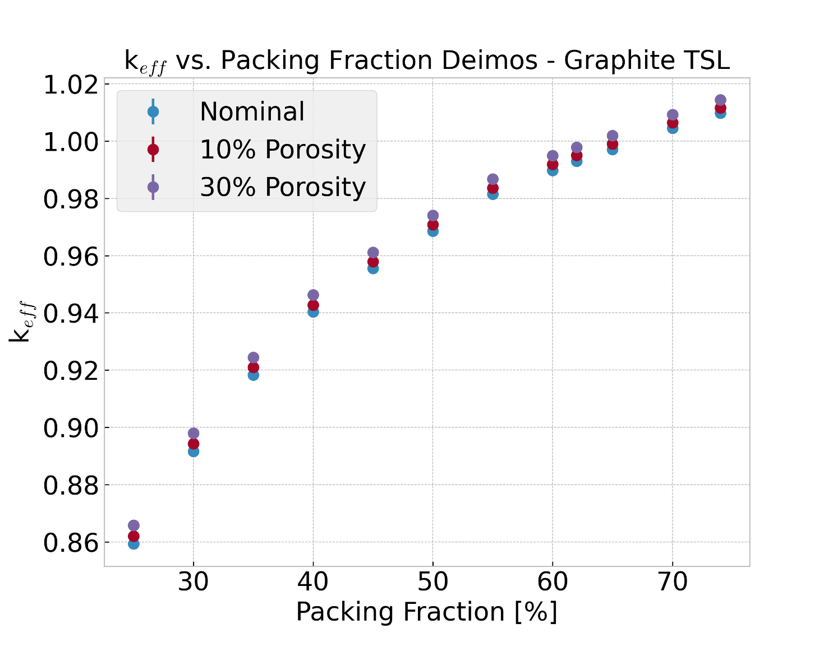
TSL for Graphite Porosity
No observable impact of TSL porosity on Infinite Lattice
Combination of intermediate spectra and lack of large graphite sections
Roughly 15-20 pcm/% porosity between 0% → 30% for Deimos

Slide 20
TSL vs Free Gas
Compared grph.40t with free gas (no TSL)
keff for free gas is a little higher than 30% porosity
TRISO Packing Fraction | TSL | Free gas | Free gas - TSL [pcm]
60 | 0.99032 | 0.99685 | 653
62 | 0.99337 | 0.99984 | 647
65 | 0.99749 | 1.00409 | 660

Slide 21
Graphite TSLs
About a 500 pcm difference between nominal (0% porosity) and 30% porosity graphite TSL
About 650 pcm difference between nominal (0% porosity) and free gas (no TSL)
Definitely a difference between how graphite is simulated, especially with the number of benchmark configurations Deimos and THETA will have

Slide 22




Acknowledgements
This work was supported by the DOE/NRC Criticality Safety for Commercial-Scale HALEU for Fuel Cycle and Transportation (DNCSH) project, a collaboration between United States Department of Energy (DOE) and the Nuclear Regulatory Commission (NRC), a component of the Office of Nuclear Energy’s HALEU Availability Program.
The Deimos experiment design was supported by the US Department of Energy through the Los Alamos National Laboratory and the Laboratory Directed Research & Development “Next Generation Small Nuclear Reactors”, 20220084DR.
NCERC is supported by the DOE Nuclear Criticality Safety Program, funded and managed by the National Nuclear Security Administration for the Department of Energy.

Slide 23
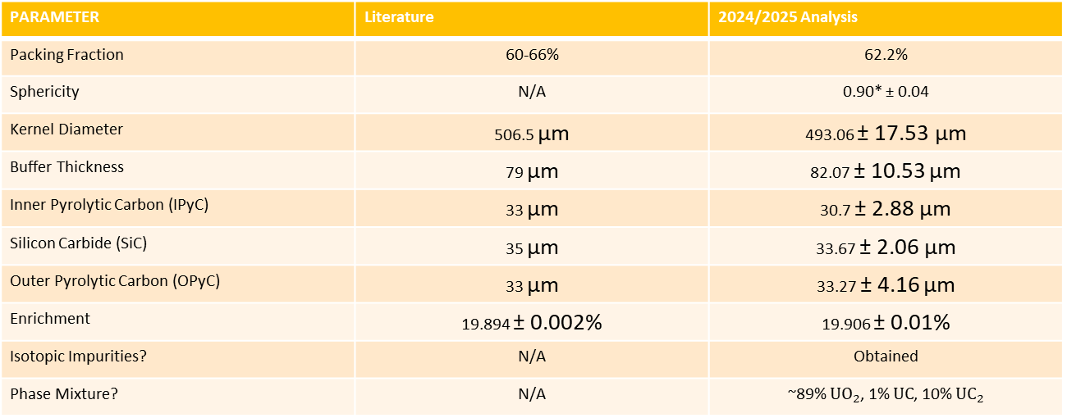
Then and Now
PARAMETER | Literature | 2024/2025 Analysis
Packing Fraction | 60-66% | 62.2%
Sphericity | N/A | 0.90* ± 0.04
Kernel Diameter | 506.5 µm | 493.06 ± 17.53 µm
Buffer Thickness | 79 µm | 82.07 ± 10.53 µm
Inner Pyrolytic Carbon (IPyC) | 33 µm | 30.7 ± 2.88 µm
Silicon Carbide (SiC) | 35 µm | 33.67 ± 2.06 µm
Outer Pyrolytic Carbon (OPyC) | 33 µm | 33.27 ± 4.16 µm
Enrichment | 19.894 ± 0.002% | 19.906 ± 0.01%
Isotopic Impurities? | N/A | Obtained
Phase Mixture? | N/A | ~89% $UO_{2}$, 1% $UC$, 10% $UC_{2}$
*Under Review

