Slide 1
Integration, Installation and Infrastructure (Triple I Group)
TIC Update
Roland Wimmer

Slide 2
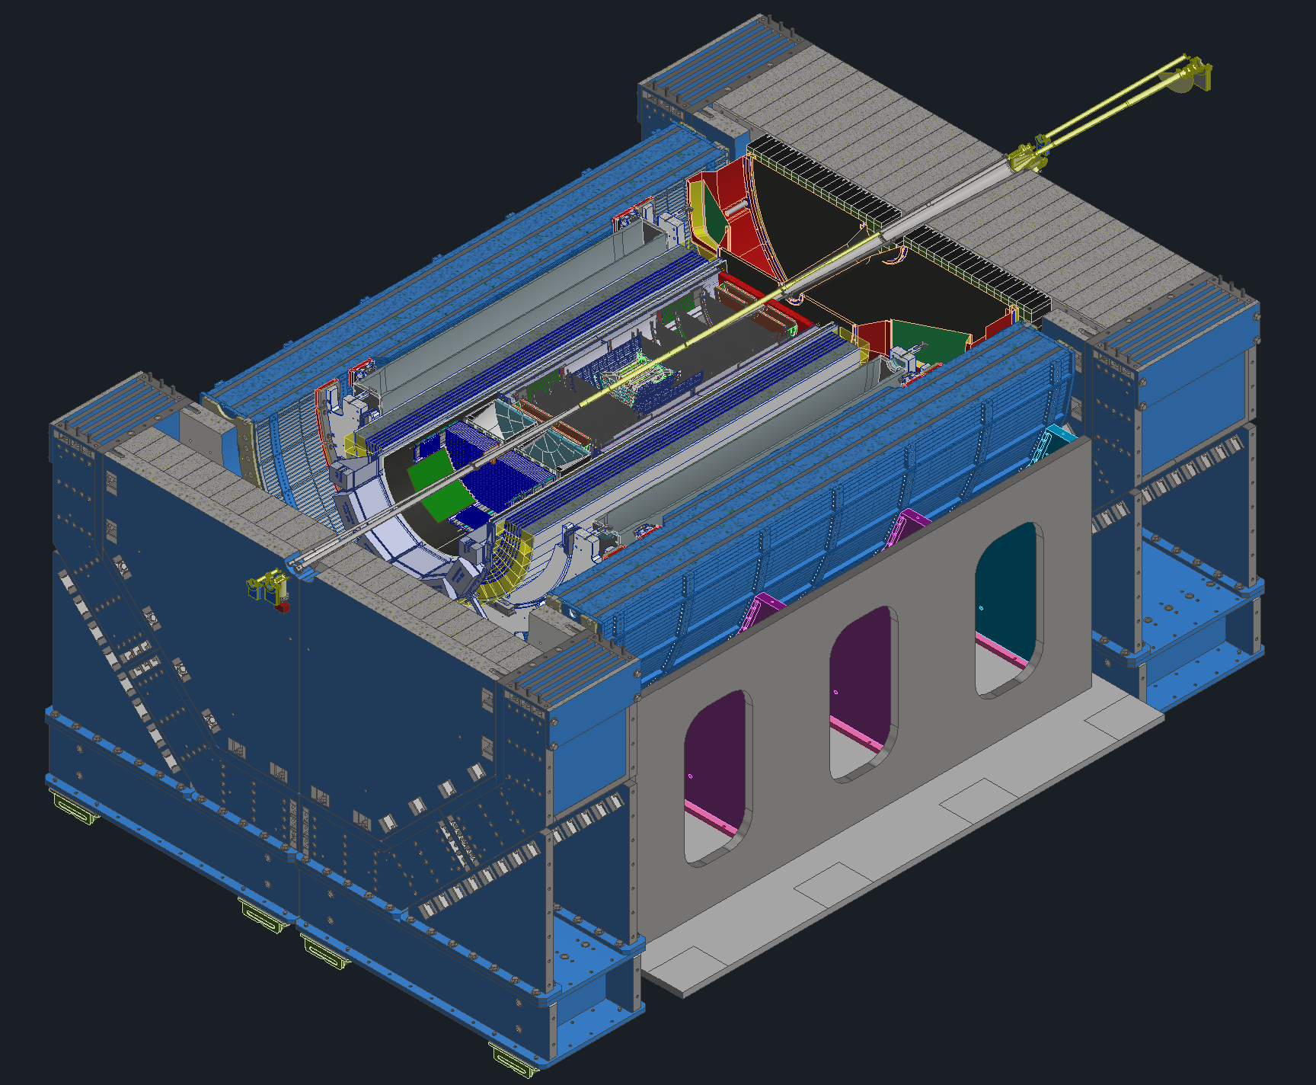
Detector Model Updates
Updates from ToF meeting
Updates from bEMCAL meeting
Considering different cradle / roller options
Alignment updates
Service updates from SVT
fECAL & cooling
Reuse updates
AC-LGAD SoW
Vault for EPIC

Slide 3
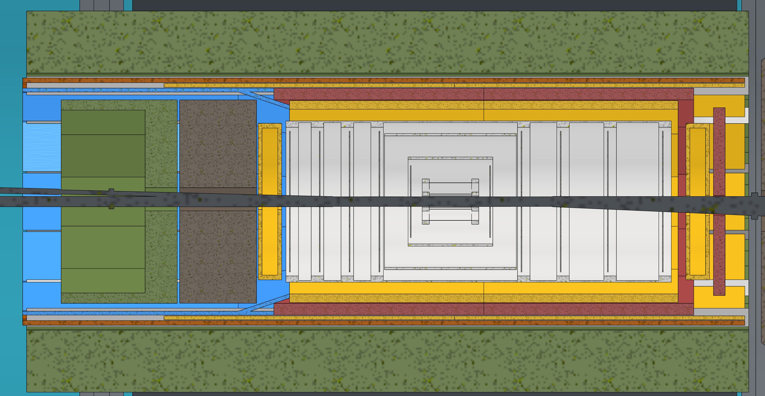
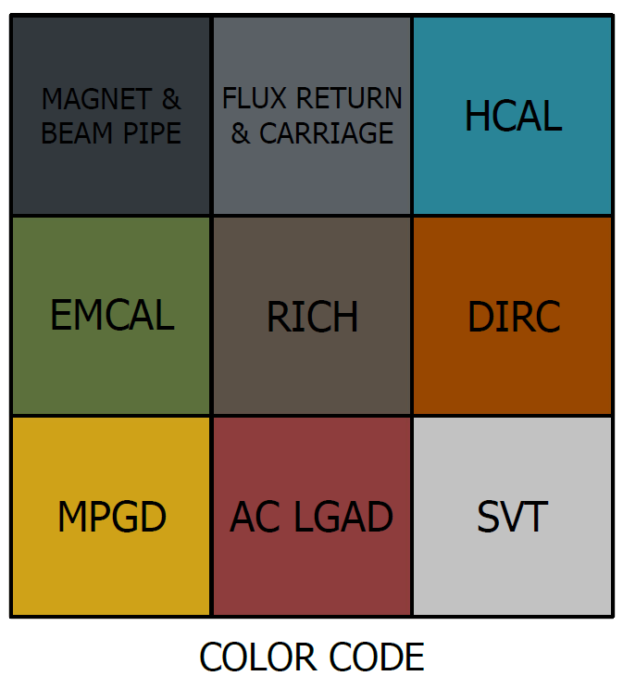
Tof Updates
Making some changes to how the GST is designed
Still need to talk with CYMBAL group before going into too much details
Overall goal is to make the inner detectors more serviceable
Looking to change the ToF such that it is a 12 sides shape as opposed to the cylinder it was before.
This Would allow for it to be assembled as “trays” that can be slid out for maintenance
GST/PST

Slide 4
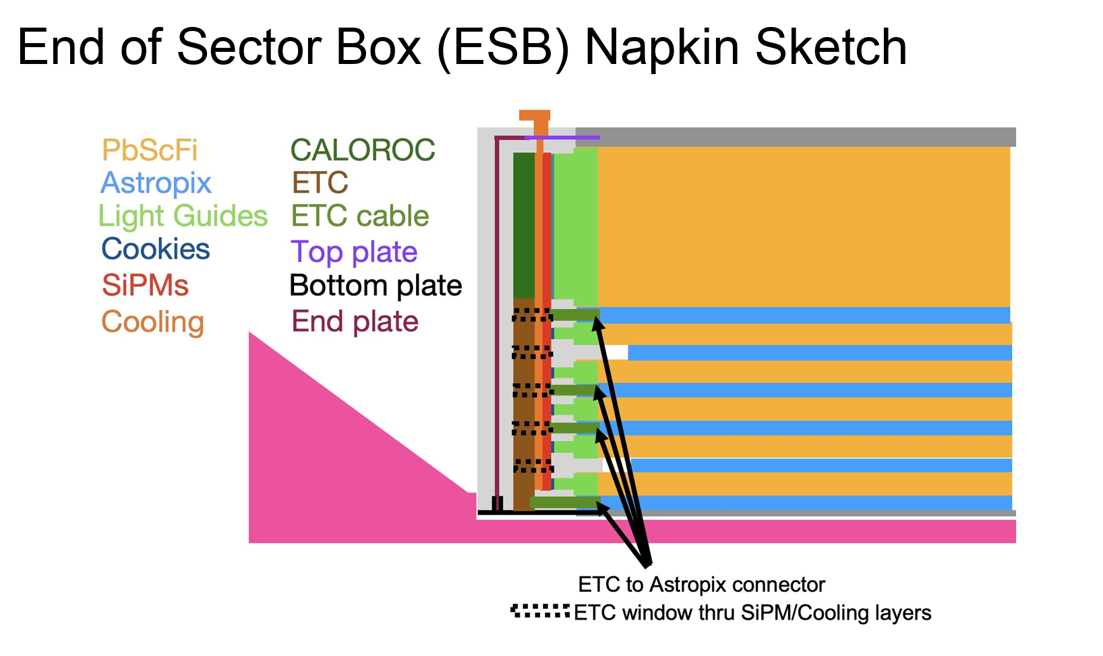
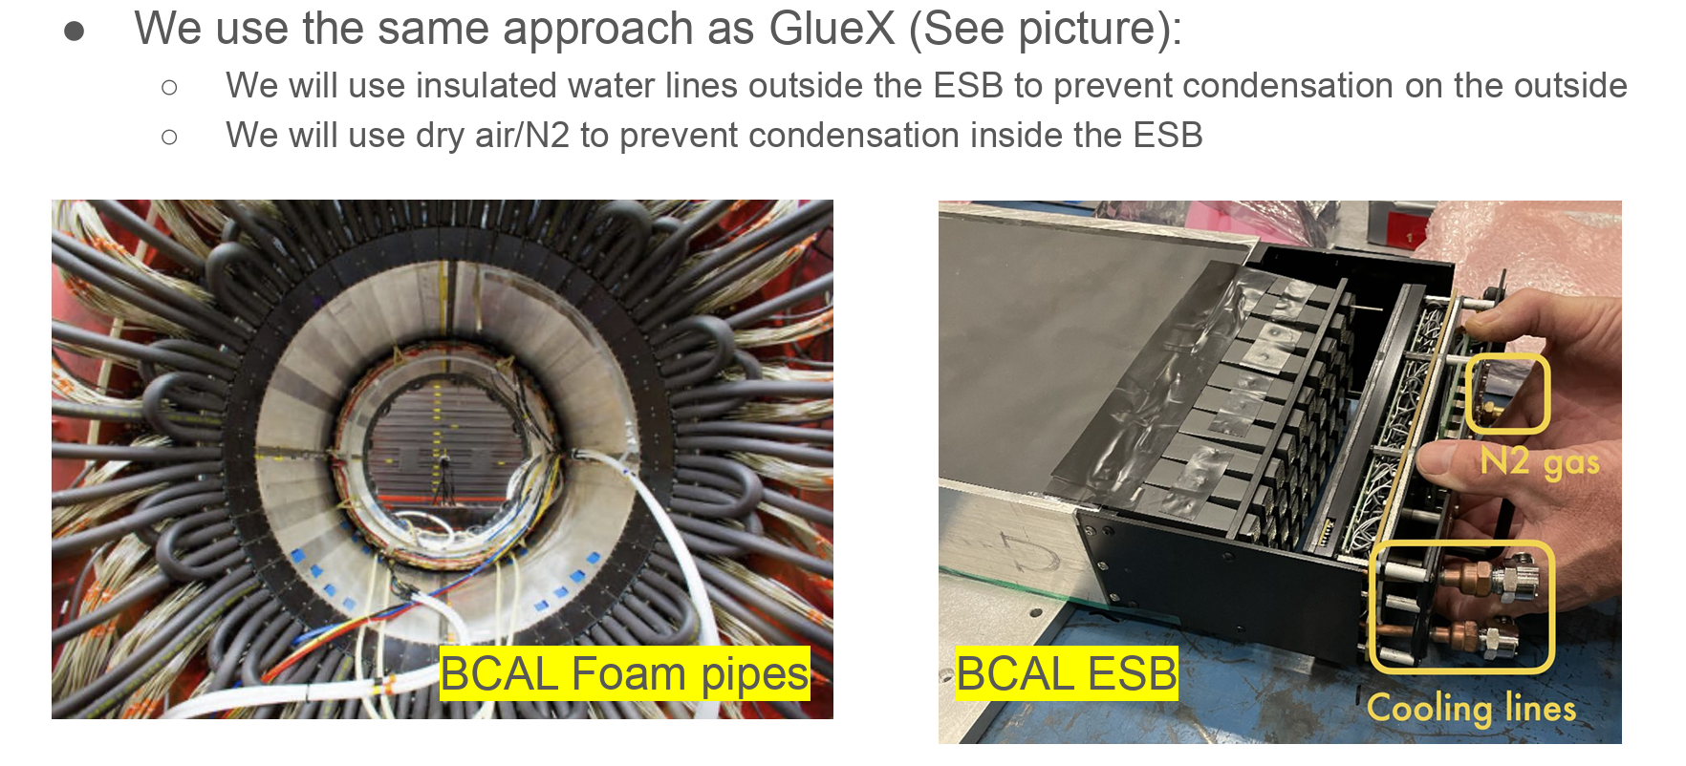
bEMCAL Updates
Received updates from the Barrel EMCal group last week regarding their end of sector boxes and cooling requirements
Some stolen screenshots from their slides below
We presented an updated bEMCAL support model
Decided against wedge jacks
There were some concerns and different ideas that will be investigated

Slide 5
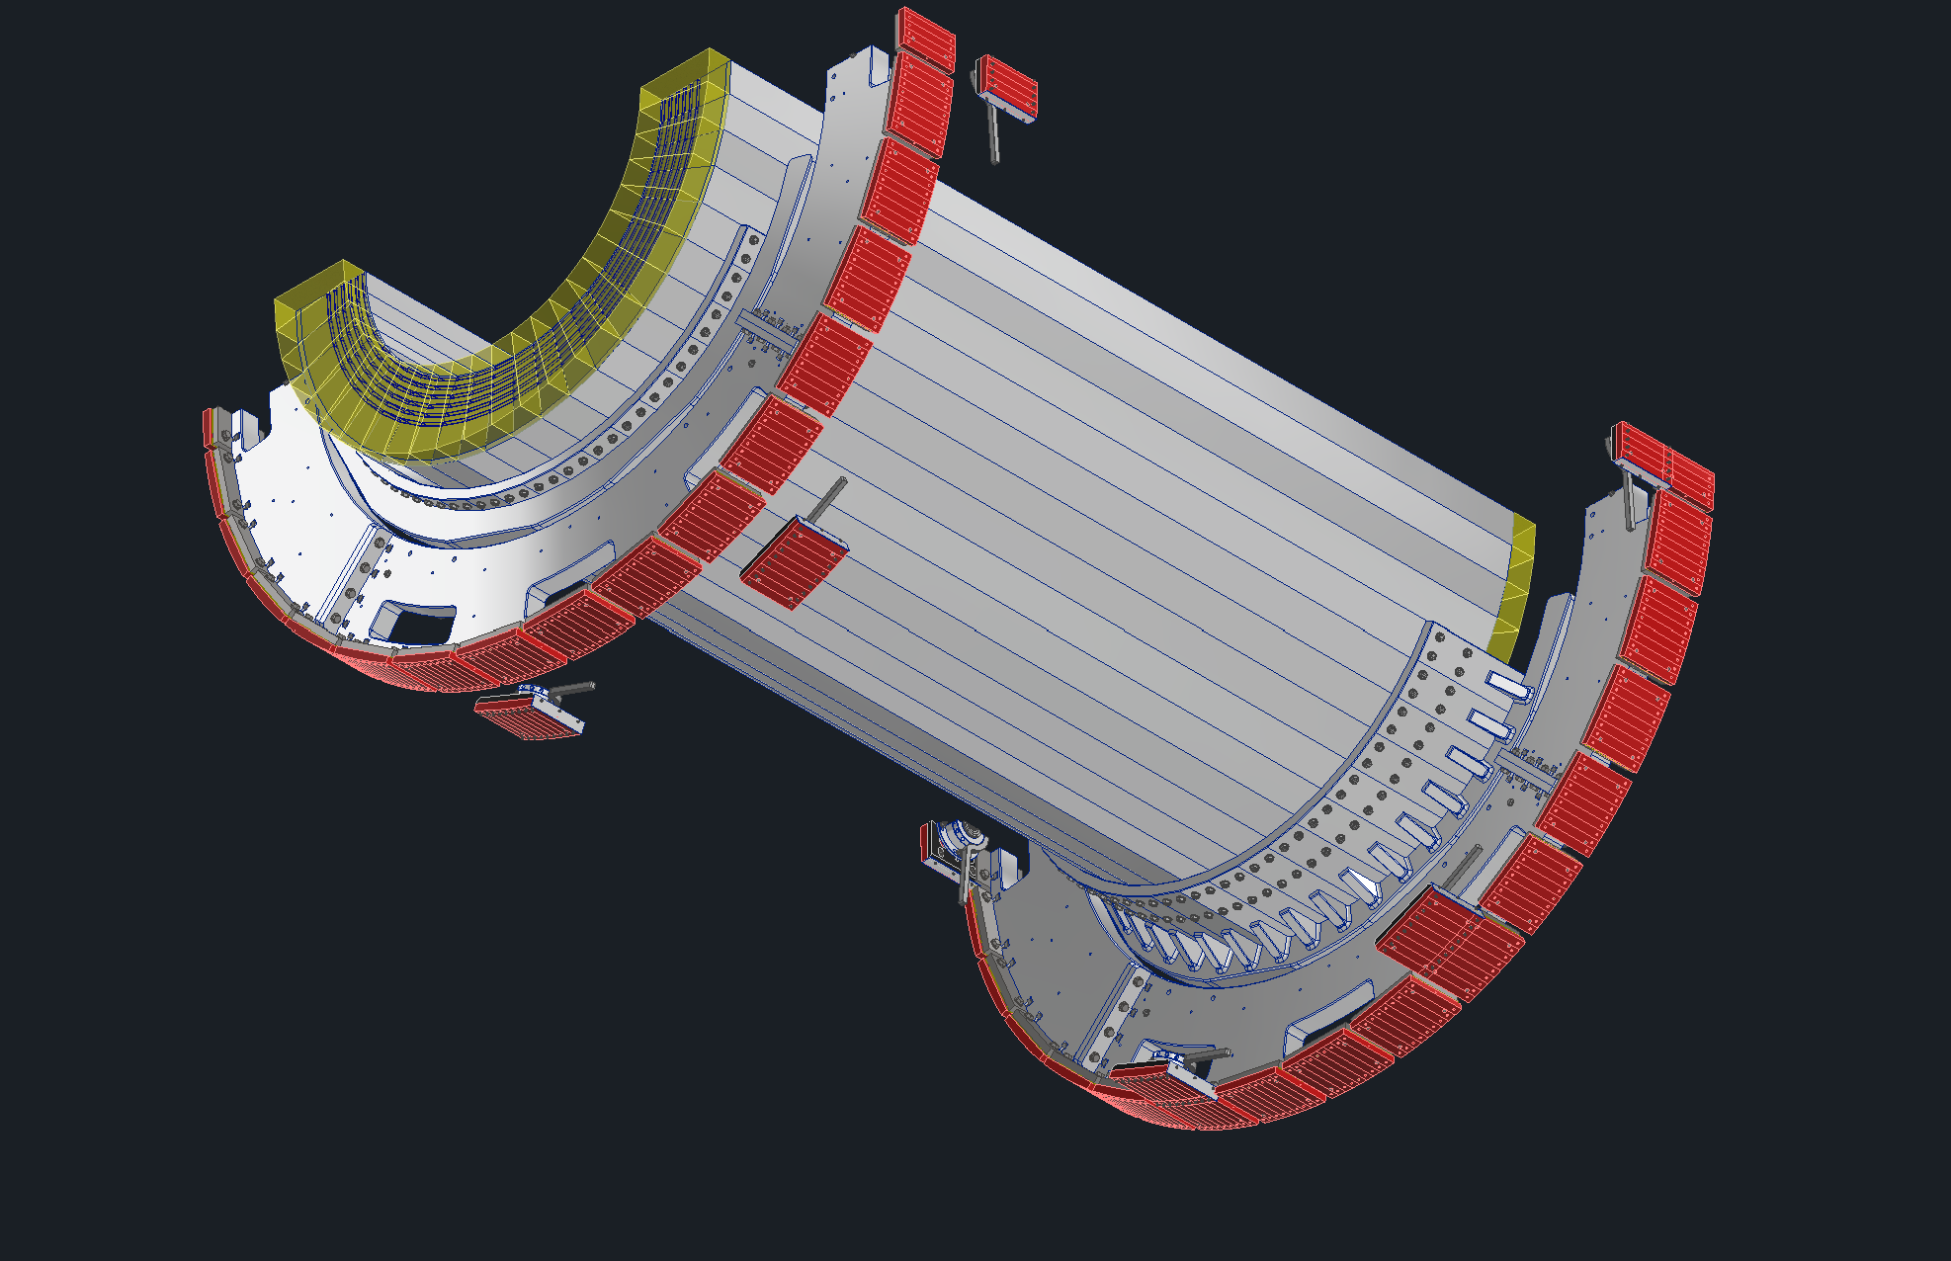
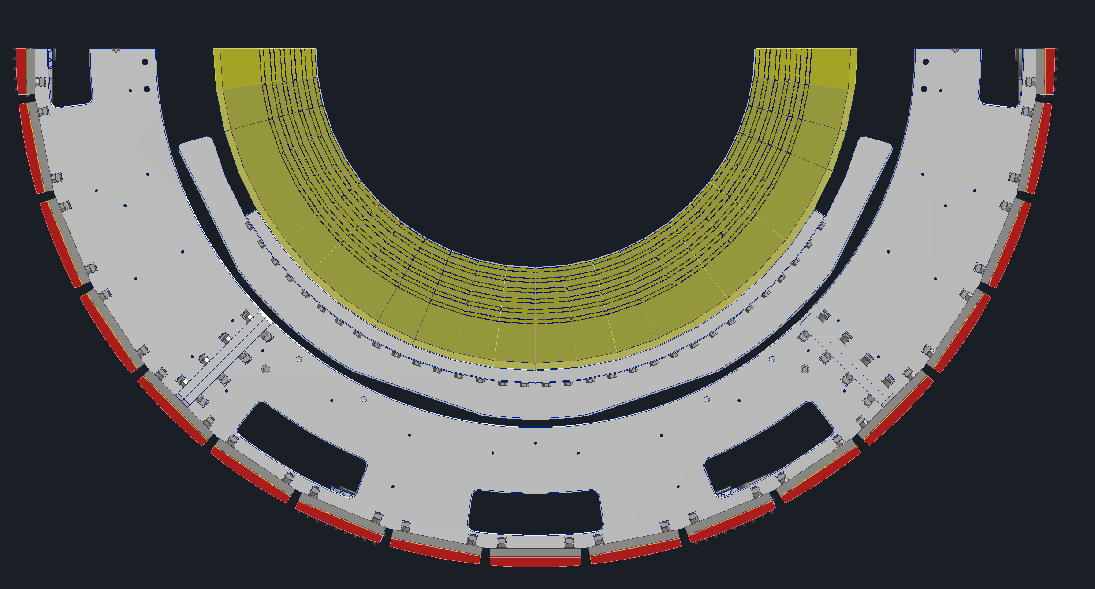
bEMCAL

Slide 6
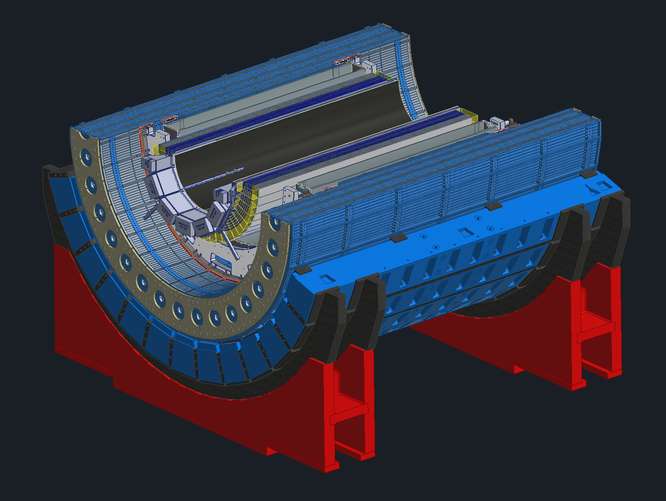
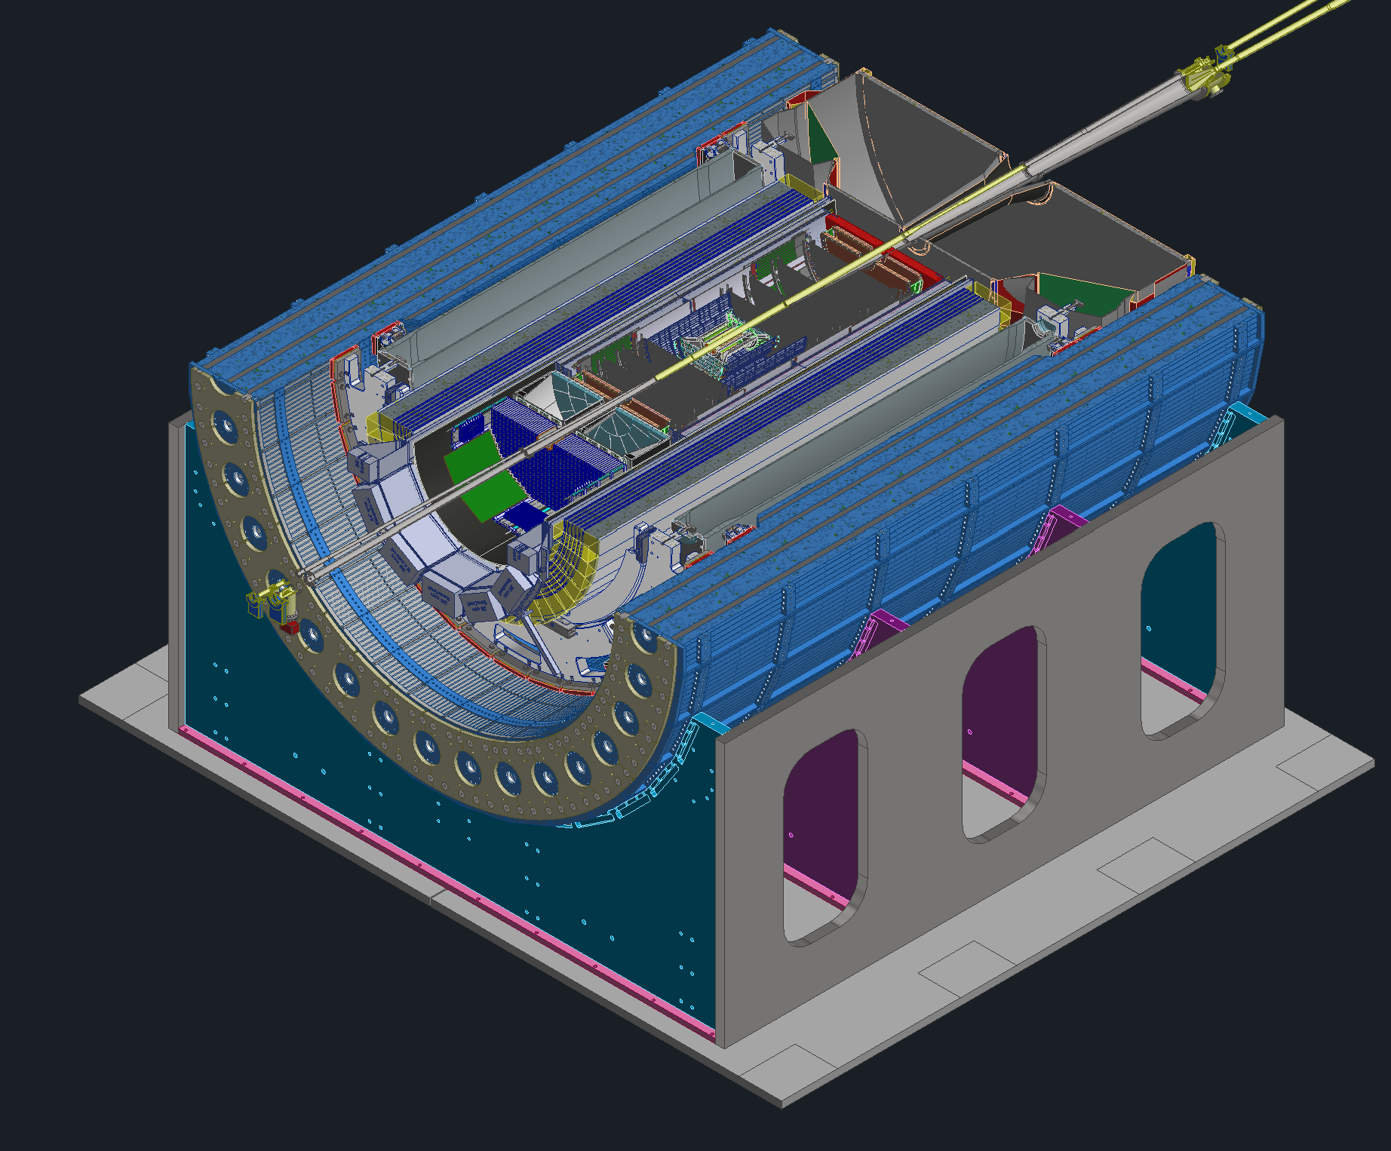
Cradle Updates
OLD
New proposed cradle design
Planning on reusing the sPHENIX support webs (shown in purple and teal)
Will use new base, the old sPHENIX base wont work with our track setup
New design pros
Incorporating 8mrad rotation will be much easier
Much less weight due to less steel
Magnet group had concerns about too much steel on the bottom of the detector
NEW

Slide 7
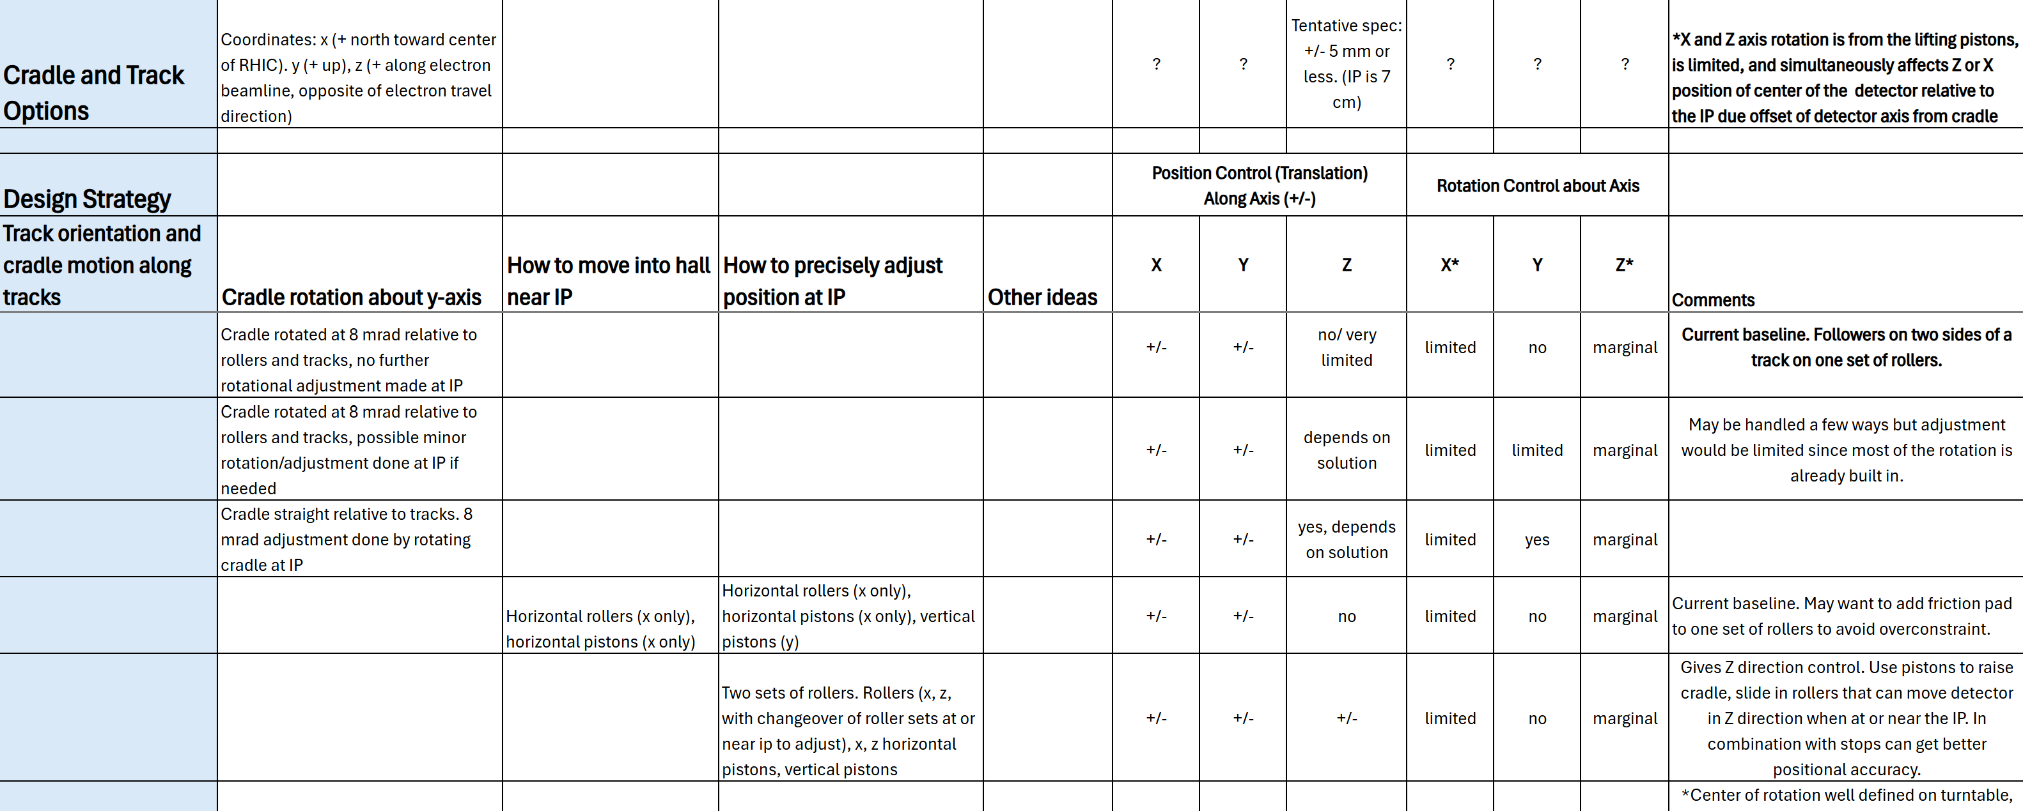
Cradle & Roller Updates
Currently considering several different options for supporting the detector and how we plan on moving it into and out of the experimental hall
Nathaniel made a spreadsheet listing the pros and cons of all the options

Slide 8
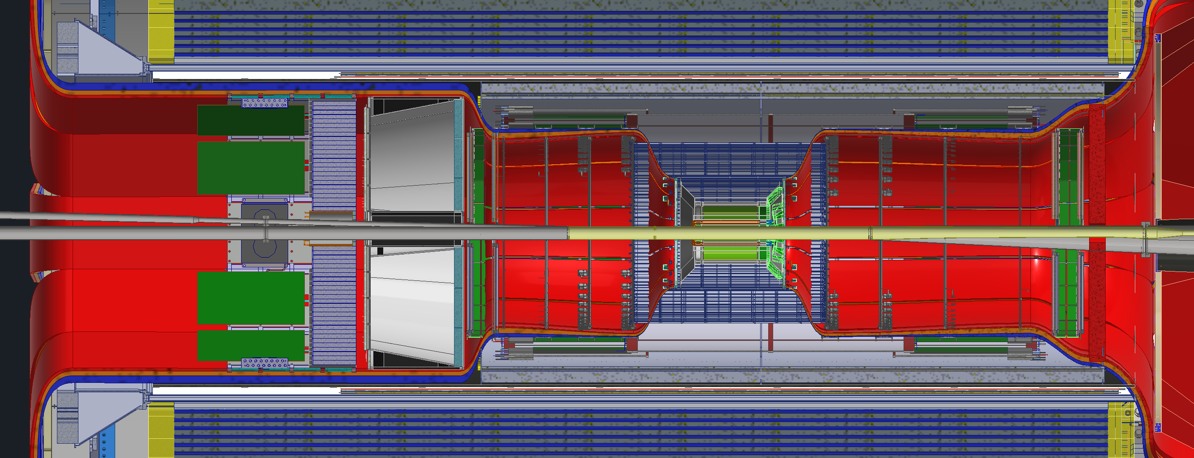
SVT Services Updates
SVT group gave an update on their power numbers last week
They are currently working with Steven Titus on updating their services
Tim Camarda went to go work on NSLS2, Steven will be his replacement
Once Steven is done, he is going to start looking at unifying cable types throughout the detector where we can.

Slide 9
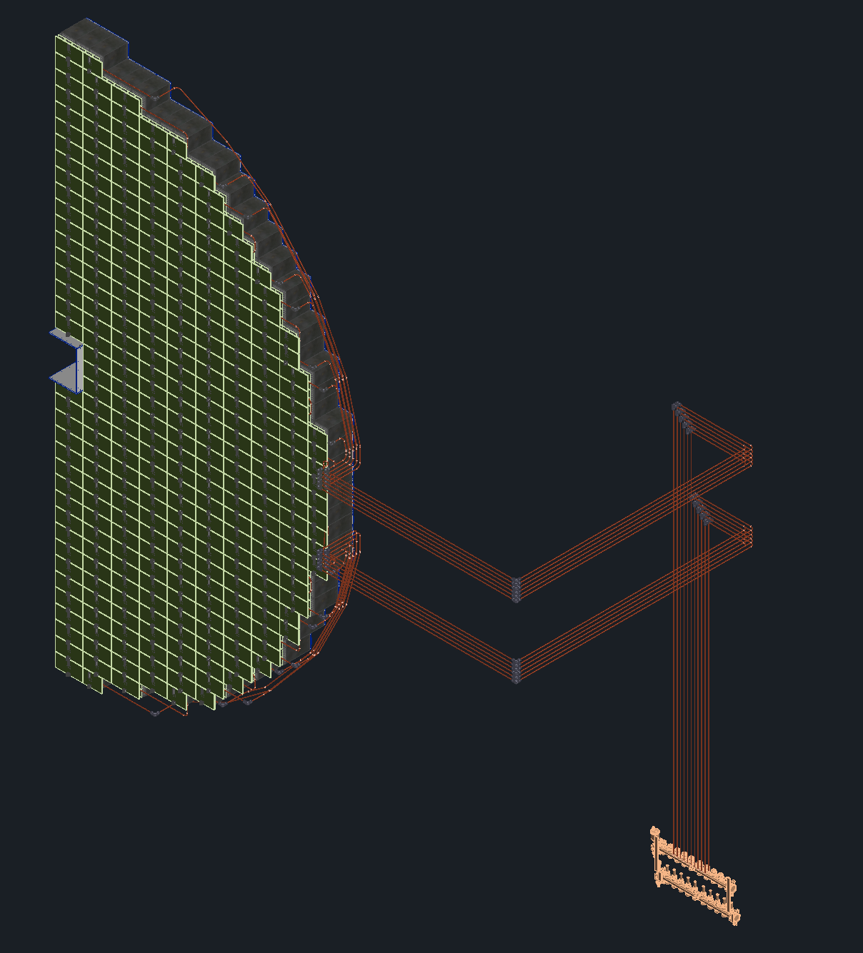
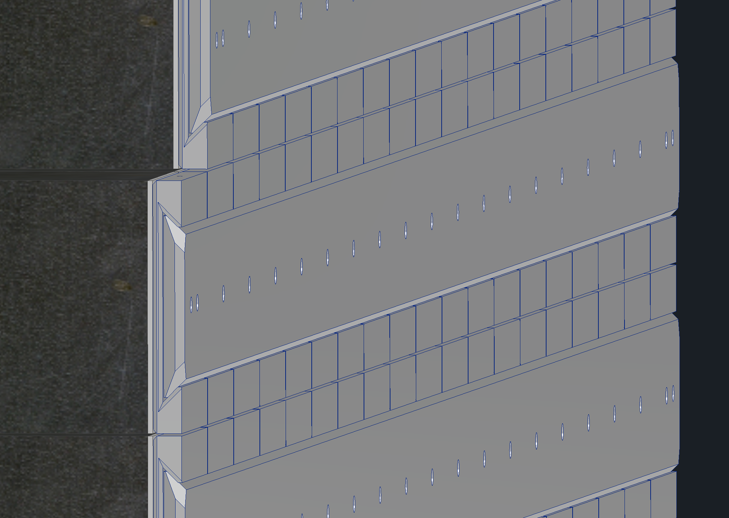
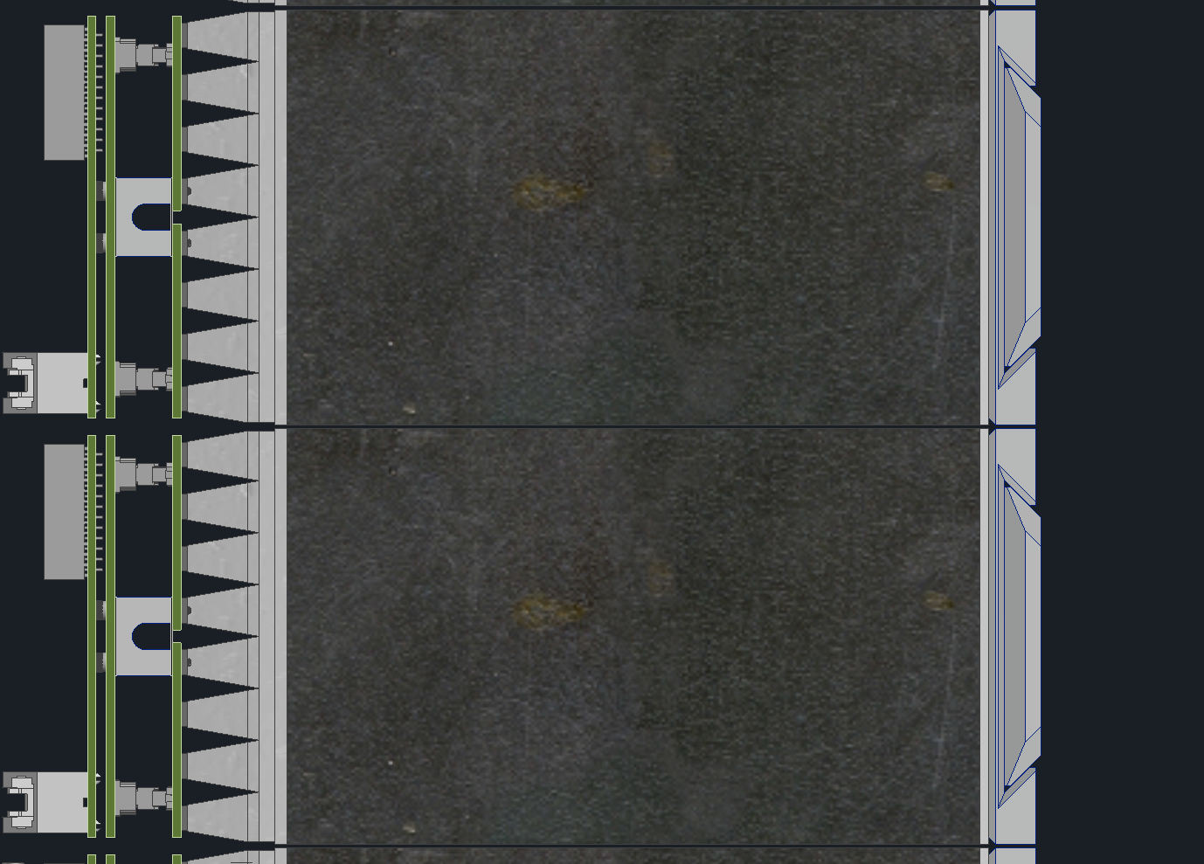
fECAL
Josh, Girish and Oleg worked together to finish the cooling and layout for the fECAL
Cooling routing will most likely be switched from copper (shown) to hoses once its past the boards
Recently switched mounting scheme to a dovetail design
Modules will now be slid into place via dovetails

Slide 10
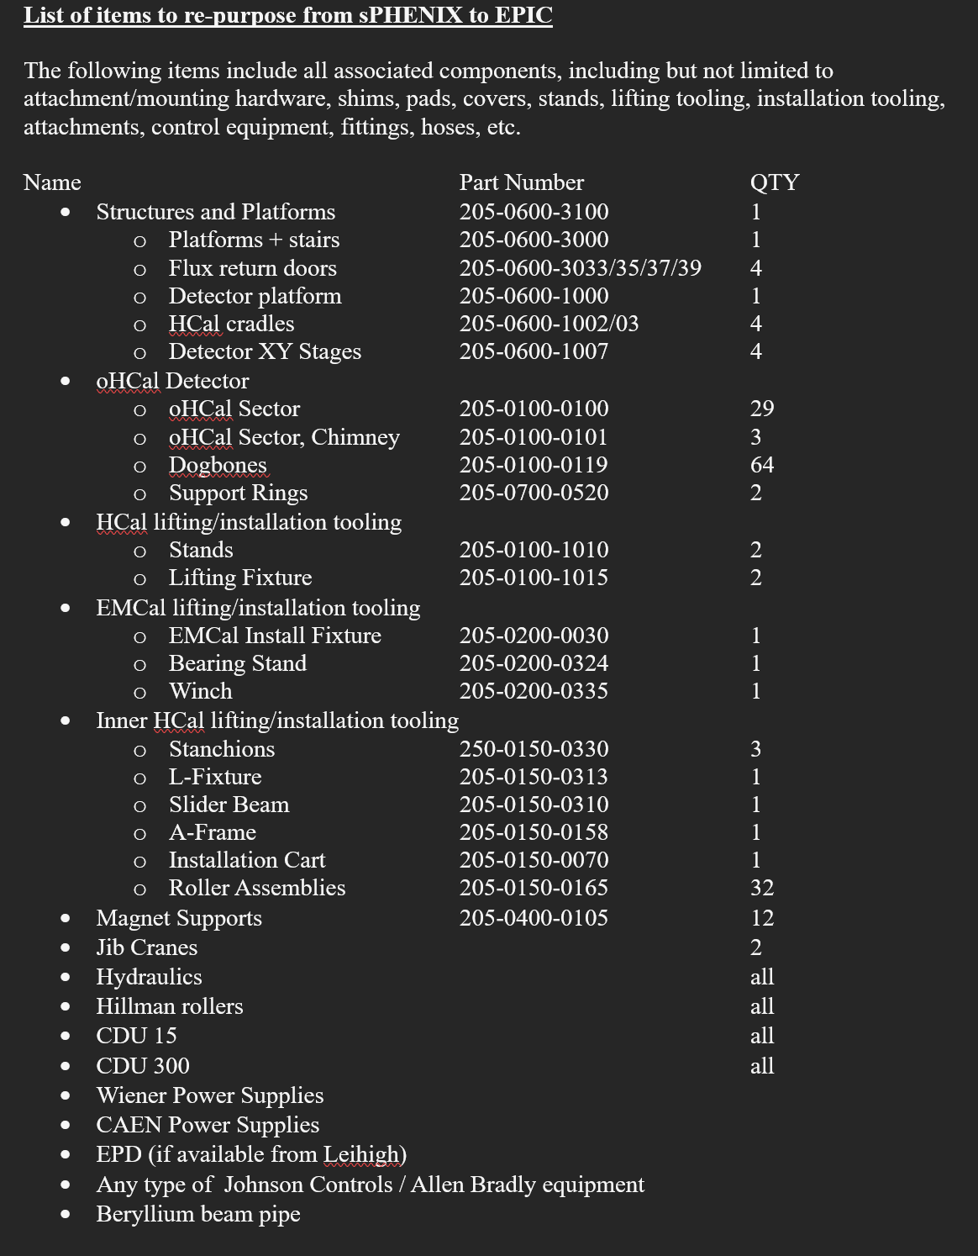
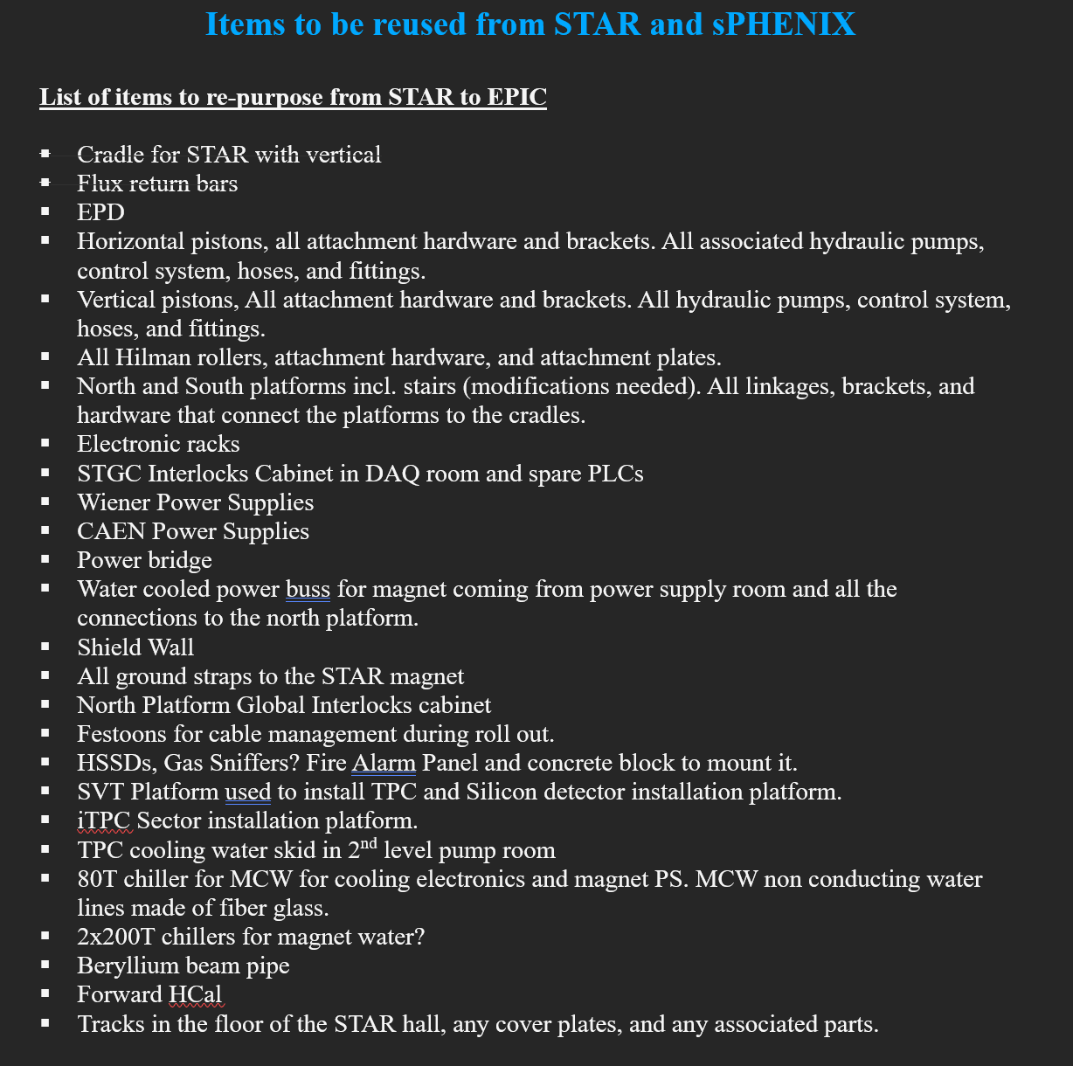
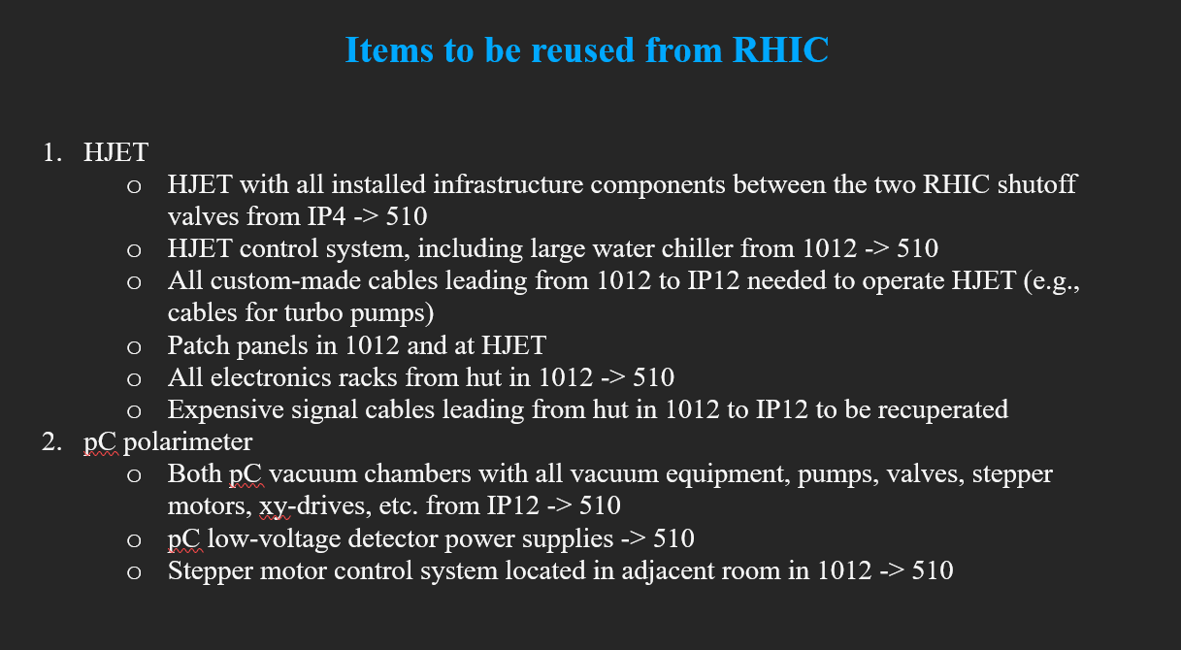
ReUse Updates
Working on finalizing the items that we need to reuse form STAR, sPHENIX and RHIC

Slide 11
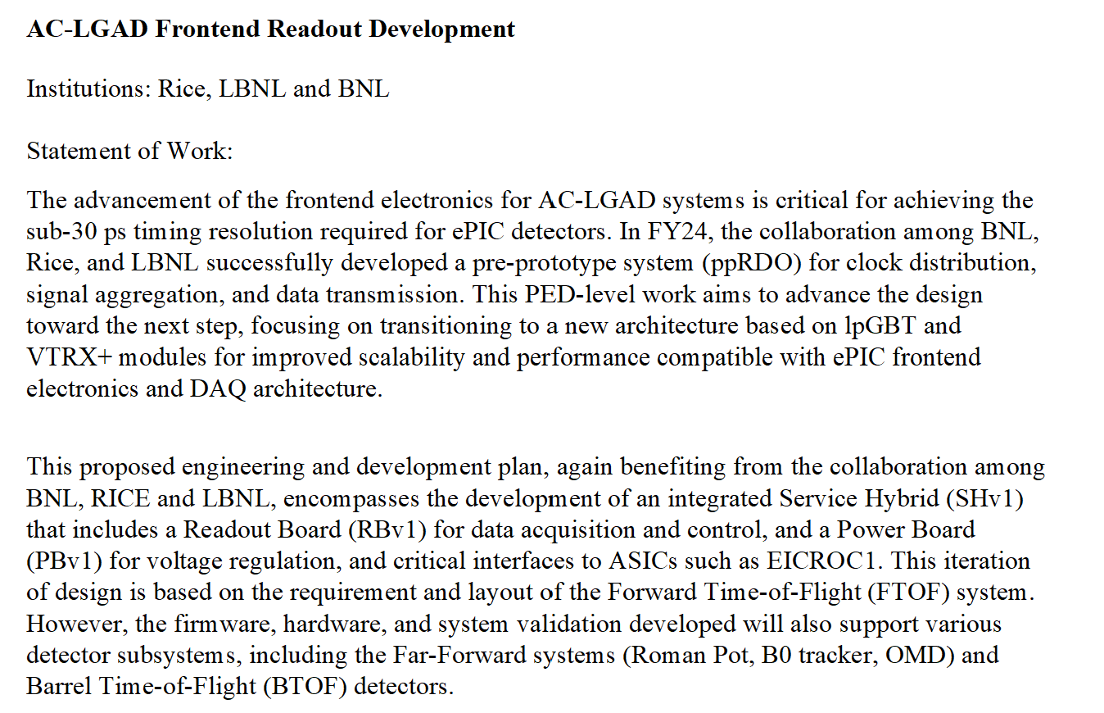
AC-LGAD SoW
Statement of work for the AC-LGAD Frontend readout development was finished last week

Slide 12
Vault for EPIC
Planning on setting up Autodesk Vault for the project for file and data management
Dan will present on this sometime soon, we still need to figure a few things out

Slide 13
Backup Slides

