Slide 1

ePIC Collaboration Survey – Tools for DSC/WG’s
John Lajoie
May 12th, 2025

Slide 2
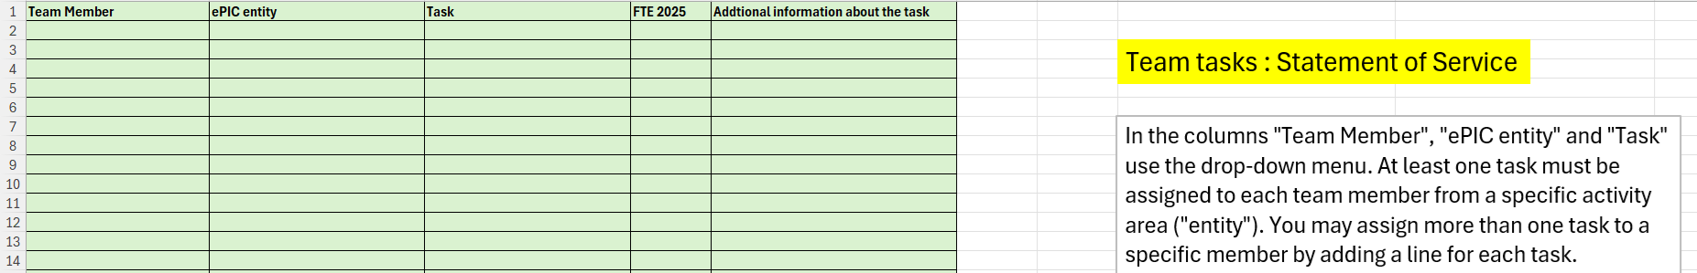
ePIC Collaboration Survey 2025
As part of the 2025 Statements of Service, CC members we asked to associate collaborators with tasks in ePIC
This data is a potentially valuable source of information that can be used to engage collaborators in the work of the DSC’s and WG’s
To make this available, we have aggregated the information across all institutions and provided it in the form of a pivot table
ePIC 2025 Statement of Service form

Slide 3
Pivot Tables
Email sent to all DSL, DSTC’s, WG conveners May 4th
Has links to both Excel and Google Sheets versions
A “pivot table” in its simplest form is a spreadsheet version of an Ntuple.
You select the data you want to see subject to a set of cuts
Two versions made available:
Only name, institution, contact information (NO FTE information)
MS Excel Version (Dropbox):
Can be downloaded and used in local Excel (doesn’t work in Dropbox viewer)
Google Sheets Version:
Use in Google Sheets – a downloaded copy will not work in Excel
Be aware – if multiple people try to use it at the same time you may clash

Slide 4
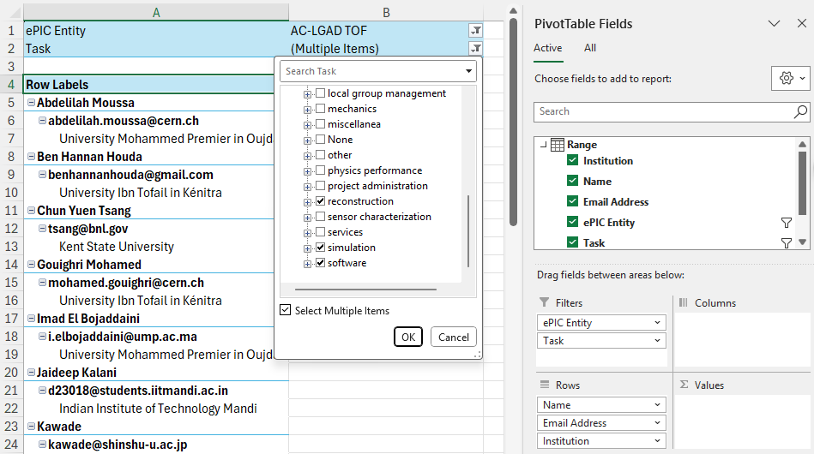
How to Use
Entity is DSC, WG, etc.
Can select multiple “tasks”
Go to the “Pivot Table” tab
Select the “ePIC Entity” you are interested in
Set conditions based on the task information

Slide 5

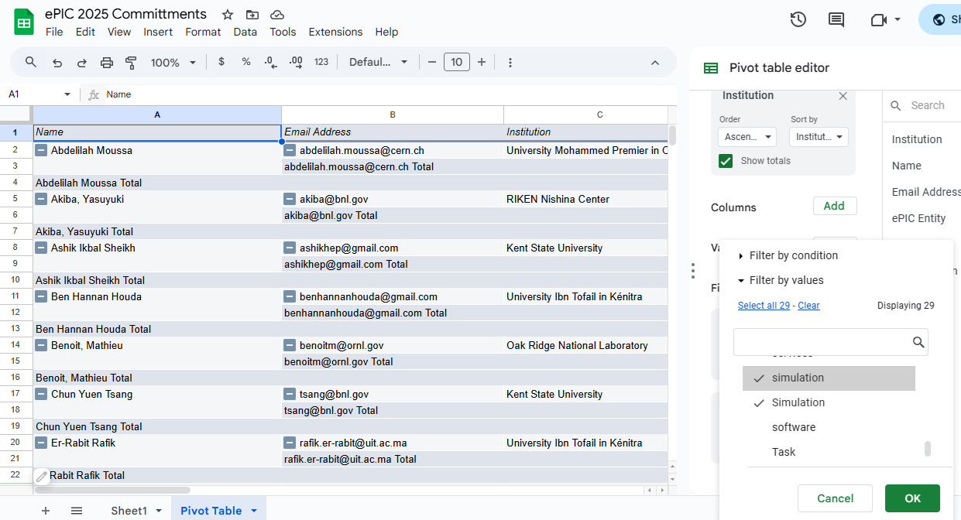
Google Sheets Version
If you don’t see the “Pivot Table Editor”, click the pencil in the lower left:
Use “Filters” to select entity and task.
NOTE: Sheets is case sensitive for tasks
Make a copy if you want to make other changes

Slide 6
Boundary Conditions
What this data is to be used for:
To engage workforce in ePIC – to match people up to tasks they have expressed an interest in and get them started.
What this data in NOT to be used for:
The evaluation of the 2025 commitments will be done by the Membership Committee as part of the 2026 survey process. It is not the job of the DSC/WG leadership to police these commitments.
If you contact someone and they don’t respond/engage, there nothing further you need to do.

Slide 7
Summary
This isn’t perfect, but we hope it is useful.
Make use of this. This is something you can actually do to help address the workforce/engagement problem in ePIC.
If you have questions or need additional information, don’t hesitate to ask

Slide 8


Slide 9

ePIC Resources
Public Website - https://www.bnl.gov/eic/epic.php
Mailing Lists – https://lists.bnl.gov/mailman/listinfo
Indico Agenda - https://indico.bnl.gov/category/402/
ePIC Software and Computing: https://indico.bnl.gov/category/435/
Wiki - https://wiki.bnl.gov/EPIC
ePIC Software Training:
Landing Page: https://eic.github.io/documentation/landingpage.html
Tutorials: https://eic.github.io/documentation/tutorials.html
Mattermost: https://chat.epic-eic.org
ePIC Zenodo Community: https://zenodo.org/communities/epic

Slide 10


EICUG Membership
The EICUG is a vital organization to promote the interests of the EIC community!
Without the EICUG we would never have gotten far enough to form ePIC!
Please register your institution!
Check with your EICUG IB representative to get registered as a member
https://www.eicug.org/content/join.html

