Slide 1
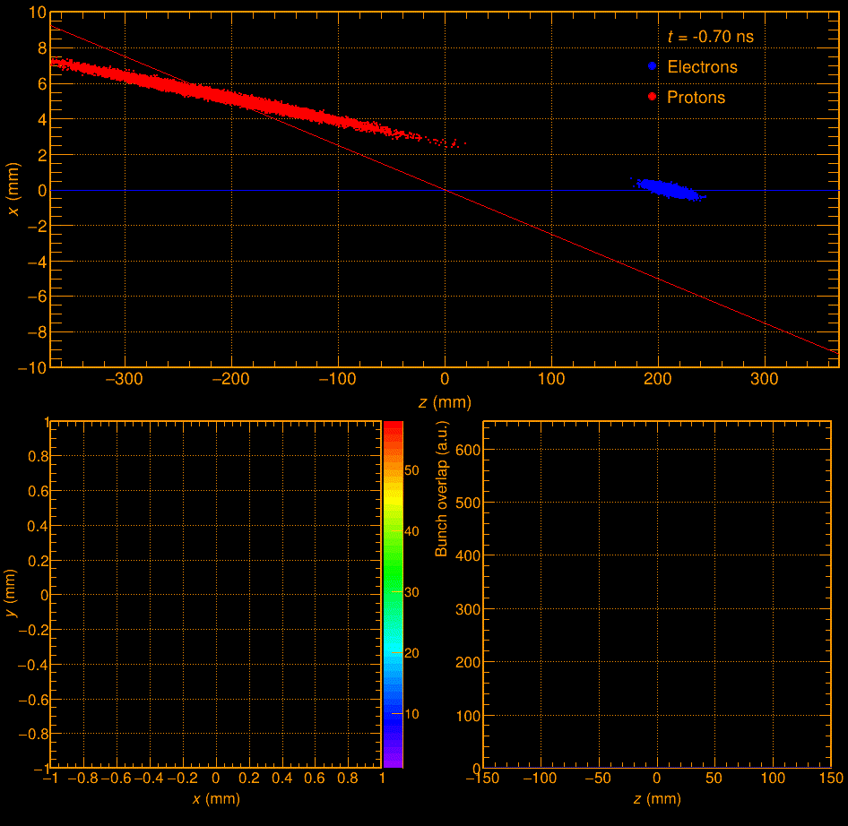
Q2: how do you determine t0 of the event (= the time particles were produced)
In the following we detail the steps and different sources playing together to get t0:
The RF clock is delivered via the common platform to DAQ with a jitter/stability estimated by EIC controls to be <8ps.
The DAQ design should add (in quadrature) <5ps to this.
There is another collider system used to control the crab cavities which can produce a clock based on the beam transit that has much better resolution than the common platform, ***if*** the common platform's resolution proves to be too poor, but this isn't the baseline.
Absolute time reference requires T0 offsets for each component, which can be applied after data is taken. The detailed calibration method hasn't been determined.
The bunches are long compared to the jitter of the RF clock
ESR -> 23-30ps bunch length
HSR -> 200-250ps bunch length
which results in an uncertainty of about 250ps as to the actual collision time if going by the bunch crossing alone
6. By tracking the z vertex to high precision one can reduce the T0 uncertainty to the order of the length of the electron bunch (~ 30ps)
If one has fully developed and tuned tracking software, one could attempt to reduce the t0 uncertainty further using the collision coordinate in the horizontal plane, at least for a fraction of events where X-vertex can be determined with a required precision of few dozens of um because the crossing angle allows for further pinpointing of the collision time as the horizontal spread of the beam is only 100-250um
The method for points 5 & 6 is detailed in the following presentation
https://indico.bnl.gov/event/17534/contributions/69698/attachments/43985/74219/vertexT0Determination_2022-10-24.pdf
Additional Material posted under Homework

