Slide 1
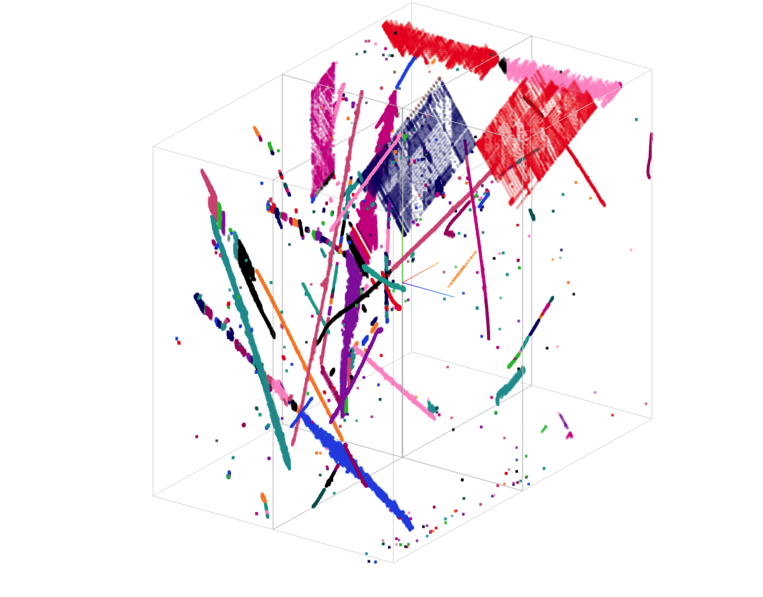
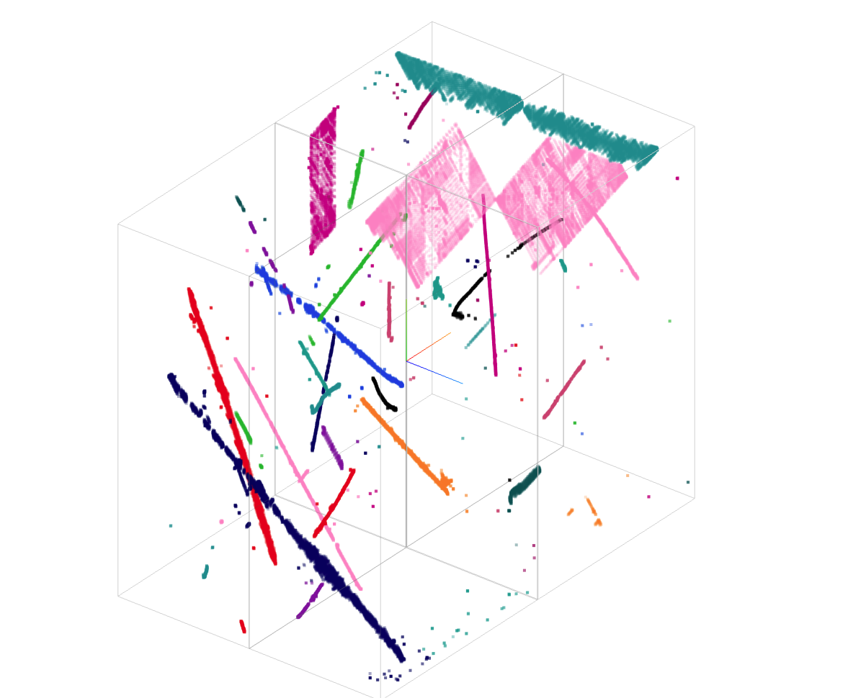
Clustering Algorithm Porting in Wire-Cell Toolkit: Design, Implementation, and Results
Xin Qian
BNL
Bee link
Bee Link

Slide 2
Introduction
~15 clustering algorithms originally developed for MicroBooNE in the Wire-Cell prototype
Ported to the Wire-Cell Toolkit framework
Introduced new underlying data structures (Façade, PointTree)
Expanded support for multiple APAs and Faces (WPID)
Porting process spanned approximately one year
CLUS repository initiated around June 17, 2024
Gained valuable insights to streamline future porting efforts
Close collaboration among Brett, Haiwang, and myself
Recent progress accelerated by AI tools (Cluade, ChatGPT)
Confidently targeting completion of remaining algorithms by end of 2025 (Pattern recognitions)

Slide 3
Disclaimer
The Wire-Cell Toolkit, including clustering, is extensive—I don’t claim to know every detail
My goal is to provide a high-level overview of the design and functionality and provide relevant context for a deeper digest
Brett – Framework design (data products and patterns)
Haiwang – Configuration for different experiments
Xin – Algorithm development and validation
This summary will emphasize algorithms, related data products, and configuration aspects. For deeper understanding, I recommend:
Reading the source code (LLMs can assist!)
Working toward a concrete goal (e.g., implementing a new clustering algorithm)
Validating results with real or simulated data

Slide 4
Data Product
Part I:

Slide 5
Overview
Core Data Structure (Point Cloud Tree)
Built on an N-ary tree for organizing clustering elements
Façade Components
Blob – Also known as merged cell in the prototype
Cluster – A collection of blobs (also 3D sampling points)
Grouping – Container holding multiple clusters
Supporting Tools and Structures
WPID – Labels APA/Face for underlying Blob and Point
2D vs. 3D KD Tree – Fast nearest-neighbor searches; 2D for projections, 3D for full space
Graph – Constructs graph with 3D points as vertices; enables algorithms like Dijkstra’s shortest path
CTPC – Handling actual 2D channel-time measurements, also dead channels
Geometry – Provides detector-specific info (e.g., anode/cathode position per TPC)

Slide 6
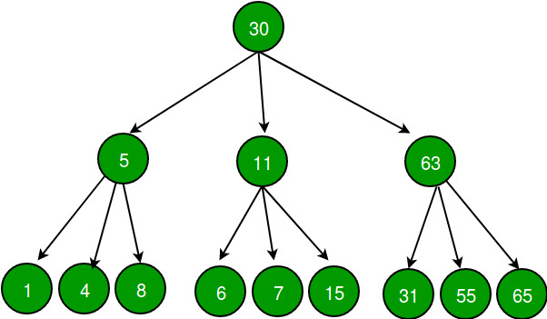
Point Cloud Tree (PCTree)
Hierarchical Data Structure: pctree is a generalized N-ary tree, where each node can have zero or more child nodes, naturally representing clustering hierarchies (e.g., grouping > cluster > blob)
Nodes Hold Point Clouds: Each node contains one or more named Point Cloud (PC) objects, representing collections of points (with coordinates and attributes) relevant to clustering
Flexible Aggregation (Depth Scope): Any node can be queried for the aggregation of its own and descendent point clouds, assembled to a specified tree depth (the depth scope parameter)
Depth=1: Only node-local PCs
Depth>1: Includes PCs from specified depth of descendants
Depth=0: Unlimited depth (all descendant PCs)
Efficient Spatial Queries (k-d Tree Integration): Provides k-d tree interfaces for fast multi-dimensional range or proximity queries on the point clouds accumulated at any node
Grouping
Cluster
Blob
e.g. Attributes: optical flash
Point (with position and attributes, 2D position, corrected position, wires …)

Slide 7
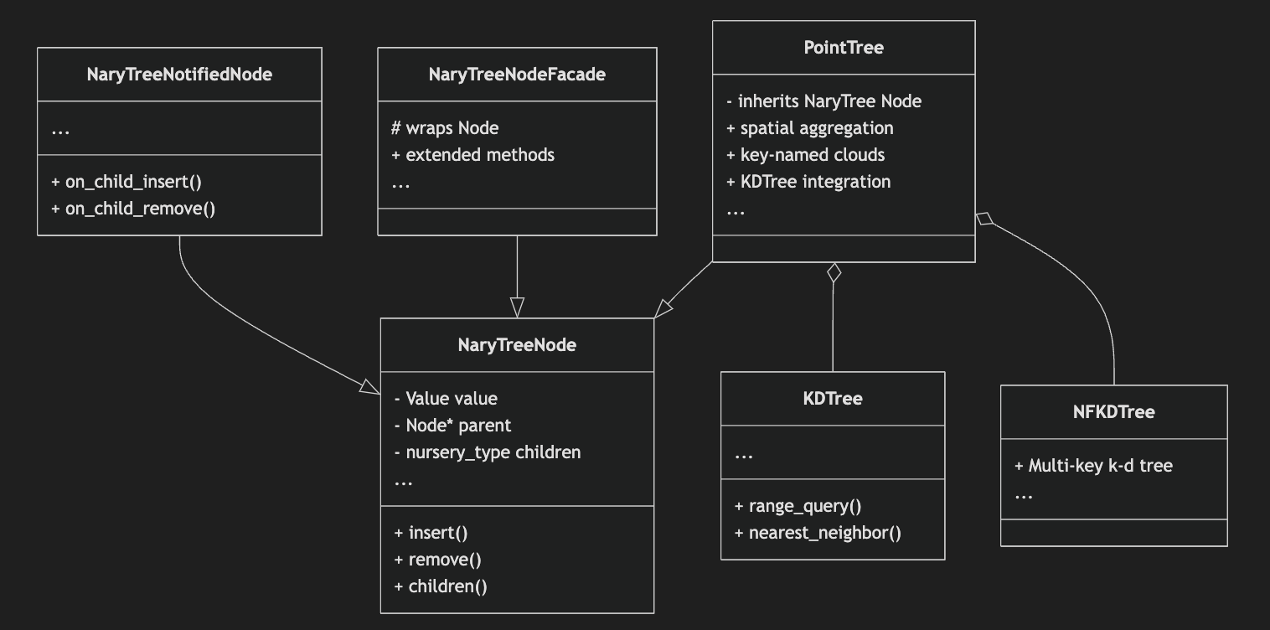
Class/Functionality Breakdown
NaryTree::Node
File: WireCellUtil/NaryTree.h
Purpose: Core n-ary tree node, generic for any payload (Value).
Key Members: value, parent, children
Key Methods: insert, remove, traversal, access children/parent
Use: Any tree-based hierarchy in WCT
NaryTree::NotifiedNode
File: WireCellUtil/NaryTreeNotified.h
Purpose: Extends Node to allow notifications/event hooks (eg, on insertion or removal of children)
Use: Scenarios where updating or tracking changes to the tree is needed
NaryTree::NodeFacade
File: WireCellUtil/NaryTreeFacade.h
Purpose: A pattern to provide more flexible/easier API “on top” of Node.
Use: Cleaner, more expressive tree manipulation, possible utility "sugar"
KDTree
File: WireCellUtil/KDTree.h
Purpose: Implements standard k-d tree for spatial query (find within region, nearest neighbor)
Use: Works with point collections for efficient range/proximity queries
NFKDTree
File: WireCellUtil/NFKDTree.h
Purpose: Flexible/multidimensional/multi-key (non-fixed-dimension) k-d tree
Use: When variable-dimension or multi-key (e.g., time+space+label) queries are required
PointTree (and PointCloud)
File: WireCellUtil/PointTree.h
Purpose: A tree of point clouds; inherits from NaryTree::Node<PointCloud>. Supports:
Hierarchical aggregation
Storage of multiple point clouds keyed by name/type
Spatial query (via KDTree/NFKDTree)
Use: Physical clustering, pattern recognition, point cloud processing in WCT.
Lots of documents can be found @ here

Slide 8
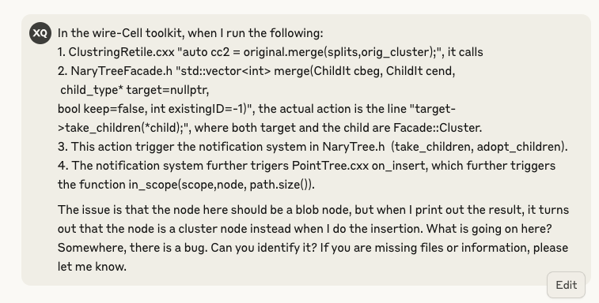
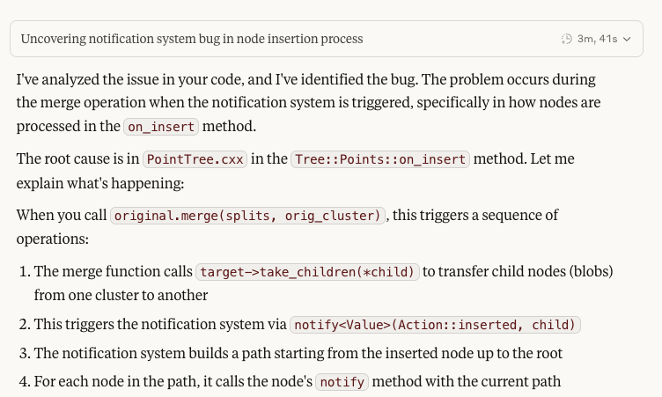
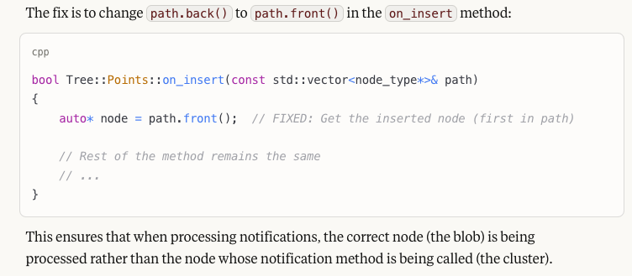
One Example of Debug
…
Brett and I discussed for one afternoon and half morning about this bug

Slide 9
Summary
NaryTree::Node is the base
PointTree inherits from this, specializing in point clouds
KDTree and NFKDTree are spatial data structures used by PointTree for queries
Facade/Notified variants extend or wrap the base tree for convenience or event handling
How to Find/Understand Functionality
Basic tree node API: See WireCellUtil/NaryTree.h & doc in util/docs/nary-tree-node.org
Tree node with notifications/events: See WireCellUtil/NaryTreeNotified.h
Tree API sugar/extension: See WireCellUtil/NaryTreeFacade.h
Spatial queries on point sets: See WireCellUtil/KDTree.h and WireCellUtil/NFKDTree.h
Hierarchical point cloud structure (the pctree): See WireCellUtil/PointTree.h (links n-ary tree and spatial k-d tree concepts; implements tree of point clouds with aggregation and efficient searches)

Slide 10
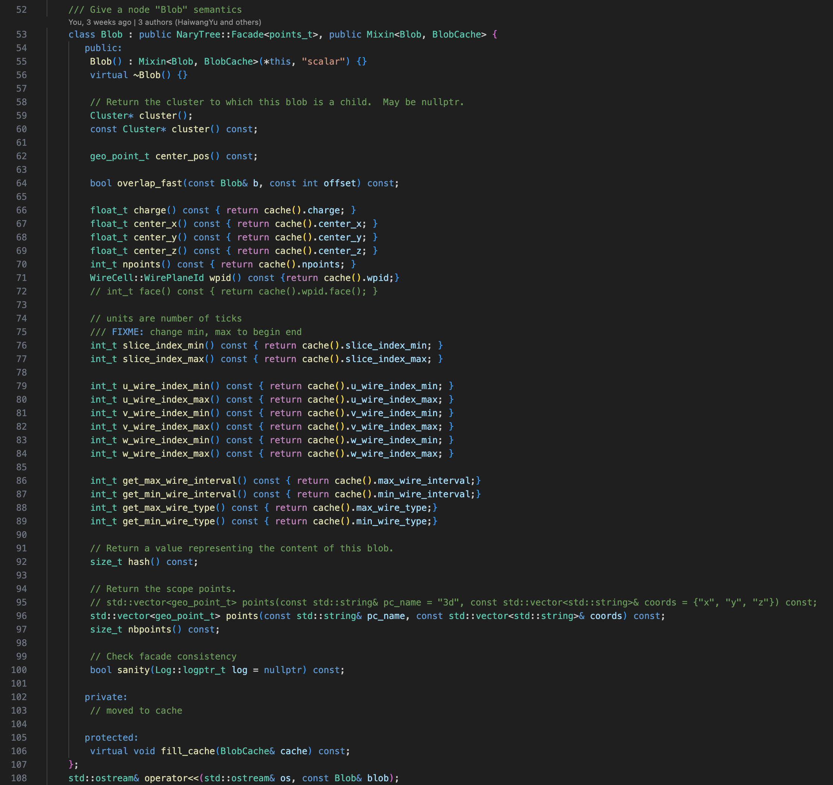
Relatively Simple -- Façade::Blob
Constructed from consecutively fired wires across all three views within one time slice (~4 ticks)
Dead blobs span a larger time range due to missing signals
Each blob holds all 3D points stored at its node in the Point Cloud Tree (PCTree)
Overlap detection uses the overlap_fast function, which checks wire range intersections between blobs
Used to build (connecting) edge in the graphs
If modified, need to be careful with Cache

Slide 11
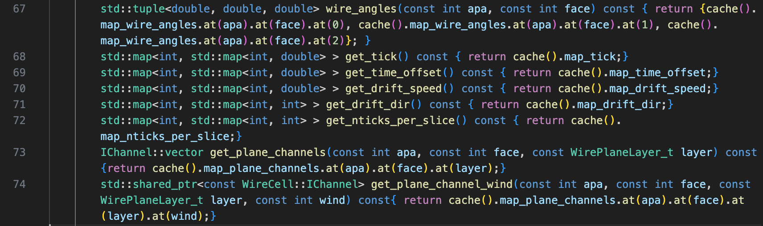
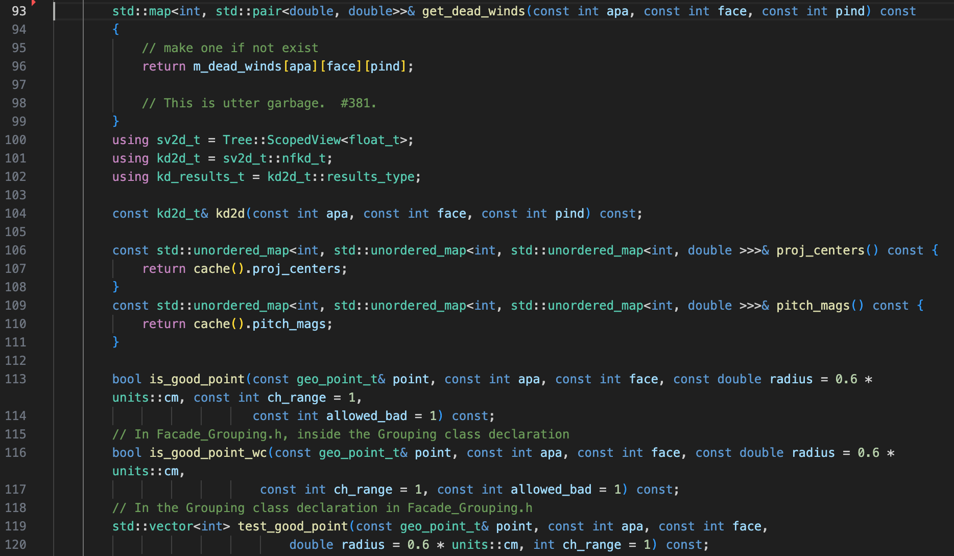
Medium Complexity -- Façade::Grouping
Holds different clusters
Store basic information for each TPC (APA/Face)
Wire angles, drift speed, drift direction etc.
Holds detector volumes, anodes
Holds CTPC for original measurement (live activity in terms of channel/wire + time and dead channels)
Queries based on 2D Point Cloud
If modified, be careful of the cache
…

Slide 12
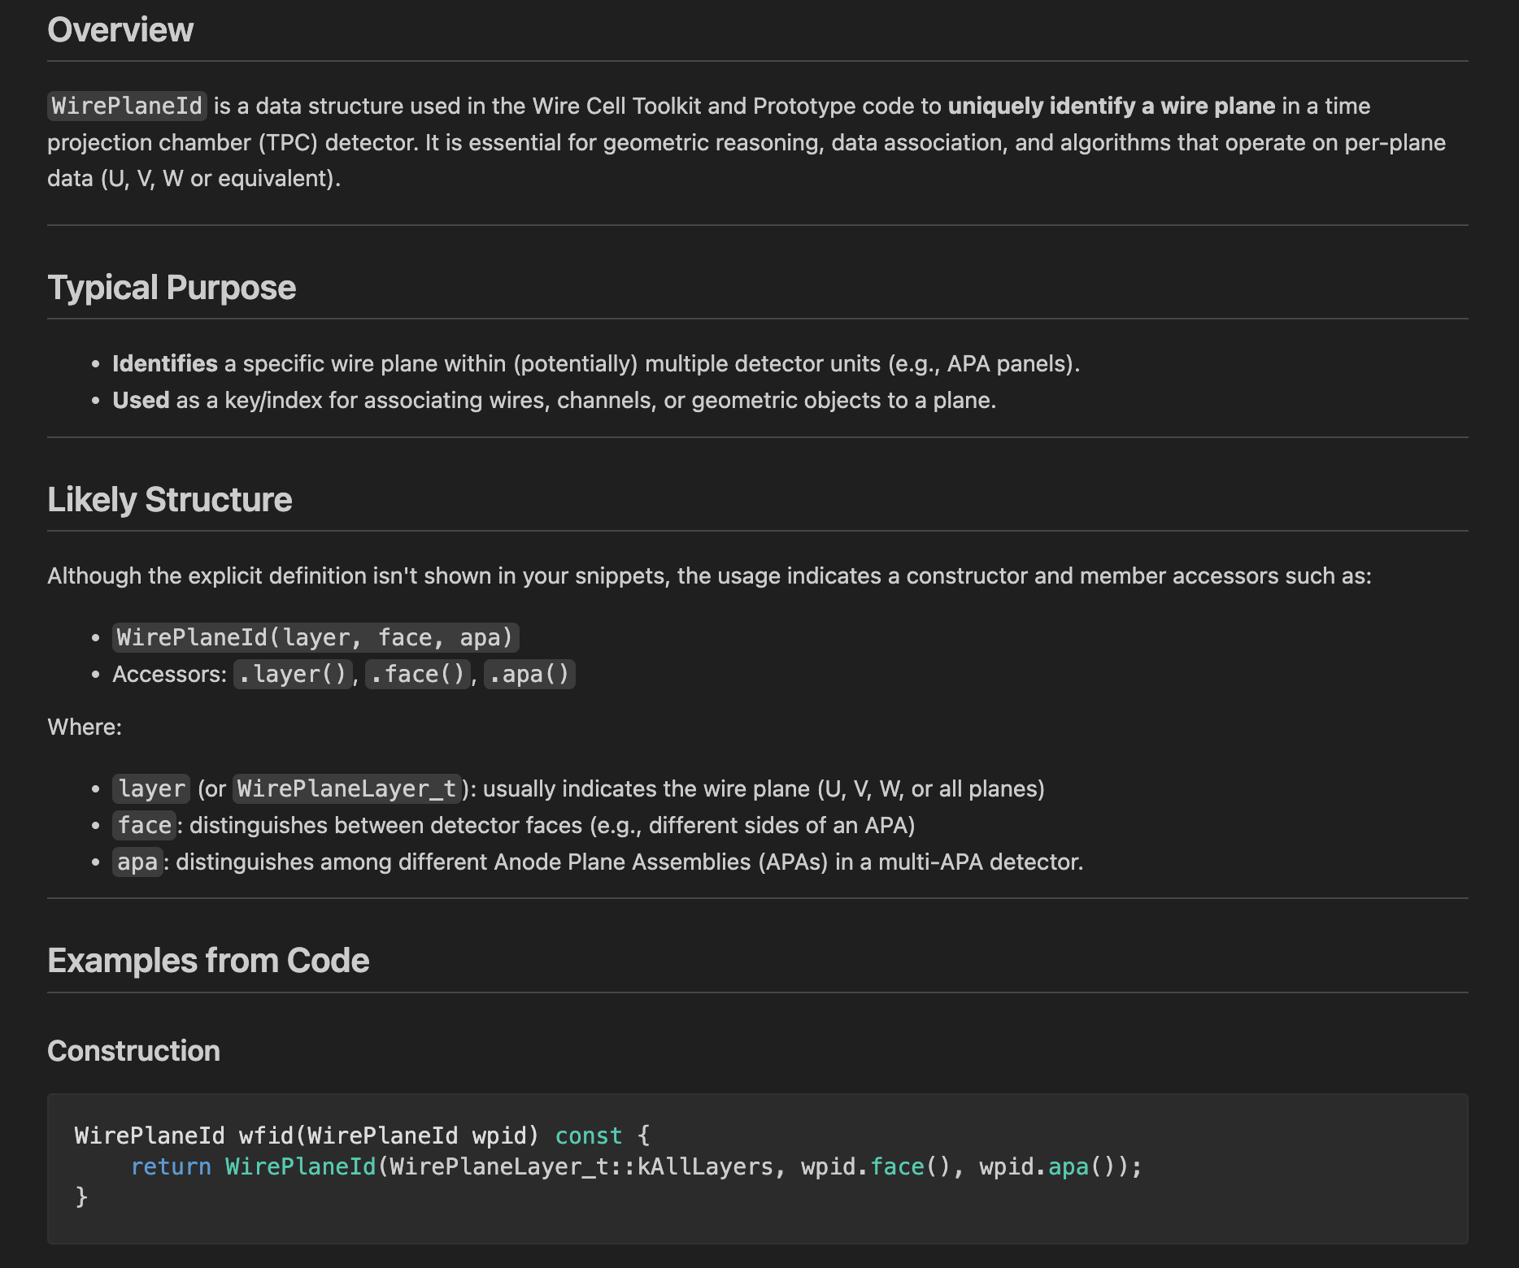
Mostly Complicate – Façade::Cluster
Primary class responsible for holding clustering information
Before exploring this class in detail, it’s helpful to first introduce key supporting tools and structures
WPID – Encodes APA/Face information to determine which TPC a given point/blob belongs to

Slide 13
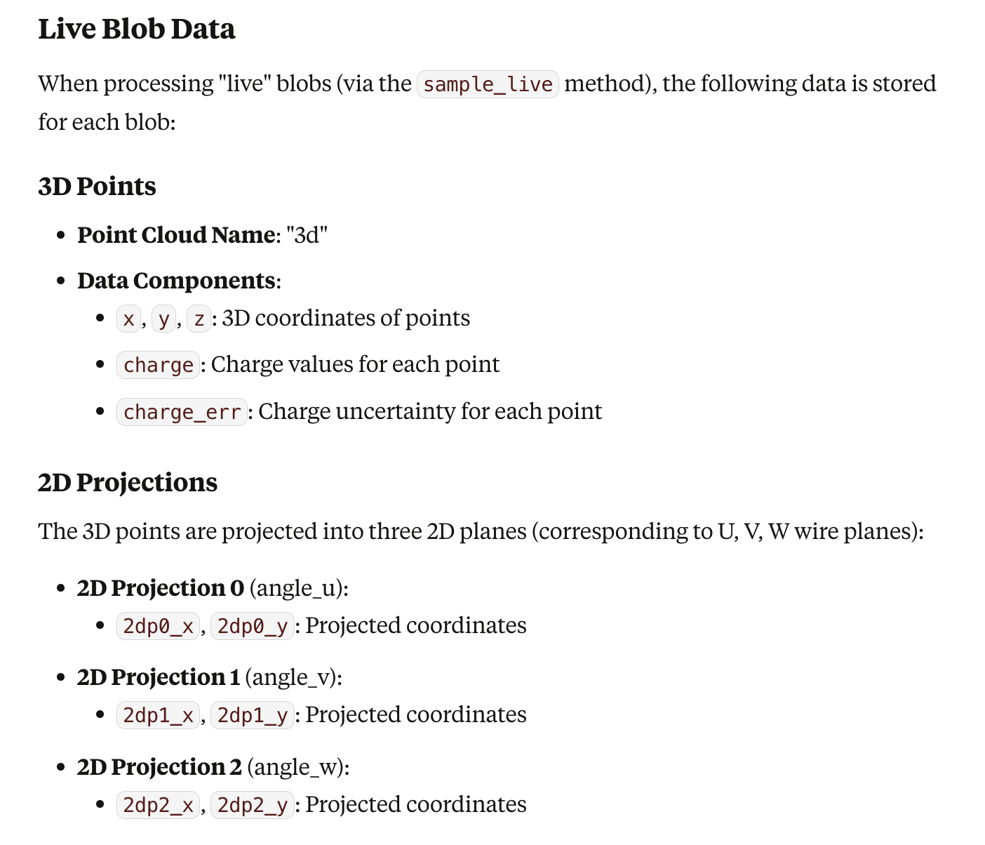
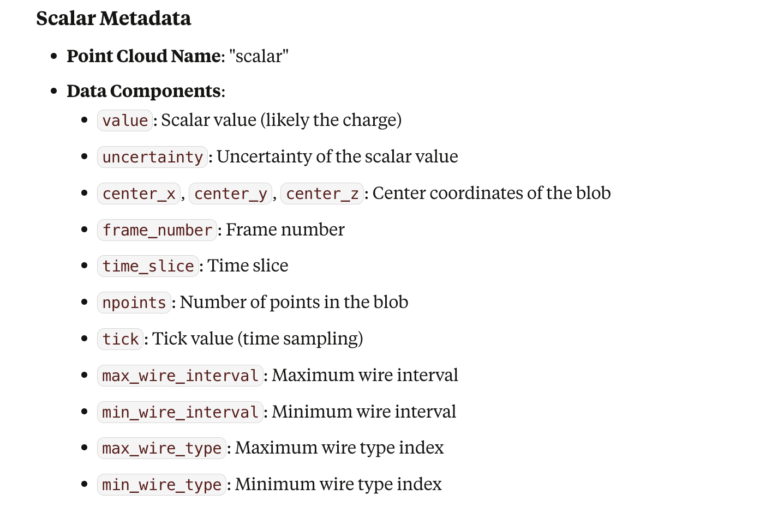
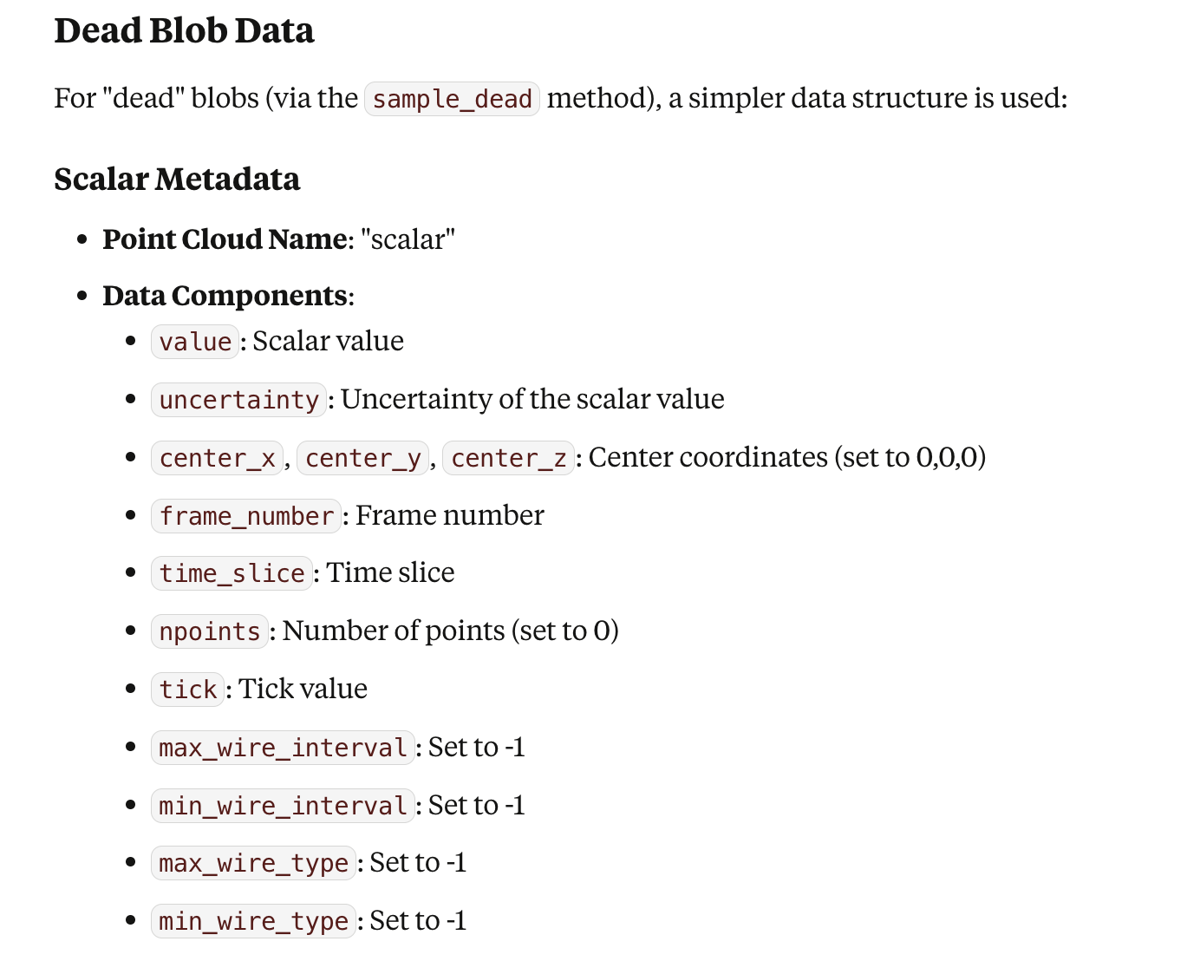
PointTree Building
PointTreeBuilding is a class in the WireCell Toolkit (wire-cell-toolkit/clus/src/PointTreeBuilding.cxx) responsible for constructing and managing "point tree" data structures
represent hierarchical collections of point clouds (used for geometric or spatial representations, such as hits or clusters in TPC reconstruction)
Point trees are m-ary (n-ary) trees where each node stores a geometric point cloud (or related metadata), and inner nodes organize this data for analysis processes such as clustering, nearest-neighbor search, or geometric partitioning
The PointTreeBuilding module coordinates the organization (building) of these trees

Slide 14
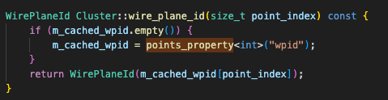
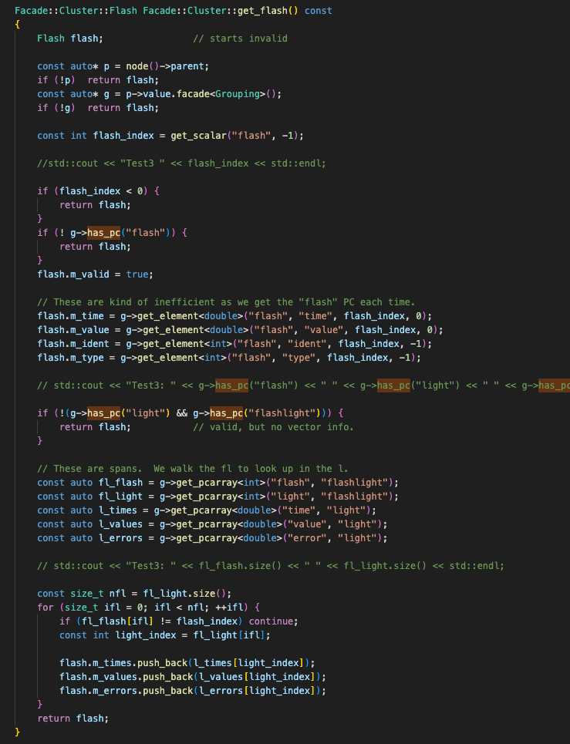
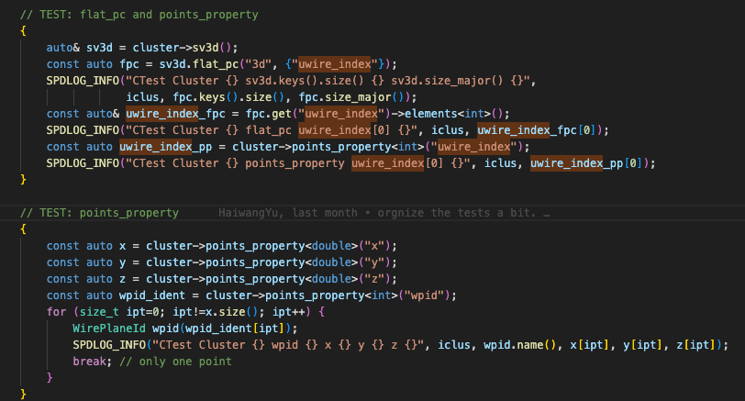
Example of Accessing Information
Note, some cache are necessary for speed considerations

Slide 15
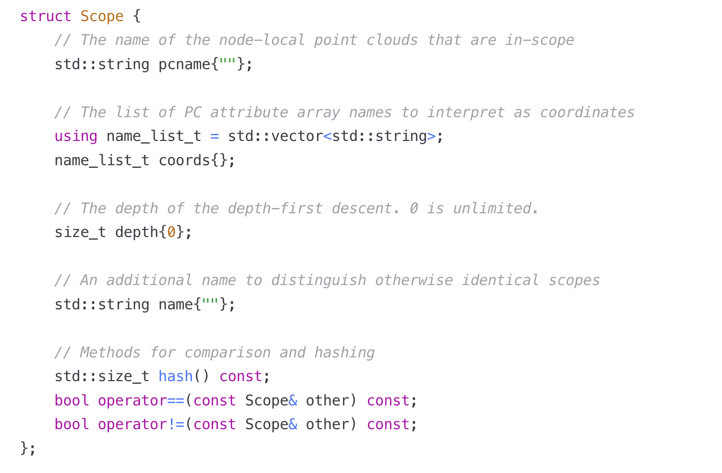
Concept of Scope
A Scope is a descriptor that defines a selection of point cloud data formed from a subset of tree nodes
It acts as a filter to determine which nodes and data points are included in a view
Scope Parameters Explained
pcname: Identifies which named point cloud datasets in each node should be considered
coords: Specifies which attributes (columns) in the point cloud dataset represent coordinates
depth: Controls how deep in the tree hierarchy to go when collecting nodes (0 means unlimited depth)
name: An optional name to distinguish otherwise identical scopes, useful for filtered views

Slide 16
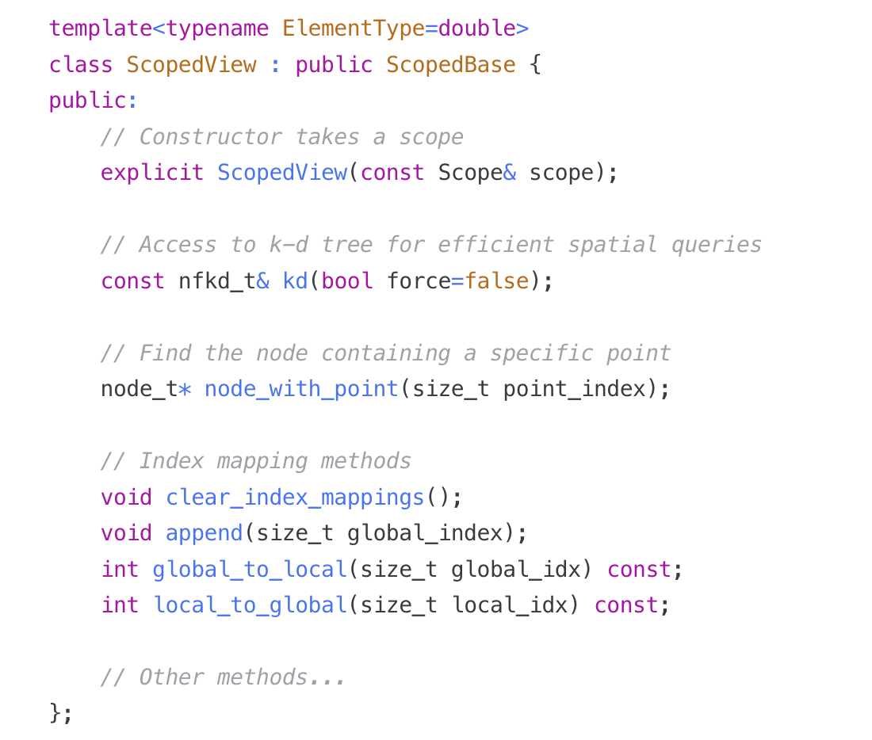
Scoped View → 3D vs. 2D KD Tree
A ScopedView is an object that provides access to the point cloud data selected by a Scope
It acts as a lens that focuses on specific parts of the tree based on the scope definition
Unfiltered Scoped View: Includes all nodes that match the scope criteria
Filtered Scoped View: Includes only a subset of matching nodes, determined by a selector function
ScopedView Capabilities
Point Access: Provides direct access to points meeting the scope criteria
Spatial Queries: Supports efficient spatial queries through k-d tree integration
Node Resolution: Maps points back to their containing nodes in the tree
Index Mapping: Maintains mappings between global indices (in the whole tree) and local indices (in the scoped view)

Slide 17
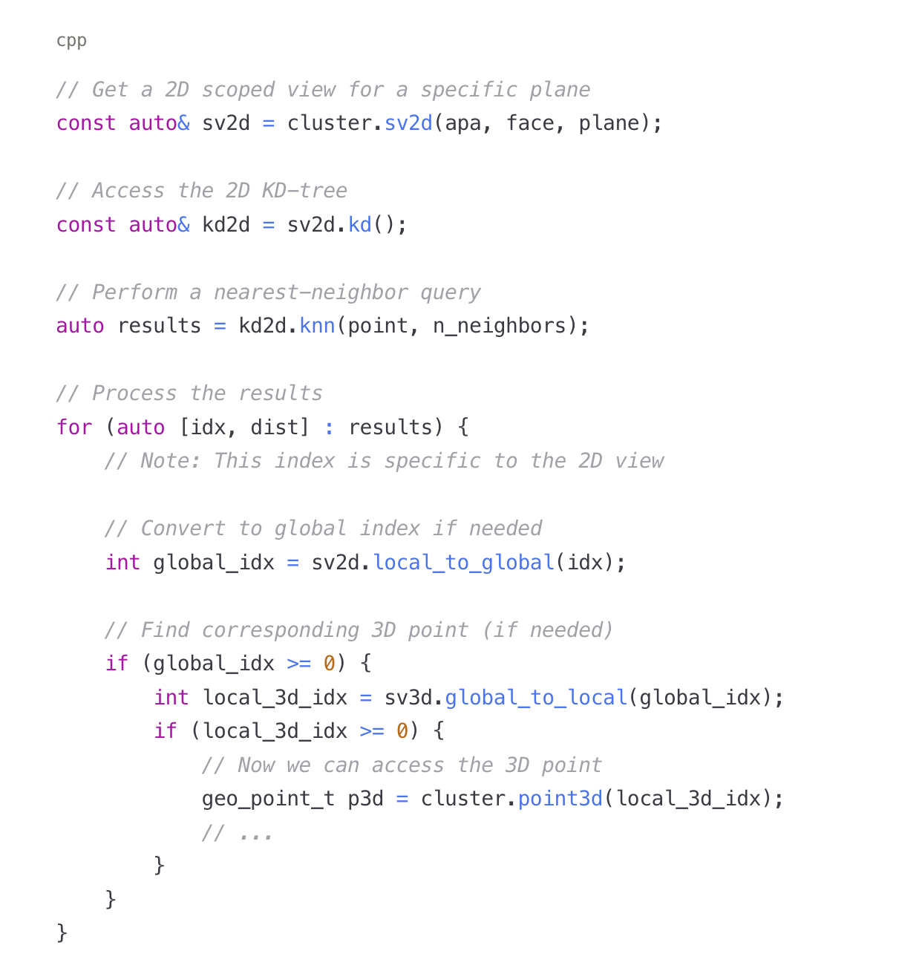
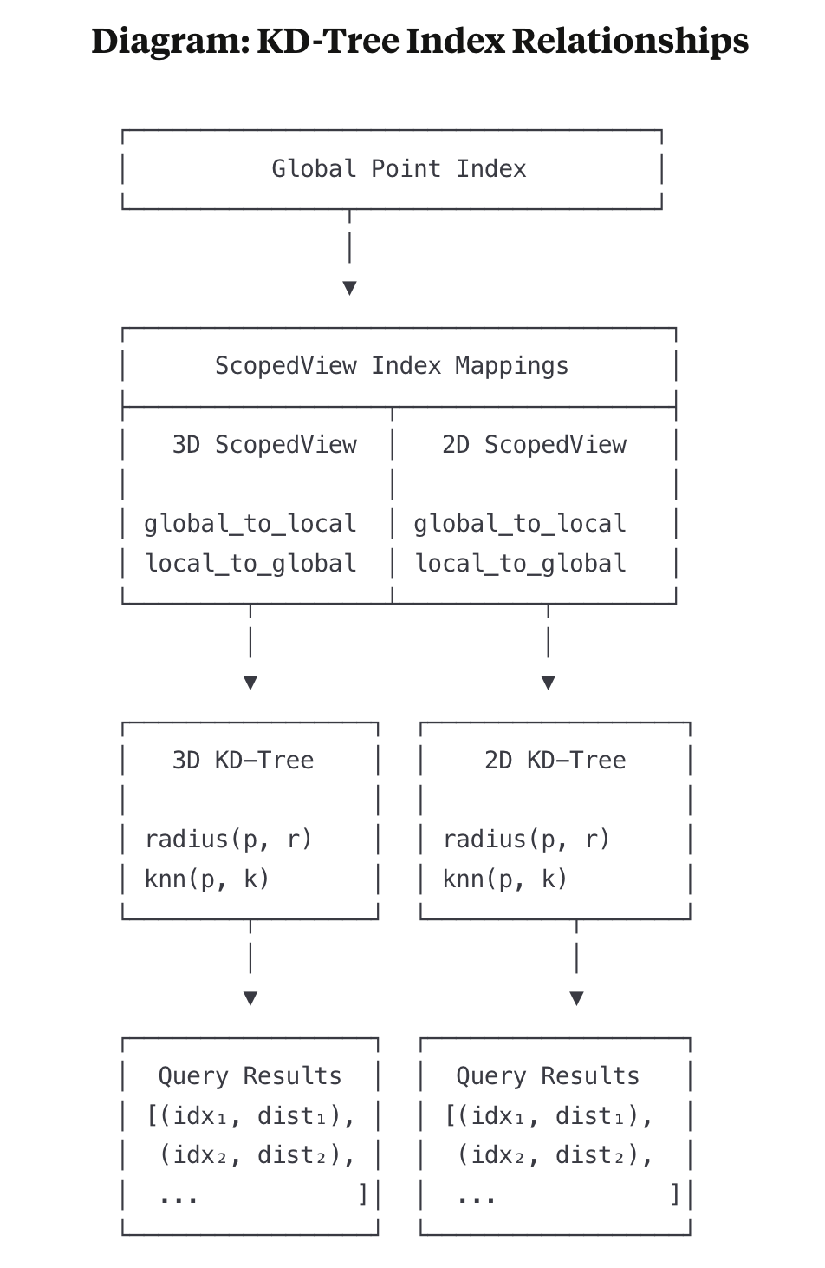
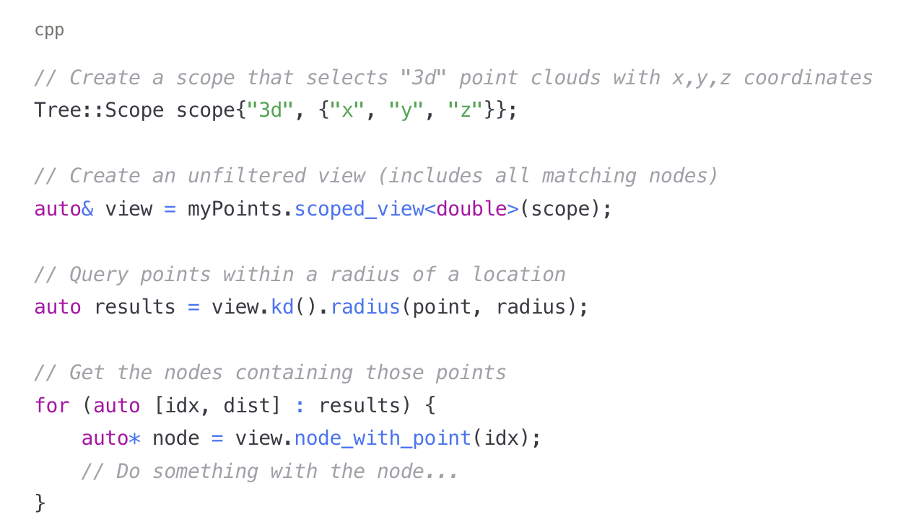
2D vs. 3D KDTree
Example of KD Tree Access
Different Scoped View represent different points (e.g. T0 or space-charged corrected vs. raw points)
Need to be clear if the points are corrected positions vs. raw positions

Slide 18
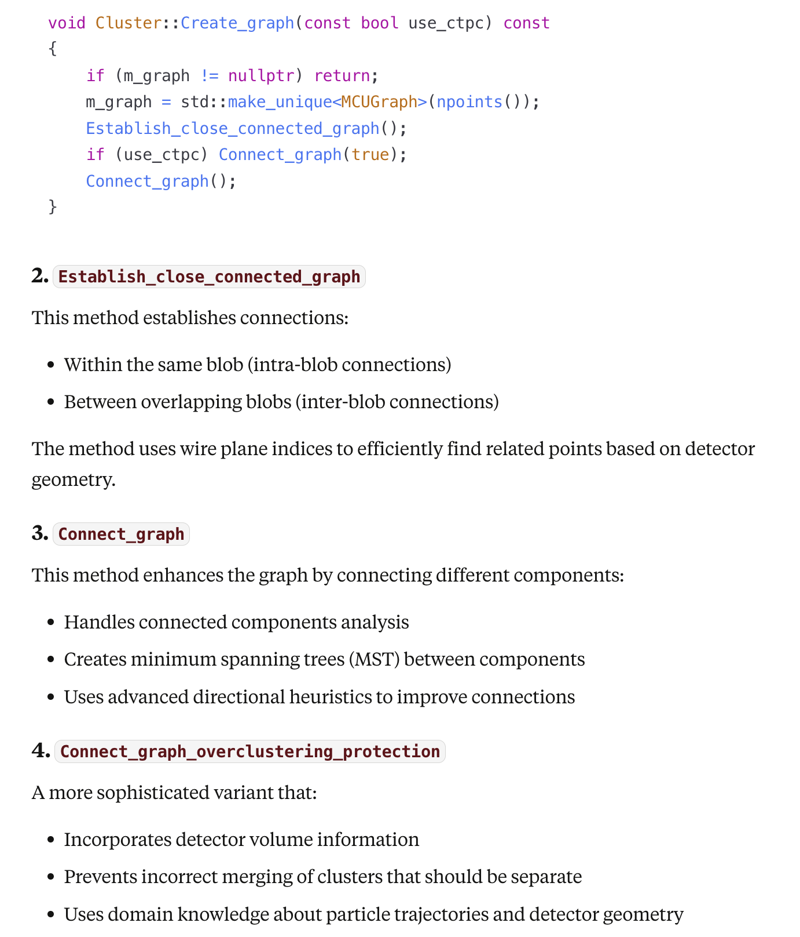
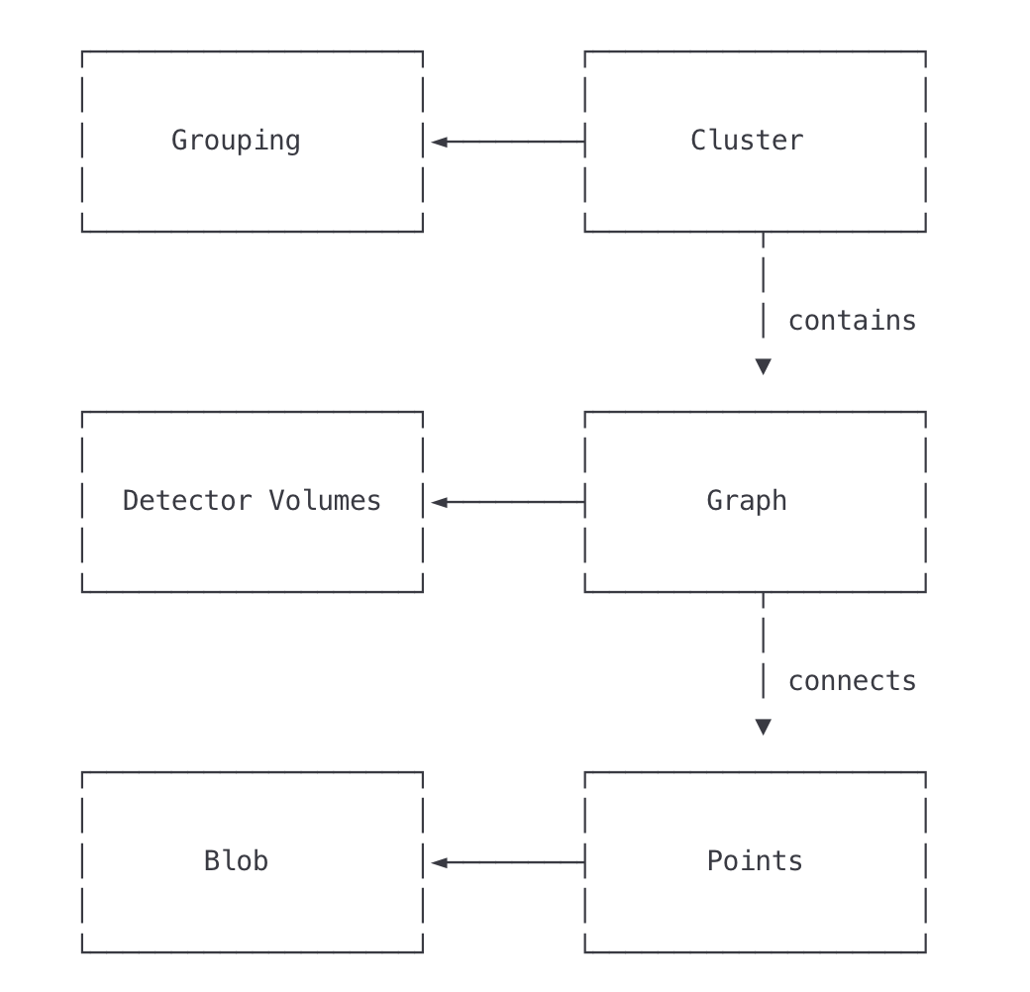
Graph
Vertex: 3D Points
Edge: relation between points
Algorithm:
Dijkstra’s shortest path
Connected Components Analysis
Minimum Spanning Tree

Slide 19
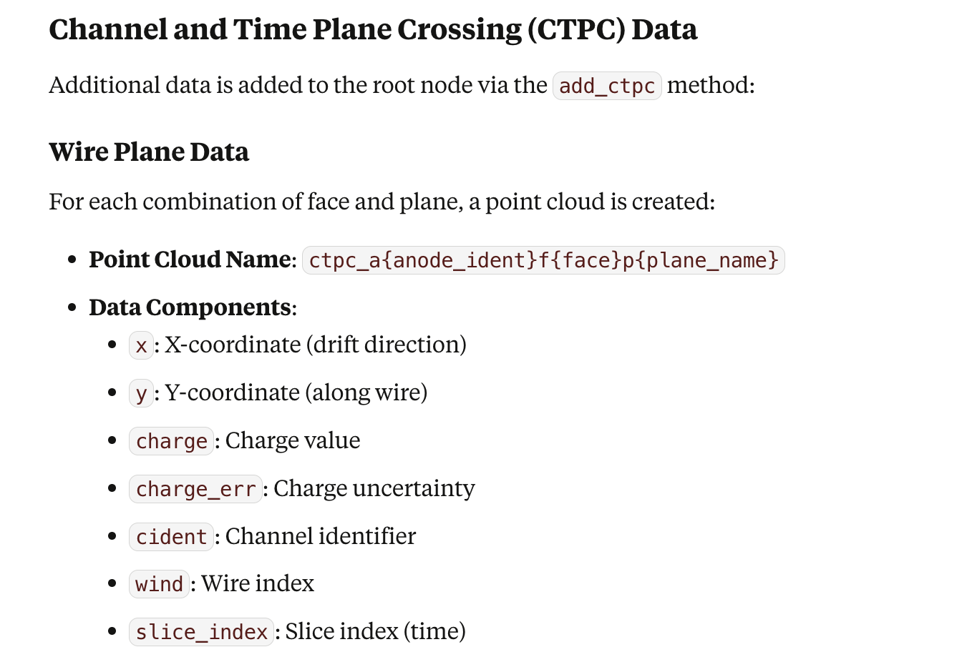
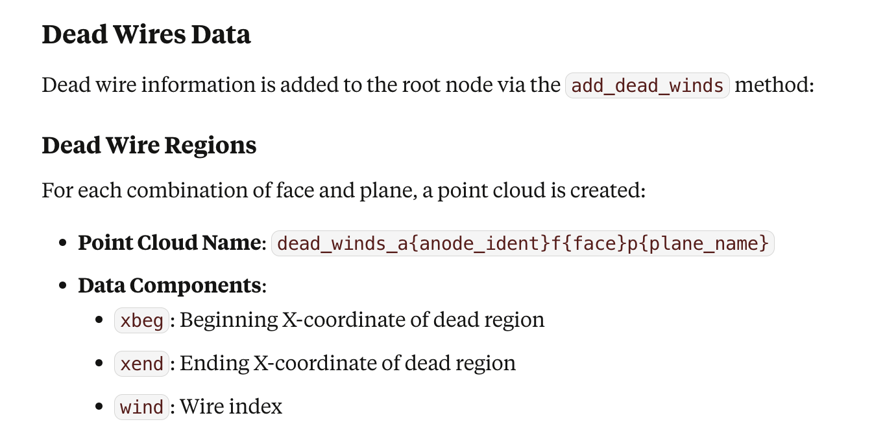
CTPC (used in Grouping)
CTPC refers to the point clouds that contain charge information stored alongside position data. These point clouds are named with a specific pattern: ctpc_a{apa}f{face}p{plane} where:
{apa} is the APA (Anode Plane Assembly) identifier
{face} is the face identifier
{plane} is the plane name (U, V, or W)
The CTPC datasets include several important attributes:
Position coordinates (x, y)
Charge values
Slice indices (time information)
Wire indices (channel information)
1. is_good_point: This method determines if a point is "good" based on:
Whether it has nearby points in the CTPC data (get_closest_points)
If not, whether it falls in a dead channel region (get_closest_dead_chs)
A point is considered "good" if:
It has matches in at least (3 - allowed_bad) planes (out of U, V, W)
A match can be either a live point or a dead channel
2. is_good_point_wc
3. test_good_point
4. get_overlap_dead_chs
5. get_overlap_good_ch_charge

Slide 20
Geometry
The DetectorVolumes class is designed to represent, manage, and query geometric volumes within a detector—such as Time Projection Chambers (TPCs), drift regions, fiducial volumes, or other inner boundaries—used for event selection, containment studies, and geometric calculations in wire-cell-based reconstruction
Describing logical or physical sub-volumes of a detector
Providing fast methods to query whether a given spatial point is inside, outside, or on the boundary of these volumes
Supporting detector-specific geometry for containment, veto, or boundary crossing logic
Given a point, can return the wpid (which TPC), or -1 for apa and face, if outside any existing TPC

Slide 21
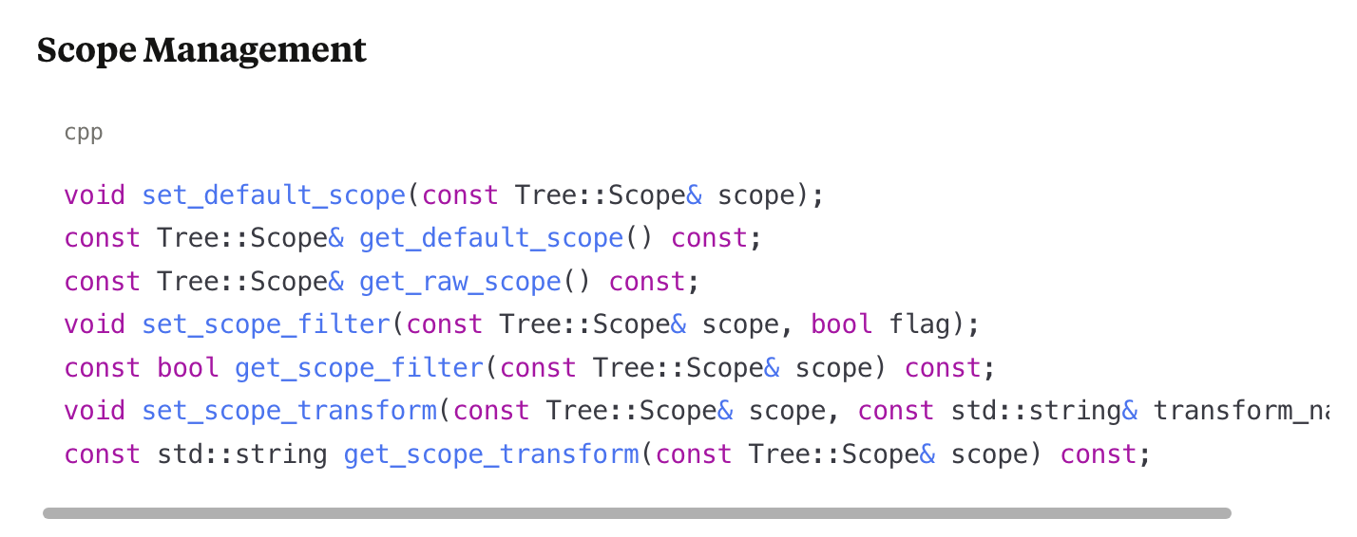
Mostly Complicate – Façade::Cluster
These methods handle "scopes," which define views onto the underlying point cloud data
Scopes can specify coordinate systems, transformations, and filtering criteria
Different scopes can represent the original points vs. corrected points
Former is important within a single TPC (e.g. connect with 2D measurement)
Latter is important to perform clustering across different TPCs
Scope filter – Determines whether a cluster should be processed
Example: clusters outside the TPC volume are skipped
Default scope – can refer to corrected 3D points
Scope transform – Used to map corrected points back to raw 2D measurements
Enables queries in the original measurement space when needed

Slide 22
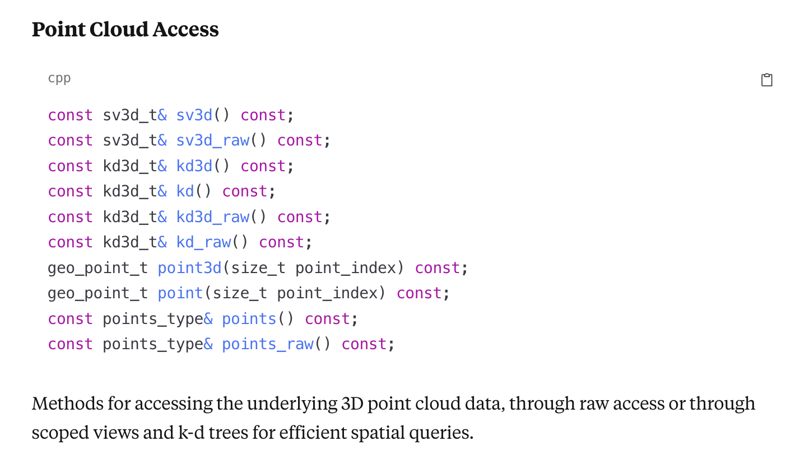
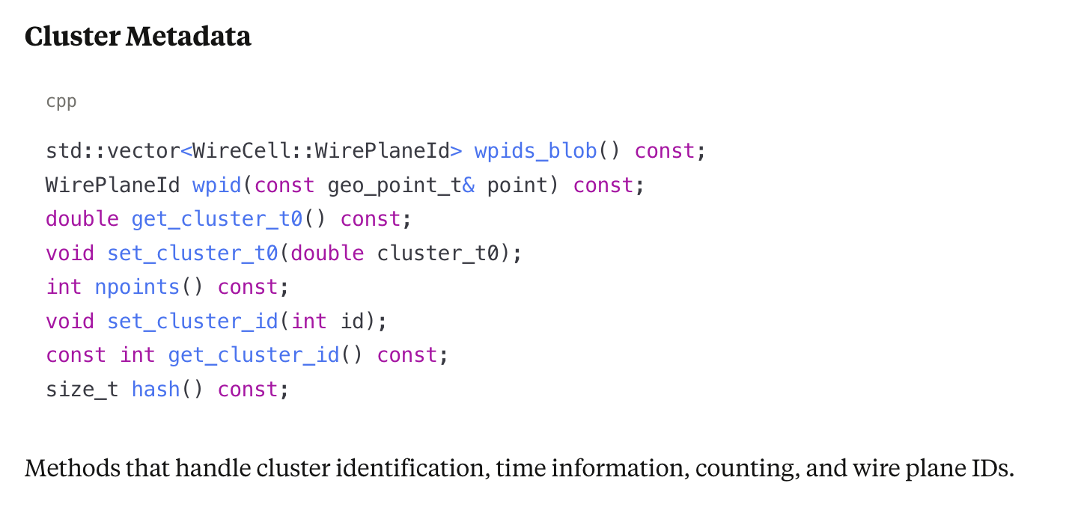
Points and Meta Data
Two sets of 3D point clouds: one for raw, and one for potential corrected points, if the default scope is the raw scope, two sets of functions are the same
Obtain the WPID given a blob or point
Set Cluster ID for Bee output

Slide 23
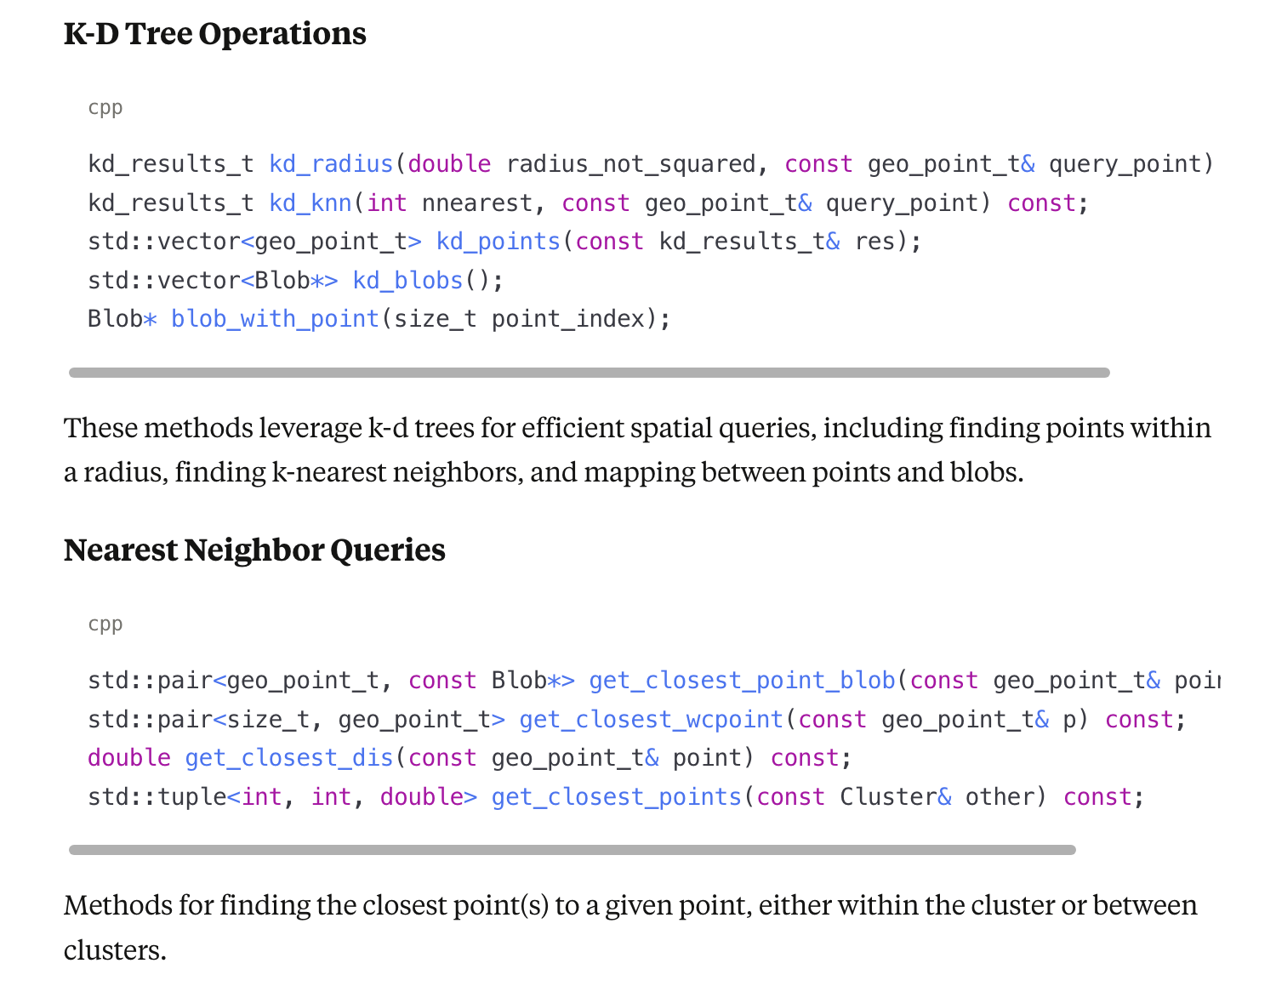
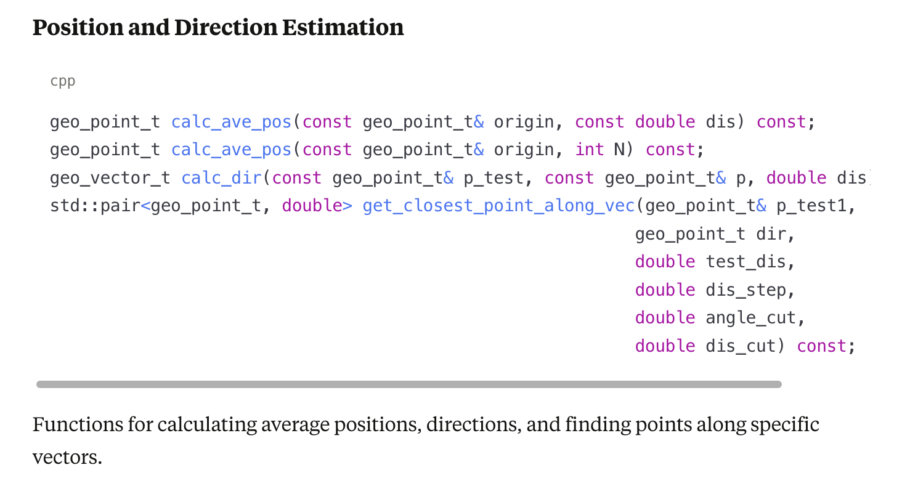
Spatial Query Operations
Based on KD tree, we can calculate the directions based on Voting (e.g. Hough Transformation)

Slide 24
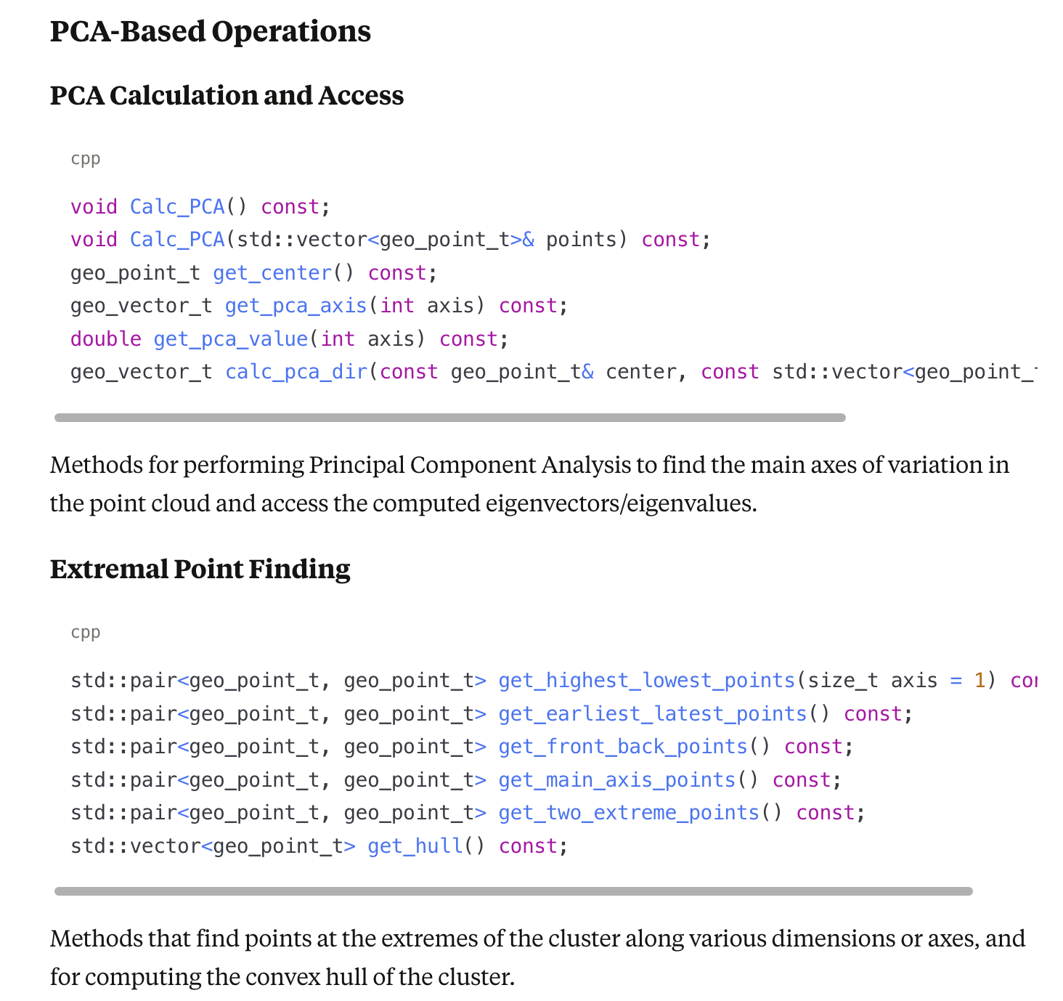
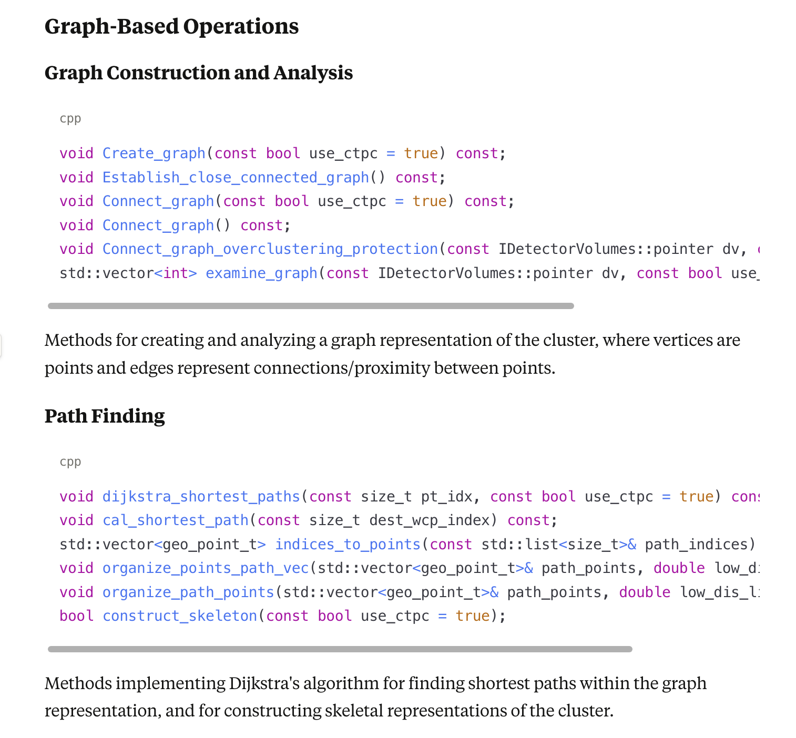
PCA and Graph

Slide 25
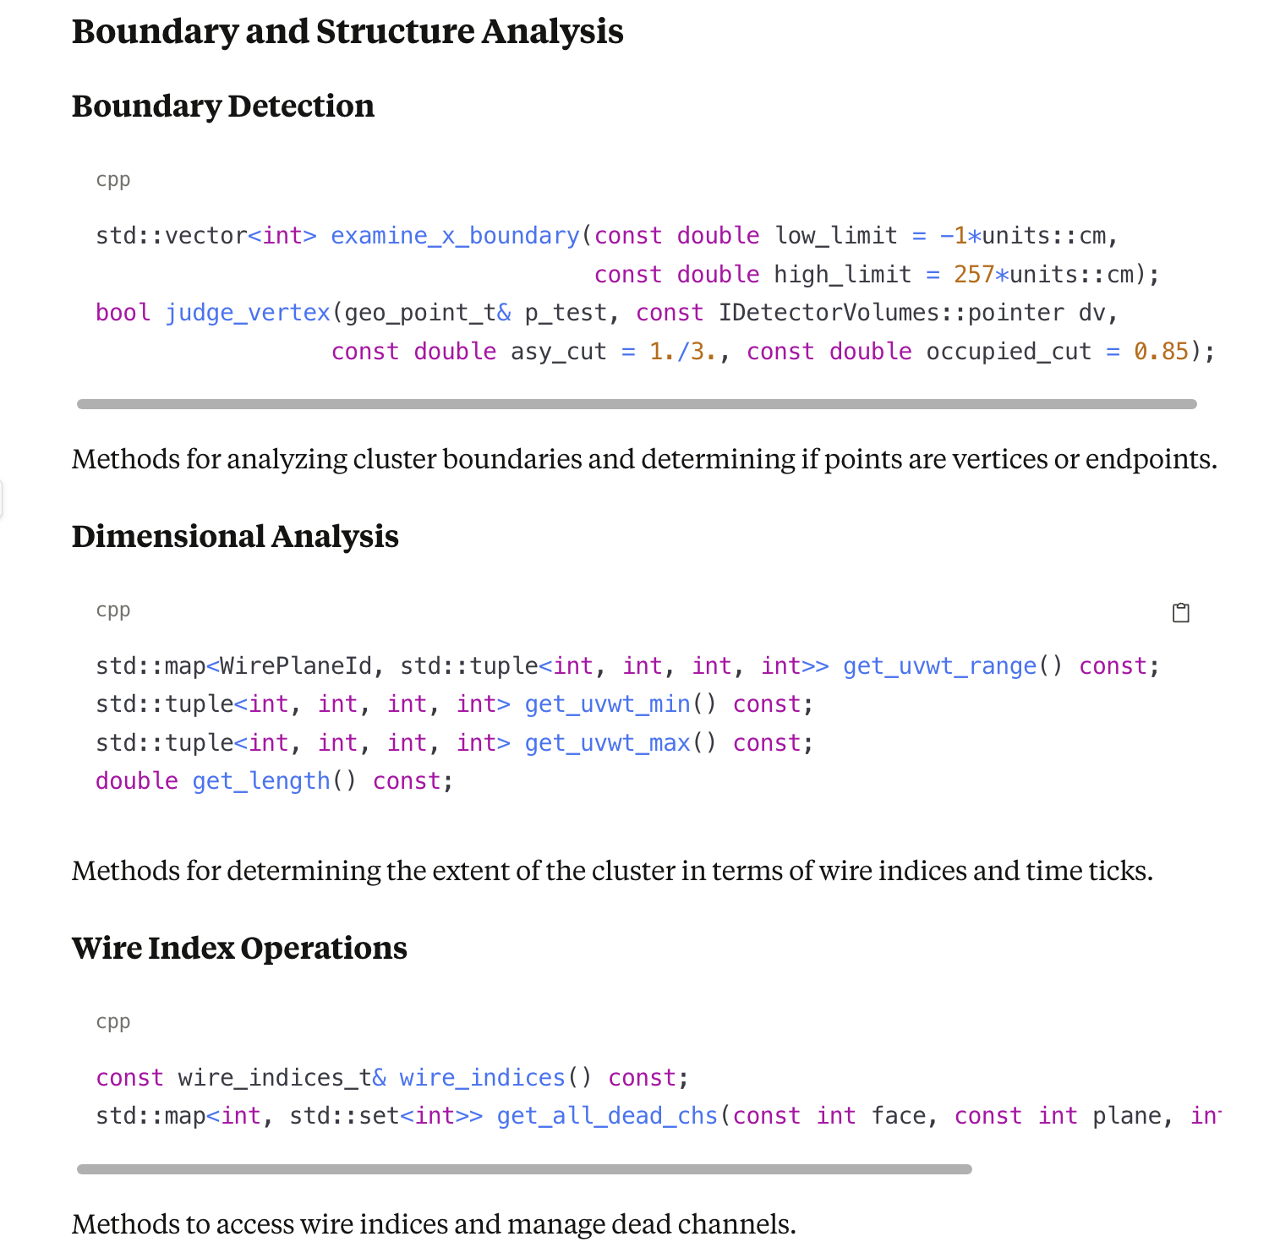
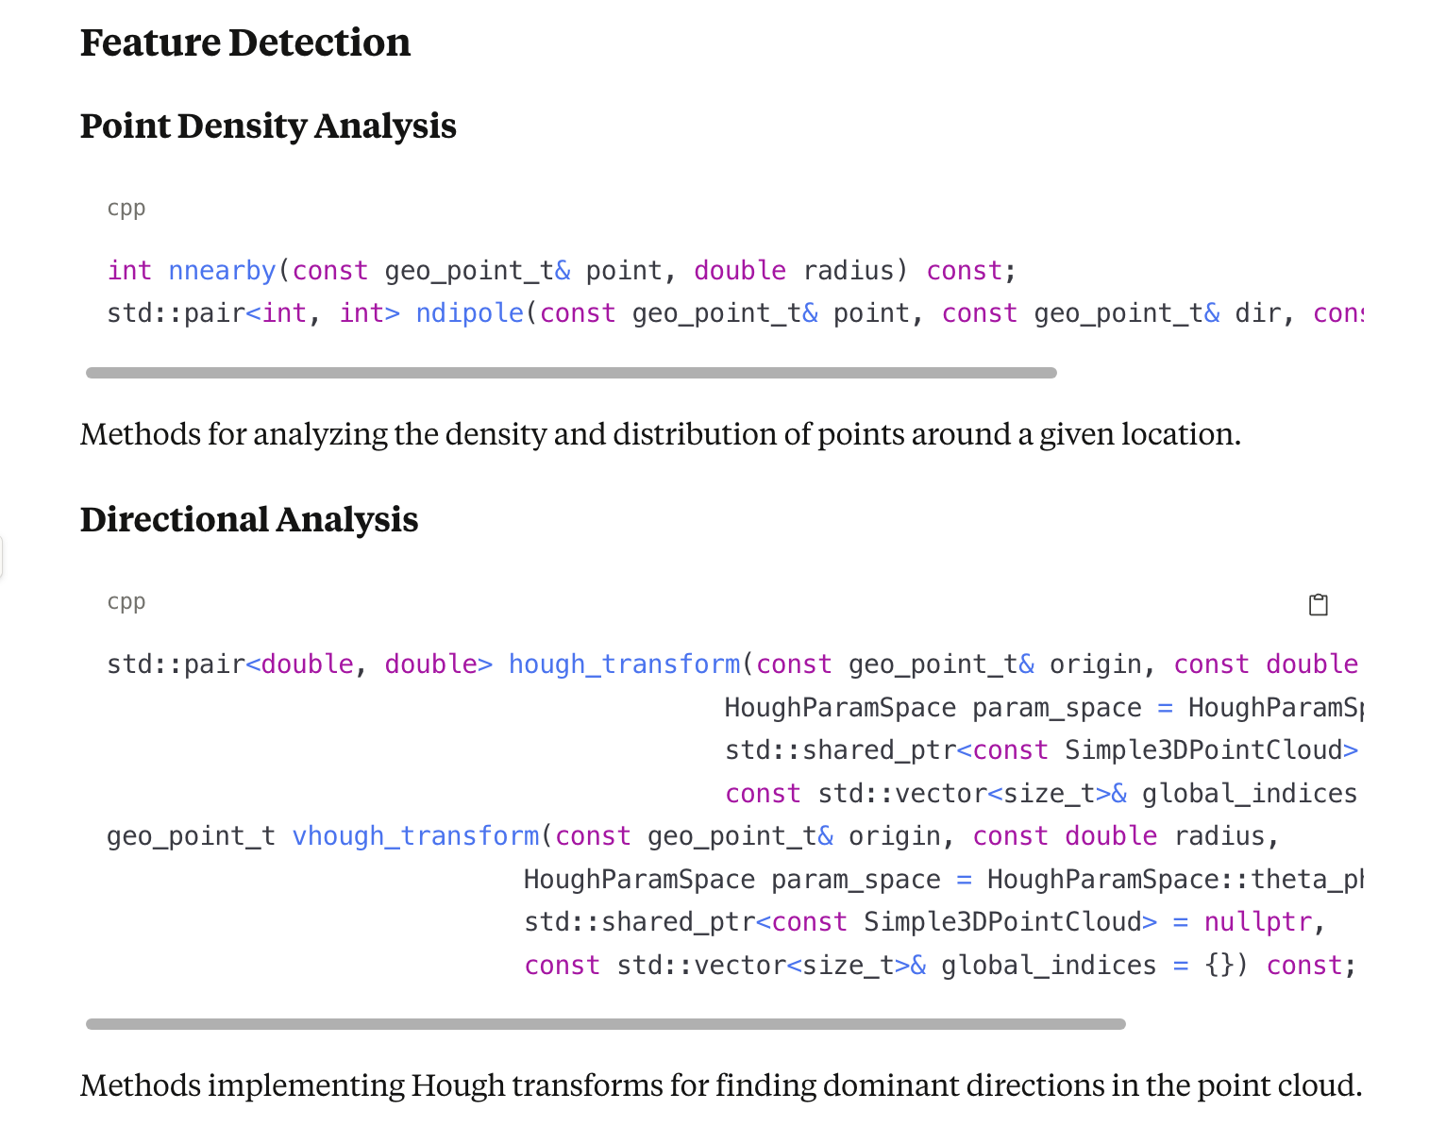
Continue

Slide 26
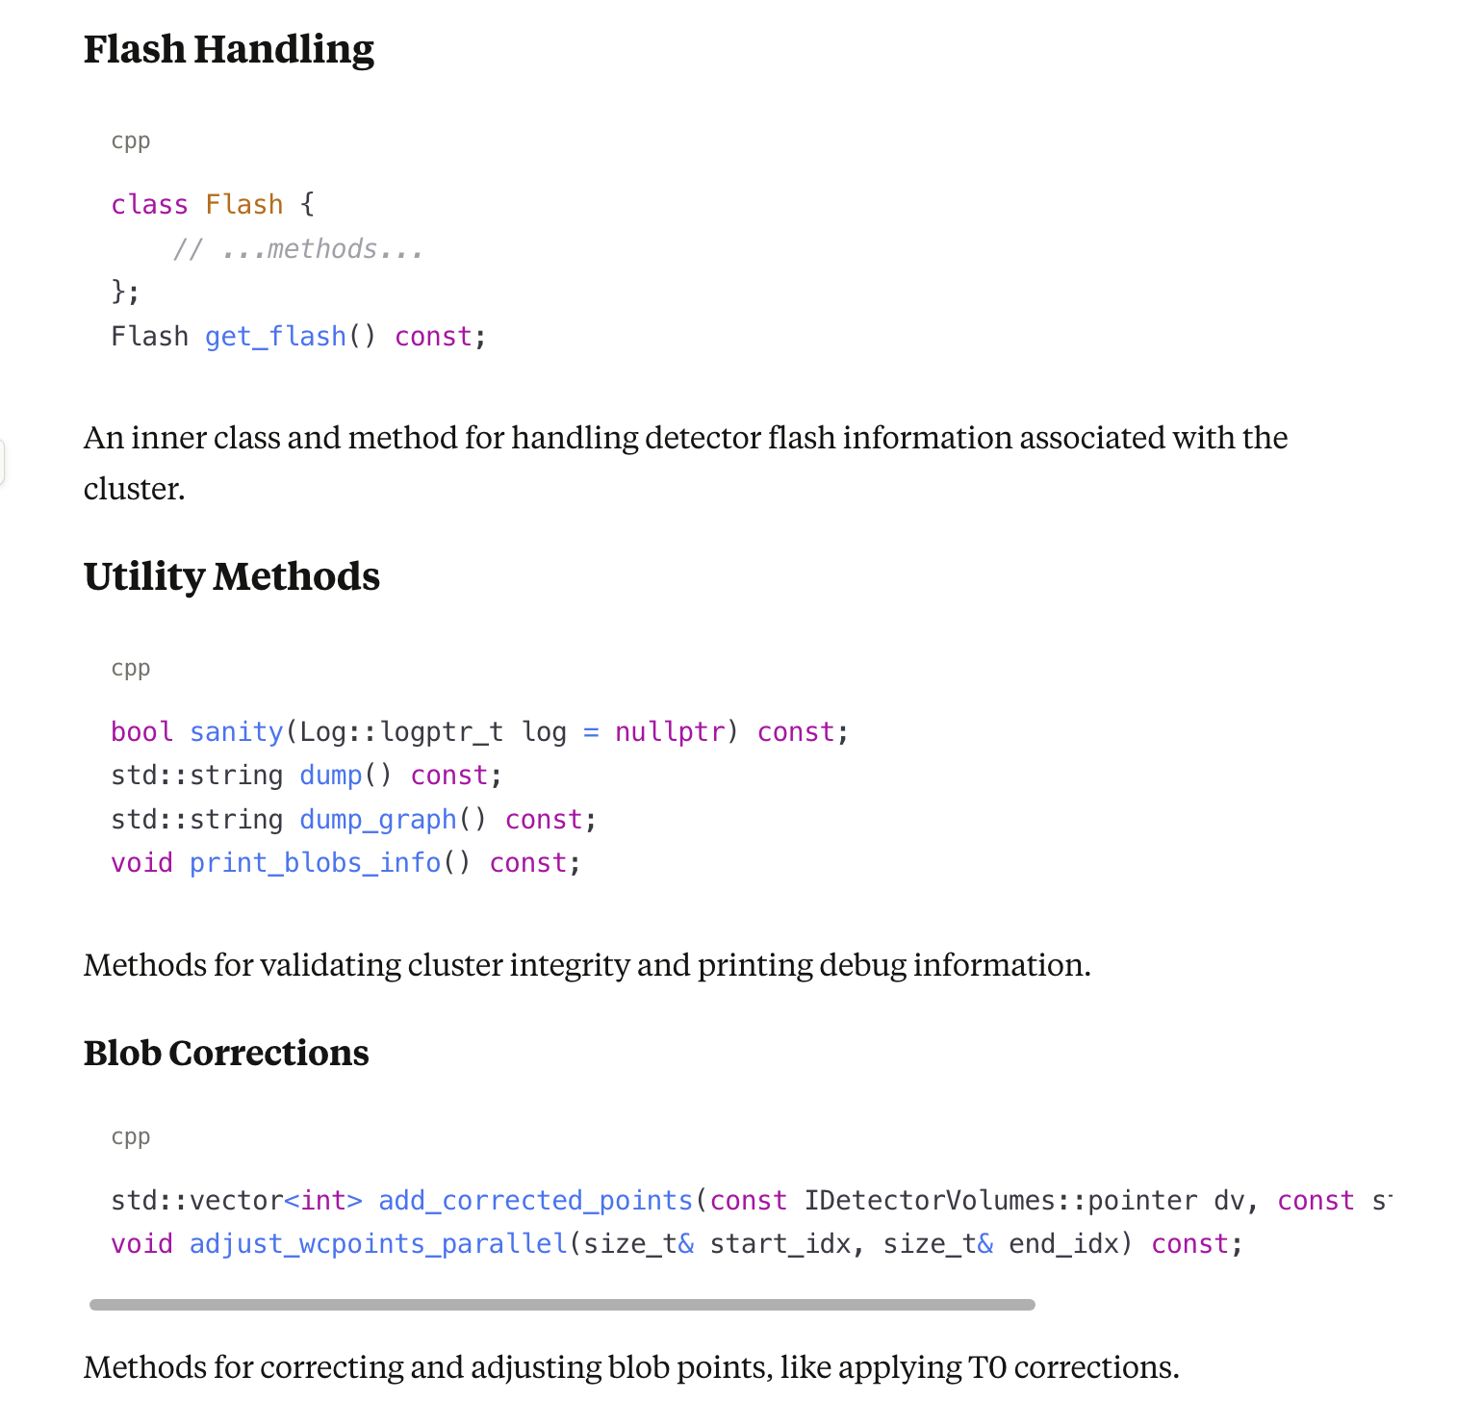
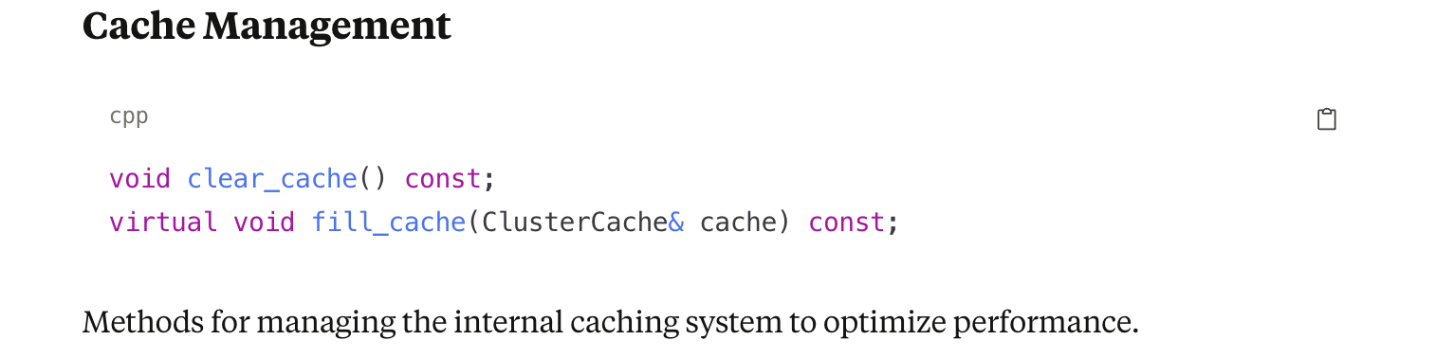
Continue
Facade::Cluster is a sophisticated class that provides high-level functionality for working with point cloud data in the context of particle detector data analysis
It combines spatial query capabilities, principal component analysis, graph theory, and detector-specific knowledge to enable complex operations on clusters of data points
The class is designed with multiple access patterns and caching strategies to balance flexibility and performance, allowing both direct access to raw data and higher-level semantic operations on the cluster as a whole

Slide 27
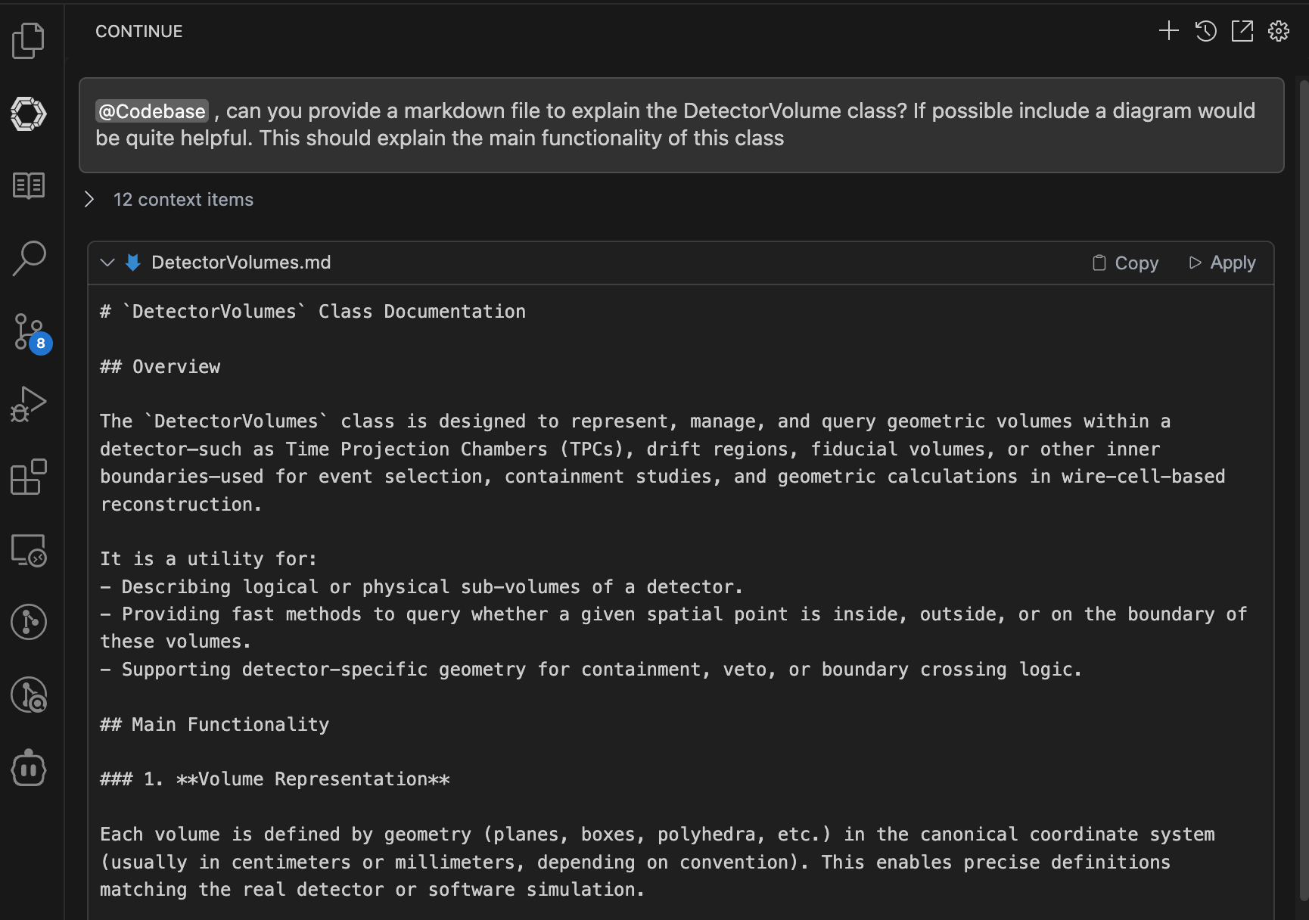
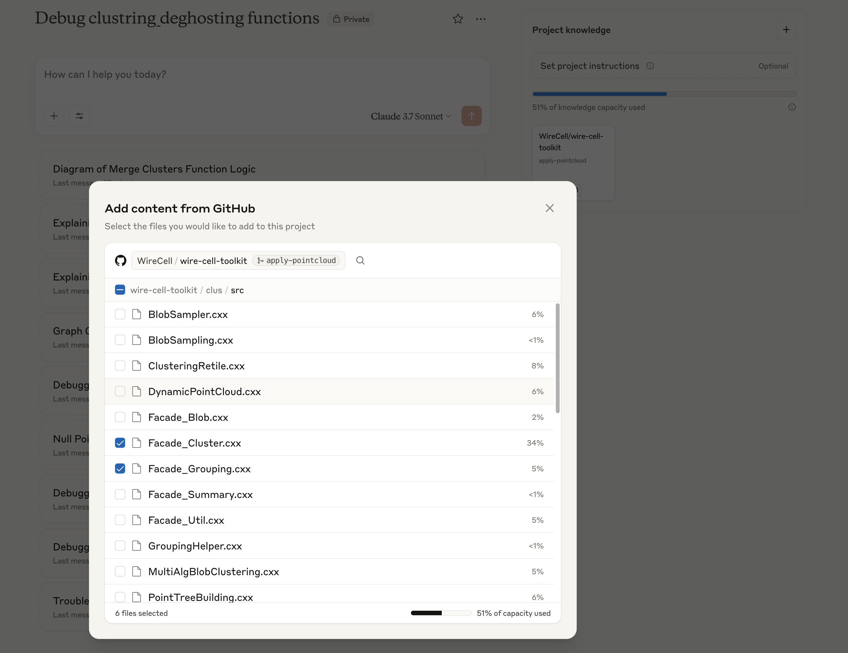
Some Tools
RAG-based: Continue Dev (free version existed)
Claude Project (require subscription, cannot be reimbursed by BNL though)
May try OpenAI with manual upload code snippet

Slide 28
Algorithm descriptions
Part II:

Slide 29
Functions | Drift_directions Wire directions | CT_PC, Graph | Main functions | Comment
clustering_live_dead | N/A, drift, angles | N/A | Blob->overlap_fast, 3D points | Algorithm is designed for single APA/face,
clustering_extend | Yes, need to update by face | N/A | 3D points, | Updated to multiple APA/face
clustering_regular | Yes, need to update by face | N/A | 3D Points, | Updated to multiple APA/face
clustering_parallel_prolong | Yes, need to update by face | N/A | 3D points | Updated to multiple APA/face
clustering_close | N/A | N/A | 3D points | Can probably work across different APAs/faces
clustering_separate | Yes: drift_dir, TPC params | Use CT_PC, also 2D point clouds, shortest path | 3D points, Graph, detector boundaries, temporary point cloud | Algorithm can handle multiple faces now
clustering_connect1 | Yes, wire angles, | CTPC, dynamic point cloud | 3D points, 2D point clouds, global point cloud | Algorithm is designed for single face
clustering_deghost | Yes, wire angles | CTPC, TPC parameters | 3D points, 3D and 2D point clouds | Algorithm need to handle both faces
clustering_examine_x_boundary | Know TPC parameters | Graph, | Graph | Algorithm is designed for single face
clustering_protect_overclustering | N/A | CTPC (is good point), Graph, | Overlap_fast, | Can in principle handle multiple APA faces, if CTPC can handle
clustering_neutrino | Drift_direction, TPC params | N/A | 3D points, Judge_vertex | Can in principle handle multiple APA faces, check angles …
clustering_isolated | Drift_direction | N/A | 3D points, | Can in principle handle multiple APA faces, check angles …
clustering_examine_bundles | N/A | CTPC, Graph | Graph, 3D points, need to enable gaps, Examine_graph functions | Need to handle multiple APAs
Clustering_retile | Wire_angles, anode, face | Graph, | Retiling, overlap | Handle clusters from each face

Slide 30
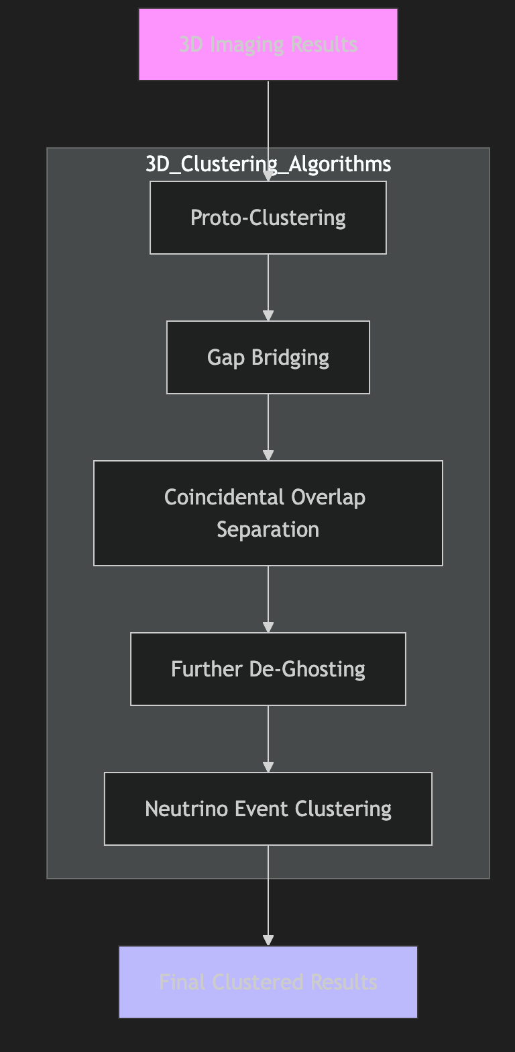
Introduction to Algorithm
Explained @ https://arxiv.org/abs/2011.01375
3D clustering section
Proto-Clustering (Initial grouping based on spatial proximity, Uses k-d tree algorithm for fast spatial queries, Forms basic connected components in 3D space)
Gap Bridging (Addresses gaps from non-functional channels/signal loss, Combines: i. Directional consistency checks (Hough transform), ii. Minimal distance criteria (k-d tree). Iii. Charge continuity analysis)
Coincidental Overlap Separation: Resolves overlapping cosmic/neutrino activities: i. PCA analysis for multi-track identification ii. Convex hull analysis for endpoint detection, iii. Dijkstra’s algorithm for trajectory separation, iv) Kalman filter-based path following
Further De-Ghosting: Removes residual ghosts using: i) Charge consistency across wire planes, ii) Sparsity constraints (L1 regularization), iii) Geometric pattern matching
Neutrino Event Clustering: Special handling for neutrino interactions: i) Vertex finding through directional analysis, ii) Neutral particle recovery (π⁰→γγ), iii) Secondary interaction identification, iv) Particle flow reconstruction

Slide 31
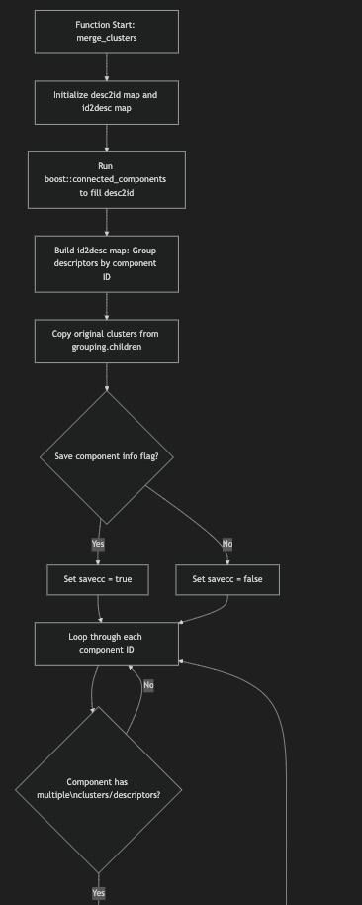
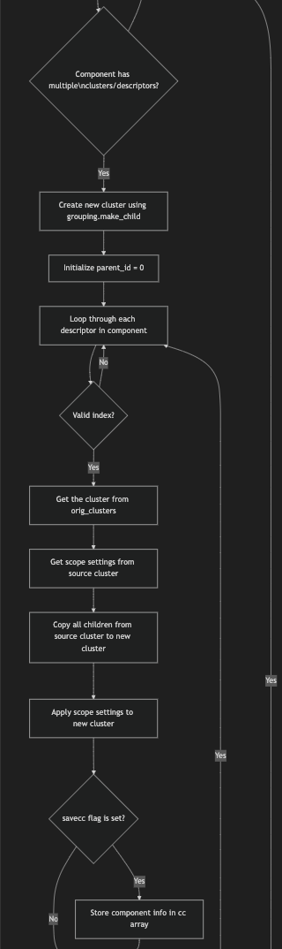
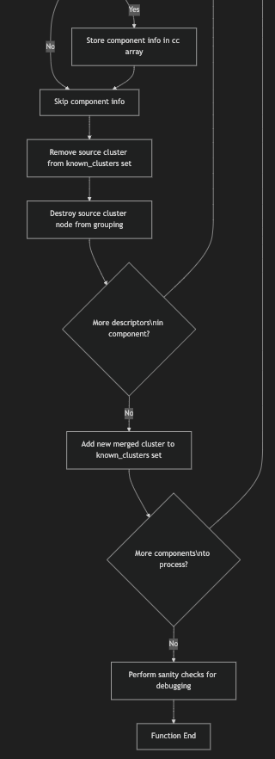
Explanation of Some Key algorithm: Merge Clusters
Include i) clustering_live_dead, ii) clustering_extend, iii) clustering_regular, iv) clustering_parallel_prolong, v) clustering_close
Form a graph with each vertex being an input cluster (inside the live_grouping)
Each algorithm would then establish edges in this graph
All the connected components would be merged to create a new cluster inside the live_grouping
Original clusters are deleted
Major used functionalities
Blob->Overlap_fast (detect overlap)
3D Point Clouds → KD Tree access
Proximity as well as directionality
Examples of how to handle WPID, Change Scope View settings, merge clusters

Slide 32
Clustering_switch_scope
This function is responsible for switching the "scope" (i.e., geometric or contextual association) of clusters within point cloud groupings (raw points → corrected points)
Iterate Over Clusters: For each cluster in the input grouping (e.g., `live_grouping`), retrieve its corresponding point cloud
Apply Coordinate Transform (if any): Optionally recalculate or correct the coordinates of points within the cloud based on a specified transformation (`correction_name`)
Containment Query: Use the `IDetectorVolumes` instance (`dv`) to check each point:
Inside: Point is contained in a (sub-)volume
Outside: Point is not within any relevant volume
Group Updates: If the cluster is no longer consistent with its current scope
Move/divide/reassociate it to the appropriate region (live/dead or another volume)
Update cluster metadata or state as needed → Set Scope Filter
Consistency Checks: Ensure bookkeeping reflects all scope changes (removal from old group, addition to new, etc.)

Slide 33
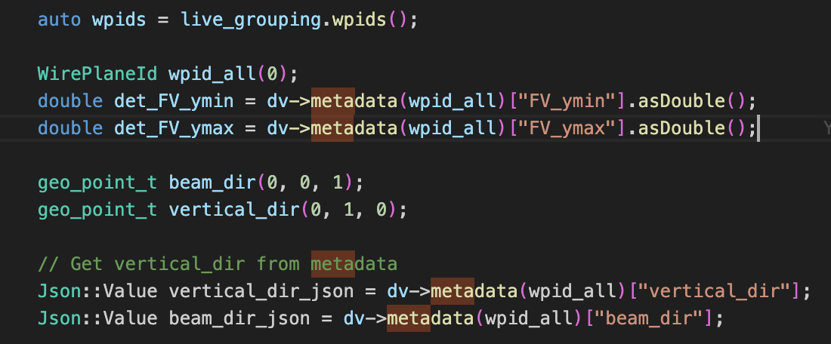
Clustering Separate
Basic Algorithm
Used functionality
Initial Iteration: For each cluster in live_grouping, retrieve/access its point cloud.
Coordinate Transform (if enabled): Optionally update cluster point positions based on coordinate system or corrections (using coords, pc_name, or via user configuration).
Volume/Containment Query:
For each cluster, check its points’ positions relative to detector volumes via the supplied IDetectorVolumes pointer (dv).
This checks for points that are: Inside a volume, Outside volumes.
Cluster Candidate Testing:
Use logic (e.g., JudgeSeparateDec_1 and related helpers) to decide if the cluster should be:
Separated from the current group,
Re-categorized (e.g., to "dead" or "out-of-volume" groupings),
Kept as-is.
Splitting/Separation Logic
If a split is required (e.g., cluster crosses boundaries, contains points in multiple regions, or matches separation criteria):
Separate points into new/existing clusters as needed
Update data structures (bookkeeping for new clusters/groups)
Maintain correct parent-child relationships and cluster metadata
Final Updates and Bookkeeping
Remove modified clusters from their old group,
Insert the separated/new clusters into the appropriate group(s) (live/dead/other)
Ensure cluster IDs and associations are kept consistent
(Optional) Post-processing: Perform any additional checks or extensions as required by configuration.
Graph operations:
Shortest path
CT_PC
Accessed through the grouping
Dynamic point cloud
2D point clouds
get_closest_2d_dis
2D point cloud:
get_closest_2d_index
detector boundaries

Slide 34
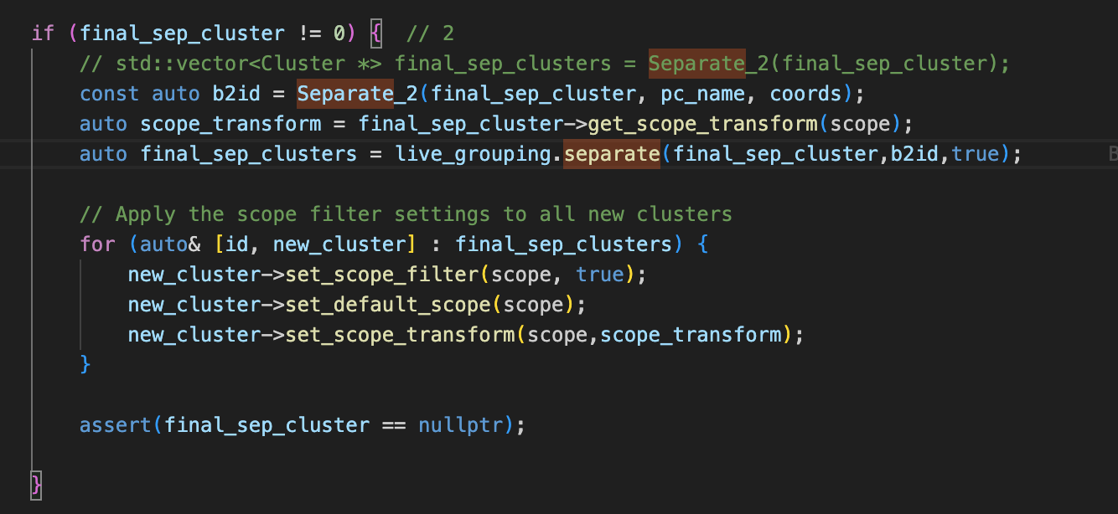
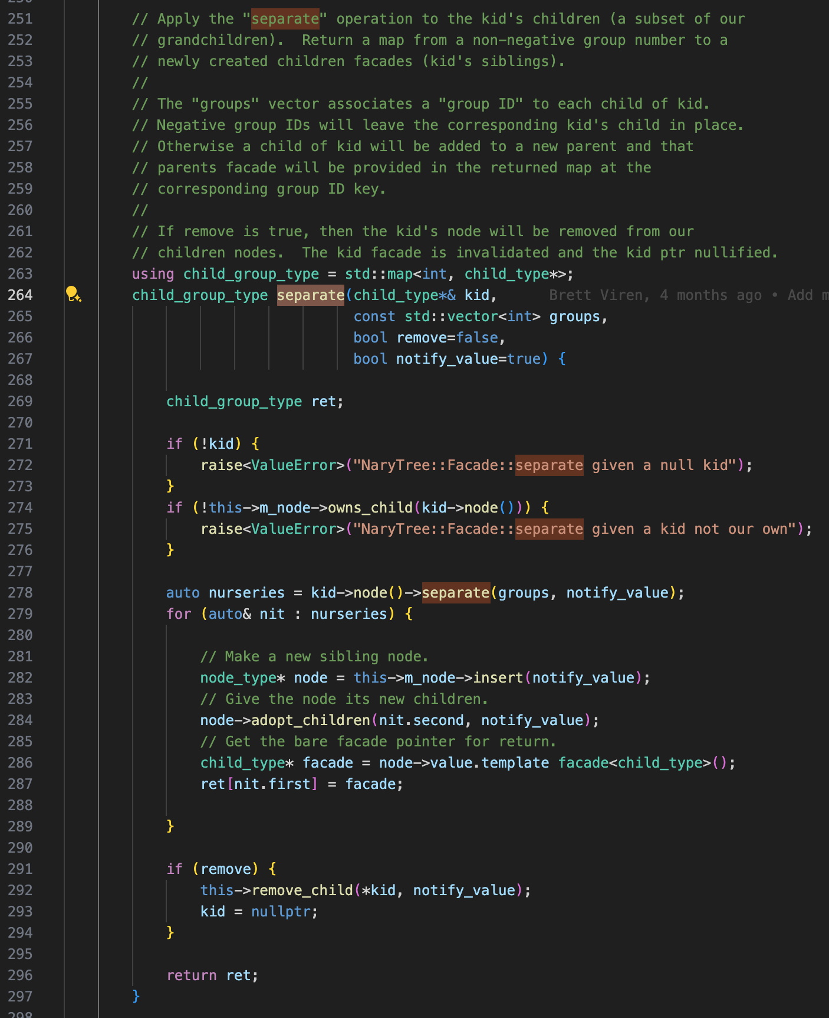
Separation Function
Separate and then Set Scope Information
NaryTreeFacade
With a separation algorithm, generate groups of blobs using b2id number
Separate cluster with NaryTree function
For each newly generated cluster, set its scope information

Slide 35
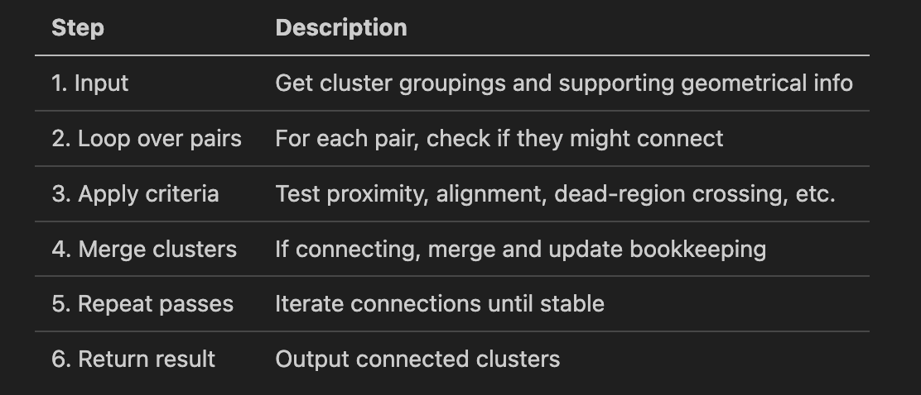
Clustering Connect (Single-Face Algorithm)
implements logic to judiciously merge clusters separated by detector effects or clustering artifacts, reconstituting complete tracks and showers for later physics analysis
Used functionality
CTPC → accessed through grouping
Dynamic point cloud
global point cloud
2D point clouds
See next slides for more detailed explanations
3D points

Slide 36
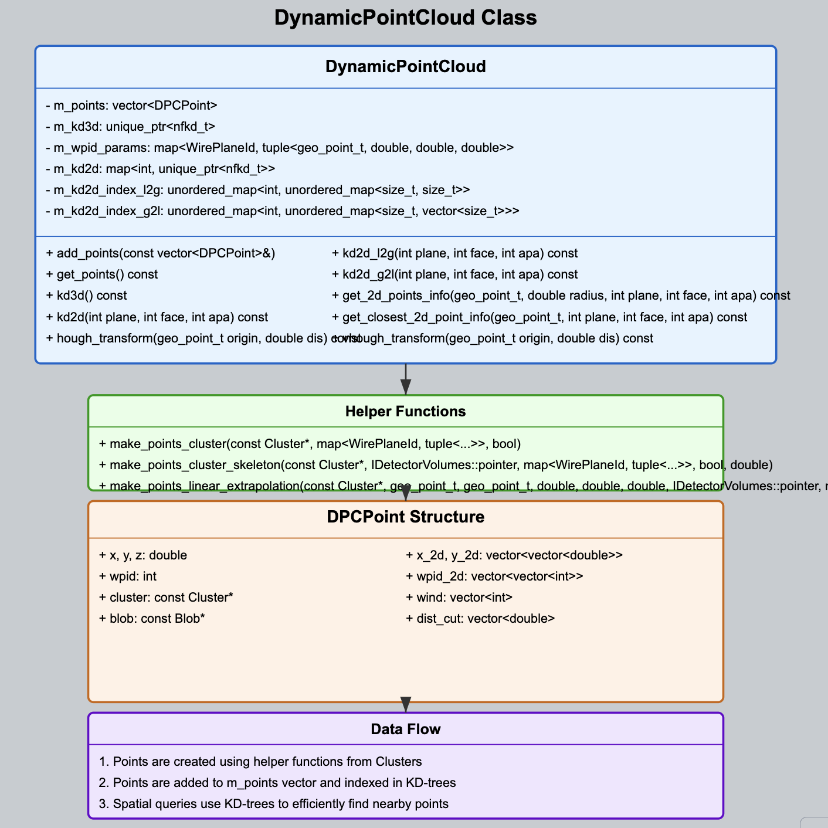
Dynamic Point Cloud
Key components
DPCPoint Structure
KD-Tree Structures
3D KD tree
Multiple 2D KD trees
Helper Functions
make_points_cluster(): Creates points from an existing Cluster
make_points_cluster_skeleton(): Creates a simplified skeleton of points
make_points_linear_extrapolation(): Generates points along a linear path
Core functionalty
Add_points
Get_2d_points_info
Get_closest_2d_point
Hough Transformation

Slide 37
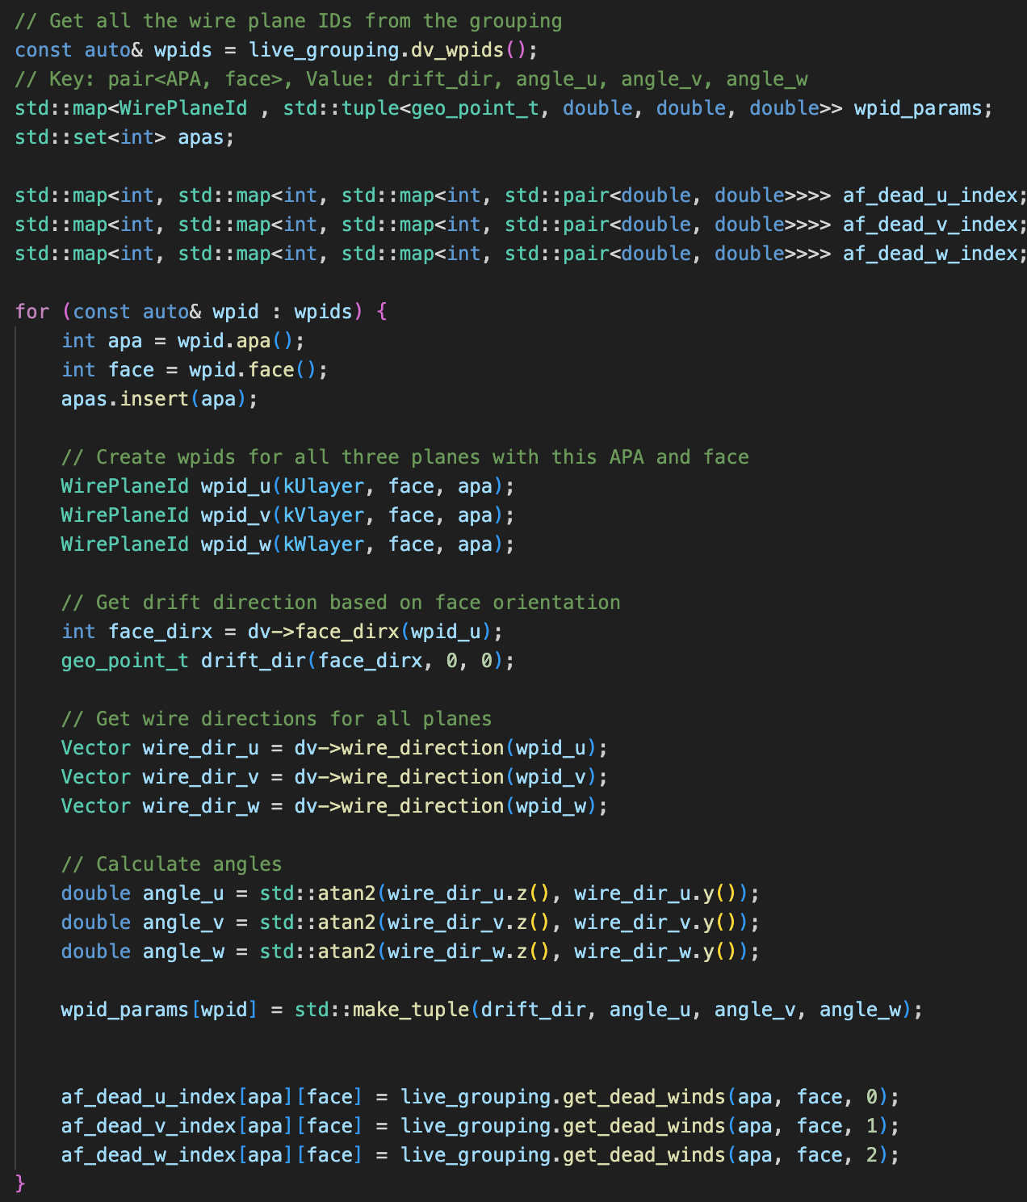
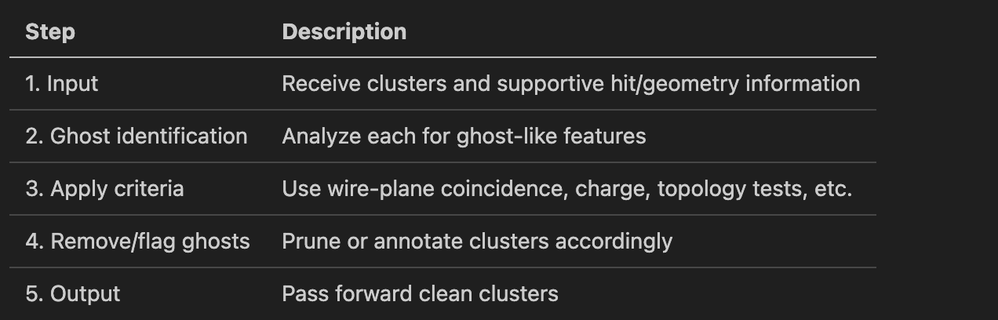
Clustering Deghost (Need to include all faces of an APA)
Algorithm
Main functionality
analyzes produced clusters to remove spurious, nonphysical "ghost" clusters, using geometric and topological signatures to maximize purity in the retained sample
CTPC (accessed through grouping)
3D points,
Dynamic Point Cloud
3D 2D point clouds
TPC parameters

Slide 38

Clustering_examine_x_boudnary and Clustering_protect_overclustering and clustering_examine_bundles
Algorithm description
Main functionality
Examine_x_boundary: divide a cluster according to anode/cathode position
Clustering_protect_overclustering: a more careful version of the graph creation → connected component analysis
Clustering_examine_bundles: another algorithm to examine the graph and perform connected component analysis → also change the pcarray information (main cluster + associated clusters)
Separate Clusters (shown before)
Examine_graph and use and access cc_array
Graph construction with different cuts
Access detector information

Slide 39
Clustering_neutrino and clustering_isolated
Performs neutrino clustering in the Wire-Cell toolkit, used for particle detection in liquid argon time projection chambers
It first collects detector metadata including wire plane IDs, drift directions, wire angles, and fiducial volume boundaries
The algorithm sorts clusters by length (longer to shorter) and identifies "contained clusters" that fall within specified detector boundaries
For candidate clusters, it calculates the closest distances between clusters and builds extension clouds along possible particle trajectories using Principal Component Analysis (PCA) and Hough transforms
It then employs a sophisticated merging process based on multiple criteria:
Distance between clusters
Angular alignment
PCA characteristics
Detector geometry constraints
Finally, it constructs a connectivity graph representing potential cluster merges and executes the merging process to create the final set of clusters.
aims to organize and merge clusters based on spatial relationships and specific criteria
First, it collects information about wire planes, including their orientations, drift directions, and angles.
The clusters are sorted by length (from large to small) and assigned a default scope for point cloud operations.
The function separates clusters into two categories:
"Big clusters" - longer, more significant clusters
"Small clusters" - shorter, potentially isolated clusters
It then performs several clustering operations: Merging small clusters with nearby big clusters (if they're within a certain distance threshold)
Merging small clusters with other small clusters that are very close to each other
Merging remaining small clusters with each other if they meet distance criteria
Merging big clusters with other big clusters based on proximity and other geometric factors
After identifying clusters to merge, it builds merged cluster sets and creates a connectivity graph.
Finally, it assigns unique IDs to each resulting cluster.

Slide 40


Clustering_retile
Main functionality
Before retiling
Rebuild Blobs by hacking activities
Get original activities
Add new activities (need mapping between the corrected points and the raw points, the latter can be associated with the 2D measurements)
Make Blobs
Associate blobs and delete the bad ones
Fill the PCT,
Provide association between original clusters (original grouping) and new clusters (Shadow grouping)
After retiling
Gaps are filled by the new activities generated by the shortest path

Slide 41
Configuration and Validations
Part III:

Slide 42

MicroBooNE
Configurations
Detector Volume Construction
Workspace @ https://github.com/HaiwangYu/wcp-porting-img/tree/main/fgval
Configuration @ https://github.com/HaiwangYu/wcp-porting-img/blob/main/wct-uboone-clustering.jsonnet
Single TPC configuration, one MABC
Load in imaging results
Validated O(30) events

Slide 43


MicroBooNE
Bee output settings
Clustering functions
Examples of
How to setup detector volumes, anodes
How to setup the Bee output and MABC
How to setup each clustering algorithm

Slide 44

QLPort
Configurations
File I/O
Workspace @ https://github.com/HaiwangYu/wcp-porting-img/tree/main/qlport
Configuration @ https://github.com/HaiwangYu/wcp-porting-img/blob/main/qlport/uboone-mabc.jsonnet
Input: rootfiles with Q-L matching done
Mostly tested two algorithm: examine_bundle and retile
How to load the MicroBooNE rootfiles
Optical Flash
Clustering bundle

Slide 45


QL Port
Full job configuration
Clustering configuration

Slide 46
PDHD: 3-stage MABC
Configurations
3-stage MABC
Workspace @ https://github.com/HaiwangYu/wcp-porting-img/tree/main/pdhd
Configuration @ https://github.com/HaiwangYu/wcp-porting-img/blob/main/pdhd/wct-clustering.jsonnet
https://github.com/HaiwangYu/wcp-porting-img/blob/main/pdhd/clus.jsonnet
Validation: 10 events from Xuyang
Mostly for validation of Multiple APA/Face implementation → Multiple TPCs
Single TPC MABC
Single APA (all faces) MABC
All APA MABC
Each can have its own Bee output
I/O from tar.gz files

Slide 47




PDHD
Detector Volumes
First MABC (single TPC)
Second MABC (single APA, all faces)

Slide 48

PDHD: Final MABC (all APAs)

Slide 49
How to use LLM to Help Learning
Part IV

