Slide 1
ROC readout preparations
Norbert will be at BNL next week, with Monday as his first day on site
We have still work to do, but have been setting up as much as we can in our HCal lab
JH and Eric prepared 2 scintillator paddles with HV etc to make a cosmics telescope
NIM Crates, CFD, etc
A coffee machine close by ☺
We’ll need to see about the actual tile/SiPM/Bias supply stuff
On Monday we’ll get all set up
If by Monday night we can re-trace the steps I did with my setup, we will have reached a stretch goal, IMHO
Speaking of my setup…

Slide 2
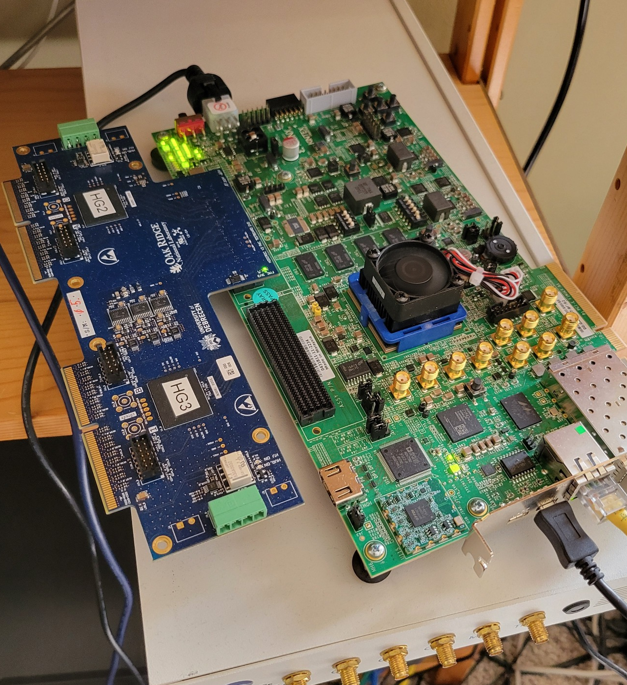
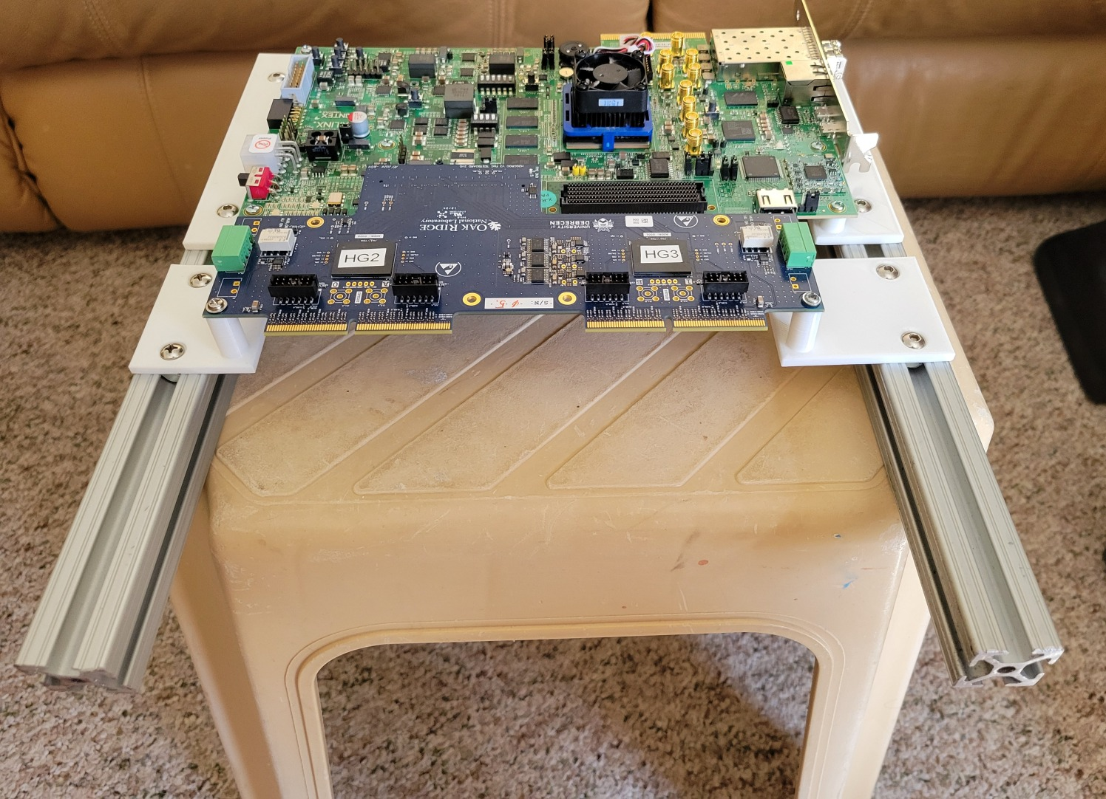
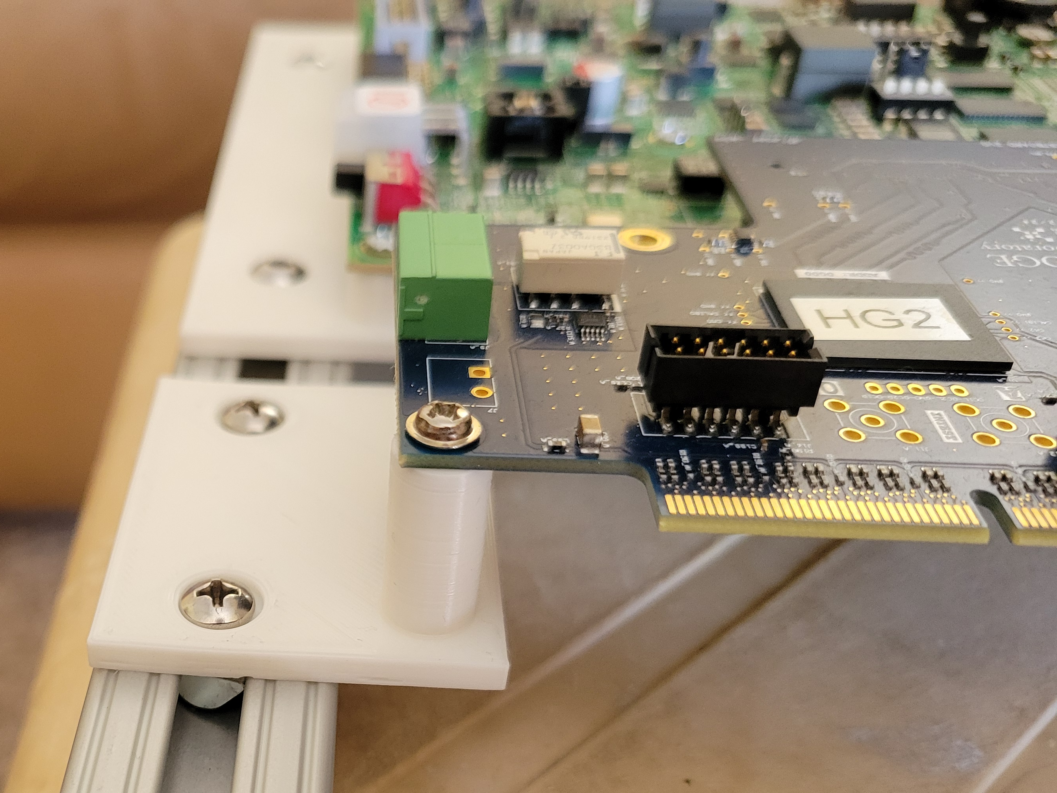
ROC mechanics
I had shown the design for a “case” for the not so mechanically-stable setup in the picture on the left
Dan had 3d-printed a piece that didn’t actually line up with the holes at all
It was also too involved to print (270mm on a 250x250 printer, get it in diagonally…), and that’s just one piece
I designed a different holder that works better and can print on my own printer (much easier, get 2 pieces/night)
I also ordered better material for the next generation, so it looks more pleasing (thanks for the authorization to spend a bit of money)

Slide 3
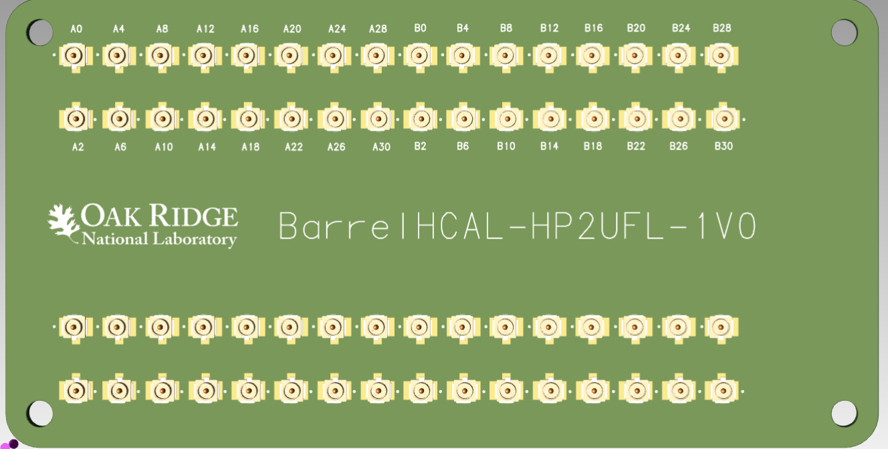
Let’s see what we need to discuss for next week
I’m a bit worried about the actual connectors and stuff
Norbert has the Gerbers for those edge connectors
Norbert brings his, so we are set for next week
But we should get a few made that can stay here – Steve?

