Slide 1
Detector Cooling - Update
Girish Gowda
05/05/2025

Slide 2
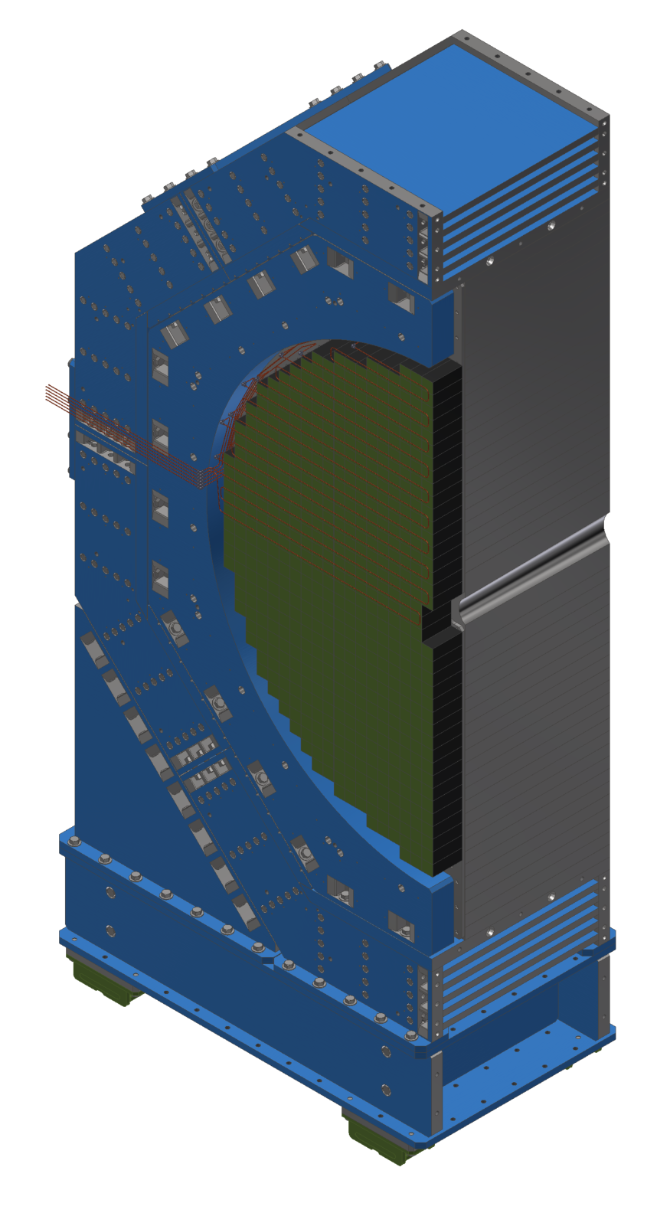
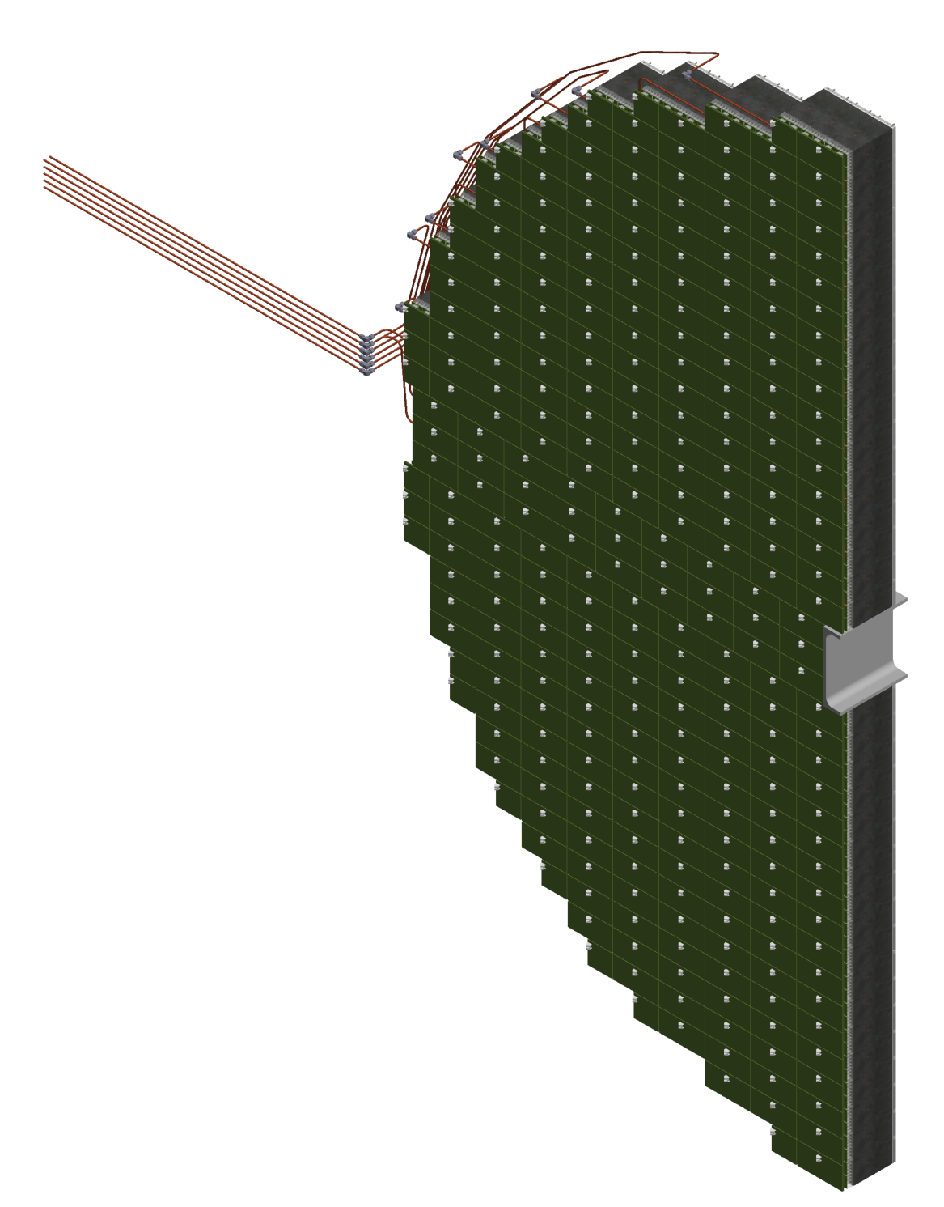
Forward EMCAL
Temperature Requirements
Forced Convection Cooling for FEB’s with and without comparison
Cooling the SiPMs to be determined
Sectional View

Slide 3
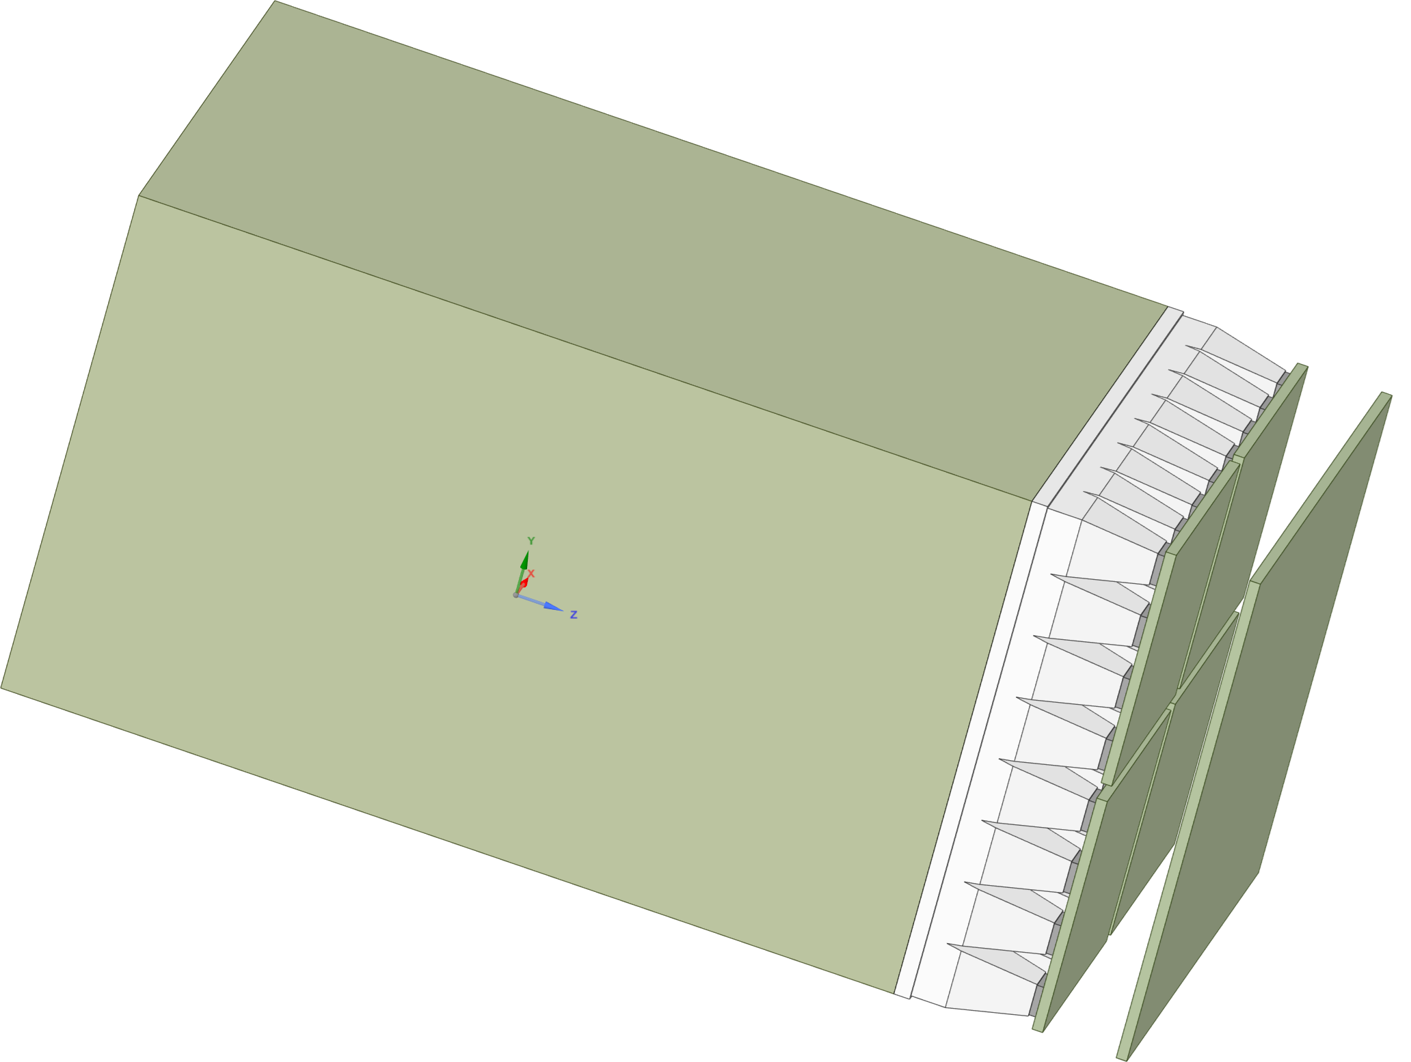
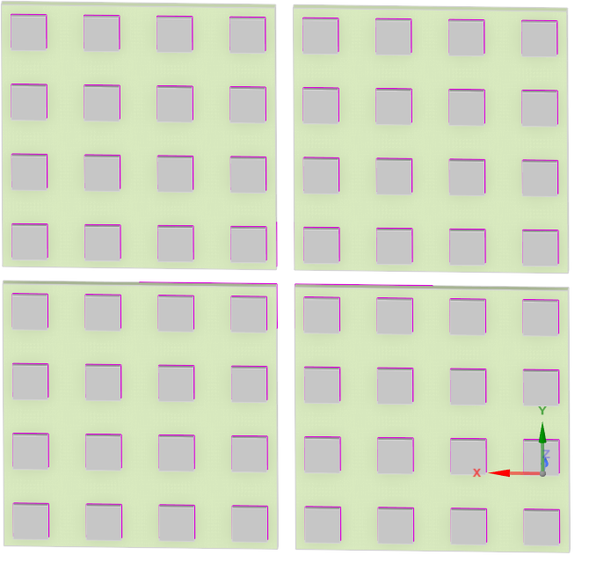
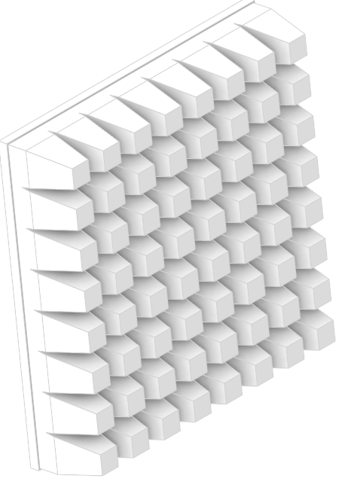
Forward EMCAL - Scenario 1
SiPM
Epoxy
SiPM Board
FEB
Tungsten Scifi
Exploded View
Acrylic
Sector Geometry

Slide 4
Forward EMCAL – CFD Simulation - Scenario 1
Technical Data :
FEB Heat load (W) | SiPM Heat load (W)
4.5 | 0.17
CFD Data :
Half FEB Heat load (W) | SiPM Heat load (W)
2.25 | 0.17
Materials
Copper thickness (10 %) in FEB
Copper thickness (5%) in SiPM Board
FEB and SiPM Board thickness : 2 mm
Simulation
Copper tubes, heat sink & thermal pad geometry not considered

Slide 5
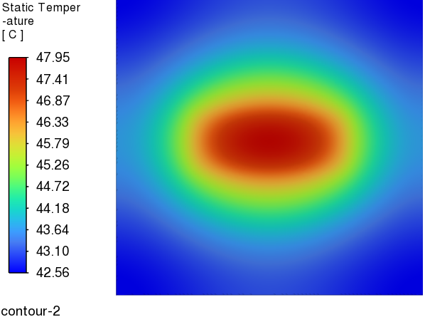
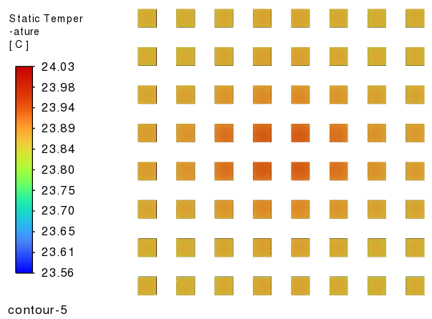
Forward EMCAL – CFD Simulation - Scenario 1
FEB Temperature
SiPM Temperature
Ambient Temperature (C) | Half FEB Heat load (W) | SiPM Heat load (W)
20 | 2.25 | 0.17
Heat Transfer Coefficient (W/m^2 C) | FEB Temperature (C) | SiPM Temperature (C)
5 | 48.0 | 24.1

Slide 6
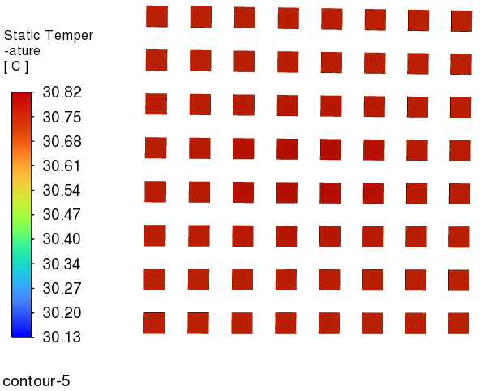
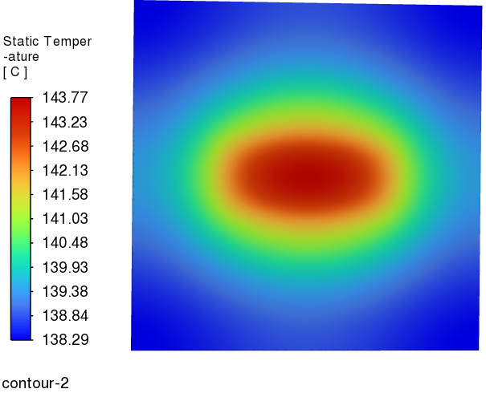
Forward EMCAL – CFD Simulation – Scenario 1
Heat Transfer Coefficient :
FEB Temperature
SiPM Temperature
Ambient Temperature (C) | Half FEB Heat load (W) | SiPM Heat load (W)
20 | 2.25 | 0.17
Heat Transfer Coefficient (W/m^2 C) | FEB Temperature (C) | SiPM Temperature (C)
1 | 143.8 | 30.8

Slide 7
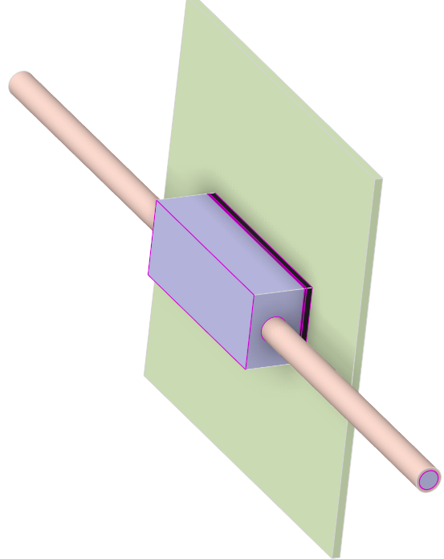
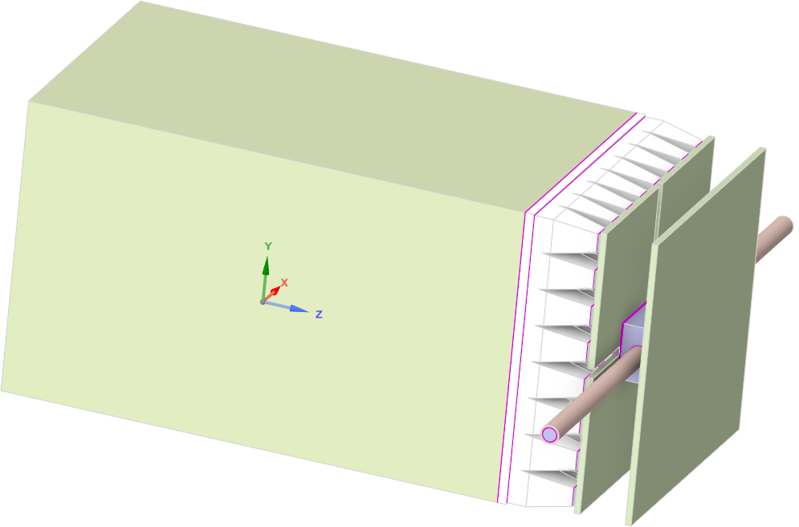
Forward EMCAL - Scenario 2
FEB
Copper tube (inch)
0.25
SiPM
Thermal Pad
Heat Sink
Epoxy
Copper tube
SiPM Board
Tungsten Scifi
Exploded View
Acrylic
Sector Geometry

Slide 8
Forward EMCAL – CFD Simulation - Scenario 2
Technical Data :
Water flow rate (litre/min) | Flow velocity (m/s) | Tube Length (m) | Pressure drop (psi) | Temperature rise (C) | FEB Heat load (W) | SiPM Heat load (W)
0.83 | 0.76 | 6 | 2.1 | 2 | 4.5 | 0.17
CFD Data :
Water flow rate (litre/min) | Flow velocity (m/s) | Tube Length (m) | Pressure drop (psi) | Temperature rise (C) | Half FEB Heat load (W) | SiPM Heat load (W)
0.83 | 0.76 | 0.21 | 0.07 | 0.04 | 2.25 | 0.17
Materials
Copper thickness (10 %) in FEB
Copper thickness (5%) in SiPM Board
FEB and SiPM Board thickness : 2 mm
Simulation
Copper tubes, heat sink & thermal pad geometry considered

Slide 9
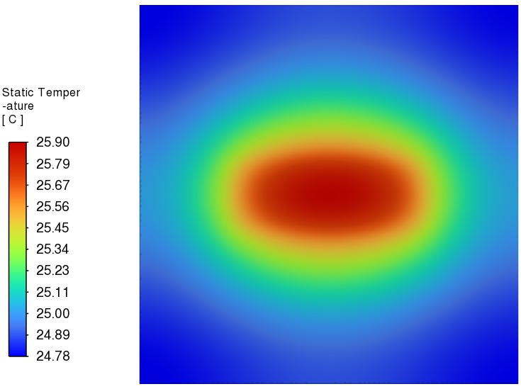
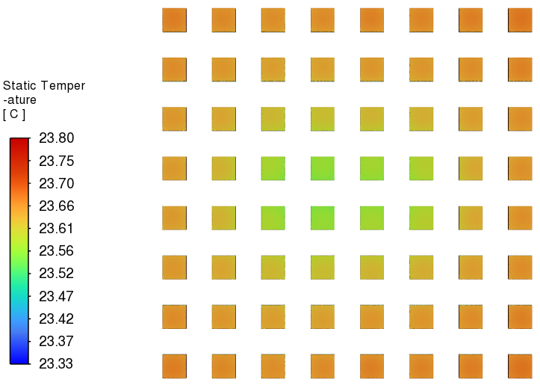
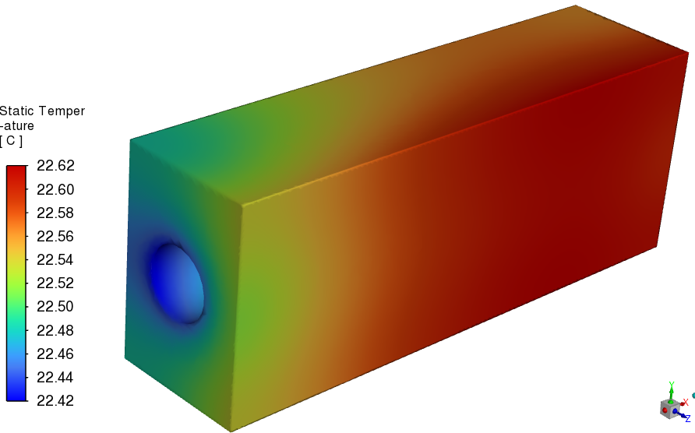
Forward EMCAL – CFD Simulation - Scenario 2
FEB Temperature
Heat Sink Temperature
SiPM Temperature
Ambient Temperature (C) | Flow velocity (m/s) | Half FEB Heat load (W) | SiPM Heat load (W)
20 | 0.76 | 2.25 | 0.17
Heat Transfer Coefficient (W/m^2 C) | Water Inlet Temperature (C) | FEB Temperature (C) | SiPM Temperature (C)
5 | 22 | 25.9 | 23.8

Slide 10
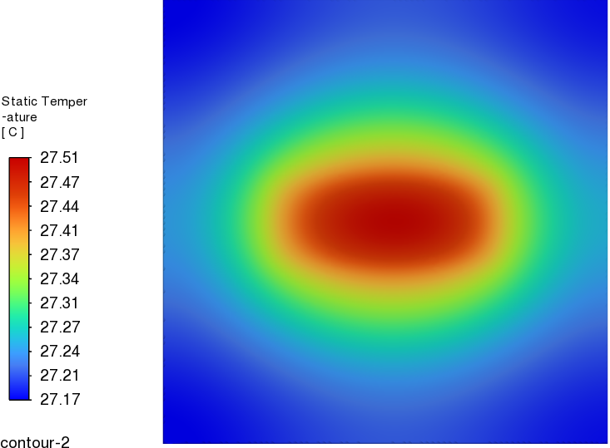
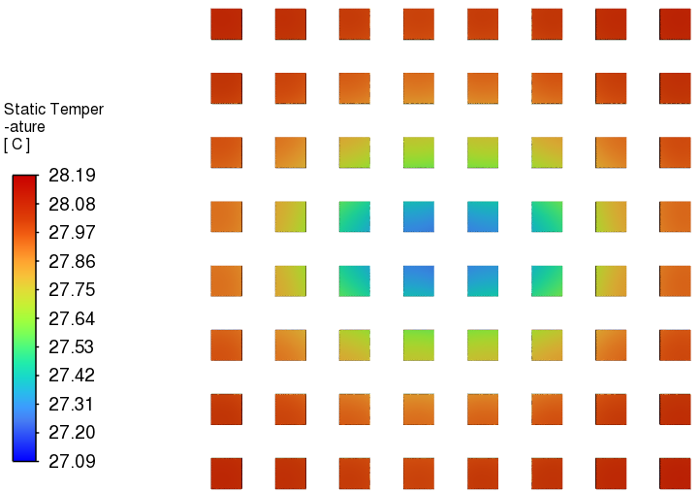
Forward EMCAL – CFD Simulation – Scenario 2
Heat Transfer Coefficient :
FEB Temperature
SiPM Temperature
Ambient Temperature (C) | Flow velocity (m/s) | Half FEB Heat load (W) | SiPM Heat load (W)
20 | 0.76 | 2.25 | 0.17
Heat Transfer Coefficient (W/m^2 C) | Water Inlet Temperature (C) | FEB Temperature (C) | SiPM Temperature (C)
1 | 22 | 27.51 | 28.19

Slide 11
Summary
Observations :
Modifying geometry without consideration of copper tubes, heat sink & thermal pad drastically increases temperature in FEB deprived of forced convection cooling as shown in slide 7.
Temperatures of FEB are further aggravated with natural convection cooling deprived due to lower heat transfer coefficient in addition to forced convection cooling as shown in slide 6.
Suggestions :
Modifying geometry from straight tube to serpentine tube will enhance heat transfer and reduce FEB temperature further.
Adding fins or turbulators in heat sink will enhance heat transfer and aid in cooling of FEB.

