Slide 1
Integration, Installation and Infrastructure Inner Detectors Maintenance and Services
Rahul Sharma, Dan Cacace, Roland Wimmer
6.10.10 Triple I group

Slide 2
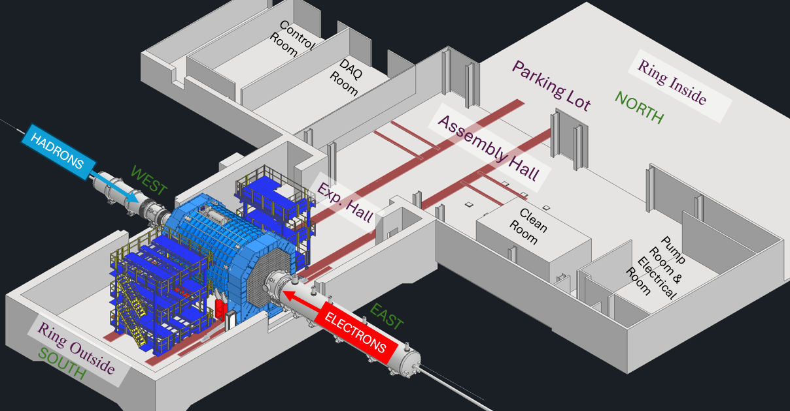
EPIC Detector, Assembly Hall and Experimental Hall
Charge 4
EPIC Detector Barrel will be assembled in the Assembly Hall and End Caps will be assembled in the Experimental Hall
During maintenance shutdowns, detector can be rolled out from Experimental Hall to the Assembly Hall

Slide 3
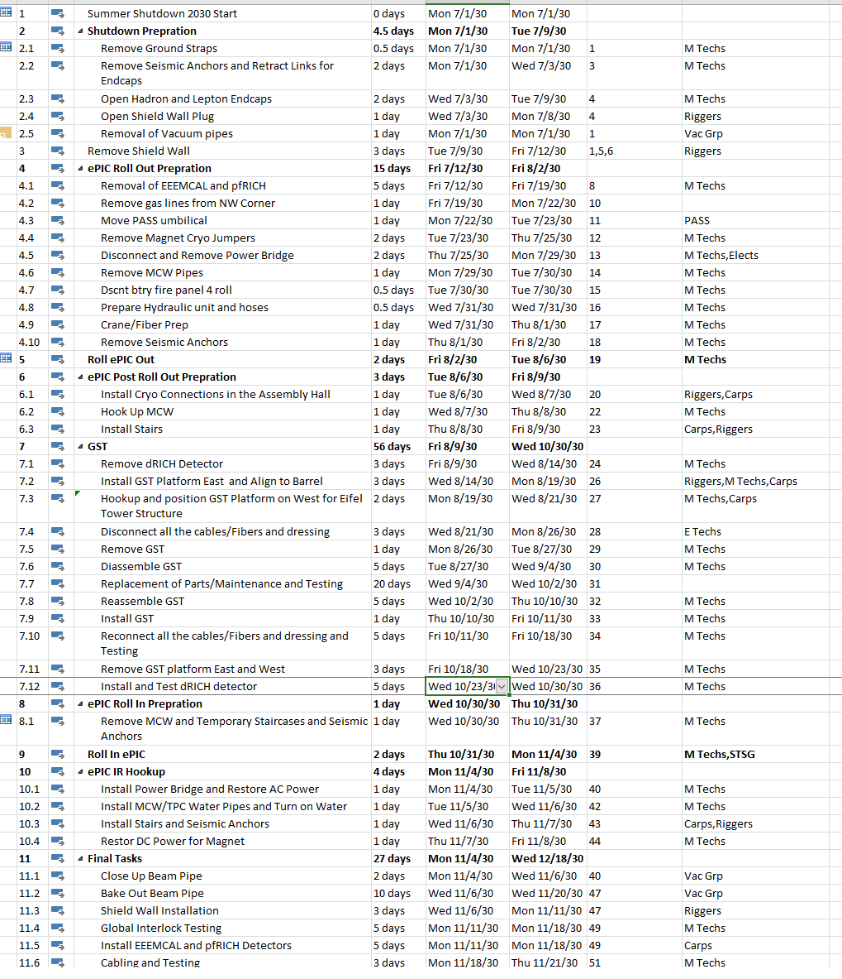
ePIC Maintenance Schedule

Slide 4
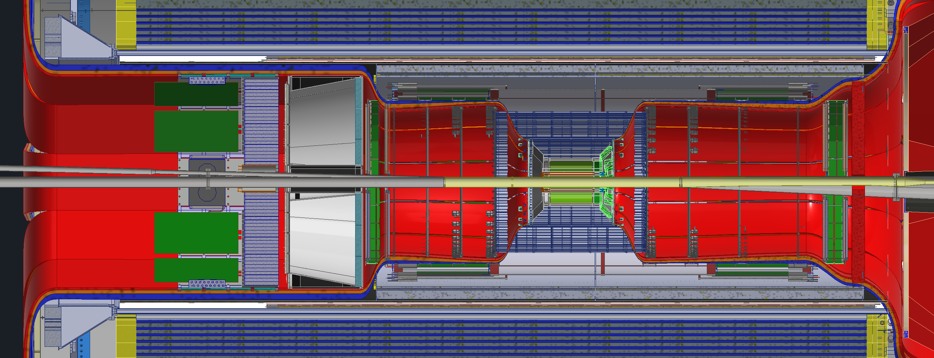
GST Model with Detectors
EEEMCAL
pfRICH
B MPGD Disk
B Si Disks
Cymbal
SVT
Barrel TOF
F Si Disks
F MPGD Disk
TOF Disk
Red : Non Servicable without removing and disassembling GST
Blue : Non Servicable currently but can be made serviceable without removing GST/ Major Design Modifications and prototyping is needed.
Green : Servicable without removing GST and Servicable in Experimental Hall

Slide 5
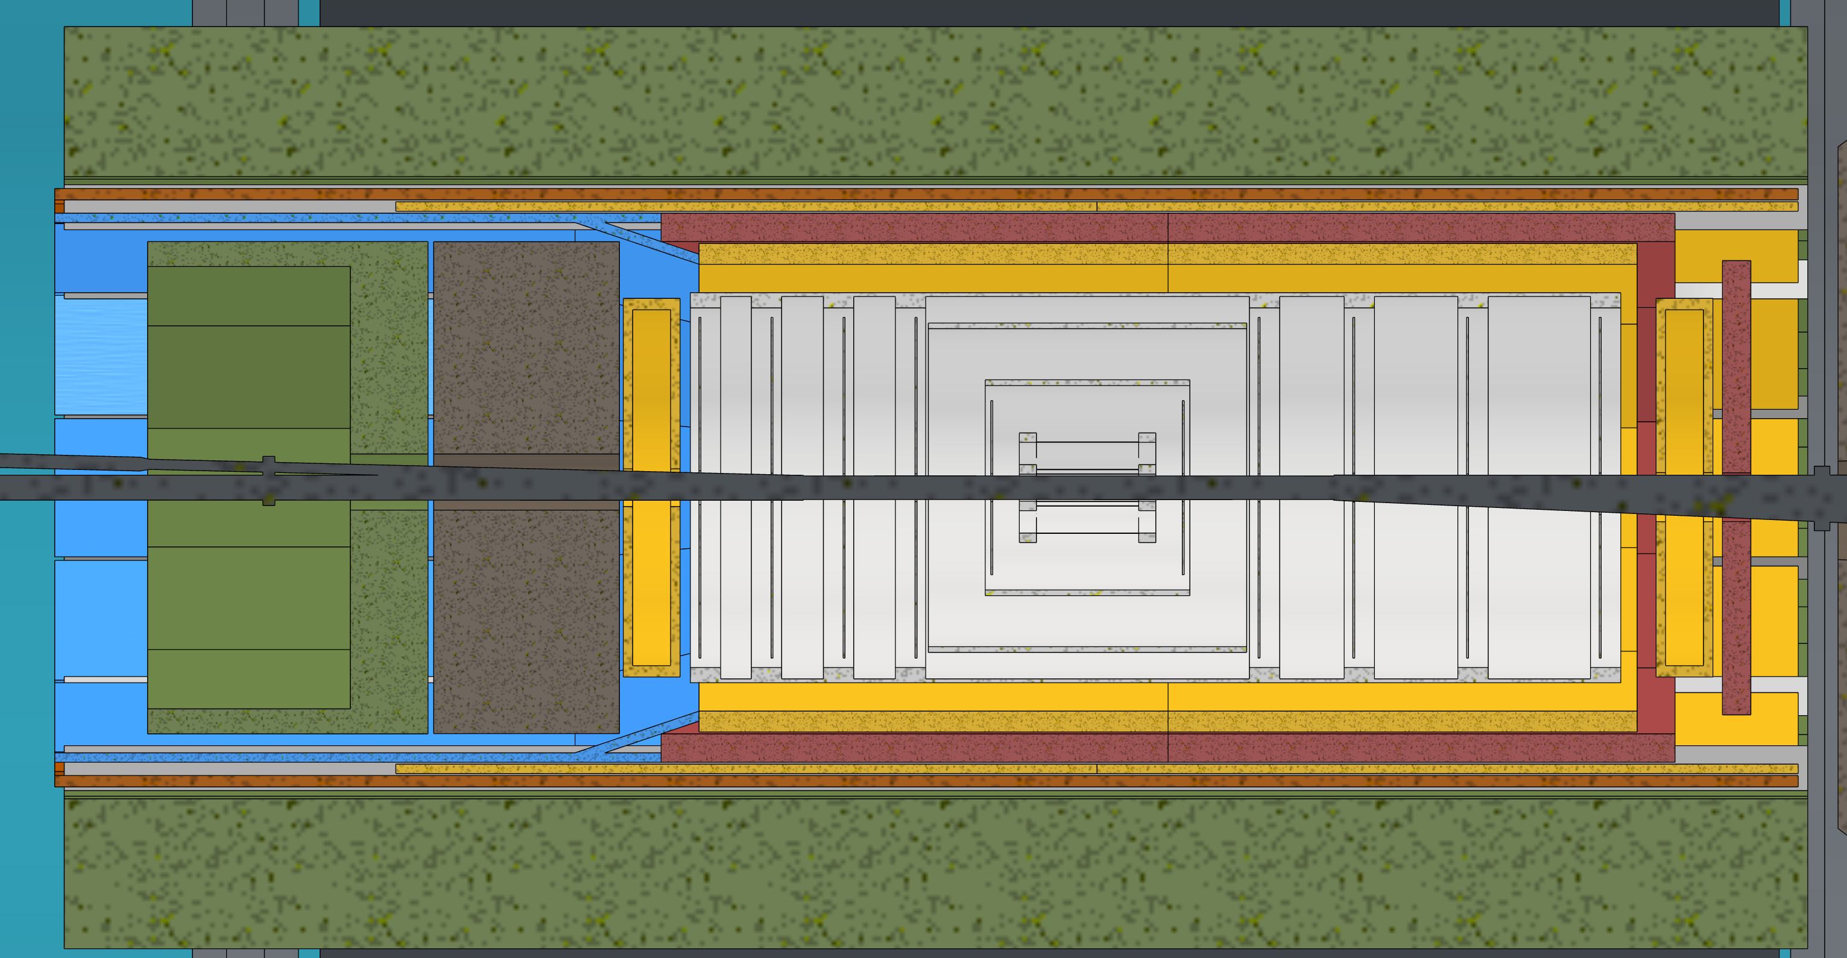
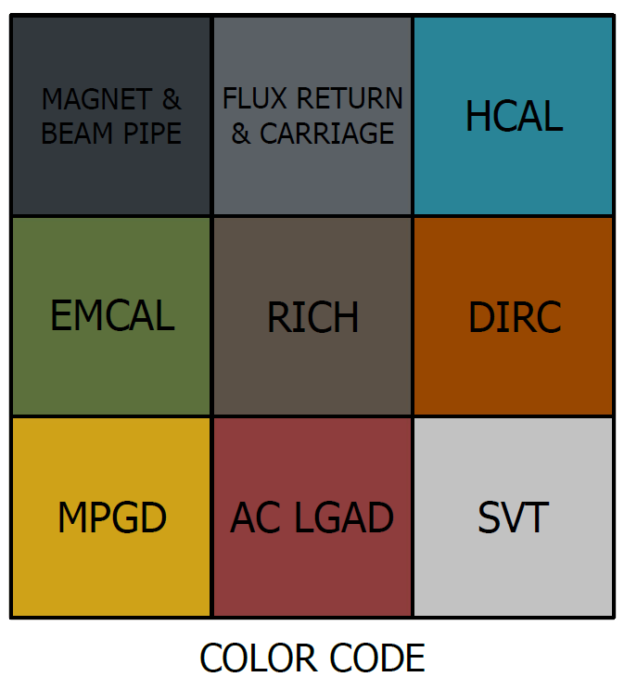
New GST + PST Envelopes model
GST and PST combine with changing diameter
Backwards flairs out for SVT services around EEEMCal/pfRICH
TOF + CYMBAL removed from forward direction
Requires 1/12 of SVT services to be detached
GST/PST
EEEMCal and pfRICH can be attached to DIRC rails
Needs more clearance, but simplifies PST
Forward TOF OD needs to be reduced to allow PST to end

Slide 6
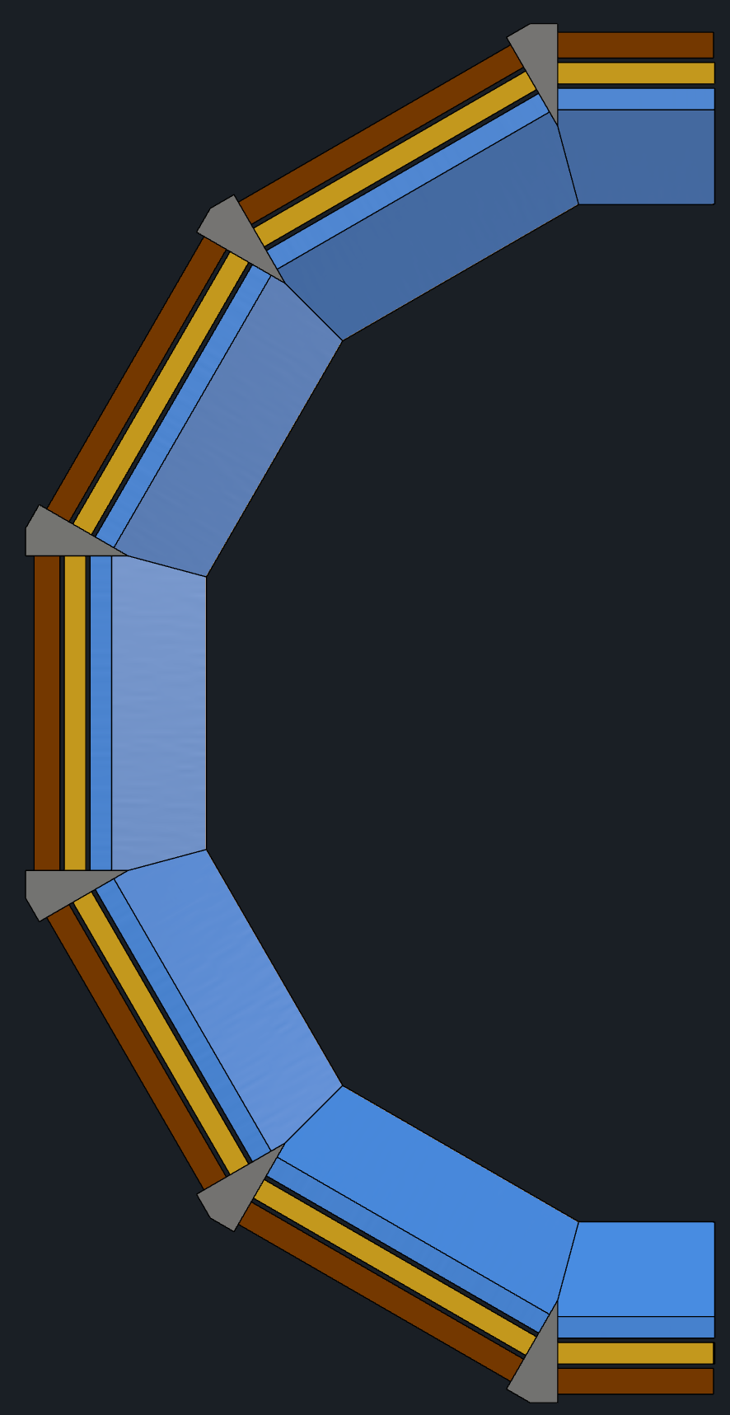
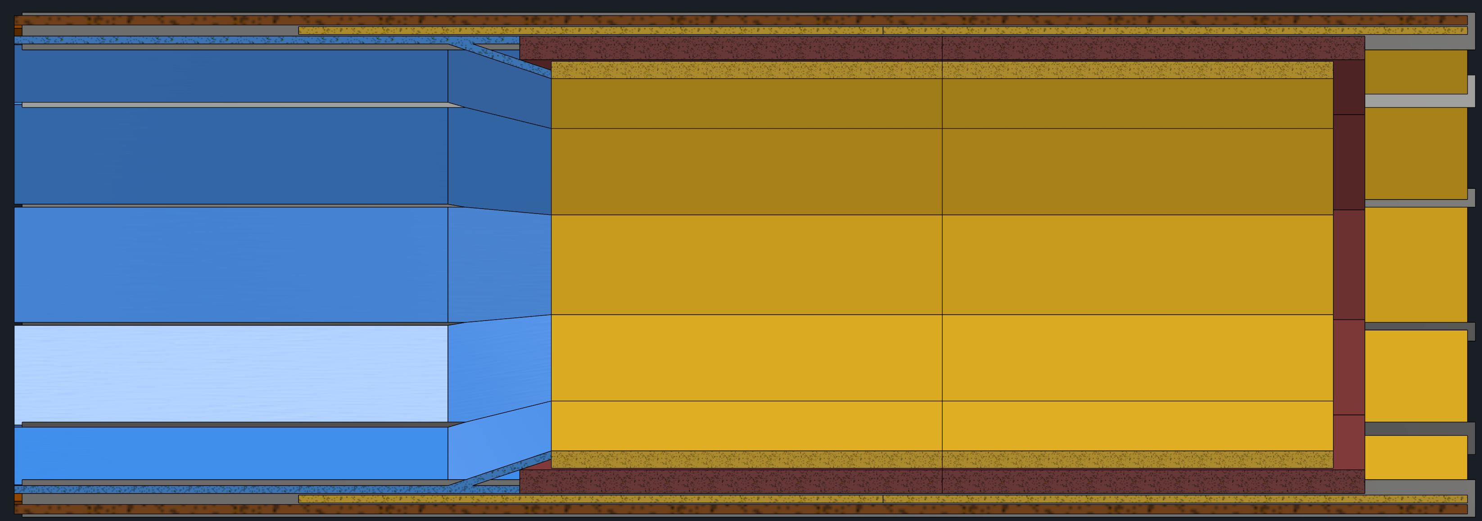
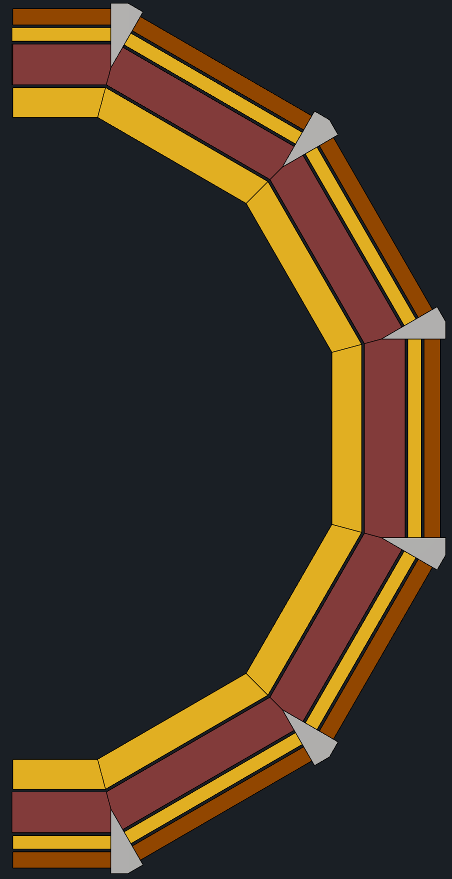
New GST + PST Envelopes model
TOF and CYMBAL divided into 12 sections attached together
Barrel TOF and CYMBAL installed on DIRC and MPGD rails
Rails
TOF and CYMCAL services in tray attach to rails
TOF and CYMBAL made in flat panels
Hermetic coverage still possible

Slide 7


Backward
BWD Disks | Radius (cm) | X Offset (cm) | Shape
Disk 1, 2 | 3.7 | 0 | Circle
Disk 3 | 3.7 | -0.2 | Oval
Disk 4 | 3.9 | -0.7 | Oval
New Disks | 3.9 | -0.75 | Oval
Disk 1, 2
Disk 3
X Offset
Disk 4
New Disk
Looking toward IP from Backward end. All new disks would be asymmetric.

Slide 8

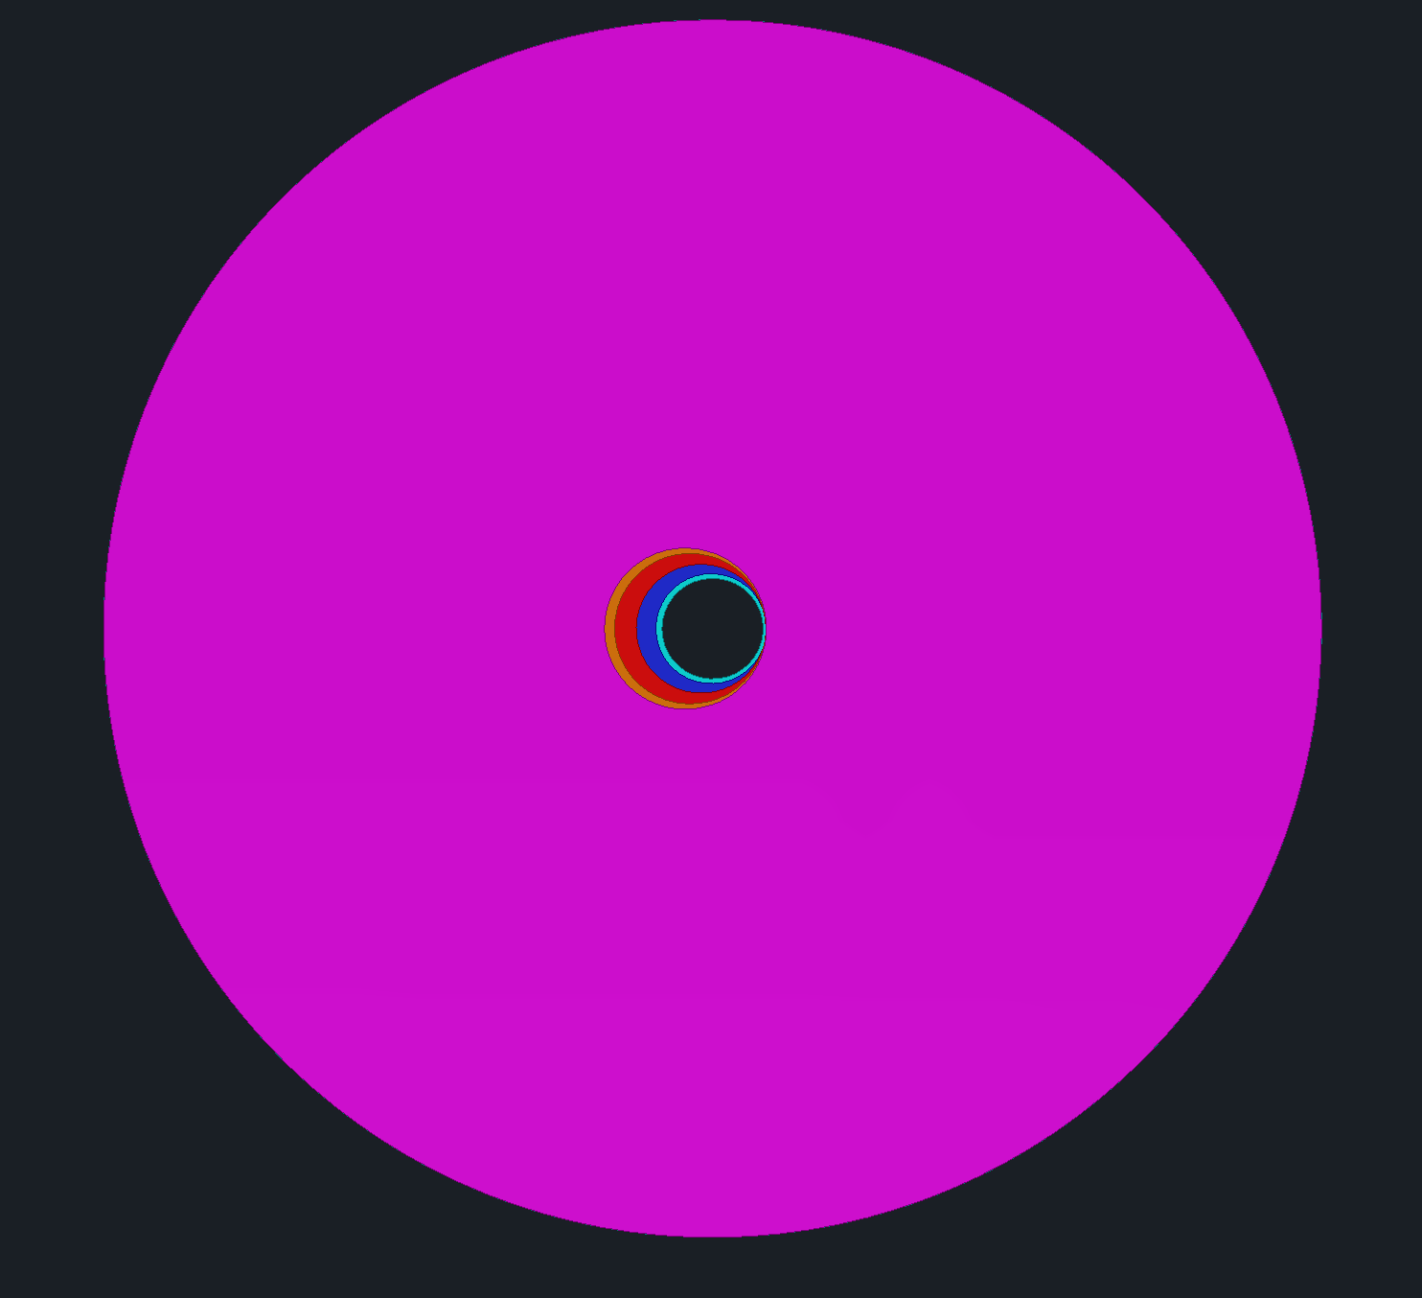
Forward
FWD Disks | Radius (cm) | X Offset (cm) | Shape
Disk 1 | 3.7 | 0 | Circle
Disk 2 | 4.05 | 0.1 | Circle
Disk 3 | 4.75 | 0.85 | Circle
Disk 4 | 5.55 | 1.65 | Circle
New Disks | 5.95 | 2 | Circle
Disk 1
Disk 2
Disk 3
X Offset
Disk 4
New Disk
Looking toward IP from Forward end

Slide 9
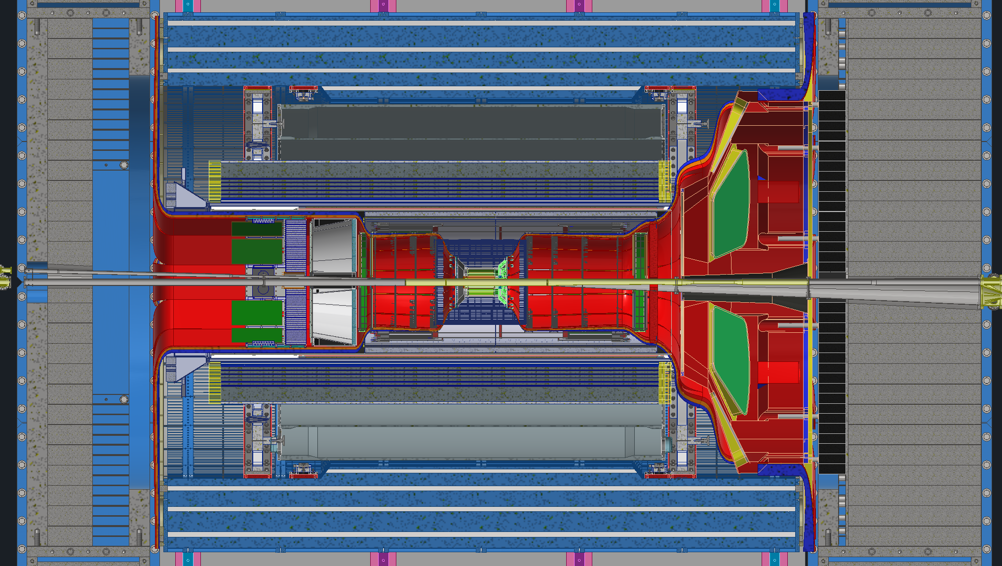
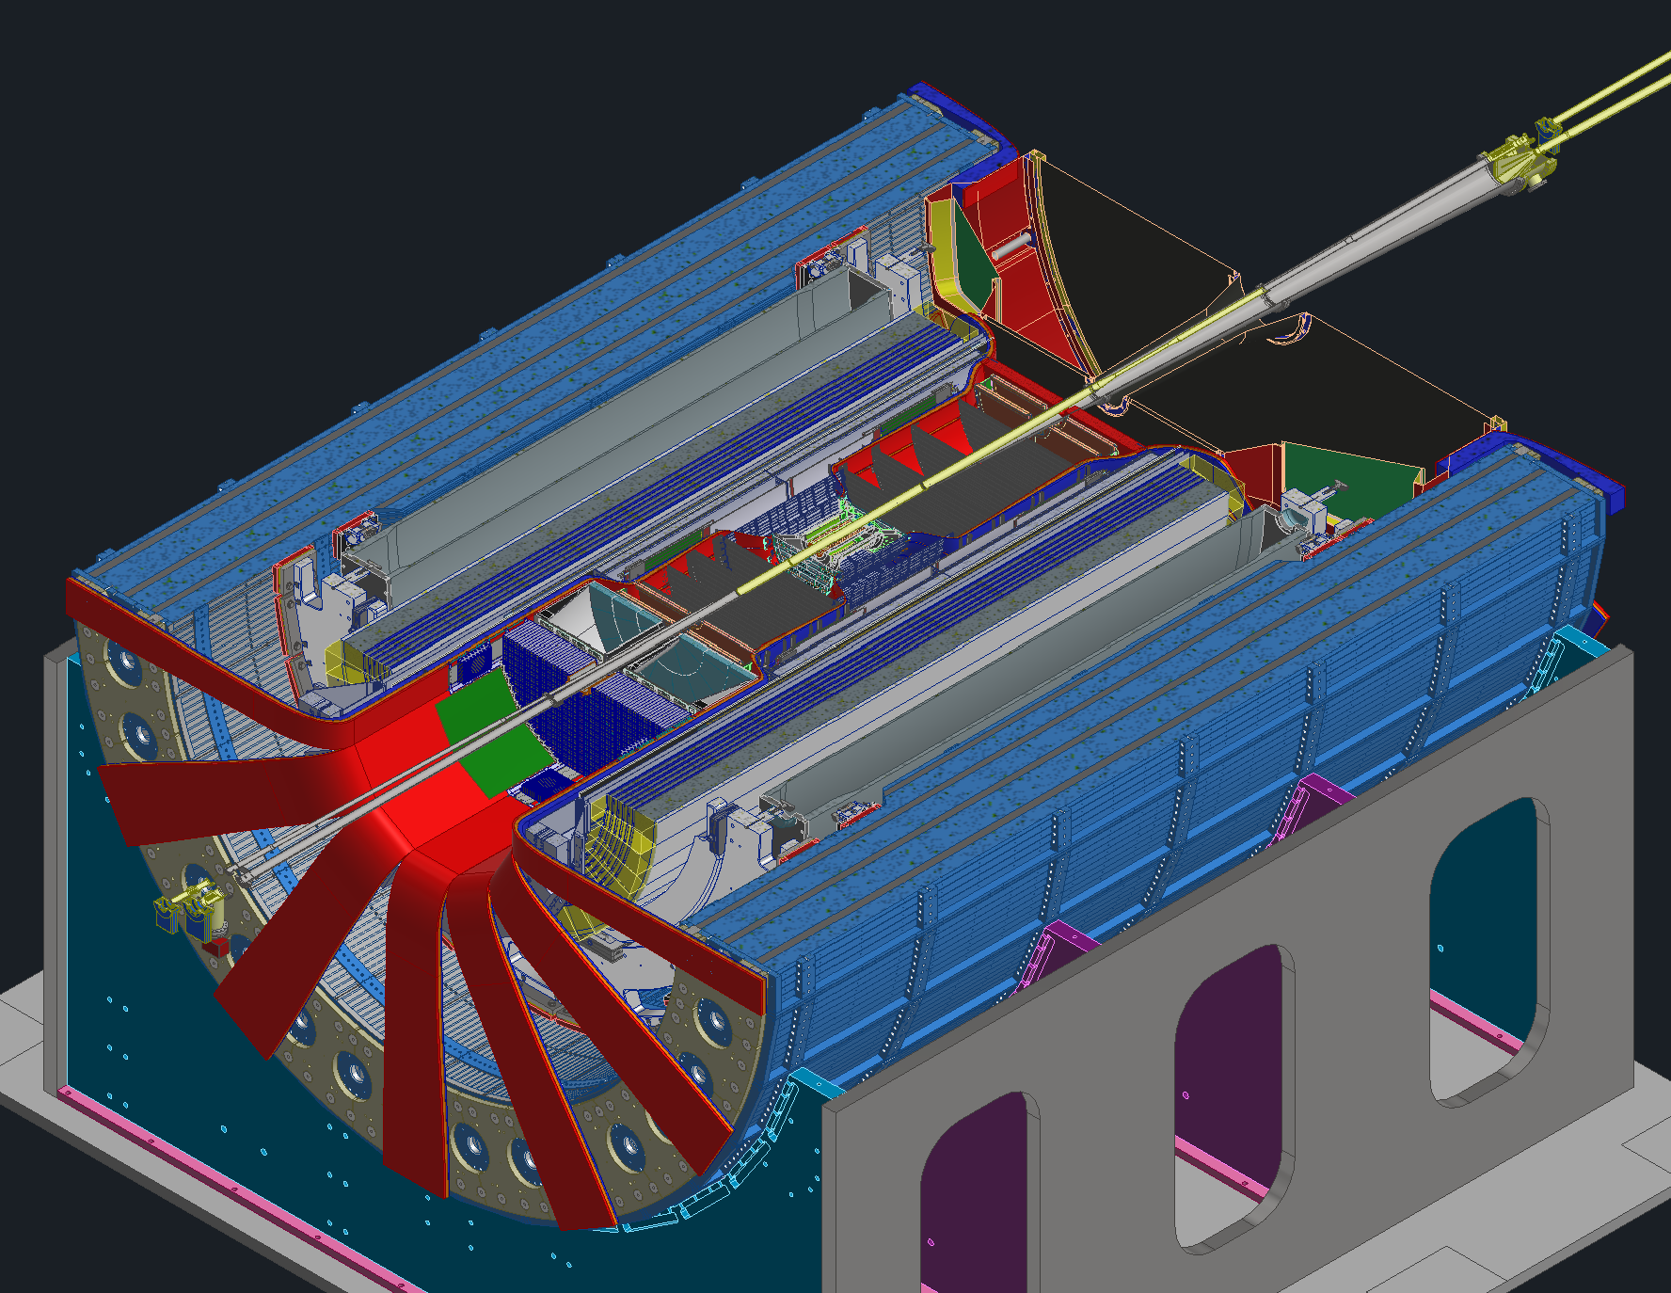
Services
Services are an issue in current design.
We will need even more room radially for services as we are making slidable cable trays.
112%
92%
89%

Slide 10
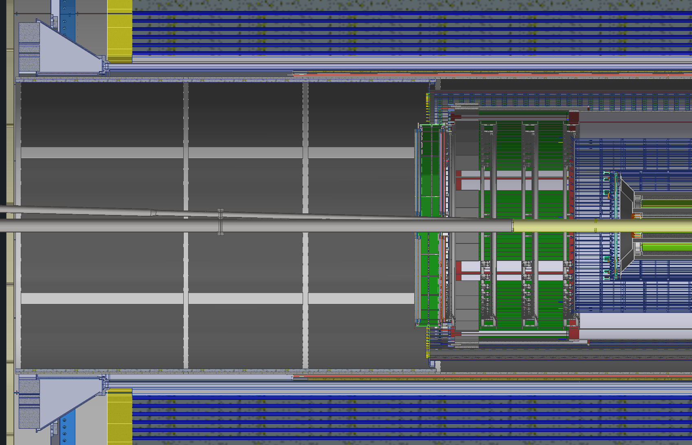
Concerns for removal of Backward MPGD and Si Disks
To Remove all the services a technician will have to get in the GST where radial clearance from beam pipe is 2 feet.
In weird orientations (laying on back or other awkward positions), technician will have to remove around 2000 connections for SVT disks and 200 connections for MPGD disks and dress them properly.
The installation rails mechanism will also have to be installed and aligned working in that awkward space which may be a challenge as well.
In nutshell, it all needs to be prototyped and tested if all of it works or not prior to making any commitments.
Forward side is a lot easier and does not have any of the above listed issues.
Flange
198cm
78in
GST Inner Diameter 142cm
56in
Beampipe Diameter ~15cm ~6in
pfRICH Diameter
130cm
51in

Slide 11
Summary
Forward Detectors (MPGD Disk, TOF Disk and Si Disks), Cymbal and Barrel TOF can be made serviceable.
Backward Detectors can be made serviceable either with large clearances around the beampipe to clear the flanges.
To make Backward detectors serviceable with smaller clearances around the beampipe, alot of prototyping and mockup installation is needed.

