Slide 1
Far-Forward / Far-Backward
Detector Integration
Jonathan Smith (JLAB), Ron Lassiter (JLAB),
India Krehbiel (JLab), David Powell (JLAB)
May 12th, 2025

Slide 2
Primary Updates Outline
Far-Forward Region
  B0 Beampipe
  B0 Detector Layout/Position
  ZDC Updates
Far-Backward Region
  17cm downstream impact
  Low Q2 Tagger Station Cooling
Upcoming Updates
B0 3D Model
New – B0 Platform Side Study

Slide 3
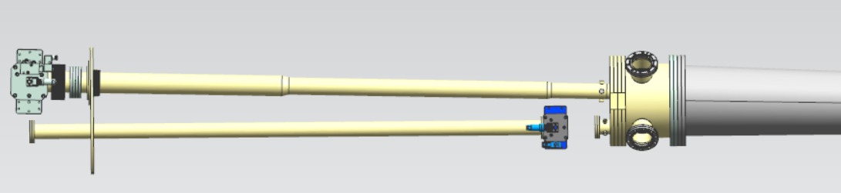
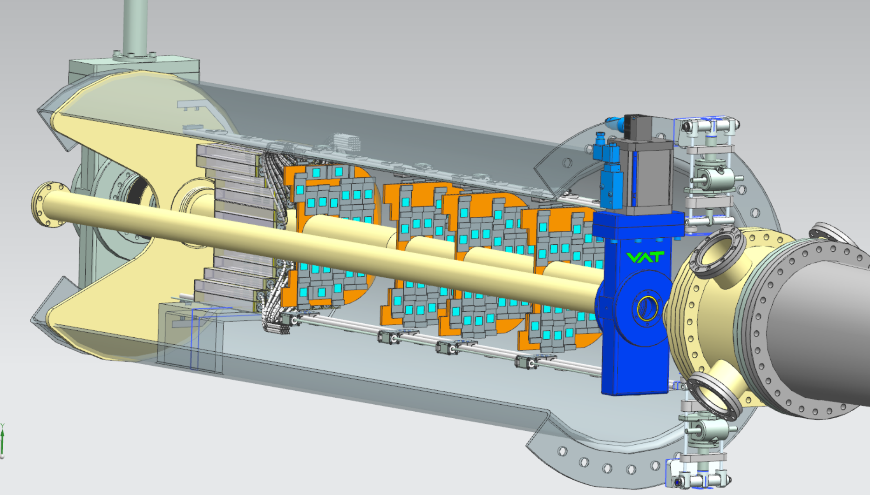
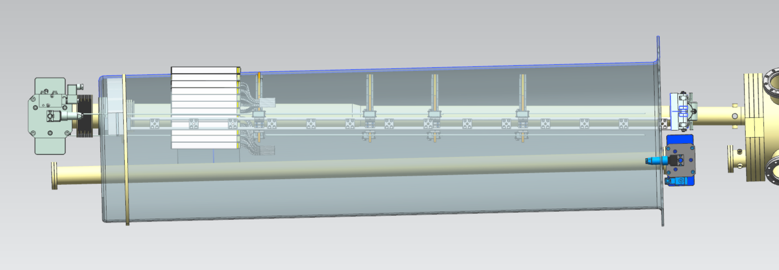
B0 Beampipe

Slide 4
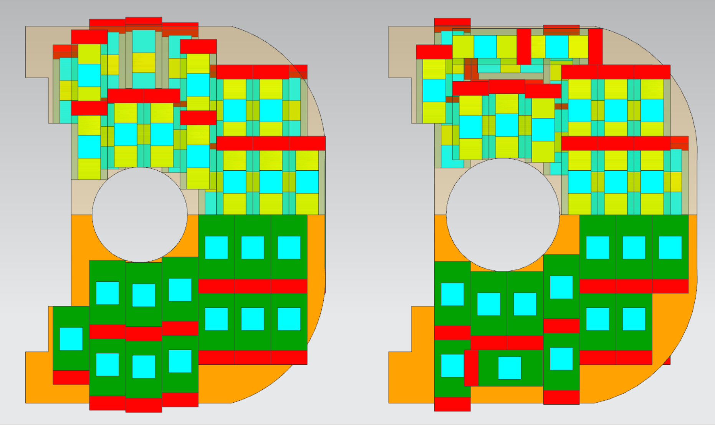
B0 Detector Layouts
Stave detectors are similar to current detectors used for Roman Pots
Staves consist of (3) Sensors per stave (1:2). In addition, Staves are secured on both sides of [Orange] mounting/cooling plane.
Current stave design is too large to be placed on inner-most position of beampipe (Highlighted in MANGETA)
  Yulia will arrange a discussion with Magnet Group to potentially update B0 to allow for additional space in this area
63.50mm Diameter Beampipe
76.20mm Diameter Beampipe

Slide 5
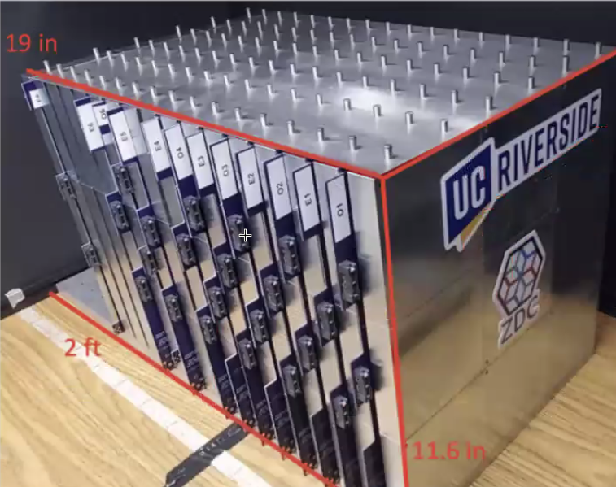
ZDC Updates
Updates on ZDC
Arrangement of Readout Boards are being rotated to come out the top of the ZDC HCAL
Previous design of Readout boards consist of (2) horizontal boards placed between each layer. Updated arrangement consists of (3) vertical boards with ‘staggered’ connector pin locations
(2) Additional readout layers in front of EMCAL
(1) Additional readout layer in the back of HCAL
Recent 80/20 ‘Black Box’ frame will be updated to include mounting hardware to accommodate additional layers

Slide 6
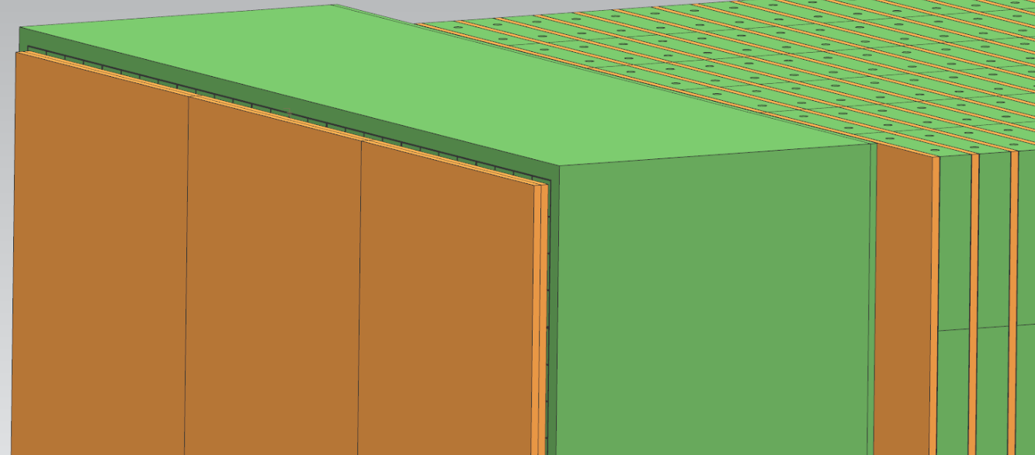
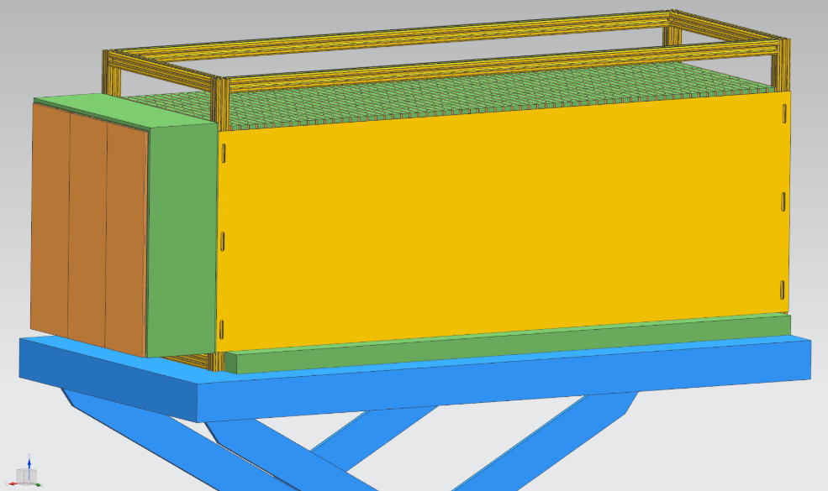
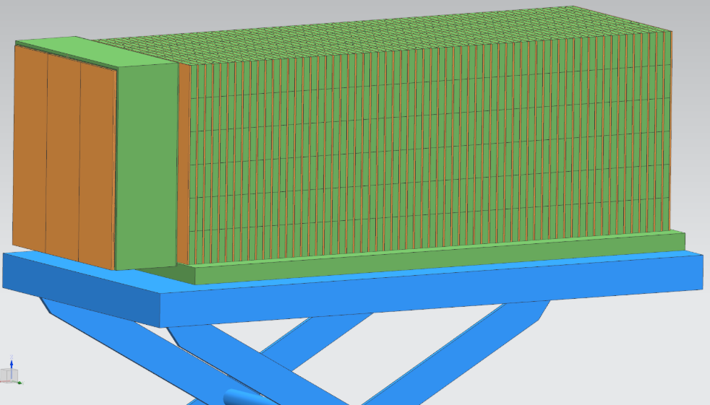
ZDC Updates
NOTE – Work in progress

Slide 7
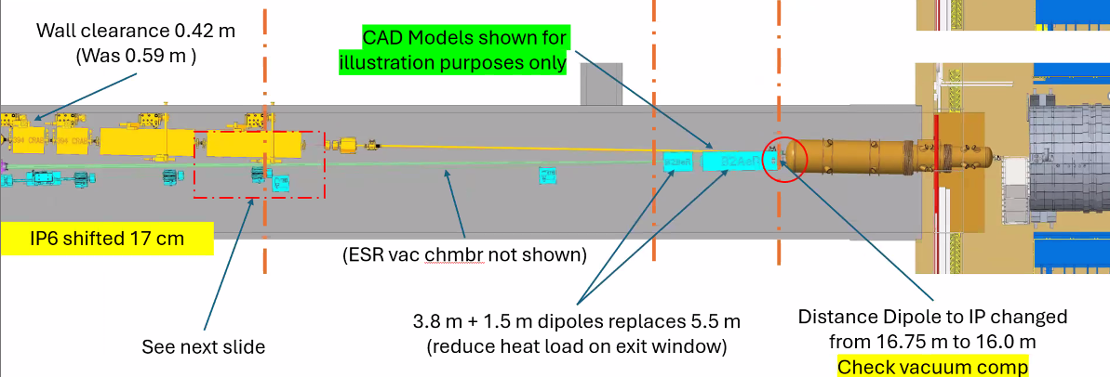
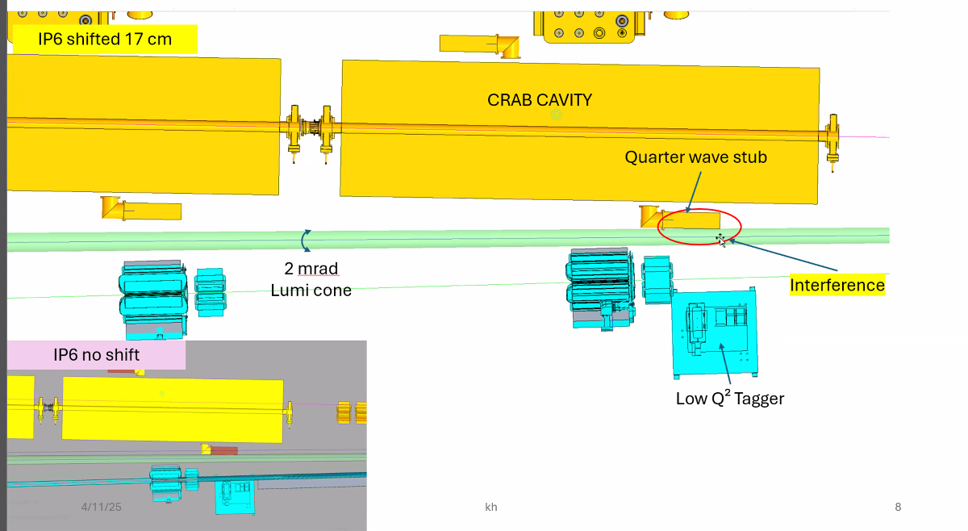
Far-Backwards IP6 17cm Shift
With the 17cm shift, the position of the Lumi system will need to be repositioned. Current Lumi-line has an interference with the Quarter Wave Stub on a nearby CRAB Cavity (circled below)
Position of the B2ER updated from one singular magnet into two separate magnets to allowing for cooling.
Position of the Low Q2 Tagger Stations are also being reviewed and may be repositioned to suit.
Credit – Karim Hamdi

Slide 8

Low Q2 Tagger Station Update
Minor update – A cooling method has been sourced for the Low Q2 Tagger detectors (cutsheet provided).

Slide 9
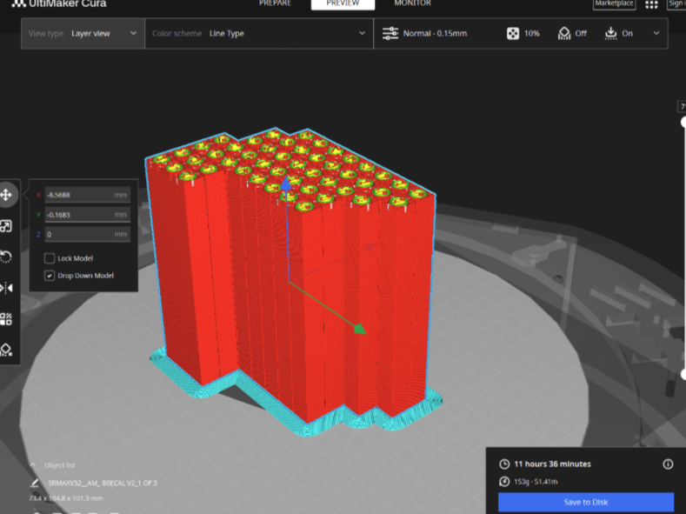
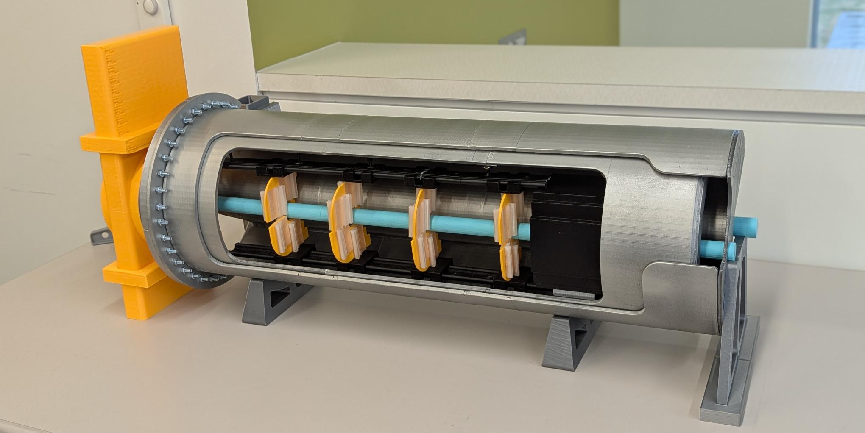
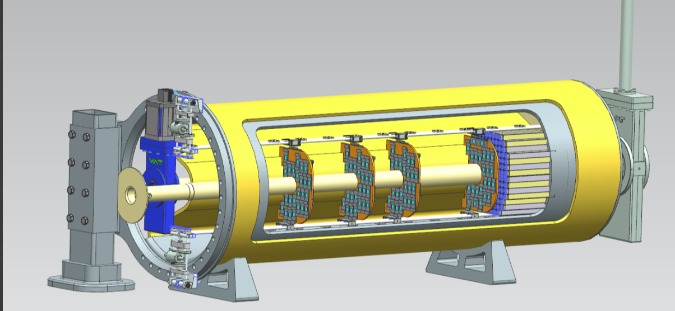
B0 3D Print Model Updating
With the latest updates to the beampipe, calorimeter, valve, and detector layer locations we are updating our onsite 3D Printed model to reflect the changes

Slide 10
Upcoming Updates
Continued progress on the ZDC Arrangement
Cost estimate for the ZDC
Continued updates on the cabling for B0 Detector System
B0 Detector Removal/Install adjustments for latest beampipe

Slide 11
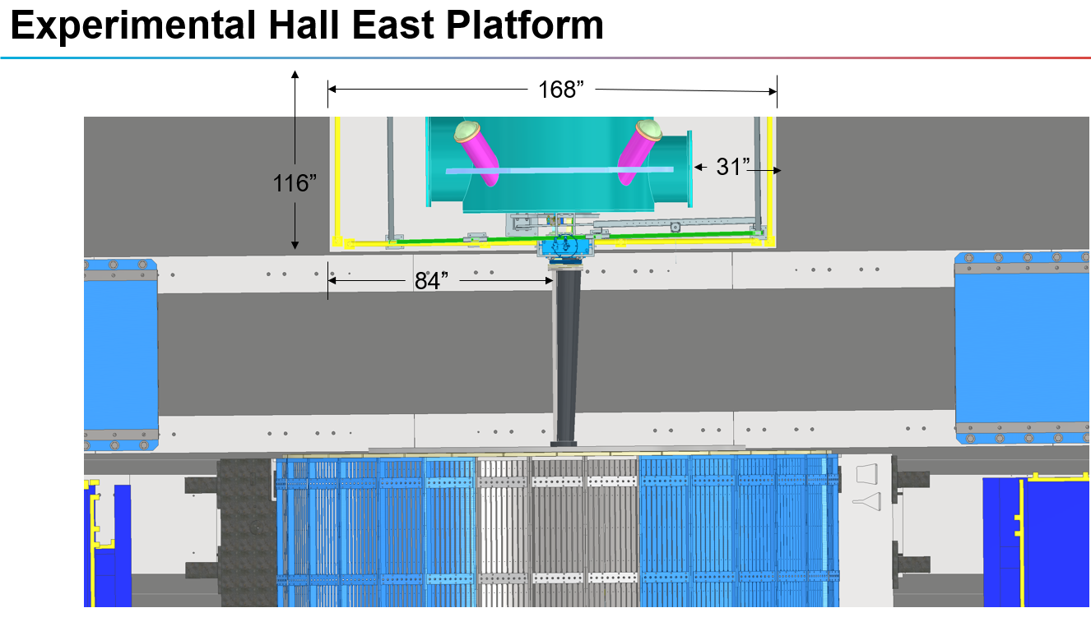
B0 Platform Side Study
With the request of additional space on the ‘Right-Hand’ side of the B0 operating space, we’re investigating the impacts of alternative solutions which include:
  Alternating the B0 Detector Tooling operation location to the opposite (left-hand) side of the B0 Magnet
  Identifying space requirements necessary for the B0 Detector Tooling and Maintenance volume
  Investigating third party mobile platform solutions
Picture Courtesy – John Tuozzollo

Slide 12
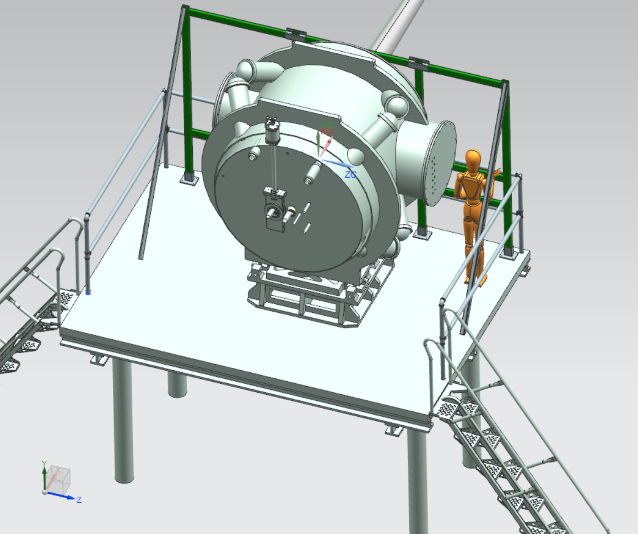
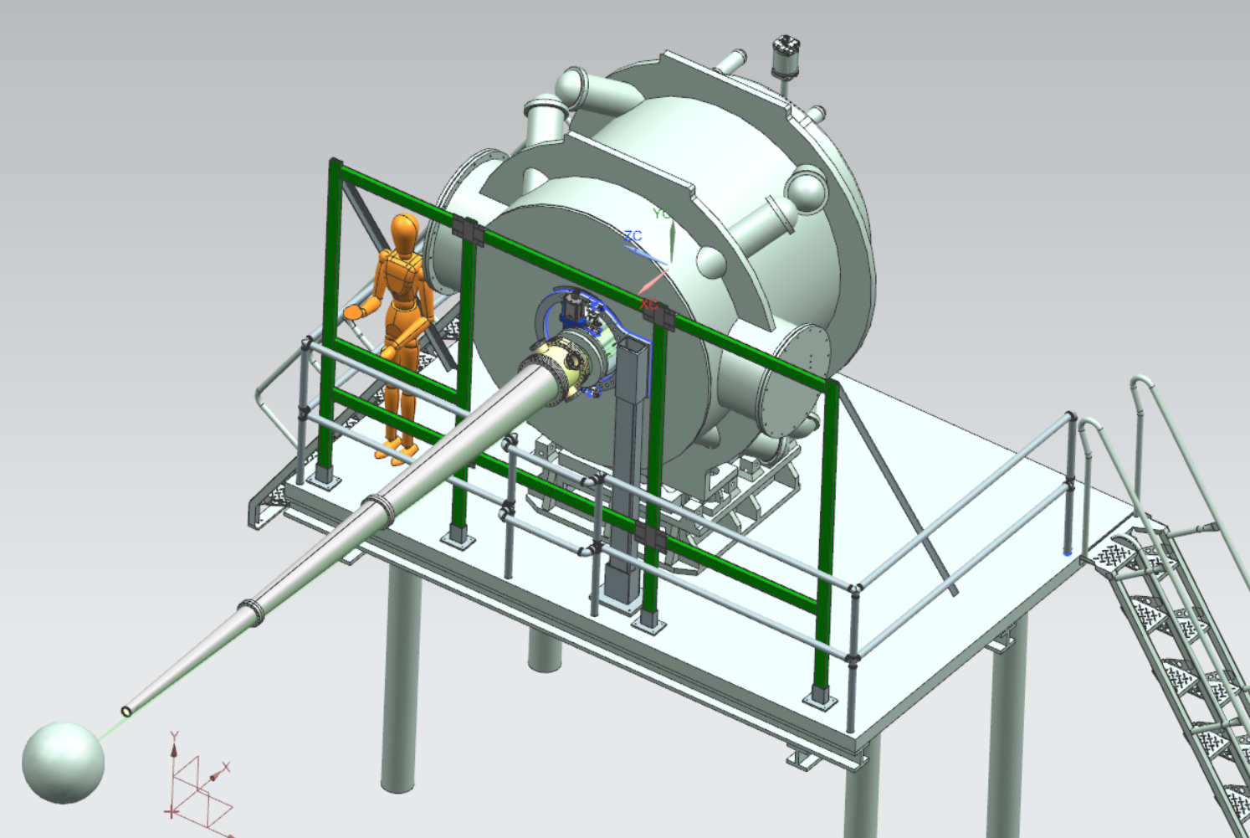
B0 Platform Side Study

Slide 13
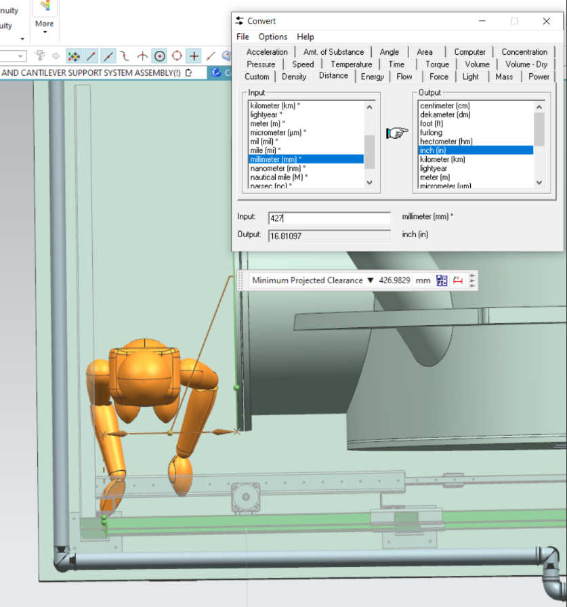
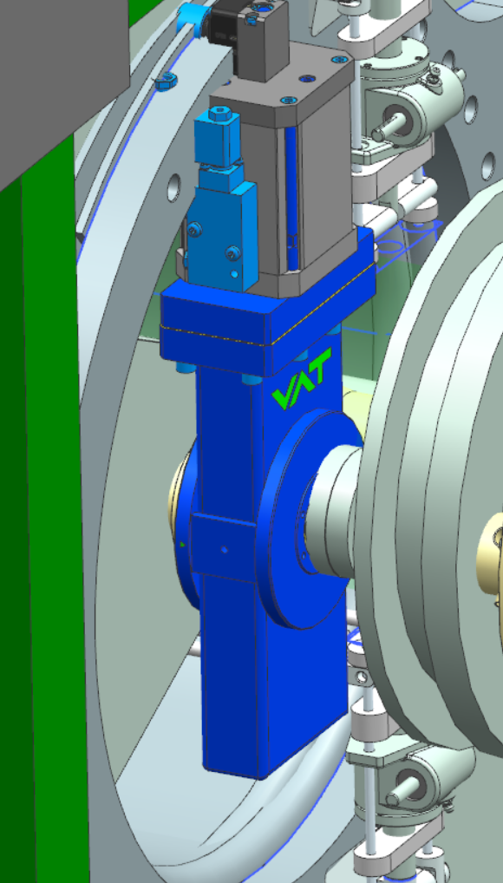
B0 Platform Side Study
Current estimate space volume to operate on opposite side of B0 is approximately 16”. May be able to increase the space to ~20” if modifying the tooling support frame to also act as safety railing.
Current model of B0 does not include the leads on the side faces of the magnet
Outside Tooling will need to navigate around updated beampipe valve
Investigation is ongoing…

