Slide 1
BIC Update
Triple I Engineering Meeting Update
Kevin Bailey
May 19, 2025

Slide 2
Swager
Adjustments and Testing
Using old GlueX lead
New lead delivery expected
Adjustment in 10’s of microns is tedious but working
Need full width lead to confirm our adjustments are correct
Test Press
- Developing techniques using old lead and inexpensive fibers
- Inexpensive fibers need to be straightened

Slide 3
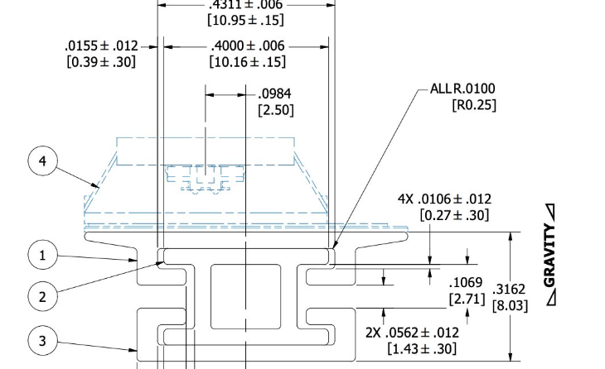
Detector Views – Astropix Update
*Preliminary Stave Design!
110” long Al parts
OLD DESIGN
Parts have arrived at Argonne
Prototype parts are due any day

Slide 4
Status / Updates
Preliminary stave/rail parts due
Test Article Pb has been delivered
Swager adjusted and working
Assembly techniques using Test Press making progress
Production at Argonne space being prepared

