Slide 1
Agenda
(https://indico.bnl.gov/conferenceDisplay.py?confId=2803)
Cable Jacket (TEFZEL …) to wrap non-thermal wires ?
  Piyush/Sonny can use Kapton/TEFZEL. But probably Kapton is too difficult to work with other signals connected with D-connectors
Voltage tap locations (Paul Giannotti)
Schedule update
  P. Rosas’ crew still haven’t started working on power supply again. Probably he’ll get back to sPHENIX next week or the week after …
  C. Schultheiss suddenly has had a RHIC “crisis” and is not able to report today and spend much time in the sPHENIX Magnet project.
  When will FSU deliver the brackets (at least 4 at the bottom) ?
Working on the project file and dictionary files for 5 WBS branches.
AOB

Slide 2
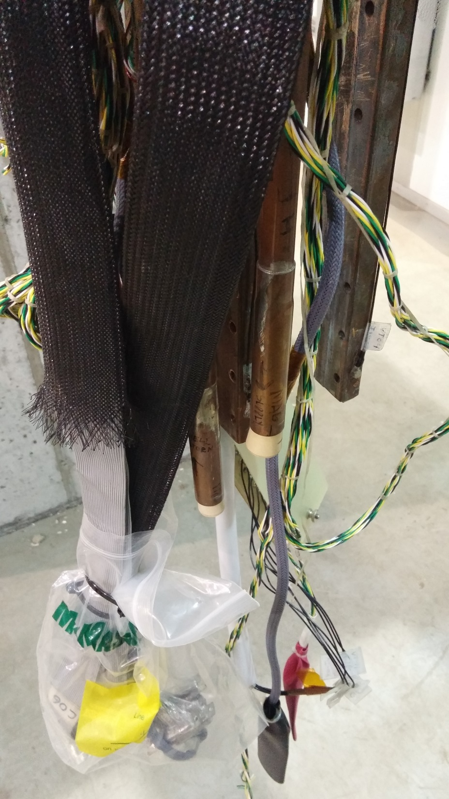
Teflon for thermal sensors
Legacy flat ribbon, also PVC

Slide 3
Changed from
WBS 1.8.2 Engineering & Design
  Mechanical …
  Cryo …
  Power Supply/Quench Protection …
  Magnetic Measurement …
WBS 1.8.3 Fabrication
  Mechanical …
  Cryo …
  Power Supply/Quench Protection …
  Magnetic Measurement …
WBS 1.8.4 Installation & Testing
  Mechanical …
  Cryo …
  Power Supply/Quench Protection …
  Magnetic Measurement …

Slide 4
To
1.9 SC- Magnet
for CD1
1.9 SC-Magnet
1.9.1 Project Management
1.9.2 Mechanical
1.9.3 Cryogenic Systems
1.9.4 Power Supply
1.9.5 Magnet Measurements
WBS 1.9.3.1 RHIC Lines S/R/H/U-Line Taps and Valvebox
WBS 1.9.3.3 LN2 Cooling System
WBS 1.9.3.4 Coldbox with Heatexchangers, Valve Box Upgrade, 500L Dewar
WBS 1.9.3.5 Cryo Controls –Hardware/Software
WBS 1.9.3.2 Helium Transfer Line Bundle System
WBS 1.9.4.1 AC/DC Power Distribution
WBS 1.9.4.2 Power Supply
WBS 1.9.4.3 Quench Detection and Dump Resistor
Level 2 Manager
WBS Level 2
WBS Level 3
Level 3 Manager
CAM
Control Accounts
And Reporting
WBS Level 4 – Work Packages
Proposed DOE Reporting Levels (Control Accounts)

