Slide 1
Cryogenic Readout Electronics Systems for
Liquid Argon TPCs in Neutrino Experiments
Shanshan Gao
10/17/2023

Slide 2
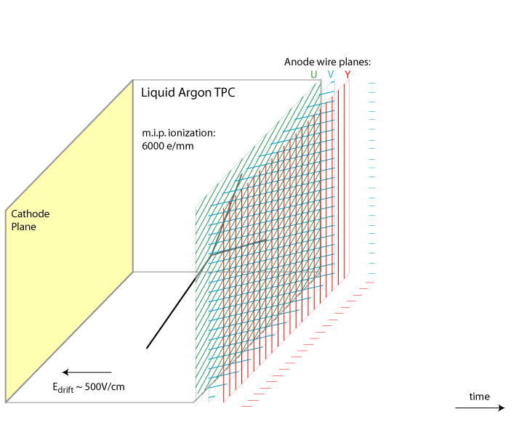
Liquid Argon TPC
Charged particles passing through detector ionize the argon atoms, and the ionization electrons drift in the electric field to the anode wall on a timescale of milliseconds. The anode consists of layers of active wires forming a grid.
time
3 Wire Plane readout with Excellent Space and Energy resolution
3D-imaging: full event topology reconstruction
Higher sensitivity to neutrino physics and for some of the proton decay channels (e.g. p → K𝛎)

Slide 3
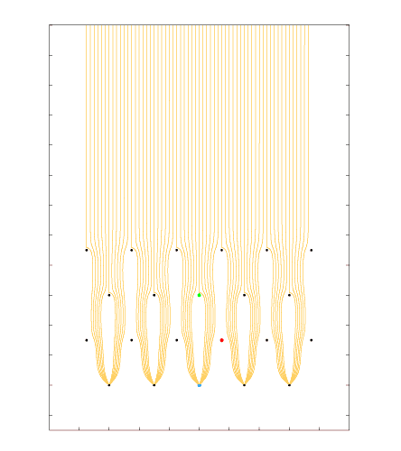
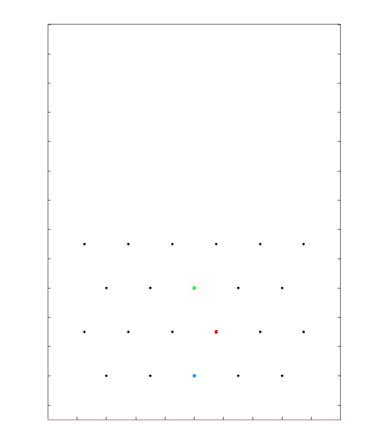
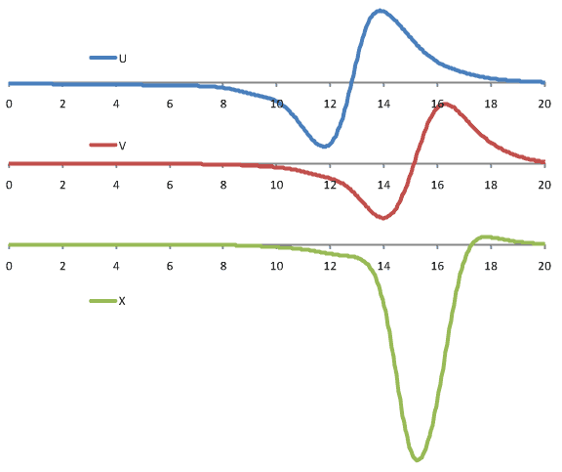
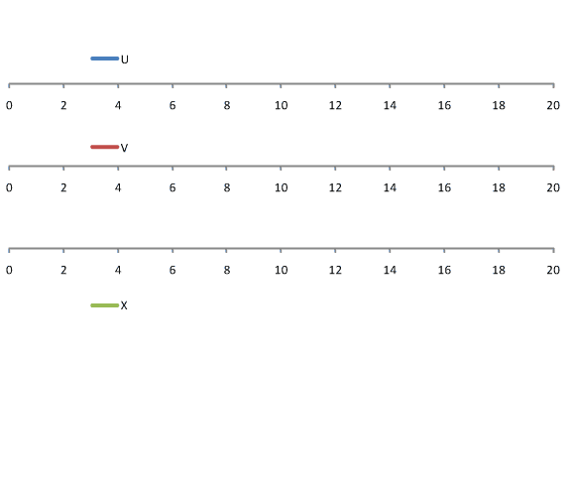
Signal Formation:
Induced Signals from a Track Segment
Grid
U
V
[µs]
X
Charge signal is very small due to there is no electron amplification inside Lar.
DUNE style wire arrangement: 3 instrumented wire planes + 1 grid plane
Raw current waveforms convolved with a 0.5µs gaussian to mimic diffusion

Slide 4

Performance as ASIC is submerged in LN₂

Slide 5

NP04 (ProtoDUNE-SP) CERN Beam Test

Slide 6
