Slide 1






The Evolution of Nuclear Detectors
Alexander Ngo
Prairie View A&M

Slide 2
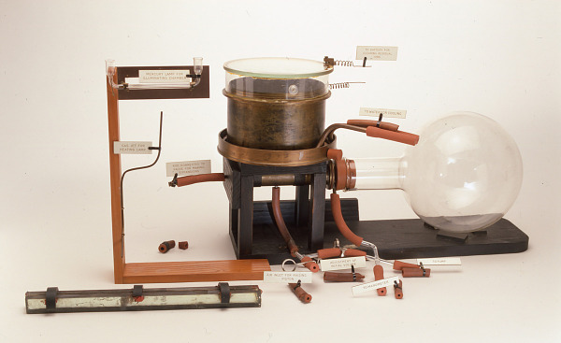
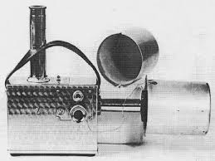
Early Beginnings (1900s-1930s)
Wilson Cloud Chamber
Inventor: Charles Wilson, 1911
Materials: Alcohol vapor, supersaturated environment, sealed container, dry ice or cooling system.
How it works: Vapor in a sealed chamber condenses along the paths of ionizing radiation, making tracks visible.
Cost (est.): ~$500–$2,000 (modern educational versions)
Power usage: Minimal; dry ice or Peltier coolers
Experiment examples: Observing alpha/beta particle tracks, cosmic ray trails
Geiger-Muller Counter
Inventors: Hans Geiger and Walther Müller, 1928
Materials: Metal tube, low-pressure gas (argon, neon), thin mica window, central wire anode
How it works: Detects ionizing radiation via gas ionization inside a metal tube, producing electric pulses.
Cost (est.): ~$100–$1,000 (modern)
Power usage: ~1–5W
Experiment examples: Background radiation surveys, radioactive decay detection

Slide 3
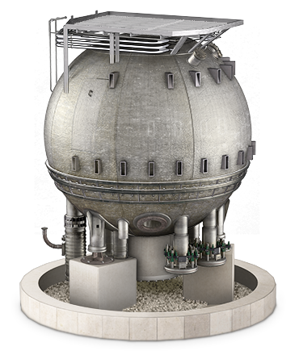
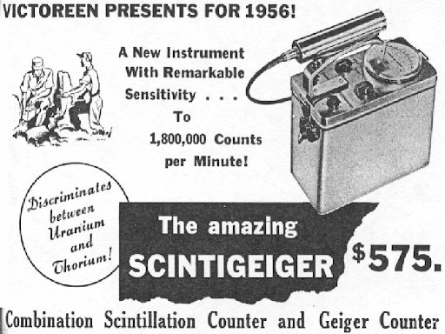
Mid-20th Century Advances (1940s-1960s)
Bubble Chamber
Invented by Donald Glaser, 1952
Materials: Liquid hydrogen/neon, large containment vessel, cameras, magnetic fields
How it works: Superheated liquid forms bubbles along ionizing tracks when particles pass through.
Cost (est.): $5M–$15M depending on size
Power usage: High; cryogenics, camera arrays, magnet systems
Experiment examples: Neutrino detection at Fermilab; pion-proton interactions
Scintillation Detector
Inventors: Work by researchers at MIT, Los Alamos, and Philips in the 1940s–1950s
Materials: NaI(Tl) crystals, plastic scintillators, photomultipliers
How it works: Incoming radiation excites scintillating material which emits light; photomultiplier tubes convert light into an electrical signal.
Cost (est.): $2,000–$50,000
Power usage: ~20–100W
Experiment examples: Radiation dosimetry, gamma spectroscopy, Manhattan Project applications

Slide 4
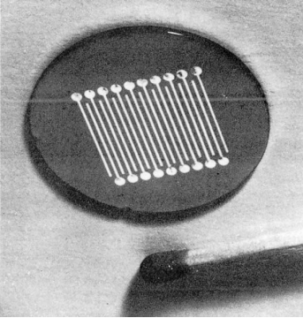
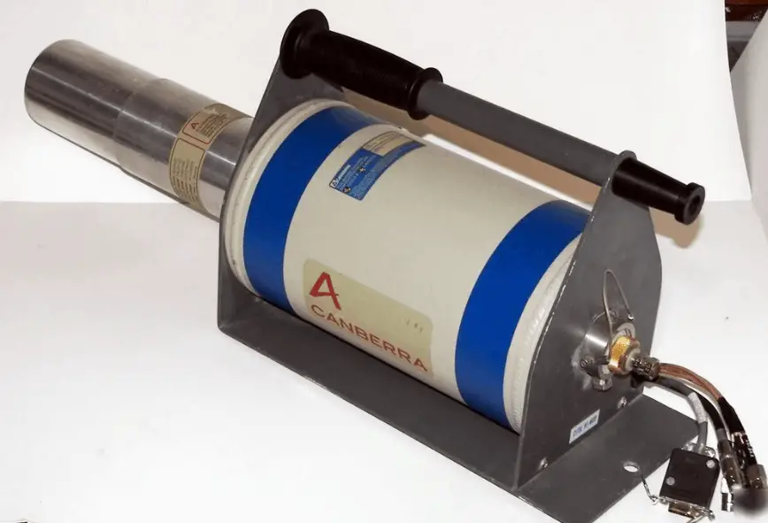
Solid-State Detectors Rise (1970s-1990s)
Silicon Strip Detector
Developer: CERN, SLAC, and other labs
Materials: High-resistivity silicon, metal contacts, readout electronics
How it works: Tracks particles via charge collected in silicon diodes segmented into strips.
Cost (est.): ~$50,000–$500,000/module
Power usage: ~10–50W/module
Experiment examples: LEP (Large Electron–Positron Collider), RHIC (Brookhaven)
High-Putirty Germanium Detector
Developers: ORTEC, Canberra, and national labs
Materials: HPGe crystal, vacuum cryostat, cooling system (liquid nitrogen or electric)
How it works: Detects gamma rays via ionization in ultra-pure germanium at cryogenic temperatures.
Cost (est.): $40,000–$150,000
Power usage: ~500W (with cryo system)
Experiment examples: Neutrino-less double beta decay (GERDA), environmental monitoring

Slide 5
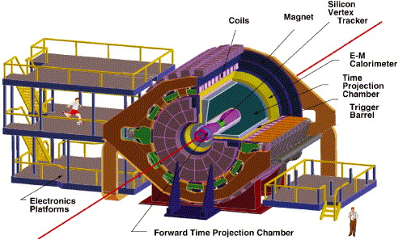
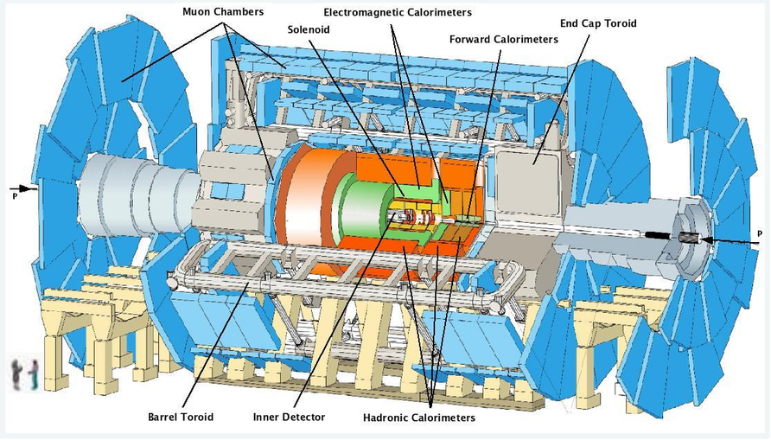
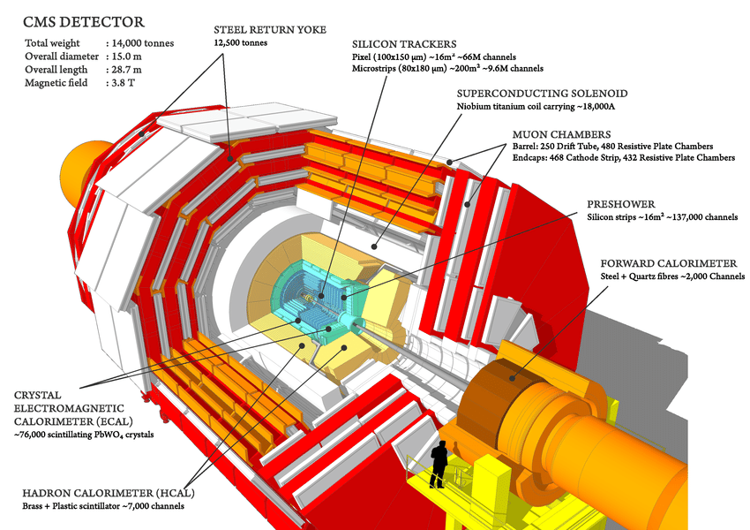
Large-Scale Detector Systems (2000s-Present)
ATLAS & CMS Detectors
Developers: International collaborations (3,000+ scientists), led by CERN
Materials: Silicon pixel detectors, liquid argon calorimeters, superconducting magnets
How they work: Combine layers of tracking, calorimetry, and muon detection to reconstruct high-energy collisions.
Cost (est.): ~$1B each (build phase)
Power usage: ~3–7 MW each
Experiment examples: Higgs boson discovery (2012), supersymmetry searches
STAR Detector (RHIC)
Developer: Brookhaven National Lab, STAR collaboration
Materials: Gas chamber, electric fields, readout pads
How it works: Time Projection Chamber (TPC) measures charged particle paths and energy loss in heavy ion collisions
Cost (est.): ~$100M (phased upgrades)
Power usage: ~500 kW–1 MW
Experiment examples: Quark-gluon plasma studies, gold ion collisions

Slide 6
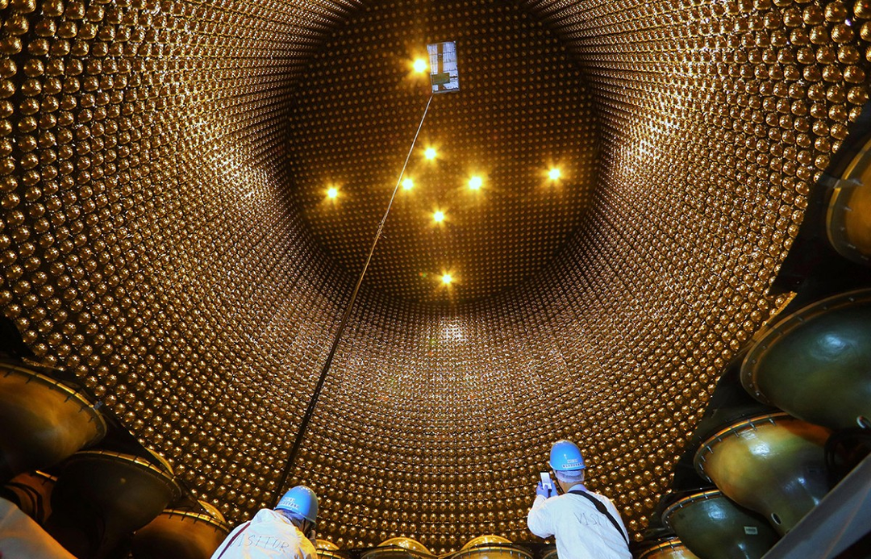
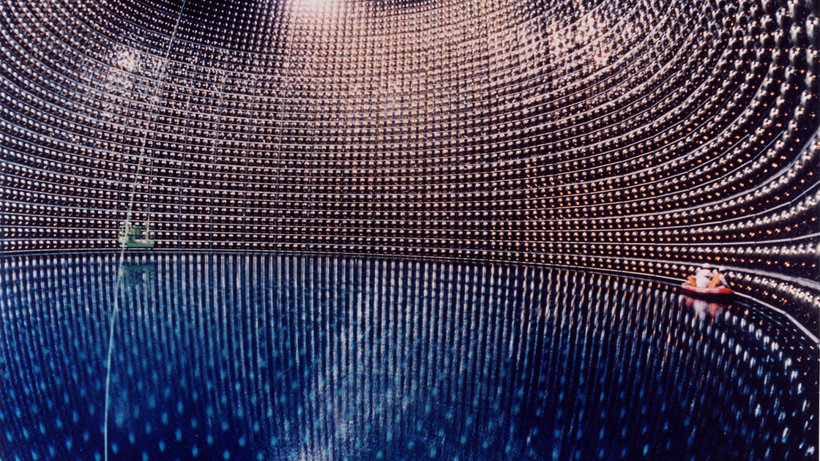
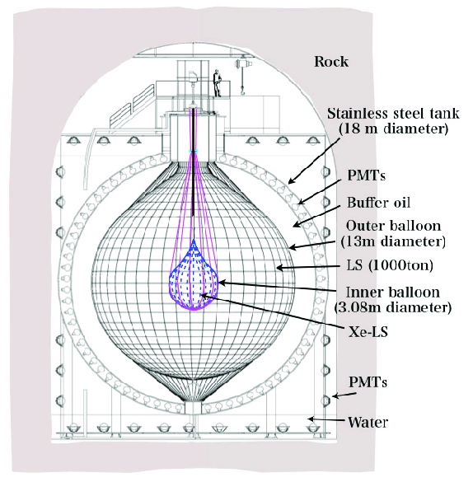
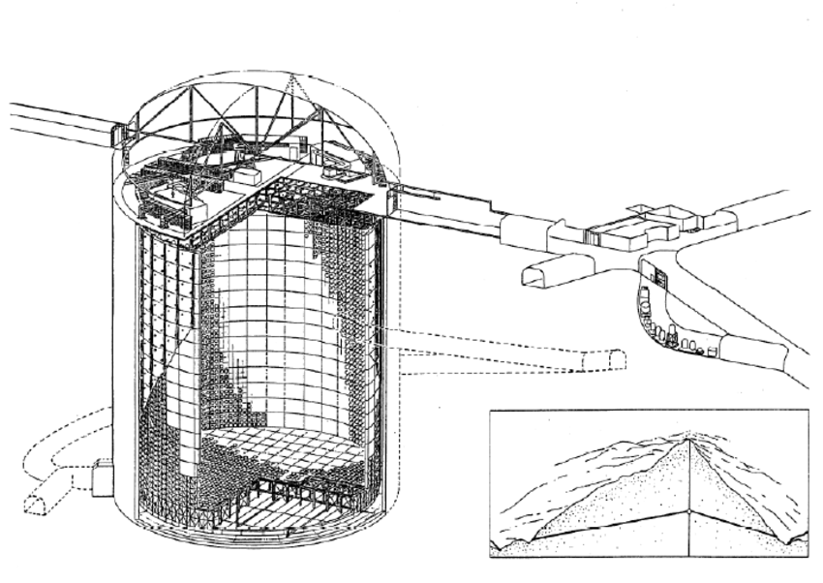
Specialized Global Detectors
KamLAND
Developers: Japanese/US collaboration
Materials: 1,000 tons of liquid scintillator, photomultiplier array
How it works: Detects neutrinos via inverse beta decay in a large liquid scintillator tank
Cost (est.): ~$15M
Power usage: Moderate (~100 kW)
Experiment examples: Reactor neutrino oscillation
Super-Kamiokande
Developer: University of Tokyo and KEK
Materials: 50,000-ton water tank, 11,000+ PMTs
How it works: Detects Cherenkov radiation from neutrino interactions in water
Cost (est.): ~$100M
Power usage: ~500–750 kW
Experiment examples: Solar and atmospheric neutrino detection, proton decay searches

Slide 7
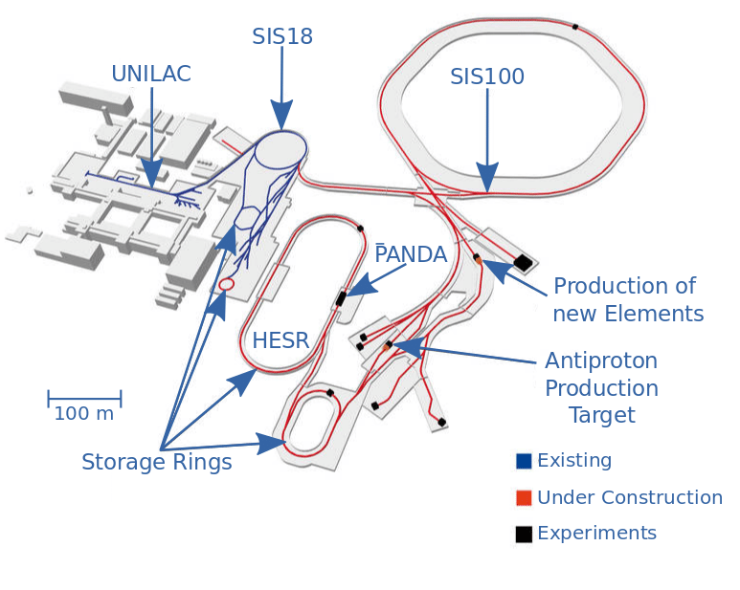
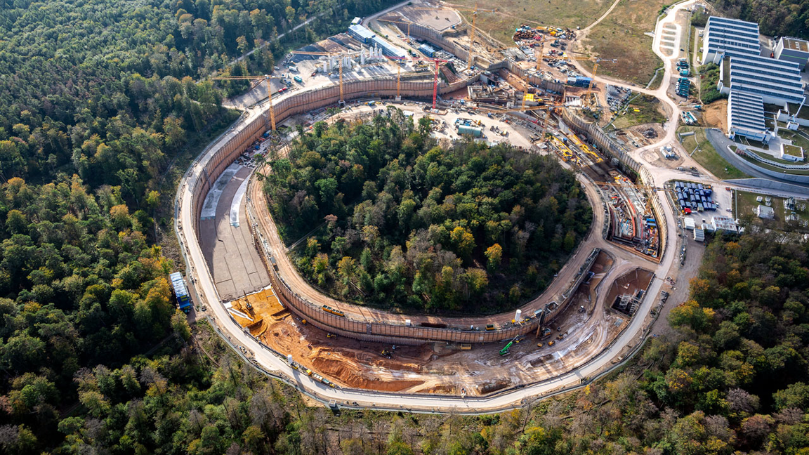
Specialized Global Detectors (Continued)
FAIR (Facility for Antiproton and Ion Research)
Status: Under construction (Germany)
Use: Heavy-ion collisions and exotic nuclei studies
Estimated cost: €3B (entire complex)
Power usage: High (est. several MW)
Planned experiments: CBM, PANDA, NUSTAR

Slide 8
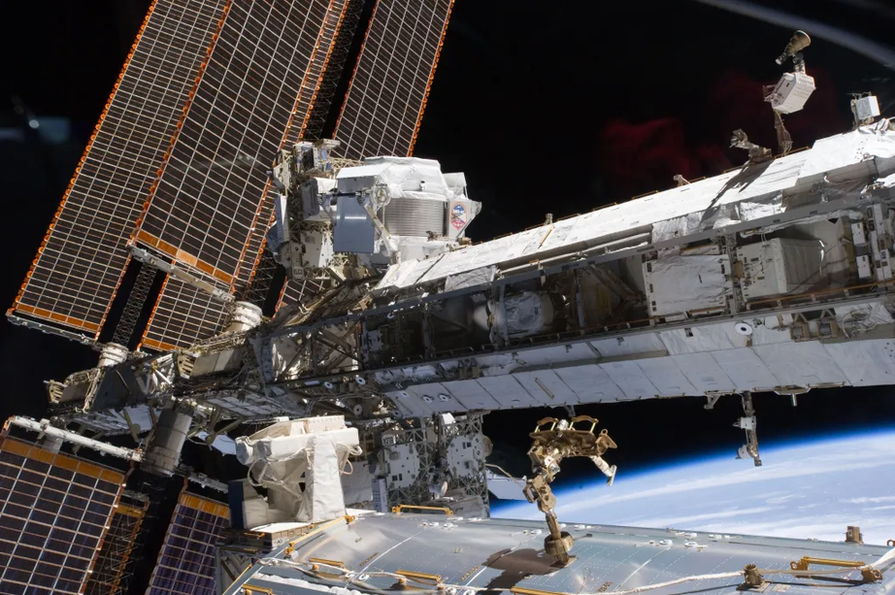
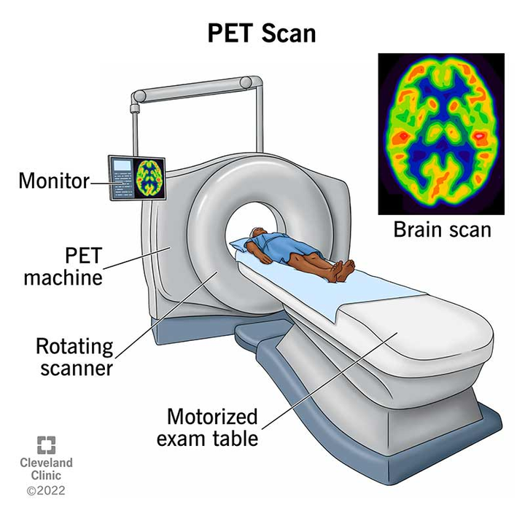
Detectors in Space & Medical Applications
AMS-02 (Alpha Magnetic Spectrometer)
Developer: CERN and international teams; installed on ISS in 2011
Materials: Silicon trackers, permanent magnet, RICH detector, transition radiation detector, ECAL.
How it works: Measures cosmic rays with silicon trackers, transition radiation detectors, and magnet spectrometers
Cost (est.): ~$2B
Power usage: ~2.5 kW
Experiment examples: Dark matter searches, cosmic antimatter studies
PET Scanners
Developers: Siemens, GE, Philips, national research hospitals
Materials: Scintillation crystals (e.g., LSO), photodetectors
How they work: Detect gamma photons from positron annihilation in medical imaging
Cost (est.): ~$1M–$3M/unit
Power usage: ~1–3 kW
Applications: Oncology, neurology, cardiology imaging

Slide 9
The Current & Future of Nuclear Detectors
Quantum Sensors
Developers: NIST, Harvard, D-Wave, NASA QDIT
Materials: Trapped ions, NV centers in diamond, ultracold atoms
How they work: Use quantum states (e.g., superposition) to detect minuscule field or radiation changes
Cost (est.): Experimental; tens of millions in R&D
Power usage: Varies (low for sensors, high for cryogenics)
Experiment examples: Gravitational wave follow-ups, dark matter detectors
AI/ML in Detection
Use: Pattern recognition, real-time data filtering, noise suppression
Example: LHCb’s real-time trigger system upgrade
Emerging Ideas:
Space-based arrays for cosmic ray studies
Perovskite-based sensors for flexible, low-cost detection
Modular AI-driven detectors for planetary missions
Quantum-enhanced PET scanners
Predicted Costs:
Highly variable; research stage to $100M+ for deployment
Power Sources:
Solar power, nuclear RTGs, advanced batteries
Planned Experiments:
Lunar/planetary surface radiation analysis, long-baseline neutrino detection (DUNE)

Slide 10
Work Cited
https://www.physics.wisc.edu/outreach/wonders-of-physics-outreach-fellows/activities/wilson-cloud-chamber/
https://americanhistory.si.edu/collections/object/nmah_700205
https://www.livescience.com/how-a-geiger-counter-works.html
http://national-radiation-instrument-catalog.com/new_page_144.htm
https://senate.universityofcalifornia.edu/_files/inmemoriam/html/DonaldArthurGlaser.html
http://national-radiation-instrument-catalog.com/historical_ads.htm
https://www.psi.ch/sites/default/files/import/lmu/DevPsdEN/history_Si_pixel_detect.pdf
https://www.nuclear-power.com/nuclear-engineering/radiation-detection/semiconductor-detectors/high-purity-germanium-detectors-hpge/
https://sites.uci.edu/energyobserver/2012/11/26/introduction-to-the-atlas-detector-at-the-lhc/
https://www.researchgate.net/figure/Schematic-overview-of-ATLAS-and-CMS-detectors_fig1_256423227
https://www.sciencedirect.com/science/article/pii/S0168900202019605
https://www.researchgate.net/figure/KamLAND-Zen-detector-In-the-center-of-the-detector-there-is-the-inner-balloon-IB_fig1_319948177
https://www.researchgate.net/figure/Schematic-view-of-the-Super-Kamiokande-50-kiloton-water-Cherenkov-detector-in-Japan_fig3_45863929
https://www.nature.com/articles/d41586-024-02221-y
https://www.symmetrymagazine.org/article/july-2015/underground-plans?language_content_entity=und
https://www.researchgate.net/figure/The-Facility-for-Antiproton-and-Ion-Research-FAIR-at-the-GSI-Helmholtzzentrum-fuer_fig1_346656100
https://www.science.org/content/article/wanted-1-billion-troubled-german-nuclear-physics-facility
https://www.nasa.gov/alpha-magnetic-spectrometer/
https://www.iaea.org/newscenter/news/advancing-radiation-detection-instruments-for-nuclear-security

