Slide 1
The Role of Data Acquisition and Software in Particle Physics
Asher Tariq • NuSTEAM 2025

Slide 2
Powering Discovery
Particle physics experiments produce vast amounts of data from high-speed collisions or rare interactions.
Data acquisition (DAQ) and software frameworks are critical for recording, processing, and analyzing this data.
Without robust DAQ and software, discoveries would be buried in noise or missed entirely.
This presentation explores how STAR and neutrino experiments use these tools to fuel breakthroughs.

Slide 3
What is Data Acquisition?
Converts detector signals into digital data for analysis, ensuring high speed and integrity
Combines hardware (triggers, digitizers) and software (event builders, filters)
Powers real-time experiments like STAR at RHIC and neutrino observatories

Slide 4

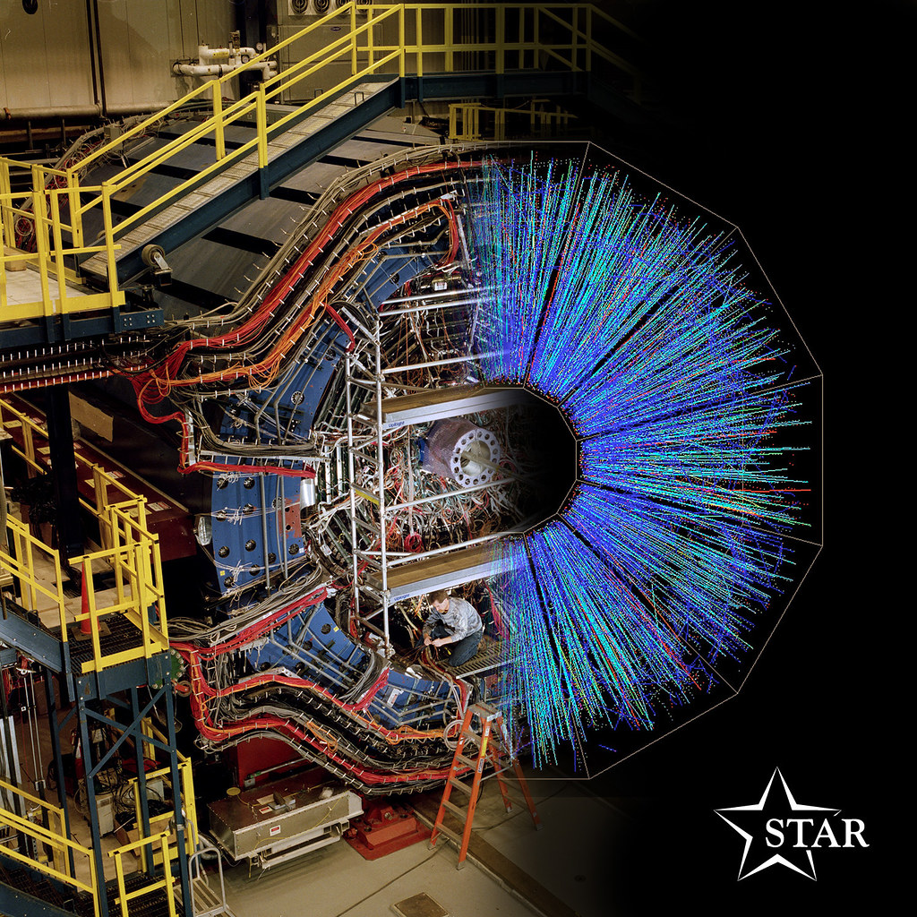
STAR's DAQ System
STAR uses a high-speed DAQ system to capture signals from detectors like the Time Projection Chamber (TPC) and small-strip Thin Gap Chamber (sTGC).
The High-Level Trigger (HLT) performs real-time event filtering to reduce data volume.
HLT allows STAR to select only the most interesting collision events for storage.

Slide 5
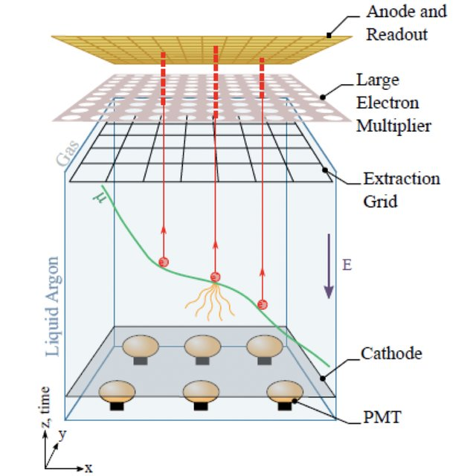
Neutrino Experiment DAQ
Detects rare interactions using highly sensitive systems to capture faint Cherenkov or scintillation light
Photomultiplier Tubes feed light signals to digitizers for processing & noise reduction
Uses Water-based Liquid Scintillator and Liquid Argon Time Projection Chamber with precision timing and waveform digitization
Liquid Argon Time Projection Chamber

Slide 6
STAR vs Neutrino DAQ Architecture Comparison
Feature | STAR (RHIC) | Neutrino Experiments
Event Type | High-rate heavy-ion collisions | Ultra-rare neutrino interactions
DAQ Goal | Maximize throughput | Maximize sensitivity
Detectors | TPC, sTGC, TOF | PMTs, LArTPCs, WbLS
Trigger System | High-Level Trigger (HLT) | Minimal trigger, record everything
Signal Type | Charge tracks, timing | Light pulses (Cherenkov, scintillation)
Data Volume | Petabytes/year | Lower rate, but high resolution needed
Sync & Timing | Nanosecond precision for collisions | Sub-nanosecond for rare signal ID

Slide 7
Software in Particle Physics
Software reconstructs particle trajectories, energies, and event topologies from raw data.
STAR and neutrino teams use frameworks like ROOT for statistical analysis and data visualization.
Geant4 (C++ software toolkit) simulates detector responses, particle decay, and material interactions.
Machine learning is increasingly used for pattern recognition and noise reduction.

Slide 8
Real-Time vs. Offline Processing
Real-time: Event selection, triggers, and data integrity checks at the moment of capture.
Offline: Full reconstruction, calibration, simulation matching, and deep analysis.
STAR’s HLT is a real-time system; neutrino experiments often rely more heavily on offline processing.
Balance between real-time filtering and offline depth is crucial for efficient discovery.

Slide 9
Real-Time vs Offline processing: Side-by-Side
Feature | Real-Time Processing | Offline Processing
Purpose | Immediate filtering & data reduction | Full reconstruction & deep analysis
Location | On-detector or near front-end | Central computing farms / cloud
Example System | STAR HLT | DUNE or T2K offline pipelines
Processing Speed | Sub-millisecond | Minutes to hours
Trade-Off | Fast but coarse decisions | Slow but detailed
Key Tools | Event builders, triggers | Calibration, simulation, ML analysis

Slide 10
Challenges & Future Outlook
Managing massive data volume, detector complexity, and real-time performance
Synchronizing thousands of sensor channels across scalable systems
Integrating AI/ML and next-gen DAQ (faster ADCs, edge computing)
Expanding hybrid and cloud-based platforms for efficient analysis

Slide 11

Why It Matters
DAQ & software make invisible physics visible
STAR and neutrino systems show how tailored tools reveal the invisible universe
Innovations help medicine, space, and defense; faster insight = faster discovery

Slide 12
THANK YOU

Slide 13
SOURCES
https://www.star.bnl.gov
https://drupal.star.bnl.gov/STAR/subsys/hlt
Knoll, G. F. (2010). Radiation Detection and Measurement (4th ed.).
Wiley. Leo, W. R. (1994). Techniques for Nuclear and Particle Physics Experiments. Springer.
Ackermann, K. H. et al. (2003). "STAR Detector Overview." Nuclear Instruments and Methods in Physics Research Section A.

