Slide 1
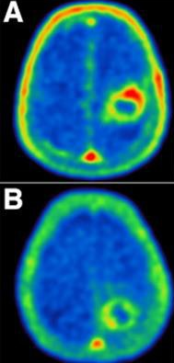

Applications of Nuclear Physics with the Medical Field
01 - PET Scans
02 - MRI’s
03 - SPECT Imaging
Alysa Patteson
Lamar University
NuSTEAM 2025

Slide 2
01 - Proton Emission Tomography (PET) Scans

Slide 3
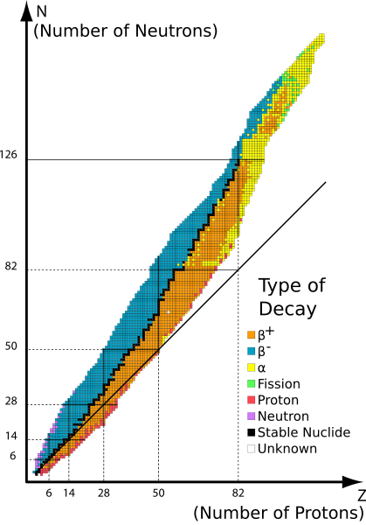
Radioisotopes
Band of Stability
Radioisotope (or radionuclide) is an atom with an unstable nucleus that emits radiation to become more stable. The band of stability shows the range of proton-neutron ratios where atomic nuclei are stable. Stability does not require equal number of protons and neutrons. Heavier atoms often need more neutrons than protons to remain stable. Atoms with nuclei located outside of this band (radioisotopes) are unstable and will undergo a reaction to reach this band of stability. Example: Beta-plus decay
Image Source: Kent Chemistry, 2010

Slide 4
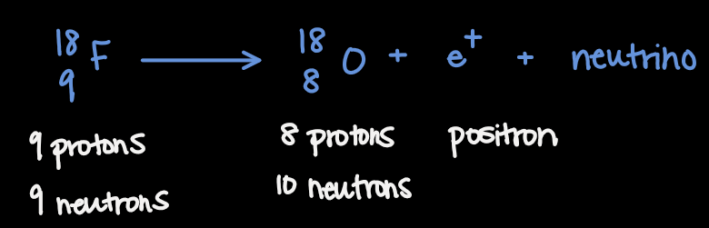
Beta-Plus Decay
Nuclei below the band of stability
Too many protons or too few neutrons
Proton turns into neutron
Positron and neutrino emitted
Fluorine-18
Fluorine-18 is a common radioisotope used in PET imaging.
Unstable
Normal Isotope: 9 protons, 10 neutrons
Fluorine-18: 9 protons, 9 neutrons
Decays into oxygen-18: 8 protons, 10 neutrons
This is a beta-plus decay

Slide 5
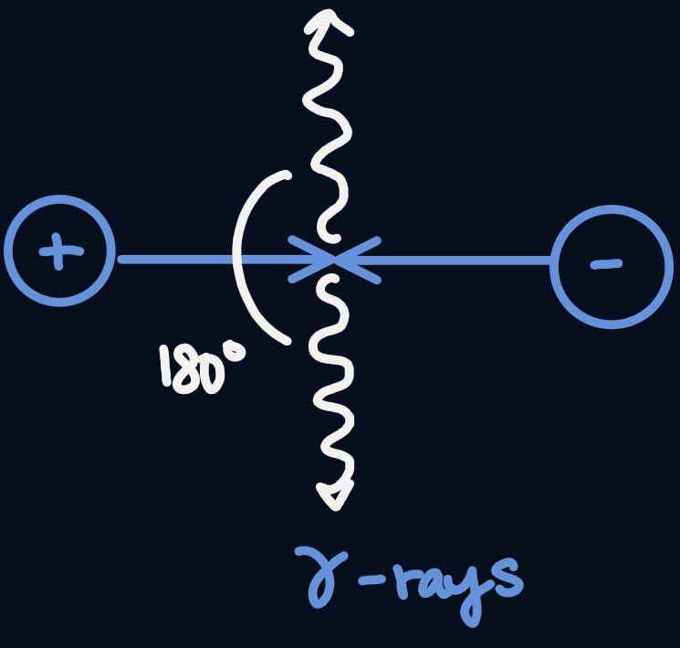
Positron Emission
Positron travels a short distance (about 1-2 mm).
Collides with an electron
Annihilation
Two gamma photons produced
Gamma photons move in exactly opposite directions (180 degrees)

Slide 6
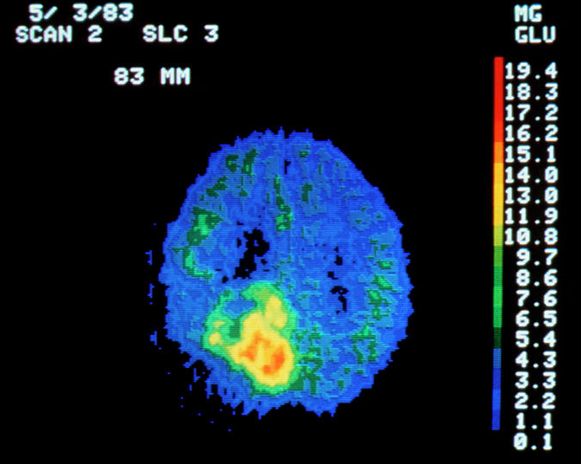
Positron Emission Tomography (PET) Scans
What is a PET Scan? A nuclear imaging technique that shows how well the tissues and organs are functioning in the body. Uses radioactive tracers (radioisotopes like Fluorine-18) that can be injected or swallowed by the patient. After injection, the tracer accumulates in areas with higher metabolic activity, making these areas brighter. The radioisotope in the tracer will decay, two photons will be released, and the photons will be detected. Purpose: to measure metabolic processes in the body Very good at detecting tumors because tumors are very metabolically active.
Image Source: Pixels, 2020

Slide 7
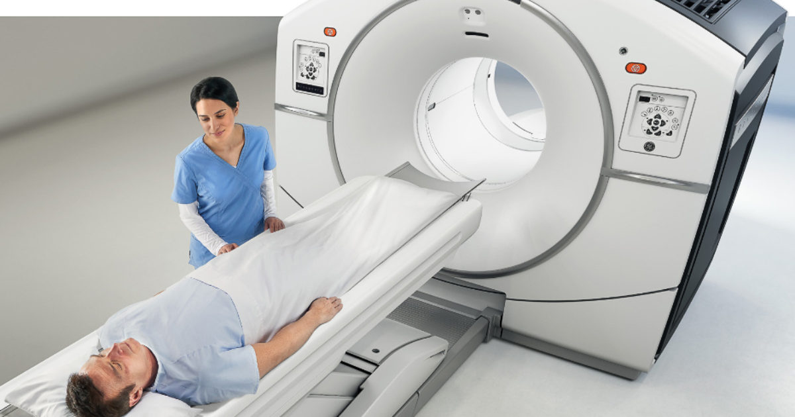
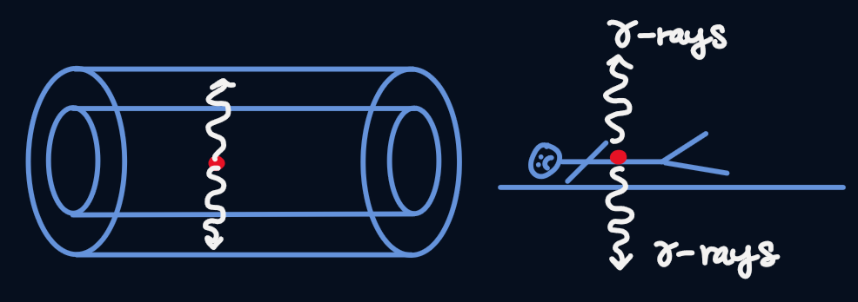
Detection
PET scanner detects both photons
Photons arrive at detectors on opposite sides of body
Example: Photons detected above and below tumor
Scanner knows annihilation happened along straight line between detections
Use time difference between detections
Pinpoints location of annihilation event
Reconstructs detailed image of where metabolic activity occurs
Image Source: Radiology SA, 2020

Slide 8
02 – Magnetic Resonance Imaging (MRI)

Slide 9
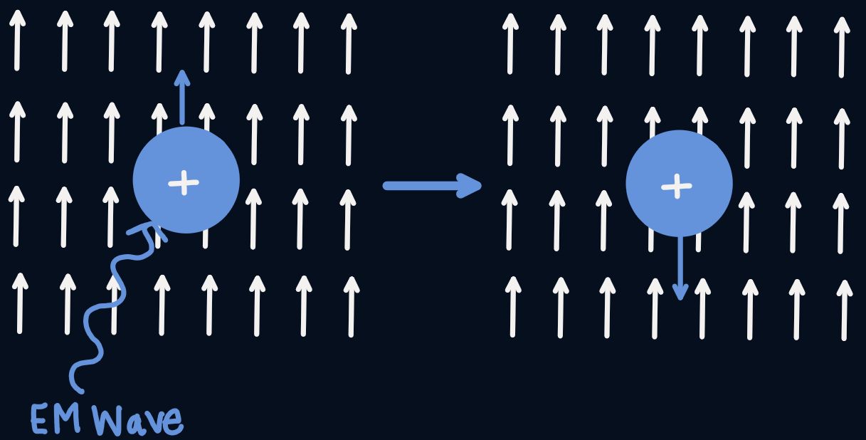
Protons
Band of Stability
Magnetic dipole moments Magnetic dipole moment tells us how strong and in what direction an objects magnetic field is Protons in a magnetic field What happens when we apply electromagnetic radiation Lower state to higher state Frequency must match energy difference Energy difference is dependent on the strength of the magnetic field

Slide 10
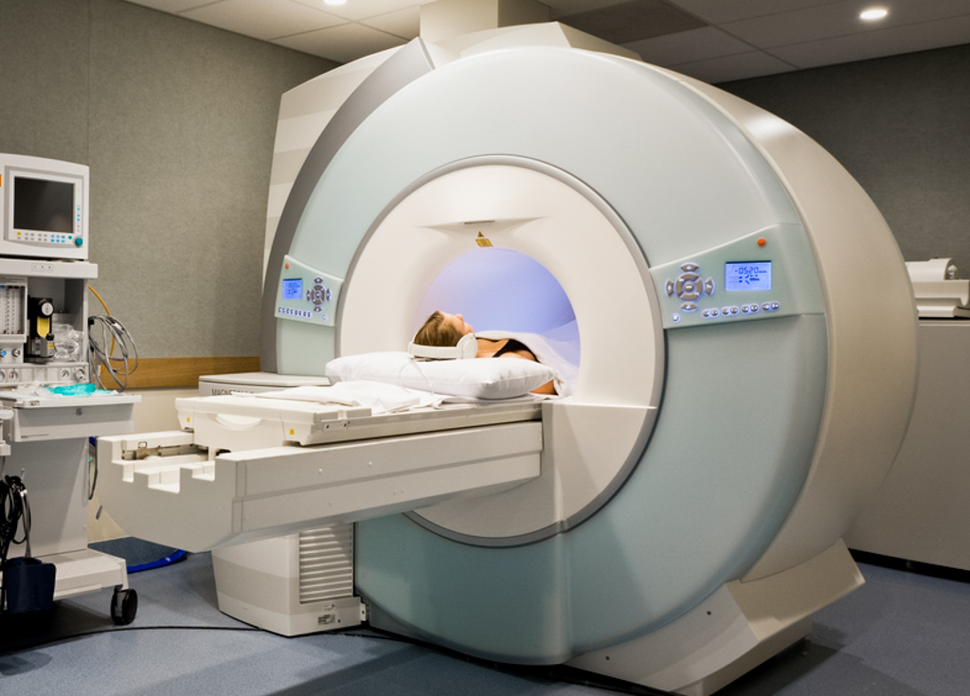
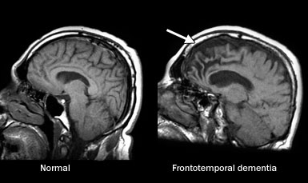
MRI Machine
Band of Stability
Creates external magnetic field of varying strength around the patient Apply radiation at a specific frequency, flipping direction of dipole moments Turn off radiation, proton goes back to lower energy state and releases radiation Radiation detected by the MRI Can work out how many protons (and therefore water molecules) are in a specific volume by the amount of radiation detected Gradually alter frequency or magnetic field strength Can work out the distribution of water at each point in the human body Purpose: used to image soft tissues
Image source: Windsor Imaging, 2020
Image source: Mayo Clinic, n.d.

Slide 11
03 – Single Photon Emission Computed Tomography (SPECT) Imaging

Slide 12
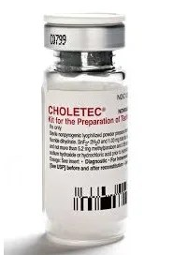
Metastable State
A metastable state is when a nucleus is in an excited energy state longer than usual before releasing that energy.
It is not stable, but it does not decay immediately.
Gives doctors enough time to let it localize in the body and perform scan while the tracer is still active. A shorter half life also means the tracer decays quickly, so the body is exposed to less radiation.
99m-Technetium
A common radioisotope used in SPECT scans is 99m-Technetium.
99m-Technetium has a metastable nucleus so it wants to lose the extra energy to become 99-Tc. Half life of 6 hours.
Unlike fluorine-18 which is unstable due to an imbalance of protons and neutrons, 99m-Tc is unstable because its nucleus is in an excited state and directly emits a photon.
99m-Tc can release energy by emitting a gamma photon.
This is the radioactive reaction that underlies SPECT.
Image source: eMedz.net, 2019

Slide 13
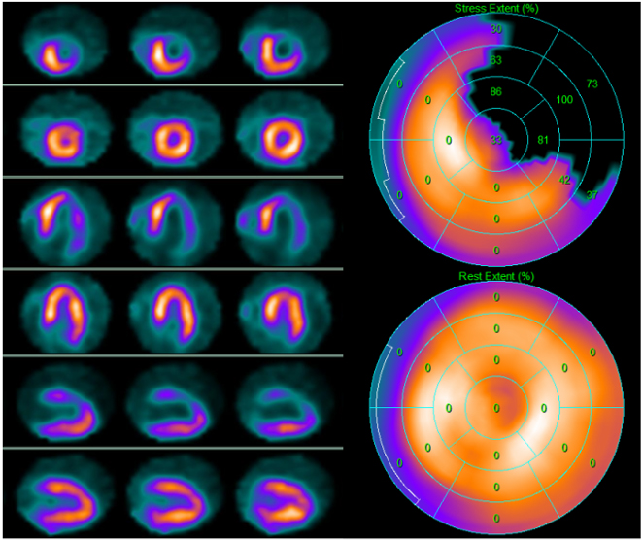
Single Photon Emission Computed Tomography (SPECT) Imaging
What is SPECT Imaging?
Another type of nuclear imaging test.
Uses radioactive tracers (contain radioisotopes like Technetium-99m) that can be given through an IV.
After the tracer has gone into the bloodstream, it travels to areas where apoptosis occurs (programmed cell death).
Technetium-99m (99m-Tc) is going to decay into 99-Tc, the normal isomer of Technetium, and release a gamma photon.
The gamma photon will be detected by the machine.
Purpose: primarily used to evaluate blood flow and organ function
Image Source: IMR Press, 2023
Myocardial perfusion SPECT scans

Slide 14
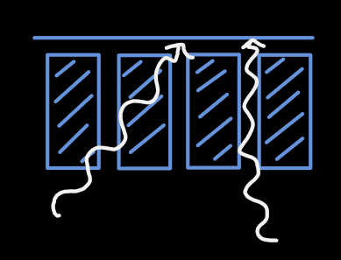
Detection
The SPECT scan detects the emission of the gamma photon.
Cannot control direction of the gamma photon
Lead Collimator – absorbs the gamma radiation

Slide 15
References
(2014). Magnetic Resonance Imaging (MRI). Retrieved from https://www.youtube.com/@elliotnicholson5117/featured.
(2014). Positron Emission Tomography (PET). Retrieved from https://www.youtube.com/@elliotnicholson5117/featured.
(2014). Single Photon Emission Computed Tomography (SPECT). Retrieved from https://www.youtube.com/@elliotnicholson5117/featured.
Ashika. (2025, June 19). Radioactive Tracers - CIE A level physics revision notes. Save My Exams. https://www.savemyexams.com/a-level/physics/cie/25/revision-notes/24-medical-physics/24-3-pet-scanning/radioactive-tracers
Band of Stability. (2010). photograph.
Coloured Pet Scan of Brain Containing a Tumour Photograph. (2020). photograph.
How Does an MRI System Produce a Diagnostic Image? (2023). photograph.
Kane, S. M. (2024, February 29). Technetium-99m. StatPearls [Internet]. https://www.ncbi.nlm.nih.gov/books/NBK559013
Langmaid, J. (2025, March 5). The 10 most common MRI scans and what they reveal about your health. Read My MRI. https://readmymri.com/blog/the-10-most-common-mri-scans
The Lifesciences Magazine. (2023, December 4). 7 best applications of Nuclear Medicine Technology. The Lifesciences Magazine. https://thelifesciencesmagazine.com/nuclear-medicine-technology/
Maffeis, C., Dondi, F., Ribichini, F. L., Giubbini, R., & Gimelli, A. (2023). Clinical Application of Myocardial Perfusion SPECT in Patients with Suspended or Known Coronary Artery Disease. What Role in the Multimodality Imaging Era? photograph.
MRI Comparison. (2017). photograph.
PET Scan. (2020). photograph.
Spine, M. B. &. (n.d.). SPECT scan. SPECT scan | Single Photon Emission Computed Tomography. https://mayfieldclinic.com/pe-spect.htm
Tafti, D. (2023, February 13). Nuclear medicine physics. StatPearls [Internet]. https://www.ncbi.nlm.nih.gov/books/NBK568731/
Technetium 99m mebrofenin for Hepatobiliary Imaging. (2020). photograph.
Vaquero, J. J., & Kinahan, P. (2015). Positron emission tomography: Current challenges and opportunities for technological advances in clinical and preclinical imaging systems. Annual review of biomedical engineering. https://pmc.ncbi.nlm.nih.gov/articles/PMC5299095/

